Slide 1
CompSat
Preschool English Language Learner Guide Connections
Notes:
Use this document connection to extend chapters 1,2, 6 or 8.
Or use this document connection to provide a base for conversation with onsite support.

Slide 2
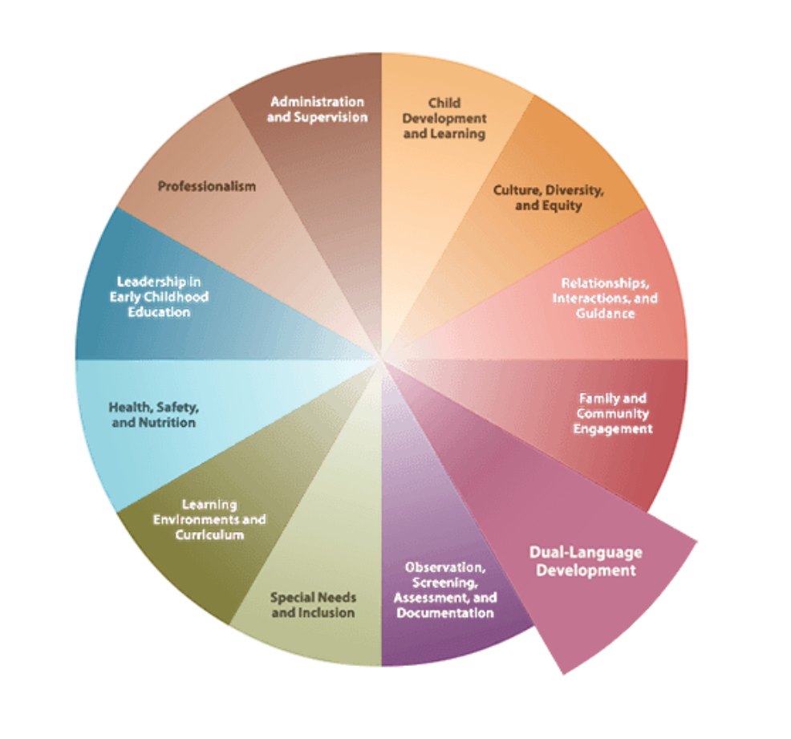
Dual Language Development: CA ECE Competencies
Notes:
This competency area addresses the knowledge and skills that early childhood educators need in order to support the optimal development and learning of young dual-language learners and the relatively small number of young children who learn more than two languages. It is based on current research and knowledge about dual-language acquisition as well as an understanding that dual-language learners represent a variety of social, cultural, and linguistic perspectives, diverse characteristics, and experiences. Key concepts include acknowledgment of young children's ability to develop proficiency in both English and the home language, and recognition of the home language as the vehicle by which children are socialized into their families and communities (CDE 2009a).

Slide 3
Dispositions
Views self as a language teacher of young dual-language learners.
Views self as a language learner.
Values and respects the home language(s) and culture(s) of all children.
Values and initiates open communication with families.
Promotes a climate of belonging to facilitate the development of dual-language learners.
Views multiple language use as a positive attribute.
Views families as children's primary teachers.
Notes:
Keep these dispositions in mind as you explore the Framing Questions. If you mindfully adopt these dispositions, you will realize the Desired Outcomes for Practitioners and for Children.
Views self as a language teacher of young dual-language learners.
Views self as a language learner.
Values and respects the home language(s) and culture(s) of all children.
Values and initiates open communication with families.
Promotes a climate of belonging to facilitate the development of dual-language learners.
Views multiple language use as a positive attribute.
Views families as children's primary teachers.
Copied from: http://ececompsat.org/competencies/dld/dld.html

Slide 4
Application of Best Practices:
Seek Multiple Perspectives
Use the Key to Reflection Handout to Seek Multiple Perspectives.
Apply your thoughts to your daily practice.
Remember to explore more Keys to Reflection and Inquiry on compsat.org.
Notes:
CompSAT has many tools to support your personal exploration of DLL concepts and applications. Today we will apply the best practice of self reflection using a CompSAT keys to reflection handout.
Use the Key to Reflection Handout to Seek Multiple Perspectives.
Apply your thoughts to your daily practice. Remember to explore more Keys to Reflection and Inquiry on compsat.org.

Slide 5
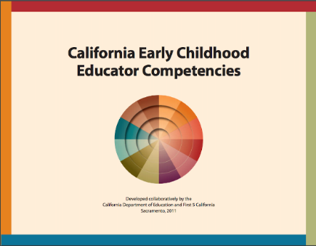
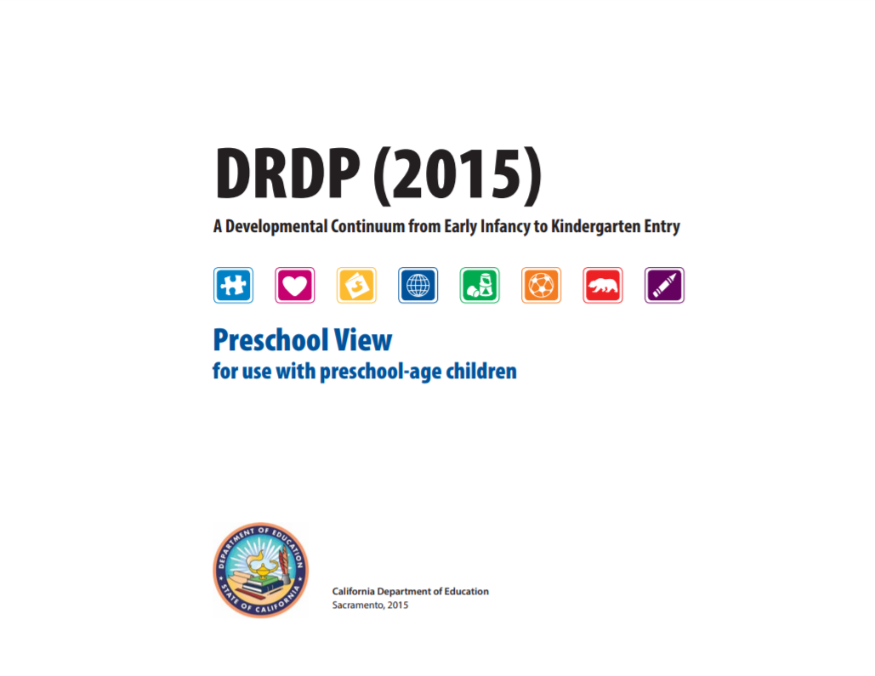
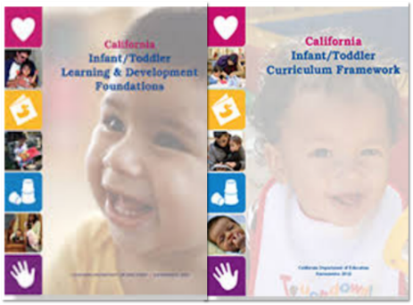
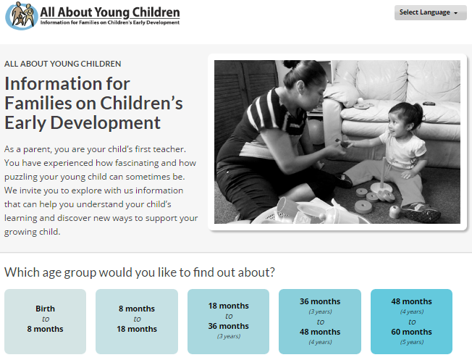
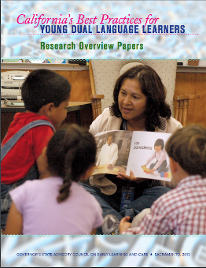
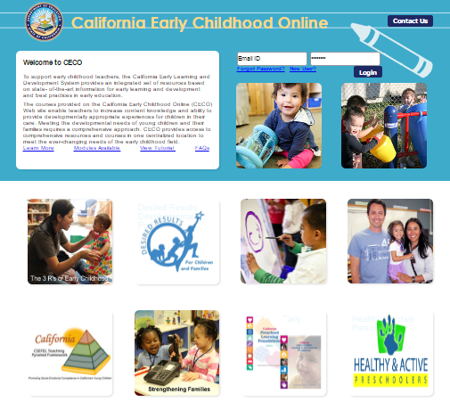
Other Resources to Rely On
Notes:
These resources will provide additional topics for on-site professional development and development strategies for supporting professionalism and continuous learning, especially for educators serving dual language learners.

