Slide 1
California English Learner Roadmap State Board of Education Policy: Educational Programs and Services for English Learners
Preschool English Language Learner Guide Connections
Notes:
Use this document connection to extend chapters 1, 2, 6 or 8.
Or use this document connection to provide a base for conversation with onsite support.

Slide 2
ELD Road Map Principles
Principle One: Assets-Oriented and Needs-Responsive Schools
Principle Two: Intellectual Quality of Instruction and Meaningful Access
Principle Three: System Conditions that Support Effectiveness
Principle Four: Alignment and Articulation Within and Across Systems
Notes:
The principles of the English Learner Roadmap: Strengthening Comprehensive Educational Policies, Programs, and Practices for English Learners (CA EL Roadmap) are intended to guide all levels of the system towards a coherent and aligned set of practices, services, relationships, and approaches to teaching and learning that add up to a powerful, effective, twenty-first century education for all English learners.
Principle One: Assets-Oriented and Needs-Responsive Schools
Principle Two: Intellectual Quality of Instruction and Meaningful Access
Principle Three: System Conditions that Support Effectiveness
Principle Four: Alignment and Articulation Within and Across Systems

Slide 3
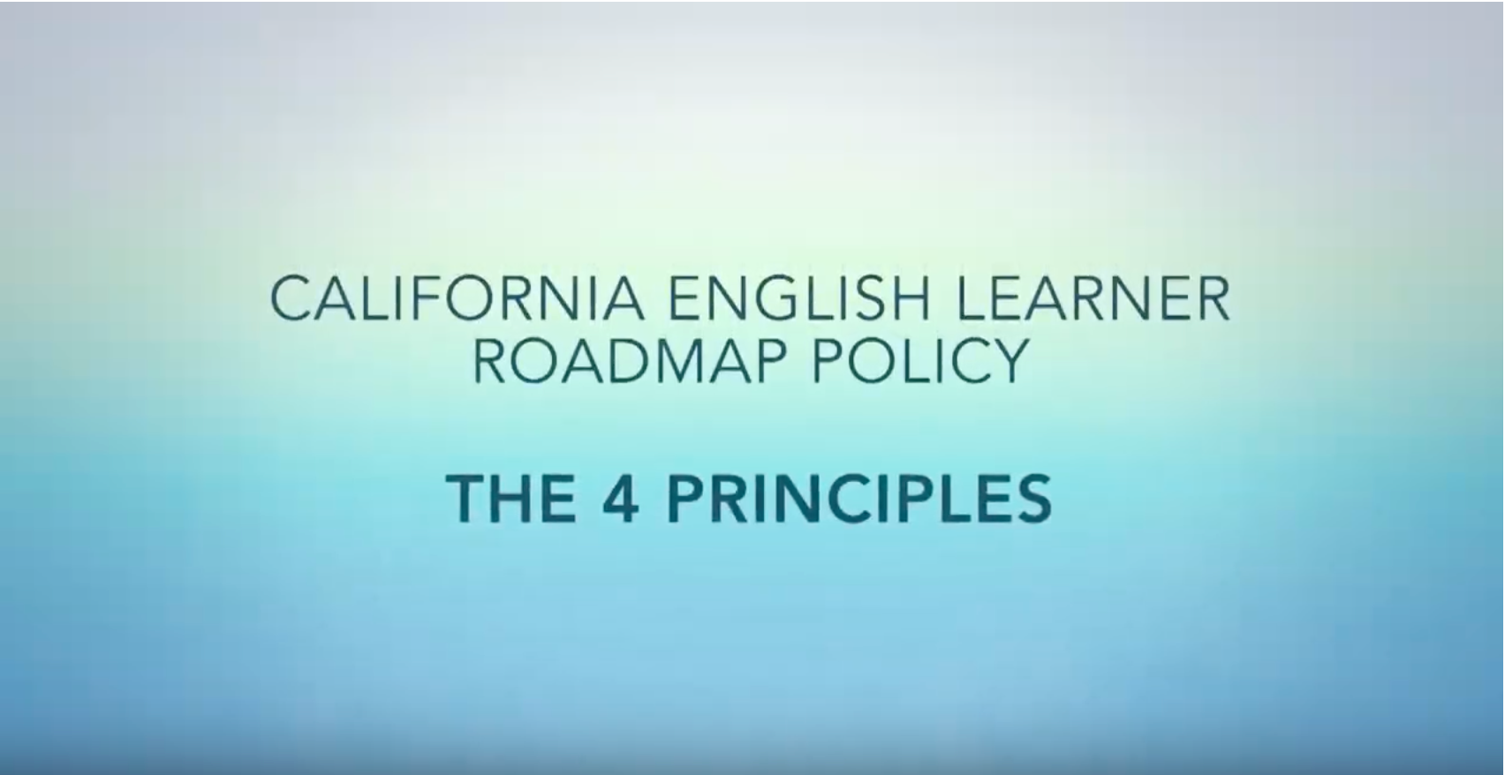
Description Video by California Association of Bilingual Education (CABE)

Slide 4
Application of Best Practices:
At your table groups, share what stood out to you about the ELD principles..
Review the core beliefs listed on page 3 of the PEL Guide..
Create a visual representation of how the ELD Road Map principles and the core beliefs relate to each other.
Notes:
Share the ELD Road Map Preschool English Learning Connection slides.
Remind participants that, in the PEL Guide training, they learned the core beliefs which are also used as the ELD guiding principles in the framework.
Ask participants to follow the steps on the slide to think about how their work connects these two sets of principles/beliefs:
At your table groups, share what stood out to you about the ELD principles.
Review the core beliefs listed on page 3 of the PEL Guide.
Create a visual representation of how the ELD Road Map principles and the core beliefs relate to each other.
Invite participants to use chart paper and markers to create the visual representation.
Optional:
With a longer time-slot, use the 3D art supplies to inspire participants to create a 3D visual representation instead of chart paper.
This can be displayed for families, teachers, or other colleagues to remind everyone of the ELD Road Map and the PEL Guide.
Debrief:
Invite all participants to share their visual representations.

Slide 5



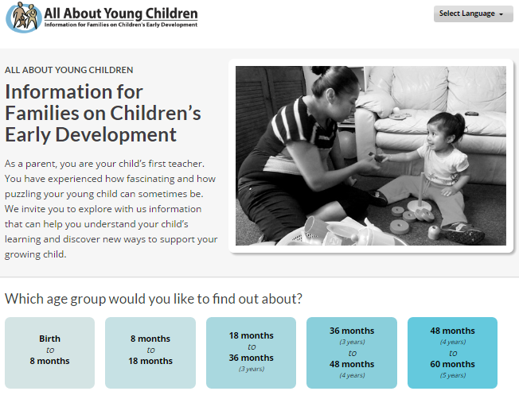


Other Resources to Rely On
Notes:
These resources will provide additional topics for on-site professional development and development strategies for supporting professionalism and continuous learning, especially for educators serving dual language learners.

