Slide 1
Best Practices for Planning Curriculum for Young Children Family Partnerships and Culture
Preschool English Learning Guide Connections
Notes:
Use this document connection to extend 2, 3 or 6 or used independently for onsite support.

Slide 2
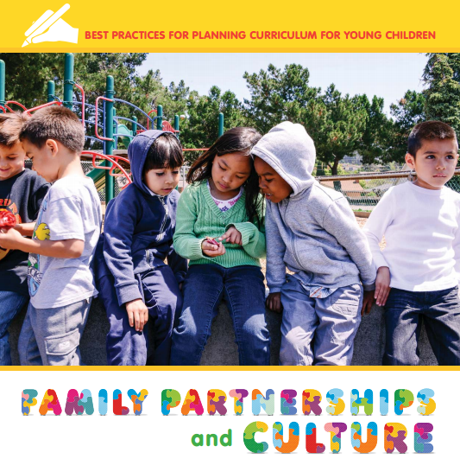
Best Practices for Planning Curriculum for Young Children: Family Partnerships and Culture
Ideas for increasing cultural competence
Ideas for communicating with families
Ideas for self-reflection
Ideas for planning with cultural reflection
Notes:
This publication:
values families and their contribution to children’s learning;
approaches cultural diversity with an open mind; and
applies knowledge gained about families, including their values and beliefs, to teaching and learning.
It is a guide for program staff members as they work through the process of learning about and working with the families of the children they serve. This guidance provides a foundation for the work that has to be done, but mastery of the ideas contained here is not enough.
In it you will find ideas for:
Increasing cultural competence
Communicating with families
Self-reflection
Planning with cultural reflection
While in the document (or slide 9), go to the introduction.

Slide 3
The Guiding Principles for Developing Cultural Competence
Reflect on one’s own cultural background.
Learn about the children in the program and their families.
Examine the belief that one culture is better than another.
Adopt a posture of cultural respect.
Be a learner before trying to be a teacher.
Notes:
Take a moment to read these principles. Do you notice any connections to the core beliefs?

Slide 4
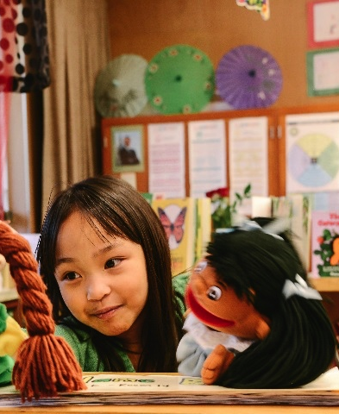
What do the principles look like in your daily routine?
“Frame child-learning objectives in ways that reflect the values and goals espoused by the children’s culture” (Family Partnerships and Culture [CDE], p. 77).
Notes:
Note: This information comes from Family Partnerships and Culture [CDE], pp 76-78 Box 4.
One of the strategies for cultural responsiveness in teaching and learning is learn about family goals.
Frame child-learning objectives in ways that reflect the values and goals espoused by the children’s culture.
Take time to find out what the most important goals of the family are. Then share with parents how their child is developing in the context of those family goals.
For example, in early childhood, some parents focus on social skills more so than on cognitive goals. They may want their children, at this age, to learn to get along with others, gain practical information, and acquire self-care skills more than they care about learning in areas such as numeracy, literacy, or drawing. Other parents may focus on learning objectives that place greater emphasis on numeracy, literacy, or drawing than on social skills.

Slide 5
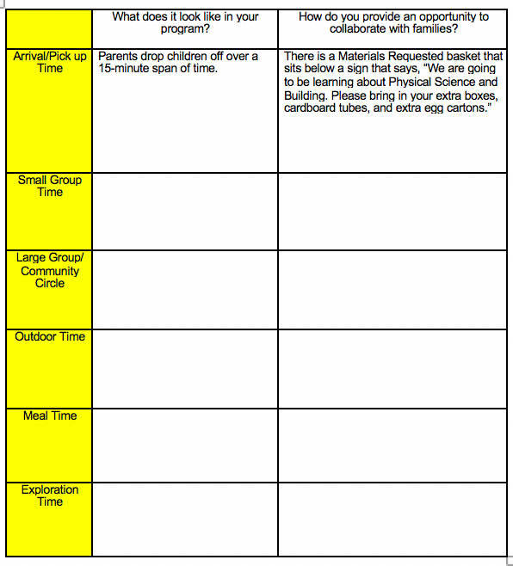
Application of Best Practices
Daily Routines
How are families welcomed into your daily routines?
Use the handout to write down your ideas.

Slide 6
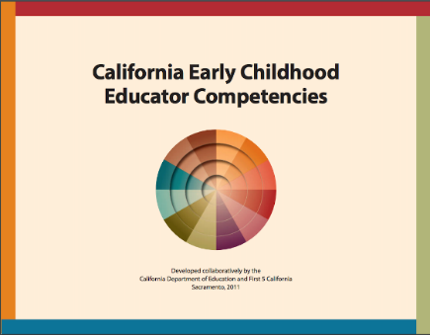
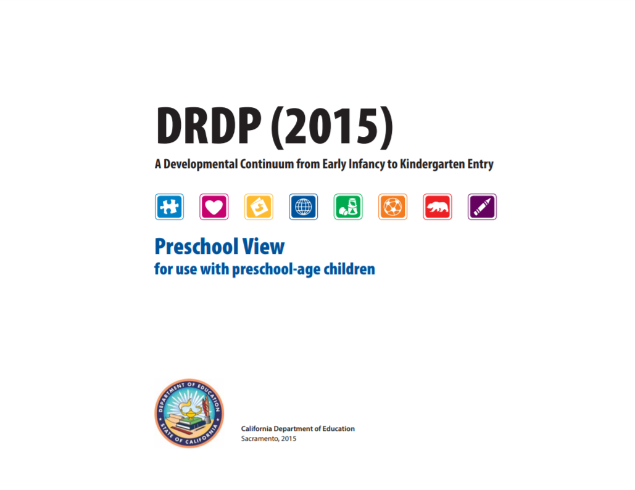
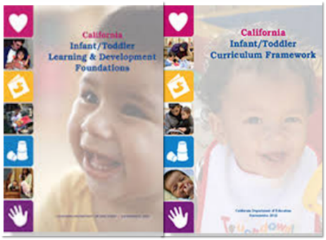
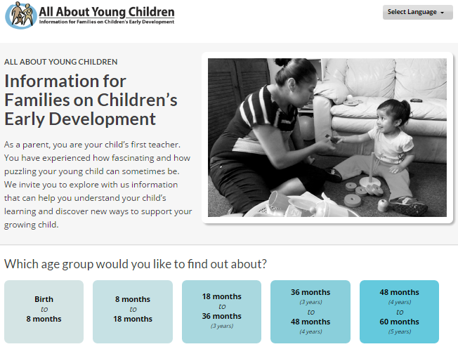
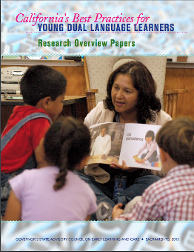
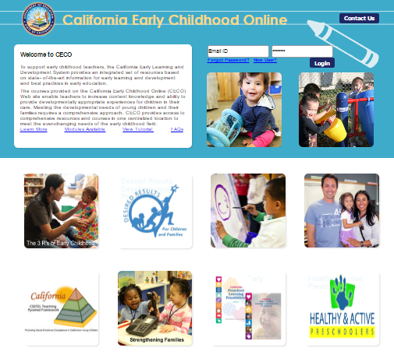
Other Resources to Rely On
Notes:
These resources will provide additional topics for on-site professional development and development strategies for supporting professionalism and continuous learning, especially for educators serving dual language learners.

