Slide 1
Integrated Nature of Learning
Preschool English Language Learner Guide Connections
Notes:
Use this document connection to extend chapters, 3, 6 or 8 as best meets your participants needs.
Or use this document connection to provide a base for conversation with onsite support.

Slide 2
Questions Addressed by the Publication
What does it mean to teach when working with infants and young children birth to age five?
What does curriculum look like in this first period of education?
Notes:
This publication is a guide for program staff members as they work through the process of learning about the integrated nature of learning.
It aims to address these questions:
What does it mean to teach when working with infants and young children birth to age five?
What does curriculum look like in this first period of education?
The short answer is all early learning professionals, regardless of title, have the same goal: “nurturing young children and their families in ways that simultaneously support them in learning” (Integrated Nature of Learning p. 6)
“Children’s thinking, their feelings, and their dispositions are the center of the curriculum and inform the planning and implementation of educational experiences (Integrated Nature of Learning p. 7).

Slide 3
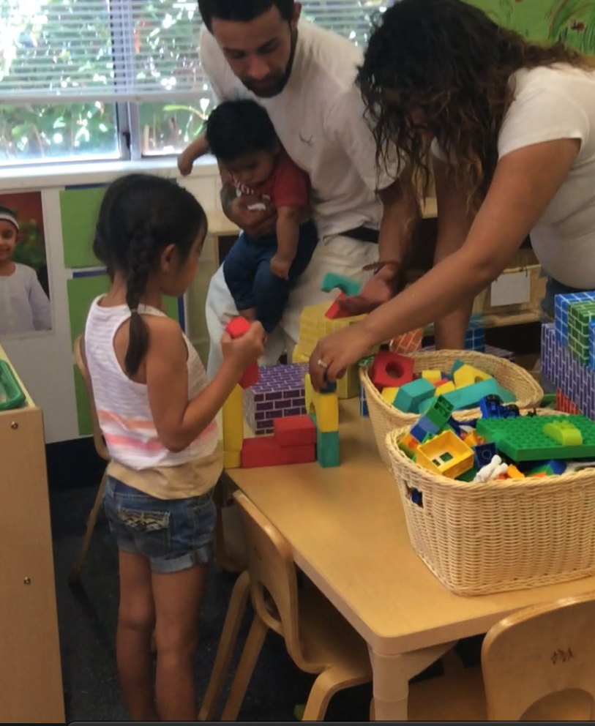
Dynamic Planning
“Curriculum plans that are dynamic, collaboratively constructed with children, and responsive put children’s thinking at the center of the curriculum planning process” (Integrated Nature of Learning, p. 54).
Notes:
“Curriculum plans that are dynamic, collaboratively constructed with children, and responsive put children’s thinking at the center of the curriculum planning process“ (Integrated Nature of Learning, p. 54).
Dynamic curriculum by nature does not look or feel just one way. It includes many qualities that change based on children and setting. Dynamic curriculum includes these qualities:
Unique
Different
Reflective of children, community and families
Inclusive
Changing
Unpredictable and predictable

Slide 4
Application of Best Practices–2
Choose a cultural/ family interest, practice, or lifeway
Map learning invitations for multiple domains
Add dual language learner supports
Cultural/ family interest, practice or lifeway
Learning Invitation
Learning Invitation
Learning Invitation

Slide 5
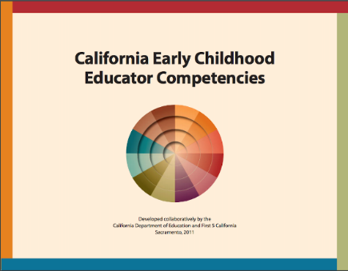
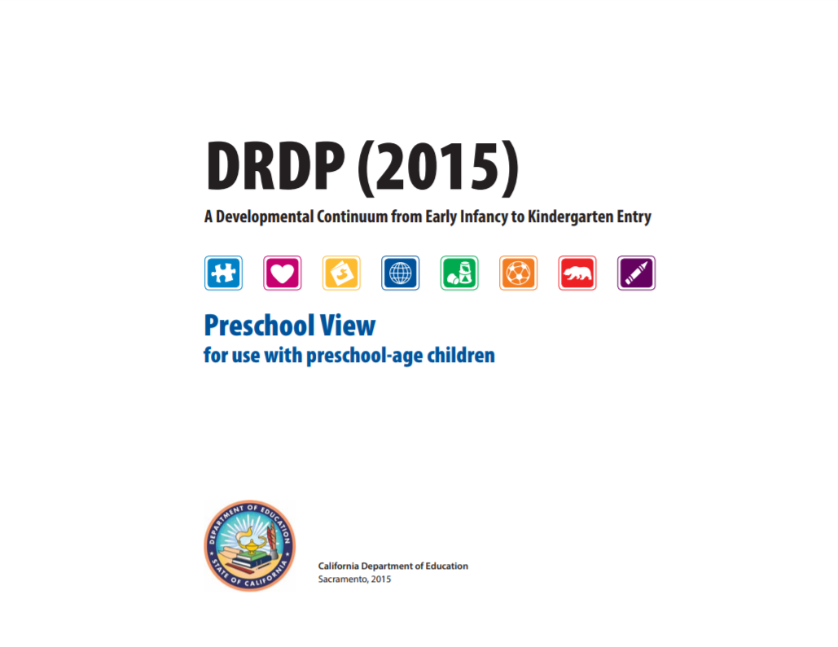

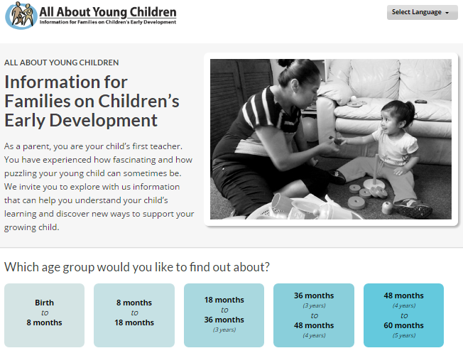

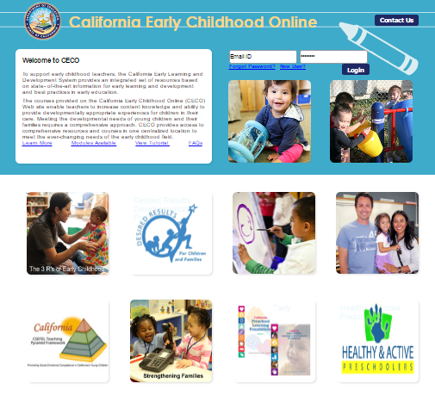
Other Resources to Rely On
Notes:
These resources will provide additional topics for on-site professional development and development strategies for supporting professionalism and continuous learning, especially for educators serving dual language learners.

