Slide 1
Preschool Program Guidelines
Preschool English Language Learner Guide Connections

Slide 2
Benefits of Bilingualism
“Being exposed to two or more languages at a young age is a gift. It is a gift because children who are able to learn through two or more languages benefit cognitively, socially, and emotionally.”
“Exposure to more than one language should be celebrated as a growth opportunity that offers many learning and social advantages. Children who are developing bilingual abilities are developing unique strengths that will add to the cultural and linguistic resources of California.”
(Source: CDE 2010, 224)
Notes:
It is critical to consider the child’s communication in all the languages that he or she is learning to have an accurate picture of a child’s knowledge and skills. Young children, including children with disabilities, can successfully learn two or more languages. Learning two or more languages has linguistic, social, cognitive, academic, and cultural benefits. The path to learning one language shares many similarities with the path to learning two or more languages.
Early childhood educators need to be knowledgeable about:
The role of the home language
The influence of cultural values
Stages of second language development
(Preschool Curriculum Framework, Volume 1 (PCF), Vol. 1, p. 179)

Slide 3
Why Both Languages Are Important
Advantages in infancy
Advantages in childhood
Advantages in later adulthood
Notes:
3
Overall, research indicates that learning and speaking more than one language bequeaths a cognitive advantage in a variety of tasks that is detectable as early as seven months of age (Kovacs and Mehler 2009 as cited in California’s Best Practices for Young Dual Language Learners Research Overview Papers) that persists throughout childhood to adulthood, and even offers some protection against symptoms of Alzheimer’s dementia (Craik, Bialystok, and Freedman 2010 as cited in California’s Best Practices for Young Dual Language Learners Research Overview Papers).

Slide 4
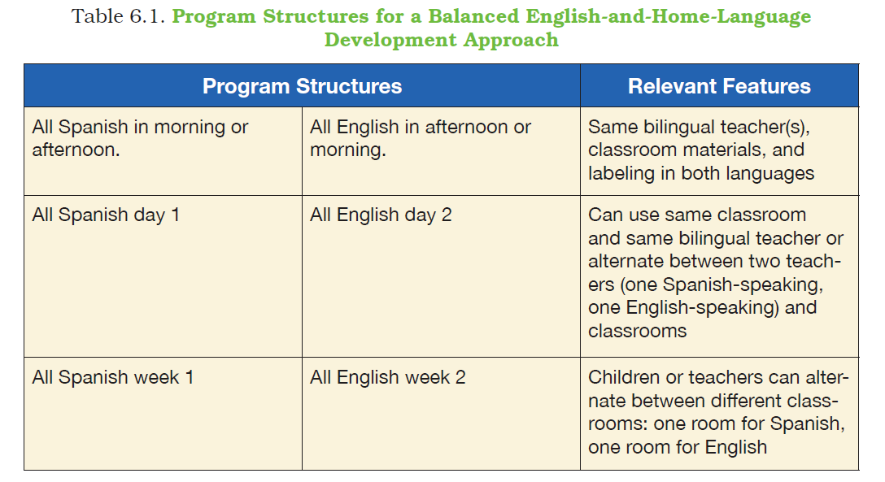
Chapter 6 (p. 75): Support for Young Dual Language Learners
Notes:
How can my program support more than one language?
California Preschool Program Guidelines provides the detailed guidance needed by administrators and teachers to offer high-quality preschool programs that prepare children to arrive in kindergarten with the foundational skills necessary for school success.

Slide 5
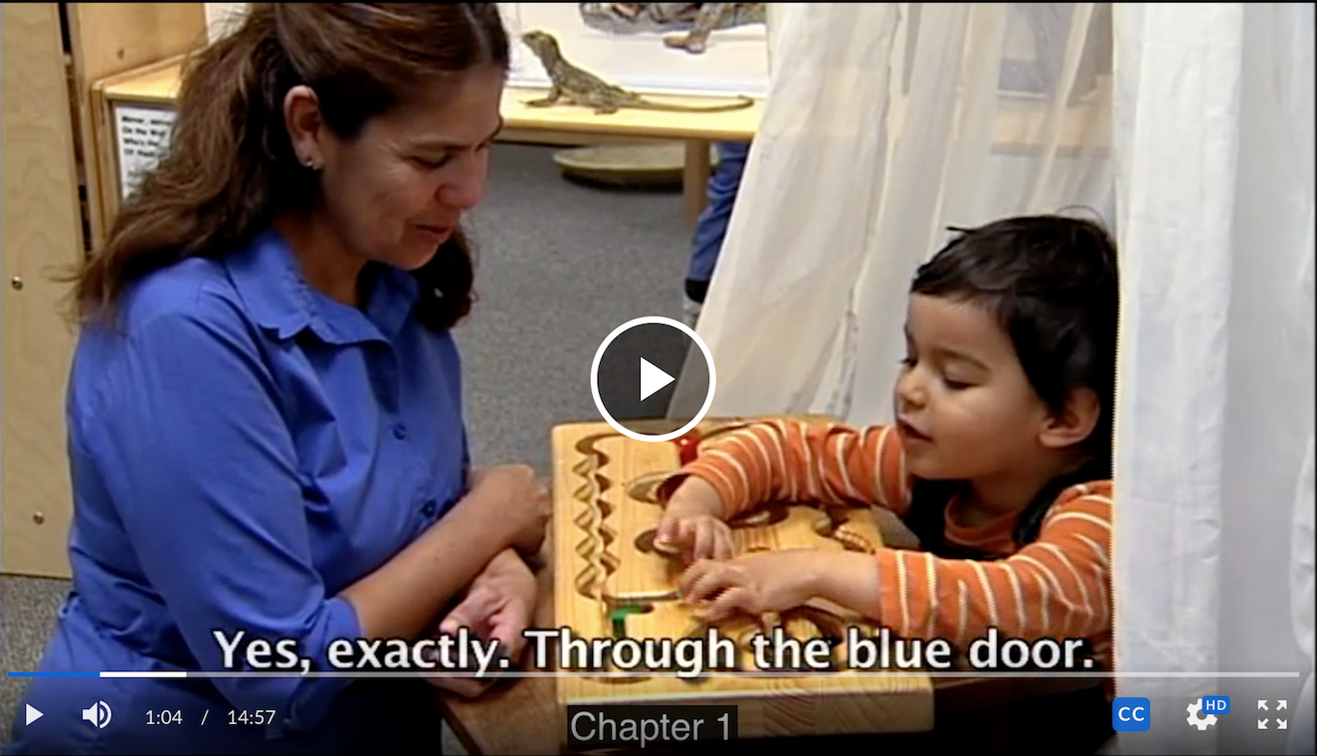
Let’s Watch an Example
SupportingDualLanguageLearners_ProgramApproaches.mp4
Notes:
Trainer note: Insert video clip
This video shows two different types of dual language:
Alternate days
Alternate teachers

Slide 6
Application of Best Practices
Three things to think about
Two things I will try
My first step will be....

Slide 7
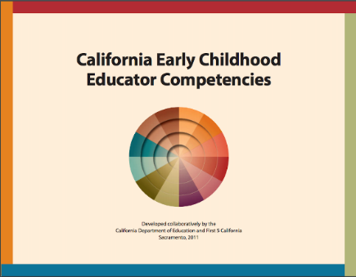
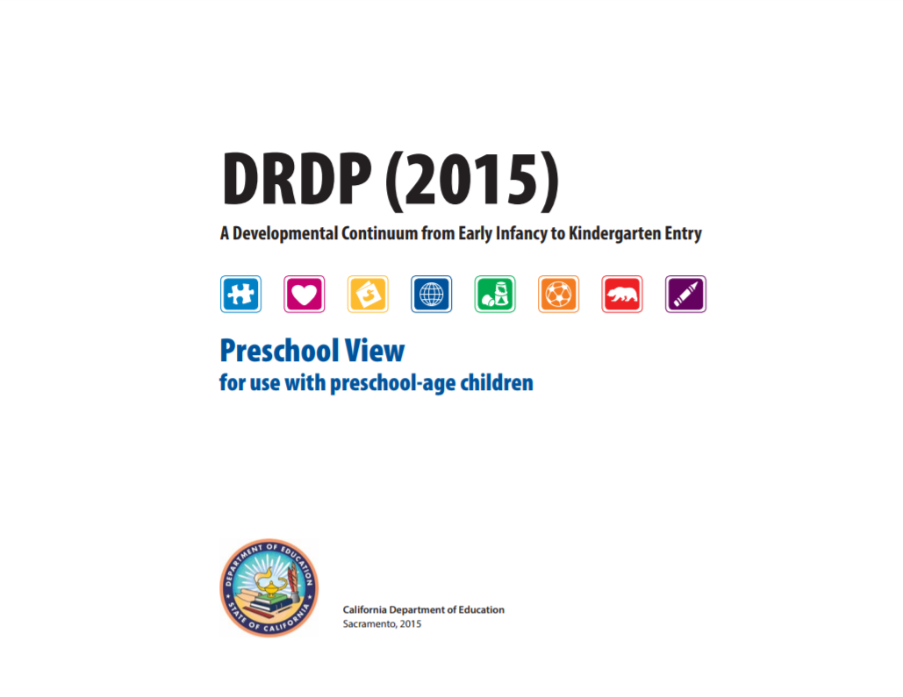
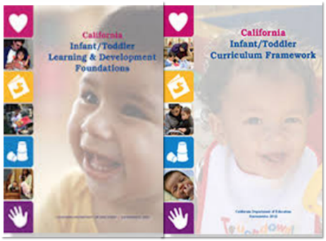
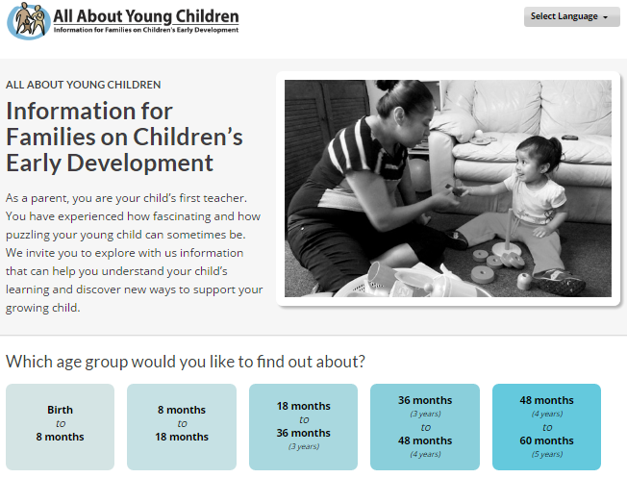
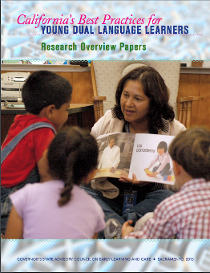
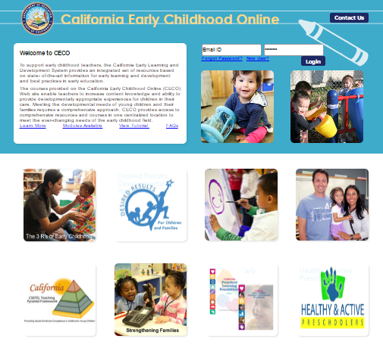
Other Resources to Rely On
Notes:
These resources will provide additional topics for on-site professional development and development strategies for supporting professionalism and continuous learning, especially for educators serving dual language learners.
Select each icon to download your own copies the publications for exploration:
Preschool Learning Foundations and Curriculum Framework
Infant/Toddler Learning and Development Foundations and Framework
Family Partnerships and Culture
PEL Guide
California’s Best Practices for Young Dual Language Learners: Research Overview Papers
DRDP (2015): A Developmental Continuum from Early Infancy to Kindergarten Entry
California Early Childhood Educator Competencies

