Slide 1
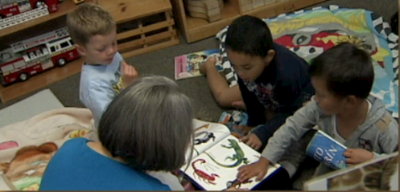
Title Slide
Language and Literacy in Transitional Kindergarten:
Comprehension and Analysis of Age-Appropriate Text
Notes:
Presenter Remarks:
Welcome to Language and Literacy in Transitional Kindergarten: Comprehension and Analysis of Age-Appropriate Text —a presentation focusing on the California Preschool Learning Foundations (Preschool Learning Foundations or PLF), the California Preschool Curriculum Framework (Preschool Curriculum Framework or PCF), and other California Department of Education (CDE) resources in support of the Language and Literacy Development domain.
This professional learning session is specifically designed to provide TK teachers with exposure to CDE resources that support TK curriculum planning, developmentally appropriate strategies, and classroom environment design recommendations that support the content area of comprehension and analysis of age-appropriate text .

Slide 2
Objectives
Gain understanding of key concepts from the California Preschool Learning Foundations, Volume 1 and the California Preschool Curriculum Framework, Volume 1—Language and Literacy domain, Reading strand, Comprehension and Analysis of Age-Appropriate Text substrand.
Observe, read, and discuss the developmental continuum for vocabulary that will guide instruction and learning in Transitional Kindergarten (TK).
Practice using the Preschool Learning Foundations and Preschool Curriculum Framework to intentionally plan developmentally appropriate, cultural, and inclusive strategies that promote the development of skills, knowledge, and behaviors related to language and literacy development.
Notes:
Presenter Remarks:
This slide shows the objectives for today’s training:
Gain understanding of key concepts from the California Preschool Learning Foundations, Volume 1 and the California Preschool Curriculum Framework, Volume 1—Language and Literacy domain, Reading strand, Comprehension and Analysis of Age-Appropriate Text substrand.
Observe, read, and discuss the developmental continuum for vocabulary that will guide instruction and learning in Transitional Kindergarten (TK).
Practice using the Preschool Learning Foundations and Preschool Curriculum Framework to intentionally plan developmentally appropriate, cultural, and inclusive strategies that promote the development of skills, knowledge, and behaviors related to language and literacy development.

Slide 3
Using Comprehension Skills
Explore the reading picture/story cards on your tables and choose the card that you most relate to.
Discuss the following questions with your table group:
What comprehension and analysis skills did you use?
What experiences do you remember as a small child that may have laid the groundwork for those skills?
Notes:
Activity 1: Using Comprehension Skills
Presenter Remarks:
Explore the reading picture/story cards on your tables and choose the card that you most relate to. This might be the picture you like best, or the picture that depicts the reading experience you use most frequently.
intent:
Reflect on a personal experience that involved reading comprehension skills.
OUTCOME:
Participants will discuss the skills involved in reading comprehension and reflect on daily activities that involve reading comprehension.
Materials Required:
Reading picture/story cards
Time: 10 minutes
Process:
Invite groups to explore the reading picture/story cards on the table.
Ask participants to choose the card that they most relate to. (It can be the picture they like best, or the picture that depicts the reading experience they use most frequently.)
Have participants look at the picture/story cards that they chose as they use the following questions to prompt discussion regarding reading comprehension within their table groups. Allow 5 minutes for discussion.
Is comprehension taking place in the picture? If so, how is it occurring, and what skills are being used?
When was the last time you had a similar experience?
What comprehension and analysis skills did you use?
What experiences do you remember as a small child that may have laid the groundwork for those skills?
Bring participants back together as a large group and debrief by holding up each picture/story card and asking participants to stand up when they see the card they chose.
Debrief—The following are possible questions and prompts to use during the debriefing as presenters best see fit:
Which cards are more popular? Why might that be?
Which specific comprehension skills are used frequently?
What emotions correlate to the pictures?
What personal meaning do some of these pictures have?
OPTIONS:
Instead of allowing participants to choose the picture/story card they most connect with, pass out the cards and tell them to find a partner with the same card. Then follow the directions above.
Post pictures/story cards around the room on chart paper and have participants walk around the room, choosing which card they want to stand by. Then complete the activity with the groups that have formed around the room.

Slide 4
CDE Publications and Resources that Support TK Implementation
Preschool Learning Foundations
California Common Core State Standards
English-Language Arts Content Standards for California Public Schools
Preschool Curriculum Framework
English Language Arts/English Language Development Framework
DRDP Specific to TK and K
Preschool Alignment Document
Preschool English Learners Guide
Transitional Kindergarten Implementation Guide
Preschool Learning Foundations
California Common Core State Standards
English–Language Arts Content Standards for California Public Schools
Preschool Curriculum Frameworks
English Language Arts/English Language Development Framework
DRDP Specific to TK and K
Preschool Alignment Document
Preschool English Learners Guide
Transitional Kindergarten Implementation Guide
Notes:
Presenter Remarks:
The California Department of Education has developed many publications, resources, and supports that enable teachers to facilitate the most positive outcomes for students.
Today our main focus will be on Volume 1 of the Preschool Learning Foundations and the Preschool Curriculum Framework. In addition, there are other key resources that support language and literacy:
California Common Core State Standards (CA CCSS)
English–Language Arts Content Standards for California Public Schools, Kindergarten Through Grade Twelve (ELA Standards)
English Language Arts/English Language Development Framework for California Public Schools: Kindergarten Through Grade Twelve (ELA/ELD Framework)
Desired Results Developmental Profile—Kindergarten (2015): A Developmental Continuum for Kindergarten (DRDP-K [2015])
Preschool English Learners: Principles and Practices to Promote Language, Literacy, and Learning—A Resource Guide (Second Edition) (PEL Resource Guide)
The Alignment of the California Preschool Learning Foundations with Key Early Education Resources (Alignment Document)
Transitional Kindergarten Implementation Guide—A Resource for Public School District Administrators and Teachers (TK Implementation Guide)
Name and hold up each resource. The Preschool Learning Foundations, Volume 1, Volume 2, and Volume 3, and the Preschool Curriculum Framework, Volume 1, Volume 2, and Volume 3, are the center of the California Early Learning and Development System.

Slide 5
Why Use the Preschool Learning Foundations for TK?
CA Law (EC 48000):
Transitional kindergarten is the first year of a two-year kindergarten program that uses a modified kindergarten curriculum that is age and developmentally appropriate.
Transitional kindergarten programs are intended, by legislative action, to be aligned to the California Preschool Learning Foundations developed by the California Department of Education.
Notes:
Background Information:
CDE.CA.gov/ci/gs/em/kinderfaq.asp#program
Presenter Remarks:
The state of California provides guidance on utilizing the Preschool Learning Foundations and the Preschool Curriculum Framework as planning and curriculum resources in the transitional kindergarten classroom.
In addition, the following publications and resources are available to support age and developmentally appropriate TK curriculum:
TK Implementation Guide
Alignment Document
CA CCSS
DRDP-K (2015)
ELA Standards
ELA/ELD Framework
We will now look at how these resources work together to support all learners.

Slide 6
Foundations and Framework, Volume 1
Notes:
Presenter Remarks:
The purposes of the Preschool Learning Foundations are to promote a common understanding of TK children's learning and to guide instructional practice. They describe the knowledge and skills that young children typically develop when provided with developmentally, culturally, and linguistically appropriate learning experiences.
The Preschool Curriculum Framework was created as a companion to the Preschool Learning Foundations. The framework ". . . presents strategies and information to enrich learning and development opportunities for all of California’s preschool [and TK] children" (PCF, Vol. 1, p. v).
The Preschool Learning Foundations and the Preschool Curriculum Framework are designed to work together. While the foundations provide the background information to understand children's developing knowledge and skills (the "what"), the framework offers guidance on how teachers and programs can support the learning and development that are described in the foundations (the "how").
Extra Notes:
The Preschool Learning Foundations were developed with research-based evidence and are enhanced with expert practitioners' suggestions and examples. All foundations were written by a team of researchers with expertise in the given domain. A complete reference list of the source materials, along with detailed bibliographic notes for each of the developmental domains, can be found in the Preschool Learning Foundations. Sources used in the development of the foundations include:
Documents from the California Department of Education, such as the English-Language Arts Content Standards for California Public Schools, Kindergarten Through Grade Twelve (Language and Literacy, Introduction, p. 48, left column).
Well-validated assessment tools such as the Ages & Stages Questionnaires (ASQ): A Parent-Completed, Child-Monitoring System (Social-Emotional, References and Source Materials, p. 36).
General sources such as the Report of the National Reading Panel 2000 (Language and Literacy, Introduction, p. 73, left column).
Early childhood education standards from other states such as Hawaii and Texas (Social-Emotional, Introduction, p. 5, footnote).

Slide 7
The Purpose of the Foundations
The purpose of the foundations is to promote a common understanding of young children’s learning and to guide instructional practice.
© 2017 California Department of Education
Notes:
Presenter Remarks:
The purpose of the foundations is to promote a common understanding of young children’s learning and to guide instructional practice.
As teachers plan learning environments and experiences, the foundations provide background information to help teachers understand children’s developing knowledge and skills.
The Preschool Learning Foundations were developed with research-based evidence and are enhanced with suggestions and examples from expert practitioners. All foundations were written by a team of researchers with expertise in the various domains.

Slide 8
Domain Organization
Domain:
Language and Literacy
Strand:
Reading
Substrand: Concepts about Print
Substrand: Comprehension and Analysis of Age-Appropriate Text
Substrand: Phonological Awareness
Substrand: Alphabetic and Word/Print Recognition
Substrand: Literacy Interest and Response
Language and Literacy
Reading
Comprehension and Analysis of Age Appropriate Text
Focus for Today
Notes:
Presenter Remarks:
In the Preschool Learning Foundations and Preschool Curriculum Framework, Comprehension and Analysis of Age-Appropriate text is a substrand within the Reading strand of the Language and Literacy domain.
“Teachers help children comprehend stories by talking with them as stories are shared and by asking questions and responding to the children’s comments and questions, such as ‘Why’d he do that?’ or ‘Why’s he crying’” (PCF, Vol. 1, p. 146)?
“Preschool children also learn to comprehend information books—books that tell about, for example, whales or vehicles; explain why it thunders during a storm; or how to make a cake” (PCF, Vol. 1, p. 146).

Slide 9
Foundations
With appropriate support
High-quality program
© 2017 California Department of Education
Notes:
Presenter Remarks:
The Preschool Learning Foundations describe what children should be able to do at around 48 (4 years old) and 60 months (5 years old).
The foundations also assume that children have access to appropriate support in high quality programs. This includes:
Environments and experiences that encourage active, playful exploration and experimentation
Clearly defined learning centers where materials are rotated
Purposeful teaching to help children gain knowledge and skills
Predictable schedules and routines with large blocks of time for play and skillful integration of curriculum with an intentional focus on content
Specific support for English learners with staff that have knowledge of the stages of English-language acquisition
Accommodations and adaptations for children with disabilities and additional support when needed
Let’s take a closer look at one of the foundations for an example. Open the Preschool Learning Foundations and find a page where the age levels appear; this is an example of a foundation page.
Look across the page at the developmental progression at around 48 months; notice the changes at 60 months of age. Solicit a few participants to read what they see.
Summarize the exploration with the following key note: Because children develop at different rates, the foundations were designed to support the belief that certain stages of development will occur at different times for all students. You will notice “at or around” in the description. It is important to remember this variability occurs.

Slide 10
Map of the Foundation
Substrand
Strand
Foundation
Age
Foundation
Description
Examples
Domain
Notes:
Presenter Remarks:
Please find Handout 1: PLF Map Comprehension and Notes Page and follow along while we discuss each component of the foundations:
The name of the domain is Language and Literacy.
The name of the strand is Reading.
The name of the substrand is Comprehension and Analysis of Age-Appropriate Text.
Note that substrands always end with a zero (1.0, 2.0, etc.).
The two age levels are at around 48 months and at around 60 months.
Each foundation describes typical behaviors at around 48 months and at around 60 months (or four to five years of age).
The foundations for each age level are listed below the age levels.
There is one for each age level on this page (1.1 for 48 months; 1.1 for 60 months).
Notice that there is a developmental progression from four years old to five years old within a substrand.
The examples for each foundation are listed.
These are only a few of the ways that children may demonstrate the behavior in the foundation.
Many of the foundations also have footnotes that include information specific for students with Individualized Education Plans (IEP) or students with disabilities, such as information about adaptations or accommodations.

Slide 11
Map of the Foundation
Substrand
Focus
Strand
Level
Foundation
Examples
Domain
Notes:
Presenter Remarks:
Flip the first page of Handout 1: PLF Map Comprehension and Notes Page over to find the English-Language Development (ELD) foundation map.
While today’s focus is on the Language and Literacy domain it is important to recognize that the English-Language Development domain also has information about developing comprehension for our students learning English as a second language. Teachers need to remember to use these two domains together to support English learners.
This is one example of a foundation that would inform our understanding of the comprehension substrands. The important things to notice on this slide are the differences from the previous LLD foundation map. Does anyone know what these differences are? Turn and talk with your neighbor about similarities and differences. Allow 1-2 minutes for participants to talk.
Can someone share what they discussed?
Ensure that these key points are shared-out:
ELD has Focus area—LLD does not have focus area
ELD has beginning, middle, and later—LLD has 48 and 60 months

Slide 12
Alignment Document
Notes:
Presenter Remarks:
The Alignment Document is another resource that will help us to answer questions related to developmental progression.
What do you know about this document? How do you use it in your work now?
Extra Notes:
Depending on the size of the group, participants can share responses with tablemates or in pairs.

Slide 13
Alignment of Preschool Learning Foundations to California Standards
Substrand 4.0: Comprehension and Analysis of Age-Appropriate Text
Reading (strand)
Reading Standards for Literature
Key Ideas and Details
Integration of Knowledge and Ideas
Reading Standards for Informational Text
Key Ideas and Details
Integration of Knowledge and Ideas
Speaking and Listening (strand)
Comprehension and Collaboration
Notes:
Presenter Remarks:
Substrand 4.0 Comprehension and Analysis of Age-Appropriate Text aligns with multiple California standards.
This slide lists the two strands of the California State Standards with which Comprehension and Analysis of Age-Appropriate Text most closely aligns. These strands are Reading, and
Speaking and Listening.
The sub categories in these strands that closely align with Comprehension and Analysis of Age-Appropriate Text are also listed.
It is important to remember that while the specific terminology may not be the same the content is consistent across the California State Standards and Early Learning Foundations. The slide graphic provide an illustration of this point.
Look at Handout 2: Alignment Document to further explore the alignment between the standards and foundations 4.1 and 4.2.

Slide 14
Teacher Role
“Preschoolers’ [Young children] competence with narratives can be greatly expanded through instructional activities guided by teachers”
(PLF, Vol. 1, p. 53).
©2017 California Department of Education
Notes:
14
Background Information:
This is a transition toward emphasis of the importance of utilizing the Preschool Curriculum Framework as a teacher resource.
Presenter Remarks:
“Preschoolers’ [Young children’s] competence with narratives can be greatly expanded through instructional activities guided by teachers” (PLF, Vol. 1, p. 53). This is also true for informational text.
“Children’s comprehension and production of narrative is an important foundation for learning to read (Burns, Griffin, and Snow, 1999; Whitehurst and Lonigan, 1998). Narratives are pervasive in children’s language, play, and thinking and tend to be naturally supported by parents and teachers. However, narrative competence can be expanded through designed interventions (Yussen and Ozcan, 1996)” (PLF, Vol. 1, p. 84).
“It is most important that adults who read with young children provide this structure consistently and systematically, so that they support children’s engagement with certain aspects of the text (e.g., causal flow of events) that children may not be drawn to incidentally or of their own accord (Ezell and Justice, 2000)” (PLF, Vol. 1, p. 85).

Slide 15
Shared Reading
“Active discussion of stories before, during, and after shared reading has been shown to improve children’s understanding and recall of oral stories…” (PLF, Vol.1, p. 84).
© 2017 California Department of Education
Notes:
Presenter Remarks:
“While storybook reading has often been considered an introduction to literacy (Adams, 1990), the practices and styles of interaction that emerge during shared reading set the foundation for the types of cognitive processing and problem solving that characterize comprehension in the elementary grades…” (PLF, Vol. 1, p. 84).

Slide 16
Book Use in Classrooms
Frequency (169 days in 100 classrooms):
66 days with no book reading
Time per session:
9 ½ minutes on average
Usually one book (average = 1.3)
Time use observed during the day:
Time reading books: 7% - 8%
Quality of conversations about books:
72% of comments with low cognitive demand
(David K. Dickinson, Effective Uses of Books in Preschool Classrooms presentation for CPIN, October 27, 2005)
Notes:
Presenter Remarks:
Unfortunately, not enough reading goes on during the school day in many classrooms.
David Dickinson, renowned researcher on book reading with children, conducted a study in 100 classrooms and found:
There was no book reading for 66 days in a 169 day period.
Each book reading session was 9 ½ minutes on average (1.3 books).
7-8% of the total day was spent on reading.
72% of the comments during reading had low cognitive demand.
(David K. Dickinson, Effective Uses of Books in Preschool Classrooms presentation for CPIN, Slide 3, October 27, 2005)

Slide 17
Recommendations to Support Comprehension of Age-Appropriate Text
Teachers should
So children can
Read stories daily
Plan support for story reading
Read stories several times over a few days
Help children understand the words and sentences in a story
Listen, think, and respond
Engage and interact with parts of the reading
Expand their thinking and share their thoughts over time
Learn new words from the reading
(PCF, Vol. 1, p. 148)
Notes:
Presenter Remarks:
Studies on reading guide us to several key recommendations toward supporting children’s comprehension of age-appropriate text.
On the slide you see a few of the important reading recommendations provided in the Preschool Curriculum Framework:
“Read stories daily. Children learn to comprehend and analyze stories as they listen and think about stories in the company of adults who respond to their comments and questions and who ask questions and share their thinking” (PCF, Vol. 1, p. 148).
“Plan support for story reading…Plan comments to make, questions to ask, and ways of using the illustrations to aid children’s understanding of the story as you read it for the first time” (PCF, Vol. 1, p. 148).
Read a story several times over a few days…With this approach, a teacher monitors a child’s understanding of a story, helps a child understand more of the story’s parts, and expands the child’s expressive language, all of which help a child learn to retell a story on his or her own” (PCF, Vol. 1, p. 148).
Help children understand the words and sentences in a story…While reading a book, teachers can explain explicitly the meanings of some new words, using friendly explanations” (PCF, Vol. 1, p. 148).
Can you think of ways to include more reading in your classroom? Ask for two or three volunteers.
Throughout the rest of the training more recommendations will be revealed and discussed. These recommendations can all be found in the Preschool Curriculum Framework as well as in the ELA/ELD Framework.

Slide 18
Guiding Principles
“Language and literacy work together”
(PCF, Vol. 1, p. 100).
©2017 California Department of Education
Notes:
Presenter Remarks:
Each domain in the Preschool Learning Foundations has a series of guiding principles that provide the lens for the entire chapter. This is one guiding principle in the Language and Literacy domain that is particularly informative when considering comprehension.
Invite someone to read the guiding principle on the slide: “Language and literacy work together” (PCF, Vol. 1, p. 100).
What implications might this statement have for supporting comprehension development?
Optional:
The following are optional discussion points to highlight:
“Children with well-developed oral language are likely to succeed in reading comprehension in later grade levels than children with less well-developed oral language” (PCF, Vol. 1, p. 100).
“…language and literacy learning often occur together in the same context. For example, talking with a child about what happened the day before sup- ports both language development and narrative skills. Helping children find their names on the helper chart and explaining how the helper chart system works support both literacy and language“ (PCF, Vol. 1, p. 100).
Invite participants to turn to page 100 in the Preschool Curriculum Framework and read through this guiding principle.

Slide 19
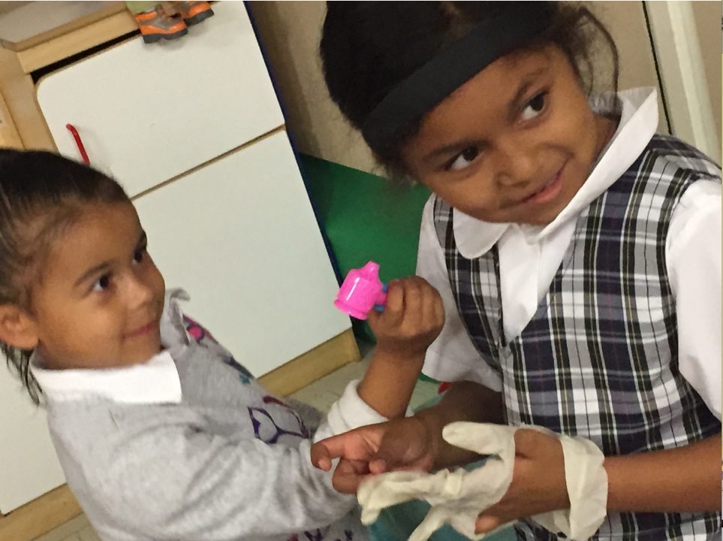
Framework Strategies
Developmentally appropriate
Reflective and intentional
Individually and culturally meaningful
Inclusive
© 2017 California Department of Education
Notes:
Presenter Remarks:
The Preschool Curriculum Framework offers guidance on how teachers can support the learning and development described in the foundations through environments, materials, and experiences that are developmentally appropriate, individually and culturally meaningful, and engaging to families.
“Teachers address ideas and concepts that children can grasp at their developmental level and then progressively build on what children already know and understand. This approach applies to all children, including children with various abilities, disabilities, or other special needs (such as delays in language, cognition, or physical ability)” (PCF, Vol. 2, p. 227).
Let’s look at an example from the Preschool Curriculum Framework for creating an inclusive environment.
“Some children may need assistance in holding a book or turning the pages either through assistive technology or with the help of an adult or peer. For example, a book can be mounted so that a child need not hold it, and sturdy tabs placed on a book’s pages make them easier to turn” (PCF, Vol. 1, p. 106).

Slide 20
Preschool Curriculum Framework
Routines, environments, and materials
Interactions and strategies
Planning learning opportunities
Teachable moments
Notes:
20
Presenter Remarks:
As we just discussed, language and literacy often develop within contexts of the daily routine, classroom environment, home environment, and through interactions with peers and adults.
“Topics [in the Preschool Curriculum Framework] include guiding principles (in particular, the vital role of the family in early learning and development); the diversity of young children in California; and the ongoing cycle of observing, documenting, assessing, planning, and implementing curriculum. The framework takes an integrated approach to early learning and describes how curriculum planning considers the connections between different domains as children engage in teacher-guided learning activities” (PCF, Vol. 2, p. v).

Slide 21
Guess Your Character!
Each participant was assigned a secret identity—the name of a well-known storybook character was placed on your back where you can’t see.
The object is to figure out your character based on your partner’s answers to your questions.
Who am I?
What story am
I from?
Notes:
Presenter Remarks:
Now we will move on to an activity called, “Guess your character!”
Each of you was assigned a secret identity—the name of a well-known storybook character was placed on your back where you can’t see.
The object is for each of you to figure out which character you are based on the questions you ask your partner.
Move on to the next slide for directions.
Extra Notes:
Story familiarity is connected to family culture. Depending on the audience, you may need to adapt the characters used for this activity.

Slide 22
Guess Your Character!
Directions:
Mingle throughout the room.
When the music stops, find a partner who is not from your table group.
Read (silently) the character name on your partner’s back and have them read yours.
Play 20 questions to figure out who your characters are.
Reflection:
What comprehension strategies did you use to determine your character?
How did language and literacy work together in this experience?
What prior knowledge and context did you rely on?
Notes:
Activity 2: Guess Your Character!
Presenter Remarks: I am going to play some background music for you as you mingle throughout the room. When the music stops, find a partner who is not from your table group.
Guess Your Character
intent:
Use comprehension strategies to determine a game character. (Note: Story familiarity is connected to family culture. Depending on the audience, you may need to adapt the characters used for this activity.)
OUTCOME:
Utilize simple questions to determine a participant’s game character.
Materials Required:
Sticker labels with character names for registration table
List of possible questions
Boom box and CD
Time: 15 minutes
Process:
As participants register in the morning, place a character sticker label on their back. Make sure they can’t see the labels and ask them not to tell other participants the character on their labels.
Play music and invite participants to mingle throughout the room.
(When the music stops) Direct participants to choose a partner who is not from their table.
Direct participants to read the character’s name on their partners back without telling each other what the labels say.
Have participants play 20 questions to figure out which character they are. The following are possible questions to use:
Is my character a male or female?
Does my character save the day?
Am I an animal?
Am I a villain?
Do I like to eat soup?
Do I wear a cape?
Do I have a horse?
Do I have two cruel stepsisters?
Do I grant wishes?
REFLECTION:
What comprehension strategies did you use to determine your character?
How did language and literacy work together in this experience?
What prior knowledge and context did you rely on?

Slide 23
Focused Video Viewing: Watch for and take note of the developmental shift.
Foundation 4.1 video foundation examples
Notes:
Background Info:
Show foundations example video Comprehension and Analysis of Age-Appropriate Text 4.1 (show both 48 and 60 month examples).
Presenter Remarks:
Let’s take a look at what this looks like in classrooms with four and five year olds.
As you watch the video notice the knowledge, skills, and behaviors that take on a developmental shift.
Extra Notes:
Optional discussion questions:
What are the differences in developmental levels (at around 48 months versus at around 60 months)?
How would you describe the different instructional strategies you see the teacher using to develop children’s comprehension and analysis of text (at around 48 months versus at around 60 months)?
How does the teacher adapt her teaching strategy (at around 48 months versus at around 60 months) to support children’s understanding of narratives?
How are you currently using these methods in your classroom?
How do you help students to build expressive language skills?

Slide 24
Video Reflection
Find someone who had the same character name as you in the last activity and discuss the following questions:
What did you notice in the developmental shift occurring between 48 and 60 months?
What did you see that reminded you of your classroom?
Notes:
Presenter Remarks:
Find someone who had the same character name as you in the last activity and discuss the questions on the slide.
Bring the group back together. Have two or three participants share-out their answers.

Slide 25
Let’s read a story! The Little Mouse, The Red-Ripe Strawberry, and the Big Hungry Bear
Notes:
Background Information:
Read The Little Mouse, The Red-Ripe Strawberry, and the Big Hungry Bear to the group as though you are reading to your class for the first time; this provides a model of how to read a book on the first reading.
Presenter Remarks:
Now that we have a visual example of the foundations, let’s use a story to better understand the knowledge, skills, and behaviors for foundations 4.1.

Slide 26
Foundation 4.1 and Story Book Reading
Notes:
Presenter Remarks:
Find this page in the Preschool Learning Foundations.
Read the foundations and discuss how the Preschool Learning Foundations define Comprehension and Analysis of Age-Appropriate Text.
Now read the 48 and 60 month examples. Circle at least one that you have experienced in your classroom.
Did reading this foundation make you think of anything from the story we just experienced?
Next, we will use the story we just experienced to better understand this foundation.

Slide 27
Creating New Foundation Examples
Step 1:
Read Handout 1: PLF Map Comprehensions and Notes Page and focus on the foundation examples.
Pay close attention to the developmental shift that is occurring between 48 months and 60 months.
Circle any examples that you have experienced in your classrooms.
Document your examples on the Notes Page of the handout (first column).
Feel free to talk with your tablemates as you work.
Notes:
Activity 3: Making Foundations Examples
Presenter Remarks:
Please read Handout 1: PLF Map Comprehensions and Notes Page and focus on the foundation examples. Play close attention to the developmental shift that is occurring between 48 months and 60 months.
As you are reading, circle any examples that you have experienced in your classrooms. Be sure to document your examples on the Notes Page of the handout (first column). Feel free to talk with your tablemates as you work.
Making Foundations Examples
intent:
Provide an opportunity to read over the foundations, reflect, and create examples.
OUTCOMES:
Participants create examples that can be utilized as reflection tools.
Materials Required:
Handout 1: PLF Map Comprehensions and Notes Page
Highlighters
Pens and markers
Time: 15 minutes
Process:
Step 1:
Instruct participants to read Handout 1: PLF Map Comprehensions and Notes Page and to focus on the foundation examples. Ask participants to play close attention to the developmental shift that is occurring between 48 months and 60 months.
Direct participants to circle any examples that they have experienced in their classrooms. Then have them document the examples on the Notes Page of the handout (first column).
Encourage participants to talk with their tablemates as they work.
Step 2:
Ask participants to think about the story they just heard.
Direct participants to create an example for 48 months and for 60 months that they could imagine observing in a child who had experienced the same story. Have them document their examples on the Notes Page of the handout (second column).
Step 3:
Ask participants to pair up with someone wearing a different character label than themselves and to share their examples with them.
Step 4:
Ask participants to again think about the story they just heard.
Have participants think of a child in their classroom who is just advancing beyond the 60-month foundation.
Direct participants to write an example they could imagine observing in this child after they had experienced the same story with similar opportunities. Have them document their example on the Notes Page of the handout (second column).
Have participants write a strategy they could plan to use to support this child on the Notes Page of the handout (third column).
Step 5:
Ask participants to pair up with a new partner—again, someone wearing a different character label than themselves—and to share their example with them.
Bring the whole group back together and have them share-out any “aha” moments.

Slide 28
Creating New Foundation Examples
Continue using Handout 1: PLF Map Comprehensions and Notes Page.
Step 2:
Think about the story you just heard.
Create an example for 48 months and for 60 months that you could imagine observing in a child who had experienced the same story.
Document your examples on the Notes Page of the handout (second column).
Step 3:
Pair up with someone wearing a different character label than you and to share your examples with them.
Notes:
Activity 3: Making Foundations Examples
Presenter Remarks:
Please read Handout 1: PLF Map Comprehensions and Notes Page and focus on the foundation examples. Play close attention to the developmental shift that is occurring between 48 months and 60 months.
As you are reading, circle any examples that you have experienced in your classrooms. Be sure to document your examples on the Notes Page of the handout (first column). Feel free to talk with your tablemates as you work.
Making Foundations Examples
intent:
Provide an opportunity to read over the foundations, reflect, and create examples.
OUTCOME:
Participants create examples that can be utilized as reflection tools.
Materials Required:
Handout 1: PLF Map Comprehensions and Notes Page
Highlighters
Pens and markers
Time: 15 minutes
Process:
Step 1:
Instruct participants to read Handout 1: PLF Map Comprehensions and Notes Page and to focus on the foundation examples. Ask participants to play close attention to the developmental shift that is occurring between 48 months and 60 months.
Direct participants to circle any examples that they have experienced in their classrooms. Then have them document the examples on the Notes Page of the handout (first column).
Encourage participants to talk with their tablemates as they work.
Step 2:
Ask participants to think about the story they just heard.
Direct participants to create an example for 48 months and for 60 months that they could imagine observing in a child who had experienced the same story. Have them document their examples on the Notes Page of the handout (second column).
Step 3:
Ask participants to pair up with someone wearing a different character label than themselves and to share their examples with them.
Step 4:
Ask participants to again think about the story they just heard.
Have participants think of a child in their classroom who is just advancing beyond the 60-month foundation.
Direct participants to write an example they could imagine observing in this child after they had experienced the same story with similar opportunities. Have them document their example on the Notes Page of the handout (second column).
Have participants write a strategy they could plan to use to support this child on the Notes Page of the handout (third column).
Step 5:
Ask participants to pair up with a new partner—again, someone wearing a different character label than themselves—and to share their example with them.
Bring the whole group back together and have them share-out any “aha” moments.

Slide 29
Stages of Development for Comprehension and Analysis of Age-Appropriate Text
External and Internal Recognition of Narrative
Understand and Relate to Characters’ Internal Responses
Construct Narrative Schemas
Construct Primitive Scripts
(PLF, Vol. 1, p. 53).
Notes:
Background Information:
Preschool Learning Foundations, Volume 1, page 53
Presenter Remarks:
“At the earliest stage, preschoolers construct narrative scripts, or primitive accounts of story plots that focus on familiar events and routine activities. In the next stage, children construct narrative schemas, which include knowledge about the main elements of stories (such as characters and settings) and about the sequence of events (such as time, order, and causal progression). Then preschoolers come to understand and relate to characters’ internal responses, such as their mental processes and experiences. Ultimately, children recognize both the external and internal features of narrative. Preschoolers’ competence with narratives can be greatly expanded through instructional activities guided by teachers” (PLF, Vol. 1, p. 53).
We need to use all of our resources to best understand and support these stages. Our resources include the Preschool Learning Foundations, the Preschool Curriculum Framework, the Transitional Kindergarten Implementation Guide, and the DRDP-K (2015).
Optional:
Invite participants to share how, when, and where they might see the different stages of comprehension occur in the TK classroom.

Slide 30
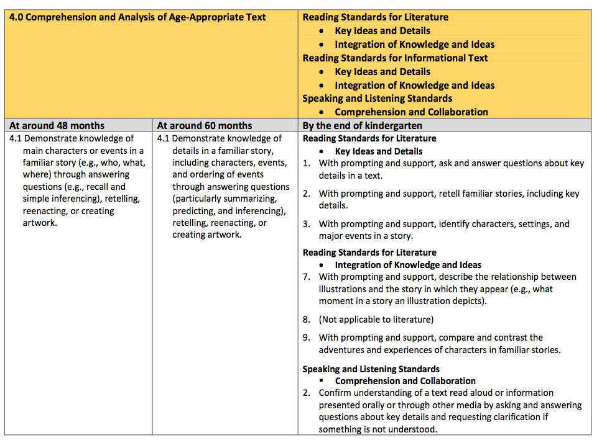
Alignment of Developmental Progression
Notes:
Background Information:
The chart on the slide can be found on page 45of the Alignment of the California Preschool Learning Foundations with the Common Core State Standards.
Presenter Remarks:
As discussed earlier, the Alignment document provides information about the connections between the foundations and the California Kindergarten Standards.
Look again at Handout 2: Alignment Document and DRDP-K Measure LLD 6 to see the detailed alignment of foundation 4.1 and the California State Standards. Underline anything you find interesting. Allow 3-4 minutes to read and underline.
Would anyone like to share out what they underlined or found interesting?
Below are optional discussion questions if participants need prompting to start discussion:
What do you observe about the different expectations for children at around 48 months of age, 60 months of age and the end of kindergarten?
How does this relate to the stages of narrative thinking discussed in the previous slide?
In recognition of these developmental stages, what are the implications for TK teachers in supporting children’s developing ability to make meaning of text and/or narrative comprehension?
Extra Notes:
Have participants review the alignment between the Preschool Learning Foundations Reading strand—substrand 4.0 Comprehension and Analysis of Age-Appropriate Text—and the three sets of reading standards in the CCSS: Reading Standards for Literature, for Informational Text, and in Foundational Skills and Standards for Speaking and Listening.

Slide 31
Key Features of the DRDP-K (2015)
An observation-based assessment tool, not a test
Individual child assessment
Completed by each child’s teacher
Based on developmental research and theory
Includes developmental sequences of behaviors along a continuum
Spans the developmental continuum of children in a two-year kindergarten program
Notes:
Presenter Remarks:
One resource that is used to support children’s development is the Desired Results Developmental Profile—Kindergarten (2015): A Developmental Continuum for Kindergarten (DRDP-K [2015]). This is especially helpful for English Learners.
The DRDP-K (2015) informs teachers’ understanding of the developmental continuum. It can be used with the Alignment Document to expand upon the developmental continuum.
One key feature of the DRDP-K (2015) to consider is that it is an observation-based assessment and not a test. It is used to support children’s learning. Observing and documenting children's progress provides teachers the information needed to differentiate instruction and experiences. It also provides information to individualize.
Observational tools are preferred over criterion-referenced tools because the information gathered by observation more accurately reflects what children are able to do.
Documentation provides concrete evidence of what children are able to do. With this documentation, we are then able to better plan activities that will meet and appropriately challenge children's developmental needs.
The DRDP-K (2015) also includes the following features:
It is an individual child assessment that can be shared with families.
It is aligned with the Preschool Learning Foundations.
It opens up the opportunity for articulation between preschool and TK teachers.
Sharing information as to where children are on the developmental continuum can better prepare the TK teacher to work with students.
A teacher can include a request form for previous records as part of the TK registration to help support the relationship between preschool, family, and TK.
The DRDP-K (2015) has been developed with world renowned experts. It is based on research and knowledge of what is most important for predicting school success.

Slide 32
DRDP-K (2015)
Notes:
Background Information:
Ask participants to pull out Handout 8: Integrated Instruction (Excerpted from the DRDP-K; Language and Literacy: Phonological Awareness). For more information go to: http://www.drdpk.org.
Presenter Remarks:
The DRDP-K (2015) provides the developmental continuum from early preschool to early first grade. Locate Handout 2: Alignment Document and DRDP-K Measure LLD 6.
Read each developmental level.
What do you notice about the similarities and differences in these measurements? Allow time for discussion.
How might you use this information in your planning for Comprehension and Analysis of Age-Appropriate Text in the TK classroom?

Slide 33
Universal Design for Learning
Multiple means of:
Representation
Engagement
Expression
© 2017 California Department of Education
Notes:
Presenter Remarks:
Recognizing that students follow different pathways to learning, this framework incorporates a concept known as Universal Design for Learning (UDL).
“Universal design provides for multiple means of representation, multiple means of engagement, and multiple means of expression…Multiple means of representation refers to providing information in a variety of ways so the learning needs of all children are met. For example, it is important to speak clearly to children with auditory disabilities while also presenting information visually (such as with objects and pictures).
Multiple means of expression refers to allowing children to use alternative ways to communicate or demonstrate what they know or what they are feeling. For example, when a teacher seeks a verbal response, a child may respond in any language, including American Sign Language. A child with special needs who cannot speak may also respond by pointing, gazing, gesturing, using a picture system of communication, or by using any other form of alternative or augmented communication system.
Multiple means of engagement refers to providing choices in the setting or program that facilitate learning by building on children’s interests. The information in this curriculum framework has been worded to incorporate multiple means of representation, expression, and engagement” (PCF, Vol. 2, p. 14).
An intentionally designed environment can support UDL strategies for supporting vocabulary. Look at the various ways children are engaging with, representing, and expressing the concept of a volcano in these photographs. How many can you see?
Extra Notes:
Print and place the following article on the gallery table for those participants who are interested in learning more about UDL: “Integrating Principles of Universal Design Into the Early Childhood Curriculum.”

Slide 34
Revisiting The Little Mouse, The Red-Ripe Strawberry and the Big Hungry Bear
Notes:
Background Information:
Prior to re-reading the story, pass out some popsicle stick puppets. You can make your own, or use the templates from the trainer materials.
As you tell the story, invite the participants with the correct puppet to come to the front of the room and act it out.
For example, when the mouse uses a disguise to hide the strawberry, the person holding the puppet with the glasses would come to the front of the room.
Presenter Remarks:
Now we will revisit The Little Mouse, The Red-Ripe Strawberry and the Big Hungry Bear. This time we will read it in a way that children can replicate and retell the story.
You will likely notice that some of the strategies we are using provide multiple means of representation and engagement—making them align with universal design for learning.
This experience meets two of the recommendations to support reading from the beginning of the day:
Read stories more than once.
Plan support for reading stories.
Read the story using the popsicle stick puppets.
Has anyone read this story another way they would like to share? There are many ways to read a story a second time and encourage students to re-tell the story.
Another thing to consider on the second reading are the reflective questions. For example, I love to ask students how they think the mouse should have tried to hide the strawberry because their answers are always very entertaining and provide incite into how they are thinking about the story.

Slide 35
Making Foundations Examples
Relocate Handout 1: PLF Map Comprehensions and Notes Page
Step 4:
Considering the strawberry story, think of a child in your classroom who is just advancing beyond the 60 month foundation.
Write an example you could imagine observing in this child after they had experienced the same story with similar opportunities.
Document your example on the Notes Page of the handout (second column).
Write a strategy you could plan to use to support this child on the Notes Page of the handout (third column).
Step 5:
Pair up with a new partner—again, someone wearing a different character label than you—and share your example with them.
Notes:
Activity 3: Making Foundations Examples continued
Presenter Remarks:
(Step 4) Again, think about the story you just heard. Now think of a child in your classroom who is just advancing beyond the 60 month foundation. Write an example you could imagine observing in this child after they had experienced the same story with similar opportunities. Document your example on the Notes Page of the handout (second column).
You will now write a strategy you could plan to use to support this child on the Notes Page of the handout (third column).
(Step 5) Pair up with a new partner—again, someone wearing a different character label than you—and share your example with them.
intent:
Provide an opportunity to read over the foundations, reflect, and create examples.
OUTCOME:
Participants create examples that can be utilized as reflection tools.
Materials Required:
Handout 1: PLF Map Comprehensions and Notes Page
Highlighters
Pens and markers
Time: 15 minutes
Process:
Step 1:
Instruct participants to read Handout 1: PLF Map Comprehensions and Notes Page and to focus on the foundation examples. Ask participants to play close attention to the developmental shift that is occurring between 48 months and 60 months.
Direct participants to circle any examples that they have experienced in their classrooms. Then have them document the examples on the Notes Page of the handout (first column).
Encourage participants to talk with their tablemates as they work.
Step 2:
Ask participants to think about the story they just heard.
Direct participants to create an example for 48 months and for 60 months that they could imagine observing in a child who had experienced the same story. Have them document their examples on the Notes Page of the handout (second column).
Step 3:
Ask participants to pair up with someone wearing a different character label than themselves and to share their examples with them.
Step 4:
Ask participants to again think about the story they just heard.
Have participants think of a child in their classroom who is just advancing beyond the 60-month foundation.
Direct participants to write an example they could imagine observing in this child after they had experienced the same story with similar opportunities. Have them document their example on the Notes Page of the handout (second column).
Have participants write a strategy they could plan to use to support this child on the Notes Page of the handout (third column).
Step 5:
Ask participants to pair up with a new partner—again, someone wearing a different character label than themselves—and to share their example with them.
Bring the whole group back together and have them share-out any “aha” moments.

Slide 36
Preschool Curriculum Framework: Interaction and Strategy
Read a story several times over a few days:
Prompts children’s thinking
Expands what the child says
Expands the child’s expressive language
Monitors a child’s understanding of a story
(PCF, Vol. 1, p. 148)
Notes:
Presenter Remarks:
Another recommendation for supporting reading was to read a story several times over a few days.
Reading a story several times over an extended amount of time helps TK children gain familiarity with the sequence of the story.
By prompting children’s thinking and through back and forth exchanges, expansion/elaboration, follow up questions and persistence, TK teachers can deepen children’s narrative comprehension.
“For example, during a second reading of Corduroy, a teacher might ask on the first page, ’So, where does Corduroy live?’ A child might say ‘in there’ or ‘at a store.’ The teacher expands the child’s response (e.g., ‘Yes, Corduroy lives in the toy department of a big store’) and follows up by encouraging the child to say, ‘toy department’” (PCF, Vol. 1, p. 148).
There are multiple ways to re-read a story. It is clear that reading several times does not mean always reading the same way.

Slide 37
Being Prepared
Understand the storyline
Characters
Plot
Transitions
Connect to interests of children
Plan an introduction
Identify possible points of confusion
Provide prompts
Provide visual and tactile cues
Notes:
Presenter Remarks:
Find Handout 3: Children's Story Retelling.
As you read through the handout, you will find that the effects of children’s story retelling on early literacy and language development was examined in a meta-analysis of 11 studies including 687 toddlers and preschoolers.
The results indicated that children’s story retelling influenced both story-related comprehension and expressive vocabulary as well as nonstory-related receptive language and early literacy development.
Findings also showed that the use of the characteristics that experts consider to be the important features of retelling practices was associated with positive child outcomes.
This handout is a great retelling strategy tool. Take five minutes to read through some of it.
What did you find through your reading?

Slide 38
Being Prepared: Finding the Evidence
Read the vignette and planned learning opportunity on page 147 of the Preschool Curriculum Framework (Vol. 1).
Work with your tablemates to look for evidence of the teacher’s preparedness in the vignette.
Consider the needs of your TK classroom; how would you replicate this idea of intentional teaching?
Notes:
Activity 4: Being Prepared: Finding the Evidence
Presenter Remarks:
Read the vignette and planned learning opportunity on page 147 of the Preschool Curriculum Framework and identify how the teacher planned ahead to increase story comprehension. Be sure to jot down the methods the teacher utilized on the sticky notes. These notes will be shared with the group.
intent:
Become familiar with one way to use vignettes to enhance teaching.
OUTCOME:
Participants will read a vignette from the Preschool Curriculum Framework (PCF) and analyze that information in relation to their personal planning practices.
Materials Required:
Preschool Curriculum Framework, Volume 1, p. 147
Sticky notes
Sticky wall or Handout 4: Finding the Evidence
Time: 15 minutes
Process:
Guide participants to read page 147 in the Preschool Curriculum Framework.
Ask participants to identify how the teacher planned ahead to increase story comprehension, jotting down the methods the teacher utilized on the sticky notes. Tell them their notes will be shared with the group.
Allow 10 minutes for reading and note taking.
After participants have finished, have them place their notes on the Sticky Wall or on Handout 4: Finding the Evidence.
Debrief:
Guide participant’s attention to the ways the teacher planned for story comprehension.
Have participants identify a planning method that they already use to increase story comprehension.
Have participants identify a planning method they will implement to increase story comprehension.
OPTIONS:
If presenters are using a Sticky Wall, debriefing can be done as one large group or with individual table groups.
The columns on Handout 4: Finding the Evidence can be separated on chart paper and hung around the room so that participants can walk around to place their sticky notes.

Slide 39
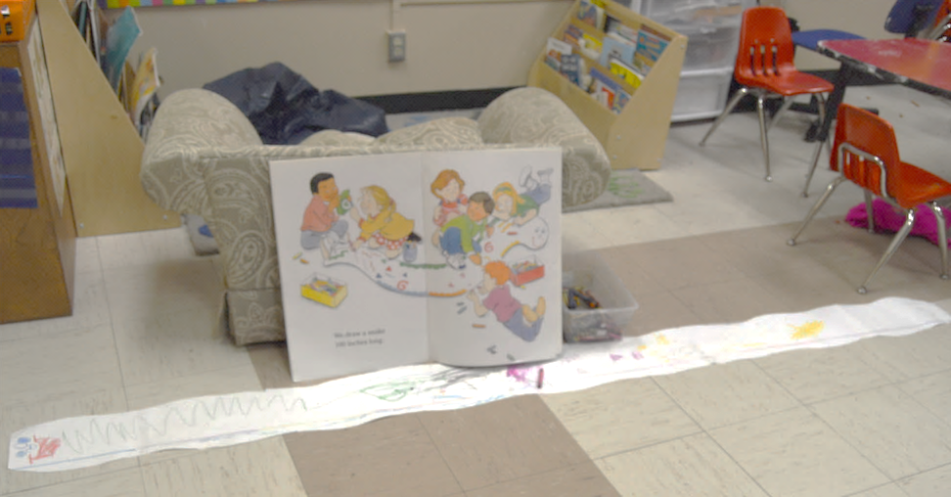
Supporting English Learners
Start with what the child knows
Expand and extend
Use repetition
Point out print features during shared reading
Use props
Notes:
Presenter Remarks:
“Be prepared to guide and scaffold children’s language and thinking as they respond [to stories] in any language” (PCF, Vol. 1, p. 149).
Hold up the PEL Resource Guide while going through these points. While reading stories with young children, some of the strategies that could be used are listed in the PEL Resource Guide (pages 54-55) and the Preschool Curriculum Framework, Volume 1 (page 210). For example:
Start with what the child knows: Use a few words in the child’s home language (come, bathroom, eat) to allow for low-level communication.
Expand and extend: Start with what the child already knows and expand on his or her language. If the child says “car,” the teacher can reply, “That is a red car.”
Use repetition: Say the same thing more than once to give the child an opportunity to understand what is being said. Talk about the here and now. Refer to the present situation to allow the child to understand the context of communication.
Point out print features during shared reading: Doing this will allow the child to visually comprehend what the story might be about.
The first picture shows a large group reading where the teacher can point out print features. The second picture is a repetitive opportunity for children to look at the book, talk about it with classmates, and use props to expand their thinking.
A short discussion after reading a story can also increase understanding.
Think about how some of these strategies could be used to support students who are English learners. Invite a few volunteers to share ideas with the whole group.

Slide 40
Interaction and Strategy: Retelling Stories
“Support children to orally reconstruct a story that was read and move toward deeper comprehension of the narrative.”
(PCF, Volume 1, p. 150).
© 2017 California Department of Education
Notes:
Background Information:
The information on this slide comes from the Preschool Curriculum Framework, Volume 1, page 150.
Presenter Remarks:
Retelling involves having students orally reconstruct a story that they have read. It also requires students to activate their knowledge of how stories work and apply it to the new reading.
As part of retelling, students engage in ordering and summarizing information and in making inferences. The teacher can use retelling as a way to assess how well students comprehend a story, then use this information to help students develop a deeper understanding of what has been read.
The teacher uses explicit instruction, explaining why retelling is useful, modeling the procedure, giving students opportunities to practice, and providing feedback. As the following chart shows, students' retellings should become more detailed as they become better readers.
Types of retelling:
Simple Retelling—the student can:
Identify and retell the beginning, middle, and end of a story in order
Describe the setting
Identify the problem and the resolution of a problem
More complete retelling—the student can:
Identify and retell events and facts in a sequence
Make inferences to fill in missing information
Identify and retell causes of actions or events and their effects
Most complete retelling—the student can:
Identify and retell a sequence of actions or events
Make inferences to account for events or actions
Offer an evaluation of the story

Slide 41
Scaffolding Comprehension of Text for English Learners
Ask questions while reading text.
Point out cognates and connections between words in the home language and English.
Provide families with topics/text to be explored so they can build content knowledge at home.
Share copies of text in child’s home language with families.
Re-read or retell the story in a small group or one-on-one using realia.
Find time to embed new vocabulary from the text throughout the day.
Notes:
Presenter Remarks:
To support comprehension of text for English Learners, it is important to choose strategies that provide scaffolding to their current level of English.
This slide has a list of strategies that may be useful. For more information, the PEL Resource Guide and/or the ELD chapters of the Preschool Learning Foundations and the Preschool Curriculum Framework should be used.
Invite a volunteer to read each bullet, then expand on the statement with the information below. After reading the expanded information to the group, ask for any ideas on how teacher could—or currently do—use this strategy to support comprehension for English learners.
Ask questions while reading text.
This is especially important so teachers can observe and understand what students are comprehending. Using gestures, wait time, and strategies such as pair-share while asking questions is also beneficial.
Point out cognates and connections between words in the home language and English.
Cognates are words that exist in different languages that have the same root or origin. For example the English word “dinosaur” and the Spanish word “dinosaurio” are cognates. NOTE: It is easier to find cognates between certain languages and sometimes it is not possible.
Provide families with topics/text to be explored so they can build content knowledge at home.
This strategy not only supports the child’s comprehension in class, but also expresses the value of families and the importance of families in continuing to support children’s home language development.
Share copies of text in child’s home language with families.
This can be done with a class library or through books that can be found online and printed for families to have. Teachers may also want to invite family members to come in and read the book in their home language.
Re-read or retell the story in a small group or one-on-one.
This can be done during structured time or by invitation during choice time. It provides another opportunity for students to hear and connect to the story and it motivates students to engage with the retelling materials called realia so that they can continue to talk about the story and use new vocabulary.
Find time to embed the new vocabulary from the text throughout the day.
After you pre-read the book, decide which vocabulary words are key for comprehension of the text and identify appropriate times and environments in the day that students will have a chance to learn about them.
Thank you for sharing your ideas does anyone have something else they would like to add?

Slide 42
Reflect and Discuss
What scaffolding can be provided for English learners to support comprehension of text?
Share opportunities that you currently provide for children to interact with text in their home language as well as in English.
Share how you expand and extend on the child’s language while reading text.
Notes:
Background Information:
The information on this slide comes from the Preschool Curriculum Framework, Volume 1, page 195
Presenter Remarks:
Invite participants to discuss the questions below.
How do you know if an English learner comprehends a story being read in English?
Does the child attend and follow along with a story read in English or does he tend to look away and appear uninterested?
Does the child show an interest in and attend to books read in their home language?
Does the child spend more time on the fringes of groups, watching and listening to others?
How are you providing focused listening opportunities in children’s home languages during group reading or small group reading?

Slide 43
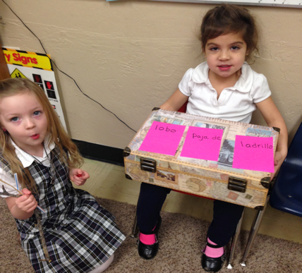
Environment Interaction and Strategy
“Plan the environment to support independent story retellings” (PCF, Vol. 1, p. 150).
The Three Little Pigs Suitcase Story in the reading area with labels in multiple languages
Materials to build houses to retell The Three Little Pigs story in the building area
Notes:
Presenter Remarks:
Let’s look at another recommendation to support reading from the Preschool Curriculum Framework.
“Plan the environment to support independent story retellings. After children have heard a story read aloud several times, place copies in the book area for children to retell, perhaps to an audience of peers or stuffed animals. Children also can retell by stories using flannel pieces or puppets, or they can dramatize stories by using simple costumes and props. Some retellings take place during quiet times, such as when children look at books as they rest. Others can take place as children read to a baby doll in the dramatic-play area, if small cardboard versions of familiar books are placed there. Children also represent story ideas creatively in the art area through drawing, painting, or sculpting” (PCF, Vol. 1, p. 150).
Given the story experience we just had with The Little Mouse, The Red-Ripe Strawberry and the Big Hungry Bear, how might we plan for the environment and independent or shared retellings?
Take a moment to silently think about this question. Imagine your classroom and what you could add that your students might gravitate toward to retell this story. Allow two minutes for thinking.
Adding materials that invite retelling can be fun and might be a new way to think about expanding comprehension of age-appropriate text because it lets the environment do some of the heavy lifting, rather than the teacher. We are going to focus on this in the next activity.

Slide 44
Environment Mapping Activity (Part 1)
Each table has a different book at the center that will be used as the focus book.
Find Handout 5: Environment Strategies and Handout 6: Environment Maps.
Read the handouts and brainstorm with your table group about what could be added to the environment to support re-telling of this story in your classroom.
Complete at least one written map to share with other table groups.
Notes:
Activity 5: Environment Map
Presenter Remarks:
Find Handout 5: Environment Strategies and Handout 6: Environment Maps. Read the handouts and brainstorm with your table group about what could be added to the environment to support re-telling of this story in the classroom. Complete at least one written map to share with other table groups.
intent:
Read and brainstorm about how to enhance story re-telling skills.
OUTCOME:
Participants will create a map with examples, share ideas, and use the ideas gathered as resources to support them during story re-telling time in their classrooms.
Materials Required:
Storytelling books
Handout 5: Environment Strategies
Handout 6: Environment Maps
Pens and markers
Time: 15 minutes
Process:
Part 1: (Each table has a different book at the center that will be used as their focus book.)
Find Handout 5: Environment Strategies and Handout 6: Environment Maps.
Read the handouts and brainstorm with your table group about what could be added to the environment to support re-telling of this story in your classroom.
Complete at least one written map to share with other table groups.
Part 2:
When the soft music starts, leave your groups’ completed map face up on your table.
Visit other tables and look at the books and completed table maps left out by the other groups.
Feel free to take photos or notes to document any interesting ideas you might want to replicate.
REFLECTION:
What new strategies will you use during story re-telling time?
How will these strategies enhance your classroom during story re-telling time?
What prior knowledge will you continue to utilize to support you during story re-telling time?

Slide 45
Environment Mapping Activity (Part 2): Table Walk
When the soft music starts:
Leave your groups’ completed map face up on your table.
Visit other tables and look at the books and completed table maps left out by the other groups.
Feel free to take photos or notes to document any interesting ideas you might want to replicate.
Notes:
Activity 5: Environment Map continued
Presenter Remarks: When the soft music starts, leave your groups’ completed map face up on your table. Visit other tables and look at the books and completed table maps left out by the other groups. Feel free to take photos or notes to document any interesting ideas you might want to replicate.
intent:
Read and brainstorm about how to enhance story re-telling skills.
OUTCOME:
Participants will create a map with examples, share ideas, and use the ideas gathered as resources to support them during story re-telling time in their classrooms.
Materials Required:
Storytelling books
Handout 5: Environment Strategies
Handout 6: Environment Maps
Pens and markers
Time: 15 minutes
Process:
Part 1: (Each table has a different book at the center that will be used as their focus book.)
Find Handout 5: Environment Strategies and Handout 6: Environment Maps.
Read the handouts and brainstorm with your table group about what could be added to the environment to support re-telling of this story in your classroom.
Complete at least one written map to share with other table groups.
Part 2:
When the soft music starts, leave your groups’ completed map face up on your table.
Visit other tables and look at the books and completed table maps left out by the other groups.
Feel free to take photos or notes to document any interesting ideas you might want to replicate.
REFLECTION:
What new strategies will you use during story re-telling time?
How will these strategies enhance your classroom during story re-telling time?
What prior knowledge will you continue to utilize to support you during story re-telling time?Please see previous slide for presenter remarks.)

Slide 46
Environment Strategy
46
“Extend the classroom beyond its walls” (PCF, Vol. 1, p. 108).
© 2017 California Department of Education
Notes:
Presenter Remarks:
The environment maps that were just created are a rich resource for embedding language and literacy opportunities throughout the classroom.
Did anyone write or read some interesting ideas for extending the classroom beyond its walls?
This can be done in conjunction with opportunities for retelling stories like we just focused upon. Or it can be done by including things of interest and informational text extension opportunities, such as books about different types of plants that children can look for in the yard, or magazines that have information about different insects children have an opportunity to observe in the yard.
In order to think deeply about what types of environments and interactions and strategies teachers can use to support student comprehension and analysis of informational text, we need to look more closely at foundation 4.2.
Optional:
Invite participants to turn to page 108 in the Preschool Curriculum Framework (Volume 1) and to read the environment strategy listed on the slide.

Slide 47
Foundation 4.2
Notes:
Presenter Remarks:
Find this page 68 in the Preschool Learning Foundations (Volume 1).
Read the foundation and discuss how the Preschool Learning Foundations define Comprehension and Analysis of Age-Appropriate Text.
Now read the 48 and 60 month examples. Circle at least one that you have experienced with children.

Slide 48
Focused Video Viewing
Foundations Video Example 4.2
Notes:
Presenter Remarks:
Watch Foundations Video Example 4.2 for 48 months ( 4 years) and 60 months (5 years).
What examples of scaffolding for specific students were shown in this activity?
Think back to the continuum of development we discussed with the DRDP-K (2015) measures. Would any of the strategies in the video be beneficial to one of the specific children you thought about?

Slide 49
Alignment to California Kindergarten Standards
Notes:
Presenter Remarks:
As discussed earlier, the Alignment document provides information about the connections between the foundations and the California Kindergarten State Standards.
Look again at Handout 2: Alignment Document. Focus on foundation 4.2. At your table group discuss the developmental progression between the 60 month foundation and the California Kindergarten Standard.
Now think about the strategies you have experienced today (for example retelling the story with props). How might these strategies support both progression to the 60 month foundation and the progression beyond the 60 month foundation.

Slide 50
Interaction and Strategy
Read information books:
To support children’s current interests
In conjunction with firsthand experiences
In the context of children’s families
(PCF, Vol. 1, p. 149)
© 2017 California Department of Education
Notes:
Presenter Remarks:
It’s time to look at another recommendation to support reading.
“Read information books. Find books that support children’s current interests and the development of new ones. Read them in conjunction with firsthand experiences (e.g., growing plants, caring for fish or other animals, playing doctor’s office), in support of interests that emerge at [school], or in the context of children’s families (e.g., finding a worm outside, seeing new leg braces worn by a peer, birth of a new baby, a grandmother’s visit, soccer, or some other sport they like)” (PCF, Vol. 1, p. 149).
Let’s discuss any firsthand classroom strategies you have used that have enhanced reading in the past.

Slide 51
Environment Interaction and Strategies
“Include information books among the materials utilized for science activities and other hands-on experiences” (PCF, Vol. 1, p.149).
“Plan for children to use information gained from an information book” (PCF, Vol. 1, p. 150).
Notes:
Presenter Remarks:
Take out and review Handout 7: ELA/ELD Framework Informational Text Strategies.
Here are a few more recommendations to support reading.
“Include information books among the materials utilized for science activities and other hands-on experiences. When planting seeds or observing the behavior of a snail or some fish, use information books, including the diagrams” (PCF, Vol. 1, p. 149).
“Plan for children to use information gained from an information book. When you read an information book to children to inform them about a process for an upcoming activity (e.g., planting seeds in small pots, making hand shadows on the wall, making paper-plate rhythm shakers, cleaning the fish aquarium), ask the children to describe the process before starting the activity. Support children’s recall, as needed, to help children provide the details of the steps they will follow in the activity” (PCF, Vol. 1, p. 149).

Slide 52
Integrate Learning with Informational Text Opportunities
Information books, placed in the indoor science area as well as outside in suitable tubs or on a cart, extend children's firsthand science experiences” (PCF, Vol. 1, p. 107).
Notes:
Background Information:
This information comes from the Preschool Curriculum Framework, Volume 1, page 107.
Presenter Remarks:
It is important to place informational books in all areas of the classroom. Informational books are resources that can increase understanding on many topics.
For example, informational books can be placed in the science area. “The science area is full of items that spark curiosity and wonder and prompt children to explore and find out… Information books, placed in the indoor science area as well as outside in suitable tubs or on a cart, extend children’s firsthand science experiences. As children explore science content, they learn rich vocabulary, ask questions, and describe what they see and hear. They also can learn to document investigations with drawings or writing, some of which they can dictate to teachers” (PCF, Vol. 1, p. 107).

Slide 53
Model Authentic Use
Invite families to bring in:
Newspapers
Food ads
Restaurant takeout menus
Children’s magazines
Food coupons
(PCF, Vol. 1, p. 150)
“Model authentic uses of book and nonbook forms of information text” (PCF, Vol. 1, p. 150).
© 2017 California Department of Education
Notes:
Presenter Remarks:
Let’s look at the next recommendation to support reading.
“Model authentic uses of book and nonbook forms of information text. Just as anyone would do before tackling a new task, use information texts when setting up a new aquarium, making muffins, or drying flowers” (PCF, Vol. 1, p. 150).
Invite families to bring in:
Newspapers
Food ads
Restaurant takeout menus
Children’s magazines
Food coupons
“[Make] sure that the variety represents the range of restaurants and languages that mirrors those used by children’s families” (PCF, Vol. 1, p. 150).

Slide 54
Guiding Principle: Connect School and Home
Read:
Read Handout 8: Interaction Strategy Toolkit for inspiration.
Discuss:
How might you build on a story we have read today to partner with families?
Notes:
Background Information:
Prior to the training make a chart paper with Partnering with Families as the title.
Presenter Remarks:
Another key guiding principle is to connect school and home.
We have already mentioned a few strategies for doing this in the environment. What are other ways you support the development of comprehension by partnering with families? Take a moment to share what you do at your table group. Allow 2-3 minutes.
Each strand of the framework ends with ideas for engaging families. Find and read Handout 8: Interaction Strategy Toolkit to gain some inspiration for the next brainstorming session. Allow 5 minutes.
Now think about one of the stories we have already worked with today. It can be the model story or the story you used in your environment map. How might you build upon this experience by partnering and engaging families? Write your ideas down on Handout 8: Interaction Strategy Toolkit.
Once they have finished writing on the handout, ask volunteers to share their ideas and write them on chart paper.

Slide 55
Planning Reading to Support Comprehension
Choose your children’s book.
There are options on each table group.
Find Handout 9: Planning for Comprehension.
Work on your own or with a partner complete Handout 9: Planning for Comprehension.
Be prepared to share.
Notes:
Activity 6: Planning for Comprehension
Presenter Remarks:
Head to the back table to choose the book that you will use for planning. Now find Handout 9: Planning for Comprehension in your packet. Use the handout to guide your planning.
Allow time for the participants to read their children’s book and to plan with their table group. Remind participants that they will have an opportunity to share-out at the end.
Planning for Comprehension
intent:
Practice planning for comprehension using the interaction and strategy ideas from the Preschool Curriculum Framework (PCF).
OUTCOME:
Participants use their personal knowledge in conjunction with information from the PowerPoint and the California Department of Education (CDE) resources to practice planning.
Materials Required:
Short, developmentally appropriate book
Handout 9: Planning for Comprehension
Time: 25 minutes
Process:
Invite table groups to the back table to choose the book that they will use for planning.
Guide participants to find Handout 9: Planning for Comprehension in their packet.
Allow time for the participants to read their children’s book and to plan with their table group. Have them use the handout to guide their planning.
Remind participants that they will have an opportunity to share-out at the end.
Debrief:
Have each table group join another table group.
Allow time for each table group to share a summary of their plan with the group they joined.
Ask for highlights of the process:
What was easy? What was hard? What are you taking away from the experience? Do you like the planning form?
OPTIONS:
Have participants work in pairs instead of in table groups.
Prior to the workshop, ask participants to bring their favorite children’s book with them to use for planning.

Slide 56
Reflect and Share
Reflect and share one new thing you will try to support comprehension of age-appropriate text.
Notes:
Presenter Remarks:
For 30 seconds, think about what you would like to do with the new information you have learned today. Allow 30 seconds.
Now turn to your elbow partner and commit to one thing you will do.

Slide 57
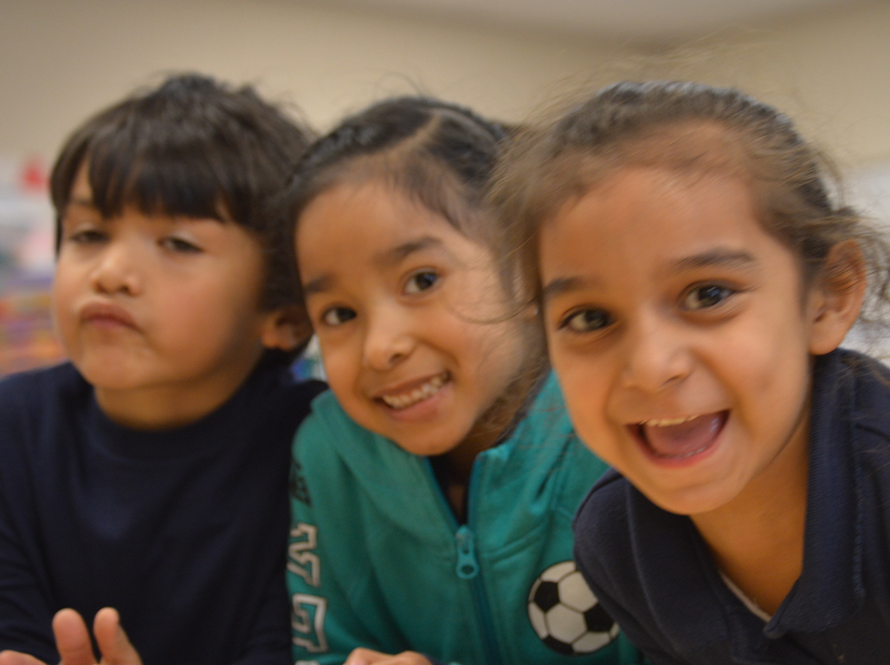
Thank You for Coming!
© 2017 California Department of Education
Notes:
Presenter Remarks:
Thank you for coming!

Slide 58
References
Bredekamp, Sue, and Carol Copple. Developmentally Appropriate Practice in Early Childhood Programs. NAEYC, 2008.
California Department of Education. 2013. Best Practices for Young Dual Language Learners Research: Overview Papers, Governor’s State Advisory Council on Early Learning and Care. http://www.cde.ca.gov/sp/cd/ce/documents/dllresearchpapers.pdf (accessed May 11, 2016).
California Department of Education. 2010. California Preschool Curriculum Framework, Volume 1. http://www.cde.ca.gov/sp/cd/re/documents/psframeworkkvol1.pdf (accessed April 10, 2016).
California Department of Education. 2011. California Preschool Curriculum Framework, Volume 2. http://www.cde.ca.gov/sp/cd/re/documents/psframeworkkvol2.pdf (accessed May 10, 2016).
California Department of Education. 2013. California Preschool Curriculum Framework, Volume 3. http://www.cde.ca.gov/sp/cd/re/documents/psframeworkkvol3.pdf (accessed May 10, 2016).
California Department of Education. 2008. California Preschool Learning Foundations, Volume 1. http://www.cde.ca.gov/sp/cd/re/documents/preschoollf.pdf (accessed April 10, 2016). California
California Department of Education. 2012. The Alignment of the California Preschool Learning Foundations with Key Early Education Resources. http://www.cde.ca.gov/sp/cd/re/documents/psalignment.pdf (accessed May 10, 2016).
California Department of Education. 2013. Transitional Kindergarten Implementation Guide: A Resource for California Public School District Administrators and Teachers. Sacramento: California Department of Education.
Dickinson, David K. Effective Uses of Books in Preschool Classrooms. Presentation for CPIN Conference, Los Angeles, CA. October 27, 2005.
State Advisory Council on Early Learning and Care. California Department of Education. California's Best Practices for Young Dual Language Learners: Research Papers. 2013. Accessed May 12, 2016. http://www.cde.ca.gov/sp/cd/ce/documents/dllresearchpapers.pdf.

