Slide 1
Photo Detectives

Slide 2
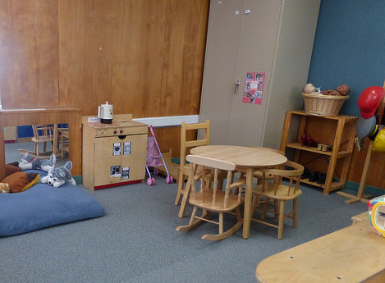
©2016 California Department of Education (CDE) with the WestEd Center for Child & Family Studies, California Preschool Instructional Network (CPIN). (05/2016)
Notes:
Blow up photos, Make binoculars, hunt for opportunities they see in the environment.
2

Slide 3
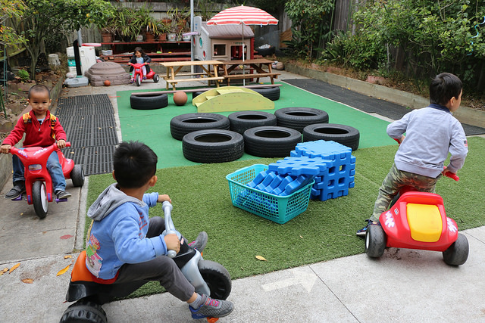
©2016 California Department of Education (CDE) with the WestEd Center for Child & Family Studies, California Preschool Instructional Network (CPIN). (05/2016)
Notes:
Blow up photos, Make binoculars, hunt for opportunities they see in the environment.
3

Slide 4
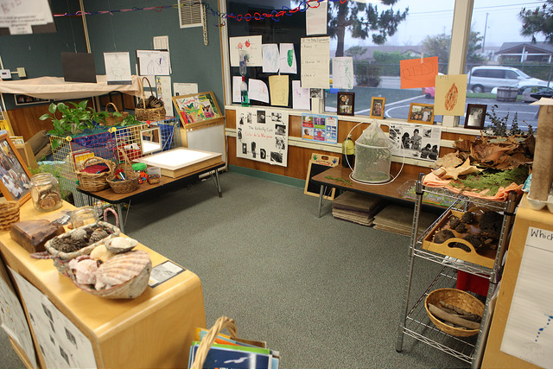
©2016 California Department of Education (CDE) with the WestEd Center for Child & Family Studies, California Preschool Instructional Network (CPIN). (05/2016)
Notes:
Blow up photos, Make binoculars, hunt for opportunities they see in the environment.
4

Slide 5
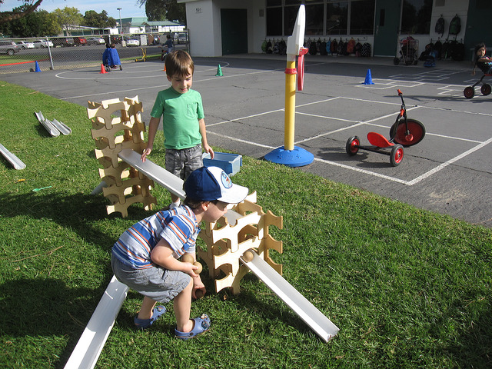
©2016 California Department of Education (CDE) with the WestEd Center for Child & Family Studies, California Preschool Instructional Network (CPIN). (05/2016)
Notes:
Blow up photos, Make binoculars, hunt for opportunities they see in the environment.
5

