Slide 1
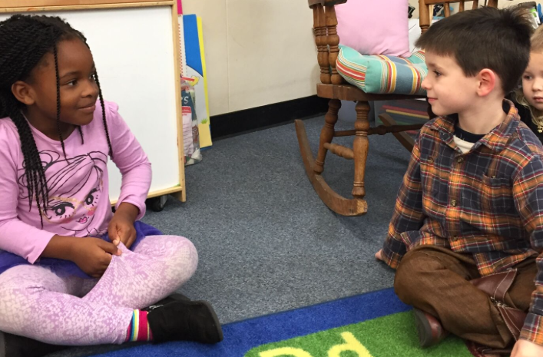
Strike a Balance
“Encourage children to take a turn” (PCF, Vol. 1., p. 102).
©2017 California Department of Education
Notes:
Presenter Remarks:
Another key guiding principle from the Language and Literacy domain is, “Encourage children to take a turn. Children learn language and learn about reading and writing through social interaction, especially when there is a lot of “back and forth” in a conversation. Strike a balance between surrounding children with language and letting them talk too” (PCF, Vol. 1., p. 102).

Slide 2
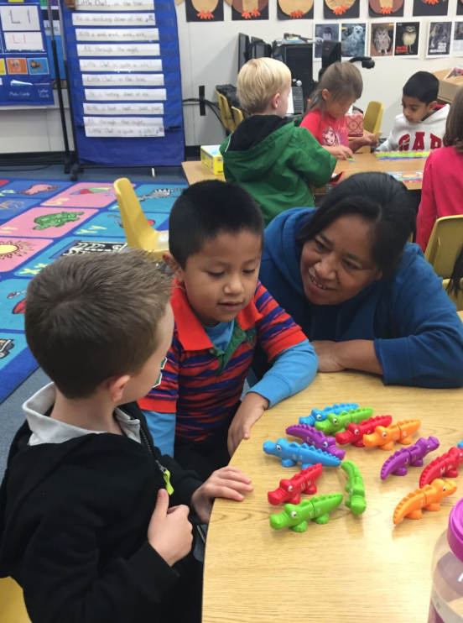
Guiding Principle
“Observe children” (PCF, Vol. 1, p. 103).
©2017 California Department of Education
Notes:
Presenter Remarks:
“By observing children’s engagement with language and literacy, teachers find ways to enter their world to support and extend their learning. These observations become a guide for intentional classroom practice. As teachers implement planned activities, their observations of children’s responses provide vital information that helps teachers meet students’ special needs” (PCF, Vol. 1, p. 103).
Please turn to pages 100-103 in the Preschool Curriculum Framework (Volume 1) and scan the complete set of guiding principles for the Language and Literacy domain can be found on pages 100-103 of the Preschool Curriculum Framework (Volume 1).
(Use a “popcorn” strategy to allow groups to share highlights from their discussions).
We will now focus on the foundations for the Grammar substrand.

