Slide 1
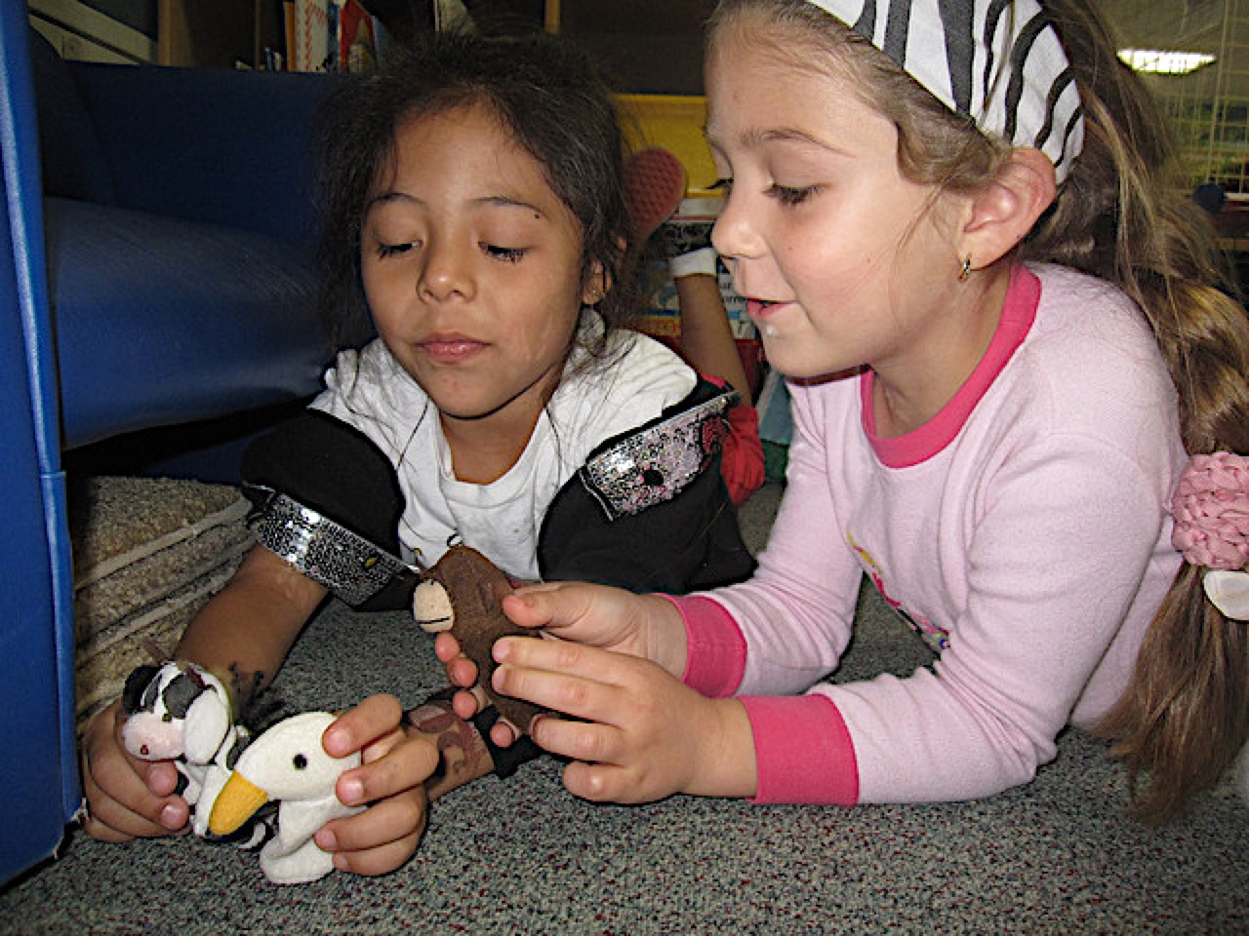
Language and Literacy in Transitional Kindergarten:
Language Use and Conventions and Grammar
California Preschool Learning Foundations, Volume 1
California Preschool Curriculum Framework, Volume 1
Notes:
Presenter Remarks:
Language and Literacy in Transitional Kindergarten: Language Use and Conventions and Grammar—a presentation focusing on the California Preschool Learning Foundations (Preschool Learning Foundations or PLF), the California Preschool Curriculum Framework (Preschool Curriculum Framework or PCF), and other California Department of Education (CDE) resources in support of the Language and Literacy domain.
This professional learning session is specifically designed to provide TK teachers with exposure to CDE resources that support TK curriculum planning of developmentally appropriate strategies. Classroom environment design recommendations are included to support the content areas of language use and conventions and grammar.

Slide 2
Objectives
Gain understanding of key concepts from the California Preschool Learning Foundations, Volume 1 and the California Preschool Curriculum Framework, Volume 1—Language and Literacy domain, Listening and Speaking strand: Language Use and Conventions and Grammar substrands.
Observe, read, and discuss the developmental continuum of language use and conventions and grammar.
Develop strategies that will guide instruction and learning in Transitional Kindergarten (TK).
Practice using the Preschool Learning Foundations and Preschool Curriculum Framework to intentionally plan developmentally appropriate, cultural, and inclusive strategies that promote the development of skills, knowledge, and behaviors related to language and literacy development.
Notes:
Presenter Remarks:
This slide shows the objectives for today’s training:
Gain understanding of key concepts from the California Preschool Learning Foundations, Volume 1 and the California Preschool Curriculum Framework, Volume 1—Language and Literacy domain, Listening and Speaking strand: Language Use and Conventions and Grammar substrands.
Observe, read, and discuss the developmental continuum language use and conventions and grammar.
Develop strategies that will guide instruction and learning in Transitional Kindergarten (TK).
Practice using the Preschool Learning Foundations and Preschool Curriculum Framework to intentionally plan developmentally appropriate, cultural, and inclusive strategies that promote the development of skills, knowledge, and behaviors related to language and literacy development.

Slide 3
Communicate and Connect—Part 1
Choose a string.
Partner with someone who has a similarly sized string.
Introduce yourself to your partner while discussing a few of the following questions:
  What interests you about language?
  What language/s do you speak?
  What is your favorite story about children learning language?
Notes:
Activity 1: Communicate and Connect
Presenter Remarks:
Let’s begin to think about language use and conventions and grammar.
intent:
Allow participants to share their personal experiences and learn from one another.
OUTCOMES:
Participants will meet each other and begin thinking about language use and conventions and grammar.
Materials Required:
PPT slide
Other participants
Different sized string pieces placed on tabletops (1 per participant)
TIME: 10 minutes
Process:
Invite participants to do the following:
Choose a string.
Partner with someone who has a similarly sized string.
Introduce yourself to your partner while discussing a few of the following questions:
What interests you about language?
What language/s do you speak?
What is your favorite story about children learning language?
Tell participants that their current partner will be their language partner for the day.
Advance to the Communicate and Connect—Part 2 slide.
Have partners tie their strings together; then have them team up with another partner pair with a similarly sized combined string.
Ask participants to share what they have learned about their language partner with the partner pair they have teamed up with.
Have partner pair teams connect their strings and hang them at the front of the room.
Ask participants to return to their seats.

Slide 4
Communicate and Connect—Part 2
Tie your string to your partner’s string.
Team up with another partner pair with a similarly sized combined string.
Share what you have learned about your language partner with the partner pair you have teamed up with.
Tie your team’s strings together and hang them at the front of the room.
Notes:
Presenter Remarks:
(What follows are the notes for the second part of the activity plan. See the notes section of the Communicate and Connect—Part 1 slide for complete activity plan.)
Have partners tie their strings together; then have them team up with another partner pair with a similarly sized combined string.
Ask participants to share what they have learned about their language partner with the partner pair they have teamed up with.
Have partner pair teams connect their strings and hang them at the front of the room.
Ask participants to return to their seats.

Slide 5
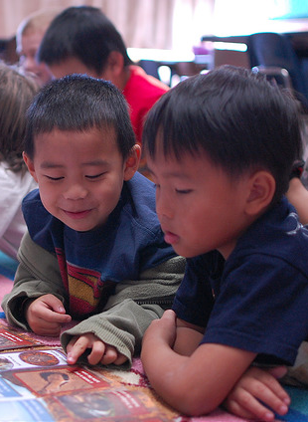
Today’s Focus
The Language Use and Conventions substrand focuses on the use of language for social and communicative purposes.
“‘Grammar’ refers to the way in which phrases and sentences are structured to make meaning” (PLF, Vol. 1, p.75).
©2017 California Department of Education
Notes:
Presenter Remarks:
We have already begun to use the skills we will be discussing today—during the string activity we used language to communicate and practiced grammar skills.
Research shows that social factors play an important role in oral language development. Therefore, it is important to provide multiple opportunities for students to engage in social interactions.
There are four specific areas that are emphasized within the Language Use and Conventions substrand:
Using language to communicate with others for a variety of purposes
Increasing clarity of communication
Developing an increasing understanding of the conventions of language use
Using language for narrative purposes
Students seem to have an natural tendency to learn the grammatical rules that govern their language. “The proportion of complex sentences contained in children’s language use ranges from 5 percent to 30 percent. This variability in the rate of growth has been linked to children’s experiences in hearing complex sentences from their teachers” (Huttenlocher and others as cited in PLF, Vol. 1, pp. 75-76).
“The foundations are organized to emphasize the child’s grammatical accomplishments at both the sentence and the word levels” (PLF, Vol.1, p. 76).

Slide 6









CDE Publications and Resources that
Support TK Implementation
Preschool Learning Foundations
California Common Core State Standards
English-Language Arts Content Standards for California Public Schools
Preschool Curriculum Framework
English Language Arts/English Language Development Framework
DRDP Specific to TK and K
Preschool Alignment Document
Preschool English Learners Guide
Transitional Kindergarten Implementation Guide
Preschool Learning Foundations
California Common Core State Standards
English–Language Arts Content Standards for California Public Schools
Preschool Curriculum Frameworks
English Language Arts/English Language Development Framework
DRDP Specific to TK and K
Preschool Alignment Document
Preschool English Learners Guide
Transitional Kindergarten Implementation Guide
Notes:
Presenter Remarks:
The California Department of Education has developed many publications, resources, and supports that enable teachers to facilitate the most positive outcomes for students.
Today our main focus will be on Volume 1 of the Preschool Learning Foundations and the Preschool Curriculum Framework. In addition, there are other key resources that support language and literacy:
California Common Core State Standards (CA CCSS)
English–Language Arts Content Standards for California Public Schools, Kindergarten Through Grade Twelve (ELA Standards)
English Language Arts/English Language Development Framework for California Public Schools: Kindergarten Through Grade Twelve (ELA/ELD Framework)
Desired Results Developmental Profile—Kindergarten (2015): A Developmental Continuum for Kindergarten (DRDP-K [2015])
Preschool English Learners: Principles and Practices to Promote Language, Literacy, and Learning—A Resource Guide (Second Edition) (PEL Resource Guide)
The Alignment of the California Preschool Learning Foundations with Key Early Education Resources (Alignment Document)
Transitional Kindergarten Implementation Guide—A Resource for Public School District Administrators and Teachers (TK Implementation Guide)
(Name and hold up each resource.) The Preschool Learning Foundations, Volume 1, Volume 2, and Volume 3, and the Preschool Curriculum Framework, Volume 1, Volume 2, and Volume 3, are the center of the California Early Learning and Development System.

Slide 7
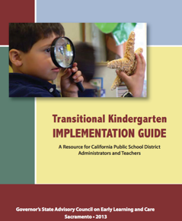
Transitional Kindergarten Implementation Guide
The TK Implementation Guide is a resource for California public school district administrators and teachers to support implementation of comprehensive TK programs.
Notes:
Presenter Remarks:
The TK Implementation Guide is a resource that focuses on the essential components for school district administrators and teachers to consider for TK programs. The TK Implementation Guide, published by the California Department of Education, is a resource to support implementation of comprehensive TK programs.
This publication provides resources and guidance in the areas of program design, curriculum, instruction, assessment, and family/community partnerships.

Slide 8
Overview of the Transitional Kindergarten Implementation Guide
  Section One
  Program Structure and Design
  Section Two
  The TK Student
  Curriculum in a TK Program
  Effective Instruction in a TK Program
  The TK Learning Environment
  Assessment and Differentiated Instruction
  Involving Families and Community Partners
  Supporting TK Implementation
Notes:
Presenter Remarks:
The TK Implementation Guide is organized into the following two sections:
Section 1 is covered in Chapter 1. The information in this section was developed with the administrator in mind and focuses on the program structure and design.
Section 2 is covered in Chapters 2-8. This section is a resource for both teachers and administrators and focuses on building a comprehensive TK program by addressing curriculum, instruction environment, assessment and partnership with families and community.
Within each of these chapters, vignettes, highlighted boxes, and resource boxes are included to illustrate examples of the information covered in each of the chapters.
A PDF copy of the document can be accessed at the California Department of Education Web page (www.cde.ca.gov/ci/gs/em/documents/tkguide.pdf).
Video footage for each chapter can be accessed at the California Department of Education. The video clips include footage of TK classrooms and interviews with teachers, administrators, and parents. https://www.youtube.com/user/caeducation
https://www.youtube.com/results?search_query=tk+implmentation+guide

Slide 9
Why Use the Preschool Learning Foundations for TK?
CA Law (EC 48000):
Transitional kindergarten is the first year of a two-year kindergarten program that uses a modified kindergarten curriculum that is age and developmentally appropriate.
Transitional kindergarten programs are intended, by legislative action, to be aligned to the California Preschool Learning Foundations developed by the California Department of Education.
Notes:
Background Information:
CDE.CA.gov/ci/gs/em/kinderfaq.asp#program
Presenter Remarks:
The state of California provides guidance on utilizing the Preschool Learning Foundations and the Preschool Curriculum Framework as planning and curriculum resources in the transitional kindergarten classroom.
In addition, the following publications and resources are available to support age and developmentally appropriate TK curriculum:
TK Implementation Guide
Alignment Document
CA CCSS
DRDP-K (2015)
ELA Standards
ELA/ELD Framework
We will now look at how these resources work together to support all learners in language and literacy development.

Slide 10

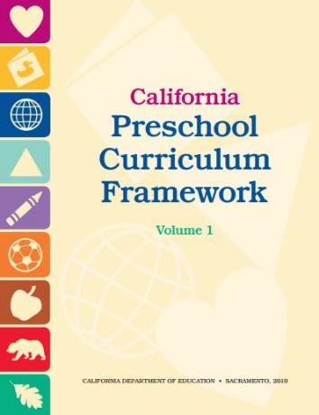
Foundations and Framework, Volume 1
Notes:
Presenter Remarks:
The purposes of the Preschool Learning Foundations are to promote a common understanding of TK children's learning and to guide instructional practice. They describe the knowledge and skills that young children typically develop when provided with developmentally, culturally, and linguistically appropriate learning experiences.
The Preschool Curriculum Framework was created as a companion to the Preschool Learning Foundations. The framework ". . . presents strategies and information to enrich learning and development opportunities for all of California’s preschool [and TK] children" (PCF, Vol. 1, p. v).
The Preschool Learning Foundations and the Preschool Curriculum Framework are designed to work together. While the foundations provide the background information to understand children's developing knowledge and skills (the "what"), the framework offers guidance on how teachers and programs can support the learning and development that are described in the foundations (the "how").
Extra Notes:
The Preschool Learning Foundations were developed with research-based evidence and are enhanced with expert practitioners' suggestions and examples. All foundations were written by a team of researchers with expertise in the given domain. A complete reference list of the source materials, along with detailed bibliographic notes for each of the developmental domains, can be found in the Preschool Learning Foundations. Sources used in the development of the foundations include:
Documents from the California Department of Education, such as the English-Language Arts Content Standards for California Public Schools, Kindergarten Through Grade Twelve (Language and Literacy, Introduction, p. 48, left column).
Well-validated assessment tools such as the Ages & Stages Questionnaires (ASQ): A Parent-Completed, Child-Monitoring System (Social-Emotional, References and Source Materials, p. 36).
General sources such as the Report of the National Reading Panel 2000 (Language and Literacy, Introduction, p. 73, left column).
Early childhood education standards from other states such as Hawaii and Texas (Social-Emotional, Introduction, p. 5, footnote).

Slide 11
Domain Organization
Domain:
Language and Literacy
Strand:
Listening and Speaking
Substrand:
Language Use and Conventions
Substrand: Grammar
Substrand: Vocabulary
Use of language to communicate with others
Sentence structure
Clarity of speech
Conversational ability
Narratives
Word structure
Language and Literacy domain
Listening and Speaking strand
  Language Use and Conventions substrand
    Use of language to communicate with others
    Clarity of speech
    Conversational ability
    Narratives
  Vocabulary substrand (not focused on today)
  Grammar substrand
    Sentence structure
    Word structure
Notes:
Presenter Remarks:
In the Preschool Learning Foundations and Preschool Curriculum Framework, Language Use and Conventions and Grammar are substrands within the Language and Literacy domain, Listening and Speaking strand.
The Language Use and Conventions substrand is organized into four skills, “… each of which is a foundation. Each of these skill areas calls for a distinct set of practices based on research evidence; therefore, …curricular suggestions are organized by skills or foundations. This organization offers teachers a structure for creating their own links between foundations that focus on different skills and activities in the classroom. The four skills are as follows:
Use language to communicate with others.
Speak clearly.
Use accepted language styles.
Tell a short story or retell something that happened earlier in the day” (PCF, Vol. 1, p. 111).
“The [G]rammar substrand is organized around two areas:
First, it focuses on how children understand and use increasingly complex and longer sentences.
Second, it focuses on how children understand and use age-appropriate grammatical bits such as subject-verb agreement (e.g., He walks; they walk), progressive tense (e.g., walking), regular and irregular past tense (e.g., walked, went), regular and irregular plurals (e.g., pails, oxen), pronouns (e.g., him, it), and possessives (e.g., mine, not mines)” (PCF, Vol. 1, p. 122).

Slide 12
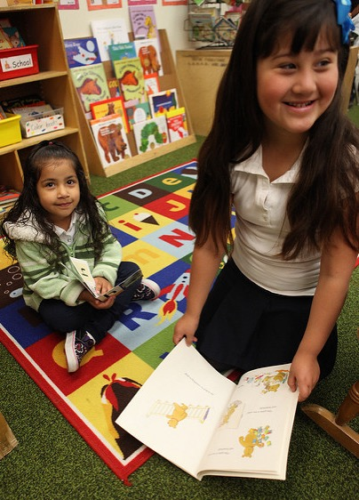
The Purpose of the Foundations
The foundations promote a common understanding of young children’s learning and guide instructional practice.
©2017 California Department of Education
Notes:
Presenter Remarks:
The foundations promote a common understanding of young children’s learning and guide instructional practice.
As teachers plan learning environments and experiences, the background information that the foundations provide can help teachers better understand students’ developing knowledge and skills.
The Preschool Learning Foundations were developed with research-based evidence and are enhanced with suggestions and examples from expert practitioners. All foundations were written by a team of researchers with expertise in the various domains.

Slide 13
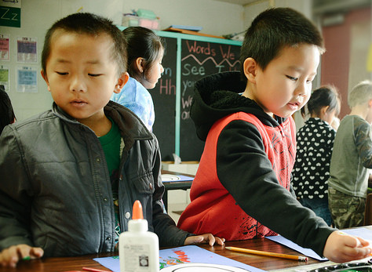
Foundations
With appropriate support
High-quality program
©2017 California Department of Education
Notes:
Presenter Remarks:
The Preschool Learning Foundations describe what children should be able to do at around 48 months (four years of age) and 60 months (five years of age).
The foundations assume that children have access to appropriate support in high-quality programs that include the following aspects:
Regularly rotated environments and experiences that encourage active, playful exploration and experimentation
Clearly defined learning centers where materials are rotated
Intentional teaching to help children gain knowledge and skills
Predictable schedules and routines with large blocks of time for play and skillful integration of curriculum with an intentional focus on content
Specific support for English learners with staff that have knowledge of the stages of English-language acquisition
Accommodations and adaptations for children with disabilities and additional support when needed
Let’s take a closer look at one of the foundations for an example. Open the Preschool Learning Foundations and find a page where the age levels appear; this is an example of a foundation page.
Look across the page at the developmental progression at around 48 months; notice the changes at around 60 months of age. (Solicit a few participants to read what they see.)
(Summarize the exploration with the following key note.) Because children develop at different rates, the foundations were designed to support the belief that certain stages of development will occur at different times for all students. You will notice “at around” in the description. It is important to remember that this variability occurs.

Slide 14
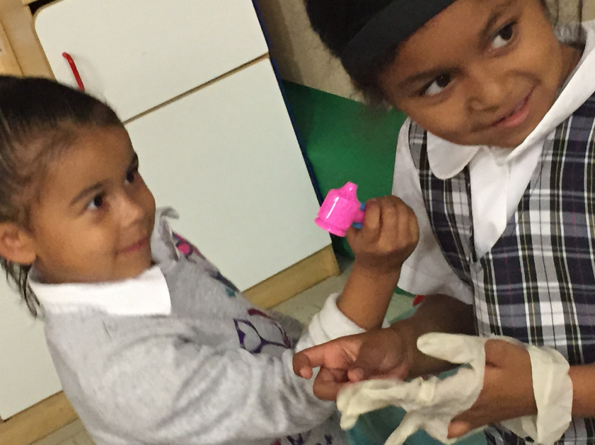
Framework Strategies
Developmentally appropriate
Reflective and intentional
Individually and culturally meaningful
Inclusive of children with disabilities or other special needs
©2017 California Department of Education
Notes:
Presenter Remarks:
The Preschool Curriculum Framework offers guidance on how teachers—through planned learning environments, materials, and experiences that are developmentally appropriate, individually and culturally meaningful, and engaging to families—can support the learning and development described in the foundations.
“Teachers address ideas and concepts that children can grasp at their developmental level and then progressively build on what children already know and understand. This approach applies to all children, including children with various abilities, disabilities, or other special needs (such as delays in language, cognition, or physical ability)” (PCF, Vol. 2, p. 227).
Let’s look at an examples from the Preschool Curriculum Framework that offer insight on creating an inclusive environment: “Around the world, children in some cultures are encouraged to speak up while children in other cultures are encouraged to remain silent. Teachers need to be respectful of home expectations for language at the same time that they support children to speak up at school. Children must be surrounded by language to acquire the vocabulary and sentence structures they need to read and write and think” (PCF, Vol. 1, p. 102).

Slide 15
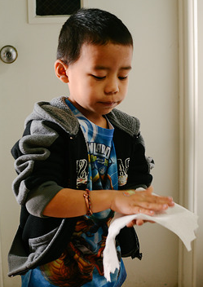
Preschool Curriculum Framework
Routines, environments, and materials
Interactions and strategies
Planned learning opportunities
Teachable moments
©2017 California Department of Education
Notes:
15
Presenter Remarks:
Again, language and literacy often develop within contexts of the daily routine, classroom environment, home environment, and through interactions with peers and adults.
“Topics [in the Preschool Curriculum Framework] include guiding principles, in particular, the vital role of the family in early learning and development; the diversity of young children in California; and the ongoing cycle of observing, documenting, assessing, planning, and implementing curriculum. The preschool curriculum framework takes an integrated approach to early learning and describes how curriculum planning considers the connections between different domains as children engage in teacher-guided learning activities” (PCF, Vol. 1, p. v).

Slide 16
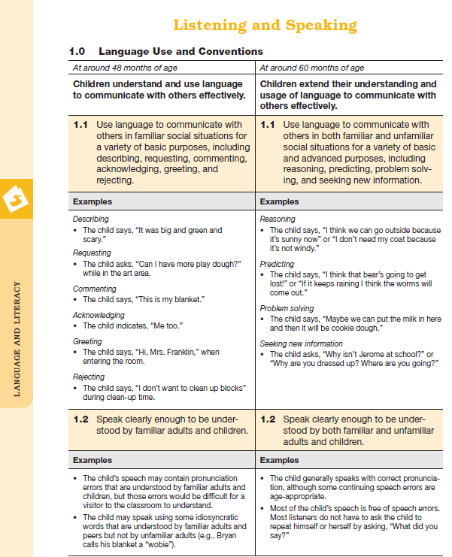
Map of the Foundations
Substrand
Strand
Age
Foundation
Examples
Domain
Notes:
Presenter Remarks:
Please find Handout 1: Foundations Map and follow along while we discuss each component of the foundations:
The name of the domain is Language and Literacy.
The name of the strand is Listening and Speaking.
The name of the substrand is Language Use and Conventions.
Note that substrands always end with a zero (1.0, 2.0, etc.).
The two age levels are at around 48 months and at around 60 months.
Each foundation describes typical behaviors at around 48 months and at around 60 months (or four to five years of age).
The foundations for each age level are listed below the age levels.
There are two for each age level on this page (1.1 and 1.2 for 48 months; 1.1 and 1.2 for 60 months).
Notice that there is a developmental progression from four years old to five years old within a substrand.
The examples for each foundation are listed.
These are only a few of the ways that children may demonstrate the behavior in the foundation.
Many of the foundations also have footnotes that include information specific for students with IEPs or students with disabilities, such as information about adaptations or accommodations.

Slide 17
Domains Work Together
LLD:
Listening and Speaking
ELD:
Listening
ELD:
Speaking
Language Use and Conventions
Using language to communicate with others
Speak clearly
Conversational ability
Narratives
1.0: Children listen with understanding
1.0 Children use nonverbal and verbal strategies to communicate with others.
2.0 Children begin to understand and use social conventions in English.
Grammar
Sentence-level accomplishments
Word-level accomplishments
3.0 Children use language to create oral narratives about their personal experiences.
©2017 California Department of Education
Notes:
Background Information:
Be sure the following talking points are mentioned when groups are sharing what they discussed with their groups:
The ELD foundations are “…meant to be used along with the language and literacy foundations, not in place of them” (PLF, Vol. 1, p. 105).
The ELD foundations show children’s development in English, which is acquired along a continuum of development, and not at specific points in time (beginning, middle, and later).
The LLD foundations outline the knowledge, skills, and behaviors children have acquired at specific points in time (48 months and 60 months).
See foundation 1.1 on page 56 of the Preschool Learning Foundations (Volume 1) for the following example: “Use language to communicate with others in familiar social situations for a variety of basic purposes, including describing, requesting, commenting, acknowledging, greeting and rejecting” (PLF, Vol. 1, p. 56).
The LLD foundations explain language development in any language, but they are based on research with children who speak English as their only language (monolinguals).
Presenter Remarks:
The Language and Literacy (LLD) foundations explain language development and are based on research with children who speak English as their only language (monolinguals); however, many of the developmental principles are universal. The English-Language Development (ELD) foundations support development of a second language—focusing on English.
The foundations work together. While you support language and literacy development with the LLD foundations, you are referencing—as a guide—the ELD foundations to determine the levels of English learners and to understand where and how you can provide support.
“Young children can learn good listening skills in any language; these skills will facilitate the ability to attend to and comprehend spoken English” (PCF, Vol. 1, p. 189).
Discuss the following questions with your table group:
Look at the charts on the screen; what similarities and differences do you notice?
At first glance, or based on your experience, how do you use these domains together to support the children in your classroom?
Would anyone like to share something interesting they discussed with their group?
Extra Notes:
There are multiple bodies of research that have examined language development. For example, there is a body of research on language development in Chinese, a body of research on language development in Italian, etc. The research review that was conducted to develop the language and literacy foundations and framework did not sample all of the research conducted on participants speaking non-English languages; it primarily focused on the body of research that was conducted with English-speaking participants.

Slide 18
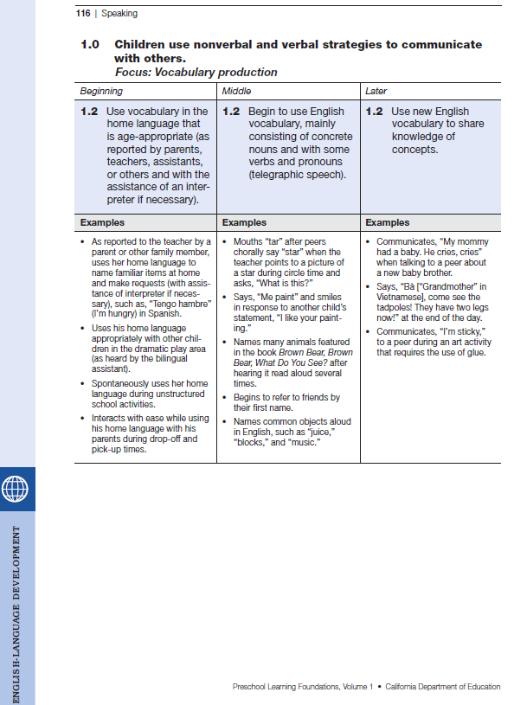
Map of the Foundations
Strand
Substrand
Level
Foundation
Examples
Domain
Notes:
Presenter Remarks:
Flip the first page of Handout 1: PLF Map Language Use and Conventions Page over to find the English-Language Development (ELD) foundation map.
While today’s focus is on the Language and Literacy domain, it is important to recognize that the English-Language Development domain also has information about developing listening and speaking for our students learning English as a second language. Teachers need to remember to use these two domains together to support English learners.
The important things to notice on this slide are the differences from the previous LLD foundation map. Does anyone know what these differences are? Turn and talk with your neighbor about similarities and differences. (Allow 1-2 minutes for participants to talk.)
Can someone share what they discussed? (Ensure that following key points are shared: ELD has Focus area—LLD does not have focus area; ELD has beginning, middle, and later—LLD has 48 and 60 months.)

Slide 19

Alignment Document
Notes:
Presenter Remarks:
The Alignment Document is another resource that will help us to answer questions related to developmental progression.
What do you know about this document? How do you use it in your work now?
Extra Notes:
Depending on the size of the group, participants can share responses with tablemates or in pairs.

Slide 20
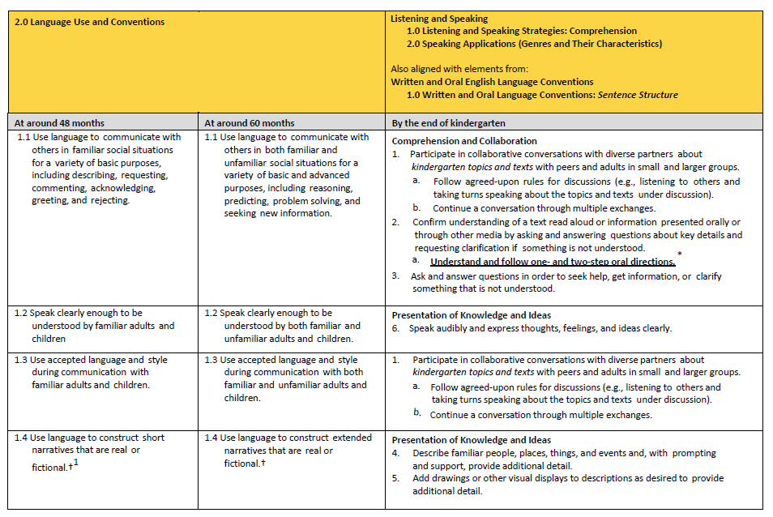
Alignment of
Developmental Progression
Notes:
Background Information:
The chart on the slide can be found on pages 39-40 of the Alignment Document.
Presenter Remarks:
The Alignment Document provides information about the connections between the Preschool Learning Foundations and the kindergarten content standards for California public schools.
Look at Handout 2: Language Use and Conventions Alignment to see the detailed alignment of substrand 2.0 and the kindergarten content standards. Underline anything you find interesting. (Allow 3-4 minutes to read and underline.)
Would anyone like to share what they underlined or found to be of interest?
When you look at the alignment table you can see the connections between the preschool foundations and the kindergarten content standards. Although the foundations and standards may, at times, be organized differently or may not correspond exactly, there is a correlational progression between them.
Extra Notes:
The following optional discussion questions that can be used if participants need prompting to start discussion:
What do you observe about the different expectations for children at around 48 months of age, at around 60 months of age, and by the end of kindergarten?
In recognition of these developmental stages, what are the implications for TK teachers in supporting children’s developing language use and conventions abilities?

Slide 21
Making Connections
Jigsaw-read the relevant introduction sections of the Preschool Learning Foundations (Volume 1):
  Language Use and Conventions (pp. 49-50)
  Grammar (pp. 51-52)
Locate the envelope labeled “Skill Circles” on your tabletop.
Use the skill circles and chart paper to create a visual graphic representing/organizing what you read.
Be ready to share your graphics.
Notes:
Activity 2: Making Connections
Presenter Remarks:
It’s time for another activity.
intent:
Allow participants to explore the introduction and to compare language use and conventions skills with grammar skills through a jigsaw reading and graphic representation.
OUTCOMES:
Participants will read about, organize, and share information regarding language use and conventions and grammar skills.
Materials Required:
PPT slide
Table groups
Chart paper
Preschool Learning Foundations (Volume 1)—introduction section
Trainer Tool: Language Use and Conventions and Grammar Work Together Cut-Outs (printed, cut out, and placed in envelopes labeled “Skill Circles”)
Tape for each table group
TIME: 15 minutes
Process:
Ask groups to jigsaw-read the relevant introduction sections of the Preschool Learning Foundations (Volume 1):
Language Use and Conventions (pp. 49-50)
Grammar (pp. 51-52)
Ask groups to locate the envelope labeled “Skill Circles” on their tabletop.
Direct groups to use the skill circles and chart paper to create a visual graphic representing/organizing what they read.
Advance the slide and share the sample representation (Language use and conventions skills are shown in red; grammar skills are shown in green.).
Invite table groups to share their graphics.
Highlight the integrated nature of these two substrands and the connection between skills.

Slide 22
Language Use and Conventions and Grammar Work Together
Start to use irregular past tense
Use accepted language styles
Use regular plurals
Tell a short story
Start to use irregular plurals
Speak clearly
Use regular possessives
Use regular past tense
Use increasingly longer and complex sentences
Begin to use irregular possessives
Retell something that happened earlier in the day
Use progressive tense
Communication
Notes:
Presenter Remarks:
This chart represents one way to organize the skill circles; language use and conventions skills are shown in red and grammar skills are shown in green.
It’s time to share your graphics with the whole group.
It is clear that language use and conventions skills and grammar skills are connected. For example, it is hard to think about communication without being able to use regular and past tense correctly. A mistake in the tense can completely change the information being communicated. However, it is important for us to understand these skills individually in order to plan for and support this integrated growth effectively.
Learning to use language effectively is a crucial life skill that develops from describing to predicting—from merely greeting someone to seeking new information about him or her. The Language Use and Conventions substrand is organized into four skills, “… each of which is a foundation…The four skills are as follows:
Use language to communicate with others.
Speak clearly.
Use accepted language styles.
Tell a short story or retell something that happened earlier in the day” (PCF, Vol. 1, p. 111).
Grammar holds words together to form sentences. “The [G]rammar substrand is organized around two areas:
First, it focuses on how children understand and use increasingly complex and longer sentences.
Second, it focuses on how children understand and use age-appropriate grammatical bits such as subject-verb agreement (e.g., He walks; they walk), progressive tense (e.g., walking), regular and irregular past tense (e.g., walked, went), regular and irregular plurals (e.g., pails, oxen), pronouns (e.g., him, it), and possessives (e.g., mine, not mines)” (PCF, Vol. 1, p. 122).
Students learn to use grammatical words and elements from parents and teachers. As they learn grammar, they begin to notice patterns, such as adding –ed to the end of words. When students first start using these patterns, they sometimes overgeneralize (e.g., using –ed on a word like “gived” instead of ”gave”). Teachers can restate the sentence with correct wording to model correct grammar. They also should use conversations with students as an opportunity to use complete sentences in order to model correct sentence structure.

Slide 23
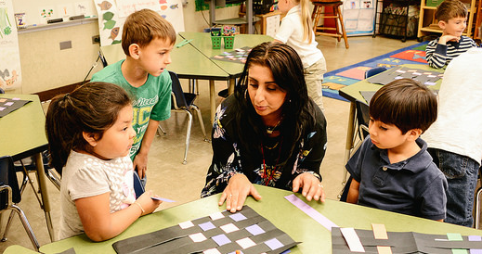
Content Development Supports Language Development
“…[C]ontent knowledge facilitates literacy and language development” (ELA/ELD Framework [CDE], p.148).
Notes:
Presenter Remarks:
Just as language use and conventions and grammar skills are connected to each other, so too are they connected to content knowledge. It is important to remember that content knowledge and language development go hand-in-hand.
As children learn content, they are also learning language. The reverse also holds true; as children learn language, they are better able to comprehend content. “Language and literacy learning depends on children’s functioning in the other domains, including social-emotional development, physical development, and for English learners, English-language development” (PLF, Vol. 1, p. 47).
The PEL Resource Guide and the TK Implementation Guide offer more information on how to support English learners with content and language development (hold up copies of these two resources).

Slide 24
Role of the Teacher in Supporting Oral Language Development
What we know:
“The proportion of complex sentences contained in children’s language use ranges from 5 percent to 30 percent. This variability in the rate of growth has been linked to children’s experiences in hearing complex sentences from their teachers” (Huttenlocher and oth­ers as cited in PLF, Vol. 1, p.p. 75-76).
What we can do:
Create opportunities in the environment, daily routines, and other interactions to engage and expand conversation.
Notes:
Presenter Remarks:
We know that early childhood environments are important for students. We also know that early childhood educators can influence a children’s language and literacy development. Let’s look at how early childhood educators can best influence the development of the students in their class.
“The proportion of complex sentences contained in children’s language use ranges from 5 percent to 30 percent. This variability in the rate of growth has been linked to children’s experiences in hearing complex sentences from their teachers” (Huttenlocher and oth­ers as cited in PLF, Vol. 1, p.p. 75-76).
The rest of the training will focus on how to utilize these strategies in the classroom.

Slide 25
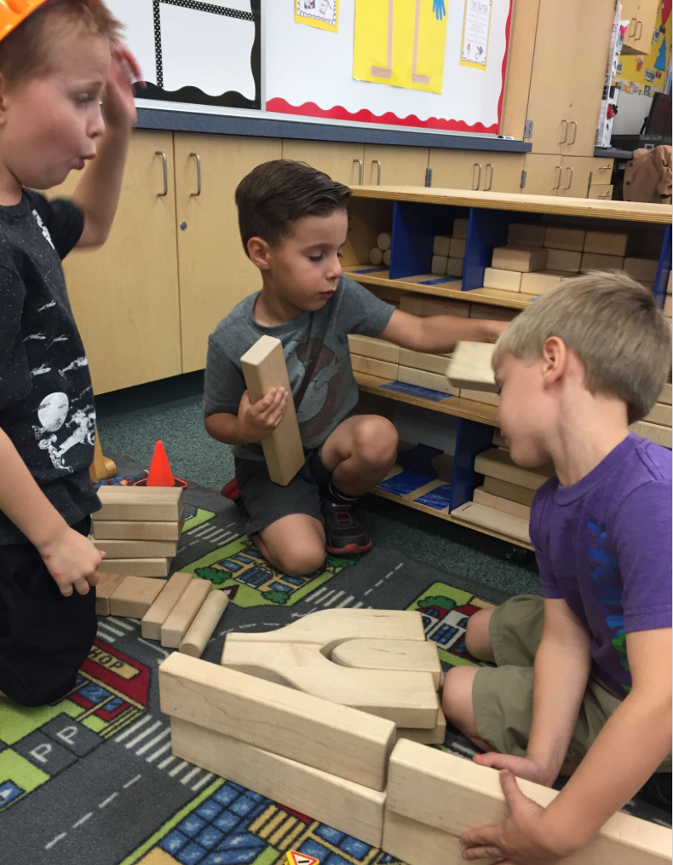
Guiding Principle
“Children learn best from experiences that are interesting, useful and fun” (PCF, Vol. 1, p. 101).
©2017 California Department of Education
Notes:
Presenter Remarks:
A key guiding principle from the Language and Literacy domain is, “Children learn best from experiences that are interesting, useful and fun” (PCF, Vol. 1, p. 101).
This is principle is particularly meaningful as we explore the Language Use and Conventions and Grammar substrands.
Think about the string activity. Why was that an interesting experience? How might we replicate that type of experience?

Slide 26
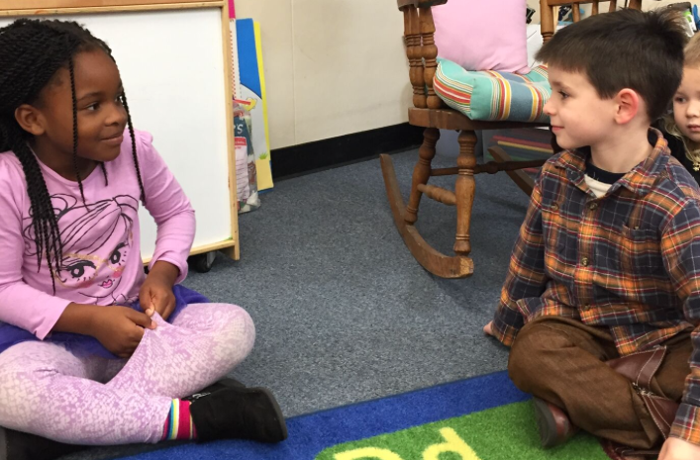
Strike a Balance
“Encourage children to take a turn” (PCF, Vol. 1., p. 102).
©2017 California Department of Education
Notes:
Presenter Remarks:
Another key guiding principle from the Language and Literacy domain is, “Encourage children to take a turn. Children learn language and learn about reading and writing through social interaction, especially when there is a lot of ‘back and forth’ in a conversation. Strike a balance between surrounding children with language and letting them talk too” (PCF, Vol. 1, p. 102).

Slide 27
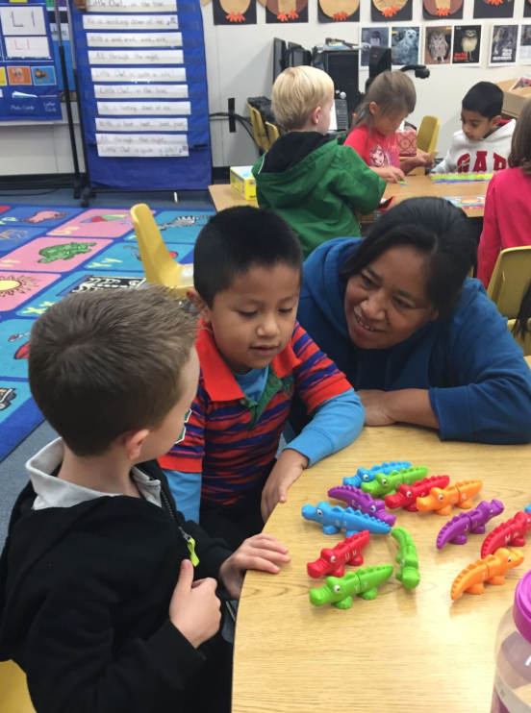
Guiding Principle
“Observe children” (PCF, Vol. 1, p. 103).
©2017 California Department of Education
Notes:
Presenter Remarks:
“By observing children’s engagement with language and literacy, teachers find ways to enter their world to support and extend their learning. These observations become a guide for intentional classroom practice. As teachers implement planned activities, their observations of children’s responses provide vital information that helps teachers meet students’ special needs” (PCF, Vol. 1, p. 103).
Please turn to pages 100-103 in the Preschool Curriculum Framework (Volume 1) and scan the complete set of guiding principles for the Language and Literacy domain.
(Use a “popcorn” strategy to allow groups to share highlights from their discussions.)

Slide 28
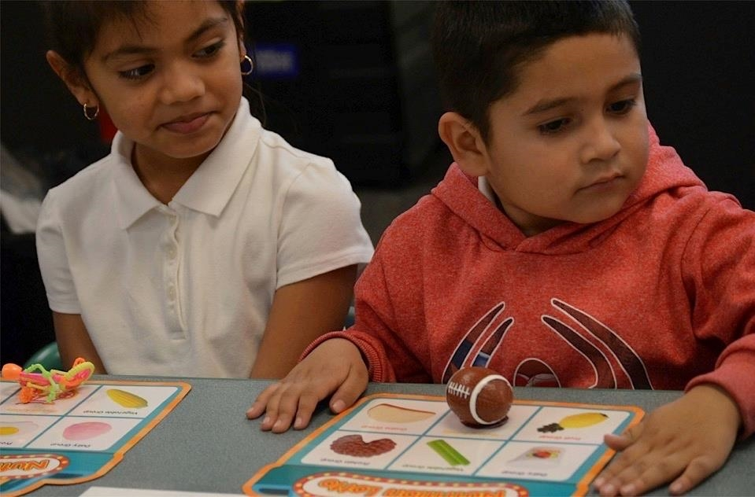
Universal Design for Learning
Multiple means of:
Representation
Engagement
Expression
©2017 California Department of Education
Notes:
Presenter Remarks:
Recognizing that students follow different pathways to learning, this framework incorporates a concept known as Universal Design for Learning.
“Universal design provides for multiple means of representation, multiple means of engagement, and multiple means of expression…Multiple means of representation refers to providing information in a variety of ways so the learning needs of all children are met. For example, it is important to speak clearly to children with auditory disabilities while also presenting information visually (such as with objects and pictures).
“Multiple means of expression refers to allowing children to use alternative ways to communicate or demonstrate what they know or what they are feeling. For example, when a teacher seeks a verbal response, a child may respond in any language, including American Sign Language. A child with special needs who cannot speak may also respond by pointing, gazing, gesturing, using a picture system of communication, or by using any other form of alternative or augmented communication system.
“Multiple means of engagement refers to providing choices in the setting or program that facilitate learning by building on children’s interests. The information in this curriculum framework has been worded to incorporate multiple means of representation, expression, and engagement” (PCF, Vol. 1, p. 14).

Slide 29
Language Use and Conventions Foundation 1.1—Communication
48 months:
Use language to communicate with others in familiar social situations for a variety of basic purposes, including describing, requesting, commenting, acknowledging, greeting, and rejecting.
60 months:
Use language to communicate with others in both familiar and unfamiliar social situations for a variety of basic and advanced purposes, including reasoning, predicting, problem solving, and seeking new information.
Notes:
Presenter Remarks:
Take out Handout 1: Language Use and Conventions and English-Language Development Foundation Maps.
Notice the developmental shift that is occurring; there is a transition from using language for basic purposes to more advanced purposes.
Take a moment to read the foundation examples on the handout. Discuss with your elbow partner what type of basic purposes you see. What advanced purposes do you see? Can you share examples of these conversations that are taking place in your classroom?
Discuss …what type of basic purposes you see. What advanced purposes do you see? Can you share examples of these conversations that are taking place in your classroom?

Slide 30
Video Example:
Language Use and Conventions—Foundation 1.1
As you watch, take note of one example of a basic purpose and one example of an advanced purpose.
Notes:
Background Information:
Insert the Language Use and Conventions 1.1 video into the text box prior to the training. It represents what you might see in a classroom.
Presenter Remarks:
Let’s watch a foundations video example to help bring these examples to life. As you watch, take note of one example of a basic purpose and one example of an advanced purpose. (At this time you may want to point out the basic purposes listed at 48 months and the advanced purposes listed at 60 months.)

Slide 31
Video Discussion
Find your language partner from the string activity.
Discuss the two examples you each recorded:
  Why did those examples resonate with you?
  How might you use this information?
Notes:
Presenter Remarks:
Find your language partner from the string activity.
Discuss the two examples you each recorded:
Why did those examples resonate with you?
How might you use this information?

Slide 32
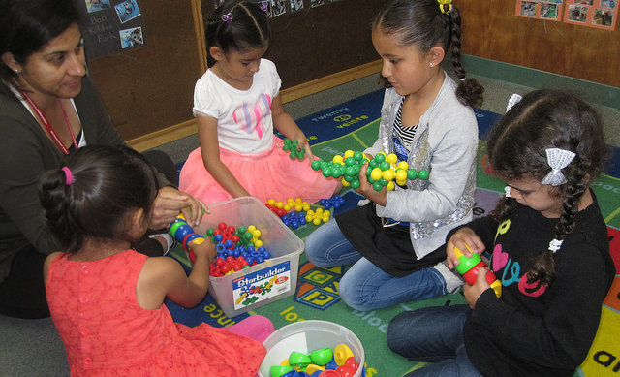
Interactions and Strategies to Spark Effective Communication
Acknowledge
Play
Set the stage
Engage
Model
Read pages 112-113 and 198-199 in the Preschool Curriculum Framework (Volume 1).
©2017 California Department of Education
Notes:
Presenter Remarks:
This slide lists strategies teachers can use to spark language and effective communication (Click to reveal one strategy at a time.):
”Set the stage for language use” (PCF, Vol. 1, p. 112).
“Acknowledge children’s contributions” (PCF, Vol. 1, p. 112).
“Play games and make them interesting and fun!” (PCF, Vol. 1, p. 113).
“Engage in ‘getting to know you’ conversations” (PCF, Vol. 1, p. 113).
“Model the use of conventional greetings…” (PCF, Vol. 1, p. 113).
Handout 4: Strategies to Spark Language and Effective Communication and take notes as you read through pages 112-113 and 198-199 in the Preschool Curriculum Framework (Volume 1).
(Allow five minutes to read and take notes, then invite individuals to share about what they read and expand on the words on the slide. Use the “extra notes” section below to support the conversation as needed.)
How might you use these strategies to also support grammar development?
Extra Notes:
Teachers can acknowledge children’s contributions by doing the following:
Making contact with children at their level
Greeting each child by name
Recasting children’s talk to indicate that they have been heard
Providing an explanation when children ask questions about what a word means
Building upon what they say
Using the child’s home language or acknowledging the child’s home language
Teachers can set the stage for language use by doing the following:
Making time for idea sharing
Providing ample wait time for responses and conversation
Acknowledging idea sharing in the home language
Making time to listen to children
Including children who use sign language or other systems of communication
Teachers can include play by using games that prompt talking.
Teachers can engage in ‘getting to know you’ conversations by learning—and teaching the class—how to say hello in all languages represented in the classroom.
Teachers can model by the use of conventional greetings by using them daily.

Slide 33
Cooking and Conversation—Part 1
Take out Handout 5: Fruit Salad Recipe.
Send one groupmate to collect the cooking materials.
Self-assign the following roles within your group:
  One teacher/facilitator—facilitates exploration of mystery object in the bag
  Two students/chefs—explores and guesses what the object in the bag is (without looking)
  One or two recorders—documents language used during activity on note paper
Play your role as you follow the recipe and converse with your groupmates.
Notes:
Activity 3: Cooking and Conversation
Presenter Remarks:
Let’s explore the concept of playing games as a strategy to prompt students to converse and ask questions.
intent:
Allow participants to experience using the skills and behaviors identified in foundation 1.1 by cooking together.
Allow participants to reflect on the conversation they had with their groupmates and consider how to scaffold a conversation to support foundation 1.1 at both 48 and 60 months.
OUTCOMES:
Participants will do the following:
Participate in a conversation with groupmates.
Identify components of foundation 1.1 in conversation as well as create tips for scaffolding this language for supporting development in both 48 and 60 months.
Materials Required:
PPT slide
Pages 112-113 and 198-199 of the Preschool Curriculum Framework (Volume 1) for reference
Tablemates
Handout 1: Language Use and Conventions and English-Language Development Foundation Maps
Handout 5: Fruit Salad Recipe
Bag, tray, or box to hold items from recipe (see recipe for complete list of cooking items)
Blank paper for notes
Pens or pencils
Chart paper
TIME: 20 minutes
Process:
Prior to training
Arrange cooking materials in the front or back of the room so that each table group can take a tray, box, or bag of materials.
PART 1:
Have participants take out Handout 5: Fruit Salad Recipe.
Invite one person from each table group to collect the cooking materials.
Have table groups self-assign the following roles:
One teacher/facilitator—facilitates exploration of mystery object in the bag
Two students/chefs—explores and guesses what the object in the bag is (without looking)
One or two recorders—documents language used on note paper
Direct groups to converse while following the recipe. Each group member should portray their role in this experience.
Move on to the next part of the activity.
PART 2:
Have participants take out Handout 1: Language Use and Conventions and English-Language Development Foundation Maps.
Ask participants to do the following:
Refer to foundation 1.1 while analyzing the recorder’s notes.
Use the questions on the screen to guide your discussion and analysis.
What language was used for basic purposes (e.g., describing, requesting, commenting, acknowledging, rejecting, etc.)?
What language was used for advanced purposes (e.g., reasoning, predicting, problem solving, seeking new information, etc.)?
What other foundations may have been experienced?
Record key points from your conversation on chart paper.
Invite groups to share one key discovery or “aha” from their discussion.
Advance to the English-Language Development slide and share the information.
Advance the Cooking and Conversation—Part 3 slide.
PART 3:
Have the participants keep the strategies they previously read on pages 112-113 and 198-199 of the Preschool Curriculum Framework (Volume 1) in mind as they do the following:
Create a list of ideas for the teacher/facilitator.
Role play again to try out these ideas.
Record the conversation.
Ask, “Are these ideas working?”
Invite groups to share one key discovery or “aha” from their discussion.
Ask participants how their experience with this activity might shift their planning in the classroom.

Slide 34
Cooking and Conversation—Part 2
Take out Handout 1: Language Use and Conventions and English-Language Development Foundation Maps.
Refer to Foundation 1.1 while analyzing the recorder’s notes.
Use the following questions to guide your discussion and analysis:
  What language was used for basic purposes (e.g., describing, requesting, commenting, acknowledging, rejecting, etc.)?
  What language was used for advanced purposes (e.g., reasoning, predicting, problem solving, seeking new information, etc.)?
  What other foundations may have been experienced?
Record key points from your conversation on chart paper.
Be ready to share one key discovery or “aha” from their discussion.
Notes:
Presenter Remarks:
(What follows are the notes for Part 2 of the activity plan. See the notes section of the Cooking and Conversation—Part 1 slide for complete activity plan.)
PART 2:
Have participants take out Handout 1: Language Use and Conventions and English-Language Development Foundation Maps.
Ask participants to do the following:
Refer to Foundation 1.1 while analyzing the recorder’s notes.
Use the questions on the screen to guide your discussion and analysis.
What language was used for basic purposes (e.g., describing, requesting, commenting, acknowledging, rejecting, etc.)?
What language was used for advanced purposes (e.g., reasoning, predicting, problem solving, seeking new information, etc.)?
What other foundations may have been experienced?
Record key points from your conversation on chart paper.
Invite groups to share one key discovery or “aha” from their discussion.
Advance to the English-Language Development slide and share the information.
Advance the Cooking and Conversation—Part 3 slide.

Slide 35
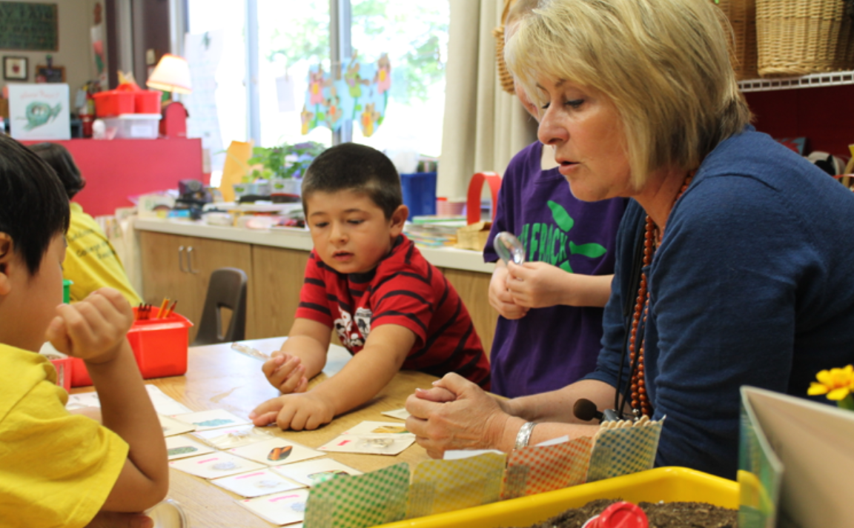
Special Considerations for Supporting English-Language Development
“Target both the content and English-language development in every activity” (PCF, Vol. 1, p. 192).
©2017 California Department of Education
Notes:
Presenter Remarks:
When planning, it is important to “target both the content and English-language development in every activity. Design activities with a dual purpose: understanding of the concept and the English label associated with it. For example, when working with a shape puzzle, demonstrate how a triangle has three corners and fits into the puzzle and that the word triangle is the name of this particular shape” (PCF, Vol. 1, p. 192).
The home language can be included by naming the key vocabulary in the child’s home language (e.g., triángulo).
Incorporating movement and tactile references can also be effective in supporting English-language development (e.g., children can create triangles with their bodies, trace a triangle with their finger, walk on a triangle taped on the floor, etc.).
Think about the Universal Design for Learning principles. When you are targeting both the content and English-language development these principles and whole body strategies they encourage become very important. Beyond supporting English learners, these principles and strategies support all children—particularly those children who may learn in different modalities or who have other special needs.

Slide 36
Cooking and Conversation—Part 3
How might you listen to a student communicating non-verbally?
How might you let students take more turns?
How might you shift this activity to support more prediction?
How might you plan to support English learners?
Create a list of ideas for the teacher/facilitator.
Role play again to try out these ideas.
Record the conversation.
Ask, “Are these ideas working?”
Be ready to share one key discovery or “aha” from your discussion.
How might you plan to support English learners?
How might you shift this activity to support more prediction?
How might you let students take more turns?
How might you listen to a student communicating non-verbally?
Notes:
Presenter Remarks:
(What follows are the notes for Part 3 of the activity plan. See the notes section of the Cooking and Conversation—Part 1 slide for complete activity plan.)
PART 3:
Have the participants keep the strategies they previously read on pages 112-113 and 198-199 of the Preschool Curriculum Framework (Volume 1) in mind as they do the following:
Create a list of ideas for the teacher/facilitator.
Role play again to try out these ideas.
Record the conversation.
Ask, “Are these ideas working?”
Invite groups to share one key discovery or “aha” from their discussion.
Ask participants how their experience with this activity might shift their planning in the classroom.

Slide 37
Irregular Nouns and Verbs
Examples of irregular nouns:
Wolf = Wolves
Loaf = Loaves
Man = Men
Mouse = Mice
Examples of irregular verbs:
Swim = Swam
Fall = Fell
Ran = Run
Go = Went
Feel = Felt
Notes:
Presenter Remarks:
Let’s turn to grammar and consider irregular nouns and verbs. Children tend to do well with regular nouns and verbs (e.g., hat=hats, walk=walks); however, irregular nouns and verbs take much longer to master.
This slide lists some examples of irregular nouns and verbs. Look at these examples and work with your groupmates to add to the list.
Look back at your observations from the cooking and conversation activity. Identify any examples of irregular nouns or verbs you used. If you did not use any during the activity, try to think of a few that the teacher could have used while facilitating.
It is important to remember that it is appropriate for children to continue to use these irregular nouns and verbs incorrectly—even at 60 months (five years of age)—as they are only learning and gaining consistency. Let’s watch a foundation video example to see how students are developing these skills.

Slide 38
Grammar
Foundation 3.1
48 months:
Understand and use increasingly complex and longer sentences, including sentences that combine two phrases or two or three concepts to communicate ideas.
60 months:
Understand and use increasingly complex and longer sentences, including sentences that combine two or three phrases or three or four concepts to communicate ideas.
Notes:
Presenter Remarks:
“Communicating effectively often requires that children knit together two or three ideas into a single sentence. Teachers can encourage children to use increasingly complex and longer sentences by modeling them, especially in conversations with children” (PCF, Vol. 1, p. 123).
Read Foundation 3.1, and the following examples, for 48 and 60 months on page 61 in the Preschool Learning Foundations (Volume 1).
What do you notice as the significant developmental shift in the foundations examples? Is this similar to what you have seen and heard in your classroom?

Slide 39
Grammar
Foundation 3.2
48 months:
Understand and typically use age-appropriate grammar, including accepted word forms, such as subject-verb agreement, progressive tense, regular past tense, regular plurals, pronouns, and possessives.
60 months:
Understand and typically use age-appropriate grammar, including accepted word forms, such as subject-verb agreement, progressive tense, regular and irregular past tense, regular and irregular plurals, pronouns, and possessives.
Notes:
Presenter Remarks:
Read Foundation 3.2, and the following examples, for 48 and 60 months on pages 61 and 62 in the Preschool Learning Foundations (Volume 1).
One significant difference is that at 60 months children have an elementary understanding of regular and irregular past tense, regular and irregular plurals, and more accuracy with pronouns and possessives.

Slide 40
Grammar Reflection
Think back to the string activity—were there chances within that activity to experience grammar?
  Think back to the cooking activity—were there chances within that activity to experience grammar?
What do you need in order to plan and create similar experiences in the classroom?
Notes:
Presenter Remarks:
Let’s take a moment to reflect on the experiences we have had today and how grammar has been integrated into those experiences.
Discuss the questions on the slide with your language partner. (Provide two-four minutes for discussion. Once discussion has quieted, click to reveal the final question.)
What do you need in order to plan and create similar experiences in the classroom?

Slide 41
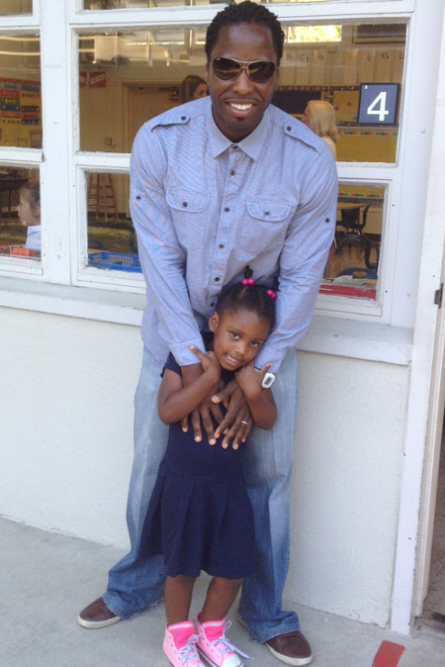
Interaction and Strategy
“Know your families and individual children” (PCF, Vol. 1, p. 124).
Find out what students like
Find out what families talk about
Talk to students about what they are familiar with
Listen attentively
©2017 California Department of Education
Notes:
Presenter Remarks:
A key interaction and strategy for the Grammar substrand is to “know your families and individual children” (PCF, Vol. 1, p. 124). Turn to page 124 in the Preschool Curriculum Framework (Volume 1) and read the notes on this interaction and strategy.
The following strategies can be used to help teachers gain knowledge about children and their families:
Find out what students like.
Find out what families talk about.
Talk to students about what they are familiar with.
Listen attentively to children and their family members.
Have you tried any of these or other similar strategies? (Solicit responses from the group.)

Slide 42
Partnering with Families to Support
Language Use and Conventions and Grammar
“Create a culturally sensitive environment” (PCF, Vol. 1, p. 102).
“Supporting students strategically begins with knowing the children. Educators should converse with families to learn about children’s experiences with language and literacy; their attitudes, interests, and expectations; and their prior schooling” (ELA/ELD Framework [CDE], p. 165).
Notes:
Presenter Remarks:
In order to partner with families, you need to talk to them about their child, to find out about their language and their culture, and to discover what their desires are for their child. Obtaining and using this information will help you build a culturally sensitive classroom.

Slide 43
Reflection
Imagine you are planning an experience similar to the cooking and conversation activity:
What would you want to learn from your families prior to the experience?
How would you use this information to plan an experience that supports language use and grammar development?
What other ways might you partner with families for this experience?
Notes:
Presenter Remarks:
Imagine you are planning an experience similar to the cooking and conversation activity:
What would you want to learn from your families prior to the experience?
How would you use this information to plan an experience that supports language use and grammar development?
What other ways might you partner with families for this experience?
(Solicit responses to the above questions from the whole group.)

Slide 44
Language Use and Conventions
Foundations 1.2 and 1.3—
Speak clearly and accepted language style
48 months:
1.2 Speak clearly enough to be understood by familiar adults.
1.3 Use accepted language and style during communication with familiar adults and children.
60 months:
1.2 Speak clearly enough to be understood by both familiar and unfamiliar adults and children.
1.3 Use accepted language and style during communication with both familiar and unfamiliar adults and children.
.
Notes:
Presenter Remarks:
“Communication is effective only when people are understood. When teachers speak clearly, they model good pronunciation, which gently helps children refine their own speech” (PCF, Vol. 1, p. 113).
Look at Foundation 1.2. What is the developmental shift? (At 48 months children are understood by familiar adults; at 60 months children are also understood by unfamiliar adults and children.)
Now look at Foundation 1.3. Do you notice any terms that might need clarification? (Ask volunteers to suggest ideas.)
Accepted language style is variable. Accepted language or behavior is what is common in the student’s environment or community. As students develop, they increasingly speak in ways that others can understand. This has to do with articulation and expression.
Developing grammar also has a strong connection to speaking clearly. How might developing grammar be related to developing clear speech?
Think about the cooking and conversation activity; were there opportunities to practice speaking clearly?

Slide 45
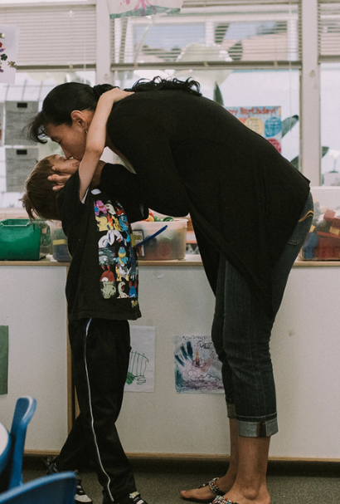
Interaction and Strategy
“Observe the child during drop-off and pick-up for cues…” (PCF, Vol. 1, p. 200):
How do parents respond to the child?
How animated is the parent when they are speaking?
Is the child more spontaneous in their speech or do they wait for a cue from the parent that it is time to talk?
©2017 California Department of Education
Notes:
Presenter Remarks:
A key interaction and strategy from the English-language development domain is “observe the child during drop-off and pick-up for cues about how the parent or other family members interact with the child and how the child reacts and behaves during those interactions“ (PCF, Vol. 1, p. 200).
This strategy is crucial for all students. What teachers are gathering by observation is an understanding of what the acceptable language styles are for each individual child. This is similar to the previously discussed “know your families and individual children” (PCF, Vol. 1, p. 124). This type of observation helps teachers to know their families and individual children.
Teachers may observe for the following types of information:
How do parents respond to the child?
How animated is the parent when they are speaking?
Is the child more spontaneous in their speech or do they wait for a cue from the parent that it is time to talk?
This strategy may be specifically beneficial after considering current research which indicates that “when the culture of the school and the culture of the family come into contact with each other, they influence and change each other...optimal learning for DLLs occurs when there is a strong, harmonious partnership between DLL families and ECE programs, which includes the consideration and incorporation of the DLL culture and language in program planning” (California’s Best Practices for Young Dual Language Learners: Research Overview Papers [CDE], p. 129).

Slide 46
Strive for Five
What is Strive for Five?
Strive for five refers to a conversational exchange that lasts for five or more turns—back and forth—between a teacher and child.
How can a teacher Strive for Five?
Be stationary long enough to converse
Make eye contact on the student’s level
Ask honest (open‐ended) questions
Genuinely seek understanding
Expand and extend children’s comments
Contribute ideas, experiences, and knowledge without taking over
Notes:
Presenter Remarks:
Strive for Five is a strategy that provides a framework for engaging in extended conversation with students. It refers to a conversational exchange that lasts for five or more turns—back and forth—between a teacher and child.
Does anyone have experience using the Strive for Five strategy? (Wait for participants to respond.)
Locate Handout 6: Strive for Five. This handout outlines the key strategies that support the teacher in utilizing this strategy:
Be stationary long enough to converse
Make eye contact on the student’s level
Ask honest (open‐ended) questions
Genuinely seek understanding
Expand and extend children’s comments
Contribute ideas, experiences, and knowledge without taking over

Slide 47
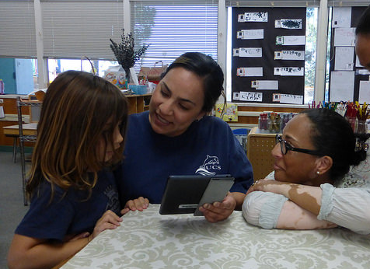
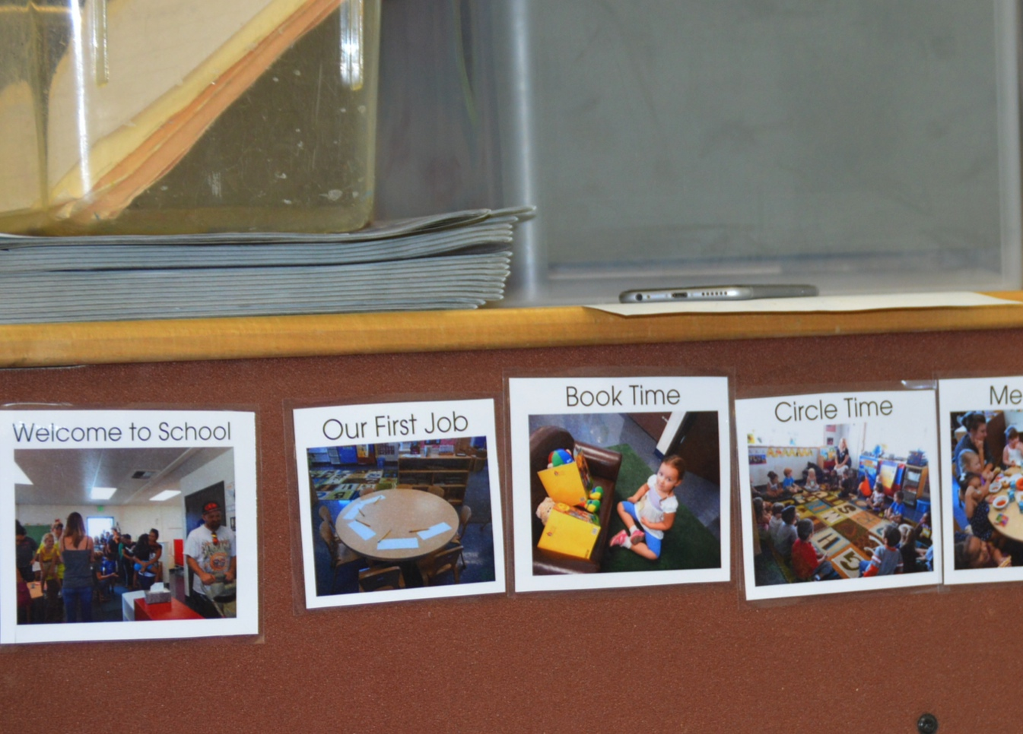
Special Considerations for Students Who
Use Alternative Communication Systems
Use technology to support communication.
Use a picture schedule to support communication.
©2017 California Department of Education
Notes:
Presenter Remarks:
All students benefit from engaging in a five exchange conversation. However, not all students communicate in the same way and special considerations for students who use an alternative communication system may need to be made. For example, teachers may engage in a Strive for Five around the picture schedule in which children touch and point to engage.
“As is true for all children, teachers can support young children’s communication knowledge and skills by repeating and extending what children say in conversations” (PCF, Vol. 1, p 115).
As we practice this strategy, think about the students you have in your classroom who might engage with Strive for Five using an alternate communication system.

Slide 48
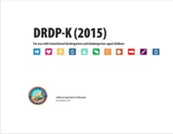
Key Features of the DRDP-K (2015)
An observation-based assessment tool,
not a test
Individual child assessment
Completed by each child’s teacher
Based on developmental research and theory
Includes developmental sequences of behaviors along a continuum
Spans the developmental continuum of children in a two-year kindergarten program
Notes:
Presenter Remarks:
One resource that is used to support children’s development is the Desired Results Developmental Profile—Kindergarten (2015): A Developmental Continuum for Kindergarten (DRDP-K [2015]). This is especially helpful for English Learners.
The DRDP-K (2015) informs teachers’ understanding of the developmental continuum. It can be used with the Alignment Document to expand upon the developmental continuum.
One key feature of the DRDP-K (2015) to consider is that it is an observation-based assessment and not a test. It is used to support children’s learning. Observing and documenting children's progress provides teachers the information needed to differentiate instruction and experiences. It also provides information to individualize.
Observational tools are preferred over criterion-referenced tools because the information gathered by observation more accurately reflects what children are able to do.
Documentation provides concrete evidence of what children are able to do. With this documentation, we are then able to better plan activities that will meet and appropriately challenge children's developmental needs.
The DRDP-K (2015) also includes the following features:
It is an individual child assessment that can be shared with families.
It is aligned with the Preschool Learning Foundations.
It opens up the opportunity for articulation between preschool and TK teachers.
Sharing information as to where children are on the developmental continuum can better prepare the TK teacher to work with students.
A teacher can include a request form for previous records as part of the TK registration to help support the relationship between preschool, family, and TK.
The DRDP-K (2015) has been developed with world renowned experts. It is based on research and knowledge of what is most important for predicting school success.

Slide 49
DRDP-K (2015) and Strive for Five
Notes:
Presenter Remarks:
The DRDP-K (2015) gives TK teachers a lens through which to measure the communication of TK students. Find and read Handout 7: DRDP-K (2015). As you read, highlight anything you find to be of interest. When you are done reading, discuss this measure and the Strive for Five strategy with your elbow partner.
(Ask for volunteers to share key points from their discussion. Be sure to highlight that the progression shows the child’s communication develop from nonverbal communication to using language with increasingly complex words and sentences.)

Slide 50
Language Use and Conventions
Foundation 1.4
48 months:
Use language to construct short narratives that are real or fictional.
60 months:
Use language to construct extended narratives that are real or fictional.
Notes:
Background Information:
Use one of the story stem strategies to model engaging someone in a short narrative prior to explaining this slide. For example, role play with a participant or other presenter by pretending to be eating at meal time. The teacher might say, “Let’s do favorite parts of the day. My favorite part of today was seeing everyone arrive at school. I missed you all since it was the weekend and I didn’t get to see you for two days. Now it is Monday and I am excited you are at school again and we can play and learn together. What was your favorite part of the day?” The participant or other presenter may then respond with a very short narrative. Presenter can then use the example narrative to explain the foundation.
Presenter Remarks:
What do you notice about this foundation (Short versus extended narratives)? We are going to look at some strategies to help scaffold language in order to extend the narratives of our students. It is important to remember students with special needs and the English learners in your classroom. “Producing narratives may vary at these ages for children who are communicating with sign language or alternative communication systems. As is true for all children, teachers can support young children’s communication knowledge and skills by repeating and extending what children communicate in conversations. Teachers can also provide opportunities for children to repeat or tell stories as a way to encourage them to produce narratives” (PLF, Vol. 1, p. 58).

Slide 51
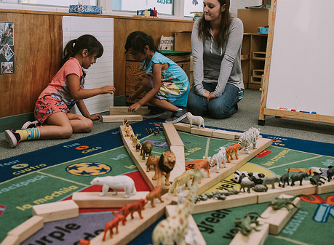
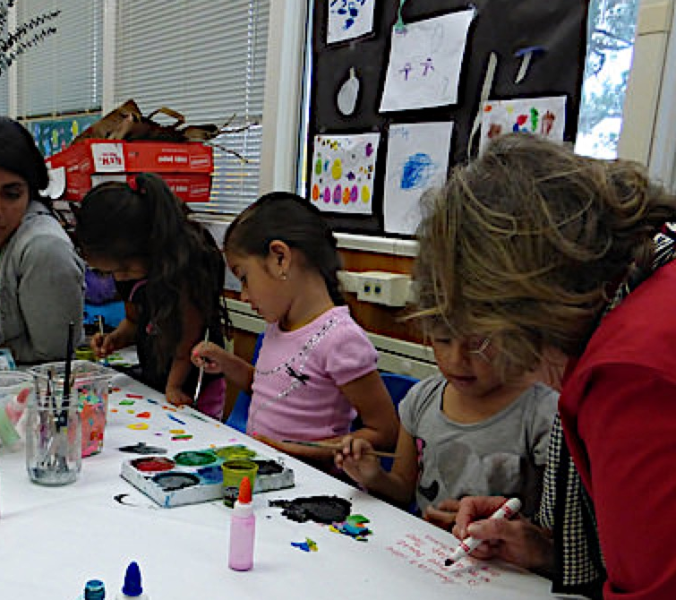
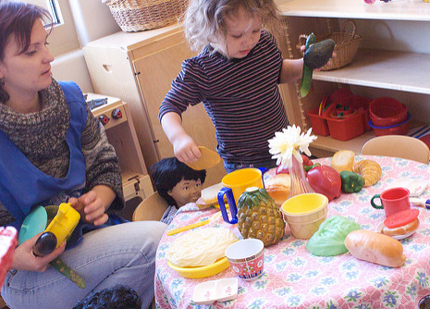
Strategies for Supporting Fictional Narratives
51
“Give story stems” (PCF, Vol. 1, p. 116).
“Build on preschool children’s own experiences” (PCF, Vol. 1, p. 116).
“Use dramatic play and co-construct stories” (PCF, Vol. 1, p. 116).
©2017 California Department of Education
Notes:
Presenter Remarks:
Foundation 1.4 includes both fictional and non-fictional narratives.
The slide shows some strategies for supporting fictional narrative:
“Build on preschool children’s own experiences” (PCF, Vol. 1, p. 116).
“Use dramatic play and co-construct stories” (PCF, Vol. 1, p. 116).
“Give story stems” (PCF, Vol. 1, p. 116).

Slide 52
Developmentally Appropriate
Story Stems
Always include the following aspects in a story stem:
Movement
Repetition
Playfulness
Connections to family
How would you include these ideas in your classroom?
Notes:
Background Information:
Story stem examples and tips and tricks can be found on the Trainer Tool: Story Stems printout.
Presenter Remarks:
Story stems are used with ages and grade levels, including the upper elementary grades. For TK children, story stems refer to a conversation that is intended to support fictional narratives. As with all other strategies, story stems that include movement, repetition, playfulness, and connections to family are the most successful.
We will now practice how to engage children with story stems. (Model the story stems from the Trainer Tool: Story Stems printout. Only model Painting a Story in the Sky if you previously modeled Favorite Parts of the Day. Invite everyone to participate with you and then allow time for table groups to discuss and practice.)
Does anyone have ideas for a story stem that include these strategies? (Elicit responses from the group.)

Slide 53
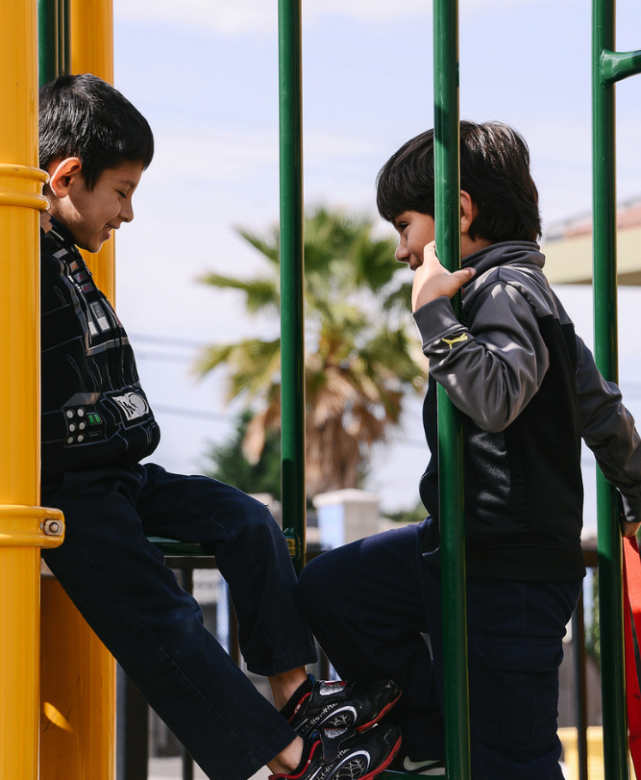
Code-Switching is Normal
“When speaking, children may code-switch; that is combine English with their home language to make themselves understood” (PLF, Vol. 1, pp. 108-109).
©2017 California Department of Education
Notes:
Presenter Remarks:
It is important to support English-language development while you are engaging students in narratives. One key consideration is code-switching.
“When speaking, children may code-switch; that is combine English with their home language to make themselves understood” (PLF, Vol. 1, pp. 108-109).
“Teachers can support young children in the area of language use and conventions by repeating and extending what children say in conversation, by telling stories themselves, and by modeling appropriate language usage” (PCF, Vol. 1, p. 111).

Slide 54
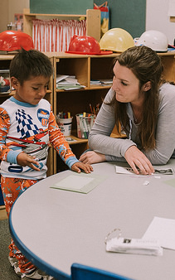
Considerations for English Learners
“Listen appreciatively to children’s stories” (PCF, Vol. 1, p. 203):
Be on the child’s level.
Provide ample wait time.
Repeat and extend in the home language and/or in English.
©2017 California Department of Education
Notes:
Presenter Remarks:
Treating students with respect helps them become curious and confident.
“Listen appreciatively to children’s stories. When children begin to provide narrative in English, they may do so in a tentative manner and possibly mix English with their home language. When this occurs, it is important to provide the child with as much undivided attention as possible. During these interactions, it is helpful to provide positive reinforcement about their attempts to relate a story to the teacher” (PCF, Vol. 1, p. 203).
The language and literacy foundations are built on the development of active listening, the social uses of language, and nonverbal communication.
In the classroom environment, daily routines and classroom rituals, such as organized circle time or peer-to-peer interaction on the playground, provide opportunities for English learners to use oral language in both their home language and in English.

Slide 55
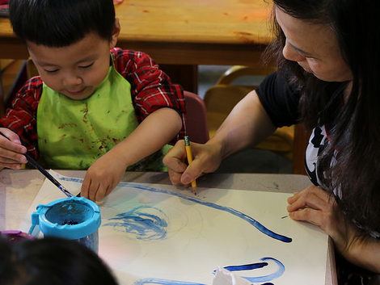
Supporting Non-Fictional Narratives
Partner with families.
Listen attentively to children.
Repeat and extend children’s stories.
Make time and space to talk with children.
©2017 California Department of Education
Notes:
Presenter Remarks:
The following strategies can be used to support non-fictional narratives:
Partner with families.
Listen attentively to children.
Repeat and extend children’s stories.
Make time and space to talk with children.
Would anyone like to share how they have used one of these strategies?

Slide 56
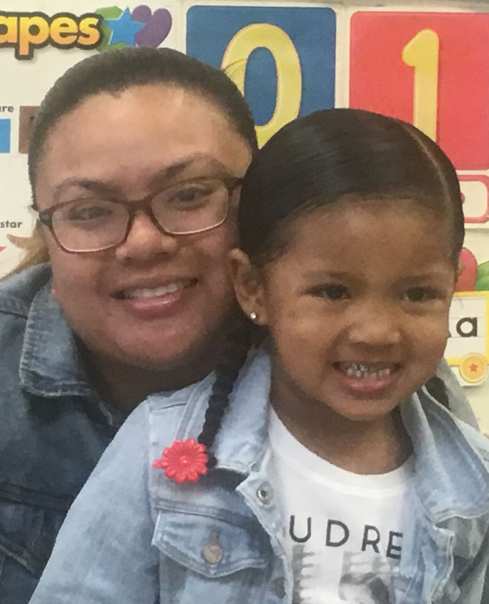
Tips to Share with Families
“Share stories with them. Stories give you a chance to share what is important to you, what you value and how you think about things. Stories can help children feel connected to you and invested in learning language” (allaboutyoungchildren.org).
Notes:
Presenter Remarks:
One great resource on partnering with families is the All About Young Children Web site.
The site offers a plethora of tips to share with families—the slide shows just one of the tips offered: “Share stories with them. Stories give you a chance to share what is important to you, what you value, and how you think about things” (allaboutyoungchildren.org).
Handout 8: All About Young Children is an example of what you can download to use as a resource or give to parents. The next slide has more resources that may support your work to partner with families.

Slide 57
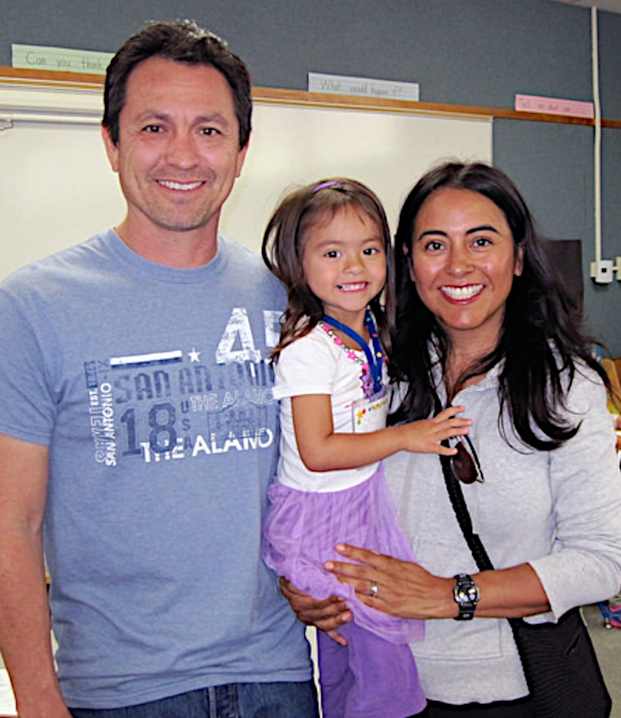
Partner with Families
Engaging Families: Preschool Curriculum Framework
All About Young Children
Best Practices for Planning Curriculum: Family Partnerships and Culture
TK Implementation Guide
Notes:
Presenter Remarks:
In order to effectively build on children's existing strengths, we must understand them. To do this, we need to partner with families to learn about their children’s strengths.
The resources on this slide are specifically beneficial for partnering with families. You may want to take a picture of this slide and refer to it later.
Optional:
Create a gallery table and have examples of documents there.
Extra Notes:
The resources are hyperlinked. If Wi-Fi access is available, display the resources and do a walkthrough.

Slide 58
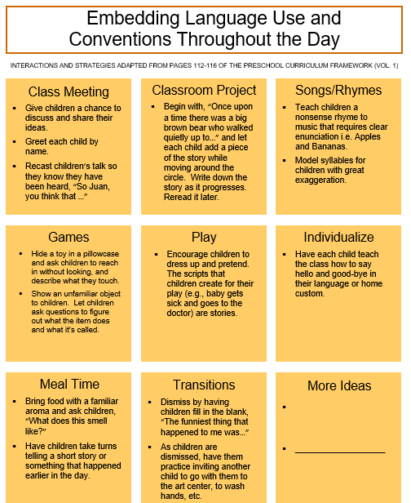
Overarching Principle:
“Learning is Integrated” (PCF, Vol. 1, p. 5)
How will you integrate ideas from today throughout your day and across your curriculum?
Notes:
Presenter Remarks:
Language is inclusive of all domains and occurs throughout the day. This is expressed in the overarching principle, “Learning is integrated” (PCF, Vol. 1, p. 5).
Locate Handout 9: Embedding Language Use and Conventions. Think quietly about the experiences we have had today as well as the ideas you talked about creating in your classroom.
Of course all of these ideas support language use and conventions and grammar, but they support many other domains as well. Keep this in mind as you consider the take-home messages from today. How will you integrate these ideas throughout your day and across your curriculum?

Slide 59
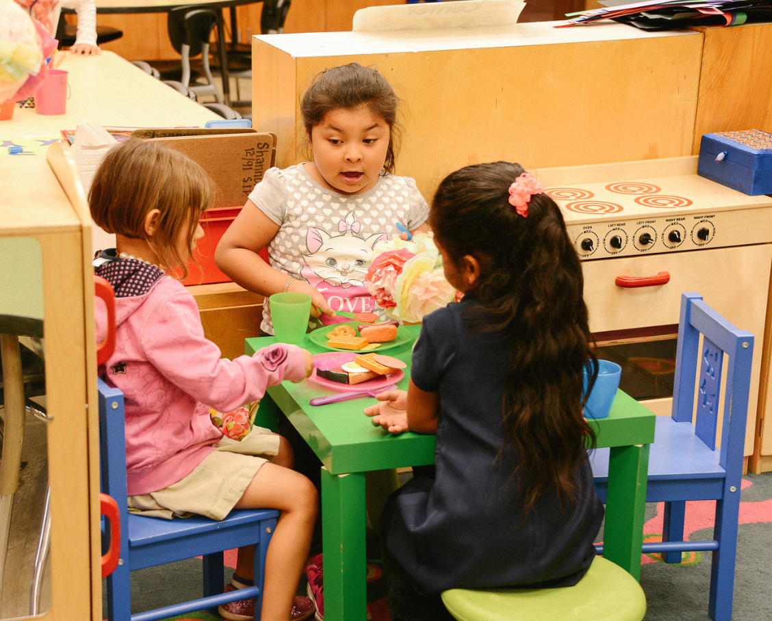
Thank you for coming!
©2017 California Department of Education
Notes:
Presenter Remarks:
Thank you for coming!

Slide 60
Reference Guide for PowerPoint Citations
California Department of Education. 2008. California Preschool Learning Foundations, Volume 1. http://www.cde.ca.gov/SP/cd/re/documents/preschoollf.pdf (accessed April 7, 2017).
California Department of Education. 2010. California Preschool Curriculum Framework, Volume 1. http://www.cde.ca.gov/sp/cd/re/documents/psframeworkkvol1.pdf (accessed April 7, 2017).
California Department of Education. 2011. California Preschool Curriculum Framework, Volume 2. http://www.cde.ca.gov/sp/cd/re/documents/psframeworkvol2.pdf (accessed April 7, 2017).
California Department of Education. 2013. California’s Best Practices for Young Dual Language Learners: Research Overview Papers. http://www.cde.ca.gov/sp/cd/ce/documents/dllresearchpapers.pdf (accessed April 7, 2017).
California Department of Education. 2013-2017. All About Young Children. https://allaboutyoungchildren.org/ (accessed April 7, 2017).
California Department of Education. 2015. English Language Arts/English Language Development Framework for California Public Schools: Kindergarten Through Grade Twelve. http://www.cde.ca.gov/ci/rl/cf/documents/elaeldfwchapter3.pdf (accessed April 7, 2017).

