Slide 1
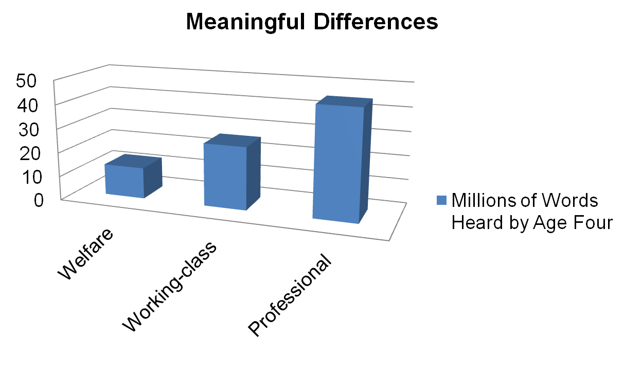
Research Indicates that
Experience Matters
Key Implications:
Early oral language and vocabulary exposure is important
Teachers as well as family have a crucial role and can make a significant difference
Teacher Intentionality of depth is crucial
Hart, B. & Risley, T.R. (1995), Meaningful differences in the everyday experience of young American children. Baltimore, MD: Brookes Publishing.
Notes:
Optional processing: Ask participants to review the chart and share their observations with a partner. Then ask participants to share what they think make these data important.
The wide variations in the rate of children’s early language growth and later language outcomes is directly related to differences in maternal and other caretakers’ verbal input (CDE, 2008, p. 71).
In Meaningful Differences in the Everyday Experience of Young American Children (1995), Betty Hart and Todd Risley compare the language environments in the home of children living in welfare, working-class and professional families. Stark differences were noticed across economic conditions. The children in professional families heard an average of 2,150 words per hour; children in working-class families heard approximately 1,250 words, and children in welfare families heard approximately 620 words. Extrapolation of these data indicates that by age four, the children in professional families would have heard more than 45 million words, the children in working-class families, 26 million, and the children in welfare families, 13 million (Hart & Risley, 1995). Thus, children in the welfare families heard one-half the words heard in working-class homes, and less than one-third of those heard in professional homes. The discrepancy in vocabulary upon school entry persists as children continue their school careers

Slide 2
Research Indicates that
Learning Leads to More Learning
“Children who have a larger vocabulary have an easier time acquiring new words” (Nash and Donaldson; Sénéchal, Thomas, and Monker as cited in PLF, Vol. 1, p. 73).

Slide 3
Research Indicates that
The Vocabulary Teachers Use Matters
Teacher Sophisticated Vocabulary
Kindergarten Emergent Literacy
4th Grade Comprehension
Key Implications:
Quality of teacher talk is important
Teachers should expanding personal vocabulary
Notes:
Dickenson 2013

Slide 4
Research Indicates that
Type of Family Support Matters
Home Literacy Support
Kindergarten Receptive Vocabulary
4th Grade
Oral Comprehension
Key Implication: The type and quality of home literacy support is important (more important that SES and education).
Notes:
Dickenson 2013

Slide 5
Research Indicates that
Play Conversation Matters
Increased Teacher Child Conversation during free play time
Increased fourth grade reading comprehension and receptive vocabulary
Kindergarten Narrative production
Key Implication: Teachers must plan time for children to play and for teachers to engage and play with children.

Slide 6
Research Indicates that
Child Talk in Conversation Matters
Less teacher talk in free play conversations
Increased fourth grade reading comprehension and language comprehension
Key Implications:
Teachers must play with and LISTEN to children.
Teachers must interact but also time for children to talk.

