Slide 1
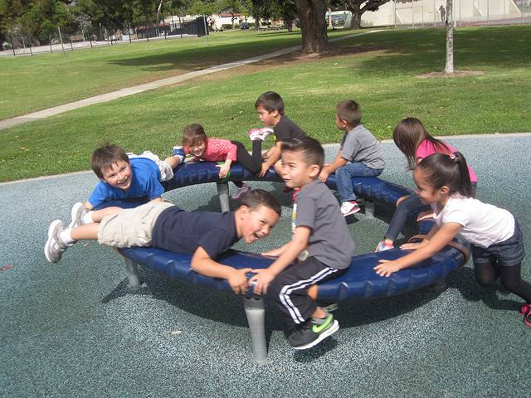
Social-Emotional Development in the Transitional Kindergarten Classroom
Focus on the Self Strand
Notes:
Presenter Remarks:
Welcome to Social-Emotional Development in Transitional Kindergarten: Self strand—a presentation focusing on the California Preschool Learning Foundations (Preschool Learning Foundations or PLF), the California Preschool Curriculum Framework (Preschool Curriculum Framework or PCF), and other California Department of Education (CDE) resources in support of the Social-Emotional Development domain.
This professional learning session is specifically designed to provide TK teachers with exposure to CDE resources that support TK curriculum planning, developmentally appropriate strategies, and classroom environment design recommendations that support the content area of self.

Slide 2
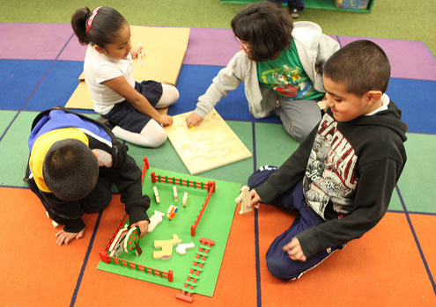
Five Substrands in the Self Strand
Self-awareness
Self-regulation
Social and Emotional Understanding
Empathy and Caring
Initiative in Learning
©2017 California Department of Education
Notes:
Presenter Remarks:
“Self covers the qualities of self-awareness, self-confidence, and personality that enable young children to be competent learners. Included in this strand are the development of self-awareness and self-confidence; self-regulation (of attention, feelings, impulses, and thinking); social and emotional understanding; the growth of empathy and caring for others; and preschool children’s initiative as enthusiastic, active learners” (PCF, Vol. 1, p. 38).
The Self strand is divided into the five substrands listed on the slide.

Slide 3
Growing and Changing
Each person will create one page for the “Growing and Changing” book:
Choose paper, crayons, or markers to write and complete the sentences on the screen.
Use paper clips to bind all pages together for each table.
With your table mates, you may choose to create and add a cover.
When I was a baby…
__________________.
Now, I can… __________________.
I am learning how to… __________________.
Notes:
Activity 1: Growing and Changing
Presenter Remarks:
We are going to do a quick make and take that combines the Self-awareness and Initiative substrands with the Language and Literacy domain. Please take out and review Handout 1: Growing and Changing.
intent:
Introduce a literacy strategy that promotes self-awareness and initiative.
GOAL:
Participants will leave with a tool to incorporate the Self strand with the Language and Literacy domain.
Materials Required:
Handout 1: Growing and Changing
White copy paper
Various colored writing and drawing tools
Paper clips or binder clips
Time: 15 minutes
Process:
Let participants know that we will do a quick make and take that combines self-awareness and initiative with language and literacy.
Ask participants to take and review Handout 1: Growing and Changing.
Individually, ask each participant to create their own page for a Growing and Changing book, based on the guidelines on the screen. Point out that the wording has been modified for an adult group.
Use paper clips to bind the table’s pages together. Add a cover. Have one volunteer read the resulting book to the rest of the table members.
Redistribute the pages to the “authors” for them to take back to the classroom.
Invite comments and feedback. How might the wording of the book be modified using Dwecks’ “Power of Yet” strategy?

Slide 4
Objectives
Gain understanding of key concepts from the California Preschool Learning Foundations, Volume 1 and the California Preschool Curriculum Framework, Volume 1—Social-Emotional Development domain, Self strand.
Observe, read, and discuss the developmental continuum for vocabulary that will guide instruction and learning in Transitional Kindergarten (TK).
Practice using the Preschool Learning Foundations (PLF) and Preschool Curriculum Framework (PCF) to intentionally plan developmentally appropriate, cultural, and inclusive strategies that promote the development of skills, knowledge, and behaviors related to social-emotional development.
Notes:
Presenter Remarks:
This slide shows the objectives for today’s training:
Gain understanding of key concepts from the California Preschool Learning Foundations, Volume 1 and the California Preschool Curriculum Framework, Volume 1—Social-Emotional Development domain, Self strand.
Observe, read, and discuss the developmental continuum for vocabulary that will guide instruction and learning in Transitional Kindergarten (TK).
Practice using the Preschool Learning Foundations and Preschool Curriculum Framework to intentionally plan developmentally appropriate, cultural, and inclusive strategies that promote the development of skills, knowledge, and behaviors related to social-emotional development.

Slide 5










CDE Publications and Resources that Support TK Implementation
Preschool Alignment Document
Transitional Kindergarten Implementation Guide
DRDP Specific to TK and K
California Common Core State Standards
Health Education Content Standards for California Public Schools
English Language Arts/English Language Development Framework
Preschool Learning Foundations
Developmentally Appropriate Practice
Preschool Curriculum Framework
Preschool English Learners Guide
Preschool Curriculum Frameworks
Preschool Alignment Document
Developmentally Appropriate Practice
California Common Core State Standards
Preschool Learning Foundations
English Language Arts/English Language Development Framework
Transitional Kindergarten Implementation Guide
DRDP Specific to TK and K
Health Education Content Standards for California Public Schools
Preschool English Learners Guide
Notes:
Presenter Remarks:
The state of California has developed many publications, resources, and supports that enable teachers to facilitate the most positive outcomes for students.
Today our main focus will be the on the foundations and framework. In addition, there are other key resources that support Social Emotional development that will be shared and utilized.
(Name and hold up each resource.) The California Preschool Learning Foundations, Volumes 1, 2, and 3 and the California Preschool Curriculum Frameworks, Volumes 1, 2, and 3 are the center of the California Early Learning and Development System. CPIN professional learning will focus on the foundations and framework.
We will also discuss alignment and make connections to all additional resources pictured in the graphic at professional learning opportunities offered through July 2017:
The Alignment of the California Preschool Learning Foundations with Key Early Education Resources
Developmentally Appropriate Practice in Early Childhood Programs Serving Children from Birth through Age 8 (National Association for the Education of Young Children, 2009)
California Common Core State Standards
Mathematics Framework for California Public Schools: Kindergarten Through Grade Twelve (2015 edition) (CDE, 2015)
English Language Arts/English Language Development Framework for California Public Schools: Kindergarten Through Grade Twelve (2015 edition) (CDE, 2015)
Preschool English Learners: Principles and Practices to Promote Language, Literacy, and Learning—A Resource Guide (Second Edition) (CDE, 2015)
Transitional Kindergarten Implementation Guide – A Resource for Public School District Administrators and Teachers (CDE, 2013)
Desired Results Developmental Profile—Kindergarten (2015): A Developmental Continuum for Kindergarten [DRDP-K (2015)]
Optional:
Consider having a book walk to introduce the resources.

Slide 6
Why Use the Preschool Learning Foundations for TK?
CA Law (EC 48000):
Transitional kindergarten is the first year of a two-year kindergarten program that uses a modified kindergarten curriculum that is age and developmentally appropriate.
Transitional kindergarten programs are intended, by legislative action, to be aligned to the California Preschool Learning Foundations developed by the California Department of Education.
Notes:
Background Information:
CDE.CA.gov/ci/gs/em/kinderfaq.asp#program
Presenter Remarks:
The state of California provides guidance on utilizing the Preschool Learning Foundations and the Preschool Curriculum Framework as planning and curriculum resources in the transitional kindergarten classroom.
In addition, the following publications and resources are available to support age and developmentally appropriate TK curriculum:
TK Implementation Guide
Alignment Document
CA CCSS
DRDP-K (2015)
ELA Standards
ELA/ELD Framework
We will now look at how these resources work together to support all learners.

Slide 7

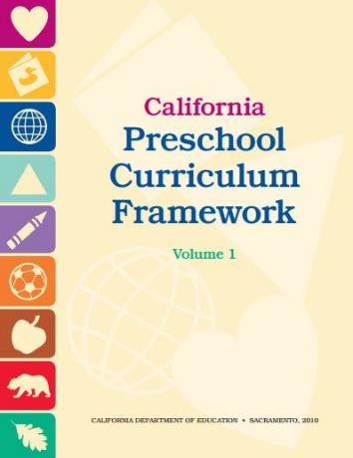
Foundations and Framework, Volume 1
Notes:
Presenter Remarks:
The purposes of the Preschool Learning Foundations are to promote a common understanding of TK children's learning and to guide instructional practice. They describe the knowledge and skills that young children typically develop when provided with developmentally, culturally, and linguistically appropriate learning experiences.
The Preschool Curriculum Framework was created as a companion to the Preschool Learning Foundations. The framework ". . . presents strategies and information to enrich learning and development opportunities for all of California’s preschool [and TK] children" (PCF, Vol. 1, p. v).
The Preschool Learning Foundations and the Preschool Curriculum Framework are designed to work together. While the foundations provide the background information to understand children's developing knowledge and skills (the "what"), the framework offers guidance on how teachers and programs can support the learning and development that are described in the foundations (the "how").
Extra Notes:
The Preschool Learning Foundations were developed with research-based evidence and are enhanced with expert practitioners' suggestions and examples. All foundations were written by a team of researchers with expertise in the given domain. A complete reference list of the source materials, along with detailed bibliographic notes for each of the developmental domains, can be found in the Preschool Learning Foundations. Sources used in the development of the foundations include:
Documents from the California Department of Education, such as the English-Language Arts Content Standards for California Public Schools, Kindergarten Through Grade Twelve (Language and Literacy, Introduction, p. 48, left column).
Well-validated assessment tools such as the Ages & Stages Questionnaires (ASQ): A Parent-Completed, Child-Monitoring System (Social-Emotional, References and Source Materials, p. 36).
General sources such as the Report of the National Reading Panel 2000 (Language and Literacy, Introduction, p. 73, left column).
Early childhood education standards from other states such as Hawaii and Texas (Social-Emotional, Introduction, p. 5, footnote).

Slide 8
Three Guiding Questions
What are the developmental progressions for the Self strand?
How can I incorporate these strategies into my existing TK classroom?
What are the developmentally appropriate strategies to support the development of self?
Notes:
Presenter Remarks:
These three guiding questions lead the process of providing the best possible environment and experiences to support the Self strand for TK students.
What does the research say about the developmental continuum social-emotional development, self and academic success?
Preschool Learning Foundations, Preschool Curriculum Framework, Developmentally Appropriate Practice, Transitional Kindergarten Implementation Guide, and Ross Thompson lecture (includes links and alignment documents).
What are the Developmentally Appropriate Strategies to support that development?
Use the Preschool Curriculum Framework, Developmentally Appropriate Practice, Transitional Kindergarten Implementation Guide, the Center on the Social and Emotional Foundations for Early Learning (CSEFEL), and the Center on the Developing Child at Harvard University
How can I incorporate these strategies into my existing program?
You will have an opportunity to reflect and plan throughout today.
Extra Notes:
We are addressing all students with these three guiding questions.

Slide 9
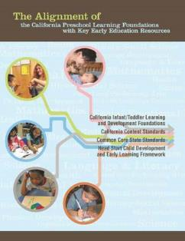



Connecting Resources for Social-Emotional Development
Notes:
Presenter Remarks:
Let’s take a deeper look at the resources for social emotional development, focusing on the Self strand. What do you know about _____? Click to reveal once resource at a time. How do you use this resource now in your work?
Transitional kindergarten (TK) is year one of a two-year program. The first year is spent focused on the learning foundations. The California state standards (Common Core) are what children in kindergarten are expected to do at the end of their kindergarten year. For children in TK, kindergarten is the second year of a two year program. The Alignment document can be used to connect the two. Additionally, the DRDP-K may be used to better understand the full range of development that occurs between the 60 month foundations (beginning of TK year) and the California state standards (end of 2nd year of kindergarten).
Please note that there is a picture of the California standards for English language arts, history-social studies, science and technical subjects as well as a picture of the California health standards for k-12. Social emotional standards for kindergarten have not been developed. Some components of social emotional development may be found in other domains such as History-Social Science (Table 1.8 Overview of the Alignment Between the Social–Emotional Development Domain and the California Content Standards for Kindergarten, p. 145) and Health. The social-emotional domain alignment between preschool and kindergarten becomes absorbed into health education in the mental, emotional, and social health content area (Table 1.1 Overview of the Alignment Between the Social–Emotional Development Domain and the California Content Standards for Kindergarten, pp. 25-32)

Slide 10
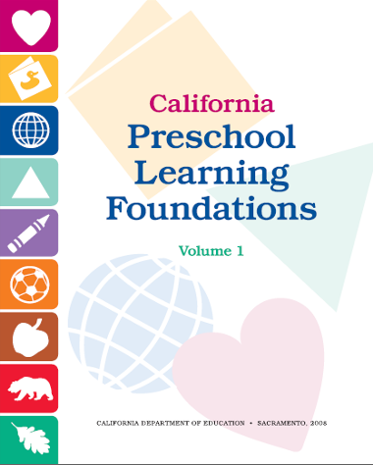
Foundations in Social-Emotional Development
The purpose of the foundations is to promote a common understanding of young children’s learning and to guide instructional practice.
Notes:
Presenter Remarks:
The purpose of the foundations is to promote a common understanding of preschool children’s learning and to guide instructional practice.
As teachers plan learning environments and experiences, the foundations provide the background information to help teachers understand children’s developing knowledge and skills.
The Preschool Learning Foundations were developed with:
Research-based evidence and are enhanced with expert practitioners’ suggestions and examples. All foundations were written by a team of researchers with expertise in that domain
Documents from the California Department of Education such as the English-Language Arts Content Standards for California Public Schools, Kindergarten Through Grade Twelve (Language and Literacy, Introduction, p. 48, left column)
Well-validated assessment tools such as the Ages & Stages Questionnaires (ASQ): A Parent-Completed, Child-Monitoring System (Social-Emotional, References and Source Materials, p. 36)
General sources such as the Report of the National Reading Panel 2000. (Language and Literacy, Introduction, p. 73, left column)
Early childhood education standards from other states such as Hawaii and Texas (Social-Emotional, Introduction, p. 5 footnote)
A reference list of these source materials is included in this document, along with detailed bibliographic notes for each of the developmental domains.

Slide 11
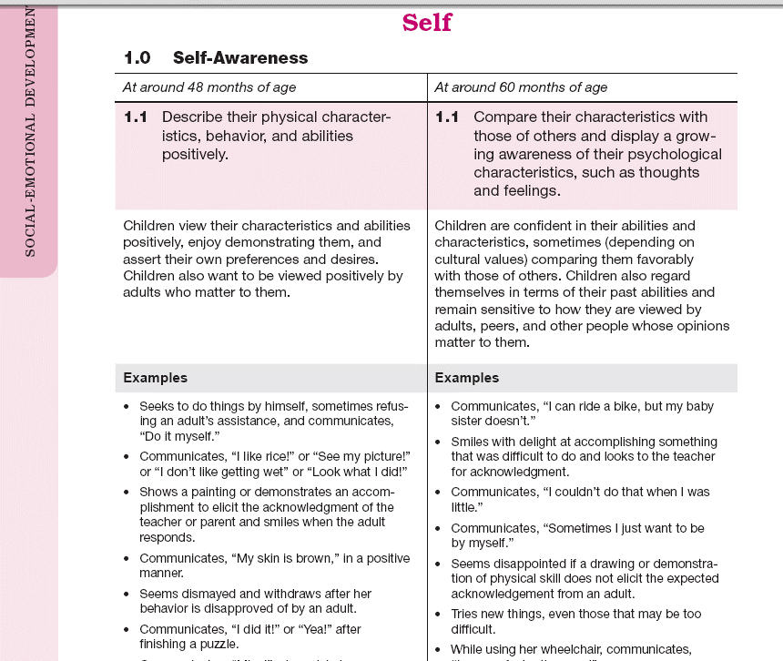
Map of the Foundations
Social-Emotional Development
Domain
Strand
Most TK students working toward
Substrand
Age
Foundation
Foundation Description
Examples
Notes:
Presenter Remarks:
Let’s discuss each component of the foundations:
The name of the domain is Social-Emotional Development.
The name of the strand is Self.
The name of the substrand is Interaction with Familiar Adults.
Note that substrands always end with a zero (1.0, 2.0, etc.).
The two age levels are at around 48 months and at around 60 months.
Each foundation describes typical behaviors at around 48 months and at around 60 months (or four to five years of age).
The foundations for each age level are listed below the age levels.
There are two for each age level on this page (1.1 and 1.2 for 48 months; 1.1 and 1.2 for 60 months).
Notice that there is a developmental progression from four years old to five years old within a substrand.
The examples for each foundation are listed.
These are only a few of the ways that children may demonstrate the behavior in the foundation.
Many of the foundations also have footnotes that include information specific for students with IEPs or students with disabilities, such as information about adaptations or accommodations.

Slide 12
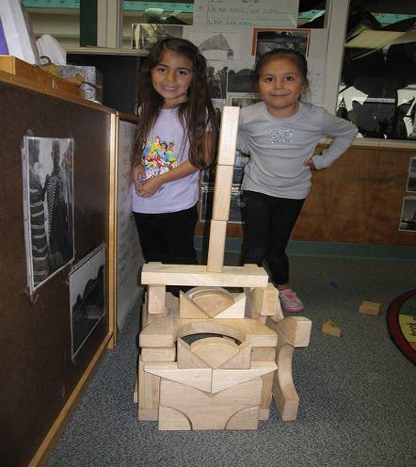
Today’s Focus: Self Strand
Self-awareness
Self-regulation
Social and Emotional Understanding
Empathy and Caring
Initiative in Learning
Notes:
Presenter Remarks:
There are three strands in the Social-Emotional Development domain: Self, Social Interactions, and Relationships. As we have discussed, today we are exploring Self.
“Self covers the qualities of self-awareness, self-confidence, and personality that enable young children to be competent learners” (PCF, Vol. 1, p. 38).
The Preschool Learning Foundations Self strand includes five topics that we will explore now.
Background information:
The five substrands are:
Self-awareness
Self-regulation
Social and Emotional Understanding
Empathy and Caring
Initiative in Learning

Slide 13
Exploring the Research: Bibliographic Notes
Each person select a different substrand of Self from the bibliographic notes on pp. 21-26 of the Preschool Learning Foundations, Volume 1.
Read and highlight something from the section that you have experienced in your work with children.
Share your findings with others at the table.
Notes:
Activity 2: Exploring the Research: Bibliographic Notes
Presenter Remarks:
Turn to the bibliographic notes section of the Preschool Learning Foundations, Volume 1, pp. 21-26. Each person selects and works on a different substrand. Read through the section and note something you’ve experienced in your own work with children.
intent:
Become familiar with the Self strand.
GOAL:
Participants will become familiar with and discuss the bibliographic notes section of the Self strand
Materials Required:
Preschool Learning Foundations, Volume 1, pp. 21-26
Time: 15 minutes
Process:
Ask participants to turn to the bibliographic notes section of PLF, Volume 1, pp. 21-26.
Have each participant at each table select to work on a different sub strand.
Ask participants to read through their section and note something they have noticed in their own work with children.
Invite participants to share out their observations with their tablemates.

Slide 14
Examples from a TK Classroom
Notes:
Background information:
Trainer should watch entire video prior to training.
Presenter Remarks:
Now we will watch a few video examples from a TK classroom that illustrate what you just read in the bibliographic notes.
The video clips reflect typical experiences in a TK classroom.
When watching, take note of behaviors in the video that you also see in your TK classroom. We will share your observations at the end.

Slide 15
Substrand Organization for the Day
15
Self-Awareness and Initiative in Learning
Social and Emotional Understanding and Empathy and Caring
Self-Regulation
Notes:
Background Information:
Invite participants to locate the Self strand in both the Preschool Learning Foundations, Volume 1, and the Preschool Curriculum Frameworks, Volume 1.
Presenter Remarks:
These substrands are split into three focus areas:
First, we will focus on the Self-Awareness and Initiative in Learning substrands. Learning is a social event and we understand ourselves based on our understanding of how others view us—thus our self-awareness is closely related to our initiative in learning.
Next, we will look at the Social and Emotional Understanding and Empathy and Caring substrands. Emotional understanding directly supports our ability to relate and empathize, therefore we can not really discuss one facet without the other.
Lastly, we will focus on the Self-Regulation substrand.
Optional Discussion Points:
Did you discuss or experience any of these substrand topics while creating and reading your book?
Please share something you experienced during Activity 1: Growing and Changing that relates to:
Self-awareness
Self-regulation
Social and emotional understanding
Empathy and caring
Initiative in learning
2. Did you discuss any of these topics while sharing your observations of the video?
Self-awareness
Self-regulation
Social and emotional understanding
Empathy and caring
Initiative in learning

Slide 16
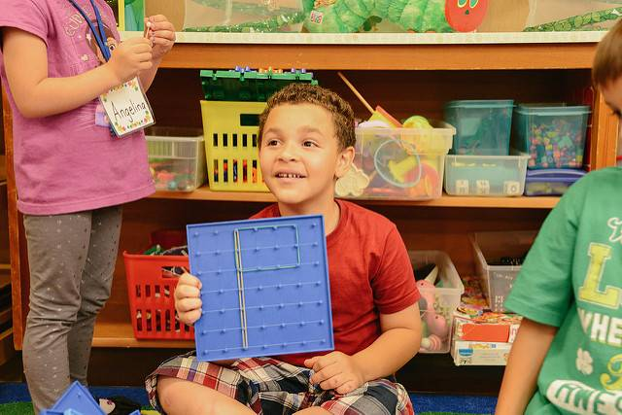
I’m Learning to Learn:
Self-Awareness and Initiative
©2017 California Department of Education
Notes:
Presenter Remarks:
We are now transitioning to focus the discussion on Self Awareness and Initiative in Learning. These two substrands are very closely linked.
“Children’s confidence and positive perception of themselves as learners, capable of growing in knowledge and skill, motivates them to pursue learning and persist through challenging tasks” (TK Guide 2013, 15).
Background Information:
“TK students are ‘learning to learn. They develop the skills and depositions that foster school achievement such as independence, appropriate risk-taking, perseverance, initiative, creativity, reasoning, and problem solving” (TK Guide 2013, 41).

Slide 17
Self-Awareness
“Self-awareness is an important component of early school success because young children’s self-confidence shapes their interest, motivation, and persistence in academic work, and their success in the classroom reciprocally influences their sense of pride and accomplishment”
(PLF, Vol. 1, p. 21).
Notes:
Presenter Remarks:
Please read this quote to yourself silently:
“Self-awareness is an important component of early school success because young children’s self-confidence shapes their interest, motivation, and persistence in academic work, and their success in the classroom reciprocally influences their sense of pride and accomplishment” (PLF, Vol. 1, p. 21).
What key words or phrases resonate with you? Please share your thoughts with your table mates.

Slide 18
Self-Awareness: Key Transitions
48 months
60 months
Describe their physical characteristics, behavior, and abilities positively.
Compare their characteristics and those of others and display a growing awareness of their psychological characteristics such as thoughts and feelings.
Notes:
Presenter Remarks:
Key transitions occur in self-awareness from early preschool to later preschool. The foundations transition from “Describe their physical characteristics, behavior and abilities positively” at 48 months to “Compare their characteristics and those of others and display a growing awareness of their psychological characteristics such as thoughts and feelings” at 60 months.
Take a moment now to read the foundations, descriptions, and examples of self-awareness in the Preschool Learning Foundations, Volume 1, p. 6. When finished reading, discuss the key transitions you noticed between 48 and 60 months with your group. Be ready to share-out an observation with the whole group.
“The period of time addressed by these foundations is an important transitional period. This period starts with the very simple, rudimentary self-awareness of the younger child, focusing on physical self-recognition (such as in a mirror image) and dispositional self-attribution (e.g., “Me big!”) and progressing to a more fully realized for of the psychological self-awareness of the early-grade-schooler” (PLF, Vol. 1, p. 21).
A number of studies have revealed the emerging awareness of internal, psychological characteristics in the self-awareness of older four-year-olds; see Eder (1989, 1990), Measelle and others (1998), and the work of Marsh and his colleagues (Marsh, Craven, and Debus 1998; Marsh, Ellis, and Craven 2002).
“This work challenges earlier, traditional views that preschoolers are focused exclusively on observable appearance and behavior in their self-perceptions and shows that when developmentally appropriate research methods are used, even four-year-olds reveal a dawning understanding of their psychological selves” (PLF, Vol. 1, p. 21).
Turn to the Preschool Learning Foundations, Volume 1, p. 6, and read the examples. At the table, share one example that you have experienced, or that is similar to something you have observed.
Extra Notes:
Add a question to teachers.

Slide 19
Understanding of Personal History Relates to Self-Awareness
(History-Social Science, Volume 3)
48 months
60 months
  Proudly display developing skills to attract adult attention and share simple accounts about recent experiences.
  Compare current abilities with skills at a younger age and share more detailed autobiographical stories about recent experiences.
Notes:
Presenter Remarks:
Self-awareness is also reflected in the Personal History substrand of the History-Social Science domain (Sense of Time strand). Often it is these autobiographical stories that co-exist with self-awareness and shape self-concepts; an understanding of personal history relates to self-awareness.
Foundation 3.1 from the Personal History substrand:
48 months - Proudly display developing skills to attract adult attention and share simple accounts about recent experiences.
60 months - Compare current abilities with skills at a younger age and share more detailed autobiographical stories about recent experiences.
How does this relate to the Growing and Changing book you made earlier?

Slide 20

Focused Video Viewing:
Dr. Ross Thompson
Notes:
Presenter Remarks:
Let’s listen to Dr. Ross Thompson to hear what he has to say about Initiative in Learning.
Extra Notes:
There is a long lead-in to the clip.
After the clip, invite elbow partners to share reactions.

Slide 21
Reactions to Dr. Thompson’s Research
Find the scarf at your table.
Stand up and prepare to toss the scarf when the music starts.
When music stops, the person holding the scarf must answer one of the questions.
What did you find interesting?
How does this relate to your TK classroom?
What other questions do you have?
Notes:
Background Information:
This reflection is personal and will vary across trainings and participants. The intent of the questions is to connect participants’ overall reactions to their daily practice.
Presenter Remarks:
Next, we are going to do an interactive reflection about your reactions to Dr. Thompson’s research.
Find the scarf at your table.
Stand up and prepare to toss the scarf when the music starts.
When the music stops, the person holding the scarf must answer one of the questions.
Now that you have had time to answer, or listen to others answer these questions, you may want to record any final thoughts on your video viewing guide.
Reflective questions include:
What did you find interesting?
How does this relate to your TK classroom?
What other questions do you have?
Extra Notes:
When all table groups have located a scarf, play music.
When all groups have tossed the scarf at least three times, stop the music.
Allow at least 1 minute for participants to choose and answer a reflective question.
Repeat these steps at least four times.
Optional:
Table groups may decide to answer the questions in order or to allow participants to choose which question they would like to answer.

Slide 22
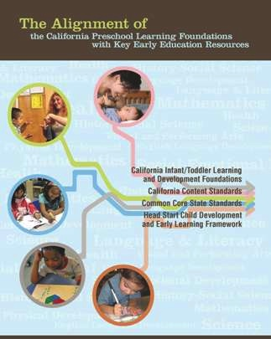
The Alignment Document
Notes:
Presenter Remarks:
The Alignment of the California Preschool Learning Foundations with Key Early Education Resources provides an in-depth analysis of how the nine domains of the preschool foundations closely align with the California Infant/Toddler Learning and Development Foundations, the California Content Standards, the Common Core State Standards, and the Head Start Child Development and Early Learning Framework.
The Alignment Document may be downloaded as a resource for teachers and administrators from the cpin.us Web site.
Together we will further explore the alignment of the Self strand.
Extra Notes:
Allow time for participants to examine handouts for 1.1 and 1.2, pp. 25, 27-29—Handout 2: Alignment Document/DRDP-K Measure 1.

Slide 23
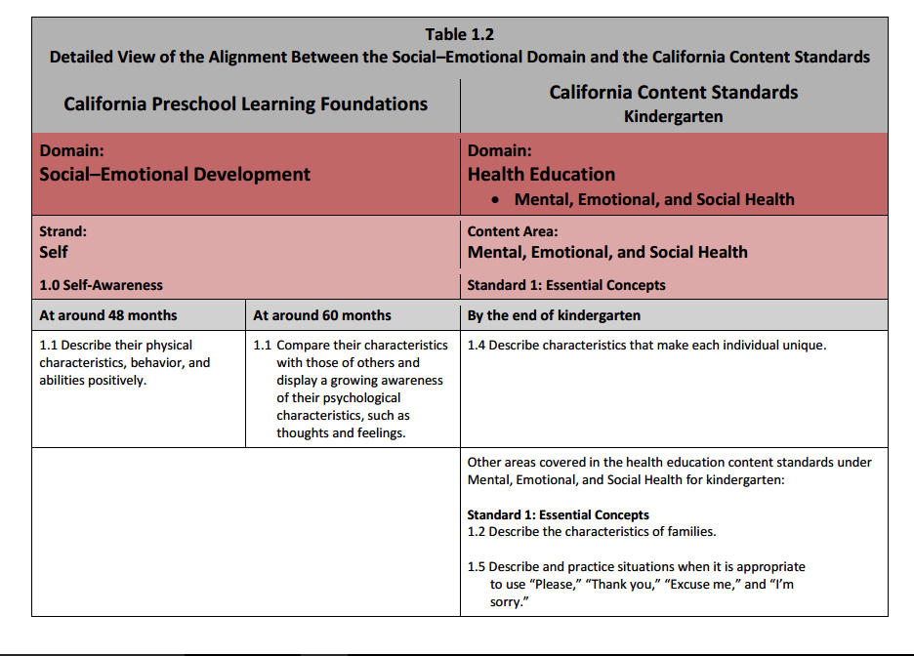
Table 1.2 Detailed View of the Alignment Between the Self-Awareness Substrand and the California Health Standards for Kindergarten
Notes:
Background information: Read The Alignment of the California Preschool Learning Foundations with Key Early Education Resources, pp. 22-32, prior to training.
Presenter Remarks: Solicit observations and point out.
The only major example of content appearing in one domain in the preschool learning foundations and in another in the kindergarten foundations is in the area of social–emotional development—specifically, some of the content in the Social–Emotional Development domain of the preschool foundations aligns with the Mental, Emotional, and Social Health strand of the kindergarten Health Education Content Standards.
Even so, the preschool social–emotional development foundations are comprehensive, while the mental, emotional, and social health standard gives narrow coverage of social–emotional development (Alignment, pp. 14-15).
Take a moment and read the foundations and standards in chronological order. What else do you notice? Think back to the information Dr. Thompson shared; does this table represent that information?
Extra Notes:
Participants may reflect on Dr. Thompson’s video and realize that the California Content Standards for kindergarten may seem less comprehensive. In this case, the trainer may elude to the bibliographic notes of the foundations and or the DRDP-K for further information regarding the later developmental continuum for TK. This is further covered later in the presentation.

Slide 24
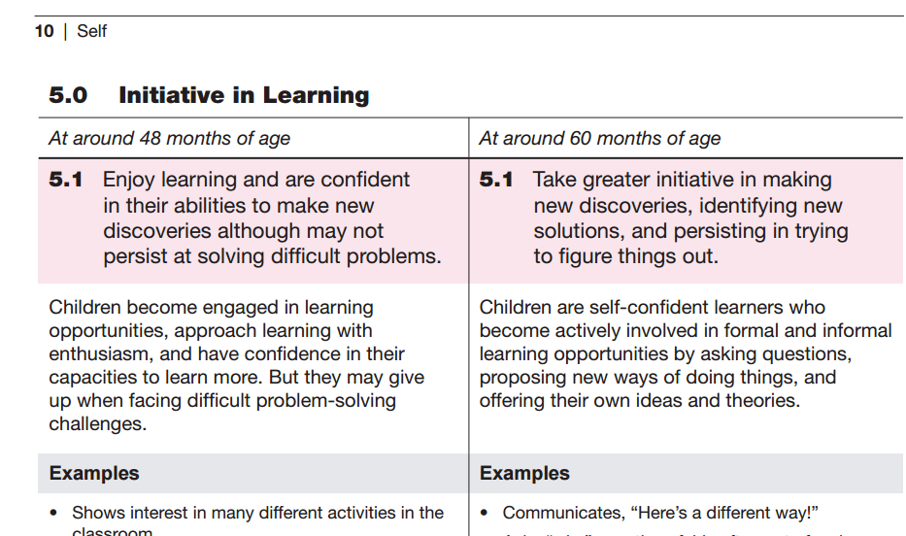
Preschool Learning Foundations, Volume 1
Notes:
Background Information:
Ask participants to turn to the Preschool Learning Foundations (PLF), Volume 1, p. 10, and share the following information.
Presenter Remarks:
Let’s look at the developmental shift of Initiative in Learning.
“Approaches to learning (or Initiative) is an important predictor of classroom achievement in kindergarten and the primary grades, with the term approaches to learning defined as…children’s classroom engagement, motivation, and participation” (PLF, Vol. 1, p. 25).
“Children's experiences shape their motivation and approach to learning such as persistence, initiative, and flexibility; in turn, these dispositions and behaviors affect their learning and development” (TK Guide, p. 40).
Invite participants to work with an elbow partner to identify developmental changes between 48 and 60 months. Invite feedback. Add, if necessary, that as children mature, they become more persistent at solving difficult problems. (This was also pointed out by Dr. Ross Thompson in the clip.)
Extra Notes:
The period of time addressed by these foundations is an important transitional period. This period starts with the very simple, rudimentary self-awareness of the younger child, focusing on physical self-recognition (such as in a mirror image) and dispositional self-attribution (e.g., “Me big!”) and progressing to a more fully realized for of the psychological self-awareness of the early-grade-schooler” (PLF, Vol. 1, p. 21).
When asked to describe themselves, kindergartners typically focus on observable characteristics: their name, physical appearance, possessions, and every day behaviors. They also mention typical emotions and attitudes, such as “I’m happy when we get to run outside” or “I don’t like to be with kids I don’t know” statements that suggest a budding grasp of their own unique personality” (DAP, p. 195).
“By the time they reach kindergarten, young children are already becoming experts in the use and interpretation of social comparison information, a skill that will continue to develop throughout the primary school years. Older preschoolers are just beginning to incorporate social comparison information into their self-perceptions” (PLF, Vol. 1, p. 22).

Slide 25
Foundations Video Example: Initiative in Learning
Look for examples of both Self-Awareness and Initiative in Learning.
Notes:
Presenter Remarks:
We are going to watch an example of a 60-month child taking initiative in learning. Please locate your video viewing guide to record observations. While watching the video, look for examples of both the Self-Awareness and Initiative in Learning strands since we know they are so closely related.
(Play Video: Social-Emotional Development Foundations DVD: Self, Initiative 5.1 (from 5:00 to 8:20))
Extra Notes:
After the video finishes, have participants discuss observations in table groups.
Create one master list at the table of these observations.
Invite tables to share out briefly.
Direct participants to keep this list nearby because it will be used again in a few slides.

Slide 26
Video Reflection
At your table, share and create a master list of examples of both self awareness and initiative in learning.
Discuss why are these examples are meaningful.
Notes:
Presenter Remarks:
At your table, share and create a master list of:
Examples of both the Self-Awareness and Initiative in Learning strands that resonate with you
Why these examples are meaningful
Extra Notes:
After the video finishes, have participants discuss their observations in table groups.
Create one master list at the table of all their observations.
Invite tables to share out briefly.
Direct participants to keep this list nearby because it will be used again in a few slides.
Optional:
Instead of creating a master list at the table, use chart paper to create a master list with the whole group.

Slide 27
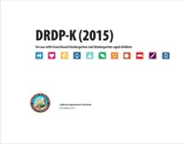
Key Features of the DRDP-K (2015)
An observation-based assessment tool,
not a test
Individual child assessment
Completed by each child’s teacher
Based on developmental research and theory
Includes developmental sequences of behaviors along a continuum
Spans the developmental continuum of children in a two-year kindergarten program
Notes:
Presenter Remarks:
Another resource that is used to support children’s development is the Desired Results Developmental Profile-Kindergarten (2015)© (DRDP-K).
The DRDP-K (2015) informs teacher’s understanding of the developmental continuum. It can be used with the Alignment document we saw on slide 12 to expand upon the developmental continuum.
One key feature of the DRDP-K (2015) to consider is that it is an observation-based assessment and not a test. It is used to support children’s learning. Observing and documenting children's progress provides teachers the information needed to differentiate instruction and experiences. It also provides information to individualize.
Observational tools are preferred over criterion-referenced tools because the information gathered by observation more accurately reflects what children are able to do.
Documentation provides concrete evidence of what children are able to do. With this documentation, we are then able to better plan activities that will meet and appropriately challenge children's developmental needs.
Other features of the DRDP-K (2015) include:
It is an individual child assessment that can be shared with families.
It is aligned with the Preschool Learning Foundations.
It opens up the opportunity for articulation between preschool and TK teachers.
Sharing information as to where children are on the developmental continuum can better prepare the TK teacher to work with students.
A teacher can include a request form for previous records as part of the TK registration to help support the relationship between preschool, family, and TK.
The DRDP-K has been developed with world renowned experts. It is based on research and knowledge of what is most important for predicting school success.

Slide 28
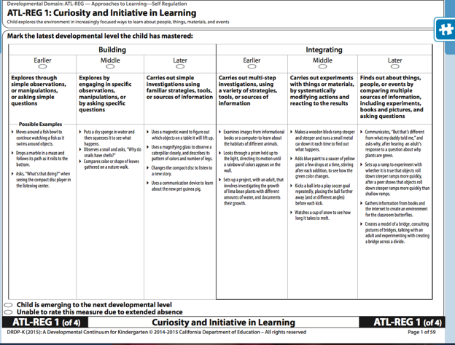
Developmental Continuum
Notes:
Presenter Remarks:
The Desired Results Developmental Profile spans the developmental continuum of children in a two-year kindergarten program (TK). The DRDP-K can provide a clear description of the developmental shift that occurs after 60 months at the end of the transitional kindergarten year.
Find Handout 2: Alignment Document/DRDP-K Measure 1. You may choose to follow along on your handout or on the screen.
Think back to the video example we watched.
With your table group, look at the list of skills explored in self awareness and initiative.
Next look at the ATL-REG Measure 1: Curiosity and Initiative in Learning.
What do you notice that would support a teacher’s understanding of the developmental progressions before and especially after the 60 months foundations?

Slide 29
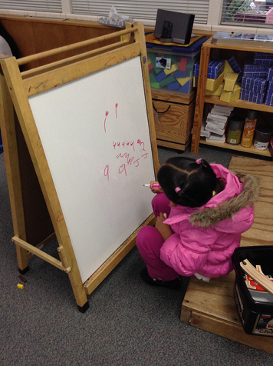
Social and Emotional Understanding and Empathy and Caring
“Young children who are more competent in understanding others’ feelings have been found to become more academically competent in the primary grades” (PLF, Vol. 1, p. 23).
Notes:
Presenter Remarks:
Now we will take a deeper look at the developmental progressions of Social and Emotional Understanding and Empathy and Caring.
Now let’s find out what the research has to say.
“Competence in understanding others’ feelings has been associated with positive peer and adult relationships as well as academic achievement” (TK Guide, p. 15).
“Young children who are more competent in understanding others’ feelings have been found to become more academically competent in the primary grades” (PLF, Vol. 1, p. 23).

Slide 30
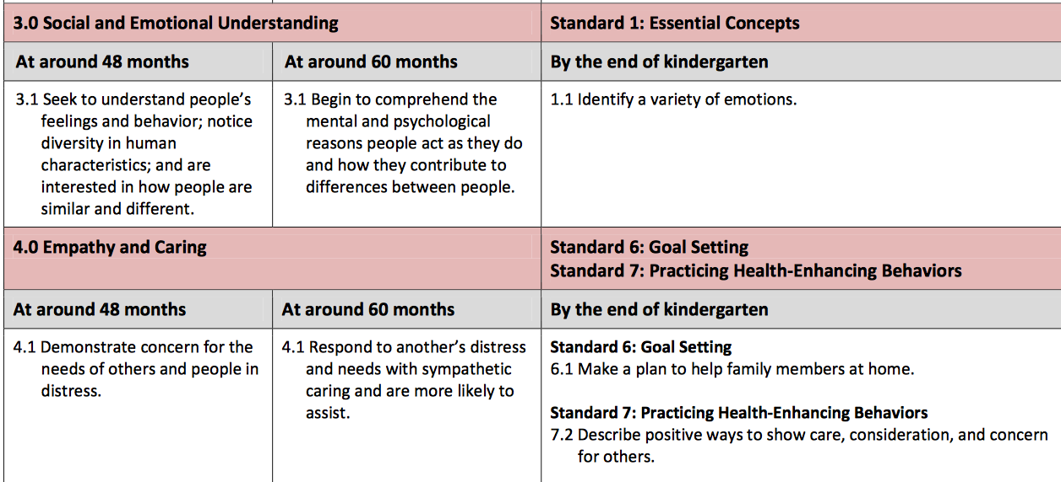
Table 1.2 Detailed View of the Alignment Between: Social and Emotional Understanding and Empathy and Caring substrands and California Health Standards for Kindergarten
Notes:
Presenter Remarks:
The title of Table 1.2 indicates that it is a Detailed View of the Alignment Between the Social–Emotional Domain and the California: Social and Emotional Understanding, Empathy and Caring Content Standards.
What do you notice about the alignment of social and emotional understanding in the first row?
What do you notice about the alignment of empathy and caring in the second row?
Share these thoughts with your table group.

Slide 31
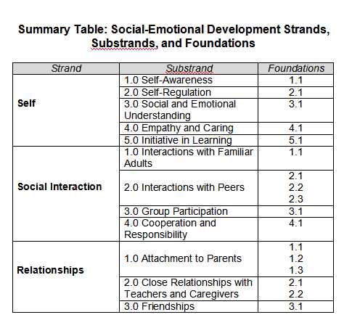
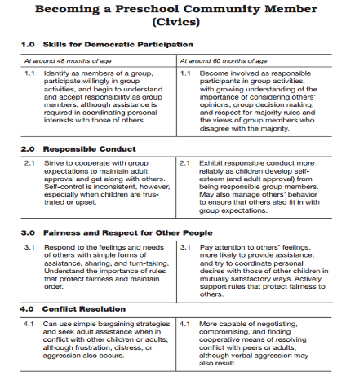
Self in History-Social Science
Notes:
Presenter Remarks:
Both Social and Emotional Understanding and Empathy and Caring are reflected in the History-Social Science domain under Fairness and Respect for Other People in the Becoming a Preschool Community Member (Civics) strand.
Understanding self as an individual and how to coordinate ones own needs, desires and interests while at the same time acknowledging the plan, thoughts and points of view as peers are what TK children are navigating.
There are many ways to support this development in the TK classroom. One way is to use children’s literacy focused on Social and Emotional Understanding and Empathy and Caring. For example here are a list of some quality books to explore: Bear Feels Sick, Can You Tell Me How Someone Feels, Understand and Care, and When I Care about Others. There are many others also listed in the CSEFEL Book Nook; this is a resource we will explore later.
Optional:
Trainers may place one of each book per table group and invite participants to read through the children’s book and discuss how the book may support Social and Emotional Understanding and Empathy and Caring.

Slide 32
Empathy and Caring 60 month
Foundations Video
Notes:
Background Information:
After video, compare notes and determine the developmental shifts.
Presenter Remarks:
We will now watch the 60 month foundation example for Empathy and Caring. Play video.

Slide 33
Video Reflection
Find someone with your same hair color.
Exchange thoughts about the video.
Discuss:
  Familiar examples of empathy
  When you typically observe these examples in the classroom
Notes:
Presenter Remarks:
Find someone with your same hair color.
Exchange thoughts about the video.
Discuss:
Familiar examples of empathy
When you typically observe these examples in the classroom

Slide 34
Self-Regulation: The Air Traffic Control System
Notes:
Background Information:
The 15 second introduction video with sound will play as soon as you advance to this slide. Have participants view this video as the transition to Self-Regulation.
Sound credit: http://www.freesfx.co.uk (This line must be left in the presentation.)
Presenter Remarks:
Let’s watch a visual representation of Self-Regulation. Play video. Share your reactions to the video at your table group. This marks our transition into discussing the developmental progressions of the last strand, Self-Regulation.
“Preschool children work hard to manage their attention, feelings, impulses, and thoughts. They seek to cooperate with others, manage their upset feelings, and participate in classroom routines and transitions, but they need ongoing adult support for their efforts” (PCF, Vol. 1, p. 48).

Slide 35
Self-Regulation Foundations
48 months
60 months
Need adult guidance in managing their attention, feelings, and impulses and show some effort at self-control.
Regulate their attention, thoughts, feelings, and impulses more consis­tently, although adult guidance
is sometimes necessary.
Notes:
Presenter Remarks:
Turn to the Preschool Learning Foundations, Volume 1, p. 7, and read the foundations, foundation descriptions, and foundation examples for the Self-Regulation strand.

Slide 36

The Developing Brain
“The developing brain…is a highly interconnected organ with different regions influencing, and being affected by, the others”
(PCF, Vol. 1, p. 39).
Notes:
Activity 3: Integrated Brain
Presenter Remarks:
We will share a modeling experience on how the brain is interconnected and grows and changes based on a variety of experiences and social interactions. We will have two duct tape “brains”: my brain that was not lucky enough to experience the rich daily experiences on the chart paper and your “brain”—which represents the children in the classroom—that will experience the daily routines.
intent:
Experience an analogy for supporting social-emotional development throughout the program day.
GOAL:
Participants will work as teams to create “brains” that will experience a variety of social-emotional experiences supporting development.
Materials Required:
Participant half-sheets with strategies (from Theory to Practice activity)
Duct tape
Confetti
Chart paper
Time: 10 minutes
Process:
Prior to Training
Prepare chart paper with a sample daily schedule. Put double-sided tape in each section so participants can stick the half sheets of paper onto the daily schedule.
During Training
Ask participants to choose two of the interactions and strategies they listed on the half-sheets of paper and to place them on the daily routine where they would most likely be used.
Provide each table group with a ball of duct tape (sticky side out) and a bowl of confetti. (Do this while table groups are taping their interactions and strategies to the daily routine.)
Read the quote from the Developing Brain slide, “The developing brain is not neatly divided into separate areas governing learning, thinking, and emotions. Instead, it is a highly interconnected organ with different regions influencing, and being affected by, the others” (PCF, Vol. 1, p. 39).
Explain that we will share a modeling experience on how the brain is interconnected and grows and changes based on a variety of experiences and social interactions.
Say to participants:
We will have two duct tape “brains”: my brain that was not lucky enough to experience the rich daily experiences on the chart paper, and all of your brains—which represent the children the classroom—that will get to experience the daily routines.
Choose one person in the group to hold your duct tape brain and follow along with me.
First, let‘s look at arrival time. It looks like in our daily routine teachers will (fill in the blank with whatever the strategy is taped here). The children in this class start the day with a rich experience. Go ahead and dip their brains in the confetti since their experience is stuck in their brain. My brain doesn’t get that.
Second, let’s look at the next time slot—it’s classroom meeting. It looks like your students will get to (share a story or trade-out for interaction and strategy listed on chart paper). Dip your brains again, they are building on the experience they will have forever in their brains.
Continue this process until you have gone through the whole program day. You can dip the unlucky trainer brain once or twice wherever it make sense. In the end, you want to have a vast difference between the unlucky brain and the lucky brains of the children in this classroom.
Compare the table group brains of the potential students (after all the strategies in daily routine have been read) to the unlucky trainer brain.
Ask participants: What do you notice?
The children’s brains who had integrated experiences of social emotional development and interactions with teachers and peers have a variety of experiences, colors, and connections to utilize. Their knowledge base to pull from is much richer.
Invite table groups to talk with each other about their take-away messages. Ask for groups to share out any aha moments they might have experienced.

Slide 37
Children and Stress
“There is growing experience of chronic unpredictable and overwhelming stress in the early years can lead to the development of neurobiological stress systems in the brain that are sensitive to threat and lead young children to overreact to ordinary stressful events” (National Scientific Council on the Developing Child 2005, as cited in PCF, Vol. 1, p. 40).
Notes:
Presenter Remarks:
“If children do not get what they need from their relationships with adults and the conditions in their environments—or (worse) if those influences are sources of toxic stress— their skill development can be seriously delayed or impaired“ (Center on the Developing Child at Harvard University 2016).
Turn to pages 40-41 of the Preschool Curriculum Framework, Vol. 1. The section on children and stress discusses special considerations for children who have experienced toxic stress in their lives. Some of these children may behave in ways that make it challenging for teachers to connect.

Slide 38
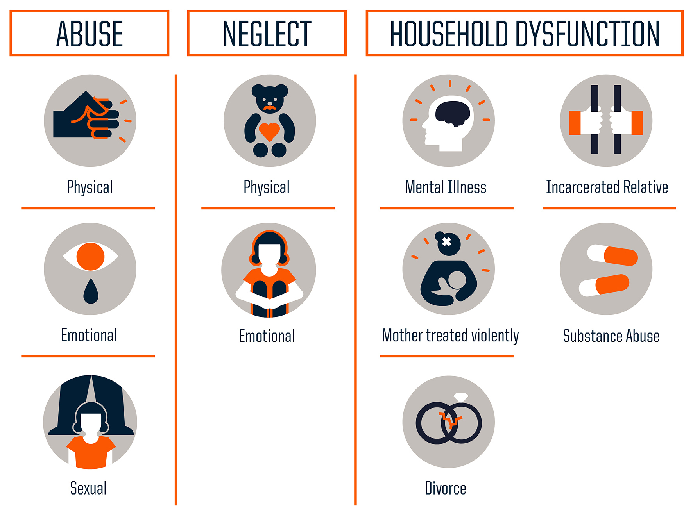
Poverty is one factor connected to toxic stress…Other factors include:
Source: Centers for Disease Control and Prevention
Notes:
Presenter Remarks:
The Adverse Childhood Experiences (ACE) Study was one of the largest investigations ever conducted to assess associations between childhood maltreatment and later-life health and well-being. The study is a collaboration between the Centers for Disease Control and Prevention and Kaiser Permanente's Health Appraisal Clinic in San Diego.
The ACE Study findings suggest that certain experiences are major risk factors for the leading causes of illness and death as well as poor quality of life in the United States. It is critical to understand how some of the worst health and social problems in our nation can arise as a consequence of adverse childhood experiences. Realizing these connections is likely to improve efforts toward prevention and recovery.
Extra Notes:
Here is a link to the ACE Study: http://www.cdc.gov/violenceprevention/acestudy/

Slide 39
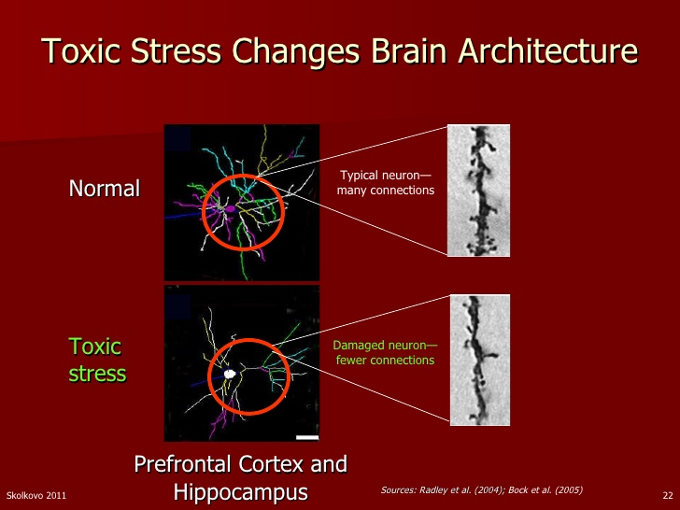
Notes:
Presenter Remarks:
“Toxic stress caused by these environments disrupts the brain circuits required for executive functioning and triggers impulsive, 'act-now-think-later’ behavior” (Center on the Developing Child at Harvard University 2016).

Slide 40
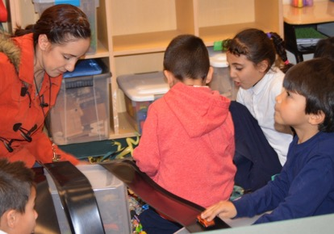
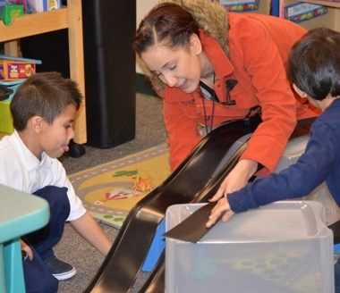
Stress and Learning
“Research shows that, even under stressful conditions, supportive, responsive relationships with caring adults as early in life as possible can prevent or reverse the damaging effects of toxic stress response” (Center on the Developing Child at Harvard University 2016).
Notes:
Presenter Remarks:
“Research shows that even under stressful conditions, supportive, responsive relationships with care adults as early in life's as possible can prevent or reverse the damaging effects of toxic stress response“ (Center on the Developing Child at Harvard University 2016).
This quote highlights the importance of the teacher’s role in the TK classroom. This is true especially considering the negative effects that can occur if a child does not have opportunities to develop positive relations with caring adults.
“If children do not get what they need from their relationships with adults and the conditions in their environments—or (worse) if those influences are sources of toxic stress— their skill development can be seriously delayed or impaired” (Center on the Developing Child at Harvard University 2016).

Slide 41
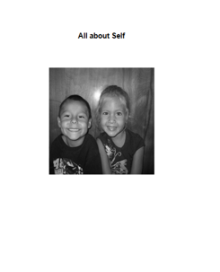
Pause for Reflection
Find the All About Self booklet.
Use the “Some key findings I don’t want to forget” pages for notes.
Record how the information from this section has impacted your thinking on a heart post-it note and display it on the group heart on the wall.
Notes:
Presenter Remarks:
Find the All About Self booklet. Use the “Some things I don’t want to forget” pages to take notes.
Now consider how this information may impact your thinking in the classroom. Notice the large heart on the wall. Here we can display how our thinking may change. On a heart post-it note, record how information from this section has impacted your thinking and display it on the group heart.
Extra Notes:
Have staplers at each table or let participants know where one is available.
Optional:
Have individual participants put booklets together as they enter the training.

Slide 42
Three Guiding Questions
What are the developmental progressions for the Self strand?
How can I incorporate these strategies into my existing TK classroom?
What are the developmentally appropriate strategies to support the development of self?
Notes:
Presenter Remarks:
We’ll now turn to the second and third questions:
What are the Developmentally Appropriate Strategies to support the Self strand?
Use the Preschool Curriculum Framework, Developmentally Appropriate Practice, Transitional Kindergarten Implementation Guide, the Center on the Social and Emotional Foundations for Early Learning (CSEFEL), and the Center on the Developing Child at Harvard University to find appropriate strategies.
How can I incorporate these strategies into my existing program?
You will have an opportunity to reflect and plan throughout today.

Slide 43


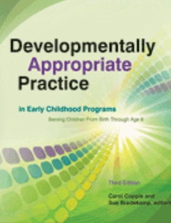
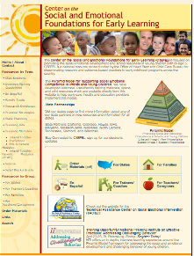
Resources to Support Developmentally Appropriate Strategies in TK
Notes:
Presenter Remarks:
Add these five suggested resources to your “bag of strategies” to support the development of self in the TK classroom: Preschool Curriculum Framework, Developmentally Appropriate Practice, Transitional Kindergarten Implementation Guide, and the Center on the Social and Emotional Foundations for Early Learning (CSEFEL).
We will look at all five substrands of the Self strand:
Self-awareness
Self-regulation
Social and Emotional Understanding
Empathy and Caring
Initiative in Learning

Slide 44

Preschool Curriculum Framework
“Created as a companion to the California Preschool Learning Foundations, Volume 1” (PCF, Vol. 1, p. v).
Notes:
Presenter Remarks: Read slide.
“Created as a companion to the California Preschool Learning Foundations, Volume 1, this framework presents strategies and information to enrich learning and development opportunities for all of California’s preschool children” (PCF , Vol. 1, p. v).

Slide 45
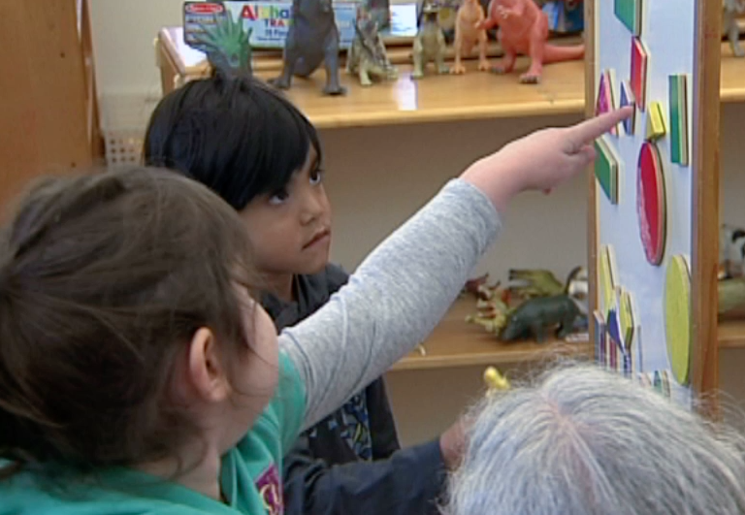
Preschool Curriculum Framework Includes Universal Design for Learning
Provides for:
Multiple means of representation
Multiple means of engagement
Multiple means of expression
      (PCF, Vol. 2, p. 14)
©2017 California Department of Education
Notes:
Background Information:
This information is from the Preschool Curriculum Framework, Volume 2, p. 14, which has the most detailed description of universal design for Learning (UDL). The same general information is found in the Preschool Curriculum Framework, Volume 1. As discussed in the slide, the strategies in Volume 1 are reflective of these UDL concepts.
Presenter Remarks:
The strategies within the Preschool Curriculum Framework include the idea of universal design for learning (UDL). This means there are many suggestions for ways to support learning that teachers can use to provide multiple means of representation, engagement, and expression.
“Multiple means of representation refers to providing information in a variety of ways so the learning needs of all children are met. For example, it is important to speak clearly to children with auditory disabilities while also presenting information visually (such as with objects and pictures).”
“Multiple means of expression refers to allowing children to use alternative ways to communicate or demonstrate what they know or what they are feeling. For example, when a teacher seeks a verbal response, a child may respond in any language, including American Sign Language. A child with special needs who cannot speak may also respond by pointing, by gazing, by gesturing, by using a picture system of communication, or by using any other form of alternative or augmented communication system.”
“Multiple means of engagement refers to providing choices in the setting or program that facilitate learning by building on children’s interests. The information in this curriculum framework has been worded to incorporate multiple means of representation, expression, and engagement” (PCF, Vol. 2, p. 14).

Slide 46
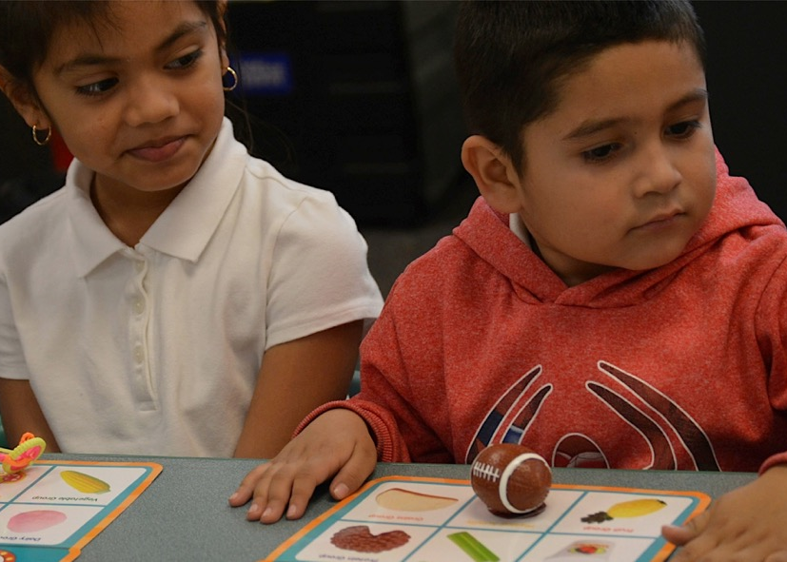
Preschool Curriculum Framework Includes Universal Design for Learning
Multiple means of…
Expression
Engagement
Representation
©2017 California Department of Education
Notes:
Background Information:
This information comes from the Preschool Curriculum Framework, Vol. 2, p. 14 which has the most detailed description of universal design for Learning (UDL). The same general information is found in the Preschool Curriculum Framework, Volume 1. As discussed in the slide, the strategies in Volume 1 are reflective of these UDL concepts.
Presenter Remarks:
The strategies within the Preschool Curriculum Framework include the idea of universal design for learning (UDL). This means there are many suggestions for ways to support learning that teachers can use to provide multiple means of representation, engagement, and expression.
“Multiple means of representation refers to providing information in a variety of ways so the learning needs of all children are met. For example, it is important to speak clearly to children with auditory disabilities while also presenting information visually (such as with objects and pictures).”
“Multiple means of expression refers to allowing children to use alternative ways to communicate or demonstrate what they know or what they are feeling. For example, when a teacher seeks a verbal response, a child may respond in any language, including American Sign Language. A child with special needs who cannot speak may also respond by pointing, by gazing, by gesturing, by using a picture system of communication, or by using any other form of alternative or augmented communication system.”
“Multiple means of engagement refers to providing choices in the setting or program that facilitate learning by building on children’s interests. The information in this curriculum framework has been worded to incorporate multiple means of representation, expression, and engagement” (PCF, Vol. 2, p. 14).

Slide 47
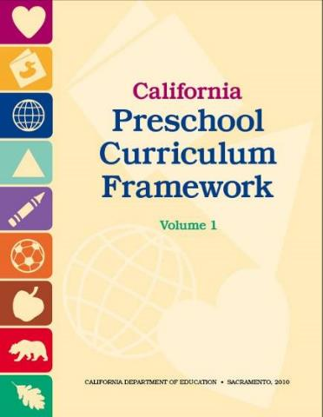
Curriculum Framework:
Strategies to Enrich Learning Opportunities
Planned learning opportunities
Routines, environments, and materials
Building on children’s knowledge, skills, and interests
Linguistically appropriate and culturally meaningful
Notes:
47
Presenter Remarks:
The Preschool Curriculum Framework offers guidance on how teachers can support learning and development described in the foundations through environments and materials that are developmentally appropriate, as well as individually and culturally meaningful experiences that engage families.

Slide 48
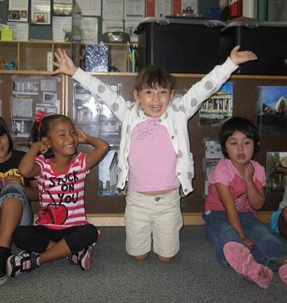
Guiding Principle Activity: We Do This Well!
Guiding principles set the stage for implementing developmentally appropriate strategies.
Together we will read the guiding principles and self-reflect.
Notes:
Activity 4: We do this well!
Presenter Remarks:
The guiding principles set the tone for the domain. Reviewing the guiding principles can be one way for teachers to reflect upon their practices as they answer the question, “Am I providing appropriate social interactions and environment experiences for this domain?”
Turn to the bulleted list of the guiding principle strategies on page 42 of the Preschool Curriculum Framework, Volume 1. Select a strategy from the bulleted list you consider a personal strength or as a strength in your program. Write the strategy down on an index card.
intent:
Explore strategies from the guiding principles for social-emotional development.
GOAL:
Participants will discuss and become familiar with the guiding principles for the Social-Emotional Development domain.
Materials Required:
Preschool Curriculum Framework (PCF), Volume 1, p. 42
Index cards
Time: 10 minutes
Process:
Explain that the guiding principles set the tone for the domain. Reviewing the guiding principles can be one way for teachers to reflect upon their practices as they answer the question, “Am I providing appropriate social interactions and environment experiences for this domain?”
Ask participants to turn to the bulleted list of the guiding principle strategies on page 42 of the Preschool Curriculum Framework , Volume 1.
Have each participant select a strategy from the bulleted list that they see as a personal strength or as a strength in their classroom. Have them jot the strategy down on an index card.
Invite participants to partner with someone from another table. Have partner pairs share their strengths and how those strengths are implemented in their classroom.
Ask participants to find a new partner and to repeat the process before returning to their tables.
Finish by stating, “As we work through this module and think about ways to support children’s sense of self, we want to constantly be reflect on our work by asking ourselves, ‘Are we exemplifying this guiding principle?’”

Slide 49
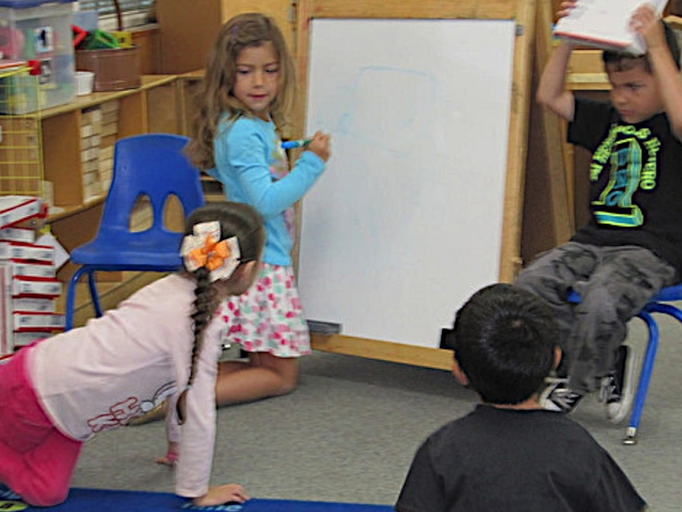
Learning to Learn
Self- Awareness and Initiative
©2017 California Department of Education
Notes:
Background Information:
This is a transition slide. The following slides highlight strategies from the Preschool Curriculum Framework, Volume 1, and the Transitional Kindergarten Guide that support the Self-Awareness and Initiative in Learning substrands.
Presenter Remarks:
We’ll begin by exploring strategies for the first two related substrands: Self-awareness and Initiative in Learning.
“Preschool children are active, enthusiastic learners who take pleasure in the ability to discover new things” (PCF, Vol. 1, p. 57).

Slide 50
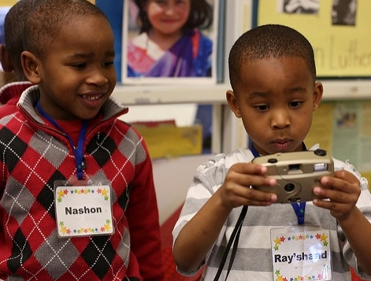
Capitalize on Enthusiasm
“Preschool children are active, enthusiastic learners who take pleasure in the ability to discover new things” (PCF , Vol. 1, 57).
©2017 California Department of Education
Notes:
Presenter Remarks:
“Preschool children are active, enthusiastic learners who take pleasure in the ability to discover new things” (PCF , Vol. 1, p. 57).
It is our job to capitalize on this enthusiasm and help them hold on to it throughout their educational experience.

Slide 51
An Environment That Supports Autonomy
“Children must be allowed to freely choose and pursue interests and activities, both alone and with others. They must be allowed to translate their own thoughts, ideas, and preferences into new activities and experiments” (PCF, Vol. 1, p. 41).
Notes:
Presenter Remarks:
Both the Self-Awareness and Initiative in Learning substrands are supported by an environment that facilitates the growth of autonomy. This wheel experience enabled you to have autonomy with the materials you chose, how you solved the problem, and the thoughts, discussions, meaning-making you brought to the activity. It is this open-ended environment, with vital scaffolding support in describing what is occurring, that we need to have throughout the program day and environment. Creating this can be a “real challenge.”
“Children must be allowed to freely choose and pursue interests and activities, both alone and with others. They must be allowed to translate their own thoughts, ideas, and preferences into new explorations” (PCF, Vol. 1, p. 41).
Read through interactions and strategies for Self-Awareness on page 47 of the Preschool Curriculum Framework, Volume 1, then read the interactions and strategies for Initiative in Learning on page 5 of the Preschool Curriculum Framework, Volume 1. Highlight or tab anything you notice that would specifically help teachers create an environment that supports autonomy.
Will a few volunteers share what they circled and one way to do this in the classroom?

Slide 52
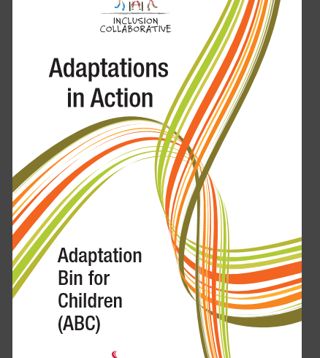
Materials for ALL Children
“Make use of adaptive tools and play materials to help the autonomous exploration of children with special needs” (PCF, Vol. 1, p. 58).
Notes:
Presenter Remarks:
Include tactile activities for children with visual impairments. Modify classroom tools by adding handles or grips for children with orthopedic impairments. Specially made communication books in the languages of the children in the classroom make possible plans for play for children with autism spectrum disorders” (PCF, Vol. 1, p. 58).
We will be looking at the idea-filled, free, downloadable book, Adaptations in Action, later in this session.

Slide 53
Performance vs. Learning Orientation
As a table, create a visual to represent:
the characteristics of the two different orientations,
the influence each has on children’s learning, and
how to support a learning orientation.
Notes:
Activity 5: Performance or Learning
Presenter Remarks:.
Silently read Handout 3: Performance vs Learning Orientation. As a table, create a visual to represent the characteristics of the two different orientations, the influence each has on children’s learning, and how to support a learning orientation.
intent:
Learn the difference between a performance orientation and a learning orientation.
GOAL:
Participants will understand the differences between a performance orientation and a learning orientation and how those differences impact children’s learning
Materials Required:
Handout 3: Performance or Learning
Chart paper
Various colored writing and drawing tools
Time: 15 minutes
Process:
Ask participants to silently read Handout 3: Performance or Learning.
As a table, create a visual to represent the characteristics of the two different orientations and the influence each has on children’s learning.
Have students hang their work on the wall in the designated area when they are done.
Invite comments and feedback

Slide 54

Transitional Kindergarten Implementation Guide
Notes:
Presenter Remarks:
The Transitional Kindergarten Implementation Guide focuses on the essential components for school district administrators and teachers to consider as they develop comprehensive TK programs.
The guide contains content that bridges preschool and kindergarten.
TK teachers have the unique opportunity to plan and implement a curriculum reflective of a developmental continuum.
The TK guide is another resource that teachers can use to support the Social-Emotional Development domain. Specifically in chapter 3, teachers may find strategies to create a sense of autonomy and provide positive feedback in a meaningful way to TK students.
We will highlight some key strategies from this chapter now.

Slide 55
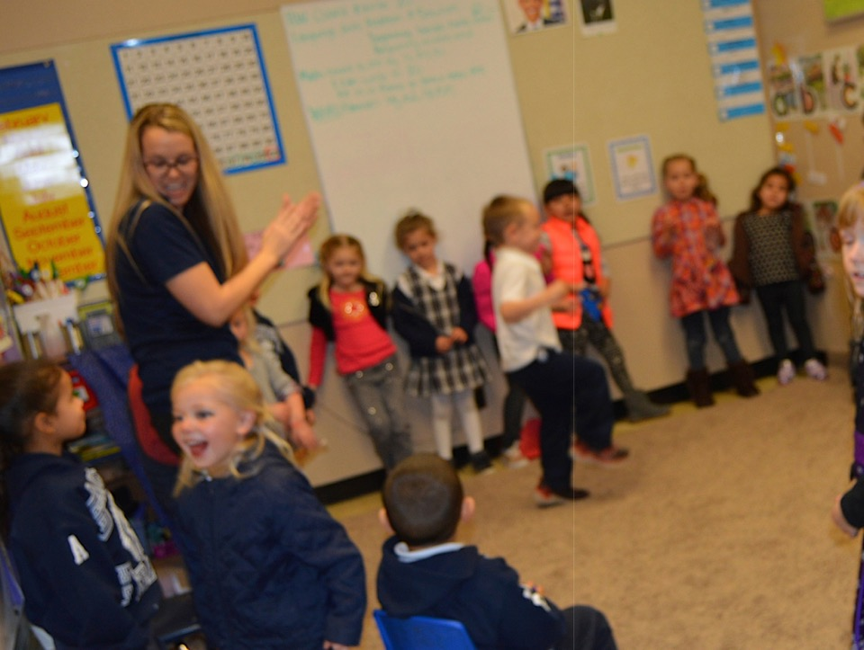
Self Confidence
“Even brief moments where the teacher pauses to observe, comment, and reflect with a student can do much to impact the child’s development of a positive sense of self”
(TK Guide, p. 16).
©2017 California Department of Education
Notes:
Presenter Remarks:
Even brief moments where the teacher pauses to observe, comment, and reflect with a student can do much to impact the child’s development of a positive sense of self” (TK Guide, p. 16).

Slide 56
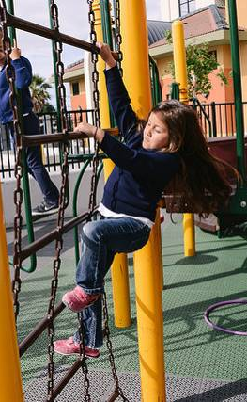
Student-Initiated Challenges
“Student-initiated challenges in outdoor environments permit students to push their limits and build self-awareness of the strengths and emerging abilities” (TK Guide, p. 79).
©2017 California Department of Education
Notes:
Presenter Remarks:
“Student-initiated challenges in outdoor environments permit students to push their limits and build self-awareness of the strengths and emerging abilities” (TK Guide, p. 79).

Slide 57
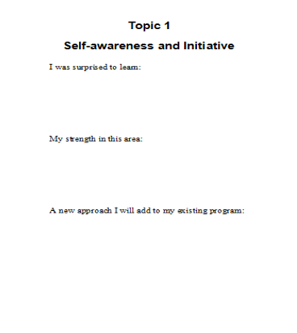
Pause for Reflection
Use the All about Self booklet to record reflections on your strengths and plans for future implementation.
When finished, create a trio and share your plan.
Notes:
Presenter Remarks:
Use the All About Self booklet to record reflections on your strengths and plans for future implementation. When finished, create a trio and share your plan.
Extra Notes:
When participants complete the writing, have them get up and find a partner from another table with whom to share. It’s a good opportunity to get up and stretch before the next section.

Slide 58
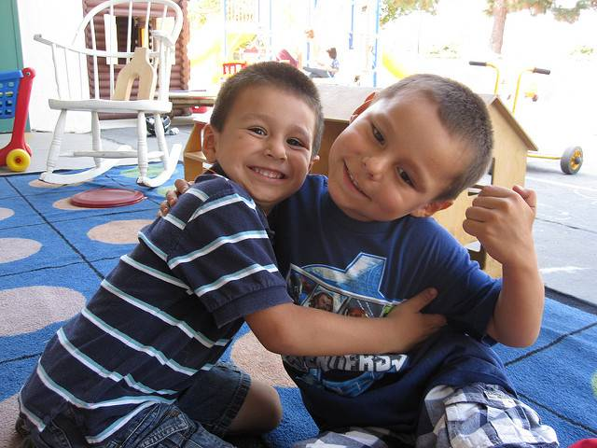
Me and You
58
Social and Emotional Understanding
Empathy and Caring
©2017 California Department of Education
Notes:
Presenter Remarks:
Now we will transition to the Social and Emotional Understanding and Empathy and Caring substrands.
Stand up and go meet someone you have never talked to, or just not talked with yet today. Share three things you know about social and emotional understanding and empathy and caring. High five and say, “You and I are an awesome pair!” And have a seat.

Slide 59

Theory to Practice
With your group, examine the theory on the chart.
Using the suggested resources, select five favorite strategies to support your assigned area of development.
Your assigned topic and theory are here.
Notes:
Activity 6: Theory to Practice
Presenter Remarks:
With your group, examine the theory on the chart. Using the suggested resources, select five favorite strategies to support your assigned area of development.
intent:
Introduce both theory and supporting practices for social and emotional understanding and empathy and caring.
GOAL:
Participants will work as teams to create a brief presentation on best practices from recommended resources to support social and emotional understanding and empathy and caring.
Materials Required:
Chart paper with Theory Sheets affixed to the center
DAP, Emotional understanding and empathy, p. 197; Promoting social and emotional development in Kindergarten PCF, Vol. 1, p. 47, pp. 53-56
PCF, Vol. 3, p. 45, 47, pp. 58-59, and p. 79
Various colored writing and drawing tools
Time: 15 minutes
Process:
Prepare chart paper for work groups in advance by printing the attached Theory Sheets and affixing one to center of each. Create enough charts so that participants can work in groups no larger than 6-8. Hang sheets on the wall making sure there is enough space for groups to work.
Divide participants into workgroups using your preferred method (counting off, drawing color cards, etc.), ensuring that participants are not working with their home table group. Assign each group to one of the charts.
Let groups know that when it is time to begin, they are free to take the sheet down and find a comfortable place to work as a team.
Have participant groups become familiar with the theory on their chart paper.
Using the resource pages on the slide, ask participants to select five of their favorite practices to add to their charts. They must use at least two of the three resources.
After 25 minutes, invite each group to give a quick (no more than 3 minute) presentation about their area of focus and the five strategies they selected.
At the end, invite feedback and comments.

Slide 60



Theory to Practice:
Resource List
p. 28, p. 48
p. 47, pp. 53-56
p. 196, p. 197
Notes:
Activity 6: Theory to Practice continued
Presenter Remarks:
Select five of your favorite practices to add to the chart. Use at least two of the three resources.
intent:
Introduce both theory and supporting practices for social and emotional understanding and empathy and caring.
GOAL:
Participants will work as teams to create a brief presentation on best practices from recommended resources to support social and emotional understanding and empathy and caring.
Materials Required:
Chart paper with Theory Sheets affixed to the center
DAP, Emotional understanding and empathy, p. 197; Promoting social and emotional development in Kindergarten PCF, Vol. 1, p. 47, pp. 53-56
PCF, Vol. 3, p. 45, 47, pp. 58-59, and p. 79
Various colored writing and drawing tools
Time: 15 minutes
Process:
Prepare chart paper for work groups in advance by printing the attached Theory Sheets and affixing one to center of each. Create enough charts so that participants can work in groups no larger than 6-8. Hang sheets on the wall making sure there is enough space for groups to work.
Divide participants into workgroups using your preferred method (counting off, drawing color cards, etc.), ensuring that participants are not working with their home table group. Assign each group to one of the charts.
Let groups know that when it is time to begin, they are free to take the sheet down and find a comfortable place to work as a team.
Have participant groups become familiar with the theory on their chart paper.
Using the resource pages on the slide, ask participants to select five of their favorite practices to add to their charts. They must use at least two of the three resources.
After 25 minutes, invite each group to give a quick (no more than 3 minute) presentation about their area of focus and the five strategies they selected.
At the end, invite feedback and comments.

Slide 61
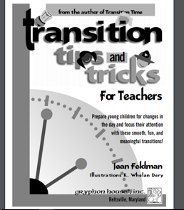
Hand Hug
Transition Tips and Tricks for Teachers
Return to your table.
Tallest person give the person on your right a hand hug by gently squeezing his/her hand.
Once you receive a hand hug, pass it on.
Once you have given a hand hug, please sit down.
Notes:
Presenter Remarks:
When you have finished with your chart paper return to your table group. We are going to practice using a hand hug to transition. Use this with your students as a way to transition that supports self-regulation and social interaction.
Tallest person give the person on your right a hand hug by gently squeezing his/her hand.
Once you receive a hand hug, pass it on.
Once you have given a hand hug, please sit down.
Extra Notes:
Download from https://www.iactivelearning.com/sites/default/files/book/samples/Jean_Feldman-Transition_Tips_and_Tricks-Sample.pdf
Optional: Show slide while group is presenting.

Slide 62
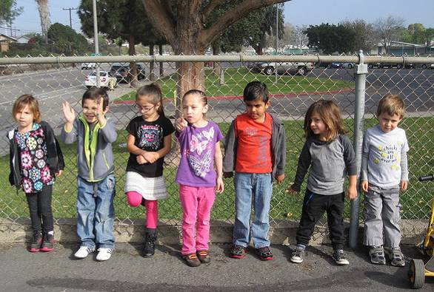
Self-Regulation Strategies
Notes:
Presenter Remarks:
Now we will transition to discuss strategies to support self-regulation. Please read the research highlight on page 49 in the Preschool Curriculum Framework to better understand the importance of implementing strategies that support the development of self-regulation.
Allow time for participants to read this handout.
Please take out Handout 5: Self-Regulation Strategies. This handout provides a variety of strategies from the Preschool Curriculum Framework to support the development of self-regulation.
All children need self-regulation support. “The development of emotional and behavioral control—self-regulation—is a skill that should be taught to all children, not just those who demonstrate behavioral problems” (DAP, p. 199).
Background Information:
Handout 5: Self-Regulation Strategies is a bulleted list of interactions and strategies from the Preschool Curriculum Framework, Vol. 1, pp. 49-51. It includes the strategies that are listed in the following four slides.

Slide 63
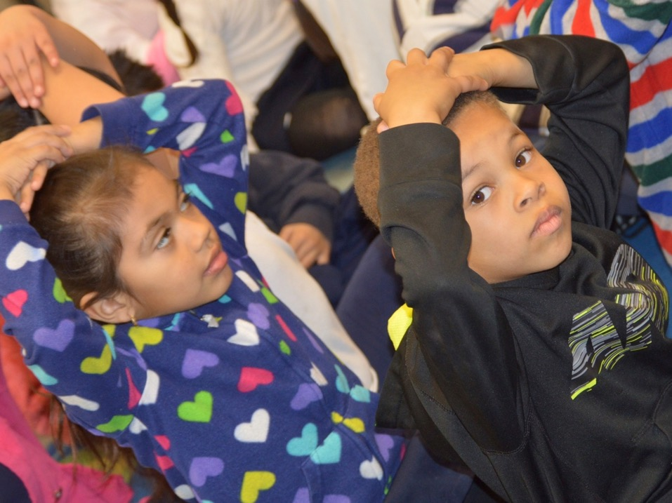
Group Experience
“Group experiences should be brief, between 10 and 15 minutes and up to 20 minutes depending on children’s ages, understanding of the English language, past experiences and levels of functioning”
(PCF, Vol. 1, p. 51).
©2017 California Department of Education
Notes:
Presenter Remarks:
Please read the quote on the slide individually. “Group experiences should be brief, between 10 and 15 minutes and up to 20 minutes depending on children’s ages, understanding of the English language past experiences and levels of functioning” (PCF, Vol. 1, p. 51).
Have you experienced a group time that exceeded 15 minutes? What happened?
(Allow time for participants to share their experiences and then summarize with this statement.)
“Ignoring a groups need for a transition can lead to more disruptive behavior and a general lack of cooperation” (PCF, Vol. 1, p. 51). For example, a teacher’s insistence on finishing a book during a large-group story time despite children’s restlessness may cause more problem behavior and work against learning goals.

Slide 64
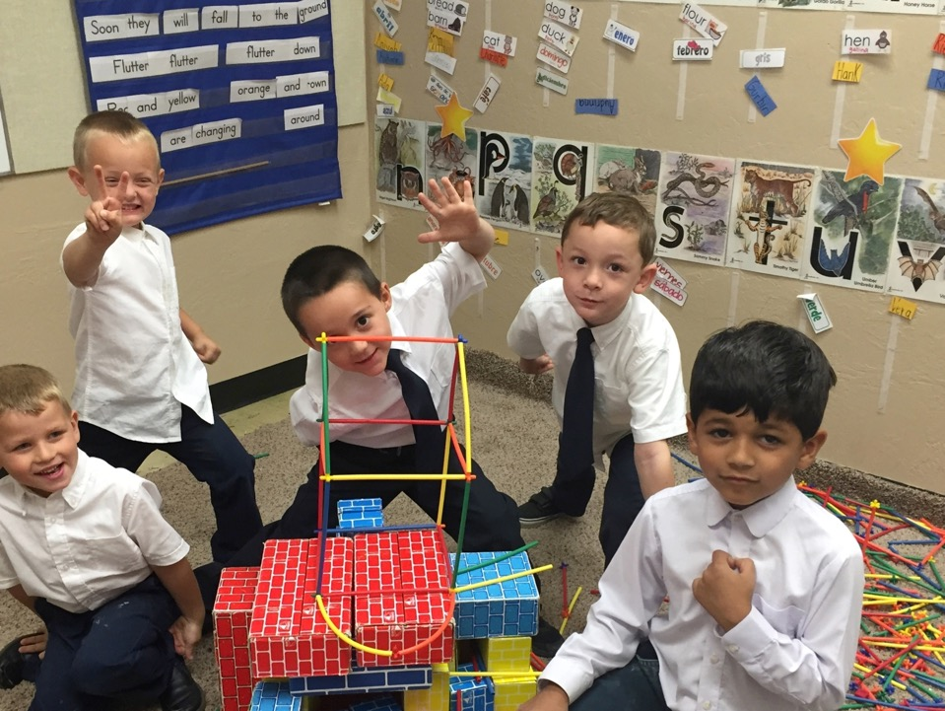
Open-Ended Creative Play
“Play is an important vehicle for developing self-regulation”
(TK Guide, p. 40).
©2017 California Department of Education
Notes:
Presenter Remarks:
Please read the slide to yourself.
“Play is an important vehicle for developing self-regulation” (TK Guide, p. 40).
Throughout the day strategies that include play have been referenced. This slide indicates yet again the importance of play in the TK classroom. Do you have experience using play to support self regulation?

Slide 65
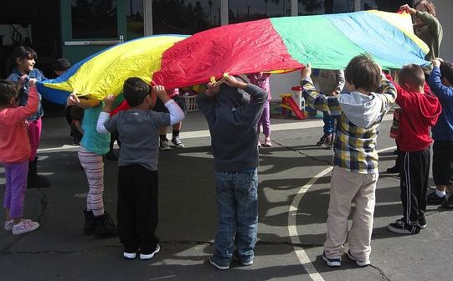
Outdoor Play
“Outdoor play promotes self-regulation”
(TK Guide, p. 80).
©2017 California Department of Education
Notes:
Presenter Remarks:
“Through individual exploration, cooperative play, and collaborative investigation, the outdoor environment promotes the development of self regulation, a positive sense of self, peer play skills and focused attention” (TK Guide, p. 80).
“Active games in the play yard such a red light, green light or Simon Says encourage children to pay close attention and to practice pausing first instead of acting impulsively. Providing visual cues (e.g., pointing to a picture of a traffic signal or using gestures in coordination with Simon Says) in addition to auditory prompts helps all children participate in games with success” (PCF, Vol. 1, p. 51).
“Incorporate vigorous physical exercise into daily activities, which has been shown to positively affect stress levels, social skills, and brain development” (Center for the Developing Child at Harvard University 2016).
Optional:
Think of a way to incorporate 15 more minutes outside every day. Turn and tell your elbow partner.

Slide 66
Interaction and Strategy:
Play Games with Rules
Make a list of all the games with rules used in your classroom.
Stand up and find someone new to exchange ideas.
Be ready to share out one new game idea.
Notes:
Presenter Remarks:
Play Games with Rules is an interaction and strategy in the Preschool Curriculum Framework, Volume 1. Please turn to page 51 and read the paragraph below it now. When you have finished reading give me a thumbs up.
What experiences have you had using games with rules to support self regulation in the classroom?
Make a list of all the games with rules used in your classroom.
Stand up and find someone new to exchange ideas and explain the games as necessary.
Be ready to share one new game you learned.
Extra Notes:
Invite participants to share a game they are excited to go back and try.

Slide 67
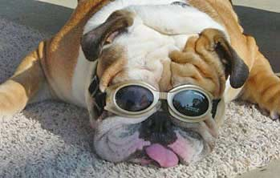
Teach and Provide Tools for Regaining Control
What is your go-to strategy when you’ve had enough…coffee? running? music? Facebook?
Share your strategy with an elbow partner.
Notes:
Background Information:
Read the slide and allow time for their discussion at the table.
Presenter Remarks:
Now that we have discussed our coping strategies, take a moment and think about what happens when we forget to use these strategies.
Maintain a peaceful classroom by providing children strategies and space to regroup before they lose control.
On the next few slides we will discuss some coping strategies you may use with children.

Slide 68
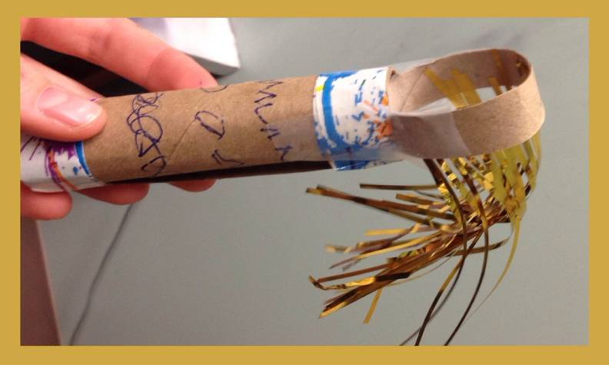
Breathing Wand
Notes:
Presenter Remarks:
One strategy to regain control is to have children breathe deeply. There are many ways to engage children with this strategy. You might create a breathing wand. Find directions for this along with many other resources on Handout 6: Supplemental Resources for Download.
Extra Notes:
This is a simple prop to support mindful breathing. Create a sample to demonstrate. (Make and Take option). See https://kristinamarcelli.wordpress.com/2014/05/10/make-your-own-mindful-breathing-wand/

Slide 69
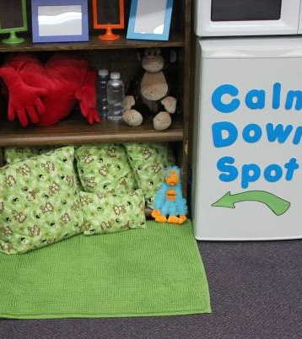
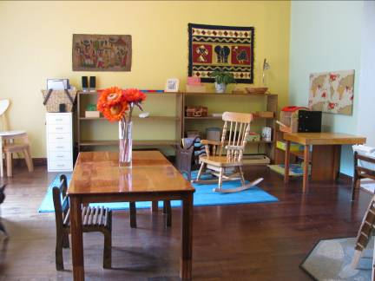
Private Spaces
Notes:
Presenter Remarks:
“The sounds of active learning can be loud and sometimes over stimulating. Many children need “private” spaces where they can find a retreat from group participation. Teachers can make private spaces inviting by including comfortable pillow and a small table for the child who would like to engage in an activity on his own” (PCF, Vol. 1, p. 43 and p. 51).

Slide 70
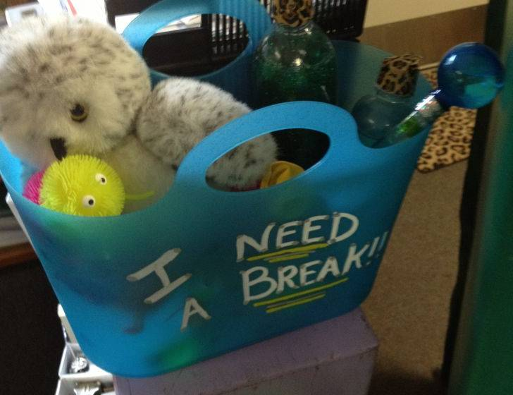
Bugged Box
Notes:
Presenter Remarks:
Add a bugged box to your private space containing items to help children calm themselves, such as a stuffed toy, pillow, personal music player with headset, paper and a variety of writing materials, a glitter bottle, etc. Alternatively, have each child identify one or two things to keep in their cubbies that help them calm down and feel better. They can take these items with them to the private space to help regroup and be ready to re-engage in classroom activities.

Slide 71
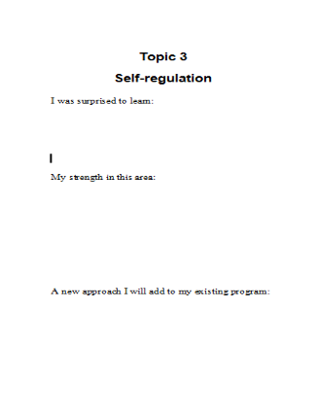
Pause and Reflect
Use the All About Self booklet to record reflections on your strengths and plans for future implementation.
Notes:
Presenter Remarks:
Now let’s take a moment to reflect about what we just learned. Use the All About Self booklet to record reflections on your strengths and plans for future implementation.

Slide 72
Three Guiding Questions
What are the developmental progressions for the Self strand?
How can I incorporate these strategies into my existing TK classroom?
What are the developmentally appropriate strategies to support the development of self?
Notes:
Presenter Remarks:
We’ll now turn to the third question:
3. How can I incorporate these strategies into my existing program?
You will have an opportunity to reflect and plan throughout the remainder of the day.

Slide 73
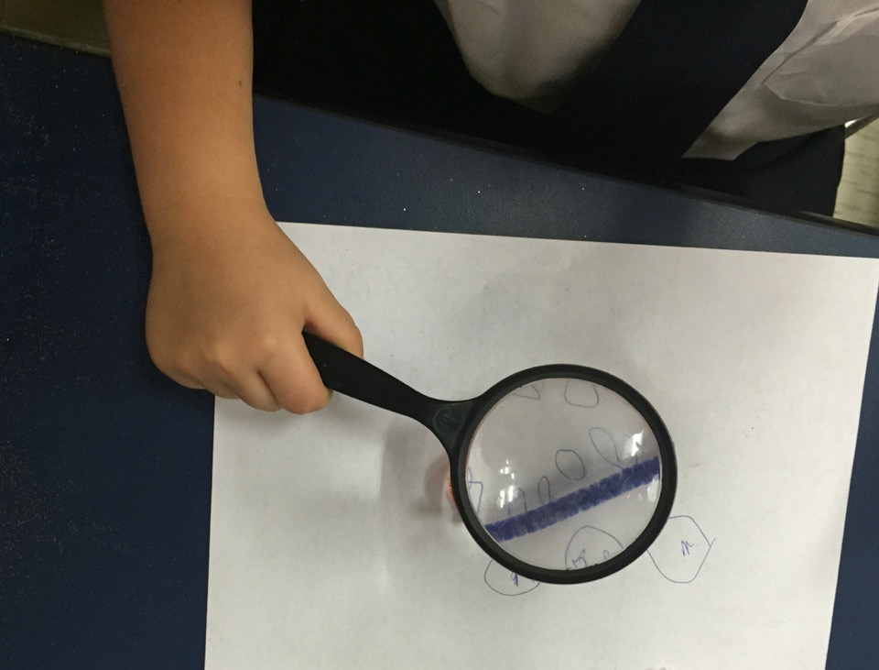
One Final Look
73
With an elbow partner, share two small changes or additions you are going to make in your TK classroom:
How will you do it?
Which foundations will these changes will be supporting?
©2017 California Department of Education
Notes:
Presenter Remarks:
Share with an elbow partner two small changes or additions you are going to make in your TK classroom:
How will you do it?
Which foundations will these changes will be supporting?
73

Slide 74
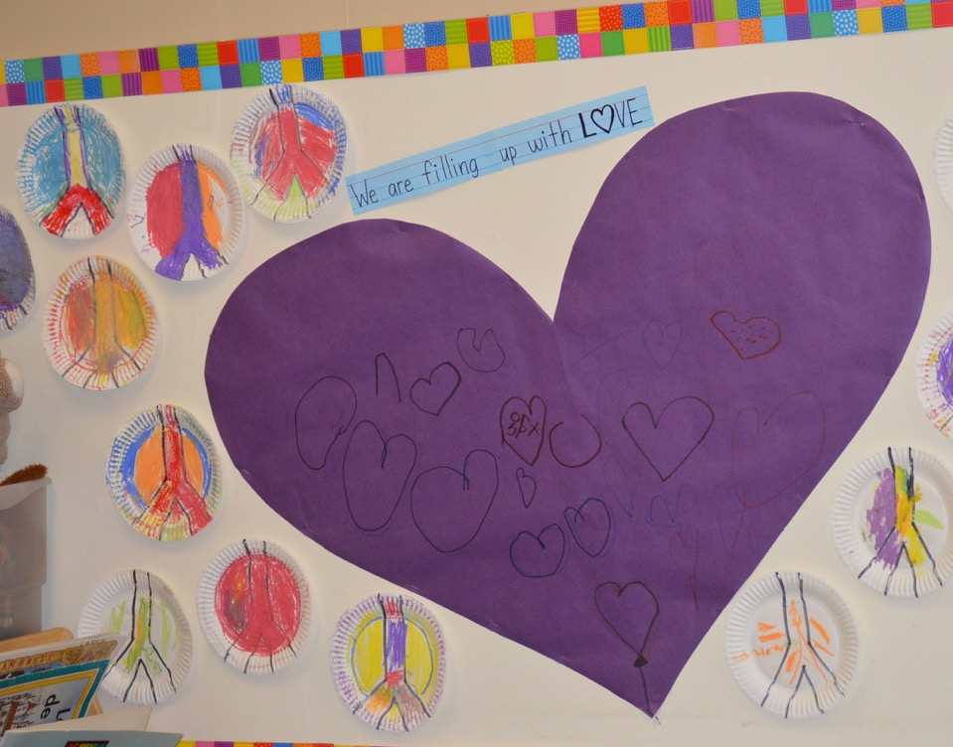
74
All kids need is a little help, a little hope, and someone who believes in them.” Magic Johnson
©2017 California Department of Education
Notes:
Presenter Remarks:
Take a moment to pause and read this quote on the slide. All kids need is a little help, a little hope, and someone who believes in them” (Magic Johnson, 2016).
Now think back to the heart post-it you created earlier today. Has your thinking changed since your reflection?
Please take another heart post-it and document how your thinking has further changed.
Add this post-it to the group heart.
You may want to take a moment and read the other heart post-its that make up our group heart as well.
Thank you for coming! We hope you collected some new ideas for your TK classroom day.

Slide 75
References
Bredekamp, Sue, and Carol Copple. Developmentally Appropriate Practice in Early Childhood Programs. NAEYC, 2008.
California Department of Education. 2016. Best Practices for Planning Curriculum for Young Children: Family Partnerships and Culture. http://www.cde.ca.gov/sp/cd/re/documents/familypartnerships.pdf (accessed May 11, 2016)
California Department of Education. 2013. Best Practices for Young Dual Language Learners Research: Overview Papers, Governor’s State Advisory Council on Early Learning and Care. http://www.cde.ca.gov/sp/cd/ce/documents/dllresearchpapers.pdf (accessed May 11, 2016).
California Department of Education. 2013. California English Language Development Standards. http://www.cde.ca.gov/sp/el/er/eldstandards.asp (accessed July 20, 2013).
California Department of Education. 2010. California Preschool Curriculum Framework, Volume 1. http://www.cde.ca.gov/sp/cd/re/documents/psframeworkkvol1.pdf (accessed April 10, 2016).
California Department of Education. 2012. California Preschool Curriculum Framework, Volume 2. http://www.cde.ca.gov/sp/cd/re/documents/psframeworkkvol2.pdf (accessed May 10, 2016).
California Department of Education. 2013. California Preschool Curriculum Framework, Volume 3. http://www.cde.ca.gov/sp/cd/re/documents/psframeworkkvol3.pdf (accessed May 10, 2016).

Slide 76
References Continued
California Department of Education. 2008. California Preschool Learning Foundations, Volume 1. http://www.cde.ca.gov/sp/cd/re/documents/preschoollf.pdf (accessed April 10, 2016).
California Department of Education. 2012. The Alignment of the California Preschool Learning Foundations with Key Early Education Resources. http://www.cde.ca.gov/sp/cd/re/documents/psalignment.pdf (accessed May 10, 2016).
California Department of Education. 2013. Transitional Kindergarten Implementation Guide: A Resource for California Public School District Administrators and Teachers. Sacramento: California Department of Education.
Center on the Developing Child at Harvard University. http://developingchild.harvard.edu/science/key-concepts/toxic-stress/ (accessed May 10, 2016).
Dweck, Carol. "The Power of Yet." Lecture. Accessed May 11, 2016. http://tedxtalks.ted.com/video/The-Power-of-Yet-|-Carol-S-Dwec.
Johnson, Magic. BrainyQuote.com, Xplore Inc, 2016. http://www.brainyquote.com/quotes/quotes/m/magicjohns142998.html (accessed May 11, 2016).
Miller, E., & Almon, J. Summary and recommendations of Crisis in the Kindergarten: Why Children Need to Play in School. A report from the Alliance for Childhood. http://www.allianceforchildhood.org/sites/allianceforchildhood.org/files/file/Kindergarten_8-page_summary.pdf (accessed May 11, 2016).

Slide 77
Optional Slides

Slide 78
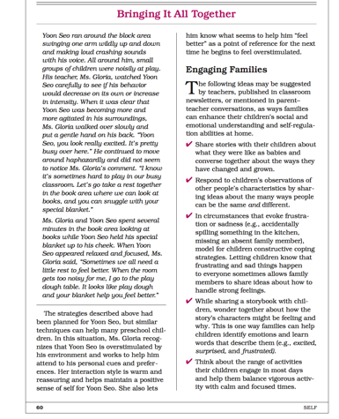
Engaging Families
Notes:
Presenter Remarks:
Research indicates the importance of partnering with families in early childhood classrooms.
We must “be a learner before trying to be a teacher.” The family is the constant in the child’s life. Both the family and you have the best interests of the child at heart. Talk to families about what is really important and what they want for their children. Share what is important to you and what the program hopes to provide for children. Build a relationship with families so that you can talk about difficult things and problems in an affirming way” (Best Practices for Planning Curriculum for Young Children: Family Partnerships and Culture, p. 10).
This partnership is specifically necessary when supporting children who have either recently immigrated or whose families speak a language other than English.
“Family engagement with schools has been linked to important outcomes for children of all families including families with English language learner students. Numerous positive developmental child outcomes have been associated with family engagement including: Early literacy skills, cognitive language developments skills, social emotional skills, and academic achievement” (California’s Best Practices for Young Dual Language Learners Research: Overview Papers, Governor’s State Advisory Council on Early Learning and Care Sacramento 2013, 121).
The Preschool Curriculum Framework has some ideas on engaging families. Before reflecting on the day and creating a mini action plan; let’s first read the section on engaging families on page 60. As you read, please highlight or circle any ideas you would like to try.

Slide 79
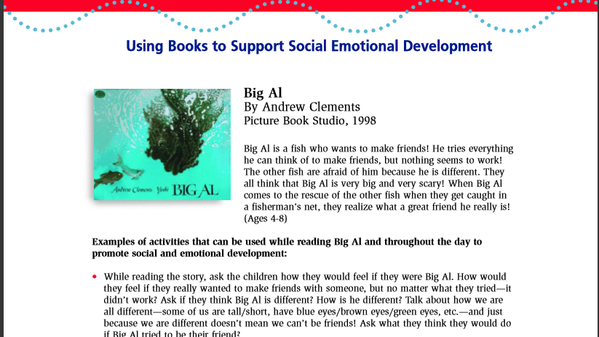
CSEFEL “Book Nook”
79
Notes:
Presenter Remarks:
TK teachers should be encouraged to use storybooks to enhance children’s understanding of friendships (PCF, Vol. 1, p. 84) and (PCF, Vol. 2, p. 79). The Book Nook page of the CSEFEL Web site lists a number of books about friendships that would be appropriate.
Extra Notes:
Demonstrate an interactive reading of book on friendship.

Slide 80






Let’s Explore Resources
Notes:
Presenter Remarks:
To conclude, we are going to explore resources that support the work we have been discussing today. When you leave here, you will have many resources in your tool kit to help support the development of self for your TK students.
Let’s review some resources…

Slide 81


Resource Notes Guide
©2017 California Department of Education
Notes:
Activity 7: Review Resources
Presenter Remarks:
For the next 20 minutes, we are going to explore resources. Please take out Handout 5: Supplemental Resources for Download and Handout 7: Resource Notes.
intent:
Explore a wide variety of additional free resources available online to support the development of self.
GOAL:
Participants will work as teams to review and evaluate a variety of resources available online to supplement those explored during the session.
Materials Required:
Handout 6: Supplemental Resources for Download
Handout 7: Resource Notes
If no internet will be available at the site, presenter will have to download and print one review copy of each resource, planning for one resource per table. Print additional copies if there are more tables than there are resources. Collect after the session since these are copyright protected.
Time: 30 minutes
Process:
Distribute one table copy of a resource per table group OR if internet is available and you have asked participants to bring laptops, assign one resource to each group for them to download on their own.
Ask participants to take out Handout 6: Supplemental Resources for Download and Handout 7: Resource Notes.
Ask participants to use Handout 7: Resource Notes as their guide when reviewing their assigned resource.
After 20 minutes, invite table groups to briefly report on their resource using the resource notes as their guide as you go through the following slides.

Slide 82

50+ Picture Books about Mixed Race Families
Notes:
Presenter Remarks:
There are no presenter notes for this slide.
Extra Notes:
See full list at http://coloursofus.com/picture-books-about-mixed-race-families/
(on handout of supplemental resources).
After participants have explored the resources, go through each slide/resource in turn and have corresponding groups report out based on the guide.
Optional:
Show slide while group is presenting.

Slide 83

Children’s Literature to Support Self-Regulation
Notes:
Presenter Remarks:
There are no presenter notes for this slide.
Extra Notes:
Mind in the Making (MITM), developed by Families and Work Institute (FWI), is an unprecedented effort to share the science of children’s learning with the general public, families and professionals who work with them. Based on Mind in the Making: The Seven Essential Life Skills Every Child Needs (HarperCollins, 2010) by Ellen Galinsky, president of FWI, its mission is to promote Executive Function Life Skills in adults and through them in children in order to keep the fire for learning burning brightly in all of us.
Mind in the Making has partnered with First Book, a nonprofit social enterprise that provides books and educational materials for educators serving children in need, to curate a groundbreaking Mind in the Making' Book Collection that combines children's books with tips for building Seven Essential Life Skills.
Optional:
Show slide while group is presenting.
Download complete set of First Book Tip Sheets from http://www.readyatfive.org/download-document/about-raf/839-mitm-fb-tips-all-sm/file.html

Slide 84


Transitions
Notes:
Presenter Remarks:
There are no presenter notes for this slide.
Extra Notes:
Download the complete article from http://journal.naeyc.org/btj/200805/pdf/BTJ_Hemmeter_Transitions.pdf
“Transitions can cause a typically positive classroom climate to unravel as activity and intensity levels increase. Songs, visual prompts, and key phrases in children’s home languages remind children of what is currently occurring, what the child’s responsibility is during the changeover, and what a child can do to help self-regulate through the transitions.
Transitions should be kept to a minimum” (PCF 2013, 51).
Optional:
Show slide while group is presenting.

Slide 85


Activities and Games to Support Self-Regulation
Notes:
Presenter Remarks:
There are no presenter notes for this slide.
Extra Notes:
“Executive function and self-regulation (EF/SR) skills provide critical supports for learning and development, and while we aren’t born with these skills, we are born with the potential to develop them through interactions and practice. This 16-page guide (available for download, below), describes a variety of activities and games that represent age-appropriate ways for adults to support and strengthen various components of EF/SR in children. Each chapter of this guide contains activities suitable for a different age group, from infants to teenagers. The guide may be read in its entirety (which includes the introduction and references) or in discrete sections geared to specific age groups” (Center for the Developing Child at Harvard University 2016).
Download from http://developingchild.harvard.edu/wp-content/uploads/2015/05/Enhancing-and-Practicing-Executive-Function-Skills-with-Children-from-Infancy-to-Adolescence-1.pdf
Optional:
Show slide while group is presenting.

Slide 86


Adaptations in Action
Notes:
Presenter Remarks:
There are no presenter notes for this slide.
Optional:
Show slide while group is presenting.

Slide 87

Table 1.1 Overview of the Alignment Between the Social–Emotional Development Domain and the California Content Standards for Kindergarten
Notes:
Presenter Remarks:
By supporting social-emotional development, we are supporting the developmental continuum that began in infancy and continues after preschool into kindergarten and elementary school.
What stands out to you about the Social-Emotional Development domain alignment between preschool and kindergarten? (It becomes absorbed into health education in the Mental, Emotional, and Social Health content area.)

Slide 88
Executive Function—Skills for Life and Learning
(Source: Center on the Developing Child at Harvard University)
Notes:
Presenter Remarks:
“Preschool children work hard to manage their attention, feelings, impulses, and thoughts. They seek to cooperate with others, manage their upset feelings, and participate in classroom routines and transitions, but they need ongoing adult support for their efforts” (PCF, Vol. 1, p. 48).
Let’s watch a short video explaining some of this process.
Extra Notes:
Video is from Center on the Developing Child at Harvard University – https://developingchild.harvard.edu/resources/inbrief-executive-function-skills-for-life-and-learning/
Click video to play.

Slide 89

Supportive Relationships
Support children’s efforts to build relationship and self-regulation skills
Model these skills
Engage in activities in which opportunities to practice the skills exist
(Center on the Developing Child at Harvard University, 2016)
Notes:
Presenter Remarks: Read slide.
Support children’s efforts to build relationship and self-regulation skills
Model the skills
Engage in activities in which opportunities to practice the skills exist
(Center on the Developing Child at Harvard University, 2016, http://developingchild.harvard.edu/resources/inbrief-executive-function/)

Slide 90

Notes:
Presenter Remarks:
Other aspects of the preschool Self strand are represented in Approaches to Learning-Self Regulation.

Slide 91

Teaching in the Sweet Spot
(Edward Miller and Joan Almon, Crisis in the Kindergarten Why Children Need to Play in School, p.12)
Notes:
Presenter Remarks:
“A child’s initiative as a learner is encouraged when teachers provide sufficient time for in-depth experimentation and exploration. Additional time for open-ended play should be included throughout the day, in both indoor and outdoor learning environments” (PCF, Vol. 1, p. 58).
Reflect on where you are on the continuum and where you would like to be. If you do find yourself in the ‘sweet spot,’ we may need to consider possible barriers and solutions.
“Student-initiated work should be balanced with teacher-directed learning experiences that are shorter in length and infused with integrated learning and movement” (TK Guide, p. 43).
“A minimum of 45 minutes of uninterrupted choice time is considered best practice” (TK Guide, p. 43).
Extra Notes:
Graphic is from:
Miller, E., & Almon, J. Summary and recommendations of Crisis in the Kindergarten: Why Children Need to Play in School. A report from the Alliance for Childhood. Retrieved from http://www.allianceforchildhood.org/sites/allianceforchildhood.org/files/file/Kindergarten_8-page_summary.pdf

Slide 92
The Power of Yet by Stanford Psychologist Carol Dweck
(Carol Dweck, “The Power of Yet” lecture, 2013)
Notes:
Presenter Remarks:
“When a child is not yet able to achieve a task, getting the feedback "Not Yet“ (rather than a red X or a failing “grade”) you help them understand that they are on a learning curve. It gives them a path into the future. Just the words "yet" or "not yet," give kids greater confidence, give them a path into the future that creates greater persistence. Praise the process that kids engage in: their effort, their strategies, their focus, their perseverance, their improvement. This process praise creates kids who are hardy and resilient” (Carol Dweck, “The Power of Yet” lecture, 2013).
Extra Notes:
Click on video to play.

