Slide 1
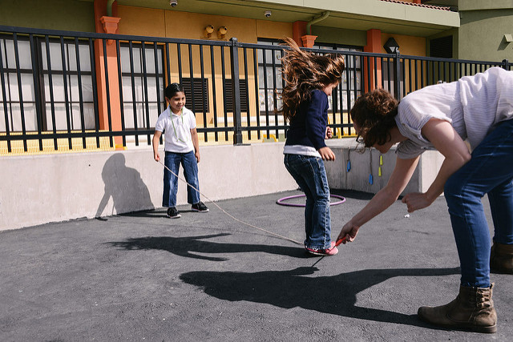
Social-Emotional Development in Transitional Kindergarten (TK)
Social Interactions

Slide 2
Objectives
Gain understanding of key concepts from the California Preschool Learning Foundations, Volume 1 and the California Preschool Curriculum Framework, Volume 1—Social-Emotional Development domain, Social Interactions strand.
Observe, read, and discuss the developmental continuum for vocabulary that will guide instruction and learning in Transitional Kindergarten (TK).
Practice using the Preschool Learning Foundations (PLF) and Preschool Curriculum Framework (PCF) to intentionally plan developmentally appropriate, cultural, and inclusive strategies that promote the development of skills, knowledge, and behaviors related to social-emotional development.
Notes:
Presenter Remarks:
This slide shows the objectives for today’s training:
Gain understanding of key concepts from the California Preschool Learning Foundations, Volume 1 and the California Preschool Curriculum Framework, Volume 1—Social-Emotional Development domain, Social Interactions strand.
Observe, read, and discuss the developmental continuum for vocabulary that will guide instruction and learning in Transitional Kindergarten (TK).
Practice using the Preschool Learning Foundations and Preschool Curriculum Framework to intentionally plan developmentally appropriate, cultural, and inclusive strategies that promote the development of skills, knowledge, and behaviors related to social-emotional development.

Slide 3

Social Interactions
Consider the different types of interactions you have with children in your classroom.
Share with tablemates a few of those teacher-child interactions and how they impact your day.
Notes:
Background Information:
This opening conversation gives participants a chance to get to know tablemates and begin the session on a positive note.
Presenter Notes:
Consider the different types of interactions you have with children in your classroom. Share with tablemates a few of those teacher-child interactions and how they impact your day.
Extra Notes:
Music: https://www.youtube.com/watch?v=33o32C0ogVM or you can purchase the single song on iTunes instead of playing the YouTube clip.

Slide 4










CDE Publications and Resources that Support TK Implementation
Preschool Alignment Document
Transitional Kindergarten Implementation Guide
DRDP Specific to TK and K
California Common Core State Standards
Health Education Content Standards for California Public Schools
English Language Arts/English Language Development Framework
Preschool Learning Foundations
Developmentally Appropriate Practice
Preschool Curriculum Framework
Preschool English Learners Guide
Preschool Curriculum Frameworks
Preschool Alignment Document
Developmentally Appropriate Practice
California Common Core State Standards
Preschool Learning Foundations
English Language Arts/English Language Development Framework
Transitional Kindergarten Implementation Guide
DRDP Specific to TK and K
Health Education Content Standards for California Public Schools
Preschool English Learners Guide
Notes:
Presenter Remarks:
The California Department of Education has developed many publications, resources, and supports that enable teachers to facilitate the most positive outcomes for students.
Today our main focus will be on Volume 1 of the Preschool Learning Foundations and the Preschool Curriculum Framework. In addition, there are other key resources that support language and literacy:
California Common Core State Standards (CA CCSS)
English–Language Arts Content Standards for California Public Schools, Kindergarten Through Grade Twelve (ELA Standards)
English Language Arts/English Language Development Framework for California Public Schools: Kindergarten Through Grade Twelve (ELA/ELD Framework)
Desired Results Developmental Profile—Kindergarten (2015): A Developmental Continuum for Kindergarten (DRDP-K [2015])
Health Education Content Standards for California Public Schools (CDE, 2008)
Preschool English Learners: Principles and Practices to Promote Language, Literacy, and Learning—A Resource Guide (Second Edition) (PEL Resource Guide)
Developmentally Appropriate Practice in Early Childhood Programs (DAP)—(NAEYC, 2009)
The Alignment of the California Preschool Learning Foundations with Key Early Education Resources (Alignment Document)
Transitional Kindergarten Implementation Guide—A Resource for Public School District Administrators and Teachers (TK Implementation Guide)
Name and hold up each resource. The Preschool Learning Foundations, Volume 1, Volume 2, and Volume 3, and the Preschool Curriculum Framework, Volume 1, Volume 2, and Volume 3, are the center of the California Early Learning and Development System.

Slide 5
Why Use the Preschool Learning Foundations for TK?
CA Law (EC 48000):
Transitional kindergarten is the first year of a two-year kindergarten program that uses a modified kindergarten curriculum that is age and developmentally appropriate.
Transitional kindergarten programs are intended, by legislative action, to be aligned to the California Preschool Learning Foundations developed by the California Department of Education.
Notes:
Background Information:
CDE.CA.gov/ci/gs/em/kinderfaq.asp#program
Presenter Remarks:
The state of California provides guidance on utilizing the Preschool Learning Foundations and the Preschool Curriculum Framework as planning and curriculum resources in the transitional kindergarten classroom.
In addition, the following publications and resources are available to support age and developmentally appropriate TK curriculum:
TK Implementation Guide
Alignment Document
CA CCSS
DRDP-K (2015)
ELA Standards
ELA/ELD Framework
We will now look at how these resources work together to support all learners.

Slide 6

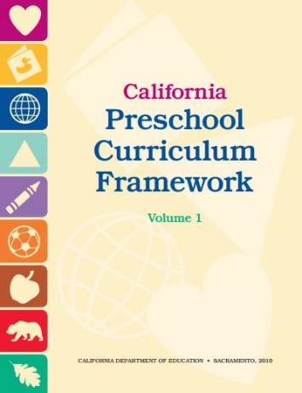
Foundations and Framework, Volume 1
Notes:
Presenter Remarks:
The purposes of the Preschool Learning Foundations are to promote a common understanding of TK children's learning and to guide instructional practice. They describe the knowledge and skills that young children typically develop when provided with developmentally, culturally, and linguistically appropriate learning experiences.
The Preschool Curriculum Framework was created as a companion to the Preschool Learning Foundations. The framework ". . . presents strategies and information to enrich learning and development opportunities for all of California’s preschool [and TK] children" (PCF, Vol. 1, p. v).
The Preschool Learning Foundations and the Preschool Curriculum Framework are designed to work together. While the foundations provide the background information to understand children's developing knowledge and skills (the "what"), the framework offers guidance on how teachers and programs can support the learning and development that are described in the foundations (the "how").
Extra Notes:
The Preschool Learning Foundations were developed with research-based evidence and are enhanced with expert practitioners' suggestions and examples. All foundations were written by a team of researchers with expertise in the given domain. A complete reference list of the source materials, along with detailed bibliographic notes for each of the developmental domains, can be found in the Preschool Learning Foundations. Sources used in the development of the foundations include:
Documents from the California Department of Education, such as the English-Language Arts Content Standards for California Public Schools, Kindergarten Through Grade Twelve (Language and Literacy, Introduction, p. 48, left column).
Well-validated assessment tools such as the Ages & Stages Questionnaires (ASQ): A Parent-Completed, Child-Monitoring System (Social-Emotional, References and Source Materials, p. 36).
General sources such as the Report of the National Reading Panel 2000 (Language and Literacy, Introduction, p. 73, left column).
Early childhood education standards from other states such as Hawaii and Texas (Social-Emotional, Introduction, p. 5, footnote).

Slide 7
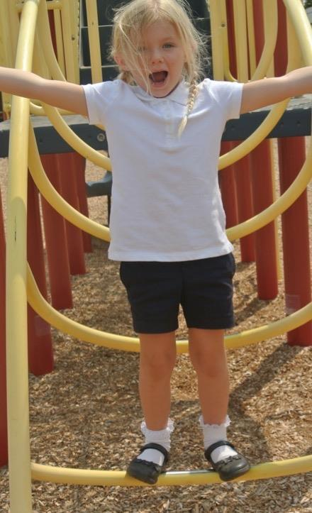
The Importance of Social Emotional Development
Silently read pages 38-39 of the Preschool Curriculum Framework, Volume 1.
Highlight one important part.
At the signal, find someone that shares your birth month.
Share the highlighted section and why you chose it.
©2017 California Department of Education
Notes:
Activity 1: This is Important Because
Presenter Remarks:
Please take out the one page copy of the Handout 1: Preschool Curriculum Framework Introduction to the Social Emotional Development Domain. Read it silently and highlight (or circle) one important piece that stands out to you.
Intent:
Work individually and in pairs to discuss the role of social-emotional development for a child.
GOAL:
Become familiar with and discuss the introductory material for the Social-Emotional Development domain of the California Preschool Curriculum Framework (PCF), Volume 1.
Materials Required:
Handout 1: Preschool Curriculum Framework, Introduction to the Social-Emotional Development Domain
Time: 20 minutes
Process:
Participants read silently and highlight (or circle) one important bit of information on Handout 1: PCF Introduction to the Social-Emotional Development Domain.
Give a signal when most participants finished. Next, each person finds a partner in the room with the same birth month as themselves.
Each person briefly shares their highlighted section and why they chose it. After participants return to their seats, invite comments before moving on.

Slide 8
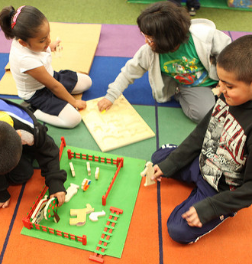
The Importance of Social Interactions
“When teachers provide high-quality emotional and instructional support to children, they develop better social skills than children in other classrooms”
(DAP, p. 194).
Notes:
Presenter Remarks:
“When teachers provide high-quality emotional and instructional support to children, they develop better social skills than children in other classrooms” (DAP, p. 194).

Slide 9
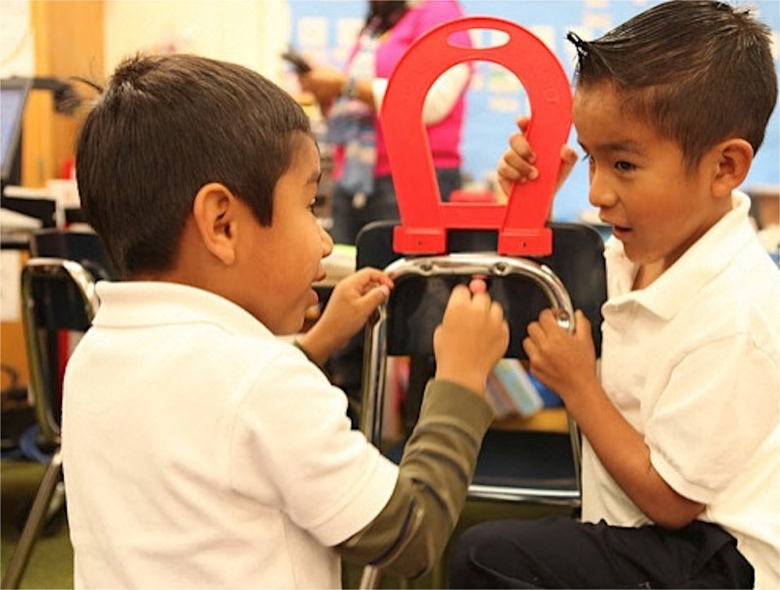
The Importance of Social Interactions
“Social skills relate not only to the obvious correlates such as peer acceptance, but also to broader well-being, such as success in school” (DAP, p.192).
©2017 California Department of Education
Notes:
Presenter Remarks:
“Social skills relate not only to the obvious correlates such as peer acceptance, but also to broader well-being, such as success in school” (DAP, p. 192).

Slide 10
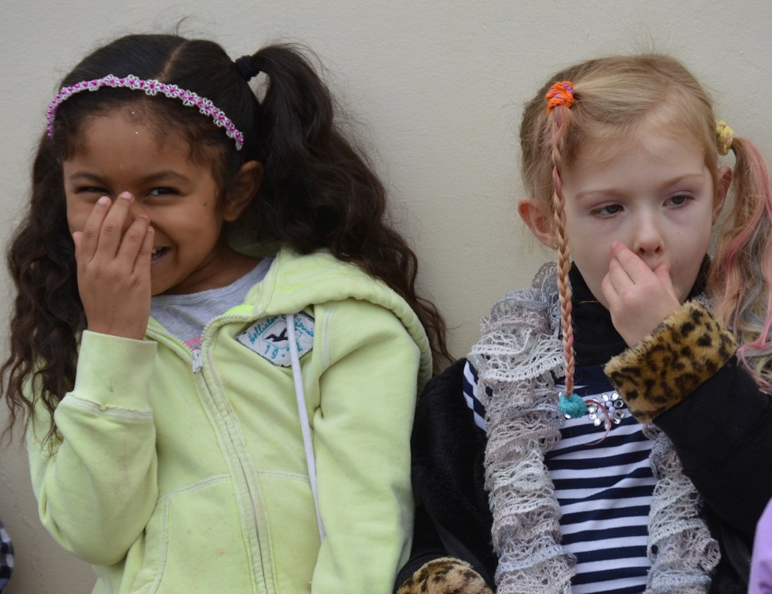
Stress
“Children under stress may exhibit behaviors that require more support from their teachers”
(PCF, Vol. 1, p. 41).
©2017 California Department of Education
Notes:
Background Information:
Link the content of the slide to behaviors sometimes seen in students who have experienced toxic stress, including children in poverty. Solicit responses from participants.
Behaviors include:
Clingy
Uncharacteristically aggressive
Unusually quiet and withdrawn
Emotionally overactive
Provocative and defiant
Loose capacity for self control
Presenter Remarks: (Read, or have volunteer read, slide content.)
Social interactions are key to children’s success in school. However, children who exhibit behaviors such as :
Clingy
Uncharacteristically aggressive
Unusually quiet and withdrawn
Emotionally overactive
Provocative and defiant
Loose capacity for self control
These children may need more support from their teachers. “This may be more difficult than one would expect because children under stress often test these relationships to see whether teachers and other adults will remain responsive to them even when the children act defiant or negatively” (PCF, Vol. 1, p. 41).
Optional Activity:
CSEFEL Hot Button Activity in optional slides.

Slide 11
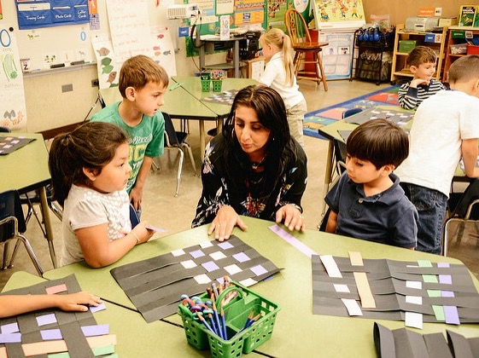
Today’s Focus: The Social Interactions Strand
Interactions with Familiar Adults
Interactions with Peers
Group Participation
Cooperation and Responsibility
Notes:
Presenter Remarks:
Social Interaction is one of three strands in the Social-Emotional Development domain: Self, Social Interactions, and Relationships. Today we will be exploring Social Interactions which includes four substrands:
Interactions with Familiar Adults
Interactions with Peers
Group Participation
Cooperation and Responsibility
The next slide will show the TK resources we will be using today as we learn about the Social Interactions strand.

Slide 12
Three Guiding Questions
What are the developmental progressions for the Social Interactions strand?
How can I incorporate these strategies into my existing TK classroom?
What are the developmentally appropriate strategies to support social interactions?
Notes:
Presenter Remarks:
Today we are going to work through three guiding questions that will lead our process of providing the best possible environment and experiences to support social interactions for TK students.
What does research say about social-emotional development, social interactions and academic success?
We will use these resources to look at the developmental progressions for social interactions: Preschool Learning Foundations, Preschool Curriculum Framework, Developmentally Appropriate Practice, Transitional Kindergarten Implementation Guide, and Ross Thompson lecture. (This would include linkages and alignment documents.)
What are developmentally appropriate strategies to support that development?
These resources all contain developmentally appropriate strategies to support development: Preschool Curriculum Framework, Developmentally Appropriate Practice, Transitional Kindergarten Implementation Guide, and the Center on the Social and Emotional Foundations for Early Learning (CSEFEL) to address this question.
How can I incorporate these strategies into my existing program?
You will have an opportunity to reflect and plan throughout today.

Slide 13
Three Guiding Questions
What are the developmental progressions for the Social Interactions strand?
How can I incorporate these strategies into my existing TK classroom?
What are the developmentally appropriate strategies to support social interactions?
Notes:
Presenter Remarks:
We’ll now turn to the first question and explore what the research says about social-emotional development, social interactions, and academic success.

Slide 14
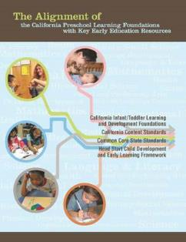


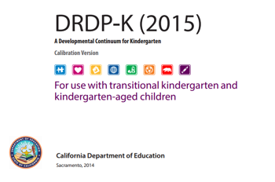

A Deeper Look at the Developmental Progressions of Social Emotional Development, Social Interactions
Notes:
Presenter Remarks:
Let’s take a deeper look at the developmental progressions of social emotional development, focusing on social interactions.
What do you know about _____? Click to reveal once resource at a time.
How do you use this resource now in your work?
As we established, transitional kindergarten (TK) is year one of a two-year program. The first year is spent focused on the learning foundations. The California state standards (Common Core) are what children in kindergarten are expected to do at the end of their kindergarten year. For children in TK, kindergarten is the second year of a two year program. The alignment document can be used to connect the two. Additionally, the DRDP-K may be used to better understand the full range of development that occurs between the 60 month foundations (beginning of TK year) and the California state standards (end of 2nd year of kindergarten).
Please note that there is a picture of the California standards for English language arts, history-social studies, science and technical subjects as well as a picture of the California health standards for k-12. Social emotional standards for kindergarten have not been developed. Some components of social emotional development may be found in other domains such as History-Social Science (Table 1.8 Overview of the Alignment Between the Social–Emotional Development Domain and the California Content Standards for Kindergarten, p.145) and Health. The Social-Emotional Development domain alignment between preschool and kindergarten becomes absorbed into health education in the Mental, Emotional, and Social Health Content Area (Table 1.1 Overview of the Alignment Between the Social–Emotional Development domain and the California Content Standards for Kindergarten, pp. 25-32)
.

Slide 15

Preschool Learning Foundations
Describe what children should be able to do at around 48 and 60 months
Assumes children have access to appropriate support and high quality programs
Notes:
Presenter Remarks:
Volume 1 of the Preschool Learning Foundations addresses four domains: Social-Emotional Development, Language and Literacy, English-language Development, and Mathematics.
Today we are looking at the chapter on English-language development. Let’s take a closer look at one foundation for an example:
Open the Preschool Learning Foundations, Volume 1, and find a page where the age levels appear. This is an example of a foundation page.
Look across the page and notice the developmental progression at around 48 months and what changes at 60 months of age. Solicit a few participants to read what they see.
Summarize the exploration with the following key note. Because children develop at different rates, the foundations were designed to support the belief that certain stages of development will occur at different times for all students. You will notice “at around” in the description. It is important to remember this variability occurs.
The foundations also assume that children have access to appropriate support in high quality programs. This includes:
Environments and experiences that encourage active, playful exploration and experimentation. Clearly defined learning centers where materials are rotated.
Purposeful teaching to help children gain knowledge and skills.
Predictable schedules and routines with large blocks of time for play and skillful integration of curriculum with an intentional focus on content.
Specific support for English learners with staff that have knowledge of the stages of English-language acquisition.
Accommodations and adaptations for children with disabilities and additional support when needed.

Slide 16
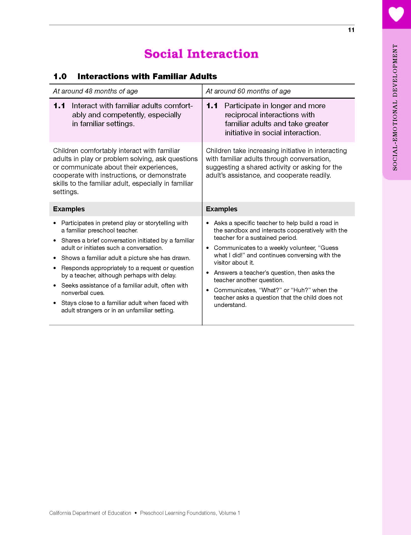
Map of the Foundations
Social-Emotional Development
Domain
Strand
Substrand
Age
Foundation
Foundation Description
Examples
Notes:
Presenter Remarks:
Let’s discuss each component of the foundations:
The name of the domain is Social-Emotional Development.
The name of the strand is Social Interaction.
The name of the substrand is Interaction with Familiar Adults.
Note that substrands always end with a zero (1.0, 2.0, etc.).
The two age levels are at around 48 months and at around 60 months.
Each foundation describes typical behaviors at around 48 months and at around 60 months (or four to five years of age).
The foundations for each age level are listed below the age levels.
There are two for each age level on this page (1.1 and 1.2 for 48 months; 1.1 and 1.2 for 60 months).
Notice that there is a developmental progression from four years old to five years old within a substrand.
The examples for each foundation are listed.
These are only a few of the ways that children may demonstrate the behavior in the foundation.
Many of the foundations also have footnotes that include information specific for students with IEPs or students with disabilities, such as information about adaptations or accommodations.

Slide 17
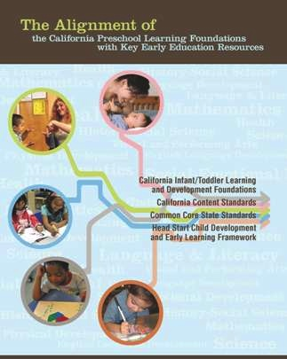
The Alignment Document
Notes:
Presenter Remarks:
The Alignment of the California Preschool Learning Foundations with Key Early Education Resources provides an in-depth analysis of how the nine domains of the preschool foundations closely align with the California Infant/Toddler Learning and Development Foundations, the California Content Standards, the Common Core State Standards, and the Head Start Child Development and Early Learning Framework.
Please take out Handout 2: The Alignment Document and Social Interactions Foundations. Take a moment to independently explore the handout. When each table member is finished, share your thoughts with each other.
Extra Note:
Trainer should walk around and listen to conversation. Share any “aha” examples or questions to the larger group.

Slide 18
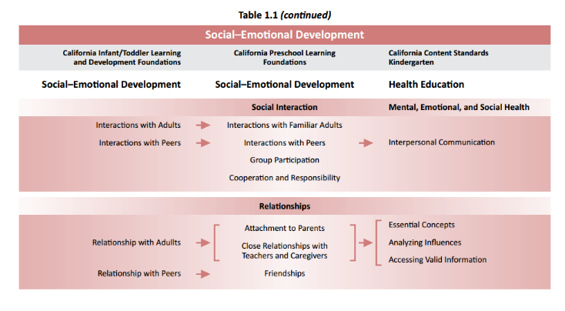

Table 1.1 Overview of the Alignment Between the Social–Emotional Development Domain and the California Content Standards for Kindergarten
Notes:
Background Information:
Read the standards listed in the chart ahead of training.
Presenter Remarks:
By supporting social-emotional development, we are supporting the developmental continuum that begins in infancy and continues in TK into elementary school.
What stands out to you about the social-emotional domain alignment between preschool and kindergarten? (It becomes absorbed into health education in the mental, emotional, and social health content area.)

Slide 19
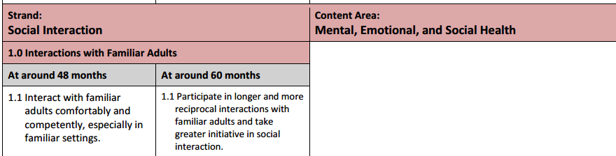
Table 1.2 Detailed View of the Alignment Between the Social Interaction Strand and the California Content Standards for Kindergarten
Notes:
Background Information:
Read the standards listed in the chart ahead of training.
Presenter Remarks: Solicit observations in your own words.
It is important to notice that while some of the social-emotional standards for preschoolers are aligned with the California Health Content Standards for Mental, Emotional, and Social Health, the Social Interaction strand addressing interactions is not specifically addressed in the California Health Content Standards.

Slide 20
Focused Video Viewing
Notes:
Background Information:
Download this video from the CPIN Web site and embed it in the PowerPoint prior to the training, or use the foundations DVD.
Presenter Remarks: (Before Video)
Now we are going to watch the 60 month example of the California Preschool Learning Foundations Interactions with Familiar Adults Foundation 1.1. from 2:40-7:10
As we watch, take note of the focus children’s behaviors. After the video, we will compare notes.
Play the video.

Slide 21
Video Conversation Debrief
Stand up and find a new partner.
Compare notes:
  Did your partner notice something you did not?
  Did either of you have a different view of a particular behavior?
  How does the video remind you of your classroom?
Notes:
Presenter Remarks:
Stand up and find someone you have not talked with yet today. Compare notes. Did your partner notice something you did not? Did either of you have a different view of a particular behavior? How does the video remind you of your classroom?

Slide 22
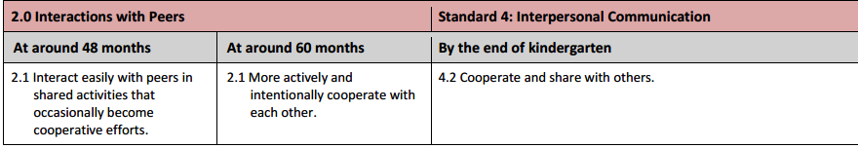

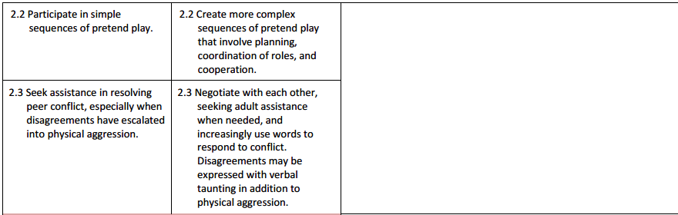
Table 1.2 Detailed View of the Alignment Between the Social Interaction Strand and the California Content Standards for Kindergarten
Notes:
Background Information:
Read the standards mentioned in the chart ahead of training.
Presenter Remarks:
Now we are moving from the continuum of interactions with familiar adults to the continuum of interactions with peers.
Solicit observations in your own words.
Extra Notes:
The Interaction with Peers substrand aligns with standard 4: Interpersonal Communication from the Mental, Emotional, and Social Health Kindergarten Content Area.

Slide 23
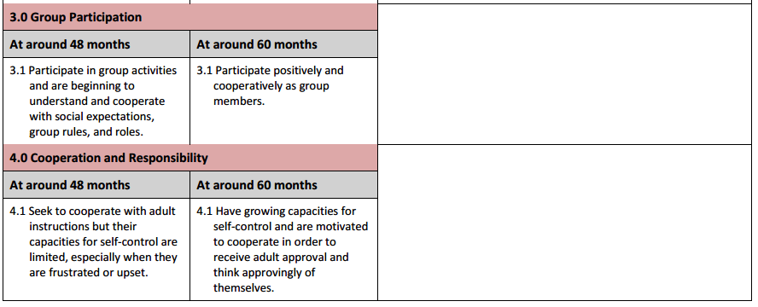
Table 1.2 Detailed View of the Alignment Between the Social–Emotional Domain and the California Content Standards for Kindergarten
Notes:
Background Information:
Read the standards listed in the chart ahead of training.
Presenter Remarks: Solicit observations in your own words.
It is important to notice that neither Group Participation, nor Cooperation and Responsibility, are specifically addressed in the California Content Standards for Kindergarten.
“The only major example of content appearing in one domain in the preschool learning foundations and in another in the kindergarten foundations is in the area of social– emotional development—specifically, some of the content in the Social–Emotional Development domain of the preschool foundations aligns with the Mental, Emotional, and Social Health strand of the kindergarten Health Education Content Standards. Even so, the preschool Social–Emotional Development foundations are comprehensive, while the Mental, Emotional, and Social Health content standard gives narrow coverage of social–emotional development” (Alignment Document, 14-15).

Slide 24
Focused Video Viewing
Notes:
Background Information:
Download this video from the CPIN website and embed it in the PowerPoint prior to the training, or use the foundations DVD.
Presenter Remarks: (Before Video):
Now we are going to watch the 60 month example of Preschool Learning Foundations Group Participation.
As we watch, take note of the focus children’s behaviors. After the video, we will compare notes.

Slide 25
Video Reflection
Find a new partner.
Compare notes:
  Did your partner notice something you did not?
  Did either of you have a different view of a particular behavior?
  How does the video remind you of your classroom?
Notes:
Presenter Remarks:
Stand up and find someone you have not talked with yet today. Compare notes. Did your partner notice something you did not? Did either of you have a different view of a particular behavior? How does the video remind you of your classroom?

Slide 26
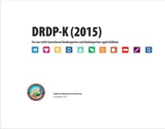
Key Features of the DRDP-K (2015)
An observation-based assessment tool,
not a test
Individual child assessment
Completed by each child’s teacher
Based on developmental research and theory
Includes developmental sequences of behaviors along a continuum
Spans the developmental continuum of children in a two-year kindergarten program
Notes:
Presenter Remarks:
Another resource that is used to support children’s development is the Desired Results Developmental Profile-Kindergarten (2015)© (DRDP-K).
The DRDP-K (2015) informs teacher’s understanding of the developmental continuum. It can be used with the Alignment document we saw on slide 12 to expand upon the developmental continuum.
One key feature of the DRDP-K (2015) to consider is that it is an observation-based assessment and not a test. It is used to support children’s learning. Observing and documenting children's progress provides teachers the information needed to differentiate instruction and experiences. It also provides information to individualize.
Observational tools are preferred over criterion-referenced tools because the information gathered by observation more accurately reflects what children are able to do.
Documentation provides concrete evidence of what children are able to do. With this documentation, we are then able to better plan activities that will meet and appropriately challenge children's developmental needs.
Other features of the DRDP-K (2015) include:
It is an individual child assessment that can be shared with families.
It is aligned with the Preschool Learning Foundations.
It opens up the opportunity for articulation between preschool and TK teachers.
Sharing information as to where children are on the developmental continuum can better prepare the TK teacher to work with students.
A teacher can include a request form for previous records as part of the TK registration to help support the relationship between preschool, family, and TK.
The DRDP-K has been developed with world renowned experts. It is based on research and knowledge of what is most important for predicting school success.

Slide 27
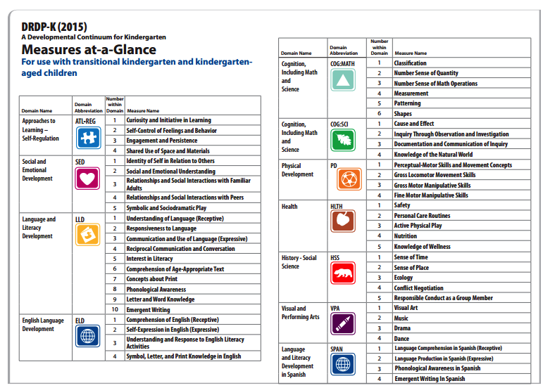
Notes:
Presenter Remarks:
Lets take a look at the social interactions that are assessed with the DRDP-K (2015). What do you notice about social interaction measures on the DRDP-K?
Even though Social-Emotional Development is not a distinct domain in the California Content Standards for Kindergarten, it is still a distinct domain in the DRDP-K (2015) and includes measures for social interactions. There are also measures in the History-Social Science domain that address some aspects of social interactions.
Later today, we will look at how to use the DRDP-K (2015) data to inform our teaching and planning for the full range of social-emotional development in the transitional kindergarten classroom.

Slide 28
Three Guiding Questions
What are the developmental progressions for the Social Interactions strand?
How can I incorporate these strategies into my existing TK classroom?
What are the developmentally appropriate strategies to support social interactions?
Notes:
Presenter Remarks:
Now let’s turn to the second question.
What are the developmentally appropriate strategies to support social interactions?
We will use the California Preschool Curriculum Frameworks, Volumes 1, 2, and 3, Developmentally Appropriate Practice (DAP), Transitional Kindergarten Implementation Guide, and Center on the Social and Emotional Foundations for Early Learning (CSEFEL) to answer this question.

Slide 29




Resources to Support Developmentally Appropriate Strategies
Notes:
Presenter Remarks:
These four resources support the development of social interactions in the TK classroom: Developmentally Appropriate Practice (DAP), the Transitional Kindergarten (TK) Implementation Guide, the Preschool Curriculum Framework, Volume 1, and resources from the Center on the Social and Emotional Foundations for Early Learning (CSEFEL).
We will look at all four substrands of social interactions:
Interactions with Familiar Adults
Interactions with Peers
Group Participation
Cooperation and Responsibility

Slide 30
Teaching Social Skills
The most effective way to teach children social skills is to provide:
  a safe and secure environment
  predictable routines
  gentle coaching, and
  an abundance of time to practice by interacting with others: teachers, partners, and the classroom community as a whole.
  (Jenna Bilmes, Beyond Behavior Management: The Six Life Skills Children Need to Thrive)
Notes:
Background Information:
This concept comes from Jenna Bilmes, Beyond Behavior Management: The Six Life Skills Children Need to Thrive.
Presenter Remarks:
Children learn how to interact with others from the worlds in which they live. Teachers can help children develop social interaction skills by reflecting upon and being intentional about the daily environment and interactions that children experience during the program day.

Slide 31
Center on the Social and Emotional Foundations for Early Learning (CSEFEL)
Notes:
Presenter Remarks:
The Center on the Social and Emotional Foundations for Early Learning (CSEFEL) is focused on promoting the social–emotional development and school readiness of young children birth to age five. The CSEFEL is a national resource center funded by the Office of Head Start and Child Care Bureau for disseminating research and evidence-based practices to early childhood programs across the country.
Extra Notes:
http://csefel.vanderbilt.edu/

Slide 32
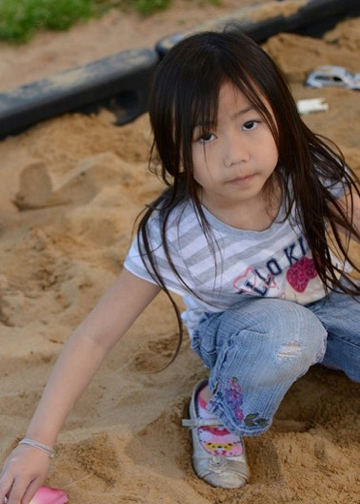
Interactions with Familiar Adults
“Every day in a hundred small ways, children ask, “Do you see me? Do you hear me? Do I matter?” Their behavior often reflects our response.”
L. R. Knost
Notes:
Presenter Remarks:
Please take a moment and read this quote to yourself. Then turn to an elbow partner and discuss your reactions. Does anyone want to share their discussions?
The next section will focus on interactions with familiar adults.

Slide 33

A Talk by Dr. Ross Thompson
Notes:
Activity 2: Idea Map
Presenter Notes:
We will now watch a video with Dr. Ross Thompson addressing teacher-child interactions in TK and participate in an activity with your table group.
intent:
Learn the significance of both teacher/child relationships and interaction strategies to support TK student success.
GOAL:
Table groups will create an Idea Map based on talk by Dr. Ross Thompson.
Materials Required:
Ross Thompson–Social and Emotional Foundations of TK Part 4 (video provided)
White chart paper
Multi-colored drawing and writing instruments
Tape or other wall fastener
Time: 25 minutes
Process:
Participants view a video with Dr. Ross Thompson addressing teacher/child interactions in TK.
Each table creates an idea map summarizing key points of the talk. Encourage the use of both graphics and words in any desired format.
The lecture (7 minutes) covers two topics: 1) why teacher-child relationships are important, and 2) teacher-child interactions.
The video will pause at the end of the first section. They have 5 minutes to begin the group Idea Map. At the end of the video, 5 additional minutes are available to complete the map. (Keep the work times very brief. Extend the second work time to no more than 7 minutes.)
At the end of the work time, participants hang their maps on the walls.
Invite participants to do a “wall walk” to see how other table groups addressed the content of the lecture.

Slide 34

Take 5
Take five minutes to collaboratively draw an idea map of the “big ideas” covered so far in this video.
Notes:
Background Information:
The goal of this activity is to focus participants on the content of the video and have them synthesize the information with others. Let participants know that it is not expected that they remember all the details, but rather that they understand the big ideas.
Presenter Remarks:
Take five minutes to collaboratively draw an idea map of the “big ideas” covered so far in this video.
Extra Notes:
After the 5 minutes, go back to finish viewing the video.

Slide 35
Continuation of Video
Notes:
Background Information:
Presenters must watch the video ahead of time and read through the activity plan for a better understanding.
Presenter Remarks:
We will now watch the remainder of the video. After the video has completed, you will have five more minutes to finish your idea map.

Slide 36
Take 5
Finish up your idea map of the big ideas and post it on the wall.
Notes:
Background Information:
Presenters must watch the video ahead of time and read through the activity plan for a better understanding.
Presenter Remarks:
You now have five more minutes to finish up your idea map of the big ideas and then post it on the wall.

Slide 37
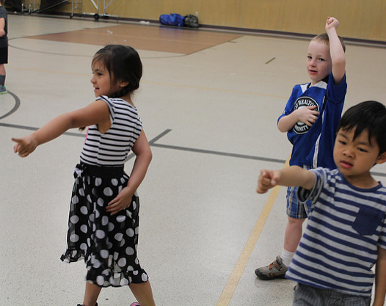
Take a Wall Walk
Walk around the room and look at how the other groups organized their maps.
Notes:
Presenter Remarks:
Walk around the room and look at the content of the other idea maps. What stands out for you?

Slide 38
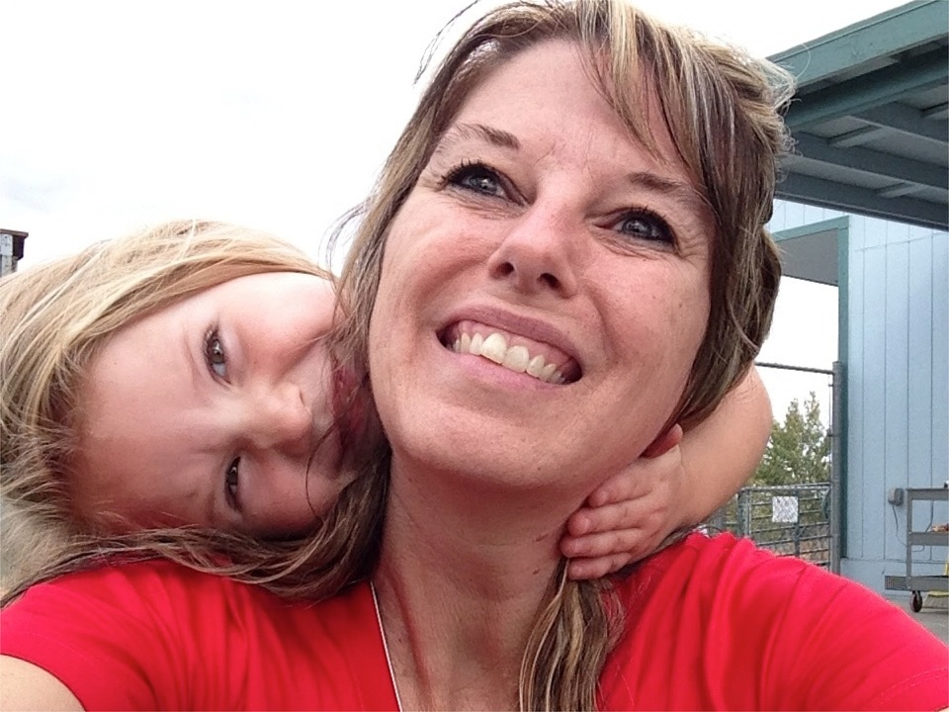
Get to Know Each Child
©2017 California Department of Education
Notes:
Presenter Remarks:
I see many of you noted the importance of adult-child relationships and getting to know children. This is also highlighted in the Preschool Curriculum Framework (PCF) and Developmentally Appropriate Practice (DAP).
Be at the child’s level as much as possible.
Get to know each child be observing the child’s interests, personality characteristics, and preferred interaction style.
Interact warmly with the child’s family members at arrival and departure times.
Match interaction approaches to the child’s social cues (e.g. eager to engage, slower to warm up)
(PC, Vol. 1, p. 63)
“Kindergarteners, even more than children of other ages, especially seek and tune into teachers’ approval” (DAP, p. 193).
“Relationships are the context that supports children's internalization of the rules and values in their world” (DAP, p. 197).

Slide 39
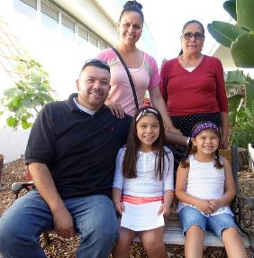
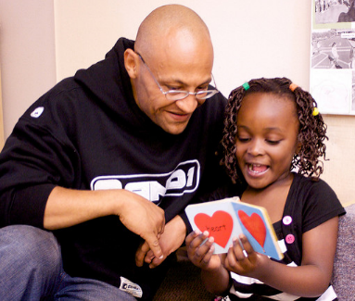
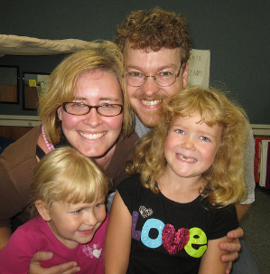
Different Cultures
“Show respect for cultural differences”
(PCF Vol. 1, p. 64)
Notes:
Presenter Remarks:
I see many of you noted the importance of building relationships with families. It is also highlighted as important in the Preschool Curriculum Framework (PCF).
Become knowledgeable about the families in your program and find out about their expectations and goals. If a child’s culture emphasizes maintaining a respectful distance between teachers and children, teachers can modify their behavior to remain approachable and friendly, but not inappropriately casual or familiar. Alternatively, if the child’s family is exceptionally affectionate and physical with one another, the teacher can be warm yet maintain a comfortable boundary with the child while acknowledging the difference (e.g., “I know you and your Uma grandma like to give each other a lot of kisses. I like to get just one kiss from you.”) (PCF, Vol. 1, p. 64).
Make it a priority to learn individual family values. Build strong relationships with families and ask authentic questions to gain insight into family norms and values. Listen attentively to each family’s goals for their child’s care and education. Show respect for each family’s preferences for communicating. Offer guidance that is sensitive to diversity, especially when negotiating conflicts (PCF, Vol. 3, p 58, and p. 79).

Slide 40
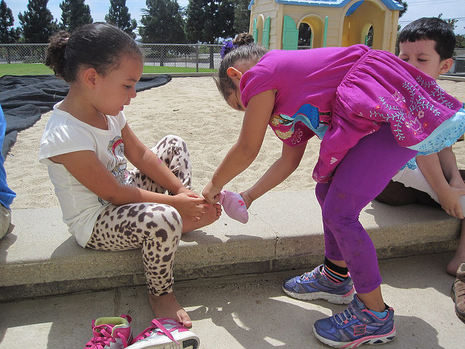
Interactions with Peers
©2017 California Department of Education
Notes:
Presenter Remarks:
We have already covered a lot of ground, but we are about to dive into the section that we all probably spend the most time in managing-Interactions with Peers. We will take a closer look at some strategies that can help us provide the most developmentally appropriate support possible in each of our unique settings.

Slide 41
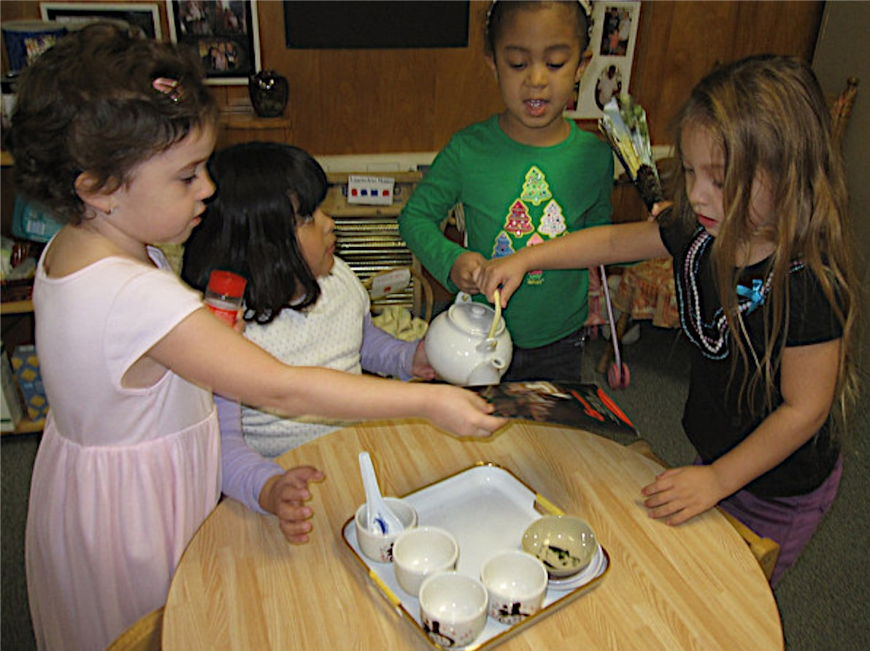
Guiding Principle: Encourage Play-Based Active Learning
©2017 California Department of Education
Notes:
Presenter Remarks:
Turn to the Guiding Principles section of the social-emotional development domain in the Preschool Curriculum Framework, Volume 1, and read the bolded principles. At this time, it is not necessary to read the explanatory text.
The guiding principles set the tone for the domain. Reviewing the guiding principles can be one way teachers may reflect upon their practices as they answer the question, “Am I providing appropriate social interactions and environment experiences for this domain?”
“One key guiding principle for social-emotional development is: Encourage play-based active learning. Play is an essential cornerstone of healthy social and emotional development in early childhood and contributes to the skills necessary for adjustment to and success in school” (PLF, Vol. 1, p. 4).
As we work through this module and think about ways to support children’s relationships, we want to constantly reflect on our work by asking ourselves, “Are we exemplifying this guiding principle?”
Please look at the picture, identify and share-out how the activity might support children’s relationships.

Slide 42
The Role of Play
“Play is an essential cornerstone of healthy social and emotional development in early childhood and contributes to the skills necessary for adjustment to and success in school” (PLF, Vol. 1, p. 4).
“Play includes social play with others, play with materials, and games with rules” (PLF, Vol. 1, p. 4).
“Active learning through purposeful play is important to the development of the child’s brain (TK Guide, p. 41).
Notes:
Presenter Remarks:
The role of play is widely accepted as an essential component of healthy social and emotional development. Each of the key resources discuss the importance of play. On this slide are a few quotes from the Preschool Learning Foundations and the Transitional Kindergarten Implementation Guide. To learn more about the importance of play you can further explore these key resources.

Slide 43
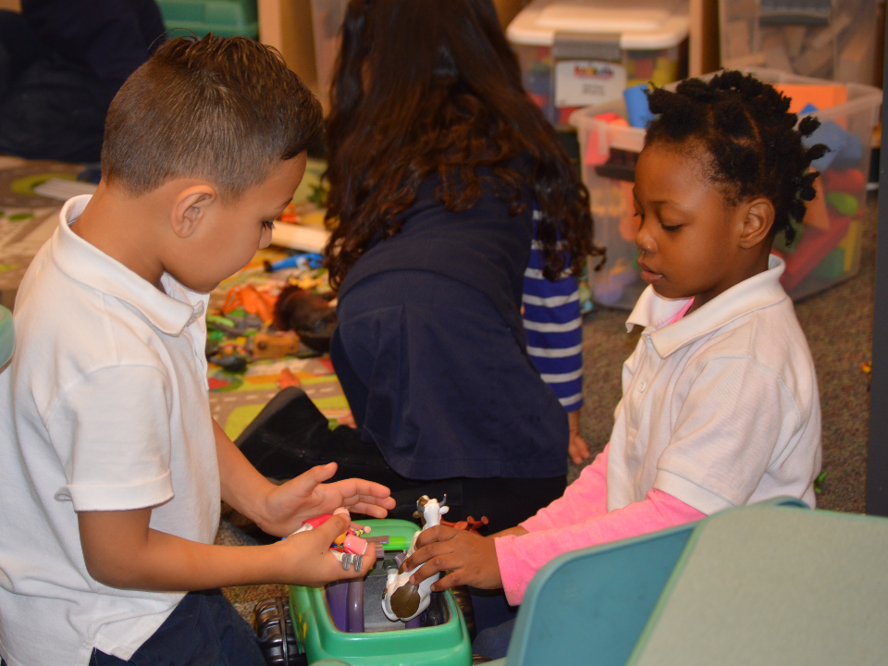
Uninterrupted Play
“A minimum of 45 minutes of uninterrupted choice time is considered best practice”
(TK Guide, 2013, 43).
©2017 California Department of Education
Notes:
Presenter Remarks:
Recommendations from the Preschool Learning Foundations and Transitional Kindergarten Implementation Guide for uninterrupted play are consistent across the early learning continuum.
Children need ample time allocated to become deeply engaged at investigating problems or creating products.

Slide 44
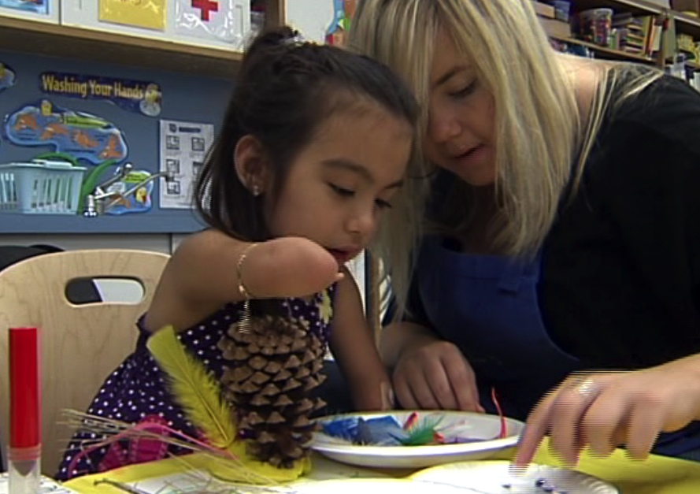
Children with Special Needs
“The vast majority of children with special needs do not develop friendship skills without thoughtful instruction”
(CSEFEL, Handout 2.3).
©2017 California Department of Education
Notes:
Presenter Remarks:
The vast majority of children with special needs do not develop friendship skills without thoughtful instruction (Center on the Social and Emotional Foundations for Early Learning (CSEFEL), Module 2, Handout 2.3).
Often children with special needs have fewer opportunities for spending time with peers and practicing peer interaction skills. They also may have spent more time one on one with adults or they may have medical needs precluding them from interacting with other children. As with every child’s teachers, use careful observation to determine the child’s individual needs and provide opportunities and support.
We have provided Handout 3: CSEFEL Friendship Strategies as a resource in your folder.

Slide 45
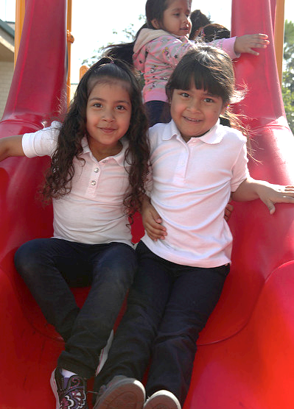
Children Who Are English Learners
“English learners may need extra assistance as they seek to participate in peer play”
(TK Guide, p. 57).
“Partner English learners with English speaking peers to help scaffold social interactions and English language development”
(PCF, Vol. 1, p. 67).
©2017 California Department of Education
Notes:
Presenter Remarks:
Pairing English learners with a socially skilled peer provides them with a model for action (e.g., I see, I do).
“Visual aids may be used to assist students as they work to meet classroom rules and resolve social conflicts” (TK Guide, p. 57).

Slide 46
Developmentally Appropriate Practice
Notes:
Presenter Remarks:
Developmentally Appropriate Practice: What do you know about this document? How do you use it in your work now?
Our next resource is from the National Association for the Education of Young Children (NAEYC). NAEYC is a national organization that provides guidelines for developmentally appropriate practice often referred to as DAP in early learning programs serving children birth through age 8
The document has guidelines for preschool children 3-5 years of age, TK and kindergarten 5 to 6 years of age that are grounded in three years of research.
DAP is a consensus document which contains a position statement and outlines the decisions good teachers have to make to become an excellent teacher.
There are charts with examples of teaching practice that support curriculum planning aligned with both the foundations and standards. The examples and intended to provide teachers with guidance to ensure students achieve important goals across the early learning continuum.
We will be using this resource and the resources on the following two slides in the next activity.

Slide 47
Transitional Kindergarten Implementation Guide
The TK Implementation Guide is a resource for California public school district administrators and teachers to support implementation of comprehensive TK programs.
Notes:
Presenter Remarks:
The TK Implementation Guide is a resource that focuses on the essential components for school district administrators and teachers to consider for TK programs. The TK Implementation Guide, published by the California Department of Education, is a resource to support implementation of comprehensive TK programs.
This publication provides resources and guidance in the areas of program design, curriculum, instruction, assessment, and family/community partnerships.

Slide 48

Preschool Curriculum Framework Strategies
Developmentally appropriate
Reflective and intentional
Individually and culturally meaningful
Inclusive of children with disabilities or other special needs
Notes:
Presenter Remarks:
The Preschool Curriculum Framework offers guidance on how teachers can support the learning and development described in the foundations, through environments, materials, and experiences that are developmentally appropriate, individually and culturally meaningful, and engaging to families.
“Teachers address ideas and concepts that children can grasp at their developmental level and then progressively build on what children already know and understand. This approach applies to all children, including children with various abilities, disabilities, or other special needs (such as delays in language, cognition, or physical ability)” (PCF, Vol. 2, p. 227).

Slide 49
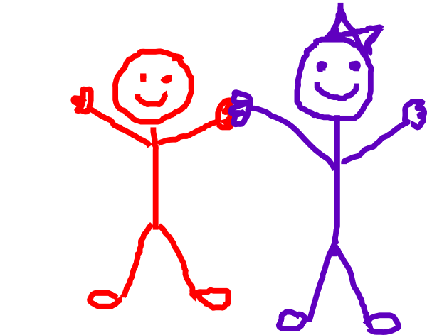
What Are We Learning? Part 1
Notes:
Activity 3: I Am Learning
Presenter Remarks:
This activity connects the developmental progressions (foundations and standards) to the strategies (framework and TK guide). Work as a table group to create one or two children on chart paper using any of the art materials provided. Read the foundations for Interactions with Peers in the Preschool Learning Foundations, Volume 1, pp. 12-14 and the Mental Health Standard 4.2. Choose a dark color and write down the skills that children are learning in social interactions in transitional kindergarten.
intent:
Use the California Preschool Learning Foundations, Volume 1 to learn the development of Interactions with Peers from 48 to 60 months.
GOAL:
Participants explore the foundations and create a poster of the developmental highlights of Interactions with Peers from 48 to 60 months in the area of Interactions with Peers.
Materials Required:
California Preschool Learning Foundations (PLF), Volume 1, pp. 12-13
Chart paper
A variety of colored writing and drawing materials
A variety of craft items such as glue, yarn, tissue paper, glitter, and fabric scraps to illustrate the child
Time: 15 minutes
Process:
Participants explore how children’s peer interactions develop from 48 to 60 months and represent that development on a poster.
Each table group creates one or two children on the chart paper.
Participants read the foundations for Interactions with Peers in the PLF, Volume 1, pp.12-14 and add notes about children’s development in this area to their poster.
Participants hang their work on the wall when finished.
invite participants to take a wall walk to see how different groups represent this growth.

Slide 50
What Are We Learning? Part 2
Notes:
Activity 3: I Am Learning (continued)
Presenter Remarks :
Now looking at your poster brainstorm with your group mates all the ways you support this growth in your classroom. For example what interactions do you make sure and have with students? What areas of the environment do you make sure and have for students?
Choose another dark color and write these ideas on the poster. When you have finished writing down your group ideas find the table material Teach Children Social Skills labels. These are a sampling of strategies from the Preschool Curriculum Framework, Transitional Kindergarten Implementation Guide and Developmentally Appropriate Practice. Glance at the labels and stick any on that you don’t think you already captured.
Now take a moment to wonder around and look at the many different children and variety of strategies we can use to support their social interaction development.
intent:
Use the California Preschool Learning Foundations, Volume 1 to learn the development of Interactions with Peers from 48 to 60 months.
GOAL:
Participants explore the foundations and create a poster of the developmental highlights of Interactions with Peers from 48 to 60 months in the area of Interactions with Peers.
Materials Required:
California Preschool Learning Foundations (PLF), Volume 1, pp. 12-13
Chart paper
A variety of colored writing and drawing materials
A variety of craft items such as glue, yarn, tissue paper, glitter, and fabric scraps to illustrate the child
Time: 15 minutes
Process:
Participants explore how children’s peer interactions develop from 48 to 60 months and represent that development on a poster.
Each table group creates one or two children on the chart paper.
Participants read the foundations for Interactions with Peers in the PLF, Volume 1, pp.12-14 and add notes about children’s development in this area to their poster.
Participants hang their work on the wall when finished.
invite participants to take a wall walk to see how different groups represent this growth.

Slide 51
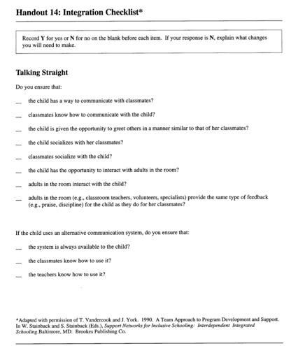
Integration Checklist
“Researchers have found that young children with and without disabilities benefit more from the curriculum when they are engaged or involved”
(Promoting Positive Outcomes for Children with Disabilities: Recommendations for Curriculum, Assessment, and Program, p. 6).
Notes:
Background Information:
Presenter should read the document Promoting Positive Outcomes for Children with Disabilities: Recommendations for Curriculum, Assessment, and Program Evaluation from the Division of Early Childhood of the Council for Exceptional Children prior to the training. The Division of Early Childhood of the Council of Exceptional Children provides guidance on support for children receiving special education services.
http://dec.membershipsoftware.org/files/Position%20Statement%20and%20Papers/Prmtg_Pos_Outcomes_Companion_Paper.pdf
Presenter Remarks:
The strategies we just read provide opportunities for children to interact with one another and become more engaged or involved in the classroom community.
This is important because “researchers have found that young children with and without disabilities benefit more from the curriculum when they are engaged or involved” (Promoting Positive Outcomes for Children with Disabilities: Recommendations for Curriculum, Assessment, and Program, p. 6).
Take a moment to find the integration checklist at the center of your table now. With your group review the items on the checklist. Discuss how you might rate that for your classroom now, and what ideas you have gathered form today that you might use to change this in your classroom.
This checklist was created specifically by the Office of Disabilities at Head Start to support inclusion of children with disabilities but as you will see it is good practice for us to consider this for all of our students so that we can optimize participation, communication and engagement.

Slide 52
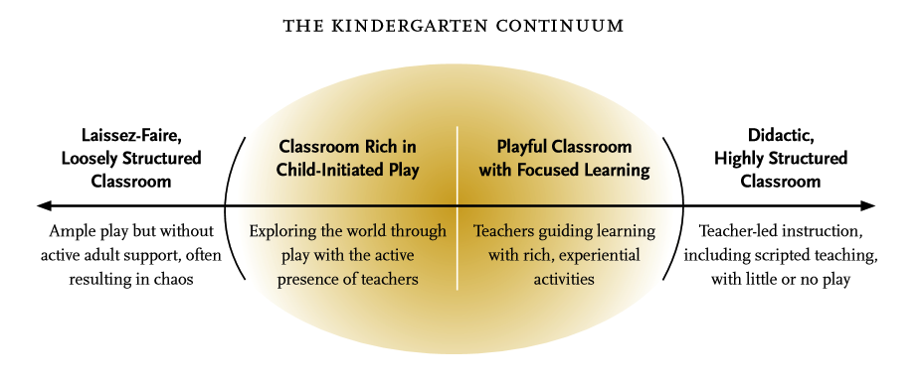
Teaching in the Sweet Spot
(Edward Miller and Joan Almon, Crisis in the Kindergarten Why Children Need to Play in School, p.12)
Notes:
Presenter Remarks:
Take out Handout 4: Teaching in the Sweet Spot from the folder.
“Integrated lessons in the TK classroom are most effectively conducted through a balanced approach that includes a wide variety of student-initiated, teacher-directed, and teacher-guided learning activities” (TK Guide, p. 41).
“A minimum of 45 minutes of uninterrupted choice time is considered best practice” (TK Guide, p. 43).
Read the following quote from DAP that connects this graphic to social interactions. “A variety of opportunities for peer interaction are offered throughout the day and throughout the week. Children work with partners as well as in small- and whole-group situations. Teachers encourage peer-to-peer scaffolding and assistance when possible” (DAP, p. 219).
Extra Notes:
Graphic is from Miller, E., & Almon, J. Summary and recommendations of Crisis in the Kindergarten: Why Children Need to Play in School. A report from the Alliance for Childhood. Retrieved from http://www.allianceforchildhood.org/sites/allianceforchildhood.org/files/file/Kindergarten_8-page_summary.pdf

Slide 53
In Summary, Children Need:
Ample time and opportunities for peer interactions
Space, materials, and encouragement for dramatic play
Opportunities for cooperative work
Problem solving opportunities with peers
(DAP, p. 199)
Notes:
Presenter Remarks:
Teach children social skills.
“Teachers support interactions with peers by helping children to learn social skills needed to get along” (PCF, Vol. 3, p. 60).
Teachers guide children to understand other people’s feelings and needs and encourage them to feel empathy and caring (PCF 2010, 65); (PLF 2008, 4); (DAP, p. 199).
Provide positive ways of solving problems, settling disputes and keeping interaction fair and inclusive without interfering unnecessarily (PCF 2010, 65); (PLF 2008, 28); (DAP, p. 199).

Slide 54
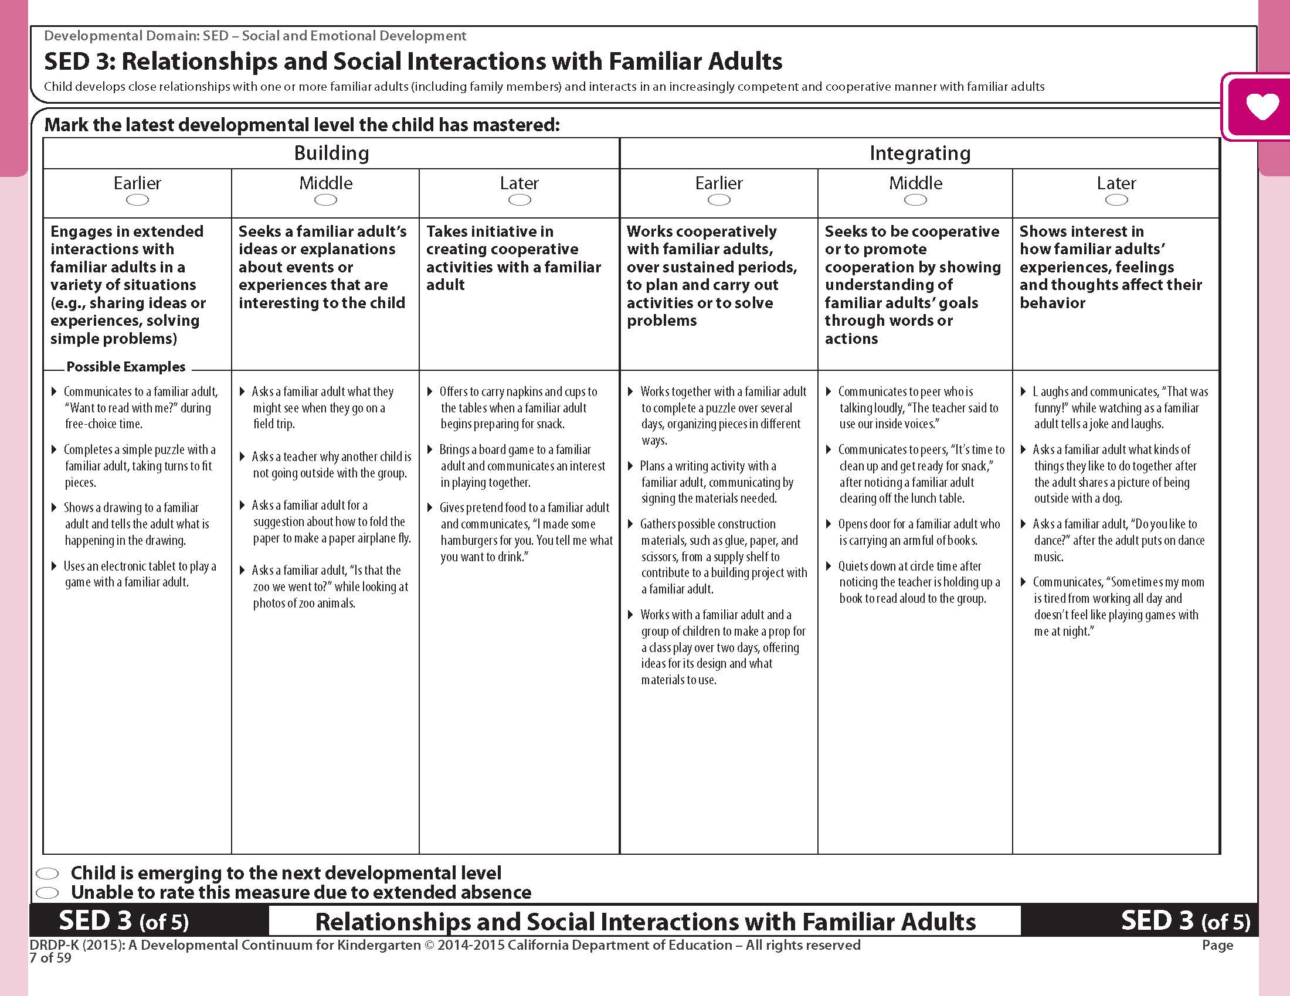
DRDP-K Measure: Interactions with Familiar Adults
Notes:
Background Information:
The DRDP-K (2015) should be on each table as a table material for reference. If that is not possible print the social emotional domain measure ahead of the training.
Presenter Remarks:
Find the Social-Emotional Development measures 3 and 4 in the DRDP-K (2015) on the table. Notice the title of the measure aligns with the substrand - Interactions with Familiar Adults.
As you read these levels, notice the developmental shift that occurs between levels. One developmental shift occurs between the Building Earlier and the Building Middle level. You see the shift from a child engaging in extended interactions with familiar adults in a variety of situations to seeking a familiar adult’s ideas or explanations about events or experiences that are interesting to the child.
Please read the measure and note the developmental shifts between levels.

Slide 55
Reflection
Think about a child in your class and where he/she might be along the DRDP-K developmental continuum:
  Read the strategies on the “What we are learning” posters.
  Circle the strategies that you think would be most helpful for you to implement.
  With your group, discuss why these particular strategies would be most helpful.
Notes:
Presenter Remarks:
Think about a child in your class and where he/she might be along the DRDP-K developmental continuum:
Read the strategies on the “What we are learning” posters.
Circle the strategies that you think would be most helpful to scaffold the child to the next level.
With your group, discuss why these particular strategies would be most helpful.

Slide 56
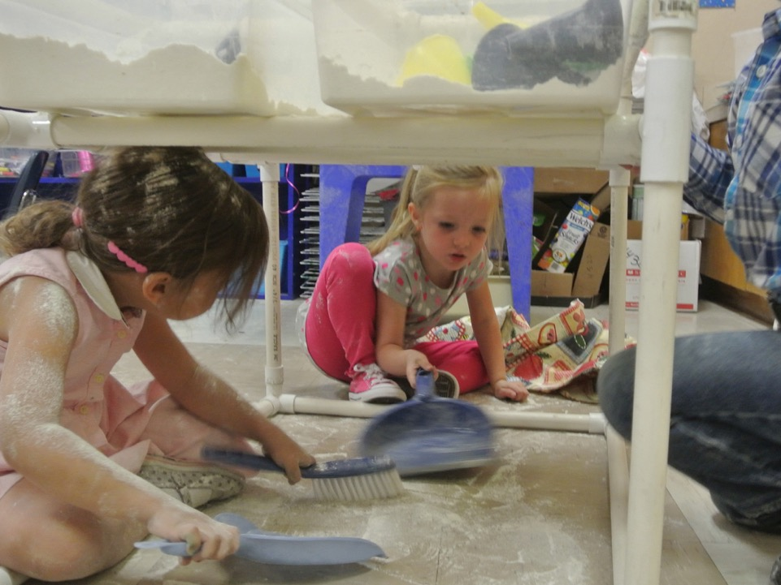
Group Participation and Cooperation and Responsibility
©2017 California Department of Education
Notes:
Presenter Remarks:
This marks the transition to the final two strands. We will address the last two together, Group Participation and Cooperation and Responsibility.

Slide 57
Group Participation
“The ability to participate cooperatively and constructively in group activity is an essential skill in any group learning activity; thus it is a critical component of school readiness”
(PLF, Vol. 1, p. 28).
“Preschool children enjoy being part of the classroom and are learning the roles and responsibilities of group participation”
(PCF, Vol. 1, p. 69).
Notes:
Presenter Remarks:
The two quotes on the slide demonstrate both the importance of developing and supporting development of group participation. Let’s take a moment and read them now.
“The ability to participate cooperatively and constructively in group activity is an essential skill in any group learning activity; thus it is a critical component of school readiness” (PLF, Vol. 1, p. 28).
“Preschool children enjoy being part of the classroom and are learning the roles and responsibilities of group participation” (PCF, Vol. 1, p. 69).
Turn and tell an elbow partner what stands out at you.

Slide 58
Group Participation
Cooperation
Self Regulation
Self Control
Event Knowledge
Social and Emotional Understanding
Self Awareness
Notes:
Presenter Remarks:
“Group participation integrates many of the other social-emotional foundations. These different developmental achievements assemble in a manner that enables older preschool children, because of this developing constellation of skills, to be more constructive group participants than younger children” (PLF, Vol. 1, pp. 28-29).

Slide 59
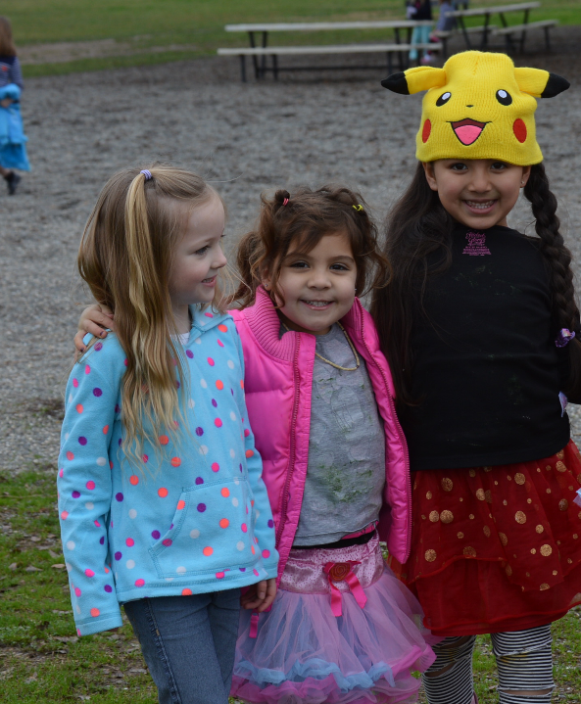
Community
59
Without a sense of caring, there can be no sense of community.
--Anthony J. D’Angelo
Notes:
Presenter Remarks:
Without a sense of caring, there can be no sense of community.
--Anthony J. D’Angelo
Share with an elbow partner two small changes or additions you are going to make.
How will you do it?
Which foundations will these changes will be supporting?

Slide 60
Cooperation and Responsibility
“Individual differences in children’s cooperation capacities are directly associated with children’s academic achievement in the early primary grades” (PLF, Vol. 1, p. 30).
“Cooperation and responsibility build on children’s developing capacities for self-regulation and changes in self-awareness”
(PLF, Vol. 1, p. 30).
Notes:
Presenter Remarks:
The two bullets on the slide explain some key components to understanding the development and necessary support of cooperation and responsibility.
Let’s read them now:
Individual differences in children’s cooperation capacities are directly associated with children’s academic achievement in the early primary grades.
Cooperation and responsibility build on children’s developing capacities for self-regulation and changes in self-awareness.(PLF, Vol. 1, p. 30)
Please turn and tell your knee partner what about these ideas is interesting to you.

Slide 61
Cooperation and Responsibility
Young children are motivated to cooperate and act responsibly
  by their emotional attachments to significant adults
  by the feelings of others to act in ways that do not cause others distress, and
  to think more approvingly of themselves.
(PLF, Vol. 1, pp. 30-31).
Notes:
Presenter Remarks:
Young children are motivated to cooperate and act responsibly
by their emotional attachments to significant adults
by the feelings of others to act in ways that do not cause others distress, and
to think more approvingly of themselves
(PLF, Vol. 1, pp. 30-31).

Slide 62
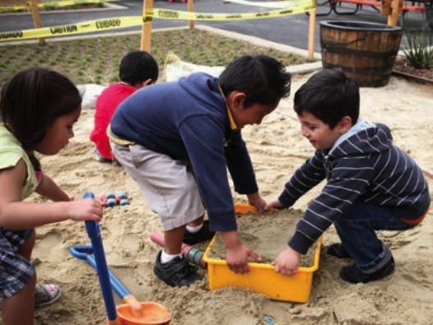
I Belong Here!
Share rituals
Class projects
Class meetings
“Big jobs” that require helpers
©2017 California Department of Education
Notes:
Presenter Remarks:
“Shared rituals (‘Every Friday we add a page to our class book’) can also be ways of affirming a sense of community. Class projects, class meetings, ‘big jobs’ for children to do together—all of these and more contribute to that important sense of ‘we’” (DAP, p. 127).
“Assign tasks for community care, such as watering plants, feeding program pets, or helping to prepare snack, to help children identify as community members and to foster the development of a sense of responsibility” (PCF, Vol. 3, p. 77).

Slide 63
Theory to Practice Treasure Hunt
What are three keys to success for large-group activities?
What are two ways to help build a sense of community?
What is one way to help children be successful with transitions?
What is an example of a non-verbal prompt?
What is one other strategy you particularly liked?
Notes:
Activity 4: Theory to Practice Treasure Hunt
Presenter Remarks:
Take out Handout 5: Treasure Hunt and something to write with.Strategy cards are posted around the room that you can use to answer questions.
intent:
Explore strategies to support group participation/cooperation and responsibility
GOAL:
Participants research strategies to support group participation cooperation, and responsibility.
Materials Required:
Handout 5: Treasure Hunt
Strategy cards
Time: 20 minutes
Process:
Hang strategy cards on the walls throughout the room.
Participants take out Handout 5: Treasure Hunt and pen.
Explain the strategy cards posted around the room are available to answer questions.
Show one of the strategy cards as an example so they know what they are looking for.
Participants share out answers after returning to their table.
Theory to Practice
Teach Children Social Skills
Teachers support interactions with peers by helping children to learn social skills needed to get along (California Preschool Curriculum Framework (PCF), Volume 2, p. 60).
Teachers guide children to understand other people’s feelings and needs and are encourage them to feel empathy and caring (California Preschool Learning Foundations (PLF), Volume 1, p. 4; PCF, Volume 1, p. 65; Developmentally Appropriate Practice (DAP), p. 199).
Provide positive ways of solving problems, settling disputes and keeping interaction fair and inclusive without interfering unnecessarily (PLF, Volume 1, p. 28; PCF, Volume 1, p. 65; DAP, p. 199).
Provide Opportunities to Interact
Teachers contribute to the development of social skills by encouraging shared activities with friends and other peers and a well-designed environment (PCF, Volume 3, p. 60; PLF, Volume 1, p. 4).
Teachers should help children who need assistance to find play partners and should teach children proactive strategies for entering and participating in social activities (DAP, p. 199).
The Role of Play
Play is an essential cornerstone of healthy social and emotional development in early childhood and contributes to the skills necessary for adjustment to and success in school (PLF, Volume 1, p. 4).
“Play” Includes social play with others, play with materials, and games with rules (PLF, Volume 1, p. 4)
“Active learning through purposeful play is important to the development of the child’s brain” (Transitional Kindergarten Implementation Guide, p. 41).

Slide 64
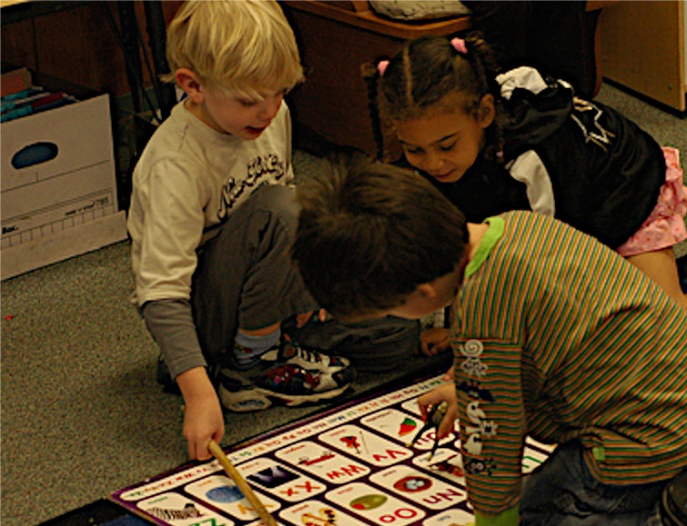
Practice Makes Perfect
Children learn how to interact by interacting.
©2017 California Department of Education
Notes:
Background Information:
Read pages in National Association for the Education of Young Children (NAEYC) Developmentally Appropriate Practice.
Presenter Remarks: (Summary of treasure hunt activity)
The more children have the opportunity to interact in small and large groups and practice cooperation and responsibility they become better at using the skills associated with group participation.

Slide 65
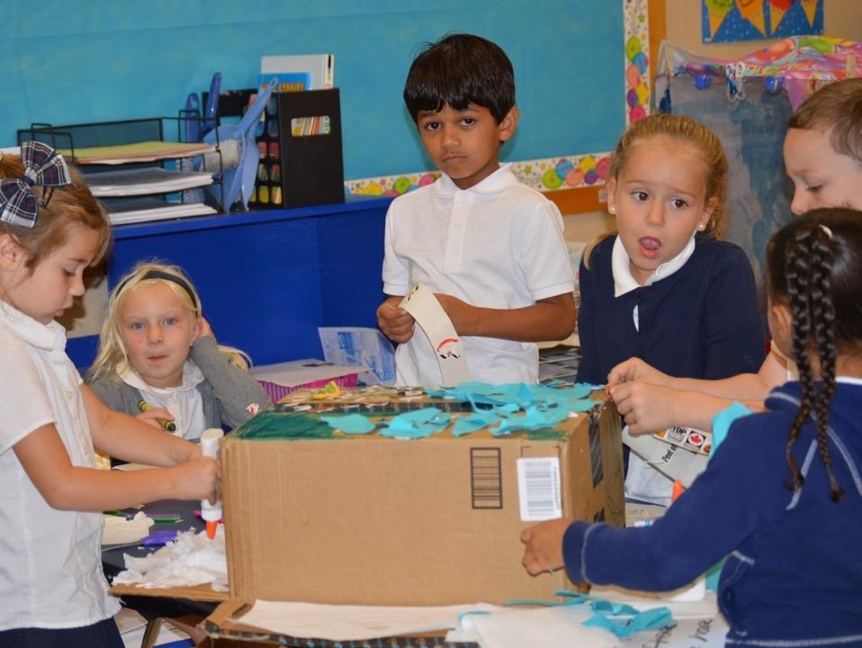
Conflict Resolution
Notes:
Presenter Remarks:
This marks the transition to conflict resolution. Let’s take a closer look.

Slide 66
Conflict Resolution
First:
Read Preschool Curriculum Framework, Volume 1, p. 67 from the bottom right through to the first column of p. 68.
Second:
  Make groups of three at the table.
  Use chart paper to list the suggested sequence of steps from the section on p. 67.
  Make a visual of each step.
Notes:
Presenter Remarks:
Teach children how to resolve conflicts on their own.
“These abilities are limited, however, especially when children are in conflict; thus adult guidance is necessary to support constructive social interactions and help children find ways of managing disagreements. Adults also encourage the development of peer interactions skills by helping children understand the feelings of other children, suggesting and modeling interaction skills, such as turn-taking, encouraging the use of words with disagreements arise, and reinforcing cooperative efforts” (PCF, Vol. 1, p. 65).
Extra Notes:
Ask participants to silently read Preschool Curriculum Framework, Volume 1, p. 67, from the bottom right through to the first column of p. 68.
In groups of three at the table, make a list of the suggested sequence of steps from the section on page 67.

Slide 67
Let’s Try It Out
First:
With a group of three, identify a:
  Teacher
  First child
  Second child
Second:
Role play each of the following scenarios:
  Two children want to use the tape dispenser at the same time
  Two children want to sit in the same spot at group meeting time
  Two children want to have a turn next at the drinking fountain
If time permits, rotate roles.
Notes:
Presenter Remarks:
Each of the same groups of three can now select one of the suggested conflicts on the screen. Take the roles of the two children and the teacher and practice the step they outlined earlier.
Extra Notes:
If time permits, have participants shift roles so that each of the three takes the role of teacher, or invite groups to role play in front of the rest of the group.

Slide 68
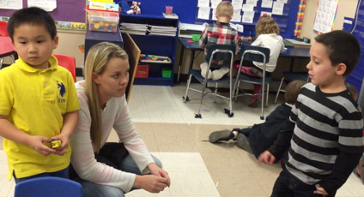
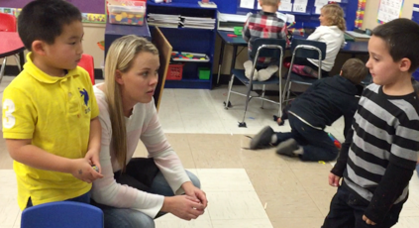
What Should We Do?
Read the vignette in the PCF, Vol. 1, pages 68-69.
In the same groups of three:
  Identify in the vignette the steps the teacher models.
  Write them on the chart paper.
Notes:
Background Information:
Read pages 68-69 in the Preschool Curriculum Framework, Volume 1.
Presenter Remarks:
Please read the vignette from the Preschool Curriculum Framework, Volume 1, p. 68-69. Again, in the same groups of three, identify the steps the teacher models in the vignette.

Slide 69
Three Guiding Questions
What are the developmental progressions for the Social Interactions strand?
How can I incorporate these strategies into my existing TK classroom?
What are the developmentally appropriate strategies to support social interactions?
Notes:
Presenter Remarks:
The final question for today is an opportunity for reflection and planning: How can I incorporate these strategies into my existing classroom?

Slide 70
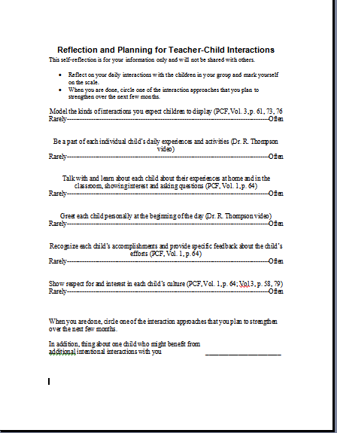
Reflect and Plan
Use Handout 6: Reflection and Planning to identify your areas of strength and possible areas for future development.
It may be helpful to identify a child needing an extra boost.
Notes:
Activity 5: Reflect and Plan
Presenter Remarks:
Now we will take a moment and reflect on our practice with some new strategy resource.
intent:
Reflect on current practices and plan for implementation of a new practice.
GOAL:
Participants reflect on their strengths and areas for future development, as well as identify a child who might need extra attention.
Materials Required:
Handout 6: Reflection and Planning for Teacher-Child Interactions
Time: 10 minutes
Process:
Using Handout 6, remind participants that this reflection is for their own use and will not be shared.
Participants reflect on their own practices and mark themselves somewhere on the continuum. (Encourage them to circle one of the suggested strategies to focus on over the next few months, and reflect on the children in the classroom to identify any child who may profit from additional interactions.)
Note: Items on the list are based on the content of Dr. Ross Thompson’s video and our other resources.

Slide 71
Think About It…
“If a child doesn’t know how to read, we teach.
If a child doesn’t know how to swim, we teach.
If a child doesn’t know how to multiply, we teach.
If a child doesn’t know how to drive, we teach.
If a child doesn’t know how to behave, we…teach? …punish?
Why can’t we finish the last sentence as automatically as we do the others?”
(Tom Herner, NASDE President, Counterpoint 1998, as cited in CSEFEL, p. 2)
Notes:
Presenter Remarks:
Is anyone willing to read this quote aloud? What do you feel when you hear this quote? Reflect for a minute on what you will take back to your classroom. What do you plan to implement? You now have new strategies and resources to continue to enhance your teaching of social interactions with children.

Slide 72
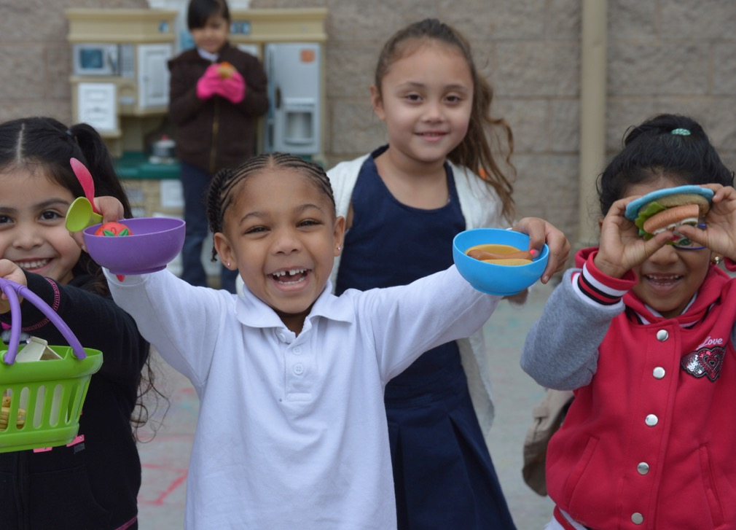
Thank You for Coming!
72

Slide 73
References
Bredekamp, Sue, and Carol Copple. Developmentally Appropriate Practice in Early Childhood Programs. NAEYC, 2008.
California Department of Education. 2013. Transitional Kindergarten Implementation Guide: A Resource for California Public School District Administrators and Teachers. Sacramento: California Department of Education.
California Department of Education. 2012. The Alignment of the California Preschool Learning Foundations with Key Early Education Resources. http://www.cde.ca.gov/sp/cd/re/documents/psalignment.pdf (accessed May 10, 2016).
California Department of Education. 2010. California Preschool Curriculum Framework, Volume 1. http://www.cde.ca.gov/sp/cd/re/documents/psframeworkkvol1.pdf (accessed April 10, 2016).
California Department of Education. 2013. California Preschool Curriculum Framework, Volume 3. http://www.cde.ca.gov/sp/cd/re/documents/psframeworkkvol3.pdf (accessed May 10, 2016).
California Department of Education. 2008. California Preschool Learning Foundations, Volume 1. http://www.cde.ca.gov/sp/cd/re/documents/preschoollf.pdf (accessed April 10, 2016).
California Department of Education. 2013. California English Language Development Standards. http://www.cde.ca.gov/sp/el/er/eldstandards.asp (accessed July 20, 2013).
D'Angelo, Anthony J. . BrainyQuote.com, Xplore Inc, 2016. http://www.brainyquote.com/quotes/quotes/a/anthonyjd101307.html, accessed May 10, 2016.

Slide 74
Optional Activity
The following slides are for an optional activity that includes multiple make and takes.

Slide 75
Activity Tables
Class name/flag/song
Buddy sit-upons
Job board
Solution wheel
Same and Different book
Helping Hands Tree
Notes:
Activity 6: Make and Take
Presenter Remarks:
Remove all personal items from your table. Take out Handout 7: Make and Take packets, select one project, and go to the designated table.
intent:
Learn to make simple tools to support social interactions.
GOAL:
Each participant creates one of a variety of tools to support social interactions
Materials Required:
Various colored drawing tools, construction paper, chart paper, poster board, copy paper, butcher paper, glue, tape, stapler, scissors, brads
Make and Take handout packet
Make and Take project signs
Time: 30 minutes
Process:
Participants remove all personal items from their table. Trainer places one project sign on each table.
Participants take out the Make and Take packets, select one project, and go to the designated table.
Trainer mention that there are a variety of materials on the front table to use for their projects.
Provide 20 minutes for group to create their projects.
Participants share out their work for the final 10 minutes

Slide 76
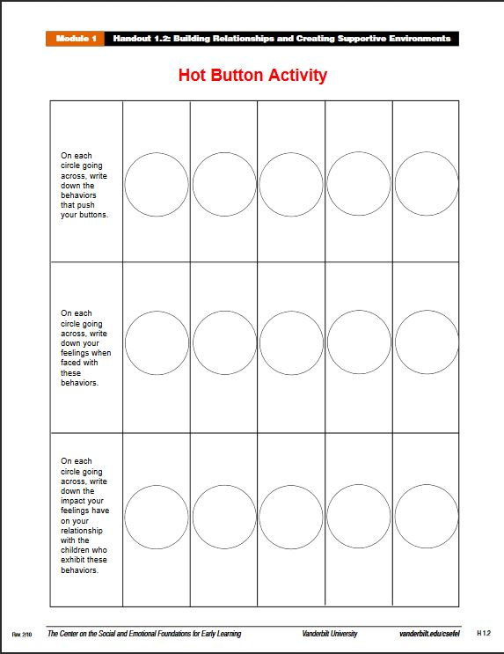
CSEFEL Hot Button Activity
Notes:
Presenter Remarks:
Find Hot Button handout. This activity is from CSEFEL material. You can download it and repeat with other staff members or even parents.
In the first row: On each circle going across, write down the behaviors that push your buttons.
In the second row: On each circle going across, write down your feelings when faced with these behaviors.
In the third row: On each circle going across, write down the impact your feelings have on your relationship with the children who exhibit these behaviors.
Take a moment and read over your completed Hot Button handout. Share your reactions and thoughts with your table group.

