Slide 1
Transitional Kindergarten Physical Development Overview Foundations and Framework Volume 2
©2017 California Department of Education
Notes:
Presenter Remarks:
Welcome to Physical Development in Transitional Kindergarten: a presentation focusing on the California Preschool Learning Foundations (Preschool Learning Foundations or PLF), the California Preschool Curriculum Framework (Preschool Curriculum Framework or PCF), and other California Department of Education (CDE) resources in support of the Physical Development domain.
This professional learning session is specifically designed to provide TK teachers with exposure to CDE resources that support TK curriculum planning of developmentally appropriate strategies. Classroom environment design recommendations are included to support the content area of active physical play.
Because our focus for today is physical development, we will have many opportunities to move. Please honor any physical restrictions or limitations that you may have and engage cognitively, if you are not able to engage physically.

Slide 2
Objectives
Gain understanding of key concepts from the California Preschool Learning Foundations, Volume 2 and the California Preschool Curriculum Framework, Volume 2— Physical Development domain.
Explore the developmental continuum for physical development strategies that will guide instruction and learning in Transitional Kindergarten (TK).
Discuss current research for physical development, brain-based learning, and obesity prevention for TK physical development.
Notes:
Presenter Remarks:
This slide shows what we will share in today’s training.
Objectives:
Gain understanding of key concepts from the California Preschool Learning Foundations, Volume 2 and the California Preschool Curriculum Framework, Volume 2— Physical Development domain.
Explore the developmental continuum for physical development strategies that will guide instruction and learning in Transitional Kindergarten (TK).
Discuss current research for physical development, brain-based learning, and obesity prevention for TK physical development.

Slide 3
Community Building
Wake Up Your Brain!
Notes:
Activity 1: Wake Up Your Brain
Presenter Remarks:
Physical activity provides more oxygen to the brain, increases alertness, readiness, attention, retention, memory, and can change moods. This training will include a few brain breaks to optimize learning!
Young children need short bursts of physical activity to move fresh blood containing glucose and oxygen throughout the brain, necessary ingredients for learning and an important reason to integrate movement activities throughout the day.
Let’s wake up our brains. Please stand up, push in your chair/bag/tote, and stand behind your chair. Make sure you have a safe path to move around your table.
intent:
Engage participants in a community building activity as they move around their tables.
OUTCOMES:
Participants will actively move around their table responding to movement prompts from the trainer as they practice various motor skills.
Participants will experience how physical activity provides more oxygen to the brain, increases alertness, and can change moods.
Materials Required:
Upbeat song – trainer’s choice
Music player
Safe space around tables to move
Time: 4-5 minutes
Process:
1. Invite participants to stand up, push in their chairs/bags/totes, and stand
behind their chair. Have everyone check to make sure they have a safe
path to move around their table.
2. Instruct participants that they will be doing various movements to a song
as they travel around their table (see music prompts on next page).
OPTIONS:
Song prompts are suggestions. Feel free to change/modify as desired.
Trainer can use a mix of songs rather than one song.
Waking Up the Brain Music Prompts
Lead participants through the following movement activity as you start and stop the song prompting a new movement each time. Each movement should last about 15-20 seconds.
1. Tap on the table with one hand.
2. Tap on the table with both hands.
3. Tap the back of your chair.
4. Walk around your table and tap chairs as you pass them.
5. Turn around, march and clap your hands from side to side.
6. March and clap your hands at a high level and then at a low level.
7. March and clap your hands in front of you and then behind your back.
8. Play patty cake with someone at your table.
9. Freestyle back to your chair and have a seat.
After the song, have the participants repeat after you...
Music moves me!
My brain is awake!
I’m ready to learn!

Slide 4
Why Use the Preschool Learning Foundations for TK?
CA Law (EC 48000):
Transitional kindergarten is the first year of a two-year kindergarten program that uses a modified kindergarten curriculum that is age and developmentally appropriate.
Transitional kindergarten programs are intended to be aligned, by legislative action, to the California Preschool Learning Foundations developed by the California Department of Education.
Notes:
Background Information:
http://cde.ca.gov/ci/gs/em/kinderfaq.asp#program
Presenter Remarks:
The state of California provides guidance on utilizing the Preschool Learning Foundations and the Preschool Curriculum Framework as planning and curriculum resources in the TK classroom.

Slide 5
CDE Publications and Resources that Support TK Implementation
Alignment Document
Developmentally Appropriate
Practice
DRDP Specific to TK and K
Preschool Curriculum Framework
Physical Education Model Content Standards for CA Public Schools, K-12
Physical Education Framework for CA Public Schools, K-12
Preschool Learning Foundations
Transitional Kindergarten Implementation Guide
California Common Core State Standards
Preschool Learning Foundations
Preschool Curriculum Framework
Active Start
Alignment Document
Transitional Kindergarten Implementation Guide
California Common Core State Standards
DRDP Specific to TK and K
Physical Education Model Content Standards for CA Public Schools, K-12
Physical Education Framework for CA Public Schools, K-12
California Common Core State Standards
Notes:
Presenter Remarks:
The California Department of Education has developed many publications, resources, and supports that enable teachers to facilitate the most positive outcomes for students.
Today our main focus will be the on the Preschool Learning Foundations and the Preschool Curriculum Framework, Volume 2, Physical Development domain.
There are additional key resources that support physical development in young children. We will also discuss alignment and make connections to additional resources pictured in the graphic (name and hold up each resource): The Alignment of the California Preschool Learning Foundations with Key Early Education Resources (Alignment Document), the Transitional Kindergarten Implementation Guide – A Resource for Public School District Administrators and Teachers (TK Implementation Guide), the Desired Results Developmental Profile—Kindergarten (2015): A Developmental Continuum for Kindergarten (DRDP-K [2015]), Physical Education Model Content Standards for California Public Schools, Kindergarten Through Grade Twelve (PE Model Content Standards), the Physical Education Framework for California Public Schools (PE Framework), and the California Common Core State Standards (CA CCSS).
Early educators typically include physical movements in their daily teaching. It is best practice to be cognizant of movement and integrate it within all content areas.
What do you know about these documents?
How do you use these resources in your work now?
Depending on the size of your group, participants can share responses at their table or in pairs.

Slide 6
Transitional Kindergarten Implementation Guide
The TK Implementation Guide is a resource for California public school district administrators and teachers to support implementation of comprehensive TK programs.
Notes:
Presenter Remarks:
The TK Implementation Guide is a resource that focuses on the essential components for school district administrators and teachers to consider for TK programs. The TK Implementation Guide, published by the California Department of Education, supports implementation of comprehensive TK programs.
This publication provides resources and guidance in the areas of program design, curriculum, instruction, assessment, and family/community partnerships.

Slide 7
Overview of the Transitional Kindergarten Implementation Guide
Section One
Program Structure and Design
Section Two
The TK Student
Curriculum in a TK Program
Effective Instruction in a TK Program
The TK Learning Environment
Assessment and Differentiated Instruction
Involving Families and Community Partners
Supporting TK Implementation
Notes:
Presenter Remarks:
The TK Implementation Guide is organized into the following two sections:
Section 1 is covered in Chapter 1. The information in this section was developed with the administrator in mind and focuses on program structure and design.
Section 2 is covered in Chapters 2-8. This section is a resource for both teachers and administrators and focuses on building a comprehensive TK program by addressing curriculum, instruction, environment, assessment, and partnership with families and community.
Within each of these chapters, vignettes, highlighted boxes, and resource boxes are included to illustrate examples of the information covered in each of the chapters.
A PDF copy of the document can be accessed at the California Department of Education Web page (www.cde.ca.gov/ci/gs/em/documents/tkguide.pdf).
Video footage for each chapter can be accessed at the California Department of Education. The video clips include footage of TK classrooms and interviews with teachers, administrators, and parents. https://www.youtube.com/user/caeducation https://www.youtube.com/results?search_query=tk+implmentation+guide

Slide 8
California P.E. Standards and Framework K-12
Standard 1. Students demonstrate the motor skills and movement patterns needed to perform a variety of physical activities.
Standard 2. Students demonstrate knowledge of movement concepts, principles, and strategies that apply to the learning and performance of physical activities.
Standard 3. Students assess and maintain a level of physical fitness to improve health and performance.
Standard 4. Students demonstrate knowledge of physical fitness concepts, principles, and strategies to improve health and performance.
Standard 5. Students demonstrate and utilize knowledge of psychological and sociological concepts, principles, and strategies that apply to the learning and performance of physical activity.
Notes:
Presenter Remarks:
Let’s take a minute to read through the five California Physical Education Standards for K-12. What do you notice?
Solicit responses. Remind audience that the five standards are the same for each grade level, recognizing that each grade has age and developmentally appropriate development.
As you can see, many of the developmental skills introduced and practiced in pre-K are continued through TK into kindergarten. Having an awareness of children’s physical development during the early years is best practice for early educators.

Slide 9
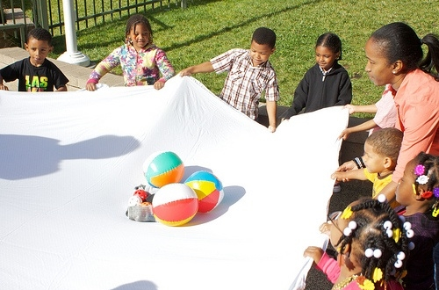
Physical Development
The Importance of Movement
©2017 California Department of Education
Notes:
Presenter Remarks:
“Through play and movement, young children move to learn and learn to move (Doherty and Bailey 2003; Gallahue 1982; Rickard, and others 1995a). They develop a sense of competence through their movement in relation to the physical and social world, which is not achieved in other ways” (PLF, Vol. 2, p. 39).
Therefore, the importance of movement and “physical development deserves the same level of attention and resources in early childhood programs as other domains” (PLF, Vol. 2, p. 37) of the curriculum. This can happen throughout the day while teachers are supporting the development of math, literacy, science, and all curricular areas. Movement can be integrated into all domains through intentional planning.
Thoughtfully planned, developmentally appropriate instruction, opportunities for engagement, and adult-guided movement experiences support children's physical development.

Slide 10
Physical Activities
“Physical activities enhance all aspects of development including cognitive, emotional, social, as well as physical”
(PCF, Vol. 2, p. 132).
©2017 California Department of Education
Notes:
Presenter Remarks:
“Cognitive growth occurs when children problem-solve how to negotiate an obstacle course or how to build a fort. Acquisition of physical skills supports emotional development by increasing children’s confidence and willingness to try new activities. Physical play creates optimal opportunities for social development. Active physical play also has clear benefits for children’s health and fitness. Promoting children’s physical fitness is critical given the increasing rates of lifestyle-related health issues (including obesity and diabetes) among children in California. All children, no matter their ability levels or backgrounds, benefit from engaging in physical activities” (PCF, Vol. 2, p. 132).

Slide 11
Movement Skills: A Foundation for Learning
Young children learn best by doing!
©2017 California Department of Education
Notes:
Presenter Remarks:
“Movement skills are a foundation for learning. Young children’s fundamental movement skills are progressively elaborated, refined, and consolidated in elementary, middle, and high school” (PLF, Vol. 2, p. 37).
“The habits of physical activity that children learn in the early years greatly increase the chance that children will continue being physically active throughout childhood and beyond” (PCF, Vol. 2, p. 192).

Slide 12
Research Highlight
“Physical activities enhance children’s brain development”
(PLF, Vol. 2, p. 133).
©2017 California Department of Education
Notes:
Presenter Remarks:
Play is a primary context for learning.
“Children use multiple senses when they engage in physical activities. Multisensory experiences create and strengthen communication pathways in children’s brains. Young children’s brains are highly malleable; thus, early experiences have a big impact on their brain development. Movement experiences that are personally meaningful and provide the “just right challenge” (i.e., challenging but doable) have the most impact on brain development. Neuroscientists studying the brain confirm that “exercise provides an unparalleled stimulus, creating an environment in which the brain is ready, willing, and able to learn” (PCF, Vol. 2, p. 133, Research Highlight).
Physical activity and brain development integrate for meaningful learning.

Slide 13
Exercise and the Brain
“Exercise grows brain cells” (Eric Jensen, Teaching with the Brain in Mind, p. 68).
“Physical activity and exercise is like ‘miracle grow’ for the brain” (John Ratey, Spark: The Revolutionary New Science of Exercise and the Brain).
Notes:
Presenter Remarks:
Just by moving, the brain is enhanced.
Exercise produces a protein called Brain Derived Neurotrophic Factor (BDNF) in the brain, which is present in the hippocampus, an area in the midbrain related to memory and learning. The release of BDNF produces stronger attraction between neurons, which makes it easier for a signal to fire and make connections (learning, remembering and memory). (John Ratey, Spark: The Revolutionary New Science of Exercise and the Brain).
Extra Notes: Spark: The Revolutionary New Science of Exercise and the Brain, by John Ratey, 2008. The entire first chapter is dedicated to the effect of exercise and physical activity on the brain.

Slide 14
Foundations and Framework, Volume 2
Notes:
Presenter Remarks:
The purposes of the Preschool Learning Foundations are to promote a common understanding of TK children's learning and to guide instructional practice. They describe the knowledge and skills that young children typically develop when provided with developmentally, culturally, and linguistically appropriate learning experiences.
The Preschool Curriculum Framework was created as a companion to the Preschool Learning Foundations. The framework ". . . presents strategies and information to enrich learning and development opportunities for all children" (PCF, Vol. 2, p. v).
The Preschool Learning Foundations and the Preschool Curriculum Framework are designed to work together. While the foundations provide the background information to understand children's developing knowledge and skills (the "what"), the framework offers guidance on how teachers and programs can support the learning and development that are described in the foundations (the "how").
Extra Notes:
The Preschool Learning Foundations were developed with research-based evidence and are enhanced with expert practitioners' suggestions and examples. All foundations were written by a team of researchers with expertise in the given domain. A complete reference list of the source materials, along with detailed bibliographic notes for each of the developmental domains, can be found in the Preschool Learning Foundations. Sources used in the development of the foundations include:
Documents from the California Department of Education, such as the English-Language Arts Content Standards for California Public Schools, Kindergarten Through Grade Twelve (Language and Literacy, Introduction, p. 48, left column)
Well-validated assessment tools such as the Ages & Stages Questionnaires (ASQ): A Parent-Completed, Child-Monitoring System (Social-Emotional, References and Source Materials, p. 36)
General sources such as the Report of the National Reading Panel 2000 (Language and Literacy, Introduction, p. 73, left column)
Early childhood education standards from other states such as Hawaii and Texas (Social-Emotional, Introduction, p. 5, footnote)

Slide 15
Preschool Learning Foundations
High-quality programs
Appropriate support
©2017 California Department of Education
Notes:
Presenter Remarks:
The Preschool Learning Foundations describe what children should know and be able to do at around 48 months (4 years old) and 60 months (5 years old).
The foundations also assume that children have access to appropriate support in high quality programs that include the following aspects:
Environments and experiences that encourage active, playful exploration and experimentation
Clearly defined learning centers where materials are rotated
Purposeful teaching to help children gain knowledge and skills
Predictable schedules and routines with large blocks of time for play and skillful integration of curriculum with an intentional focus on content
Specific support for English learners with staff that have knowledge of the stages of English-language acquisition
Accommodations and adaptations for children with disabilities and additional support when needed
Summarize the exploration with the following key note:
Because children develop at different rates, the foundations were designed to support the belief that certain stages of development will occur at different times for all students. Notice “at around” in the description. It is important to remember this variability occurs.

Slide 16
The Preschool Curriculum Framework
“…presents strategies and information to enrich learning and development opportunities for all of California’s preschool children” (PCF, Vol. 1, p. v).
Notes:
Presenter Remarks:
The Preschool Curriculum Framework ‟…presents strategies and information to enrich learning and development opportunities for all of California’s preschool children” (PCF, Vol. 1, p. v).
This resource provides teachers with the opportunity to gain ideas and expand their creativity.

Slide 17
Physical Development
Strands | Substrands
Fundamental Movement Skills | 1.0 Balance
 | 2.0 Locomotor Skills
 | 3.0 Manipulative Skills
Perceptual-Motor Skills and Movement Concepts | 1.0 Body Awareness
 | 2.0 Spatial Awareness
 | 3.0 Directional Awareness
Active Physical Play | 1.0 Active Participation
 | 2.0 Cardiovascular Endurance
 | 3.0 Muscular Strength, Muscular Endurance and Flexibility
Notes:
Presenter Remarks:
The Preschool Learning Foundations for physical development are organized in terms of three strands:
• Fundamental Movement Skills
• Perceptual–Motor Skills and Movement Concepts
• Active Physical Play
“The first strand is Fundamental Movement Skills. Most preschool [and TK] children can acquire reasonable levels of competence in a wide range of movement activities, including balance, locomotor skills, and manipulative skills (both gross motor and fine motor), when given opportunities for instruction and practice in an enriched environment. The second strand is Perceptual–Motor Skills and Movement Concepts. This strand focuses on the development of body awareness, spatial awareness, and directional awareness. These skills are important for interacting with others and for exploring the environment. The third strand is Active Physical Play. Active physical play promotes children’s health and physical fitness by increasing their levels of active participation, cardiovascular endurance, muscular strength, muscular endurance, and flexibility” (PCF, Vol. 2, p. 138).
Each strand has its own individual module for which CPIN provides professional learning.

Slide 18
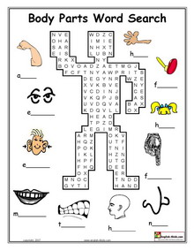
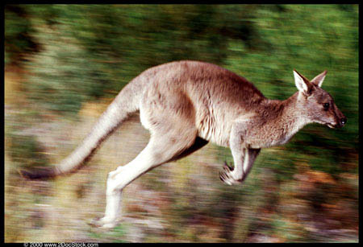
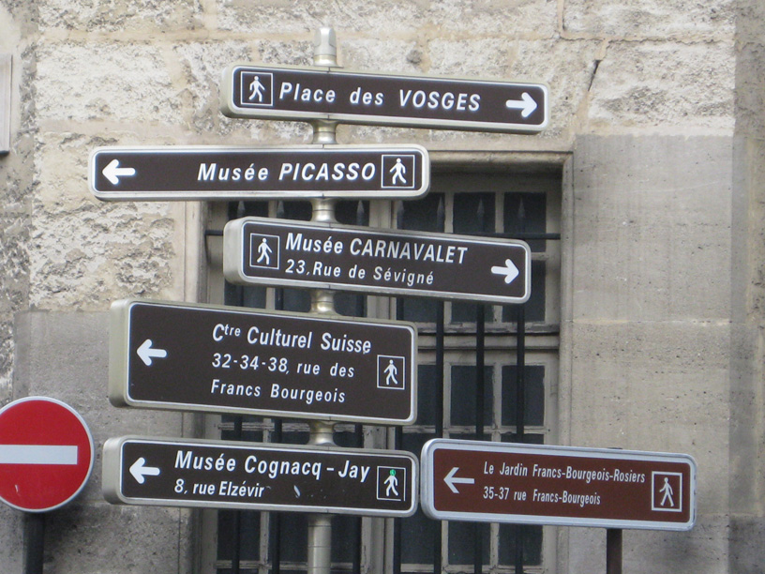
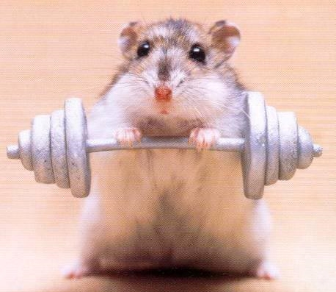
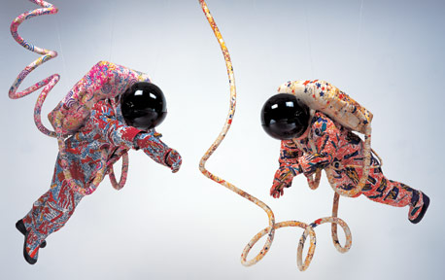
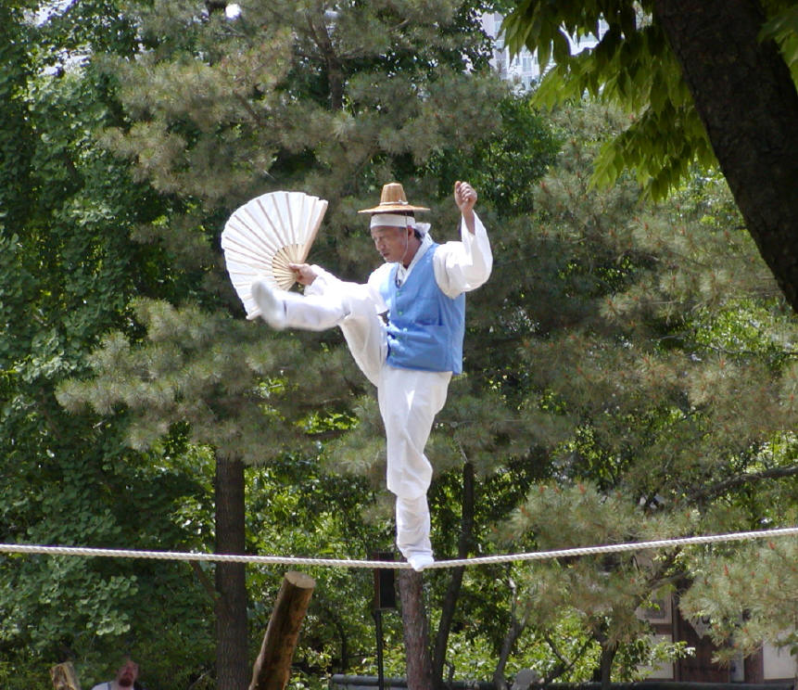
Which Substrand Am I?
Match pictures to the strand/ substrand cards.
Each picture can only be used once.
Use the physical development foundations for help!
©2017 California Department of Education
Notes:
Activity 2: Which Substrand Am I?
Presenter Remarks:
There are two envelopes on your table. Please open each envelope and notice that one envelope has substrand cards; and the other envelope contains nine photos. Your task, as a table, is to cooperatively decide which card and photo match. You have seven minutes to complete this task.
intent:
Give participants an opportunity to become familiar with the physical development framework.
OUTCOME:
Participants will look at the physical development handouts copied from the Preschool Learning Foundations and Preschool Curriculum Framework to identify which physical development substrand matches the correct pictures.
Materials Required:
One per participant – Handout 2: Physical Development Domain Alignment and Handout 5: PCF PD Chapter (pages 131-138)
One per table - Physical Development Strand Activity Cards (envelope with laminated nine substrand cards)
One per table – Photo Envelope with nine photos that illustrate the nine substrands
Time: 10 min.
Process:
Prior to activity, place Physical Development Strand Activity Cards and Photo Envelope on each table.
Participants work cooperatively as a table to research and match each substrand card to a photo using Handout 2 Physical Development Domain Alignment and Handout 5: PCF PD Chapter (pages 131-138).
Facilitators move around the room to support participants and listen to conversations.
Share out results by holding up one picture and asking for answer from the group. If a table has a different answer, ask if someone is willing to share their rationale. It is okay if there are different interpretations. If someone has a different viewpoint, it is important that participants feel safe to share.
OPTIONS:
Use photos of children engaged in physical activities instead of the ones provided for this activity.
Show video clips and ask people to identify the strand by holding up the foundation substrand card.
Have facilitator act out a substrand and participants hold up the foundations substrand card that matches the action.
Facilitator can hold up a substrand card, or project the substrand name on the screen, and ask the group to stand and demonstrate it.
If not laminated, materials may be printed on cardstock.

Slide 19
Physical Development Foundations Map
Strand
Substrand
Age
Foundation
Domain
Examples
Universal Design
Notes:
Presenter Remarks:
Please find Handout 1: Physical Development Foundations Map.
Discuss each area of the map.
Children are different and may not demonstrate the behaviors in the examples exactly as stated. The examples listed under each foundation give a range of possible ways in which children can demonstrate a foundation. The examples suggest different kinds of contexts in which children may show the competencies reflected in the foundations.

Slide 20
Alignment Document
Notes:
Presenter Remarks:
The Alignment Document is another resource that will help us answer questions related to developmental progression.
What do you know about this document? How do you use it in your work now?
Extra Notes:
Depending on the size of the group, participants can share responses with table partners or in pairs.

Slide 21
Alignment Document
Notes:
Presenter Remarks:
Please refer to Handout 2: Physical Development Domain Alignment. This handout provides an example from each domain.
This shows the alignment between strands and substrands in the Preschool Learning Foundations and the content categories in the California Common Core State Standards (CA CCSS).
For most substrands of the Preschool Learning Foundations there is a category in the California State Standards with corresponding content.

Slide 22
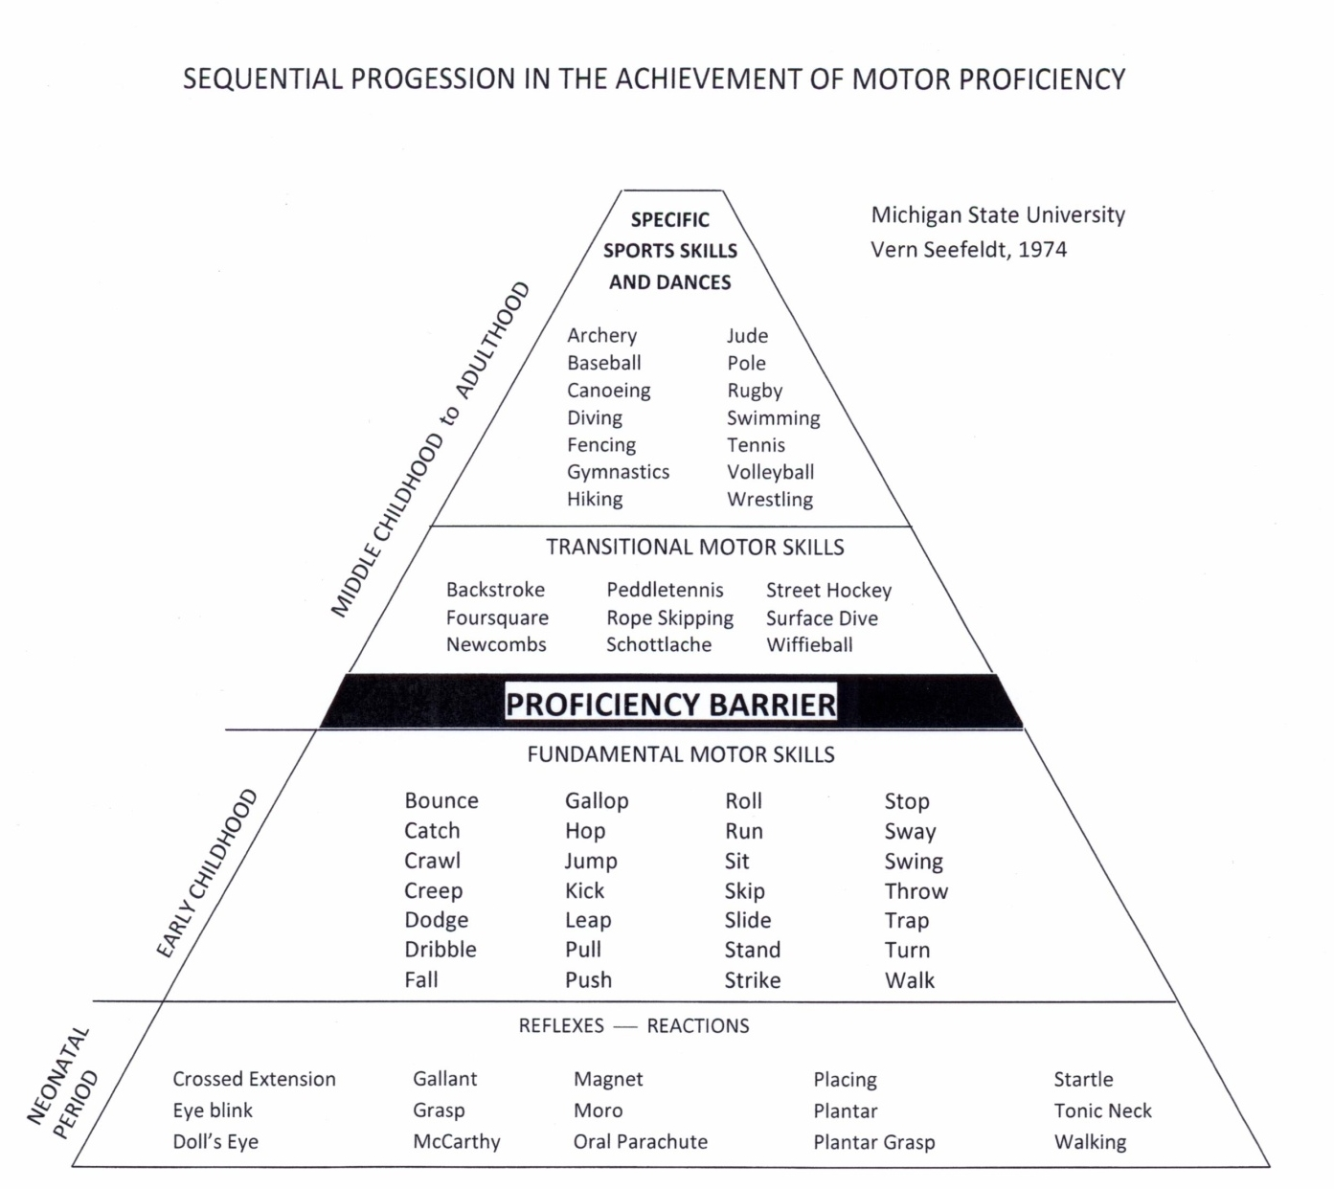
Fundamental Movement Skills Set the Stage for a Lifetime of Activity
Middle Childhood to Adulthood
Proficiency Barrier
Early Childhood
(Vern Seefeldt, “Sequential Progression in the Achievement of Motor Proficiency”)
Notes:
Presenter Remarks:
During the early childhood years, the introduction and practice of fundamental movement skills is essential to set the foundation for more complex motor skills needed later in life for fitness activities, organized sports, and recreation.
As seen on this slide, Sequential Progression in the Achievement of Motor Proficiency by Vern Seefeldt is a research-based model that illustrates the trajectory of physical development.
The “proficiency barrier,” the black line indicated by the arrow, is like a filter. If a person does not develop the fundamental motor skills during the early childhood years, it will be very difficult to move through the proficiency barrier and engage in more complex skills into middle childhood or adulthood.
The upper part of the model illustrates how transitional motor skills are crucial for developing specific sports skills and dances, which are combinations of different fundamental skills in sequences under changing conditions.
Feeling confident in one’s ability, being physically active, and enjoying movement lends itself to a lifetime of activity.

Slide 23
The Need for Physical Development
Physical development does not always happen naturally or automatically.
Lack of physical development adversely affects all domains of development.
The consequences of the lack of foundations of movement development can be devastating.
Notes:
Presenter Remarks:
Physical development does not always happen naturally or automatically. Teachers do not leave reading and writing up to chance; physical development should not be left to chance either. Teachers need to provide opportunities for TK children to practice and develop fundamental movement skills (FMS) to develop movement competence.
“Physical activities in the preschool [or TK] setting that emphasize perceptual– motor abilities are different from those that emphasize gross motor abilities, and curricula need to include both. There are relationships between fine motor and hand–eye coordination in kindergarten and early school achievement in mathematics and language (Son and Meisel 2006). Children who fail to establish good perceptual–motor skills in preschool [or TK] will not only have trouble with movement and coordination but may also be at risk of academic failure” (PLF, Vol. 2, p. 59).
“Many children start on the path to obesity during the preschool [or TK] period (Blair and others 2007; Ekelund and others 2006; Nader and others 2006). Their ability to participate in physical activities may be affected later in life, including activities that are important for physical and mental health (McKenzie 2004; Seefeldt 1980). (PLF, Vol. 2, p. 43).
Providing children with opportunities to learn skills is important; as children engage in such learning, teachers need to be sensitive to the fact that some children may have mild to moderate physical disabilities that have not yet been identified” (PLF, Vol. 2, p. 44).

Slide 24
Childhood Obesity
Physical development and physical activity play an important role in health throughout a child’s life span.
©2017 California Department of Education
Notes:
Presenter Remarks:
“Physical inactivity is common during early childhood in the United States” (PLF, Vol. 2, p. 37).
Background Information:
The obesity rate among children ages 6 to 11 has more than quadrupled in the last 40 years; for adolescents 12 to 19, it has more than tripled. Among young children 2 to 5, rates more than doubled between the mid–1970s and 2000s before beginning a decline (www.cdc.gov).

Slide 25
The Most Concerning Trends About Childhood Obesity
After increasing steadily for decades, the national childhood obesity rate has leveled off, but it is still alarmingly high compared to a generation ago.
(The State of Obesity, Better Policies for a Healthier America 2016, Robert Wood Johnson Foundation, p. 7)
Notes:
Presenter Remarks:
The State of Obesity, Better Policies for a Healthier America 2016 was released in 2016 by the Robert Wood Johnson Foundation updating obesity statistics. The good news is that after increasing steadily for decades, the national childhood obesity rate has leveled off, but it is still alarmingly high compared to a generation ago.

Slide 26
The State of Obesity 2016
Rates are:
Declining among 2 to 5-year-olds
Stable among 6 to 11-year-olds
Increasing among 12 to19-year-olds
Obesity rates have also become much higher starting in earlier ages: 8.9% of 2- to 3-year-olds are now obese.
(The State of Obesity, Better Policies for a Healthier America 2016, Robert Wood Johnson Foundation, June 2016)
Notes:
Presenter Remarks:
The rate of obesity is declining in very young children, but this trend is new. Rates are stable in early to middle childhood and are increasing in later middle childhood and adolescents.
The last bullet is very important as we work with young children. It tells us that we need to ensure children have ample opportunities to engage in physical activities throughout the day

Slide 27
Childhood Obesity Facts
Childhood obesity has been associated with cardiovascular risk factors, increased health care costs, and premature death.
Childhood obesity increases the prevalence of cardiovascular risk factors with severity of childhood obesity.
Children who are obese or extremely obese during early childhood are also likely to be obese during middle or late childhood and adulthood. (Pan, Blanck, Sherry, Dalenius, & Grummer-Strawn. Trends in the Prevalence of Extreme Obesity Among US Preschool-Aged Children Living in Low-Income Families, 1998-2010.)
Notes:
Presenter Remarks:
We know that children imitate adults and childhood obesity is affecting young children. Take a moment to read the slide. Are any of these facts alarming to you?

Slide 28
Childhood to Adulthood
Obese adults are at increased risk for:
Stroke
Coronary heart disease
Hypertension
Type 2 diabetes
Certain types of cancer
(Pan, Blanck, Sherry, Dalenius, & Grummer-Strawn. Trends in the Prevalence of Extreme Obesity Among US Preschool-Aged Children Living in Low-Income Families, 1998-2010.)
Notes:
Presenter Remarks:
The obesity trends that track from childhood to adulthood carry with them increased risks for many health issues. Take a moment to look at the screen. Do you know anyone with these health issues in adulthood?

Slide 29
Age-adjusted Prevalence of Obesity and Diagnosed Diabetes Among US Adults
Obesity (BMI ≥30 kg/m²)
1994
2000
2013
No Data <14.0% 14.0%–17.9% 18.0%–21.9% 22.0%–25.9% > 26.0%
Diabetes
1994
2000
2013
No Data <4.5% 4.5%–5.9% 6.0%–7.4% 7.5%–8.9% >9.0%
CDC’s Division of Diabetes Translation. National Diabetes Surveillance System available at http://www.cdc.gov/diabetes/statistics
Notes:
Presenter Remarks:
This slide, available on the CDC’s website (www.cdc.gov), illustrates how the nation has increased obesity levels and diabetes from 1994 to 2013.
What do you notice? Solicit responses.
As the obesity levels have increased so has diabetes. We have a national health crisis. We can reach out to the youngest and help them develop healthy habits while preferences are being formed.

Slide 30
Teachers are important role models in the area of physical development.
People of all ages benefit from
physical activity!
©2017 California Department of Education
Notes:
Presenter Remarks:
“Teachers are important role models in the area of physical development. Children benefit immensely when teachers engage in physical activities alongside children and share in the fun of physical movement“ (PCF, Vol. 2, p. 132).
“When educators stand aside as observers on the playground, they may inadvertently model inactivity and miss opportunities to provide instruction and to support practice” (PLF, Vol. 2, p. 43).
When teachers engage in physical activity they not only model a healthy lifestyle but they accumulate minutes of physical activity as well.
Background Information:
The Surgeon’s General Report (1996) states that “People of all ages benefit from physical activity.” In the CDC’s 2008 Physical Activity Guidelines for Americans, it is recommended that adults obtain 150 minutes per week of moderate physical activity. CDC recommends you spread your activity out during the week, so you don't have to do it all at once. Breaking it up into smaller chunks, at least 10 minutes at a time, during the day is fine. (www.cdc.gov/physicalactivity/basics/adults/index.htm)

Slide 31
Daily Physical Activity Recommendations
Notes:
Presenter Remarks:
Refer to Handout 4: Physical Activity Recommendations for Young Children.
As you look at the handout, note how physical activity recommendations from various organizations are generally consistent for young children—60 minutes a day. The minutes are to be accumulated and spread throughout the day in short bouts. Young children are intermittent in their energy level. They tire quickly, but recover fast. So, short rest periods are recommended.
Active Start: A Statement of Physical Activity Guidelines for Children Birth to Age 5 by the National Association for Sport and Physical Education (NASPE, 2009), is a widely recognized national document for physical activity recommendations for infant, toddlers and preschoolers.
“The 2008 Physical Activity Guidelines for Americans, which have been adopted by former First Lady Michelle Obama’s Let's Move! initiative and the American Academy of Pediatrics, recommend that youth participate in daily moderate-to-vigorous physical activity for at least 60 minutes” (http://www.cdc.gov/nchs/data/databriefs/db141.htm).
As children transition into the elementary years, there are state mandates for minutes of physical education in grades 1-6, therefore engaging TK and kindergartners in physical activity is highly recommended.

Slide 32
Daily Physical Activity Recommendations
TK children should accumulate at least 60 minutes of structured daily physical activity (PA) and at least 60+ minutes of daily unstructured PA.
TK children should remain active and not be sedentary for more than 60 minutes at a time, except when sleeping.
TK children should develop competence in fundamental movement skills.
TK children should have access to indoor and outdoor areas for performing large muscle activities.
Individuals responsible for the health and well-being of young children should be aware of the importance of PA and should facilitate children's movement skills.
National Association for Sport and Physical Education [NASPE 2009], Active Start: A Statement of Physical Activity Guidelines for Children Birth to Age 5.
Notes:
Presenter Remarks:
Read bullets on slide or invite participants to read aloud to group.
These recommendations are from previously mentioned Active Start: A Statement of Physical Activity Guidelines for Children Birth to Age 5 by the National Association for Sport and Physical Education [NASPE, 2009].
Take note of the bolded word accumulate. It is important to note these physical activity (PA) recommendations are for the whole day. If a child is not with a teacher for most of the day, parents and caregivers should be aware of the need for PA.
Children should engage in both structured and unstructured daily physical activity indoors and outdoors. What is the difference between structured and unstructured?

Slide 33
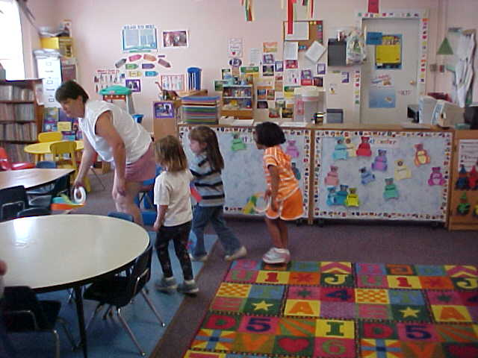
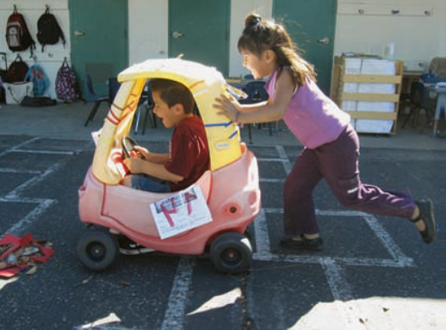
Structured and Unstructured PA
Adult-Led
Intentional Facilitation
Play with a Purpose
Self-Selected
Free Play
Child’s Choice
Notes:
Presenter Remarks:
Structured physical activity means movement experiences designed by teachers to support learning (PLF, Vol. 2, p. 41). Activities are thoughtfully designed, developmentally and age-appropriate. Best practices tell us to:
“Involve all children (no elimination games/activities) and maximize participation (all children should have props or equipment to play with).
Preserve the joy and exuberance that young children bring to physical activity.
Focus on the process (such as how to kick a ball), not the end result (such as whether the child hits the ball or scores a goal).
Recognize the wide range of movement skills, fitness, and previous movement experiences of young children and avoid comparison and competition.
Respond to the needs of individual children for instruction and encouragement, modify as needed for children with special needs” (PLF, Vol. 2, p. 41).
Unstructured physical activity is child-selected, free-play for children, with adult supervision. Children will begin to transfer learned activities taught during structured time to their unstructured, child-initiated play— increasing further developmental time. Trade out or provide new props or equipment for children to experiment with—providing new materials often leads to further development.

Slide 34
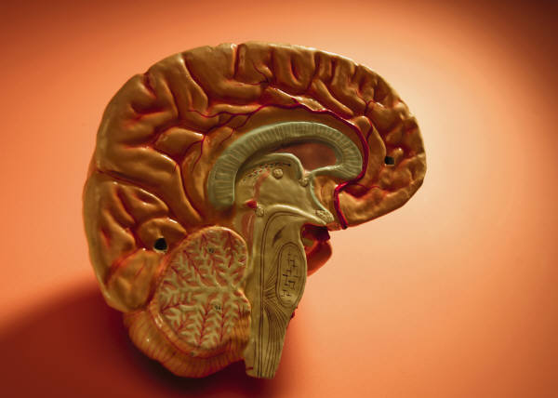
Brain Break with Rags!
©2017 California Department of Education
Notes:
Activity 3: Brain Break with Rags
Presenter Remarks:
This activity is going to provide our brains with a little break. Please stand behind your chair for the brain break activity, and make sure all bags and totes are out of the way. Look around you for possible safety hazards.
intent:
Provide a brain break for participants that involve physical activity.
OUTCOME:
Participants will engage in a simple tossing activity to increase blood flow to the brain and realize how the brain and muscles work effortlessly together.
Materials Required:
Music player and upbeat song (trainer’s choice)
Four rags for each table (washcloth, dinner napkin, or car wash rags that can be purchased from Costco, Walmart or an auto parts store)
Time: 3-4 minutes
Process:
Prior to activity, place four rags on each table.
Invite all participants to stand behind their chair for the brain break activity. Check clothing and shoes and push in chairs at tables, along with bags/totes/etc. Check area for possible safety hazards.
Introduce the activity and direct each table to gently toss one rag around the table. Begin music.
After 20 seconds, add an additional rag so each table is tossing two rags simultaneously. Toss for about 30 seconds. Add an additional rag every 20-30 seconds stopping music each time.
After the activity, ask questions to illustrate how integrated the brain and muscles are when they are doing a physical task: What was easier to toss and catch–one towel or multiple towels? What did your brain have to do to keep all the rags going? Did you consciously change the way you were tossing and catching the rags when there were multiple rags?
After the song ends, have the group take a deep breath and then sit down.
OPTIONS:
This activity illustrates how physical activity does not have to be expensive. Items found around the house can be recycled into play props.
Share this activity with families to illustrate how easy it is to engage brain and muscles together in physical activity.

Slide 35
Let’s Dig Deeper!
Notes:
Background Information:
Does your brain feel energized now?
Presenter Remarks:
“All children, no matter their ability levels or backgrounds, benefit from engaging in physical activities” (PCF, Vol. 2, p. 132).
“Promoting children’s physical fitness is critical given the increasing rates of lifestyle-related health issues (including obesity and diabetes) among children in California” (PCF, Vol. 2, p. 132).
The guiding principles at the beginning of the physical development section of the Preschool Curriculum Framework provide a lens through which to read and understand the content of the chapter. Teachers can use the guiding principles to direct their efforts in creating an appropriate environment to support active physical play. Let’s dig deeper into the guiding principles now.

Slide 36
Twelve Guiding Principles to Support Physical Development
Developmentally appropriate movement programs accommodate a variety of individual differences among children.
Notes:
Presenter Remarks:
Please find Handout 5: PCF PD Chapter, pages 131-138. Each chapter in the Preschool Curriculum Framework, Volume 2, includes domain specific guiding principles. Note the Research Highlight section on page 133. Research indicates the positive effects that physical development has on brain development.
Take a few minutes to read through the guiding principles on pages 133-135.
Highlight 3-4 principles that resonate with you.
Choose one guiding principle and reflect upon an activity you have done with TK children that exemplifies the principle.
Share your reflection with a partner at your table.
Time allocation: 7-8 minutes

Slide 37
Guiding Principle Bumper Stickers Activity
Each person take one card from the Environmental Factors envelope on your table.
Refer to Handout 5: PCF Physical Development, pages 136-137.
Read the factors.
Fold paper in half and use the materials on the table to make a bumper sticker that will illustrate your factor.
Prepare to share with the table group.
Notes:
Activity 4: Environmental Factor Bumper Stickers
Presenter Remarks:
This activity will help us apply environmental factors that support physical development in a unique activity called Environmental Factor Bumper Stickers.
intent:
Apply understanding of the Environmental Factors from the Physical Development (PD) domain chapter in the Preschool Curriculum Framework (PCF), Volume 2, on a uniquely designed bumper sticker.
OUTCOMES:
Participants will explore the Environmental Factors section from Handout 5: PCF PD Chapter, pages 131-138, and design a bumper sticker that explains a selected factor.
Participants will share their bumper sticker with table mates.
Materials Required:
PowerPoint slide
Handout 5: PCF PD Chapter
Envelope with individual laminated environmental factor cards
8.5” x 11” plain sheets of paper – 1/participant (have extras on hand)
Markers and crayons
Time: 15 minutes
Process:
Prior to activity, place envelope, paper, markers and crayons on each table.
Each participant will pull one laminated card out of the envelope and then create a bumper sticker (fold plain paper in half vertically) about the selected factor. Encourage participants to be creative, make bumper stickers bright and attractive. Direct participants to find and read about their factor on pages 136-137 of Handout 5: PCF PD Chapter.
Participants have 8 minutes to create and 7 minutes to share their bumper sticker with their table.
Trainer circulates among the tables asking individuals about their bumper stickers.
OPTIONS:
The bumper stickers can be shared by table, group or throughout the session.
Display the bumper stickers on a wall for all to view.
Participants can create a bumper sticker for the environment factors that influence physical development.

Slide 38
Universal Design for Learning
12
Multiple means of representation
Multiple means of expression
Multiple means of engagement
Notes:
Background Information:
Information on universal design for learning is available on page 14 of the Preschool Curriculum Framework, Vol. 1.
Presenter Remarks:
The strategies within the Preschool Curriculum Framework include the idea of Universal Design for Learning (UDL). This means there are many suggestions for ways to support learning that teachers can use to provide multiple means of representation, engagement, and expression.
“Multiple means of representation refers to providing information in a variety of ways so the learning needs of all children are met. For example, it is important to speak clearly to children with auditory disabilities while also presenting information visually (such as with objects and pictures).”
“Multiple means of expression refers to allowing children to use alternative ways to communicate or demonstrate what they know or what they are feeling. For example, when a teacher seeks a verbal response, a child may respond in any language, including American Sign Language. A child with special needs who cannot speak may also respond by pointing, by gazing, by gesturing, by using a picture system of communication, or by using any other form of alternative or augmented communication system.”
“Multiple means of engagement refers to providing choices in the setting or program that facilitate learning by building on children’s interests. The information in this curriculum framework has been worded to incorporate multiple means of representation, expression, and engagement” (PCF, Vol. 2, p. 14).

Slide 39
Activity Time We Count With Numbers
by Angela Russ
Notes:
Activity 5: We Count with Numbers
Presenter Remarks:
Let’s do a song that integrates movement, math, and sign language across the curriculum. As adults we can challenge ourselves to learn something new, number signs! Let’s practice each number sign before we perform the song. Click on each picture individually and practice signs with participants.
intent:
Engage participants in a song that integrates movement, math, and sign language across the curriculum.
OUTCOMES:
Participants will actively engage to prompts in the song integrating math, movement, and sign language illustrating how physical activity can be blended with content areas.
Participants will learn how to sign numbers from 1-10 in American Sign Language increasing their cultural awareness and sensitivity to children with special needs.
Materials Required:
Song: We Count with Numbers, by Angela Russ, CD: Math, Music & Motion (www.ABridgleClub.com)
Music player
PowerPoint slide with prompts for movement
Space around tables for each participant to move safely
Time: 4 minutes
Process:
Invite all participants to stand behind their chair for the song. Check clothing and shoes and push in chairs at tables, along with bags/totes/etc. Check area for possible safety hazards.
Introduce and practice the hand signs (American Sign Language) for numbers 1-10. Use the PowerPoint slide as a visual aid.
Explain how the song has movements for each number (shown on PPT slides). Perform the movements for the number one as practice. At the end of each verse, count from the number one all the way up to the new number.
Begin the song. Advance the slides for the movement activities for each number. See hand signs for each number, lyrics, and movements on the next page.
OPTIONS:
Song prompts are suggestions. Change/modify as desired.
Instead of doing both movements, only move to the first prompt.
Signs are taught to adults to challenge them, but children can just show fingers for counting part.

Slide 40
We Count With Numbers Can you show me?
The number one?
one big rainbow, one squat down low,
one
The number two?
two pats on your chin, two jumps on in,
one, two
The number three?
three waves in the air, three stomps like a bear,
one, two, three
Notes:
Activity 5: We Count with Numbers–continued
Presenter Remarks:
The number one?
one big rainbow, one squat down low,
one
The number two?
two pats on your chin, two jumps on in,
one, two
The number three?
three waves in the air, three stomps like a bear,
one, two, three

Slide 41
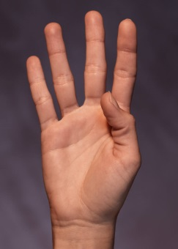
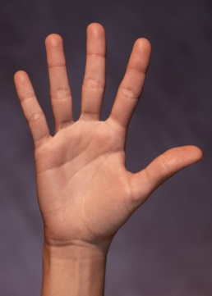
We Count With Numbers Can you show me?
The number four?
four knocks on the door, four steps on the floor,
one, two, three, four
The number five?
five ins and outs, five hops all about,
one, two, three, four, five
The number six?
six claps to the beat, six kicks with our feet,
one, two, three, four, five, six
Notes:
Activity 5: We Count with Numbers–continued
Presenter Remarks:
The number four?
four knocks on the door, four steps on the floor,
one, two, three, four
The number five?
five ins and outs, five hops all about,
one, two, three, four, five
The number six?
six claps to the beat, six kicks with our feet,
one, two, three, four, five, six

Slide 42
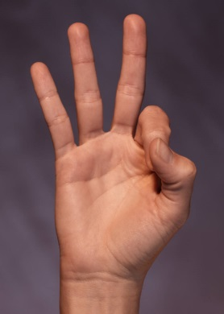
We Count With Numbers Can you show me?
The number seven?
seven taps on your knee, seven climbs up a tree,
one, two, three, four, five, six, seven
The number eight?
eight ups and down, eight marches around,
one, two, three, four, five, six, seven, eight
The number nine?
nine flaps on the sides, nine slides and glides,
one, two, three, four, five, six, seven, eight, nine
Notes:
Activity 5: We Count with Numbers–continued
Presenter Remarks:
The number seven?
seven taps on your knee, seven climbs up a tree,
one, two, three, four, five, six, seven
The number eight?
eight ups and down, eight marches around,
one, two, three, four, five, six, seven, eight
The number nine?
nine flaps on the sides, nine slides and glides,
one, two, three, four, five, six, seven, eight, nine

Slide 43
We Count With Numbers Can you show me?
The number ten?
ten circles with your wrist, ten turns and twists, one, two, three, four, five, six, seven, eight, nine, ten
Table talk one: Discuss how the song represents universal design for learning.
Table talk two: How many motor skills were integrated into the song?
Notes:
Activity 5: We Count with Numbers–continued
Presenter Remarks:
The number ten?
ten circles with your wrist, ten turns and twists, one, two, three, four, five, six, seven, eight, nine, ten
Table talk one: Discuss how the song represents universal design for learning.
Table talk two: How many motor skills were integrated into the song?

Slide 44
Pulling It All Together
How did the song represent the foundations?
How did the song represent Universal Design for Learning?
How did the song illustrate Guiding Principles and Environmental Factors?
How could the song be modified for children with specials needs or English learners?
How many motor skills can you list that were included in the song?
Notes:
Presenter Remarks:
We just experienced several of the concepts discussed today. With your table group, consider and discuss the questions on the slide.
Allow five minutes for discussion and invite table groups to share out.

Slide 45
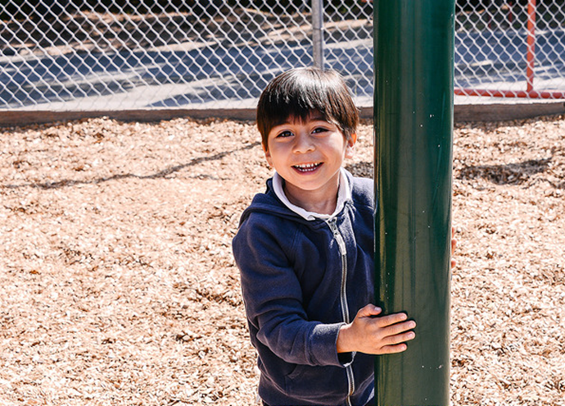
Vignettes
Interactions and
Strategies
©2017 California Department of Education
Notes:
Presenter Remarks:
Each chapter has numerous vignettes to illustrate typical classroom scenarios. Vignettes are in italicized typestyle and are identified in the column to the left with the word VIGNETTE in bold. Immediately following each Vignette are Interactions and Strategies for each strand.

Slide 46
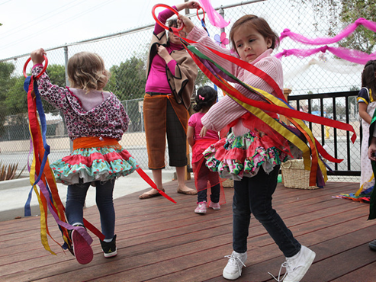
Important Considerations
Cultural Understanding
English Learners
©2017 California Department of Education
Notes:
Presenter Remarks:
Let’s begin to wrap up the training by addressing a few more important considerations when teaching physical development to young children: cultural understanding, English learners, inclusion, children with disabilities and engaging families.
“Children in California come from diverse cultures. In these diverse cultures, the importance of physical activity to children’s socialization and expectations about parental involvement in children’s active physical play vary. For example, some children are sent to school in their best clothes and are not encouraged to engage in the rough-and-tumble play that promotes the development of fundamental movement skills. In other families, physical activity is regarded as less important than intellectual activities, such as being read to, learning the sounds of letters, or using a computer” (PLF, Vol. 2, p. 39).
Consider the values and beliefs of children in your classroom as you plan movement opportunities that develop physical skills.
Become familiar with the culture, ethnicity, and background of families. Open communication with parents and caregivers to better meet the needs of children.
Knowing what we know today about childhood obesity and the way the brain works, teachers can assist families in changing their views and be more proactive toward their children’s involvement in physical activities.

Slide 47
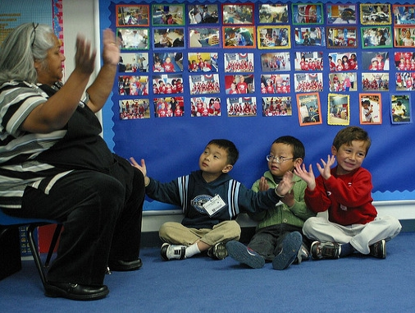
Inclusion
Children with Disabilities
©2017 California Department of Education
Notes:
Presenter Remarks:
“Inclusion is the full acceptance of all students and leads to a sense of belonging within the community” (Florida State University Center for Prevention & Early Intervention Policy, Inclusion White Paper, What is Inclusion?, p. 1).
Through the physical development domain, TK educators can use universal design to promote inclusion of:
Students’ culture
Teacher’s culture
Students’ ability
Students’ interests
Teacher’s interests
Children with disabilities:
Research children who have disabilities, check their IEPs (if available) and work with the families who can share insights as to what works best for their child. Use your resources.
Children vary in the spectrum of disabilities and within a disability. They need physical development just like any other child.
Children with disabilities go through the exact same sequences and stages of development as mainstream children do. The difference is that they take a bit longer in most cases.
Another important consideration is that, depending on the child’s disability, he/she may need to adjust the movement, or the teacher may need to adjust the equipment.
Teachers will be rewarded when they get involved and enjoy activities at the child’s level of participation.

Slide 48
Engaging Families
Parent Opportunities Invite parents to share cultural games/songs/ activities when they volunteer.
Family Fun Nights Schedule special events.
Communication Create newsletters and post pictures in classroom.
Notes:
Presenter Remarks:
Empower families on the importance of developing motor skills and how they can incorporate physical activity into their routine. Encourage families to participate together – going on a walk, playing at a park, playing catch with homemade props, designing an obstacle course in the home. Parents who model physical activity have more active children and they begin to set a lifetime of physical activity.
Communicate with families on the importance of allowing children opportunities for play. Share information on physical development via newsletters, emails, and by posting pictures of children being active at school to remind parents of fundamental movement skills.
Parent opportunities include inviting parents to share cultural games/songs with the classroom or volunteer in the classroom and experience the daily activities including movement experiences they can share with their family. Empower parents with knowledge and share information on how physical activity enhances other domains. Share the importance of fundamental movement skills and how families may incorporate motor skills into their daily life such as ask a child to gallop/skip when walking to the grocery store or stand on one foot and balance while waiting in line.
Family Fun Nights are special events where parents are invited with their children to partake in an activity that is planned with fun activities and healthy lifestyle messages.

Slide 49
The End of Each Chapter
Bringing it All Together
Engaging Families
Questions for Reflection
Finally…
Each chapter ends with:
Teacher Resources
Endnotes
Bibliography
Don’t Overlook…
Appendices
Glossary
Notes:
Presenter Remarks:
The Bringing it All Together section begins with a vignette that integrates the substrands into one scenario. Following the vignette is an explanation of what the teacher did and why.
The Engaging Families section has ideas for teachers to pass on to families in conferences, workshops, newsletters, etc.
Finally, the Questions for Reflection guides teachers to reflect on their practice and plan for implementation of new strategies learned in the strand section.
These features are located at the end of the domain chapter. The Teacher Resources have been contributed by California’s Early Childhood community.
The Glossary begins on p. 286 in Preschool Curriculum Framework, Volume 2, and p. 61 in the Preschool Learning Foundations, Volume 2.

Slide 50
In Summary
Physical development impacts the overall development of children.
Physical development supports young children’s brain development.
The early years are critical for the foundation of movement skills.
Physical activity and development contributes to the formation of healthy habits that can last a lifetime and prevent the risks associated with obesity.
Notes:
Presenter Remarks:
This is a summary of today’s key points. Take a moment to read the slide and then we will finish the day by sharing out thoughts with each other.
Extra Notes:
Summary continues onto following slide.
.

Slide 51
In Summary—Continued
Culture, beliefs, and values need to be infused in physical development activities (meaningful activities).
Inclusion and diverse needs of children need to be addressed and are of paramount importance for the physical development of all children.
Teachers, families, and caregivers are important contributors for children’s learning in the physical domain.
Notes:
Presenter Remarks:
Continue reading the slide and we will share our thoughts in a moment.

Slide 52
Sharing Forum
Take at least five steps to find a partner and share your answers:
What is your overall training impressions?
Do you have other additional resources/tools to share?
What is one new activity/strategy you are inspired to implement?
Notes:
Presenter Remarks:
Let’s finish with a sharing forum. Stand and move one last time today by taking at least five steps to find a partner.
Look at the questions on the screen and discuss with your partner.
After sharing one thing you are going to implement, high five and walk back to your table group.

Slide 53
Thank you for moving and learning!
©2017 California Department of Education
Notes:
Presenter Remarks:
Thank you for coming. We hope you enjoyed moving and learning with us.

Slide 54
Reference Guide for PowerPoint Citations
California Department of Education. 2011. California Preschool Curriculum Framework, Volume 2. http://www.cde.ca.gov/sp/cd/re/documents/psframeworkvol2.pdf (accessed October 3, 2016).
California Department of Education. 2010. California Preschool Learning Foundations, Volume 2. http://www.cde.ca.gov/sp/cd/re/documents/psfoundationsvol2.pdf (accessed October 3, 2016).
Centers for Disease Control and Prevention. Trends in the Prevalence of Extreme Obesity Among US Preschool-Aged Children Living in Low-Income Families, 1998-2010. JAMA. 2012; 308 (24): 2563-2565.
International, Inc. Advanced Solutions. "Active Start Active Start: A Statement of Physical Activity Guidelines for Children From Birth to Age 5, 2nd Edition.“ Active Start. http://portal.shapeamerica.org/standards/guidelines/activestart.aspx. (accessed May 04, 2017).
Florida State University Center for Prevention & Early Intervention Policy (2002). What is Inclusion? Including School-Age Students with Developmental Disabilities in the Regular Education Setting. Florida State University Center for Prevention & Early Intervention Policy. http://staff.pausd.org/~areyes/B_Park_Inclusion/Resources/Resources_files/%20what%20is%20inclusion.pdf (accessed May 3, 2017).
Jensen, Eric. Teaching with the brain in mind. Alexandria, VA: Association for Supervision and Curriculum Development, 2005.

Slide 55
Reference Guide for PowerPoint Citations
Pan, Liping, Heidi M. Blanck, Bettylou Sherry, Karen Dalenius, and Laurence M. Grummer-Strawn. "Trends in the Prevalence of Extreme Obesity Among US Preschool-Aged Children Living in Low-Income Families, 1998-2010." Jama 308, no. 24 (2012): 2563. doi:10.1001/jama.2012.108099.
Ratey, John J. Spark: The Revolutionary New Science of Exercise and the Brain. New York: Little, Brown and Company, 2008.
Seefeldt, Vern. “Sequential Progression in the Achievement of Motor Proficiency.” Michigan State University, 1974.
"The State of Obesity: Better Policies for a Healthier America." Resources: The State of Obesity. June 2016. http://stateofobesity.org/files/stateofobesity2016.pdf (accessed May 04, 2017).
"US Data & Trends Redirect." Centers for Disease Control and Prevention. April 04, 2012. Accessed May 04, 2017. http://www.cdc.gov/diabetes/statistics.

