Slide 1
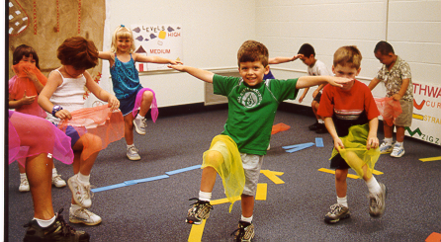
Physical Development in Transitional Kindergarten:
Perceptual-Motor Skills and Movement Concepts
©2017 California Department of Education (CDE) with the WestEd Center for Child & Family Studies, California Preschool Instructional Network (CPIN). (05/2017)
Notes:
Presenter Remarks:
Welcome to Physical Development in Transitional Kindergarten: Perceptual-Motor Skills and Movement Concepts presentation focusing on the California Preschool Learning Foundations (Preschool Learning Foundations or PLF), the California Preschool Curriculum Framework (Preschool Curriculum Framework or PCF), and other California Department of Education (CDE) resources in support of the Physical Development domain.
This professional learning session is specifically designed to provide TK teachers with exposure to CDE resources that support TK curriculum planning of developmentally appropriate strategies. Classroom environment design recommendations are included to support the content area of perceptual-motor skills and movement concepts.

Slide 2
Objectives
Become aware of key concepts from the California Preschool Learning Foundations, Volume 2—Physical Development domain, Perceptual-Motor Skills and Movement Concepts.
Explore the developmental continuum of perceptual-motor skills and movement concepts and develop strategies that will guide instruction and learning in transitional kindergarten (TK).
Discuss current research underlying the teaching strategies used to support the development of perceptual-motor skills.
Practice using the Preschool Learning Foundations and Preschool Curriculum Framework to intentionally plan age-appropriate, developmentally appropriate, cultural and inclusive strategies that promote perceptual-motor skills and movement concepts.
Notes:
Presenter Remarks:
This slide shows what we will cover in today’s training.
Objectives:
Become aware of key concepts from the California Preschool Learning Foundations, Volume 2—Physical Development domain, Perceptual-Motor Skills and Movement Concepts.
Explore the developmental continuum of perceptual-motor skills and movement concepts and develop strategies that will guide instruction and learning in transitional kindergarten (TK).
Discuss current research underlying the teaching strategies used to support the development of perceptual-motor skills.
Practice using the Preschool Learning Foundations and Preschool Curriculum Framework to intentionally plan age-appropriate, developmentally appropriate, cultural and inclusive strategies that promote perceptual-motor skills and movement concepts.

Slide 3
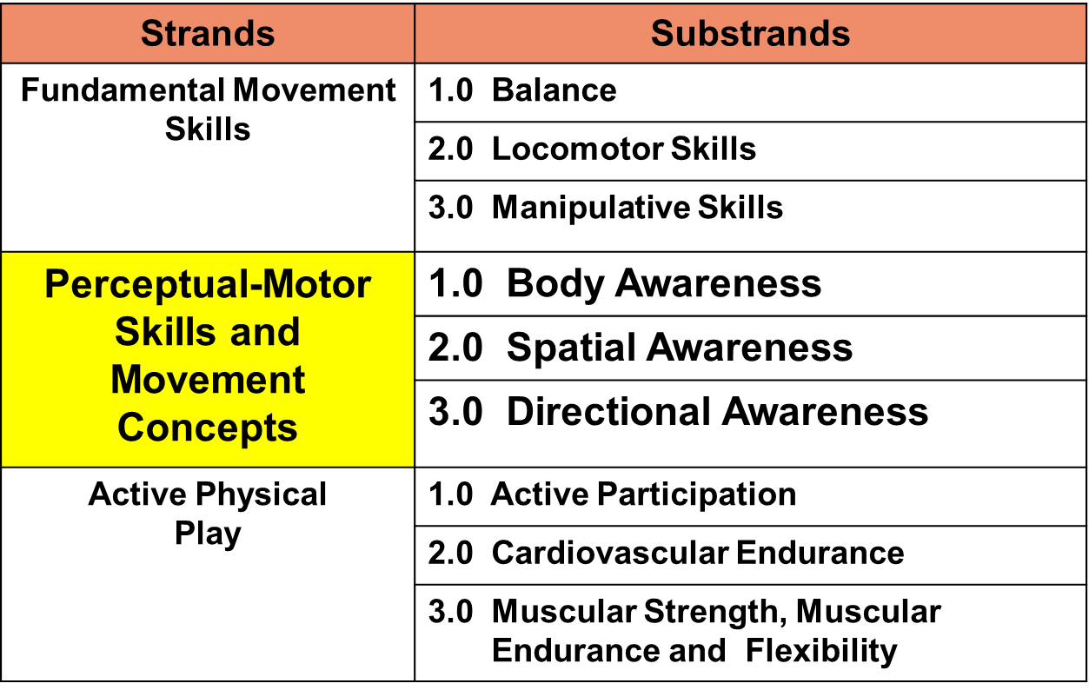
Perceptual-Motor Skills and Movement Concepts
Notes:
Background Information:
Refer participants to Handout 1: Physical Development Domain Alignment.
Presenter Remarks:
Perceptual-Motor Skills and Movement Concepts is the second strand in Physical Development, it consists of three substrands: Body Awareness, Spatial Awareness, and Directional Awareness. Each substrand will be explored in this training.
Take a moment to read the definitions of body, spatial and directional awareness in the handout.

Slide 4
Perceptual-Motor Skills and Movement Concepts
Perceptual-motor coordination is the process of receiving, interpreting, and using information from all of the body’s senses.
Movement concepts are the cognitive components of movement.
(PCF, Vol. 2, p. 176)
©2017 California Department of Education
Notes:
Presenter Remarks:
“Perceptual-motor coordination is the process of receiving, interpreting, and using information from all of the body’s senses” (PCF, Vol. 2, p. 176).
“Movement concepts are the cognitive components of movement” (PCF, Vol. 2, p. 176).
Children gain important knowledge about how the body can move in an almost endless variety of ways.

Slide 5




Daily Physical Activity Recommendations
Notes:
Background Information:
2008 Physical Activity Guidelines for Americans (PAG) (http://www.cdc.gov/nchs/data/databriefs/db141.htm)
Presenter Remarks:
It is widely recognized that many organizations are consistent in their daily physical activity recommendations for young children—to accumulate at least 60 minutes and up to several hours of physical activity every day of the week.
Again, the minutes are to be accumulated and should be spread throughout the day in short bouts that are developmentally appropriate and fun.
Refer to Handout 2: Physical Activity Recommendations for Young Children.
Active Start is a widely recognized national document with physical activity recommendations for infants, toddlers, and preschoolers.
The 2008 Physical Activity Guidelines for Americans (PAG), which have been adopted by the First Lady Michelle Obama’s Let's Move! initiative and the American Academy of Pediatrics, recommend that youth participate in daily moderate-to-vigorous physical activity for at least 60 minutes.
California Department of Education policies require, at minimum, 200 physical education minutes every 10 days in elementary grades 1-6. Preparing children in TK and kindergarten for physical activity is highly recommended.

Slide 6
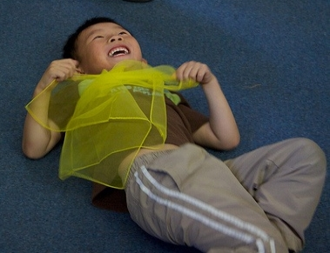
Active physical play provides
children with movement opportunities
to develop perceptual-motor skills and movement concepts.
©2017 California Department of Education
Notes:
Presenter Remarks:
Meeting daily physical activity recommendations through movement opportunities will provide young children with Active Physical Play (3.0 in Physical Development) that will develop Perceptual-Motor Skills and Movement Concepts in the Physical Development domain.

Slide 7

Community Building
Find a partner and introduce yourself!
Hello!
Notes:
Activity 1: Community Building with Balloons
Presenter Remarks:
How familiar are you with the vocabulary of perceptual motor skills and movement concepts? This community building activity requires cooperative play and the use of a manipulative. Today we are going to use balloons to illustrate how movement vocabulary can be integrated into active physical play for people of all ages – students, staff and families. If your site/center/district has a policy against balloons, other items can be used (Nerf balls, pillows, beach balls, etc.).
intent:
This activity cooperatively engages participants in a community building activity illustrating vocabulary for perceptual motor skills and movement concepts using balloons.
OUTCOMES:
Participants will cooperatively engage in partner and small group activities involving balloons, as well as identify perceptual motor skills and movement concepts. Discuss vocabulary in small groups after activity.
Materials Required:
Balloons, 1/pair (extra balloons are needed in case balloons pop)
1-2 balloon pumpers (to speed up inflating balloons)
Music and music player (trainer’s choice)
Open space free of obstacles
Optional: Large trash bag to store balloons, recycled plastic grocery bags or beach balls for individuals with latex allergies
Time: 5 minutes
Process:
Prepare participants for movement with ample space for movement, push in chairs/bags/tote, be aware of objects or others nearby, check shoes (move with caution if shoes are not flat or secured to feet). Remind participants to work within their limitations and move into open space. Cue music.
Ask participants how familiar they are with vocabulary for perceptual motor skills and movement concepts.
See balloon instruction prompts below.
Balloon Instruction Prompts (Music can be played in background if desired.)
Ask participants how familiar they are with perceptual motor skills and movement concepts vocabulary. This community building activity illustrates how balloons can introduce and reinforce movement vocabulary through active physical play. This activity can be used with all ages. Teachers can use it with children for development of perceptual-motor skills and movement concepts, as well as with parents at a parent meeting illustrating how play can enhance motor development in young children. Staff can use it as a physical activity break during a long meeting.
When I say GO, find a partner about your same height and introduce yourself. Decide who will be a kiwi and who will be a papaya. If you are the kiwi, please pick up one balloon for you and your partner.
Stand side-to-side, place the balloon between your hips – no hands allowed. Begin moving in open space when you hear the music and freeze when the music stops. Communicate with your partner so you don’t lose your balloon. Allow 15-20 seconds of movement.
Stand front-to-front, place the balloon between your bellies – no hands allowed. Begin moving in open space when you hear the music, and freeze when the music stops. Allow 15-20 seconds of movement.
Stand back-to-back with knees slightly bent, one partner holds the balloon. On GO, twist and turn going from side to side, exchanging the balloon with your partner. Allow 10 seconds, otherwise dizziness may occur.
Remain back-to-back, place the balloon between your back. Begin moving in open space when you hear the music, and freeze when the music stops. Allow 15-20 seconds of movement.
Remain back-to-back again with a little space in between. One partner bends forward and passes the balloon between their legs to the other partner who is also bending forward. Then stretch up high overhead and pass the balloon to your partner. Keep bending and stretching as you pass the balloon from low to high. Allow 10 seconds, otherwise dizziness may occur.
Combine your pair with another pair and stand in a straight line, balloons between your bellies and backs. (The first person in line holds their balloon.) Begin moving in open space when you hear the music, and freeze when the music stops. Move slowly so you don’t lose a balloon!
In your small group, discuss vocabulary terms you heard during our community building activity. Were there additional domains of learning that this activity connects to?
OPTIONS:
If an odd number exists, trainer can be a partner or have a group of three.
Additional substitution items include Nerf balls, bean bags, stuffed animals, beach balls, etc.

Slide 8
Perceptual-Motor Skills and Movement Concepts Strands and Substrands
Refer to Preschool Learning Foundations, Volume 2, pages 51-54, or Handout 3: Perceptual Motor Strand and Substrands.
Read the three awareness substrands and examples.
How did the last activity address these substrands?
How could you adapt the activity to further address the substrands?
How could you integrate the substrands into other domains?
Notes:
Background Information:
Refer to Preschool Learning Foundations, Volume 2, pp. 51-54, and/or to Handout 3: Perceptual Motor Strand and Substrands.
Presenter Remarks:
Follow the directions on the slide. Discuss the questions in table groups.

Slide 9
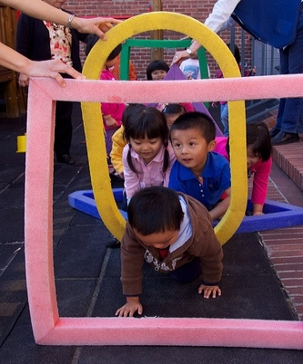
Perceptual-Motor Skills and Movement Concepts develop through integration
into the:
School or TK curriculum
Daily lives of children at home
©2017 California Department of Education
Notes:
Presenter Remarks:
Physical activity can be integrated into every domain through intentional planning. The Preschool Learning Foundations’ domains contain opportunities to connect physical activity seamlessly. The adults in this picture are actively involved in helping the children crawl through the shapes by holding the foam shapes for them. Children can be asked about the shapes or colors, as well as asked to verbally explain how their bodies move through the shapes to incorporate vocabulary.
“Being physically active boosts children’s attention span and capitalizes on multisensory learning so that children are more likely to retain academic concepts such as colors, shapes and the alphabet” (PCF, Vol. 2, p. 137).
Interspersing physical activity throughout the day with learning experiences makes it developmentally appropriate and more meaningful.

Slide 10
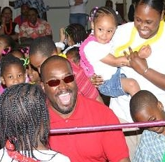
Information with Families
Communication
Use newsletters or post pictures in the classroom.
Parent Opportunities
Invite parents to share cultural games/songs/ activities when they volunteer or empower them with knowledge during meetings.
Family Fun Nights
Schedule special events.
Notes:
Presenter Remarks:
Educate families on the importance of children developing motor skills. Provide information on how families can incorporate physical activity in at-home routines. Encourage families to participate in physical activities together by going on walks, playing at a park, playing catch, and designing indoor and outdoor obstacles courses at home. Remind parents that children who have physical activities modeled for them, have more active children who will likely enjoy a lifetime of physical activity.
Communication: Communicate with families about the importance of encouraging children to physically play. Share information on physical development in newsletters, emails, and photographs of active children.
Parent Opportunities: Invite parents to share cultural games/songs with children in the classroom. Encourage family members to volunteer in the classroom and experience the daily activities including movement experiences they can share at home.. Empower parents with knowledge and share information on how physical activity enhances other domains. Share physical movement that can development motor skills in daily life such as going to the grocery store by walking, skipping, galloping, and hopping. Parents can encourage children to remain active while waiting in the check-out line by standing on one foot and balancing.
Family Fun Nights: Family Fun Nights are special events when parents and other family members can participate in physical activities with children. Fun activities and healthy lifestyle messages will encourage families to extend motor development beyond the classroom.(Note: For additional information on planning Family Fun Nights, see Activity Plan 8: Family Fun Night Blueprint in Fundamental Movement Skills on the CPIN website.)

Slide 11



Understanding the Link Between Preschool and Kindergarten
Preschool
Kindergarten
TK
Notes:
Presenter Remarks:
Today we are focusing on coming to a better understanding of the linkage between preschool and kindergarten in physical development. How do we meet the needs of TK for physical development with best practice and research-based evidence as well as developmentally appropriate strategies?

Slide 12
Why Use the Preschool Learning Foundations in TK?
CA Law (EC 48000):
Transitional kindergarten is the first year of a two-year kindergarten program that uses a modified kindergarten curriculum that is age and developmentally appropriate.
Transitional kindergarten programs are intended to be aligned to the California Preschool Learning Foundations developed by the California Department of Education.
Notes:
Background Information:
CDE.CA.gov/ci/gs/em/kinderfaq.asp#program
Presenter Remarks:
The state of California provides guidance on utilizing the Preschool Learning Foundations and the Preschool Curriculum Framework as planning and curriculum resources in the TK classroom.
In addition, the following publications and resources are available to support age and developmentally appropriate TK curriculum:
Active Start
Alignment Document
TK Implementation Guide
DRDP-K (2015)
PE Model Content Standards
PE Framework
CA CCSS

Slide 13









CDE Publications and Resources that Support TK Implementation
Alignment Document
Developmentally Appropriate
Practice
DRDP Specific to TK and K
Preschool Curriculum Framework
Physical Education Model Content Standards for CA Public Schools, K-12
Physical Education Framework for CA Public Schools, K-12
Preschool Learning Foundations
Transitional Kindergarten Implementation Guide
California Common Core State Standards
Preschool Learning Foundations
Preschool Curriculum Framework
Active Start
Alignment Document
Transitional Kindergarten Implementation Guide
California Common Core State Standards
DRDP Specific to TK and K
Physical Education Model Content Standards for CA Public Schools, K-12
Physical Education Framework for CA Public Schools, K-12
California Common Core State Standards
Notes:
Presenter Remarks:
The California Department of Education has developed many publications, resources, and supports that enable teachers to facilitate the most positive outcomes for students.
Today our main focus will be the on the Preschool Learning Foundations and the Preschool Curriculum Framework, Volume 2, Physical Development domain.
There are additional key resources that support physical development in young children. We will also discuss alignment and make connections to additional resources pictured in the graphic (name and hold up each resource): The Alignment of the California Preschool Learning Foundations with Key Early Education Resources (Alignment Document), the Transitional Kindergarten Implementation Guide – A Resource for Public School District Administrators and Teachers (TK Implementation Guide), the Desired Results Developmental Profile—Kindergarten (2015): A Developmental Continuum for Kindergarten (DRDP-K [2015]), Physical Education Model Content Standards for California Public Schools, Kindergarten Through Grade Twelve (PE Model Content Standards), the Physical Education Framework for California Public Schools (PE Framework), and the California Common Core State Standards (CA CCSS).
Early educators typically include physical movements in their daily teaching. It is best practice to be cognizant of movement and integrate it within all content areas.
What do you know about these documents?
How do you use these resources in your work now?
(Depending on the size of your group, participants can share responses at their table or in pairs.)

Slide 14


Foundations and Framework, Volume 2
The purpose of the Preschool Learning Foundations is to promote a common understanding of young children’s learning and to guide instructional practice.
Notes:
14
Presenter Remarks:
The purpose of the foundations is to promote a common understanding of young children’s learning and to guide instructional practice. The foundations and framework are designed to work together. While the foundations—known as standards in the K-12 arena—provide the background information to understand children’s developing knowledge and skills (the “what”), the curriculum framework offers guidance on how teachers and programs can support the learning and development that are described in the foundations (the “how”).
Handout 3: Perceptual-Motor Skills and Movement Concepts Strands and Substrands shows the strands and substrands we will discuss today.

Slide 15
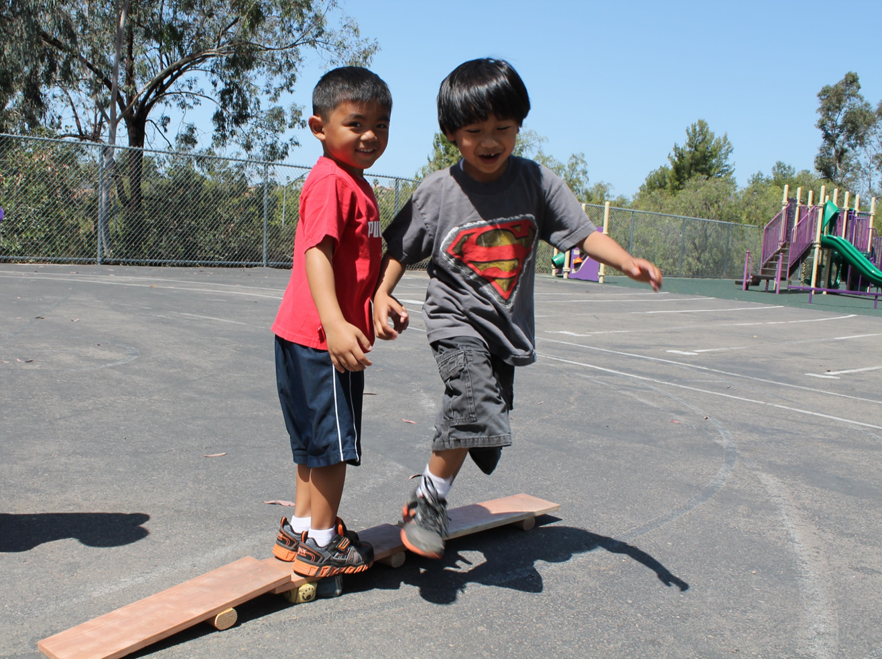
Foundations tell us what children should know and be able to do at around 48 or 60 months.
©2017 California Department of Education
Notes:
15
Presenter Remarks:
Because children develop at different rates the foundations were designed to support the belief that certain stages of development will occur at different times for all students.

Slide 16
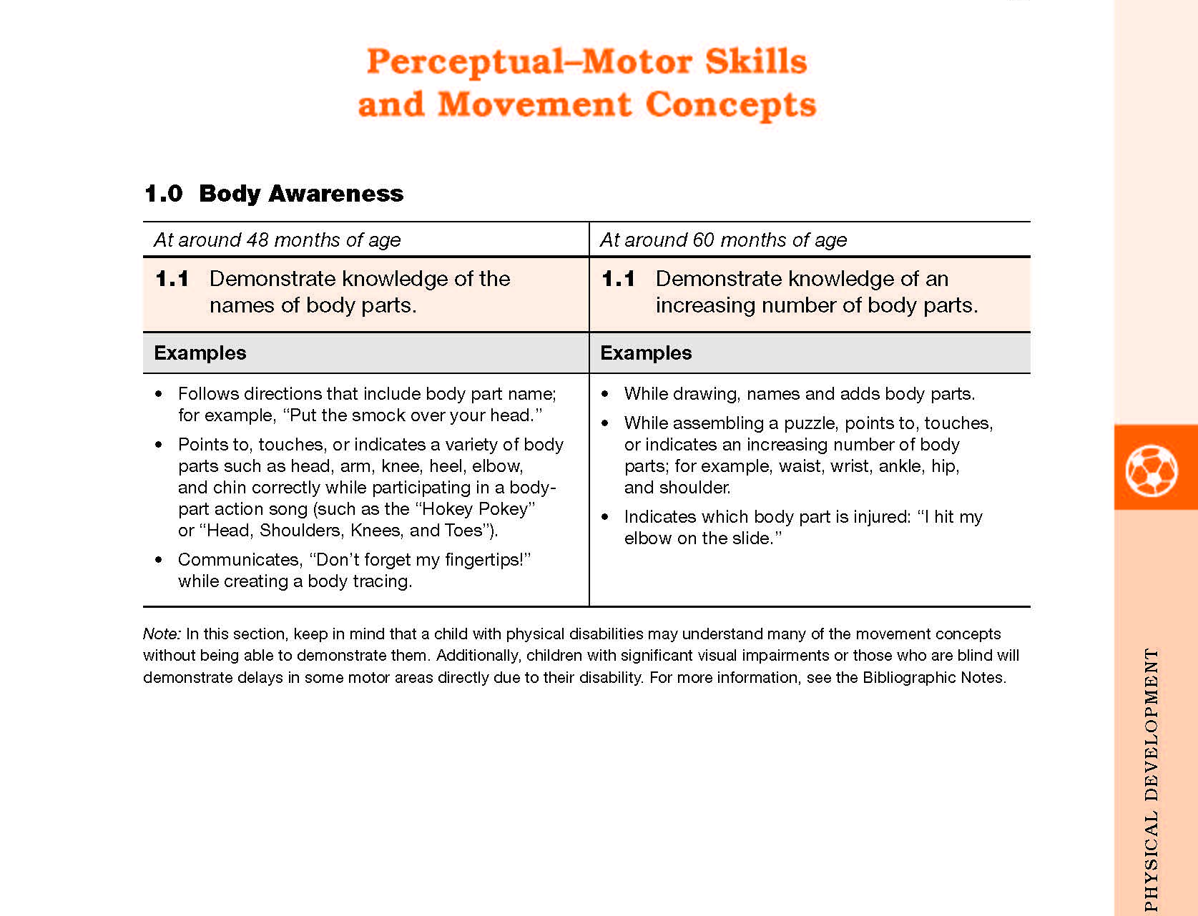
Physical Development Foundations Map
Strand
Substrand
Age
Foundation
Domain
Examples
Examine the developmental progression between 48 and 60 months in the foundation:
What do you notice is developing?
Use the examples to help you think about growth and change.
Footnotes
Notes:
Background Information:
Refer to Handout 4: Perceptual Motor Foundation Map.
Presenter Remarks:
Please locate the Perceptual Motor Foundation Map handout in your folder.
Click and discuss each label individually. Point out:
The name of the domain (Physical Development)
The name of the strand at the top of the table (Perceptual-Motor Skills and Movement Concepts)
The name of the substrand (1.0 Body Awareness)
Note that substrands always end in ".0.“
The two age levels (at around 48 months and at around 60 months)
Each foundation describes typical behaviors at around 48 months and at around 60 months or four to five years old.
The foundations for the substrand
There are two for each age level on this page (1.1 for 48 months and 1.1 for 60 months, 1.2 for 48 months and 1.2 for 60 months).
The examples for each foundation
These are only a few of the ways that children may demonstrate the behavior in the foundation.
Many of the foundations have footnotes that include information specific for students with IEPs or students with disabilities, such as information about adaptations or accommodations.
Notice that there is a developmental progression from four years old to five years old within a substrand.
(Click to reveal prompt.) Examine the developmental progression between 48 and 60 months in your foundation:
What do you notice is developing?
Use the examples to help you think about growth and change.

Slide 17
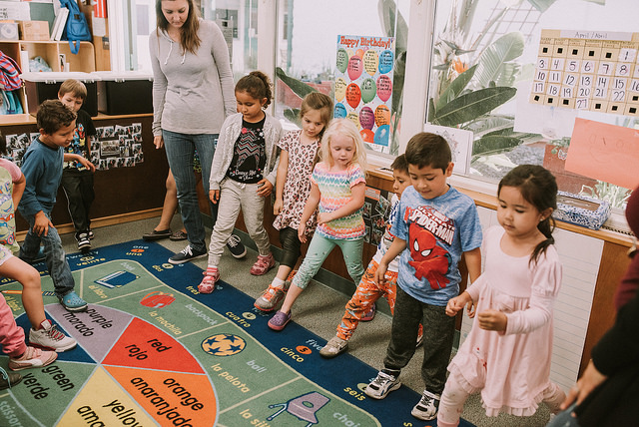
Preschool Learning Foundations
High-quality programs
Appropriate support
Research-based evidence
©2017 California Department of Education
Notes:
Presenter Remarks:
The foundations assume that children have access to appropriate support and high quality programs. This includes:
High Quality Programs:
Environments and experiences that encourage active, playful exploration and experimentation; clearly defined learning centers where materials are rotated
Purposeful teaching to help children gain knowledge and skills; predictable schedules and routines with large blocks of time for play and skillful integration of curriculum with an intentional focus on content
Appropriate Support:
Specific support for English language learners with staff that have knowledge of the stages of English language acquisition
Accommodations and adaptations for children with disabilities and additional support when needed
Research-based:
The Preschool Learning Foundations were developed and enhanced with expert practitioners’ suggestions and examples.
The foundations were written by a team of researchers with expertise in each domain.

Slide 18
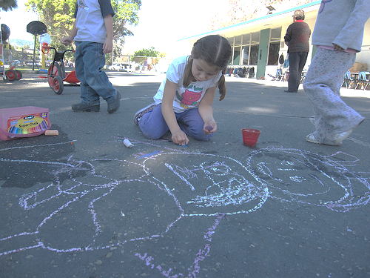
Preschool Curriculum Framework Strategies
Teachable Moments
Interactions & Strategies
Planning Learning Opportunities
Engaging Families
Notes:
Presenter Remarks:
The Preschool Curriculum Framework (PCF) provides practical suggestions for teachers. These sections in the Preschool Curriculum Framework provide specific suggestions including: interactions and strategies, planning learning opportunities, teachable moments, and engaging families.

Slide 19
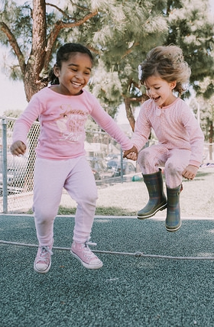
Framework Strategies
Developmentally appropriate
Reflective and intentional
Individually and culturally meaningful
Inclusive
©2017 California Department of Education
Notes:
Background Information:
Refer to the Preschool Curriculum Framework, Volume 2.
Presenter Remarks:
Framework strategies address ideas and concepts that children can grasp at their developmental level and then progressively build on what children already know and understand. This approach applies to all children, including children with various abilities, disabilities, or other special needs such as delays in language, cognition, or physical ability.

Slide 20



Alignment of Physical Development Foundations and PE Model Content Standards
TK
Notes:
Presenter Remarks:
Let’s explore the connection between the Physical Development domain in the Preschool Learning Foundations and the Physical Education Model Content Standards for Kindergarten. (Hold up the Preschool Learning Foundations, the Physical Education Model Content Standards, and the Alignment Document.)
The Preschool Learning Foundations illustrate how important it is for TK teachers to continue to set the foundation for physical development in order to provide an uninterrupted transition from preschool, to TK, and into kindergarten.
20

Slide 21

Alignment Document
Notes:
Presenter Remarks:
The Alignment Document is another resource that will help us to answer questions related to developmental progressions.
The Alignment Document emphasizes that high-quality early learning is the foundation of a successful K-12 educational system. The knowledge and skills of young children are foundational to their future learning.
Understanding the links between different ages and different early childhood stages allows educators to build on children’s earlier learning and prepare them for the next educational challenge.
Find Handout 5: Fundamental Movement Skills Domain Alignment and take a moment to review it. Allow two minutes to review.
Discuss the following questions with your table group. Allow three minutes for discussion.
What do you know about this document?
How do you currently use it in your work?
Extra Notes:
Depending on the size of the group, participants can share responses with table partners or in pairs.

Slide 22
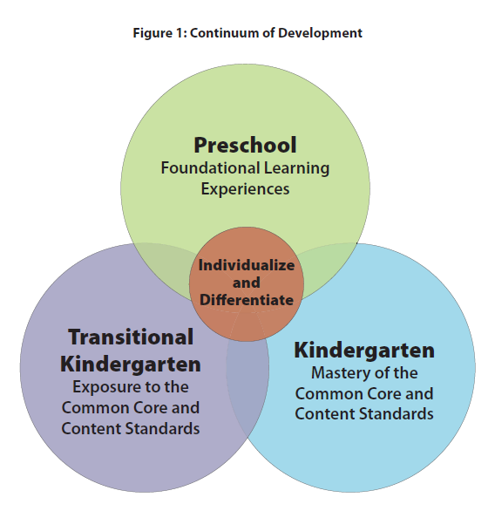

TK Implementation Guide
Notes:
Presenter Remarks:
Early learning experiences should be meaningful and integrated across subject areas. Learning should also include experiential and hands-on activities in real contexts. Introduce the TK Implementation Guide.
“Successful TK programs are the result of thoughtful teacher reﬂection and planning. The TK teacher has a thorough understanding of the TK curriculum and understands the critical skills and concepts for each subject area. TK teachers understand the developmental trajectories of their students and identify the standards for learning that align with both students’ assessed needs and eﬀective instructional strategies (see chapter 4). TK teachers create cohesive curriculum plans that are reﬂective of individual and group learning needs. Decisions about what to teach in a TK classroom are guided by key CDE resources, including the…alignment document. Guidelines for selecting and adapting curriculum materials and lessons help TK teachers plan engaging encounters that address learning standards” (Transitional Kindergarten Implementation Guide: A Resource for California Public School District Administrators and Teachers [CDE], p. 36).
“Furthermore, teachers who understand that all students beneﬁt from diﬀerentiated instruction will ﬁnd that the tools, curriculum, and routines they use to support typically developing children are easily adapted or modiﬁed to accommodate students with disabilities” (Transitional Kindergarten Implementation Guide: A Resource for California Public School District Administrators and Teachers [CDE], p. 52).

Slide 23
Overview of Alignment
California Preschool Learning Foundations | California Kindergarten Content Standards | Common Core State Standards
Social-Emotional Development | Health, Education Mental, Emotional, and Social Health
Language and Literacy | English-Language Arts | English-Language Arts
English-Language Development | English-Language Development | ELDA Framework
Mathematics | Mathematics | Mathematics
Visual and Performing Arts | Visual and Performing Arts
Physical Development | Physical Education
Health | Health Education
History-Social Science | History-Social Science
Science | Science | Next Generation Science
Notes:
Presenter Remarks:
Let’s look more in depth at the Alignment of the California Preschool Learning Foundations with Key Early Learning Education Resources. This table represents an overview of the alignment among the nine domains of the Preschool Learning Foundations with the content of the CA Standards and the Common Core State Standards (CCSS).
The alignment demonstrates that early learning is a significant part of the educational system and that the knowledge and skills of young children are foundational to future learning.
Understanding the links between the different ages and different early childhood services allows educators to build on children’s earlier learning and prepare them for the next educational challenge.
All domains of the Preschool Learning Foundations correspond to the California Kindergarten Content Standards.
Visual and Performing Arts, Physical Development, Health, History-Social Science and Science are all separate domains in the Preschool Learning Foundations. The Physical Development domain in the Preschool Learning Foundations provides a developmental foundation that corresponds with the California Physical Education Standards, K-12.
The Common Core includes English Language Arts & Literacy in History/Social Studies, Science, and Technical Subjects.
23

Slide 24


PE Model Content Standards and PE Framework
Find and read Handout 6: Physical Education Content Standards.
What do you notice?
Notes:
Presenter Remarks:
Take out Handout 6: Physical Education Content Standards and read through the standards for kindergarten. What do you notice?
Solicit responses. Remind participants that there are five standards and the standards are the same for each grade level, recognizing that each grade has different ages and levels of developmentally appropriate development.
This handout provides a more detailed look at each physical education content standard and correlating examples. As you likely noticed, many of the developmental skills introduced and practiced in pre-K are continued through TK and into kindergarten. Having an awareness of children’s physical development during the early years is best practice for all early childhood educators.

Slide 25

DRDP-K (2015)
An observation-based assessment tool, not a test
Individual child assessment
Completed by each child's teacher
Based on developmental research and theory
Includes developmental sequences of behaviors along a continuum
Spans the developmental continuum of children in a two-year kindergarten program
Notes:
Presenter Remarks:
The DRDP-K (2015) informs teachers' understanding of the developmental continuum.
One key feature of the DRDP-K to consider is that it is an observation-based assessment too and not a test. It is used to support children's learning.
Observing and documenting children's progress provides teachers with the information that they need to differentiate instruction and experiences. It also provides information to individualize.
Observational tools are preferred over criterion-referenced tools because the information gathered by observation more accurately reflects what children are able to do. Understanding what children are able to do allows teachers to better plan for activities that will meet and appropriately challenge children's developmental needs.
Other features of the DRDP-K (2015) include:
It is an individual child assessment that can be shared with families.
It is aligned with the Preschool Learning Foundations.
It opens up the opportunity for articulation between preschool and TK teachers.
Sharing information as to where children are on the developmental continuum can better prepare TK teachers to work with students.
It allows teachers to include a request form for previous records as part of TK registration, to help support the relationships between preschool, family, and TK.
The DRDP-K (2015) has been developed with world-renowned experts. It is based on research and knowledge regarding what is most important for predicting school success.

Slide 26
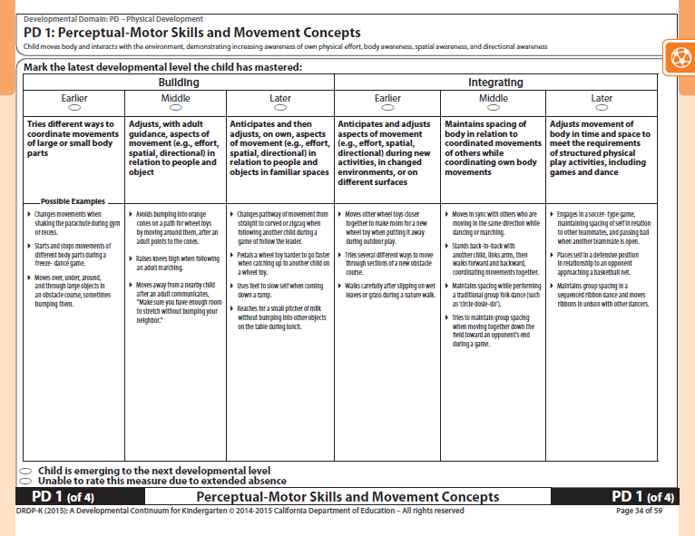
DRDP-K (2015)
Perceptual-Motor Skills and Movement Concepts
Notes:
Presenter Remarks:
Refer to Handout 7: DRDP-K Perceptual-Motor Skills and Movement Concepts.
The physical development measures for Perceptual-Motor Skills and Movement Concepts are located on page 34 in the DRDP-K (2015) document. The measure is PD 1: Perceptual-Motor Skills and Movement Concepts.
It is important for participants to understand that the foundations describe the knowledge and skills that all young children typically exhibit:
at about 48 and 60 months of age
as they complete their first or second year of preschool
with appropriate support and
when attending a high-quality preschool program
The DRDP is the child observational assessment instrument that is used by teachers to record a child’s progress on a developmental continuum.

Slide 27
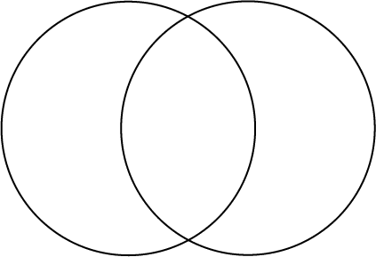
Understanding the Link Between Preschool and Kindergarten
Pre-K
TK
K
Introduction and Practice of Motor Skills
Introduction of Movement Combinations
Motor Skill Practice and Complexity
Notes:
Presenter Remarks:
Refer to Handout 3: Perceptual Motor Strands and Substrands, Handout 6: CA P.E. Content Standards for Kindergarten, Handout 7: DRDP-K Perceptual-Motor Skills and Movement Concepts Measure (PD 1), and Handout 8: Movement Charts. This slide demonstrates the connection and overlap between preschool, transitional kindergarten and kindergarten.
Click on each Venn Diagram section on the slide separately noting the following information:
Pre-K: Pre-K is a time when young children should be introduced, and given time to practice, many motor skills. Handout 8: Movement Chart mentions many of the skills teachers should be introducing to preschool aged children.
K: In kindergarten, young children are given more time to practice and refine motor skills and have built in complexity by combining one or more motor skills. Glance through the Handout 7: DRDP-K measure and the Handout 8: CA PE Content Stands for Kindergarten and note the added complexity and development for motor skills. Allow 2-3 minutes.
TK: TK is a time for added practice and refinement of motor skills as well as the introduction of movement combinations.
With your table, review the handouts and discuss how to create movement combinations for TK children that will bridge the gap from pre-K to kindergarten.
Total time allocation: Approximately 8 minutes
27

Slide 28

Dance Freeze
Start and stop song.
Use auditory discrimination.
Practice/review locomotor and non-locomotor skills, balance skills and active physical play.
Build in complexity and movement combinations.
Notes:
Activity 2: Dance Freeze
Presenter Remarks:
Invite audience to push in chairs and move safely in the area. Another song may be used if desired. Start and stop music segments every 20 seconds.
This start and stop song provides opportunities for practicing a variety of movement skills that include many perceptual-motor and movement concepts. In addition, locomotor and non-locomotor skills, balance skills and active physical play are reviewed from Fundamental Movement Skills and Active Physical Play. This song is instrumental. It can be used and modified in a variety of movement opportunities.
Let’s get started. When I say GO, walk into the open space area and listen for the first movement prompt. When the music stops, remember to freeze. GO!
intent:
This song engages participants while integrating perceptual motor skills, movement concepts, locomotor and non-locomotor skills, balance, as well as active physical play that requires young children to use auditory discrimination skills as they start and stop to music.
OUTCOMES:
Participants actively participate in the song, responding to movement prompts as they practice and integrate various motor skills. Participants record/discuss perceptual-motor skills and movement concepts reflected in the song.
Materials Required:
Song: Dance Freeze, by Angela Russ, CD: Smart Moves 2
(www.ABridgleClub.com)
Music player
Movement prompts (see next page).
Open space (indoors or outdoors) for each participant to move safely
Optional: Chart paper and markers, 1 per table
Time:
3-4 minutes
Process:
Prepare participants for movement. Check clothing and shoes and push in chairs at tables, along with bags/totes/etc.
Invite all participants to move to an area with open space and be aware of others and objects nearby.
Introduce the song instructing participants to freeze when the music is off and to listen for a new movement prompt during each freeze segment. Cue song. (Note: There are 15 music segments. See the next page for movement prompts.)
After the song, ask table groups to record and discuss the perceptual-motor and movement concepts experienced in the song activity.
OPTIONS:
Half way through the song, have participants create a new way to move using a variety of perceptual-motor skills and movement concepts.
Song prompts are suggestions only; change/modify/adapt as needed.
Advise participants to check their music library for additional start/stop songs or to use any music and start/stop manually. Moving segments should be approximately 20 seconds long.
Dance Freeze CD: Smart Moves 2 by Angela Russ
Lyrics
Movement Cues
Dance when you hear music.
And when it stops you freeze.
Start dancing when it starts again. Dance freeze, dance freeze, dance freeze.
Walk at a half-speed in open space.
Musical interlude, followed by a pause – repeats 14 times
Walk quickly and give high-5s.
Step sideways leading with the same foot.
Step sideways leading with opposite foot.
Put one foot in front and gallop.
Turn around, gallop with the opposite foot in front.
Stand and sway your arms gently (little force).
Stand and sway your arms vigorously (a lot of force.)
Jump side to side with just a little effort.
Jump forward with a lot of effort.
Skip slowly at a high level (hands over head).
Skip slowly at a high level on a curved pathway.
Jog at a low level on a zigzag pathway.
Move your favorite way at a medium level half speed (half speed is whatever you want it to be).
Walk slowly back to your seats!

Slide 29
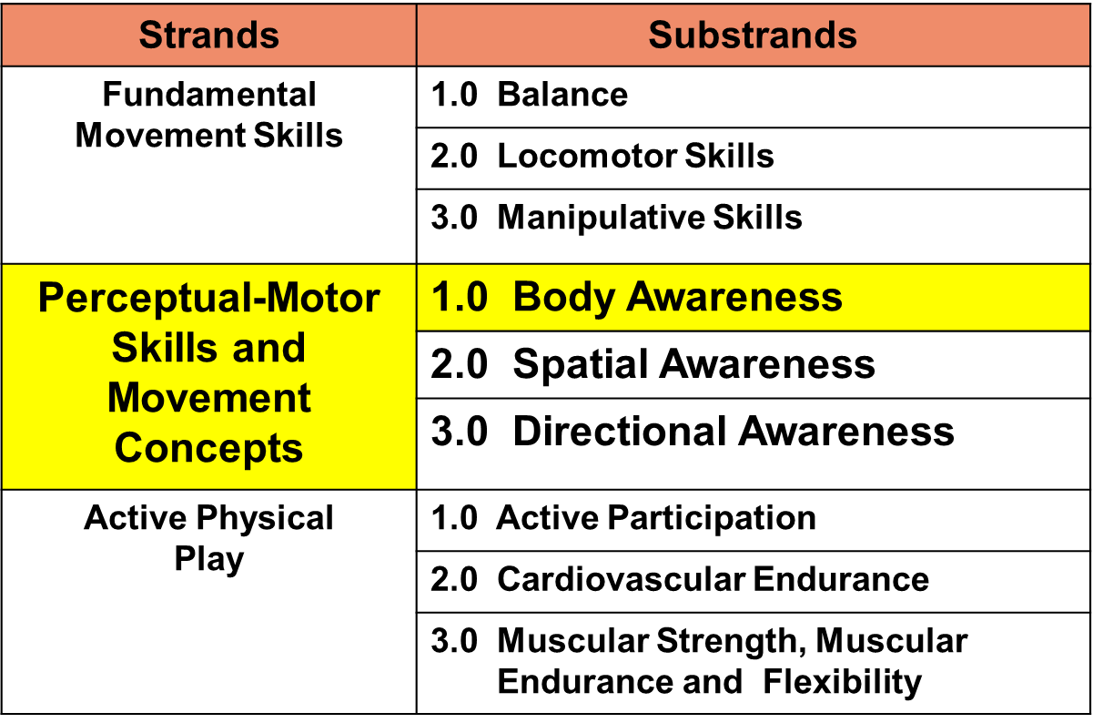
Perceptual-Motor Skills and Movement Concepts
(PLF, Vol. 2, p. 51)
Notes:
Presenter Remarks:
The first substrand of Perceptual-Motor Skills and Movement Concepts is Body Awareness.
“Body awareness refers to the ability to accurately describe body parts and their functions. Laterality is the ability to distinguish between the two sides of the body, which leads to the ability to coordinate the two sides of the body” (PLF, Vol. 2, p. 58).

Slide 30
Body Awareness
Body awareness refers to knowledge about the body and its parts.
(PLF, Vol. 2, p. 61)
Notes:
Presenter Remarks:
The definition of body awareness is knowledge about the body and its parts. (PLF, Vol. 2, p. 61)
Share with an elbow partner activities you see that involve body awareness.

Slide 31
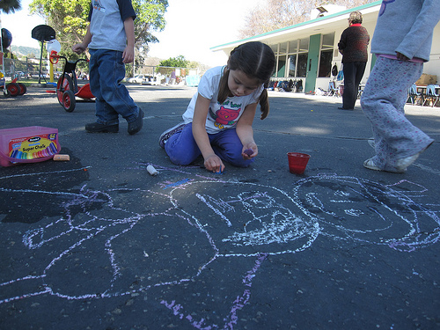
Interactions and Strategies to Support the Development of Body Awareness
“Provide opportunities for children to see external representations of their bodies”
(PCF, Vol. 2, p. 180).
©2017 California Department of Education
Notes:
Presenter Remarks:
Children are often motivated to draw pictures of themselves or a significant person in their life such as a family member. Encourage children to talk about their drawing as you model incorporation of body parts vocabulary when commenting on the children’s drawing.
Seeing external images of their bodies by playing in front of mirrors, making body shadows, drawing rope bodies and tracing body parts (such as hands or feet) onto paper, enhances development of children’s “visual maps” of their body parts.
TK children may enjoy making collages by cutting out different body parts from magazine pictures.

Slide 32
Interactions and Strategies to
Support the Development of
Body Awareness
Introduce body-parts vocabulary during structured group games.
Use body-parts vocabulary in the child’s home language.
Provide constructional play for children to build or put together body parts.
(PCF, Vol. 2, pp. 179-180)
Notes:
Presenter Remarks:
“Young children are learning to identify, describe, and differentiate an increasing number of body parts. Teachers can use novel props to construct body parts that adds a multisensory approach to the movement experience” (PCF, Vol. 2, pp. 179-180).
For example, teachers may provide opportunities for children to trace their bodies with different materials. One day a teacher may invite students to trace their bodies using chalk, the next day the same teacher may invite children to trace their bodies using a jump rope, and the third day invite children to trace their bodies using tape. Each of these props (chalk, rope and tape) provide a different sensory experience and contribute to the students knowledge of their body outline in a new way.

Slide 33
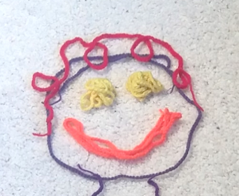
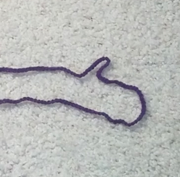
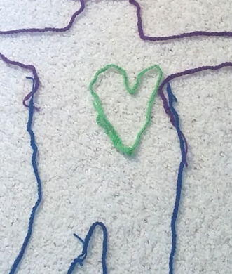
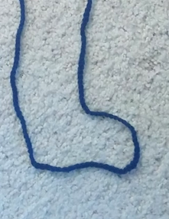
Body Parts
Using rope, draw a body part on the floor.
Ask children to describe their drawings of parts.
Notes:
Activity 3: Body Parts and Giant Bodies
Presenter Remarks:
We are going to construct a body part on the floor. Tell someone nearby about the body part you drew. As you ask participants the following questions, draw attention to vocabulary used in movement concepts:
Do you see different pathways (lines – straight, curved or zigzag) in your body part?
Is your body part at a high, medium or low level of the body?
Touch and name your body part. How can your body part move?
Practice directional awareness: Place your foot inside the yarn body part, walk your fingers around the yarn body part, put your elbow next to the yarn body part, put your hand under the yarn body part.
See additional remarks in Activity 3.
intent:
This activity uses a novel prop (yarn rope) to construct, individually and cooperatively, body parts using fine motor skills. Participants identify body parts, positional areas, and integrate phonological awareness.
OUTCOMES:
Participants will:
Individually construct body parts with a yarn rope and cooperatively create a giant body using yarn ropes on the floor/carpet.
Identify body parts on yarn body and one’s own body.
Move their body to various positional areas on/near/by yarn body.
Point to body parts based upon initial letter sounds.
Materials Required:
Yarn ropes, 4-6’, 1/participant + extras
Floor/carpet space - check for cleanliness (Offer table space for those not comfortable working on the floor/carpet.)
Time: 7-8 minutes
Process:
Spread out yarn ropes (4-6’ in length) on the floor. Leave extra yarn ropes on the floor for “Giant Bodies” activity.
Invite participants to pick up one yarn rope and find open space on the floor to draw a body part with their rope. For participants not comfortable on the floor, use a table or nearby counter.
For “Body Parts” Slide:
Instruct participants to construct a body part on the floor and tell someone nearby the body part they drew. As you ask participants the following questions, draw attention to vocabulary used in movement concepts:
Do you see different pathways (lines – straight, curved or zigzag) in your body part?
Is your body part at a high, medium or low level of the body?
Touch and name your body part. How can your body part move?
Practice directional awareness: Place your foot inside the yarn body part, walk your fingers around the yarn body part, put your elbow next to the yarn body part, put your hand under the yarn body part, etc.
Domain Connections:
What sound do you hear at the beginning of the word of your body part? What letter is your sound? Can you make your body into the letter of the initial sound?
Do you know how to say your body part in another language? (Incorporate the child’s familiar communication method when introducing body parts vocabulary.)
Variation: Teachers can make a “body parts die” by placing pictures of different body parts on each side of a small cardboard box, rolling a die, then everyone draws the body part with their rope.
OPTIONS:
Children may benefit from additional visual cues provided by sign language or pictures.
Children with special needs may communicate using sign language, picture communication systems, or other augmentative communication methods.

Slide 34
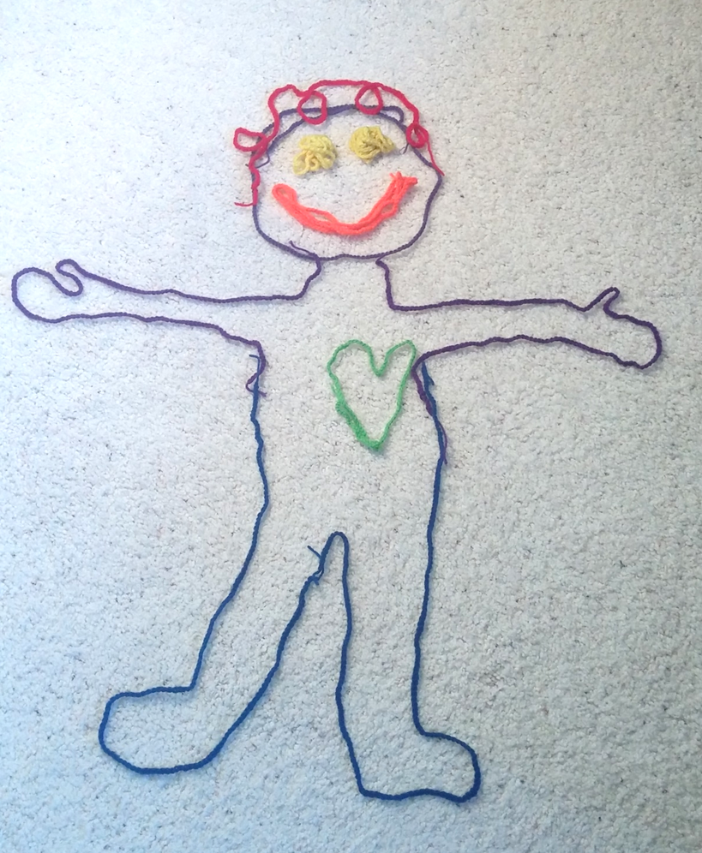
Giant Yarn Bodies
In a small group of 5-6, draw a giant body cooperatively.
Touch yarn body then own body part.
Move your body to directional prompts.
Point to body parts that start with the sounds of /s/, /l/, /f/.
Notes:
Activity 3: Body Parts and Giant Bodies continued
Presenter Remarks:
In a small group of 5-6, draw a giant body cooperatively. Instruct small groups of 5-6, each with a yarn rope, to create a giant body cooperatively on the floor. Invite groups to use extra yarn ropes to create their giant bodies. Encourage groups to make bodies with shapes or outline a person on the floor so they can touch inside of a body area for directional cueing.
Touch yarn body then own body part.
Body awareness: First touch your head, say “head,” then touch the head on the giant body. Continue naming various body parts - arm, hand, leg, foot, torso, etc. Incorporate the child’s familiar communication method when introducing body parts vocabulary.
Move your body to directional prompts.
Directional awareness: Stand inside the giant yarn body, gallop around the yarn body, put your foot next to a yarn body part that is at a low level, or stand above the yarn body.
Point to body parts that start with the sound of /s/, /l/, /f/.
Domain Connection: Practice phonological awareness by identifying/touching/pointing to body parts that begins with various initial sounds such as touch a body part that starts with the sound of “s” (smile, shoulder, shin, etc.), the sound of “l”, the sound of “f.”
Note:
Children may benefit from additional visual cues provided by sign language or pictures.
Children with special needs may communicate using sign language, picture communication systems, or other augmentative communication methods.

Slide 35
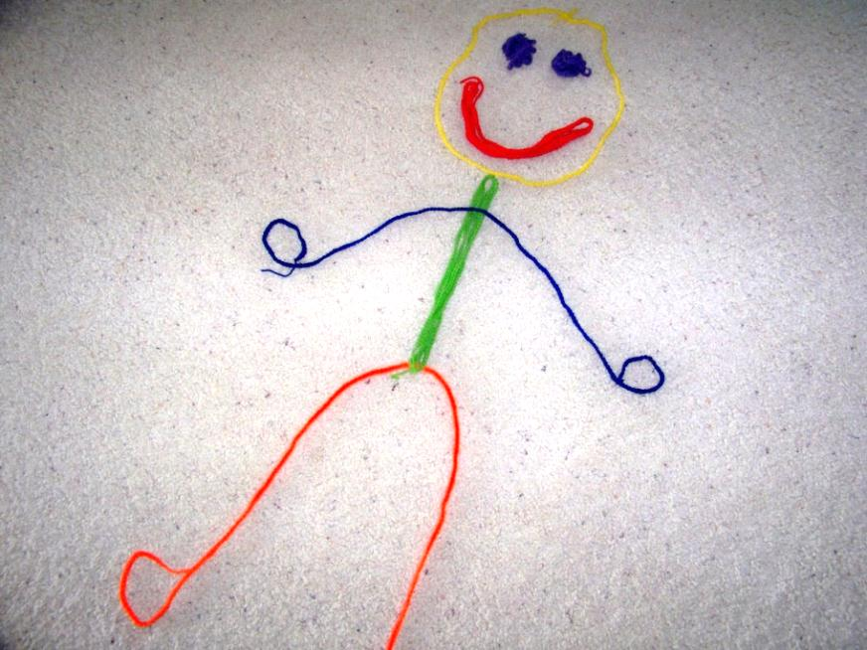
Interactions and Strategies to Support the Development of Body Awareness
“Engage children in singing and movement activities to teach body parts”
(PCF, Vol. 2, p. 179).
©2017 California Department of Education
Notes:
Presenter Remarks:
Children build positive self esteem as they increase their knowledge of body parts. The next slide is a song that engages a movement opportunity that identifies and moves body parts in a coordinated fashion.
The song is available in both English and Spanish.
Trainer may ask audience which song they prefer to hear.

Slide 36
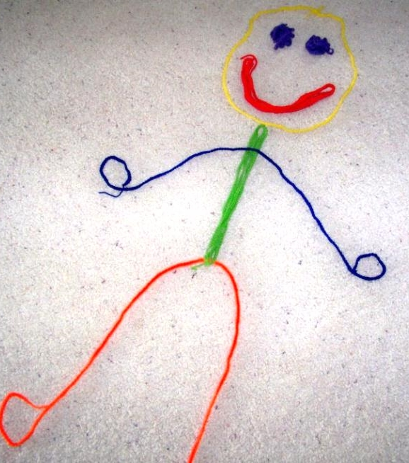
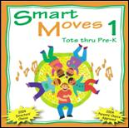
In My Body
Chorus:
In My Body, My Body
So great to be in my body
Two waving hands
Two tapping feet
Two flapping ears
One shaking seat
Two hugging arms
Two knocking knees
Two blinking eyes
And chomping teeth
One nodding head
One round tummy
Two kissing lips
10 finger tips
En mi cuerpo, Mi cuerpo
¡Que bueno es estar
En mi cuerpo!
Dos manos saludando
Dos pies golpeando
Dos orejas batiendo
Una colita sacudiendo
Dos brazos abrazando
Dos rodillas tocando
Dos ojos parpadeando
Los dientes mordiendo
Una cabeza inclinando
Un estómago redondo
Dos labios besando
Diez puntas de dedos
By Angela Russ
Notes:
Activity 4: In My Body
Presenter Remarks:
Let’s move our body parts and celebrate how important our bodies are to us. Get ready for some coordination since each verse begins with one moving body part, followed by a second moving body part.
Let’s practice the chorus:
In my body – Tap your body all over
My body – Make a muscle pose (Do a different muscle pose each time.)
So great to be in my body! – Arms up and turn in a circle
Cue song.
After song ask, “Can you identify additional domains this song incorporates?”
intent:
This activity is designed to engage participants in a song that celebrates one’s body, identifies body parts and promotes positive self-image.
OUTCOMES:
Participants will actively participate in the song, moving one set of body parts followed by a second set of body parts simultaneously, as prompted in the song. Participants may engage in the Spanish version of the song, experiencing another language or a home language increasing cultural awareness.
Materials Required:
Song: In My Body (Spanish version - En Mi Cuerpo), by Angela Russ
CD: Smart Moves 1 (www.ABridgleClub.com)
Music player
PowerPoint slide with English and/or Spanish prompts for movement
Open space (indoors or outdoors) for each participant to move safely
Time: 3-4 minutes
Process:
Prepare participants for movements. Check clothing and shoes and push in chairs at tables, along with bags/totes/etc.
Invite all participants to stand, stand behind their chair or find an area that has ample personal space.
Introduce the song and practice the chorus movements. See next page for lyrics and movements. Encourage participants to strike a different muscle pose for each chorus interlude. If time allows, practice body moves and then begin the song.
OPTIONS:
Song prompts are suggestions; feel free to change/modify as desired.
Posing may be done individually, with a partner, as a group, or select a different person for each chorus to create a pose that the group will imitate.
In My Body / En Mi Cuerpo CD: Smart Moves 1 by Angela Russ

Slide 37
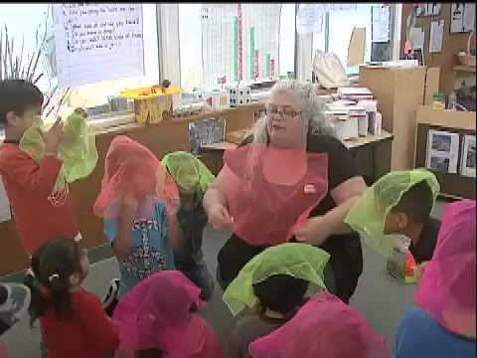
What It Might Look Like…
What it looks like…
©2017 California Department of Education
Notes:
Background Information:
Show video from CPIN Website: Scarf 2. (duration of 1 minute, 22 seconds)
Presenter Remarks:
This video shows a teacher asking children to place a scarf on different body parts and use movements, such as swaying or waving. Notice how every child has a scarf for maximum participation and the teacher is an active role model.
After the video, ask, “How can you make accommodations for a child with a physical limitation?”

Slide 38
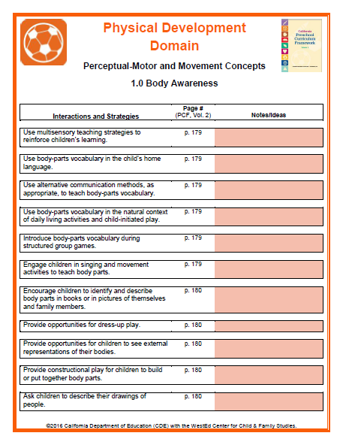

1.0 Body Awareness
Interactions and Strategies
Provide 3!
At your table, provide three additional ideas to share that develop body awareness.
Notes:
Background Information:
Refer participants to Handout 9: Substrand Reflection Interactions and Strategies 1.0 and Handout 10: Body Awareness Reflection Worksheet.
Presenter Remarks:
Review Handout 9: Substrand Reflection Interactions and Strategies 1.0 and brainstorm three new activities to share that integrate body awareness interactions and strategies. Be aware of cultural influences and include special needs.
Allow 5 minutes then share with whole group.

Slide 39
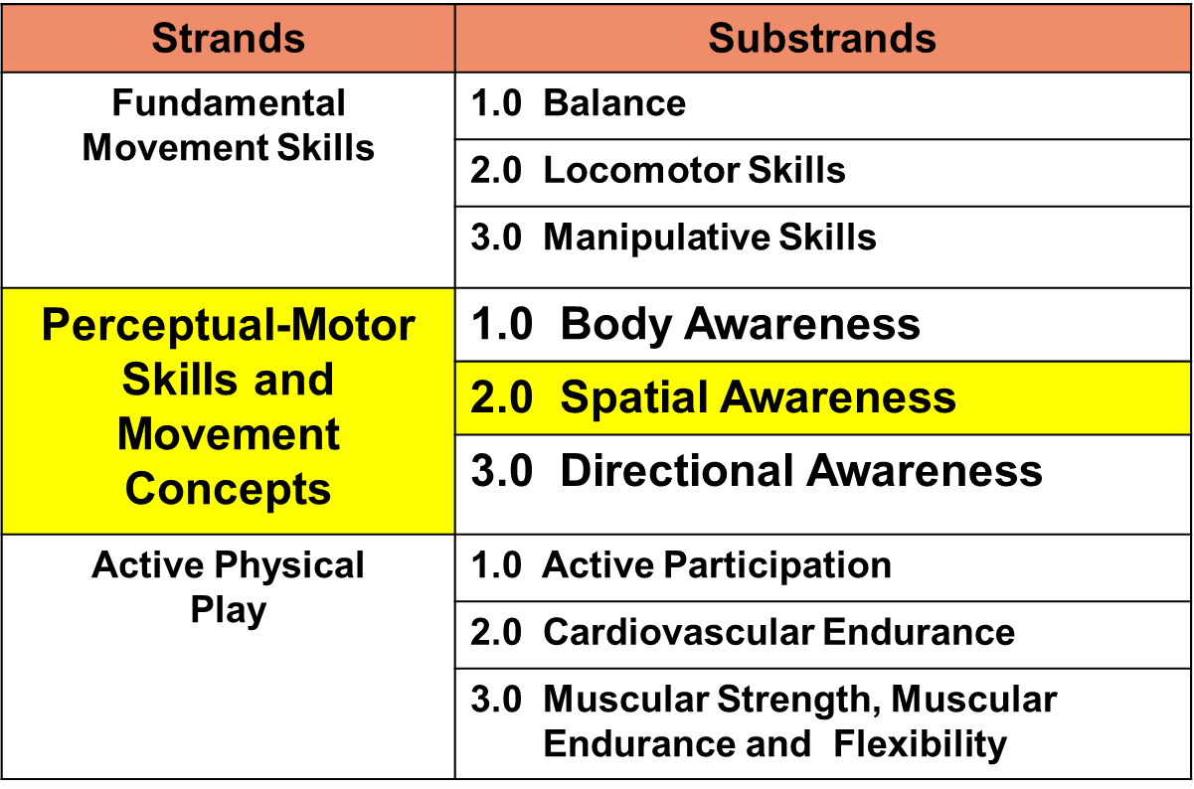
Perceptual-Motor Skills and Movement Concepts
Notes:
Presenter Remarks:
The second substrand of Perceptual-Motor skills and Movement Concepts is Spatial Awareness.

Slide 40
Spatial Awareness
Spatial awareness refers to how a child moves their body in space and awareness of how much space the body takes up; its relationship to other objects or people in the environment; and ability to project the body into space.
(PLF, Vol. 2, p. 63)
Notes:
Presenter Remarks:
Read the definition of spatial awareness on the slide.
Adults may use spatial awareness automatically. They have developed a radar that tells them when they are too close to others or objects. When driving a car, spacing is important. Young children lack spatial awareness. This makes it difficult for them to play sports such as soccer. They only focus on the ball and often run into others because their awareness of others and controlling their body at an early developmental stage. Young children are not miniature adults; they need time and practice to develop their skills.
There are many spatial awareness situations, not just moving in general space. There’s an awareness of feet when stepping inside a hoop or of others who are jumping into a hoop pattern on the floor; climbing through a tunnel or on playground equipment; jumping off of something and landing; making one’s body small/big/narrow/wide/thin/tall; and the ability to lower one’s body to the floor/apparatus/furniture/etc.
In the opening activity with balloons, what spatial awareness knowledge did you consciously and unconsciously apply? How did you move your body in relation to others and objects? How did you move around at the same time as others and not crash?

Slide 41
Developmental Sequence of Spatial Awareness
Around Age 3: Child bumps into others who are close by during all types of activities.
Around Age 4: Child participates in seated activities without bumping into others.
Around Age 5: Child participates in standing activities (primarily staying in place) without bumping into others.
Around Age 5½: During a locomotor activity while moving in the same direction, child (with prompting) maintains space around self without bumping into others.
Around Age 6: During a locomotor activity moving in different directions, child maintains space around self without bumping into others. (PCF, Vol. 2, p.181)
Notes:
Background Information:
Refer to Handout 11: Perceptual Motor Developmental Sequences. This handout outlines what is on page 181 and 186 of the Preschool Curriculum Framework, Volume 2, in the spatial and directional substrand.
Presenter Remarks:
The developmental sequence of spatial awareness illustrates stages children progress through as they develop and define their personal space. TK children should have ample opportunity to practice moving in general space, both in the same direction as others and in a scattered format, within a play area. Teachers who are aware of the developmental sequence can intentionally plan and facilitate movement experiences as well as observe and assess.

Slide 42
Tag Game Notes
Tag games require children to chase and flee; to be aware of their personal space and then travel safely within general space.
Introduce tag games by having children move in the same direction.
Begin tag games slowly to check for understanding, and gradually increase the speed by changing the locomotor skill.
Ensure play area is free of obstacles.
Begin with adult taggers‒sometimes taggers aren’t even necessary!
Notes:
Background Information:
Many teachers play tag games with young children, often with a lot of frustration and a few bumps and bruises. The spatial awareness of young children are at the early stages of development. Review the bullets on the slide to inform participants about developmentally appropriate practice.
Presenter Remarks:
Young children need a lot of practice defining their personal space, moving safely in general space as well as starting and stopping efficiently. Due to these factors, tag games may or may not be appropriate. If playing a tag game, it is best to begin slowly by having everyone walking, then gradually increase the speed or change the locomotor skill that allows children to go faster such as galloping or skipping.
Sometimes a teacher can be the “tagger” and the children will scatter at will, not even caring that there is a tagger or not.

Slide 43
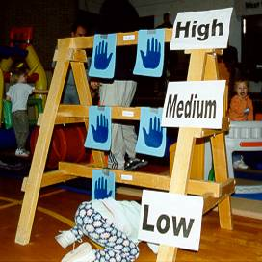
Interactions and Strategies to Support the Development of Spatial Awareness
Narrate or ask questions about children’s play using positional-concepts vocabulary in English and/or in the child’s home language.
Provide opportunities for children to experience moving at different levels of body positioning, ranging from high to low.
Over
Through
Under
Notes:
Presenter Remarks:
This is an example of an obstacle that an adult has designed to encourage a child to discuss and experience the words high, medium, and low.
In physical development, demonstration typically occurs with less support directed to verbal and/or visual context. Displaying movement words in the TK environment provides additional support to young learners. In the picture, an adult has engaged the child in a short conversation about her intentions, does she want to---go UNDER at a LOW level; go THROUGH at a MEDIUM level; or go OVER at a HIGH level? Sight words are on display so the child can recognize words about “space” while actually experiencing spatial awareness.
Children’s play time is a great opportunity to infuse home language skills using new vocabulary words for positional concepts in English. Incorporate vocabulary in the child’s home language when giving instructions (“Stand behind the rope.”) or when orally describing children’s play (“You are next to your fort.”).
Encourage teachers to obtain (from other teaching/support staff, bilingual assistants, family or community members) and share movement vocabulary for every child in the classroom.
Amongst your table group, discuss additional ways children may move and explore traveling at different levels with or without props.

Slide 44
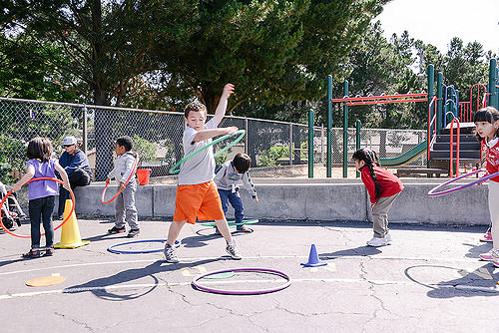
What Do You See?
©2017 California Department of Education
Notes:
Presenter Remarks:
How can adults intentionally plan for spatial awareness activities?
Ask participants what they see in the picture.
Identify perceptual-motor skills and movement concepts that occur naturally when adults facilitate movement opportunities for TK.

Slide 45
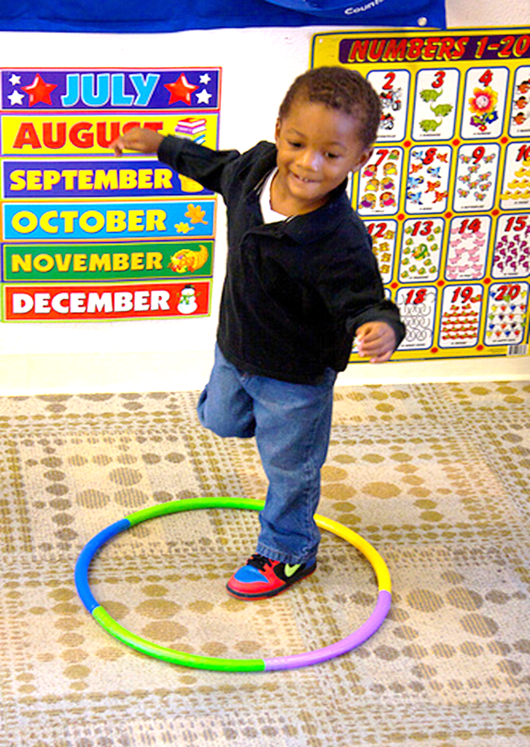
Interactions and Strategies to Support the Development of Spatial Awareness
Use props or play objects to guide children in positioning their bodies (hoops, carpet squares, poly spots, rope circles, used computer mouse pads, pot holders, old bike tires, chalk, tape, etc.)
(PCF, Vol. 2, p. 185).
Personal Space
General Space
Notes:
Presenter Remarks:
This picture illustrates how to define personal space for young children using a prop, which helps children to learn about spatial qualities. Learning how to travel in general space while keeping personal space (i.e. not colliding into others) is a very important concept young children need to practice and develop.
A variety of props can be used to define personal space: hoops, carpet squares, poly spots, rope yarns on carpet, used computer mouse pads, pot holders, old bike tires (check local bike shop for donations), chalk circles on the playground, tape, etc.

Slide 46
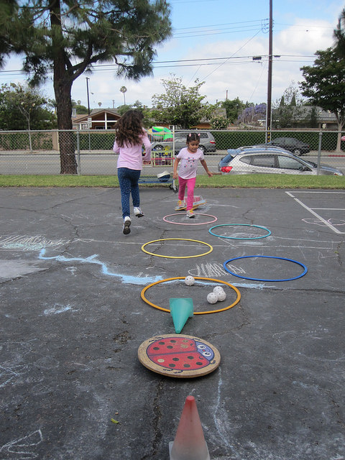
Hoop Play
Hoop Exploration
Hoop Movement Concepts
Musical Hoops
I Want a Hoop
Hoop Cars–Beep Beep
Hoop Tunnels
Zigzag Hoops
©2017 California Department of Education
Notes:
Activity 5: Hoop Play
Presenter Remarks:
Invite participants to engage in hoop activities in open space. Remind participants to be aware of others and objects nearby, to not pull or push on hoops causing the hoop to bend, and to not step on hoops since they can be slippery.
intent:
This activity illustrates how hoop play can develop and integrate perceptual-motor skills and movement concepts into active physical play for young children.
OUTCOMES:
Participants engage in a variety of integrated hoop activities that demonstrate perceptual-motor skills and movement skills they can share with teachers, young children, and families. In small groups, they discuss environment supports and teaching strategies to promote the development of perceptual-motor skills and movement concepts for English learners and children with special needs.
Materials Required:
Hoops, 1/participant
Music player and song (trainer’s choice)
Open space where participants can move safely
Optional: whistle
Time: Depending on time availability, the trainer may choose a few or all of the hoop activities listed below.
Process:
1. Spread out hoops in the open space; cue music.
2. Invite participants to stand in one hoop, make sure ample space is
available so everyone has room to move.
3. After activity, prompt participants to discuss in small groups
questions found at the Post Activity Discussion section.
HOOP ACTIVITIES:
Hoop Exploration
Encourage participants to explore with their hoop for 30-60 seconds. When playing with a new prop, children are naturally curious and they listen better after they explore.
Hoop Movement Concepts
Put the hoop in front of/behind/beside your body, under a body part, between two body parts, near your body, above your body.
Can your body go through the hoop?
Balance the hoop on: palm of hand, back of hand, arm, shoulder, knee, foot, etc.
Balance on one foot inside of hoop (hoop is on the ground).
Gallop around your hoop.
Skip quickly to touch another hoop that is the same color as your hoop and then return to your hoop.
Begin standing in the hoop, jump out when the whistle blows (or hand clap), jump in on the next whistle. Keep repeating; add faster whistle cues or two whistle cues in a row. This activity will increase everyone’s heart rate quickly!
Musical Hoops
Spread hoops out in area, 1 hoop/participant. On music cue, walk/gallop/slide, etc. in play area. When the music is off, quickly get into a hoop. If there is someone in a hoop already, look for a new hoop. Young children don’t need competition so eliminating a hoop isn’t necessary. The thrill of getting to a hoop is exciting.
I Want A Hoop
Everyone stands in their own hoop on the ground. Remove one hoop, that participant becomes the “hoop shopper” and calls out loudly, “I WANT A HOOP!” All participants leave their hoop to quickly get into another hoop. Whoever is without a hoop becomes the next hoop caller and calls out “I Want a Hoop” for everyone to switch quickly again.
Hoop Cars – Beep Beep
Hold hoop like a steering wheel, begin driving slowly and safely on cue. Change locomotor skill, drive at different levels, motor along different pathways and change the pace with tempos such as drive/walk slowly at a high level; pretend to go under a bridge at a low level; travel/gallop on a zigzag pathway quickly. Be aware of others, don’t bump into other cars – if a bump occurs, apologize to the driver (“sorry for crashing”), pull over to the side for 10 seconds and watch others drive safely, then rejoin the game.
Variation: Helicopters, Race Cars and UFOs. Hold hoop horizontally, vertically or stand inside of it and pretend to be a helicopter, race car or UFO, respectively. Travel in a variety of ways, different levels, pathways and tempos. Add sound effects to make it more interactive!
Hoop Tunnels
Make a line of 5-6, standing side-to-side to each other; each participant holds their hoop vertically on the ground to make a cooperative hoop tunnel. The first participant in line removes their hoop and crawls through the hoop tunnel. Once through the tunnel, the participant exchanges position with the next hoop holder who crawls through. Keep repeating until everyone has had a turn. For added complexity, participants can balance a bean bag on a body part as they crawl through the tunnel.
Zigzag Hoops
Small group of 5-6 place their hoops in a zigzag pattern on the ground and then jump or hop through the hoop pattern. As children create their pattern (hopscotch patterns work well too), teachers can discuss key concept words such as “Can you place your hoop next to/near/on top of/below the next hoop to make a hoop pattern?” “Are the hoops near or far apart from each other?” “Describe with your words how your body is going to move through the hoop pattern.” Once the hoop pattern is ready, everyone gets a turn at moving through the hoops by hopping, jumping or leaping. This is a great cardiovascular activity too!
POST ACTIVITY DISCUSSION:
In small groups, discuss perceptual-motor skills and movement concepts vocabulary from the community building activity.
What types of activities, environmental supports and teaching strategies may promote the development of perceptual-motor skills and movement concepts for children who are English learners?
What types of activities, environmental supports and teaching strategies may promote the development of perceptual-motor skills and movement concepts for children with special needs?
OPTIONS:
For groups not very familiar with vocabulary for perceptual-motor and movement concepts, refer to the Movement Charts handout (CPIN website) during small group discussion.
If commercial hoops are not available, homemade hoops can be constructed.
At your local home improvement store purchase 1/2-inch flexible tubing (cut to any desired length for small, medium, or large hoops). Dip the ends of the tubing into very hot water to expand the tubing (adults only). Insert a wooden plug (wooden dowel cut 2 inches in length) in the tubing at both ends to complete the circle. Wrap colored electrical tape or duct tape to secure. Continue to add tape at intervals around hoop for more color. (Adapted from Choosy Kids Homemade Props.)

Slide 47
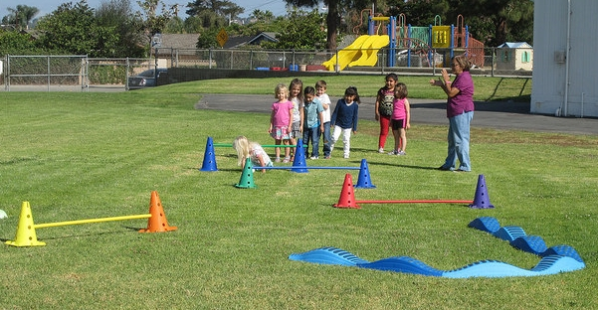
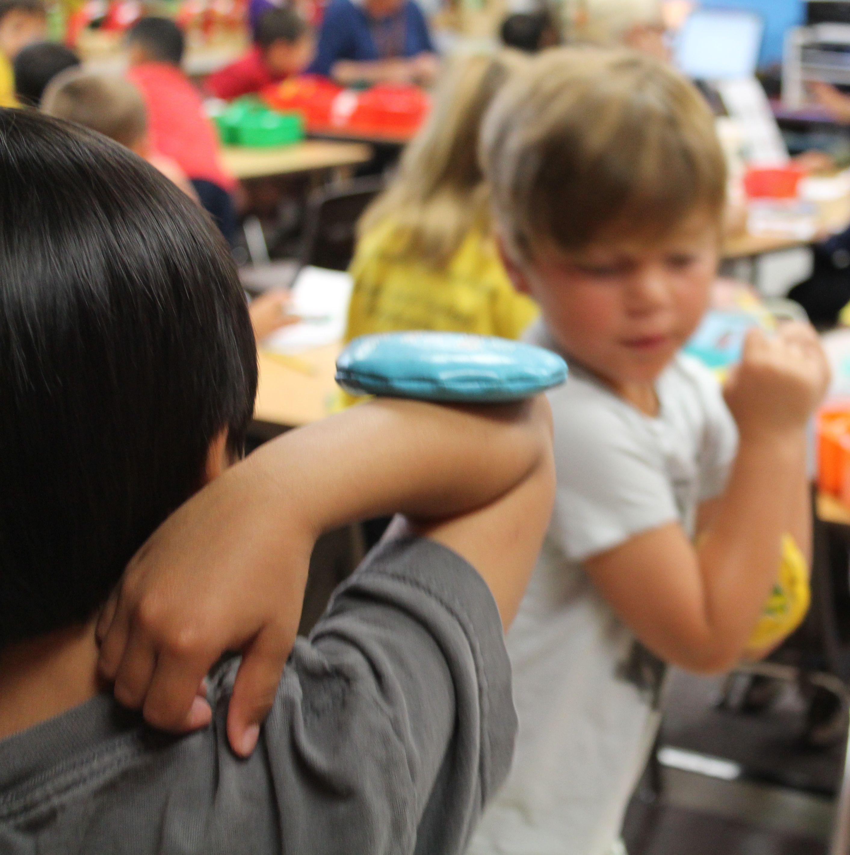
Interactions and Strategies to
Support the Development of
Spatial Awareness
Design obstacle courses that encourage children to go over, under, through, and between objects.
Incorporate activities where children move around with objects balanced on different parts of the body.
(PCF, Vol. 2, p. 183)
©2017 California Department of Education
Notes:
Presenter Remarks:
Draw attention to the two pictures. The top picture illustrates an outside obstacle course. Although this picture contained commercially bought equipment, homemade props and materials used in the environment are a great substitute for classrooms and home-based settings.
The bottom picture illustrates an activity center for motor skills in the classroom (notice the children in the background at other centers). The center was designed for children to walk behind a table, between a wall and a table, on tape that was straight, angled and zigzag all while balancing a bean bag on various body parts. Two bean bags were added and children were asked to see how they could balance bean bags and move their bodies in different ways (tip-toe, side-step – some children even tried to hop!).
In addition to supporting special awareness, these are wonderful activities for dual language learners because it does not require oral language to be successful.

Slide 48
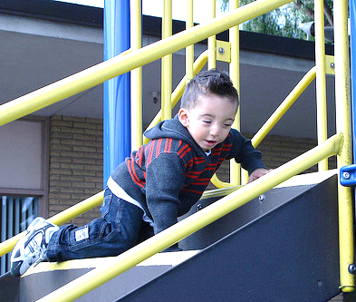
Interactions and Strategies to Support the Development of Spatial Awareness
Provide alternative ways for children with physical disabilities or other special needs to learn spatial concepts.
Use alternative learning activities as needed for children with special needs.
(PCF, Vol. 2, p. 185)
Notes:
Presenter Remarks:
For children with IEPs, consult the special education provider to get ideas on how to best meet the needs of the child. There are many things the teacher can do to help all children participate. For example, children who lack the mobility to participate in active physical play may not have the same opportunities for physical exploration. Teachers can provide alternative learning activities for children, such as manipulating dolls and actions figures during pretend play or identifying positions of characters and objects in books. When possible, it is very helpful for the child to have the physical experience of moving through different positions.
Children who are blind or have visual impairments may also need extra assistance to explore their physical environments.
Some children with special needs, such as those with hearing or visual impairments, may need extra help to avoid bumping into other people or environmental obstacles during play and daily routines.
Sometimes children do not have an accurate awareness of their body dimensions and position in space. Other times they may not be able to plan or sequence movements (i.e., motor plan) in order to negotiate around obstacles or climb onto/off playground equipment. Teachers can help by providing extra verbal prompts, visual aids, or physical guidance as appropriate.

Slide 49
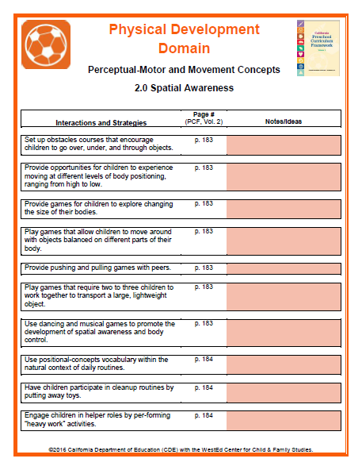
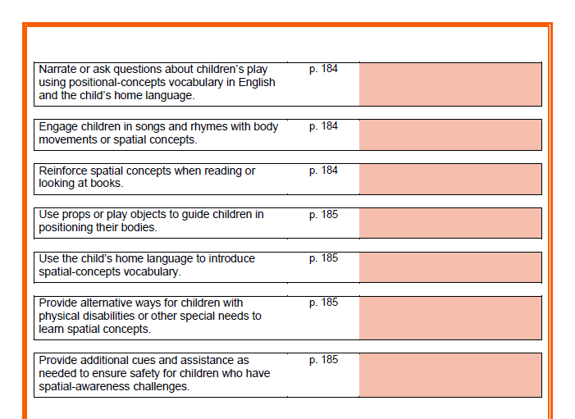
2.0 Spatial Awareness
Interactions and Strategies
Spatial Awareness Vignettes:
Each table will cooperatively write a short vignette illustrating spatial awareness, connecting key elements to a Teachable Moment or Planning Learning Opportunities.
Notes:
Presenter Remarks:
Please take a moment to read the Handout 13: Spatial Awareness Vignette (or read p. 181-182 in the Preschool Curriculum Framework, Volume 2).
Using Handout 12: Substrand Reflection Interactions and Strategies, 2.0, each table will brainstorm a short vignette illustrating spatial awareness that is developmentally appropriate for TK.
Please record your vignette on the Handout 14: Spatial Awareness Vignette Worksheet and discuss key elements that make it a Teachable Moment or Planned Learning Opportunity.
If time permits, allow groups to share their vignettes.
Time allocation: 10-12 minutes

Slide 50
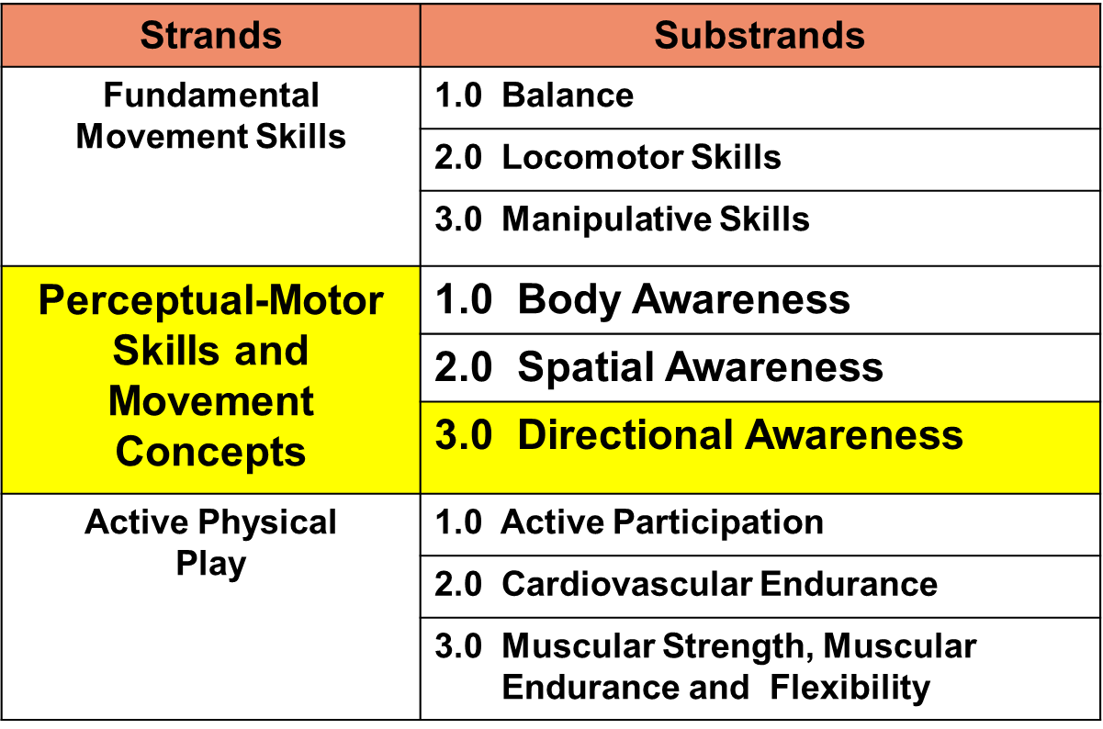
Perceptual-Motor Skills and Movement Concepts
Notes:
Presenter Remarks:
The third substrand of Perceptual-Motor Skills and Movement Concepts is Directional Awareness.

Slide 51
Directional Awareness
Directional awareness refers to where the body moves; includes handedness, laterality, sequence, and rhythm.
(PLF, Vol. 2, p. 61)
➲ Laterality
➲ Directionality
Notes:
Background Information:
Read the definition on the screen and explain the two terms, laterality and directionality.
Presenter Remarks:
Laterality: Laterality is the awareness that one’s body has two separate sides that can move independently. The most obvious example of laterality is handedness, or the preference for using one hand over the other to perform activities. Preschool children cannot yet identify right and left, but they can distinguish one side of their bodies from the other and coordinate movements of the two sides (bilateral coordination). For example, they can hold a beach ball in one hand and hit it with the other hand. Laterality must develop before children can develop directionality.
Directionality: Directionality is the ability to project the body’s spatial dimensions into surrounding space and to grasp spatial concepts about the movements or locations of objects in the environment such as throwing a scarf up in the air on the dominant side of the body, tossing a scarf overhead from one hand to the other and tossing the scarf up in the air and letting it land on a foot, both of which involve midline crossing.

Slide 52
Developmental Sequence of
Directional Awareness
As children mature, they develop a “sense of direction” in a predictable sequence.
Ages 2-3: Children can identify front/back and top/bottom on their own bodies.
Around 4: Children are aware that their bodies have two distinct sides and are learning to determine which side is left and which is right.
Ages 6-7: Children can accurately identify left and right sides of their own body.
(PCF, Vol. 2, p. 186)
Notes:
Background Information:
Refer to Handout 11: Perceptual Motor Developmental Sequences. This handout outlines what is on page 181 and 186 of the Preschool Curriculum Framework, Volume 2, in the spatial and directional substrands. For more information on laterality, see page 62 of the Preschool Curriculum Framework, Volume 2.
Presenter Remarks:
The developmental sequence of directional awareness provides a progression for young children as they become aware of and define their “sense of direction.” TK teachers can further promote development of directional awareness by providing both planned games and child-initiated play to encourage children to move their bodies in different ways.
Preschool children are learning to identify the top, bottom, front, or back of objects, but they do not clearly understand that objects have a left or right side. Working on both sides of the body promotes laterality.
Around age 8, children become aware that objects also have a left and right side.

Slide 53
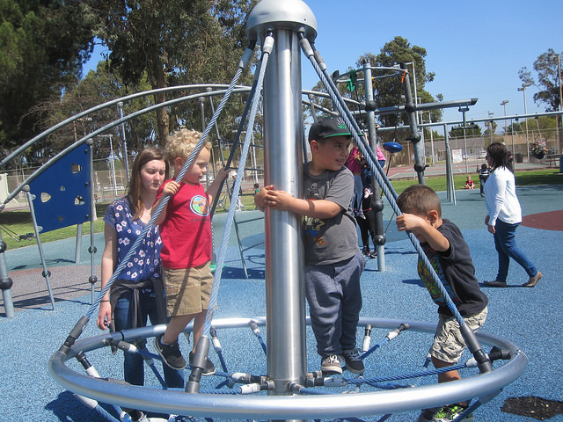
Interactions and Strategies to Support the Development of Directional Awareness
Interactions and Strategies to Support the Development of Spatial Awareness
“Provide safe environments in which children can climb up and down”
(PCF, Vol. 2, p. 187).
©2017 California Department of Education
Notes:
Background Information:
If time allows, and Preschool Curriculum Framework resources are available, invite participants to view Interactions and Strategies for Directional Awareness.
Presenter Remarks:
Children like to climb and develop muscular strength. They like to explore what their body can and can not do. Climbing experiences can occur in a variety of environments, such as outside on play equipment under adult supervision, or with family members as they count steps in the community, hike trails, or climb on a mountain of cushions.

Slide 54
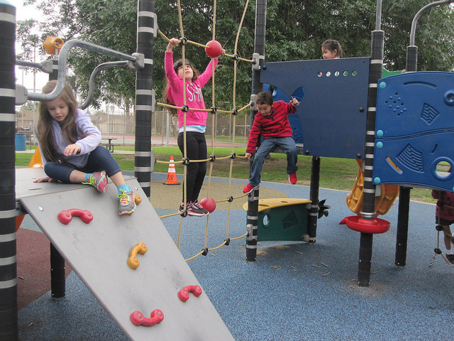
Over
Behind
Sideways
Up
Between
Backward
Down
Under
“Provide opportunities for child-initiated play in areas with open space”
(PCF, Vol. 2, p. 187).
©2017 California Department of Education
Notes:
Presenter Remarks:
The outside environment is ideal for allowing children to explore moving their bodies while running, chasing, jumping or moving alongside other children. Indoor spaces can also be adapted to create open space for children to run, chase, and move about freely. Notice the movement words throughout the picture, as so much is happening while children are playing!
Extra Notes:
Prompt tables to discuss activities they have seen children engage in, outside and indoors, that support the development of directional awareness. Give groups a few minutes to talk and then discuss and/or chart the responses.

Slide 55
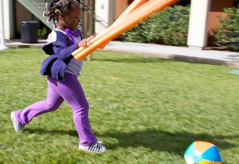
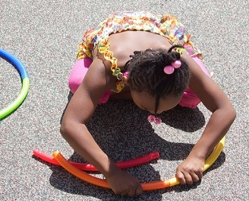
Interactions and Strategies to
Support the Development of Directional Awareness
“Engage children in two-handed play activities”
(PCF, Vol. 2, p. 188).
©2017 California Department of Education
Notes:
Presenter Remarks:
Using two hands together during play increases children’s awareness of the two sides of their body. Moving feet and manipulatives simultaneously may be challenging for some children as some may only be able to do one task at a time. The girls in the pictures are demonstrating more precision by putting hoop segments together as well as increased coordination using two swim noodles to project a beach ball.
Other props children can explore with include scarves, rhythm sticks, and instruments for children to bang together or shake with both hands during movement activities such as dancing or marching.
Homemade props may include paper tubes filled with small rocks or beads (secured tightly), wooden dowels cut and sanded smooth, pots and pans (including lids), metal cups, and plates.
Note: For some cultures striking utensils together is considered inappropriate.

Slide 56
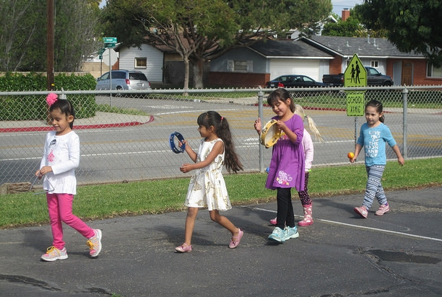
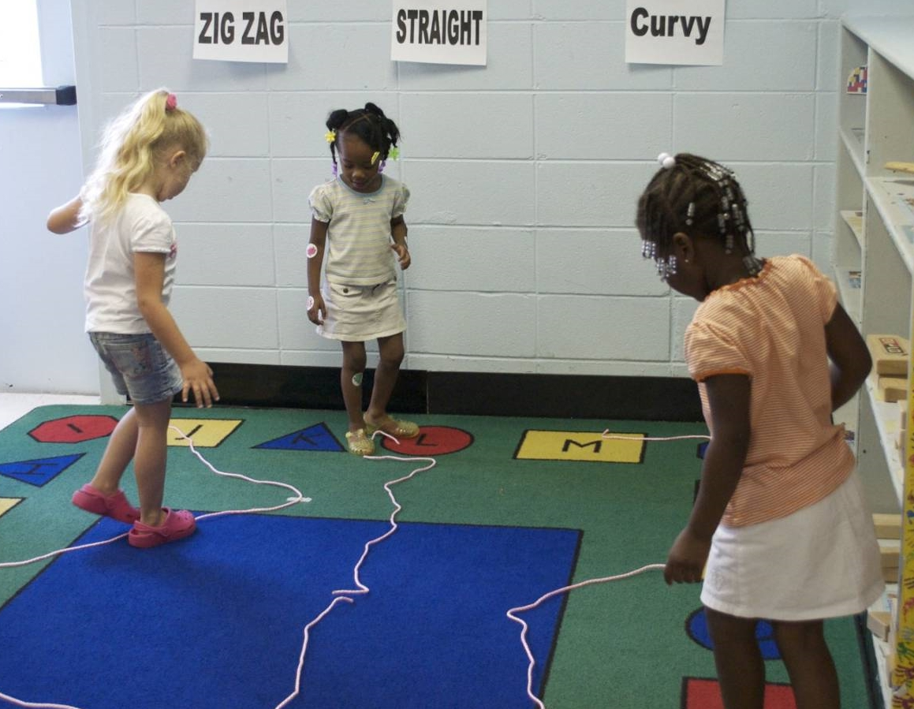
Interactions and Strategies to
Support the Development of
Directional Awareness
Design activities for children to practice moving alongside or in a line with other people.
Encourage children to move in different directions and in different pathways.
(PCF, Vol. 2, pp. 187-188)
©2017 California Department of Education
Notes:
Presenter Remarks:
Games, such as Follow the Leader, provide opportunities for children to move in different directions, including forward, backward, and sideways. Moving alongside or behind another child while marching in a parade or dancing provides a wonderful challenge for both directional awareness and spatial awareness. Encourage children to move in a variety of pathways as they travel across play areas or while transitioning from one area to another. In traditional childhood games, such as Red Light Green Light, prompt children to move at different levels, tempos, and pathways while incorporating pretend play and moving like ants, leaping like gazelles, and swimming like fish.

Slide 57
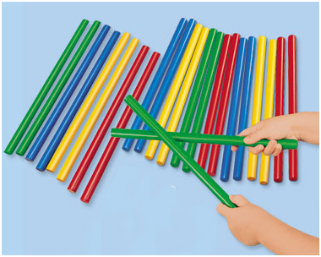
Rhythm and Movement
Rhythm
Directional awareness
Gross Motor
Crossing Midlines
Active Physical Play
Notes:
Activity 6: Rhythm Sticks
Presenter Remarks:
The interactions and strategies mentioned in the previous two slides are exemplified in this next activity which involves traveling on a pathway already marked on the floor and tapping rhythm sticks at various locations to the beat of the music. After the activity, partners will discuss all the directional cues intentionally planned in this activity. Please grab two rhythm sticks and stand on the pathway.
intent:
This activity engages participants in a rhythmic activity that blends perceptual motor skills, movement concepts, locomotor skills, and active physical play in a movement pattern that includes directional cues, pathways, crossing midlines and object manipulation.
OUTCOMES:
Participants will:
Actively participate in a rhythmic activity, responding to movement prompts as they integrate perceptual motor skills, movement concepts, locomotor skills, and active physical play as they travel on a directional pathway.
Tap rhythm sticks to the beat of the music in a variety of directional locations.
Discuss how a rhythmic manipulative activity can enhance directional awareness through physical activity while crossing midlines.
Materials Required:
Rhythm sticks, two per participant (or use wooden dowels)
Yarn, painter’s tape, pair of scissors
Music player and music (a high energy song with a beat – trainer’s choice, suggestion: I Like to Move It, Disney movie – Madagascar)
Movement prompts (see next page)
Open space for each participant to move safely
Time: 7-8 minutes
PREPARATION:
Prior to activity, prep floor by taping yarn (or use painters tape) in straight, curved and zigzag pathways (see examples below).
Set rhythm sticks on tables, two per participant.
Process:
Prepare participants for movement. Pass out two rhythm sticks per participant and move to yarn/tape pathway. Be aware of others and objects nearby.
Inform participants they will be traveling on the pathway around the area as they tap their rhythm sticks to a variety of movement prompts. When the music is off, stop in place and listen for a new movement prompt.
Cue music and begin moving in a clockwise fashion – see movement prompts below. Individual music segments should be approximately 30-40 seconds in length.
After activity, discuss how directional cues (right/left, side to side, up/down, forward, and sideways) integrated with rhythm and object manipulation can enhance crossing midlines (tapping side across left and right sides of the body; tapping high and low crossed top and bottom; tapping front to back crossed in front and in back of the body; side stepping engaged right/left and top/bottom midlines) for an inclusive movement experience.
Rhythm Sticks Movement Prompts (30-40 seconds)
When you hear the music, begin walking and tapping sticks together to the beat in a clockwise fashion. Make sure your feet follow the pathway on the floor.
Walk and tap sticks from side to side, begin tapping on the right side first.
Turn around, walk and tap sticks high and low.
Turn around, walk and tap sticks front and back.
Now face your body toward the center of the area. Step sideways leading with your right foot and tap your sticks up high by your right shoulder.
Still facing inward, step sideways leading with your left foot and tap your sticks down low by your left knee.
Can you do a disco step tap? Step sideways leading with your right foot and tap your sticks up high by your right shoulder. Bring your left foot next to your right foot and tap your stick down low by your left knee. Keep repeating.
OPTIONS:
Instead of using a single song, use a variety of music genres that contain different rhythm, beat, tempos, etc.
Ask participants for a movement pattern everyone can do.
This activity can be done outside on a chalk pathway.
Smooth wooden dowels or new pencils (unsharpened) may be substituted for sticks.
For safety, moving backwards is not recommended.

Slide 58
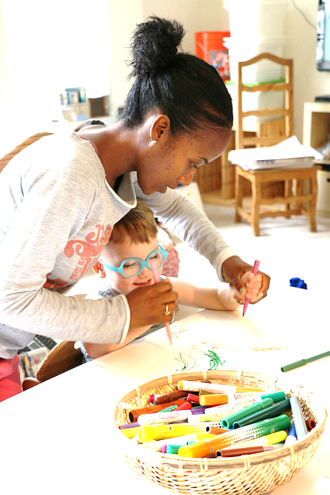
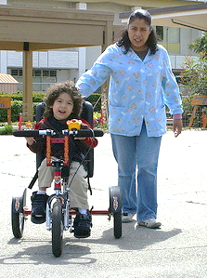
Interactions and Strategies to Support the Development of Directional Awareness
Adapt movement experiences as needed for children with physical disabilities.
Children with physical disabilities can experience movement in different directions and follow pathways.
(PCF, Vol. 2, p. 189)
Notes:
Presenter Remarks:
From the previous slide’s discussion, review a few of the participants’ ideas. If not mentioned, create different pathways using different widths when you have children that walk with assistant devices or wheel chairs. Some children with physical disabilities may not be able to move their own bodies in different directions through space. However, they still benefit from the experience of moving forward, backwards, or sideways in a wagon or wheelchair.
For children with IEPs, consult the special education provider to get ideas on how to best meet the needs of the child. Check with family members and caregivers for additional ideas families employ at home.

Slide 59
Planned and Facilitated: Movement Opportunity in the Classroom
Notes:
Background Information:
Show video from CPIN website: Motor Development Activity Center. (Video clip is 8 minutes and 50 seconds in length.)
Presenter Remarks:
This video clip illustrates a planned, structured, and facilitated activity in the classroom that enhances both cognitive and physical skills. The activity was sequentially planned from simple to complex and built upon successes and challenges.
The concepts facilitated during the activity include the following concepts:
Physical activity in the classroom – a center activity that involves movement and motor skills in limited space
Practice on various pathways – tape was placed on the floor to practice traveling on straight and zigzag pathways
Balance activity with a bean bag – both single and multi-object handling is involved
Spatial awareness – as children move between a table and cabinets, they practice spatial awareness as well as spacing between each other in order to successfully navigate the pathway taped on the floor
Movement vocabulary – hearing about low/medium/high levels, fast and slow movement words
Target practice – children gently toss to a target in the classroom
Problem solving – balancing bean bags on different body parts, using various locomotor skills on a pathway with straight and zigzag lines, navigating space while on the pathway with peers in close proximity
Force – at the end of the video the teacher asks children to throw from a farther distance and has a discussion about how many muscles were used (too many muscles, too little, or just right)
As part of domain integration, the beginning of the lesson includes a quick discussion about fruits and vegetables on the bean bags. One bean bag graphic includes a salad and the teacher integrated nutrition into the lesson. They also compare “same” and “different” concepts.

Slide 60
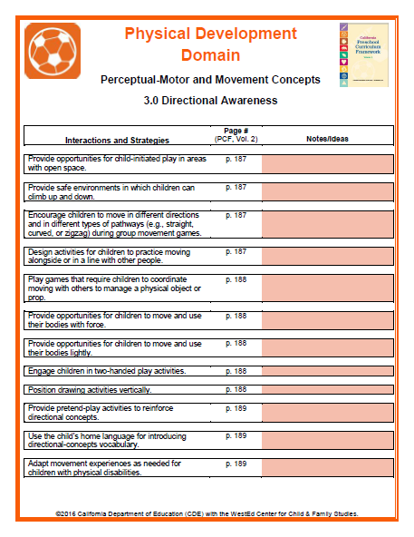
3.0 Directional Awareness
Interactions and Strategies
Walk and Talk:
With a partner, walk around the room and talk about additional interactions and strategies to be shared with staff that would increase directional awareness in TK children.
Notes:
Presenter Remarks:
Let’s apply our knowledge. Please review Handout 15: Substrand Reflection Interactions and Strategies, 3.0. Then, find a partner and walk around the room as you talk about the interactions and strategies for directional awareness. Discuss specific examples of how you currently implement a few strategies and what you can do in the near future to include more strategies into your daily routine.
Time allocation: 2-3 minutes

Slide 61
Putting It All Together
In table groups, design an activity that puts all three substrands together.
Please use any of the materials provided.
Present the activity to the whole group.
Consider adaptations for a child with a disability.
Include potential ELD strategies.
Notes:
Activity 7: Putting It All Together
Presenter Remarks:
This activity is designed for table groups to incorporate all the three substrands in the presentation and design an activity for teachers to do with children. Each table will review the module information and choose materials they want to use (bean bags, ropes, etc.) that exemplifies knowledge acquired through the training as an authentic assessment. Please consider strategies for English language development and accommodations for children with disabilities.
intent:
This activity is designed for participants to incorporate the information they learned in the presentation and design an activity for teachers to do with children.
OUTCOMES:
Participants will consider all the information about the three substrands and design a perceptual motor skills and movement concepts activity.
Materials Required:
Participants’ notes from the module presentation
Perceptual motor skills and movement concepts handout
If available, Preschool Learning Foundations, Volume 2 and/or Preschool Curriculum Framework, Volume 2
Ropes, scarves, bean bags, beach balls, pool noodles, jump ropes, and any other materials to enhance this activity
Time: 20-30 min. depending on the size of group (Give each table 10 minutes to design an activity and allow each table to demonstrate the activity to the rest of the group for a few minutes.)
Process:
Participants review the module information.
Participants choose the materials they want to use (bean bags, ropes, etc.).
They should consider strategies for English language development and accommodations for children with disabilities.
OPTIONS:
The whole group can participate in the activities designed by the different groups.
Each table can be given a bag of materials to use in their activity.

Slide 62
Reflection
How can the family be engaged in providing opportunities that support the development of perceptual motor skills and movement concepts?
How can teachers recognize if children are experiencing challenges and difficulties in perceptual motor skills and movement concepts?
How can teachers infuse more perceptual motor skills in their daily routines?
Notes:
Presenter Remarks:
Please choose and respond to one of the questions with your table group.

Slide 63
Questions and Answers
Parking lot questions

Slide 64
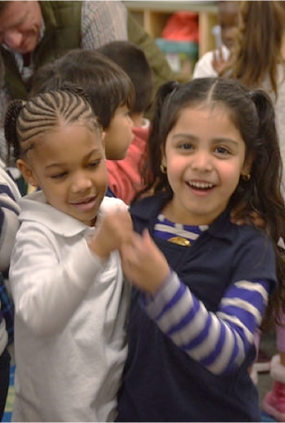
Sharing Forum
  Impressions of today’s training?
  Additional resources or tools to share?
©2017 California Department of Education
Notes:
Presenter Remarks:
Please feel free to share your impressions or resources and tools with your table or the whole group.

Slide 65
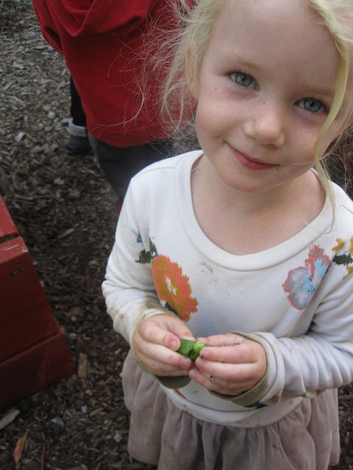
Thank you for planning a variety of movement opportunities!
©2017 California Department of Education
Notes:
Presenter Remarks:
Thank you for participating and remember to intentionally facilitate movement experiences for young children.

Slide 66
Reference Guide for PowerPoint Citations
California Department of Education. 2011. California Preschool Curriculum Framework, Volume 2. http://www.cde.ca.gov/sp/cd/re/documents/psframeworkvol2.pdf (accessed October 3, 2016).
California Department of Education. 2008. California Preschool Learning Foundations, Volume 2. http://www.cde.ca.gov/sp/cd/re/documents/psfoundationsvol2.pdf (accessed October 3, 2016).
California Department of Education. 2013. Transitional Kindergarten Implementation Guide: A Resource for California Public School District Administrators and Teachers. http://www.cde.ca.gov/ci/gs/em/documents/tkguide.pdf (accessed October 3, 2016).

