Slide 1
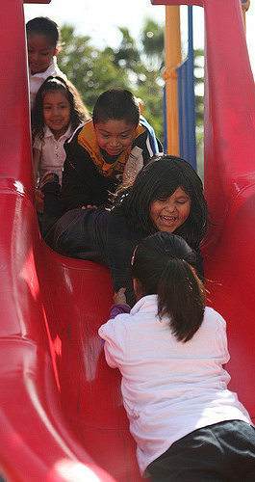
Physical Development in Transitional Kindergarten:
Active Physical Play
California Preschool Learning Foundations, Volume 2
California Preschool Curriculum Framework, Volume 2
©2016 California Department of Education
Notes:
Presenter Remarks:
Welcome to Physical Development in Transitional Kindergarten: Active Physical Play—a presentation focusing on the California Preschool Learning Foundations (Preschool Learning Foundations or PLF), the California Preschool Curriculum Framework (Preschool Curriculum Framework or PCF), and other California Department of Education (CDE) resources in support of the Physical Development domain.
This professional learning session is specifically designed to provide TK teachers with exposure to CDE resources that support TK curriculum planning of developmentally appropriate strategies. Classroom environment design recommendations are included to support the content area of active physical play.
Because our focus for today is active play, we will have many opportunities to move ourselves. Please honor any physical restrictions or limitations that you may have and engage mentally, if you are not able to engage physically.
Extra Notes:
Check everyone’s shoes and advise those wearing inappropriate shoes to be careful.
Be aware of spatial concerns, e.g., push in chairs/purses/bags/totes.
Remind participants that the materials on the tables are for their use during the session only.

Slide 2
Objectives
Gain understanding of key concepts from the California Preschool Learning Foundations, Volume 2 and the California Preschool Curriculum Framework, Volume 2—Physical Development domain, Active Physical Play strand.
Observe, read, and discuss the developmental continuum for active physical play and develop strategies that will guide instruction and learning in Transitional Kindergarten (TK).
Practice using the Preschool Learning Foundations and Preschool Curriculum Framework to intentionally plan, developmentally appropriate, cultural, and inclusive strategies that promote active physical play.
Notes:
Presenter Remarks:
These are our objectives for today’s training:
Gain understanding of key concepts from the California Preschool Learning Foundations, Volume 2 and the California Preschool Curriculum Framework, Volume 2 Physical—Development domain, Active Physical Play strand.
Observe, read, and discuss the developmental continuum for active physical play and develop strategies that will guide instruction and learning in Transitional Kindergarten (TK).
Practice using the Preschool Learning Foundations and Preschool Curriculum Framework to intentionally plan, developmentally appropriate, cultural, and inclusive strategies that promote active physical play.

Slide 3

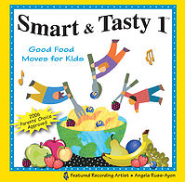
Community Building
Farmer’s Market:
Walk over to the broccoli.
Gallop over to the tangerines.
Cross over to the strawberries.
Jump over to the artichokes.
Dance over to the blueberries.
Skip over to the cauliflower.
Rock over to the pineapples.
For each locomotor skill, move your body as prompted and meet a new person each time!
Notes:
Activity #1: Community Building
Background Information:
Instruct the audience to stand up, push in their chairs, and get ready to meet new people!
Trainer may want to review the locomotor skills in the song or just proceed with the song. “Cross over” means stepping to the side and crossing one foot over the other as you continue stepping to the side. “Rock over” is freestyle—move any way you want to.
Presenter Remarks:
Now it’s time to meet and greet! For each locomotor skill (walk, gallop, etc.) in the song, quickly perform the prompted movement as you meet and greet new people. Once you find a new person, shake hands and introduce yourself, then get ready to listen to the next music prompt so you meet another new person. How many people are you going to meet? 7! Be mindful to move carefully while you move your way through the Farmer’s Market. (CD: Smart & Tasty 1 by Angela Russ)
intent:
This activity is designed for participants to meet and greet one another, as well as to engage all participants in physical activity that represents the Physical Development strand, Active Physical Play.
OUTCOMES:
Participants move to locomotor prompts heard in the song. (Prompts are also on the “Community Building” slide located at the beginning of the PowerPoint.)
Materials Required:
Song: “Farmer’s Market” by Angela Russ, on the Smart & Tasty 1 CD—it is highly recommended to download the song from the CPIN website and embed it directly into the PowerPoint
Speaker/amplification system
Optional: Use an MP3 player rather than embedding the song into the PowerPoint
Time: 3–4 minutes
Process:
Prepare participants for movement—check clothing and shoes and remind participants to move safely and within limitations.
Have participants push in chairs at tables, along with bags/totes/etc.
Introduce the song to the audience. The song is “Farmer’s Market” by Angela Russ and is found on the Smart & Tasty 1 CD—visit http://www.AbridgeClub.com/ for lyrics and additional information.
Review the locomotor movements on the slide (bolded text). Remind participants that the song is quick, so when each locomotor skill is sung, they should move quickly to find a new partner and do a fast introduction.
After the song, inform the participants that they just experienced active physical play, the topic of the training!
OPTIONS:
If the facility is limited on space or time is restricted do half of the song.
Trainer may start and stop the song to slow the pace of the activity.
Trainer may opt to use the song as background music, and lead the participants in a meet and greet with only two or three partners each.

Slide 4
Why Use the Preschool Learning Foundations for TK?
CA Law (EC 48000):
Transitional kindergarten is the first year of a two-year kindergarten program that uses a modified kindergarten curriculum that is age and developmentally appropriate.
Transitional kindergarten programs are intended to be aligned to the California Preschool Learning Foundations developed by the CDE.
Notes:
Background Information:
http://cde.ca.gov/ci/gs/em/kinderfaq.asp#program
Presenter Remarks:
The state of California provides guidance on utilizing the Preschool Learning Foundations and the Preschool Curriculum Framework as planning and curriculum resources in the TK classroom.

Slide 5









CDE Publications and Resources that Support TK Implementation
Alignment Document
Developmentally Appropriate
Practice
DRDP Specific to TK and K
Preschool Curriculum Framework
Physical Education Model Content Standards for CA Public Schools, K-12
Physical Education Framework for CA Public Schools, K-12
Preschool Learning Foundations
Transitional Kindergarten Implementation Guide
California Common Core State Standards
Preschool Learning Foundations
Preschool Curriculum Framework
Active Start
Alignment Document
Transitional Kindergarten Implementation Guide
California Common Core State Standards
DRDP Specific to TK and K
Physical Education Model Content Standards for CA Public Schools, K-12
Physical Education Framework for CA Public Schools, K-12
California Common Core State Standards
Notes:
Presenter Remarks:
The California Department of Education has developed many publications, resources, and supports that enable teachers to facilitate the most positive outcomes for students.
Today our main focus will be the on the Preschool Learning Foundations and the Preschool Curriculum Framework, Volume 2, Physical Development domain.
There are additional key resources that support physical development in young children. We will also discuss alignment and make connections to additional resources pictured in the graphic (name and hold up each resource): The Alignment of the California Preschool Learning Foundations with Key Early Education Resources (Alignment Document), the Transitional Kindergarten Implementation Guide – A Resource for Public School District Administrators and Teachers (TK Implementation Guide), the Desired Results Developmental Profile—Kindergarten (2015): A Developmental Continuum for Kindergarten (DRDP-K [2015]), Physical Education Model Content Standards for California Public Schools, Kindergarten Through Grade Twelve (PE Model Content Standards), the Physical Education Framework for California Public Schools (PE Framework), and the California Common Core State Standards (CA CCSS).
Early educators typically include physical movements in their daily teaching. It is best practice to be cognizant of movement and integrate it within all content areas.
What do you know about these documents?
How do you use these resources in your work now?
(Depending on the size of your group, participants can share responses at their table or in pairs.)

Slide 6

Preschool Learning Foundations
The purpose of the Preschool Learning Foundations is to promote a common understanding of young children’s learning and to guide instructional practice.
Notes:
Presenter Remarks:
The purpose of the foundations is to promote a common understanding of preschool children’s learning and to guide instructional practice. The foundations and framework are designed to work together. While the foundations—known as standards in the K-12 arena—provide the background information to understand children’s developing knowledge and skills (the “what”), the curriculum framework offers guidance on how teachers and programs can support the learning and development that are described in the foundations (the “how”).
Please take out Handout 1: Active Physical Play Substrands. Think about the experience we just had while moving and meeting each other. Did we experience some of these substrands (Active Participation, Cardiovascular Endurance, or Muscular Strength Endurance and Flexibility)?
The rest of today will focus on these substrands.

Slide 7
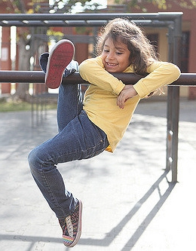
Preschool Learning Foundations
The foundations tell us what children should know and be able to do with appropriate support at around 48 or 60 months (four to five years of age).
©2016 California Department of Education
Notes:
Presenter Remarks:
The Preschool Learning Foundations describe what children should be able to do at around 48 (4 years old) and 60 months (5 years old).
The Preschool Learning Foundations describe the knowledge and skills that young children typically develop when provided with developmentally, culturally, and linguistically appropriate learning experiences.

Slide 8
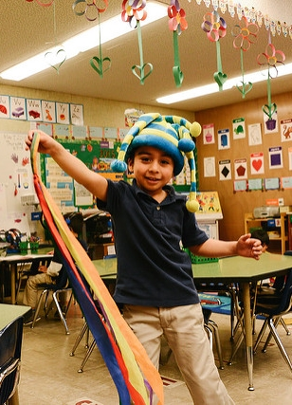
Preschool Learning Foundations
High-quality programs
Appropriate support
Research-based evidence
© 2016 California Department of Education
Notes:
Presenter Remarks:
The foundations also assume that children have access to appropriate support in high quality programs that include the following aspects:
Environments and experiences that encourage active, playful exploration and experimentation
Clearly defined learning centers where materials are rotated
Purposeful teaching to help children gain knowledge and skills
Predictable schedules and routines with large blocks of time for play and skillful integration of curriculum with an intentional focus on content
Specific support for English learners with staff that have knowledge of the stages of English-language acquisition
Accommodations and adaptations for children with disabilities and additional support when needed
Let’s take a closer look at one of the foundations as an example. Open the Preschool Learning Foundations and find a page where the age levels appear; this is an example of a foundation page.
(If participants need guidance direct them to pages 55-57 in the Preschool Learning Foundations; if there are not enough copies of the book direct participants to Handout 1: Active Physical Play Substrands.)
Look across the page at the developmental progression at around 48 months; notice the changes at 60 months of age.
(Solicit a few participants to read what they see. Summarize the exploration with the following key note.)
Because children develop at different rates, the foundations were designed with the understanding that certain stages of development will occur at different times for all students. You will notice “at around” in the description. It is important to remember this variability occurs.

Slide 9
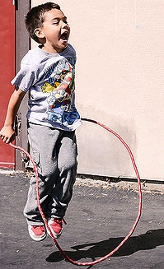

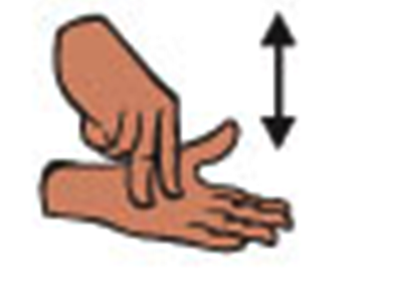
Universal Design for Learning
See the word.
Hear the word.
Experience the word.
Do “jump” in sign language.
Read a book with “jump” in it.
Scaffold “jump.”
Notes:
Presenter Remarks:
In recognition that children follow different pathways to learning, Universal Design for Learning (UDL) is incorporated into the Preschool Learning Foundations. Active play incorporates UDL naturally.
This “jump” example is a wonderful illustration of UDL. When you look at the word “jump” and nothing else, you are only viewing letters that represent the word jump, and therefore only engaging two learning styles—visually (by reading the word) and verbally (by hearing it).
When you experience jumping with a jump rope or jumping for joy due to a past experience, you engage multiple senses—which helps in the learning process.
Take a moment to read the rest of the bullets on the slide. This list represents a variety of ways the action of jump may be represented, experienced and expressed.
English-language learners may not recognize the word in English, but may be familiar with the meaning of jump. Physically experiencing and learning new vocabulary through active physical play benefits everyone, especially English learners.
Students learning to communicate with American Sign Language may not recognize the word when it is verbally spoken but understand the content with it is signed.

Slide 10
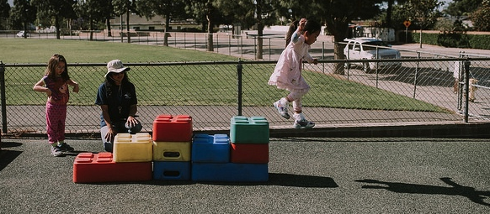
Universal Design for Learning
Jump off!
Multiple means of representation
Multiple means of expression
Multiple means of engagement
Notes:
Presenter Remarks:
UDL provides for multiple means of representation, multiple means of engagement, and multiple means of expression. For example, a teacher can teach a child to “jump off” once the student knows what “jump” means.
“Multiple means of representation refers to providing information in a variety of ways so the learning needs of all children are met. For example, it is important to speak clearly to children with auditory disabilities while also presenting information visually (such as with objects and pictures).
“Multiple means of expression refers to allowing children to use alternative ways to communicate or demonstrate what they know or what they are feeling. For example, when a teacher seeks a verbal response, a child may respond in any language, including American Sign Language. A child with special needs who cannot speak may also respond by pointing, by gazing, by gesturing, by using a picture system of communication, or by using any other form of alternative or augmented communication system.
“Multiple means of engagement refers to providing choices in the setting or program that facilitate learning by building on children’s interests. The information in this curriculum framework has been worded to incorporate multiple means of representation, expression, and engagement” (PCF, Vol. 2, p. 14).
For example a child may not be a risk taker and may not want to jump off of blocks that are high. A teacher can offer variations for jumping stations so that the child can choose the station with which he or she is most comfortable.

Slide 11
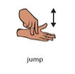
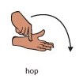
A Jump Check
When I say GO, show me your very best JUMP.
When I say GO, show me your very best HOP.
Discuss with someone near you. What is the difference between a jump and a hop?
Notes:
Presenter Remarks:
Click on each number, one at a time, with the participants demonstrating the skill:
When I say GO, show me your very best JUMP.
When I say GO, show me your very best HOP.
Discuss with someone near you: what is the difference between a jump and a hop?
(Allow 30 seconds for the participants to discuss, then ask individuals to share with the group. Many will say that jumps are large, explosive, and moving forward, and that hops are small, not very explosive, and do not cover a large area moving forward.)
(Click on the graphics to illustrate the signs [ASL] for jump and hop. Practice both hand signs with participants.)
What is the difference? The difference between a hop and a jump is that a hop is only on one foot, and a jump is on two feet. Both hops and jumps may be small, large, explosive, cover a little or a lot of area, go forward/backward or side to side, etc.
(For additional information, see the illustrations and descriptors of developmental sequences for jumping and hopping on pages 212 and 213 of the Preschool Curriculum Framework.)
Please return to your seats. We are now going to watch a video with children jumping on bubble wrap. With your new knowledge of jumping and hopping, observe what the children are doing on the bubble wrap.

Slide 12

Foundations and Framework, Volume 2
Notes:
Presenter Remarks:
The purposes of the Preschool Learning Foundations are to promote a common understanding of TK children's learning and to guide instructional practice; they describe the knowledge and skills that young children typically develop when provided with developmentally, culturally, and linguistically appropriate learning experiences.
The Preschool Curriculum Framework was created as a companion to the Preschool Learning Foundations. The framework ". . . presents strategies and information to enrich learning and development opportunities for all children" (PCF, Vol. 2, p. v).
The Preschool Learning Foundations and the Preschool Curriculum Framework are designed to work together. While the foundations—known as "standards" in the K–12 arena—provide the background information to understand children's developing knowledge and skills (the "what"), the framework offers guidance on how teachers and programs can support the learning and development that are described in the foundations (the "how").
Extra Notes:
The Preschool Learning Foundations were developed with research-based evidence and are enhanced with expert practitioners' suggestions and examples. All foundations were written by a team of researchers with expertise in the given domain. A complete reference list of the source materials, along with detailed bibliographic notes for each of the developmental domains, can be found in the Preschool Learning Foundations. Sources used in the development of the foundations include:
Documents from the California Department of Education, such as the English-Language Arts Content Standards for California Public Schools, Kindergarten Through Grade Twelve (Language and Literacy, Introduction, p. 48, left column).
Well-validated assessment tools such as the Ages & Stages Questionnaires (ASQ): A Parent-Completed, Child-Monitoring System (Social-Emotional, References and Source Materials, p. 36).
General sources such as the Report of the National Reading Panel 2000 (Language and Literacy, Introduction, p. 73, left column).
Early childhood education standards from other states such as Hawaii and Texas (Social-Emotional, Introduction, p. 5, footnote).

Slide 13
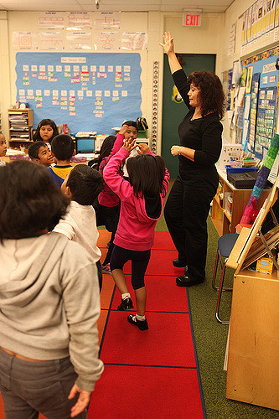

Active Start
Active Start:
A Statement of Physical Activity Guidelines for Children from Birth
to Five Years
Notes:
Presenter Remarks:
Active Start, published by the National Association for Sport and Physical Education, is an important document in that it provides guidelines for the recommended amounts of daily physical activity (PA) that infants, toddlers, and TK children should accumulate. We will discuss physical activity recommendations more in depth later in the training.

Slide 14



Physical Development and Physical Education Alignment
TK
Notes:
Presenter Remarks:
We will revisit this graphic throughout this session since it represents the bridge from preschool to kindergarten: TK. Hold up both the Preschool Learning Foundations and the Physical Education Model Content Standards (MCS) to illustrate that this is the bridge for TK.
Let’s explore the connection between physical development foundations and the standards of physical education (PE).
Refer to Handouts 2 and 3.
The Preschool Learning Foundations illustrate how important it is for preschool teachers to set the foundation for physical development, and how TK teachers can continue this development and provide an uninterrupted transition from preschool to TK and then from TK to kindergarten.
Take a minute to look at both documents and notice how the PE standards align with the foundations – their categories differ slightly, but the same content areas are evident in both sets of standards. In the PE Standards, each grade level has the same “standard” description but each grade level is specific to the skills and development for each grade level.
Are there any questions or comments?
14

Slide 15
Overview of Alignment
California Preschool Learning Foundations | California Kindergarten Content Standards | Common Core State Standards
Social-Emotional Development | Health, Education Mental, Emotional, and Social Health
Language and Literacy | English-Language Arts | English Language Arts
English-Language Development | English-Language Development | ELDA Framework
Mathematics | Mathematics | Mathematics
Visual and Performing Arts | Visual and Performing Arts
Physical Development | Physical Education
Health | Health Education
History-Social Science | History-Social Science
Science | Science | Next Generation Science Standards
Notes:
Presenter Remarks:
Let’s look more in depth at The Alignment of the California Preschool Learning Foundations with Key Early Education Resources. This table represents an overview of the alignment between the nine domains of the Preschool Learning Foundations and the content of the CA Standards and the CCSS.
The alignment demonstrates that early learning is a significant part of the educational system and that the knowledge and skills of young children are foundational to future learning.
Understanding the links between the different ages and different early childhood services allows educators to build on children’s earlier learning and prepare them for the next educational challenge.
All domains of the Preschool Learning Foundations correspond to the California Kindergarten Content Standards.
Visual and Performing Arts, Physical Development, Health, History–Social Science, and Science are all separate domains in the Preschool Learning Foundations. The Physical Development domain in the Preschool Learning Foundations provides a developmental foundation that corresponds with the California Physical Education Standards, K–12.
The Common Core includes English Language Arts & Literacy in History/Social Studies, Science, and Technical Subjects.
15

Slide 16

California PE Standards and Framework, K–12
Standard 1. Students demonstrate the motor skills and movement patterns needed to perform a variety of physical activities.
Standard 2. Students demonstrate knowledge of movement concepts, principles, and strategies that apply to the learning and performance of physical activities.
Standard 3. Students assess and maintain a level of physical fitness to improve health and performance.
Standard 4. Students demonstrate knowledge of physical fitness concepts, principles, and strategies to improve health and performance.
Standard 5. Students demonstrate and utilize knowledge of psychological and sociological concepts, principles, and strategies that apply to the learning and performance of physical activity.
Notes:
Presenter Remarks:
Let’s look at Handout 3: California PE Content Standards and take a minute to read through the standards for kindergarten. What do you notice?
(Solicit responses. Remind the audience that there are five standards and the standards are the same for each grade level, recognizing that each grade has age-appropriate and developmentally appropriate development.)
This handout provides a more detailed look at each standard and examples thereof. As you can see, many of the developmental skills introduced and practiced in pre-K are continued through TK and into kindergarten. Having an awareness of children’s physical development during the early years is best practice for early educators.

Slide 17
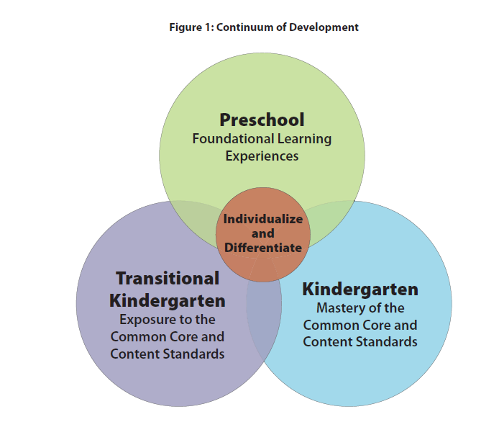

Transitional Kindergarten
Implementation Guide
Notes:
Presenter Remarks:
“Successful TK programs are the result of thoughtful teacher reflection and planning. TK teachers have a thorough understanding of the TK curriculum and understand the critical skills and concepts for each subject area. They understand the developmental trajectories of their students and can identify the standards for learning that align with students’ assessed needs as well as with effective instructional strategies. They create cohesive curriculum plans that are reflective of individual and group learning needs. Decisions about what to teach in a TK classroom are guided by key CDE resources. Guidelines for selecting and adapting curriculum materials and lessons help TK teachers plan engaging encounters that address learning standards” (TK Implementation Guide, p. 36).
“The Preschool Learning Foundations, California’s Common Core State Standards for Kindergarten, and the Kindergarten Content Standards for California Public Schools are resources that help teachers define what to teach in the TK classroom” (TK Implementation Guide, p. 24).
Learning experiences should be meaningful and integrated across subject areas. Learning should also include experiential and hands-on activities in real contexts.
Having a deep knowledge of both preschool-age children and kindergartners is important for TK teachers who seek to differentiate and individualize instruction to meet the unique educational and social–emotional learning needs across the continuum of development (Figure 1).
“Furthermore, teachers who understand that all students benefit from differentiated instruction will find that the tools, curriculum, and routines that they use to support typically developing children can be easily adapted or modified to accommodate students with disabilities” (TK Implementation Guide, p. 52).
More strategies can be found in the Transitional Kindergarten
Implementation Guide. This document also has strategies for supporting community partnerships which are a crucial component of a quality early learning program.
“Creating family and community partnerships for children who are learning English is also an important goal for educators. Teachers make use of dynamic instructional strategies that engage different modalities to bridge linguistic backgrounds. They provide concrete tools for making sense of and acquiring skills in the English language” (TK Implementation Guide, p. 55).

Slide 18

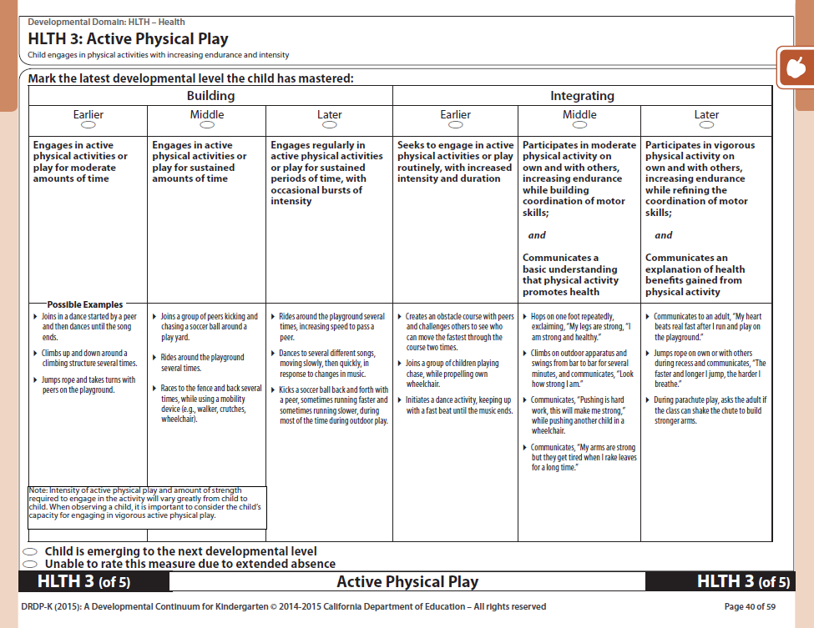
DRDP-K (2015)
DRDP-K (2015)
For Use with TK and K
The DRDP-K (2015) is an observational assessment instrument.
The DRDP-K (2015) provides a developmental continuum.
The DRDP-K (2015) is for all children, including English language learners and children with disabilities.
The Active Physical Play measure is located in the Health domain (HLTH 3—Child engages in physical activities with increasing endurance and intensity).
Notes:
Presenter Remarks:
It is important for participants to understand that the foundations describe the knowledge and skills that all young children typically exhibit:
at about 48 and 60 months of age;
as they complete their first or second year of preschool;
with appropriate support;
when attending a high-quality preschool program.
The DRDP-K is the child observational assessment instrument that is used by teachers to record a child’s progress on a developmental continuum.
(Refer participants to Handout 4: HLTH Measure 3 DRDP-K Active Physical Play 2015. Note: The DRDP-K measure of Active Physical Play is in the Health domain, measure 3 of 5.)

Slide 19
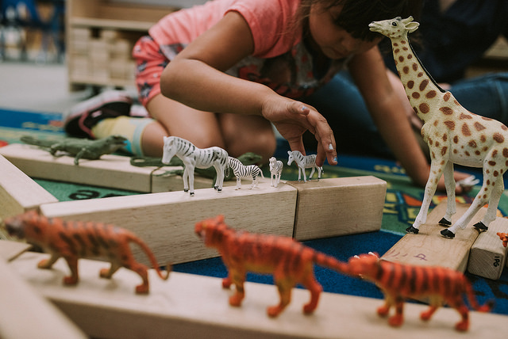

Developmentally Appropriate Practice in Early Childhood Programs
Serving Children from Birth through Age 8
Notes:
Presenter Remarks:
Developmentally Appropriate Practice (DAP) presents research-based, highly-effective strategies to promote learning, design environments, and organize daily routines. It also has a “what it is not” section that is very illuminating.
You can use all of these resources together to create the richest experience for your students.

Slide 20
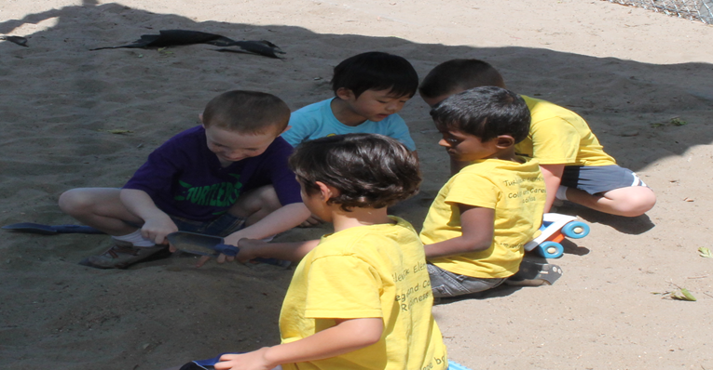

Let’s Dig Deeper!
Notes:
Background Information:
(This is a transition slide to the guiding principles.)
Presenter Remarks:
“All children, no matter their ability levels or backgrounds, benefit from engaging in physical activities” (PCF, Vol. 2, p. 132).
“Promoting children’s physical fitness is critical given the increasing rates of lifestyle-related health issues (including obesity and diabetes) among children in California” (PCF, Vol. 2, p. 132).
The guiding principles at the beginning of the Physical Development section of the Preschool Curriculum Framework provide a lens through which to read and understand the content of the chapter. Teachers can use the guiding principles to direct their efforts in creating an appropriate environment to support Active Physical Play. Let’s dig deeper into the guiding principles now.

Slide 21
Guiding Principles to Support Physical Development
Developmentally appropriate movement programs accommodate a variety of individual difference among children.
Children often learn best through maximum active participation.
The physical safety of children’s play environments should be of paramount importance at all times.
Family members working as partners with teachers are key to enriching the physical development of children.
Inclusion of children with special needs is beneficial to all and promotes greater understanding and respect for diversity.
Children are multisensory learners with unique learning styles.
To maximize teaching effectiveness, movement skill learning should first focus on how children are moving with their bodies.
Notes:
Presenter Remarks:
Let’s explore the guiding principles for the Physical Development domain, on page 133 in the Preschool Curriculum Framework (Vol. 2). We will revisit these principles and have an opportunity to spend more time on them in the closing activity. Handout 5: Physical Development Domain Guiding Principles summarizes the principles.
As we read the slide think about what you already do in the classroom that supports these guiding principles. There will be time to discuss in a moment.
(Share the slide with the group.)

Slide 22
Guiding Principles to Support Physical Development
Children generally learn new movement skills more easily when they can focus on one specific aspect of the skill at a time.
Children benefit from ample opportunities to practice new physical skills.
Children benefit from integrated learning activities across the curriculum.
Frequency, intensity, type, and duration are the four key parameters to designing active physical play to enhance children’s fitness and health.
Physical skills are more easily learned when clear instructions and appropriate feedback are provided in children’s home language using familiar communication methods.
Notes:
Presenter Remarks:
(Share the slide with the group.)
Using Handout 5: Physical Development Domain Guiding Principles talk about what you already do and what you might want to do to support these guiding principles in your classroom. You have 2 minutes to discuss at your table group.

Slide 23
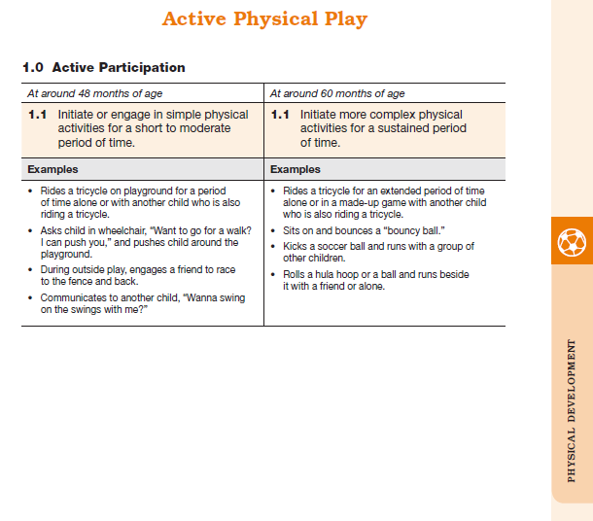
Map of the Foundations
Strand
Substrand
Age
Foundation
Examples
Examine the developmental progression between 48 and 60 months in the foundation:
What do you notice is developing?
Use the examples to help you think about growth and change.
Domain
Notes:
Background Information:
Refer to Handout 6: Physical Development Foundations Map.
Presenter Remarks:
Please locate Handout 6: Physical Development Foundations Map in your folder and follow along while we discuss each component:
The name of the domain (Physical Development).
The name of the strand (Active Physical Play).
The name of the substrand (Active Participation).
Note that substrands always end in “zero.“
The two age levels (at around 48 months and at around 60 months).
Each foundation describes typical behaviors at around 48 months and at around 60 months or four to five years old.
The foundations for the substrand.
There is one for each age level on this page (1.1 for 48 months and 1.1 for 60 months).
The examples for each foundation.
These are only a few of the ways that children may demonstrate the behavior in the foundation.
Many of the foundations have footnotes that include information specific for students with IEPs or students with disabilities, such as information about adaptations or accommodations.
Notice that there is a developmental progression from four years old to five years old within a substrand.
(Click to reveal prompt.) Examine the developmental progression between 48 and 60 months in your foundation:
What do you notice is developing?
Use the examples to help you think about growth and change.

Slide 24
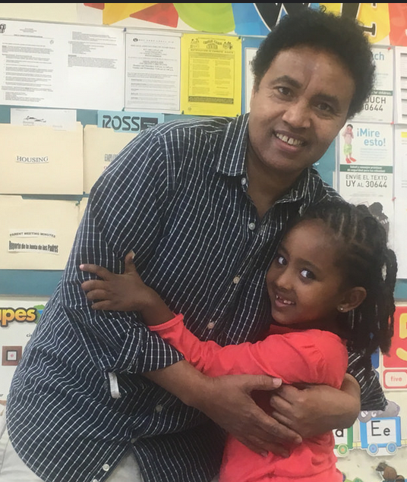
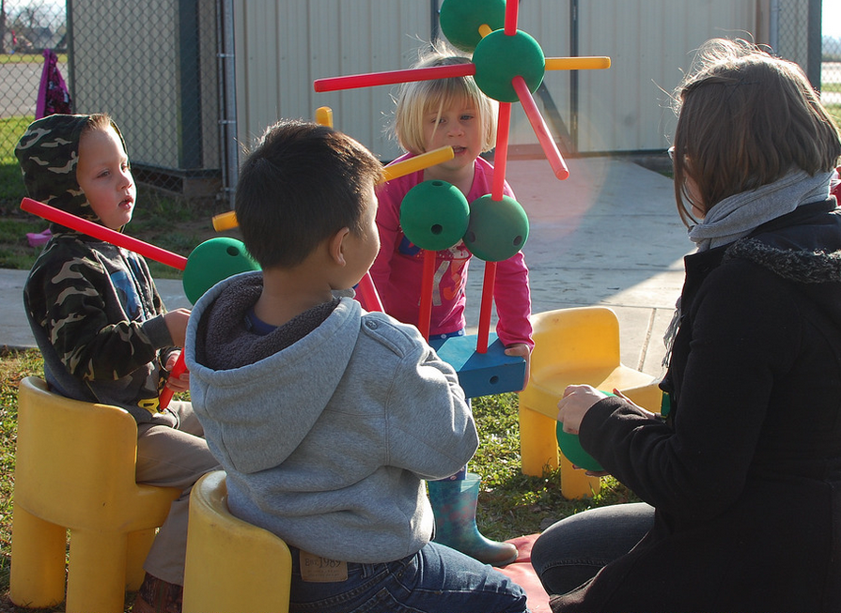
Preschool Curriculum Framework Sections
Interactions & Strategies
Planning Learning Opportunities
Teachable Moments
Engaging Families
Notes:
Presenter Remarks:
The Preschool Curriculum Framework provides practical suggestions for teachers. Some of the sections where you will find specific suggestions are Interactions and Strategies, Planning Learning Opportunities, Teachable Moments, and Engaging Families.

Slide 25
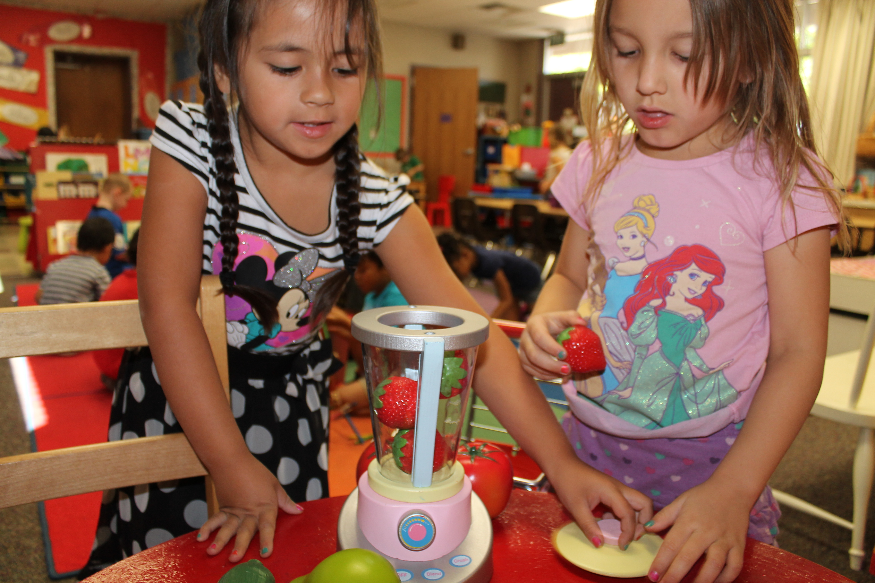
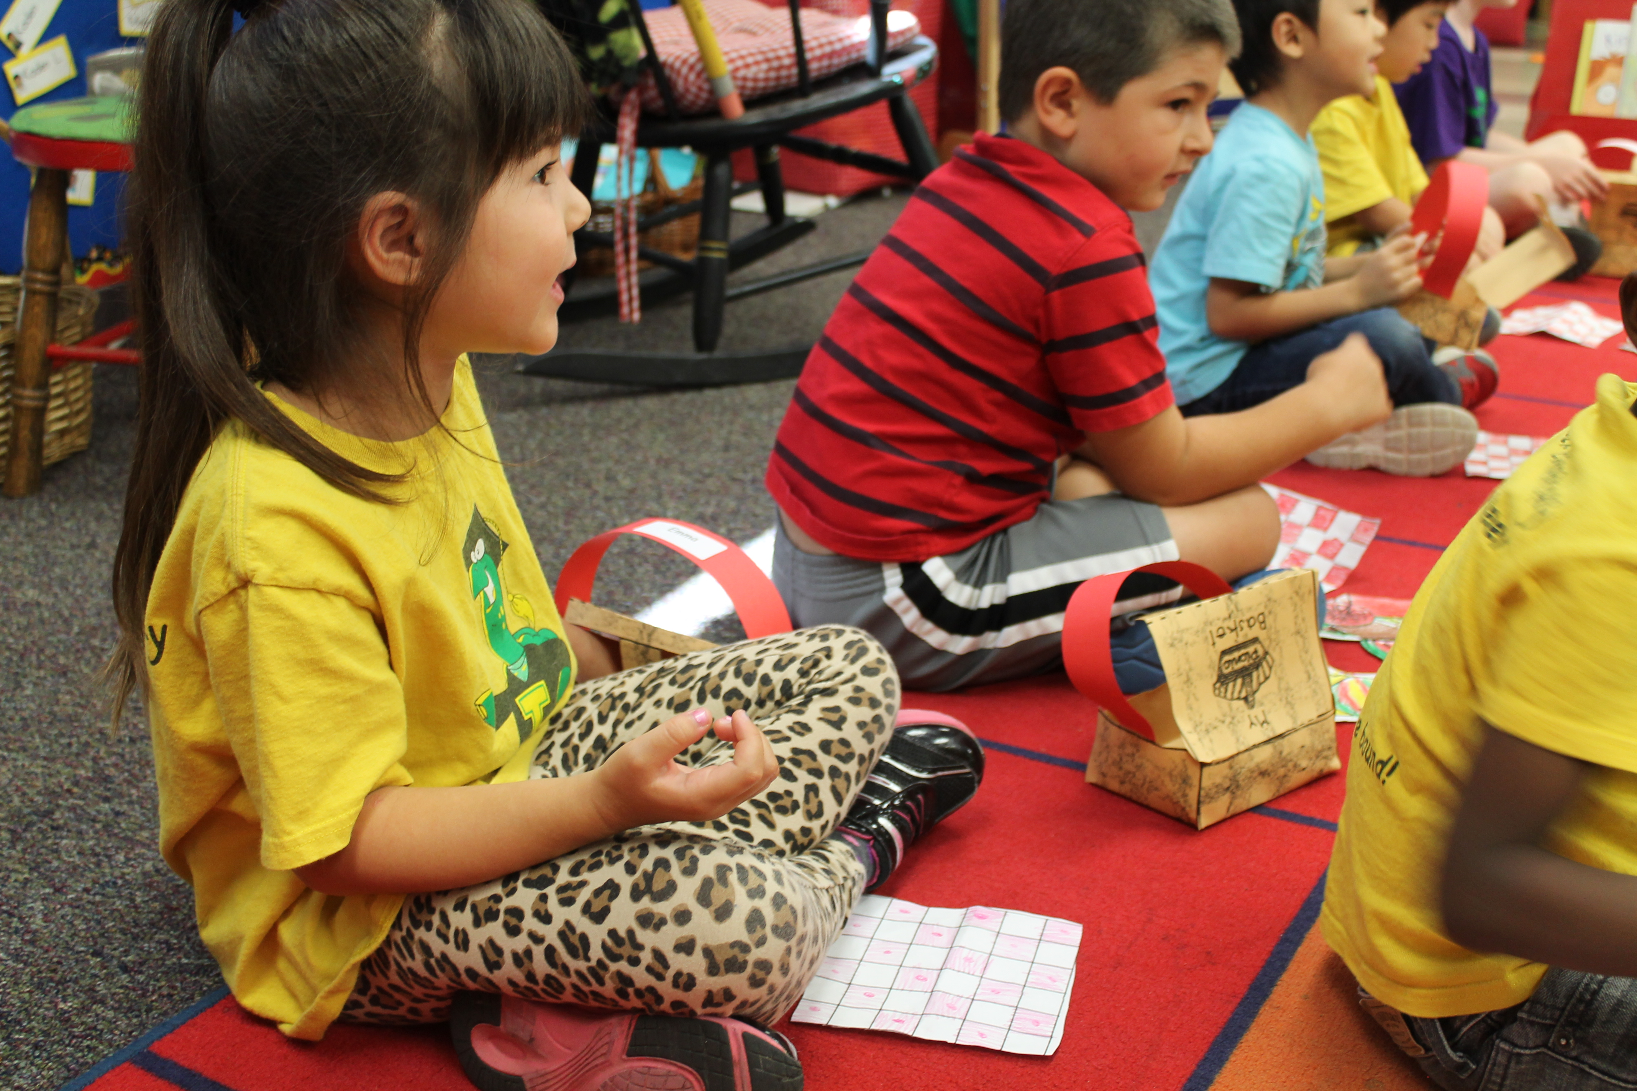
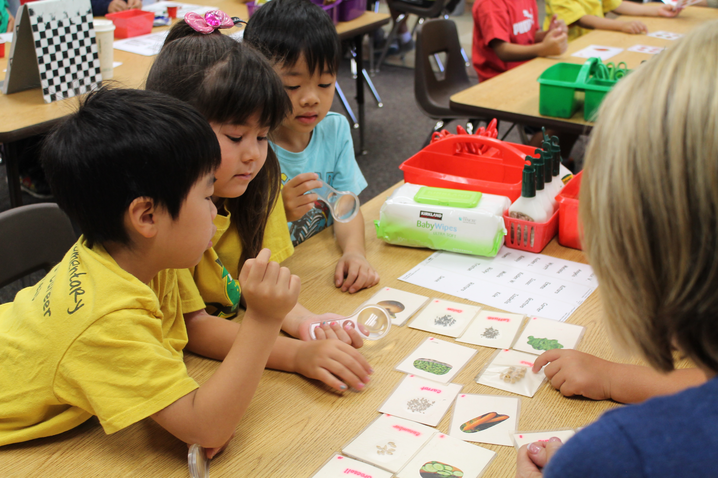
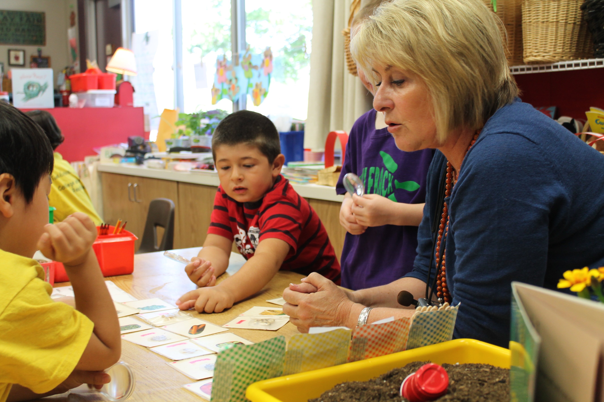
Framework Strategies
Developmentally appropriate
Reflective and intentional
Individually and culturally meaningful
Inclusive
©2016 California Department of Education (CDE) with the WestEd Center for Child & Family Studies, California Preschool Instructional Network (CPIN). (05/2016)
Notes:
Background Information:
Refer to the Preschool Curriculum Framework (Vol. 2).
Presenter Remarks:
Teachers address ideas and concepts that children can grasp at their developmental level, and then progressively build on what children already know and understand. This approach applies to all children, including children with various abilities, disabilities, or other special needs (such as delays in language, cognition, or physical ability).

Slide 26
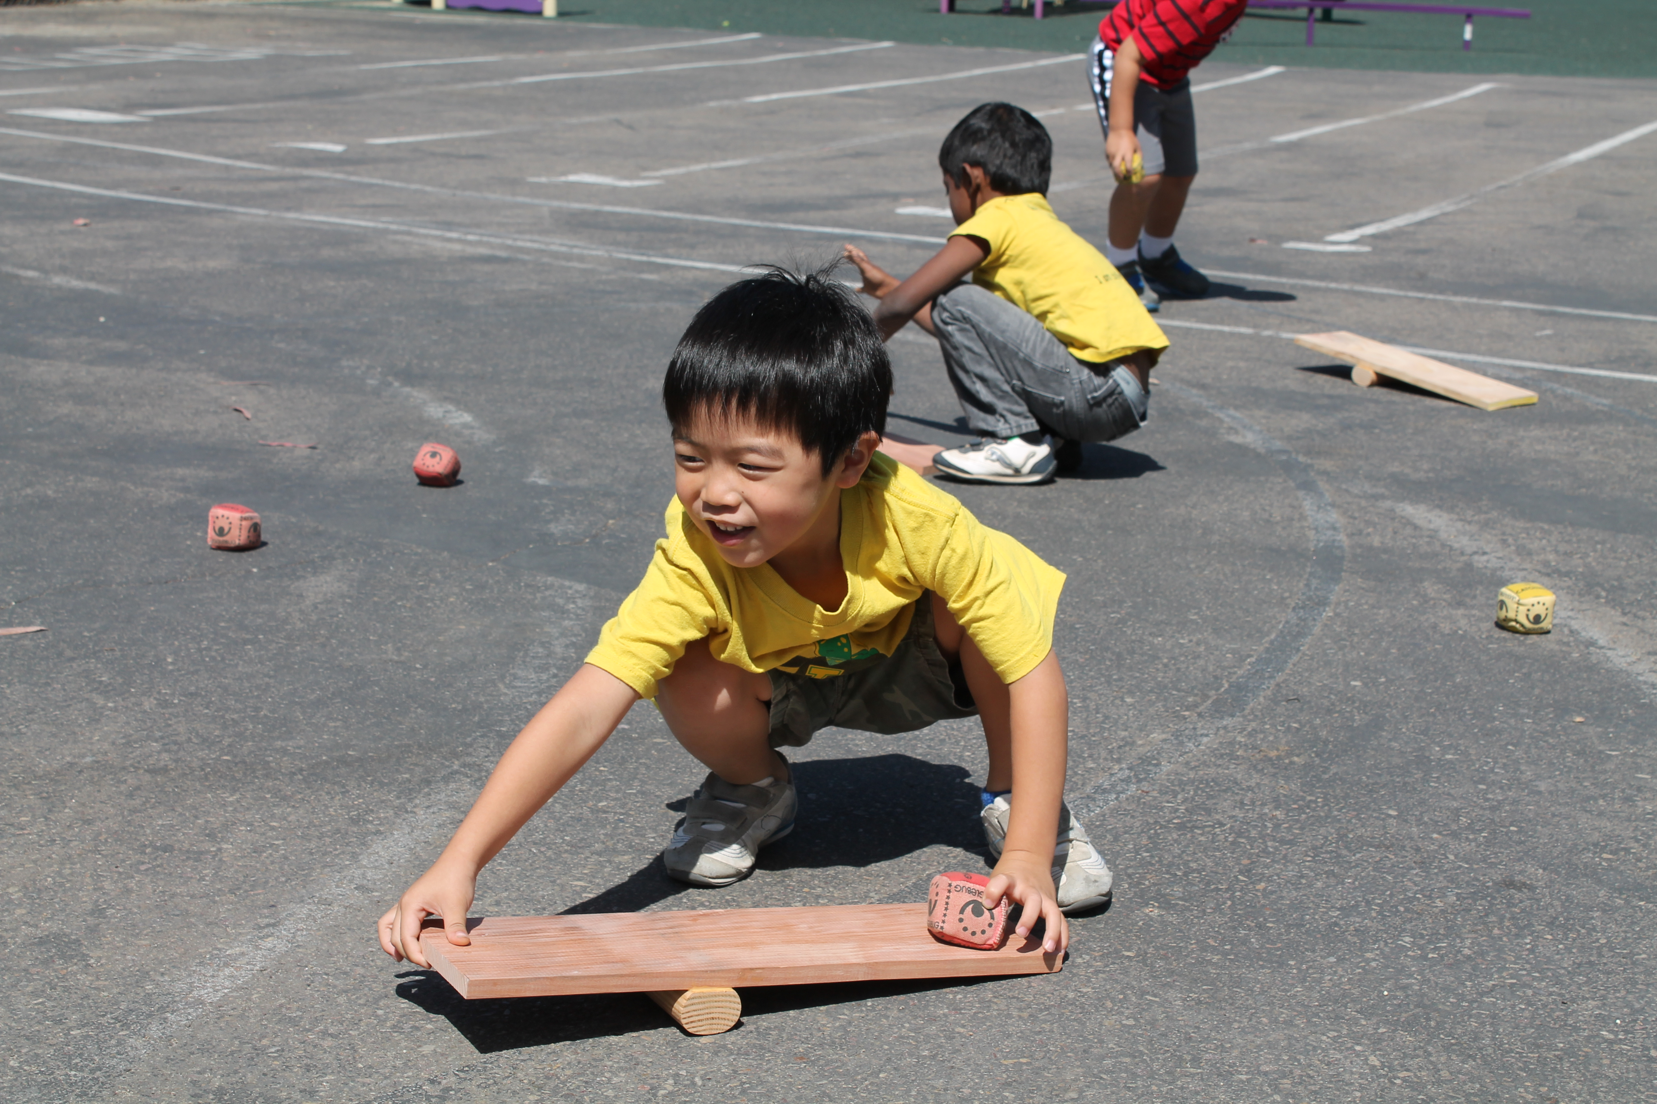
Habits of Physical Activity
“The habits of physical activity that children learn in the early years greatly increase the chance that children will continue being physically active throughout childhood and beyond” (PCF, Vol. 2, p. 192).
“Most importantly, children must see active play as fun” (PCF, Vol. 2, p. 192).
Notes:
Presenter Remarks:
“The habits of physical activity that children learn in the early years greatly increase the chance that children will continue being physically active throughout childhood and beyond” (PCF, Vol. 2, p. 192).
“Most importantly, children must see active play as fun” (PCF, Vol. 2, p. 192).
Let’s experience a little physical activity and fun!

Slide 27
Active Physical Play
Young children learn best by doing.
Let’s experience active physical play.
During the song, think about skills a child may develop through actively participating.
Notes:
Presenter Remarks:
This song illustrates many skills that children may develop through active participation. Please stand up, push in all chairs, and find a partner in the room, with ample space to move.
(Those without a partner may meet in the middle to find a partner. The trainer may ask an audience member to be his or her demonstration partner. Remind the audience to move safely and be aware of restrictions or limitations.)

Slide 28

Build a Bridge
✵ Build a Bridge 
Bridge
Tunnel
Road
Cave
Tower
Wall
Diagram Courtesy of Angela Russ
Notes:
Activity 2: Build a Bridge
Background Information:
It is suggested that you embed the song in the PPT prior to the training. To start the song, simply click on the embedded icon.
Presenter Remarks:
This diagram will help demonstrate the movements for the song. Please join hands with your partner and follow along as we practice each movement to the song before we try it with the music.
With partner:
Build a bridge, build a tunnel, build a road. (2x)
Build a bridge, build a tunnel, build a bridge, build a tunnel,
Build a bridge, build a tunnel, build a road.
Individually:
Build a cave, build a tower, build a wall. (2x)
Build a cave, build a tower, build a cave, build a tower,
Build a cave, build a tower, build a wall.
Extra Notes:
Immediately after the song, have the audience place a hand over their heart and ask them if they experienced an increase in their heart rate. This illustrates a positive health benefit to the cardiovascular system. It’s called moderate to vigorous physical activity (MVPA).
intent:
This activity is designed to cooperatively engage pairs as they follow a sequential pattern in the song. After the song, pairs discuss skills that young children would be learning by actively engaging in the song. This activity exemplifies Active Participation, the first substrand in the Active Physical Play strand.
OUTCOMES:
Participants will actively engage and cooperatively move with a partner and by themselves throughout the song.
Participants will connect skills in various domains that are engaged via the activity.
Participants will increase their moderate to vigorous physical activity (MVPA) through active engagement.
Materials Required:
Song: “Build a Bridge” by Angela Russ, on the Smart Moves 2 CD—it is highly recommended to download the song from the CPIN website and embed it directly into the PowerPoint
Speaker/amplification system
Optional: Use an MP3 player rather than embedding the song into the PowerPoint
Time: 5 minutes
Process:
Prepare participants for movement—check clothing and shoes and remind participants to move safely and within limitations.
Have participants push in chairs at tables, along with bags/totes/etc.
Invite participants to find a partner and stand facing their partners.
Introduce all of the movements of the song to the audience (see lyrics and diagram at end of sheet) so everyone can practice first. Encourage everyone to say the words to the song for better retention (the song will be revisited at “warp speed” later in the training).
Cue the music. The song is “Build a Bridge” by Angela Russ and is found on the Smart Moves 2 CD—visit http://www.AbridgeClub.com/ for lyrics and additional information.
After the song, have pairs discuss what children would be learning by engaging in the song.
Lyrics:
With partner:
Build a bridge, build a tunnel, build a road. (2x)
Build a bridge, build a tunnel, build a bridge, build a tunnel,
Build a bridge, build a tunnel, build a road.
Individually:
Build a cave, build a tower, build a wall. (2x)
Build a cave, build a tower, build a cave, build a tower,
Build a cave, build a tower, build a wall.
OPTIONS:
If the time is limited, do half of the song.
If a participant does not have a partner, the trainer can invite the participant to be his or her partner in front of the group, or have a group problem-solve using a third person.
For participants with physical restrictions, pairs can problem-solve new movements to represent each action.
Ask each pair to share what they discussed that children would be learning by engaging in the song. Have the pairs try not to repeat what another pair has said—this keeps everyone mindful of all the responses.

Slide 29
Discussion Time
With your partner, discuss the many skills a child would develop by engaging in the song “Build a Bridge."
Notes:
Presenter Remarks:
(Prompt pairs to discuss skills that children may develop by participating in the song. Allow 60–90 seconds for discussion. Ask several pairs to share their answers with the group. Answers may include many of the following: cooperative play, language/vocabulary development, listening skills, following directions, sequencing/patterning, imaginative play, gross motor practice, balance, levels, rhythm, spatial awareness, problem solving, etc.)

Slide 30
Preschool Learning Foundations—Physical Development
Strands | Substrands
Fundamental Movement Skills | 1.0 Balance
 | 2.0 Locomotor Skills
 | 3.0 Manipulative Skills
Perceptual-Motor Skills and Movement Concepts | 1.0 Body Awareness
 | 2.0 Spatial Awareness
 | 3.0 Directional Awareness
Active Physical Play | 1.0 Active Participation
 | 2.0 Cardiovascular Endurance
 | 3.0 Muscular Strength, Muscular Endurance, and Flexibility
Notes:
Background Information:
Be sure to say “zero” when mentioning the substrand numbers (1.0, 2.0, and 3.0).
Presenter Remarks:
Today we are going to explore the Active Physical Play strand.
The previous song beautifully illustrates the three substrands of the Active Physical Play strand:
1.0–Active Participation: Simply engaging in the song is active participation.
2.0–Cardiovascular Endurance: By the end of the song, the heart rate should be increased.
3.0–Muscular Strength, Muscular Endurance, and Flexibility: Moving the body through various actions in the song.

Slide 31
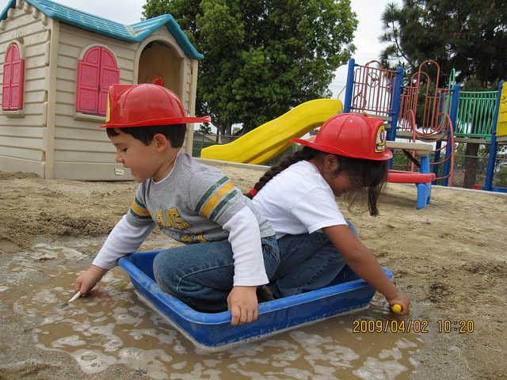

Let’s Dig Deeper!
Let’s Dig Deeper!
Physical activities enhance all aspects of development.
Promoting children’s physical fitness is critical.
All children benefit from engaging in physical activities.
Notes:
Presenter Remarks:
Physical activities enhance all aspects of development, including cognitive, emotional, social as well as physical.
Promoting children’s physical fitness is critical given the increasing rates of lifestyle-related health issues (including obesity and diabetes) among children in California.
All children, no matter their ability levels or backgrounds, benefit from engaging in physical activities.

Slide 32
Active Physical Play
Strands | Substrands
Fundamental Movement Skills | 1.0 Balance
 | 2.0 Locomotor Skills
 | 3.0 Manipulative Skills
Perceptual-Motor Skills and Movement Concepts | 1.0 Body Awareness
 | 2.0 Spatial Awareness
 | 3.0 Directional Awareness
Active Physical Play | 1.0 Active Participation
 | 2.0 Cardiovascular Endurance
 | 3.0 Muscular Strength, Muscular Endurance, and Flexibility
Notes:
Presenter Remarks:
The first substrand in Active Physical Play is Active Participation.
Active participation means that children are engaged in moderate (slightly elevated heart rate) to vigorous physical activities throughout the course of the day. We just experienced active participation in the song “Build a Bridge.”

Slide 33
Substrand 1.0
Active Participation
Notes:
Presenter Remarks:
(If time allows, have participants give the directions below and have participants open and read from the Preschool Learning Foundations [Vol. 2], otherwise refer to the slide.)
Turn to page 55 in the Preschool Learning Foundations (Vol. 2) and read both foundations. Think of one thing you saw a student do in the last week that might demonstrate development of this foundation.
(Participants may also refer to this substrand more closely in Handout 1: Active Physical Play Substrands.)

Slide 34


Why Do Children Need
Physical Activity?
Too many preschoolers are obese.
Notes:
Background Information:
Source: http://www.cdc.gov/vitalsigns/ChildhoodObesity/index.html
Presenter Remarks:
Let’s discuss the need for physical activity.
In the United States, about one in eight preschoolers (12%) is obese. Obese children are more likely to be obese later in childhood and adolescence. In these older children and adolescents, obesity is associated with high cholesterol, high blood sugar, asthma, and mental health problems.
Children are considered obese if their Body Mass Index is at or above the ninety-fifth percentile for children of the same age and sex, according to the 2000 CDC Growth Charts.
Children who are overweight or obese as preschoolers are five times as likely as normal-weight children to be overweight or obese as adults.

Slide 35
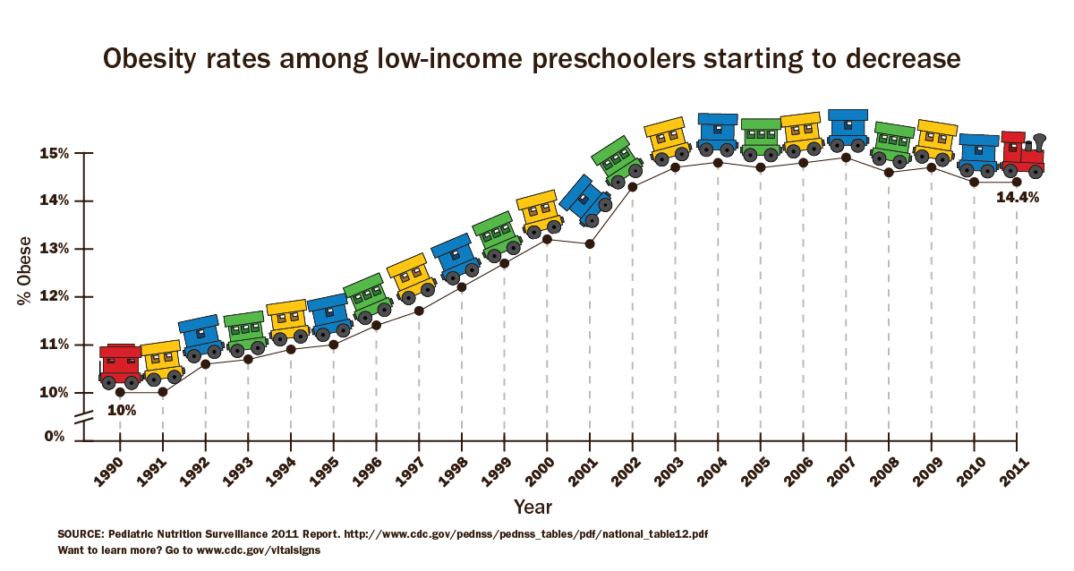
Good News!
Obesity rates among preschoolers are improving, but there is more work to be done to continue this downward trend.
Notes:
Background Information:
Source: http://www.cdc.gov/vitalsigns/ChildhoodObesity/index.html
Presenter Remarks:
Obese children are more likely to become obese adults and suffer lifelong physical and mental health problems. Obesity rates in low-income preschoolers, after decades of rising, began to level off from 2003 through 2008, and now are showing small declines in many states; however, too many preschoolers are obese.

Slide 36
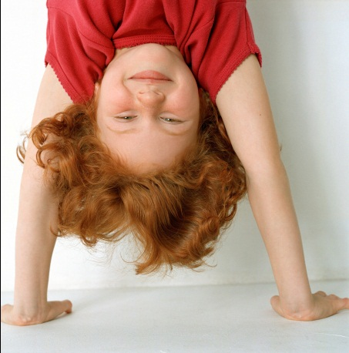
What is the daily physical activity recommendation for 4- and 5-year old children?
Notes:
Presenter Remarks:
Does anyone know the daily physical activity recommendations for 4- and 5-year old children?
(Answers may vary, depending on which source they are referring to.)
It is widely recommended that children accumulate at least 60 minutes and up to several hours of physical activity every day of the week.

Slide 37




Daily Physical Activity Recommendations
Notes:
Presenter Remarks:
Refer to Handout 7: Physical Activity Recommendations for Young Children.
As you look at the handout note how physical activity recommendations from various organizations are generally pretty consistent for young children - 60 minutes a day. The minutes are to be accumulated and spread throughout the day in short bouts. Young children are intermittent in their energy level, they tire quickly but they recover fast as well so short rest periods are recommended.
Active Start: A Statement of Physical Activity Guidelines for Children Birth to Age 5 by the National Association for Sport and Physical Education (NASPE, 2009), is a widely recognized national document for physical activity recommendations for infant, toddlers and preschoolers.
“The 2008 Physical Activity Guidelines for Americans, which have been adopted by the First Lady's Let's Move! initiative and the American Academy of Pediatrics, recommend that youth participate in daily moderate-to-vigorous physical activity for at least 60 minute” (http://www.cdc.gov/nchs/data/databriefs/db141.htm).
As children transition into the elementary years, there are state mandates for minutes of physical education in grades 1-6, so preparing TK and kindergartners for physical activity is highly recommended.

Slide 38
Daily Physical Activity Recommendations
Accumulate at least 60 minutes of
structured daily physical activity (PA)
At least 60+ minutes of daily unstructured PA
Should not be sedentary for more than 60 minutes at a time, except when sleeping
Develop competence in fundamental movement skills
PA should occur both indoors and outdoors
Individuals responsible for the health and well-being of preschoolers should be aware of the importance of PA and should facilitate preschoolers’ movement skills.
Notes:
Presenter Remarks:
(Read bullets on slide or invite participants to read aloud to group. These recommendations are from Active Start: A Statement of Physical Activity Guidelines for Children Birth to Age 5 by the National Association for Sport and Physical Education [NASPE, 2009].)
Take note of the bolded word “accumulate.” It is important to note these physical activity (PA) recommendations are for the whole day. If a child is not with a teacher for most of the day, parents and caregivers should be aware of the need for PA.
Children should engage in both structured and unstructured daily physical activity indoors and outdoors. What is the difference between structured and unstructured?

Slide 39
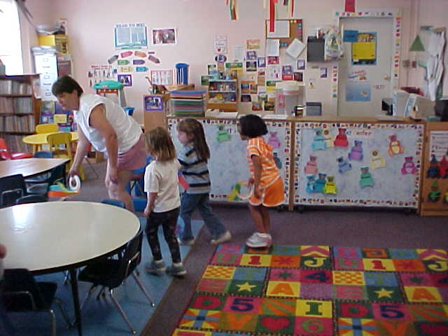
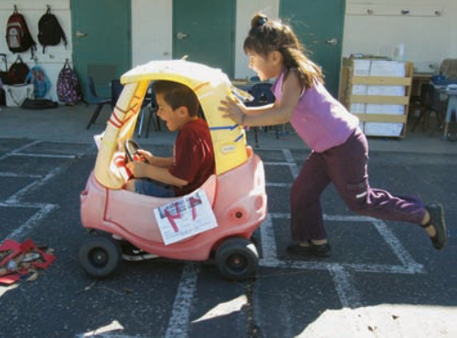
Structured and Unstructured Physical Activity
Adult-led
Intentional facilitation
Play with a purpose
Self-selected
Free play
Child’s choice
Notes:
Background Information:
The content of the bullets is a summary created by Patty Kimbrell.
Presenter Remarks:
“Structured physical activity means movement experiences designed by teachers to support learning” (PLF, Vol. 2, p. 41). In the context of four and five year old children, this means incorporating developmentally appropriate activities that meet the following requirements:
Involve all children and provide frequent participation time
Preserve the joy and exuberance that young children bring to physical activity
Focus on the process (such as how to kick a ball), not the end result (such as whether the child hits the ball or scores a goal)
Recognize the wide range of movement skills, fitness, and previous movement experiences of young children and avoid comparison and competition
Respond to the needs of individual children for instruction and encouragement
Unstructured physical activity is child-selected, with adult supervision.

Slide 40
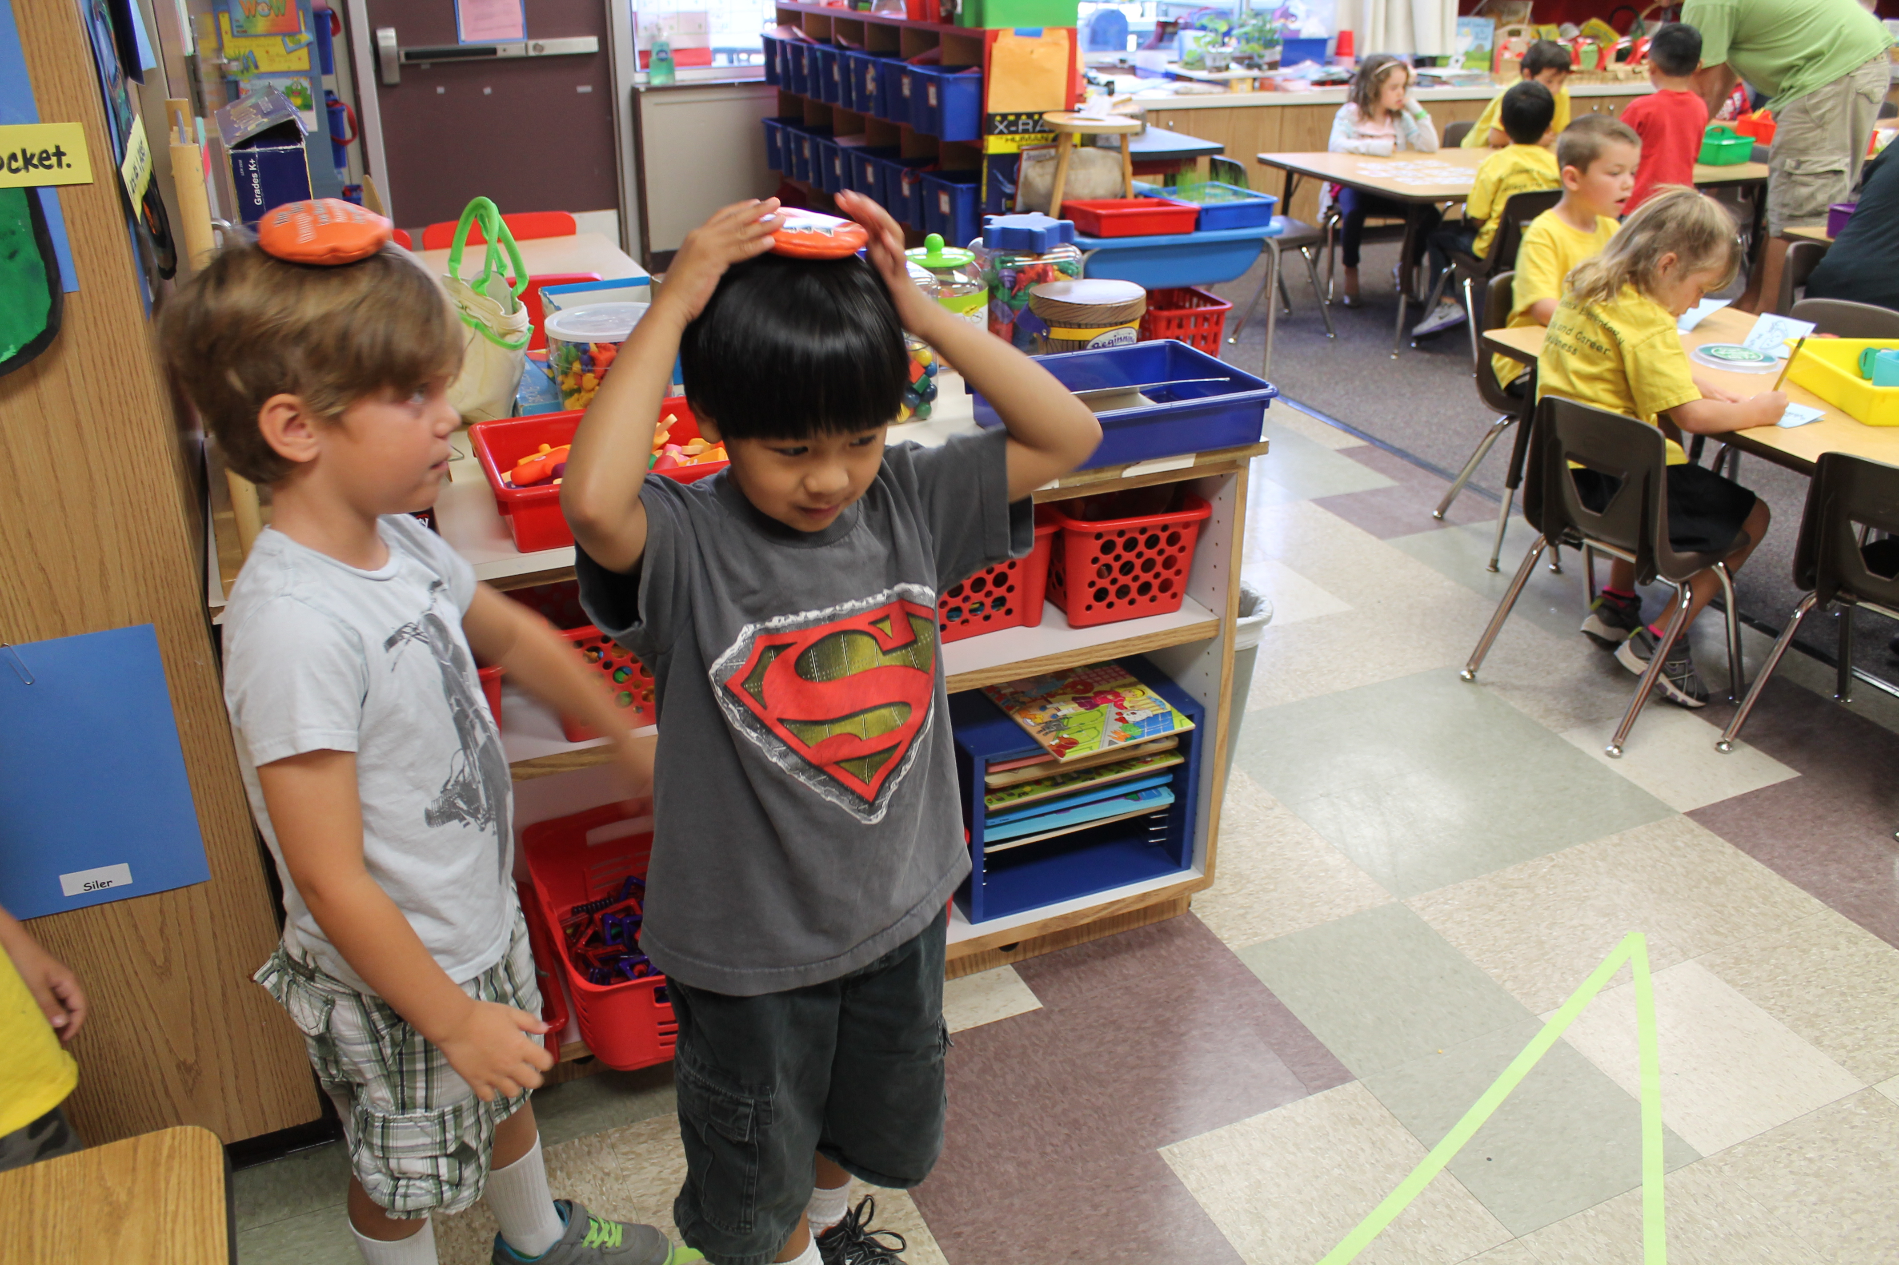
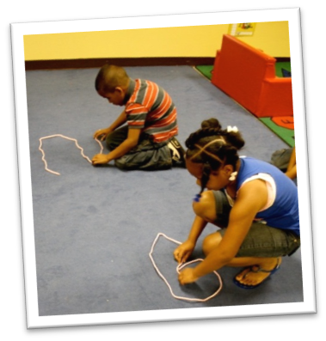
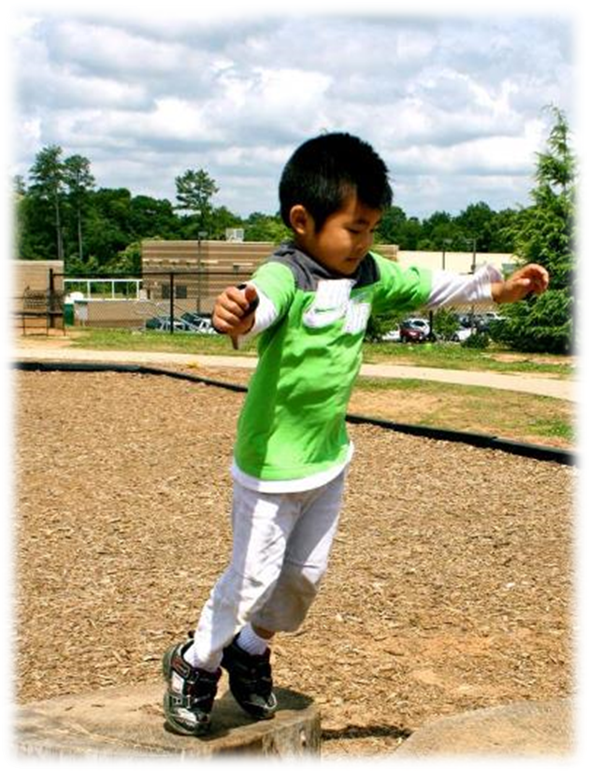
Where does active physical play take place?
Where does active physical play take place?
Indoors
and outdoors!
Notes:
Presenter Remarks:
Many times adults believe that active physical play takes place only outdoors, but it occurs both indoors and outdoors. This is important to remember when you have limited space. Moderate to vigorous physical activity can still happen in limited space if it is planned intentionally.

Slide 41

Name 5 in a Group of 5!
GOAL
“Accumulate 60 minutes of daily structured PA.”
Name five different activities you can do with young children to accumulate PA minutes.
Notes:
Presenter Remarks:
Stand up and make groups of five—stand in a circle with your group.
Each groupmate will share an activity that can be done in or out of the classroom to accumulate short bouts of PA.
Try not to repeat an activity that has already been said—be creative!

Slide 42
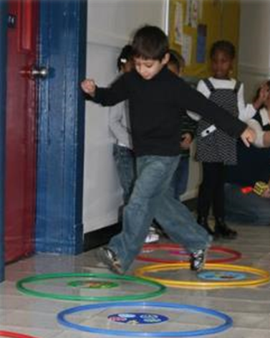
Physical Activity Opportunities
In the classroom
Out of the classroom
During transitioning times
Notes:
Presenter Remarks:
While you were in your groups, did your group discuss activities that can take place in each of the areas shown on this slide? If not, fill in any gaps that your group may have.
Additional thoughts:
In the classroom: adult-led songs, large- or small-group activities, planned and facilitated centers
Out of the classroom: on the playground, during walks large open room, open hallways free of obstacles
During transitioning times: in and out of the classroom, to and from areas inside the classroom

Slide 43
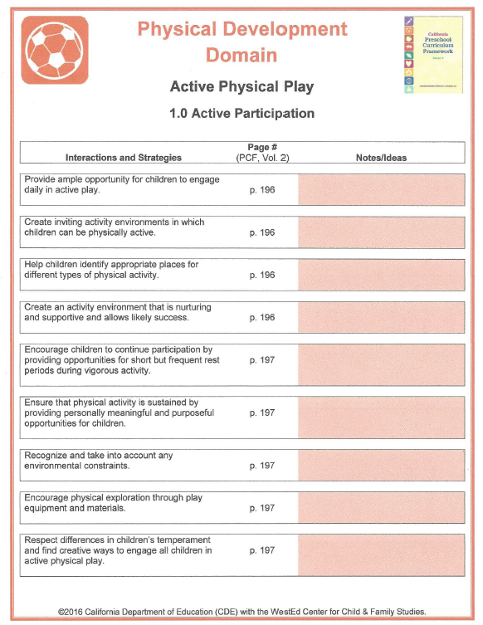
1.0 Interactions and Strategies
Walk and Talk:
With a partner, walk around the room and talk about how the interactions and strategies can be incorporated into your daily routine.
Notes:
Activity 3: Substrand Reflection Interactions and Strategies (for 1.0, 2.0, and 3.0)
Background Information:
Refer to Handout 8: Substrand Reflection Interactions and Strategies, 1.0.
Presenter Remarks:
Let’s apply our knowledge as we review Handout 8: Substrand Reflection Interactions and Strategies, 1.0. Please find a partner and walk around the room as you discuss the interactions and strategies for active physical play. Talk about specific examples of how you currently implement a few strategies and what you can do to include more strategies into your daily routine for TK children.
intent:
This activity is intended for participants to use a physically active technique to review and apply interactions and strategies for each substrand,
OUTCOMES:
Discuss each substrand reflection with a partner while engaging in physical activity that is relevant to the substrand.
Acquire a new strategy to share with other staff and/or families.
Materials Required:
Participant folders
Handout 8: Substrand Reflection Interactions and Strategies
Time: 2–3 minutes for each substrand reflection
Process:
At the appropriate place in the training PPT, each substrand reflection slide indicates how partners will engage in physical activity while discussing the interactions and strategies for the identified substrand. Remind participants to move safely, be aware of others and objects around them, and honor physical restrictions or limitations.
The substrand 1.0 activity is Walk and Talk. Walking and talking illustrates the substrand of Active Participation.
The substrand 2.0 activity is to March and Talk. Marching quickly and talking illustrates the substrand of Cardiovascular Endurance.
The substrand 3.0 activity is to Sit and Stretch. Sitting and stretching illustrates the substrand of Muscular Strength, Muscular Endurance, and Flexibility.
OPTIONS:
Participants create new movement strategies rather than the ones listed.

Slide 44
Active Physical Play
Strands | Substrands
Fundamental Movement Skills | 1.0 Balance
 | 2.0 Locomotor Skills
 | 3.0 Manipulative Skills
Perceptual-Motor Skills and Movement Concepts | 1.0 Body Awareness
 | 2.0 Spatial Awareness
 | 3.0 Directional Awareness
Active Physical Play | 1.0 Active Participation
 | 2.0 Cardiovascular Endurance
 | 3.0 Muscular Strength, Muscular Endurance, and Flexibility
Notes:
Presenter Remarks:
Cardiovascular Endurance is the second substrand of Active Physical Play.
“Cardiovascular endurance is defined as the capacity for sustained physical activity. It includes activities that involve the heart, the lungs, and the vascular system” (PLF, Vol. 2, p. 61).

Slide 45
Substrand 2.0:
Cardiovascular Endurance
Notes:
Presenter Remarks:
(If time allows, have participants give the directions below and have participants open and read from the Preschool Learning Foundations [Vol. 2], otherwise refer to the slide.)
Turn to page 56 in the Preschool Learning Foundations (Vol. 2).
(Participants may also refer to this substrand more closely in Handout 1: Active Physical Play Substrands.)
Generally it is assumed that children are naturally active and that they get plenty of vigorous physical activity as a normal part of the day. However, research does not support this. Page 199 of the Preschool Curriculum Framework (Vol. 2) affirms that in order to reverse the rate of obesity among young children, moderate to vigorous levels of exercise are needed, coupled with good nutrition.

Slide 46

Moderate to Vigorous Physical Activity (MVPA)
Moderate to Vigorous
Physical Activity (MVPA)
The heart is a muscle.
It’s the size
of a fist.
It needs PA.
Notes:
Presenter Remarks:
(Read the slide text. Have audience members hold up a fist during this slide and squeeze it, imitating a heart beating, sending oxygenated blood to all cells of the body.)
The heart is made of cardiac muscle fibers. Muscles need physical activity to remain healthy. The CDC states that health benefits are gained by all individuals who partake in moderate to vigorous physical activity (MVPA) regularly. MVPA is an important concept, and it is explained in the next few slides.

Slide 47
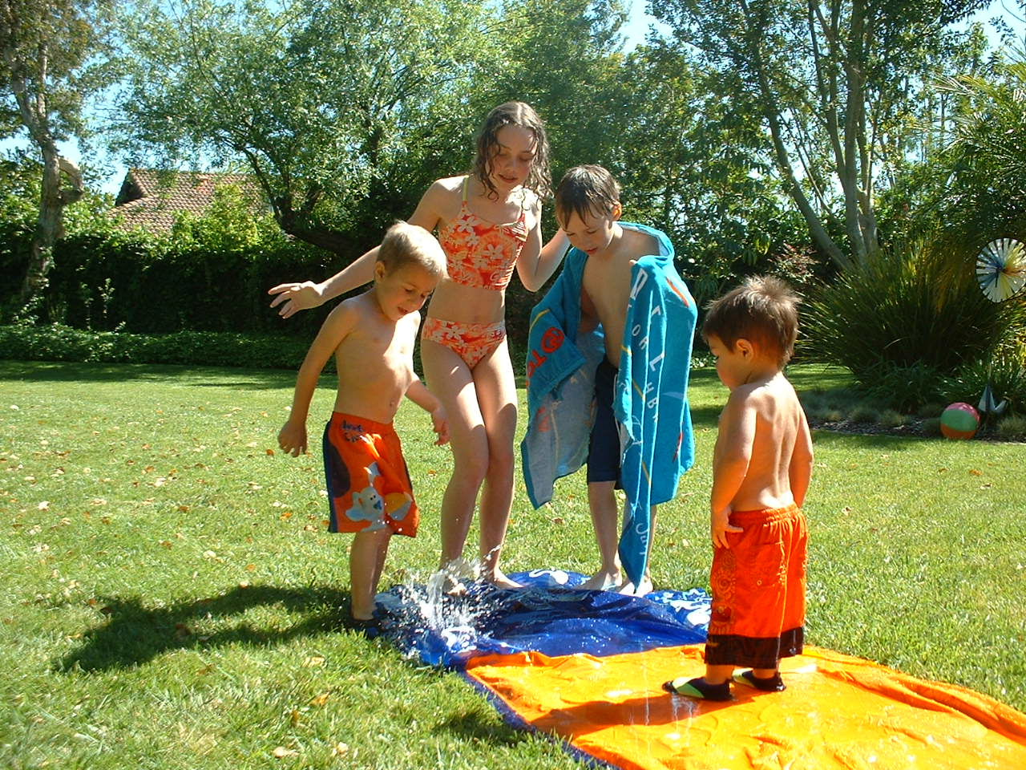
Moderate Level
Moderate Level:
Elevated heart rate
Swinging
Playing
Moving to a song
Walking
Notes:
Presenter Remarks:
Moderate levels of physical activity raise the heart rate from a resting heart rate. Moderate levels may be obtained through various physical activities. What do young children do that raises their heart rate?

Slide 48
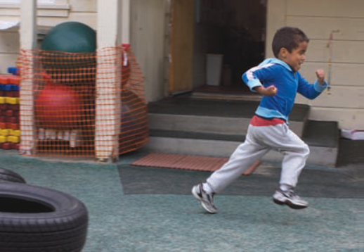
Vigorous Level
Vigorous Level:
Hard to talk while doing activity
Pulling or pushing someone
Running
Climbing
Moving to a song
Notes:
Presenter Remarks:
Vigorous levels of physical activity greatly increase the heart rate and make it hard to talk during the activity. There may be heavy breathing and/or sweating.
What do young children do that raises their heart rate to a vigorous level?
“Time spent out-doors is a strong determinant of vigorous physical activity in preschool-age [TK] children” (Baranowski and others; McKenzie and others as cited in PLF, Vol. 2, p. 38).
“Children play longer and more vigorously when programs provide play equipment (especially simple, inexpensive, and portable equipment such as balls, tricycles, and hoops), physical activity education, and space for active play” (Boldemann and others; Bower and others; Dowda and others as cited in PLF, Vol. 2, p. 38).

Slide 49
Build a Bridge: Warp Speed
✵ Build a Bridge 
Bridge
Una puente
Tunnel
Un tunel
Road
Una calle
WARP SPEED
Cave
Una cueva
Tower
Una torre
Wall
Una pared
Diagram Courtesy of Angela Russ
Notes:
Activity 2: Build a Bridge—Warp Speed
Background Information:
Cue music: “Build a Bridge—Warp Speed” (CD: Smart Moves 2 by Angela Russ).
Presenter Remarks:
This version of “Build a Bridge” has no words. Using the movements that we previously learned, sing the song with me as it progresses faster and faster. Immediately after the song, we will check our heart rates. If your heart rate increased, you experienced moderate to vigorous physical activity (MVPA)—a positive health benefit for people of all ages for cardiovascular fitness.
intent:
The activity is designed to illustrate how music and movement can greatly increase moderate to vigorous physical activity (MVPA). This activity exemplifies Cardiovascular Endurance, the second substrand in the Active Physical Play strand.
OUTCOMES:
Participants will actively engage and cooperatively move with a partner and by themselves throughout the song.
Participants will check their heart rate immediately after the song and make the connection that increased heart rate equals moderate to vigorous physical activity.
Materials Required:
Song: “Build a Bridge—Warp Speed” by Angela Russ, on the Smart Moves 2 CD—it is highly recommended to download the song from the CPIN website and embed it directly into the PowerPoint
Speaker/amplification system
Optional: Use an MP3 player rather than embedding the song into the PowerPoint
Time: 5 minutes
Process:
Prepare participants for movement—check clothing and shoes and remind participants to move safely and within limitations.
Have participants push in chairs at tables, along with bags/totes/etc.
Invite participants to find a partner and stand facing their partners.
Inform participants that this is the same song that they previously performed, but at “warp speed.” There are no words to the song, so everyone needs to sing. The song will get faster and faster. See the end of this sheet for lyrics and movements of the song.
Cue the music. The song is “Build a Bridge—Warp Speed” by Angela Russ and is found on the Smart Moves 2 CD—visit http://www.AbridgeClub.com/ for lyrics and additional information.
Immediately after the song, have everyone check their heart rate. The majority of people should be able to identify an increased heart rate. Congratulate everyone on attaining moderate to vigorous physical activity (MVPA)!
Music is an easy way to accumulate minutes of moderate to vigorous physical activity—share this message with families too.
Lyrics:
With partner:
Build a bridge, build a tunnel, build a road. (2x)
Build a bridge, build a tunnel, build a bridge, build a tunnel,
Build a bridge, build a tunnel, build a road.
Individually:
Build a cave, build a tower, build a wall. (2x)
Build a cave, build a tower, build a cave, build a tower,
Build a cave, build a tower, build a wall.
OPTIONS:
If the time is limited or the fitness of the group is extremely low, do half of the song.
If a participant does not have a partner, the trainer can invite the participant to be his or her partner in front of the group, or have a group problem-solve using a third person.
Pairs can discuss activities that they do in their everyday routine and that provide them with moderate and/or vigorous physical activity.

Slide 50

Increasing Awareness
Increasing Awareness
Teach children to recognize their heart rates.
Thank you,
thank you,
thank you!
Notes:
Presenter Remarks:
Increasing awareness of how fast the heart beats during or after various activities helps children to understand basic health concepts. Children can be taught to place a hand on their chests, over their hearts, after physical activity, to feel their heart rate. Adults can then ask, “What is your heart saying?” Children can respond, “Thank you, thank you, thank you!”

Slide 51
Foundation Video Example 2.1:
What It Might Look Like
Notes:
Background Information:
Prior to the training, embed the Active Physical Play foundation video example for both 48 and 60 months. It is one video clip.
Presenter Remarks:
This video clip illustrates how teachers can instruct students in the fundamental movement skill of kicking and increase cardiovascular awareness. The children kick and chase their foam soccer ball across the field. When they return, they are asked “What is your heart saying?” This activity involves many skills in physical development, such as kicking, chasing, running, and spatial awareness. It also involves listening skills (one whistle = stop, two whistles = pick up ball and run back), increases muscular strength and endurance, and increases a child’s awareness about cardiovascular endurance (age appropriate for TK).

Slide 52
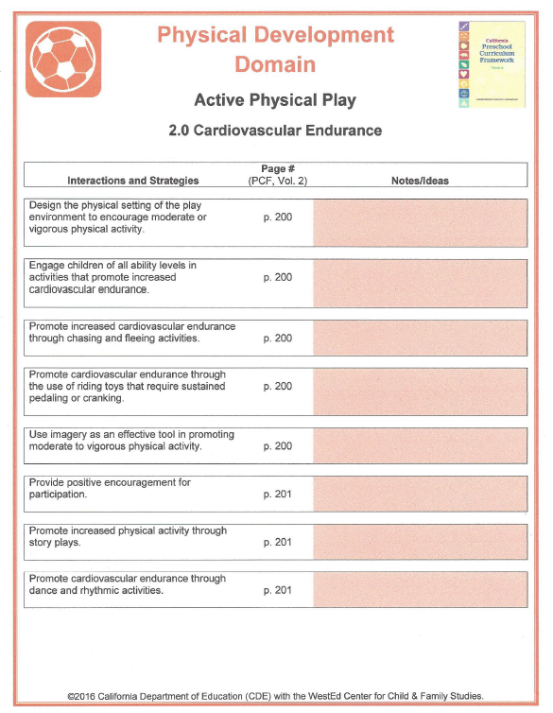
2.0 Interactions and Strategies
March and Talk
While marching quickly in place, discuss with a partner how to incorporate the interactions and strategies into your classroom.
Notes:
Presenter Remarks:
Refer to page two of Handout 8: Substrand Reflection Interactions and Strategies.
Now march quickly in place and talk with a partner about the interactions and strategies on page two of the handout. Consider the following questions during your discussion:
What strategies are you currently using?
What could you do to implement additional strategies into your classroom?
(Depending on time, allow 2–3 minutes for discussion.)

Slide 53
Active Physical Play
Strands | Substrands
Fundamental Movement Skills | 1.0 Balance
 | 2.0 Locomotor Skills
 | 3.0 Manipulative Skills
Perceptual-Motor Skills and Movement Concepts | 1.0 Body Awareness
 | 2.0 Spatial Awareness
 | 3.0 Directional Awareness
Active Physical Play | 1.0 Active Participation
 | 2.0 Cardiovascular Endurance
 | 3.0 Muscular Strength, Muscular Endurance, and Flexibility
Notes:
Presenter Remarks:
The third substrand is Muscular Strength, Muscular Endurance, and Flexibility.
One person at each table, please locate the terms shown in the 3.0 section of the slide, on page 62 of the Preschool Learning Foundations, and share those definitions with your table.
Muscular strength is ”the amount of force that the muscles can produce” (PLF, Vol. 2, p. 62). Muscular strength refers to how strong a person is.
Muscular endurance is “the ability to exert force against an object external from the body for several repetitions without tiring” (PLF, Vol. 2, p. 62). Muscular endurance refers to the ability to sustain a physical task, such as climbing stairs repeatedly.
Flexibility is “the range of motion of a joint and the elasticity of muscle and connective tissue” (PLF, Vol. 2, p. 61). Flexibility refers to the ability to move one’s joints through a range of motion.
It is important to note that, “There are large increases in endurance and strength between the ages of four and seven” (PLF, Vol. 2, p. 60).

Slide 54
Substrand 3.0 Muscular Strength, Muscular Endurance, and Flexibility
Notes:
Presenter Remarks:
Turn to and review page 57 of the Preschool Learning Foundations (Vol. 2) as we discuss this slide.
(Participants may also refer to this substrand more closely in Handout 1: Active Physical Play Substrands.)
Our final substrand is Muscular Strength, Muscular Endurance, and Flexibility. By engaging in increasing amounts of active play, all three components will naturally develop. When children don’t engage in active play, adults need to be aware of this and plan for intentional activities.

Slide 55
Video Example:
What It Might Look Like
Notes:
Background Information:
Use the video “Strength” from the CPIN Web site.
The video is four minutes and 10 seconds long. The trainer may choose to end the video around two minutes and 30 seconds.
Presenter Remarks:
Note how children’s play is their work. By moving heavy items, pushing and pulling, they are developing muscular strength and muscular endurance.
Share with an elbow partner some activities that you have noticed children doing and that would build muscular strength and endurance.

Slide 56
The Many Benefits of Yoga
    Muscular strength
    Muscular endurance
    Flexibility
Balance
Coordination
Spatial and body awareness
Notes:
Presenter Remarks:
Yoga is an excellent activity that develops many physical attributes in young children, including muscular strength, endurance, and flexibility, as well as balance, coordination, and spatial and body awareness.

Slide 57
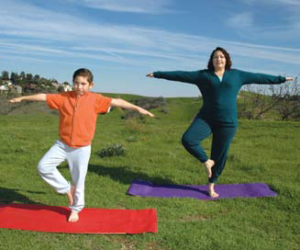
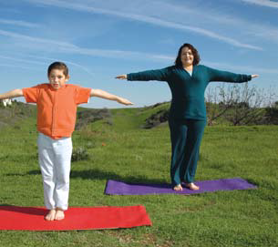
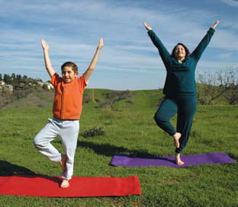

Shape of Yoga
        “Apple Tree”
A
B
C
  Children with special needs can participate too:
Notes:
Activity 4: Yoga
Presenter Remarks:
“Shape of Yoga” is a free resource in English and Spanish and is available at http://www.cdph.ca.gov/programs/cpns/Documents/Network-ShapeofYoga.pdf.
Many yoga poses can be adapted for children with special needs and yoga is a great activity to share with families. The “apple tree” pose is included in your folder, in both English and Spanish, as Handout 9: Apple Tree Pose English and Spanish.
Let’s do a few poses and experience muscular strength, muscular endurance and flexibility.
Follow these steps to perform the “Apple Tree” pose (Advise the audience to hold on to a chair for balance if they want to.):
Stand tall and strong, like a healthy apple tree (A).
When your legs are deeply rooted and balanced, breathe in and raise your arms out to your sides, like the branches of an apple tree (A).
Lift your right leg and place your right foot on the inner part of your left leg (B).
Hold for two breaths.
Raise your arms higher and wiggle your fingers like leaves on an apple tree (C).
Breathe out and slowly return to the start position (A).
Switch sides and repeat.
Extra Notes:
(During the balance pose, ask the audience if they can feel messages being transmitted from their muscles to their brain, telling their brain how their body is balancing.) Muscles and the brain communicate effortlessly to each other all the time. Balance is a good skill for all ages, young and old—the young need to practice balance so that they become more coordinated, and older folks need balance to prevent falls.
intent:
This activity is designed to engage participants in three basic yoga poses from the Shape of Yoga document that illustrates muscular strength, muscular endurance, and flexibility.
OUTCOMES:
Participants practice three yoga poses by holding poses and breathing and experience how to engage muscles.
Materials Required:
Shape of Yoga document (printed in English and Spanish), available at https://www.cdph.ca.gov/programs/cpns/Documents/Network-ShapeofYoga.pdf
PowerPoint slides containing illustrations of poses for the audience to view
Ample space for each participant to partake in poses free of obstacles
Time: 7–10 minutes
Process:
Prepare participants for movement—check clothing and shoes and push in chairs at tables, along with bags/totes/etc.
Prompt participants to stand and find an area that has ample space and is free of obstacles. Invite all participants to partake in three yoga poses.
Introduce each pose. (See the next page for instructions on each pose.) Remind participants to take their time as they work through each yoga pose and to move within limitations.
OPTIONS:
Ask participants to hold onto chairs if needed for balance.
Encourage participants with physical restrictions or limitations to modify the poses to meet their needs, or to relax and take the time to focus on their breathing, clearing their mind of thoughts.
Many yoga programs are available for children. If your resource library includes such programs, feel free to share them with the audience.
YOGA POSES:
Apple Tree:
Stand tall and strong, like a healthy apple tree (A).
When your legs are deeply rooted and balanced, breathe in and raise your arms out to your sides, like the branches of an apple tree (A).
Lift your right leg and place your right foot on the inner part of your left leg (B).
Hold for two breaths.
Raise your arms higher and wiggle your fingers, like leaves on an apple tree (C).
Breathe out and slowly return to the start position (A).
Switch sides and repeat.
(During the balance pose, ask the audience if they can feel messages being transmitted from their muscles to their brain, telling their brain how their body is balancing.) Muscles and the brain communicate effortlessly to each other all the time. Balance is a good skill for all ages, young and old—the young need to practice balance so that they become more coordinated, and older folks need balance to prevent falls.

Slide 58
Shape of Yoga
        “Folding Quesadilla”
A
B
C
  Think of a child with a mobility disability; how might this individual participate?
Notes:
Presenter Remarks:
Stand up and find an area with ample space for posing.
Follow these steps to perform the “Folding Quesadilla” pose. Remember to take your time as you work through each step and to honor restrictions or limitations:
Stand tall with your feet slightly apart (A).
Breathe in, raising your arms out to your sides (A).
Hold for two breaths (A).
Breathe in again as you look up and reach for the sky (B).
Breathe out, sweep your arms back down to your sides, and bend at the waist, toward your knees (C).
Return to the start position (A).
Where do you feel the stretch in your body? Breathing into the stretch sends oxygen to the muscles, enabling them to perform better.

Slide 59
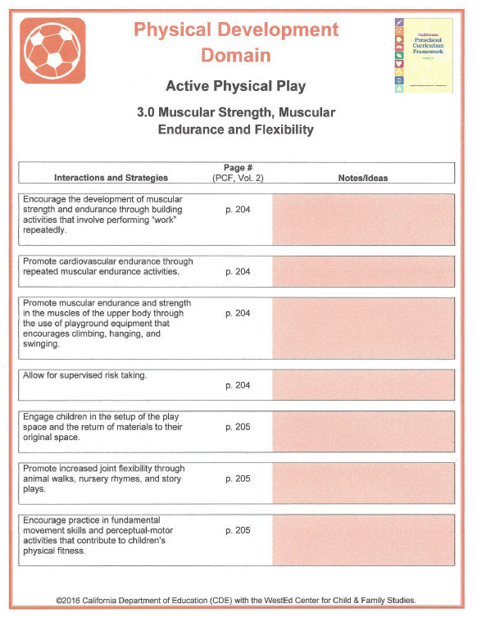
3.0 Interactions and Strategies
Sit and Stretch:
While sitting and stretching in your chair, discuss with a partner how to incorporate the interactions and strategies into your classroom.
Notes:
Presenter Remarks:
Refer to page three of Handout 8: Substrand Reflection Interactions and Strategies.
Now sit and stretch in chairs, side-by-side with a partner as you discuss the interactions and strategies noted on the handout. Consider the following questions during your discussion:
What strategies are you currently using?
What could you do to implement additional strategies into your classroom?
(Depending on time, allow 2–3 minutes for discussion.)

Slide 60
Environmental Factors That
Influence Physical Development
Teachers promote optimal physical development when they provide children with positive encouragement and quality instruction (both indirect and direct).
The immediate physical environment is a powerful influence on children’s physical development.
Indoor and outdoor play environments should include a variety of appropriately sized equipment that promotes both gross and fine motor development.
Learning is most meaningful when the environment/materials reflect and accommodate children’s individual interests, backgrounds, and present abilities.
Source: PCF, Vol. 2, pp. 136–137.
Notes:
Presenter Remarks:
As our culminating activity, let’s visit the Environmental Factors That Influence Physical Development, on the next few slides (PCF, Vol. 2, p. 136–137). These factors, along with the guiding principles, will help guide us as we do an authentic assessment.
(Read, or ask volunteers to read, each factor on the slide.)

Slide 61
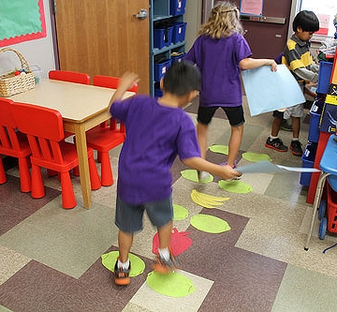
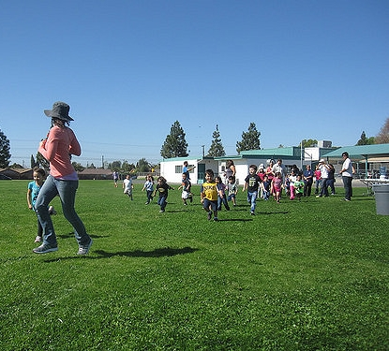
Environmental Factors That
Influence Physical Development
Take time to build safety into both indoor and outdoor play.
Movement experiences should include exploration, discovery, and appreciation of the natural environment.
Thoughtfully designed, adult-guided movement experiences support children’s physical development.
Source: PCF, Vol. 2, pp. 136–137
Notes:
Presenter Remarks:
Invite a different participant to stand and read each factor aloud.
The last factor on this slide is going to help us design a movement experience for authentic assessment.
Would anyone like to read that for the group? (Wait for participant to read.)
Thoughtfully designed, adult-guided movement experiences support children’s physical development.
Using the guiding principles or the Environmental Factors, groups will create a station activity using the homemade streamer (directions are on the next slide). First we all need to make a homemade streamer. The next slide has these instructions.

Slide 62
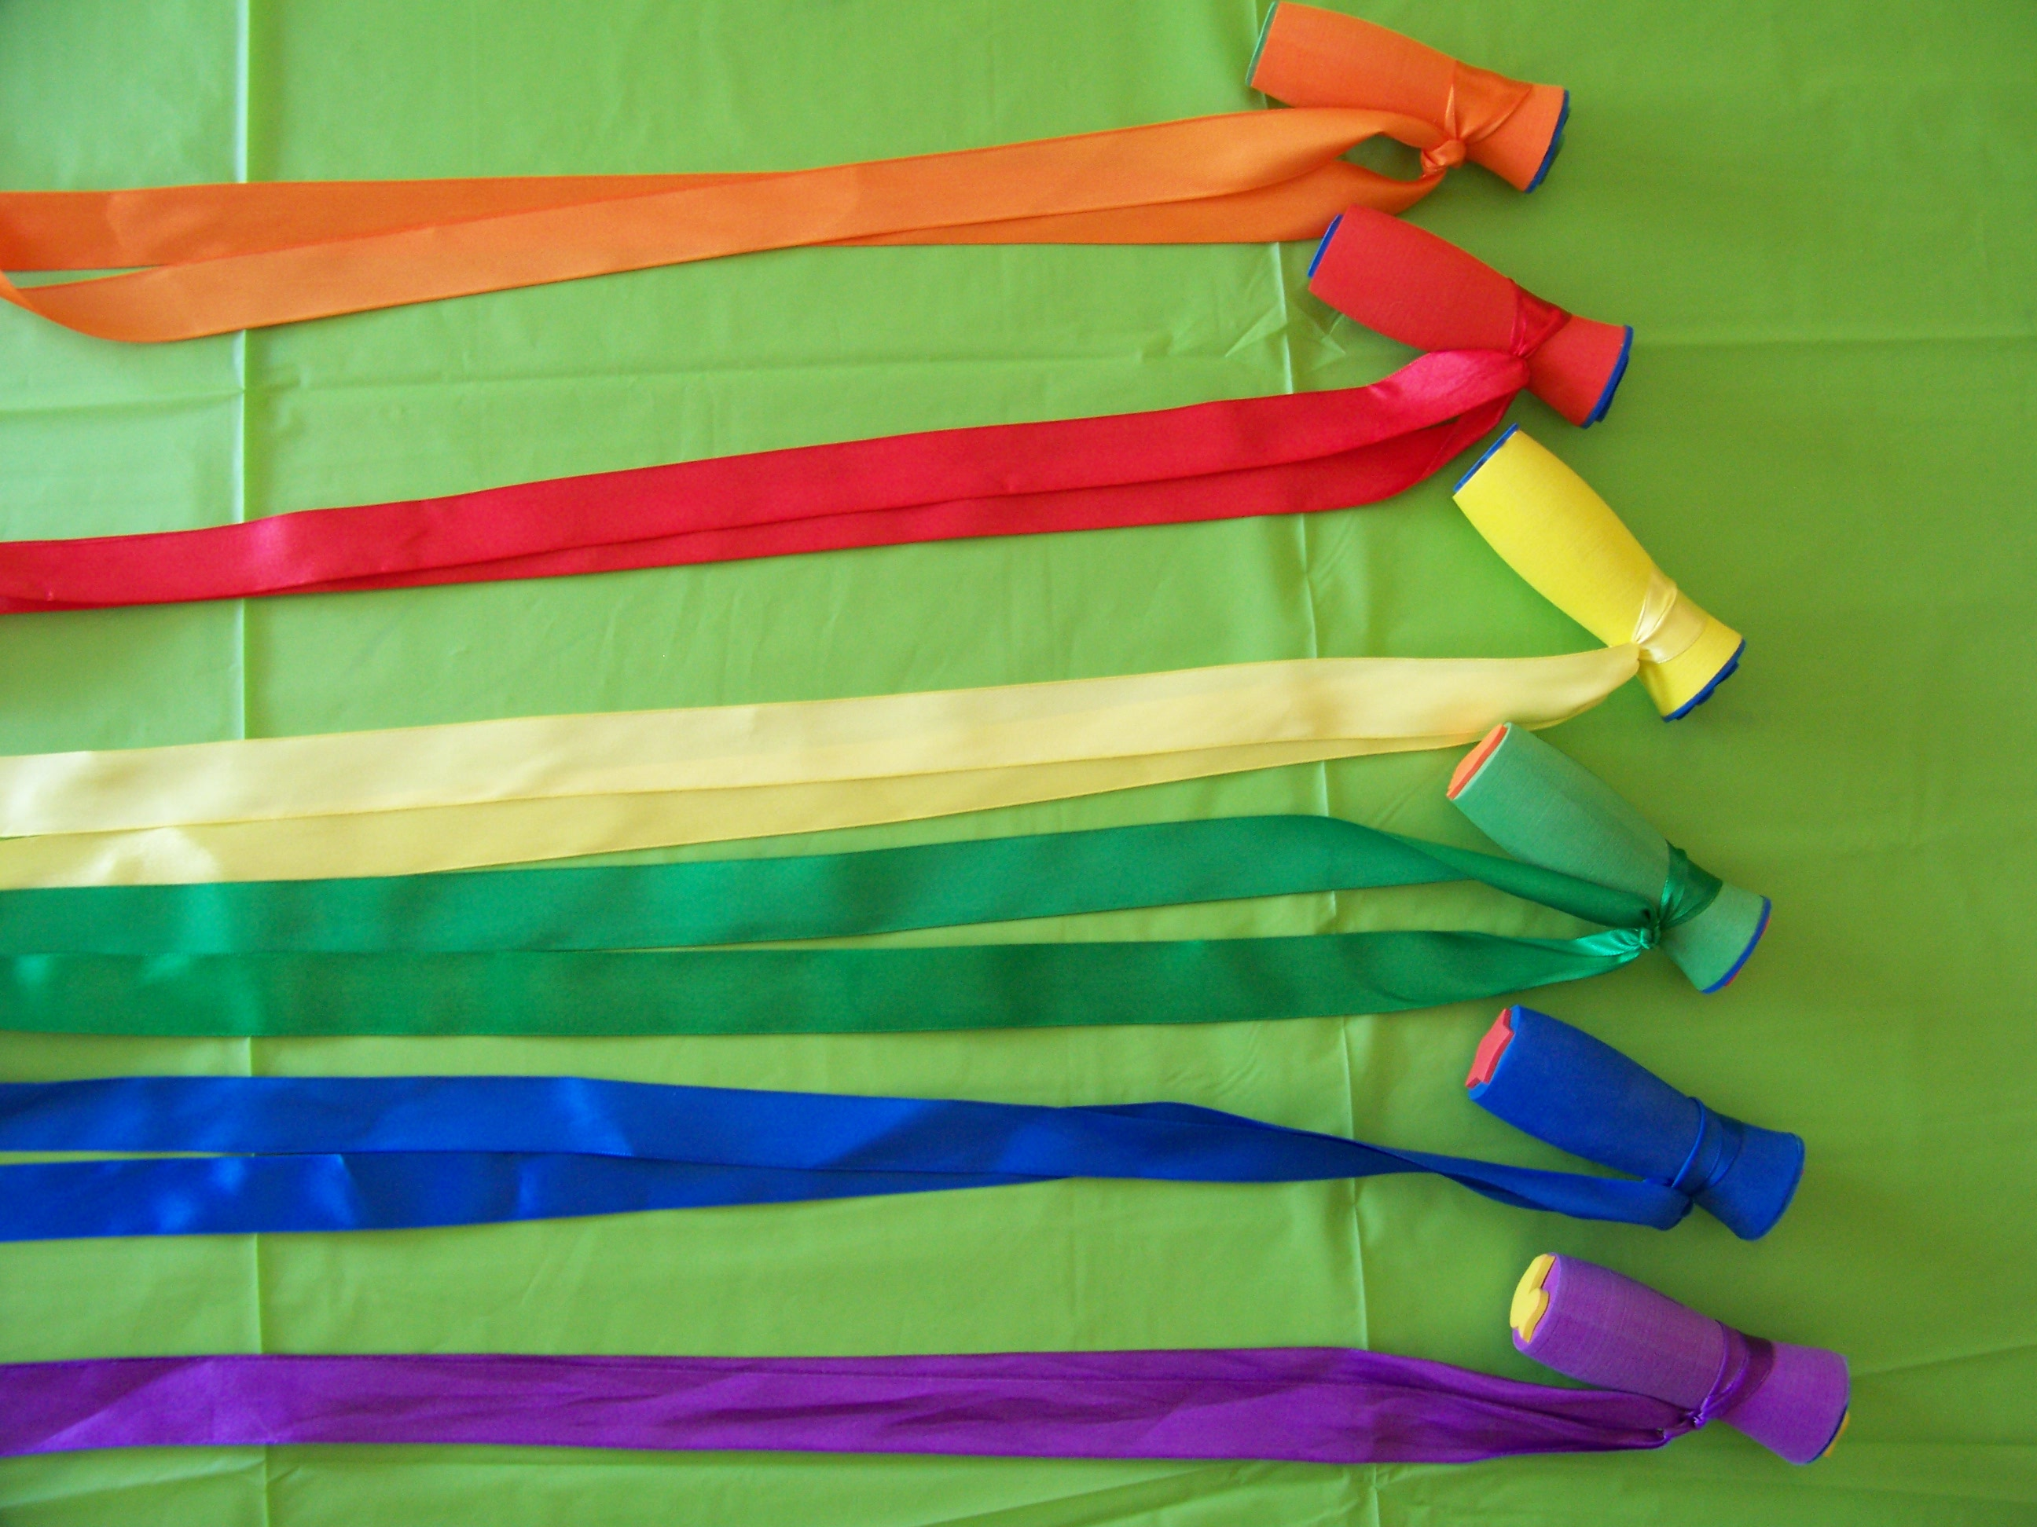
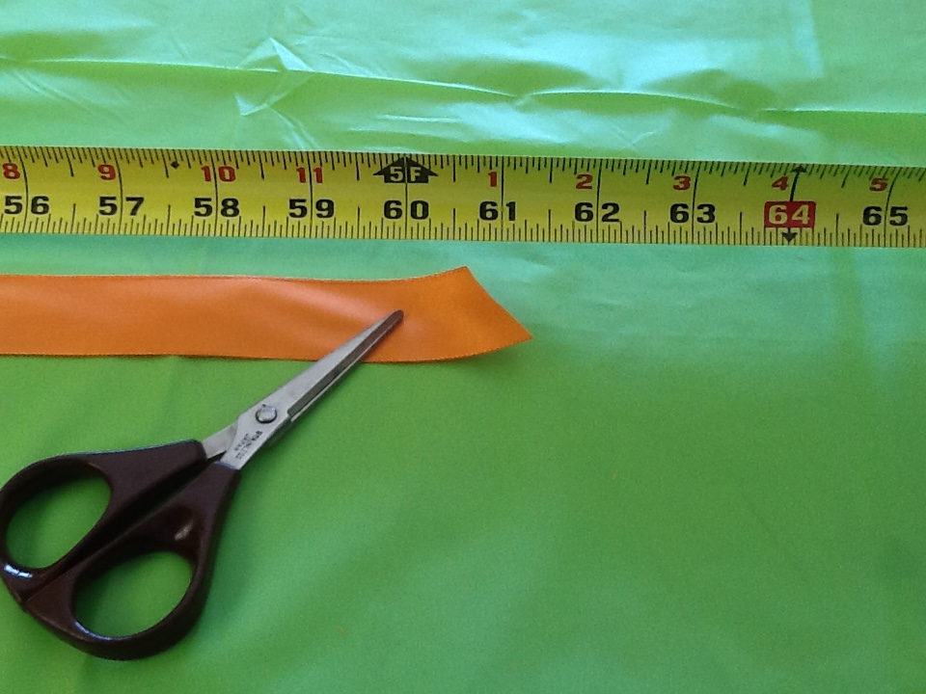
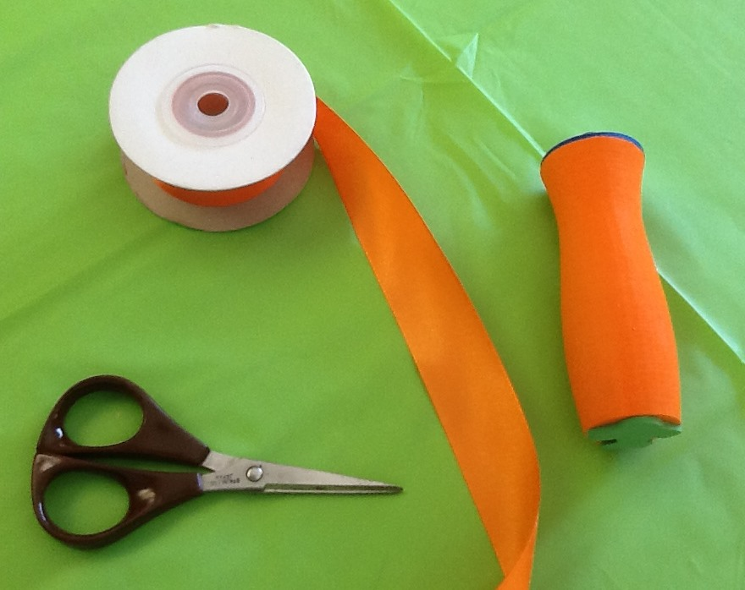
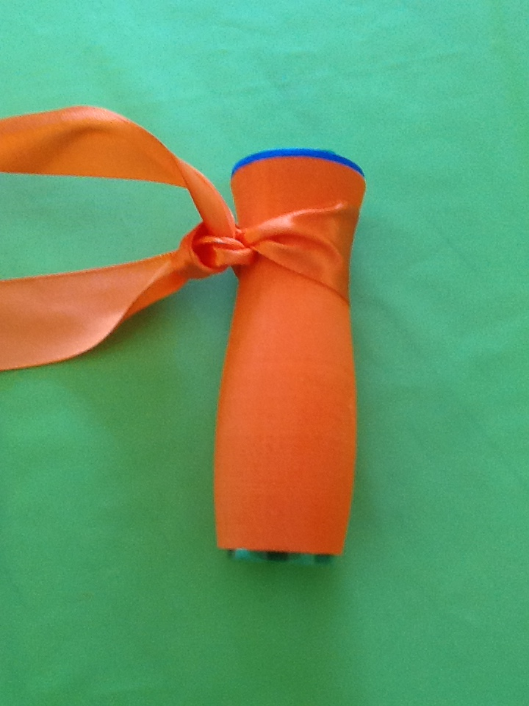
Make It Take It Time
Make It Take It Time
Homemade streamer materials:
1 satin ribbon
1 gripper stamp
Notes:
Activity 5: Homemade Streamer
Background Information:
Items for the Make It Take It Time activity should be precut and pre-assembled prior to the training (this eliminates the need for bringing scissors and saves time). Each participant should have a stamper and a matching ribbon. Teachers/family members may want to apply a solution called Fray Block to the ends of the ribbon to prevent fraying (it is generally available at large retailers or fabric stores).
Presenter Remarks:
Refer to Handout 10: How to Make Homemade Streamer Directions and Info for step-by-step directions so we can all make streamers now. Notice there is purchasing information as well; this handout may be duplicated and shared with families so this activity can be replicated at a family night.
intent:
This activity, the culminating activity for the Active Physical Play strand, is designed to engage cooperative planning among tables, utilizing a homemade prop (streamer) to create an age-appropriate station activity.
OUTCOMES:
Participants assemble a homemade streamer that can be used to increase physical activity and connect to content areas through active physical play.
Participants are able to share ideas and directions with teachers, early childhood educators, and families to increase physical activity in young children.
Materials Required:
5’ satin ribbon, 1/participant
Gripper stamps, 1/participant
Scissors
Sandwich bags, 1/participant
Time: 3–5 minutes
Process:
Prior to training, ribbon and gripper stamps need to be purchased (see the next page for ordering info or refer to Handout 10).
Cut the ribbon into 5’ lengths.
Place each ribbon and a gripper stamp of a matching color into a separate sandwich bag. The bags will be placed on tables at the beginning of the training.
To make the streamers, wrap the ribbon to the gripper stamp and secure it with two or three knots. See Handout 10: How to Make Homemade Streamer Directions and Information for step-by-step directions.
OPTIONS:
Substitute hair ties in lieu of gripper stamps.
A variety of colored crepe paper may be used if the budget is restricted or if time is limited.

Slide 63
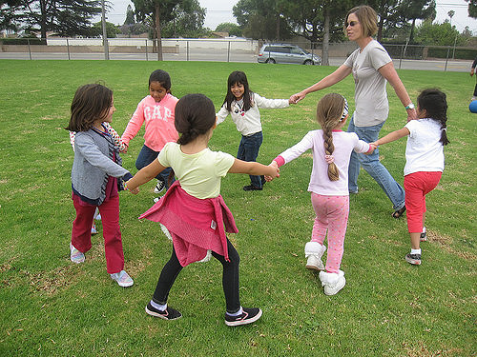
Authentic Assessment!
Authentic Assessment
Work in table teams using homemade streamers to thoughtfully design an adult-guided movement experience for a station that supports children’s physical development illustrating Active Physical Play. (5–7 minutes)
Refer to the Preschool Learning Foundations (Vol. 2), the Preschool Curriculum Framework (Vol. 2), Handout 5: Physical Development Domain Guiding Principles, Handout 6: Physical Development Foundations Map, Handout 8: Interactions and Strategies, and the Environmental Factors section on pages 136-137 of the Preschool Curriculum Framework (Vol. 2).
Be prepared to share with the whole group.
Notes:
Activity 6: Station Creation
Presenter Remarks:
Here is your task:
Work in table teams using homemade streamers to thoughtfully design an adult-guided movement experience for a station that supports children’s physical development illustrating Active Physical Play. (5–7 minutes)
Refer to the Preschool Learning Foundations (Vol. 2), the Preschool Curriculum Framework (Vol. 2), Handout 5: Physical Development Domain Guiding Principles, Handout 6: Physical Development Foundations Map, Handout 8: Interactions and Strategies, and the Environmental Factors section on pages 136-137 of the Preschool Curriculum Framework (Vol. 2).
Be prepared to share with the whole group.
intent:
Participants transfer their knowledge of the Active Physical Play strand and substrands in which they apply guiding principles and/or environmental factors (Preschool Learning Foundations [Vol. 2] and Preschool Curriculum Framework [Vol. 2]) into an age-appropriate, practical station activity to share with the whole group as a culminating activity.
OUTCOMES:
Participants use homemade streamers and Handout 5: Physical Development Domain Guiding Principles, and/or the Environmental Factors on the PowerPoint slides, to cooperatively create an age-appropriate station activity that will represent one, two, or all three substrands of Active Physical Play.
Participants display a poster on chart paper with their station activity name and brief directions.
Materials Required:
Preschool Learning Foundations (PLF), Volume 2
Preschool Curriculum Framework (PCF), Volume 2
Handout 5: Physical Development Domain Guiding Principles
Handout 6: Physical Development Foundations Map
Handout 8: Interactions and Strategies
Environmental Factors in Preschool Curriculum Framework, Volume 2, pp. 136-137
Chart paper and markers
Time: 5–7 minutes to create station activity and 1 minute per table to share out
Process:
After presenting the Environmental Factors slides in the PowerPoint, have participants turn to Handout 5 and/or locate in the PLF and/or the PCF.
Provide directions to the whole group. Have participants work cooperatively, by table, to design an age-appropriate station that uses the homemade streamer created in Activity Plan 5: Homemade Streamer.
Instruct each table to create a poster on chart paper, with the title of the station and brief directions, and display it on walls around room.
Throughout the activity, visit tables to check on their designs. Encourage tables to integrate additional content areas into the station, and monitor whether too many tables have similar activities. See the following page for possible suggestions for activities, if needed.
OPTIONS:
Participants can create station activities that include additional strands of the Physical Development domain.
Depending on time, the stations may be shared one table at a time, or the participants may walk around the room and visit all of the posters.
Suggestions for Station Activities
Move the streamer in a sweeping motions:
Make large motions—down below, in front, overhead (like a rainbow), and on the side.
Make small motions—down below, in front, overhead, and on the side.
Repeat using the non-dominant hand.
Make shapes with the streamer:
Move the streamer in air to draw different shapes (e.g., circles, squares, triangles).
Make shapes in the front, to the side, and overhead.
Make large shapes and small shapes.
Repeat using the non-dominant hand.
Be a painter and paint a giant picture in the air; use the streamer like a paintbrush.
Lay the streamer on the ground in various shapes (e.g., circle, square, triangle) and do the following:
Trace the streamer with one hand, then trace it with the other hand.
Make the streamer shape with your body.
Make the streamer shape smaller.
Point to shapes you see in the environment.
Make pathways (straight, curved, zigzag) in the air with the streamer:
Make pathways horizontally and vertically.
Repeat using the non-dominant hand.
Make letters or numbers with the streamer, individually or with a partner.
Copy poster shapes with the streamer:
Draw a different shape on each poster and place the posters around the area.
Walk/march/gallop/etc. to a poster and make the poster shape in the air with the streamer five times, then go to the next poster.
Pretend to be butterflies that fly around the area and visit different flowers.
Use movement combinations with the streamer and try to keep streamer moving:
Walk on a straight pathway.
Side-slide and make up-and-down sweeping movements to the front.
March and make zigzags to the side.
Gallop at a low level and sweep the floor.
Skip while circling the streamer overhead.
Play with a partner:
Give each child a streamer.
Pair the children up; put one in front as the leader.
Turn music on and have partners move the same as the leader.
Turn the music off after 20 seconds and have everyone turn around—now there is a new leader.
Turn the music on again and repeat.
Begin moving slowly at first and gradually add speed at an appropriate pace for the group.
Follow the leader (indoors or outdoors):
Line the children up and give each a steamer.
Have children march around the area—all moving the streamer simultaneously.

Slide 64
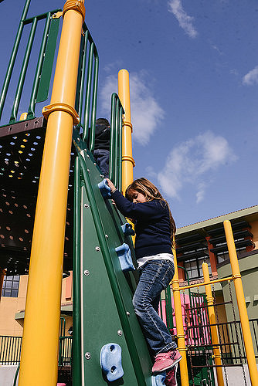
Scaling New Heights
Scaling New Heights
Let’s see what everyone created!
©2016 California Department of Education
Notes:
Presenter Remarks:
Now let’s see what everyone created!
(Depending on time, allow each group a brief amount of time to share their ideas. Highlight specific strategies mentioned in the training. If groups did not make connections to other domains in the Preschool Learning Foundations, point out what you see to illustrate how physical activity can impact all domains of learning.)

Slide 65
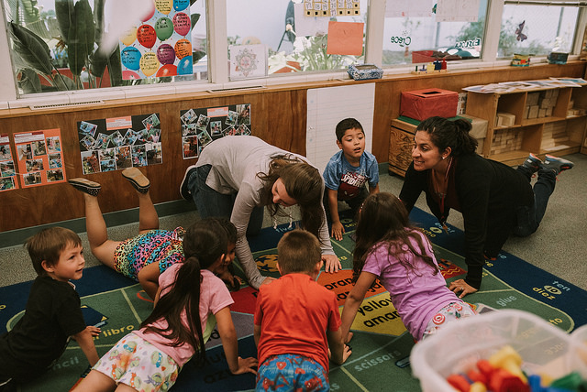
What is Your Plan to Include Active Physical Play?
Notes:
Presenter Remarks:
Let’s plan to include the strategies we have read, discussed, and experienced today into our classrooms.
(Provide time for the participants to write notes on Handout 11: Physical Development Active Physical Play Action Steps, and, if time allows, share action items with an elbow partner.)
Optional:
The trainer may wish to have participants complete the optional Handout 12: Physical Development Active Physical Play Strategies Worksheets.

Slide 66
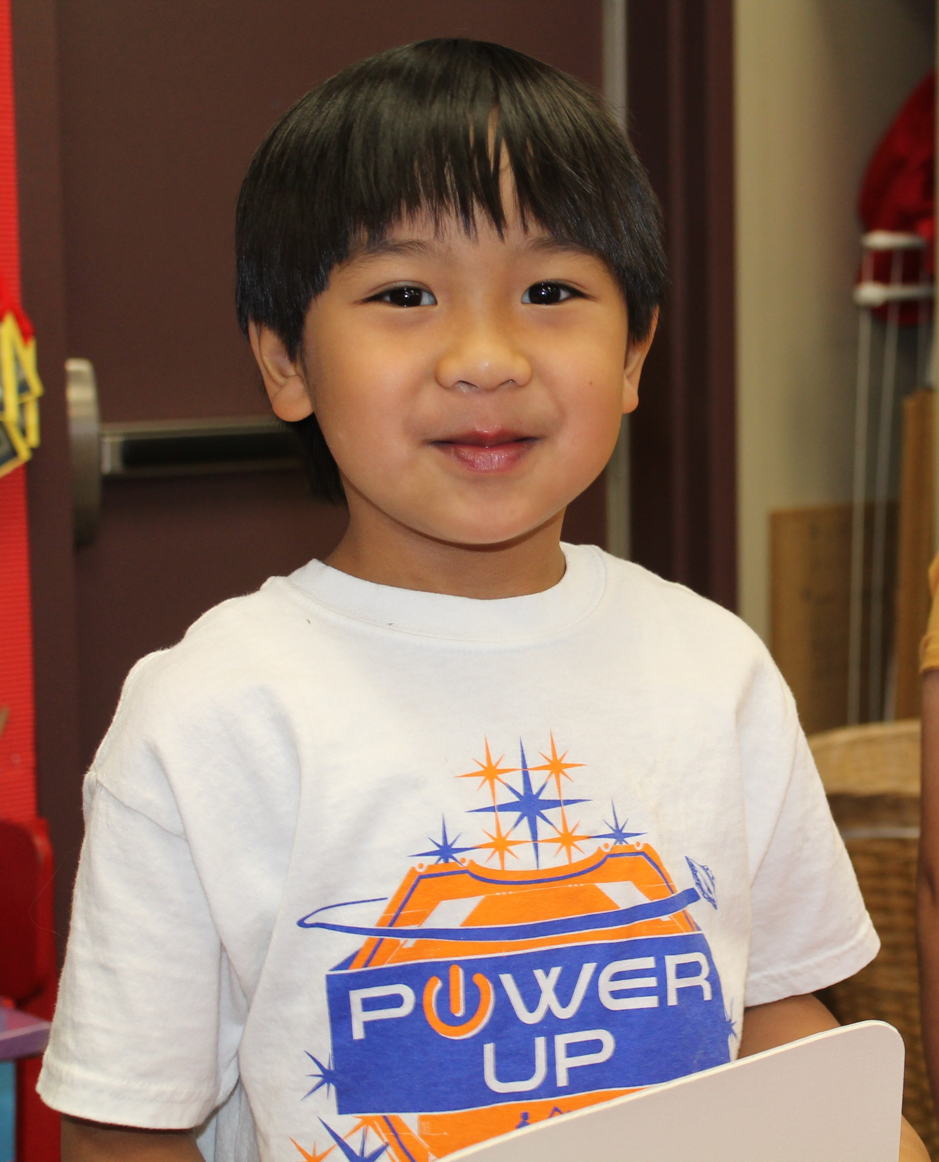
Thank you for keeping me active!
Thank you for keeping me active!
Thank you for coming!
©2016 California Department of Education
Notes:
Presenter Remarks:
Thank you for your active participation and engagement during this training!

Slide 67
Reference Guide for PowerPoint Citations
California Department of Education. 2011. California Preschool Curriculum Framework, Volume 2. http://www.cde.ca.gov/sp/cd/re/documents/psframeworkvol2.pdf (accessed October 3, 2016).
California Department of Education. 2008. California Preschool Learning Foundations, Volume 2. http://www.cde.ca.gov/sp/cd/re/documents/psfoundationsvol2.pdf (accessed October 3, 2016).
California Department of Education. 2013. Transitional Kindergarten Implementation Guide: A Resource for California Public School District Administrators and Teachers. http://www.cde.ca.gov/ci/gs/em/documents/tkguide.pdf (accessed October 3, 2016).
"Physical Activity in U.S. Youth Aged 12–15 Years, 2012." Centers for Disease Control and Prevention. 2014. http://www.cdc.gov/nchs/data/databriefs/db141.htm. (accessed October 06, 2016).

