Slide 1
Visual and Performing Arts: Drama in Transitional Kindergarten
California Preschool Learning Foundations, Volume 2
California Preschool Curriculum Framework, Volume 2
Notes:
Presenter Remarks:
Welcome to Visual and Performing Arts: Drama in Transitional Kindergarten—a presentation focusing on the California Preschool Learning Foundations (Preschool Learning Foundations or PLF), the California Preschool Curriculum Framework (Preschool Curriculum Framework or PCF), and other California Department of Education (CDE) resources in support of the Visual and Performing Arts domain.
This professional learning session is specifically designed to provide TK teachers with exposure to CDE resources that support TK curriculum planning of developmentally appropriate strategies. Classroom environmental design recommendations are included to support the content area of drama.

Slide 2
Objectives
Gain understanding of key concepts from the California Preschool Learning Foundations, Volume 2 and the California Preschool Curriculum Framework, Volume 2—Visual and Performing Arts domain, Drama strand.
Observe, read, and discuss the developmental continuum for drama and develop strategies that will guide instruction and learning in Transitional Kindergarten (TK).
Practice using the Preschool Learning Foundations and Preschool Curriculum Framework to intentionally plan developmentally appropriate, cultural, and inclusive strategies that promote the development of skills, knowledge, and behaviors related to drama.
Notes:
Presenter Remarks:
This slide shows what we will cover in today’s training.
Objectives:
Gain understanding of key concepts from the California Preschool Learning Foundations, Volume 2 and the California Preschool Curriculum Framework, Volume 2—Visual and Performing Arts domain, Drama strand.
Observe, read, and discuss the developmental continuum for drama and develop strategies that will guide instruction and learning in Transitional Kindergarten (TK).
Practice using the Preschool Learning Foundations and Preschool Curriculum Framework to intentionally plan developmentally appropriate, cultural, and inclusive strategies that promote the development of skills, knowledge, and behaviors related to drama.

Slide 3
Dramatic Play
“…drama for preschoolers [TK students] is unleashing the child’s imagination”
(PCF, Vol. 2, p. 48).
Notes:
Presenter Remarks:
‟A goal in dramatic play and drama for preschoolers [TK students] is unleashing the child’s imagination. Thus the focus is on children’s creative engagement in drama rather than on actual performance or ‛the theater’” (PCF, Vol. 2, p. 48).
Drama is an experience in which two or more children participate by pretending to be someone else or be someplace else. Drama, in the TK classroom, is an experiential, play-based learning medium. The difference between ‟the theater” and drama, is that theater is performance-oriented and drama is process-oriented and improvisational in nature.
Think about your classroom. Where do children participate in drama? For young children, the experience of drama takes the form of dramatic play. Play for children is a progression from solitary play to parallel play and then to group play. At three years old, children almost exclusively participate in solitary play. At four, they spend equal time between solitary, parallel, and group play. By five, they are engaged in mostly group play with some solitary and parallel play.
Solitary play—playing alone
Parallel play—playing next to someone but not “with” them
Group play—engaging with others in play
(PCF, Vol. 2, p.86)

Slide 4
Key Guiding Principles
The arts reinforce the integrated nature of learning.
Art experiences for preschoolers are more about the process than the product.
Cultural competence is approached through art.
(PCF, Vol. 2, p. 44)
©2017 California Department of Education
Notes:
Presenter Remarks:
Each drama strand guiding principle has significant meaning. However, as we progress through this training, pay special attention to the following guiding principles as they will enhance your understanding of the whole child and the integrated nature of drama:
“The arts reinforce the integrated nature of learning” (PCF, Vol. 2, p. 44).
“Participation in the arts helps children develop language skills. The social context of arts activities supports English language learners, who can participate as their language skills develop” (PLF, Vol. 2, p. 1).
“Art experiences for preschoolers are more about the process than product” (PCF, Vol. 2, p. 44).
“Preschool children [Young children] enthusiastically take part in the arts” (PLF, Vol. 1, p. 2).
“Art at the preschool level involves play and exploration” (PLF, Vol. 1, p. 2).
“Cultural competence is approached through arts” (PCF, Vol. 2, p. 44).
“The arts provide opportunities for children to participate in the shared cultural practices of the program. Through the arts, a preschool environment can be created that includes and celebrates children from diverse linguistic and cultural backgrounds” (PLF, Vol. 2, p. 1).

Slide 5
Guiding Principles Tell a Story
Directions:
Find the story sticks.
Each tablemate pull one story stick.
This is your guiding principle.
You will each have 30 seconds to SILENTLY dramatize the story of your guiding principle.
When time is up, each tablemate can guess the guiding principle you were dramatizing.
Notes:
Activity 1: Guiding Principles Tell a Story
Presenter Remarks:
In this activity, we will become familiar with guiding principles in relation to the dramatic arts.
intent:
Participants become familiar with guiding principles while engaging in dramatic arts.
OUTCOME:
Participants learn guiding principles and participate in a community building activity.
Materials Required:
Preschool Curriculum Framework (PCF), Vol. 2, pp. 42-45
Drama story sticks (guiding principles written on popsicle sticks)
Handout 1: Guiding Principles
Time:
10 minutes
Process:
Invite participants to read through the subitizing game.
Participants locate the drama story sticks (guiding principles written on popsicle sticks)
Each tablemate then pulls a stick from the can.
Trainer provides the following directions:
You will have 30 seconds to silently use dramatization to tell the story of your chosen guiding principle.
Your tablemates may use pages 42-45 of the PCF to help guess which guiding principle you are dramatizing.
At the end of the 30 second timer, each of tablemates may make one guess.
Optional - Tables keep score of the most correct guesses to win a prize.
DEBRIEF:
Each of the guiding principles addresses all of the arts substrands (Dance, Drama, Visual Art, and Music). As we go through the rest of the training, feel free to use this handout to take notes and relate information back to the guiding principles.

Slide 6
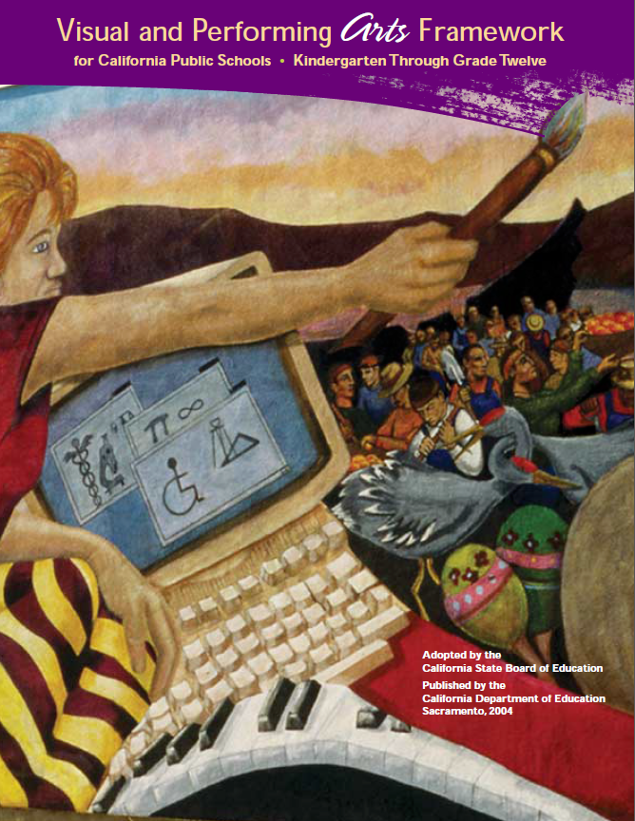
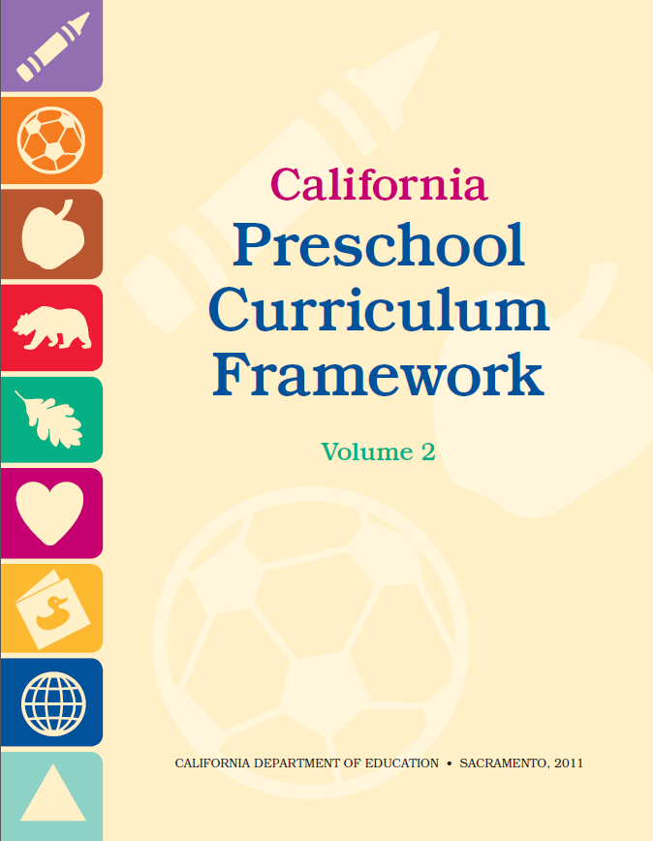
CDE Publications and Resources that Support TK Implementation
Preschool Learning Foundations
California Common Core State Standards
Visual and Performing Arts Framework for California Public Schools
Preschool Curriculum Framework
Visual and Performing Arts Content Standards
DRDP Specific to TK and K
Preschool Alignment Document
Preschool English Learners Guide
Transitional Kindergarten Implementation Guide
Preschool Learning Foundations
California Common Core State Standards
Visual and Performing Arts Framework for California Public Schools
Preschool Curriculum Frameworks
English Language Arts/English Language Development Framework
DRDP Specific to TK and K
Preschool Alignment Document
Preschool English Learners Guide
Transitional Kindergarten Implementation Guide
Notes:
Presenter Remarks:
The California Department of Education has developed many publications, resources, and supports that enable teachers to facilitate the most positive outcomes for students.
Today our main focus will be on the Preschool Learning Foundations and the Preschool Curriculum Framework, Volume 2—Visual and Performing Arts domain.
There are additional key resources that support dance development in young children. We will also discuss alignment with CA standards and make connections to additional resources pictured in the graphic (name and hold up each resource):
The Alignment of the California Preschool Learning Foundations with Key Early Education Resources (Alignment Document)
California Common Core State Standards (CA CCSS)
Visual and Performing Arts Content Standards for California Public Schools, Kindergarten Through Grade Twelve (CA VPA Standards)
Preschool English Learners: Principles and Practices to Promote Language, Literacy, and Learning—A Resource Guide (Second Edition) (PEL Resource Guide)
Visual and Performing Arts Framework for California Public Schools, Kindergarten Through Grade Twelve (VPA Framework)
Desired Results Developmental Profile—Kindergarten (2015): A Developmental Continuum for Kindergarten (DRDP-K [2015])
Transitional Kindergarten Implementation Guide – A Resource for Public School District Administrators and Teachers (TK Implementation Guide)

Slide 7
Transitional Kindergarten Implementation Guide
The TK Implementation Guide is a resource for California public school district administrators and teachers to support implementation of comprehensive TK programs.
Notes:
Presenter Remarks:
The TK Implementation Guide is a resource that focuses on the essential components for school district administrators and teachers to consider for TK programs. The TK Implementation Guide, published by the California Department of Education, is a resource to support implementation of comprehensive TK programs.
This publication provides resources and guidance in the areas of program design, curriculum, instruction, assessment, and family/community partnerships.

Slide 8
Overview of the Transitional Kindergarten Implementation Guide
Section One
Program Structure and Design
Section Two
The TK Student
Curriculum in a TK Program
Effective Instruction in a TK Program
The TK Learning Environment
Assessment and Differentiated Instruction
Involving Families and Community Partners
Supporting TK Implementation
Notes:
Presenter Remarks:
The TK Implementation Guide is organized into the following two sections:
Section 1 is covered in Chapter 1. The information in this section was developed with the administrator in mind and focuses on the program structure and design.
Section 2 is covered in Chapters 2-8. This section is a resource for both teachers and administrators and focuses on building a comprehensive TK programs by addressing curriculum, instruction environment, assessment and partnership with families and community.
Within each of these chapters, vignettes, highlighted boxes, and resource boxes are included to illustrate examples of the information covered in each of the chapters.
A PDF copy of the document can be accessed at the California Department of Education Web page (www.cde.ca.gov/ci/gs/em/documents/tkguide.pdf).
Video footage for each chapter can be accessed at the California Department of Education. The video clips include footage of TK classrooms and interviews with teachers, administrators, and parents. https://www.youtube.com/user/caeducation https://www.youtube.com/results?search_query=tk+implmentation+guide

Slide 9
Why Use the Preschool Learning Foundations for TK?
CA Law (EC 48000):
Transitional kindergarten is the first year of a two-year kindergarten program that uses a modified kindergarten curriculum that is age and developmentally appropriate.
Transitional kindergarten programs are intended, by legislative action, to be aligned to the California Preschool Learning Foundations developed by the California Department of Education.
Notes:
Background Information:
CDE.CA.gov/ci/gs/em/kinderfaq.asp#program
Presenter Remarks:
The state of California provides guidance on utilizing the Preschool Learning Foundations and the Preschool Curriculum Framework as planning and curriculum resources in the TK classroom.
In addition, the following publications and resources are available to support age and developmentally appropriate TK curriculum:
Alignment Document
TK Implementation Guide
DRDP-K (2015)
VPA Framework
CA VPA Standards
CA CCSS

Slide 10
Foundations and Framework, Volume 2
Notes:
Presenter Remarks:
The purposes of the Preschool Learning Foundations are to promote a common understanding of TK children's learning and to guide instructional practice. They describe the knowledge and skills that young children typically develop when provided with developmentally, culturally, and linguistically appropriate learning experiences.
The Preschool Curriculum Framework was created as a companion to the Preschool Learning Foundations. The framework ". . . presents strategies and information to enrich learning and development opportunities for all children" (PCF, Vol. 2, p. v).
The Preschool Learning Foundations and the Preschool Curriculum Framework are designed to work together. While the foundations provide the background information to understand children's developing knowledge and skills (the "what"), the framework offers guidance on how teachers and programs can support the learning and development that are described in the foundations (the "how").
Extra Notes:
The Preschool Learning Foundations were developed with research-based evidence and are enhanced with expert practitioners' suggestions and examples. All foundations were written by a team of researchers with expertise in the given domain. A complete reference list of the source materials, along with detailed bibliographic notes for each of the developmental domains, can be found in the Preschool Learning Foundations. Sources used in the development of the foundations include:
Documents from the California Department of Education, such as the English-Language Arts Content Standards for California Public Schools, Kindergarten Through Grade Twelve (Language and Literacy, Introduction, p. 48, left column).
Well-validated assessment tools such as the Ages & Stages Questionnaires (ASQ): A Parent-Completed, Child-Monitoring System (Social-Emotional, References and Source Materials, p. 36).
General sources such as the Report of the National Reading Panel 2000 (Language and Literacy, Introduction, p. 73, left column).
Early childhood education standards from other states such as Hawaii and Texas (Social-Emotional, Introduction, p. 5, footnote).

Slide 11
Domain Organization
Domain:
Visual Performing Arts
Strand:
Drama
Substrand:
Notice, Respond, and Engage
Substrand:
Develop Skills to Create, Invent, and Express Through Drama
Domain: Language and Literacy
Strand: Reading
Substrand: Comprehension and Analysis of Age Appropriate Text
Notes:
Presenter Remarks:
In the Preschool Learning Foundations and Preschool Curriculum Framework, Drama is a strand within the Visual and Performing Arts domain.
There are two substrands within Drama strand:
Notice, Respond, and Engage
Develop Skills to Create, Invent, and Express Through Drama
Within each of these two substrands there are foundations for both 48 and 60 months.
Take a moment now to find where the foundations begin in the Drama strand on page 15 of the Preschool Learning Foundations, Volume 2.
Silently read and place your finger on a foundation in the Notice, Respond, and Engage substrand. Check with your neighbor and make sure he/she has found one as well.
Now, silently read and place your finger on a foundation in the Develop Skills and Create, Invent, and Express Through Drama substrand. Check with your neighbor again.
Understanding this structure is important to effectively and efficiently plan and scaffold for children.

Slide 12
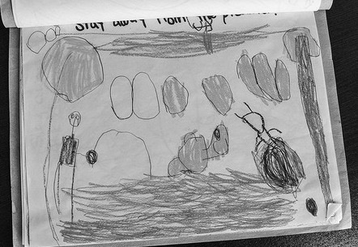
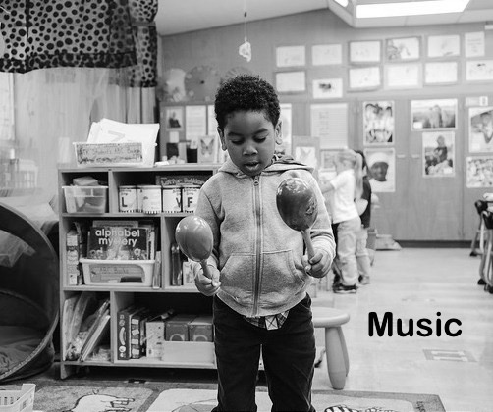
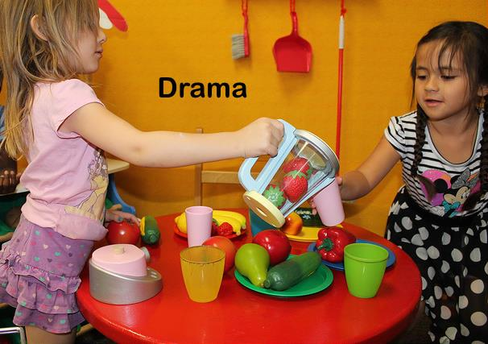
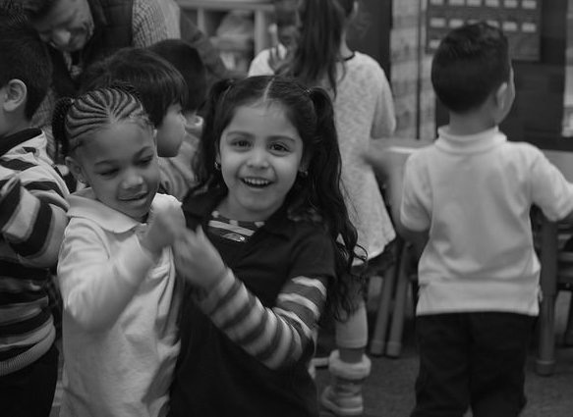
Visual Arts
Music
Drama
Dance
©2014 California Department of Education (CDE) with the WestEd Center for Child & Family Studies, California Preschool Instructional Network (CPIN). (06/2014)
Notes:
Presenter Remarks:
(Click to reveal Visual Art.) The foundations for visual arts include observing and commenting on art, developing art skills, and creating art (e.g., painting, drawing, sculpting, and collages).
(Click to reveal Music.) The foundations for music include responding to and recognizing sounds and music, learning music skills, and creating music by keeping a beat with one’s body, by singing, and by using musical instruments.
(Click to reveal Drama.) The foundations for drama include pretend play and reenacting stories as well as using props, costumes, and roles in play.
(Click to reveal Dance.) The foundations for dance include engaging in dance movements, being aware of body space, and expressing oneself through dance.

Slide 13
Foundations
High-quality program
With appropriate support
©2017 California Department of Education
Notes:
Presenter Remarks:
The Preschool Learning Foundations describe what children should know and be able to do at around 48 months (4 years old) and 60 months (5 years old).
The foundations also assume that children have access to appropriate support in high quality programs that include the following aspects:
Environments and experiences that encourage active, playful exploration and experimentation
Clearly defined learning centers where materials are rotated
Purposeful teaching to help children gain knowledge and skills
Predictable schedules and routines with large blocks of time for play and skillful integration of curriculum with an intentional focus on content
Specific support for English learners with staff that have knowledge of the stages of English-language acquisition
Accommodations and adaptations for children with disabilities and additional support when needed
Summarize the exploration with the following key note:
Because children develop at different rates, the foundations were designed to support the belief that certain stages of development will occur at different times for all students. Notice “at around” in the description. It is important to remember this variability occurs.

Slide 14
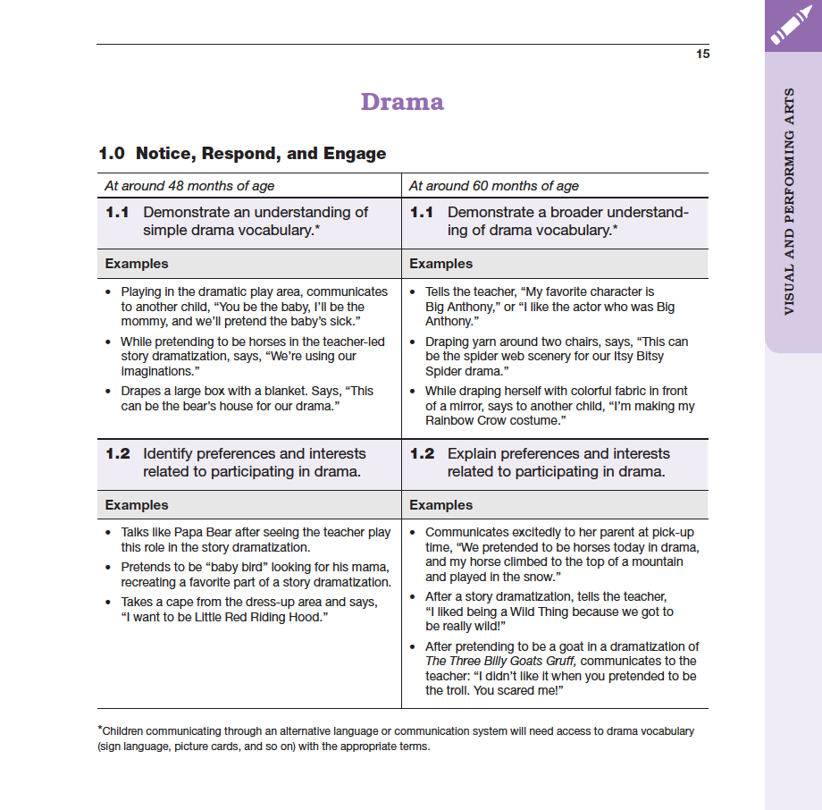
Map of the Foundation
Strand
Substrand
Domain
Age
Foundation
Examples
Footnotes
Notes:
Presenter Remarks:
Please locate Handout 2: Foundations Map. This handout illustrates the way the foundations are organized. Follow along while we discuss each component:
The name of the domain (Visual and Performing Arts)
The name of the strand (Drama)
The name of the substrand (Notice, Respond, and Engage)
Note that substrands always end in “zero.”
The two age levels (at around 48 months and at around 60 months)
Each foundation describes typical behaviors at around 48 months and at around 60 months or four to five years old.
The foundations for the substrand
There are two for each age level on this page (1.1 for 48 months and 1.1 for 60 months, 1.2 for 48 months and 1.2 for 60 months).
The examples for each foundation
These are only a few of the ways that children may demonstrate the behavior in the foundation.
Many of the foundations have footnotes that include information specific for students with IEPs or students with disabilities, such as information about adaptations or accommodations.
Notice that there is a developmental progression from four years old to five years old within a substrand.

Slide 15
Alignment Document
Notes:
Presenter Remarks:
The Alignment Document is another resource that will help us answer questions related to developmental progression.
What do you know about this document? How do you use it in your work now?
Extra Notes:
Depending on the size of the group, participants can share responses with table partners or in pairs.

Slide 16
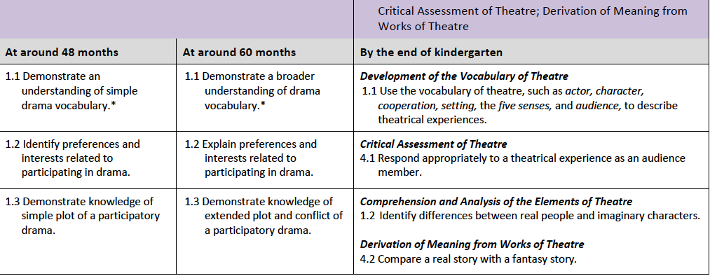
Alignment of Developmental Progression
Notes:
Presenter Remarks:
As discussed earlier, the Alignment Document provides information about the connections between the foundations and the California Kindergarten Standards.
Look again at Handout 2b: Alignment Document to see the detailed alignment of foundation 1.0 and the California State Standards. Underline anything you find interesting. Allow 3-4 minutes to read and underline.
Would anyone like to share out what they underlined or found interesting?
Possible Discussion Points:
There is significant overlap with literacy, acting out stories, and drama. Throughout the training today there will be multiple experiences that integrate drama and literacy.
Below are optional discussion questions if participants need prompting to start discussion:
What do you observe about the different expectations for children at around 48 months of age, 60 months of age and the end of kindergarten?
How does this relate to the stages of narrative thinking discussed in the previous slide?
In recognition of these developmental stages, what are the implications for TK teachers in supporting children’s developing ability to make meaning of text and/or narrative comprehension?
Extra Notes:
Have participants review the alignment between the Preschool Drama strand—substrand 1.0 Notice, Respond, and Engage—and the two sets of language standards in the CCSS: Conventions of Standard English.

Slide 17
Guiding Principle “Children make their own meaning” (PCF, Vol. 2, p. 43).
©2017 California Department of Education
Notes:
Presenter Remarks:
Guiding Principle: Children make their own meaning.
“Children are unique in their own artistic interests and abilities; they process, construct and assimilate information and skills according to their own desires” (PCF, Vol. 2, p. 43).
Even though children make their own meaning, it is still important that adults scaffold (in appropriate amounts) children in order to “reinforce, promote, extend, or redirect” their learning” (PCF, Vol. 2, p. 43). What would that scaffolding look like? Let’s think about a child acting out a story that was just read. When might a teacher need to “scaffold” the child’s learning?
Extra Notes:
Trainer may ask questions such as, What do you think his face looked like or voice sounded like when he did that? What happened after the goose took off running? How could you dress like the character?

Slide 18
Remember the Following Words…
Notes:
Background Information:
This experience works since many participants have stories in their head that connect the second list of words. For example, Janet and Michael may be connected in the presenter’s mind because they think of a story about Janet Jackson and Michael Jackson. All words will not work for all participants, but a few will. This is a simple, short way to remind participants that stories—like the ones we create in dramatic arts—help us to learn and encode information even when we do not realize that we are focusing on the story.
Presenter Remarks:
We are going to play a game. Everyone put their pencils down. We will have this half of the room versus the other half of the room.
Everyone remember these names:
Bob
Alex
Davis
Theresa
Dana
Anna
One side at a time, shout them back to me. Oh man, you guys need some help! Let's try again. Remember these names:
Noah
Moses
Michael
Janet
Mickey
Goofy
Now, one side at a time, shout them back to me. Wow! You did better that time. Why? Because the words were connected through stories. Drama can connect what we are learning through stories.

Slide 19
Preschool Curriculum Framework
“…presents strategies and information to enrich learning and development opportunities for all of California’s preschool children”
(PCF, Vol. 1, p. v).
Notes:
Presenter Remarks:
Take a moment to read the slide.
The Preschool Curriculum Framework, “…presents strategies and information to enrich learning and development opportunities for all children” (PCF, Vol. 1, p. v).
This resource provides teachers with the opportunity to gain ideas and expand their creativity.

Slide 20
Preschool Curriculum Framework
Guiding principles
Environment and materials
Vignettes
Planning learning opportunities
Teachable moments
Interactions and strategies
Engaging families
Notes:
Presenter Remarks:
The Preschool Curriculum Framework is organized in sections for teachers to collect ideas for the classroom. We will explore the following sections today:
Guiding Principles
Environment and Materials
Vignettes
Planning learning opportunities
Teachable moments
Interactions and strategies
Engaging Families

Slide 21
Partner with Families
Engaging Families: Preschool Curriculum Framework
All About Young Children
Best Practices for Planning Curriculum: Family Partnerships and Culture
TK Implementation Guide
Notes:
Presenter Remarks:
In order to effectively build on children's existing strengths, we must understand them. To do this, we need to partner with families to learn about their children’s strengths.
The resources on this slide are specifically beneficial for partnering with families. You may want to take a picture of this slide and refer to it later.
Optional:
Create a gallery table with examples of documents.
Extra Notes:
The resources are hyperlinked. If Wi-Fi access is available, display the resources and do a walkthrough.

Slide 22
Drama Engages the Whole Child
“…drama is experiential in nature, involving imagination, imitation, and a ‘living through’ quality that engages the whole child”
(PLF, Vol. 2, p. 24).
Notes:
Presenter Remarks:
“Like dramatic play, drama is experiential in nature, involving imagination, imitation, and a ‛living through’ quality that engages the whole child” (PLF, Vol. 2, p. 24).
Remember the following guiding principle:
“The arts reinforce the integrated nature of learning” (PCF, Vol. 2, p. 44).
Drama can be used as a powerful intervention for children struggling to access curriculum.
Are there special education teachers in the room who have had this experience?

Slide 23
Universal Design for Learning
23
©2017 California Department of Education
Notes:
Background Information:
PCF, Vol. 2, p. 14
Presenter Remarks:
The strategies within the Preschool Curriculum Framework include the idea of Universal Design for Learning (UDL). This means there are many suggestions for ways to support learning that teachers can use to provide multiple means of representation, engagement, and expression.
“Multiple means of representation refers to providing information in a variety of ways so the learning needs of all children are met. For example, it is important to speak clearly to children with auditory disabilities while also presenting information visually (such as with objects and pictures).”
“Multiple means of expression refers to allowing children to use alternative ways to communicate or demonstrate what they know or what they are feeling. For example, when a teacher seeks a verbal response, a child may respond in any language, including American Sign Language. A child with special needs who cannot speak may also respond by pointing, by gazing, by gesturing, by using a picture system of communication, or by using any other form of alternative or augmented communication system.”
“Multiple means of engagement refers to providing choices in the setting or program that facilitate learning by building on children’s interests. The information in this curriculum framework has been worded to incorporate multiple means of representation, expression, and engagement” (PCF, Vol. 2, p. 14).

Slide 24
Dramatic Play
Notes:
Background:
Prior to the training, embed video IMG0646.mov from Video Files All Final Clips, TK Modules, TK VPA Module.
Presenter Remarks:
This video clip is an example of the integrated nature of learning and showcases both drama and social-emotional development. The clip is specifically an example of the social-emotional domain (development of friendships). However, notice the two situations that are clearly grounded in dramatic play.
What other domains could potentially be represented in this clip?
Possible answers:
Physical Development
English-Language Development
Language and Literacy Development

Slide 25
The Language Literacy Connection
Experiencing stories through dramatic art may increase children’s:
Story understanding
Reading achievement
Writing skills
(PCF, Vol. 2, p. 87)
Notes:
Presenter Remarks:
In the video you clip you may have noticed language and literacy development. The integrated nature of drama provides a clear connection to language and literacy development.
Experiencing stories through dramatic art may increase children’s:
Story understanding
Reading achievement
Writing skills
(PCF, Vol. 2, p. 87)
“Research suggests that learning and development in the arts provides an underpinning for literacy and language development, in part, through cultivating representation skills” (PLF, Vol. 2, p. 2).
Extra Notes:
Optional: Invite participants to read the research highlight on page 94 of the Preschool Curriculum Framework, Volume 2.
Optional discussion questions:
What was interesting about the research highlight?
What do you currently do in your classroom with drama that this research highlight discusses as a positive influence.
How might this specifically support a child in your classroom with an IEP?

Slide 26
Language and Literacy and Drama
Notes:
Presenter Remarks:
Drama can foster development in spoken language as well as causing gains in reading readiness. Think about the children in your class. Think about the conversations that go on and vocabulary that children are learning. Do you scaffold their vocabulary when they are involved in dramatic play?
Think about the discussion we had today around the alignment document. How many people noticed the connection between literacy, acting out stories, and understanding fantasy in literacy and drama?
The next activity will provide an opportunity for deeper reflection around the skills and behaviors in the drama learning foundations followed by a reflection focused on an integrated learning experience including literacy and drama.

Slide 27
How to Connect the Story of Drama (PART 1)
Directions:
Discussion Questions:
Look at the drama foundation for 1.1 (48 and 60 months) on page 15 of the PLF, Vol. 2.
Underline the specific vocabulary used by the child in the examples.
Compare the differences between 48 and 60 months.
Compare the differences between 60 months and children currently in your class. What do you notice?
How might you support the development of a child approaching the 60 month foundation?
How is this different from what you might do when approaching the end of TK foundation?
What other domain would you be facilitating when supporting this vocabulary development?
Notes:
Presenter Remarks:
It is important to consider these differences within all the foundations when intentionally planning for dramatic experiences.
Locate Handout 3: How to Connect the Story of Drama. Use this handout and follow the directions on the slide.

Slide 28
How to Connect the Story of Drama (PART 2)
Locate the Three Billy Goats Gruff vignette and teachable moment in the PCF, Vol. 2, p. 88.
With your table group, read the vignette and discuss the following questions:
What was your immediate impression of the vignette?
What part of the vignette have you seen or have you done something similar in your classroom?
What part of the vignette would you want to replicate?
What did you discover that might work for facilitating drama foundation 1.1?
Notes:
Activity 2: Connecting the Story of Drama
Presenter Remarks:
In this activity, we are going to explore the first foundation in the Drama substrand, Notice, Respond, and Engage (PLF, Vol. 2, p. 15).
intent:
Participants practice reading and applying information from the vignettes and the interactions and strategies in the Preschool Curriculum Framework.
OUTCOME:
Participants reflect on and connect the reading to the personal teaching style they utilize when using drama to bring stories to life.
Materials Required:
Preschool Curriculum Framework (PCF), Vol. 2, pp. 88-89
Preschool Learning Foundations (PLF), Vol. 2, p. 15
Handout 3: How to connect the story of drama
Time: 20 minutes
Process:
PArt 1 (Understanding Foundations)
Ask participants to identify the first foundation in the Drama substrand, Notice, Respond, and Engage (PLF, Vol. 2, p. 15).
The key to this foundation is drama vocabulary. Using a photocopy or pencil, underline each vocabulary word in the examples.
Noting the sections underlined, participants compare the differences between the foundations examples at 48 and 60 months.
Table groups discuss the following questions:
What do you notice?
How is this different from what you might do for a child approaching the 60 months foundation?
What other domains might this scaffolding support?
PART 2 (UNDERSTANDING APPLICATIONS)
Locate The Three Billy Goats Gruff vignette and teachable moment in the PCF, Vol. 2, p. 88.
Table groups read the vignette and then discuss the following questions:
What was your immediate impression of the vignette?
What part of the vignette have you seen or have you done something similar in your classroom?
What part of the vignette would you want to replicate?
What did you discover that might work for facilitating drama foundation 1.1?
SHARE OUT OPTIONS:
Ask participants to turn to their elbow partner and share one thing they are going to take away from this activity.
Ask participants to take 10 seconds per tablemate and share one take-away (use a chime to indicate 10 seconds).

Slide 29
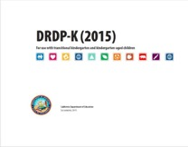
Key Features of the DRDP-K (2015)
An observation-based assessment tool, not a test
Individual child assessment
Completed by each child’s teacher
Based on developmental research and theory
Includes developmental sequences of behaviors along a continuum
Spans the developmental continuum of children in a two-year kindergarten program (TK)
Notes:
Presenter Remarks:
One resource that is used to support children’s development is the Desired Results Developmental Profile—Kindergarten (2015): A Developmental Continuum for Kindergarten (DRDP-K [2015]). This is especially helpful when considering the developmental continuum of drama for 4, 5 and 6 year old students.
The DRDP-K (2015) informs teachers’ understanding of the developmental continuum. It can be used with the Alignment Document to expand upon the developmental continuum.
One key feature of the DRDP-K (2015) to consider is that it is an observation-based assessment and not a test. It is used to support children’s learning. Observing and documenting children's progress provides teachers the information needed to differentiate instruction and experiences. It also provides information to individualize.
Observational tools are preferred over criterion-referenced tools because the information gathered by observation more accurately reflects what children are able to do.
Documentation provides concrete evidence of what children are able to do. With this documentation, we are then able to better plan activities that will meet and appropriately challenge children's developmental needs.
The DRDP-K (2015) also includes the following features:
It is an individual child assessment that can be shared with families.
It is aligned with the Preschool Learning Foundations.
It opens up the opportunity for articulation between preschool and TK teachers.
Sharing information as to where children are on the developmental continuum can better prepare the TK teacher to work with students.
A teacher can include a request form for previous records as part of the TK registration to help support the relationship between preschool, family, and TK.
The DRDP-K (2015) has been developed with world renowned experts. It is based on research and knowledge of what is most important for predicting school success.

Slide 30
DRDP-K (2015)
Notes:
Presenter Remarks:
The DRDP-K (2015) gives TK teachers a lens to measure the developing capacity of TK children to understand details and ideas from age-appropriate text presented by adults.
Look on the back side of Handout 3: How to Connect the Story of Drama. The image is a copy of the DRDP-K (2015) measure that most closely relates to the foundations for drama. This measure can help teachers understand the story of drama development in 4, 5 and 6 year old students.
Look closely at this DRDP-K (2015) measure. Take a few minutes to read each stage along with a few of the examples. Underline examples you have seen in your classroom.
Think of your favorite dramatic art performance such as Cats, the musical on Broadway, or the local 6th grade rendition of The Nutcracker. Stand up and find someone who has a different favorite performance. Exchange thoughts about the performance and how you might use this assessment tool to support planning and teaching in your classroom.

Slide 31
Foundations Video Example
What did you notice/observe?
How did your prior reading of the DRDP-K influence your observation?
Notes:
Background:
Prior to the training, embed video titled Drama Foundation 1.3.
Presenter Remarks:
Now we will watch a video example of drama foundation 1.3. After watching the video, we will discuss how our background knowledge of the DRDP-K developmental continuum influenced our video observation.

Slide 32
English Learners
“The high-quality early childhood practices described in other domains will also benefit preschool [TK] children who are English learners” (PCF, Vol. 1, p. 178).
©2017 California Department of Education
Notes:
Presenter Remarks:
“The high quality early childhood practices described in other domains will also benefit preschool children who are English learners” (PCF, Vol. 1, p. 178).
Remember two of the key guiding principles we discussed:
The arts reinforce the integrated nature of learning.
Cultural competence is approached through art.
(PCF, Vol. 2, p. 44)
These guiding principles suggest that best practice strategies in drama may also support children learning multiple languages including English.

Slide 33
Use Drama-Based Vocabulary
Directions:
With your table group, find the paragraph following this interaction and strategy in the Preschool Curriculum Framework, Vol. 2, p. 89).
Chart it!
Notes:
Presenter Remarks:
Examples of drama interactions and strategies that would support both monolingual and bilingual children are:
Use drama-based vocabulary.
Encourage the proper use of drama based vocabulary.
(PCF, Vol. 2, p. 89)
Read the interaction and strategy with your table group.
Extra Notes:
Participants share what they found in the reading by saying appropriate vocabulary words while presenter or helpers chart them. Discuss developmentally inappropriate words, if they are shared, and how these words are specifically too complex. A drama teacher might want to start introducing them, but should focus on the appropriate list with the class.
Appropriate words:
act, actor, character, clap, stage, costume, imagination, prop, pretend, puppet, scenery, voice, movement, audience
Inappropriate words:
blocking, positioning
How might you incorporate the ideas of universal design when introducing and reinforcing this vocabulary?

Slide 34
English Learner Strategies
Notes:
Presenter Remarks:
In addition to high-quality interactions research indicates that:
“…students who are learning content in a language they are simultaneously learning to speak and understand, probably need additional supports to make the content comprehensible to them. Teachers must therefore consider using modifications such as interactive approaches targeting both content and language…” (California’s Best Practices for Young Dual Language Learners: Research Overview Papers [CDE], Paper 3, p. 106).
The Preschool Curriculum Framework contains specific strategies for supporting English learners when developing English skills in the English-Language Development (ELD) domain. Teachers must consider these strategies and how they relate to developing drama skills while intentionally planning to meet the needs of their classroom.
Locate Handout 4: ELD Strategies in your packet now. Notice the highlighted strategies in purple. These represent SOME of the strategies that may easily cross domains between English-language development and drama. Take a moment to look with your elbow partner and decide if you agree. Do you recognize other strategies that may need to be highlighted?

Slide 35
ELD Strategies in the Vignette
Directions:
Locate the vignette on page 91 of the PCF, Vol. 2.
Read the vignette with your group.
Review Handout 4: ELD Strategies
Check any strategy in the vignette.
What strategies would enhance this situation for young bilingual learners?
Circle two strategies you would use.
Share a quick description of how you would use these strategies to build on a teachable moment or planned learning opportunity.
Notes:
Activity 3: Expanding Drama with English-Language Development Strategies
Presenter Remarks:
Please locate Handout 4: VPA Highlighted English-Language Development Strategies that you discussed with your table group.
intent:
Participants practice reading and applying information from the vignettes and interactions and strategies.
OUTCOME:
Participants reflect on their reading of the vignettes and strategies in the Preschool Curriculum Framework and make connections to the personal teaching style they utilize when using drama to bring stories to life.
Materials Required:
Preschool Curriculum Framework (PCF), Vol. 2, p. 91
Handout 4: Visual and Performing Arts (VPA) Highlighted English-Language Development Strategies
Time: 15 minutes
Process:
Ask participants to identify Handout 4: VPA Highlighted English-Language Development Strategies that they just discussed with their table group.
Participants work with elbow partner and follow the instructions on the screen:
Turn to page 91 in the PCF (Vol. 2) to locate the vignette you see here.
Read this vignette.
Review Handout 4: VPA Highlighted English-Language Development Strategies.
Put a check mark next to any strategy you find in the vignette.
Consider which strategies you might use to enhance this situation for young English learners.
Circle two strategies you would use in a situation similar to that of the vignette.
Be ready to share a quick description of how you would use these strategies to build on this teachable moment or planned learning opportunity.
SHARE-OUT OPTIONS:
Using Poll Everywhere, tally what strategies participants choose to use. Share this on the screen and discuss the most popular strategies.
Invite elbow partners to role-play how they might utilize the strategy. Offer raffle tickets to volunteers.
Ask volunteers to verbally share their ideas for the strategies and have two trainers chart the responses.

Slide 36
Interactions and Strategies
Use strategies such as pre-teaching and repetition.
Incorporate pictures, sign language, and other multisensory enrichment to support new language and concepts.
Provide space designated for movement with easy to use props and costumes.
Assign adapted roles for children with specific needs.
(PCF, Vol. 2, p. 95)
Notes:
Presenter Remarks:
“All children are able to participate in and benefit from drama if teachers make appropriate accommodations as needed” (PCF, Vol. 2, p. 95).
Read through the slide. What specific examples have you used or seen used? Please share at your table.

Slide 37
Environment
“Many things handy in a preschool [TK] environment can serve as props for dramatic play and drama”
(PCF, Vol. 2, p. 45).
Notes:
Presenter Remarks:
“Many things handy in a preschool [TK] environment can serve as props for dramatic play and drama, where imagination can turn almost anything into something else” (PCF, Vol. 2, p. 45).
What items can you imagine in this dramatic play area?
Possible ideas:
Flower market
Farmers market
Flower shop
Garden party
Wedding

Slide 38
Adult participation is integral for the environment.
38
“Model and note appropriate ways of using drama materials”(PCF, Vol. 2, p. 92).
“Use costumes, props, and scenery to inspire dramatic play and drama”(PCF, Vol. 2, p. 96).
©2017 California Department of Education
Notes:
Presenter Remarks:
“Model and note appropriate ways of using drama materials” (PCF, Vol. 2, p. 94).
A teacher’s participation is extremely important. This is one way to scaffold children’s learning in this area. There may be items that children are unfamiliar with. Showing them what they are for not only broadens their knowledge but also increases their vocabulary.
“Use costumes, props, and scenery to inspire dramatic play and drama” (PCF, Vol. 2, p. 96).
Remember to provide open-ended materials as well. This allows children’s imagination and creativity to take off. For example, one teacher put yarn and ribbon in the dramatic play area. One child used it as a leash for her pretend dog. Another child used it as the pasta she was cooking.

Slide 39
Environment and Materials
39
“Sufficient open space [is needed] for movement, dance, and theater play” (PCF, Vol. 2, p. 47).
“Imagination can turn almost anything into something else” (PCF, Vol. 2, p. 45).
©2017 California Department of Education
Notes:
Presenter Remarks:
“Sufficient open space [is needed] for movement, dance, and theater play” (PCF, Vol. 2, p. 47).
Think about the difference in space inside your classroom and outside. Is there a difference in the dramatic play your children engage in based on the amount of space they have available?
“Imagination can turn almost anything into something else” (PCF, Vol. 2, p. 45).
Share some examples from your classroom, such as using a block as a phone.

Slide 40
It’s Just Fabric…or Is It?
Notes:
Activity 4: It’s Just Fabric…or Is It?
Presenter Remarks:
Now, we invite you to activate your imaginations.
intent:
Participants experience the wealth of opportunities that intentional materials can bring to drama.
OUTCOME:
Participants determine how to enhance drama opportunities by increasing the variety of materials available in their classroom.
Materials Required:
Scarves
Large scraps of fabric
Cue cards
Time: 15 minutes
Process:
Transition from the information given on slide to inviting participants to activate their imaginations.
Trainer models how to role-play with fabric, acting out two or three examples of the cue cards:
Trainer pulls a cue card that says “Superman” and does not show audience.
Using the fabric to help act out the word, the trainer turns the fabric into a cape and acts out superman until someone correctly guesses the word.
Trainer says to participants:
Now it’s your turn to use your imagination with fabric.
Working as a table group, pass the fabric around and act out each of the cue cards on your table.
Act out as many cue cards as possible before time runs out.
Ready? Begin at the sound of the music.
Provide about 4-5 minutes for participants to role-play with fabric.
After time is up, bring the group back together.
Acknowledge the table group that got through the most cue cards.
Brainstorm for other things the fabric could have been used for with the entire group. Chart this at the front of the room.
Wrap-up by asking participants to discuss what areas of the classroom they plan to add large fabric scraps to for enhancement of dramatic play and imagination. (Possible answers include outside, block area, dramatic play area and/or time, music and movement time, etc.)

Slide 41
Suggested Drama Materials
What other inexpensive materials could you add to the drama list?
Circle three new materials to invite families to bring to the classroom.
Notes:
Presenter Remarks:
Find Handout 5: Art Materials.
Working with your table group, identify other inexpensive materials can you add to the drama list. Highlight or circle three new materials to invite families to bring to the classroom.

Slide 42
The Helicopter Technique
"The classroom has all the elements of theatre, and the observant, self-examining teacher will not need a drama critic to uncover character and plot, and meaning. We are, all of us, the actors trying to find the meaning of the scenes in which we find ourselves. The scripts are not yet fully written, so we must listen with curiosity and great care to the main characters who are, of course, the children.”
–Vivian Gussin Paley (NAEYC 2013)
Notes:
Background:
Hyperlink for the video is http://youtu.be/UkJl8dyzRQQ. Watch video prior to the training.
Presenter Remarks:
The quote on the slide was shared at the closing session of NAEYC 2013: "The classroom has all the elements of theatre, and the observant, self-examining teacher will not need a drama critic to uncover character and plot, and meaning. We are, all of us, the actors trying to find the meaning of the scenes in which we find ourselves. The scripts are not yet fully written, so we must listen with curiosity and great care to the main characters who are, of course, the children” (Vivian Gussin Paley, "Monsters and superheroes—The Helicopter Technique of Storytelling and Story Acting" [NAEYC 2013].
It is a reflection of Vivian Gussin Paley who created one strategy, the helicopter technique, for teachers to connect children's literature to their lives through drama. This strategy is particularly special because it capitalizes on what many teachers are already very good at-recording children's dictated stories.
Let’s watch the first few minutes of the video to learn about the Helicopter Technique.

Slide 43
The Helicopter Technique
http://www.makebelievearts.co.uk/Helicopter
Notes:
Presenter Remarks:
Let’s watch the first few minutes of the video to learn about the Helicopter Technique.

Slide 44
Modeling the Helicopter Technique
Please locate:
Handout 6: Domain Reflection
Handout 7: Helicopter Technique
We need eight volunteers!
Use your handout to consider:
What drama foundations were addressed?
What drama vocabulary was used?
What other VPA foundations could be addressed?
What other domains were addressed?
Notes:
Activity 5: Helicopter Technique ̶ Fish Bowl
Presenter Remarks:
Now we are going to experience the helicopter technique.
intent:
Participants experience the helicopter technique.
OUTCOME:
Participants participate in the helicopter strategy and reflect on how to apply that strategy in their classroom.
Materials Required:
Handout 6: Domain Reflection
Handout 7: Helicopter
Time: 15 minutes
Process:
Invite eight participants to sit in a chair circle at the front of the room.
Ask one person to be the author/ story teller.
Model how to record the story. Ask the author to tell you a story and record it on the small sheet of paper. Remember, it cannot be longer than what will fit on the piece of paper.
Invite the other seven participants to be the components of the story.
When the story is finished, ask the audience to applaud and acknowledge the group.
Reflect on the helicopter strategy using Handout 6: Domain Reflection.
Which drama foundations were addressed?
What drama vocabulary was used?
What other domains of development were addressed?
This is just one way to incorporate drama into the daily routine. Because teachers already have children tell stories and participate in circle time, it is easy to embed this strategy. Teachers already utilize the skills necessary to use this strategy on a daily basis.
Working in table groups, come up with one opportunity to use this activity.

Slide 45
Reflecting on the Helicopter Technique
What are the components of the helicopter technique?
What do you already do that includes this technique?
What is intriguing to you about this technique?
Which children in your classroom would enjoy this activity?
What would you need to set up in the classroom?
©2017 California Department of Education
Notes:
Presenter Remarks:
Key points of the helicopter technique:
The child is the center.
The teacher outlines rules (tapes off a stage, story can’t be longer than the page, etc.).
Child directs the story.
Teacher asks for classmates to act out the story.
Entire class is the audience.

Slide 46
What Will You Fit into Your Schedule Next Week?
©2017 California Department of Education
Notes:
Presenter Remarks:
What will you fit into your schedule next week?
Here are some ideas:
Plan time with staff to scaffold the foundations.
Plan time to add materials like fabric to different areas.
Intentionally model dramatic play.
Incorporate drama vocabulary after reading a story or playing in a dramatic play area.
Use the helicopter technique at circle time.
Utilize families with drama strengths.
Utilize other staff strengths.

Slide 47
Thank You for Coming!
What stories will you drive away with today?
©2017 California Department of Education
Notes:
Extra Notes:
Options:
Invite participants to “quick whip” around the room with a one-word answer.
Have table groups stand up in front of chart paper with DRIVE written vertically. Each participant writes something they will take away from today, beginning with the next letter D.
For example:
D - develop skills
R - real stories
I - individualize for interests
V - variety of materials
E - environment adjustments
Have participants share their stories with the table group. Each participant will then write one goal that they will implement next week. Each tablemate should sign the paper.

Slide 48
Reference Guide for PowerPoint Citations
California Department of Education. 2013. California’s Best Practices for Young Dual Language Learners: Research Overview Papers, Paper 3. http://www.cde.ca.gov/sp/cd/ce/documents/dllresearchpapers.pdf (accessed January 6, 2017).
California Department of Education. 2011. California Preschool Curriculum Framework, Volume 2. http://www.cde.ca.gov/sp/cd/re/documents/psframeworkvol2.pdf (accessed January 6, 2017).
California Department of Education. 2008. California Preschool Learning Foundations, Volume 2. http://www.cde.ca.gov/sp/cd/re/documents/psfoundationsvol2.pdf (accessed January 6, 2017).
Pailey, Vivian Gussin. "Monsters and superheroes—The Helicopter Technique of Storytelling and Story Acting." NAEYC Annual Conference and Expo, Washington D.C., November 13, 2013.

