Slide 1
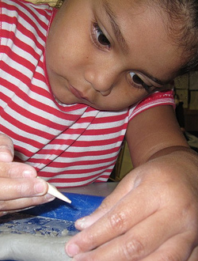
Visual and Performing Arts in Transitional Kindergarten
Visual Art
©2017 California Department of Education
Notes:
Presenter Remarks:
Welcome to Visual and Performing Arts: Visual Art in Transitional Kindergarten—a presentation focusing on the California Preschool Learning Foundations (Preschool Learning Foundations or PLF), the California Preschool Curriculum Framework (Preschool Curriculum Framework or PCF), and other California Department of Education (CDE) resources in support of the Visual and Performing Arts domain.
This professional learning session is specifically designed to provide TK teachers with exposure to CDE resources that support TK curriculum planning of developmentally appropriate strategies. Classroom environment design recommendations are included to support the content area of visual art.

Slide 2

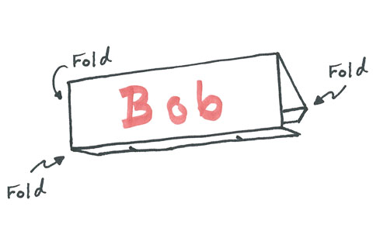
As You Settle in…
2
Use the markers and paper on the table (and any other materials you may have brought) to create name tags on your “painter’s pallet.”
Notes:
Activity 1: Who Am I?
Presenter Remarks:
Using the materials on your table, we are going to create our own nametags.
INTENT:
Gain hands-on experience with visual art.
OUTCOMES:
Become oriented to the topic for today—visual art.
MATERIALS REQUIRED:
8 ½ x 11 sheets of white paper (one for each participant)
Variety of colored markers on each table (at least one per table member)
Tape
TIME: 5 minutes
PROCESS:
Invite participants to create a name table tent for themselves using the supplied paper, tape, and markers.
Invite participants to use any additional materials they may have brought.
Debrief: By a raise of hands, ask participants to indicate whether they simply wrote their names on their table tents or if they added artistic elements.

Slide 3
Objectives
Gain understanding of key concepts from the California Preschool Learning Foundations, Volume 2 and the California Preschool Curriculum Framework, Volume 2—Visual and Performing Arts domain, Visual Art strand.
Observe, read, and discuss the developmental continuum for visual art and develop strategies that will guide instruction and learning in Transitional Kindergarten (TK).
Practice using the Preschool Learning Foundations and Preschool Curriculum Framework to intentionally plan developmentally appropriate, cultural, and inclusive strategies that promote the development of skills, knowledge, and behaviors related to visual art.
Notes:
Presenter Remarks:
This slide shows what we will cover in today’s training.
Objectives:
Gain understanding of key concepts from the California Preschool Learning Foundations, Volume 2 and the California Preschool Curriculum Framework, Volume 2—Visual and Performing Arts domain, Visual Art strand.
Observe, read, and discuss the developmental continuum for visual art and develop strategies that will guide instruction and learning in Transitional Kindergarten (TK).
Practice using the Preschool Learning Foundations and Preschool Curriculum Framework to intentionally plan developmentally appropriate, cultural, and inclusive strategies that promote the development of skills, knowledge, and behaviors related to visual art.

Slide 4


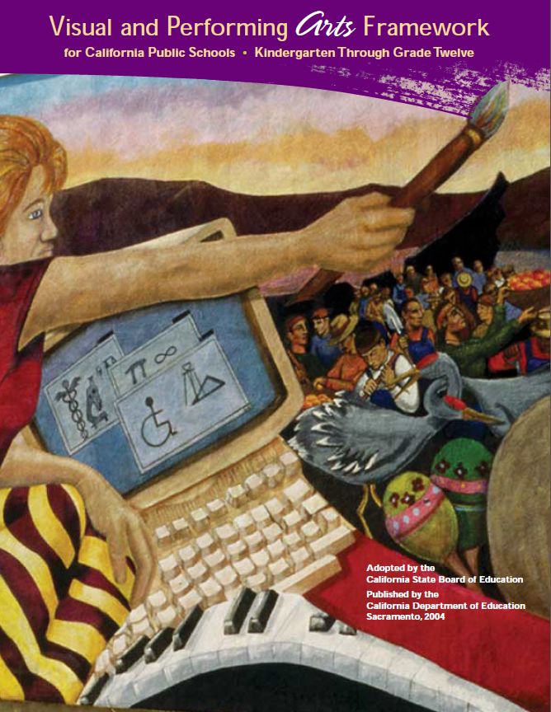
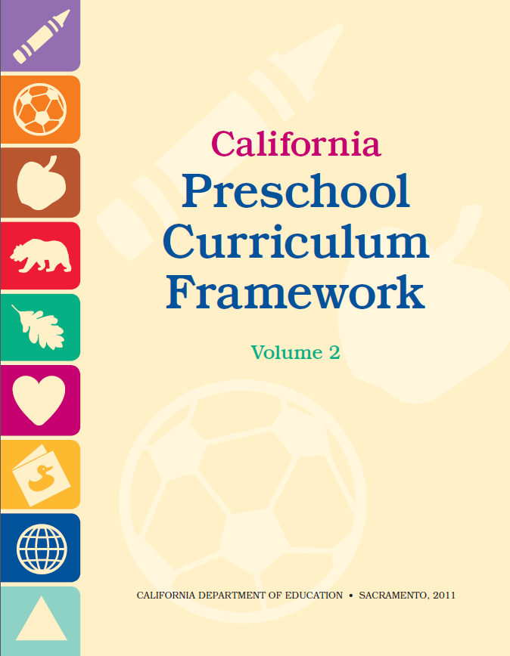





CDE Publications and Resources that Support TK Implementation
Preschool Learning Foundations
California Common Core State Standards
Visual and Performing Arts Framework for California Public Schools
Preschool Curriculum Framework
Visual and Performing Arts Content Standards
DRDP Specific to TK and K
Preschool Alignment Document
Preschool English Learners Guide
Transitional Kindergarten Implementation Guide
Preschool Learning Foundations
California Common Core State Standards
Visual and Performing Arts Framework for California Public Schools
Preschool Curriculum Frameworks
English Language Arts/English Language Development Framework
DRDP Specific to TK and K
Preschool Alignment Document
Preschool English Learners Guide
Transitional Kindergarten Implementation Guide
Notes:
Presenter Remarks:
The California Department of Education has developed many publications, resources, and supports that enable teachers to facilitate the most positive outcomes for students.
Today our main focus will be on the Preschool Learning Foundations and the Preschool Curriculum Framework, Volume 2—Visual and Performing Arts domain.
There are additional key resources that support visual art development in young children. We will also discuss alignment with CA standards and make connections to additional resources pictured in the graphic (name and hold up each resource):
The Alignment of the California Preschool Learning Foundations with Key Early Education Resources (Alignment Document)
California Common Core State Standards (CA CCSS)
Visual and Performing Arts Content Standards for California Public Schools, Kindergarten Through Grade Twelve (CA VPA Standards)
Preschool English Learners: Principles and Practices to Promote Language, Literacy, and Learning—A Resource Guide (Second Edition) (PEL Resource Guide)
Visual and Performing Arts Framework for California Public Schools, Kindergarten Through Grade Twelve (VPA Framework)
Desired Results Developmental Profile—Kindergarten (2015): A Developmental Continuum for Kindergarten (DRDP-K [2015])
Transitional Kindergarten Implementation Guide – A Resource for Public School District Administrators and Teachers (TK Implementation Guide)

Slide 5
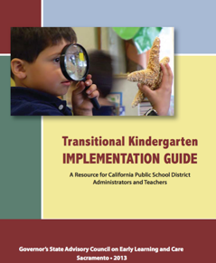
Transitional Kindergarten Implementation Guide
The TK Implementation Guide is a resource for California public school district administrators and teachers to support implementation of comprehensive TK programs.
Notes:
Presenter Remarks:
The TK Implementation Guide is a resource that focuses on the essential components for school district administrators and teachers to consider for TK programs. The TK Implementation Guide, published by the California Department of Education, is a resource to support implementation of comprehensive TK programs.
This publication provides resources and guidance in the areas of program design, curriculum, instruction, assessment, and family/community partnerships.

Slide 6
Overview of the Transitional Kindergarten Implementation Guide
  Section One
  Program Structure and Design
  Section Two
  The TK Student
  Curriculum in a TK Program
  Effective Instruction in a TK Program
  The TK Learning Environment
  Assessment and Differentiated Instruction
  Involving Families and Community Partners
  Supporting TK Implementation
Notes:
Presenter Remarks:
The TK Implementation Guide is organized into the following two sections:
Section 1 is covered in Chapter 1. The information in this section was developed with the administrator in mind and focuses on program structure and design.
Section 2 is covered in Chapters 2-8. This section is a resource for both teachers and administrators and focuses on building a comprehensive TK program by addressing curriculum, instruction environment, assessment and partnership with families and community.
Within each of these chapters, vignettes, highlighted boxes, and resource boxes are included to illustrate examples of the information covered in each of the chapters.
A PDF copy of the document can be accessed at the California Department of Education Web page (www.cde.ca.gov/ci/gs/em/documents/tkguide.pdf).
Video footage for each chapter can be accessed at the California Department of Education. The video clips include footage of TK classrooms and interviews with teachers, administrators, and parents. https://www.youtube.com/user/caeducation
https://www.youtube.com/results?search_query=tk+implmentation+guide

Slide 7
Why Use the Preschool Learning Foundations for TK?
CA Law (EC 48000):
Transitional kindergarten is the first year of a two-year kindergarten program that uses a modified kindergarten curriculum that is age and developmentally appropriate.
Transitional kindergarten programs are intended to be aligned, by legislative action, to the California Preschool Learning Foundations developed by the California Department of Education.
Notes:
Background Information:
http://cde.ca.gov/ci/gs/em/kinderfaq.asp#program
Presenter Remarks:
The state of California provides guidance on utilizing the Preschool Learning Foundations and the Preschool Curriculum Framework as planning and curriculum resources in the TK classroom.

Slide 8
Foundations and Framework, Volume 2
Notes:
Presenter Remarks:
The purposes of the Preschool Learning Foundations are to promote a common understanding of TK children's learning and to guide instructional practice. They describe the knowledge and skills that young children typically develop when provided with developmentally, culturally, and linguistically appropriate learning experiences.
The Preschool Curriculum Framework was created as a companion to the Preschool Learning Foundations. The framework ". . . presents strategies and information to enrich learning and development opportunities for all children" (PCF, Vol. 2, p. v).
The Preschool Learning Foundations and the Preschool Curriculum Framework are designed to work together. While the foundations provide the background information to understand children's developing knowledge and skills (the "what"), the framework offers guidance on how teachers and programs can support the learning and development that are described in the foundations (the "how").
Extra Notes:
The Preschool Learning Foundations were developed with research-based evidence and are enhanced with expert practitioners' suggestions and examples. All foundations were written by a team of researchers with expertise in the given domain. A complete reference list of the source materials, along with detailed bibliographic notes for each of the developmental domains, can be found in the Preschool Learning Foundations. Sources used in the development of the foundations include:
Documents from the California Department of Education, such as the English-Language Arts Content Standards for California Public Schools, Kindergarten Through Grade Twelve (Language and Literacy, Introduction, p. 48, left column)
Well-validated assessment tools such as the Ages & Stages Questionnaires (ASQ): A Parent-Completed, Child-Monitoring System (Social-Emotional, References and Source Materials, p. 36)
General sources such as the Report of the National Reading Panel 2000 (Language and Literacy, Introduction, p. 73, left column)
Early childhood education standards from other states such as Hawaii and Texas (Social-Emotional, Introduction, p. 5, footnote).

Slide 9
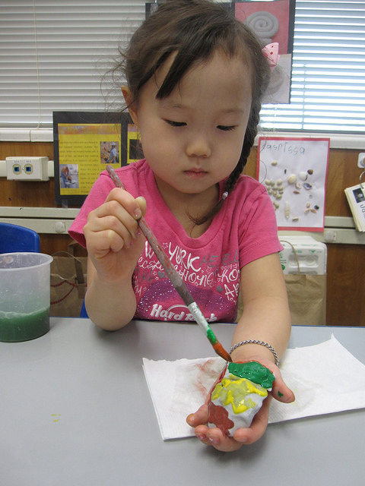
Every Child Is an Artist
9
“Every child is an artist. The problem is how we remain an artist once we grow up.”
-Pablo Picasso
Notes:
Presenter Remarks:
“Research shows that creativity in humans peaks at approximately 54 months of age (four-and-a-half years old). Encouraging the practice and development of visual art capacities is one way teachers can extend and develop creativity in preschool [TK] children” (PCF, Vol. 2, p. 61).
Take a moment to read the quote on the slide. Share your reaction with an elbow partner.
9

Slide 10
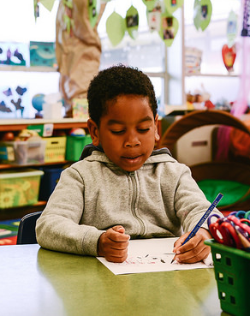
The Purpose of the Foundations
The purpose of the foundations is to promote a common understanding of young children’s learning and to guide instructional practice.
Notes:
Presenter Remarks:
The purpose of the foundations is to promote a common understanding of young children’s learning and to guide instructional practice.
As teachers plan learning environments and experiences, the foundations provide the background information to help teachers understand children’s developing knowledge and skills.
The Preschool Learning Foundations were developed with research-based evidence and are enhanced with suggestions and examples from expert practitioners. All foundations were written by a team of researchers with expertise in the various domains.

Slide 11
Foundations
With appropriate support
High-quality program
©2017 California Department of Education
Notes:
Presenter Remarks:
The Preschool Learning Foundations describe what children should be able to do at around 48 (4 years old) and 60 months (5 years old).
The foundations also assume that children have access to appropriate support in high quality programs. This includes:
Environments and experiences that encourage active, playful exploration and experimentation
Clearly defined learning centers where materials are rotated
Purposeful teaching to help children gain knowledge and skills
Predictable schedules and routines with large blocks of time for play and skillful integration of curriculum with an intentional focus on content
Specific support for English learners with staff that have knowledge of the stages of English-language acquisition
Accommodations and adaptations for children with disabilities and additional support when needed
Let’s take a closer look at one of the foundations as an example. Open the Preschool Learning Foundations and find a page where the age levels appear. This is an example of a foundation page.
Look across the page at the developmental progression at around 48 months. Notice the changes at 60 months of age. Solicit a few participants to read what they see.
Summarize the exploration with the following key note: Because children develop at different rates, the foundations were designed to support the belief that certain stages of development will occur at different times for all students. You will notice “at around” in the description. It is important to remember this variability occurs.

Slide 12
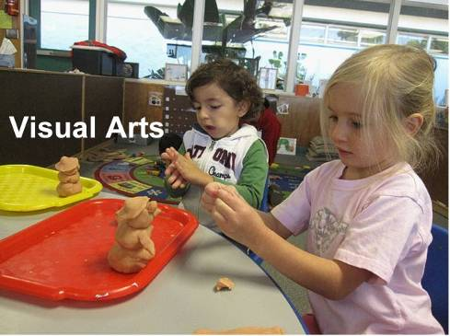
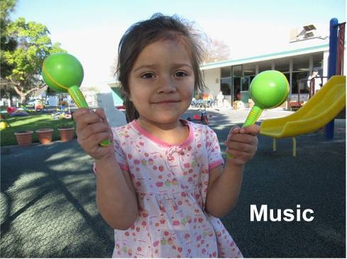
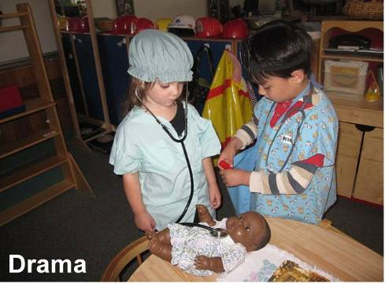
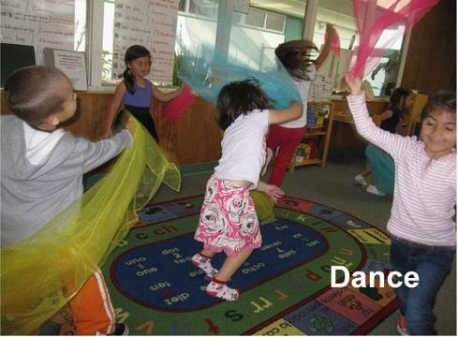
What are the visual and performing arts?
12
©2017 California Department of Education
Notes:
Presenter Remarks:
(Click to reveal Visual Art.) The foundations for visual arts include observing and commenting on art, developing art skills, and creating art (e.g., painting, drawing, sculpting, and collages).
(Click to reveal Music.) The foundations for music include responding to and recognizing sounds and music, learning music skills, and creating music by keeping a beat with one’s body, by singing, and by using musical instruments.
(Click to reveal Drama.) The foundations for drama include pretend play and reenacting stories as well as using props, costumes, and roles in play.
(Click to reveal Dance.) The foundations for dance include engaging in dance movements, being aware of body space, and expressing oneself through dance.

Slide 13
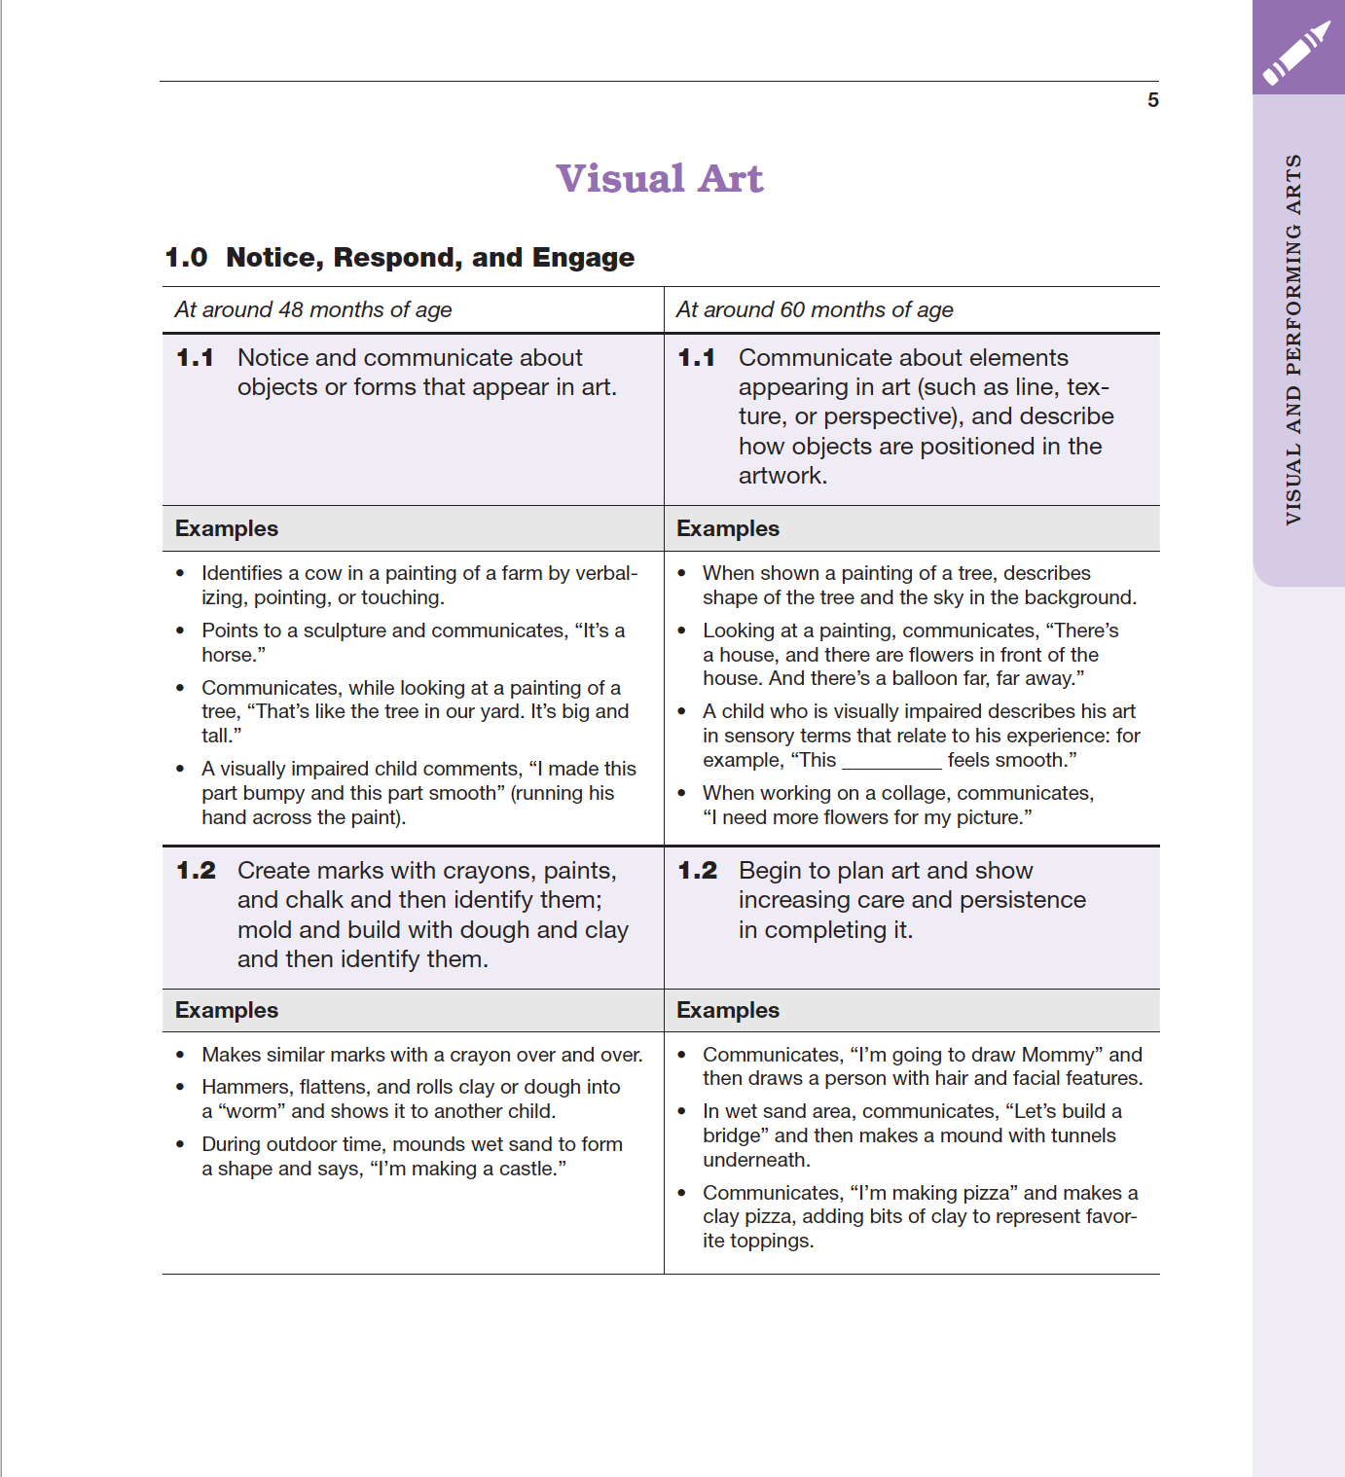
Map of the Foundation
Substrand
Strand
Age
Domain
Foundation
Foundation
Description
Examples
Notes:
Presenter Remarks:
Please locate Handout 1: Visual Art Foundations Map. This handout illustrates the way the foundations are organized. Please follow along while we discuss each component:
The name of the domain (Visual and Performing Arts)
The name of the strand (Visual Art)
The name of the substrand (Notice, Respond, and Engage)
Note that substrands always end in “zero.”
The two age levels (at around 48 months and at around 60 months)
Each foundation describes typical behaviors at around 48 months and at around 60 months or four to five years old.
The foundations for the substrand
There are two for each age level on this page (1.1 for 48 months and 1.1 for 60 months, 1.2 for 48 months and 1.2 for 60 months).
The examples for each foundation
These are only a few of the ways that children may demonstrate the behavior in the foundation.

Slide 14
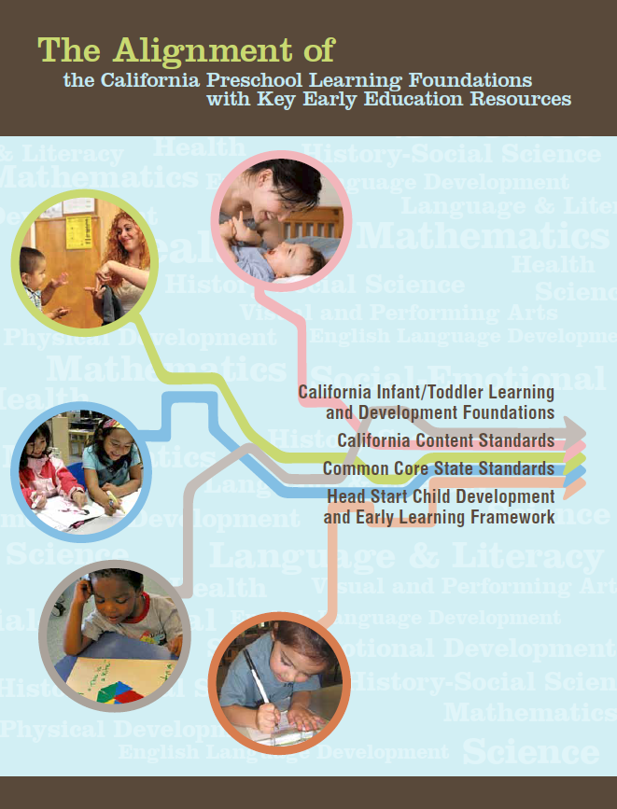
Alignment Document
Notes:
Presenter Remarks:
The Alignment Document is another resource that will help us answer questions related to developmental progression.
What do you know about this document? How do you use it in your work now?
Extra Notes:
Depending on the size of the group, participants can share responses with table partners or in pairs.

Slide 15
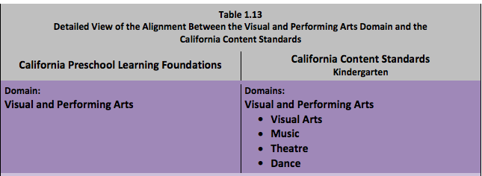
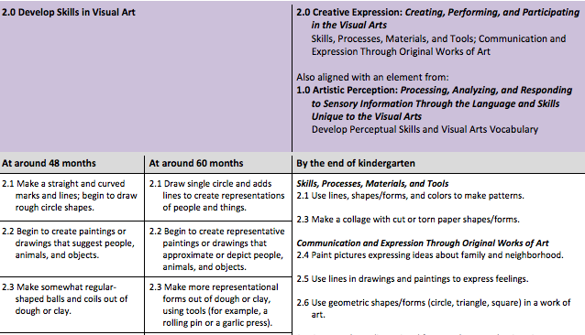
Alignment Document
Notes:
Presenter Remarks:
Look at Handout 2: Alignment Document.
This is a screen shot of the alignment in Visual and Performing Arts content between the Infant/Toddler Learning and Development Foundations, the Preschool Learning Foundations, and the California Content Standards for Kindergarten.
Teacher scaffolding in visual art enables important connections between the arts and other developments. We need to understand the connections with past and future development in order to effectively scaffold our children.
Optional debrief questions:
Guide participants to turn to page six in Volume 2 of the PLF and read the 48 month and 60 month foundations. What differences do they notice? What different types of conversational prompts or questions might they use respectively? Using the alignment document as a guide, how might they support further development of a child who was still working towards the 48 month foundation? What about the child who is moving to TK or K?

Slide 16
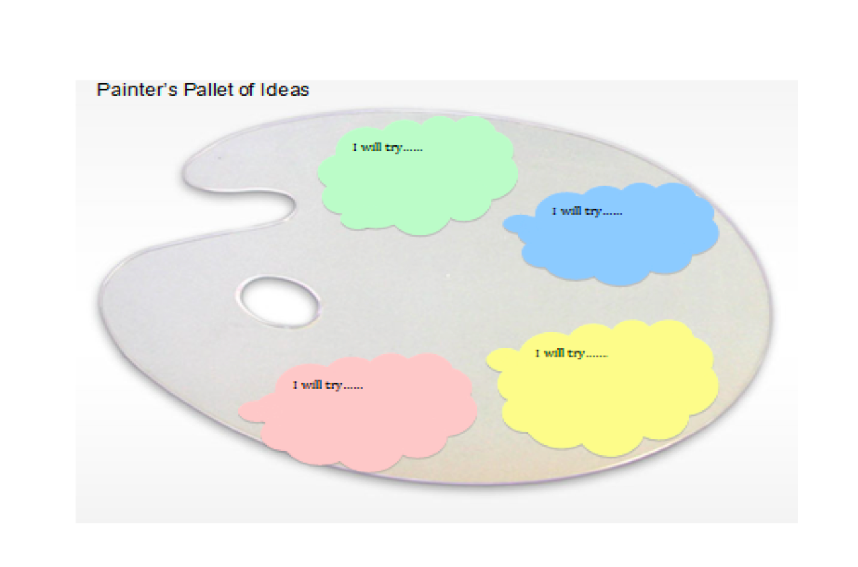
Reflective Painter’s Pallet
Notes:
Presenter Remarks:
In order to make today's training reflective and intentional, as well as individually and culturally meaningful, use Handout 3: Painter’s Pallet Action Plan throughout the day to record your thoughts. These thoughts can then be used to intentionally plan for your classroom or program.

Slide 17
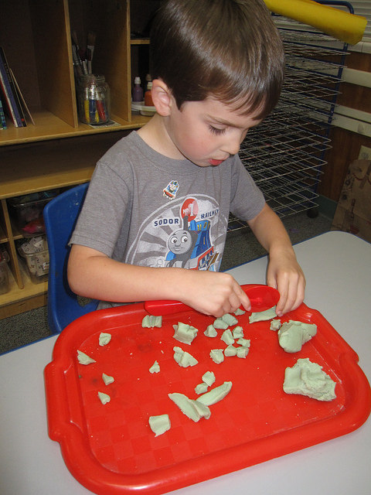
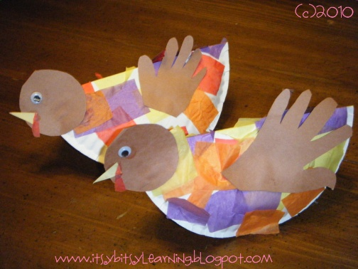
What Is Visual Art?
17
Visual art is about participation, engagement, and involvement.
Visual art is not about product or crafts.
Notes:
Presenter Remarks:
As you add ideas to the Painter’s Pallet, consider if the art activities are about the process or the product.
“During the preschool [TK] period, the arts are more about the process (in the sense of participation, engagement, and involvement) than about the product (click to reveal the ‘no’ sign), or the end result, of an artistic activity” (PLF, Vol. 2, p. 1).
“Making crafts with children is not the same as teaching visual art. [Visual art] activities should be open-ended…teachers should focus on the process of doing the activity, not on the end product” (PCF, Vol. 2, p. 61).
“The visual art framework is designed to encourage creativity; open-ended projects emphasize the process of working with visual materials. In other words, the [visual art] curriculum is not focused on encouraging a child to produce, for example, a specific painting, but rather to practice using a brush on paper without a set outcome” (PCF, Vol. 2, p. 50).
“If children engage in art, that is what matters—regardless of the end result or product. The process may be messy and the result undistinguishable, but the child will likely take much joy in the experience and pride in her accomplishment” (PCF, Vol. 2, p. 44).

Slide 18
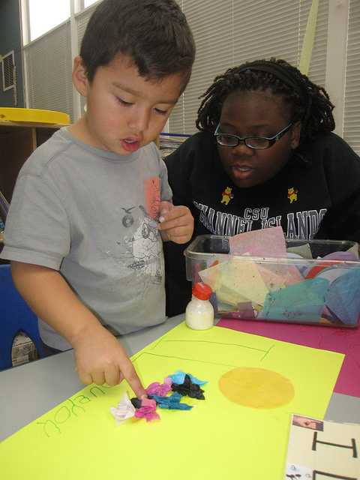
Visual Art Is…
18
Child-initiated
Teacher-facilitated
Notes:
Presenter Remarks:
As you add ideas to the Painter’s Pallet, remember to include both child-initiated and teacher-facilitated ideas.
“Child-initiated artistic activity is valuable not only because it is so enmeshed with a host of developments for children, but also because children cherish ownership of much of what they do” (PCF, Vol. 2, p. 40).
“Although some behaviors and skills in the arts develop more or less naturally through the course of children’s everyday experience, others need the support of adult guidance and intentional teaching: for example, using art implements…” (PLF, Vol. 2, p. 3).
“Teachers can and should support young learners in their development. An element of this scaffolding is creating conditions in the preschool [TK] program in which interesting and important connections between the arts and other developments can take place” (PCF, Vol. 2, p. 41).
“[Teachers can] spark actions and reactions on the part of children, to ensure full inclusion of children in the early childhood setting, to bring about specific language learning in a formal, planned way...” (PCF, Vol. 2, p. 41).

Slide 19
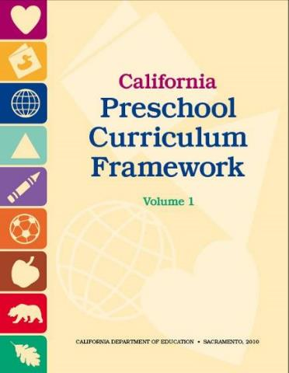
Framework Strategies
Developmentally appropriate
Reflective and intentional
Individually and culturally meaningful
Inclusive of children with disabilities or other special needs
Notes:
Presenter Remarks:
The Preschool Curriculum Framework offers guidance on how teachers can support the learning and development described in the foundations, through environments, materials, and experiences that are developmentally appropriate, individually and culturally meaningful, and engaging to families.
“Teachers address ideas and concepts that children can grasp at their developmental level and then progressively build on what children already know and understand. This approach applies to all children, including children with various abilities, disabilities, or other special needs (such as delays in language, cognition, or physical ability)” (PCF, Vol. 2, p. 227).
The VPA domain begins with guiding principles that set the tone for the entire chapter. Let’s take a moment to look at these guiding principles and see what they are:
The arts are inclusive of all children.
The arts are a language that is common to all.
The arts promote dispositions for learning.
Children make their own meaning.
Children are capable of creating original art in all its forms.
Children learn about human connections, beauty, and appreciation of the arts.
The child’s work is play.
Children are active learners who thrive when challenged appropriately.
Arts experiences for [young children] are more about process than product.
The arts reinforce the integrated nature of learning.
Cultural competence is approached through art.
The arts are motivating and engaging for learners.
Art can nurture the nurturer.
The arts provide a unique means for families to interact.
(PCF, Vol. 2, pp. 42-45)

Slide 20
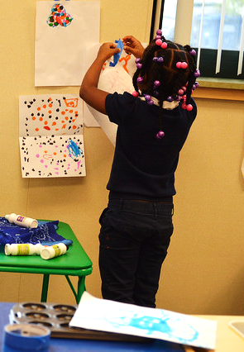
The Preschool Curriculum Framework:
“…presents strategies and information to enrich learning and development opportunities for all of California’s preschool children”
(PCF, Vol. 1, p. v).
©2017 California Department of Education
Notes:
Presenter Remarks:
“The Preschool Curriculum Framework presents strategies and information to enrich learning and development opportunities for all of California’s preschool children” (PCF, Vol. 1, p. v).
This resource provides teachers with the opportunity to gain ideas and expand their creativity.

Slide 21
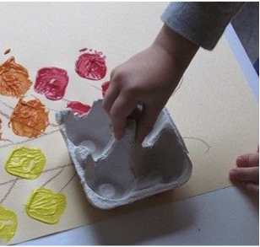
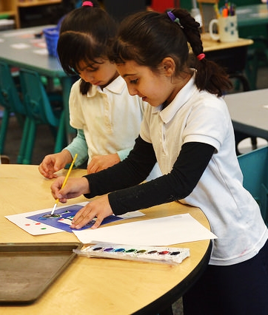
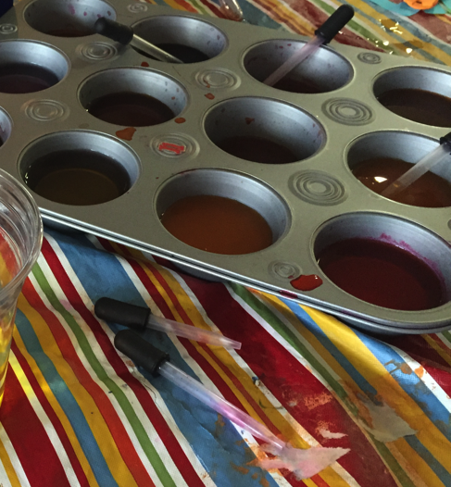
Universal Design for Learning
Multiple means of:
Representation
Engagement
Expression
Notes:
Background Information:
PCF, Vol. 2, p. 14
Presenter Remarks:
The strategies within the Preschool Curriculum Framework include the idea of Universal Design for Learning (UDL). This means there are many suggestions for ways to support learning that teachers can use to provide multiple means of representation, engagement, and expression.
“Multiple means of representation refers to providing information in a variety of ways so the learning needs of all children are met. For example, it is important to speak clearly to children with auditory disabilities while also presenting information visually (such as with objects and pictures).
“Multiple means of expression refers to allowing children to use alternative ways to communicate or demonstrate what they know or what they are feeling. For example, when a teacher seeks a verbal response, a child may respond in any language, including American Sign Language. A child with special needs who cannot speak may also respond by pointing, by gazing, by gesturing, by using a picture system of communication, or by using any other form of alternative or augmented communication system.
“Multiple means of engagement refers to providing choices in the setting or program that facilitate learning by building on children’s interests. The information in this curriculum framework has been worded to incorporate multiple means of representation, expression, and engagement” (PCF, Vol. 2, p. 14).
The three photographs on the slide are examples of multiple means of engagement and expression of color mixing and painting.

Slide 22
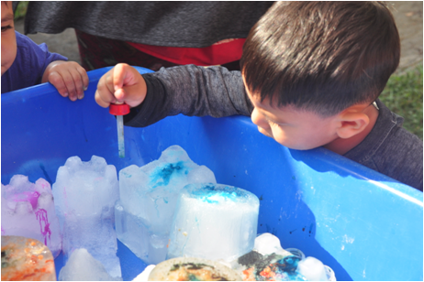
Discover Strategies
22
Discover strategies to assist in the following tasks:
Setting up environments
Encouraging and expanding self-initiated play
Selecting appropriate materials
Planning and implementing teacher-guided learning activities
Notes:
Presenter Remarks:
Discover strategies to assist in the following tasks:
Setting up environments
Encouraging and expanding self-initiated play
Selecting appropriate materials
Planning and implementing teacher-guided learning activities
Each strategy incorporates UDL concepts.

Slide 23
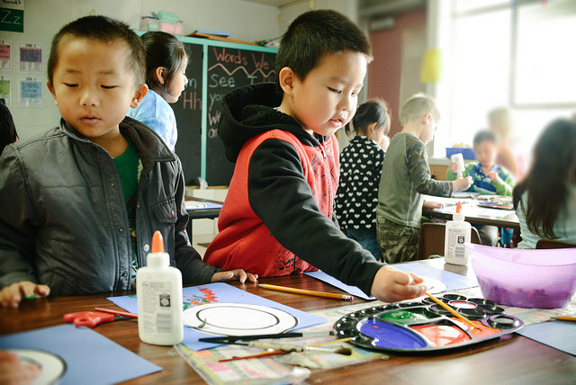
The Arts Are Inclusive and Integrated
Notes:
Presenter Remarks:
The arts are inclusive and integrated, meaning that all children can enjoy them and art can be integrated into other subjects throughout the day. Art is a way for children to express themselves.

Slide 24
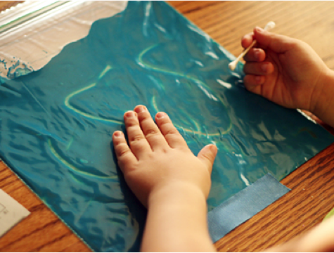
Inclusiveness of Art
“The arts are inclusive of all children… [they] are a language that is common to all”
(PCF, Vol. 2, p. 42).
©2017 California Department of Education
Notes:
Presenter Remarks:
“The arts are a means to explore, take risks, communicate, and define personal perspectives and preferences regardless of culture, development status, or ability” (PCF, Vol. 2, p. 44).
Think about a time when you had the opportunity to participate in an “art” activity. What did you create? Did the ideas come from your culture? Was it something that was personal to you? Did you use the opportunity to communicate something?
“In groups where children speak multiple languages and may not share common words, visual art can create connections and a way of communicating. Art can be a way for people to connect across cultures to their common humanity; an appreciation for it may begin in preschool [TK]” (PCF, Vol. 2, p. 50).
Think about the art projects in your classroom. Do you provide opportunities for children to work together? What about providing opportunities for them to share their art work? Art provides another opportunity for English language learners to develop and strengthen their vocabulary, as well as their communication skills.

Slide 25

The Arts Are Inclusive and Integrated
Notes:
Background:
Prior to the training, embed the video, Initiative in Learning 5.1. This video is from the social emotional foundations DVD, Volume 1.
Presenter Remarks:
The first 2 minutes and 45 seconds of the video provide an example of an activity that facilitates initiative in learning as well as visual art development.
In addition, the child in the video provides a clear example of how all children can participate in the visual and performing arts.

Slide 26
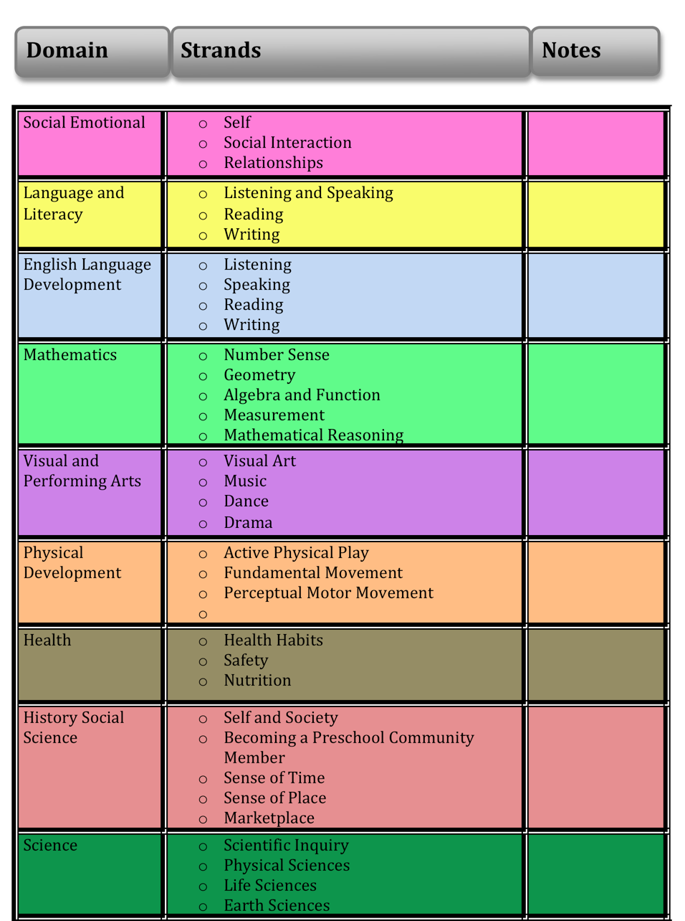
The Arts Are Integrated
Notes:
Activity 2: Integrated Partner Visual Art
Presenter Remarks:
The arts are also inclusive of all domains.
As we explore the Painter’s Pallet together, you may also want to reflect on all the domains that are addressed or facilitated through the arts.
This chart is on the back side of the Painter’s Pallet. You can put a check mark next to them throughout the day or just use the sheet to reflect.
intent:
Gain hands-on experience with visual art.
OUTCOME:
Participants experience visual art in an integrated manner.
Materials Required:
Paint
Huge box
Marbles
Ping pong balls
Other items that roll
Paper to fit in the box
Time: 5 minutes
Process:
Share materials that are available for partners to create art together including boxes, paper, marbles, paints etc.
Invite participants to find a partner and gather materials to create together.
After participants create partner art, invite them to discuss the domains they experienced.
For support, they can look at the sample domains art relates to on the slide.

Slide 27
Visual Art
Foundation | Substrand | Substrand Definition
48 months 60 months | Notice, Respond, and Engage | Notice, interact, and be interested in
48 months 60 months | Develop Skills | Learn the basic skills of performing, inventing, and creating, such as using a paintbrush
48 months 60 months | Create, Invent, and Express | Use skills to participate, express, invent, and create
Notes:
Presenter Remarks:
What do each of the substrands mean?
Notice, Respond, and Engage describes children’s interest and enjoyment in the arts. For example, a child might notice a drawing of a horse in a book and say, “This looks like Nana’s horse. Nana lets me ride it.”
Develop Skills explores the basic skills preschool [TK] children need to develop in order to create their own art. Examples are learning how to draw a circle, singing along at group time, and moving in time to the music.
Create, Invent, and Express means using the skills children have developed to do things like creating a pizza out of play dough, using a table as a drum, and inventing a dance about a thunderstorm.
Extra Note:
You may take the time to show the foundation map here, if your group is new to foundations.

Slide 28
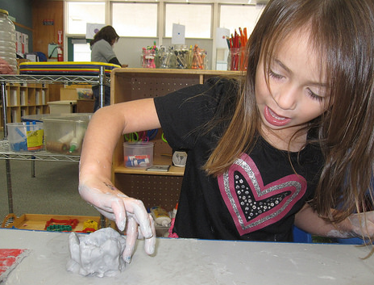
1.0 Notice, Respond, and Engage
©2017 California Department of Education
Notes:
Presenter Remarks:
“This substrand describes children’s interest and enjoyment in the visual arts (for example, in drawing, making sculptures, or painting)” (PCF, Vol. 2, p. 51).
Ask participants to look at the substrand 1.1 Notice, Respond, and Engage on page 5 of PLF.
Do a quick whip around your table group with each person saying one type of visual art that brings them joy.
Think about what your tablemates said and decide which responses are about the process.

Slide 29
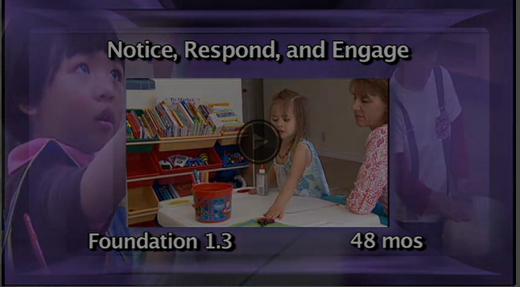
Video
Notes:
Background:
Prior to the training, embed video VisualArtNoticeRespondAndEngage_1.3.mp4
Presenter Remarks:
Let’s watch the video to see the developmental shift between 48 months and 60 months.

Slide 30
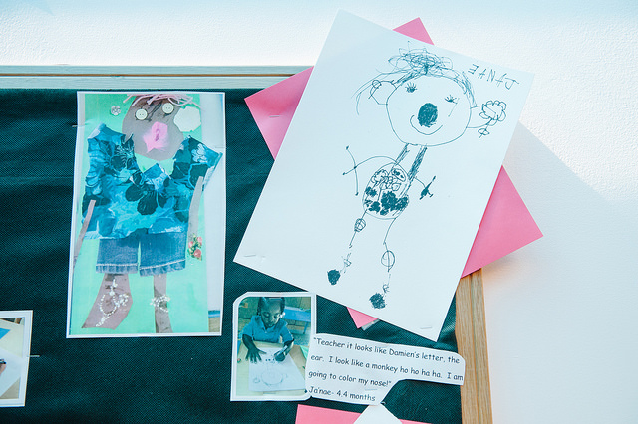
Reflection
What shifts did you see between 48 months and 60 months?
What did the teacher do to scaffold the child’s engagement with the art?
What examples have you seen in your own classroom of children noticing, responding, and engaging with art?
Notes:
Presenter Remarks:
Let’s take a few minutes and discuss these questions with your tablemates.
After the discussion, have a few people share their answers with the group.

Slide 31
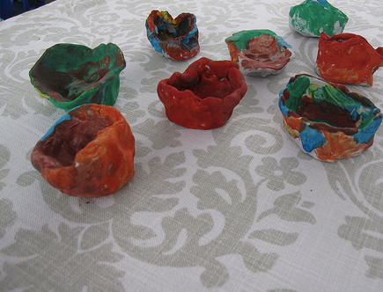
Cultural Traditions
“All children are empowered by sharing each other’s family art traditions” (PCF, Vol. 2, p. 44).
©2017 California Department of Education
Notes:
Presenter Remarks:
“The arts can help children reflect on their own cultures and origins as well as those of others…All children are empowered by sharing each other’s family art traditions” (PCF, Vol. 2, p. 44).
“Inviting families into the environment to share works of art from the home is an opportunity to build a bridge to the home” (PCF, Vol. 2, p. 50).
Reflection: Do you have a family art tradition you share with your children? Think about what makes this joy-filled tradition meaningful. Is it about the process or product?
Trainer note: if you have a family art tradition you may want to share it here.

Slide 32
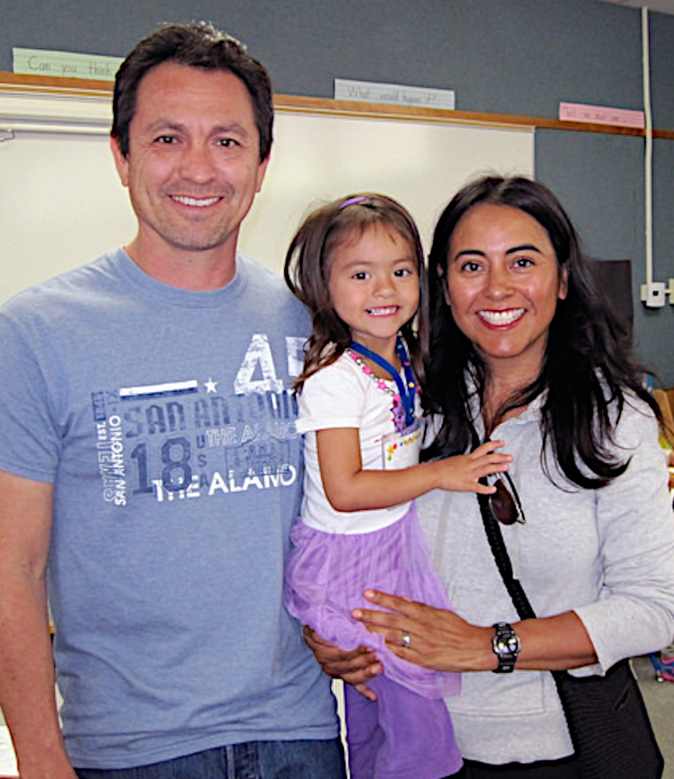
Partner with Families
Engaging Families: Preschool Curriculum Framework
All About Young Children
Best Practices for Planning Curriculum: Family Partnerships and Culture
TK Implementation Guide
Notes:
Presenter Remarks:
In order to effectively build on children's existing strengths, we must understand them. To do this, we need to partner with families to learn about their children’s strengths.
The resources on this slide are specifically beneficial for partnering with families. You may want to take a picture of this slide and refer to it later.
Optional:
Create a gallery table with examples of documents.
Extra Note:
The resources are hyperlinked. If Wi-Fi access is available, display the resources and do a walkthrough.

Slide 33
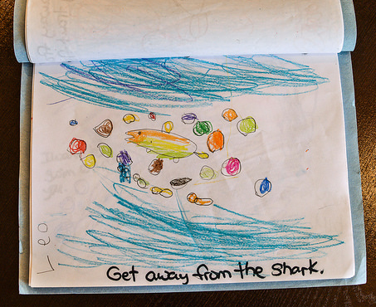
The Arts and Language Development
“Research suggests that learning and development in the arts provides an underpinning for literacy and language development, in part, through cultivating representation skills”
(PLF, Vol. 2, p. 2).
Notes:
Presenter Remarks:
“Research suggests that learning and development in the arts provides an underpinning for literacy and language development, in part, through cultivating representation skills” (PLF, Vol. 2, p. 2).
In this picture, the student used visual art to represent the important take-away from a story that was read.
What representation art skills do you see children engaging in-in the classroom? How do you think those skills provide the groundwork for language and literacy development? Find someone at another table and share your thoughts.

Slide 34
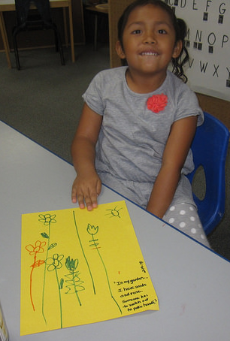
Reflection
“Encourage children to talk in their own language about what they have drawn. In describing or communicating about their work, children develop their vocabulary and perception of art”
(PCF, Vol. 2, p. 53).
©2017 California Department of Education
Notes:
Presenter Remarks:
Visual arts can be beneficial for language and literacy development if students are given the opportunity to discuss their work.
“Encourage children to talk in their own language about what they have drawn. In describing or communicating about their work, children develop their vocabulary and perception of art” (PCF, Vol. 2, p. 53).
This is further supported by current research:
“DLL families can promote their children’s language development through everyday conversations and verbal exchanges with them. Responses to children’s queries and efforts to explain events and elaborate verbally on children’s experiences expand children’s vocabulary and language skills” (Linda Halgunseth, Gisela Jia, and Oscar Barbarin, California’s Best Practices for Young Dual Language Learners Research Overview Papers [CDE], p. 148).

Slide 35
Let’s Face It, “Talk counts!”
Notes:
Activity 3: Let’s Face It, “Talk Counts!”
Presenter Remarks:
Picasso is one of the most famous artists of all time. He was a child prodigy and became famous for an art style called Cubism in which paintings resemble broken glass. Today, we will create Cubist drawings and then practice teacher language interactions with the drawings.
intent:
Experience a new art activity and identify the importance of teacher conversation in enhancing the visual art experience.
OUTCOME:
Participants think intentionally about new art experiences as they are facilitated through teacher language interactions.
Materials Required:
White drawing paper
Crayons, colored pencils, chalk, markers
Scissors
White glue
PowerPoint
Handout 4: Talking to Young Children About Art
Chart paper
Time: 20 minutes
Process:
Introduction:
Front-load participants by sharing the Picasso PowerPoint slide.
Share that Picasso is one of the most famous artists of all time. He was a child prodigy and became famous for an art style called Cubism in which paintings resemble broken glass.
Tell participants that we will create Cubist drawings today. Then we will enhance this experience by practicing teacher language interactions with the drawings.
Part 1:
Invite participants to get into partners and use the art materials at their table (white paper, pencils, crayons, makers, etc.) to draw face portraits of each other. (5-8 minutes)
When participants have finished, have them cut their portraits up into “broken glass” sections.
Mix up the sections and glue them on the second piece of paper, creating a cubist broken glass portrait.
Part 2:
Highlight the Preschool Curriculum Framework interaction and strategy around language.
Invite participants to practice enhancing the art experience through teacher talk.
Ask participants to list all of the natural things they discussed with their partner while creating their portraits.
Have participants use Handout 4: Talking to Young Children About Art and circle three new things they would like to focus on in this activity.
To push their limits, ask them to choose things they may not naturally talk about.
We will now role-play (one person as the student and one as the teacher).
The teacher will use Handout 4: Talking to Young Children About Art and the three items circled to facilitate conversation.
The student will engage with the teacher and expand as they feel necessary. Ready, go! (2-3 minutes)
Now switch roles. Ready, go! (2-3 minutes)
Remind presenters to talk about the substrand 1.1 so that teachers make the connections to notice, respond and engage-- and understand the reason this activity supports using the elements of art in their conversations with children.
Take a moment and quietly think about this experience. What are you going to take away?
Chart responses at front of room.
Participants can chart responses on Handout 3: Painter’s Pallet Action Plan.

Slide 36
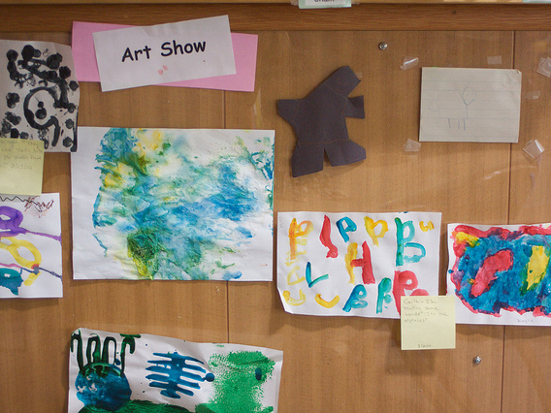
Teacher Scaffolding Tip
“Encourage discussion of particular works by the group”
(PCF, Vol. 2, p. 53).
©2017 California Department of Education
Notes:
Presenter Remarks:
“Encourage discussion of particular works by the group” (PCF, Vol. 2, p. 53).
This provides an opportunity for children to have a discussion about their work which helps with vocabulary development and with social interactions as well.
This slide shows a photo of a school who invites families in once a month for an art show. If you were this teacher how might you facilitate large group discussions about the art displayed? Where and when would you have these conversations? (Welcome meeting? Farewell meeting? A tour around the class with everyone?) Star your thoughts at your table group, then have facilitator solicit one idea form each table.

Slide 37
Reflective Painter’s Pallet Handout
Notes:
Presenter Remarks:
Stop and reflect with Handout 3: Painter’s Pallet Action Plan.
You may also flip the pallet over and jot down new learning, or notice the other domains that may be supported, when you implement your idea.

Slide 38
Research Highlight
“Over the years, the work of Nelson Goodman and Howard Gardner at Harvard University’s Project Zero has helped to demystify children’s art. Those scholars view art through the lens of cognition rather than through a value-driven critique of aesthetics. Art is a cognitive activity, requiring thinking, problem solving, communication, and intent. And learning in art is frequently tied to learning in language as well as culture”
(PCF, Vol. 2, p. 59).
Notes:
Background Information:
This information comes from the Preschool Curriculum Framework, Volume 2, p. 59.
Presenter Remarks:
This quote clearly does not take away from the experience or process, but rather adds to the process by illuminating the contribution art has on cognition.
Extra Notes:
Invite participants to read the full research highlight. This will lay the foundation for the following activity that allows participants practice using an everyday art experience (play dough) to plan for integration of art and a cognitive domain (math, literacy, or science).

Slide 39
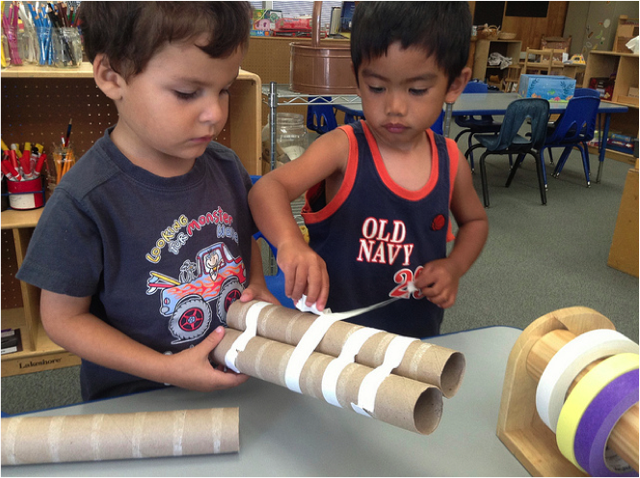
Links to Art
Thinking
Culture
Problem
solving
ART
Language
Communication
Intent
©2017 California Department of Education
Notes:
Presenter Remarks:
“Art is a cognitive activity, requiring thinking, problem solving, communicating, and intent. And learning in art is frequently tied to learning in language as well as culture” (PCF, Vol. 2, p. 59).
“Through the arts, children draw upon their interests, experiences, and personalities as they express themselves, create with others, and participate in their preschool [TK] community” (PLF, Vol. 2, p. 1).
Reflection question for the entire group:
When you look at this map, what other domains do you see visual and performing arts being tied to?
Use the back of Handout 3: Painter’s Pallet Action Plan to help guide your thinking.

Slide 40
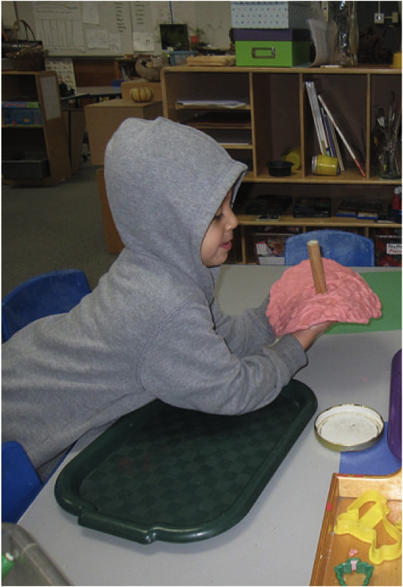
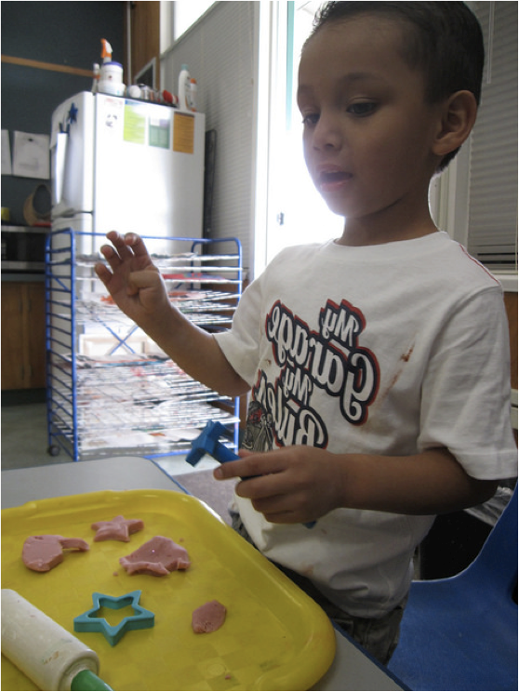
The Art of Double Dipping with Play Dough
©2017 California Department of Education
Notes:
Activity 4: The Art of Double Dipping with Play Dough
Presenter Remarks:
I invite you to choose a partner and find some play dough to play with.
intent:
Take an everyday TK experience (working with play dough) and enhance the intentionality of the activity through opportunities in visual art as well other cognitive domains (language, literacy, math, science, etc.).
OUTCOME:
Engage in play and use a curriculum web with two intentional goals (visual art and language, literacy, math, or science).
Materials Required:
Play dough and materials (sticks, molds, rollers, cutting utensils, etc.)
Markers
Chart paper
PowerPoint
Preschool Learning Foundations (PLF), Volume 2
Preschool Curriculum Framework (PCF), Volume 2
Time: 15 minutes
Process:
Invite participants to choose partners, find play dough, and begin “playing.”
While they are playing, ask participants to observe what strands the play dough enables them to experience (notice, respond, and engage, develop skills, etc.).
Roll the domain dice.
As a group, participants choose a substrand of the visual art domain, combining it with the domain their dice landed on to plan an intentional learning opportunity for children.
The learning opportunity should enhance both the visual art substrand they chose and the domain they rolled.
Once participants have designed an art activity, have them review all the teacher strategies used and add one strategy to specifically support a child in their classroom who:
Has sensory integration needs
Has language development needs
Is developing English as a second language (Specify for which stage of language development this might be most beneficial.)
Participants chart the learning opportunity on their chart paper. (Be ready to share-out with the group.)
Share-out options:
Invite each table to share-out their learning opportunity.
Ask table groups to hang up charts around the room and invite participants to do a gallery walk.
Roll a domain dice and then invite one group per domain to share out their learning opportunity.

Slide 41
Teacher Tips: Stages of Second Language Acquisition
41
Home Language Use Teaching Tips:
Activities should focus on listening comprehension.
Activities should build receptive vocabulary.
Observational and Listening Period Teaching Tips:
Activities should expand receptive vocabulary.
Activities should be designed to motivate children.
Telegraphic and Formulaic Speech Teaching Tips:
Activities should expand receptive vocabulary.
Activities are designed to develop higher levels of language use.
Fluid Language Use Teaching Tips:
Activities should expand receptive vocabulary.
Activities are designed to develop higher levels of language use in content areas.
Notes:
Background Information:
These teacher tips are from chapter 5 of the PEL Resource Guide, pp. 45-52.
Presenter Remarks:
There are four stages of second-language acquisition. Children do not necessarily follow these stages in a linear fashion; they often move in and out of these stages depending on the types of supports available to them in any particular interaction or setting.
Home language use teaching tips:
Activities should focus on listening comprehension
Activities should build receptive vocabulary
Observational and listening period teaching tips:
Activities should expand receptive vocabulary
Activities should be designed to motivate children to produce vocabulary which they already understand
Telegraphic and formulaic speech teaching tips:
Activities should expand receptive vocabulary
Activities are designed to develop higher levels of language use
Introduce language experience activities
Fluid language use teaching tips:
Activities should expand receptive vocabulary
Activities are designed to develop higher levels of language use in content areas
Using Handout 4B: Let’s Face It, “Talk counts!”, reflect on the following questions:
Take a moment to consider the play dough learning opportunities. How might you implement one of these teacher tips into your activity?
At which stage are the majority of your English learners in your program?
Now specifically think about those teaching tips. With your elbow partner, think of two ways to enhance your play dough activity utilizing the teaching tips.

Slide 42
Reflective Painter’s Pallet Handout
Notes:
Presenter Remarks:
Take a moment now to add ideas to the Painter’s Pallet.
You may also flip the pallet over and jot down new learning, or notice the other domains that may be supported when implementing ideas.

Slide 43
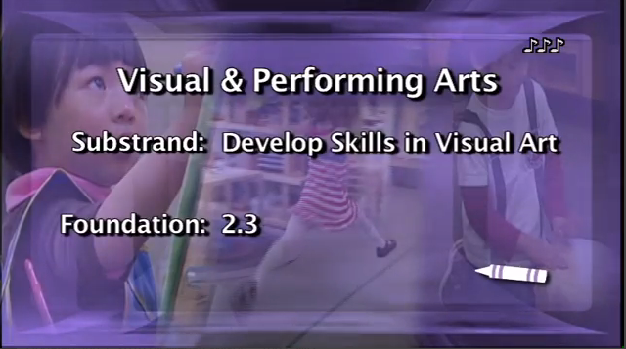
Video
Notes:
Background:
Prior to the training, embed video DevelopSkillsInVisualArt_2.3.mp4
Presenter Remarks:
Let’s watch the video to see the developmental shift between 48 months and 60 months.

Slide 44
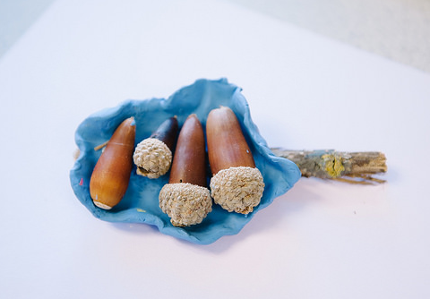
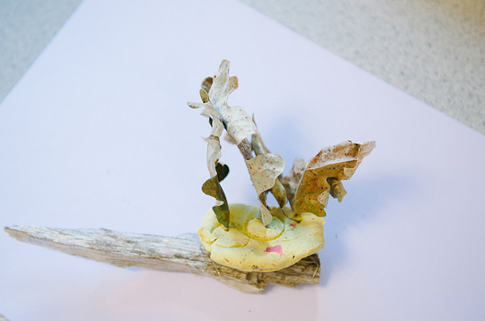
Reflection
What shifts did you see between 48 months and 60 months?
What was the teacher’s role in scaffolding the children’s skills?
What do you do in your classroom to help children in this area?
Notes:
Presenter Remarks:
Let’s take a few minutes and discuss these questions with your tablemates.
After the discussion, have a few people share their answers with the group.

Slide 45
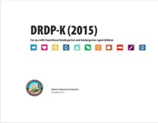
Key Features of the DRDP-K
An observation-based assessment tool,
not a test
Individual child assessment
Completed by each child’s teacher
Based on developmental research and theory
Includes developmental sequences of behaviors along a continuum
Spans the developmental continuum of children in a two-year kindergarten program (TK)
Notes:
Presenter Remarks:
The Desired Results Developmental Profile-Kindergarten (2015)© informs teachers understanding of the developmental continuum. It can be used with the Alignment document we looked at to expand upon the developmental continuum.
One key feature of the DRDP-K to consider is that it is an observation-based assessment and not a test. It is used to support children’s learning. Observing and documenting children's progress provides teachers the information needed to differentiate instruction and experiences. It also provides information to individualize.
Observational tools are preferred over criterion-referenced tools because the information gathered by observation more accurately reflects what children are able to do.
Documentation provides concrete evidence of what children are able to do. With this documentation, we are then able to better plan activities that will meet and appropriately challenge children's developmental needs.
Other features of the DRDP-K include:
It is an individual child assessment that can be shared with families.
It is aligned with the Preschool Learning Foundations.
It opens up the opportunity for articulation between preschool and TK teachers.
Sharing information as to where children are on the developmental continuum can better prepare the TK teacher to work with students.
A teacher can include a request form for previous records as part of the TK registration to help support the relationship between preschool, family, and TK.
The DRDP-K has been developed with world renowned experts. It is based on research and knowledge of what is most important for predicting school success.

Slide 46
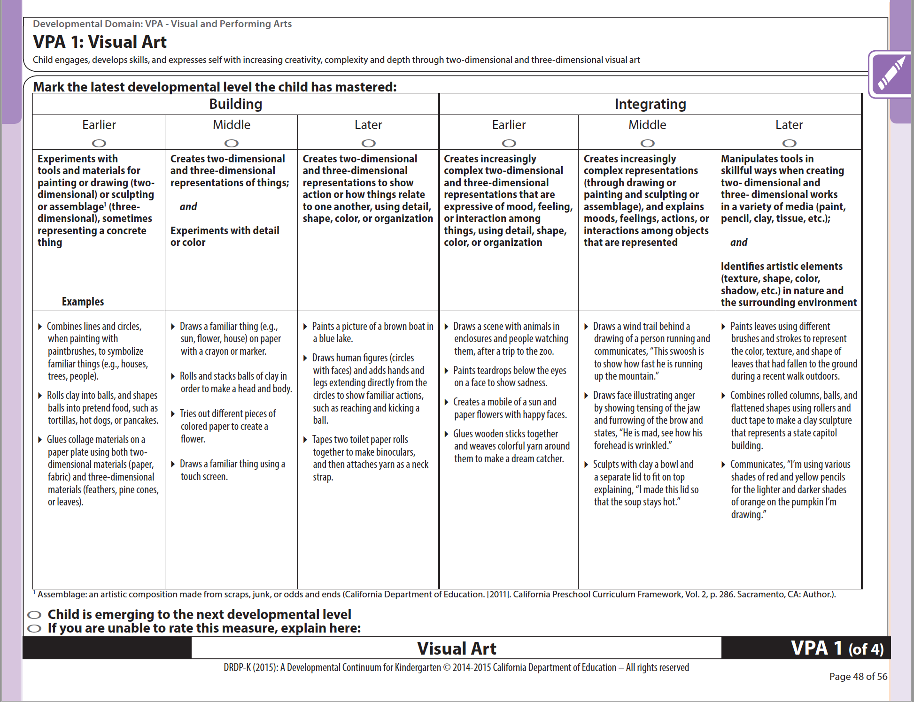
DRDP-K (2015)
Notes:
Presenter Remarks:
The DRDP-K gives TK teachers a lens to measure TK children’s developing capacity to understand details and ideas from age-appropriate text presented by adults.
The measurements show the, ‟…series of stages that ultimately lead to [TK children] making sense of stories and the world around them” (PLF, Vol. 1, p. 53).
Take out Handout 5: DRDP-K Measure VPA 1: Visual Art. This handout is a copy of the DRDP-K measure that most closely relates to the foundations for Visual Art.
Look closely at this DRDP-K measure. Take a few minutes to read each stage along with a few of the examples. Underline examples that you have seen in your classroom.

Slide 47
2.0 Develop Skills
©2017 California Department of Education
Notes:
Presenter Remarks:
“This substrand refers to the basic skills needed to invent and create through visual art. Examples of skills include the ability to draw a line or circle, to use a paintbrush, to chose and mix colors, and to combine materials together to create an assemblage” (PCF, Vol. 2, p. 54).
Teachers need to be specific in creating environments and scaffolding opportunities to support the development of skills.
Part of creating environments and scaffolding opportunities for children is to provide adaptions for those with disabilities.
Look at Handout 6: Adaptations for Children with Disabilities. Take a moment to read over it.
Discuss with your table group: What are some things that you all ready do? What did you see that was new? What might you try in your classroom?

Slide 48
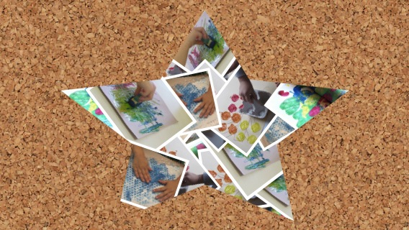
Helping Children Acquire Painting Skills
“Help children acquire painting skills through:
  Demonstration
  Encouragement to mix colors
  Time to explore”
  (PCF, Vol. 2, p. 55).
©2017 California Department of Education
Notes:
Presenter Remarks:
“Help children acquire painting skills through practice with the tools. In the beginning, simply show children how to make a mark with paint and a brush without dripping paint in unwanted places” (PCF, Vol. 2, p. 55).
“Stimulate children’s interest in color and application of paint through other forms of painting. Teach children about colors and paint by spraying color onto a mural wall or providing paint stamping activities. Encourage children to try mixing colors. Isolate the skill of using a brush to make marks by giving the children time to paint with only water” (PCF, Vol. 2, p. 55).
Take a moment to look at your domain chart. If you were to use one of these interactions and strategies, what other domains might potentially be supported?
The Physical Development domain can be easily integrated with the Visual Art strand. It is important to note that the developmental sequence of cutting is addressed in the Fundamental Movement strand of the Physical Development domain in the Preschool Learning Foundations and Curriculum Framework.

Slide 49
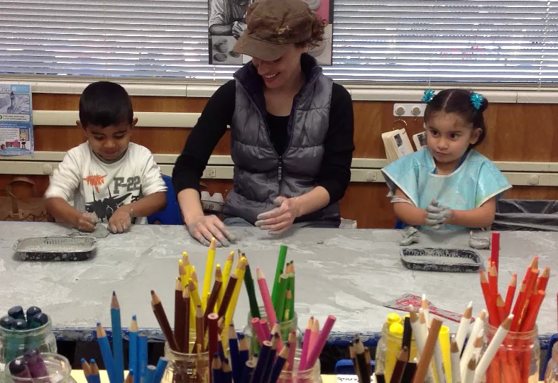
Interactions and Strategies
©2017 California Department of Education
Notes:
Background:
Prior to the training, embed video IMG0668edited.mp4 in Video Files All Final Clips, TK Modules, TK VPA Module.
Presenter Remarks:
“Create opportunities for children to work with dough, clay, or wet sand. Creating sculptures begins as a tactile, sensory experience” (PCF, Vol. 2, p. 55).
”Provide only malleable material, without tools, during children’s initial explorations of sculpting so that children have a chance to explore through touch” (PCF, Vol. 2, p. 55).
This video is an example of this strategy. Watch the video and observe how the teacher facilitates this opportunity for children to work with clay and how she supports their development of sculpting and exploration of visual art.

Slide 50
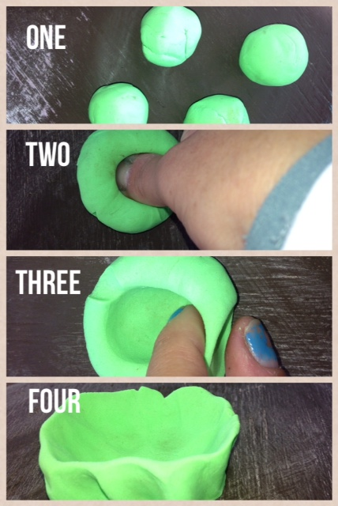
Sculpting the Push-Pot
Prepare ping-pong-sized balls of clay.
Push the center down with one finger.
Pinch the sides to open the pot.
Set the pot down until the bottom is flattened.
(PCF, Vol. 2, p. 55)
Notes:
Presenter Remarks:
In the video you observed, the teacher provided a safe space for exploration and skill development with clay.
Sculpting skills can be supported in multiple ways.
“A good example of a tactile clay activity is a push-pot. Prepare several ping-pong-sized balls of clay for each child. Then, demonstrate how to push the center down with a finger and pinch the sides to open the “pot.” Set the pot down on the table until the bottom is flattened and the pot stands” (PCF, Vol. 2, p. 55).
This is a great example of a skill building activity that a visual step schedule would benefit. You can see an example here in the gallery. Take a moment to think about what other skill building visual art activities you do that may benefit from a visual schedule. Can you think specifically about a child in your program that this strategy might work well for?
Extra Note:
Many times children receiving special education services may have a service provider that utilizes visual schedules. However, it is often even more beneficial for the general education teacher to create mini schedules for individual activities such as this push-pot activity that may benefit the entire class.

Slide 51
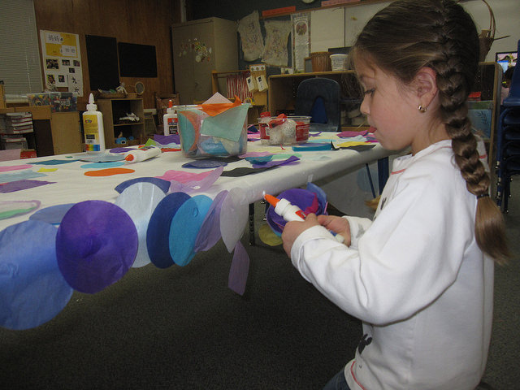
Environment and Materials
“The environment and materials should support the choices children typically make to pursue visual art…and also need to support what teachers wish to bring to artistic activities in the classrooms” ( PCF, Vol. 2, p. 41).
©2017 California Department of Education
Notes:
Presenter Remarks:
“The environment and materials should support the choices children typically make to pursue visual art…and also need to support what teachers wish to bring to artistic activities in the classrooms” (PCF, Vol. 2, p. 41).
“Provide [both] indoor and outdoor environments for creating art. Children will find inspiration from variety…Choices of materials and settings will allow children an array of opportunities to [create] in varying light” (PCF, Vol. 2, p. 47).
“Children need flat places to draw and paint—tabletops, the floor, or outdoor surfaces, such as fences” (PCF, Vol. 2 p. 46).

Slide 52
What do I have? What do I need?
52
Please take out your Suggested Art Materials checklist.
Put a checkmark next to those things you have that are always, or often available, for children to use.
Circle the materials you want to add to the art center.
Notes:
Presenter Remarks:
Take a few minutes to do the Suggested Art Materials checklist (handout 7) activity. If desired and if time permits, ask for volunteers to share what they will add to their art areas.
Extra Notes:
Provide movement by inviting participants to stand up in response to the following questions:
Stand up if you added assemblage supplies.
Stand up if you added painting supplies.
Stand up if you added modeling supplies.
Stand up if you added drawing supplies.

Slide 53
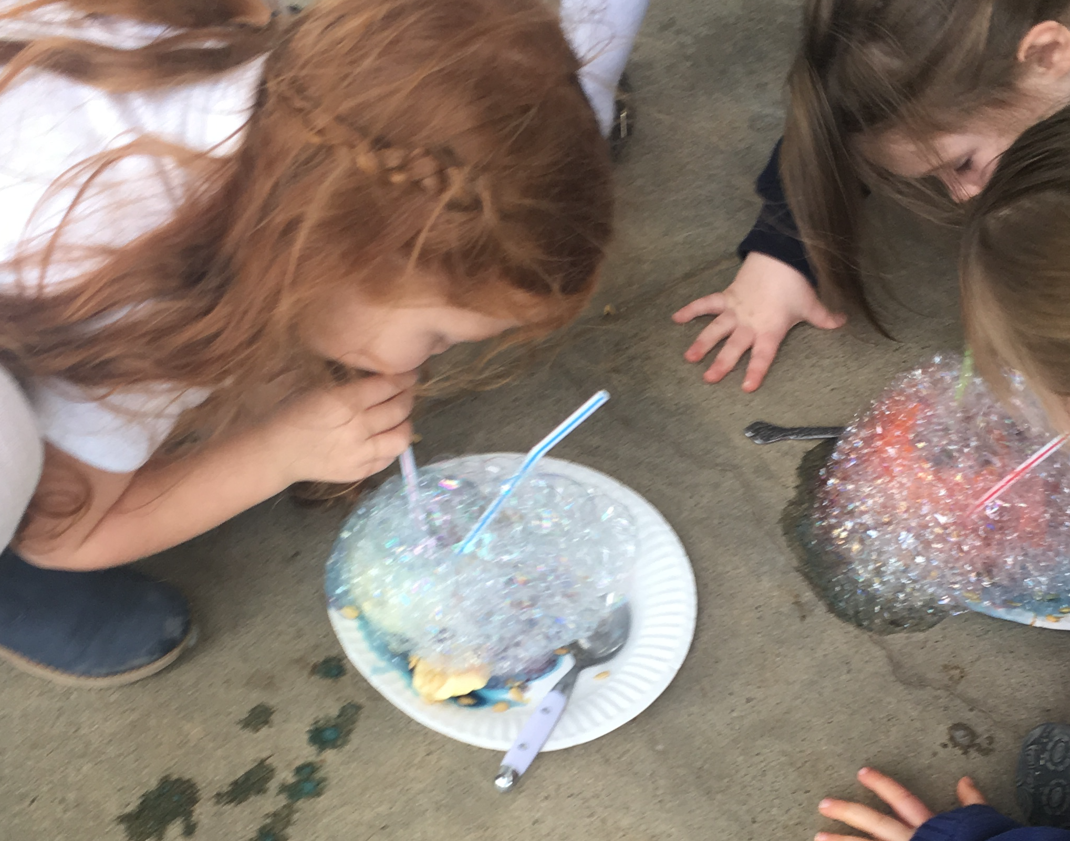
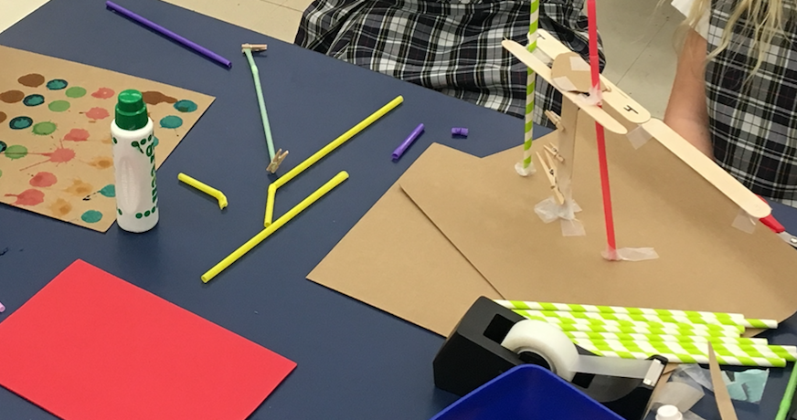
3.0 Create, Invent, and Express
Notes:
Presenter Remarks:
“This substrand describes how children use their skills to participate, express, invent, and create through the arts” (PCF, Vol. 2, p. 58).
The pictures show that this creation does not have to result in a product such as the bubbles, but it may result in a product like the popsicles stick straw building. Furthermore, these photographs show the integration of visual art and the sciences.

Slide 54

Creating with
Intention
Plans and creates a figure or object
©2017 California Department of Education
Notes:
Background Information:
Information is from the Preschool Curriculum Framework, Volume 2, pp. 58-60.
Presenter Remarks:
In this substrand, children have moved beyond simply experimenting with art materials to planning and intentionally creating works of art to represent things or feelings.
The work may be as simple as painting the sky by using a marker to make a blue line at the top of the paper or as complex as building a house out of boxes, tape, and paint.
Not all art projects are representations of “things.” A child may decide to represent the “feeling” of a thunderstorm by making dark scribbles on their paper.

Slide 55

Developing Skills with the Masters of Art
Determine which master group you are in.
Complete the activity.
Discuss the activity with the group.
Notes:
Activity 5: Using the Masters to Enhance the Joy of Art (Part 1)
Presenter Remarks:
In this activity, we will use influences from the masters of art to support the development of visual art foundations.
intent:
Use influences from the masters of art to support the development of visual art foundations in an activity.
OUTCOME:
Experience three different forms of visual art and apply practice toward the facilitation of the visual art foundation.
Materials Required:
Handout 8: Masters of Art
Preschool Learning Foundations (PLF), Volume 2
Preschool Curriculum Framework (PCF), Volume 2
Time: 15 minutes
Process (Part 1):
Participants:
Determine which master group you are in.
Follow instructions to experience a new art activity inspired by your art master.
Discuss and answer the reflection questions on the chart paper.

Slide 56
Masters of Art Reflection
JOY:
What did you enjoy?
Why was it joyful?
How might you recreate the same joy for children?
SCAFFOLDING:
How might you scaffold this activity for children?
What specifically might be adapted for a child with a special need?
MATERIALS:
What materials do you already have for this activity?
What materials do you need?
How will you obtain these materials?
Notes:
Using the Masters to Enhance the Joy of Art (Part 2)
Presenter Remarks:
Please return to your seats and share your experience with your tablemates.
PROCESS (Part 2):
Participants return to seats and share experiences with tablemates using the following questions:
What was joyful about this experience to you? Why was it joyful? How might you recreate this joy for children?
How you might change the experience to be more developmentally appropriate?
Why might this experience specifically benefit a child with a disability in your program?
Which substrand of the visual art foundation does this experience specifically enhance?
What materials would you need on hand to make this opportunity available to children?
Remember to jot down ideas on the Painter’s Pallet.

Slide 57

Thank You for Coming!
“It took me four years to paint like Raphael, but a lifetime to paint like a child.”
- Pablo Picasso
©2017 California Department of Education
Notes:
Presenter Remarks:
Please take a moment now to reflect on the JOY of today. As you look at the Painter’s Pallet one last time, please think about what made today joyful.
Consider all the ideas we discussed for increasing the joy of visual art, as well as increasing the teacher scaffolding of visual art. We discussed many specific techniques to support teachers, enhance the experience of English learners, and provide a more accessible environment for children with special needs.
Turn to your elbow partner and share the most meaningful addition to your painter’s pallet from the day.
Thank you for coming! We hope your pallet of ideas and knowledge has expanded!

Slide 58
Reference Guide for PowerPoint Citations
California Department of Education. 2013. California’s Best Practices for Young Dual Language Learners: Research Overview Papers. http://www.cde.ca.gov/sp/cd/ce/documents/dllresearchpapers.pdf (accessed March 8, 2017).
California Department of Education. 2010. California Preschool Curriculum Framework, Volume 1. http://www.cde.ca.gov/sp/cd/re/documents/psframeworkkvol1.pdf (accessed January 7, 2016).
California Department of Education. 2011. California Preschool Curriculum Framework, Volume 2. http://www.cde.ca.gov/sp/cd/re/documents/psframeworkvol2.pdf (accessed January 6, 2017).
California Department of Education. 2008. California Preschool Learning Foundations, Volume 2. http://www.cde.ca.gov/sp/cd/re/documents/psfoundationsvol2.pdf (accessed January 6, 2017).
California Department of Education. 2009. Preschool English Learners: Principles and Practices to Promote Language, Literacy, and Learning—A Resource Guide (Second Edition). http://www.cde.ca.gov/sp/cd/re/documents/psenglearnersed2.pdf (accessed January 6, 2017).

