Slide 1
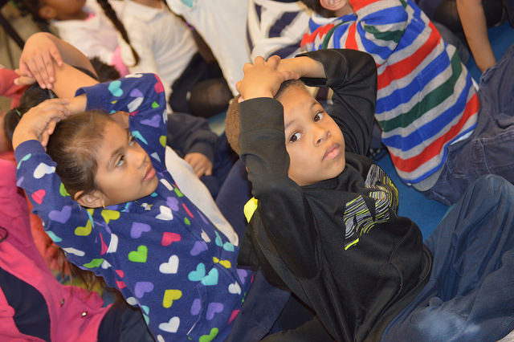
Visual and Performing Arts in Transitional Kindergarten
An Overview
Notes:
Presenter Remarks:
Welcome to Visual and Performing Arts in Transitional Kindergarten: An Overview—a presentation focusing on the California Preschool Learning Foundations (Preschool Learning Foundations or PLF), the California Preschool Curriculum Framework (Preschool Curriculum Framework or PCF), and other California Department of Education (CDE) resources in support of the Visual and Performing Arts domain.
This professional learning session is specifically designed to provide TK teachers exposure to California Department of Education resources that support transitional kindergarten curriculum planning, developmentally appropriate strategies, and classroom environment design recommendations that support the visual and performing arts.

Slide 2
Objectives
Gain understanding of key concepts from the California Preschool Learning Foundations, Volume 2 and the California Preschool Curriculum Framework, Volume 2—Visual and Performing Arts domain.
Observe, read, and discuss the developmental continuum that will guide instruction and learning of the visual arts in Transitional Kindergarten (TK).
Practice using the Preschool Learning Foundations and Preschool Curriculum Framework to intentionally plan developmentally appropriate, cultural, and inclusive strategies that promote the development of skills, knowledge, and behaviors in the arts.
Notes:
2
Presenter Remarks:
This slide shows what we will cover in today’s training.
Objectives:
Gain understanding of key concepts from the California Preschool Learning Foundations, Volume 2 and the California Preschool Curriculum Framework, Volume 2—Visual and Performing Arts domain.
Observe, read, and discuss the developmental continuum that will guide instruction and learning of the visual arts in the Transitional Kindergarten (TK).
Practice using the Preschool Learning Foundations and Preschool Curriculum Framework to intentionally plan developmentally appropriate, cultural, and inclusive strategies that promote the development of skills, knowledge, and behaviors in the arts.

Slide 3


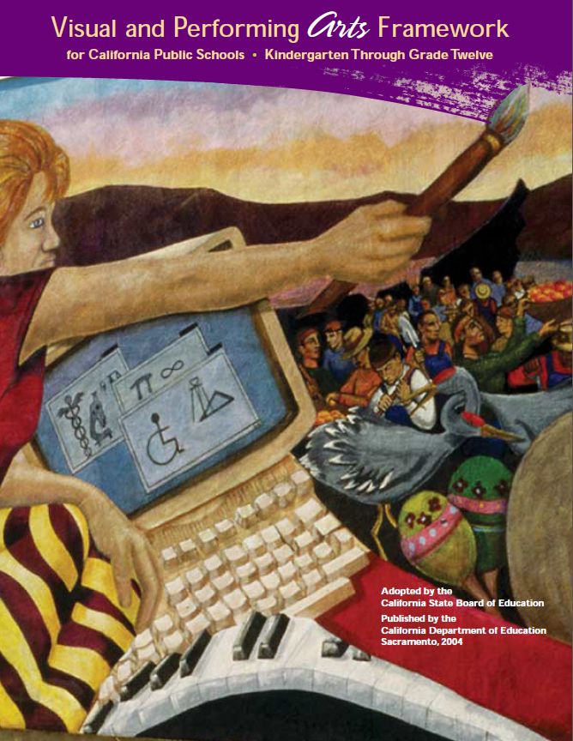






CDE Publications and Resources that Support TK Implementation
Preschool Learning Foundations
California Common Core State Standards
Visual and Performing Arts Framework for California Public Schools
Preschool Curriculum Framework
Visual and Performing Arts Content Standards
DRDP Specific to TK and K
Preschool Alignment Document
Preschool English Learners Guide
Transitional Kindergarten Implementation Guide
Preschool Learning Foundations
California Common Core State Standards
Visual and Performing Arts Framework for California Public Schools
Preschool Curriculum Frameworks
English Language Arts/English Language Development Framework
DRDP Specific to TK and K
Preschool Alignment Document
Preschool English Learners Guide
Transitional Kindergarten Implementation Guide
Notes:
Presenter Remarks:
The California Department of Education has developed many publications, resources, and supports that enable teachers to facilitate the most positive outcomes for students.
Today our main focus will be on the Preschool Learning Foundations and the Preschool Curriculum Framework, Volume 2—Visual and Performing Arts domain.
There are additional key resources that support visual arts development in young children. We will also discuss alignment with CA standards and make connections to additional resources pictured in the graphic (name and hold up each resource):
The Alignment of the California Preschool Learning Foundations with Key Early Education Resources (Alignment Document)
California Common Core State Standards (CA CCSS)
Visual and Performing Arts Content Standards for California Public Schools, Kindergarten Through Grade Twelve (CA VPA Standards)
Preschool English Learners: Principles and Practices to Promote Language, Literacy, and Learning—A Resource Guide (Second Edition) (PEL Resource Guide)
Visual and Performing Arts Framework for California Public Schools, Kindergarten Through Grade Twelve (VPA Framework)
Desired Results Developmental Profile—Kindergarten (2015): A Developmental Continuum for Kindergarten (DRDP-K [2015])
Transitional Kindergarten Implementation Guide – A Resource for Public School District Administrators and Teachers (TK Implementation Guide)

Slide 4
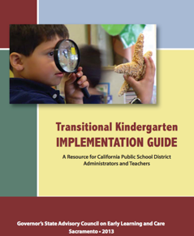
Transitional Kindergarten Implementation Guide
The TK Implementation Guide is a resource for California public school district administrators and teachers to support implementation of comprehensive TK programs.
Notes:
Presenter Remarks:
The TK Implementation Guide is a resource that focuses on the essential components for school district administrators and teachers to consider for TK programs. The TK Implementation Guide, published by the California Department of Education, is a resource to support implementation of comprehensive TK programs.
This publication provides resources and guidance in the areas of program design, curriculum, instruction, assessment, and family/community partnerships.

Slide 5
Overview of the Transitional Kindergarten Implementation Guide
  Section One
  Program Structure and Design
  Section Two
  The TK Student
  Curriculum in a TK Program
  Effective Instruction in a TK Program
  The TK Learning Environment
  Assessment and Differentiated Instruction
  Involving Families and Community Partners
  Supporting TK Implementation
Notes:
Presenter Remarks:
The TK Implementation Guide is organized into the following two sections:
Section 1 is covered in chapter 1. The information in this section was developed with the administrator in mind and focuses on the program structure and design.
Section 2 is covered in chapters 2-8. This section is a resource for both teachers and administrators and focuses on building a comprehensive TK programs by addressing curriculum, instruction, environment, assessment and partnership with families and community.
Within each of these chapters, vignettes, highlighted boxes, and resource boxes are included to illustrate examples of the information covered in each of the chapters.
A PDF copy of the document can be accessed at the California Department of Education Web page (www.cde.ca.gov/ci/gs/em/documents/tkguide.pdf).
Video footage for each chapter can be accessed at the California Department of Education. The video clips include footage of TK classrooms and interviews with teachers, administrators, and parents. https://www.youtube.com/user/caeducation
https://www.youtube.com/results?search_query=tk+implmentation+guide

Slide 6
Why Use the Preschool Learning Foundations for TK?
CA Law (EC 48000):
Transitional kindergarten is the first year of a two-year kindergarten program that uses a modified kindergarten curriculum that is age and developmentally appropriate.
Transitional kindergarten programs are intended, by legislative action, to be aligned to the California Preschool Learning Foundations developed by the California Department of Education.
Notes:
Background Information:
http://cde.ca.gov/ci/gs/em/kinderfaq.asp#program
Presenter Remarks:
The state of California provides guidance on utilizing the Preschool Learning Foundations and the Preschool Curriculum Framework as planning and curriculum resources in the TK classroom.
In addition, the following publications and resources are available to support age and developmentally appropriate TK curriculum:
Alignment Document
TK Implementation Guide
DRDP-K (2015)
VPA Framework
CA VPA Standards
CA CCSS

Slide 7
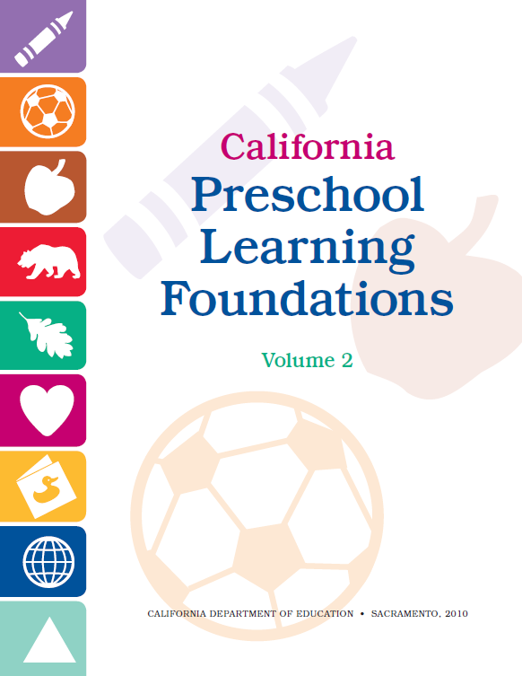
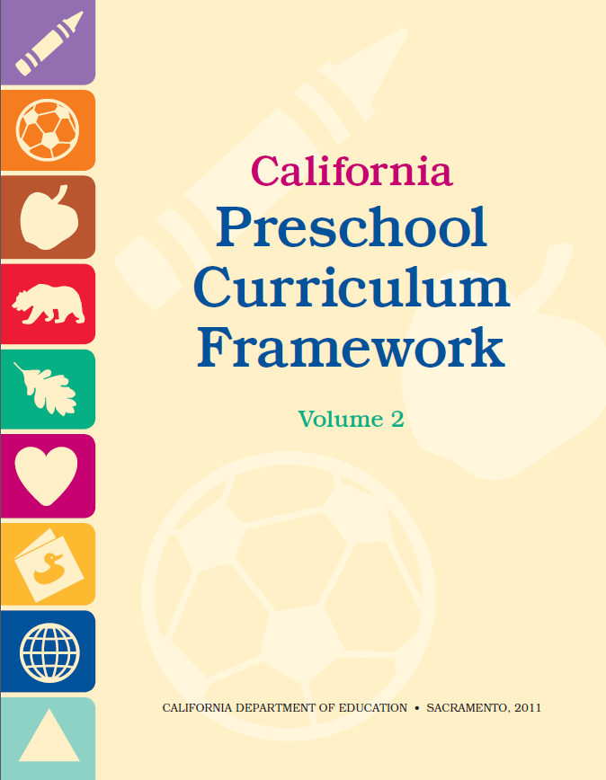
Foundations and Framework, Volume 2
Notes:
Presenter Remarks:
The purposes of the Preschool Learning Foundations are to promote a common understanding of TK children's learning and to guide instructional practice. They describe the knowledge and skills that young children typically develop when provided with developmentally, culturally, and linguistically appropriate learning experiences.
The Preschool Curriculum Framework was created as a companion to the Preschool Learning Foundations. The framework ". . . presents strategies and information to enrich learning and development opportunities for all children" (PCF, Vol. 2, p. v).
The Preschool Learning Foundations and the Preschool Curriculum Framework are designed to work together. While the foundations provide the background information to understand children's developing knowledge and skills (the "what"), the framework offers guidance on how teachers and programs can support the learning and development that are described in the foundations (the "how").
Extra Notes:
The Preschool Learning Foundations were developed with research-based evidence and are enhanced with expert practitioners' suggestions and examples. All foundations were written by a team of researchers with expertise in the given domain. A complete reference list of the source materials, along with detailed bibliographic notes for each of the developmental domains, can be found in the Preschool Learning Foundations. Sources used in the development of the foundations include:
Documents from the California Department of Education, such as the English-Language Arts Content Standards for California Public Schools, Kindergarten Through Grade Twelve (Language and Literacy, Introduction, p. 48, left column).
Well-validated assessment tools such as the Ages & Stages Questionnaires (ASQ): A Parent-Completed, Child-Monitoring System (Social-Emotional, References and Source Materials, p. 36).
General sources such as the Report of the National Reading Panel 2000 (Language and Literacy, Introduction, p. 73, left column).
Early childhood education standards from other states such as Hawaii and Texas (Social-Emotional, Introduction, p. 5, footnote).

Slide 8
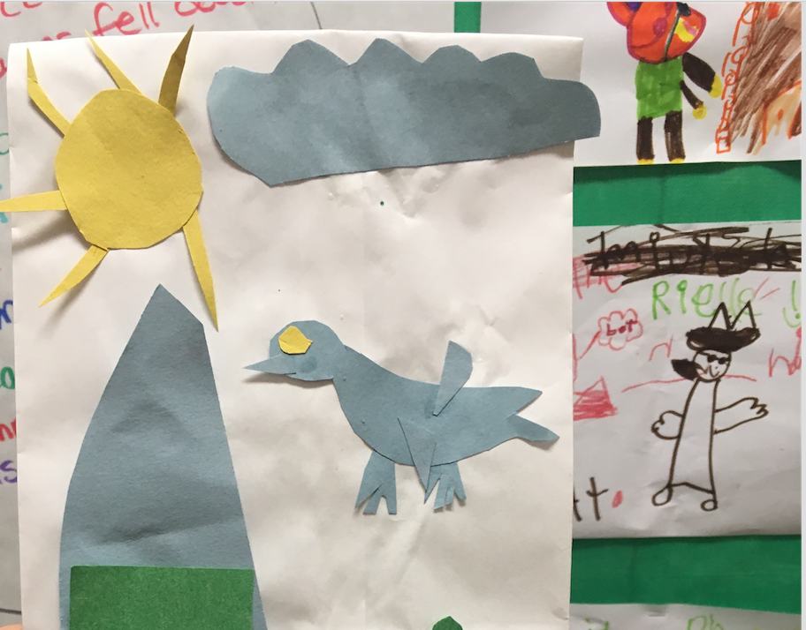
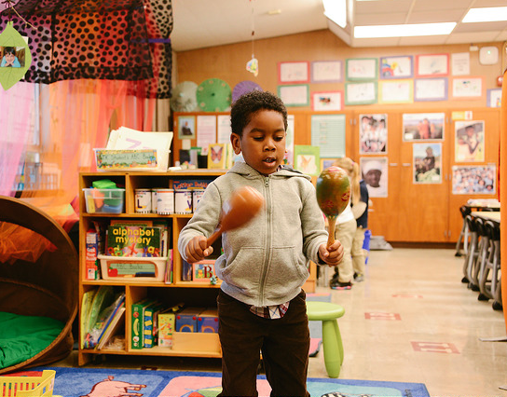
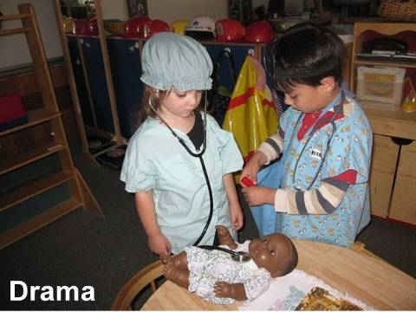
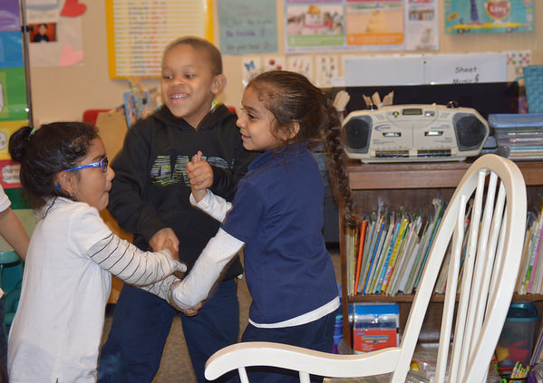
What Are the Visual and Performing Arts?
Visual Arts
Music
Drama
Dance
© 2017 California Department of Education
Notes:
Presenter Remarks:
Find Handout 1: Strands and Substrands and follow along.
(Click to reveal Visual Art.) The foundations for visual arts include observing and commenting on art, developing art skills, and creating art (e.g., painting, drawing, sculpting, and collages).
(Click to reveal Music.) The foundations for music include responding to and recognizing sounds and music, learning music skills, and creating music by keeping a beat with one’s body, by singing, and by using musical instruments.
(Click to reveal Drama.) The foundations for drama include pretend play and reenacting stories as well as using props, costumes, and roles in play.
(Click to reveal Dance.) The foundations for dance include engaging in dance movements, being aware of body space, and expressing oneself through dance.

Slide 9

Find Your Inner Artist
© 2017 California Department of Education
Notes:
Activity 1: Where Do You Stand?
Presenter Remarks:
For the first round of this activity, please go and stand by the strand you enjoy the most. Think of yourself both as an audience member and as an art creator.
intent: Reflect on personal attitudes towards visual and performing arts and connect with other participants.
OUTCOME: Participants reflect on their personal comfort with the four strands of visual and performing arts: visual arts, music, drama, and dance. This activity will help launch module content.
Materials Required:
Four signs - one each for visual arts, music, drama, and dance
Paint brushes
Markers
Time: 20 minutes
Process: Place the signs high on wall around the room with as much space as possible in between signs so participants can have focused conversations and not be distracted by other groups. For the first round, participants stand by the strand they enjoy the most. Emphasize that they should think of themselves both as audience members and as art creators. Once in groups, participants discuss:
“What artistic experiences do you remember as a child?”
“Did you have a teacher who influenced this enjoyment?”
“What do you do now that makes you enjoy this type of art?”
“What do you do in your classroom that is influenced by this enjoyment?”
For the second round, participants stand by the strand they enjoy the least. Once in groups, have participants discuss:
“What artistic experiences do you remember as a child?”
“How do you feel now when you are asked to participate in this experience?”
“What do you do, or not do, in your classroom that is influenced by your feelings?”
Participants return to their tables.
OPTIONS:
Ask participants to engage in this activity again at the end of the session to see if their feelings have changed towards the visual and performing arts.

Slide 10
What Do You Think?
“Every child is an artist. The problem is how to remain an artist once we grow up.”
~Pablo Picasso
“When my daughter was about seven years old, she asked me one day what I did at work. I told her I worked at the college - that my job was to teach people how to draw. She stared at me, incredulous, and said, ‘You mean they forget?’”
~Howard Ikemoto
Notes:
Presenter Remarks:
Click to reveal each quotation.
You will have seven minutes to discuss these two quotes at your table. We will then have a few tables share their thoughts.
Option:
Have participants discuss one quote, debrief, and then reveal and discuss the second quote.

Slide 11
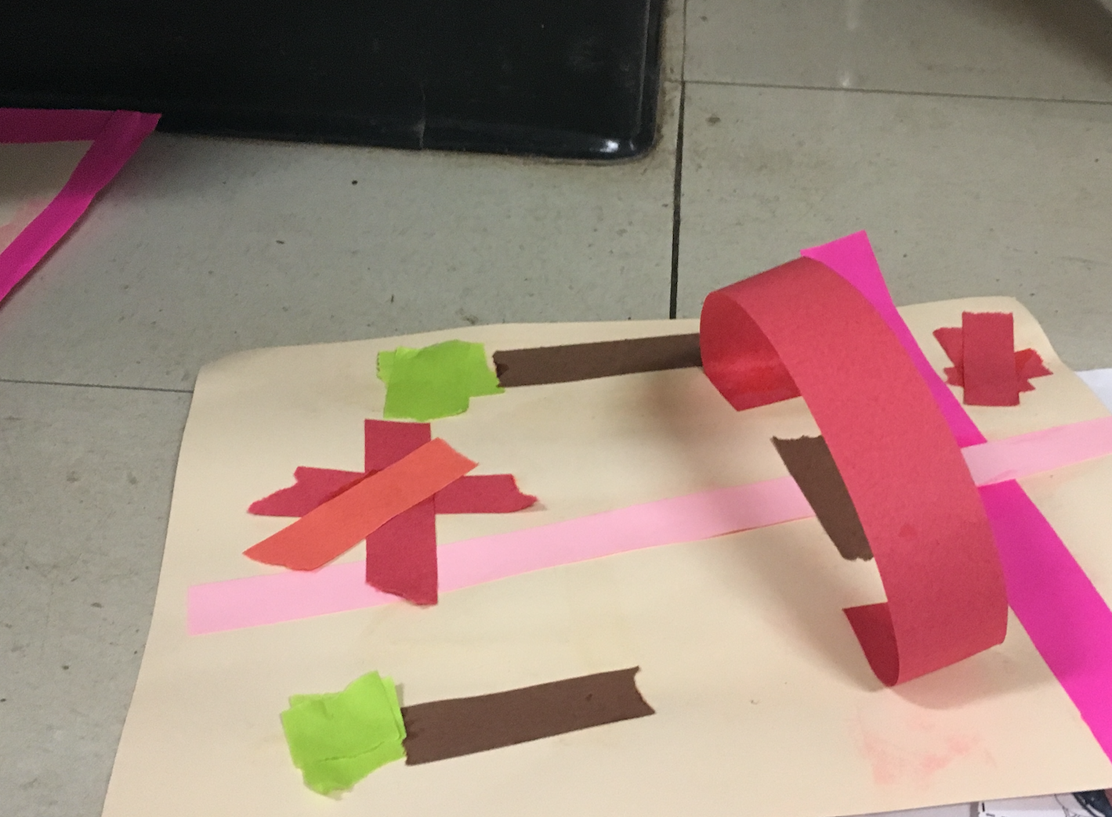
“Arts reinforce the integrated nature of learning”
(PCF, Vol. 2, p. 44).
© 2017 California Department of Education
Notes:
Presenter Remarks:
“Arts reinforce the integrated nature of learning” (PCF, Vol. 2, p. 44).
This photograph is an example of visual art. What other domains of learning may have been experienced in the process of creating this art??
This guiding principle is an introduction to the following five slides.
“The arts are a unique way of knowing, but they also support learning across the curriculum.
Engagement in the arts can be an effective means through which important early childhood skills and dispositions are developed—such as empathy and cooperation, curiosity in and knowledge about linguistic and cultural differences, ease with differences among people, vocabulary, symbolic understanding, and math-related concepts such as number, size and shape.
Because children learn holistically, the arts should be presented in a way that is integrated with other domains of learning.
Artistic expression and products connect to other domains in the preschool curriculum, and these connections can be emphasized at strategic times during arts activities” (PCF, Vol. 2, p. 44).
Let’s look at specific ways that the arts connect to other areas in preschool. The next four slides provide information on these areas.

Slide 12
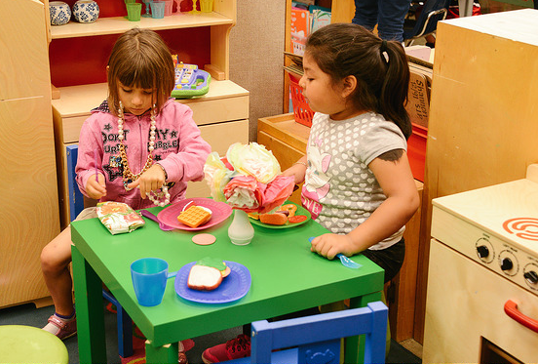
Problem Solving
© 2017 California Department of Education
Notes:
Presenter Remarks:
The arts help children build problem solving and critical thinking skills. In the dramatic play center, children must be able to think through the play, decide on parts, and resolve problems.
One example: “Many teachable moments in story dramatizations occur when a story is half-told, such as when the teacher uses a book or story as a starting point—but not a blueprint—for an episode. This provides enriching opportunity for creativity and problem solving. Children must think of ways the story can continue and eventually end as they act out the story” (PCF, Vol. 2, p. 96).

Slide 13
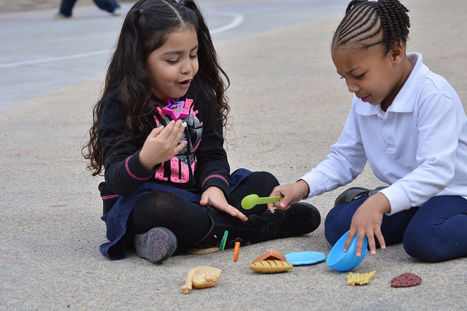
Language and Communication
© 2017 California Department of Education
Notes:
Presenter Remarks:
Participation in the arts helps in the development of language and communication. When children work together in the arts they have to communicate. This participation provides an opportunity for children to learn how to speak with others, communicate their thoughts, and listen to others. It also provides an opportunity for children learning the English language to hear English and practice speaking English. Such peer interactions are incredibly important for language acquisition.

Slide 14
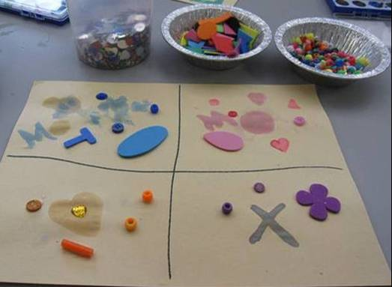
Mathematical Concepts
© 2017 California Department of Education
Notes:
Presenter Remarks:
The arts help children develop mathematical concepts. This photograph demonstrates the integrated nature of math and visual art. This may be a student directed visual art activity in which the child choose to categorize and use math concepts, or it may have been a teacher directed math activity in which the student had the opportunity to categorize and explore visual art materials.
Here are some examples:
“By asking children what shapes they see in the flowers, the teacher encourages children to observe and describe the flower (before painting it) and to recognize the shapes of leaves, petals, and stems. Opportunities to talk about shapes of objects and describe their attributes develop children’s ability to identify and know the names for different shapes and to use shapes in creating their own drawings” (PCF, Vol. 2, p. 61).
“…through singing and expressing music with different instruments, children may learn about mathematical concepts related to numbers and patterns. Repetiton of phrases in music signals patterns in the music; children’s songs frequently involve counting” (PCF, Vol. 2, p. 84).

Slide 15
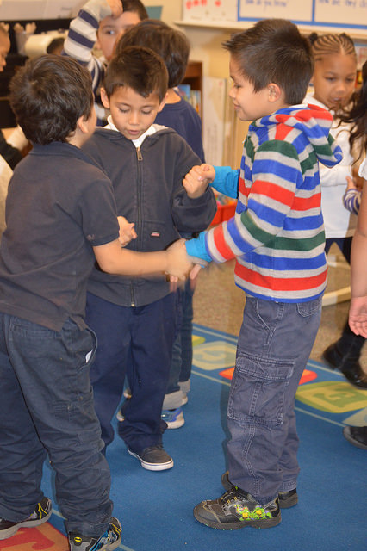
Social Skills
© 2017 California Department of Education
Notes:
Presenter Remarks:
The arts promote the development of social and emotional skills.
The “social–emotional substrands of cooperation and self-regulation grow as children negotiate with peers about their roles in making art and in artistic play and as children reflect on their preschool experiences more generally” (PCF, Vol. 2, p. 117).

Slide 16
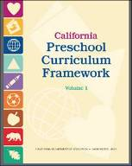
What’s a Teacher to Do?
Guiding Principles
Environment
and Materials
Build on Children’s Play
Plan Learning Opportunities
Notes:
Presenter Remarks:
What do we do now that we understand the importance of including the arts in an early childhood program?
Click to reveal each of the following in turn, explaining each as you reveal.
First we need to figure out the Guiding Principles for how to integrate the arts into the curriculum.
Then we need to take a look at the classroom to make sure we have set up the environment and have the materials children need to develop skills and knowledge in visual and performing arts.
Third, we need to become aware of how to build on children’s spontaneous play to support development of the arts.
Finally, we need to think about planning learning opportunities to support children’s development of knowledge and skills in the visual and performing arts.
This information is in the Preschool Curriculum Framework, Volume 2.

Slide 17
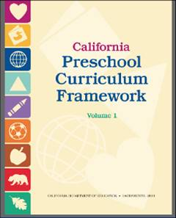
What’s a Teacher to Do?
Guiding Principles
Environment and Materials
Build on Children’s Play
Plan Learning Opportunities
Notes:
Presenter Remarks:
Let’s look first at the Guiding Principles to Support Learning in the Visual and Performing Arts domain. This section begins on page 42 in the Preschool Curriculum Framework, Volume 2. Please find that section now.

Slide 18


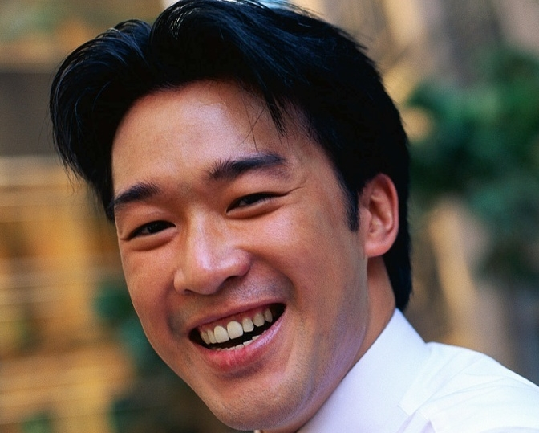
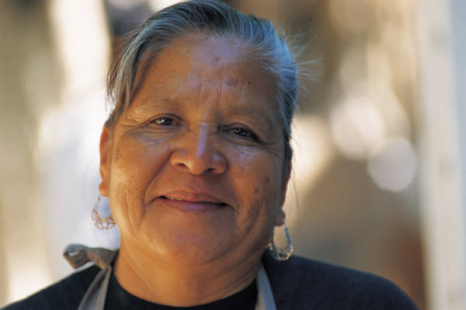
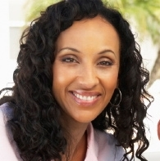

Guiding Principles
Each One Teach One
Notes:
Activity 2: Guiding Principles—Each One Teach One
Presenter Remarks:
Find a paintbrush with one principle taped to it. Read that guiding principle paragraph and then go find someone with a different principle and share with each other. Once finished, switch brushes and find a new person with whom to share.
intent:
The intent of this activity is to have participants become familiar with the Guiding Principles.
OUTCOME:
Participants will interact with each other to analyze the Guiding Principles.
Materials Required:
Paintbrushes with one Guiding Principle taped on each (one for each participant)
(Alternative) Visual and Performing Arts Guiding Principles section of Preschool Curriculum Framework, Volume 2
Time:
20 minutes
Process:
Ask participants to take the following steps:
Find a paintbrush with one principle taped to it.
Read that guiding principle paragraph and then go find someone with a different principle and share with each other.
Switch brushes and find a new person with whom to share.
Repeat the process 3-5 times.
Have participants return to their tables.
OPTIONS:
Each table group chooses one preferred guiding principle.
Participants read the paragraph in the framework and discuss daily experiences that they have related to that guiding principle.
Next, each table group has 8-10 minutes to develop a representation of their guiding principle using dance, music, art or drama.
Each group has up to 60 seconds to present their creation to the full group.

Slide 19
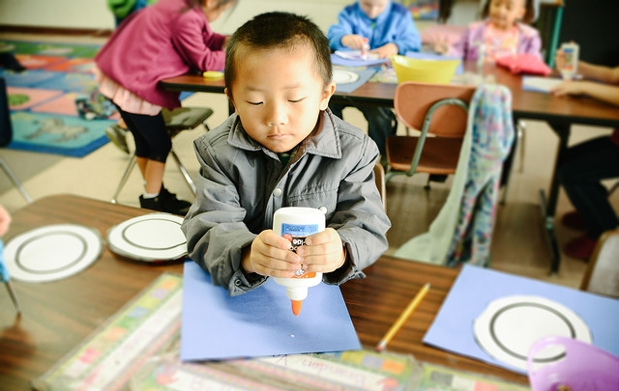
Take Away Messages
Notes:
Presenter Remarks:
What are the important points to take away from Activity 1: Guiding Principles—Each One Teach One?
Chart the responses. Prompt/Add the following points if they have been missed:
The Guiding Principles are based on contemporary theories of learning and child development.
The principles emphasize the importance of knowing each child.
The arts are inclusive of all children.
They remind us of children’s innate enthusiasm for the arts.
They emphasize the value of the creative process over the end product.

Slide 20
What’s a Teacher to Do?
Guiding Principles
Environment and Materials
Build on Children’s Play
Plan Learning Opportunities
Notes:
Presenter Remarks:
Let’s look now at Environments and Materials to Support Creative Learning and Learning Through Creative Experiences.
This section begins on page 45 in the Preschool Curriculum Framework, Volume 2. Please find that section now.

Slide 21
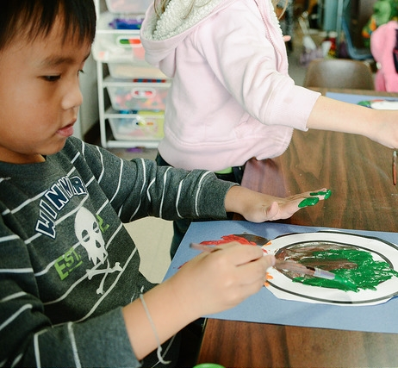
Environment and Materials
Support child choice
Support teacher planned opportunities
Notes:
Presenter Remarks:
Both environments and materials will serve to support the choices children typically make to pursue visual art, music, drama, and dance.
“Environmental conditions and material provisions also need to support what teachers wish to bring to artistic activities in their classrooms” (PLF, Volume 2, p. 41).
Think about your classroom. How does the environment support child choice? Do materials in the classroom support and encourage artistic activities during free choice?

Slide 22
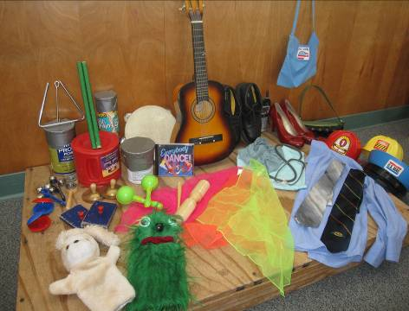
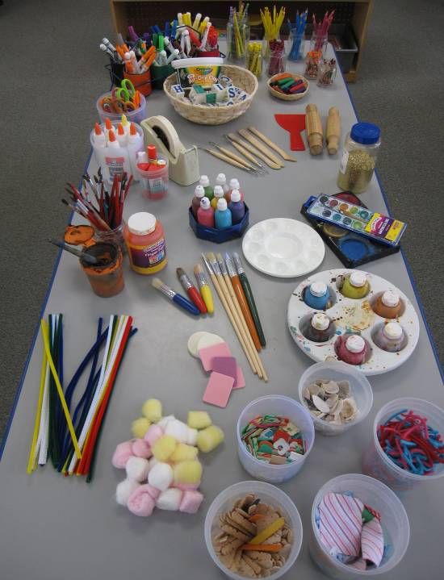
Materials and Props
Inexpensive
Homemade
Varying cultures
Varying abilities
Shared across visual arts, music, dance, and drama
© 2017 California Department of Education
Notes:
Presenter Remarks:
Materials and props may include these features:
Are often inexpensive and homemade
Can be inclusive of varying cultures
Can be used or adapted for children with varying abilities
Can often be shared across visual arts, music, dance, and drama
(PCF, Vol. 2, pp. 45-48)

Slide 23
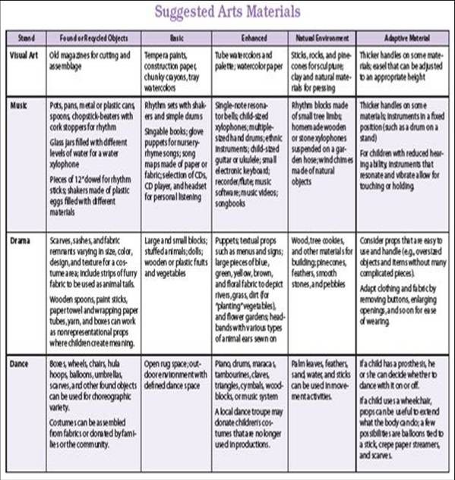
Environment and Materials
(Option A)
Notes:
Activity 3A: Environment and Materials (Option A)
Presenter Remarks:
We will begin this activity by reading the section of appendix A that corresponds to the strand on your table tent.
intent:
Explore the environments and materials that support creative learning and learning through creative experiences.
OUTCOMES:
Participants interact as they review lists of materials that can be used to support creative learning and learning through creative experiences. They also create a “to-do list” of materials to add to their classroom environment.
Materials Required:
Table tent cards with one strand name on each card
Handout 1: Visual and Performing Arts Materials Action Plan
Appendix A of the Visual and Performing Arts chapter
Time: 20 minutes
Process:
Participants read the section of appendix A that corresponds to the strand on their table tent.
Together, they highlight all of the materials that anyone at the table is currently or has used in the classroom.
Each individual should note on Handout 1: Visual and Performing Arts Action Materials Plan one or more new items to add to the classroom in the following week.
OPTION:
See option two on Activity 3B: Environment and Materials.
23

Slide 24
Environment and Materials
(Option B)
What was your art experience?
What was exciting or surprising about your experience?
How did the materials effect your experience?
How might you recreate these feelings and experiences in your work?
Notes:
Activity 3B: Environment and Materials (Option B)
Presenter Remarks:
Each table group is going to send one member to get the box of materials that matches the strand on their table tent. We’ll spend 10 minutes using and experiencing the materials individually and with others at the table.
intent:
Explore the environments and materials that support creative learning and learning through creative experiences.
OUTCOMES:
Participants interact with materials that can be used to support creative learning and learning through creative experiences. They also create a “to-do list” of materials to add to their classroom environment.
Materials Required:
Table tent cards with one strand name
Boxes of materials for each strand (Make enough boxes so that each table can work with one box. For ideas on materials, see appendix A.)
Handout 1: Visual and Performing Arts Materials Action Plan
Time:
20 minutes
Process:
Each table group sends one member to get the box of materials that matches the strand on their table tent.
Participants spend 10 minutes using and experiencing the materials individually and with others at the table.
As they work, participants discuss the “processing questions” on the slide.
Each individual should note on Handout 1: Visual and Performing Arts Materials Action Plan one or more new items to add to the classroom in the following week.
OPTIONS:
Ask each table group to discuss these questions.
Ask each question verbally and have the table discuss each question verbally as a table group one question at a time.
Ask each question verbally and have a few people share out on their experience.
Ask participants to silently process each question for 30 seconds. Presenter reads the question, says, “Thinking time for 30 seconds,” and then provides 30 seconds to share thoughts with a neighbor.

Slide 25
What’s a Teacher to Do?
Guiding Principles
Environment and Materials
Build on children’s play
Plan Learning Opportunities
Notes:
Presenter Remarks:
Let’s turn now to thinking about how to build on children’s play and plan learning opportunities to help children develop the skills and knowledge they need in the visual and performing arts.

Slide 26
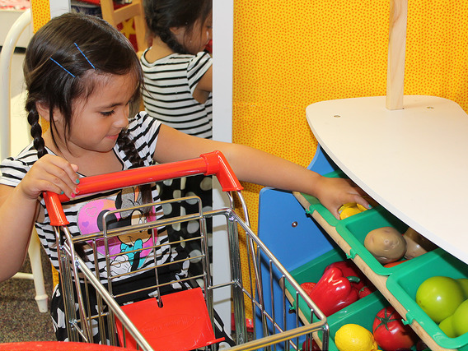
Foundations
High-quality program
With appropriate support
©2017 California Department of Education
Notes:
Presenter Remarks:
The Preschool Learning Foundations describe what children should know and be able to do at around 48 (4 years old) and 60 months (5 years old).
The foundations also assume that children have access to appropriate support in high quality programs, including:
Environments and experiences that encourage active, playful exploration and experimentation
Clearly defined learning centers where materials are rotated
Purposeful teaching to help children gain knowledge and skills
Predictable schedules and routines with large blocks of time for play and skillful integration of curriculum with an intentional focus on content
Specific support for English learners with staff that have knowledge of the stages of English-language acquisition
Accommodations and adaptations for children with disabilities and additional support when needed
Let’s take a closer look at one of the foundations for an example. Open the Preschool Learning Foundations, Volume 2 and find a page in the purple section where the age levels appear. This is an example of a foundation page.
Look across the page at the developmental progression at around 48 months. Notice the changes at 60 months of age. Solicit a few participants to read what they see.
Summarize the exploration with the following key note:
Because children develop at different rates, the foundations were designed to support the belief that at certain stages development will occur at different times for all students. You will notice “at or around” in the description. It is important to remember this variability occurs.

Slide 27

Step One
What should children know and be able to do?
Turn to page 5 in the Preschool Learning Foundations, Volume 2.
Notes:
Presenter Remarks:
In the visual and performing arts chapter of the Preschool Learning Foundations, Volume 2 we find out what children should know and be able to do in each of the four strands (Visual Art, Music, Drama, and Dance) at around 48 months old and at around 60 months old.
These foundations are found on pages 5-21.
Take about 5 minutes to look over the foundations now with an elbow partner.

Slide 28
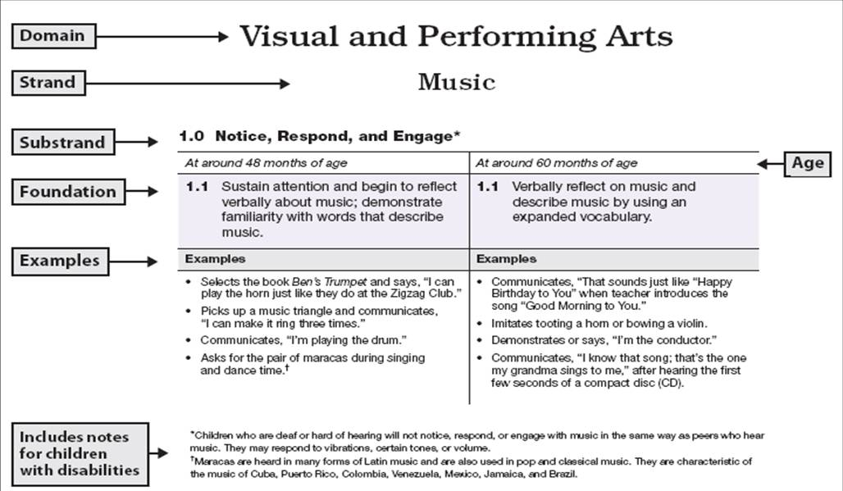
Visual and Performing Arts Foundations Map
Notes:
Presenter Remarks:
Please take out Handout 2: VPA Foundations Map Music and follow along as I explain the features.
Option: Use the fill-in-the-blanks version of the foundations map handout and have participants fill in the blanks as you go over the map.
Click to reveal domain name, strand name, and the substrand name. Substrands always end in a zero (1.0, 2.0, 3.0, etc.)
The footnote area also includes notes to explain unfamiliar terms and cultural traditions. The examples under each column separate the foundation into discrete skills. It is important to remember that the examples provide only a few ways that children may demonstrate the foundation. Since skills, knowledge, and behaviors in the language and literacy foundations may be demonstrated in the home language, a variety of home languages are used in the examples.
Look at foundations and examples after we go deeper into strands and substrands.
Go to next slide.

Slide 29
Visual and Performing Arts
Strands and Substrands
Visual Art | Music | Drama | Dance
Notice, Respond, and Engage | Notice, Respond, and Engage | Notice, Respond, and Engage | Notice, Respond, and Engage
Develop Skills in Visual Art | Develop Skills in Music | Develop Skills to Create, Invent, and Express Through Drama | Develop Skills in Dance
Create, Invent, and Express Through Visual Art | Create, Invent, and Express Through Music |  | Create, Invent, and Express Through Dance
Substrand
Strand
Notes:
Presenter Remarks:
On the screen are the strands and substrands for Visual and Performing Arts domain. These strands and substrands are the same for both the foundations and the framework.
Please take out Handout 3: Strand and Substrand to follow along. Along the top of the table are the four strands: Visual Art, Music, Drama, and Dance. These are the same strands used in Activity 1: Find Your Inner Artist. These strands are the four topics covered in the Visual and Performing Arts domain of both the foundations and framework.
Under each strand are two or three substrands. In this domain, the substrands are very similar to each other. Discuss briefly with a table partner about how the substrands in drama are different from the substrands in visual art, music, and dance.
Extra Notes:
Give participants a few minutes to chat. Solicit feedback from participants. Clarify if needed on the unique structure of the drama substrands. (It combines the second and third substrands of the other strands into one substrand.).

Slide 30
Substrands
Notice, Respond, and Engage | Notice, interact, and be interested in
Develop Skills | Learn the basic skills of performing, inventing, and creating, such as using a paintbrush
Create, Invent, and Express | Use skills to participate, express, invent, and create
Develop Skills to Create, Invent, and Express through Drama | Combination of developing and using skills
Notes:
Presenter Remarks:
What do each of the substrands mean?
Notice, respond, and engage describes children’s interest and enjoyment in the arts. For example, a child might notice a drawing of a horse in a book and say, “This looks like Nana’s horse. Nana lets me ride it.”
Develop skills considers all the basic skills preschool children need to develop in order to create their own art. Examples are learning how to draw a circle, singing along at group time, and moving in time to the music.
Create, invent, and express means using the skills children have developed to do things like creating a pizza out of play dough, using the table as a drum, and inventing a dance about a thunderstorm.
In the Drama strand, developing skills is combined with using skills to create, invent, and express. For example, a child might build a boat out of blocks, and sit inside it pretending to go fishing in the lake.

Slide 31
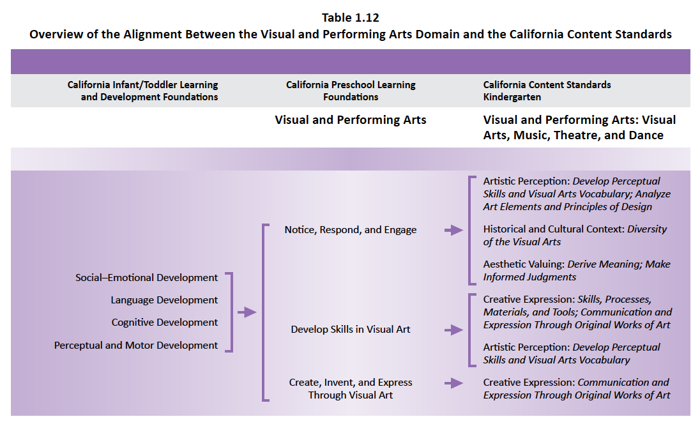
Alignment Document: Table 1.12
Notes:
Presenter Remarks:
Now let’s look at how the Preschool Learning Foundations are aligned with the state standards.
Please refer to Handout 4: Alignment Document Tables 1.12 and 1.13. This is the Visual Art strand.
Table 1.12 shows the alignment between strands and substrands in the Preschool Learning Foundations and the content categories in the California Common Core State Standards (CA CCSS) for Visual and Performing Arts: Visual Arts, Music, Theatre and Dance.
Table 1.13 details alignment between specific preschool foundations and specific kindergarten standards in the CA CCSS for Visual and Performing Arts.
For every substrand of the Preschool Learning Foundations, there is a category in the CA CCSS with corresponding content.
Find one or two people in your group and talk about what you find interesting in Handout 4: Alignment Document Tables 1.12 and 1.13.

Slide 32
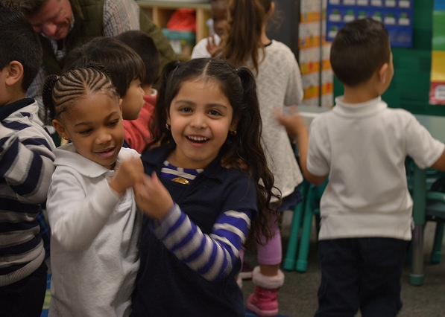
Dance
©2017 California Department of Education
Notes:
Presenter Remarks:
The first strand we will look at is Dance.
“The Dance domain for preschool [TK] is interested in the creative and often expressive use of movement. Movement is explored in all its range (e.g., small and large, fast or slow, hopping or marching) and for various purposes, such as learning math or language skills, or for the joy of moving. Dance can be a nonverbal tool for expressing ideas, telling stories, or communicating emotions. It is often rhythmic and accompanied by music” (PCF, Vol. 2, p. 49).

Slide 33
Dance
“Movement, a natural process of life, is now understood to be essential to learning, creative thought, and high level formal reasoning. It is time to consciously bring integrative movement back into every aspect of our lives and realize, as I have, that something this simple and natural can be the source of miracles.”
Carla Hannaford, Smart Moves: Why Learning Is Not All in Your Head, p.236
Notes:
Presenter Remarks:
Take a minute to read the quote and then discuss it at your table for three minutes.
Briefly solicit comments.

Slide 34
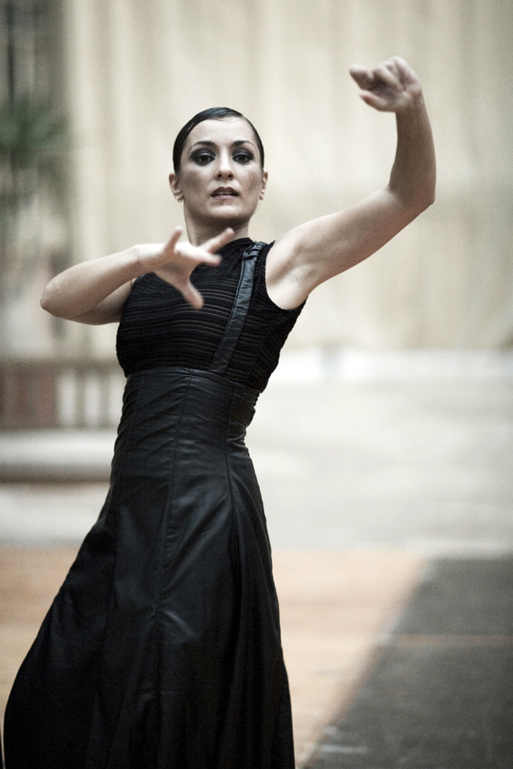

Marker Dance
We're fools whether we dance or not, so we might as well dance.
~Japanese Proverb
© 2017 California Department of Education
Notes:
Background Information:
This is an optional Brain Break activity.
Prepare tables in the front or back of the room. Place butcher paper on each table like a table cloth. Choose any music that will inspire your group.
Presenter Remarks:
Take a marker from your table and go stand by one of the four tables with butcher paper in the back. When the music starts, walk around the table and dance with your marker.
Options:
Put your folder and books on your chair and push your chair about two feet away form the table. Take a marker from the box in the middle of the table. When the music starts, walk around the table and dance with your marker.
Take a marker from your table and stand by one of the strips of butcher paper hanging on the walls. When the music starts, walk around the table and dance with your marker.

Slide 35
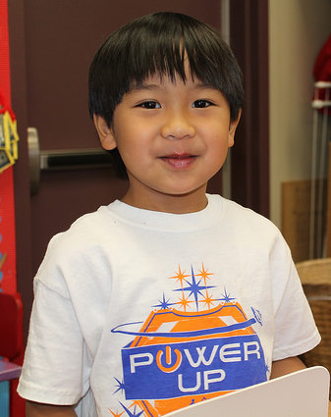
Dance
“Dance is a
natural vehicle
for expression of emotions and moods”
(PCF, Vol. 2, p. 102).
Notes:
Presenter Remarks:
Research highlights are scattered throughout the Preschool Curriculum Framework, Volume 2. Turn to page 102 to look at one of these highlights. The quote on this slide comes from the research highlight found on page 102.
“Research supports the inclusion of dance in a preschool curriculum for a number of reasons, not the least of these being the social-emotional benefits gained from dancing at an early age.
In The Feeling of What Happens, neuroscientist Antonio Damasio describes the body as the theater for emotions and considers emotional responses to be responsible for profound changes in the body’s (and the brain’s) landscape.
Damasio creates three distinct classifications for emotions based on the source of the emotion and the physical response to the emotion: primary, secondary, and background emotions.
The primary emotions are the familiar emotions recognizable in preschoolers and adults alike: happiness, sadness, fear, anger, and surprise.
Damasio describes secondary emotions as social emotions, such as jealousy or envy when a child is eyeing a friend’s toy or feelings of pride when accomplishing a difficult task.
And of particular interest in a discussion of dance are the background emotions-much like moods. These refer to indications that a person feels down, tense, cheerful, discouraged, or calm, and others.
Background emotions do not use the differentiated repertoire of explicit facial expressions that easily define primary and social emotions; they are also richly expressed in musculoskeletal changes, for instance, in subtle body posture and overall shaping of body movement. Movement and dance are natural vehicles for expression of these emotions” (PCF, Vol. 2, p. 102).

Slide 36
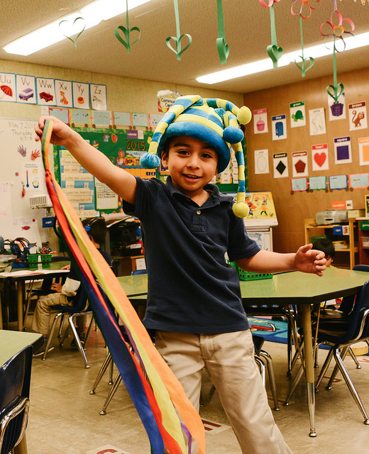
Dance Promotes
Physical development
Language acquisition
Joy of movement
© 2017 California Department of Education
Notes:
Presenter Remarks:
Dance is important for development in other domains. Let’s look at three areas: physical development, language acquisition, and the joy of movement.
“Requiring thinking, social interaction, and physical exercise, dance is a motivating way for preschoolers to engage in learning” (PCF, Vol. 2, p. 49).
“Dance can serve a variety of learning purposes, such as physical development and language acquisition. As part of this learning, children gain increased confidence with movement and language and benefit emotionally as they better understand their body and use newfound skills to communicate with others…Teachers and families will likely observe these developments, along with others, as dance enhances children’s learning. However, although these positive outcomes are important, the children’s immediate experience will highlight the primary reason to learn dance: for the joy of movement and appreciation of an art form” (PCF, Vol. 2, p. 101).

Slide 37
Dance Foundations
Notice, Respond, and Engage | 4 foundations
Develop Skill in Dance | 3 foundations
Create, Invent, and Express Through Dance | 4 foundations
Notes:
Activity 4: Dance Foundations Practice
Presenter Remarks:
Next we will view a video clip of a teacher leading children in a dance activity.
intent:
Learn how to identify the foundations supported by an activity.
OUTCOME:
Participants become familiar with the dance foundations and are able to identify foundations supported by a given activity.
Materials Required:
Table Materials Dance Foundation Observation worksheets for strands 1.0, 2.0, and 3.0
Time:
20 minutes
Process:
Prior to the training give each table one of the versions of the Dance Observation worksheet, one for each table member.
Inform group that they will view a video clip of a teacher leading children in a dance activity during which they need to take notes of what they see and hear.
Give participants three minutes to read over the foundations on their worksheet before showing the video.
After showing the video, give participants seven minutes to discuss observations at their table and decide which foundations from the worksheet were addressed.
At the end of the work time, ask for feedback from the group, beginning with the first strand and moving on to the second and third strands. As each group identifies a foundation, follow up by asking for evidence they saw or heard.
OPTIONS:
Give each table copies of all three substrands to distribute among the table members.

Slide 38

Scarf Dancing
Notes:
Presenter Remarks:
We are going to watch this video twice. The first time you should watch it to get a feel for what is happening. The second time, take notes on what you see and hear.
Embed VPA field\video clips\scarves.wmv

Slide 39

What did you observe?
© 2017 California Department of Education
Notes:
Background Information:
Show video again (2nd viewing).
Presenter Remarks:
For the next seven minutes, discuss your observations and decide which foundations from the worksheet were addressed.
Extra Notes:
At the end of the work time, ask for feedback from the group, beginning with the first strand, and moving on to the second and third strands. As each group identifies a foundation they saw, follow up by asking for evidence they saw or heard.

Slide 40
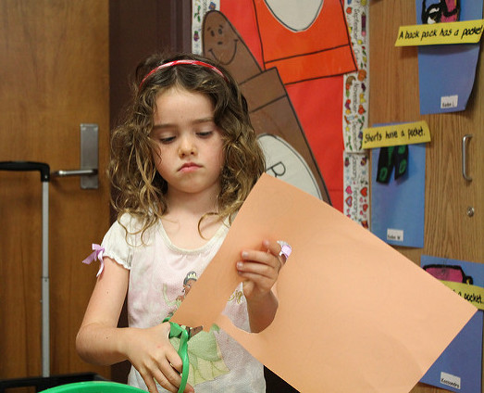
Visual Arts
© 2017 California Department of Education
Notes:
Presenter Remarks:
Let’s look now at the Visual Arts strand.
“The Visual Arts domain includes the practice of drawing, painting, sculpting, and assembling collages in two or three dimensions. Preschool [TK] visual art is process-based and open-ended, allowing children to explore by using a variety of materials. The product is not the focus, though the children will likely view their creation as a masterpiece!” (PCF, Vol. 2, p. 48).

Slide 41
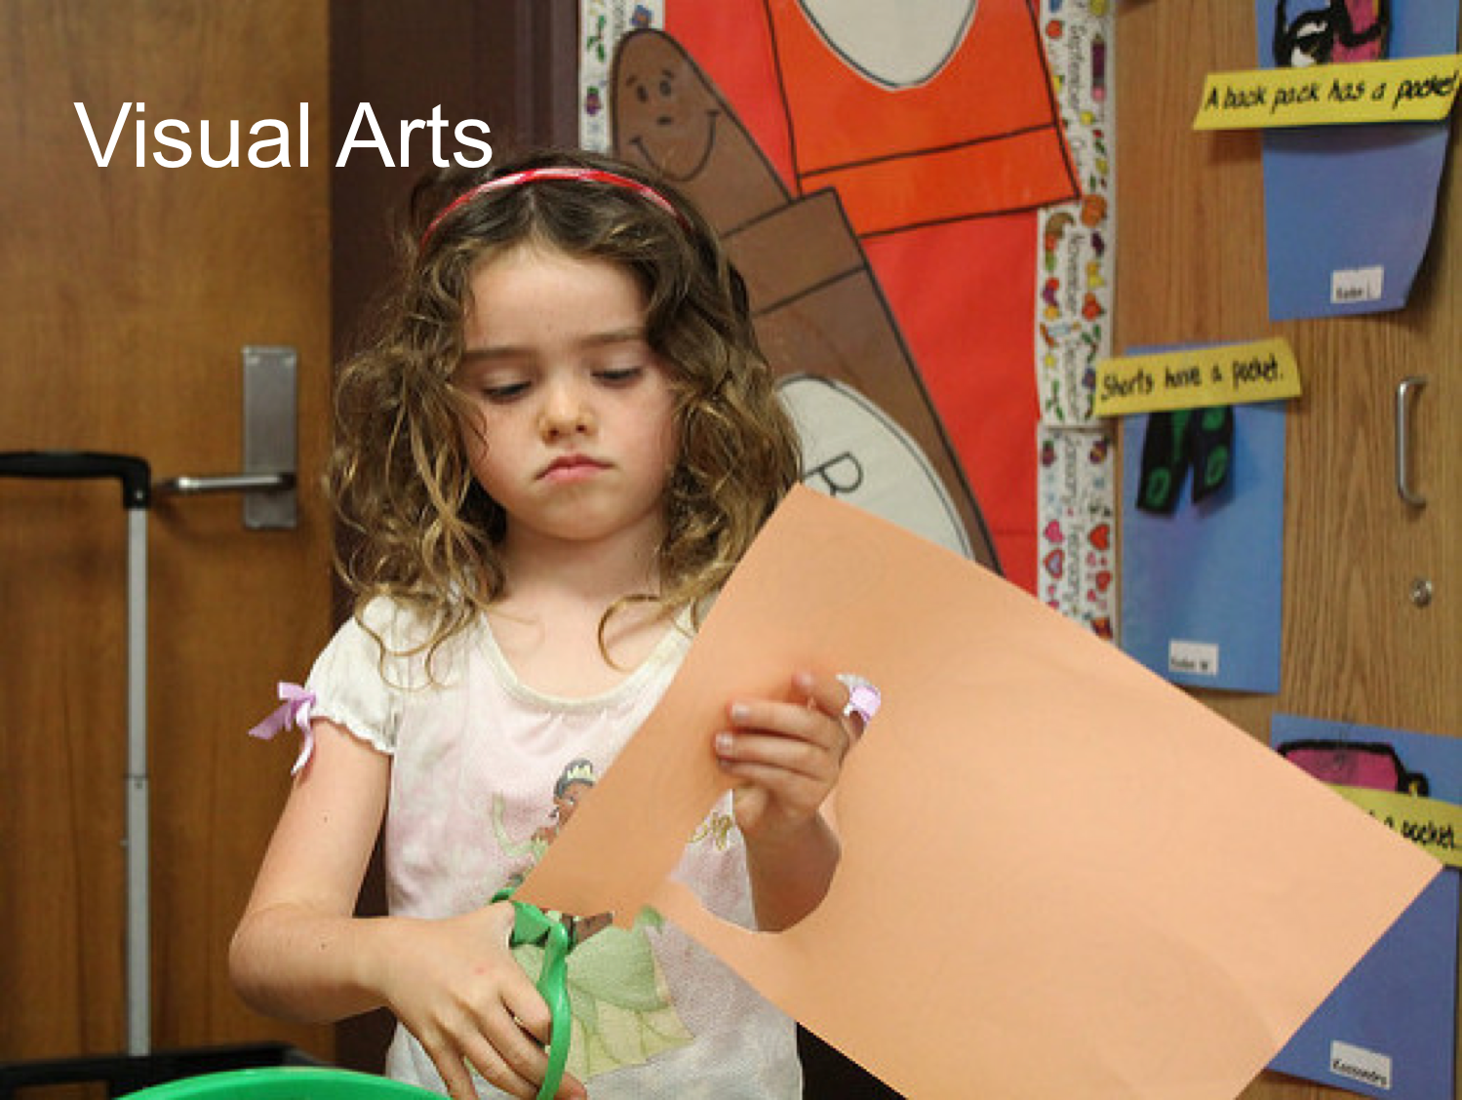
Name That Substrand
Visual Art
Notice, Respond, and Engage
Develop Skills in Visual Art
Create, Invent, and Express Through Visual Art
Notes:
Presenter Remarks:
Let’s look again at the photograph on the previous slide. What visual arts substrand might this illustrate? Turn to pp. 5-10 of the Preschool Learning Foundations, Volume 2 as a reference. Take a few minutes to discuss your answer with an elbow partner.
Extra Notes:
After a few moments, solicit feedback from the group. Ask for evidence for their decision.

Slide 42
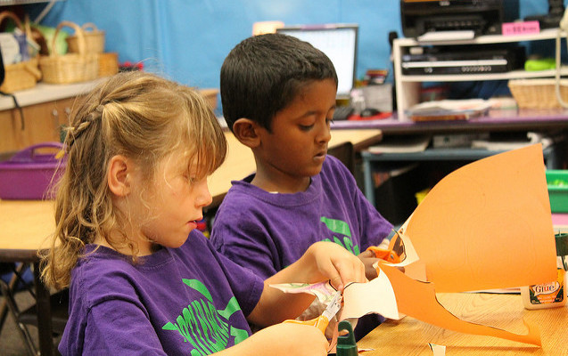
The Arts Are Inclusive of All Children
Notes:
Background Information:
Optional video clip. Needs internet access to youtube.com. Click picture to start video (2 minutes 13 seconds). “I am an Artist” movie trailer about visual arts and children with special needs.
Presenter Remarks:
Whether or not the clip is shown, explain the following from the Preschool Curriculum Framework, Volume 2, Guiding Principles, p. 42
“The arts are inclusive of all children. The arts allow all children to participate in a meaningful and significant way and can help in developing a collaborative preschool environment. All individuals, including children with disabilities or other special needs can find the arts satisfying and enjoyable. Accomplished artists with disabilities—Henri de Toulouse-Lautrec, Chuck Close (Wylie Coyote), Frida Kahlo, and Itzhak Perlman among others—can serve as inspiration to all child artists, especially those with a shared experience of a disability” (PCF, Vol. 2, p. 42).

Slide 43
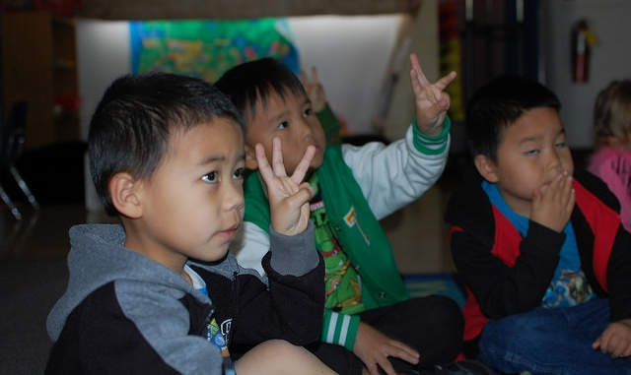
Universal Design for Learning
Provides for:
Multiple means of representation
Multiple means of engagement
Multiple means of expression
© 2017 California Department of Education
Notes:
Background Information:
This information comes from the Preschool Curriculum Framework, Volume 2, p. 14.
Presenter Remarks:
The strategies within the Preschool Curriculum Framework include the idea of Universal Design for Learning (UDL). This means there are many suggestions for ways to support learning that teachers can use to provide multiple means of representation, engagement, and expression.
“Multiple means of representation refers to providing information in a variety of ways so the learning needs of all children are met. For example, it is important to speak clearly to children with auditory disabilities while also presenting information visually (such as with objects and pictures).
Multiple means of expression refers to allowing children to use alternative ways to communicate or demonstrate what they know or what they are feeling. For example, when a teacher seeks a verbal response, a child may respond in any language, including American Sign Language. A child with special needs who cannot speak may also respond by pointing, by gazing, by gesturing, by using a picture system of communication, or by using any other form of alternative or augmented communication system.
Multiple means of engagement refers to providing choices in the setting or program that facilitate learning by building on children’s interests. The information in this curriculum framework has been worded to incorporate multiple means of representation, expression, and engagement” (PCF, Vol. 2, p. 14).
Find Handout 5: Suggested Visual Arts Materials. The lists of materials on this handout demonstrate the principles of Universal Design for Learning. Look at the list of materials under modeling supplies. Providing a variety of materials that can be used for modeling enables more students to participate. For example, students developing hand strength may choose easy-to-mold materials like playdoh while students who require higher levels of sensory feedback may choose stiffer materials such as clay.

Slide 44
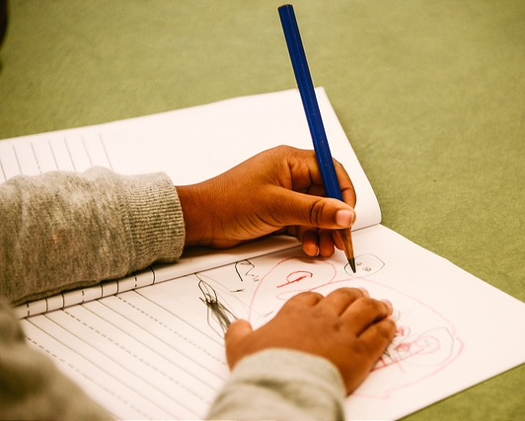
Visual Arts Promote…
Thinking
Problem solving communication
Intent
Language learning
Cultural learning
Notes:
Presenter Remarks:
Visual arts promote thinking, problem solving, communication, intent, language learning, and cultural learning.
“Over the years, the work of Nelson Goodman and Howard Gardner at Harvard University’s Project Zero has helped to demystify children’s art. These scholars view art through the lens of cognition rather than through a value-driven critique of aesthetics. Art is a cognitive activity, requiring thinking, problem solving, communication, and intent. And learning in art is frequently tied to learning in language as well as culture” (PCF, Vol. 2, p. 59).

Slide 45


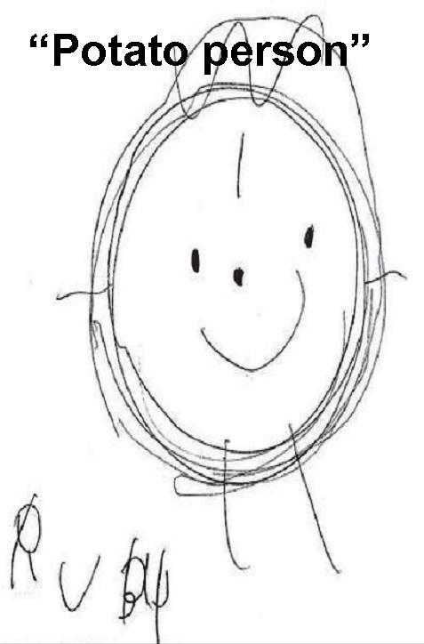
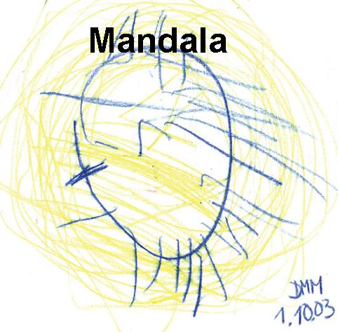
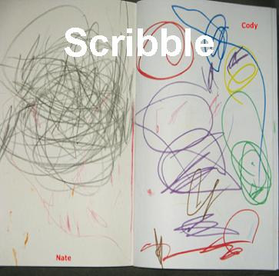
Developmental Sequence of Drawing
PCF, Vol. 2, p. 59
© 2017 California Department of Education
Notes:
Background Information:
Guide participants to the Preschool Curriculum Framework, Volume 2, p. 59, and highlight the information below.
Presenter Remarks:
“Appearing commonly in drawings of children, especially those of two- or three-year-olds, is the mandala, a term used to designate symbolic representations that include a circular motif typically incorporating a crosslike figure. For the child, the mandala is a well-balanced, pleasing form that lies en route to genuine representation. The contrasting, superimposed elements of the circle and cross are precursors to the figure’s metamorphoses to rounded figures with legs, arms, and facial details” (PCF, Vol. 2, p. 59).

Slide 46
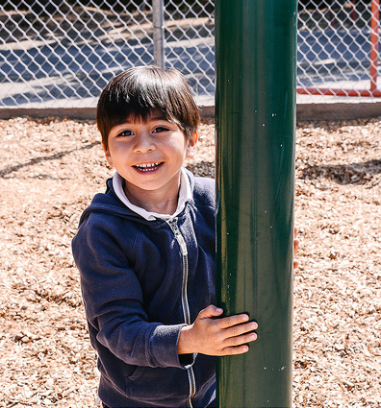
English Learners
“Children who are English learners need to be supported not only in activities focused on language and literacy, but across the entire curriculum”
(PCF, Vol. 1, p. 181).
Notes:
Presenter Remarks:
“Language is a tool of communication used in all developmental domains. Children who are English learners need to be supported not only in activities focused on language and literacy, but across the entire curriculum” (PCF, Vol. 1, p. 181).
“All children, particularly children at the beginning and middle levels of English-language acquisition, may show knowledge and skills in other domains, such as the visual and performing arts or mathematics, using their home language. The Desired Results Developmental Profile (DRDP) recognizes this possibility by considering children’s demonstration of knowledge, and skills in their home language as evidence of developmental progress” (PCF, Vol. 2, p. 13).
Think about the arts in your classroom. How might you engage and support a child who is learning English as a second language? Do you include songs in the home language? Do you act out stories available in the home language? Do you play music that includes words from the home language for dancing? Think about these examples and discuss with your elbow partner.

Slide 47
Support All Learners with Visual Art Invitations in the Environment
Encourage engagement with art on all levels.
Respect individual developmental, cultural, and linguistic differences.
Give children the time and space they need to explore their creativity.
Provide an environment that makes the practice of art comfortable.
(PCF, Vol. 2, pp. 59-60)
Notes:
Presenter Remarks:
As I click each of the examples of interaction and strategies on the slide, think about what it means to you. What examples have you seen? What do you do in your classroom? Give the opportunity for discussion on each topic.
“Encourage engagement with art on all levels. Make comments or questions that stress the different ways that similar or same things can be represented through drawings. Encourage mutual respect for the individual choices involved.
Respect individual developmental, cultural, and linguistic differences, and encourage children to respect them. Children may respond to art in a wide variety of ways depending on individual preferences, developmental differences, and cultural background. [Some] children may have sensitivities to different textures and need an opportunity to observe or participate in other ways.
Give children the time and space they need to explore their creativity. Some children will not be able to complete their work in a single block of time and will want to continue into the next day. Create a safe place for works in process.
Provide an environment that makes the practice of art comfortable. Engaging visual art activities capitalize on young children’s need for sensory-motor exploration and physical development. For example, when working with sculpture, children need space to pinch, pound, pull, roll, flatten, and punch the clay. When painting, children need a large standup easel for sweeping arm movements” (PCF, Vol. 2, pp. 59-60).

Slide 48
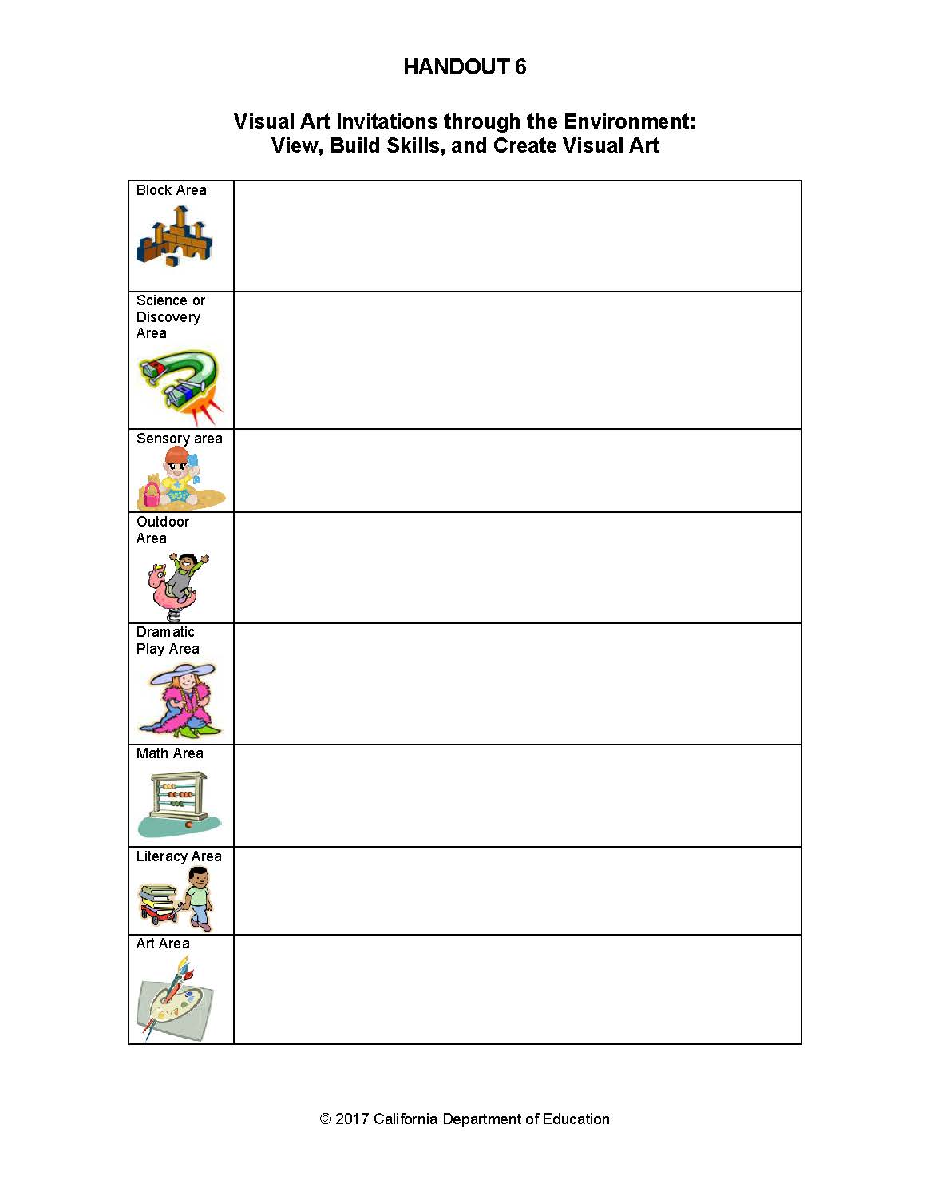
Your Turn
Notes:
Activity 5: Visual Arts Invitations through the Environment
Presenter Remarks:
Next, each table group is going to jot down ideas to infuse visual art opportunities through the classroom environment. Turn to pages 54-56 in the Preschool Curriculum Framework, Volume 2 to stimulate your thinking.
intent:
Consider how to infuse visual arts opportunities throughout the entire classroom environment.
OUTCOME:
Participants explore ways to infuse opportunities for children to develop skills and knowledge in visual arts throughout all areas in the classroom environment.
Materials Required:
Handout 5: Suggested Visual Arts Materials (optional)
Handout 6: Visual Arts Invitations through the Environment worksheet (one copy for each participant)
Preschool Curriculum Framework, Volume 2
Time: 20-40 minutes
Process:
Give each participant a copy of Handout 6: Visual Arts Invitations through the Environment worksheet.
Ask each table team to jot down ideas to infuse visual art opportunities through the classroom environment. Direct participants to pages 54-56 in the Preschool Curriculum Framework, Volume 2, to stimulate thinking.
Model the activity by saying something like, “Let’s look for an example from the interactions and strategies. Can someone read the section, Help children acquire painting skills through practice with the tools. What area of the environment might this take place? What other ideas do you have for integrating art around the classroom and outside?” Solicit one or two responses from the group and say, “Remember, visual arts include things like drawing, painting, chalk, sculpting, collage work, and making three dimensional art works. Think of opportunities to view visual art, build visual art skills, and create visual art.”
Give participants 20 minutes to jot down ideas.
Then ask each group to share out five best ideas. Ask each participant to write down one idea they would like to try on the action plan. (If no action plan is provided, just ask them to create one.)
OPTIONS:
Ask each group to choose one area on which to focus.
Participants split up the areas within their table group. Each participant uses the Preschool Curriculum Framework, Volume 2 to fill in ideas they would use to enhance their assigned area. After 10 minutes, table participants share out ideas. End with each person at the table verbally committing to try one new thing.

Slide 49
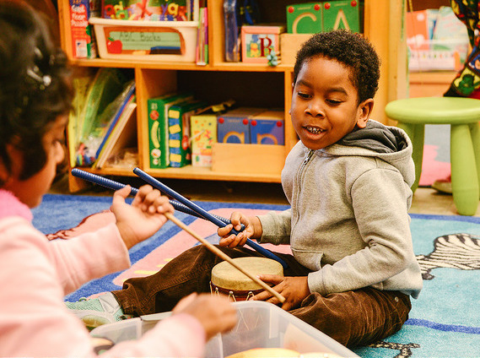
Music
Notes:
Presenter Remarks:
“Preschoolers [transitional kindergartners] love to listen to music as well as sing along and move with music. Music learning in preschool is a time to make new discoveries. Preschoolers [transitional kindergartners] can engage in music making, performing rhythms, musical sounds and passages with a variety of instruments, or simply sing along to a favorite tune” (PCF, Vol. 2, p. 48).

Slide 50
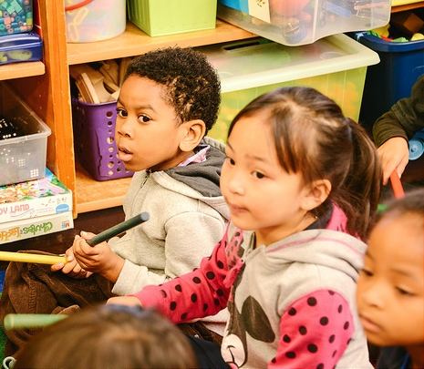
Research Highlight
“As preschool [TK] children not only listen to music, but also learn to make music by singing and playing instruments together (and responding to music in a variety of ways), they create important contexts for the early learning of vital life skills such as cooperation, collaboration, and group effort”
(PCF, Vol. 2, p. 84).
Notes:
Background Information:
Read the excerpt from the Research Highlight in the Preschool Curriculum Framework, Volume 2, p. 84.
Presenter Remarks:
The takeaway message is that we can see, through the research, that music isn’t only valuable for its aesthetic sense, but it also helps children develop social and emotional skills such as cooperating and working well with others.

Slide 51
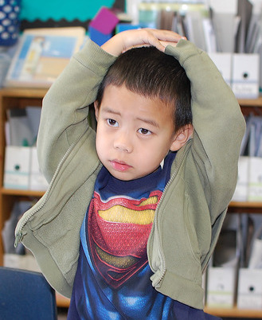
Music Promotes:
Reading acquisition
Sequence learning
Phonological awareness
(PCF, Vol. 2, p. 71)
© 2017 California Department of Education
Notes:
Presenter Remarks:
“When children have opportunities to participate in music activities, it stimulates and strengthens parts of the brain that help children with phonological awareness, learning how to sequence, and learning how to read. Let’s see, then, how we can provide children with music opportunities throughout the program day, and not only at special music times” (PCF, Vol. 2, p. 71).

Slide 52

Build Into the Daily Schedule
Time to schedule opportunities
Time to engage
Time to wind down
Notes:
Presenter Remarks:
Time is key for the success of facilitating visual and performing arts development.
“Children need ample blocks of time for sustained involvement with the artistic and creative process. Some children will not be able to complete their work in a single block of time and will want to continue into the next day” (PCF, Vol. 2, p. 60).
How will you provide these times for children?
Efficient use of time is essential for teachers to provide ample opportunities for children to engage and experience all types of art during the school day.
Time is necessary for children to appropriately engage and experience art materials.
Time is necessary for children to “wind down” from the often exciting and emotional experiences, particularly from dance and performing arts.
What does your schedule look like? Have you provided the time that children need for opportunities, engagement, and winding down?

Slide 53
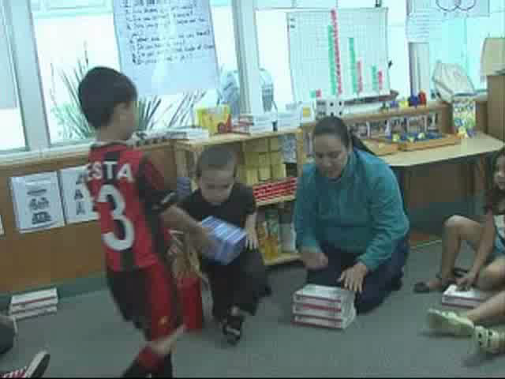
Music
© 2017 California Department of Education
Notes:
Presenter Remarks:
This is an example of how one teacher infuses music into transition times.
Extra Notes:
Embed video VPA field\video clips\musictrans.wmv

Slide 54
Find that Foundation
© 2017 California Department of Education
Notes:
Presenter Remarks:
Turn to pp. 11-14 in the Preschool Learning Foundations, Volume 2. As a table group, find one foundation that the music transition activity might illustrate.
Extra Notes:
Give the group a few minutes to work. Solicit responses and ask for evidence. There will be multiple responses to this question.

Slide 55
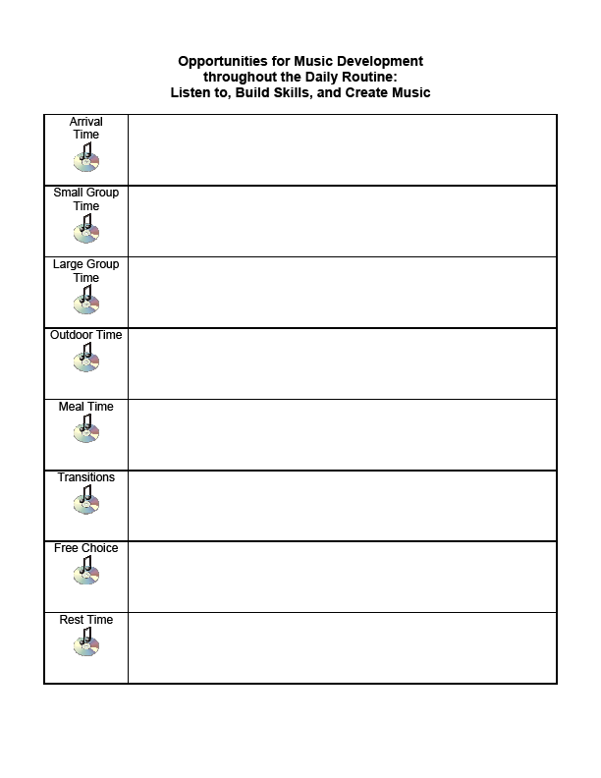
Your Turn
Notes:
Activity 6: Opportunities for Music Development throughout the Daily Routines
Presenter Remarks:
Now each table group is going to jot down ideas to infuse music opportunities through the classroom environment. Turn to page 65 in the Preschool Curriculum Framework, Volume 2 to stimulate your thinking.
intent:
Consider how to infuse music opportunities throughout the entire daily routine.
OUTCOME:
Participants explore ways to infuse opportunities for children to develop skills and knowledge in music throughout all parts of the program day.
Materials Required:
Handout 5: Suggested Visual Arts Materials (optional)
Handout 7: Opportunities for Music Development throughout the Daily Routine (one copy for each participant)
Preschool Curriculum Framework, Volume 2
Time: 20-40 minutes
PROCESS:
Give each participant Handout 7: Opportunities for Music Development throughout the Daily Routine worksheet.
Ask each table group to jot down ideas to infuse music opportunities throughout the day. Direct them to Interactions and Strategies, page 65, in the Preschool Curriculum Framework, Volume 2, to stimulate thinking.
Model the activity by saying, “Let’s look for an example at outdoor time. Page 65 talks about making instruments for outdoor musical play. So we might think of adding a box of cans and containers to the outdoor environment and inviting children to make drums for an outdoor parade. What other ideas do you have for children to participate in visual arts outside?” Solicit responses from the group and remind them, “Music includes things like listening to music, singing, keeping a beat, playing musical instruments, making sound effects, moving to music, and drawing pictures to music. Think of opportunities to listen to, build skills, and create music.”
Give participants 20 minutes to jot down their ideas.
Then ask each group to share out their five best ideas. Ask each participant to write down one idea they would like to try on the action plan. (If no action plan is provided, ask them to create one.)
OPTIONS:
Have participants divide the times on the daily schedule within the table group.
Have participants split up times of day within the table group. Then use the framework to fill in ideas to add music opportunities to that time of day. After 10 minutes, table participants share out ideas. End with each person at the table verbally committing to try one new thing.

Slide 56
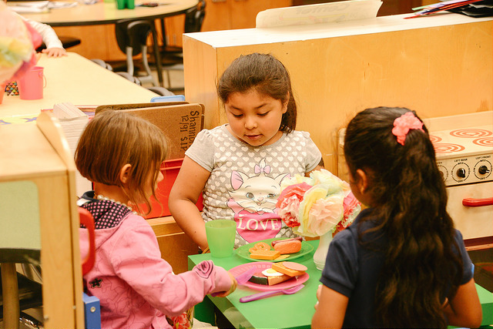
Drama
Notes:
Presenter Remarks:
“For preschoolers, this domain involves both spontaneous dramatic play and teacher-structured drama, each of which inspires the other. Preschoolers are naturally inclined to engage in solitary, parallel, and group play, and draw on these experiences when acting out situations and using props (with teacher guidance). Similarly, engaging in drama feeds children’s imagination and inspires dramatic play. A goal in dramatic play and drama for preschoolers is unleashing the child’s imagination. Thus, the focus is on children’s creative engagement in drama rather than on actual performance or ‘the theater’” (PCF, Vol. 2, p. 48).

Slide 57
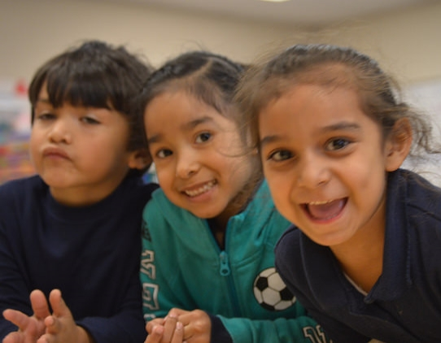
Drama
“Drama is…a great way to create a culture that embraces and celebrates all children”
(PCF, Vol. 2, p. 87).
Notes:
Background Information:
“Drama is…a great way to create a culture that embraces and celebrates all children” (PCF, Vol. 2, p. 87).
Optional video clip. Needs internet access to youtube.com. Click picture to start video (2 minutes, 40 seconds) Daddy Ross Preschool, Bueno Aires, Argentina, Drama and dual language learners.
Whether or not you show the clip, remind participants that there will not be a section titled “English Learner” in this chapter, but that great ideas are embedded within all the interaction and strategies.
Presenter Remarks:
Read quote and see Background Information.

Slide 58
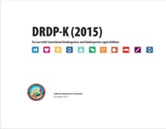
Key Features of the DRDP-K
An observation-based assessment tool,
not a test
Individual child assessment
Completed by each child’s teacher
Based on developmental research and theory
Includes developmental sequences of behaviors along a continuum
Spans the developmental continuum of children in a two-year kindergarten program
Notes:
Presenter Remarks:
One resource that is used to support children’s development is the Desired Results Developmental Profile-Kindergarten (2015)© (DRDP-K). This is especially helpful for English learners.
The DRDP-K informs teachers understanding of the developmental continuum. It can be used with the Alignment document we just looked at to expand upon the developmental continuum.
One key feature of the DRDP-K to consider is that it is an observation-based assessment and not a test. It is used to support children’s learning. Observing and documenting children's progress provides teachers the information needed to differentiate instruction and experiences. It also provides information to individualize.
Observational tools are preferred over criterion-referenced tools because the information gathered by observation more accurately reflects what children are able to do.
Documentation provides concrete evidence of what children are able to do. With this documentation, we are then able to better plan activities that will meet and appropriately challenge children's developmental needs.
Other features of the DRDP-K include:
It is an individual child assessment that can be shared with families.
It is aligned with the Preschool Learning Foundations.
It opens up the opportunity for articulation between preschool and TK teachers.
Sharing information as to where children are on the developmental continuum can better prepare the TK teacher to work with students.
A teacher can include a request form for previous records as part of the TK registration to help support the relationship between preschool, family, and TK.
The DRDP-K has been developed with world renowned experts. It is based on research and knowledge of what is most important for predicting school success.

Slide 59
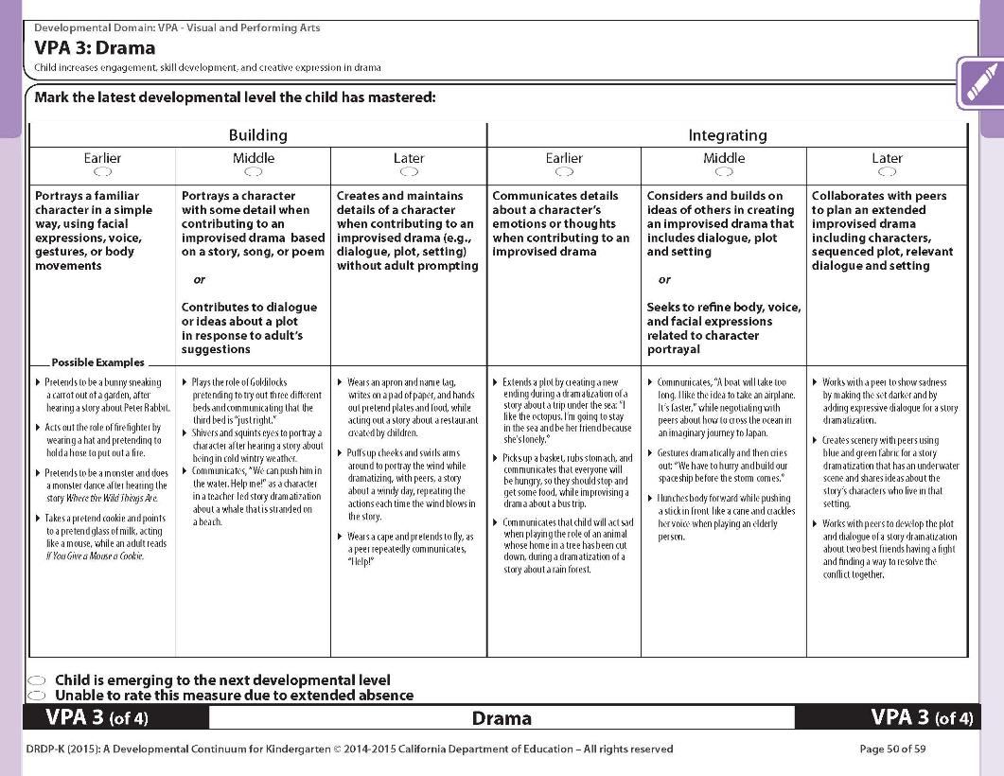
DRDP-K (2015)
Notes:
Background Info:
Preschool Learning Foundations, Volume 2, page 104
Presenter Remarks:
The DRDP-K gives TK teachers a lens to measure TK children’s developing capacity to understand details and ideas from age-appropriate text presented by adults.
The measurements show the, “…series of stages that ultimately lead to [preschool children] making sense of stories and the world around them” (PLF, Vol.1, 53).
Take out Handout 4: Alignment Document and Handout 8: DRDP-K Drama. The last page of this handout is a copy of the DRDP-K measure that most closely relates to the dance foundations.
Look closely at this DRDP-K measure. Take a few minutes to read each stage along with a few of the examples. Underline examples that you have seen in your classroom.

Slide 60

Dramatic Play Promotes
Social Interactions and
Self-awareness
© 2017 California Department of Education
Notes:
Presenter Remarks:
“In addition to being fun and enjoyable, drama has numerous benefits for preschool-age children. When participating in dramatic play and drama with others, children must work together to decide a plot, choose characters, and act out a situation or story. Completing these tasks gives children valuable practice in interacting with others. Reflection on a dramatic play or drama experience also enhances self-awareness by helping children to think about their actions and choices” (PCF, Vol. 2, p. 87).

Slide 61

Teacher Involvement Is Vital
Join in by playing a role
Suggest new themes
Add props
(PCF, Vol. 2, p. 93-94)
© 2017 California Department of Education
Notes:
Presenter Remarks:
Read the following Research Highlight in the Preschool Curriculum Framework, Volume 2, p. 94. What key takeaways do you see?
It is important that children be given the opportunity to make decisions and determine the course of action during dramatic play and drama, as this helps cultivate social-emotional skills such as taking initiative in one’s learning.
However, look for opportunities to participate in children’s play often. The teacher’s participation adds an important dimension to children’s play. Research suggests that young children derive greater benefits from dramatic play when the teacher or other adult is involved that is, monitoring and assisting children in engaging in fruitful play, rather than just observing passively.
What are some ways that teachers can join in ongoing dramatic play?
Possible answers:
Model roles
Give helpful suggestions and comments
Teach children how to engage in dramatic play who do not have previous experiences
Enhance language
Refresh play by adding new themes and/or props
Join into the play by playing a role (PCF, Vol. 2, p. 93-94)

Slide 62

Act Out Stories
Greater understanding
Better recall
(PCF, Vol. 2, p. 94)
Notes:
Presenter Remarks:
“In the 17 studies…children listened to a story and either acted it out or listened to the story a second time, Podlozny found not only that children displayed greater story understanding and recall when acting out the story rather than just hearing it, but that story understanding was greatest when the teacher or other adult was in-role, working with the children during the drama” (PCF, Vol. 2, p. 94).

Slide 63



Who Took the Cookies?
Notes:
Presenter Remarks:
How can we tie together the visual and performing arts and one of the other domains?
We’re going to use the book Who Took the Cookies from the Cookie Jar as our inspiration and starting point.

Slide 64
Integrate the Arts with Other Domains
Drama
Math
Notes:
Presenter Remarks:
We will combine the Drama strand with the Mathematics domain.
Click to activate the visual effect.

Slide 65

Drama
Bake cookies using a recipe
Help children understand the sequence of the plot line
Put measuring cups and spoons in the sensory table
Act out the story
Math
Make props for the play
Make cookies of various shapes
Teach vocabulary: prop, actor, costume, scenery, stage
Count how many actors are needed for the drama
Playdough with shape cookie cutters to make cookie props
© 2017 California Department of Education
Notes:
Presenter Remarks:
I am going to read a book aloud and as you listen, think of activities you can do with this book that might address the development of skills and knowledge in drama, math, or both.
Extra Notes:
Read the book aloud to the group.
Give the group 5 minutes to brainstorm after the reading. Go around the room and ask each table to contribute one idea.
Click to reveal ideas on the slide. They will dissolve one after the other.
Talk about ideas the group thought of that are not on the slide, and vice versa.
Explain:
Now it’s your turn to take a popular children’s picture book and brainstorm activities to integrate one of the arts with another domain.
Each table will get one picture book along with a card suggesting an art strand and another domain that they might try.
They should feel free to choose a different art strand and domain. The ideas on the card are only a suggestion.

Slide 66

Your Turn
© 2017 California Department of Education
Notes:
Activity 7: Culminating Activity - Putting it All Together
Presenter Remarks:
We are going to spend 15 minutes using picture books as a starting point for one or more activities that combine the visual and performing arts with another domain.
intent:
Practice integrating creative learning and learning through creative experiences with other domains.
OUTCOME:
Participants use children’s literature as a starting point as they work in groups to create classroom activities that integrate the visual and performing arts (VPA) with other domains.
Materials Required:
Picture books
Handout 9: Putting it All Together
Materials and props (optional)
Time:
30 minutes
Process:
Give each table a copy of a picture book that can be used for both visual and performing arts and another domain, such as mathematics, language and literacy, social-emotional development, or English-language development.
Have one table member read the book aloud to the table group.
Ask them to spend 15 minutes using the picture book as a starting point for one or more activities that combine the visual and performing arts with another domain.
Participants can use Handout 9: Putting it All Together as a template for brain storming.
After groups are finished documenting their ideas invite each group to present their ideas to all participants.
Encourage table groups to demonstrate their best idea.
OPTIONS:
Assign table groups specific VPA strands and domains rather than having each group to select their own.
Give table groups boxes with materials and props to work with as they complete this task.

Slide 67

Arts-Based Activities
“For children from diverse linguistic or cultural communities, arts-based activities can provide a link between home and preschool”
(PLF, Vol. 2, p. 2).
Notes:
Presenter Remarks:
“For children from diverse linguistic or cultural communities, arts-based activities can provide a link between home and preschool. Teachers welcome children’s cultures to preschool programs when they encourage children and families to share songs, dances, poems, music, visual art, or art-related objects and practices from home. Programs serving diverse children can create positive learning opportunities, culturally relevant curricula, and a sense of community by including visual and performing arts that represent the children’s home cultures” (PLF, Vol. 2, p. 2).
“Diversity is an essential quality of human existence and the visual arts and performing arts provide excellent opportunities to learn, understand, and express diversity!” (PLF, Vol. 2, p. 2).
How could you use what we’ve talked about today to connect with families?
Turn to pages 115 to 116 and read the Engaging Families section for suggestions families can use at home to promote the arts.
Turn to p. 123 and tab the End Notes to return to and read later.
Turn to p. 119 and tab the Teacher Resources to return to and read later.
Turn to p. 116 and tab the Questions for Reflection to return to and read later.

Slide 68

Partner with Families
Engaging Families: Preschool Curriculum Framework
All About Young Children
Best Practices for Planning Curriculum: Family Partnerships and Culture
TK Implementation Guide
Notes:
Presenter Remarks:
In order to effectively build on children's existing strengths, we must understand them. To do this, we need to partner with families to learn about their children’s strengths.
The resources on this slide are specifically beneficial for partnering with families. You may want to take a picture of this slide and refer to it later.
Optional:
Create a gallery table and include examples of documents.
Extra Notes:
The resources are hyperlinked. If Wi-Fi access is available, display the resources and do a walkthrough.

Slide 69


Visual and Performing Arts in TK
“The many strategies, examples, illustrations of developmental patterns, and links to the insights of researchers offered in this chapter will help the teacher capitalize on what adults and children together bring to the learning process. The benefits of shaping clay, drawing, imagining, pretending, making music, and moving the body support the development of the whole child. Children with rich arts-involvement in preschool [transitional kindergarten] experiences become adults full of possibility” (PCF, Vol. 2, p. 117).
© 2017 California Department of Education
Notes:
Presenter Remarks:
Click to reveal text.
“The many strategies, examples, illustrations of developmental patterns, and links to the insights of researchers offered in this chapter will help the teacher capitalize on what adults and children together bring to the learning process. The benefits of shaping clay, drawing, imagining, pretending, making music, and moving the body support the development of the whole child. Children with rich arts-involvement in preschool [transitional kindergarten] experiences become adults full of possibility” (PCF, Vol. 2, p. 117).
Discussion:
Invite participants to think back to opening Activity 1: Where Do You Stand? Has their comfort level shifted? Invite participants to return to the chart that was their least strong art and discuss new ideas for integrated and support this type of art in their classroom.

Slide 70

Final Thoughts
I was wondering…
Would it be ok if…?
Does anyone here know…?
© 2017 California Department of Education
Notes:
Background Information:
Click to reveal thought bubbles.
Presenter Remarks:
What questions or thoughts do you have regarding the Visual and Performing Arts domain?

Slide 71

Thank You!

Slide 72
Reference Guide for PowerPoint Citations
California Department of Education. 2010. California Preschool Curriculum Framework, Volume 1. http://www.cde.ca.gov/sp/cd/re/documents/psframeworkkvol1.pdf (accessed January 7, 2016).
California Department of Education. 2011. California Preschool Curriculum Framework, Volume 2. http://www.cde.ca.gov/sp/cd/re/documents/psframeworkvol2.pdf (accessed January 6, 2017).
California Department of Education. 2008. California Preschool Learning Foundations, Volume 2. http://www.cde.ca.gov/sp/cd/re/documents/psfoundationsvol2.pdf (accessed January 6, 2017).

