Slide 1
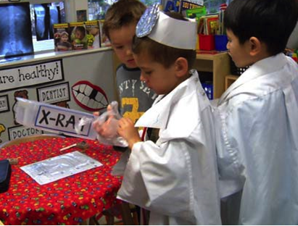
Health in Transitional Kindergarten
California Preschool Learning Foundations, Volume 2
California Preschool Curriculum Framework, Volume 2
Notes:
Presenter Remarks:
Welcome to Health in Transitional Kindergarten—a presentation focusing on the California Preschool Learning Foundations (Preschool Learning Foundations or PLF), the California Preschool Curriculum Framework (Preschool Curriculum Framework or PCF), and other California Department of Education (CDE) resources in support of the Health domain.
This professional learning session is specifically designed to provide TK teachers with exposure to CDE resources that support TK curriculum planning of developmentally appropriate strategies. Classroom environment design recommendations are included to support the content area of health.

Slide 2
Objectives
Gain understanding of key concepts from the California Preschool Learning Foundations, Volume 2 and the California Preschool Curriculum Framework, Volume 2—Health domain.
Observe, read, and discuss the developmental continuum in health and develop strategies that will guide instruction and learning in Transitional Kindergarten (TK).
Practice using the Preschool Learning Foundations and Preschool Curriculum Framework to intentionally plan developmentally appropriate, cultural, and inclusive strategies that promote health.
Notes:
Presenter Remarks:
This slide shows the objectives for today’s training:
Gain understanding of key concepts from the California Preschool Learning Foundations, Volume 2 and the California Preschool Curriculum Framework, Volume 2—Health domain.
Observe, read, and discuss the developmental continuum in health and develop strategies that will guide instruction and learning in Transitional Kindergarten (TK).
Practice using the Preschool Learning Foundations and Preschool Curriculum Framework to intentionally plan developmentally appropriate, cultural, and inclusive strategies that promote health.

Slide 3
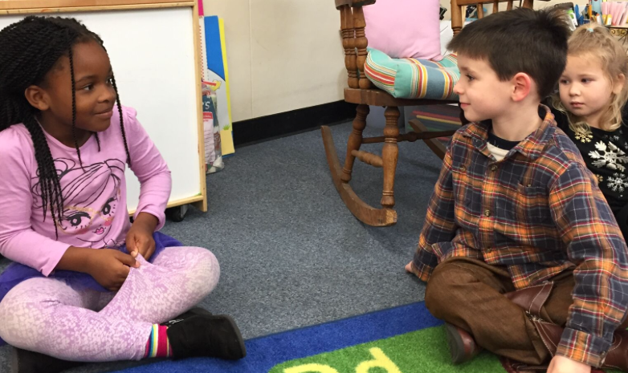
Lifelong Learning
Early childhood education about health “can begin a lifelong process of learning about oneself, relationships to others, and the world” (PCF, Vol. 2. p. 226).
©2017 California Department of Education (CDE)
Notes:
Presenter Remarks:
“The preschool health foundations describe the health knowledge, attitudes, and behaviors that set the groundwork for all preschool children to develop into healthy adults. They explain what children should know about health, and what health habits and practices should be part of their daily routines when they are provided with high-quality health education in preschool. These skills and behaviors set young children on the path toward health and healthy lifestyle choices” (PCF, Vol. 2, p. 226).

Slide 4
Health Routines
Think about the health practices that you have performed in the last 24 hours.
Jot the first three to five practices that come to mind on a sticky note.
Walk around the room until you find a sign that matches one of the health practices you wrote down. Go to the “Other” sign if you don’t have a match.
Answer the following questions with those gathered at your sign:
  [Washing hands] is a healthy practice; what other health practices have your participated in today?
  How do you feel about these health practices?
  Why do you choose to engage in them?
  When did you begin this practice?
Notes:
Activity 1: Health Routines
Presenter Remarks:
Let’s reflect on our personal experiences and attitudes towards health practices.
Background Information:
If time allows, this activity can be conducted again at the end of the session to allow participants to explore how their feelings about health may have changed over the course of the training.
intent:
Participants reflect on their personal experiences and attitudes towards health practices.
OUTCOMES:
Participants will reflect on their personal use of health practices and be introduced to module content.
Materials Required:
Sticky notes for participants
Signs labeled with common health practices hung around the room (e.g., take a bath, floss teeth, go for a run, go to the gym, cook a healthy meal, get a massage, go for a walk, get a haircut, eat a healthy snack, sanitize hands, etc.)
Label one sign as “other”
TIME: 15 minutes
Process:
Place the signs high up on the walls with as much space as possible between them to allow participants to have focused conversations without being distracted by other groups.
Ask participants to think about the health practices that they have performed in the last 24 hours. Instruct them to quickly jot down the first three to five that come to mind on a sticky note.
Ask participants to walk around the room until they find a sign that matches one of the health practices they have written on their sticky note. If they do not have a match, ask participants to go to the “other” sign.
Wait for participants to group next to the signs, then have them answer the following questions together:
[Washing hands] is a healthy practice; what other health practices have your participated in today?
How do you feel about these health practices?
Why do you choose to engage in them?
Ask participants to return to their tables.
Debrief with the following script:
The Preschool Learning Foundations (Volume 2) divides the Health domain into three strands: Health Habits, Nutrition, and Safety. Consider the sign you stood by; which strand would that health practice belong to?
Stand up if you think you think your sign belongs in the Health Habits substrand.
Stand up if you think you think your sign belongs in the Nutrition substrand.
Stand up if you think you think your sign belongs in the Safety substrand.

Slide 5
Today’s Focus: Health
Health Habits | Safety | Nutrition
Basic Hygiene | Injury Prevention | Nutrition Knowledge
Oral Health |  | Nutrition Choices
Knowledge of Wellness |  | Self-Regulation of Eating
Sun Safety
Health Habits strand:
Basic Hygiene substrand
Oral Health substrand
Knowledge of Wellness substrand
Sun Safety substrand
Safety strand:
Injury Prevention substrand
Nutrition strand:
Nutrition Knowledge substrand
Nutrition Choices substrand
Self-Regulation of Eating substrand
Notes:
Presenter Remarks:
“Teachers can help children establish positive health habits. This learning is progressive and preschool teaching often focuses on scripts and routines for prevention of disease and injury. Later, as children grow and develop knowledge and skills, they begin to believe and understand that they are responsible for their own health” (PCF, Vol. 2, p. 233).
Children’s health knowledge is an amalgamation of the experiences they are afforded throughout the day at school and the experiences they have at home and in their communities. The focus of today’s training will be on integrating the three core areas of health identified in the Preschool Learning Foundations (Volume 2)—Health Habits, Safety, and Nutrition—into the TK curriculum.
These core areas also align with K-12 standards, a connection we will explore later in the training.

Slide 6



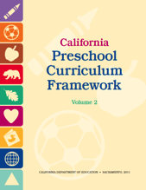





CDE Publications and Resources that Support TK Implementation
Preschool Learning Foundations
California Common Core State Standards
Health Education Content Standards for California Public Schools
Preschool Curriculum Framework
English Language Arts/English Language Development Framework
DRDP Specific to TK and K
Preschool Alignment Document
Preschool English Learners Guide
Transitional Kindergarten Implementation Guide
Preschool Learning Foundations
California Common Core State Standards
Health Education Content Standards for California Public Schools
Preschool Curriculum Framework
English Language Arts/English Language Development Framework
DRDP Specific to TK and K
Preschool Alignment Document
Preschool English Learners Guide
Transitional Kindergarten Implementation Guide
Notes:
Presenter Remarks:
The California Department of Education has developed many publications, resources, and supports that enable teachers to facilitate the most positive outcomes for students.
Today our main focus will be on Volume 3 of the Preschool Learning Foundations and the Preschool Curriculum Framework. In addition, there are other key resources that support history-social science:
California Common Core State Standards (CA CCSS)
Health Education Content Standards for California Public Schools, Kindergarten Through Grade Twelve (Health Standards)
English Language Arts/English Language Development Framework for California Public Schools: Kindergarten Through Grade Twelve (ELA/ELD Framework)
Desired Results Developmental Profile—Kindergarten (2015): A Developmental Continuum for Kindergarten (DRDP-K [2015])
Preschool English Learners: Principles and Practices to Promote Language, Literacy, and Learning—A Resource Guide (Second Edition) (PEL Resource Guide)
The Alignment of the California Preschool Learning Foundations with Key Early Education Resources (Alignment Document)
Transitional Kindergarten Implementation Guide—A Resource for Public School District Administrators and Teachers (TK Implementation Guide)
(Name and hold up each resource.) The Preschool Learning Foundations, Volume 1, Volume 2, and Volume 3, and the Preschool Curriculum Framework, Volume 1, Volume 2, and Volume 3, are the center of the California Early Learning and Development System.

Slide 7

Transitional Kindergarten Implementation Guide
The TK Implementation Guide is a resource for California public school district administrators and teachers to support implementation of comprehensive TK programs.
Notes:
Presenter Remarks:
The TK Implementation Guide is a resource that focuses on the essential components for school district administrators and teachers to consider for TK programs. The TK Implementation Guide, published by the California Department of Education, is a resource to support implementation of comprehensive TK programs.
This publication provides resources and guidance in the areas of program design, curriculum, instruction, assessment, and family/community partnerships.

Slide 8
Overview of the Transitional Kindergarten Implementation Guide
  Section One
  Program Structure and Design
  Section Two
  The TK Student
  Curriculum in a TK Program
  Effective Instruction in a TK Program
  The TK Learning Environment
  Assessment and Differentiated Instruction
  Involving Families and Community Partners
  Supporting TK Implementation
Notes:
Presenter Remarks:
The TK Implementation Guide is organized into the following two sections:
Section 1 is covered in Chapter 1. The information in this section was developed with the administrator in mind and focuses on the program structure and design.
Section 2 is covered in Chapters 2-8. This section is a resource for both teachers and administrators and focuses on building a comprehensive TK program by addressing curriculum, instruction environment, assessment and partnership with families and community.
Within each of these chapters, vignettes, highlighted boxes, and resource boxes are included to illustrate examples of the information covered in each of the chapters.
A PDF copy of the document can be accessed at the California Department of Education Web page (www.cde.ca.gov/ci/gs/em/documents/tkguide.pdf).
Video footage for each chapter can be accessed at the California Department of Education. The video clips include footage of TK classrooms and interviews with teachers, administrators, and parents. https://www.youtube.com/user/caeducation
https://www.youtube.com/results?search_query=tk+implmentation+guide

Slide 9
Why Use the Preschool Learning Foundations for TK?
CA Law (EC 48000):
Transitional kindergarten is the first year of a two-year kindergarten program that uses a modified kindergarten curriculum that is age and developmentally appropriate.
Transitional kindergarten programs are intended to be aligned, by legislative action, to the California Preschool Learning Foundations developed by the California Department of Education.
Notes:
Background Information:
CDE.CA.gov/ci/gs/em/kinderfaq.asp#program
Presenter Remarks:
The state of California provides guidance on utilizing the Preschool Learning Foundations and the Preschool Curriculum Framework as planning and curriculum resources in the transitional kindergarten classroom.
In addition, the following publications and resources are available to support age and developmentally appropriate TK curriculum:
TK Implementation Guide
Alignment Document
CA CCSS
DRDP-K (2015)
ELA Standards
ELA/ELD Framework
We will now look at how these resources work together to support all learners in language and literacy development.

Slide 10


Foundations and Framework, Volume 2
Notes:
Presenter Remarks:
The purposes of the Preschool Learning Foundations are to promote a common understanding of TK children's learning and to guide instructional practice. They describe the knowledge and skills that young children typically develop when provided with developmentally, culturally, and linguistically appropriate learning experiences.
The Preschool Curriculum Framework was created as a companion to the Preschool Learning Foundations. The framework ". . . presents strategies and information to enrich learning and development opportunities for all of California’s preschool [and TK] children" (PCF, Vol. 2, p. v).
The Preschool Learning Foundations and the Preschool Curriculum Framework are designed to work together. While the foundations provide the background information to understand children's developing knowledge and skills (the "what"), the framework offers guidance on how teachers and programs can support the learning and development that are described in the foundations (the "how").
Extra Notes:
The Preschool Learning Foundations were developed with research-based evidence and are enhanced with expert practitioners' suggestions and examples. All foundations were written by a team of researchers with expertise in the given domain. A complete reference list of the source materials, along with detailed bibliographic notes for each of the developmental domains, can be found in the Preschool Learning Foundations. Sources used in the development of the foundations include:
Documents from the California Department of Education, such as the English-Language Arts Content Standards for California Public Schools, Kindergarten Through Grade Twelve (Language and Literacy, Introduction, p. 48, left column).
Well-validated assessment tools such as the Ages & Stages Questionnaires (ASQ): A Parent-Completed, Child-Monitoring System (Social-Emotional, References and Source Materials, p. 36).
General sources such as the Report of the National Reading Panel 2000 (Language and Literacy, Introduction, p. 73, left column).
Early childhood education standards from other states such as Hawaii and Texas (Social-Emotional, Introduction, p. 5, footnote).

Slide 11
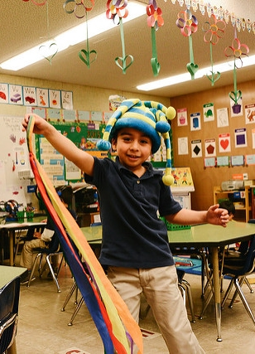
Foundations
High-quality programs
Appropriate support
Research-based evidence
©2017 California Department of Education
Notes:
Presenter Remarks:
The foundations also assume that children have access to appropriate support in high quality programs that include the following aspects:
Environments and experiences that encourage active, playful exploration and experimentation
Clearly defined learning centers where materials are rotated
Purposeful teaching to help children gain knowledge and skills
Predictable schedules and routines with large blocks of time for play and skillful integration of curriculum with an intentional focus on content
Specific support for English learners with staff that have knowledge of the stages of English-language acquisition
Accommodations and adaptations for children with disabilities and additional support when needed
Let’s take a closer look at one of the foundations as an example. Open the Preschool Learning Foundations (Volume 2) to a page in the health section where the age levels appear; this is an example of a foundation page.
(If participants need guidance, direct them to pages 80-87 in the Preschool Learning Foundations (Volume 2); if there are not enough copies of the book, direct participants to Handout 1: Foundations Map.)
Look across the page at the developmental progression at around 48 months; notice the changes at around 60 months of age.
(Solicit a few participants to read what they found. Summarize the exploration with the following key note.)
Because children develop at different rates, the foundations were designed with the understanding that certain stages of development will occur at different times for all students. You will notice “at around” in the description. It is important to remember this variability occurs.

Slide 12
Framework Strategies
Developmentally appropriate
Reflective and intentional
Individually and culturally meaningful
Inclusive of children with disabilities or other special needs
Notes:
12
The Preschool Curriculum Framework offers guidance on how teachers—through planned learning environments, materials, and experiences that are developmentally appropriate, individually and culturally meaningful, and engaging to families—can support the learning and development described in the foundations.
“Teachers address ideas and concepts that children can grasp at their developmental level and then progressively build on what children already know and understand. This approach applies to all children, including children with various abilities, disabilities, or other special needs (such as delays in language, cognition, or physical ability)” (PCF, Vol. 2, p. 227).
Let’s look at an examples from the Preschool Curriculum Framework that offer insight on creating an inclusive environment: “Around the world, children in some cultures are encouraged to speak up while children in other cultures are encouraged to remain silent. Teachers need to be respectful of home expectations for language at the same time that they support children to speak up at school. Children must be surrounded by language to acquire the vocabulary and sentence structures they need to read and write and think” (PCF, Vol. 1, p. 102).

Slide 13
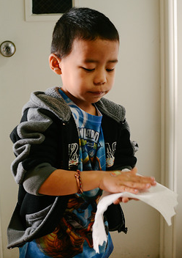
Preschool Curriculum Framework
Routines, environments, and materials
Interactions and strategies
Planned learning opportunities
Teachable moments
Engaging families
©2017 California Department of Education
Notes:
13
Presenter Remarks:
Health concepts and habits develop within context of the daily routine, classroom environment, home environment, and through interactions with peers and adults.
“Topics [in the Preschool Curriculum Framework] include guiding principles, in particular, the vital role of the family in early learning and development; the diversity of young children in California; and the ongoing cycle of observing, documenting, assessing, planning, and implementing curriculum. The preschool curriculum framework takes an integrated approach to early learning and describes how curriculum planning considers the connections between different domains as children engage in teacher-guided learning activities” (PCF, Vol. 1, p. v).

Slide 14

Alignment Document
Notes:
Presenter Remarks:
The Alignment Document is another resource that will help us to answer questions related to developmental progression.
What do you know about this document? How do you use it in your work now?
Extra Notes:
Depending on the size of the group, participants can share responses with tablemates or in pairs.

Slide 15
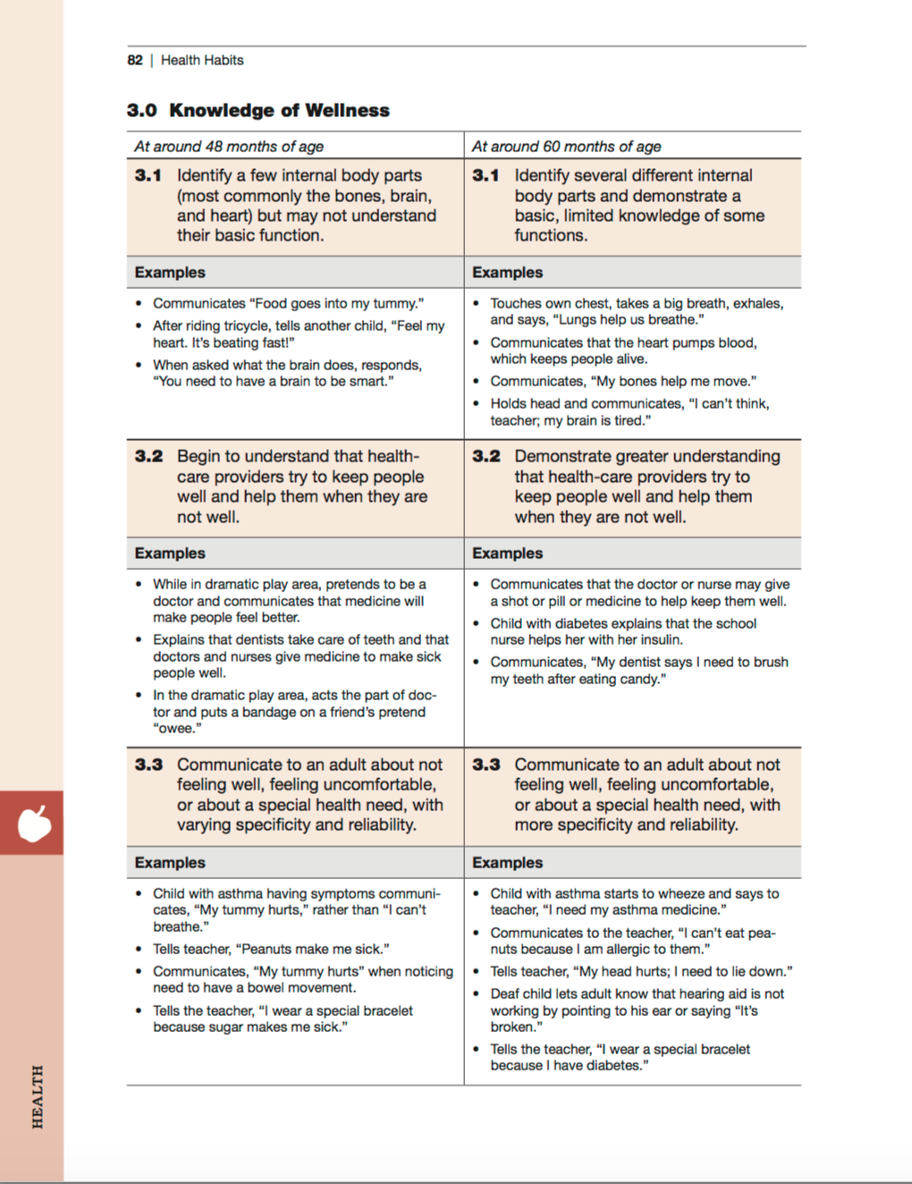
Map of the Foundations
Strand
Substrand
Age
Foundation
Examples
Examine the developmental progression between 48 and 60 months in the foundation:
What do you notice is developing?
Use the examples to help you think about growth and change.
Domain
Notes:
Background Information:
Refer to Handout 1: Foundations Map.
Presenter Remarks:
Please find Handout 1: Foundations Map and follow along while we discuss each component of the foundations:
The name of the domain is Health.
The name of the strand is Health Habits.
The name of the substrand is Knowledge of Wellness.
Note that substrands always end with a zero (1.0, 2.0, etc.).
The two age levels are at around 48 months and at around 60 months.
Each foundation describes typical behaviors at around 48 months and at around 60 months (or four to five years of age).
The foundations for each age level are listed below the age levels.
There are three for each age level on this page (3.1, 3.2, and 3.3 for 48 months; 3.1, 3.2, and 3.3 for 60 months).
Notice that there is a developmental progression from four years old to five years old within a substrand.
The examples for each foundation are listed.
These are only a few of the ways that children may demonstrate the behavior in the foundation.
Many of the foundations also have footnotes that include information specific for students with IEPs or students with disabilities, such as information about adaptations or accommodations.

Slide 16
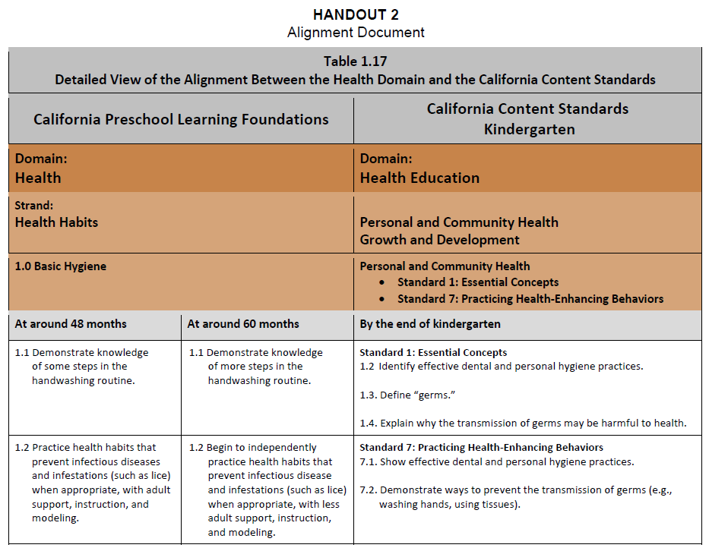
Alignment of
Developmental Progression
Notes:
Background Information:
The chart on the slide can be found on pages 39-40 of the Alignment Document.
Presenter Remarks:
The Alignment Document provides information about the connections between the Preschool Learning Foundations and the kindergarten content standards for California public schools.
Look at Handout 2: Language Use and Conventions Alignment to see the detailed alignment of the Health domain substrands and the kindergarten content standards. Underline anything you find interesting. (Allow 3-4 minutes to read and underline.)
Would anyone like to share what they underlined or found to be of interest?
When you look at the alignment table you can see the connections between the preschool foundations and the kindergarten content standards. Although the foundations and standards may, at times, be organized differently or may not correspond exactly, there is a correlational progression between them.
Extra Notes:
The following optional discussion questions that can be used if participants need prompting to start discussion:
What do you observe about the different expectations for children at around 48 months of age, at around 60 months of age, and by the end of kindergarten?
In recognition of these developmental stages, what are the implications for TK teachers in supporting children’s developing language use and conventions abilities?

Slide 17
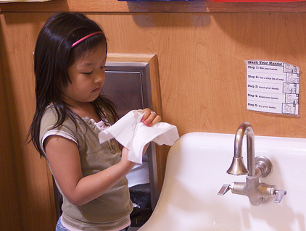
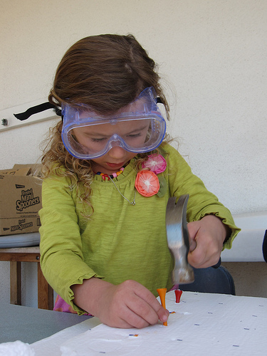
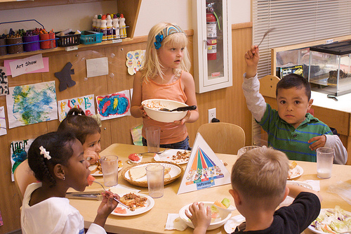
Health Strands: Health Habits, Safety, and Nutrition
Health Habits
Safety
Nutrition
©2017 California Department of Education
Notes:
Presenter Remarks:
The foundations for the health domain are grouped into three strands:
(Click to reveal) Health Habits strand
The Health Habits strand includes the Basic Hygiene, Oral Health, Knowledge of Wellness and Sun Safety substrands.
(Click to reveal) Safety strand
The Safety strand includes the Injury Prevention substrand.
(Click to reveal) Nutrition strand
The Nutrition strand includes the Nutrition Knowledge, Nutrition Choices, and Self-Regulation of Eating substrands.
(Turn to page 79 in the Preschool Learning Foundations [Volume 2] to see the overview of the foundations.)

Slide 18
Environments and Routines Matter
Guiding Principle: “Children learn through their experiences, including play, routines and scripts, modeling, and developing and sustaining relationships at preschool” (PCF, Vol. 2, p. 228).
  Think of how many fruits and vegetables you ate yesterday and write the number on the back of Handout 3.
  Hold up your number and find a partner who ate the same or closest number.
  Read over the handout together and discuss any thoughts or ideas you might have.
Notes:
Presenter Remarks:
One key guiding principle that highlights the importance of utilizing intentional daily routines, the environment, and natural play experiences to support health development is, “Children learn through their experiences, including play, routines and scripts, modeling, and developing and sustaining relationships at preschool” (PCF, Vol. 2, p. 228).
Just as with all learning, teachers must approach their health curriculum with intentionality and planning. Although it is beneficial to first introduce a topic through teacher-guided activities, we must remember that “learning is primarily achieved through children’s daily routines (e.g. washing hands at certain times, brushing teeth after meals) and verbal or nonverbal scripts that illustrate the desired lifelong behavior (e.g., using tissue when blowing the nose, coughing into elbows)” (PCF, Vol. 2, p. 233).
The environment plays a key role in supporting the type of play that elaborates on health topics. The Preschool Curriculum Framework (Volume 2) lists seven key strategies that teachers may utilize to create an environment that supports the development of healthy habits, safety, and nutrition in young children. These strategies are listed on Handout 3: Environments and Materials.
Think of how many fruits and vegetables you ate yesterday and write the number on the back of Handout 3. Hold up your number and find a partner who ate the same or the closest number. Briefly read over the handout together and discuss any thoughts or ideas you might have.

Slide 19
Universal Design for Learning
Multiple means of:
Representation
Engagement
Expression
Notes:
Presenter Remarks:
“Recognizing that students follow different pathways to learning, this framework incorporates a concept known as universal design for learning.
“Universal design provides for multiple means of representation, multiple means of engagement, and multiple means of expression…Multiple means of representation refers to providing information in a variety of ways so the learning needs of all children are met. For example, it is important to speak clearly to children with auditory disabilities while also presenting information visually (such as with objects and pictures).
“Multiple means of expression refers to allowing children to use alternative ways to communicate or demonstrate what they know or what they are feeling. For example, when a teacher seeks a verbal response, a child may respond in any language, including American Sign Language. A child with special needs who cannot speak may also respond by pointing, gazing, gesturing, using a picture system of communication, or by using any other form of alternative or augmented communication system.
“Multiple means of engagement refers to providing choices in the setting or program that facilitate learning by building on children’s interests. The information in this curriculum framework has been worded to incorporate multiple means of representation, expression, and engagement” (PCF, Vol. 2, p. 14).
The photograph on the slide shows a teacher using Universal Design for Learning by simultaneously explaining the schedule verbally and displaying it visually.

Slide 20
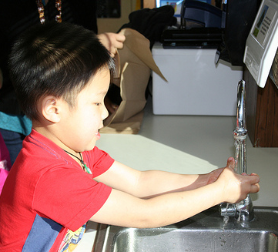
Guiding Principle
Guiding Principle: “Health knowledge is individualized” (PCF, Vol. 2, p. 227).
©2017 California Department of Education
Notes:
Presenter Remarks:
“There is considerable research on the direct and indirect health benefits of comprehensive, model early childhood programs. The benefits are even more significant for children with risk factors and are evident in the outcomes: the reduced incidence of child injuries, child abuse, depression, drug use, emergency room visits, and hospitalizations; better eating habits; and improved use of health services, including health screenings and immunizations” (Braveman, Sadegh-Nobariand, and Ergeter as cited in PLF, Vol. 2, p. 70).
“Individual differences in personal health often begin early in life and are maintained across the lifespan” (Guyer and others as cited in PLF, Vol. 2, p. 71).
“For all children, but especially for children with special healthcare needs, the management of symptoms, the prevention of complications and the promotion of health are critically important for education success in preschool and beyond” (PLF, Vol. 2, p. 71).
“Forty-five percent of children with a chronic illness are reported to fall behind in school” (Thies as cited in PLF, Vol. 2, p. 72).

Slide 21
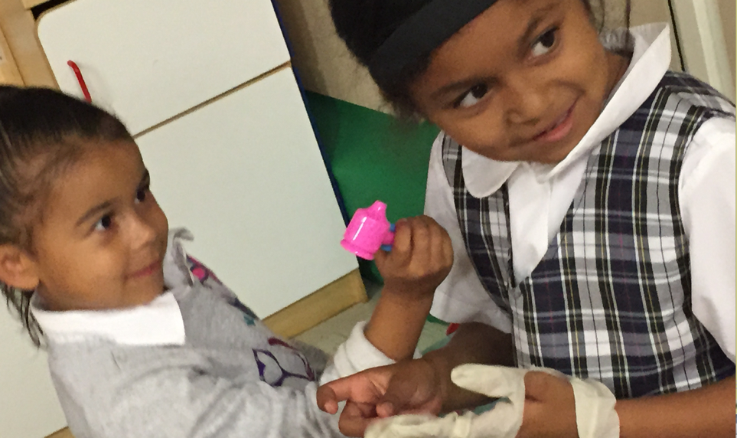
Guiding Principle
Guiding Principle: “Preschool children and their families possess diverse backgrounds and cultural practices” (PCF, Vol. 2, p. 227).
©2017 California Department of Education
Notes:
Presenter Remarks:
One key guiding principle highlights the need to partner with families while supporting health development in the classroom.
It reads ”Preschool children and their families possess diverse backgrounds and cultural practices” (PCF, Vol. 2, p. 227).
Think about your personal family and cultural practices around health you are willing to discuss. Share this with your table group. (Allow for discussion.)
Was there diversity in the health practices you shared? How might these discussions inform your approach to supporting health development in your students?
Extra Note: Trainers may want to think of a personal health practice to share as an example. For instance a trainer may be a vegetarian, or only drink goats milk, or own a dairy and only drink cows milk, or not eat gluten. These examples may be shared before the table group discussion.

Slide 22
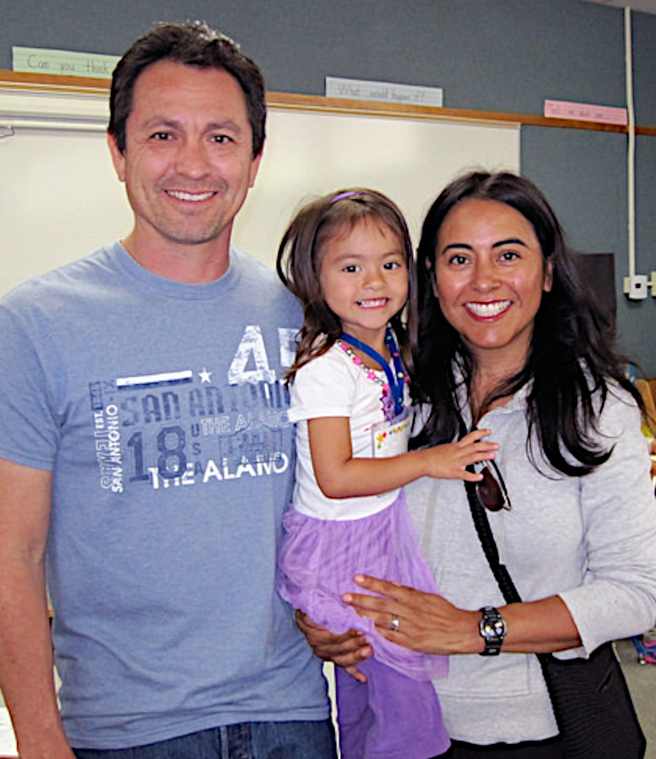
Partner with Families
Engaging Families: Preschool Curriculum Framework
All About Young Children
Best Practices for Planning Curriculum: Family Partnerships and Culture
TK Implementation Guide
Notes:
Presenter Remarks:
In order to effectively build on children's existing strengths, we must understand them. To do this, we need to partner with families to learn about their children’s strengths.
The resources on this slide are specifically beneficial for partnering with families. You may want to take a picture of this slide and refer to it later.
Optional:
Create a gallery table and have examples of documents there.
Extra Notes:
The resources are hyperlinked. If Wi-Fi access is available, display the resources and do a walkthrough.

Slide 23
Time Machine
First:
Read Handout 3: Environments and Materials.
Have a table discussion about the ways the classroom environment might be enhanced by using the ideas from the handout.
Second:
Step into your time machine.
Travel forward six months.
Look at your amazing, successful program!
What do you see, hear, and feel that is making the health environment a success?
Represent what you see in your future classroom by filling out Handout 4: Time Machine.
Notes:
Activity 2: Time Machine
intent:
Participants gain experience using the Preschool Curriculum Framework (Volume 2) to enhance the classroom environment.
OUTCOMES:
Participants will read, reflect upon, and plan using the environmental suggestions listed in the Preschool Curriculum Framework (Volume 2).
Materials Required:
Handout 3: Environments and Materials
Handout 4: Time Machine
(Optional) Back to the Future music
TIME: 10 minutes
Process:
Have participants read Handout 3: Environments and Materials.
Allow five minutes for table groups to discuss potential ways they might enhance the classroom environment using the ideas from the handout.
Read the following script:
Step into your time machine.
Travel forward six months.
Look at your amazing, successful program!
What do you see, hear, and feel that is making the health environment a success?
Ask participants to represent what they saw in their future classroom by filling out Handout 4: Time Machine (write, draw, etc.)

Slide 24
First Substrand: Health Habits
Basic Hygiene
Oral Health
Knowledge of Wellness
Sun Safety
Notes:
Presenter Remarks:
The Health Habits strand includes the following substrands: Basic Hygiene, Oral Health, Knowledge of Wellness, and Sun Safety.
Think of a time you may have been in a hurry to transition from the bathroom back to the classroom. You may have even not noticed that all students had not washed their hands and practiced basic hygiene. If this happens in the middle of the year most likely the students reminded you themselves protesting that they could not leave yet because they had not washed their hands. This is an example of students shifting from having the teachers remind them of health habits to taking responsibility on their own.
Think of one way your children experience these health habits throughout the day. Share at your table group.

Slide 25
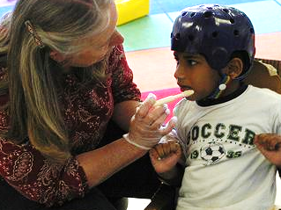
Health Habits
Turn to page 80 in the Preschool Learning Foundations (Volume 2).
©2017 California Department of Education
Notes:
Presenter Remarks:
Please turn to page 80 in the Preschool Learning Foundations (Volume 2) and begin reading about the Health Habits substrands. Underline one sentence that is interesting to you about each of the substrands: Basic Hygiene, Oral Health, Knowledge of Wellness, and Sun Safety. (Provide five minutes to read and underline.)
Find your fruit and vegetable partner from earlier today and exchange thoughts. Did you underline any of the same sentences? Explain why you choose the sentences you did. (Allow five minutes for discussion.)
Would anyone like to share highlights from their discussion?
Thank you for sharing. Please return to your seats. As you walk back to your chair, consider the health routines you listed in the first activity. Do any of them fit within one of these substrands?

Slide 26
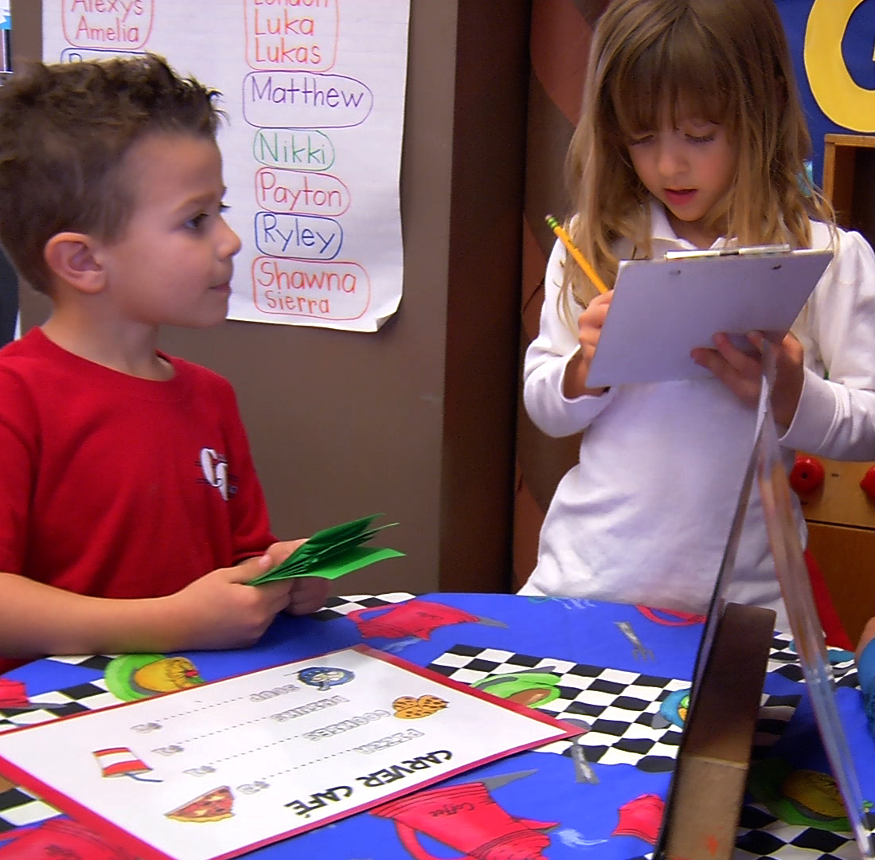
Health Habits
“Language scripts in both English and the child’s home language (including sign language), along with daily routines, help health behaviors become internalized for preschool children and establish a basis for lifelong healthy habits” (PCF, Vol. 2, p. 234).
Notes:
Presenter Remarks:
“Learning about health practices has a language component” (PCF, Vol. 2, p. 227). In order to incorporate the language component, teachers need to enhance understanding of unfamiliar terms by modeling, using visual cues and props, and demonstrating. It’s important to support learning in English as well as the other home languages used by children—including sign language—when introducing new terms.
“Before children develop a ‘life concept,’ practicing scripts or rules of behavior can be used to establish certain health-promoting behaviors or habits. For example, an early study (Poche, McCubbrey, and Munn, 1988) on teaching three- and four-year-old children how to brush their teeth divided the task up into 16 discrete steps. Children were taught how to perform each step in order over a period of several weeks. These children were able to learn how to brush their teeth effectively and retained the skill several months after the instruction ended (Poche, McCubbrey, and Munn 1988). Such habits can provide the scaffolding for the child’s developing theories about and understanding of the body, health, and life (Eiser 1989; Nelson and Gruendel 1986)” (PLF, Vol. 2, p. 74).
“Language scripts in both English and the child’s home language (including sign language), along with daily routines, help health behaviors become internalized for preschool children and establish a basis for lifelong healthy habits. Combining pictures with the spoken home language is also very helpful. An example of a handwashing poster that is available in English, Spanish, or both languages can be downloaded at http://www.child-healthonline.org/downloadform.html.9” (PCF, Vol. 2, p. 234).

Slide 27
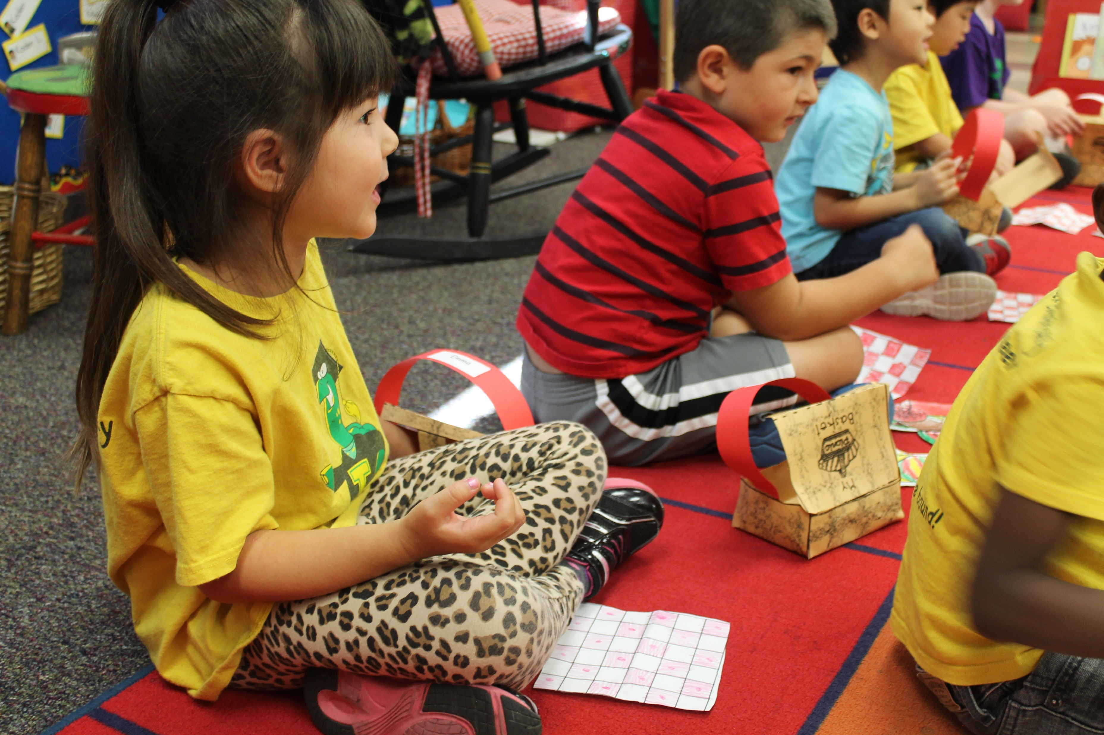
Interaction and Strategy
“Reinforce learning with stories and music” (PCF, Vol. 2, p. 237).
©2017 California Department of Education
Notes:
Presenter Remarks:
One key interaction and strategy to use is, “Reinforce learning with stories and music. Teach short (i.e., 20-second) songs about handwashing and include music tapes or CDs in the interest areas. Play or sing songs in both English and the children’s home languages to remind children of routine hand-washing times. Read books or tell stories about preventing the spread of germs through proper handwashing, covering a cough, sneezing into the elbow, and using disposable tissue when blowing noses” (PCF, Vol. 2, p. 237).
This photograph shows children listening to a story about gathering and washing fruits for a picnic.
Locate Handout 5: Songs. This handout provides some song examples to sing in the classroom. You may choose one of these songs to practice as a group or you can select a different song that a group member uses to support health habits. (Allow two-three minutes to practice.)
Invite table groups to share if they practiced a different song.
Did any of the songs we practiced support children’s knowledge of wellness? Let’s look at a tool that would help inform our understanding of our student’s development of knowledge of wellness.

Slide 28

Key Features of the DRDP-K (2015)
An observation-based assessment tool,
not a test
Individual child assessment
Completed by each child’s teacher
Based on developmental research and theory
Includes developmental sequences of behaviors along a continuum
Spans the developmental continuum of children in a two-year kindergarten program
Notes:
Presenter Remarks:
One resource that is used to support children’s development is the Desired Results Developmental Profile—Kindergarten (2015): A Developmental Continuum for Kindergarten (DRDP-K [2015]). This is especially helpful for English Learners.
The DRDP-K (2015) informs teachers’ understanding of the developmental continuum. It can be used with the Alignment Document to expand upon the developmental continuum.
One key feature of the DRDP-K (2015) to consider is that it is an observation-based assessment and not a test. It is used to support children’s learning. Observing and documenting children's progress provides teachers the information needed to differentiate instruction and experiences. It also provides information to individualize.
Observational tools are preferred over criterion-referenced tools because the information gathered by observation more accurately reflects what children are able to do.
Documentation provides concrete evidence of what children are able to do. With this documentation, we are then able to better plan activities that will meet and appropriately challenge children's developmental needs.
The DRDP-K (2015) also includes the following features:
It is an individual child assessment that can be shared with families.
It is aligned with the Preschool Learning Foundations.
It opens up the opportunity for articulation between preschool and TK teachers.
Sharing information as to where children are on the developmental continuum can better prepare the TK teacher to work with students.
A teacher can include a request form for previous records as part of the TK registration to help support the relationship between preschool, family, and TK.
The DRDP-K (2015) has been developed with world renowned experts. It is based on research and knowledge of what is most important for predicting school success.

Slide 29
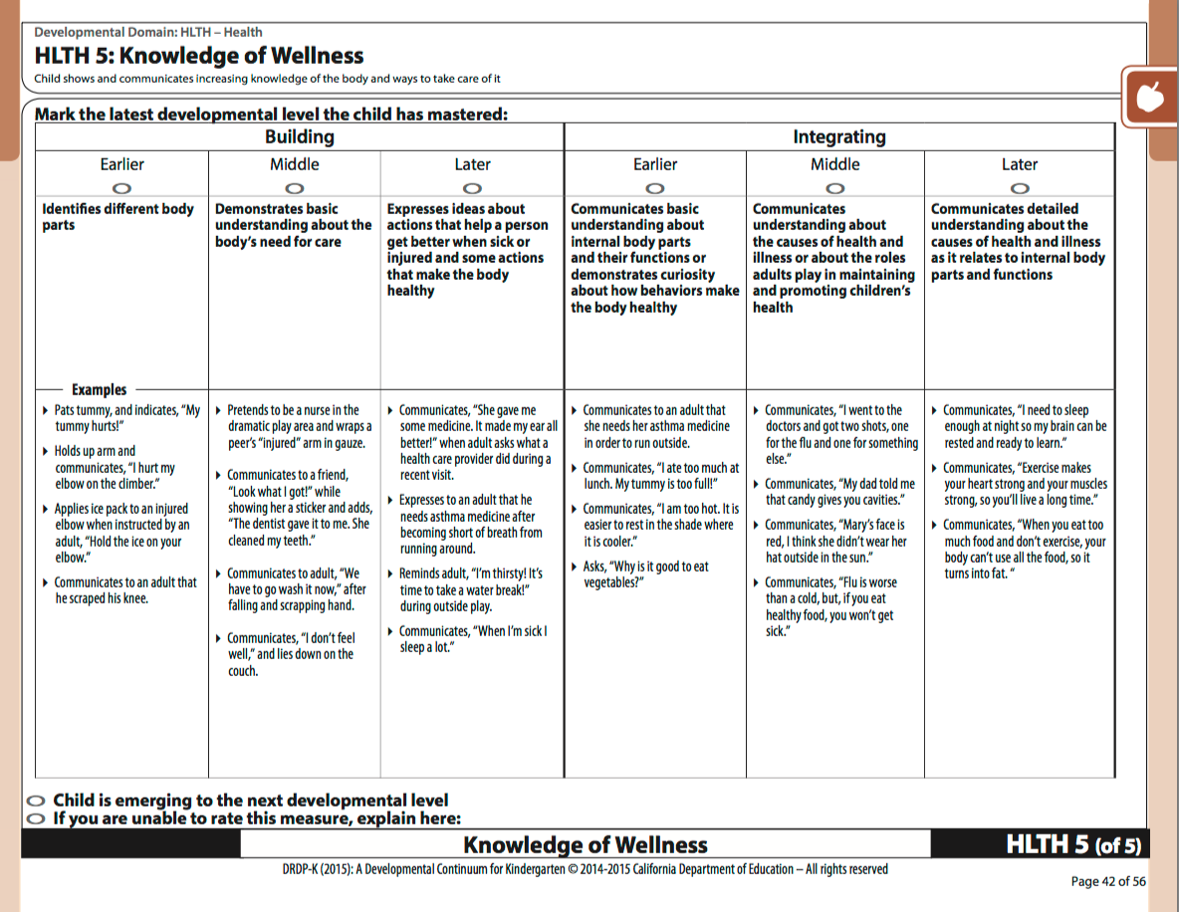
DRDP-K (2015) Discussion
Notes:
Presenter Remarks:
The DRDP-K (2015) gives TK teachers a lens through which to measure TK students’ knowledge of wellness.
The Knowledge of Wellness measure shows the child’s knowledge developing from identifying different body parts to communicating detailed understanding about the causes of health and illness as it relates to internal body part functions.
Look at Handout 6: DRDP-K (2015). Read through the measure and highlight what is interesting to you. Have a conversation with your elbow partner about how this tool might support your curriculum planning.

Slide 30
Integrating Health Habits
Read through the interactions and strategies from the Health Habits strand section of the Preschool Curriculum Framework (Volume 2)—starting on page 233.
Explore the objects in the Health Box and discuss each item’s connection to health with your groupmates.
Take out Handout 7: Integrating Health Habits into Daily Routines.
Select one item from the box and consider how it could be used to inspire activities that support the development of health knowledge and practices.
Write your activity ideas on Handout 7
Share your activity ideas with your groupmates.
Notes:
Activity 3: Integrating Health Habits
Presenter Remarks:
Let’s look at interactions and strategies that support the development of health knowledge and practices.
intent:
Participants read interactions and strategies from the Preschool Curriculum Framework (Volume 2) and share activities that support the development of health knowledge and practices.
OUTCOMES:
Participants will do the following:
Read interactions and strategies from the health habits section of the Preschool Curriculum Framework (Volume 2)
Explore health-related items
Brainstorm for item-based activities that could be used in the classroom to facilitate development of the health foundations
Share activity ideas with groupmates
Materials Required:
Preschool Curriculum Framework (Volume 2)
Handout 7: Integrating Health Habits into Daily Routines
One Health Box per table group—each containing a variety of health items (e.g., toothbrush, sunscreen, apple, carrot, hand sanitizer, tissue, washcloth, hair brush, band aid, etc.)
TIME: 20 minutes
Process:
Direct participants to the Health Habits strand section of the Preschool Curriculum Framework (Volume 2)—starting on page 233.
Point out that there are interactions and strategies listed for each substrand section: Basic Hygiene, Oral Health, Knowledge of Wellness, and Sun Safety.
Highlight and read one interaction and strategy aloud to the whole group.
Give participants five minutes to read through more of the interactions and strategies.
Direct participants to the Health Box on their tabletop. Have them explore the objects and discuss each item’s connection to health with their groupmates.
Ask participants to take out Handout 7: Integrating Health Habits into Daily Routines.
Have each participant to select one item from the box and consider how they would use that item to inspire activities that support the development of health knowledge and practices. Remind participants to consider the interactions and strategies they read as they brainstorm these activities.
Direct participants to write their activity ideas on the handout.
Have groupmates share their activity ideas with each other.
OPTIONAL debrief scenarios:
Allow time for each table group to share their favorite ideas.
Have table groups write down the health habit foundations being addressed by each idea.
Have participants think about a specific child in their program that would benefit from targeted support of health foundations.
How might the ideas they wrote down specifically support this child?

Slide 31
Safety Substrand
Health Habits | Safety | Nutrition
Basic Hygiene | Injury Prevention | Nutrition Knowledge
Oral Health |  | Nutrition Choices
Knowledge of Wellness |  | Self-Regulation of Eating
Sun Safety
Health Habits strand:
Basic Hygiene substrand
Oral Health substrand
Knowledge of Wellness substrand
Sun Safety substrand
Safety strand:
Injury Prevention substrand
Nutrition strand:
Nutrition Knowledge substrand
Nutrition Choices substrand
Self-Regulation of Eating substrand
Notes:
Presenter Remarks:
Turn to the Safety strand on page 84 of the Preschool Learning Foundations (Volume 2).
Injury prevention is vital for children’s well being. It is the responsibility of adults to support this for young children. The following slides will focus on key strategies to help children develop their abilities regarding injury prevention.

Slide 32
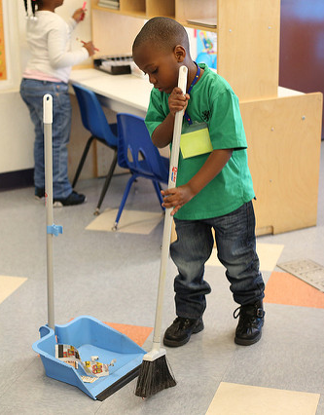
Safety
“Environment is the first component of safety; a safe environment allows children to explore, play, and learn without unnecessary restriction”
(PCF, Vol. 2, p. 229).
©2017 California Department of Education
Notes:
Presenter Remarks:
“Safety in preschool involves establishing and maintaining a safe environment; supervising children while being involved in their activities; and helping children develop skills and learn ways to stay safe” (PCF, Vol. 2, p. 254).
“Provide furnishings and utensils appropriate for children’s size and abilities. Child-sized tables and chairs let preschool children easily reach the table while sitting comfortably with feet touching the floor. Small sturdy trays, plates, and cups make it easier for children to grasp, lift, and carry. There are a variety of utensils available with larger grip handles or bent angles to support children who do not yet turn their wrist. Handwashing sinks should be child-sized; if not, provide wide-based sturdy step stools with non-slip base and top. Teachers may consult an early childhood special education teacher or other specialist for guidance in selecting items appropriate for children with special physical needs” (PCF, Vol. 2, p. 231).
“The purpose of safety rules and guidance is to promote awareness and encourage developmentally appropriate behavior to prevent injury. Teachers may include separate rules for the classroom, playground, hallways, busses, or emergency drills” (PCF, Vol. 2, p. 254).
Consider some of the ways that you establish a safe environment and discuss these methods with your tablemates.

Slide 33
Safety
“It is up to responsible adults to protect the children in their care…” (Debby Cryer, Thelma Harms, and Cathy Riley, All About the ECERS-R: A Detailed Guide In Words & Pictures to Be Used with the ECERS-R, p. 135).
Notes:
Presenter Remarks:
“It is up to responsible adults to protect the children in their care, to minimize hazards present in a child’s space, and to also supervise carefully. Supervision cannot take the place of minimizing hazards. No assumptions can be made, such as saying, ‘I know it is dangerous, but the children know not to go near it,’ or, ‘We have never had a child fall from that place,’ or, ‘We are always watching.’ Accidents will happen” (Debby Cryer, Thelma Harms, and Cathy Riley, All About the ECERS-R: A Detailed Guide In Words & Pictures to Be Used with the ECERS-R, p. 135).

Slide 34
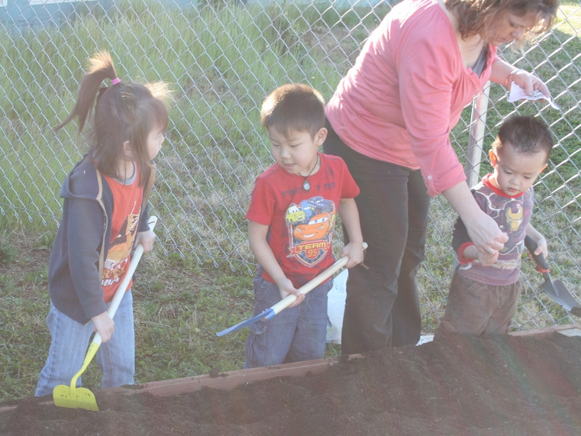
Effective Supervision
“How do you effectively supervise children while being actively engaged in their play?” (PCF, Vol. 2, p. 261).
©2017 California Department of Education
Notes:
Presenter Remarks:
Discuss the following questions with your tablemates:
“How do you effectively supervise children while being actively engaged in their play?” (PCF, Vol. 2, p. 26).
“What practices are in place to ensure that children with special needs will be safe in emergency situations?” (PCF, Vol. 2, p. 261).

Slide 35
Safety Interactions and Strategies
Table group discussion:
Number off at your table group to discover your assigned strategy.
Locate and read your strategy section in the Preschool Curriculum Framework (Volume 2).
Take turns explaining your strategies to each other.
“Provide coaching and gentle reminders to help children follow safety rules” (PCF, Vol. 2, p. 256).
“Involve children in creating rules” (PCF, Vol. 2, p. 256).
“Role-play safety helpers” (PCF, Vol. 2, p. 258).
“Practice problem solving” (PCF, Vol. 2, p. 258).
“Introduce safety signs” (PCF, Vol. 2, p. 259).
Notes:
Presenter Remarks:
This slide lists key interactions and strategies that teachers may use to support safety development. Let’s discuss these strategies in our table groups to better understand how to implement them in the classroom.
Please number off at your table group to discover your assigned strategy. Now locate and read your strategy section in the Preschool Curriculum Framework (Volume 2). Take turns explaining your strategies to each other once everyone at your table is finished reading. (Allow time for groups to read and share.)
Would anyone like to share something they are excited to implement in their classroom?
There are many other strategies—as well as other relevant information—in the Preschool Curriculum Framework (Volume 2). You may want to make a note to return later to read the research highlight on page 257; it is impactful and provides motivation for continuing our work in regards to the promotion of safety.

Slide 36
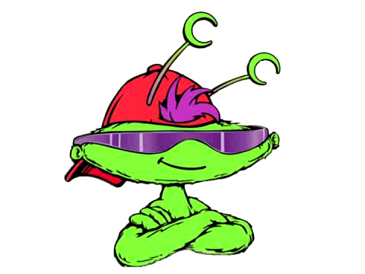
Nutrition Transition
Insert singing/dancing video clip here
Notes:
Background Information:
Insert the video prior to the presentation. The video is from the Head Start “I Am Moving, I Am Learning” training materials.
Presenter Remarks:
Let’s get moving with a nutrition song as we transition our energy into the Nutrition substrand. Please stand up and join in. Remember to honor your own body allowances. (Play the video and move along with the music.)
This video demonstrates teachers integrating nutrition into their daily music and movement time. While the intention is nutrition, what other learning domains did you see? (Solicit responses from the group.)
Yes, this song also facilitates vocabulary development, fine motor development, large motor development, balance, music awareness, and group participation.
It is crucial to consider the integration of learning, especially with regards to nutrition, as it can be such a vital component for lifelong health.

Slide 37
Nutrition Substrand
Health Habits | Safety | Nutrition
Basic Hygiene | Injury Prevention | Nutrition Knowledge
Oral Health |  | Nutrition Choices
Knowledge of Wellness |  | Self-Regulation of Eating
Sun Safety
Health Habits strand:
Basic Hygiene substrand
Oral Health substrand
Knowledge of Wellness substrand
Sun Safety substrand
Safety strand:
Injury Prevention substrand
Nutrition strand:
Nutrition Knowledge substrand
Nutrition Choices substrand
Self-Regulation of Eating substrand
Notes:
Presenter Remarks:
Turn to page 85 of the Preschool Learning Foundations (Volume 2) to find the Nutrition strand.
Look through the substrands (Nutrition Knowledge, Nutrition Choices, and Self-Regulation of Eating) and underline something that you find to be particularly interesting. Share your interesting finding with an elbow partner.

Slide 38
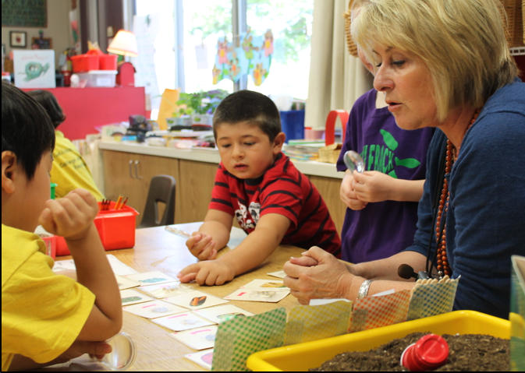
Nutrition Integration
“Providing nutritionally balanced meals and snacks and integrating nutrition education and healthy eating habits in the home and early childhood environment can help prevent health risks such as childhood obesity” (PCF, Vol. 2, p. 262).
Notes:
Presenter Remarks:
“Life-long eating habits are shaped during a child's early years, offering teachers of young children a special opportunity to help establish a healthy relationship with food and lay the foundation for sound eating habits. Nutrition education and activities help set children on the path to a healthful lifestyle. Providing nutritionally balanced meals and snacks and integrating nutrition education and healthy eating habits in the home and early childhood environment can help prevent health risks such as childhood obesity” (PCF, Vol. 2, p. 262).
There are learning associations between nutrition and:
Learning readiness
Academic achievement
Decreased discipline and emotional problems
(I am Moving I am Learning-IMIL slide 8 Nutritional Building Blocks)
There are multiple resources available to support the home and school connection. For example, Tip Sheet 7 from the California Department of Education, Nutrition Services Division, has healthy snack ideas and recipes for both home and school. Resources are available in English and Spanish. Refer participants to visit www.healthypreschoolers.com for more information.

Slide 39
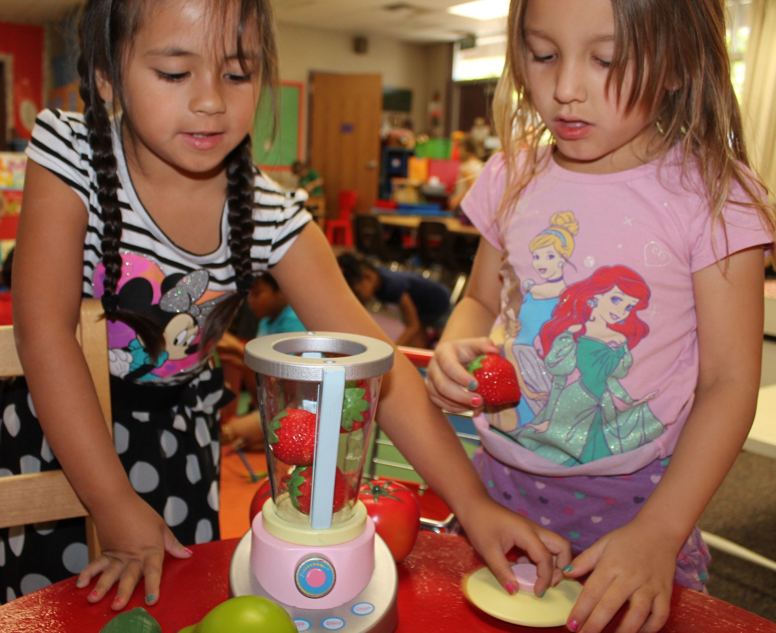
Nutrition Interactions and Strategies
“Discuss how the body uses food” (PCF, Vol. 2, p. 273).
“Integrate nutrition education with other learning areas” (PCF, Vol. 2, p. 270).
©2017 California Department of Education
Notes:
Presenter Remarks:
The two following interactions and strategies support nutrition development:
“Discuss how the body uses food” (PCF, Vol. 2, p. 273).
“Integrate nutrition education with other learning areas” (PCF, Vol. 2, p. 270).
There are great resources available that expand upon the strategies in the Preschool Curriculum Framework. Take a moment now to look through the Nutrition and Self-Assessment packets on your tabletop. How might you use these resources?
Trainer Note: You will find these packets in the Table Resources to print prior to training.

Slide 40
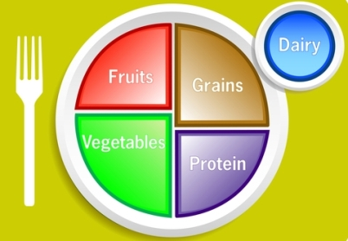
Food Plate Toss
Notes:
Activity 4: Food Plate Toss
Presenter Remarks:
Let’s practice a nutrition-based activity that can be used in the classroom.
intent:
Participants experience a nutrition-based activity that can be used in the classroom.
OUTCOMES:
Participants will reflect on their personal knowledge of nutrition. This activity will help launch module content regarding the nutrition strand, and serve as an example activity for teachers to do with students.
Materials Required:
For inside play:
Drop cloth with food plate on it or marked with colored masking tape (orange, green, red, blue, and purple)
Grab bag filled with objects and/or pictures representing foods from each food group
Name cards for each of the five groups (grains, vegetables, fruits, milk, meat and beans)
For outside play:
Sidewalk chalk
Name cards for each of the five food groups
Bean bags with pictures of foods on them
TIME: 5 minutes
Process:
Place the drop cloth on the floor with the food labels clearly displayed.
Review food group names and contents to remind participants of food plate organization.
Take out the grab bag and ask four or five volunteers to join you.
Have the first volunteer blindly reach into the bag and choose one thing to pull out.
Have the first volunteer hold up the object they chose, showing the whole group.
Provide support to the volunteer as needed to help them identify the food group the object belongs to.
Guide the participant to stand on the correct food group (i.e., match the object to the correct food group and stand with the object on the drop cloth).
Repeat these steps for the remaining volunteers.
Guide participants to discuss what ways they might front-load, enhance, and expand this activity to meet the needs of all the children in their programs.
Ask participants to analyze which foundations in the Nutrition strand might be supported by this activity.
Invite participants to share their ideas with the whole group or have two groups join up to share their ideas with each other.
Have participants return to their tables.
Give participants the following tip: Introduce the food plate with another activity or book—such as The Beastly Feast by Bruce Goldstone—one or two days prior to doing this activity in your classroom.

Slide 41
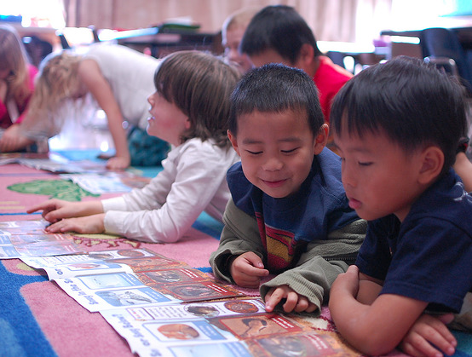
Nutrition
True or False?
Fear of new foods is common in children.
©2017 California Department of Education
Notes:
Background Information:
The answer to the question on the slide is true. See the research highlight on page 262 if the Preschool Curriculum Framework (Volume 2) for more details.
Presenter Remarks:
“Fear of new foods is common in children. It may take many tries before a child will taste a new food and up to 20 exposures before a child decides he likes or truly dislikes a food. Food jags (when a child will eat only one food item meal after meal) are also common. Food jags rarely last long enough to cause harm. Children’s eating habits are a way for them to feel independent. They reflect typical development in children” (PCF, Vol. 2, p. 262).
For more ideas on introducing foods to children, see the Spring Snacking page in the Nutrition Packet (page 115 from Food for Thought: Nutrition Across the Curriculum).
41

Slide 42
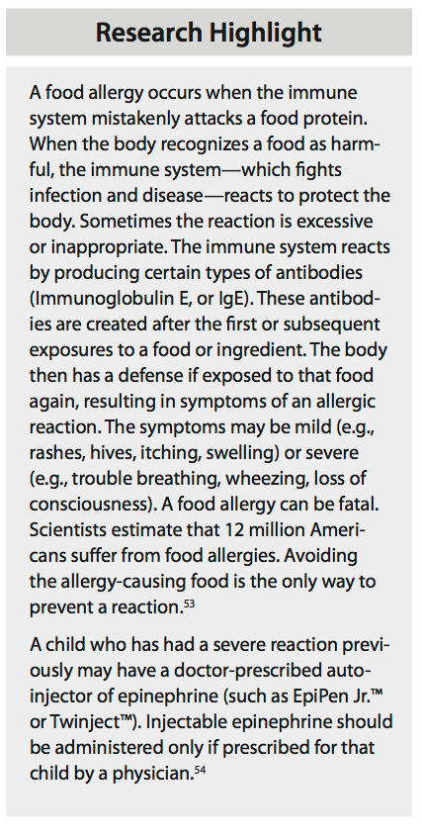
Research Highlight
Turn to the page 270 in the Preschool Curriculum Framework (Volume 2) and read the research highlight on food allergies.
Discuss the following question with your tablemates: “How have you addressed individual needs (e.g., food allergies, eating difficulties, religious or cultural preferences) when planning cooking activities?” (PCF, Vol. 2, p. 275).
Notes:
Presenter Remarks:
Turn to the page 270 in the Preschool Curriculum Framework (Volume 2) and read the research highlight on food allergies.
Discuss the following reflection question with your tablemates: “How have you addressed individual needs (e.g., food allergies, eating difficulties, religious or cultural preferences) when planning cooking activities?” (PCF, Vol. 2, p. 275).

Slide 43
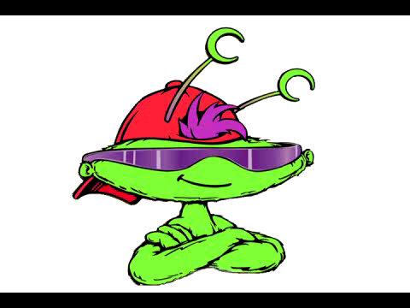
What might health look like in the TK classroom?
Insert smoothie video here
Notes:
Background Information:
The questions you ask the participants regarding the video may provoke conversations around the integration of the Health domain with other domains such as Physical Development, Mathematics, and Language and Literacy. Be prepared to facilitate these thoughts as needed by inviting participants to think about the following:
DRDP-K (2015) measures potentially observed in this video
How this might look with children who are English learners
What they liked about the video
What they didn’t like about the video and what they might do differently
Presenter Remarks:
This video is from the Head Start “I Am Moving, I Am Learning” training materials.
(Ask the following questions following the video.)
What did you see happening in the video?
Was there anything that seemed exciting or interesting to you?
Why was that so meaningful?
How might you replicate the same idea in your classroom?

Slide 44
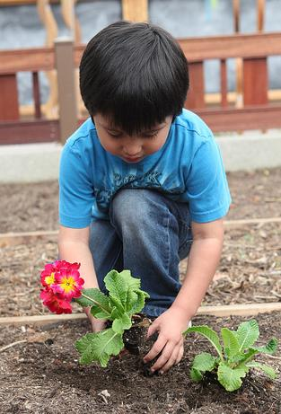
Thank you for coming!
Turn to your elbow partner and share one new health idea you will try in your classroom.
You may also share one health idea that is already blooming in your classroom.
©2017 California Department of Education
Notes:
Presenter Remarks:
Turn to your elbow partner and share one new health idea you will try in your classroom.
You may also share one health idea that is already blooming in your classroom.
Thank you for coming!

Slide 45
Reference Guide for PowerPoint Citations
California Department of Education. 2010. California Preschool Curriculum Framework, Volume 1. http://www.cde.ca.gov/sp/cd/re/documents/psframeworkkvol1.pdf (accessed May 8, 2017).
California Department of Education. 2011. California Preschool Curriculum Framework, Volume 2. http://www.cde.ca.gov/sp/cd/re/documents/psframeworkvol2.pdf (accessed May 8, 2017).
California Department of Education. 2008. California Preschool Learning Foundations, Volume 2. http://www.cde.ca.gov/sp/cd/re/documents/psfoundationsvol2.pdf (accessed May 8, 2017).
California Department of Education. 2013. Transitional Kindergarten Implementation Guide: A Resource for California Public School District Administrators and Teachers. http://www.cde.ca.gov/ci/gs/em/documents/tkguide.pdf (accessed May 8, 2017).
Cryer, Debby, Thelma Harms, and Cathy Riley. All About the ECERS-R: A Detailed Guide In Words & Pictures to Be Used with the ECERS-R. New York: Teachers College Press, 2003.

