Slide 1
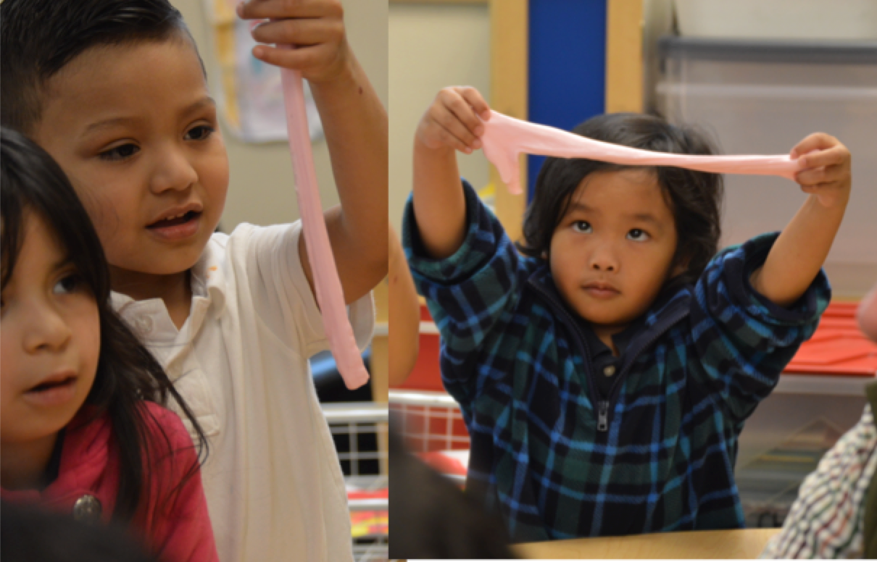
Scientific Inquiry in Transitional Kindergarten
Preschool Learning Foundations and Curriculum Framework, Volume 3 Science Domain
©2016 California Department of Education
Notes:
Presenter Remarks:
Welcome to Scientific Inquiry in Transitional Kindergarten—a presentation focusing on the California Preschool Learning Foundations (Preschool Learning Foundations or PLF), the California Preschool Curriculum Framework (Preschool Curriculum Framework or PCF), and other California Department of Education (CDE) resources in support of the Science domain.
This professional learning session is specifically designed to provide TK teachers with exposure to CDE resources that support TK curriculum planning, developmentally appropriate strategies, and classroom environment design recommendations that support the content area of scientific inquiry.

Slide 2
Objectives
Become aware of key concepts to be developed in the Scientific Inquiry strand of the California Preschool Learning Foundations, Volume 3 (Preschool Learning Foundations or PLF).
Experience, read, and discuss key strategies in the California Preschool Curriculum Framework, Volume 3 (Preschool Curriculum Framework or PCF) regarding scientific inquiry.
Reflect and discuss how to support the development of scientific inquiry foundations for English-language learners.
Plan to adapt learning experiences to ensure access for children with varying needs.
Notes:
Presenter Remarks:
During this session we will:
Become aware of key concepts to be developed in the Scientific Inquiry strand of the California Preschool Learning Foundations, Volume 3 (Preschool Learning Foundations or PLF).
Experience, read, and discuss key strategies in the California Preschool Curriculum Framework, Volume 3 (Preschool Curriculum Framework or PCF) regarding scientific inquiry.
Reflect and discuss how to support the development of scientific inquiry foundations for English-language learners.
Plan to adapt learning experiences to ensure access for children with varying needs.

Slide 3
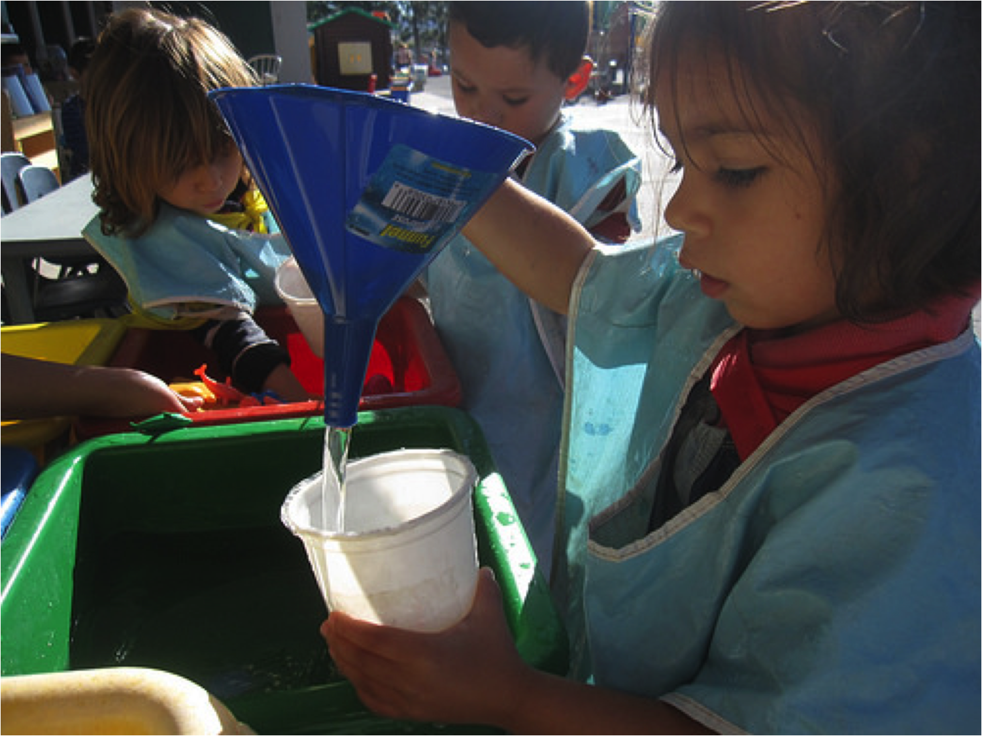
Natural Scientists
“Children have a sense of wonder and natural curiosity about objects and events in the environment. Just like scientists, they seek information and actively explore and investigate the world around them…” (PCF, Vol. 3, p. 136).
©2016 California Department of Education
Notes:
Presenter Remarks:
It is important to utilize a variety of techniques when incorporating science into the transitional kindergarten classroom.
“Children’s natural inclination and ability to observe and try to understand their world, to develop conceptual knowledge, and to reason about many scientific concepts make science an excellent fit for the preschool [or TK] environment” (PLF, Vol. 3, p. 48).
“Science in preschool [and TK] is built on children’s natural curiosity and tendency to actively explore, experiment, and discover the nature of things in their everyday life…Science…is about children observing and investigating objects and events in their environment. Through a planned, play-based, supportive environment, they expand their existing knowledge and experience of their everyday world. Science is about providing children with the basic skills of scientific inquiry, such as observing and describing, comparing and contrasting, classifying, experimenting and recording, and using the scientific vocabulary associated with these skills” (PLF, Vol. 3, p. 49).

Slide 4



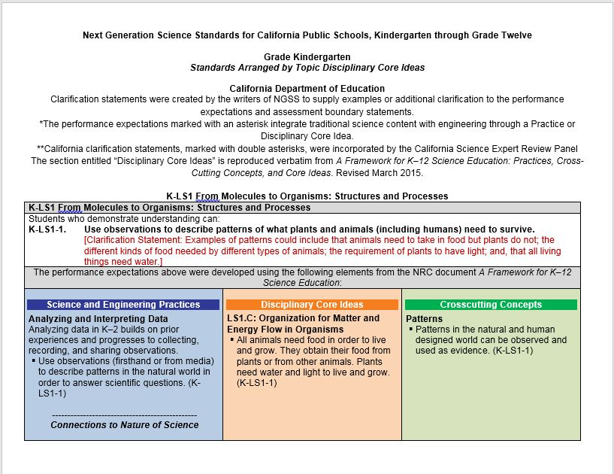




CDE Publications and Resources that Support TK Implementation
Preschool Learning Foundations
California Common Core State Standards
Preschool Curriculum Framework
Next Generation Science Standards
DRDP Specific to TK and K
Alignment Document
PEL Resource Guide
TK Implementation Guide
Preschool Learning Foundations
California Common Core State Standards
Health Education Content Standards for California Public Schools
Preschool Curriculum Frameworks
English Language Arts/English Language Development Framework
DRDP Specific to TK and K
Preschool Alignment Document
Preschool English Learners Guide
Transitional Kindergarten Implementation Guide
Notes:
Presenter Remarks:
The California Department of Education has developed many publications, resources, and supports that enable teachers to facilitate the most positive outcomes for students.
Today our main focus will be on Volume 3 of the Preschool Learning Foundations and the Preschool Curriculum Framework. In addition, there are other key resources that support science: the California Common Core State Standards (CA CCSS), the Transitional Kindergarten Implementation Guide—A Resource for Public School District Administrators and Teachers (TK Implementation Guide), and the Desired Results Developmental Profile—Kindergarten (2015): A Developmental Continuum for Kindergarten (DRDP-K [2015]).
(Name and hold up each resource.) The Preschool Learning Foundations, Volume 1, Volume 2, and Volume 3, and the Preschool Curriculum Framework, Volume 1, Volume 2, and Volume 3, are the center of the California Early Learning and Development System.
During additional professional learning opportunities we will also discuss alignment and make connections to all additional resources pictured in the graphic:
The Alignment of the California Preschool Learning Foundations with Key Early Education Resources (Alignment Document)
Next Generation Science Standards for California Public Schools, Kindergarten through Grade Twelve (NGSS for CA)
Preschool English Learners: Principles and Practices to Promote Language, Literacy, and Learning—A Resource Guide (Second Edition) (PEL Resource Guide)

Slide 5
Why Use the Preschool Learning Foundations for TK?
CA Law (EC 48000):
Transitional kindergarten is the first year of a two-year kindergarten program that uses a modified kindergarten curriculum that is age and developmentally appropriate.
Transitional kindergarten programs are intended to be aligned to the California Preschool Learning Foundations developed by the CDE.
Notes:
Background Information:
CDE.CA.gov/ci/gs/em/kinderfaq.asp#program
Presenter Remarks:
The state of California provides guidance on utilizing the Preschool Learning Foundations and the Preschool Curriculum Framework as planning and curriculum resources in the transitional kindergarten classroom.
In addition, the following publications and resources are available to support age and developmentally appropriate TK curriculum:
TK Implementation Guide
Alignment Document
CA CCSS
DRDP-K (2015)
We will now look at how these resources work together to support all learners in science.

Slide 6

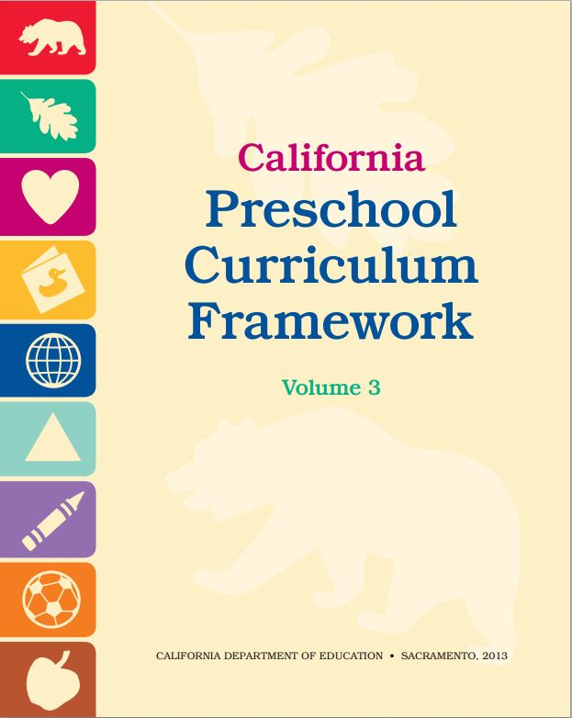
Foundations and Framework, Volume 3
Notes:
Background Information:
The Science domain is found in Volume 3 of the Preschool Learning Foundations and Preschool Curriculum Framework.
Presenter Remarks:
The purpose of the Preschool Learning Foundations is to promote a common understanding of preschool children’s learning and to guide instructional practice; they describe the knowledge and skills that young children typically develop when provided with developmentally, culturally, and linguistically appropriate learning experiences.
The Preschool Curriculum Framework was created as a companion to the Preschool Learning Foundations. The framework, “…presents strategies and information to enrich learning and development opportunities for all children” (PCF, Vol. 1, p. v).
The foundations and framework are designed to work together. While the foundations—known as standards in the K-12 arena—provide the background information to understand children’s developing knowledge and skills (the what), the curriculum framework offers guidance on how teachers and programs can support the learning and development that are described in the foundations (the how).

Slide 7
Preschool Learning Foundations
Describe what children should be able to do at around 48 and 60 months
Assumes children have access to appropriate support and high quality programs
Notes:
Presenter Remarks:
Volume 3 of the Preschool Learning Foundations addresses two domains: History-Social Science and Science.
Today we are looking at the chapter on Science. Let’s take a closer look at one foundation for an example.
Open the Preschool Learning Foundations and find a page where the age levels appear. This is an example of a foundation page.
Look across the page and examine the developmental progression between 48 months and 60 months of age. (Solicit a few participants to read what they see.)
(Summarize the exploration with the following key note.)
Because children develop at different rates, the foundations were designed to support the belief that certain stages of development will occur at different times for all students. You will notice “at around” in the description. It is important to remember this variability occurs.
The foundations also assume that children have access to appropriate support in high quality programs. This includes:
Environments and experiences that encourage active, playful exploration and experimentation
Clearly defined learning centers where materials are rotated
Purposeful teaching to help children gain knowledge and skills
Predictable schedules and routines with large blocks of time for play and skillful integration of curriculum with an intentional focus on content
Specific support for English learners with staff that have knowledge of the stages of English-language acquisition
Accommodations and adaptations for children with disabilities and additional support when needed

Slide 8
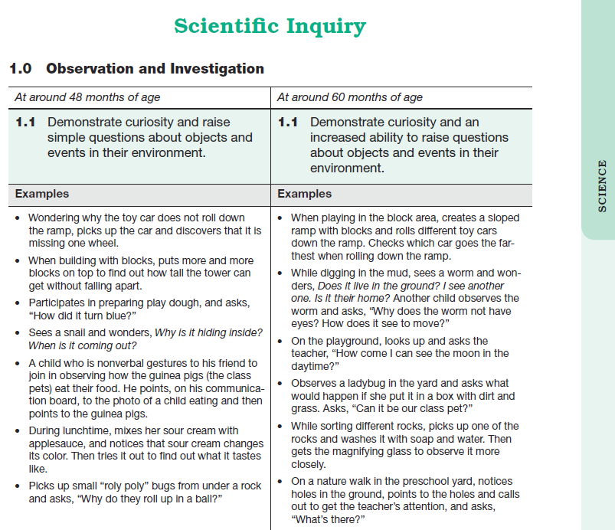
Science Foundations Map
Strand
Substrand
Foundation
Age
Domain
Examples
Notes:
Presenter Remarks:
Let’s review substrand 1.0 Observation and Investigation.
Take out Handout 1: Science Domain Map. This handout illustrates the way the foundations are organized. (The front of the handout breaks down all four Science domain substrands, the back side matches this slide.)
Extra Notes:
Use a laser pointer to draw participants’ eyes to each part of the page.
Draw attention to the following elements:
The name of the domain (Science)
The name of the strand at the top of the table (in this case, Scientific Inquiry)
The name of the substrand (Observation and Investigation)
Substrands always end in a zero (1.0, 2.0, 3.0, etc.)
The foundations (at around 48 months and around 60 months)
The examples under each column separate the foundation into discrete skills. It is important to remember that the examples provide only a few of the ways that children may demonstrate the foundation.

Slide 9
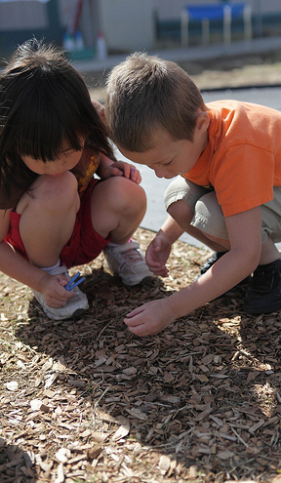
The purpose of science in transitional kindergarten is to nurture and foster children’s:
Habits of inquiry
Critical thinking
Creativity
Innovative problem solving
Open mindedness
Motivation to learn
©2016 California Department of Education
Notes:
Background Information:
Utilize one of the following strategies to track question responses:
Option 1: Popcorn Strategy—First ask participants ideas with their tablemates. Then have them popcorn their ideas to the larger group. Have a trainer chart at the front while answers are being given. After all participants who wish to add their thoughts have had a chance to share, advance the slide and see words appear.
Option 2: Poll Everywhere—Use Poll Everywhere (or another polling system) to have participants text answers in.
Option 3: Table Chart—Have each table group chart their responses. Then have them share and compare charts with the entire group.
Presenter Remarks:
(Pose these questions to the entire group and have participants create the list.)
What is the purpose of science in TK? How does science in TK support development of the whole child?
(Facilitate creation of the list by utilizing one of the options listed in the Background Information section.)
(Reflect with entire group.) Did you come up with a similar list?

Slide 10
Preschool Science
“Science fosters skills that are recognized as critical for success in work and in life in the twenty-first century…”(Bellanca and Brandt as cited in PLF, Vol. 3, p. 49).
“The purpose of preschool science is to nurture children's habits of inquiry, critical thinking, creativity, and innovative problem solving, and to foster open mindedness, and the motivation to learn” (PCF, Vol. 3, p. 136).
During the infant/toddler years, children develop key cognitive skills that support their understanding of objects and events in the world around them. CPIN Lead Presentation by Dr. Zur
©2016 California Department of Education (CDE) with the WestEd Center for Child & Family Studies, California Preschool Instructional Network (CPIN).
Notes:
Background Information:
Dr. Zur is the author of the science sections of the Preschool Learning Foundations and Preschool Curriculum Framework.
Presenter Remarks:
Let’s look at this slide from the bottom up.
First we have the infant/toddler foundations. During the infant/toddler years, children develop key cognitive skills that support their understanding of objects and events in the world around them:
Cause-and-Effect: The understanding that one event or action brings about another.
Spatial Relationships: The developing understanding of how things move and fit in space.
Problem-Solving: The developing ability to engage in purposeful effort to reach a goal or to determine how something works.
Classification: The ability to group, sort, categorize, and form expectations based on the attributes of objects and people.
Let’s move on to the Preschool Learning Foundations which serve to support the purpose of preschool science which is, “…to nurture children's habits of inquiry, critical thinking, creativity, and innovative problem solving, and to foster open mindedness, and the motivation to learn” (PCF, Vol. 3, p. 136).
Lastly, let’s look at the School-Age/Next Generation Science Standards. Science fosters skills that are recognized as critical for success in work and in life in the twenty-first century: critical thinking, problems solving, creativity, collaboration, and communication” (Bellanca and Brandt as cited in PLF, Vol. 3, p. 49).

Slide 11
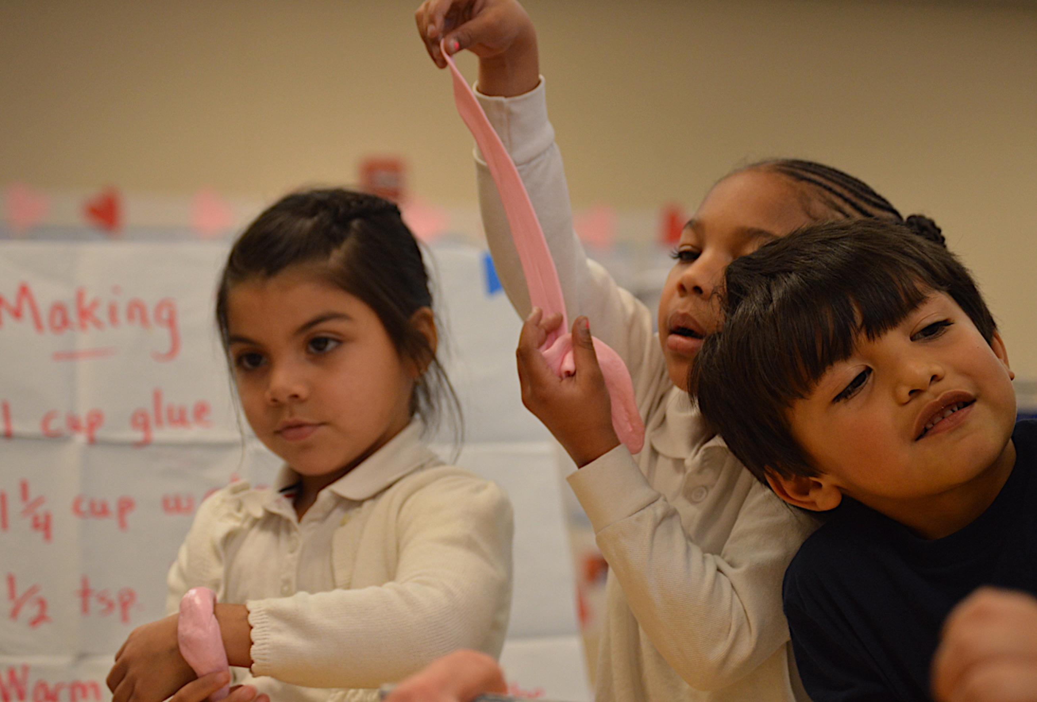
Individual, Cultural, and Linguistic Variations
“All students, regardless of age, sex, cultural ethnic background, disabilities, aspirations, or interest and motivation in science, should have the opportunity to attain high levels of scientific literacy” (National Committee on Science Education Standards and Assessment, National Research Council, National Science Education Standards, p. 20).
©2016 California Department of Education
Notes:
Background Information:
The following information can be found on Handout 2: Culture and Attitudes.
Presenter Remarks:
“The goal in developing the preschool foundations for science is to describe age-appropriate scientific skills and knowledge that are typically displayed by preschool children under conditions that support healthy development. Children are different from one another and vary in their abilities, family and socioeconomic background, home experiences, and cultural heritage and values. Therefore, they may vary in the way they develop and display the knowledge and skills described in these foundations” (PLF, Vol. 3, p. 51).
Just as it is important to recognize the varying ways in which children may develop and display their knowledge and skills, it is equally important to utilize a variety of techniques when incorporating science into the transitional kindergarten classroom.
“Universal design provides for multiple means of representation, multiple means of engagement, and multiple means of expression. Multiple means of representation refers to providing information in a variety of ways so the learning needs of all children are met. For example, it is important to speak clearly to children with auditory disabilities while also presenting information visually such as with objects and pictures. Multiple means of expression refers to allowing children to use alternative ways to communicate or demonstrate what they know or what they are feeling. For example, when a teacher seeks a verbal response, a child may respond in any language, including American Sign Language. A child with special needs who cannot speak may also respond by pointing, by gazing, by gesturing, by using a picture system of communication, or by using any other form of alternative or augmented communication system. Multiple means of engagement refers to providing choices in the setting or program that facilitate learning by building on children’s interests. The information in this curriculum framework has been worded to incorporate multiple means of representation, expression, and engagement” (PCF, Vol. 1, p. 13).
“Although science is important for all children, it is especially relevant to English learners and many children with special needs, for whom the development of new vocabulary and language skills in authentic learning experiences is most effective” (PLF, Vol. 3, p. 49).
“Research indicates that the language to which children are exposed and culturally shared belief systems may play a role in children’s development of core biological concepts and reasoning (Anggoro, Waxman, and Medin 2005; Waxman and Medin 2006; Hatano and others 1993)” (PLF, Vol. 3, p. 51).
“…[S]ome children with special needs (e.g., children with speech or language delay) may express themselves by using nonverbal means of communication, through gestures, drawings, and actions. Teachers should be aware that when foundations or examples indicate verbal expression, children might use any means of communication (including home language)” (PLF, Vol. 3, p. 52).

Slide 12
Exploring Culture and
Attitudes in Science
Review and complete Handout 2: Culture and Attitudes.
Exchange thoughts with your partner about the questions from the handout.
Share-out key messages from the experience.
Notes:
Activity 1: Culture and Attitudes
Presenter Remarks:
We will be reflecting on our early experiences and memories of science and scientific inquiry.
Please review, and complete Handout 2: Culture and Attitudes. Feel free to use the colored pencils to express your thoughts and feelings in a graphic representation.
Locate the “Occupations in Science” picture on the top right hand corner of your paper; partner with someone who has a different picture than you and exchange your thoughts about the questions from the handout. (Allow 3-5 minutes for discussion.)
(Have participants return to their tables.) Please share-out any key messages you gleaned from this experience. (As participants volunteer to share, one trainer should be charting responses so all participants can see.)
intent:
Activate prior knowledge and early messages about learning and exploring in science.
OUTCOMES:
Participants build community by considering and sharing the early experiences and messages they received and internalized regarding science and the nature of scientific inquiry.
Materials Required:
Handout 2: Culture and Attitudes Worksheet
White copy paper Various colored writing and drawing tools
(Optional) Lakeshore Learning Science Occupations cards
TIME: 15 minutes
Process:
Explain that we will be reflecting on our early experiences and memories of science and scientific inquiry.
Ask participants to take out, review, and complete Handout 2: Culture and Attitudes; participants can also use the colored pencils to express their thoughts and feelings in a graphic representation.
Have participants locate the “Occupations in Science” picture on the top right hand corner of their paper.
Invite participants to find someone who has a different “Occupations in Science” picture and to exchange their thoughts about the questions from the handout. (Allow 3-5 minutes for discussion.)
Have participants return to their tables and ask them to share-out any key messages they gleaned from this experience. (As participants volunteer to share, one trainer should be charting responses so all participants can see.)
Optional: (If trainers have access to the Lakeshore Learning Science Occupations cards.) Display occupations cards around the room to inspire conversation during this activity.
SUMMARY:
Participants will become aware of the early messages and biases children receive regarding science and how these messages can influence their personal attitudes and biases regarding learning science and the nature of scientific inquiry.
Extra Notes:
If you have access to them, display the Lakeshore Learning Science Occupations cards around the room to inspire conversation during this activity.

Slide 13
Culture and Attitudes
  Discuss the following questions about the culture and attitudes activity with your tablemates:
  What did you learn about yourself or your colleagues?
  What did you find to be surprising or interesting?
  How might you use what you learned about yourself as you plan for science?
Notes:
Presenter Remarks:
Please discuss the questions on the slide with your tablemates:
What did you learn about yourself or your colleagues?
What did you find to be surprising or interesting?
How might you use what you learned about yourself as you plan for science?
Extra Notes:
Additional debrief questions:
How did these early messages influence your interest and curiosity in science?
Did you experience any challenges when exploring science?
How do these early messages influence you as a teacher?
What messages do you give the students in your classroom?
How do you help children overcome negative messages they may receive from others?

Slide 14
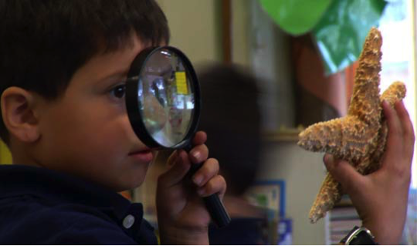
21st Century Skills
“Twenty-first century skills are seen to promote creativity and innovative thinking while deepening the skills experts view as needed to promote careers in a global society” (National Education Association).
©2016 California Department of Education
Notes:
Background Information:
National Education Association (http://www.nea.org/tools/52217.htm)
The full document can be found with the trainer support materials.
Presenter Remarks:
“Science in preschool [and TK] fosters a joy of discovery and a positive approach to learning. Making discoveries, identifying solutions, and trying to figure things out develops children's initiative in learning and helps them become self-confident learners. Science fosters skills that are recognized as critical for success in work and in life in the twenty-first century: critical thinking, problem-solving, creativity, collaboration, and communication” (Bellanca and Brandt as cited in PLF, Vol. 3, p. 49).

Slide 15
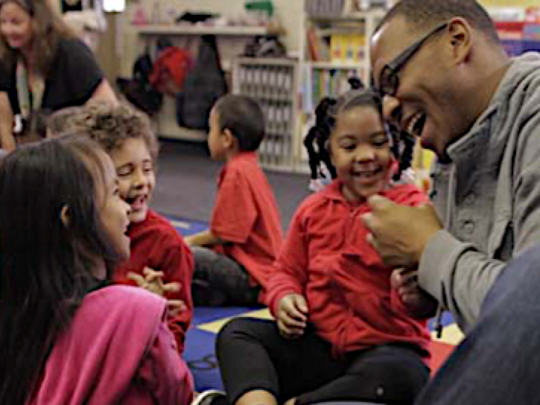
Important 21st Century Skills
Often referred to as the “Four Cs” include:
Critical thinking
Communication
Collaboration
Creativity
(National Education Association [http://www.nea.org/tools/52217.htm])
©2016 California Department of Education
Notes:
Background Information:
See trainer support materials for more information on the “Four Cs” (Preparing 21st Century Students for a Global Society).
Presenter Remarks:
As we prepare young learners for the future we need to cultivate the “Four Cs.” The Science domain is recognized as promoting the “Four Cs” in children.
The “Four Cs” are the four specific 21st century skills that are considered most important for K-12 education (National Education Association [http://www.nea.org/tools/52217.htm]):
Critical thinking—The ability to look at problems in a critical manner that allows for new thinking and solving problems across multiple subjects and disciplines.
Communication—The ability to share and exchange thoughts and ideas, ask questions, and discuss solutions to problems.
Collaboration—The ability to work together for a mutual goal or outcome using ones talent, expertise, and knowledge.
Creativity—The ability to think of new ideas and approaches in an innovative and inventive manner.

Slide 16
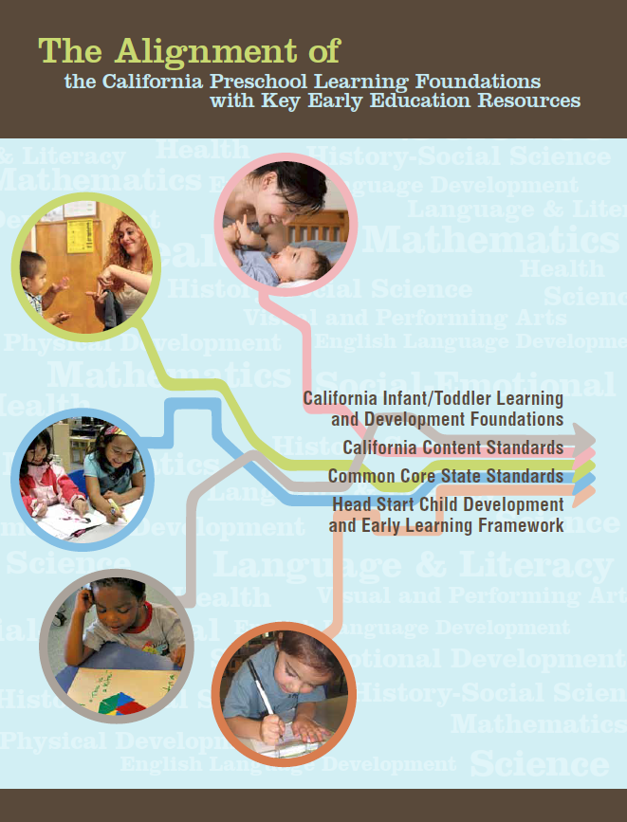
Overview of Alignment
Notes:
Presenter Remarks:
This table represents an overview of the alignment among the nine domains of the Preschool Learning Foundations with the content of the CA Standards and the Common Core State Standards (CCSS). The Alignment document includes the previous standards for science. It does not include current NGSS standards.
The alignment demonstrates that early learning is a significant part of the educational system and that the knowledge and skills of young children are foundational to future learning.
Understanding the links between the different ages and different early childhood services allows educators to build on children’s earlier learning and prepare them for the next educational challenge.
All domains of the Preschool Learning Foundations correspond to the California Kindergarten Content Standards.
The Preschool Learning Foundations Language and Literacy domain aligns with the California Common Core State Standards (CCSS) for English Language Arts and the Preschool Learning Foundations Mathematics domain aligns with the California Common Core State Standards for Mathematics.
Visual and Performing Arts, Physical Development, Health, History-Social Science, and Science are all separate domains in the Preschool Learning Foundations. The Common Core includes English Language Arts & Literacy in History/Social Studies, Science, and Technical Subjects.
16

Slide 17
Key Features of the DRDP-K
An observation-based assessment tool, not a test
Individual child assessment
Completed by each child’s teacher
Based on developmental research and theory
Includes developmental sequences of behaviors along a continuum
Spans the developmental continuum of children in a two-year kindergarten program (TK)
Notes:
Presenter Remarks:
The DRDP-K has four measures under Cognition: Science:
COG:SCI 1: Cause and Effect—Child demonstrates an increasing ability to observe, anticipate, and reason about the relationship between cause and effect
COG:SCI 2: Inquiry Through Observation and Investigation—Child observes and investigates objects (living and nonliving things) and events in the environment and becomes increasingly sophisticated in pursing knowledge about them
COG:SCI 3: Documentation and Communication of Inquiry—Child develops the capacity to describe and record observations and investigations about objects (living and nonliving things) and events, and to share ideas and explanations with others
COG: SCI 4: Knowledge of the Natural World—Child develops the capacity to understand objects (living and nonliving things) and events in the natural world, including how they change and their characteristics
The DRDP-K is an observation-based assessment and not a test. It is used to support children’s learning. Observing and documenting children's progress provides teachers the information needed to differentiate instruction and experiences. It also provides information to individualize.
Observational tools are preferred over criterion-referenced tools because the information gathered by observation more accurately reflects what children are able to do.
Documentation provides concrete evidence of what children are able to do. We are then able to better plan activities that will meet and appropriately challenge children's developmental needs.
The DRDP-K has been developed with world renowned experts. It is based on the research and knowledge of what is most important for predicting school success.
The DRDP-K:
Is an individual child assessment that can be shared with families
Is aligned with the Preschool Learning Foundations
Opens up the opportunity for articulation between the preschool and TK teachers (Sharing information as to where children are on the developmental continuum can better prepare the TK teacher to work with students.)
Allows a teacher to include a request form for previous records as part of the TK registration to help support the relationship between preschool, family, and TK

Slide 18
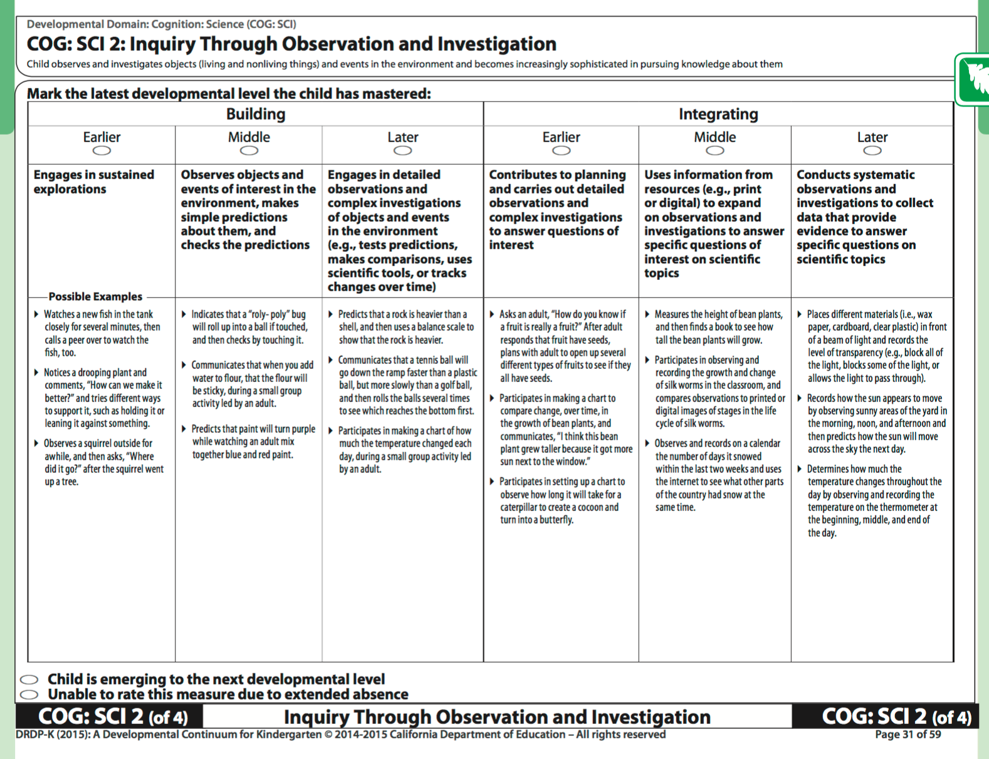
Cognitive Development
COG: SCI 2: Inquiry Through Observation and Investigation
Notes:
Presenter Remarks:
Each measure can provide information on the developmental continuum within the Science Domain.
Please take out and review Handout 3: DRDP-K COG: SCI: 2.

Slide 19

Next Generation Science Standards (NGSS)
The Next Generation Science Standards:
Are standards with a purpose
Represent a fundamental shift in science education
Require a different approach to teaching science than has been used in the past
Notes:
Presenter Remarks:
Please take out Handout 4: Next Generation Science Standards: An Overview for Principals.
“A Science Framework for K-12 Science Education provides the blueprint for the Next Generation Science Standards (NGSS). The Framework expresses a vision in science education that requires students to operate at the nexus of three dimensions of Learning: Science and Engineering Practices, Crosscutting Concepts, and Disciplinary Core Ideas” (APPENDIX F: Science and Engineering Practices in the NGSS, p. 1).
The K-12 science content standards cover every grade and every scientific discipline, setting expectations for what students should know and be able to do in science.
“Science—and therefore science education—is central to the lives of all Americans, preparing them to be informed citizens in a democracy and knowledgeable consumers. If the nation is to compete and lead in the global economy and if American students are to be able to pursue expanding employment opportunities in science-related fields, all students must have a solid K–12 science education that prepares them for college and careers” (NGSS FAQs Page [http://www.nextgenscience.org/faqs##Contents1], accessed on 08/12/2016).

Slide 20
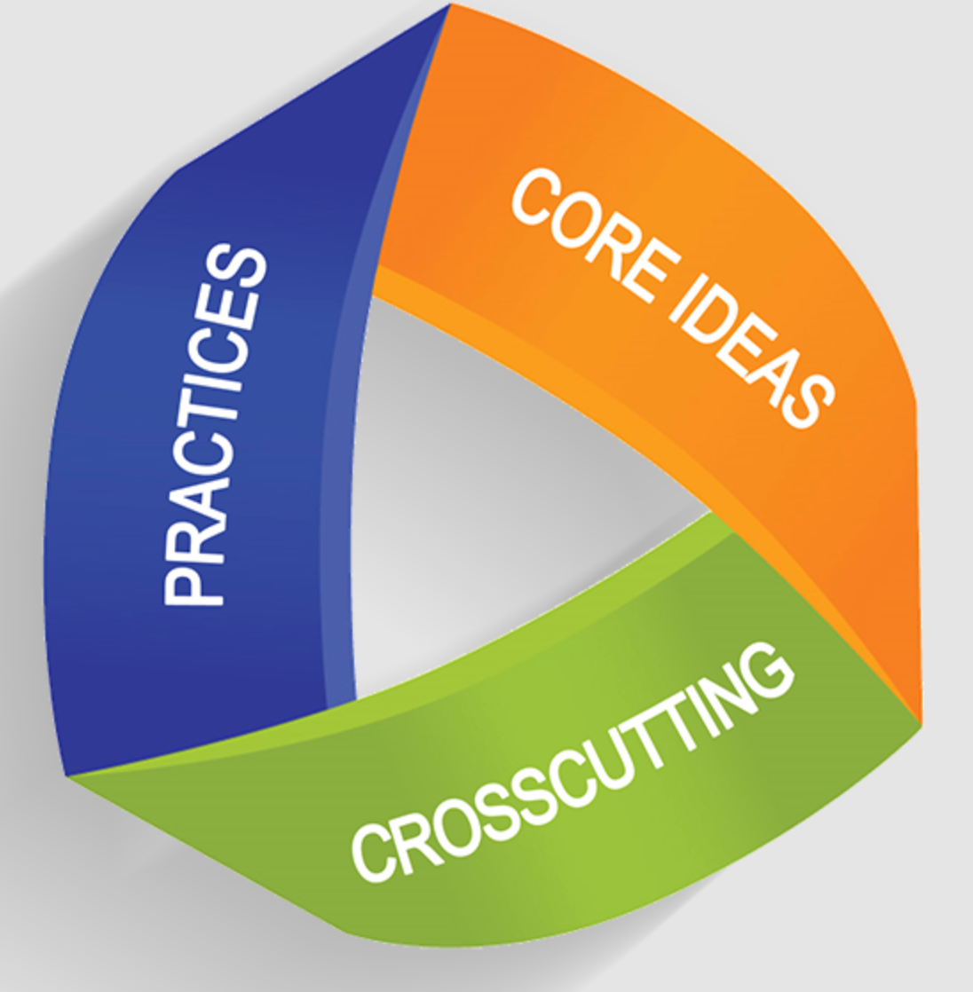
Three-Dimensional Learning
The key difference between the NGSS and previous science standards is the process of “three-dimensional” (3D) learning:
Practices
Disciplinary core ideas
Crosscutting concepts
Notes:
Presenter Remarks:
There are excellent resources and links on the second page Handout 4: Next Generation Science Standards: An Overview for Principals.
The NGSS represent a fundamental shift in science education and requires a new and different approach to teaching science. Looking ahead, teachers can use a range of strategies to engage students and create opportunities to demonstrate their thinking and learning.
“A major difference between the NGSS and previous science standards is ‘three-dimensional’ (3D) learning. 3D learning refers to the thoughtful and deliberate integration of three distinct dimensions: Scientific and Engineering Practices (SEPs), Disciplinary Core Ideas (DCIs), and Crosscutting Concepts (CCCs). Through 3D learning, the NGSS emphasize that science is not just a series of isolated facts. This awareness enables students to view science more as an interrelated world of inquiry and phenomena rather than a static set of science disciplines. The NGSS represent a fundamental shift in science education and require a different approach to teaching science than has been done in the past. Looking ahead, teachers can use a range of strategies to engage students and create opportunities to demonstrate their thinking and learning” (NGSS: An Overview for Principals [http://ngss.nsta.org/Documents/NGSS%20Overview%20for%20Principals.pdf], p. 1).

Slide 21
The Science Framework for
K-12 Science Education
Teachers can
So children will
Use a wide range of strategies to engage students.
Create opportunities for students to demonstrate thinking and learning.
Understand how scientific knowledge develops.
Appreciate the wide range of approaches that are used to investigate, model, and explain the world.
Notes:
Presenter Remarks:
The Next Generation Science Standards support the development of the “Four Cs” by providing opportunities to demonstrate student’s thinking and learning.
The Science Framework for K-12 Science Education provides a blueprint for developing NGSS.
The Preschool Learning Foundations and Curriculum Framework support the interconnected nature of science and the practices in the Science Framework for K-12 Science Education.
“Science learning in the TK classroom focuses on teaching inquiry skills through the use of simple science equipment and books. Experiences that explore the diverse areas of scientiﬁc study (e.g., physical science, life science, earth science) can be integrated into other subjects including English language arts, mathematics, history–social science, physical education, and visual and performing arts” (TK Implementation Guide [CDE], p. 30).

Slide 22
Eight Practices of the Science and Engineering Framework
Asking questions (for science) and defining problems (for engineering)
Developing and using models
Planning and carrying out investigations
Analyzing and interpreting data
Using mathematics and computational thinking
Constructing explanations (for science) and designing solutions (for engineering)
Engaging in argument from evidence
Obtaining, evaluating, and communicating information
Notes:
Background Information:
Eight Practices of the Science and Engineering Framework:
Asking questions (for science) and defining problems (for engineering)
Developing and using models
Planning and carrying out investigations
Analyzing and interpreting data
Using mathematics and computational thinking
Constructing explanations (for science) and designing solutions (for engineering)
Engaging in argument from evidence
Obtaining, evaluating, and communicating information
Presenter Remarks:
The Science Framework for K-12 Science Education provides a blueprint for developing NGSS. The eight practices of the science and engineering Framework include the list on the screen.
Take a moment and read this list. What similarities do you notice between this list and Handout 1: Science Domain Map?
Choose the number of a practice that stands out to you and hold that number of fingers up in the air. Now partner with someone holding up the same number. You can find more than one partner if you would like. Together, talk about what you think this practice looks like in your classroom. (Allow 5 minutes for discussion. When discussion comes to a close invite everyone back to their seats).

Slide 23
Curriculum Framework:
Strategies to Enrich Learning Opportunities
Planned learning opportunities
Routines, environments, and materials
Building on children’s knowledge, skills, and interests
Linguistically appropriate and culturally meaningful
Notes:
Presenter Remarks:
The Preschool Curriculum Framework offers guidance and strategies that align with the eight practices of science and engineering framework. For instance, it provides examples on how teachers can support the learning and development described in the foundations through environments and materials that are developmentally appropriate, individually and culturally meaningful, and engaging to families.
“Family engagement with schools has been linked to important outcomes for children of all families including families with English language learner students. Numerous positive developmental child outcomes have been associated with family engagement including: Early literacy skills, cognitive language developments skills, social emotional skills, and academic achievement” (California’s Best Practices for Young Dual Language Learners: Research Overview Papers [CDE], p. 121).

Slide 24
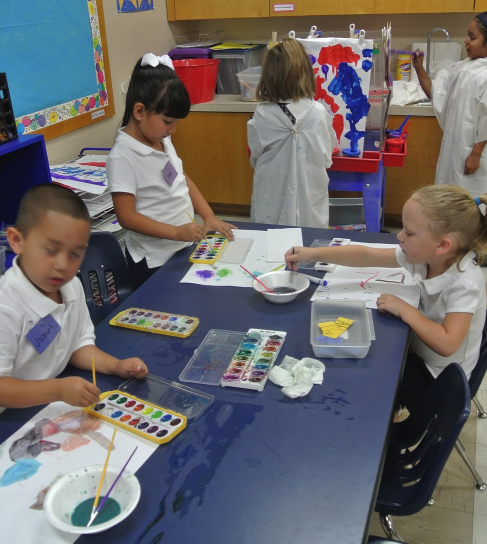
Framework Strategies
24
Developmentally appropriate
Reflective and intentional
Individually and culturally meaningful
Inclusive
©2016 California Department of Education
Notes:
Presenter Remarks:
Strategies from Preschool Curriculum Framework are:
Developmentally appropriate
Reflective and intentional
Individually and culturally meaningful
Inclusive
There are strategies in the Preschool Curriculum Framework that include adaptations, “For example, a book can be mounted so that a child need not hold it, and sturdy tabs can be placed on a book’s pages make them easier to turn” (PCF, Vol. 1, pp. 106-107).
This is a strategy that could be used to provide access for all students to books related to science.

Slide 25
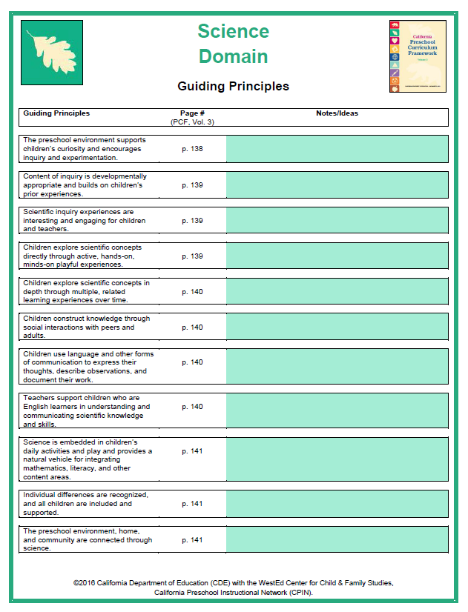
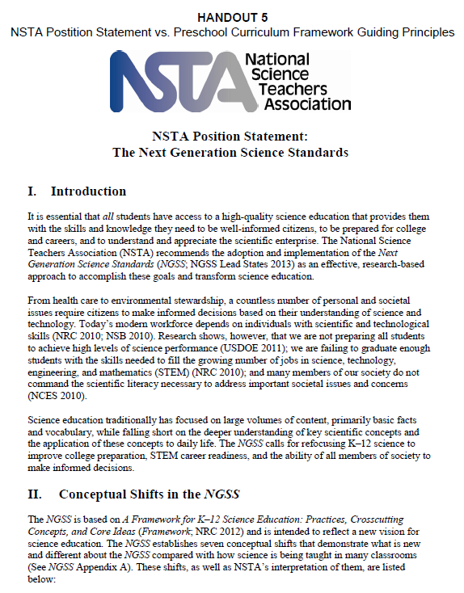
Compare and Contrast
Notes:
Presenter Remarks:
“Science fosters skills that are recognized as critical for success in work and in life in the twenty-first century: critical thinking, problem solving, creativity, collaboration, and communication” (Bellanca and Brandt as cited in PLF, Vol. 3, p. 49).
This philosophy is consistent across national resources such as the National Science Teachers Association (NSTA) as well as K-12 resources (Common Core and CA K-12 standards).
Let’s compare and contrast the NSTA Position Statement and the California preschool guiding principles for science. Please find Handout 5: NSTA Position Statement vs. Preschool Curriculum Framework Guiding Principles.
(Debrief options:
Ask for volunteers to highlight the similarities.
Ask for one volunteer per table to stand up and share a similarity.
Use the surfing monkey to play “hot potato” with music; whoever is holding the monkey when the music stops shares out one similarity.)
It is particularly important to follow the following guiding principles:
“Children explore scientific concepts directly through active, hands-on, minds-on playful experiences” (PCF, Vol. 3, p. 139).
“Children construct knowledge through social interactions with peers and adults” (PCF, Vol. 3, p. 140).
Throughout the day we will address many more of the guiding principles; however, these two will continue to be highlighted through all of our activities.

Slide 26
Four Elements that Support Scientific Inquiry
Scientific Inquiry
Culture and Attitude
Content
Tools and Materials
Skills and Language
Content
Tools and Materials
Skills and Language
Culture and Attitude
Notes:
Background Information:
This diagram is from a presentation given by Dr. Zur, a main author of the Preschool Learning Foundations and Preschool Curriculum Framework, for the California Preschool Instructional Network.
Presenter Remarks:
Scientific inquiry includes four elements:
Culture and Attitude
Content
Tools Materials
Skills and Language
We discussed culture and attitudes earlier as we examined the early messages we received regarding our early science experiences. These early messages and our outlook on science influence the classroom environment and our teaching practices.

Slide 27
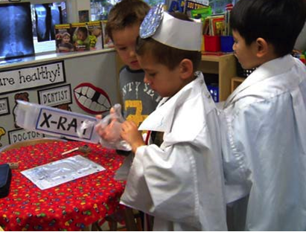
Social Environment
“The social environment must support exploration and investigation and encourage children to pursue their own questions and develop their ideas” (PCF, Vol. 3, 147).
©2016 California Department of Education
Notes:
Presenter Remarks:
“The social environment must support exploration and investigation and encourage children to pursue their own questions and develop their ideas” (PCF, Vol. 3, p. 147).
Teachers can create environments that promote exploration by including items that help children think, wonder, and ask questions. Some example items are: seeds and plants, scales, magnifying glasses, and magnets.
Think about one or two items you currently use in your classroom to support exploration and investigation, turn to your elbow partner and share.

Slide 28
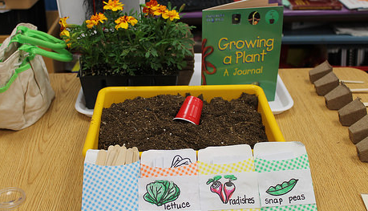
Guiding Principle:
“Content of inquiry is developmentally appropriate and builds on children’s prior experiences” (PCF, Vol. 3, p. 139).
©2016 California Department of Education
Notes:
Background Information:
Show video Observation and Investigation 1.6
Discuss with participants how the video clip demonstrated this guiding principle from the Preschool Curriculum Framework: “Content of inquiry is developmentally appropriate and builds on children’s prior experiences” (PCF, Vol. 3, p. 139).
Presenter Remarks:
It is clear from the video that inquiry, observation, and questions have been modeled in meaningful situations in the classroom. Students in the video draw from prior knowledge as they investigate.
(Reinforce the fact that scientific inquiry is also used in the Physical Sciences, Life Sciences, and Earth Sciences strands.)

Slide 29
Guiding Principles Match-Up
Locate your guiding principle and definition envelopes (on tabletop).
Match each description to the correct guiding principle.
  Use pages 138-141 of the Preschool Curriculum Framework (Vol. 3) for help.
Think about the following:
    How do the guiding principles promote children’s natural curiosity in science?
    How do the guiding principles help to support all learners?
    How do the guiding principles help to minimize preconceived ideas or biases a student may have around age, sex, culture, ethnic background, or disabilities?
Notes:
Activity 2: Guiding Principles Match-Up
Background Information:
Optional: Instead of conducting this as an individual match-up activity, trainers can choose to instead give each table group two envelopes and have tablemates work together to complete the match-up activity.
Presenter Remarks:
The guiding principles, “…guide teachers in establishing a preschool science program that fosters children’s curiosity and develops their skills and habits to explore and learn about their world. These principles are consistent with a constructivist approach to learning, where children actively construct knowledge through physical and mental interactions with objects and people in their environment” (PCF, Vol. 3, p. 138).
intent:
Introduce participants to the guiding principles of the Science domain.
OUTCOMES:
Participants will gain a deeper understanding of the guiding principles of the Science domain and how they support children’s curiosity and their development of the skills and habits that will help them explore and learn about the world.
Materials Required:
Handout 6: Guiding Principles Matching Activity
TIME: 15 minutes
Process:
Prior to training:
Print a copy of Handout 6: Guiding Principles Matching Activity for each participant.
Take each handout and cut the guiding principles and the descriptions apart; then place them into two separate envelopes—one for guiding principles and one for descriptions. (Each participant will receive two envelopes.)
During training:
Ask participants to work individually to match each description to the correct guiding principle.
Invite comments and feedback regarding the guiding principles.
Discuss how the guiding principles support children’s curiosity and their development of the skills and habits that will help them explore and learn about the world.
SUMMARY:
Participants will become familiar with the guiding principles of the Science domain and discover how the principles can guide teaching practices.

Slide 30
Four Elements that Support Scientific Inquiry
Scientific Inquiry
Culture and Attitude
Content
Tools and Materials
Skills and Language
Content
Tools and Materials
Skills and Language
Culture and Attitude
Notes:
Presenter Remarks:
“From a very young age, children have intuitive ideas or naïve (folk) theories about physics and biology…The content covered in the preschool science foundations includes core scientific ideas and concepts that, based on research, are developmentally appropriate for young children” (PLF, Vol. 3, p. 55).
The content of three science strands (Physical Sciences, Life Sciences, and Earth Sciences) can be introduced to children as teachers use, “…experiences to encourage children to observe closely, using their senses and tools, and describe their observations, which helps them in learning about properties and characteristics of objects and materials” (PCF, Vol. 3, p. 154).
Refer to Handout 1: Science Domain Map.

Slide 31
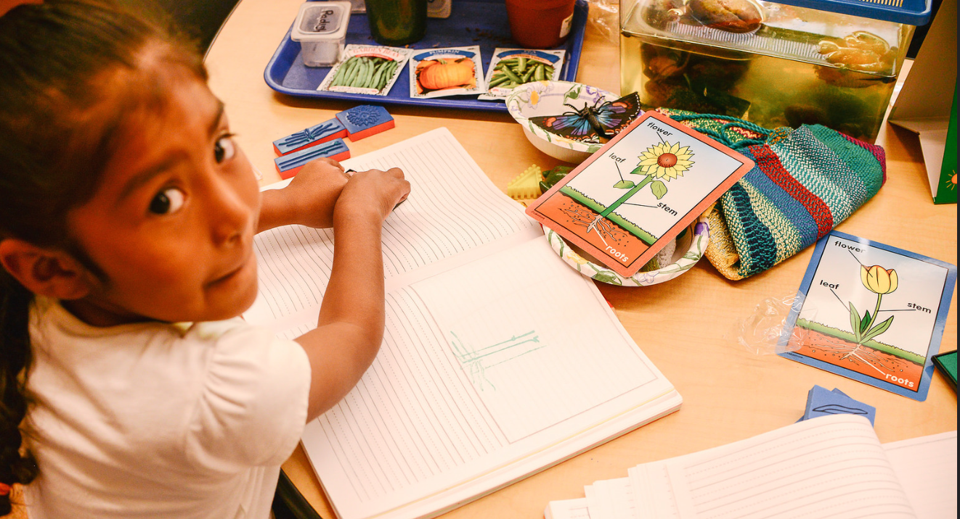
Basic Inquiry Skills
Observe and describe
Use scientific tools
Measure
Classify
Compare and contrast
Predict and check
Record and document
Communicate
Draw inferences and conclusions
Notes:
Presenter Remarks:
“Scientific inquiry skills are integral to children’s ongoing play and explorations and are not taught in isolation. Children develop their abilities to make observations, ask questions, and gather information, as part of meaningful exploration and investigation experiences” (PCF, Vol. 3, p. 153).
Scientific inquiry (observation, investigation, documentation, and communication) plays an integral role in how children explore and develop knowledge in the content areas of physical, life, and earth sciences.
Basic scientific inquiry skills help promote the NGSS and 21st Century Skills in young children.
Because many of these skills require communicating about a experiences it is important for teachers to provide students with a variety of ways to communicate (e.g., verbally describing, drawing, utilizing picture communication systems, etc.).
You may wish to consult with special education providers to assist you in developing and establishing communication systems in your classroom.

Slide 32
Focused Video Viewing:
Scientific Inquiry Foundations
Video Example 1.3
Notes:
Background Information:
Show scientific inquiry foundations video example 1.3.
Presenter Remarks:
Let’s take a look at what this looks like in classrooms with four and five-year-olds. As you watch the video, take note of all the inquiry skills you see occurring in both the 48 and 60 month examples. (Play the video.)

Slide 33
Focused Video Discussion
Discuss with your tablemates:
What basic inquiry skills did you notice?
What did you see that you have experienced in your classroom?
Notes:
Presenter Remarks:
Compare notes with your tablemates.
Did you find an example of each of the basic inquiry skills? While watching, did you notice anything you have experienced in your classroom?

Slide 34
Summary Table of Science Foundations
Strand | Substrand | Foundation
Scientific Inquiry | 1.0 Observation and Investigation | 1.0, 1.2,1.3,1.4,1.5,1.6
 | 2.0 Documentation and Communication | 2.1, 2.2
Physical Sciences | 1.0 Properties and Characteristics of Nonliving Objects and Materials | 1.1
 | 2.0 Changes in Living Things | 1.1
Life Sciences | 1.0 Properties and Characteristics of Living Things | 1.1, 1.2, 1.3, 1.4
 | 2.0 Changes in Living Things | 2.1
Earth Sciences | 1.0 Properties and Characteristics of Earth Materials and Objects | 1.1
 | 2.0 Changes in the Earth | 2.1, 2.2, 2.3, 2.4
Notes:
Presenter Remarks:
This is the Summary Table of Science Foundations; it shows the strands, substrands, and foundations of the Science domain.
Refer to page 152 of the Preschool Learning Foundations (Vol. 3) as you review the Scientific Inquiry stand and substrands.
Take a moment to reflect on one of the things that you currently do to support observation, investigation, and documentation. Turn to your elbow partner and share your reflections.

Slide 35
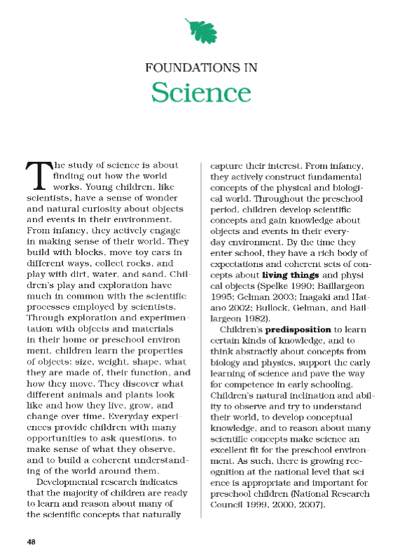
Children’s Play
“Children's play and exploration has much in common with the scientific processes employed by scientists” (PLF, Vol. 3, p. 48).
Notes:
Presenter Remarks:
Take out Handout 7: Science Foundations Introduction or open the Preschool Learning Foundations (Vol. 3) to the beginning of the Science Chapter. Read the introduction section (on pages 48-49) and reflect on the bolded terms.
(Point out and discuss the quotations below.)
“Children's play and exploration has much in common with the scientific processes employed by scientists” (PLF, Vol. 3, p. 48).
“Throughout the preschool [and TK] period[s], children develop scientific concepts and gain knowledge about objects and events in their everyday environment” (PLF, Vol. 3, p. 48).
“Children’s natural inclination and ability to observe and try to understand their world, to develop conceptual knowledge, and to reason about many scientific concepts make science an excellent fit for the preschool [and TK] environment[s]” (PLF, Vol. 3, p. 48).
How do the highlighted terms support the Science strands and substrands? How do the highlighted words and concepts support and expand children’s knowledge of and experiences in their everyday world? How can parents support the transitional kindergarten science curriculum?

Slide 36
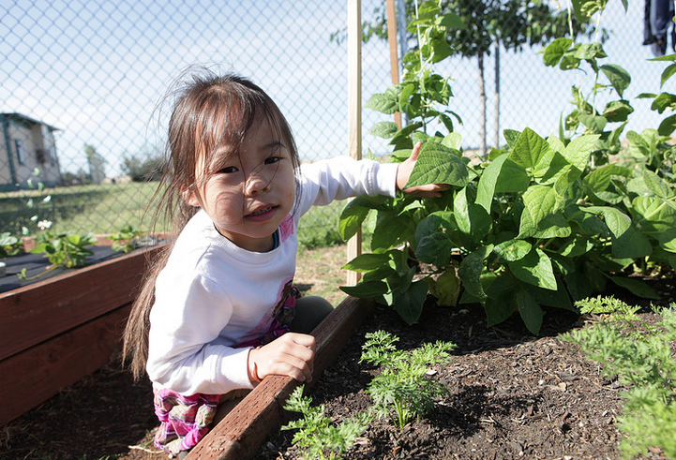
Scientific Inquiry
“Children begin to adopt scientific ideas and to acquire the basic skills and language of scientific inquiry (ways to explore and develop knowledge and understanding of scientific ideas)” (PCF, Vol. 3, p. 136).
©2016 California Department of Education
Notes:
Presenter Remarks:
Scientific inquiry is essential for learning about science. “Making observations, posing questions, planning investigations, using tools to gather information, making predictions, recording information, and communicating findings and explanations all combine in an evolving process of developing science understanding and creating a disposition to choose to learn science in the future” (PCF, Vol. 3, pp. 136-137).

Slide 37
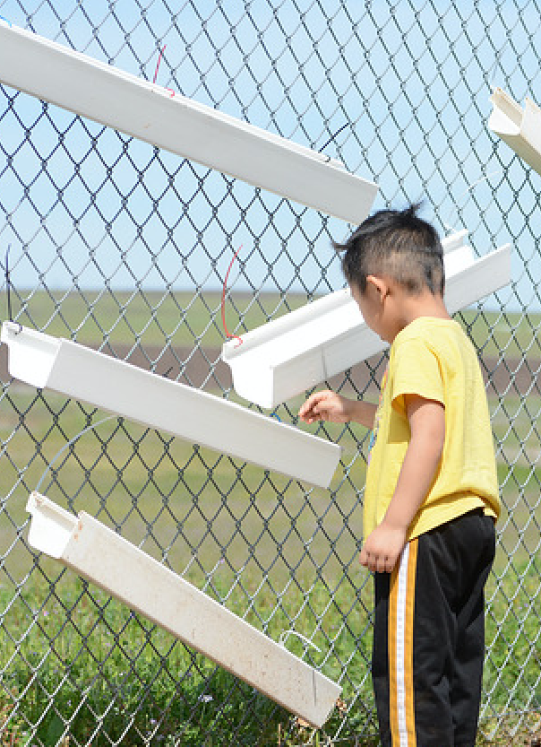
Key Components of Physical Science
Through physical sciences children learn about the following:
Size, shape, weight, texture, and other properties of objects and materials
Form and function of objects
Cause and effect of objects
Physical properties of objects and materials
Transformation of objects and materials
©2016 California Department of Education
Notes:
Presenter Remarks:
“In exploring objects and materials, children develop understanding of key concepts about the physical world” (PCF, Vol. 3, p. 177).
The key components of physical science that children learn about are (PCF, Vol. 3, p. 177):
Size, shape, weight, texture, and other properties of objects and materials
Form and function of objects
Cause and effect of objects
Physical properties of objects and materials
Transformation of objects and materials

Slide 38
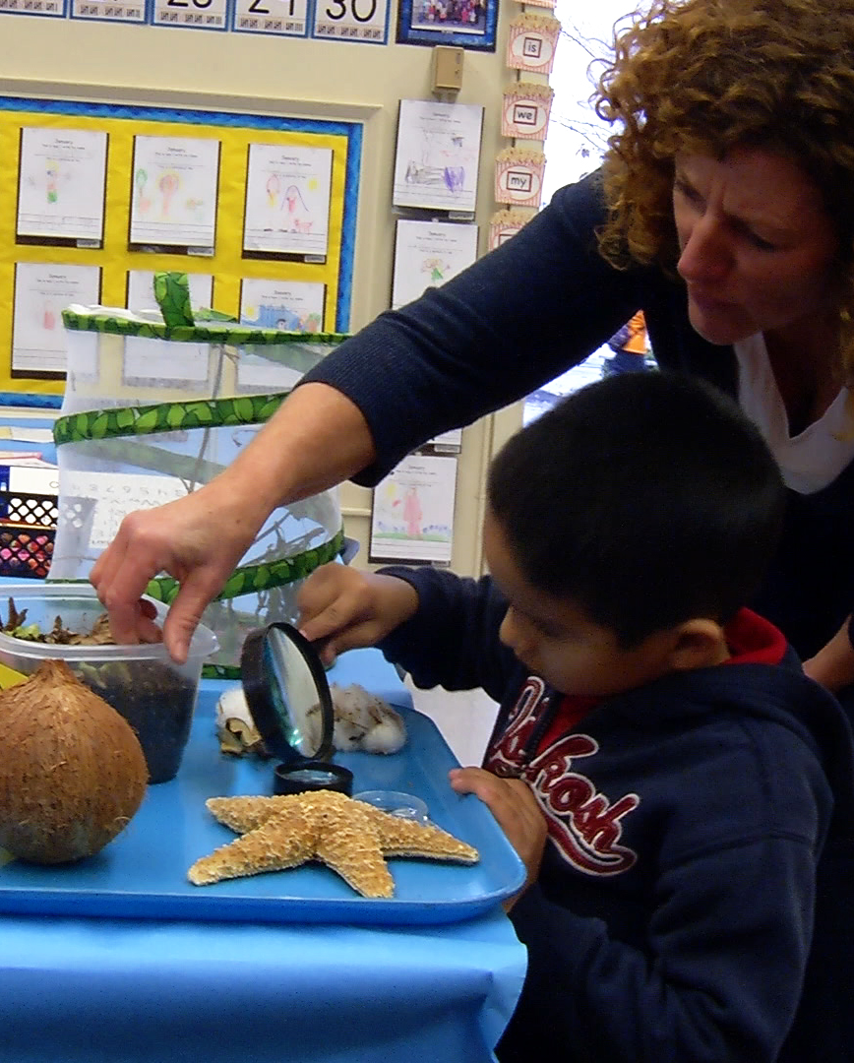
Key Components of Life Sciences
38
Through life sciences children learn about the following:
Appearance and Behaviors
Body Parts and Bodily Processes (of living things)
Habitats
Growth and Transformations
Basic Needs
©2016 California Department of Education
Notes:
Presenter Remarks:
“The foundations focus on children’s ability to actively explore, observe, and study the characteristics of animals and plants in the everyday environment, including appearances (insides and outsides), body parts, behaviors, habitats, and the changes and growth of living things over time” (PLF, Vol. 3, p. 57).
“By studying and comparing the needs of different animals and plants, children begin to realize that some needs (e.g., food, water, air) are basic to all living things and develop a greater understanding of the basic needs of living things—namely, humans, animals, and plants” (PLF, Vol. 3, p. 58).
The key components of life sciences that children learn about are written on the screen. You can find them in the Preschool Curriculum Framework (Vol. 3) at the beginning of the Life Sciences section.
Appearance and Behaviors
Body Parts and Bodily Processes
Habitats
Growth and Transformations
Basic Needs

Slide 39
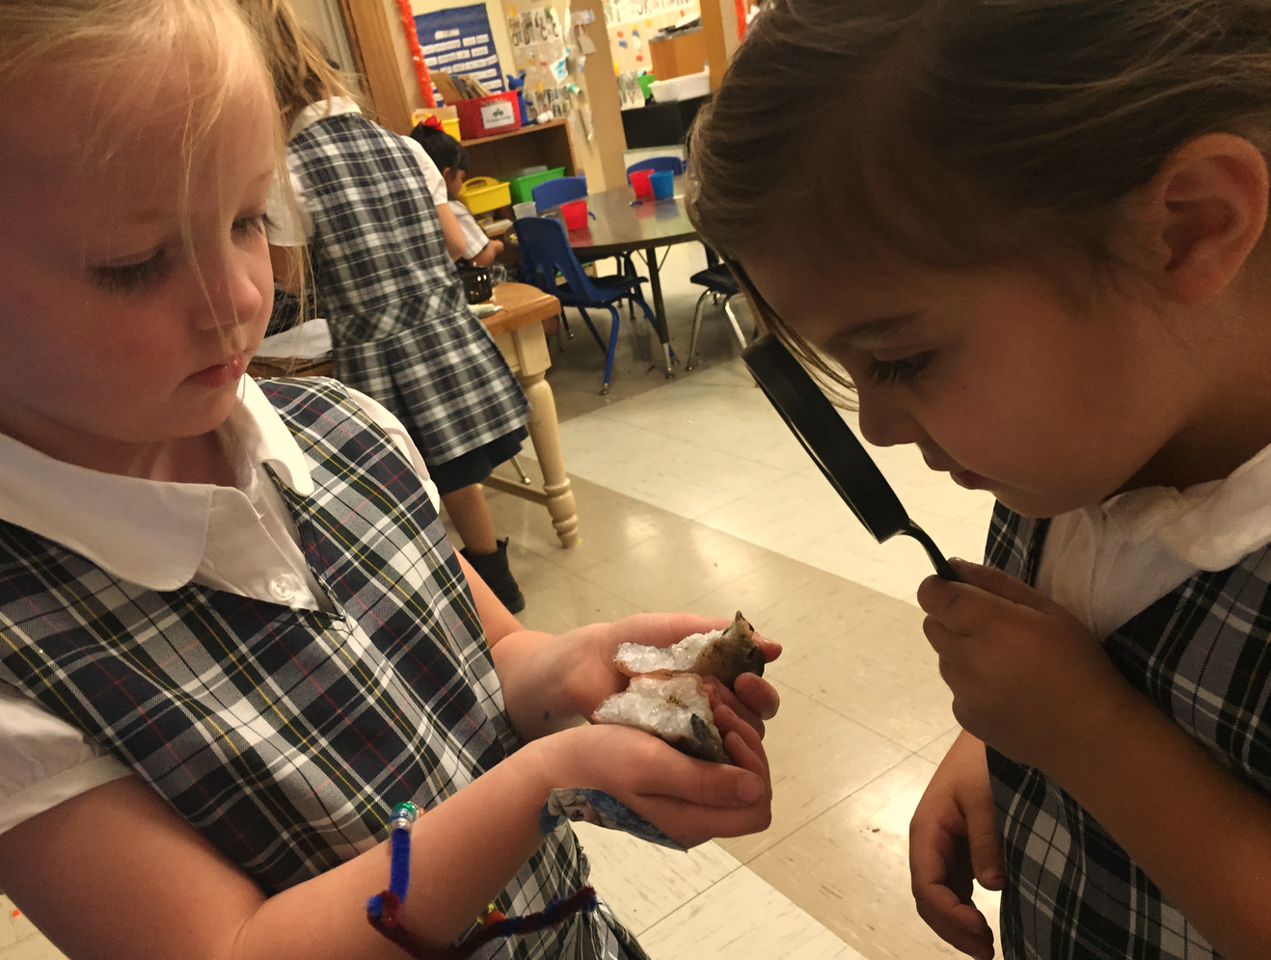
Key Components of Earth Sciences
Through earth sciences children learn about the following:
Earth materials
Changes in the weather
Changes in the environment
Natural objects in the sky (e.g., sun, moon, stars, etc.), and how they appear to move
Caring for and respecting the environment
©2016 California Department of Education
Notes:
Presenter Remarks:
“In studying earth materials and phenomena, children become aware of key characteristics of earth:
Earth materials (soil, sand, rocks, air, water) are part of the natural environment.
Earth materials have different properties.
There are patterns of change in earth phenomena (day/night; seasons).
Natural objects in the sky (sun, moon) are not always in the same place.
Temperature and weather changes can be tracked over time.
Weather and seasonal changes affect the environment.
People should respect and care for the environment” (PCF, Vol. 3, p. 215).

Slide 40
Four Elements that Support Scientific Inquiry
Scientific Inquiry
Content
Tools and Materials
Skills and Language
Culture and Attitude
Content
Tools and Materials
Skills and Language
Culture and Attitude
Notes:
Presenter Remarks:
Please read and discuss the slide with your tablemates; consider how these elements support scientific inquiry. Be prepared to share your thoughts.
Scientific tools and materials are essential to the development of the science concepts of observation, investigation, documentation, and communication.
“Promote the use of scientific tools to extend children’s observations and investigations of objects. Children’s investigations of objects and phenomena can be augmented with the use of observation and measurement tools” (PCF, Vol. 3, p. 158).
“Teachers can take can take time to introduce children to the [scientific] tools and to demonstrate their functions” (PCF, Vol. 3, p. 159).
These elements provide support in helping children gain understanding. What are some of the thoughts your table gathered? How do you think these elements provide support? (Allow one per person per table to share their thoughts.)

Slide 41
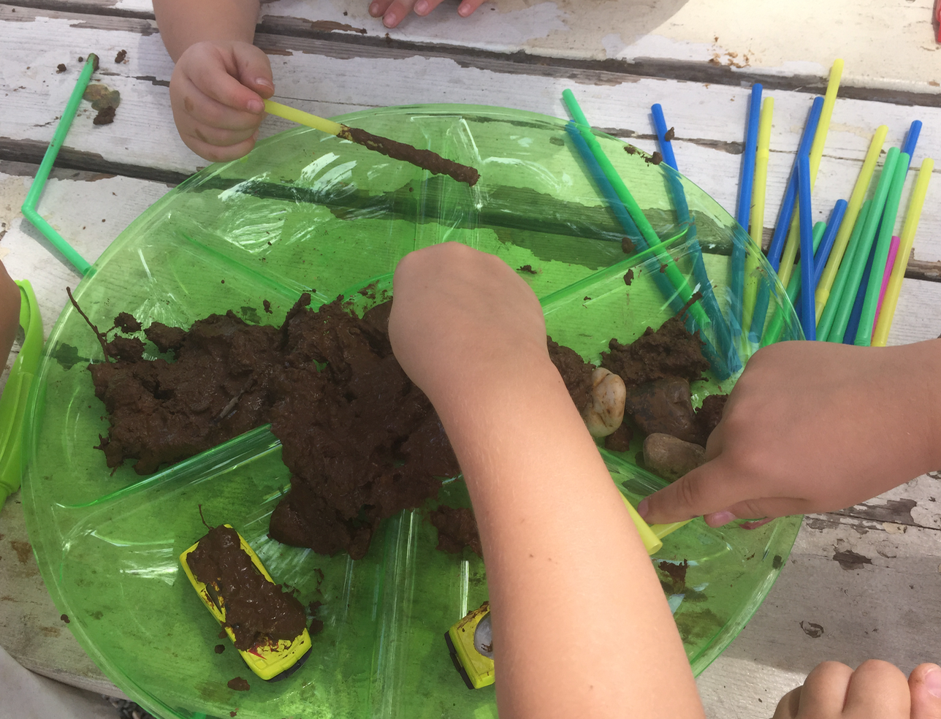
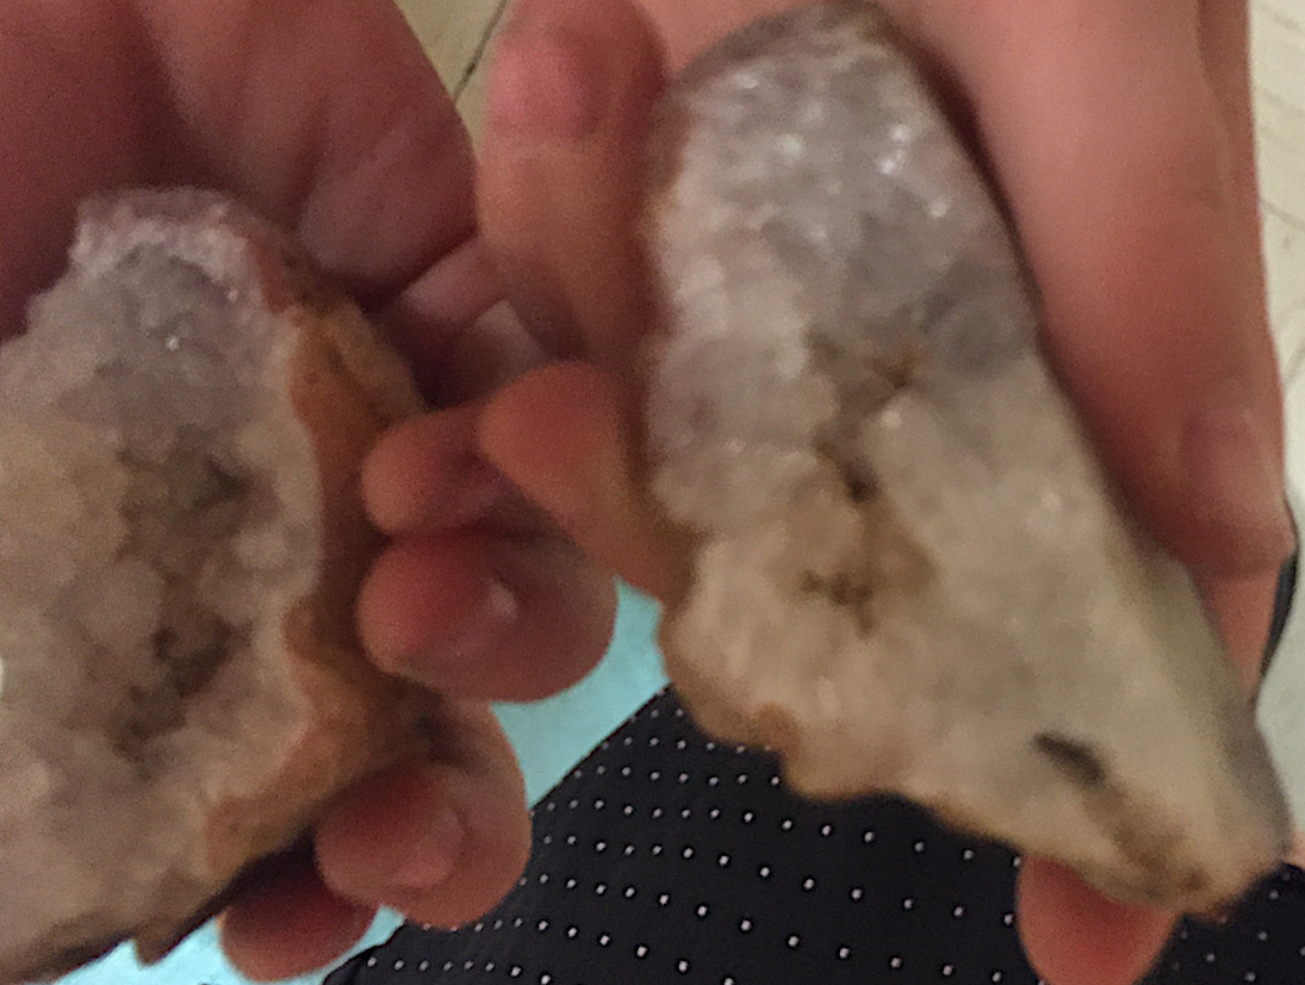
Guiding Principle
“Children explore scientific concepts directly through active, hands-on, minds-on playful experiences” (PCF, Vol. 3, 139).
Notes:
Presenter Remarks:
“Children explore scientific concepts directly through active, hands-on, minds-on playful experiences” (PCF, Vol. 3, p. 139).
Take a moment to write down why this guiding principle is meaningful.
While these active hands-on experiences support the science development of all children, they may specifically support the English learners in your classroom.
Two practices that would explicitly benefit young English learners are, “Using puppets and game-like activities to illustrate concepts and actions to engage children physically (Pasha, et al. 2006) and using materials with familiar content to promote comprehension and facilitate learning of new concepts (Kenner 1999)” (California’s Best Practices for Young Dual Language Learners: Research Overview Papers [CDE], p. 106).

Slide 42
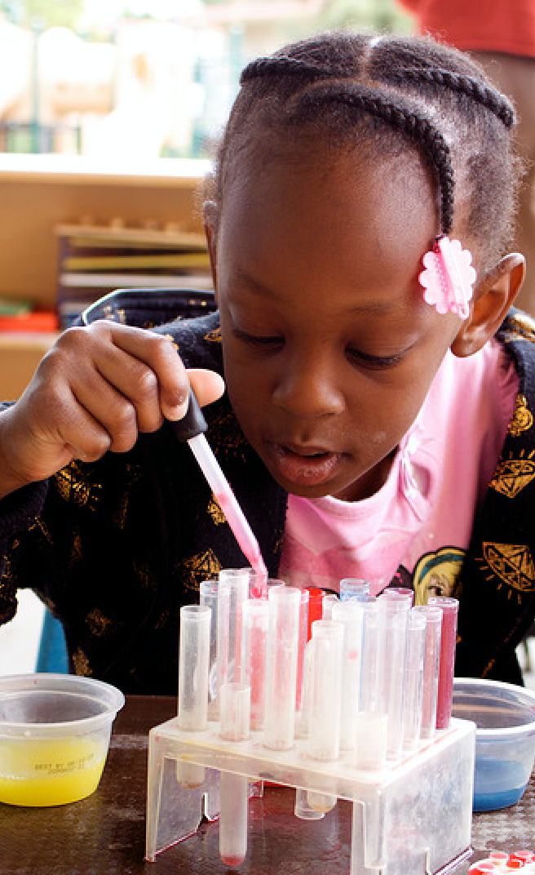
Power of Observation and Investigation
Scientific inquiry is an integral part of children’s play and exploration.
Skills of scientific inquiry provide children with the tools for investigating and learning about science topics.
©2016 California Department of Education
Notes:
Presenter Remarks:
Within the Scientific Inquiry strand the first substrand is Observation and Investigation. “Making observations, posing questions, planning investigations, using tools together information, making predictions, recording information, and communicating findings and explanations all combine in an evolving process of developing science understanding and creating a disposition to choose to learn science in the future” (PCF, Vol. 3, pp. 136-137).

Slide 43
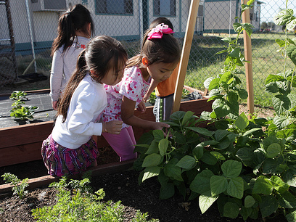
Observations in the Home Language
“Invite them to share their observations in their home language whenever possible” (PCF, Vol. 3, 156).
©2016 California Department of Education
Notes:
Presenter Remarks:
Communication is a key component of observation and investigation. Teachers need to employ multiple strategies to support communication for all children in their classrooms.
“Invite them to share their observations in their home language whenever possible” (PCF, Vol. 3, p. 156).
Look at Handout 8: Open-Ended Questions and Science Materials. Notice that there are multiple questions in two languages. This will support teachers in validating children’s use of their home language. You can post open-ended questions in multiple languages throughout the classroom for bilingual teachers and parents to serve as a reminder and reference for expanding children’s thoughts.

Slide 44
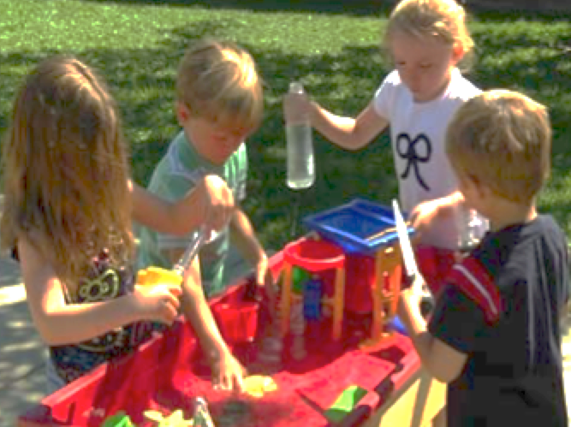
Other Forms of Communication
“Children use language and other forms of communication to express their thoughts, describe observations, and document their work” (PCF, Vol. 3, 2013).
©2016 California Department of Education
Notes:
Presenter Remarks:
Please take out Handout 9: ELD Strategies.
Now let’s reflect on this guiding principle, “Children use language and other forms of communication to express their thoughts, describe observations, and document their work” (PCF, Vol. 3, p. 140).
After reflecting, discuss the following questions with your tablemates:
Why is this guiding principle meaningful?
How is this guiding principle helpful for English learners?
What types of communication did you utilize during the seashell investigation? Would it be beneficial to plan for any of these modes of communication to support English learners?
Children with identified disabilities may also require different modes of communication. For example, if doing the seashell exploration with students who have a hearing disability, a teacher may ask the special education provider to teach them how to sign a few descriptive words; this will the teacher to model describing the seashells through use of another form a communication. The teacher can also provide paper and crayons for all students to use to express observations and document their work.

Slide 45
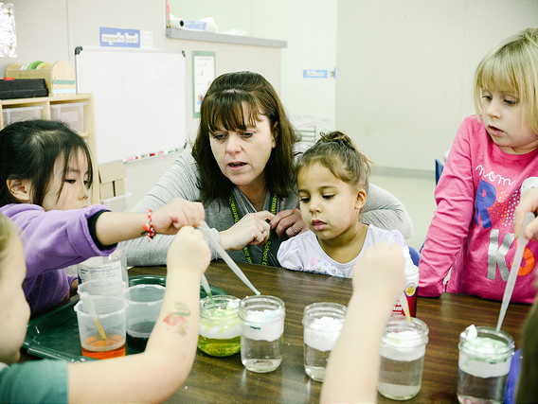
Guiding Principle
“Teachers support children who are English learners in understanding and communicating scientific knowledge and skills” (PCF, Vol. 3, p. 140).
©2016 California Department of Education
Notes:
Presenter Remarks:
“Teachers support children who are English learners in understanding and communicating scientific knowledge and skills. Asking questions and modeling comparative language helps promote language development” (PCF, Vol. 3, p. 140).
“Children who are English learners may be at a stage in which they are still developing their confidence and ability to express themselves in English. Having an adult encourage, prompt, and scaffold the use of expressive language in English and in the child’s home language whenever possible, would support the child’s overall development of scientific knowledge and language skills” (PCF, Vol. 3, p. 169).

Slide 46
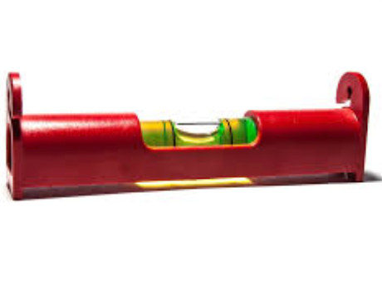
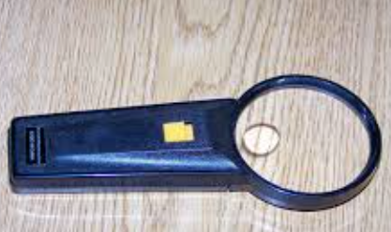
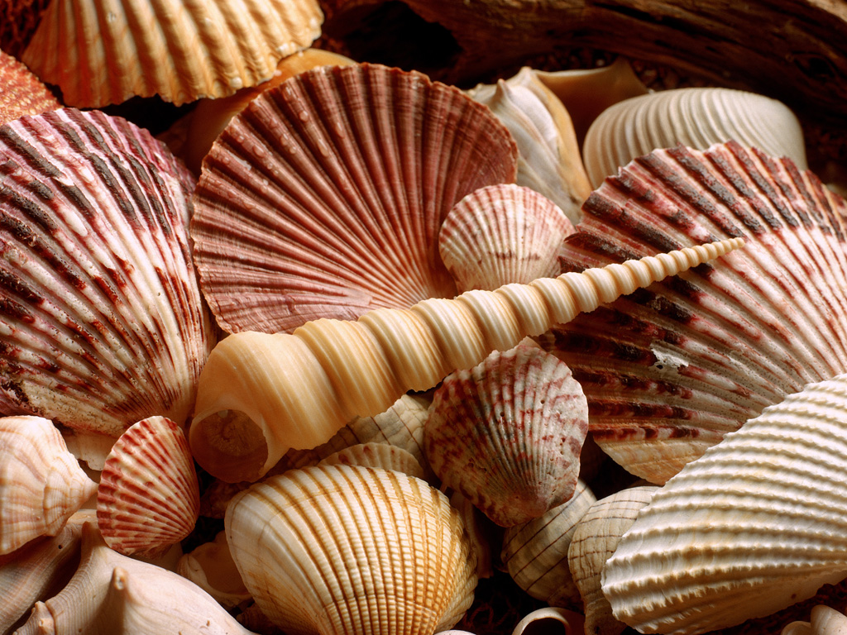

Investigating Seashells
©2016 California Department of Education
Notes:
Activity 3: Digging into Seashells
Presenter Remarks:
We are going to explore the components of scientific inquiry—observation, investigation, documentation, and communication—through the hands-on exploration of seashells. (Refer to slide appropriate PPT slide.)
Take out Handout 10: Digging into Seashells; you will be working to complete this handout throughout the activity. I will guide you through the following steps using the handout:
Begin by completing the first question: What do I know about seashells? Be sure to identify vocabulary words that are integral to exploring seashells.
Now observe, investigate, compare, and classify the seashells. Feel free to pick up and explore the size, shape, and feel of the shells. Think about what questions you might ask students as you observe and investigate the seashells. (Refer participants to Handout 8: Open-Ended Questions and Science Materials.)
Move on to the second question: What new things did I discover about seashells? (Place scientific tool bags on the tables as participants are working.)
Open the scientific tool bag I put on your table and continue observing and investigating.
Now complete the third question: How did the scientific tools expand the scientific inquiry process and deepen your exploration of seashells? Feel free to document your discoveries by drawing on paper.
Turn to your tablemates and discuss your observations and reflections.
Now chart your top three scientific inquiry insights; be sure to include a pictorial representation of your learning on the chart paper.
(Have participants display their charts and share their learning. Idea for display: ocean scene: child playing by the sea, seashell, bucket, shovel, and sand.)
intent:
Engage participants with the process of scientific inquiry through observation, investigation, documentation, and communication.
OUTCOMES:
Participants build community with each other as they increase their understanding of the scientific inquiry process (observation, investigation, documentation, and communication) while reflecting on other domains addressed in STEAM.
Materials Required:
PPT slide
Trainer notes
Handout 10: Digging into Seashells
Handout 8: Open-Ended Questions and Science Materials
Materials for each table: Tray with sand and seashells, paper, crayons, pencils, markers, chart paper, scientific tools in a paper bag
TIME: 20 minutes
Process:
Prior to training: Lay out all the table materials—except for the scientific tools—at each table; the scientific tools will be brought out later during the activity.
Explain that we are going to explore the components of scientific inquiry—observation, investigation, documentation, and communication—through the hands-on exploration of seashells. (Refer to slide appropriate PPT slide.)
Invite participants to take out Handout 10: Digging into Seashells; they will be working to complete this handout throughout the activity.
Guide participants through the following steps using Handout 10: Digging into Seashells:
Ask participants to complete the first question: What do I know about seashells? Identify vocabulary words that are integral to exploring seashells.
Have participants to observe, investigate, compare, and classify the seashells. Explain that they can pick up and explore the size, shape, and feel of the shells. Ask them to identify what questions they might ask students as they observe and investigate the seashells. Refer participants to Handout 8: Open-Ended Questions and Science Materials.
Ask participants to complete the second question: What new things did I discover about seashells? (Place scientific tool bags on the tables as participants are working.)
Have participants open their scientific tool bags and to continue observing and investigating.
Ask participants to complete the third question: How did the scientific tools expand the scientific inquiry process and deepen your exploration of seashells?
Invite participants to document their discoveries by drawing on paper.
Have participants discuss their observations and reflections with their tablemates.
Ask groups to chart their top three scientific inquiry insights; have them include a pictorial representation of their learning on the chart paper.
Have participants display their charts and share their learning. (Idea for display: ocean scene: child playing by the sea, seashell, bucket, shovel, and sand.)
Debrief:
What was interesting to you about the conversations you had?
Was there something you found surprising?
How might you use what you felt in this activity in the classroom?
What is one new idea regarding science that you can add to your classroom that utilizes your strengths as a teacher?

Slide 47
Discussion
What was interesting to you about the conversations you had?
Was there something you found surprising?
How might you facilitate this feeling of discovery in your classroom?
What is one new idea regarding science that you will add to your classroom that utilizes your strengths as a teacher?
What adaptation might you add to support access to the experience for all children?
Notes:
Presenter Remarks:
Let’s debrief together:
What was interesting to you about the conversations you had?
Was there something you found surprising?
How might you facilitate this feeling of discovery in your classroom?
What is one new idea regarding science that you will add to your classroom that utilizes your strengths as a teacher?
What adaptation might you add to support access to the experience for all children?

Slide 48
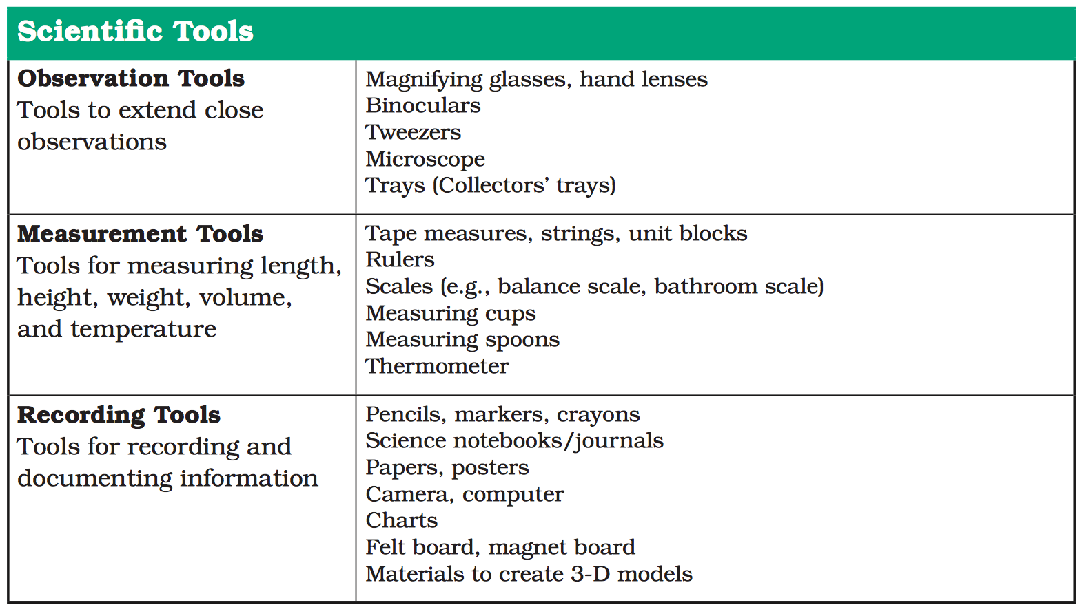
TOOLS List
Notes:
Presenter Remarks:
Let’s reflect on using scientific tools:
How do scientific tools deepen and expand observation and investigation?
Do you spend time teaching students how to use scientific tools to expand observations and investigations?
What other scientific tools can you add to your classroom?

Slide 49
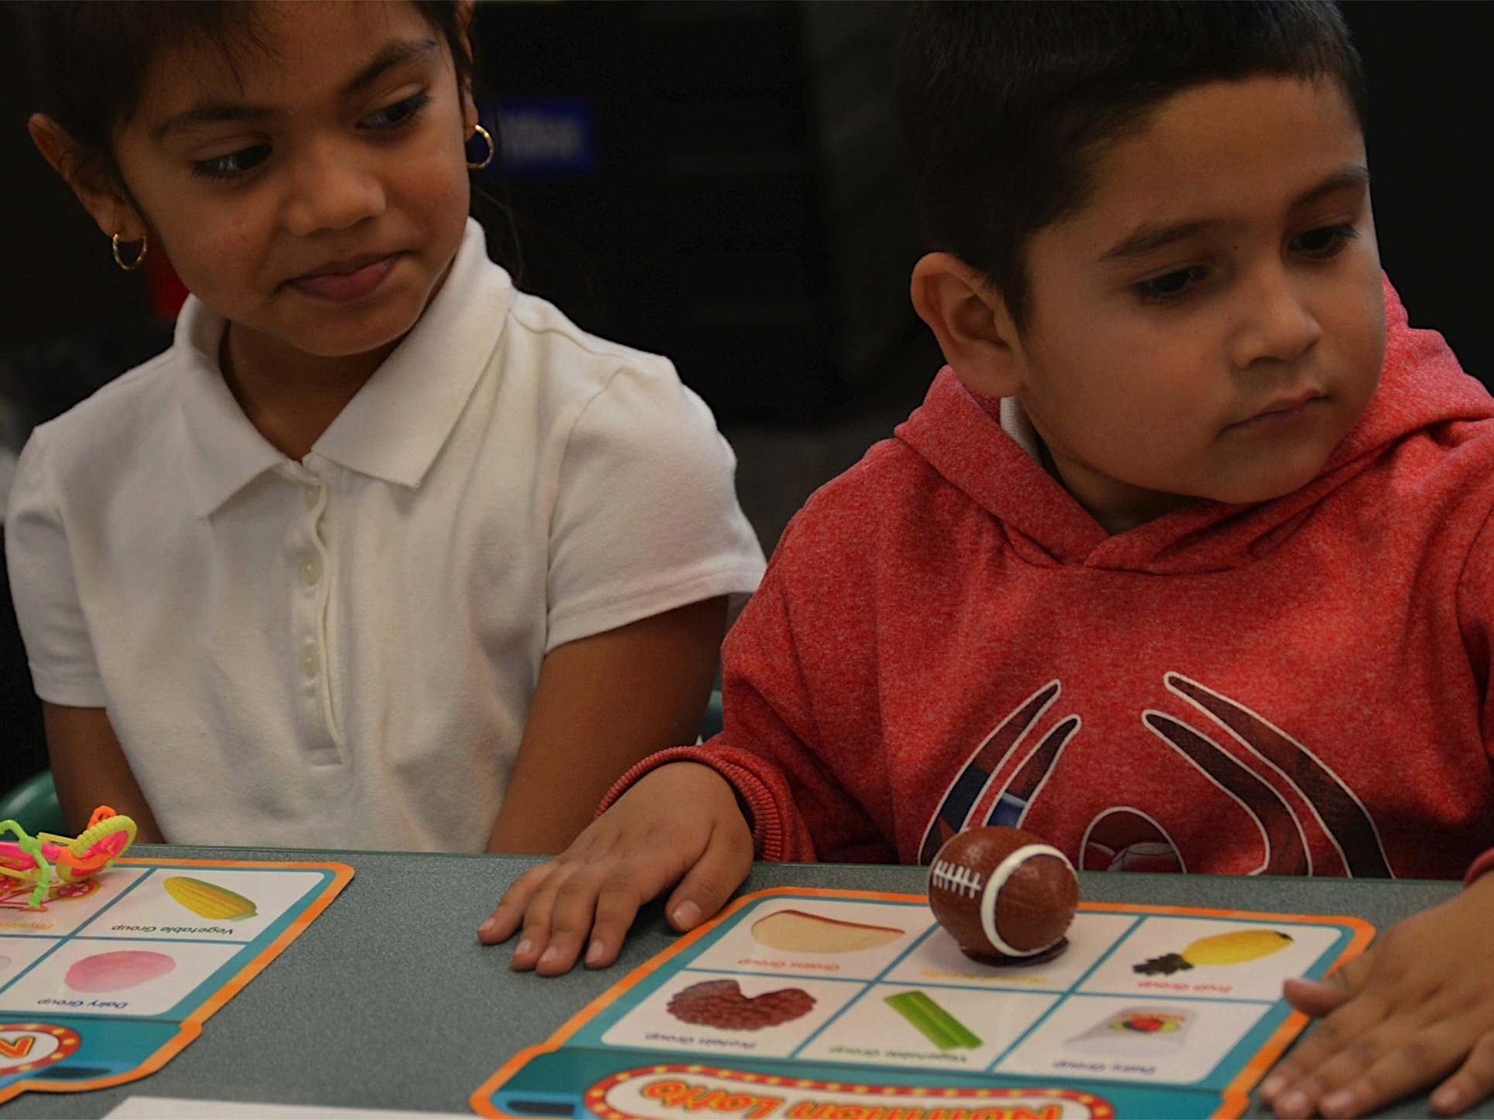
Universal Design for Learning
Multiple means of:
Representation
Engagement
Expression
©2016 California Department of Education
Notes:
Presenter Remarks:
The Preschool Curriculum Framework includes Universal Design for Learning. Many of the strategies we have already discussed are examples of Universal Design for Learning. Is anyone familiar enough with this concept of Universal Design to share their understanding with us?
(Allow participants to share.)
“Universal design provides for multiple means of representation, multiple means of engagement, and multiple means of expression…Multiple means of representation refers to providing information in a variety of ways so the learning needs of all children even if they communicate in another language. For example, it is important to speak clearly to all children while also presenting information visually (such as with objects and pictures) so that they may be able to learn as much as possible.
“Multiple means of expression refers to allowing children to use alternative ways to communicate or demonstrate what they know or what they are feeling. For example, when a teacher seeks a verbal response, a child may respond in any language, including American Sign Language. A child with special needs who cannot speak may also respond by pointing, by gazing, by gesturing, by using a picture system of communication, or by using any other form of alternative or augmented communication system.
“Multiple means of engagement refers to providing choices in the setting or program that facilitate learning by building on children’s interests. The information in this curriculum framework has been worded to incorporate multiple means of representation, expression, and engagement” (PCF, Vol. 2, p. 14).
The next slide and handout highlight a variety of interactions and strategies for both ELD and LLD that also incorporate ideas of supporting students with Universal Design for Learning.

Slide 50
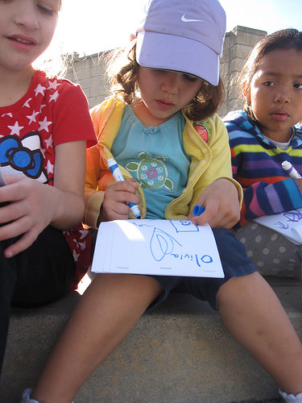
Investigations
“Teachers often need to do some investigations of their own so they know where to take the children in future investigations”
(PCF, Vol. 3, p. 149).
©2016 California Department of Education
Notes:
Presenter Remarks:
Take a moment to read the quote on the slide : “Teachers often need to do some investigations of their own so they know where to take the children in future investigations” (PCF, Vol. 3, p. 149).
For example, think about what your group discovered about seashells. Considering this new knowledge, how might you guide future investigations of seashells in your classroom? Take a moment to talk about this with your group.
(Allow 2-3 minutes for table discussion and then invite groups to share-out key responses).

Slide 51
Four Elements that Support Scientific Inquiry
Scientific Inquiry
Content
Tools and Materials
Skills and Language
Culture and Attitude
Content
Tools and Materials
Skills and Language
Culture and Attitude
Notes:
Presenter Remarks:
Skills and language are key components to scientific inquiry. As teachers plan and engage children in the scientific process, children begin to adopt scientific ideas and language of scientific inquiry—ways to explore and develop knowledge and understanding of scientific ideas.
“Teachers can use the experiences to encourage children to observe closely, using their senses and tools, and describe their observations, which helps them in learning about properties and characteristics of objects and materials” (PCF, Vol. 3, p. 154).

Slide 52
Communication Supports Inquiry
Inquiry Experiences
Language
Inquiry experiences support language development
Guided discussions support conceptual growth
Notes:
Presenter Remarks:
“Science is about providing children with the basic skills of scientific inquiry, such as observing and describing, comparing and contrasting, classifying, experimenting and recording, and using the scientific vocabulary associated with these skills” (PLF, Vol. 3, p. 48).

Slide 53
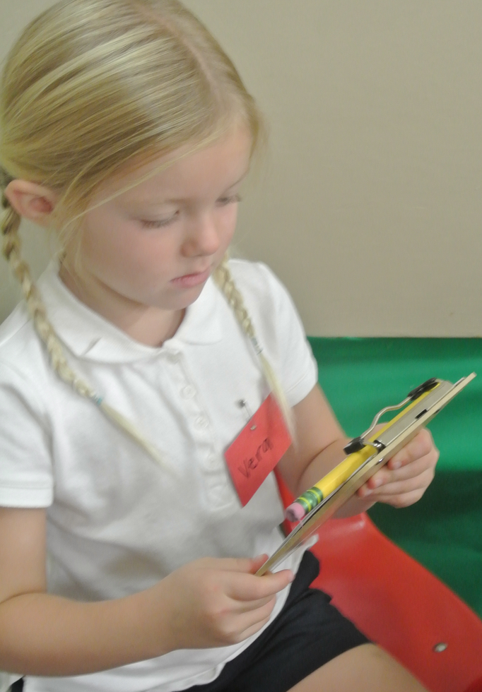
Research Highlight: Culture of Inquiry
53
“Integral to children’s processes of scientific inquiry is their communication about what they are doing and thinking” (PCF, Vol. 3, p. 166).
©2016 California Department of Education
Notes:
Presenter Remarks:
“Integral to children’s processes of scientific inquiry is their communication about what they are doing and thinking” (PCF, Vol. 3, p. 166).
Communication provides children with many opportunities to use language. For example, they are able to express their thoughts, opinions, and views. When children communicate what they are thinking or doing, a great opportunity is provided for the teacher to expand the conversation by asking questions that will enable children to further describe and/or explain.

Slide 54
Focused Video Viewing:
Scientific Inquiry Foundations
Video Example 2.2
Notes:
Presenter Remarks:
Watch the video example of foundation 2.2 Communication and Documentation to see how four and five year olds may document and communicate their scientific thinking.

Slide 55
Focused Video Discussion
Discuss with your tablemates:
What resonates with you from the foundations example?
What did you see in the video that you have also seen in your classroom?
Notes:
Presenter Remarks:
Discuss the questions on the slide with your tablemates:
What resonates with you from the foundations example?
What did you see in the video that you have also seen in your classroom?

Slide 56
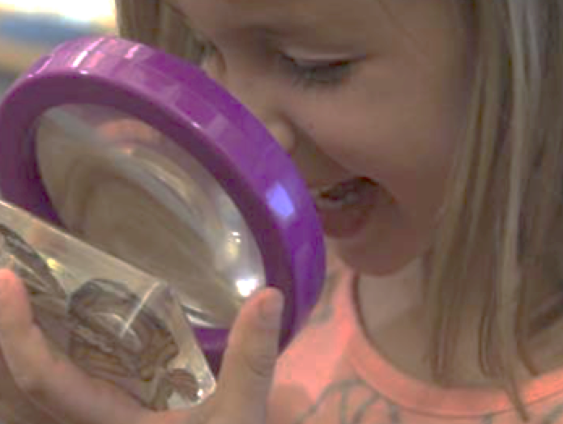
Scientific Exploration
“Scientific exploration exposes young children to a variety of new words in meaningful contexts”
(PLF, Vol. 3, p. 49).
©2016 California Department of Education
Notes:
Presenter Remarks:
“Scientific exploration exposes young children to a variety of new words in meaningful contexts” (PLF, Vol. 3, p. 49).
What are some of these words that you have focused on in your classrooms? Take a moment and discuss this with an elbow partner.
On the next slide we will explore some science vocabulary words.

Slide 57
Science Language Challenge
Observe, observation
Predict, prediction
Test
Similar, different
Compare, contrast
Count
Hypothesis
Measure
Investigate
Explore
Experiment
Discover
Record
Explain
Notes:
Activity 4: Science Language Challenge
Presenter Remarks:
Let’s do the Science Language Challenge!
intent:
Teach participants science vocabulary and provide movement breaks throughout the training.
OUTCOMES:
Participants build community with each other, gain familiarity with science vocabulary, and experience the connection between movements, art, and science.
Materials Required:
PPT slide
Trainer notes
Sticks with vocabulary words written on them
Container for the sticks (pencil jar, mason jar, plastic cup, etc.)
Preschool Learning Foundations glossary for support
Handout 11: Glossary Markers, crayons, etc.
Scratch paper
Time: 30 minutes (broken up throughout the day)
10 min., 5 min., 5 min., 5 min., 5 min.
PROCESS:
Each table group must identify a science vocabulary word (one per table group):
One player from each table group is labeled the “scientist.” The “scientist” pulls a vocabulary stick. Each stick has a word on it. The “scientist” must keep the stick hidden from their tablemates.
Trainer rolls the die and announces what it lands on (verbalize, dramatize, or picturize).
Verbalize: This indicates that the “scientist” will describe the word without actually saying the word or any parts of it (similar to Catch Phrase!).
Dramatize: This indicates the “scientist” will act out the word and provide clues through dramatization (similar to charades).
Picturize: This indicates the “scientist” will draw clues for the group to guess the word (similar to Pictionary).
Each “scientist” must provide clues to their table group to help them guess the word by using the technique specified by the die cast.
When a table group has correctly identified the vocabulary word the entire table group stands up and says, “Complete.” The table that shouts “Complete” first is the winner.
Trainer turns the timer over and says, “Language challenge on!”
Trainer congratulates the winning table and asks the remaining “scientists” to tell their table groups what their vocabulary word was.
Trainer asks all participants to find the definition of the word they were just guessing on the science glossary handout. Participants can add anything to the description that they think would be helpful to them.
Throughout the day the trainer can replay this game by stopping and saying, “Time for a language challenge!” Simply have each table group identify a new “scientist,” pull a new vocabulary stick, and roll the die again for each new round.
SUMMARY:
Participants learn science vocabulary through an interactive guessing game.
Extra Notes:
Throughout the day you can replay this game by stopping and saying, “Time for a language challenge!” Simply have each table group identify a new “scientist,” pull a new vocabulary stick, and roll the die again for each new round.

Slide 58
Predict and Check
“Encourage children to make predictions” (PCF, Vol. 3, p. 163).
“Introduce children to the idea of predicting” (PCF, Vol. 3, p. 163).
“Encourage children to first predict and then check their predictions” (PCF, Vol. 3, p. 164).
“Elicit children’s predictions by asking questions allowing them opportunities to make inferences and draw conclusions” (PCF, Vol. 3, p. 164).
Notes:
Presenter Remarks:
“Invite children to compare and contrast objects and phenomena related to their current focus on inquiry” (PCF, Vol. 3, p. 162).
Introduce children to the idea of predicting and checking predictions. “When children first predict and then check their predictions with actions, they learn to compare what actually happens with what they thought would happen rather than merely accepting facts without thinking about them…” (PCF, Vol. 3, p. 164).
“Even though the words prediction and hypothesis are often used interchangeably in everyday usage, a prediction is not the same as a hypothesis. Unlike a prediction, which is a guess about what is going to happen, a hypothesis is a proposed explanation of observable phenomena that is either confirmed or disproved by an experiment” (PCF, Vol. 3, p. 164).

Slide 59
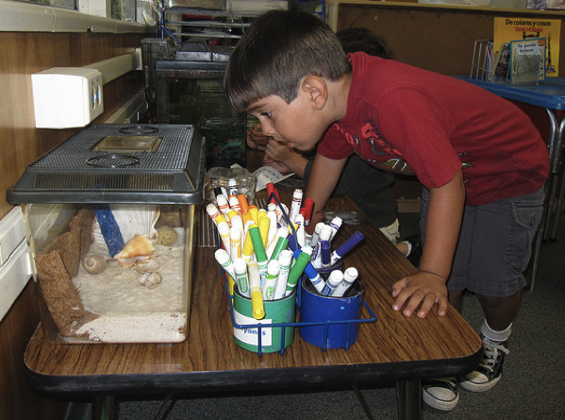
Not all children express themselves verbally.
“Children may express their questioning and interest nonverbally, through their facial expressions, body language, and behaviors” (PCF, Vol. 3, p. 148).
©2016 California Department of Education
Notes:
Presenter Remarks:
“Not all children use words to express curiosity. Children may express their questioning and interest nonverbally, through their facial expressions, body language, and behaviors” (PCF, Vol. 3, p. 148).
“Children with hearing impairments or motor challenges may communicate with signs, gestures, or devices. Describing observations that depend on use of all senses is a prime opportunity to teach new vocabulary” (PCF, Vol. 3, p. 156).
“Teachers should be aware that when foundations or examples indicate verbal expression, children might use any means of communication (including home language, Sign Language, and communication devices) to display their knowledge” (PLF, Vol. 3, p. 52).

Slide 60
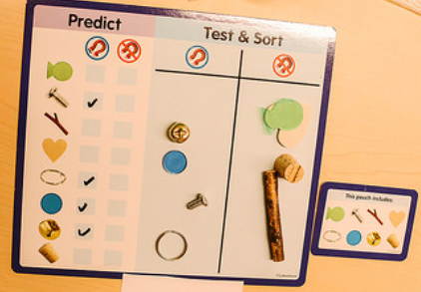
Role of Documentation and Recording
“Documentation and recording of information…illustrates for children the link between spoken and written language and supports the development of print concepts” (PLF, Vol. 3, p. 50).
Notes:
Presenter Remarks:
Please take out Handout 12: Observations and Documentation.
“Documentation and recording of information on charts, graphs, books, and science journals also illustrates for children the link between spoken and written language and supports the development of print concepts” (PLF, Vol. 3, p. 50).
You can facilitate interactions using the following strategies:
“Encourage children to record observations and document investigation and findings. Introduce children to the idea of recording” (PCF, Vol. 3, p. 167).
“Promote the use of different forms to record and document information” (PCF, Vol. 3, p. 168).
“Consider adaptations for children with specials needs” (PCF, Vol. 3, p. 168).
“Encourage children to describe their representations while you write their words” (PCF, Vol. 3, p. 168).
“Encourage children to use different means of communication and forms of recording” (PCF, Vol. 3, p. 169).

Slide 61
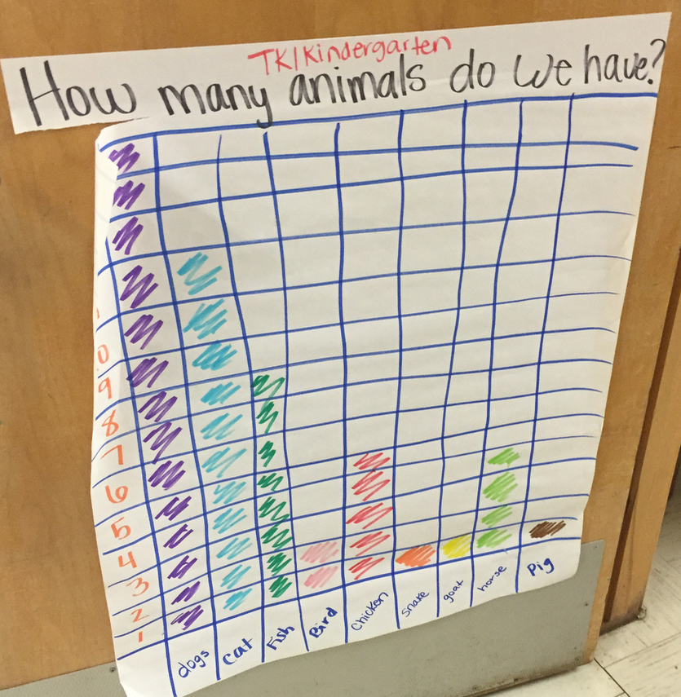
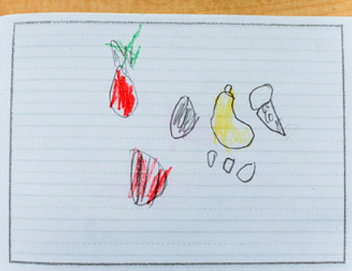
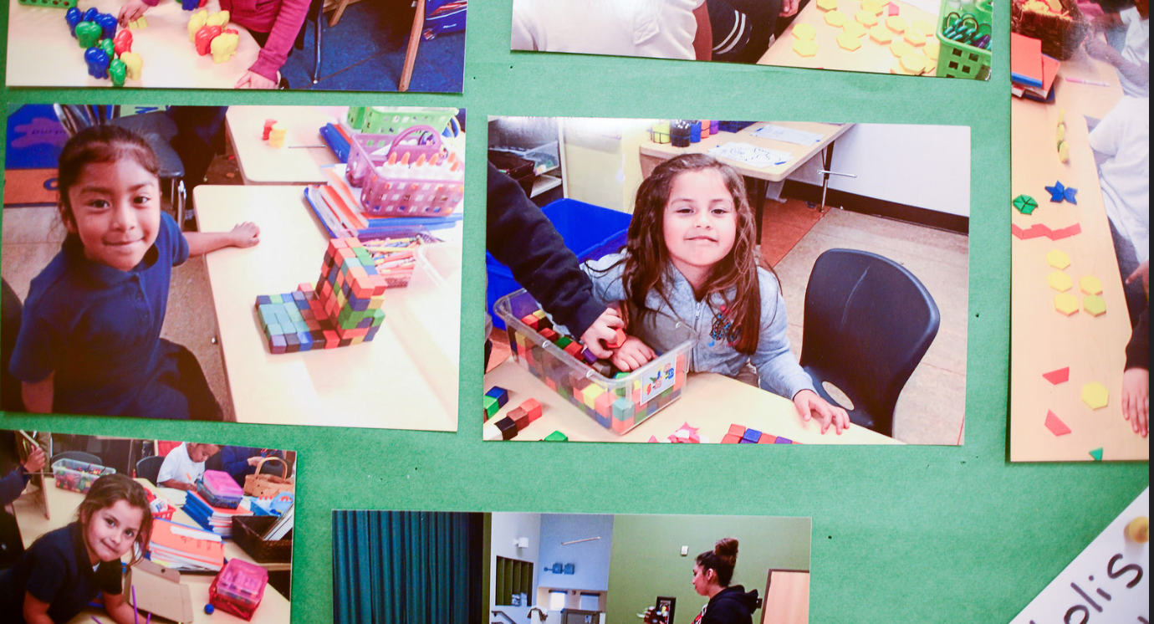
Forms of Documentation
Drawings
Words
Photos
Charts
Notes:
Presenter Remarks:
Let’s continue to look at Handout 12: Observations and Documentation.
Provide students with a variety of strategies to document their observations and investigations including drawings, words, photos, charts, and other forms of information. Documentation also serves to build children’s language and communication skills.
“Making children’s and teachers’ documentation visible in the room allows children to revisit and experience, provides a focus of conversation for children and teachers, and makes the process of inquiry visible for children and families. It also gives a positive message to children about the importance of their investigations and the value the teacher places on their work” (PCF, Vol. 3, p. 145).

Slide 62
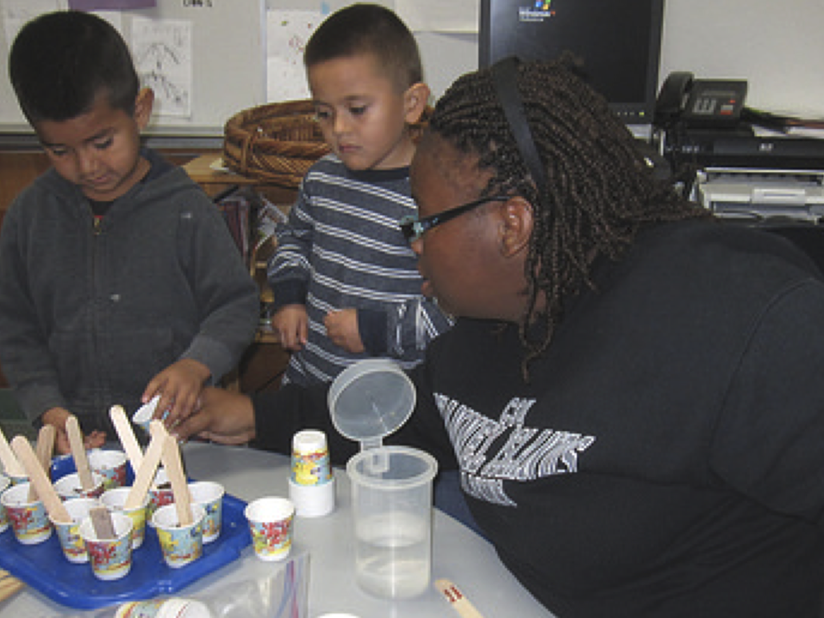
Open Ended Questions
“Families can support children’s learning of science, using their home language, and be partners in the education of their children” (PCF, Vol. 3, p. 173).
©2016 California Department of Education
Notes:
Presenter Remarks:
“Families can support children’s learning of science, using their home language, and be partners in the education of their children” (PCF, Vol. 3, p. 173).

Slide 63
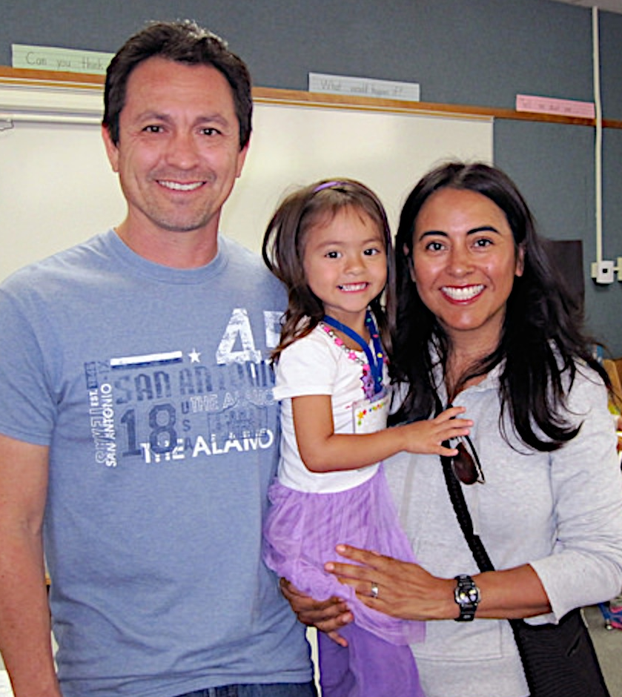
Partner with families to learn about children’s strengths.
Best Practices for Planning Curriculum: Family Partnerships and Culture
  CDE Publication (2016)
All About Young Children
  CDE Web site
California Preschool Curriculum Framework (Engaging Families Section)
  CDE Publication (2010)
Notes:
Presenter Remarks:
To effectively build on children's existing strengths, we must understand them. We can better learn about their strengths by partnering with families.
These resources are specifically beneficial for partnering with families. You may want to take a picture of this screen for future reference.
Optional:
Create a gallery table and have examples of documents there.
Extra Notes:
The resources are hyperlinked. If Wi-Fi access is available, you may go directly to them for a resource walk through.

Slide 64
Find Multi-Lingual Parent Tips
Parent Tips
Notes:
Background Information:
http://allaboutyoungchildren.org/english/36-months-to-48-months/
Presenter Remarks:
The All About Young Children Web site has great videos and parent tip sheets in multiple languages that highlight how children approach learning.
These tips address observation, investigation, and other scientific inquiry processes. Please see Handout 13: Family Strategies.

Slide 65
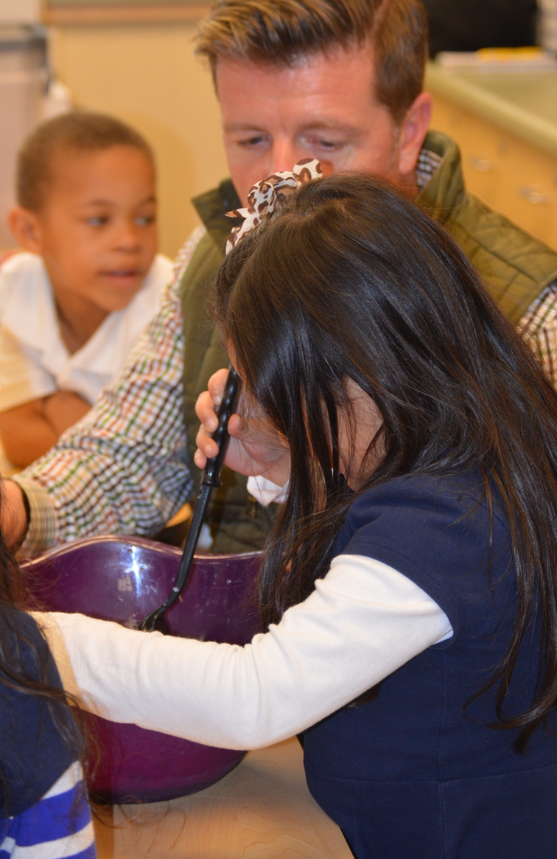
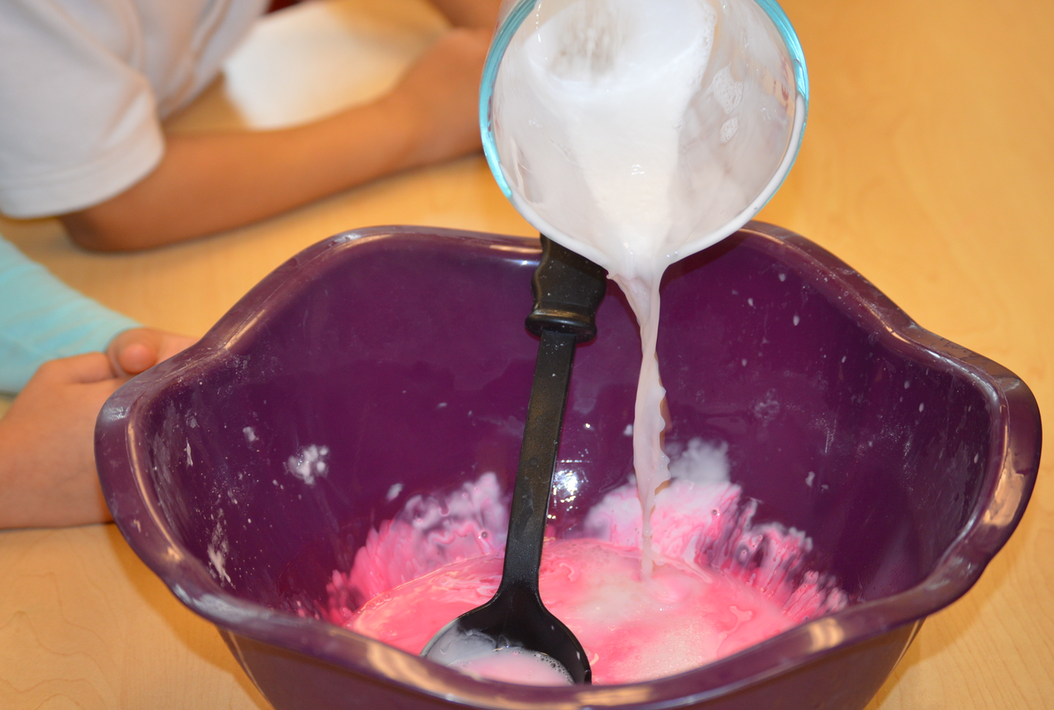
Scientific Inquiry
“Like scientists, children have a natural desire to inquire, but need guidance in developing the skills of scientific inquiry” (PCF, Vol. 3, 153).
©2016 California Department of Education (CDE) with the WestEd Center for Child & Family Studies, California Preschool Instructional Network (CPIN).
Notes:
Presenter Remarks:
“Preschool [and TK] teachers play a pivotal role in expanding children’s understanding of science concepts and developing children’s attitudes, skills, and the language of scientific inquiry” (PCF, Vol. 3, p. 137).
“With teachers’ intentional planning, guidance, and support, children’s play and interactions with objects can become rich experiences of scientific inquiry and facilitate children’s knowledge and understanding of objects and events in the world” (PCF, Vol. 3, p. 137).

Slide 66
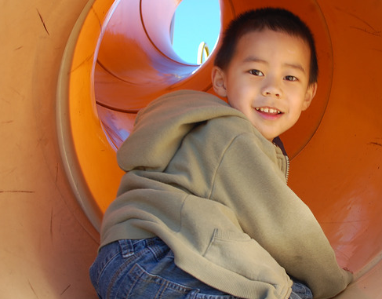
Thanks for coming!
Notes:
Background Information:
See trainer support materials (Preparing 21st Century Students for a Global Society).
Presenter Remarks:
Scientific inquiry is essential for learning about science. “Making observations, posing questions, planning investigations, using tools to gather information, making predictions, recording information, and communicating findings and explanations all combine in an evolving process of developing science understanding and creating a disposition to choose to learn science in the future” (PCF, Vol. 3, pp. 136-137).
The very same concepts of scientific inquiry that support 21st century skills and the Next Generation Science Standards are present in the transitional kindergarten classroom when teachers create an environment where, “Children explore scientific concepts directly through active, hands-on minds-on playful experiences” (PCF, Vol. 3, p. 139).

Slide 67
Reference Guide for PowerPoint Citations
California Department of Education. 2010. California Preschool Curriculum Framework, Volume 1. http://www.cde.ca.gov/sp/cd/re/documents/psframeworkkvol1.pdf (accessed September 9, 2016).
California Department of Education. 2012. California Preschool Learning Foundations, Volume 3. www.cde.ca.gov/.../preschoolfoundationsvol3.pdf (accessed September 9, 2016).
California Department of Education. 2013. California Preschool Curriculum Framework, Volume 3. www.cde.ca.gov/sp/.../preschoolframeworkvol3.pdf (accessed September 9, 2016).
California Department of Education. 2013. California’s Best Practices for Young Dual Language Learners: Research Overview Papers. http://www.cde.ca.gov/sp/cd/ce/documents/dllresearchpapers.pdf (accessed September 9, 2016).
California Department of Education. 2013. Transitional Kindergarten Implementation Guide: A Resource for California Public School District Administrators and Teachers. Sacramento: California Department of Education.
National Committee on Science Education Standards and Assessment, National Research Council. 1996. National Science Education Standards. http://www.nap.edu/catalog/4962.html (accessed September 9, 2016).
National Education Association. n.d. An Educator’s Guide to the “Four Cs”: Preparing 21st Century Students for a Global Society. http://www.nea.org/assets/docs/A-Guide-to-Four-Cs.pdf (accessed September 9, 2016).
NGSS Lead States. 2013. Next Generation Science Standards: For States, By States. Chapter: APPENDIX F: Science and Engineering Practices in the Next Generation Science Standards. Washington, DC: The National Academies Press.
NGSS Lead States. n.d. Next Generation Science Standards: An Overview for Principals. http://ngss.nsta.org/Documents/NGSS%20Overview%20for%20Principals.pdf (accessed September 9, 2016).
Notes:
California Department of Education. 2010. California Preschool Curriculum Framework, Volume 1. http://www.cde.ca.gov/sp/cd/re/documents/psframeworkkvol1.pdf (accessed September 9, 2016).
California Department of Education. 2012. California Preschool Learning Foundations, Volume 3. www.cde.ca.gov/.../preschoolfoundationsvol3.pdf (accessed September 9, 2016).
California Department of Education. 2013. California Preschool Curriculum Framework, Volume 3. www.cde.ca.gov/sp/.../preschoolframeworkvol3.pdf (accessed September 9, 2016).
California Department of Education. 2013. California’s Best Practices for Young Dual Language Learners: Research Overview Papers. http://www.cde.ca.gov/sp/cd/ce/documents/dllresearchpapers.pdf (accessed September 9, 2016).
California Department of Education. 2013. Transitional Kindergarten Implementation Guide: A Resource for California Public School District Administrators and Teachers. Sacramento: California Department of Education.
National Committee on Science Education Standards and Assessment and National Research Council. 1996. National Science Education Standards. http://www.nap.edu/catalog/4962.html (accessed September 9, 2016).
National Education Association. n.d. An Educator’s Guide to the “Four Cs”: Preparing 21st Century Students for a Global Society. http://www.nea.org/assets/docs/A-Guide-to-Four-Cs.pdf (accessed September 9, 2016).
NGSS Lead States. 2013. Next Generation Science Standards: For States, By States. Chapter: APPENDIX F: Science and Engineering Practices in the Next Generation Science Standards. Washington, DC: The National Academies Press.
NGSS Lead States. n.d. Next Generation Science Standards: An Overview for Principals. http://ngss.nsta.org/Documents/NGSS%20Overview%20for%20Principals.pdf (accessed September 9, 2016).

