Slide 1
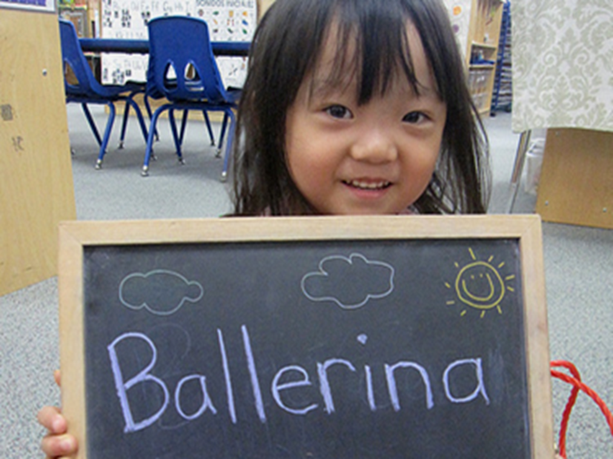
Title Slide
Visual and Performing Arts in Transitional Kindergarten
Dance
California Preschool Learning Foundations, Volume 2
California Preschool Curriculum Framework, Volume 2
Notes:
Presenter Remarks:
Welcome to Visual and Performing Arts: Music in Transitional Kindergarten—a presentation focusing on the California Preschool Learning Foundations (Preschool Learning Foundations or PLF), the California Preschool Curriculum Framework (Preschool Curriculum Framework or PCF), and other California Department of Education (CDE) resources in support of the Visual and Performing Arts domain.
This professional learning session is specifically designed to provide TK teachers with exposure to CDE resources that support TK curriculum planning of developmentally appropriate strategies. Classroom environment design recommendations are included to support the content area of dance.

Slide 2
Objectives
Gain understanding of key concepts from the California Preschool Learning Foundations, Volume 2 and the California Preschool Curriculum Framework, Volume 2—Visual and Performing Arts domain, Dance strand.
Observe, read, and discuss the developmental continuum for dance and develop strategies that will guide instruction and learning in Transitional Kindergarten (TK).
Practice using the Preschool Learning Foundations and Preschool Curriculum Framework to intentionally plan developmentally appropriate, cultural, and inclusive strategies that promote the development of skills, knowledge, and behaviors related to dance.
Notes:
Presenter Remarks:
This slide shows what we will cover in today’s training.
Objectives:
Gain understanding of key concepts from the California Preschool Learning Foundations, Volume 2 and the California Preschool Curriculum Framework, Volume 2—Visual and Performing Arts domain, Dance strand.
Observe, read, and discuss the developmental continuum for dance and develop strategies that will guide instruction and learning in Transitional Kindergarten (TK).
Practice using the Preschool Learning Foundations and Preschool Curriculum Framework to intentionally plan developmentally appropriate, cultural, and inclusive strategies that promote the development of skills, knowledge, and behaviors related to dance.

Slide 3
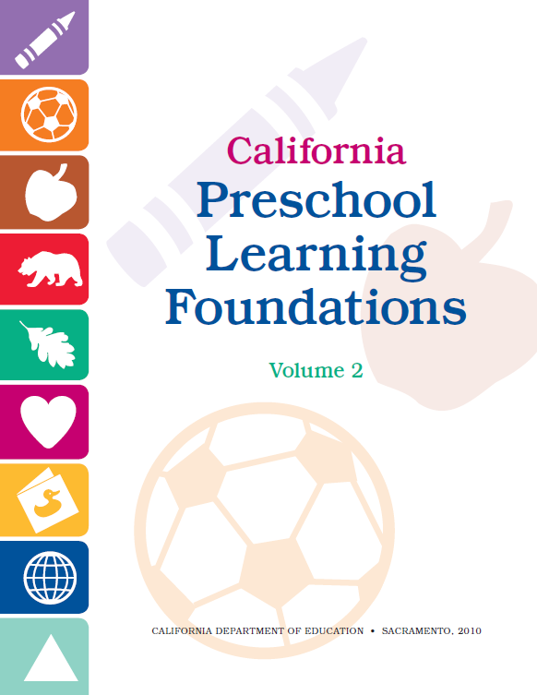

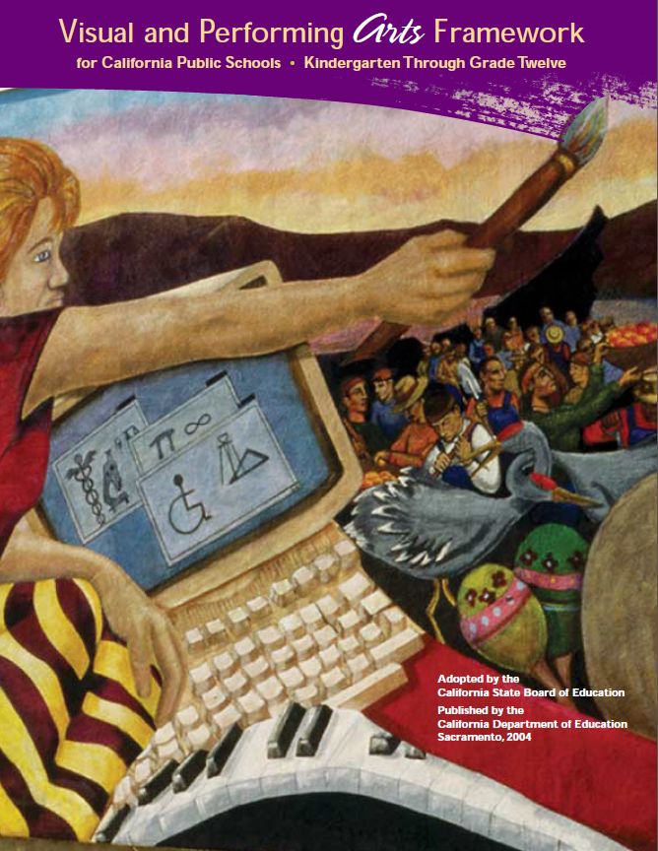
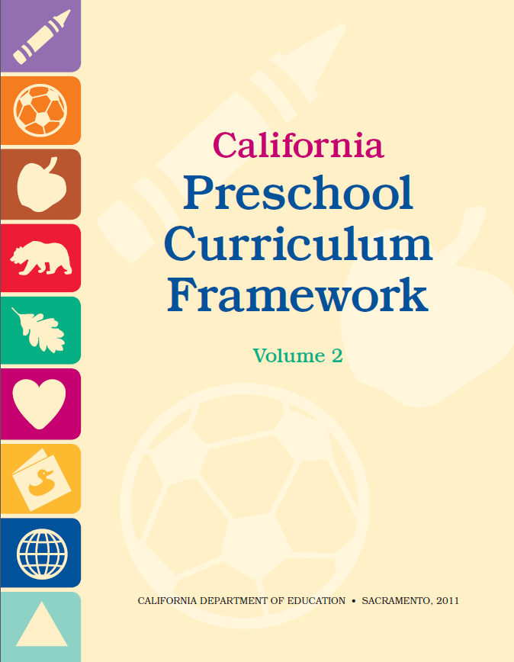





CDE Publications and Resources that Support TK Implementation
Preschool Learning Foundations
California Common Core State Standards
Visual and Performing Arts Framework for California Public Schools
Preschool Curriculum Framework
Visual and Performing Arts Content Standards
DRDP Specific to TK and K
Preschool Alignment Document
Preschool English Learners Guide
Transitional Kindergarten Implementation Guide
Preschool Learning Foundations
California Common Core State Standards
Visual and Performing Arts Framework for California Public Schools
Preschool Curriculum Frameworks
English Language Arts/English Language Development Framework
DRDP Specific to TK and K
Preschool Alignment Document
Preschool English Learners Guide
Transitional Kindergarten Implementation Guide
Notes:
Presenter Remarks:
The California Department of Education has developed many publications, resources, and supports that enable teachers to facilitate the most positive outcomes for students.
Today our main focus will be on the Preschool Learning Foundations and the Preschool Curriculum Framework, Volume 2—Visual and Performing Arts domain.
There are additional key resources that support dance development in young children. We will also discuss alignment with CA standards and make connections to additional resources pictured in the graphic (name and hold up each resource):
The Alignment of the California Preschool Learning Foundations with Key Early Education Resources (Alignment Document)
California Common Core State Standards (CA CCSS)
Visual and Performing Arts Content Standards for California Public Schools, Kindergarten Through Grade Twelve (CA VPA Standards)
Preschool English Learners: Principles and Practices to Promote Language, Literacy, and Learning—A Resource Guide (Second Edition) (PEL Resource Guide)
Visual and Performing Arts Framework for California Public Schools, Kindergarten Through Grade Twelve (VPA Framework)
Desired Results Developmental Profile—Kindergarten (2015): A Developmental Continuum for Kindergarten (DRDP-K [2015])
Transitional Kindergarten Implementation Guide – A Resource for Public School District Administrators and Teachers (TK Implementation Guide)

Slide 4
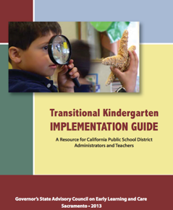
Transitional Kindergarten Implementation Guide
The TK Implementation Guide is a resource for California public school district administrators and teachers to support implementation of comprehensive TK programs.
Notes:
Presenter Remarks:
The TK Implementation Guide is a resource that focuses on the essential components for school district administrators and teachers to consider for TK programs. The TK Implementation Guide, published by the California Department of Education, is a resource to support implementation of comprehensive TK programs.
This publication provides resources and guidance in the areas of program design, curriculum, instruction, assessment, and family/community partnerships.

Slide 5
Overview of the Transitional Kindergarten Implementation Guide
  Section One
  Program Structure and Design
  Section Two
  The TK Student
  Curriculum in a TK Program
  Effective Instruction in a TK Program
  The TK Learning Environment
  Assessment and Differentiated Instruction
  Involving Families and Community Partners
  Supporting TK Implementation
Notes:
Presenter Remarks:
The TK Implementation Guide is organized into the following two sections:
Section 1 is covered in Chapter 1. The information in this section was developed with the administrator in mind and focuses on the program structure and design.
Section 2 is covered in Chapters 2-8. This section is a resource for both teachers and administrators and focuses on building a comprehensive TK programs by addressing curriculum, instruction environment, assessment and partnership with families and community.
Within each of these chapters, vignettes, highlighted boxes, and resource boxes are included to illustrate examples of the information covered in each of the chapters.
A PDF copy of the document can be accessed at the California Department of Education Web page (www.cde.ca.gov/ci/gs/em/documents/tkguide.pdf).
Video footage for each chapter can be accessed at the California Department of Education. The video clips include footage of TK classrooms and interviews with teachers, administrators, and parents. https://www.youtube.com/user/caeducation
https://www.youtube.com/results?search_query=tk+implmentation+guide

Slide 6
Why Use the Preschool Learning Foundations for TK?
CA Law (EC 48000):
Transitional kindergarten is the first year of a two-year kindergarten program that uses a modified kindergarten curriculum that is age and developmentally appropriate.
Transitional kindergarten programs are intended to be aligned, by legislative action, to the California Preschool Learning Foundations developed by the California Department of Education.
Notes:
Background Information:
http://cde.ca.gov/ci/gs/em/kinderfaq.asp#program
Presenter Remarks:
The state of California provides guidance on utilizing the Preschool Learning Foundations and the Preschool Curriculum Framework as planning and curriculum resources in the TK classroom.

Slide 7
Foundations and Framework, Volume 2
Notes:
Presenter Remarks:
The purposes of the Preschool Learning Foundations are to promote a common understanding of TK children's learning and to guide instructional practice. They describe the knowledge and skills that young children typically develop when provided with developmentally, culturally, and linguistically appropriate learning experiences.
The Preschool Curriculum Framework was created as a companion to the Preschool Learning Foundations. The framework ". . . presents strategies and information to enrich learning and development opportunities for all children" (PCF, Vol. 2, p. v).
The Preschool Learning Foundations and the Preschool Curriculum Framework are designed to work together. While the foundations provide the background information to understand children's developing knowledge and skills (the "what"), the framework offers guidance on how teachers and programs can support the learning and development that are described in the foundations (the "how").
Extra Notes:
The Preschool Learning Foundations were developed with research-based evidence and are enhanced with expert practitioners' suggestions and examples. All foundations were written by a team of researchers with expertise in the given domain. A complete reference list of the source materials, along with detailed bibliographic notes for each of the developmental domains, can be found in the Preschool Learning Foundations. Sources used in the development of the foundations include:
Documents from the California Department of Education, such as the English-Language Arts Content Standards for California Public Schools, Kindergarten Through Grade Twelve (Language and Literacy, Introduction, p. 48, left column).
Well-validated assessment tools such as the Ages & Stages Questionnaires (ASQ): A Parent-Completed, Child-Monitoring System (Social-Emotional, References and Source Materials, p. 36).
General sources such as the Report of the National Reading Panel 2000 (Language and Literacy, Introduction, p. 73, left column).
Early childhood education standards from other states such as Hawaii and Texas (Social-Emotional, Introduction, p. 5, footnote).

Slide 8
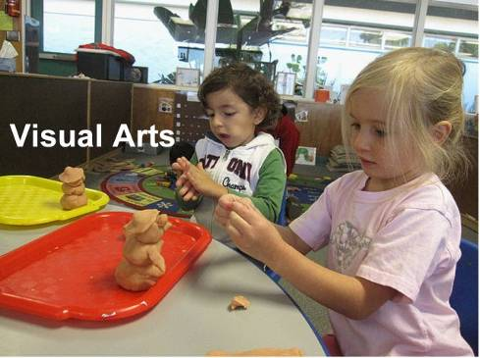
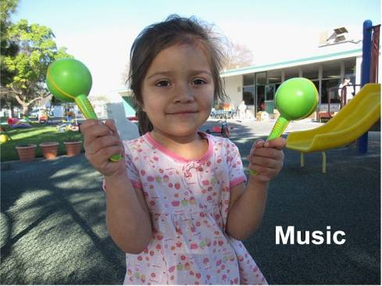
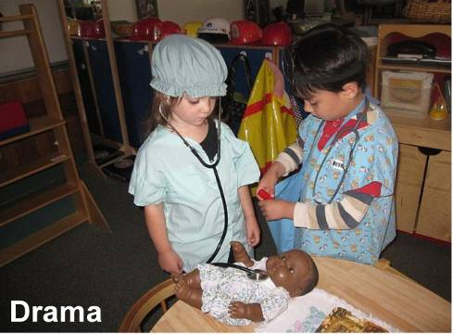
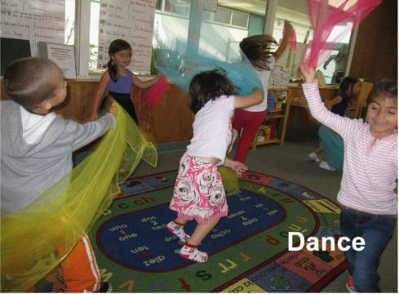
What are the visual and performing arts?
©2017 California Department of Education
Notes:
Presenter Remarks:
(Click to reveal Visual Art.) The foundations for visual arts include observing and commenting on art, developing art skills, and creating art (e.g., painting, drawing, sculpting, and collages).
(Click to reveal Music.) The foundations for music include responding to and recognizing sounds and music, learning music skills, and creating music by keeping a beat with one’s body, by singing, and by using musical instruments.
(Click to reveal Drama.) The foundations for drama include pretend play and reenacting stories as well as using props, costumes, and roles in play.
(Click to reveal Dance.) The foundations for dance include engaging in dance movements, being aware of body space, and expressing oneself through dance.

Slide 9
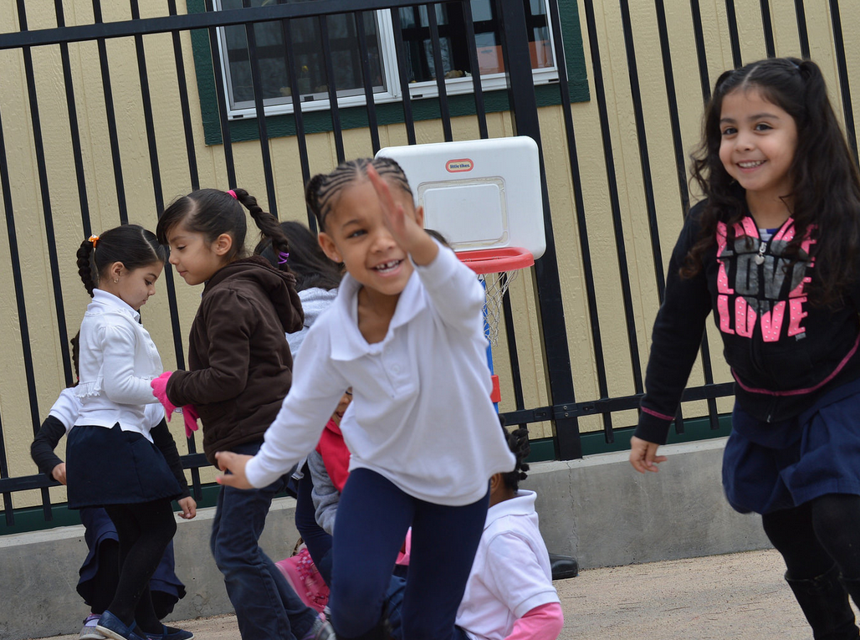
Warm-Up!
PCF, Vol. 2, p. 104
©2017 California Department of Education
Notes:
Activity 1: Warm-Up and Freeze!
Presenter’s Remarks:
Today we are going to warm-up our bodies and minds for the dance strand with a game called “Warm-Up and Freeze!
You will see a movement cue card as well as my modeling. When the music starts you will begin moving your body as cued. When the music stops you will freeze your body.
We will repeat this process several times until our entire bodies have become warm.
Remember, we must all choose to move our bodies at our own pace. Choose whether it is best for your body to sit and move or stand and move. Listen to your body.
intent:
Participants warm-up their minds and bodies while experiencing an interactive dance strategy that can be used in the classroom.
OUTCOME:
Participants prepare their minds and bodies and learn some key dance terms utilized in the Preschool Learning Foundations (PLF) and Preschool Curriculum Framework (PCF).
Materials Required:
Music (Use slow, medium, and fast tempo music.)
Movement cue cards
PowerPoint slide with warm-up strategy
Trainers as models
Time: 10 minutes
Process:
Share the PowerPoint slide titled “Warm-Up.” Read the notes explaining how important it is for both adults and children to warm-up their bodies before movement activities such as dancing.
Explain the following directions:
Today we are going warm-up our bodies and minds for the dance strand with a game called “Warm-Up and Freeze!
You will see a movement cue card as well as my modeling. When the music starts you will begin moving your body as cued. When the music stops you will freeze your body.
We will repeat this process several times until our entire bodies have become warm.
Remember, we must all choose to move our bodies at our own pace, so you choose weather it is best for your body to sit and move or stand and move. Listen to your body.
When participants are ready, select a cue card and turn on the music. Model how to slowly move to the music while warming up your body.
When you have been moving for about 15-20 seconds pause the music and model freezing. Wait for everyone to freeze.
Repeat steps three and four several times until your body is warm and participants have had a chance to experience moving all of their body parts.

Slide 10
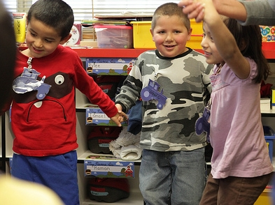
“Children move naturally – they move to get around, to express a thought or feeling, and they move because moving is joyful and comforting” (PCF, Vol. 2, p. 101).
Why do you move?
When is your favorite time to dance?
How do you feel when you dance?
©2017 California Department of Education
Notes:
Presenter Remarks:
Take a moment to read the quote at the bottom of the slide: “Children move naturally – they move to get around, to express a thought or feeling, and they move because moving is joyful and comforting” (PCF, Vol. 2, p. 101).
Just like children are primed to learn language; their bodies are primed to move and learn movement.
“They learn movement patterns as readily as they learn language” (PCF, Vol. 2, p. 101).
Invite participants to discuss the following questions at their table group:
Why do you move?
When is your favorite time to dance?
How do you feel when you dance?
Extra Notes:
After participants have discussed the questions, consider the following debrief options:
Quick-whip around the room, inviting each participant to share a one-word answer.
Pass or toss a scarf to volunteers who share their short answers.
Invite participants to turn to an elbow partner and exchange answers. Next have them find another “dance” partner to share answers with. Repeat.

Slide 11
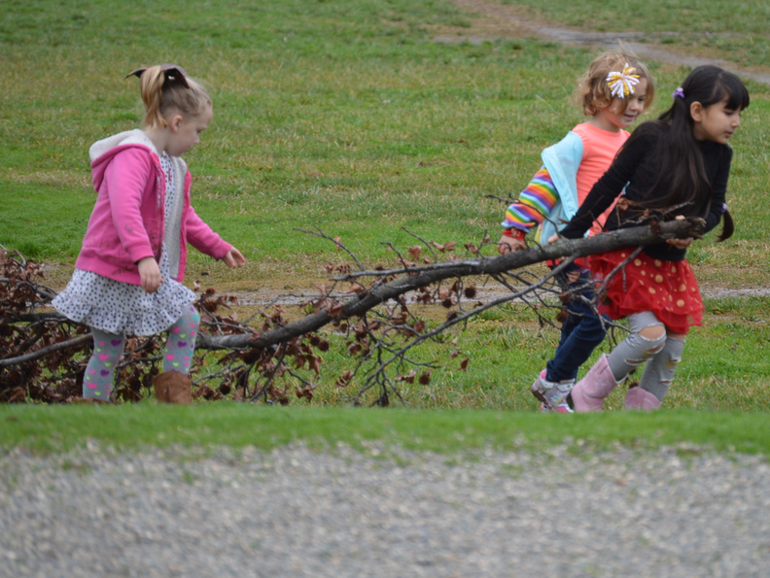
Foundations
High-quality programs
With appropriate support
©2017 California Department of Education
Notes:
Presenter Remarks:
The Preschool Learning Foundations describe what children should know and be able to do at around 48 months (4 years old) and 60 months (5 years old).
The foundations also assume that children have access to appropriate support in high quality programs that include the following aspects:
Environments and experiences that encourage active, playful exploration and experimentation
Clearly defined learning centers where materials are rotated
Purposeful teaching to help children gain knowledge and skills
Predictable schedules and routines with large blocks of time for play and skillful integration of curriculum with an intentional focus on content
Specific support for English learners with staff that have knowledge of the stages of English-language acquisition
Accommodations and adaptations for children with disabilities and additional support when needed
Let’s take a closer look at one of the foundations for an example. Open the Preschool Learning Foundations, Volume 2, and turn to pages 18-21 where the age levels appear. This is an example of a foundation page.
Look across the page at the developmental progression at around 48 months. Notice the changes at 60 months of age.
Solicit a few participants to read what they see. Summarize the exploration with the following key note:
Because children develop at different rates, the foundations were designed to support the belief that certain stages of development will occur at different times for all students. Notice “at around” in the description. It is important to remember this variability occurs.

Slide 12
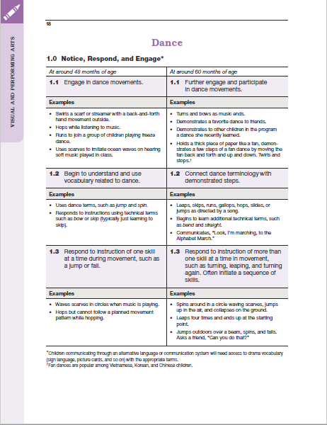
Map of the Foundations
Substrand
Strand
Domain
Foundation
Age
Examples
Notes:
Presenter Remarks:
Please locate Handout 1: Foundations Map. This handout illustrates the way the foundations are organized. Please follow along while we discuss each component:
The name of the domain (Visual and Performing Arts)
The name of the strand (Music)
The name of the substrand (Notice, Respond, and Engage)
Note that substrands always end in “zero.”
The two age levels (at around 48 months and at around 60 months)
Each foundation describes typical behaviors at around 48 months and at around 60 months or four to five years old.
The foundations for the substrand
There are two for each age level on this page (1.1 for 48 months and 1.1 for 60 months, 1.2 for 48 months and 1.2 for 60 months).
The examples for each foundation
These are only a few of the ways that children may demonstrate the behavior in the foundation.
Many of the foundations have footnotes that include information specific for students with IEPs or students with disabilities, such as information about adaptations or accommodations.
Notice that there is a developmental progression from four years old to five years old within a substrand.

Slide 13
Dance through the Foundations
Earlier Development
Later Development
Directions:
Find the envelope labeled “Dance through the Foundations.”
Pass out the 3 x 5 cards to each table mate.
Individually, or in groups, look up each quote or statement on the 3 x 5 cards in the PLF, Vol. 2.
Determine if the card is true for earlier development (about 48 months), later development (about 60 months), or both.
Be ready to share your “dancing” thoughts with the group.
Notes:
Activity 2: Dancing through the Foundations
Presenter Remarks:
Read the surrounding information in the book to help you determine if the statement or quote represents something that is true for children during earlier development, later development, or both. Discuss with your group if the answer is not readily apparent.
Each person will have an opportunity to share-out their information, so be ready and confident with your decision.
intent:
Participants explore the dance sections of the Preschool Learning Foundations (PLF), Volume 2, and analyze key concepts for early development versus later development in transitional kindergarten.
OUTCOME:
Participants reflect on the reading from the PLF and apply their understanding of the differences between earlier development and later development by creating a Venn diagram as a group.
Materials Required:
Preschool Learning Foundations (PLF), Volume 2
Dancing through the Foundations envelope
3 x 5 cards with quotes/statements and page numbers
Cards also labeled by dance categories (salsa, two step, hip hop, the twist, modern, ballet)
Time: 20 minutes
Process:
Part 1: Understanding the Foundations
Ask participants to find the envelope on the table labeled “Dancing through the Foundations.”
Each person should take one 3 x 5 card from the envelope.
Provide the following information to participants to help them understand the overview of the activity:
One side of the card is labeled with a dance group (i.e., salsa, two step, etc.). We will use this group to facilitate the sharing out process. It is not important at the beginning of the activity.
The other side has a quote or statement taken directly from the PLF. The page number is also listed. This is the important content to begin with.
Participants (on own or in table groups) find and read each of the statements in the PLF.
Say to the participants:
Read the surrounding information in the book to help you determine if the statement or quote represents something that is true for children during earlier development, later development, or both.
Discuss with your group if the answer is not readily apparent.
Each person will have an opportunity to share-out their information, so be ready and confident with your decision.
PART 2 (Sharing Out)
When all table groups are ready to share-out, begin by bringing the group’s attention to the Venn diagram.
NOTE: You can use an actual Venn diagram or you can use a sticky wall with three columns.
Participants will have the opportunity to place their 3 x 5 card where they think it belongs on the diagram or chart. All “salsa” group members will bring their cards to the front at the same time and so on.
Optional: Play music and invite participants to “dance” as they bring their 3 x 5 card to the front of the room.

Slide 14
What Does Each of the Substrands Mean?
Foundation | Substrand | Substrand Definition
48 months 60 months | Notice, Respond, and Engage | Notice, interact, and be interested in
48 months 60 months | Develop Skills in Dance | Learn the basic skills of performing, inventing, and creating, such as using a paintbrush
48 months 60 months | Create, Invent, and Express Through Dance | Use skills to participate, express, invent, and create
Notes:
Presenter Remarks:
Now we will look closer at what each of the substrands encompasses.
Notice, respond, and engage--describes children’s interest and enjoyment in the arts. For example, a child might notice people dancing, “I like to dance. Nana let’s dance.”
Develop skills--talks about all the basic skills preschool children need to develop in order to create their own art. Examples are learning a new dance move, dancing along at group time, and moving in time to the music.
Create, invent, and express--means using the skills children have developed to do things like using music instruments and dancing with them, using a table as a drum, and inventing a dance about a thunderstorm.

Slide 15
Foundations Video Example
Notes:
Background Info:
Prior to the training, embed the foundations example DevelopSkillsInDance_2.3.
Presenter Remarks:
Let’s take a look at what this looks like in classrooms with four and five year olds.
As you watch the video, observe the knowledge, skills, and behaviors that take on a developmental shift.

Slide 16
Video Reflection
What are the differences in developmental levels (at around 48 months versus at around 60 months)?
How would you describe the different instructional strategies teachers use to develop dance (at around 48 months versus at around 60 months)?
How are you currently using these strategies in your classroom?
Notes:
Presenter Remarks:
Turn to the person on your right and discuss the questions on the slide. Do a little dance when finished discussing the questions.
Bring the group back together. Have two or three participants share-out their answers.

Slide 17
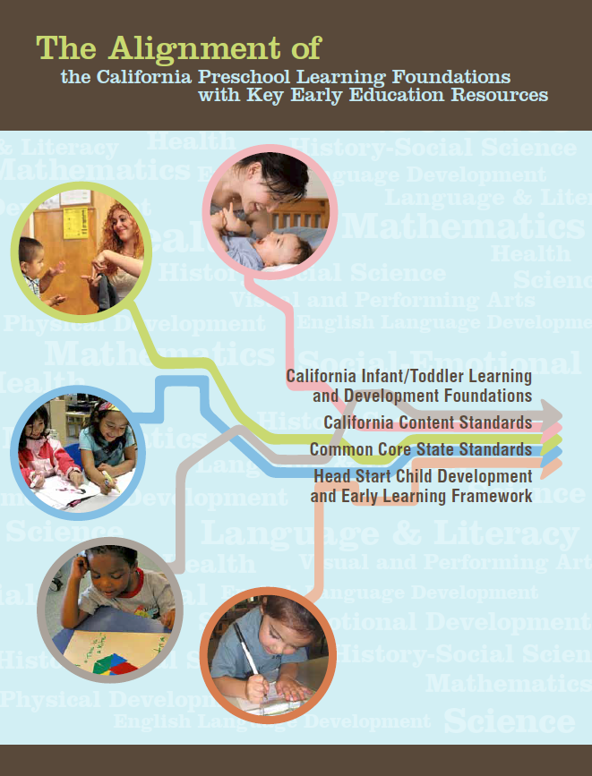
Alignment Document
Notes:
Presenter Remarks:
The Alignment Document is another resource that will help us answer questions related to developmental progression.
What do you know about this document? How do you use it in your work now?
Extra Notes:
Depending on the size of the group, participants can share responses with table partners or in pairs.

Slide 18
Alignment Document: Table 1.13
California Department of Education, 2012, The Alignment of the California Preschool Learning Foundations with Key Early Education Resources, pp. 111-113
Notes:
Presenter Remarks:
Please refer to Handout 2: Alignment Document Table 1.12 and Handout 2b: Alignment Document Table 1.13. (Alignment document, p.99 & 111-113)
Table 1.12 shows the alignment between strands and substrands in the Preschool Learning Foundations and the content categories in the California Common Core State Standards (CA CCSS) for Visual and Performing Arts.
Table 1.13 details alignment between specific preschool foundations and specific kindergarten standards in the CA CCSS for VPA.
For every substrand of the Preschool Learning Foundations there is a category in the CA CCSS with corresponding content.
As shown in Table 1.12, the substrands under Dance—correspond directly to the CA CCSS in the categories of Dance.

Slide 19
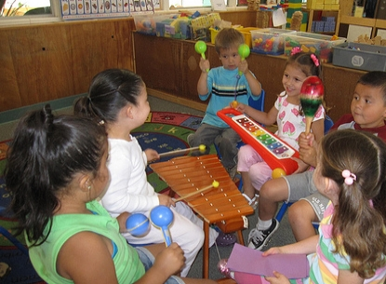
Environments
“The challenge for the teacher is to produce complexity and variation in environments”
(PCF, Vol. 2, p. 103).
©2017 California Department of Education
Notes:
Presenter Remarks:
Take a moment and read the quote on the screen “The challenge for the teacher is to produce complexity and variation in environments, with tasks and activities in which children can engage in movement and sustain focus without being over stimulated” (PCF, Vol. 2, p.103).
What are some challenges that you have had in your classes? Share at your table. Ask someone to write out the challenges. At the end of the session, look back at your paper and see if you can come up with ideas to help with these challenges.

Slide 20
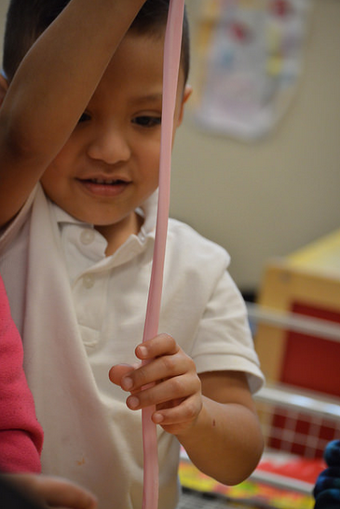
The Preschool Curriculum Framework:
“…presents strategies and information to enrich learning and development opportunities for all of California’s preschool children”(PCF, Vol. 1, p. v).
©2017 California Department of Education
Notes:
Presenter Remarks:
“The Preschool Curriculum Framework presents strategies and information to enrich learning and development opportunities for all of California’s preschool children” (PCF, Vol. 1, p. v).
This resource provides teachers with the opportunity to gain ideas and expand their creativity.

Slide 21
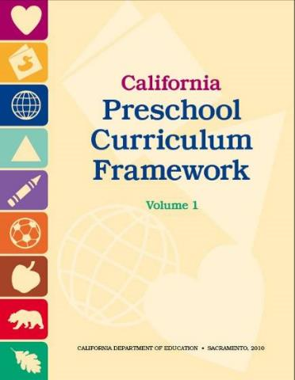
Framework Strategies
Developmentally appropriate
Reflective and intentional
Individually and culturally meaningful
Inclusive of children with disabilities or other special needs
Notes:
Presenter Remarks:
The Preschool Curriculum Framework offers guidance on how teachers can support the learning and development described in the foundations, through environments, materials, and experiences that are developmentally appropriate, individually and culturally meaningful, and engaging to families.
“Teachers address ideas and concepts that children can grasp at their developmental level and then progressively build on what children already know and understand. This approach applies to all children, including children with various abilities, disabilities, or other special needs (such as delays in language, cognition, or physical ability)” (PCF, Vol. 2, p. 227).
The VPA domain begins with guiding principles that set the tone for the entire chapter. Let’s take a moment to look at these guiding principles and see what they are:
The arts are inclusive of all children.
The arts are a language that is common to all.
The arts promote dispositions for learning.
Children make their own meaning.
Children are capable of creating original art in all its forms.
Children learn about human connections, beauty, and appreciation of the arts.
The child’s work is play.
Children are active learners who thrive when challenged appropriately.
Arts experiences for preschoolers are more about process than product.
The arts reinforce the integrated nature of learning.
Cultural competence is approached through art.
The arts are motivating and engaging for learners.
Art can nurture the nurturer.
The arts provide a unique means for families to interact.

Slide 22
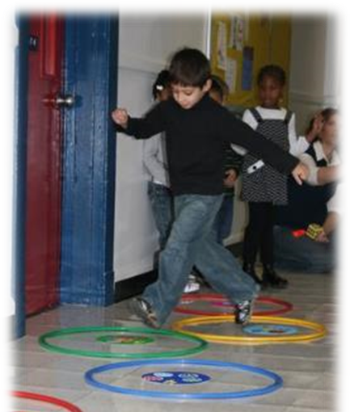
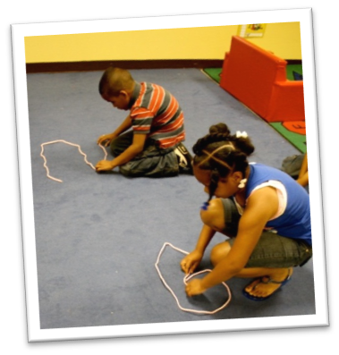
Universal Design for Learning
Provides for:
Multiple means of representation
Multiple means of engagement
Multiple means of expression
Notes:
Background Information:
PCF, Vol. 2, p. 14
Presenter Remarks:
The strategies within the Preschool Curriculum Framework include the idea of Universal Design for Learning (UDL). This means there are many suggestions for ways to support learning that teachers can use to provide multiple means of representation, engagement, and expression.
Multiple means of representation refers to providing information in a variety of ways so the learning needs of all children are met. For example, it is important to speak clearly to children with auditory disabilities while also presenting information visually (such as with objects and pictures).
Multiple means of expression refers to allowing children to use alternative ways to communicate or demonstrate what they know or what they are feeling. For example, when a teacher seeks a verbal response, a child may respond in any language, including American Sign Language. A child with special needs who cannot speak may also respond by pointing, by gazing, by gesturing, by using a picture system of communication, or by using any other form of alternative or augmented communication system.
Multiple means of engagement refers to providing choices in the setting or program that facilitate learning by building on children’s interests. The information in this curriculum framework has been worded to incorporate multiple means of representation, expression, and engagement” (PCF, Vol. 2, p. 14).

Slide 23
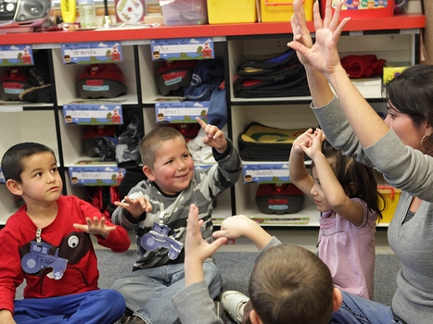
Accommodations
“When a child is not able to walk independently, dance can be accomplished through movement of the body”
(PLF, Vol. 2, p. 26).
©2017 California Department of Education
Notes:
Presenter Remarks:
This strategy is an example of utilizing Universal Design for Learning in the Preschool Curriculum Framework.
“When a child is not able to walk independently, dance can be accomplished through movement of the body. These types of movement activities help children with motor delays appreciate the ways in which their bodies move” (PLF, Vol. 2, p. 26).
What are some activities that you could do to bring dance into your classroom? Share at your table and then each table will share out to the whole group.

Slide 24
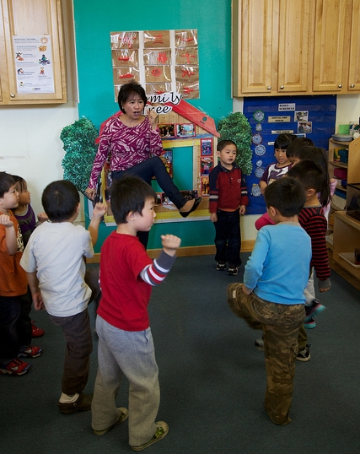
Teacher’s Attitude Is Important
“Children will follow the teacher’s willingness to explore”
(PCF, Vol. 2, p. 102).
Notes:
Presenter Remarks:
How the teacher feels about and approaches dance in the early childhood classroom is important. It affects how children approach dance as well.
“Children will follow the teacher’s willingness to explore” (PCF, Vol. 2, p. 102).
“When joining children in movement activities, feel open to sharing that you are nervous because you have not hopped or wiggled since you were four years old. Importantly, begin with simple activities such as acting out movement and vocal sounds from a story in a book” (PCF, Vol. 2, p. 102).
Be willing to look silly and have fun. This will help even the very shy children to come out of their shell.
Let’s try dancing and singing together on the next slide.

Slide 25
Individually and culturally meaningful:
Playground Hand Rhythms
Down, down, baby
Down by the roller coaster
Sweet, sweet, baby
I'll never let you go
Shimmy, shimmy cocoa pop
Shimmy, shimmy pow
Shimmy, shimmy cocoa pop
Shimmy, shimmy pow
Grandma, grandma sick in bed
She called the doctor and the doctor said
Let's get the rhythm of the head, ding dong
Let's get the rhythm of the hands
Let's get the rhythm of the feet
Let's get the rhythm of the hot dog (place hands on hips and twirl)
Put it all together and what do you get?
……………………….
Put it all backwards and what do you get?
……………………….
Notes:
Presenter Remarks:
Individually and culturally meaningful:
“[Children] learn movement patterns as readily as they learn language. Like language, movement patterns are embedded in young children’s cultural experiences” (PCF, Vol. 2, p. 101).
Who remembers rhythm games from the playground? Together we are going to dance and sing this rhythm. Then you will have a chance to share other rhythms that are individually meaningful to you.
While all of these rhythms may not be developmentally appropriate for preschoolers, they are appropriate to spark excitement in us (teachers). Teachers can model these rhythms to excite preschoolers, scaffold these rhythms to make them developmentally appropriate, or discuss these rhythms with families to support family engagement around rhythm and dance.
Model and invite participants to do the rhythm with you.

Slide 26
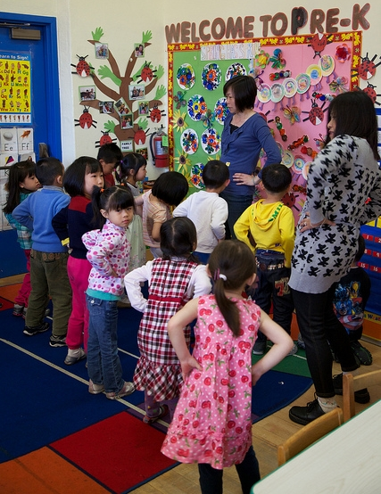
Interaction and Strategy
“Teach rhythm using traditional movement games” (PCF, Vol. 2, p. 110).
Notes:
Presenter Remarks:
One interaction and strategy teachers can use to provide culturally and individually meaningful experiences is to:
“Teach rhythm using traditional movement games. A variation on hopscotch can teach the locomotor movement of hopping while children learn rhythm patterns. Clap or drum various rhythms (begin with a steady four-count rhythm) while children perform the hopscotch. As the children gain mastery, longer balances can be used and the children can add arm movements so that the game begins to more closely resemble a dance” (PCF, Vol. 2, p. 110).
For example, we can do the same dance we did on the previous slide “Down, Down Baby” to teach rhythm by adding the use of a metronome. This will take the experience from being interesting and engaging to including developing skills. Let’s try it.
Turn on the metronome and invite participants to do the rhythm activity with you again.
Debrief:
What differences did you notice?
How might you replicate this in your classroom?

Slide 27
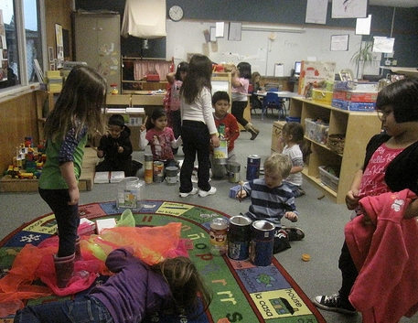
Guiding Principles To Remember
“The arts reinforce the integrated nature of learning” (PCF, Vol. 2, p. 44).
“The arts promote dispositions for learning” (PCF, Vol. 2, p. 43).
Notes:
Presenter Remarks:
Read the two key guiding principles for dance on the slide.
We have already experienced this guiding principle today when we practiced rhythm, rhyming and movement. We were integrating dance, music, phonological awareness, language use and convention, physical development and much more.
Turn to pages 43 and 44 of the Preschool Curriculum Framework, Vol. 2, and read the paragraphs below these guiding principles. Use Handout 3: VPA Guiding Principles to take notes.
Allow 3 -5 minutes.
What is one thing you do in your classroom to support one of these guiding principles? Find someone you have not yet worked with today and exchange thoughts.

Slide 28
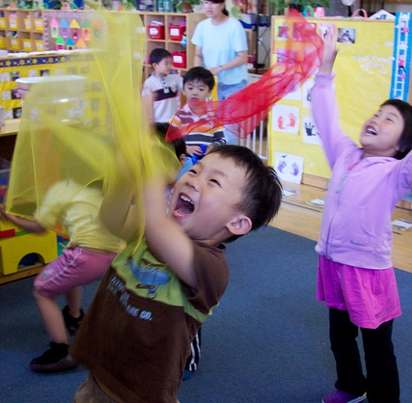
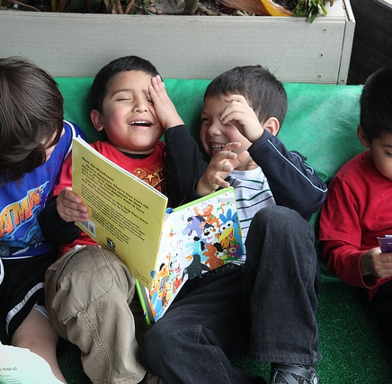
Interaction and Strategy
“Integrate dance with literacy development”
(PCF, Vol. 2, p. 113).
Notes:
Activity 3: Musical Salsa Scarves
Presenter Remarks:
Did anyone share an idea that includes dance and literacy? One interaction and strategy in the Preschool Curriculum Framework is to integrate dance with literacy development. “Movement in storytelling is an excellent activity for improving comprehension skills, especially for children who are English learners. This activity can be modified for use with many children’s stories or poems and may focus on various literary elements (e.g., character, setting, dialogue, imagery, conflict)” (PCF, Vol. 2, p. 112).
Movement in storytelling also helps children recall the story and be able to reenact/tell the story on their own. Let’s try it together now.
intent: Participants gain familiarity with an interaction and strategy from the Dance strand in the Preschool Curriculum Framework (PCF), Volume 2, and practice integrating literacy and dance.
OUTCOME: Participants practice integrating literacy and dance.
Materials Required:
Preschool Curriculum Framework (PCF), Volume 2
Salsa children’s book or other book with movement
Scarf
Salsa music or other music
Time: 10 minutes
Process:
PArt 1 (Practicing Integrating Literacy and Dance)
Ask participants to find and read the interactions and strategies on pages 112-113 of the PCF.
Invite participants to find the salsa book and other stories with movement at their table.
Participants read through the book with their table group.
Using the chart paper, participants take notes regarding ideas for how to integrate an intentional dance and literacy activity utilizing this book.
PART 2 (Sharing Out with Dancing Scarves)
Invite each table group to stand and hand one person a scarf.
Share that we are going to play a version of musical dancing scarves. Like musical chairs, you pass the scarf to the music and when the music stops the person with the scarf is “it.”
In this version, “it” means that they can model any dance move and everyone else has to copy them.
After everyone copies the dance move, the person who was it can point to someone at their table group to share-out one of their ideas.
Trainers chart the ideas as they are shared out.

Slide 29
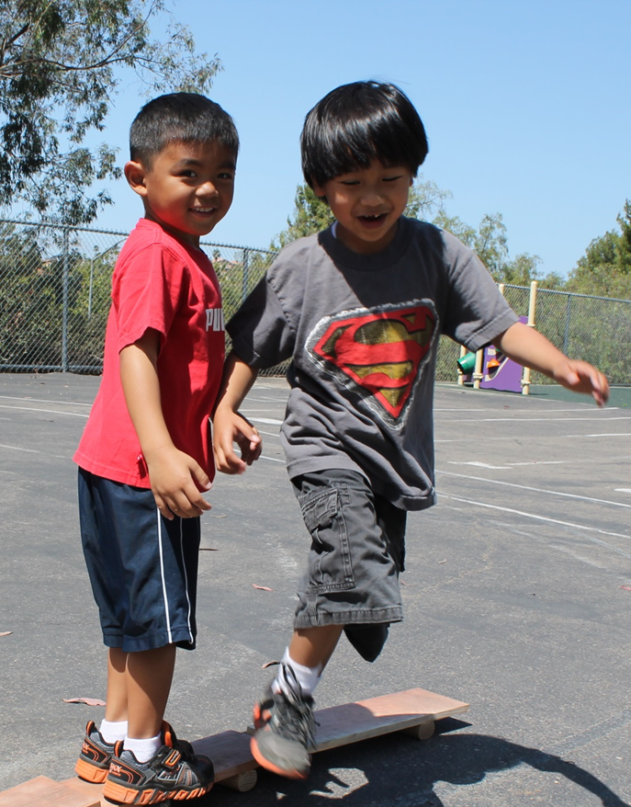
English Learners
“Children who are English learners need to be supported not only in activities focused on language and literacy, but across the entire curriculum”
(PCF, Vol. 1, p. 181).
Notes:
Presenter Remarks:
“Language is a tool of communication used in all developmental domains. Children who are English learners need to be supported not only in activities focused on language and literacy, but across the entire curriculum” (PCF, Vol. 1, p. 181).
“All children, particularly children at the beginning and middle levels of English-language acquisition, may show knowledge and skills in other domains, such as the visual and performing arts or mathematics, using their home language. The Desired Results Developmental Profile (DRDP) recognizes this possibility by considering children’s demonstration of knowledge, and skills in their home language as evidence of developmental progress” (PCF, Vol 2, p. 13).

Slide 30
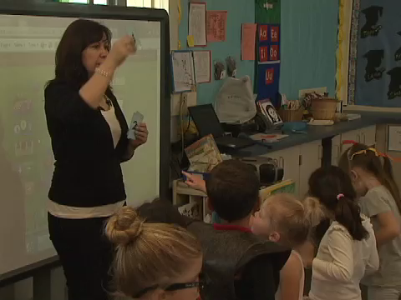
Dancing into Mathematics
Notes:
Background Info:
Prior to the training, embed the video: Rolling (Math Dance)
Presenter Remarks:
Dance and Math are two other domains that are easily and effectively integrated. This video is an example of how… “The arts reinforce the integrated nature of learning” (PCF, Vol. 2, p. 44).
As you watch the video, take note of how the intentionally designed mathematics song also infuses dance skills.
Watch the video.
Post-video debrief options:
Using Handout 4: DRDPK Measure VPA 4, identify the following items that were addressed:
math substrands
other domains
dance susbtrands

Slide 31
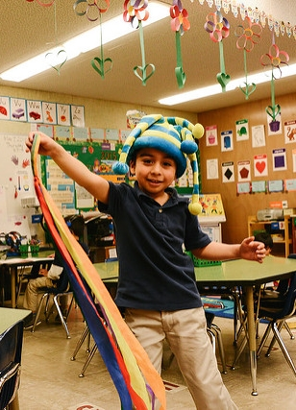
Interaction and Strategy
“Use dance to communicate feelings”
(PCF, Vol. 2, p. 114).
Notes:
Presenter Remarks:
Another interaction and strategy to support the integration of dance in the PCF is to “use dance to communicate feelings.”
“[Teachers can] Provide children with a “feeling word” (e.g., surprise, anger, sadness, confusion) and request a shape to express the feeling: Show me anger in a shape (not only in facial expression)” (PCF, Vol. 2, p. 114).
Have children translate their shape into a movement. Put a phrase to their movement such as, "You are turning and you are confused.” Children will eventually be able to use movement phrases to express their feelings. This not only helps them express emotion, but will also help build vocabulary.
Does anyone have another strategy for using dance to communicate feelings they have used in the classroom to share?
Extra Notes:
Trainers may want to print Center on the Social and Emotional Foundations for Early Learning (CSEFEL) faces to use as an example. Many teachers are familiar with these already. CSEFEL faces are in the table materials.

Slide 32
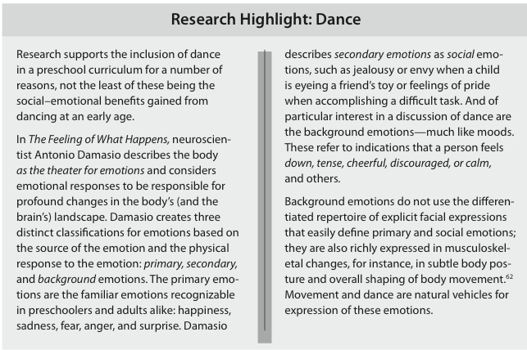
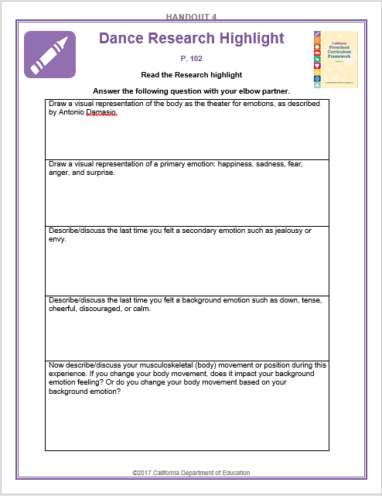
The Emotional Benefits of Dance
32
Read the research highlight.
Complete the handout with your elbow partner.
Share your “dancing” thoughts.
Notes:
Activity 4: Emotion of Dance
Presenter Remarks:
Read the research highlight on page 102 of the Preschool Curriculum Framework. Complete the handout with your elbow partner. Share your “dancing” thoughts with the group.
intent:
Participants explore a research highlight and apply the information from the highlight to their daily practice.
OUTCOME:
Participants increase their understanding of the connection between emotion and dance.
Materials Required:
Preschool Curriculum Framework (PCF), Volume 2
Handout 5: Research Highlight
Time: 10 minutes
Process:
Provide participants with the following directions:
Read the research highlight on page 102 of the PCF.
Complete the handout with your elbow partner.
Share your “dancing” thoughts with the group (either with table group or the larger group as a whole).

Slide 33
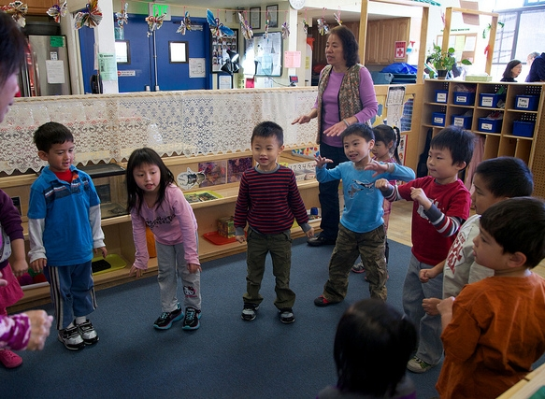
Interaction and Strategy
“Use children's prior knowledge”
(PCF, Vol. 2, p. 105).
©2017 California Department of Education
Notes:
Presenter Remarks:
Another important interaction and strategy to implement is “Use children’s prior knowledge” (PCF, Vol. 2, p. 105).
As in all content areas, teachers must have in-depth familiarity with the needs and understandings of each child so that current skills and prior knowledge can be accessed.
“Children have generally experienced many of the elements of dance outside preschool. This may be from exposure to dance in their home culture or from active play with siblings or friends, or from using dance terminology (e.g., big, fast, arm) in other contexts” (PCF, Vol. 2, p. 105).
This strategy also supports including children with disabilities. For example, if a child has mobility restrictions the teacher can find out what types of dance he or she has prior experience with and incorporate these types of movements into games, songs, and other experiences including dance in the classroom.

Slide 34
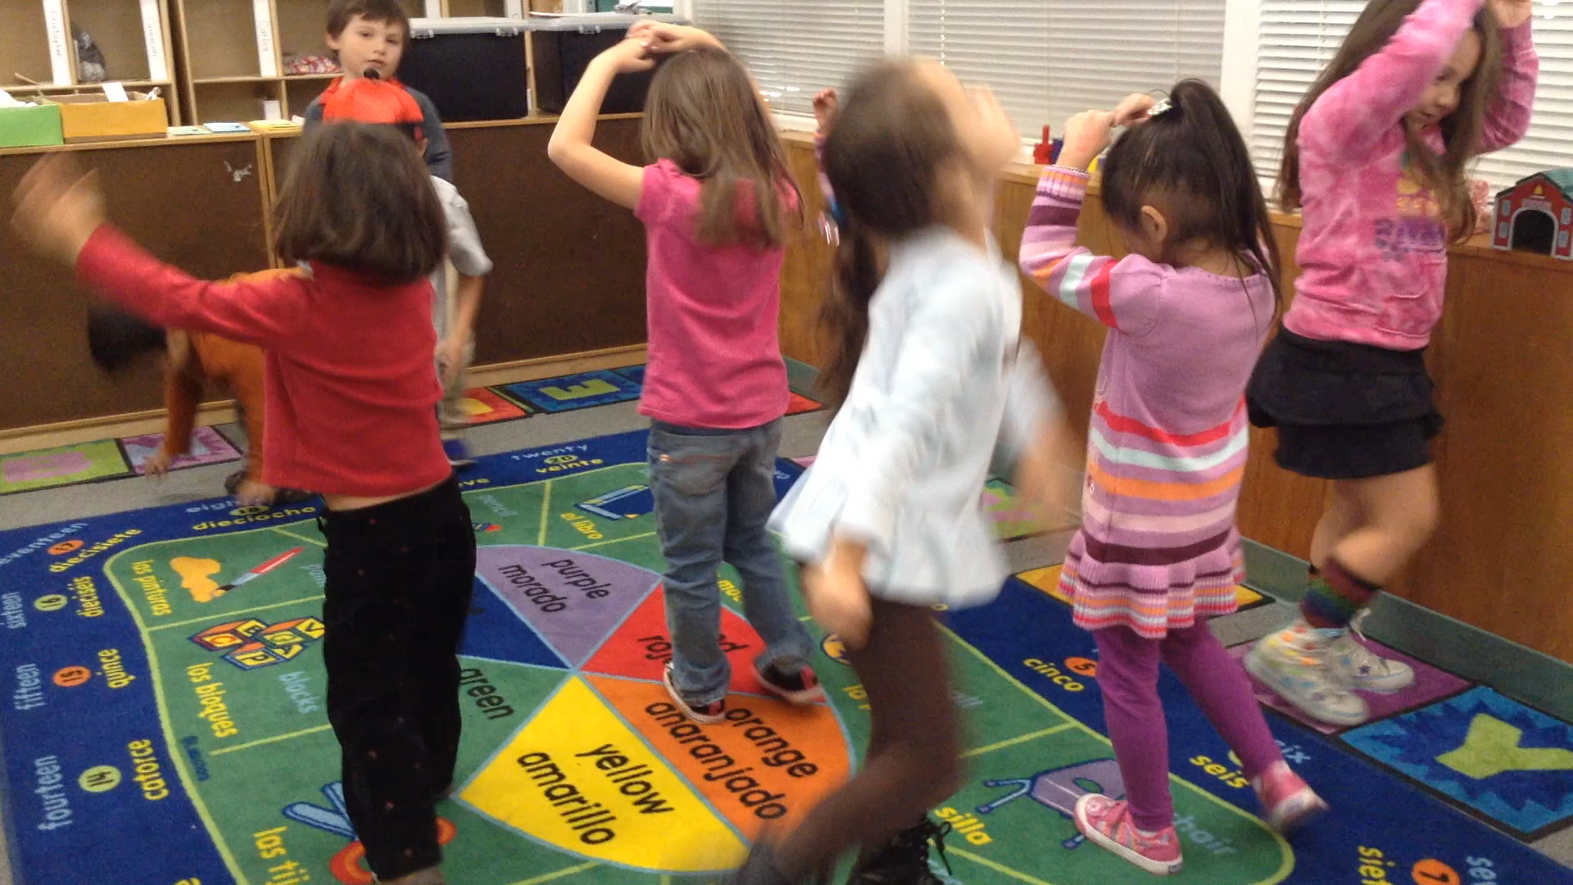
Interaction and Strategy
“Draw on children’s interests in dance making” (PCF, Vol. 2, p. 107).
Does this dancing look like it interests the children?
If so, how can you tell?
Notes:
Presenter Remarks:
Insert video from CPIN.us.
Dance experiences integrated with other domains also “draw on children’s interests in dance making.” This is vital for supporting dance in early education. “If children are to become totally involved in an experience, it must feel as if it is theirs” (PCF, Vol. 2, p. 107).
Dance development is about the process not the product. There is no right way to move in children’s dance making.
After watching the video, answer the questions on the slide.
Does this dancing look like it interests the children? If so, how can you tell?

Slide 35
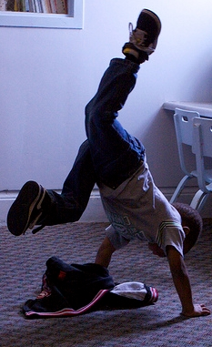
Research Indicates:
Increased self-esteem
Enhanced motor awareness, coordination, and balance
Improved confidence in movement
(PLF, Vol. 2, p. 26)
©2017 California Department of Education
Notes:
Presenter Remarks:
The video we just watched not only shows how dance crosses domains, it also provides an example of non formal dance instruction. The following remark is about formal dance instruction.
“Research suggests that formal dance instruction in early childhood has many potential benefits, such as increasing self-esteem, enhancing motor awareness and control, heightening coordination, and improving balance and confidence in movement” (Faber as cited in PLF, Vol. 2, p. 26).
Again, it is important to notice the integration dance has with other domains such as:
Physical Development
Enhancing motor awareness, coordination, and balance
Social Emotional Development
Increasing self-esteem and improving confidence in movement

Slide 36
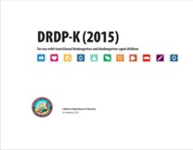
Key Features of the DRDP-K
An observation-based assessment tool,
not a test
Individual child assessment
Completed by each child’s teacher
Based on developmental research and theory
Includes developmental sequences of behaviors along a continuum
Spans the developmental continuum of children in a two-year kindergarten program (TK)
Notes:
Presenter Remarks:
One resource that is used to support children’s development is the Desired Results Developmental Profile-Kindergarten (2015)© (DRDP-K). This is especially helpful for English learners.
The DRDP-K informs teachers understanding of the developmental continuum. It can be used with the Alignment document we just looked at to expand upon the developmental continuum.
One key feature of the DRDP-K to consider is that it is an observation-based assessment and not a test. It is used to support children’s learning. Observing and documenting children's progress provides teachers the information needed to differentiate instruction and experiences. It also provides information to individualize.
Observational tools are preferred over criterion-referenced tools because the information gathered by observation more accurately reflects what children are able to do.
Documentation provides concrete evidence of what children are able to do. With this documentation, we are then able to better plan activities that will meet and appropriately challenge children's developmental needs.
Other features of the DRDP-K include:
It is an individual child assessment that can be shared with families.
It is aligned with the Preschool Learning Foundations.
It opens up the opportunity for articulation between preschool and TK teachers.
Sharing information as to where children are on the developmental continuum can better prepare the TK teacher to work with students.
A teacher can include a request form for previous records as part of the TK registration to help support the relationship between preschool, family, and TK.
The DRDP-K has been developed with world renowned experts. It is based on research and knowledge of what is most important for predicting school success.

Slide 37
DRDP-K (2015)
Notes:
Background Info:
PLF, Vol. 2, page 104
Presenter Remarks:
Take out Handout 2 and 2b: Alignment Document and Handout 4: DRDP-K Measure VPA 4. Handout 4 provides a copy of the DRDP-K measure that most closely relates to the dance foundations.
Look closely at this DRDP-K measure. Take a few minutes to read each stage along with a few of the examples. Underline examples that you have seen in your classroom.

Slide 38
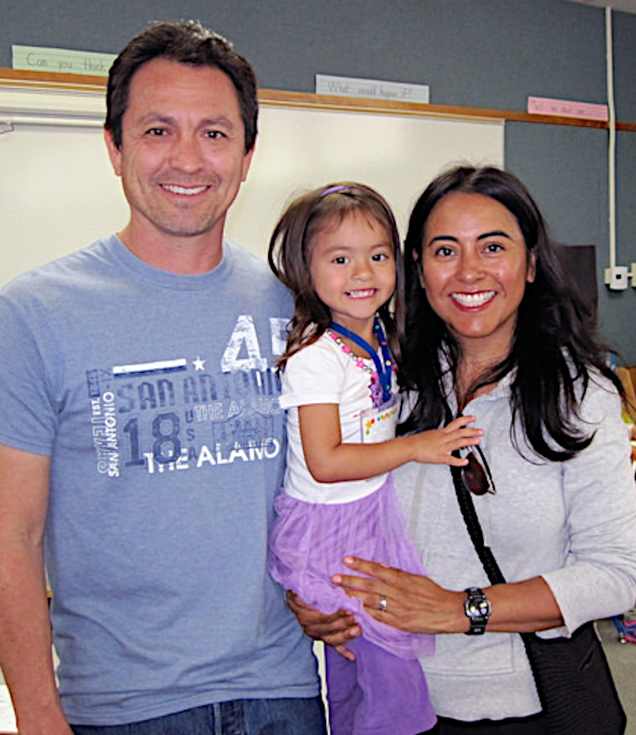
Partner with Families
Engaging Families: Preschool Curriculum Framework
All About Young Children
Best Practices for Planning Curriculum: Family Partnerships and Culture
TK Implementation Guide
Notes:
Presenter Remarks:
In order to effectively build on children's existing strengths, we must understand them. To do this, we need to partner with families to learn about their children’s strengths.
The resources on this slide are specifically beneficial for partnering with families. You may want to take a picture of this slide and refer to it later.
Optional:
Create a gallery table and have examples of documents there.
Extra Notes:
The resources are hyperlinked. If Wi-Fi access is available, display the resources and do a walkthrough.

Slide 39
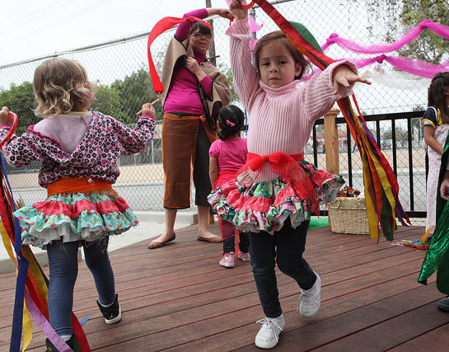
Environments and Materials
“Provide costumes and music to inspire improvisational movement”
(PCF, Vol. 2, p. 113).
Notes:
Presenter Remarks:
Provide costumes and music to inspire improvisational movement.
“Adults move differently based on their dress, whether it is shorts and flip-flops or a skirt and high heels. Children are no different. Costumes encourage creativity and expression in movement” (PCF, Vol. 2, p. 113).
Economical ideas for clothes to wear while dancing include:
Dollar store tutus
Capes made from old t-shirts
Scraps of material tied to waistband and wrists
Shoe laces with ends cut off tied on wrists

Slide 40
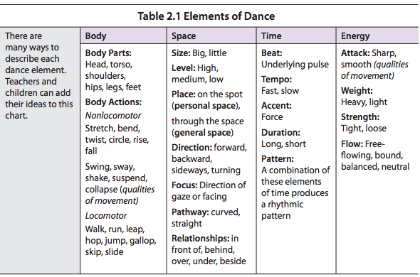
Elements of Dance
PCF, Vol. 2, p.106
Notes:
Activity 5: Elements of Dance
Presenter Remarks:
In order to intentionally plan formal dance activities, teachers must better understand the elements of dance.
Next, we are going to enact these elements of dance and discuss at least two elements in each category (body, space, time, and energy).
We will watch the video for various elements of dance. When you see an example of children practicing the element of dance on your card, stand up and hold your card in the air. As you stand up with your card, we may pause the video to further discuss that element.
INTENT: Participants practice identifying different elements of dance.
OUTCOME: Participants observe, practice, and identify the elements of dance in a video.
MATERIALS REQUIRED:
Elements of Dance PowerPoint slide
Elements of Dance cards
Elements of Dance video (Option 1 or Option 2)
Preschool Curriculum Framework, Volume 2, page 106, Table 2.1 Element of Dance
TIME: 15 minutes
PROCESS: Before Video:
Using the Elements of Dance PowerPoint slide, explain and model several of the elements of dance. Explain the differences between the four categories (body, space, time, and energy). During explanation, invite participants to model some elements of dance.
Pass out the Elements of Dance cards to the table groups.
Provide 2-3 minutes for table groups to become familiar with the elements of dance on their card. (PCF, Vol. 2, p. 106)
Re-introduce the video. Tell the participants: This time we will be watching for the various elements of dance. When you see an example of the children practicing the element of dance on your card, stand up and hold your card in the air. As you stand up with your card, we may pause the video to further discuss that element.
During Video:
As participants stand up, decide if you will pause the video to discuss that element of dance further. Make sure to draw everyone’s attention to the specific child practicing that element of dance and have participants think about other opportunities that teachers may have to facilitate that element of dance.
Debrief: Ask the participants: Could you see an activity like this happening in your classroom? Which dance elements would you choose to focus on in this particular activity with this particular music? What would you do before the dancing experience to help children practice these specific elements of dance? What would you do during the activity to assist children in practicing these elements of dance?

Slide 41
Second Look:
Developing Skills and Elements of Dance
Notes:
Background Info:
Prior to the training, embed the Elements of Dance video (Option 1 or Option 2).
Activity 5: Elements of Dance continued
Presenter Remarks:
Could you see an activity like this happening in your classroom? Which dance elements would you choose to focus on in this particular activity with this particular music? What would you do before the dancing experience to help children practice these specific elements of dance? What would you do during the activity to assist children in practicing these elements of dance?

Slide 42
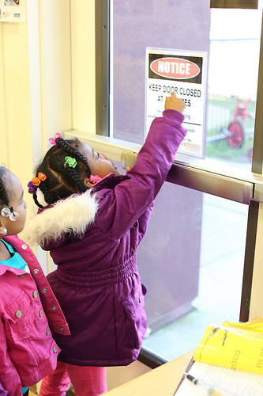
What Themes Have You Noticed Today?
©2017 California Department of Education
Notes:
Presenter Remarks:
Solicit responses after asking each of the following reflective questions.
What themes have you noticed today?
What are some of the interactions and strategies you will be trying in your classroom?
How might these changes impact children?

Slide 43
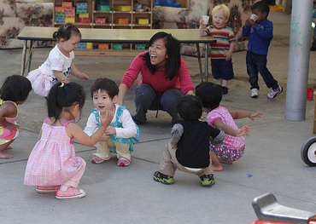
Teachers Must
Intentionally:
Involve all children as active participants
Plan based on various developmental stages
(PCF, Vol. 2, p. 105)
©2017 California Department of Education
Notes:
Presenter Remarks:
“Young children will be frustrated if asked to merely observe a sequence of movements or frequently be required to wait for their turn. Developmentally and culturally appropriate movement programs for young children are designed so that all children are active participants, not passive listeners or observers” (PCF, Vol. 2, p. 105).
“Plan movement activities appropriate for various developmental stages and skill levels” (PCF, Vol. 2, p. 109).
What activities could you include in your classroom? Which activities could you enhance by adding movement to them?

Slide 44
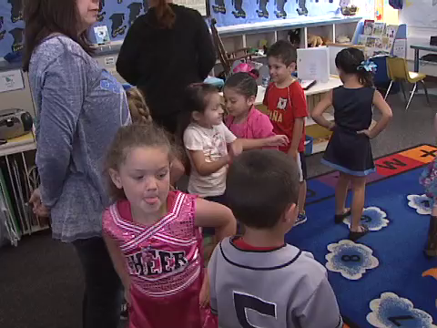
Active Participation
“Developmentally and culturally appropriate movement programs are designed so that all children are active participants”
(PCF, Vol. 2, p. 105).
Notes:
Background Info:
Prior to the training, embed the Elements of Dance video: Option 1.
Note: If this video was previously shown for Activity 5 preface the video with the following: “We already watched this video to better understand the elements of dance. Now we are going to watch the video through the lens of providing developmentally and culturally appropriate strategies.”
Presenter Remarks:
This video is an example of how a teacher intentionally planned according to the following statement:
“Developmentally and culturally appropriate movement programs for young children are designed so that all children are active participants, not passive listeners or observers” (PCF, Vol. 2, p. 105).
Please share your observations of the teacher. How did she plan in order to meet the criteria of this statement?

Slide 45
Remember the Dance Steps
Involve children
Make it joyful
Integrate with other domains
Notes:
Presenter Remarks:
Remember the dance steps:
Involve children
Integrate with other domains
Make it joyful
Turn to your elbow partner and share an idea you are going to try next week. Which of these dance steps does it fall within?

Slide 46
Into the Classroom
At the table, read and discuss Ms. B’s classroom vignette.
Brainstorm two ways Ms. B uses her student's interest in dance to increase vocabulary and self-regulation.
Record ideas and focus areas on chart paper.
Choose a reporter to share-out ideas with the whole group.
Notes:
Optional Slide/Activity
Activity 6: Ms. B’s Culminating Activity Dance
Presenter Remarks:
In this activity, we are going to read and discuss the Ms. B Classroom Vignette with table partners. After reading, brainstorm ways that Ms. B can expand the use of dance to engage students and support learning in her focus areas.
Next, record ideas on the chart paper and include the focus area you are addressing. Choose a reporter to share with the whole group. Remember to consider strategies that include English learners, infuse the environment, account for adaptations, and promote family involvement.
See additional debrief remarks in Process section below.
intent:
Participants use a classroom vignette to plan dance activities that engages all learners across curricular domains.
OUTCOME:
Participants plan dance activities to support engaged learning for all students across the learning domains.
Materials Required:
Ms. B’s Classroom Vignette
Chart paper/pens
Time: 15 minutes
Process:
Participants read and discuss Ms. B’s Classroom vignette.
Participants brainstorm three ways to expand the use of dance as a tool to intentionally engage students in learning across curricular areas.
Verbally share the following activity instructions with participants:
Read and discuss the Ms. B Classroom Vignette with table partners.
Brainstorm ways that Ms. B can expand the use of dance to engage students and support learning in her focus areas.
Record ideas on the chart paper and include the focus area you are addressing.
Choose a reporter to share with the whole group.
Remember to consider strategies that include English learners, infuse the environment, account for adaptations, and promote family involvement.
When participants have completed the planning, ask table reporters to share their best idea and identify how the activity addresses Ms. B’s goals.
OPTIONAL: Participants can post their charts and do a gallery walk, or groups can demonstrate their activity through skit, song, chant, etc.
Ask participants:
Could you use an activity like this in your classroom?
Which dance elements would you choose to focus on in this particular activity, and with this particular music?
What would you do before the dancing experience to help children practice these specific elements of dance?
What would you do during the activity to assist children to in practicing these elements of dance?

Slide 47
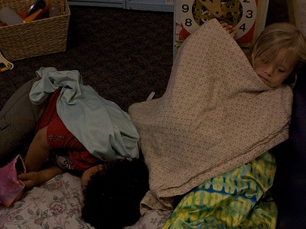
Thank you for coming. You have earned a rest!
©2017 California Department of Education

Slide 48
Reference Guide for PowerPoint Citations
California Department of Education. 2011. California Preschool Curriculum Framework, Volume 2. http://www.cde.ca.gov/sp/cd/re/documents/psframeworkvol2.pdf (accessed October 3, 2016).
California Department of Education. 2008. California Preschool Learning Foundations, Volume 2. http://www.cde.ca.gov/sp/cd/re/documents/psfoundationsvol2.pdf (accessed October 3, 2016).
California Department of Education. 2013. Transitional Kindergarten Implementation Guide: A Resource for California Public School District Administrators and Teachers. http://www.cde.ca.gov/ci/gs/em/documents/tkguide.pdf (accessed October 3, 2016).

