Slide 1
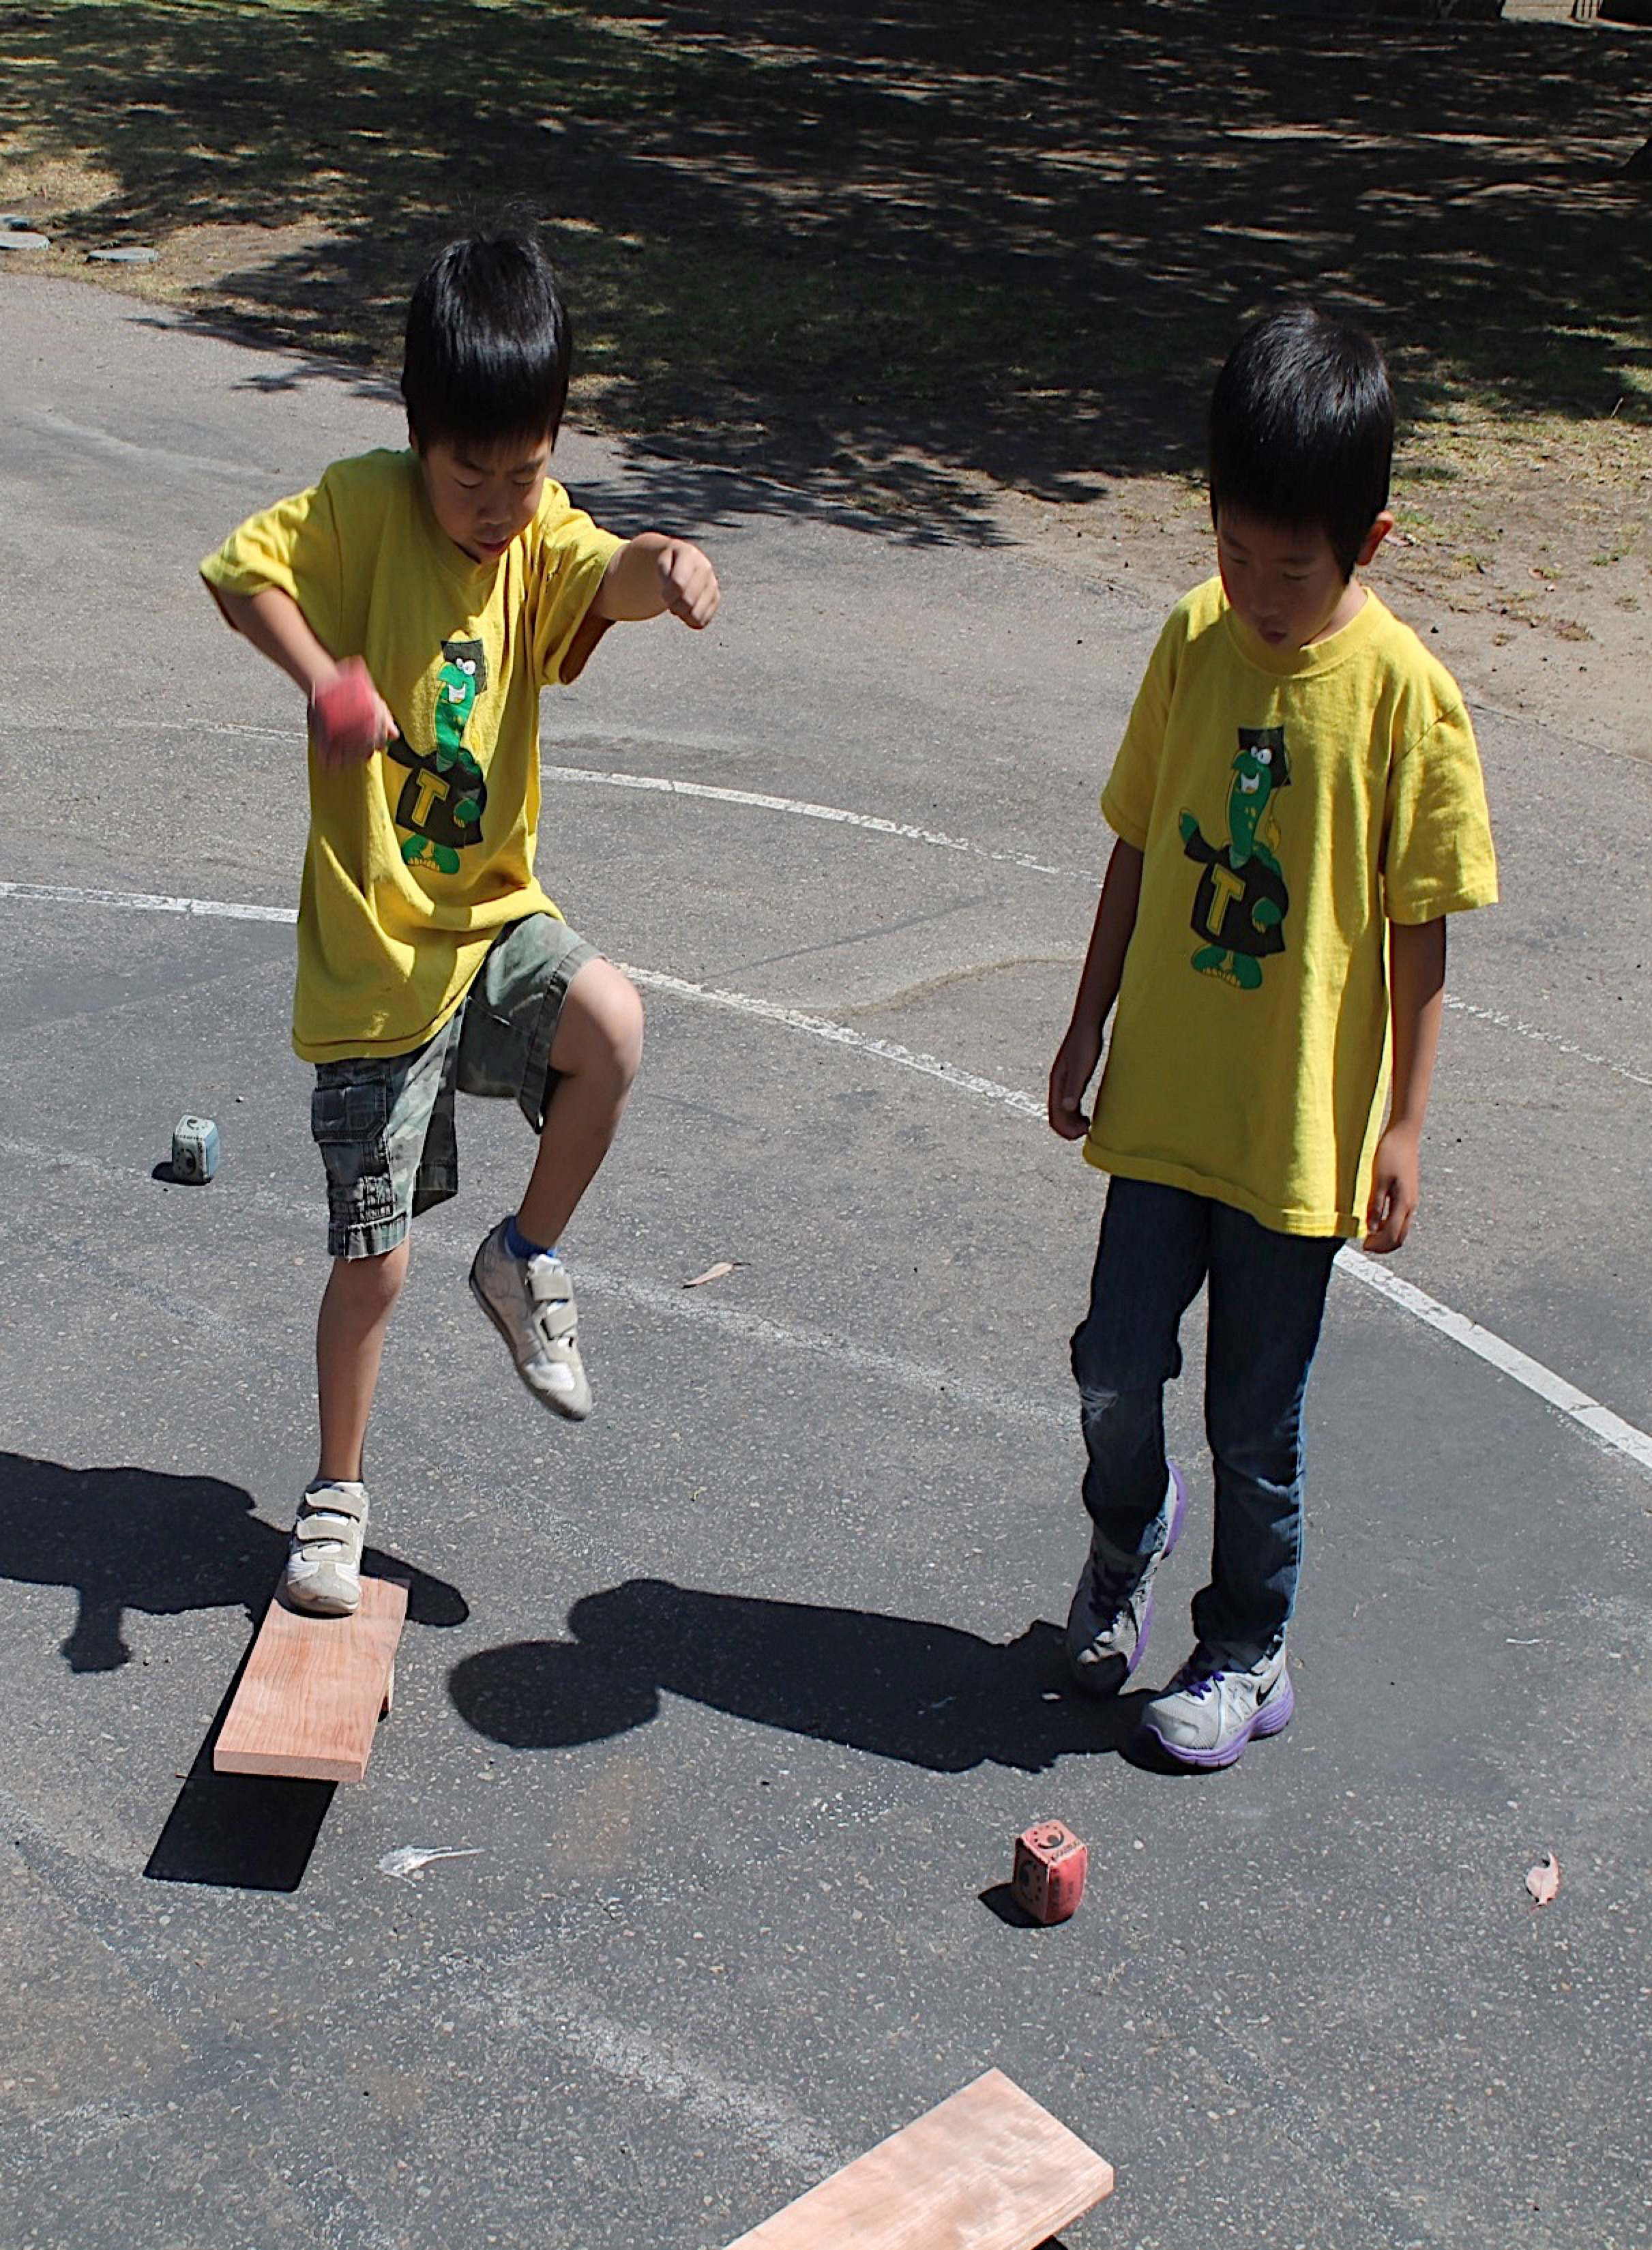

Physical Development in Transitional Kindergarten:
Fundamental Movement Skills
California Preschool Learning Foundations, Volume 2
California Preschool Curriculum Framework, Volume 2
©2016 California Department of Education
Notes:
Background Information:
This module requires active participation from attendees. Please be sure to include the following statement on all announcement materials, “Wear comfortable shoes to this session.”
Presenter Remarks:
Welcome to Physical Development in Transitional Kindergarten: Fundamental Movement Skills—a presentation focusing on the California Preschool Learning Foundations (Preschool Learning Foundations or PLF), the California Preschool Curriculum Framework (Preschool Curriculum Framework or PCF), and other California Department of Education (CDE) resources in support of the Physical Development domain.
This professional learning session is specifically designed to provide TK teachers with exposure to CDE resources that support TK curriculum planning, developmentally appropriate strategies, and classroom environment design recommendations that support the content area of fundamental movement skills (FMS).
Because our focus for today is on movement, we will have many opportunities to move ourselves. Please honor any physical restrictions or limitations that you may have and engage mentally if you are not able to engage physically.
Extra Notes:
Check everyone’s shoes and advise those wearing inappropriate shoes to be careful.
Be aware of spatial concerns. When it’s time for physical activity (PA) push in chairs/purses/bags/totes and be aware of walls and the proximity of other people.
Remind participants that the materials on the tables are for their use during the session only.

Slide 2
Objectives
Become aware of key concepts from the California Preschool Learning Foundations, Volume 2—Physical Development domain, Fundamental Movement Skills strand.
Observe, read about, and discuss the developmental continuum of fundamental movement skills and develop strategies that will guide instruction and learning in transitional kindergarten (TK).
Discuss current research underlying the teaching strategies used to support the development of fundamental movement skills.
Practice using the Preschool Learning Foundations and Preschool Curriculum Framework to intentionally plan age-appropriate, developmentally appropriate, cultural and inclusive strategies that promote fundamental movement skills.
Notes:
Presenter Remarks:
This slide shows what we will cover in today’s training.
Objectives:
Become aware of key concepts from the California Preschool Learning Foundations, Volume 2—Physical Development domain, Fundamental Movement Skills strand.
Observe, read about, and discuss the developmental continuum of fundamental movement skills and develop strategies that will guide instruction and learning in transitional kindergarten (TK).
Discuss current research underlying the teaching strategies used to support the development of fundamental movement skills.
Practice using the Preschool Learning Foundations and Preschool Curriculum Framework to intentionally plan age-appropriate, developmentally appropriate, cultural and inclusive strategies that promote fundamental movement skills.

Slide 3
FUN-damental Scramble
Start Line
Voc.
Cards
Voc.
Cards
Voc.
Cards
Def.
Cards
Match as many words and definitions as you can in two minutes.
Hold on to the crepe paper.
Work quickly as a team!
Def.
Cards
Def.
Cards
Notes:
Activity 1: FUN-damental Scramble
Background Information:
Prepare participants for the activity by reviewing Handout 1: Physical Development Glossary.
Scatter FMS definition cards and FMS vocabulary cards face up on opposite sides of the area. Use a rope/chalk/tape as the start line.
If possible, make sure that teams are made up of an even number of participants in each group.
Presenter Remarks:
How familiar are you with the vocabulary related to physical development? We are going to do the FUN-damental Scramble; this is a cooperative activity that will connect movement and vocabulary.
Please line up in teams of 5-6 over by the start line. Each team will receive a strip of crepe paper 6 inches long. This is how to play the game:
On the GO signal, each team will travel to an area of scattered cards on the floor, pick up one card, and return to the start line. Teams will then go to the opposite area to retrieve the correct vocabulary or definition card that is needed to make a match.
You may choose whichever area to travel to first. Some will want to pick up the definition card first and then find the vocabulary word that matches or vice versa.
Teams will continue making matches until time is called or all cards have been picked up (usually two minutes).
Once the game is over, teams will check to see how many correct matches they collected by referring to Handout 1: Physical Development Glossary.
It is important to travel together because every break in the strip of the crepe paper will result in one match being deducted. If a break occurs, teams have to stop and tie it back together.
(This activity provides participants with the vocabulary needed to explore the Fundamental Movement Skills strand.)
Let’s get started! Every team needs to hold onto a six-inch strip of crepe paper behind the start line. Work cooperatively and travel safely – be aware of others!
Ready GO!
intent:
Cooperatively engage in a community building activity in preparation to learn about fundamental movement skills (FMS).
OUTCOMES:
Participants will cooperatively engage in movement as they try to retrieve cards from different areas of the room while holding onto crepe paper.
Participants will match vocabulary cards and definition cards using locomotor skills.
Materials Required:
Handout 1: Physical Development Glossary
FMS vocabulary cards
FMS definition Cards
Six-inch strip of crepe paper for each team (tear or cut)
Time: 7–8 minutes
Process:
Prepare participants for the activity by reviewing Handout 1: Physical Development Glossary.
Scatter FMS definition cards and FMS vocabulary cards face up on opposite sides of the area. Use a rope/chalk/tape as the start line.
Invite participants to line up by teams/tables behind the start line (approximately 5-6 participants per team). Each team needs a six-inch strip of crepe paper.
Activity prompts and directions:
How familiar are you with the vocabulary related to physical development? FUN-damental Scramble is a cooperative activity that will connect movement and vocabulary.
On the GO signal, each team will travel to an area of scattered cards on the floor, pick up one card, and return to the start line. Teams will then go to the opposite area to retrieve the correct vocabulary or definition card that is needed to make a match.
You may choose whichever area to travel to first. Some will want to pick up the definition card first and then find the vocabulary word that matches or vice versa.
Teams will continue making matches until time is called or all cards have been picked up (usually two minutes).
Once the game is over, teams will check to see how many correct matches they collected by referring to Handout 1: Physical Development Glossary.
It is important to travel together because every break in the strip of the crepe paper will result in one match being deducted. If a break occurs, teams have to stop and tie it back together.
This activity provides us with the vocabulary we need to explore the Fundamental Movement Skills strand.
Let’s get started! Every team needs to hold onto a six-inch strip of crepe paper behind the start line. Work cooperatively and travel safely – be aware of others!
Ready GO!
OPTIONS:
Add more length to the crepe paper for teams with more than six members—typically one foot for each participant. Try to keep teams with even numbers.
Make two or three sets of vocabulary and definition cards for larger training sessions. Laminating cards is suggested for multiple uses.
Change the locomotor skill used during the activity or ask for a participant to name a locomotor skill everyone can move to.

Slide 4
Fundamental Movement Skills
Strands
Substrands
Fundamental Movement Skills
1.0 Balance
2.0 Lomomotor Skills
3.0 Manipulative Skills
Perceptual-Motor Skills and Movement Concepts
1.0 Body Awareness
2.0 Spatial Awareness
3.0 Directional Awareness
Active Physical Play
1.0 Active Participation
2.0 Cardiovascular Endurance
3.0 Muscular Strength, Muscular Endurance, and Flexibility
Notes:
Presenter Remarks:
The Fundamental Movement Skills strand is the first strand in the Physical Development domain. It consists of three substrands: balance, locomotor skills, and manipulative skills.
We will explore each of these substrands during this training.

Slide 5
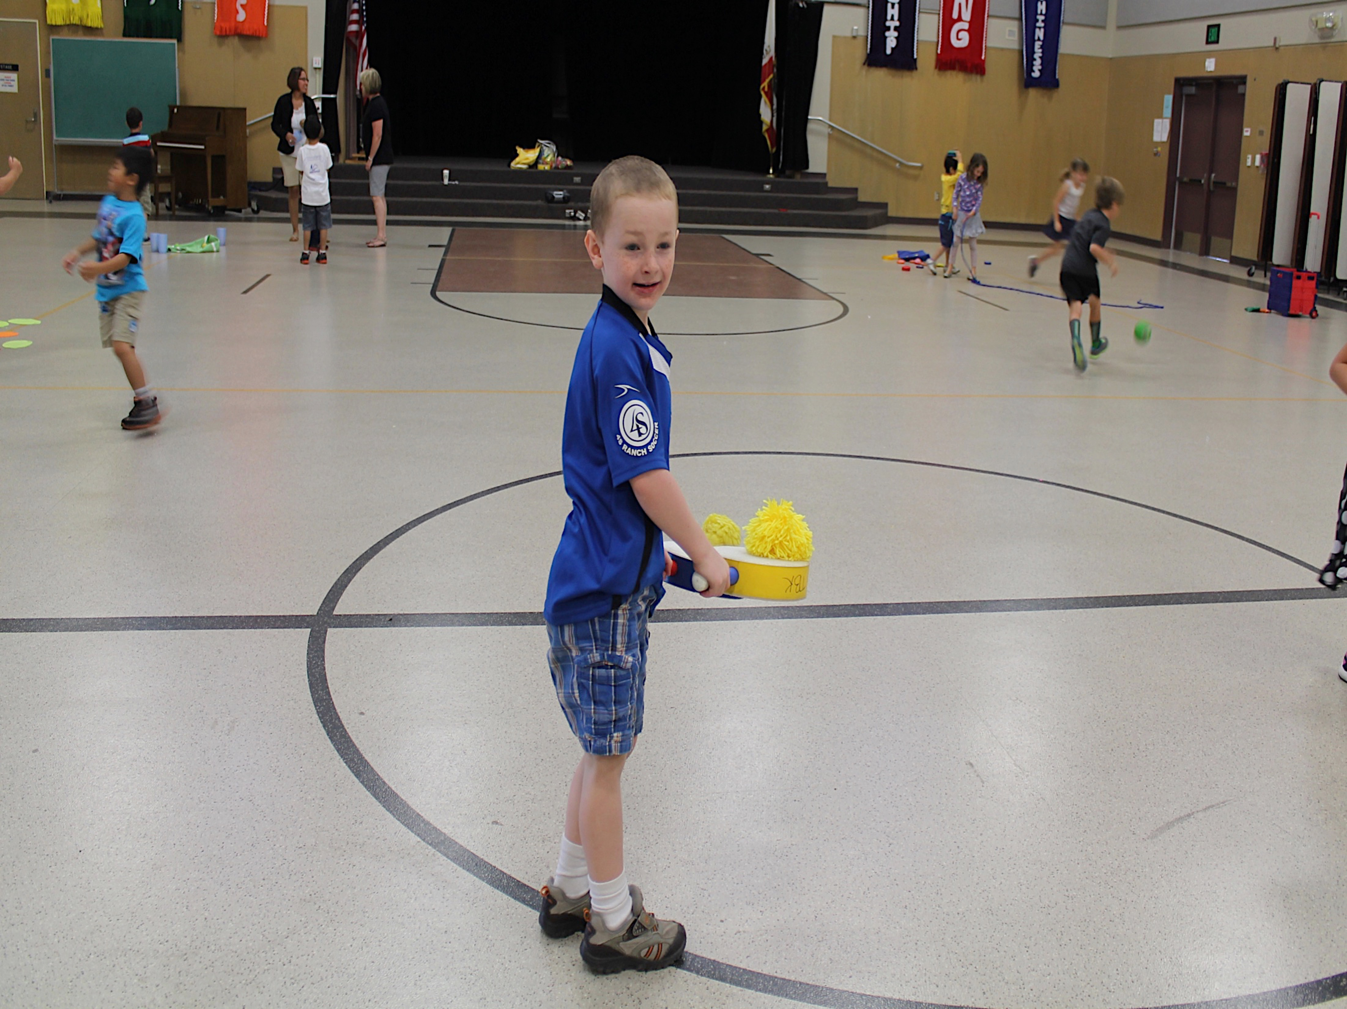
Fundamental Movement Skills
“…[E]ach child’s development is unique and affected by many factors” (PCF, Vol. 2, p. 139).
“Early childhood is a crucial and unique time for developing coordination of basic movement skills” (PCF, Vol. 2, p. 139).
©2016 California Department of Education.
Notes:
Presenter Remarks:
“…[E]ach child’s development is unique and affected by many factors” (PCF, Vol. 2, p. 139). Teachers should expect variations in individual development.
“Early childhood is a crucial and unique time for developing coordination of basic movement skills. During this period, daily movement experiences can significantly influence a child’s level of confidence in their motor skills and positively affect their future as happy, active movers” (PCF, Vol. 2, p. 139).
This training will highlight the typical developmental path children take and provide ideas to support students in a variety of developmental areas.
In addition, the resources used and ideas shared today will include ideas for the adaptation of materials that may support some students with special needs.

Slide 6
Confident Movers
“Children who develop fundamental movement skills tend to become confident movers and have the building blocks for an active way of life” (PCF, Vol. 2, p. 139).
©2016 California Department of Education.
Notes:
Presenter Remarks:
“Children who develop fundamental movement skills tend to become confident movers and have the building blocks for an active way of life” (PCF, Vol. 2, p. 139).
This is can be a very powerful statement and can serve as motivation for teachers to support children in their active physical development now so as to positively impact their future habits.

Slide 7



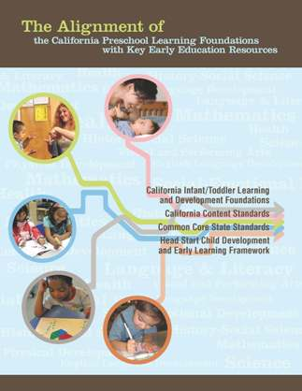





CDE Publications and Resources that Support TK Implementation
Alignment Document
Developmentally Appropriate
Practice
DRDP Specific to TK and K
Preschool Curriculum Framework
Physical Education Model Content Standards for CA Public Schools, K-12
Physical Education Framework for CA Public Schools, K-12
Preschool Learning Foundations
Transitional Kindergarten Implementation Guide
California Common Core State Standards
Preschool Learning Foundations
Preschool Curriculum Framework
Active Start
Alignment Document
Transitional Kindergarten Implementation Guide
California Common Core State Standards
DRDP Specific to TK and K
Physical Education Model Content Standards for CA Public Schools, K-12
Physical Education Framework for CA Public Schools, K-12
California Common Core State Standards
Notes:
Presenter Remarks:
The California Department of Education has developed many publications, resources, and supports that enable teachers to facilitate the most positive outcomes for students.
Today our main focus will be the on the Preschool Learning Foundations and the Preschool Curriculum Framework, Volume 2, Physical Development domain.
There are additional key resources that support physical development in young children. We will also discuss alignment and make connections to additional resources pictured in the graphic (name and hold up each resource): The Alignment of the California Preschool Learning Foundations with Key Early Education Resources (Alignment Document), the Transitional Kindergarten Implementation Guide – A Resource for Public School District Administrators and Teachers (TK Implementation Guide), the Desired Results Developmental Profile—Kindergarten (2015): A Developmental Continuum for Kindergarten (DRDP-K [2015]), Physical Education Model Content Standards for California Public Schools, Kindergarten Through Grade Twelve (PE Model Content Standards), the Physical Education Framework for California Public Schools (PE Framework), and the California Common Core State Standards (CA CCSS).
Early educators typically include physical movements in their daily teaching. It is best practice to be cognizant of movement and integrate it within all content areas.
What do you know about these documents?
How do you use these resources in your work now?
(Depending on the size of your group, participants can share responses at their table or in pairs.)

Slide 8
Why Use the Preschool Learning Foundations for TK?
CA Law (EC 48000):
Transitional kindergarten is the first year of a two-year kindergarten program that uses a modified kindergarten curriculum that is age and developmentally appropriate.
Transitional kindergarten programs are intended to be aligned to the California Preschool Learning Foundations developed by the CDE.
Notes:
Background Information:
CDE.CA.gov/ci/gs/em/kinderfaq.asp#program
Presenter Remarks:
The state of California provides guidance on utilizing the Preschool Learning Foundations and the Preschool Curriculum Framework as planning and curriculum resources in the TK classroom.
In addition, the following publications and resources are available to support age and developmentally appropriate TK curriculum:
Active Start
Alignment Document
TK Implementation Guide
DRDP-K (2015)
PE Model Content Standards
PE Framework
CA CCSS

Slide 9


Foundations and Framework, Volume 2
The purpose of the Preschool Learning Foundations is to promote a common understanding of young children’s learning and to guide instructional practice.
Notes:
9
Presenter Remarks:
The purpose of the foundations is to promote a common understanding of young children’s learning and to guide instructional practice. The foundations and framework are designed to work together. While the foundations—known as standards in the K-12 arena—provide the background information to understand children’s developing knowledge and skills (the “what”), the curriculum framework offers guidance on how teachers and programs can support the learning and development that are described in the foundations (the “how”).
Handout 2: Fundamental Movement Skills Strands and Substrands shows the strands and substrands we will be talking about today.

Slide 10
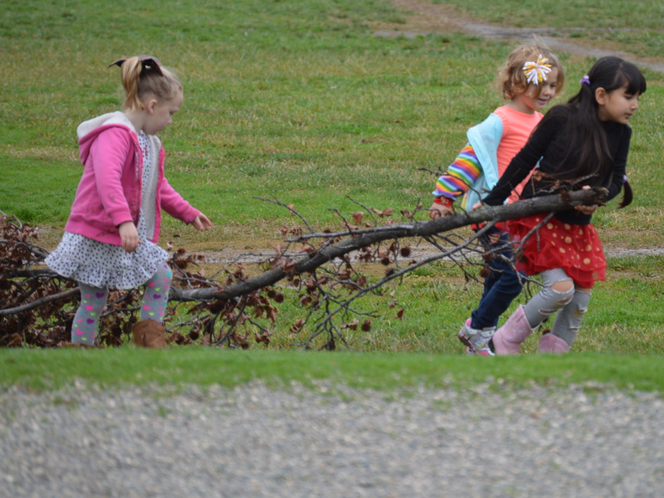
Foundations
With appropriate support
High-quality program
©2016 California Department of Education
Notes:
Presenter Remarks:
The Preschool Learning Foundations describe what children should be able to do at around 48 months (4 years old) and 60 months (5 years old).
The foundations also assume that children have access to appropriate support in high quality programs that include the following aspects:
Environments and experiences that encourage active, playful exploration and experimentation
Clearly defined learning centers where materials are rotated
Purposeful teaching to help children gain knowledge and skills
Predictable schedules and routines with large blocks of time for play and skillful integration of curriculum with an intentional focus on content
Specific support for English learners with staff that have knowledge of the stages of English-language acquisition
Accommodations and adaptations for children with disabilities and additional support when needed
Let’s take a closer look at one of the foundations for an example. Open the Preschool Learning Foundations and find a page where the age levels appear; this is an example of a foundation page.
Look across the page at the developmental progression at around 48 months; notice the changes at 60 months of age. (Solicit a few participants to read what they see.)
(Summarize the exploration with the following key note.) Because children develop at different rates, the foundations were designed to support the belief that certain stages of development will occur at different times for all students. You will notice “at or around” in the description. It is important to remember this variability occurs.

Slide 11
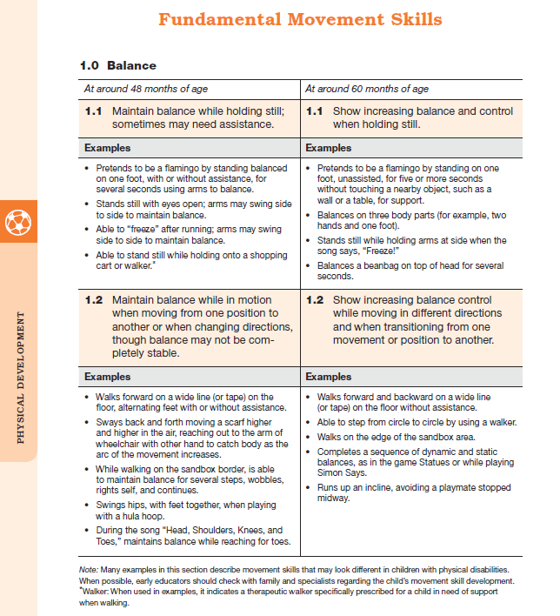
Map of the Foundations
Strand
Substrand
Age
Foundation
Examples
Foundation
Domain
Examine the developmental progression between 48 and 60 months in the foundation:
What do you notice is developing?
Use the examples to help you think about growth and change.
Footnotes
Notes:
Background Information:
Refer to Handout 3: Fundamental Movement Skills Foundations Map.
Presenter Remarks:
Please locate Handout 3: Fundamental Movement Skills Foundations Map in your folder and follow along while we discuss each component:
The name of the domain (Physical Development).
The name of the strand (Fundamental Movement Skills).
The name of the substrand (Balance).
Note that substrands always end in ".0.“
The two age levels (at around 48 months and at around 60 months).
Each foundation describes typical behaviors at around 48 months and at around 60 months or four to five years old.
The foundations for the substrand.
There are two for each age level on this page (1.1 for 48 months and 1.1 for 60 months, 1.2 for 48 months and 1.2 for 60 months).
The examples for each foundation.
These are only a few of the ways that children may demonstrate the behavior in the foundation.
Many of the foundations have footnotes that include information specific for students with IEPs or students with disabilities, such as information about adaptations or accommodations.
Notice that there is a developmental progression from four years old to five years old within a substrand.
(Click to reveal prompt.) Examine the developmental progression between 48 and 60 months in your foundation:
What do you notice is developing?
Use the examples to help you think about growth and change.

Slide 12
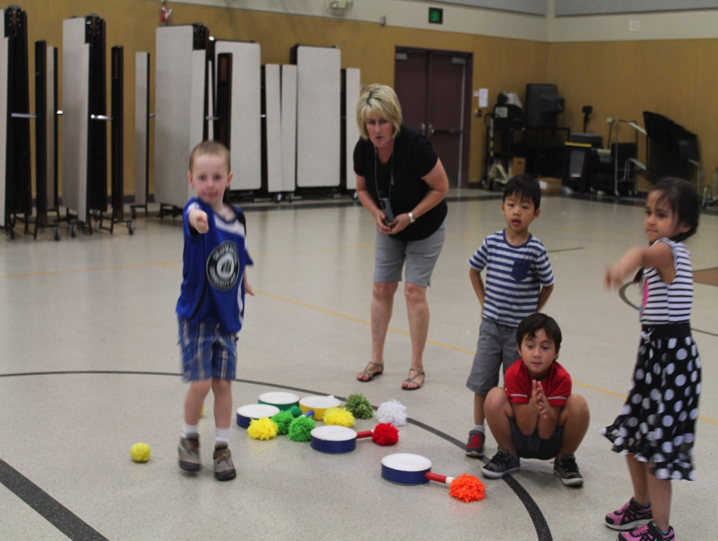
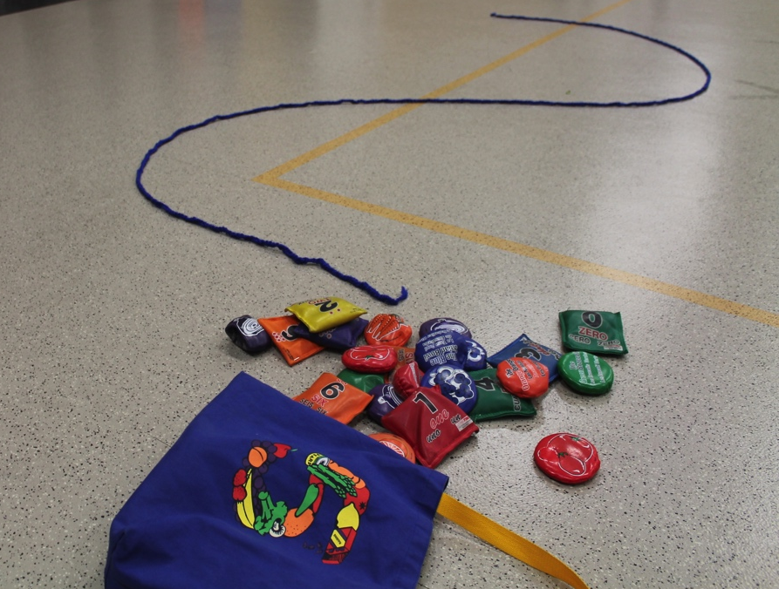
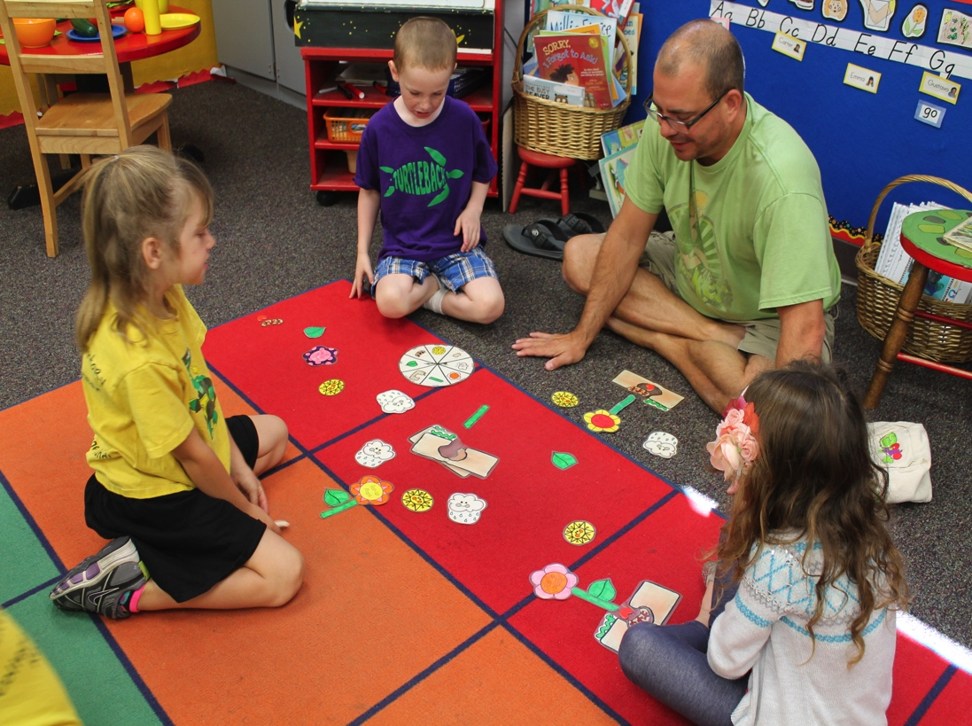
Suggestions and Strategies l
Teachable Moments
Planning Learning Opportunities
Interactions and Strategies
Engaging Families
©2016 California Department of Education
©2016 California Department of Education (CDE) with the WestEd Center for Child & Family Studies, California Preschool Instructional Network (CPIN). (05/2016)
Notes:
Presenter Remarks:
The Preschool Curriculum Framework provides practical suggestions for teachers.
These are some of the section titles in the Preschool Curriculum Framework where you will find specific suggestions for teachers:
Interactions and strategies
Planning Learning Opportunities
Teachable Moments
Engaging Families
This training will highlight and expand on these suggestions and strategies.
12

Slide 13
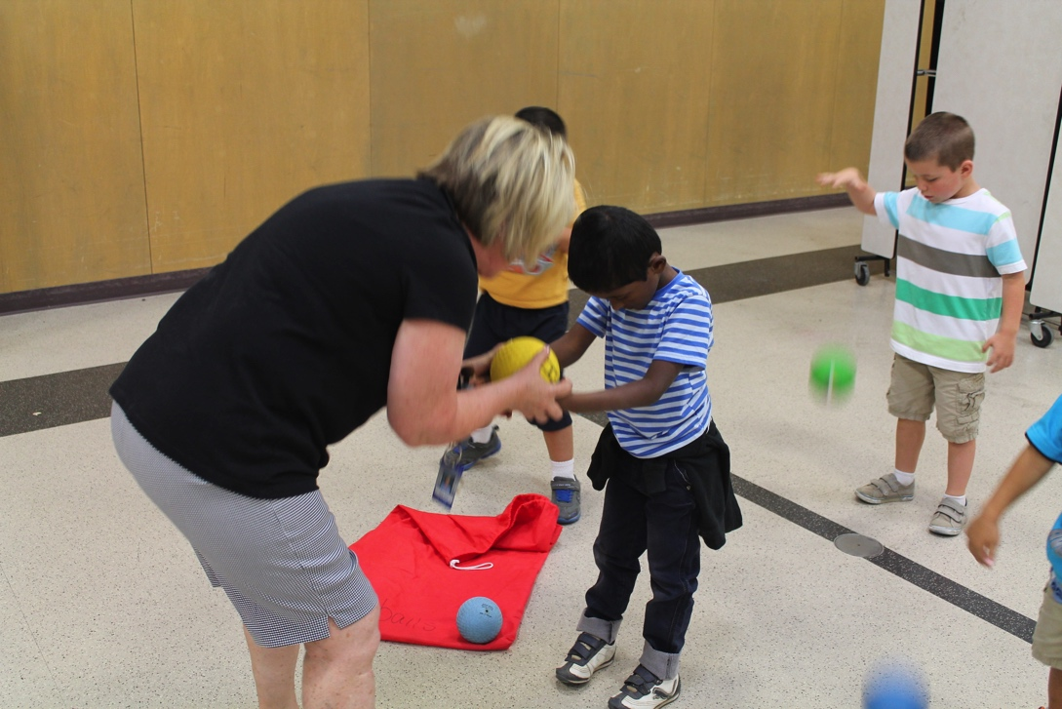
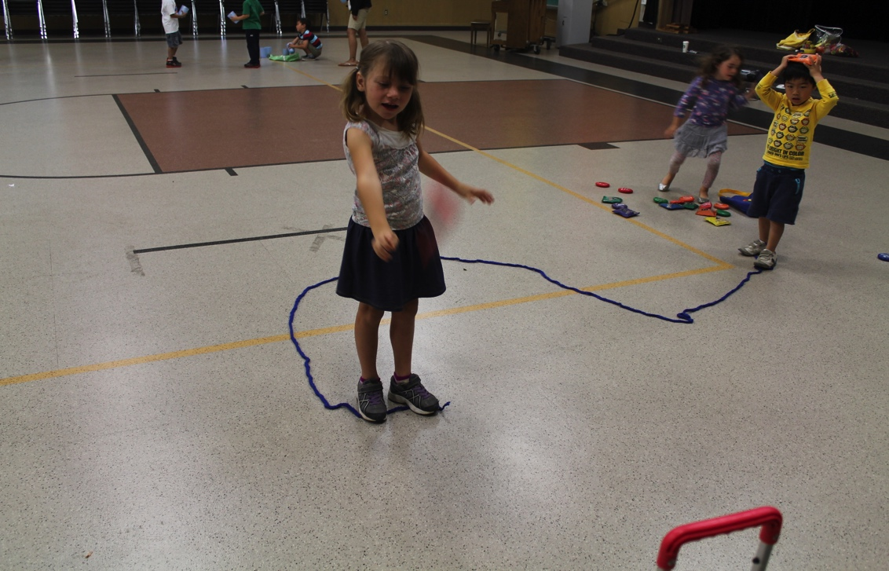
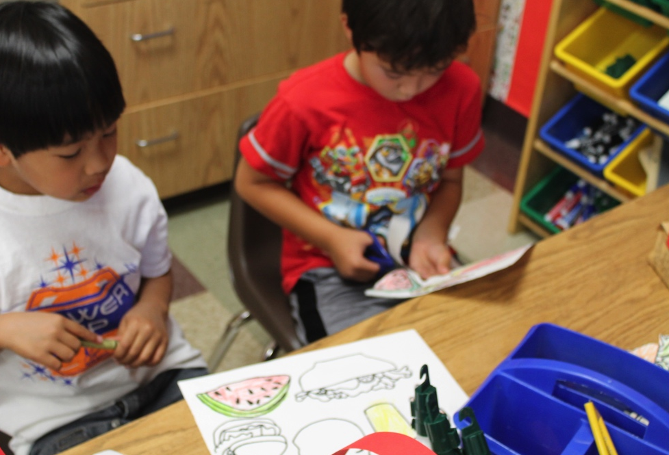
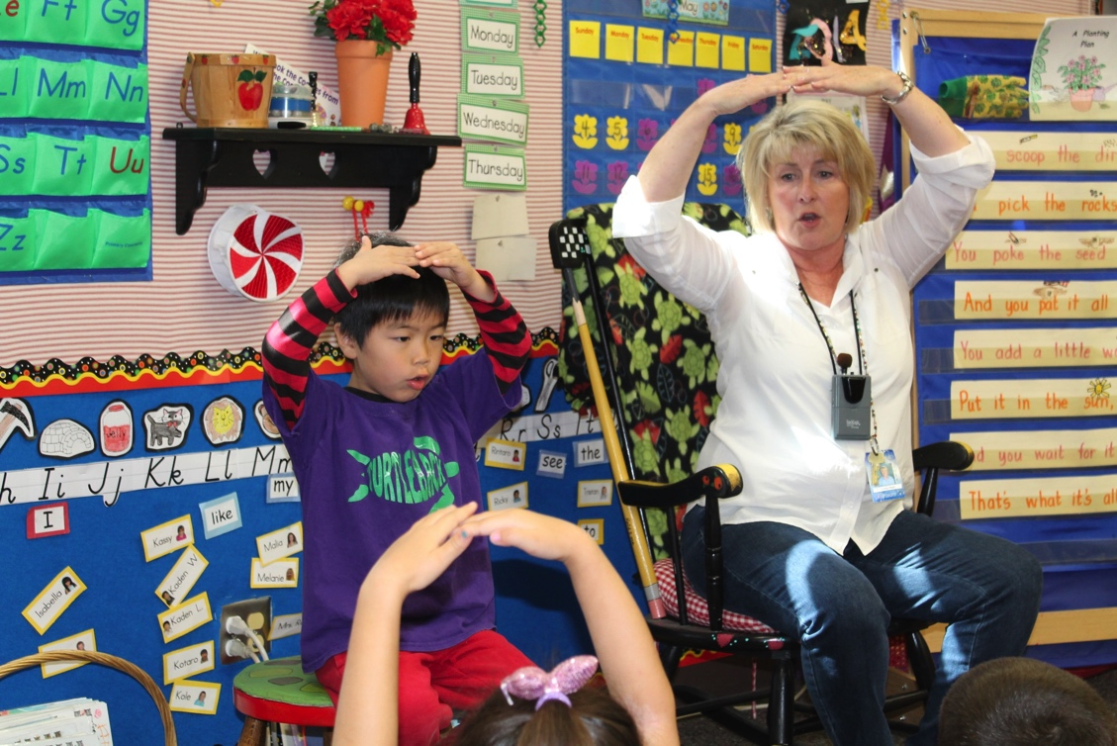
Framework Strategies
Developmentally appropriate
Reflective and intentional
Individually and culturally meaningful
Inclusive
©2016 California Department of Education
Notes:
Presenter Remarks:
Let’s check on framework strategies that enrich the ability of teachers to address ideas and concepts that children can grasp at their developmental level and progressively build on what children already know and understand.
This approach applies to all children, including children with various abilities, disabilities, or other special needs (such as delays in language, cognition, or physical ability).
Throughout the training you may refer to Handout 4: Fundamental Movement Skills Strategies Worksheet
to record any framework strategies you would like to remember. There is a section for things you already do that you might want to remember to add more of and a section for new ideas you would like to try.

Slide 14



Alignment of Physical Development Foundations and PE Model Content Standards
TK
Notes:
Presenter Remarks:
Let’s explore the connection between the Physical Development domain in the Preschool Learning Foundations and the PE Model Content Standards for kindergarten. (Hold up the Preschool Learning Foundations, the PE Model Content Standards, and the Alignment Document.)
The Preschool Learning Foundations illustrate how important it is for TK teachers to continue to set the foundation for physical development in order to provide an uninterrupted transition from preschool, to TK, and into kindergarten.
14

Slide 15

Alignment Document
Notes:
Presenter Remarks:
The Alignment Document is another resource that will help us to answer questions related to developmental progressions.
The Alignment Document emphasizes that early learning is a significant part of the educational system and that the knowledge and skills of young children are foundational to their future learning.
Understanding the links between different ages and different early childhood stages allows educators to build on children’s earlier learning and prepare them for the next educational challenge.
Find Handout 5: Fundamental Movement Skills Domain Alignment and take a moment to review it. (Allow two minutes to review.)
Discuss the following questions with your table group (Allow three minutes for discussion):
What do you know about this document?
How do you currently use it in your work?
Extra Notes:
Depending on the size of the group, participants can share responses with table partners or in pairs.

Slide 16


PE Model Content Standards and PE Framework
Find and read Handout 6: Physical Education Content Standards.
What do you notice?
Notes:
Presenter Remarks:
Take out Handout 6: Physical Education Content Standards and read through the standards for kindergarten. What do you notice? (Solicit responses. Remind participants that there are five standards and the standards are the same for each grade level, recognizing that each grade has different ages and levels of developmentally appropriate development.)
This handout provides a more detailed look at each physical education content standard and correlating examples. As you likely noticed, many of the developmental skills introduced and practiced in Pre-K are continued through TK and into kindergarten. Having an awareness of children’s physical development during the early years is best practice for all early childhood educators.

Slide 17

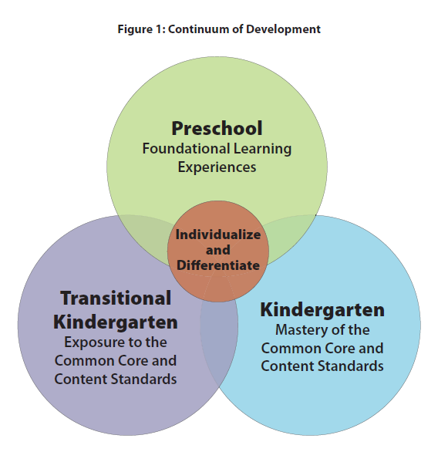
TK Implementation Guide
Notes:
Presenter Remarks:
Early learning experiences should be meaningful and integrated across subject areas. Learning should also include experiential and hands-on activities in real contexts.
(Introduce the TK Implementation Guide.)
“Successful TK programs are the result of thoughtful teacher reﬂection and planning. The TK teacher has a thorough understanding of the TK curriculum and understands the critical skills and concepts for each subject area. TK teachers understand the developmental trajectories of their students and identify the standards for learning that align with both students’ assessed needs and eﬀective instructional strategies (see chapter 4). TK teachers create cohesive curriculum plans that are reﬂective of individual and group learning needs. Decisions about what to teach in a TK classroom are guided by key CDE resources, including the…alignment document. Guidelines for selecting and adapting curriculum materials and lessons help TK teachers plan engaging encounters that address learning standards” (Transitional Kindergarten Implementation Guide: A Resource for California Public School District Administrators and Teachers [CDE], p. 36).
“Furthermore, teachers who understand that all students beneﬁt from diﬀerentiated instruction will ﬁnd that the tools, curriculum, and routines they use to support typically developing children are easily adapted or modiﬁed to accommodate students with disabilities” (Transitional Kindergarten Implementation Guide: A Resource for California Public School District Administrators and Teachers [CDE], p. 52).

Slide 18




Daily Physical Activity Recommendations
Notes:
18
Background Information:
2008 Physical Activity Guidelines for Americans (PAG) (http://www.cdc.gov/nchs/data/databriefs/db141.htm)
Presenter Remarks:
It is widely recognized that many organizations are consistent in their daily physical activity recommendations for young children—to accumulate at least 60 minutes and up to several hours of physical activity every day of the week.
Again, the minutes are to be accumulated and should be spread throughout the day in short bouts that are developmentally appropriate and fun.
(Refer to Handout 7: Physical Activity Recommendations for Young Children)
Active Start is a widely recognized national document with physical activity recommendations for infants, toddlers, and preschoolers.
The 2008 Physical Activity Guidelines for Americans (PAG), which have been adopted by the First Lady Michelle Obama’s Let's Move! initiative and the American Academy of Pediatrics, recommend that youth participate in daily moderate-to-vigorous physical activity for at least 60 minutes.
California Department of Education policies require, at minimum, 200 physical education minutes every 10 days in elementary grades 1-6. Preparing children in TK and kindergarten for physical activity is highly recommended.

Slide 19





Make and Take Yarn Balls
Gather supplies:
Yarn
Scissors
Zip ties
Cardboard squares
Wrap yarn 200 times around square; bend square to pull yarn off.
Wrap zip tie around yarn and pull tight; cut zip tie at base to secure in place.
Cut all ends and trim as needed.
Make a variety of yarn balls to use anytime!
Notes:
Presenter Remarks:
Some of the best materials for supporting fundamental movement skills are homemade and very inexpensive. We are going to make some materials now that you can use for the rest of the day and take back to your classroom.
Please follow the directions on the screen to make your own yarn balls or refer to Handout 8: How to Make a Yarn Ball.
You may choose your own materials from the table; feel free to help each other.
When everyone has finished we will use the yarn balls in an activity.
Get started!

Slide 20
Fundamental Movement Skills
Strands
Substrands
Fundamental Movement Skills
1.0 Balance
2.0 Lomomotor Skills
3.0 Manipulative Skills
Perceptual-Motor Skills and Movement Concepts
1.0 Body Awareness
2.0 Spatial Awareness
3.0 Directional Awareness
Active Physical Play
1.0 Active Participation
2.0 Cardiovascular Endurance
3.0 Muscular Strength, Muscular Endurance, and Flexibility
Notes:
Presenter Remarks:
Balance is the first substrand from the Fundamental Movement Skills strand.
“Children develop their balance skills by experiencing a variety of balancing challenges, such as holding still in postures; moving the arm, leg, or head while maintaining balance; continuously moving while balancing; and making big changes in body positions” (PCF, Vol. 2, p. 140).
“All movement involves elements of balance, and each movement has different balance requirements” (PCF, Vol. 2, p. 140).

Slide 21

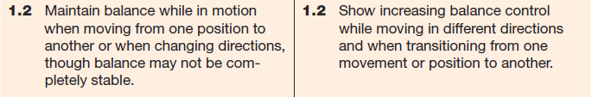
1.0 Balance
1.1 Static Balance
1.2 Dynamic Balance
Activities:
“Simon Says”
Statues
Hopscotch
Notes:
Presenter Remarks:
Please turn to page 46 in the Preschool Learning Foundations (Vol. 2).
Balance contains two elements: static balance (maintaining balance while holding still) and dynamic balance (maintaining balance while the body is moving or changing directions).
“The ability to balance is fundamental to all body movements” (PCF, Vol. 2, p. 140).
Children expand their balancing abilities when afforded opportunities to practice in different environments (on low balance beams, over sand/dirt, on grass and soft environments like playground areas) and in a variety of movements.
Simple childhood games include balance elements, activities such as “Simon Says” (which requires static balance), “Statues” (which includes dynamic balance), or a simple game of hopscotch engage a child’s balance skills.

Slide 22
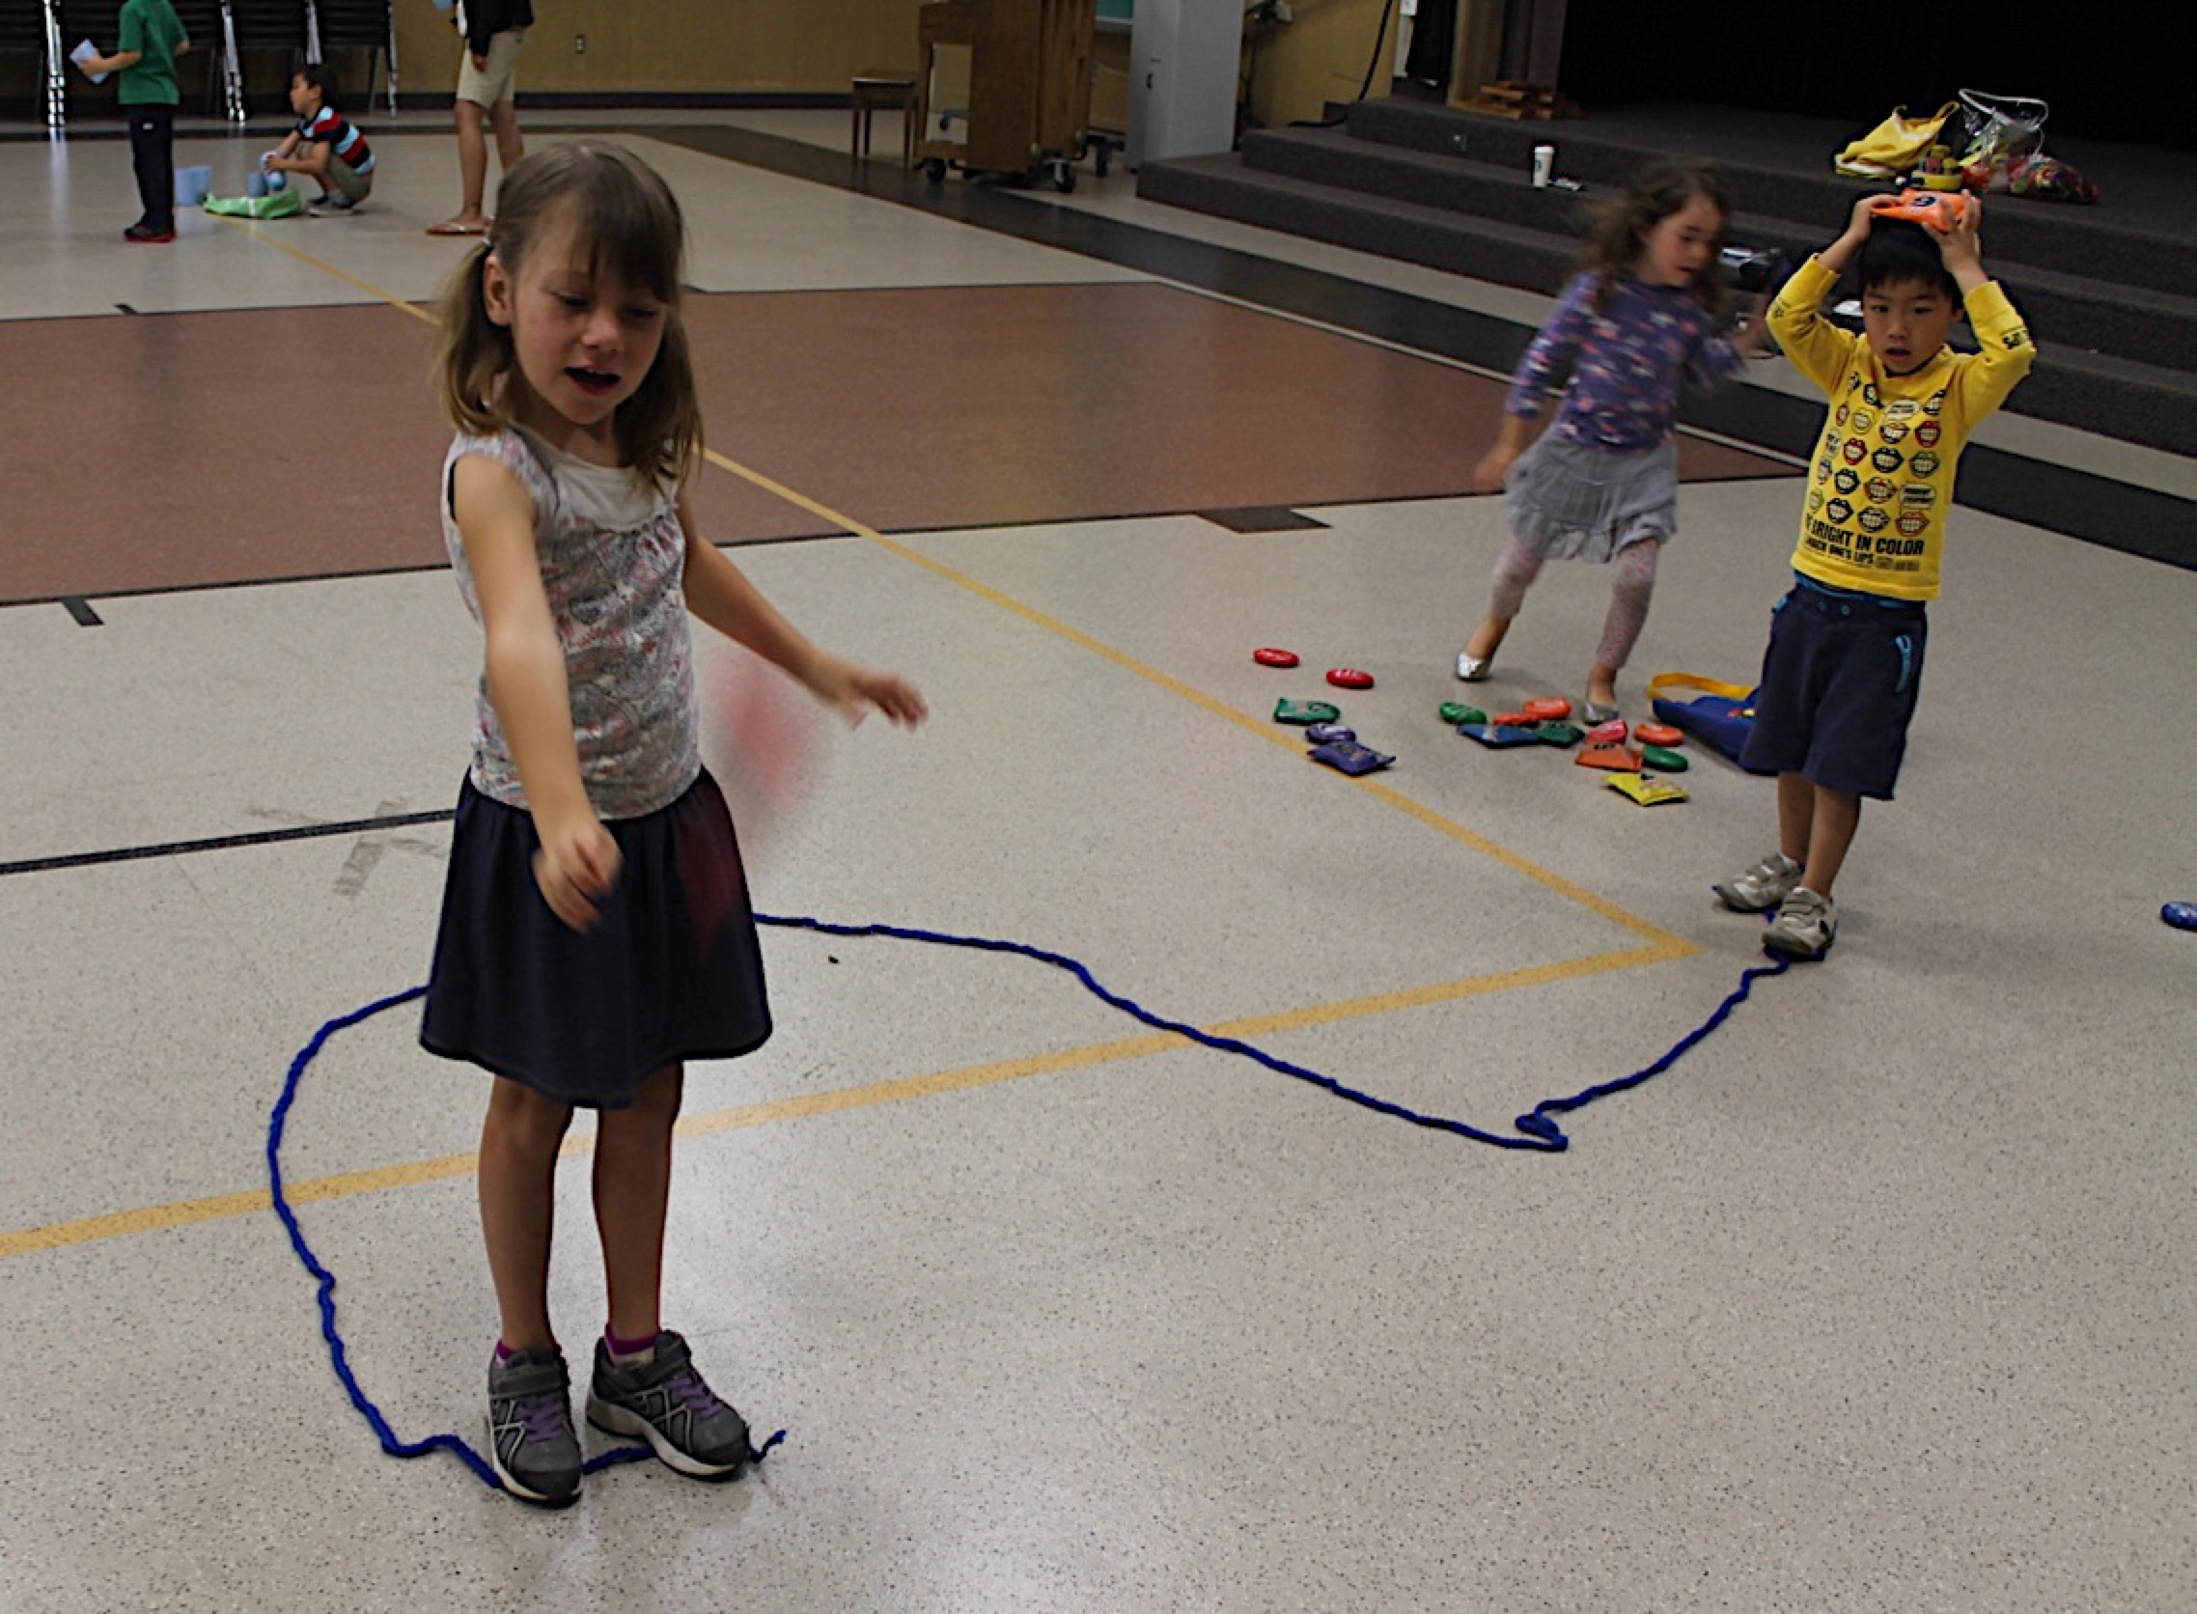
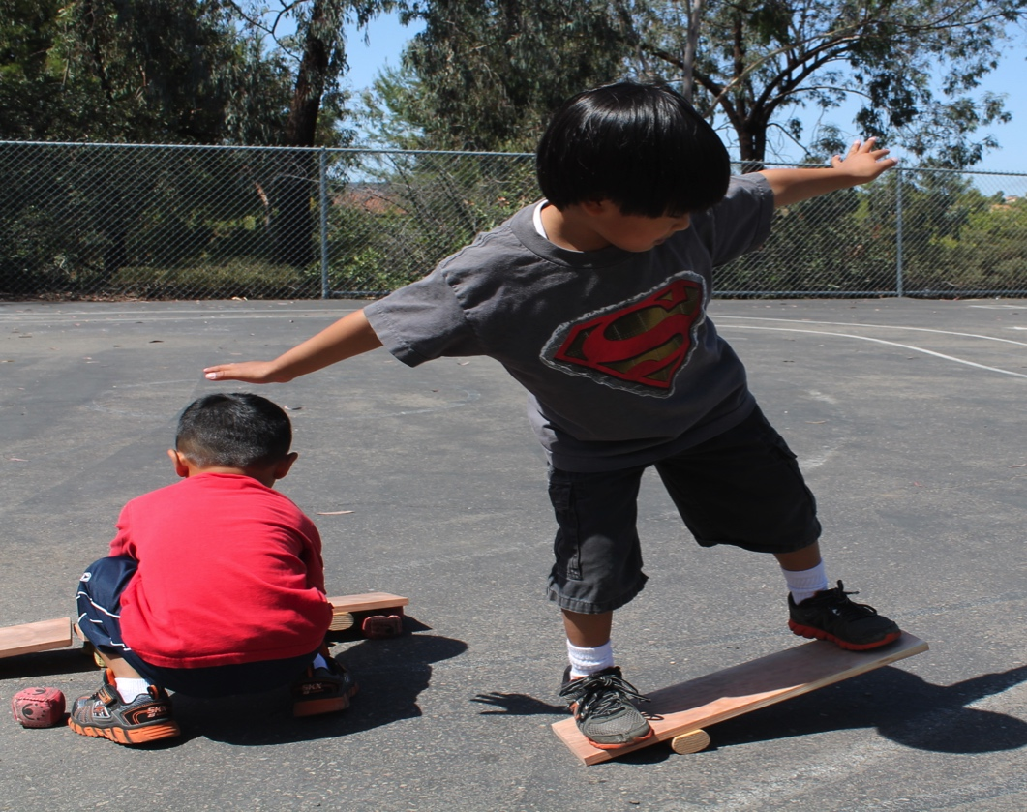
Balance Opportunities
Bodies or Objects
Notes:
Presenter Remarks:
Children can increase their balance skills through a variety of situations.
Developmentally, balance progresses from simple to more complex movements. Young children practice using their body first to balance an object; then they practice balancing objects on their body as they move—see the picture on the left where TK children walk on a rope that is a curved pathway while balancing a bean bag on their heads—or they practice balancing their body on an object—see the picture on the right where a child balances on a board.
Elevated surface areas also afford children additional balance practice (e.g., low balance beams or Styrofoam balance objects, raised sidewalks, stepping stones, etc.).
Once elevated surfaces have been practiced, adding an object to balance on a body part offers even more of a challenge.
Work with your tablemates to brainstorm additional situations where a TK child could practice the skill of balancing with objects/manipulatives.

Slide 23
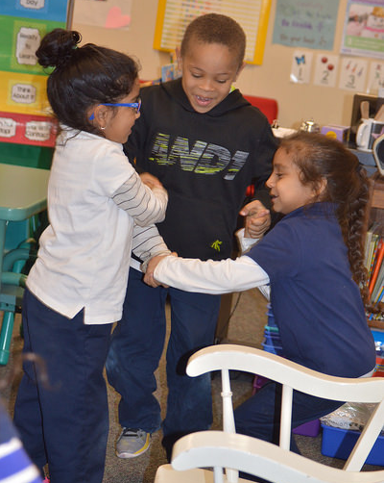
Interactions and Strategies to Support the Development of Balance Skills
“Provide opportunities that include diverse cultural themes” (PCF, Vol. 2, p. 142).
“Incorporate balance activities into the children’s world” (PCF, Vol. 2, p. 142).
©2016 California Department of Education
Notes:
Background Information:
Refer to pages 142-146 of the Preschool Learning Foundations (Vol. 2) and/or Handout 9: Substrand Reflection: Interactions and Strategies, 1.0.
Presenter Remarks:
This picture shows children dancing, an activity which requires balance. Dance related activities provide a great opportunity to include a variety of music in the classroom—including music children are familiar with from their home cultures.
Cultural activities afford children opportunities to learn about others while incorporating balancing skills. Songs, dances, and age-appropriate games develop children’s awareness and enhance stability. Invite family or community members to share a cultural activity with the children.
What cultural activities happen in your TK setting? (Invite individual responses to the question.) What motor skills are developed during such activities?
It is important to incorporate balance activities into a child’s world. There are many ways to do this. For example, teachers may choose to read stories and act them out, invite students to pretend to be zoo animals, or spin in a safe area to activate the vestibular system.
The key is to incorporate balance activities into everyday routines: during structured and unstructured play time, when transitioning from one area to another, or while waiting in line.

Slide 24
Interactions and Strategies to Support Development of Balance Skills
“Design the environment so children combine balance skills with fundamental movement skills and movement concepts” (PCF, Vol. 2, p. 144).
“Modify balance activities to increase participation by children with disabilities and special needs” (PCF, Vol. 2, p. 146).
Notes:
Presenter Remarks:
Interactions and strategies to support the development of balance are found in on pages 142-146 of the Preschool Curriculum Framework and have been provided in Handout 9: Substrand Reflection: Interactions and Strategies, 1.0.
Read the two interactions and strategies on the slide and consider how you accomplish this in your classroom.
Next, read the list of strategies on Handout 9: Substrand Reflection: Interactions and Strategies, 1.0 and reflect about how to provide more opportunities for similar experiences in your classroom. Take about 3-5 minutes for this reflection.

Slide 25
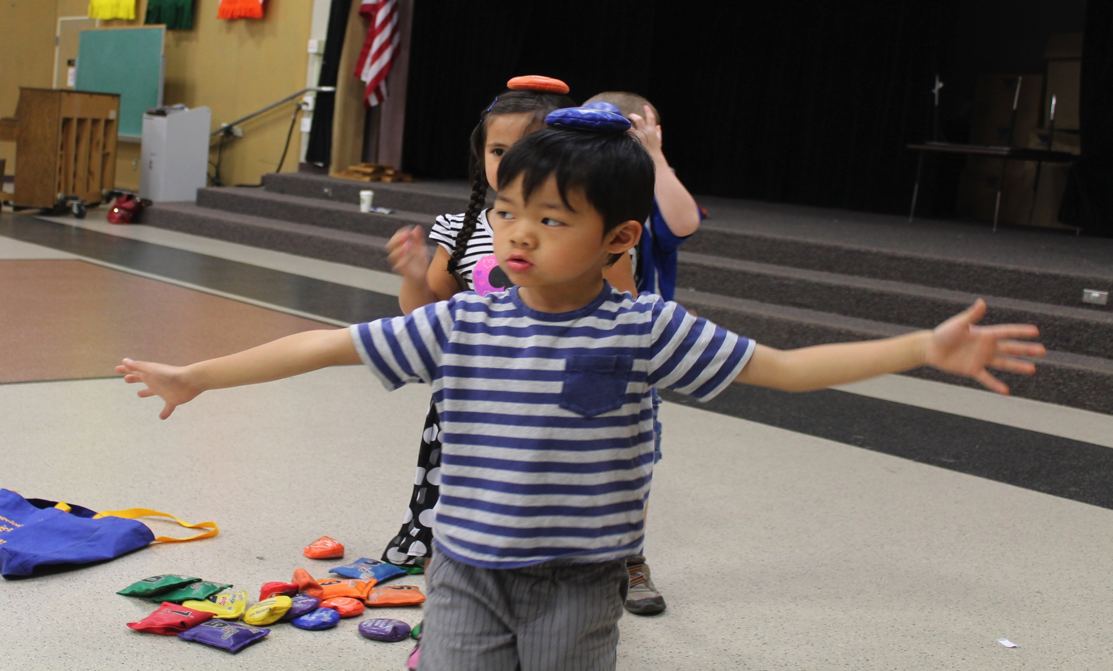
Balance Time!
Grab a rope and a yarn ball and find your own personal space.
©2016 California Department of Education
Notes:
Activity 2: Balance Time
Background Information:
Prior to activity, scan area to ensure everyone has ample space to move safely.
Place the yarn balls on the ground until needed.
Presenter Remarks:
Please honor your bodies and join in some balance activities at your own pace.
Grab a rope and a yarn ball and find your own personal space.
Let’s experience some activities where we have static and dynamic balance prompts:
Make a straight line using a rope on the ground. Jump from side to side over the rope. Gallop around the rope.
Make a curved or zigzag line with the rope (known as pathways in motor development). Tip-toe on the rope.
Make a circle, square, or triangle (geometry) on the ground with the rope. Make the shape of your body using the rope. Find shapes in the environment that are the same as your rope shape.
Demonstrate a 2-, 3-, or 4-point bridge within, near, or over your shape (*See bridge explanation below.). Can you balance a new way using the same or different body points?
Let’s add a little complexity to our balance prompts:
Hold your yarn ball and balance on one foot inside the shape. Try the other foot.
Balance a yarn ball on an elbow and move the elbow side to side or up and down.
Balance the yarn ball on your back while your walk around the room, give handshakes to three people, and return to your shape.
Balance the yarn ball on a new body part and walk to a new shape.
intent:
Experience static and dynamic balance activities that are developmentally appropriate for TK children.
OUTCOMES:
Participants will experience a developmental progression by using a manipulative during static and dynamic balance activities.
Participants will combine locomotor skills in balance activities and experience moving on different pathways.
Participants will create bridges within, near, or over a rope shape while balancing.
Materials Required:
4 to 6-inch rope (e.g., yarn, nylon, clothesline, etc.)
Yarn ball (1 per person)
Open space (indoors or outdoors) free of obstacles to move safely
Time: 7–8 minutes
Process:
Invite participants to partake in balance activities. Each participant needs a rope, a yarn ball, and personal space (Before the activity, scan area to ensure everyone has ample space to move safely). Yarn balls should be placed on the ground until needed. Caution participants not to step on yarn balls while performing the activities.
Activity prompts and directions:
Let’s experience some activities where we have static and dynamic balance prompts.
Make a straight line using a rope on the ground. Jump from side to side over the rope. Gallop around the rope.
Make a curved or zigzag line with the rope (known as pathways in motor development). Tip-toe on the rope.
Make a circle, square, or triangle (geometry) on the ground with the rope. Make the shape of your body using the rope. Find shapes in the environment that are the same as your rope shape.
Demonstrate a 2-, 3-, or 4-point bridge within, near, or over your shape (*See bridge explanation below.). Can you balance a new way using the same or different body points?
Let’s add a little complexity to our balance prompts:
Hold your yarn ball and balance on one foot inside the shape. Try the other foot.
Balance a yarn ball on an elbow and move the elbow side to side or up and down.
Balance the yarn ball on your back while your walk around the room, give handshakes to three people, and return to your shape.
Balance the yarn ball on a new body part and walk to a new shape.
Is there a new way you can balance the yarn ball and move?
*Bridge explanation: Young children can make bridges using various parts on the ground. A bridge can be made with tummies facing up or down to the ground. If two hands and both feet are used, it is called a 4-point bridge. If a child lifts one hand off the ground, it becomes a 3-point bridge. If one hand and one foot are off the ground, it becomes a 2-point bridge. Bridges can be made in the rope shape, over the rope shape, or both in and out of the rope shape—the possibilities are endless. Participants should be cautioned to demonstrate bridges within their limitations. Check the ground for safety and cleanliness.
OPTIONS:
Additional prompts can be created that add variety and challenge the participants.
All activities can be performed with bean bags if available. Participants can also use both yarn balls and bean bags to experience the difference between the two props.
Yarn ropes can be made by crocheting a single line to create a rope 4 to 6 inches long, crocheting the rope strengthens the yarn and makes it easier to manipulate.

Slide 26
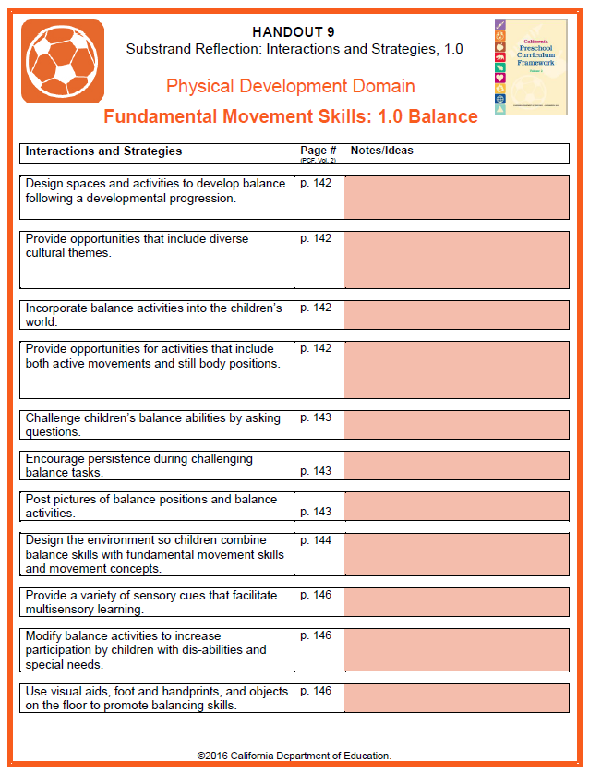
Interactions and Strategies
Talk and Balance:
Find a partner or make a small group.
Stand on one foot and discuss the interactions and strategies noted on the handout with your partner/group.
Provide specific examples of how you implement these strategies or what you can do in the near future to include more strategies into your daily routine.
Notes:
Presenter Remarks:
Let’s apply our knowledge to Handout 9: Substrand Reflection: Interactions and Strategies, 1.0.
Please follow these steps:
Find a partner or make a small group.
Stand on one foot and discuss the interactions and strategies noted on the handout with your partner/group.
Provide specific examples of how you implement these strategies or what you can do in the near future to include more strategies into your daily routine.
Feel free to stand on the opposite foot when you are ready or hold on to a chair while balancing. (Allow 3-4 minutes for this activity.)

Slide 27
Fundamental Movement Skills
Strands
Substrands
Fundamental Movement Skills
1.0 Balance
2.0 Lomomotor Skills
3.0 Manipulative Skills
Perceptual-Motor Skills and Movement Concepts
1.0 Body Awareness
2.0 Spatial Awareness
3.0 Directional Awareness
Active Physical Play
1.0 Active Participation
2.0 Cardiovascular Endurance
3.0 Muscular Strength, Muscular Endurance, and Flexibility
Notes:
Presenter Remarks:
Locomotor Skills is the second substrand from the Fundamental Movement Skills strand.

Slide 28
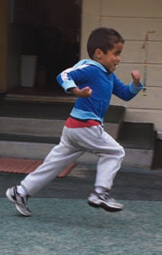
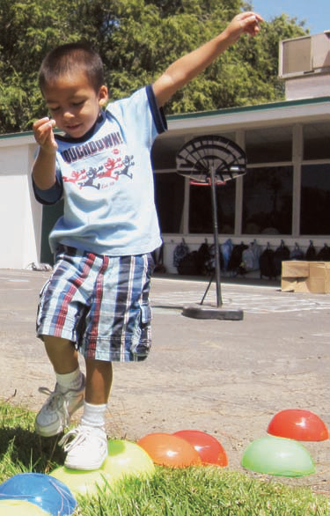
Locomotor Skills
Locomotor skills are movement skills used to move effectively and efficiently through space.
Can you name five locomotor skills?
©2016 California Department of Education
Notes:
Presenter Remarks:
Locomotor skills are ways in which we move our bodies through space from one point to another point (locomotor skills are also called traveling skills).
Young children travel, explore, and discover their environment through various locomotor skills.
Turn to your elbow partner and try to name five locomotor skills.

Slide 29
Examples of Locomotor Skills
Climbing
Crawling
Tip-Toeing
Galloping
Skipping
Sliding
Leaping
Walking
Running
Jumping
Hopping
Notes:
Presenter Remarks:
Typically, the main focus of development and practice for locomotor skills in TK is on walking, running, jumping, galloping, sliding, leaping, skipping, and hopping.
Once basic locomotor skills are acquired, movement concepts can be added to each locomotor skill for more complex movement patterns—for example, walking at a low level on a zigzag pathway.
Often times, games and activities are played with children running as the only locomotor skill. A variety of locomotor skills should be added to activities to create an enriched lesson.

Slide 30
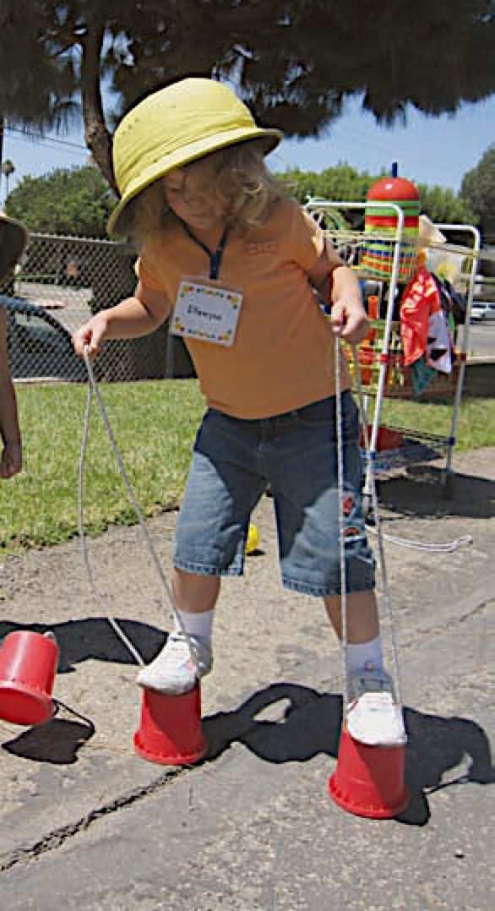
Key Concept
Focus on the process rather than the end product.
©2016 California Department of Education
Notes:
Presenter Remarks:
A key concept when observing and assessing motor skills is to focus on the process rather than the end product.
This means watching a child while the child is performing a skill.
During the pictured activity, many adults will watch to see if the child makes it from one place to another successfully.
For the picture above, trained eyes should be on the child and how the child actually maneuvers the more complex skill of walking at a higher level using manipulatives, a skill that requires more balance.
Training the adult eye to focus on the child performing the skill helps to provide information on where a child is developmentally.
Children mature at different rates. Recognizing where a child is developmentally will enable an adult to better assist a child in their development or provide them with more challenges as they acquire more mature skills.

Slide 31
Interactions and Strategies to Support Development of Locomotor Skills
“Observe and analyze children’s locomotor skills to facilitate planning for learning opportunities” (PCF, Vol. 2, p. 150).
“Promote and be aware of the progressive development of coordination of locomotor skills” (PCF, Vol. 2, p. 150).
Notes:
Presenter Remarks:
During children’s play teachers and caregivers can observe how they move and the kinds of locomotor skills they are able to perform. In this way, assistance can be provided to children who may need and accept more support and those who are ready for more complex movement skills can be challenged.
Observations can guide the focus and purpose of planned and facilitated movement opportunities.
The following are example of questions teachers can ask as they observe and evaluate balance skills:
What kind of locomotor skills are children using? Which ones do they repeat the most? Which ones do they not use at all?
What body parts do they move when using various locomotor skills?
How do they move their body parts when performing a locomotor skill?
We will now become familiar with observing and assessing how children’s body movements develop along a continuum by looking at sample developmental sequences. (Locomotor skills may be found on page 147 of the Preschool Curriculum Framework [Vol. 2]).

Slide 32
Continuum of Motor Development
Exploring
Developing
Transitioning
Integrating
Notes:
Presenter Remarks:
There are many continuums for motor development. Some continuums have 12 indicators, while others only have two or three.
The Preschool Curriculum Framework uses a continuum with four indicators. The four levels used are: exploring, developing, transitioning, and integrating (mature).
For developmental and assessment purposes, children should be observed on a continuum; they are not wrong if a skill they performed is not at the integrating level since there are many factors in development to consider: opportunities for practice, instruction by an informed adult, cultural considerations, and physical and neurological maturation of the child.
Development should be noted over time by an adult who monitors and evaluates the progress of a TK child. If development does not occur within a reasonable time frame, a child may need to be referred for specialized evaluation.
Providing many movement opportunities and experiences throughout the day and the school year will encourage and support the development of motor skills in young children.

Slide 33
Stages of Continuum
Exploring: Newly emerging skills, not very coordinated, fewer muscles engaged
Developing: Requires more muscle engagement, begins to look coordinated but still rough
Transitioning: More muscles involved makes movement appear more coordinate, though inconsistent
Integrating: Many repetitions of opportunities leads to coordinate, fluid muscle movement
Notes:
Presenter Remarks:
At a very basic exploring level, fewer muscles are engaged in a task, indicating the child is in the early stage of development.
As a child’s neurological system matures, more muscles are engaged and work cooperatively to execute a movement task—for example, throwing a ball using arm and same side of body.
When both sides of the body are working cooperatively together, the smoother and more coordinated a motor task will look.
Exploring: Newly emerging skills, not very coordinated, fewer muscles engaged
Developing: Requires more muscle engagement, begins to look coordinated but still rough
Transitioning: More muscles involved makes movement appear more coordinated, though inconsistent
Integrating: Many repetitions of opportunities leads to coordinate, fluid muscle movement
Let’s analyze specific locomotor skills!

Slide 34

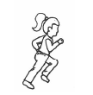
Sample Developmental Sequence of Running
PCF, Vol. 2, p. 212
DEVELOPING
Child runs alternating flat feet with heel to toe action
Bigger strides
Arms are down to the side
Knee bend is less than 90 degrees
Inconsistency
Exploring level
Child runs with feet flat
Arms are at the waist and move side to side
Small steps, little bend of knees and little reach with legs
Integration level
Child runs showing opposition of arms and legs, heel to toe action
Knees bend more than 90 degree in recovery
Increased speed, body leans forward
Consistency
TRANSITION
Notes:
Background Information:
The images on the screen can be found on page 212 of the Preschool Learning Foundations (Vol. 2).
Presenter Remarks:
Take a moment to review the progression on the slide and on Handout 10: Fundamental Movement Skills Developmental Sequences. (Note: There may be subtle differences between the slide and the handout which do not affect the overall sequence).
Observe the differences between levels:
Notice the difference in the leg actions.
Notice the difference in the arm actions.
Notice the difference in the step size.
Notice the difference in how the body leans forward.
Extra Notes:
Noticing the differences in the illustration will help teachers in the observation of real children and in finding out how the body segments move and what body segments need to develop more. This analysis is key to the intentional activity planning that will provide purposeful opportunities for locomotor growth and improvement.

Slide 35
Quick Check
When I say GO, show me your very best JUMP!
2. When I say GO, show me your very best HOP!
3. Discuss the difference between a jump and a hop with someone near you.
Notes:
Background Information:
Before continuing on with additional locomotor skills, a quality check is needed.
This activity is quick and very impactful; it illustrates how many adults are uninformed about the difference between a jump and a hop, which is often taught incorrectly.
Presenter Remarks:
Please stand up near your table and push in all chairs and other nearby objects.
(Click on each number one at a time with the participants demonstrating their skill as you go.)
When I say GO, show me your very best JUMP! (Wait for participants to demonstrate a jump.)
When I say GO, show me your very best HOP! (Wait for participants to demonstrate a hop.)
Discuss the difference between a jump and a hop with someone near you.
(Allow 30 seconds for discussion.) Would anyone like to share what they discussed?
(Some might say that jumps are large, explosive, and moving forward and that hops are small, not very explosive, and do not cover a large area moving forward.)
Based on your discussions can anyone share the defined difference between a hop and a jump? (Wait for responses and then provide correct answer if needed.)
The difference between a hop and a jump is that a hop is on only one foot and a jump is on two feet. Both hops and jumps may be small, large, explosive, cover a little or a lot of the area, go forward/backward or side-to-side, etc. But the main difference is how many feet are involved in the skill.
For additional information, see the illustrations and descriptors for the sample developmental sequences for jumping and hopping on pages 212 and 213 in the Preschool Curriculum Framework.

Slide 36
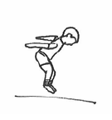
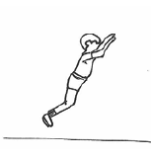
Sample Developmental Sequence of Jumping
PCF, Vol. 2, p. 212
DEVELOPING
Child brings arms sideways on the takeoff
Arms do a complete circle at takeoff
Body leans forward and jumps forward
Body and legs flexed during flight phase
Lands on hands and feet
Inconsistency
Exploring level
Child bring arms back on takeoff
Legs do not completely extend
Body bends
Small vertical jump
Integration level
Child swings arms forward over head
Body gets extended during the flight phase, jump is diagonal
Lands on feet
Consistency
TRANSITION
Notes:
Presenter Remarks
Take a moment to review the progression for jumping on the slide and on Handout 10: Fundamental Movement Skills Developmental Sequences.
Observe the differences between levels:
Arm movement: In the early stages of development, arms do not assist with propulsion or lift. With practice, arms help with body projection upward as they move in opposition to legs.
Leg action: Early learners may not flex their knees much whereas in later development a child will bend their legs in preparation for flight.
Upper body position: Early learners will have a very erect body stance whereas in later development the upper body has a slight learn forward.
Body in the air: In the early stage, upper torso may be bent forward whereas in later development the body is stretched out in flight.
Length or height of the jump: This observation will give teachers an idea of child’s leg strength.
Coordinated movement: Is the movement fluid, smooth, rhythmical or is it choppy and uncoordinated?
(If time allows, have audience practice imitating various levels discussed while jumping.)

Slide 37
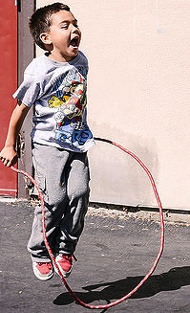
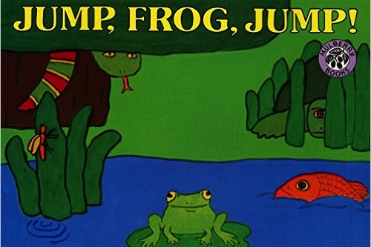
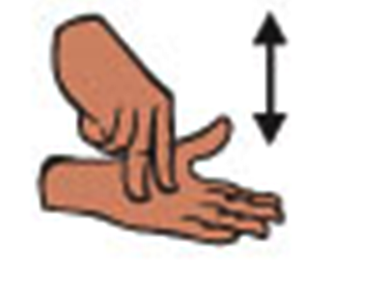
Universal Design for Learning
See the word.
Hear the word.
Experience the word.
Do “jump” in sign language.
Read a book with “jump” in it.
Scaffold “jump.”
Notes:
Presenter Remarks:
In recognition that children follow different pathways to learning, Universal Design for Learning (UDL) is incorporated into the Preschool Learning Foundations. Active play incorporates UDL naturally.
This “jump” example is a wonderful illustration of UDL. When you look at the word “jump” and nothing else, you are only viewing letters that represent the word jump, and therefore only engaging two learning styles—visually (by reading the word) and verbally (by hearing it).
When you experience jumping with a jump rope or jumping for joy due to a past experience, you engage multiple senses—which helps in the learning process.
English-language learners may not recognize the word in English, but may be familiar with the meaning of jump. Physically experiencing and learning new vocabulary through active physical play benefits everyone, especially English learners.

Slide 38
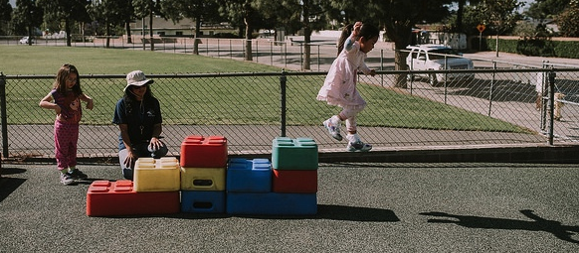
Universal Design for Learning
Jump off!
Multiple means of representation
Multiple means of expression
Multiple means of engagement
Notes:
Presenter Remarks:
UDL provides for multiple means of representation, multiple means of engagement, and multiple means of expression. For example, a teacher can teach a child to “jump off” once the student knows what “jump” means.
“Multiple means of representation refers to providing information in a variety of ways so the learning needs of all children are met. For example, it is important to speak clearly to children with auditory disabilities while also presenting information visually (such as with objects and pictures).
“Multiple means of expression refers to allowing children to use alternative ways to communicate or demonstrate what they know or what they are feeling. For example, when a teacher seeks a verbal response, a child may respond in any language, including American Sign Language. A child with special needs who cannot speak may also respond by pointing, by gazing, by gesturing, by using a picture system of communication, or by using any other form of alternative or augmented communication system.
“Multiple means of engagement refers to providing choices in the setting or program that facilitate learning by building on children’s interests. The information in this curriculum framework has been worded to incorporate multiple means of representation, expression, and engagement” (PCF, Vol. 2, p. 14).
For example a child may not be a risk taker and may not want to jump off of blocks that are high. A teacher can offer variations for jumping stations so that the child can choose the station that he or she is the most comfortable with.

Slide 39
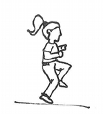
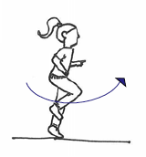
Sample Developmental Sequence of Hopping
PCF, Vol. 2, p. 213
DEVELOPING
Hopping leg flexed and moves up and down
Forceful hops; arms pull up
Body leans forward too much
Leg hangs behind the body
Arms uncoordinated
Inconsistency
Exploring level
Child holds hopping leg up parallel to the floor. Body erect. Difficult to maintain leg up and hop.
Integration level
Child swings leg as in a pendulum action. Shows opposition of arm and leg. Smooth, rhythmical hopping. Body leans forward.
Consistency
TRANSITION
Notes:
Background Information:
The images on the screen can be found on page 213 of the Preschool Curriculum Framework (Vol. 2).
Presenter Remarks:
Take a moment to review the progression for hopping on the slide and on Handout 10: Fundamental Movement Skills Developmental Sequences.
Work with your table group to identify the differences between the levels.
Would anyone like to share what they discovered? (The correct answers are listed below.)
Arm movement: In the early stages of development, arms are held bent at side or out stretched. With practice, arms help with body projection upward as they move in opposition to legs.
Non-support swinging leg: It moves more up and down in the early stages of development rather than a pendulum-like swing in the later stage.
Body position: Early learners will have a very erect body stance whereas in later development the upper body has a slight lean forward.
Support leg: Is the support leg able to support the child’s weight for repeated hops? Is the child able to switch support legs and hop?
Coordinated movement: Is the movement fluid, smooth, rhythmical or is it choppy and uncoordinated?

Slide 40
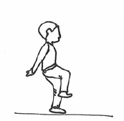
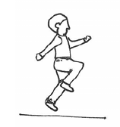
Sample Developmental Sequence of Skipping
PCF, Vol. 2, p. 213
DEVELOPING
Deliberated skip
High skips
Arms used to pull body up
Slow rhythm
Arm used bilaterally
Uneasy skips
Inconsistency
Exploring level
Child has difficulty alternating feet. May hop, step, or run while trying.
Arms bilateral and uncoordinated.
Integration level
Child shows smooth alternative skip. Smooth and rhythmical pattern. Arms are used in opposition to legs.
Consistency
TRANSITION
Notes:
Background Information:
The images on the screen can be found on page 213 of the Preschool Curriculum Framework (Vol. 2).
Presenter Remarks:
Take a moment to review the progression for skipping on the slide and on Handout 10: Fundamental Movement Skills Developmental Sequences.
A skip is a very complex skill and requires more neurological maturation; therefore, it takes longer to develop in children.
The skip is a movement combination—it contains a step and a hop. If a child does not have a fluid hop or a child has an unnatural gait, skipping will be very difficult.
Providing opportunities to practice skip aids will help in the development of skipping, but for some children the skip will come later, reflecting neurological maturation. If a child is unable to skip by the end of second grade, an evaluation may be advised.
Work with your table group to identify the differences between the levels.
Would anyone like to share what they discovered? (The answers are listed below.)
Arm movement: In the early stages of development, arms are uncoordinated with legs, they may move more up and down. With practice, arms move in opposition to legs.
Feet: The foot placement may be narrow (underneath the hips) or wide (causing a greater shift in weight). There should be equal emphasis stepping and hopping to create a skip on each foot.
Body position: Early learners will have a very erect body stance, sometimes almost appearing to be more like a sitting position; in later development the upper body has a slight lean forward helping with the momentum of the skip.
Leg movement: In early learners, the leg movements are made deliberately with high knees; in later development there is a smoother leg action with knees bent gently.
Skip pattern: How consistent is the skipping pattern? Is it more like a run or a step and run? Does the child switch smoothly between each side on both legs or does the child only do a skip on one side of the body? Is the skip slow and deliberate or rhythmical, smooth and easy?

Slide 41
Interactions and Strategies to Support the Development of Locomotor Skills
“Encourage practice of locomotor movements in both indoor and outdoor environments” (PCF, Vol. 2, p. 152).
“Provide appropriate challenges for children with special needs” (PCF, Vol. 2, p. 155).
“Plan meaningful, purposeful, and connected locomotor activities and games” (PCF, Vol. 2, p. 153).
Notes:
Background Information:
These interactions and strategies come from pages 150-155 of the Preschool Curriculum Framework (Vol. 2).
Presenter Remarks:
Please review the interactions and strategies for locomotor skills on Handout 11: Substrand Reflection: Interactions and Strategies, 2.0.
There are many practical activities where locomotor skills can be integrated into movement, both indoors and outdoors. An important message to take back to the classroom is that teachers need to be intentional about facilitating locomotor skills in daily routines.
Let’s experience a movement lesson!

Slide 42
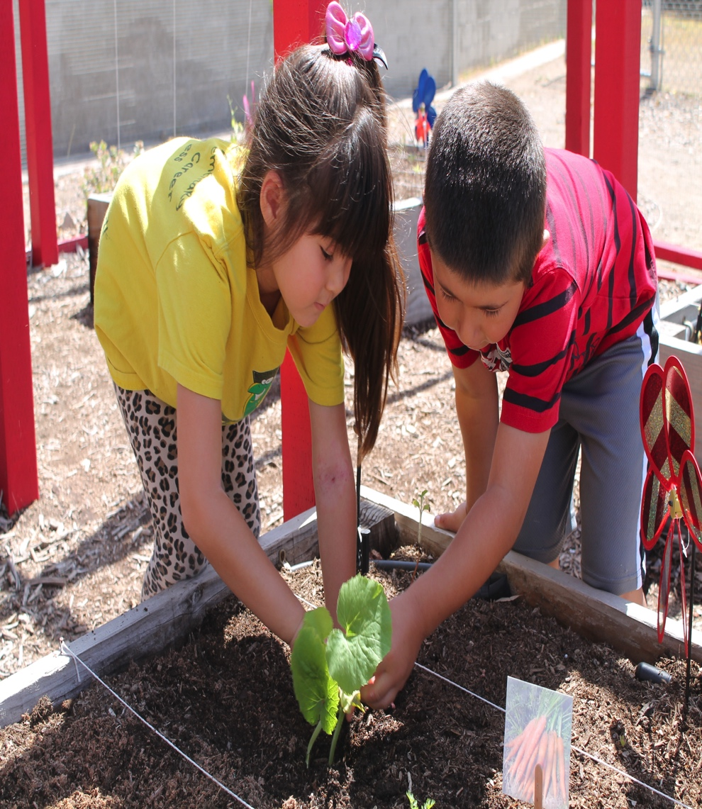

✵ Balancing in the Garden 
Tip-toe
Turn around
Side-step
Gallop
Skip
Balance on one foot
Notes:
Activity 3: Balancing in the Garden
Background Information:
Prior to activity:
Review Activity 3: Balancing in the Garden for song lyrics and movement cues
Prep the song “Balancing in the Garden,” by Angela Russ, CD: Smart and Yummy 1
Prepare participants for movement—check clothing and shoes and push in chairs at tables, along with bags/totes/etc.
Presenter Remarks:
Stand up and find an area that has open space and is free of obstacles.
Pretend that everyone is standing in a garden planted with rows of yummy vegetables.
We are going to listen and move to a song called “Balancing in the Garden.” This activity highlights how locomotor skills and balance can be integrated into a movement opportunity with a nutrition focus.
(See the activity plan for lyrics and movement prompts.).
Ready? Move! (Play the song and model movements.)
intent:
Integrate locomotor skills and balance while singing a song that connects to gardening and nutrition.
OUTCOMES:
Participants will actively participate during song activity, moving slowly with balance and coordination as they perform various locomotor skills.
Participants will experience a movement lesson that integrates nutrition through active play.
Materials Required:
Song: “Balancing in the Garden,” by Angela Russ, CD: Smart and Yummy 1 (www.ABridgleClub.com)
Music player
PPT slide with prompts for movement
Open space (indoors or outdoors) for each participant to move safely
Time: 3-4 minutes
Process:
Prepare participants for movement—check clothing and shoes and push in chairs at tables, along with bags/totes/etc.
Invite all participants to stand and find an area that has open space and is free of obstacles.
Ask participants to pretend that everyone is standing in a garden planted with rows of yummy vegetables.
Introduce the song and highlight how locomotor skills and balance can be integrated into a movement opportunity with a nutrition focus (See the next page for lyrics and movement prompts.).
Cue the song and move!
OPTIONS:
Song prompts are suggestions only; feel free to change using other locomotor skills.
The balance pose at the end of the song reminds participants of the ease of blending fundamental movement skills into movement opportunities. Other types of balance poses may also be used.

Slide 43
Expanding to Meet TK Needs
Find and review Handout 12: Locomotor Substrand and Example Worksheet.
Brainstorm with your tablemates to create additional example activities for TK under each section.
Be prepared to share in 5-7 minutes.
Notes:
43
Presenter Remarks:
Please locate and review Handout 12: Locomotor Substrand and Example Worksheet.
Notice that the first two pages are a duplication of the information from pages 47-48 of the Preschool Learning Foundations (Vol. 2). The third and fourth pages contain empty boxes for your table group to fill-in with new examples created for TK; the examples your group selects should be based upon your knowledge of the substrand and of age-appropriate activities.
After 5-7 minutes we will share a few examples with the whole group.

Slide 44
Fundamental Movement Skills
Strands
Substrands
Fundamental Movement Skills
1.0 Balance
2.0 Lomomotor Skills
3.0 Manipulative Skills
Perceptual-Motor Skills and Movement Concepts
1.0 Body Awareness
2.0 Spatial Awareness
3.0 Directional Awareness
Active Physical Play
1.0 Active Participation
2.0 Cardiovascular Endurance
3.0 Muscular Strength, Muscular Endurance, and Flexibility
Notes:
Background Information:
The final substrand requires ample space for movement as participants explore a variety of manipulative skills. The focus is to explore and analyze motor skills such as throwing, catching, kicking, and striking. Depending on your space, props, and/or equipment available, it is recommended that you chose activities that are applicable and safe for the environment and the audience. Remind participants of safety concerns throughout; caution participants to move within their limitations and to be aware of others and objects near them: tables, chairs, bags, walls, etc.
Presenter Remarks:
Manipulation Skills is the third and final substrand from the Fundamental Movement Skills strand.
“Manipulative skills allow children to use their arms, hands, legs, and feet to project an object away from the body (e.g., throwing a beanbag) or to receive and absorb the force of an object coming to the body (e.g., catching a balloon)” (PCF, Vol. 2, p. 156).
Fundamental motor skills contain gross motor skills (involving large muscle groups) and fine motor skills (involving small muscles groups like fingers, hands, and wrist).

Slide 45
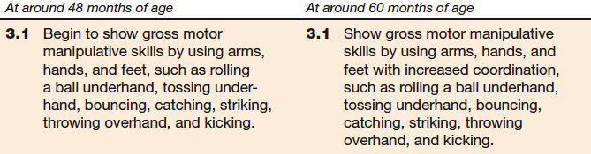
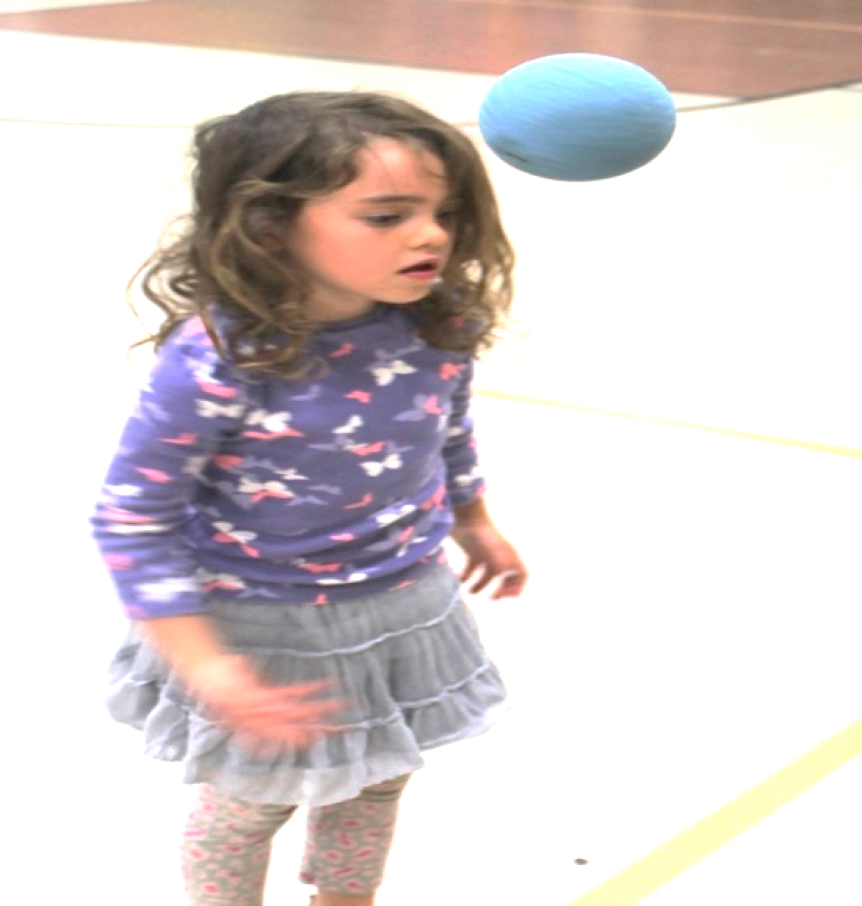
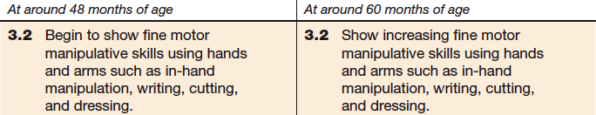
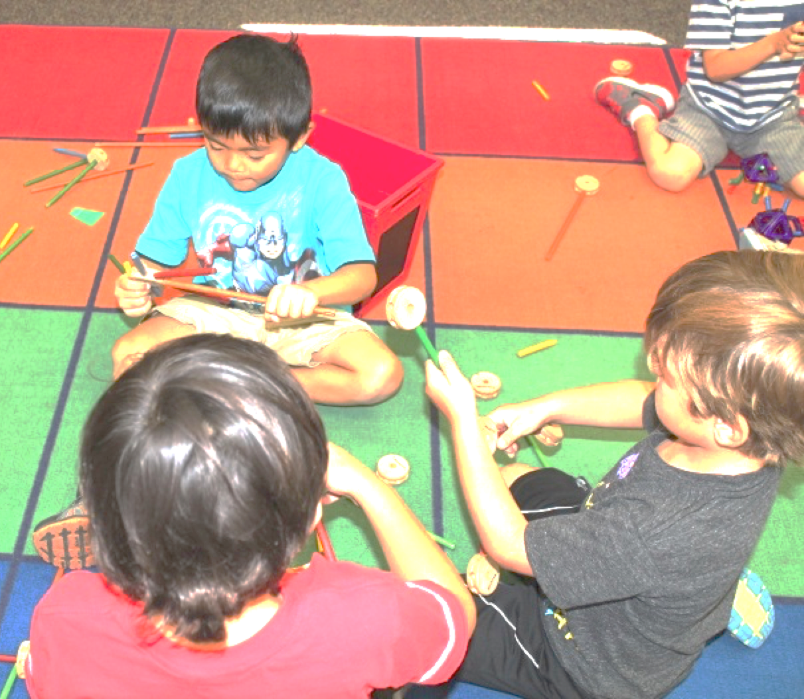
Manipulative Skills
3.1 Gross Motor
3.2 Fine Motor
Notes:
Background Information:
The foundations shown on the slide can be found on pages 49-50 of the Preschool Learning Foundations (Vol. 2).
Presenter Remarks:
Most children are naturally eager to play with objects and during such play discover their ability to manipulate the objects around them in different ways.
“The conditions of the learning environment, the requirements of the movement task, and the uniqueness of the individual play important roles in the learning of manipulative skills. Strategies for teaching manipulative skills should be flexible and sensitive to individual and cultural differences in a variety of environments” (PCF, Vol. 2, p. 157).
(Remind participants to focus on the process rather than the end product in this section as well.)

Slide 46
Interactions and Strategies to Support the Development of Gross Manipulative Skills
“Provide opportunities for repeated practice in a safe environment” (PCF, Vol. 2, p. 161).
“Provide plenty of encouragement” (PCF, Vol. 2, p. 162).
“Observe developmental sequences of fundamental manipulative skills” (PCF, Vol. 2, p. 159).
Notes:
Presenter Remarks:
“Children need plenty of opportunities to practice their manipulative motor skills in a variety of settings and with a variety of materials and equipment. Manipulative activities can be practiced indoors and outdoors, in interest areas, and during small- or large-group activities” (PCF, Vol. 2, p. 161).
Working on the same motor skills but changing the manipulative/prop keeps the interest of a young child.
Always check the play area to ensure possible safety concerns are addressed as well as provide clear directions and a recognized signal for starting and stopping all activities.
“Adults’ demonstration of enjoyment and genuine enthusiasm for children’s skill development are a powerful motivational for young children” (PCF, Vol. 2, pp. 162-163). Use both verbal and non-verbal communication that encourages perseverance and motivation.
FMS typically increase in complexity as the body moves from simple to more complex body coordination. Awareness of developmental sequences enables teachers to better support children in their growth and development of manipulative skills. Modifying activities for individual skill levels is an everyday aspect of teaching. Teachers can enhance and facilitate success by setting up the environment with appropriate challenges for all skill levels.
Let’s breakdown a couple of important manipulative skills: throwing and catching!

Slide 47
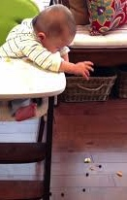
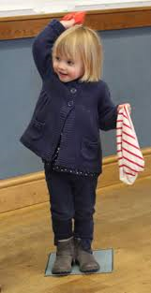
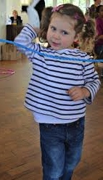
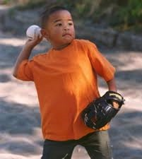
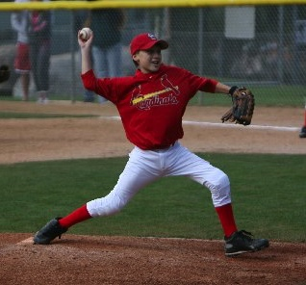
Throwing Timeline
Object projection
Classic preschool throw
    Elbow high, no leg action
Same side step and throw (homo-lateral)
Step and throw in opposition (contra-lateral)
Trunk rotation
Notes:
Background Information:
Click through the steps on the slide to cause a corresponding picture to appear. Invite participants to go through the motions as you talk about each stage. The yarn balls made earlier in the training may also be used.
If yarn balls are unavailable a variety of substitutions may be made: sponge balls, sock balls, waded up newspaper balls, etc.
Presenter Remarks:
Let’s go through the throwing timeline on the screen and discuss examples of each step.
(Read each number and ask for participants to share what they think an example would be, then clarify or add using the notes next to the number.)
Step 1—Object projection: Infants/toddlers project objects away from them. The picture illustrates an infant projecting a cereal bowl off the high-chair to see what happens.
Step 2—Classic preschool throw: Preschool children begin to throw using a few muscles; typically, a child will use their favorite hand to throw, elbow held high, with no leg action. The ball release can be forward, downward, or behind.
Step 3—Same side step and throw (homo-lateral): A significant development in throwing is the emergence of stepping in conjunction with the throw; however, the step is on the same side as the throwing arm, called homo-lateral. This new stage should be noted as a huge milestone in motor development fueled by major neurological development; the brain is now engaging both arm and leg muscles and a whole side of the body is involved in the action.
Throwing is stage-related (it progresses through sequential stages), and not age related (some people have never been taught how to throw properly). It is important for adults to recognize that children don’t naturally acquire all motor skills; structured time invites children to practice and develop their motor skills.
Step 4—Step and throw in opposition (contra-lateral): A major advancement in throwing is stepping in opposition, called contra-lateral. The neurological system is now engaging the whole body as the brain coordinates muscles from both sides of the body to execute a more mature throw.
Step 5—Trunk rotation: This stage looks like a baseball player throwing a ball by reaching behind the body, rotating the trunk from a sideways position to a forward facing position, with a contra-lateral step and an arm follow-through action. This stage is not often seen in young children, but can be developed through instruction and repetition.
On the next slide, we’ll perform a simple drill that helps to develop stepping in opposition and the trunk rotation.

Slide 48
Teaching the Ding-a-Ling Drill
Stand with your chest perpendicular (sideways) to the target, feet spread shoulder width apart.
Extend your throwing arm out to the side (opposite the target) and pretend a phone is ringing in your hand—say, “Ding-a-ling-a-ling.”
Bring the pretend phone (yarn ball) to your ear and say, “Hello.”
Turn your hips towards the target as you extend your arm forward and say, “It’s for you,” causing the trunk and body to rotate.
Notes:
Activity 4: Ding-a-Ling Drill
Background Information:
Give all participants a yarn ball and direct them to either spread out around the room (or outdoors) or to line up with ample space to throw. Prepare participants by asking them if they know how to throw like a baseball player.
Presenter Remarks:
Do you know what an old fashion telephone ring sounds like? “Ding-a-ling-a-ling.” This activity gives simple cues to teach how to throw a ball overhead correctly. First we’ll practice without the yarn ball.
Stand with your chest perpendicular to the target (wall), feet spread shoulder width apart (The left leg will be closest to target for right-handed participants, and the right leg will be closest to the target for left-handed participants.). Pretend a phone is ringing, reach out to grab the phone, bend your arm and bring the phone by your ear and say, “Hello.”
Rotate your hips towards the target, extend your arm forward and say, “It’s for you!” (Move as if you are handing a phone to someone.)
Let’s try it a couple more times.
Now let’s add the yarn ball and say the cues as we step in opposition and throw.
intent:
Provide simple cues to young learners that assist in throwing a yarn ball overhead with a mature form.
OUTCOMES:
Participants will apply a mature throwing technique for an overhead throw using the Ding-a-Ling method taught in the Fundamental Movement Skills module.
Materials Required:
Ample space, free of obstacles for safe moving and throwing
Yarn balls (1 per person)
Time: 5 minutes
Process:
Participants will spread out in the designated area, all facing the same direction/wall; each with a yarn ball.
Activity prompts and directions:
Do you know what an old fashion telephone ring sounds like? “Ding-a-ling-a-ling.” This activity gives simple cues to teach how to throw a ball overhead correctly. First we’ll practice without the yarn ball.
Stand with your chest perpendicular to the target (wall), feet spread shoulder width apart*. Pretend a phone is ringing, reach out to grab the phone, bend your arm and bring the phone by your ear and say, “Hello.” Rotate your hips towards the target, extend your arm forward and say, “It’s for you!” (Move as if you are handing a phone to someone.) Let’s try it a couple more times.
Now let’s add the yarn ball and say the cues as we step in opposition and throw.
*The left leg will be closest to the target for right-handed participants, and the right leg will be closest to the target for left-handed participants.
OPTIONS:
The audience can be split in half, facing each other on opposite lines. During the throwing phase, each line can throw to the opposite side, eliminating the need to constantly “throw and retrieve” and saving time.
Pair participants up and have one partner throw while the other observes and offers feedback—then have them switch roles.

Slide 49
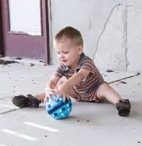
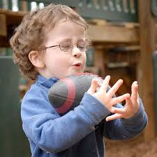
Catching Timeline
Object collection
Classic preschool catch/trap
  Arms as scoops
Hands touch ball but still trap
Hands reach and catch ball
Notes:
Background Information:
Click through the steps on the slide and invite participants to go through the motions as you talk about each stage. The yarn balls made earlier in the training may also be used. If yarn balls are unavailable a variety of substitutions may be made: sponge balls, sock balls, waded up newspaper balls, etc.
The pictures on the slide illustrate the first two stages: object collection and classic catch/trap.
Presenter Remarks:
Catching is a more difficult skill than throwing since it requires timing of an incoming object toward the body. The brain uses it’s visual system to see the incoming object, sending information to the brain that engages the arm muscles in order to catch the object. Objects tossed at a chest level (horizontal) are easier to catch compared to objects tossed up into the air overhead (vertical).
Please find a partner and an open space to stand 5-6 feet apart. You will need one yarn ball.
Object collection: Infant/toddler gathers object toward them. The picture illustrates an infant bringing an object towards him.
Classic preschool catch/trap: Preschool children use their arms as scoops to trap the ball/object against their chest; at this point their hands do not make contact with ball/object.
Hands touch ball but still trap: This new stage is a major development since the hands are now making contact with the incoming ball/object signifying that hand-eye coordination is developing and that a child is tracking the ball/object as it comes in toward the body.
Hands reach and catch ball: For Pre-K and TK children, two-hand catching develops first, then they begin to transition into tossing and catching with one hand.

Slide 50
Clean Your Room Game
Objectives:
  Make your side of the room cleaner than the other side
  Practice throwing/catching
  Achieve moderate to vigorous physical activity
Rules:
  Throw yarn balls when the music is ON
  Freeze when the music STOPS
  Use hands only, no feet or kicking
  Stay on your side
Notes:
Activity 5: Clean Your Room
Background Information:
Prior to activity:
Prepare an area that can be divided in half and has ample space to move (outdoors: on grass or blacktop, inside: in a large room).
Separate the participants into two equal sides.
Toss half of the yarn balls on one side and the remaining yarn balls on the other side.
Presenter Remarks:
This game is called, “Clean Your Room.” Pretend that this is your room and you have been asked to clean it. The easy way to clean it is to throw everything to the other side!
When the music in ON, everyone will throw yarn balls to the opposite side. After 30 seconds, the music will STOP. Everyone will stop throwing and make an X (feet apart, arms stretched to the sky) with their whole body. We will count the yarn balls to see which side has the fewest and then we’ll begin again.
Here are the safety rules:
Stay on your side.
Be careful not to hit other people or objects when you throw.
NO FEET are allowed. No kicking the yarn balls; someone might be leaning down to pick up a ball near you.
When you hear the music turn on, begin throwing the yarn balls to the other side of the room.
Ready—clean your room!
Intent:
Transfer the mature throw skill learned during a previous activity to a cardiovascular-intense game.
OUTCOMES:
Participants will actively engage in a cardiovascular-intense game.
Participants will apply a mature throwing technique for an overhead throw using the method taught during Activity 3: Ding-a-Ling Drill.
Participants will acquire knowledge of a game that can be shared with staff and families that incorporates throwing and active physical play.
Materials Required:
Ample space, free of obstacles for safe moving and throwing
Yarn balls (1 per person)
Dividing line (e.g., rope, chalk, tape, cones, etc.)
Music to start/stop activity and music player
Time: 7-8 minutes
Process:
Prepare an area that can be divided in half and has ample space to move (outdoors: on grass or blacktop, inside: in a large room).
Separate the participants into two equal sides (*See the easy organizing tip below.).
Toss half of the yarn balls on one side and the remaining yarn balls on the other side.
Activity prompts and directions:
This game is called, “Clean Your Room.” Pretend that this is your room and you have been asked to clean it. The easy way to clean it is to throw everything to the other side!
When the music in ON, everyone will throw yarn balls to the opposite side.
After 30 seconds, the music will STOP. Everyone will stop throwing and make an X (feet apart, arms stretched to the sky) with their whole body. We will count the yarn balls to see which side has the fewest and then we’ll begin again.
Here are the safety rules:
Stay on your side.
Be careful not to hit other people or objects when you throw.
NO FEET are allowed. No kicking the yarn balls; someone might be leaning down to pick up a ball near you.
When you hear the music turn on, begin throwing the yarn balls to the other side of the room. Ready—clean your room!
*Easy organizing tip: Have participants get into pairs. One person is an apple, the other is a kiwi. Apples go on one side of the play area; kiwis go on the other side.
OPTIONS:
Extra yarn balls may be used to create a higher intensity activity.
If music is not available, use a whistle, loud bell, or loud sound to stop play.
This game is cardiovascular intense, so use short increments—30-45 seconds at a time. In between rounds, ask the group to check their heart beat. If their heartrate has increased, remind them that happy and healthy hearts like to beat faster throughout the day. Hearts say, “Thank you, thank you for keeping me healthy!”
For smaller groups, integrate math into the activity by counting the yarn balls and comparing which side has more or less.

Slide 51
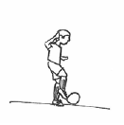
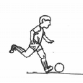
Sample Developmental Sequence of Kicking
PCF, Vol. 2, p. 215
DEVELOPING
Child swings leg back before kicking. Shows better balance.
Child steps toward the ball and kicks.
Child makes few steps and kicks forcefully with opposition of arm and leg.
Inconsistency
Exploring level
Child is stationary, usually pushes ball with one foot, and steps back quickly to catch balance.
Integration level
Child approaches the ball running or with few steps, leaps before kicking, and hops after the kick. Shows contra-lateral opposition of arm and leg. Forceful kicking.
Consistency
TRANSITIONING
Notes:
Background Information:
The images on the screen can be found on page 215 of the Preschool Curriculum Framework (Vol. 2).
Presenter Remarks
Take a moment to review the progression for kicking on the slide and on Handout 10: Fundamental Movement Skills Developmental Sequences.
Let’s work with your table group to identify the differences among the levels.
Leg action: Does the leg bend at the knee backward and the foot “push” through the ball or do the legs have a step-and-plant motion that allows the foot to kick through the ball? Does the child approach the ball with a few steps before kicking the ball? Does the child use his/her dominant leg consistently?
Arm action: Does the child use his arms in any capacity while kicking? How do the arms differ from exploring to integrating? How do arms in opposition (contra-lateral) assist the kick? (By offsetting weight distribution and producing more force.)
Consistency: Does the child consistently repeat the same kicking pattern and make successful contact?

Slide 52
Foundation Video Example: What It Might Look Like
Notes:
Background Information:
Insert foundations video example 3.1, 48 and 60 months.
Presenter Remarks:
Let’s watch an example video of what foundation 3.1—at 48 months (four years) and at 60 months (5 years)—may look like in the classroom.
Find your Video Viewing Guide and use it to take notes about what you find interesting.

Slide 53
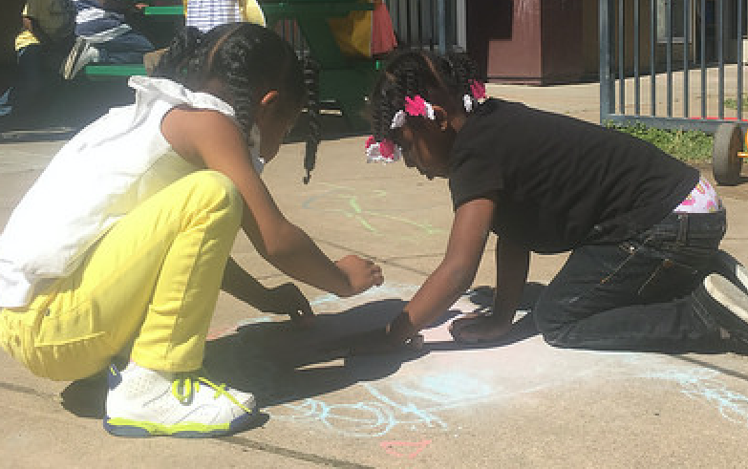
Interactions and Strategies to Support the Development of Fine Motor Manipulative Skills
©2016 California Department of Education
Notes:
Presenter Remarks:
The final section of this presentation will focus on fine motor skills.
Children need hand strength and precision when completing fine motor tasks.
Teachers who intentionally plan for a variety of opportunities with various manipulatives will accommodate individual differences and skill levels.
Pages 165-170 of the Preschool Curriculum Framework (Vol. 2) provide many examples of fine motor skill activities for children.

Slide 54
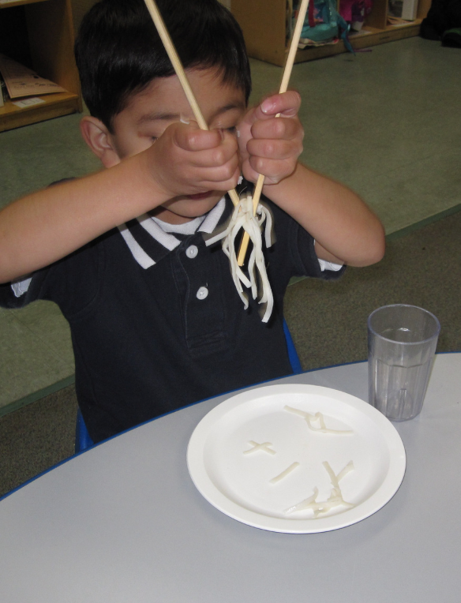
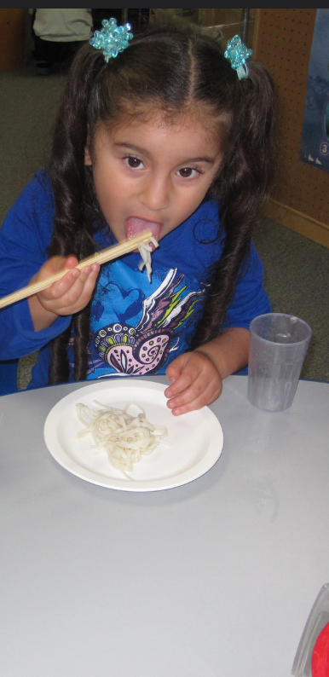
Development of Fine Motor Skills
“Provide opportunities for children to engage in fine motor activities in a variety of positions” (PCF, Vol. 2, p. 168).
“Focus on the quality of movement rather than the end product” (PCF, Vol. 2, p. 166).
Learn about families’ values related to fine motor activities” (PCF, Vol. 2, p. 165).
©2016 California Department of Education
Notes:
Presenter Remarks:
It is important to focus on the developmental progression of hand and arm movements when children are acquiring new fine motor skills.
Fine motor skills may be highly valued and encouraged in some cultures, but viewed as less important in others. Gender-based cultural expectations may also exist; some cultures expect girls to engage in more fine motor activities and boys to be more proficient in gross motor activities.
Remain respectful of children’s cultural contexts while communicating openly with family members about the importance and benefits of fine motor skills for all children.
How can children’s different cultures be included in fine motor activities and games? (Solicit responses from the whole group.)

Slide 55

Provide adaptations:
Provide a variety of tools of differing sizes and grips: paint brushes, pencils, tweezers, laces, etc.
©2016 California Department of Education
Notes:
Background Information:
If available, bring samples of adaptations to training from the Preschool English Learners: Principles and Practices to Promote Language, Literacy, and Learning—A Resource Guide (Second Edition), Chapter 7 adaptation bin (from the PEL Guide Training session).
Presenter Remarks:
It is important to provide a variety of tools to support participation of children with disabilities or other special needs.
Some children may benefit from postural support during fine motor activities or adaptive grips on materials like markers, paint brushes, etc. For example, small tubing might be used for stringing beads instead of shoestring or yarn.
Common positioning strategies for postural support include providing a tabletop or tray to support the elbows, positioning firm blankets or pillows to prevent loss of balance sideways, or utilizing hip straps to keep the pelvis in place.
If a child has use of only one hand, teachers can stabilize fine motor materials using no-slip mats, binder clips, or clamps.

Slide 56
Foundation Video Example: What It Might Look Like
Notes:
Background Information:
Insert foundations video example 3.2, 48 and 60 months.
Presenter Remarks:
Let’s watch another example video of what foundation 3.2—at 48 months (four years) and at 60 months (5 years)—may look like in the classroom.
Use your Video Viewing Guide to take notes about what you find interesting.

Slide 57

DRDP-K (2015)
An observation-based assessment tool, not a test
Individual child assessment
Completed by each child's teacher
Based on developmental research and theory
Includes developmental sequences of behaviors along a continuum
Spans the developmental continuum of children in a two-year kindergarten program (TK)
Notes:
Presenter Remarks:
The DRDP-K (2015) informs teachers' understanding of the developmental continuum.
One key feature of the DRDP-K to consider is that it is an observation-based assessment too and not a test. It is used to support children's learning.
Observing and documenting children's progress provides teachers with the information that they need to differentiate instruction and experiences. It also provides information to individualize.
Observational tools are preferred over criterion-referenced tools because the information gathered by observation more accurately reflects what children are able to do. Understanding what children are able to do allows teachers to better plan for activities that will meet and appropriately challenge children's developmental needs.
Other features of the DRDP-K (2015) include:
It is an individual child assessment that can be shared with families.
It is aligned with the PLF.
It opens up the opportunity for articulation between preschool and TK teachers.
Sharing information as to where children are on the developmental continuum can better prepare TK teachers to work with students.
It allows teachers to include a request form for previous records as part of TK registration, to help support the relationships between preschool, family, and TK.
The DRDP-K (2015) has been developed with world-renowned experts. It is based on research and knowledge regarding what is most important for predicting school success.

Slide 58



DRDP–K (2015): A Developmental Continuum for Kindergarten
Fundamental Movement Skills:
PD 2: Gross Locomotor Skills
PD 3: Gross Motor Manipulative Skills
PD 4: Fine Motor Manipulative Skills
©2016 California Department of Education
Notes:
58
Presenter Remarks:
Please refer to Handout 13: DRDP-K (2015) Fundamental Movement Skills Measures.
This slide illustrates how we can continue to bridge the transition from Pre-K to TK. The DRDP-K (2015) is an child observational assessment instrument that is used by teachers to record a child’s progress on a developmental continuum and can be used with TK children.
The physical development measures for fundamental movement skills are located on pages 35-37 of the DRDP-K (2015):
PD 2: Gross Locomotor Skills
PD 3: Gross Motor Manipulative Skills
PD 4: Fine Motor Manipulative Skills

Slide 59
Environmental Factors that
Influence Physical Development
“Teachers promote optimal physical development when they provide children with positive encouragement and quality instruction (both indirect and direct)” (PCF, Vol. 2, p. 136).
“The immediate physical environment is a powerful influence on children’s physical development” (PCF, Vol. 2, p. 136).
“Indoor and outdoor play environments should include a variety of appropriately sized equipment that promotes both gross and fine motor development” (PCF, Vol. 2, p. 136).
Notes:
Background Information:
The Environmental Factors section can be found on pages 136-137 of the Preschool Curriculum Framework (Vol. 2).
Presenter Remarks:
Please follow along on Handout 14: Physical Development Domain Guiding Principles as we discuss the guiding principles that are listed on the slide and on the handout.
As we begin to wrap things up, let’s visit the environmental factors that can influence physical development. These factors, along with the guiding principles, will help guide us as we plan our culminating activity.
Please read the screen and choose the factor that resonates with you the most. (Allow 2-3 minutes to read screen.)
Did anyone choose the first factor? Would you like to share why? (Allow only one or two people to share.)
Did anyone choose the second factor? Would you like to share why? (Allow only one or two people to share.)
Did anyone choose the third factor? Would you like to share why? (Allow only one or two people to share.)

Slide 60
Environmental Factors that
Influence Physical Development
4. “Learning is most meaningful when the environment and materials reflect and accommodate children’s individual interests, backgrounds, and present abilities” (PCF, Vol. 2, p. 136).
5. “Take time to build safety into both indoor and outdoor play” (PCF, Vol. 2, p. 136).
6. “Movement experiences should include exploration,
discovery, and appreciation of the natural environment” (PCF, Vol. 2, p. 137).
7. “Thoughtfully designed, adult-guided movement
experiences support children’s physical development” (PCF, Vol. 2, p. 137).
Notes:
Presenter Remarks:
Please read the factors on this slide. As you read, try to think about the experiences we have had here today and the strategies we have discussed. What connections can you make between today’s presentation and the factors on the slide?
Did anyone think of a connection between today and the fourth factor? (Allow only one or two people to share.)
Did anyone think of connections between today and the fifth factor? (Allow only one or two people to share.)
Did anyone think of a connection between today and the sixth factor? (Allow only one or two people to share.)
Did anyone think of a connection between today and the seventh factor? (Allow only one or two people to share.)

Slide 61

Partner with Families
Engaging Families: Preschool Curriculum Framework
All About Young Children
Best Practices for Planning Curriculum: Family Partnerships and Culture
TK Implementation Guide
Notes:
Presenter Remarks:
In order to effectively build on children's existing strengths, we must understand them. To do this, we need to partner with families to learn about their children’s strengths.
The resources on this slide are specifically beneficial for partnering with families. You may want to take a picture of this slide and refer to it later.
Optional:
Create a gallery table and have examples of documents there.
Extra Notes:
The resources are hyperlinked. If Wi-Fi access is available, display the resources and do a walkthrough.

Slide 62

“Family Fun Night”
Review the handouts used throughout today’s presentation.
Work with your tablemates to cooperatively design a “Family Fun Night” blueprint.
  The blueprint must include an introduction, multiple stations, and a conclusion that is inclusive of all fundamental movement skills.
Prepare to share your blueprint with one or two other table groups.
Notes:
Activity 6: “Family Fun Night” Blueprint
Presenter Remarks:
We will be working in table groups for our last activity.
Use your experiences and the strategies discussed here today to make a blue print for a “Family Fun Night”.
Follow the directions on the slide. Be ready to share your ideas when you are finished!
intent:
Incorporate the information learned in the presentation to design a blueprint for a “Family Fun Night” that staff/parents/volunteers can create with TK children and families.
OUTCOMES:
Participants will review information from the presentation and cooperatively design a blueprint for a “Family Fun Night” that is appropriate for TK children and families.
Materials Required:
Participants’ notes from the presentation
Chart Paper (1 per table) and markers
Handouts used during presentation
OPTIONAL: Yarn balls, bean bags, beach balls, pool noodles, scarves, jump ropes, or other materials to enhance activity
Time: 20-30 minutes (depending on the size of group). Tables have 20 minutes to design an activity and share their blueprint (chart paper) with one or two other tables.
Process:
Activity prompts and directions:
Review the handouts used throughout the presentation.
Work with your tablemates to cooperatively design a “Family Fun Night” blueprint. The blue print must include an introduction, multiple stations, and a conclusion that is inclusive of all fundamental movement skills.
Prepare to share your blueprint with one or two other table groups.
OPTIONS:
Participants should consider and apply accommodations for children with disabilities and strategies for English-language development.
Groups can set up a small version of stations for demonstration purposes.
Encourage groups to integrate content areas (Math, Science, Language and Literacy, etc.) to illustrate moving and learning through active physical play.

Slide 63

Questions, Comments, Concerns?
©2016 California Department of Education
Notes:
Presenter Remarks:
Does anyone have any questions, comments, or concerns?

Slide 64

Thank you!
64
Thank you for developing our
fundamental movement skills!
©2016 California Department of Education
Notes:
Presenter Remarks:
Thank you for your active participation and engagement in today’s fundamental movement skills training!

Slide 65
Reference Guide for PowerPoint Citations
California Department of Education. 2011. California Preschool Curriculum Framework, Volume 2. http://www.cde.ca.gov/sp/cd/re/documents/psframeworkvol2.pdf (accessed October 3, 2016).
California Department of Education. 2013. Transitional Kindergarten Implementation Guide: A Resource for California Public School District Administrators and Teachers. http://www.cde.ca.gov/ci/gs/em/documents/tkguide.pdf (accessed October 3, 2016).

