Slide 1
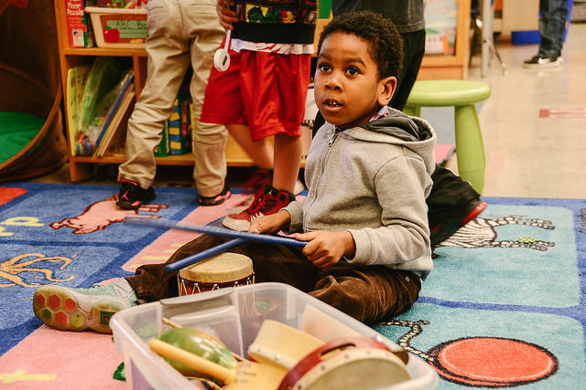
Title Slide
Visual and Performing Arts:
Music in Transitional Kindergarten
California Preschool Learning Foundations, Volume 2
California Preschool Curriculum Framework, Volume 2
Notes:
Presenter Remarks:
Welcome to Visual and Performing Arts: Music in Transitional Kindergarten—a presentation focusing on the California Preschool Learning Foundations (Preschool Learning Foundations or PLF), the California Preschool Curriculum Framework (Preschool Curriculum Framework or PCF), and other California Department of Education (CDE) resources in support of the Visual and Performing Arts domain.
This professional learning session is specifically designed to provide TK teachers with exposure to CDE resources that support TK curriculum planning of developmentally appropriate strategies. Classroom environmental design recommendations are included to support the content area of music.

Slide 2
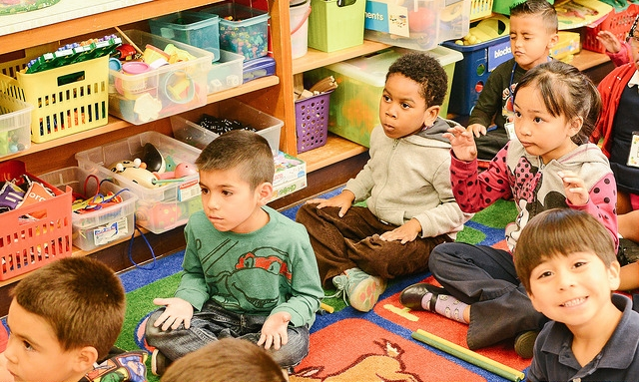
Going on a Bear Hunt
©2017 California Department of Education
Notes:
Activity 1: Going on a Bear Hunt
Presenter Remarks:
We are going to begin with an activity.
intent: Engage participant interest in the workshop content by modeling and involving them in a typical classroom activity using musical instruments.
OUTCOME: Participants will actively participate in the day’s workshop, become familiar with key musical vocabulary, and successfully implement the modeled strategy to engage all learners in the classroom.
Materials Required:
“Going on a Bear Hunt” recording from Kids in Action by Greg and Steve
Musical Instruments: Drum, pair of sand blocks, wooden percussion block with mallet, triangle, and either a shell rattle, egg shaker, or gourd rattle
Photos of instruments
Class list with 10 participant names and a clothespin
Clothespin
TIME: 5-7 minutes
Process:
Before the workshop begins, make a “class list” with 10 participant names using the template. Place the clothespin on one of the names.
Introduce the activity. Then have the group listen to “Going on a Bear Hunt” by Greg and Steve and use their bodies as instruments or the photos of instruments to “play” along.
Model and engage participants in the activity as if you, the presenter, are the teacher and they are the children. See the following sample “teacher” script:
Teacher: We’re going on a bear hunt! Today I brought some special instruments that we can use to make the sounds we hear as we go on our bear hunt adventure. We’ll need some musicians! Musicians are people who make music! Did you know we can all be musicians? We can make music with instruments like these (Teacher shows and plays one of the instruments.) Or, with our bodies, like this (Teacher drums rhythmically on chest, making ahhh sound with voice.) You can do it with me.
Teacher: We need five musicians to tell our story today. Let’s see whose turn it is (Use the “class list” to model for participants this classroom management strategy. Show who is next by moving the clothespin as you select each musician. As each name is called, the “child” participant comes to the front of the room and chooses an instrument.)
Teacher: Let’s rehearse our story. Rehearse means we’ll practice with our instruments before we play along with the story on the CD:
Everyone stand up. Let’s all make the sounds of walking together like this (Start a rhythmic march with a steady walking tempo beat, tapping one hand at a time on thigh coordinated with marching leg. Participants do this with the teacher.)
Drummer, you help us keep the beat as we use our walking feet. Come stand by me (Show the photo of the drum and prompt the drummer to follow the beat using the drum.) Can everyone feel the beat? (Continue the walking beat as you preview the parts of the story as follows.)
First, we’ll walk through the wheat field. That sounds like this. (Hold up the photo of the sand blocks. Prompt the “musician” to stand next to the drummer and play while the other participants make the movement and sounds with hands/voices as they continue the walking beat.)
Next, we’ll walk over the bridge. That sounds like this. (Hold up the photo of the wood percussion block/mallet. Prompt the “musician” to stand next in line and play while the other participants to make a clicking sound with their tongue/mouth.)
Then, we’ll climb up the tree. When we get to the top, it sounds like this. (Hold up the photo of the triangle. Prompt the “musician” to stand next in line and play the “ding” while the other participants make a “ting” sound with their voices.)
Now, we get in the boat and row across the water. It sounds like this. (Hold up the photo of the rattle/egg shaker. Prompt the “musician” to stand next in line and play while the other participants make a “shuuuuuu” sound with their mouths.)
After we see the bear, we are soooo scared, so we take his picture and run, run, run home. Let’s make a running beat! (Speed up the walking beat to a running beat tempo. Prompt participants to make appropriate sounds as you encounter each place on the path on the way home.) We’ll go back over the water! Climb up the tree! Walk over the bridge! And walk through the wheat field! Until whew! We’re home!
Teacher: Now we’re ready to go on a bear hunt! (Play “Going on a Bear Hunt” from the Kids in Action CD and lead the group to participate as they listen to the prompts in the story.)
Debrief with participants by saying, “The musical concepts demonstrated in this activity include: being a musician, rehearsing (practicing), beat, tempo, dynamics (soft/loud), and rhythm.”

Slide 3
Objectives
Gain understanding of key concepts from the California Preschool Learning Foundations, Volume 2 and the California Preschool Curriculum Framework, Volume 2—Visual and Performing Arts domain, Music strand.
Observe, read, and discuss the developmental continuum for music and develop strategies that will guide instruction and learning in Transitional Kindergarten (TK).
Practice using the Preschool Learning Foundations and Preschool Curriculum Framework to intentionally plan developmentally appropriate, cultural, and inclusive strategies that promote the development of skills, knowledge, and behaviors related to music.
Notes:
Presenter Remarks:
This slide shows what we will cover in today’s training.
Objectives:
Gain understanding of key concepts from the California Preschool Learning Foundations, Volume 2 and the California Preschool Curriculum Framework, Volume 2—Visual and Performing Arts domain, Music strand.
Observe, read, and discuss the developmental continuum for music and develop strategies that will guide instruction and learning in Transitional Kindergarten (TK).
Practice using the Preschool Learning Foundations and Preschool Curriculum Framework to intentionally plan developmentally appropriate, cultural, and inclusive strategies that promote the development of skills, knowledge, and behaviors related to music.

Slide 4
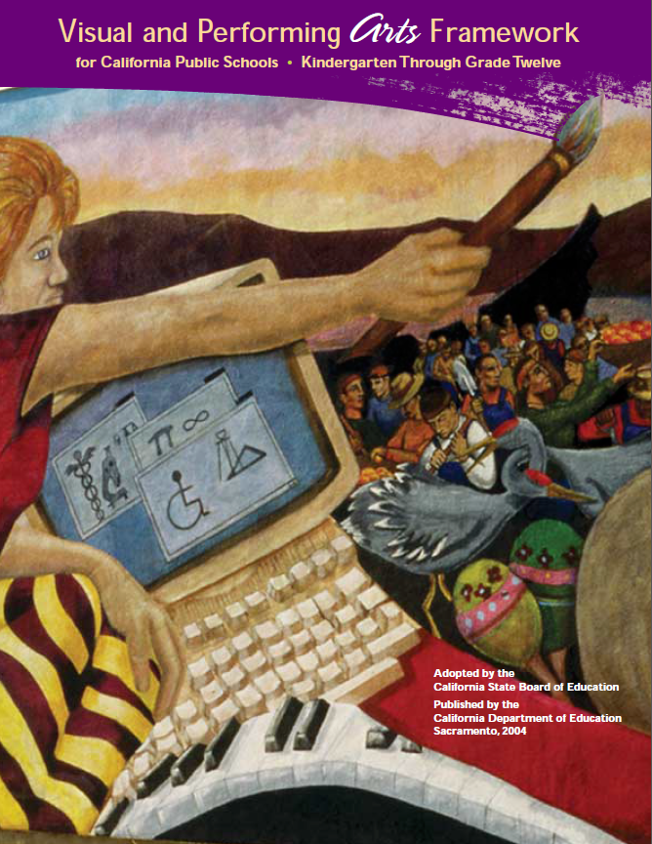
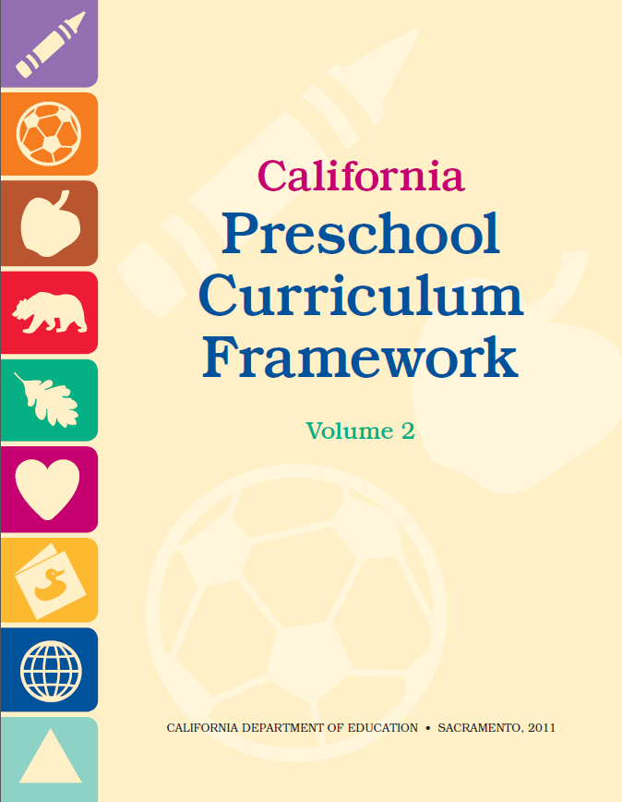
CDE Publications and Resources that Support TK Implementation
Preschool Learning Foundations
California Common Core State Standards
Visual and Performing Arts Framework for California Public Schools
Preschool Curriculum Framework
Visual and Performing Arts Content Standards
DRDP Specific to TK and K
Preschool Alignment Document
Preschool English Learners Guide
Transitional Kindergarten Implementation Guide
Preschool Learning Foundations
California Common Core State Standards
Visual and Performing Arts Framework for California Public Schools
Preschool Curriculum Frameworks
English Language Arts/English Language Development Framework
DRDP Specific to TK and K
Preschool Alignment Document
Preschool English Learners Guide
Transitional Kindergarten Implementation Guide
Notes:
Presenter Remarks:
The California Department of Education has developed many publications, resources, and supports that enable teachers to facilitate the most positive outcomes for students.
Today our main focus will be on the Preschool Learning Foundations and the Preschool Curriculum Framework, Volume 2—Visual and Performing Arts domain.
There are additional key resources that support dance development in young children. We will also discuss alignment with CA standards and make connections to additional resources pictured in the graphic (name and hold up each resource):
The Alignment of the California Preschool Learning Foundations with Key Early Education Resources (Alignment Document)
California Common Core State Standards (CA CCSS)
Visual and Performing Arts Content Standards for California Public Schools, Kindergarten Through Grade Twelve (CA VPA Standards)
Preschool English Learners: Principles and Practices to Promote Language, Literacy, and Learning—A Resource Guide (Second Edition) (PEL Resource Guide)
Visual and Performing Arts Framework for California Public Schools, Kindergarten Through Grade Twelve (VPA Framework)
Desired Results Developmental Profile—Kindergarten (2015): A Developmental Continuum for Kindergarten (DRDP-K [2015])
Transitional Kindergarten Implementation Guide – A Resource for Public School District Administrators and Teachers (TK Implementation Guide)

Slide 5
Transitional Kindergarten Implementation Guide
The TK Implementation Guide is a resource for California public school district administrators and teachers to support implementation of comprehensive TK programs.
Notes:
Presenter Remarks:
The TK Implementation Guide is a resource that focuses on the essential components for school district administrators and teachers to consider for TK programs. The TK Implementation Guide, published by the California Department of Education, is a resource to support implementation of comprehensive TK programs.
This publication provides resources and guidance in the areas of program design, curriculum, instruction, assessment, and family/community partnerships.

Slide 6
Overview of the Transitional Kindergarten Implementation Guide
Section One
Program Structure and Design
Section Two
The TK Student
Curriculum in a TK Program
Effective Instruction in a TK Program
The TK Learning Environment
Assessment and Differentiated Instruction
Involving Families and Community Partners
Supporting TK Implementation
Notes:
Presenter Remarks:
The TK Implementation Guide is organized into the following two sections:
Section 1 is covered in Chapter 1. The information in this section was developed with the administrator in mind and focuses on the program structure and design.
Section 2 is covered in Chapters 2-8. This section is a resource for both teachers and administrators and focuses on building a comprehensive TK programs by addressing curriculum, instruction environment, assessment and partnership with families and community.
Within each of these chapters, vignettes, highlighted boxes, and resource boxes are included to illustrate examples of the information covered in each of the chapters.
A PDF copy of the document can be accessed at the California Department of Education Web page (www.cde.ca.gov/ci/gs/em/documents/tkguide.pdf).
Video footage for each chapter can be accessed at the California Department of Education. The video clips include footage of TK classrooms and interviews with teachers, administrators, and parents. https://www.youtube.com/user/caeducation https://www.youtube.com/results?search_query=tk+implmentation+guide

Slide 7
Why Use the Preschool Learning Foundations for TK?
CA Law (EC 48000):
Transitional kindergarten is the first year of a two-year kindergarten program that uses a modified kindergarten curriculum that is age and developmentally appropriate.
Transitional kindergarten programs are intended, by legislative action, to be aligned to the California Preschool Learning Foundations developed by the California Department of Education.
Notes:
Background Information:
CDE.CA.gov/ci/gs/em/kinderfaq.asp#program
Presenter Remarks:
The state of California provides guidance on utilizing the Preschool Learning Foundations and the Preschool Curriculum Framework as planning and curriculum resources in the TK classroom.
In addition, the following publications and resources are available to support age and developmentally appropriate TK curriculum:
Alignment Document
TK Implementation Guide
DRDP-K (2015)
VPA Framework
CA CCSS

Slide 8
Foundations and Framework, Volume 2
Notes:
Presenter Remarks:
The purposes of the Preschool Learning Foundations are to promote a common understanding of TK children's learning and to guide instructional practice. They describe the knowledge and skills that young children typically develop when provided with developmentally, culturally, and linguistically appropriate learning experiences.
The Preschool Curriculum Framework was created as a companion to the Preschool Learning Foundations. The framework ". . . presents strategies and information to enrich learning and development opportunities for all children" (PCF, Vol. 2, p. v).
The Preschool Learning Foundations and the Preschool Curriculum Framework are designed to work together. While the foundations provide the background information to understand children's developing knowledge and skills (the "what"), the framework offers guidance on how teachers and programs can support the learning and development that are described in the foundations (the "how").
Extra Notes:
The Preschool Learning Foundations were developed with research-based evidence and are enhanced with expert practitioners' suggestions and examples. All foundations were written by a team of researchers with expertise in the given domain. A complete reference list of the source materials, along with detailed bibliographic notes for each of the developmental domains, can be found in the Preschool Learning Foundations. Sources used in the development of the foundations include:
Documents from the California Department of Education, such as the English-Language Arts Content Standards for California Public Schools, Kindergarten Through Grade Twelve (Language and Literacy, Introduction, p. 48, left column).
Well-validated assessment tools such as the Ages & Stages Questionnaires (ASQ): A Parent-Completed, Child-Monitoring System (Social-Emotional, References and Source Materials, p. 36).
General sources such as the Report of the National Reading Panel 2000 (Language and Literacy, Introduction, p. 73, left column).
Early childhood education standards from other states such as Hawaii and Texas (Social-Emotional, Introduction, p. 5, footnote).

Slide 9
Foundations
With appropriate support
High-quality program
©2017 California Department of Education
Notes:
Presenter Remarks:
The Preschool Learning Foundations describe what children should know and be able to do at around 48 months (4 years old) and 60 months (5 years old).
The foundations also assume that children have access to appropriate support in high quality programs that include the following aspects:
Environments and experiences that encourage active, playful exploration and experimentation
Clearly defined learning centers where materials are rotated
Purposeful teaching to help children gain knowledge and skills
Predictable schedules and routines with large blocks of time for play and skillful integration of curriculum with an intentional focus on content
Specific support for English learners with staff that have knowledge of the stages of English-language acquisition
Accommodations and adaptations for children with disabilities and additional support when needed
Let’s take a closer look at one of the foundations for an example. Open the Preschool Learning Foundations and find a page where the age levels appear. This is an example of a foundation page.
Look across the page at the developmental progression at around 48 months. Notice the changes at 60 months of age. Solicit a few participants to read what they see.
Summarize the exploration with the following key note:
Because children develop at different rates, the foundations were designed to support the belief that certain stages of development will occur at different times for all students. Notice “at around” in the description. It is important to remember this variability occurs.

Slide 10
Purpose of the Foundations
The purpose of the Preschool Learning Foundations is to promote a common understanding of young children’s learning and to guide instructional practice.
©2017 California Department of Education
Notes:
Presenter Remarks:
The purpose of the foundations is to promote a common understanding of young children’s learning and to guide instructional practice. The foundations and framework are designed to work together. While the foundations—known as standards in the K-12 arena—provide the background information to understand children’s developing knowledge and skills (the “what”), the curriculum framework offers guidance on how teachers and programs can support the learning and development that are described in the foundations (the “how”).

Slide 11
Domain Organization
Notes:
Presenter Remarks:
In the Preschool Learning Foundations and Preschool Curriculum Framework, Music is a strand within the Visual and Performing Arts domain.
There are three substrands within Music strand:
Notice, Respond, and Engage
Develop Skills
Create, Invent, and Express
Within each of these three substrands there are foundations for both 48 and 60 months.
Take a moment now to find where the foundations begin in the Music strand on page 11 of the Preschool Learning Foundations, Volume 2.
Silently read and place your finger on a foundation in the Notice, Respond, and Engage substrand. Check your neighbor and make sure they have found one as well.
Now, silently read and place your finger on a foundation in the Develop Skills and Create, Invent, and Express Through Music substrand. Check your neighbor again.
Understanding this structure is important to effectively and efficiently plan and scaffold for children.

Slide 12
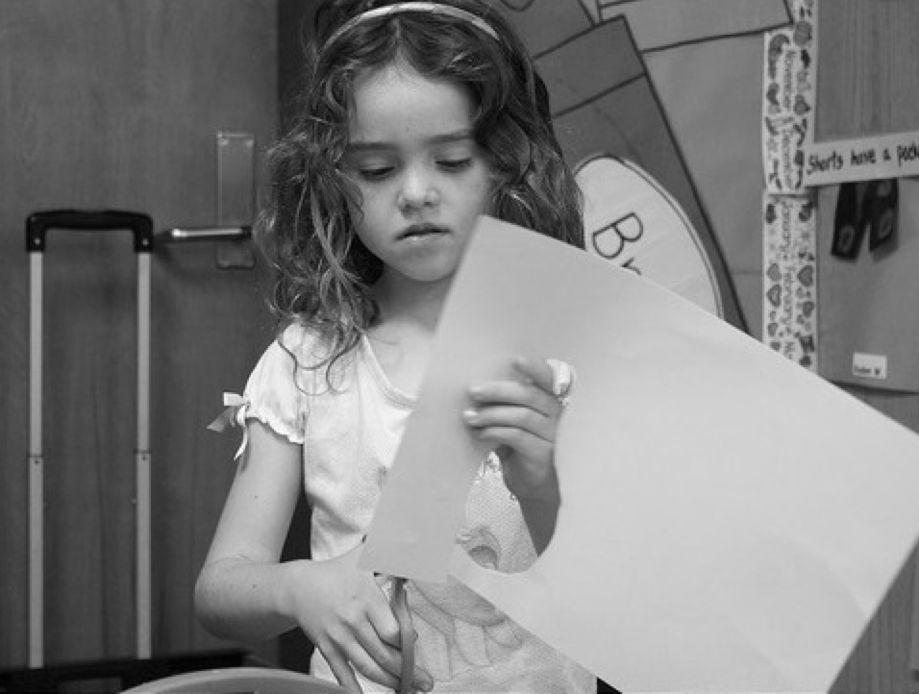
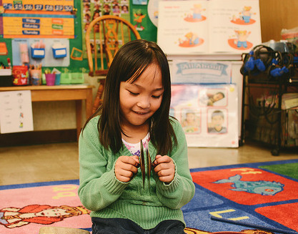
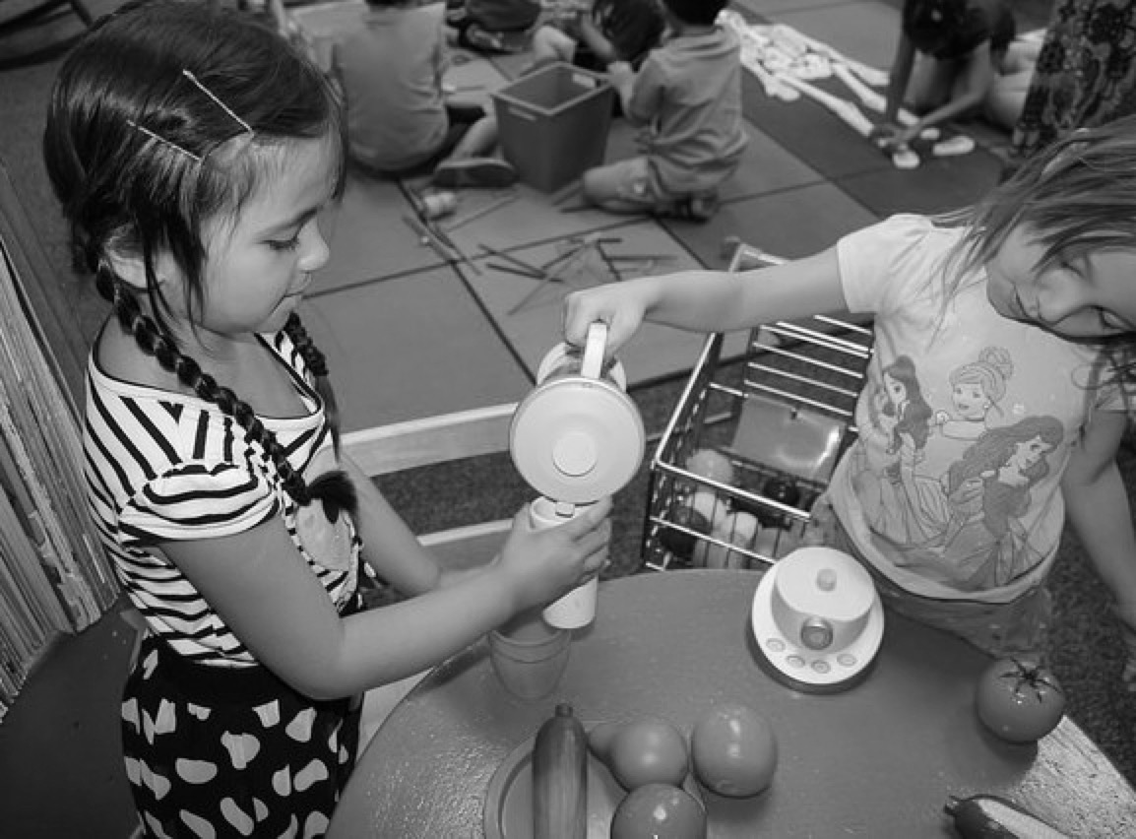
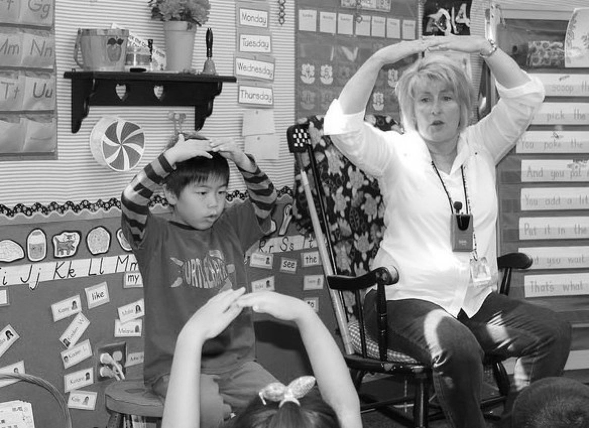
What are the Visual and Performing Arts
Visual Art
Music
Drama
Dance
©2017 California Department of Education
Notes:
Presenter Remarks:
(Click to reveal Visual Art.) The foundations for visual arts include observing and commenting on art, developing art skills, and creating art (e.g., painting, drawing, sculpting, and collages).
(Click to reveal Music.) The foundations for music include responding to and recognizing sounds and music, learning music skills, and creating music by keeping a beat with one’s body, by singing, and by using musical instruments.
(Click to reveal Drama.) The foundations for drama include pretend play and reenacting stories as well as using props, costumes, and roles in play.
(Click to reveal Dance.) The foundations for dance include engaging in dance movements, being aware of body space, and expressing oneself through dance.

Slide 13
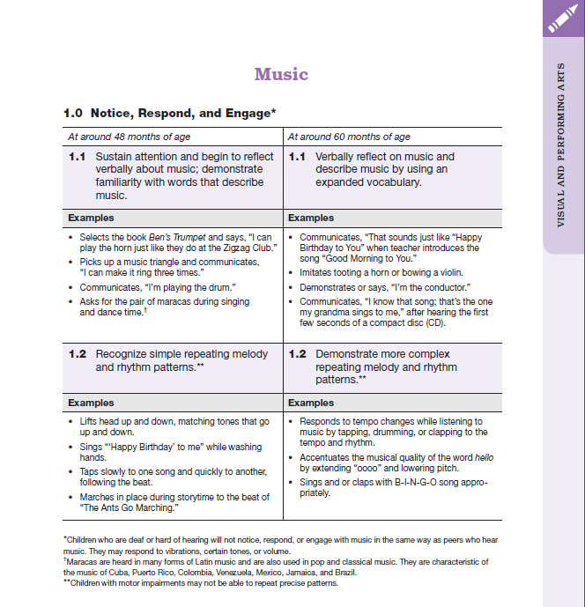
Map of the Foundations
Strand
Substrand
Age
Foundation
Domain
Examples
Foundation
Footnotes
Notes:
Presenter Remarks:
Please locate Handout 1: Foundations Map. This handout illustrates the way the foundations are organized. Follow along while we discuss each component:
The name of the domain (Visual and Performing Arts)
The name of the strand (Music)
The name of the substrand (Notice, Respond, and Engage)
Note that substrands always end in “zero.”
The two age levels (at around 48 months and at around 60 months)
Each foundation describes typical behaviors at around 48 months and at around 60 months or four to five years old.
The foundations for the substrand
There are two for each age level on this page (1.1 for 48 months and 1.1 for 60 months, 1.2 for 48 months and 1.2 for 60 months).
The examples for each foundation
These are only a few of the ways that children may demonstrate the behavior in the foundation.
Many of the foundations have footnotes that include information specific for students with IEPs or students with disabilities, such as information about adaptations or accommodations.
Notice that there is a developmental progression from four years old to five years old within a substrand.

Slide 14
Alignment Document
Notes:
Presenter Remarks:
The Alignment Document is another resource that will help us answer questions related to developmental progression.
What do you know about this document? How do you use it in your work now?
Extra Notes:
Depending on the size of the group, participants can share responses with table partners or in pairs.

Slide 15
Alignment Document: Table 1.13
(The Alignment of the California Preschool Learning Foundations with Key Early Education Resources [CDE], p. 105)
Notes:
Background Information:
The chart on the slide can be found on page 105 of the Alignment Document.
Presenter Remarks:
The Alignment Document provides information about the connections between the Preschool Learning Foundations and the kindergarten content standards for California public schools.
Look at Handout 2: Alignment Document and DRDP-K Measure VPA 2 to see the detailed alignment of substrand 1.0 and the kindergarten content standards. Underline anything you find interesting. Allow 3-4 minutes to read and underline.
Would anyone like to share what they underlined or found to be interesting?
When you look at the alignment table you can see the connections between the preschool foundations and the kindergarten content standards. For example, the preschool foundation at around 60 months (1.1: Verbally reflect on music and describe music by using an expanded vocabulary.) directly relates to kindergarten content standard Listen to, Analyze, and Describe Music (1.2: Identify and describe basic elements in music [e.g., high/low, fast/slow, loud/soft, beat]). Although the foundations and standards may, at times, be organized differently or may not correspond exactly, there is a correlational progression between them.
Optional:
Below are optional discussion questions that can be used if participants need prompting to start discussion:
What do you observe about the different expectations for children at around 48 months of age, at around 60 months of age, and by the end of kindergarten?
In recognition of these developmental stages, what are the implications for TK teachers in supporting children’s developing ability to notice, respond to, and engage with music?

Slide 16
Alignment Document: Table 1.13 Continued
(The Alignment of the California Preschool Learning Foundations with Key Early Education Resources [CDE], p. 106)
Notes:
Background Information:
The chart on the slide can be found on page 106 of the Alignment Document.
Presenter Remarks:
This chart is from page 106 of the Alignment Document. The circled section is a continuation of the alignment table on page 105.

Slide 17
Music in Your Classroom
Part 1:
Read the table tent definitions of each substrand with your table group and reflect on the following questions:
How do you currently engage children with music?
What music skills do you focus on?
What opportunities are available for children to create, invent, and express themselves through music?
Part 2:
Read and review the music foundations on Handout 1: Foundations Map.
Use Handout 3: Take "Note" of Ideas to record ideas, reflections, and action plans.
Notes:
Activity 2: Music in Your Classroom
Presenter Remarks:
Let’s look at using music in the classroom.
intent: Engage participants with Music substrands and foundations by connecting this activity with their current classroom practices related to music and identifying areas for growth.
OUTCOME: Participants will reflect on current classroom practices that support music development in relation to the foundations and identify areas for improving musical supports for children in their classrooms.
Materials Required:
Substrand table tents
Handout 1: VPA Music Foundation
Handout 3: Take “Note” of Ideas
Optional: Chart paper/pens
Time: 10-15 minutes
Process: This is a two part activity. Before beginning the activity, provide participants with instructions for both Part 1 and 2 of the activity. Participants will use Handout 3: Take “Note” of Ideas to record ideas, reflections, and action plans.
Part 1: Instruct table groups to read the definitions of each substrand on the table tent aloud. Ask them to reflect on the following questions as it relates to their experience and practice:
How do you currently engage children with music?
What music skills do you focus on?
What opportunities are available for children to create, invent, and express themselves through music?
Give participants 5-7 minutes to discuss and share at the table and make any notes on Handout 3: Take “Note” of Ideas.
Part 2: Instruct participants to read and review the music foundations on Handout 1: VPA Music Foundation. Using the handout, participants record new things to try and areas to learn more about.
OPTIONS:
Participants can share their areas of interest and what they want to know more about with the whole group. Presenter charts responses which can be used to relate content to participant goals.

Slide 18
Music In Action
Video Clip: Trumpet Jingle Bells
Notes:
Background Information:
Jingle Bells Trumpet Video Clip
Presenter Remarks:
This video clip shows the link between the classroom and some key concepts/vocabulary from the foundations and substrands of the Music domain.
Please refer to Handout 4: VPA at-a-Glance. Briefly review and reflect on the substrands and foundations from the Music domain and notice which of these the video example illustrated.
To help you understand the key differences between the three substrands from the Music domain, the next few slides look specifically at each one:
Notice, Respond, and Engage
Develops Skills in Music
Create, Invent, Express
Following the substrand description slides, we’ll view three more classroom video clips and practice identifying how the classroom example supports development in the various substands.
Please keep Handout 4: VPA At-a-Glance available as we talk through the following substrand slides and video clips.

Slide 19
Notice, Respond, and Engage
“They are curious about environmental sounds and musical instruments in the classroom and will respond to music they hear” (PCF, Vol. 2, p. 64).
Notes:
Presenter Remarks:
“As children become more engaged in musical activities, they may request favorite activities and songs to be played repeatedly. Because children begin to use their language more fluently around age three, it is important to encourage them to talk about the music they hear and make” (PCF, Vol. 2, p. 64).
Think about your classroom. What songs or activities do the children most request?

Slide 20
Develop Skills in Music
“This substrand refers to the basic skills of
performing, inventing,
and creating through the arts” (PLF, Vol. 2, p. 4).
Notes:
Presenter Remarks:
“Music skills…develop along a continuum” (PCF, Vol. 2, p. 72).
The following examples represent the developmental continuum for music:
“When singing, three-year-olds are usually able to sing a recognizable song when starting on their own pitch, and they become better at matching pitches when singing with others. They enjoy improvising and making up songs to accompany their play and are able to use their voices expressively (e.g., loudly and softly). By age four, they enjoy a wide variety of songs and are better at singing in tune when they sing in their own range” (PCF, Vol. 2, p. 72).
“When listening, three-year-olds can recognize correct and incorrect melodies and rhythms of songs. They are not always able to reproduce what they hear. They like to play matching or sound-identiﬁcation games, and enjoy listening to shorter instrumental music. By age four, children become more competent at showing their awareness of beat, tempo, dynamics, melodic movement, and structures of musical form. They can follow the sequence of a musical story or song and are able to focus on longer listening selections” (PLF, Vol. 2, p. 72).
In the Preschool Curriculum Framework, the Develop Skills in Music section, “…focuses on and is divided into the musical skills of singing, moving, and playing musical instruments. Listening is woven into all of these skills” (PCF, Vol. 2, p. 72).
“Most children love to move; therefore, singing, listening and playing are typically expressed in movement. Three and four-year old children begin to show a sense of musical phrasing and expressiveness when moving or improvising. They gain coordination to tap rhythms, handle instruments and mallets, and maintain steady beat when accompanying their own music. Both age groups often like to use manipulatives and props when moving, listening, and singing” (PCF, Vol. 2, p. 72).

Slide 21
Create, Invent, Express
“Helping and encouraging [children] to create, invent, and express themselves musically can be an eye-opening experience for the teacher” (PCF, Vol. 2, p. 80).
Notes:
Presenter Remarks:
“Preschool [and TK] children spend much of their time creating, inventing, and expressing themselves, and they use various means and approaches to do so” (PLF, Vol. 2, p. 4).
“Three-, four-, and five-year-olds are quite enthusiastic about musical experimentation. They enjoy creating different sounds on instruments and with their voices, and they delight in uninhibited, expressive movement… Until the child “externalizes” what she is thinking about in regard to what is heard, seen, or imagined musically, adults have no idea what is going on in the child’s mind or how she is processing musical thought. When the teacher gives the child an opportunity to create her own music and invent symbol systems, the child is able to express musical meaning on her own terms, then communicate this meaning to others” (PCF, Vol. 2, p. 80).

Slide 22
Music in Action
Notes:
Prior to training insert preschool learning foundations video clip: Create Invent And Express Through Music 3.3
Activity 3: Music in Action
intent:
Using video classroom examples, engage participants in a process of analyzing how the activities support learning in the Music domain and other learning domains.
OUTCOMES:
Participants demonstrate understanding of how classroom activities support the three music substrands and learning foundations.
Materials Required:
Foundation video examples (Notice Respond And Engage1.4, Develop Skills In Music 2.2, and Create Invent And Express Through Music 3.3)
Handout 4: VPA At-A-Glance
Time: 30 minutes
Process:
Show participants one video clip at a time, pausing after each one to engage participants in process of understanding how the clip supports learning in one or more of the Music substrand/foundations.
Presenter says, “Take out Handout 4: VPA At-a-Glance as we’ll be using this as we view video clips from preschool classrooms. I’ll show one video at a time, giving you a minute or so after viewing to think about which substrands and foundations are supported by the classroom example.”
Show 1st video clip.
Give participants 1 or 2 minutes to review substrand/foundations.
Presenter says, “If you thought this example supports the substrand Notice, Respond, and Engage, stand up.” Presenter facilitates a 1-2 min discussion by asking a few of the participants to share how they thought the activity supports this substrand and any specific foundations. Participants sit down.
Presenter says, “If you thought this example supports the substrand Develops Skills, stand up.” Presenter facilitates a 1-2 minute discussion by asking a few of the participants to share how they thought the activity supports this substrand and any specific foundations. Participants sit down.
Presenter says, “If you thought this example supports the substrand Create, Invent, and Express, stand up.” Presenter facilitates a 1-2 minute discussion by asking a few of the participants to share how they thought the activity supports this substrand and any specific foundations. Participants sit down.
Presenter can replay video clip after discussion if desired.
REPEAT THE ABOVE PROCESS FOR REMAINING 2 VIDEO CLIPS
OPTIONAL: Instead of standing up to show which substrand/foundations they chose, participants can make a music sound with available table instruments or their body such as clap hands/feet, pretend tooting of horn.

Slide 23
Music in Action
Notes:
Prior to training insert preschool learning foundations video clip: Develop Skills In Music
2.2
Activity 3: Music in Action
intent:
Using video classroom examples, engage participants in a process of analyzing how the activities support learning in the Music domain and other learning domains.
OUTCOMES:
Participants demonstrate understanding of how classroom activities support the three music substrands and learning foundations.
Materials Required:
Foundation video examples (Notice Respond And Engage1.4, Develop Skills In Music 2.2, and Create Invent And Express Through Music 3.3)
Handout 4: VPA At-A-Glance
Time: 30 minutes
Process:
Show participants one video clip at a time, pausing after each one to engage participants in process of understanding how the clip supports learning in one or more of the Music substrand/foundations.
Presenter says, “Take out Handout 4: VPA At-a-Glance as we’ll be using this as we view video clips from preschool classrooms. I’ll show one video at a time, giving you a minute or so after viewing to think about which substrands and foundations are supported by the classroom example.”
Show 1st video clip.
Give participants 1 or 2 minutes to review substrand/foundations.
Presenter says, “If you thought this example supports the substrand Notice, Respond, and Engage, stand up.” Presenter facilitates a 1-2 min discussion by asking a few of the participants to share how they thought the activity supports this substrand and any specific foundations. Participants sit down.
Presenter says, “If you thought this example supports the substrand Develops Skills, stand up.” Presenter facilitates a 1-2 minute discussion by asking a few of the participants to share how they thought the activity supports this substrand and any specific foundations. Participants sit down.
Presenter says, “If you thought this example supports the substrand Create, Invent, and Express, stand up.” Presenter facilitates a 1-2 minute discussion by asking a few of the participants to share how they thought the activity supports this substrand and any specific foundations. Participants sit down.
Presenter can replay video clip after discussion if desired.
REPEAT THE ABOVE PROCESS FOR REMAINING 2 VIDEO CLIPS
OPTIONAL: Instead of standing up to show which substrand/foundations they chose, participants can make a music sound with available table instruments or their body such as clap hands/feet, pretend tooting of horn.

Slide 24
Music In Action
Notes:
Prior to training insert preschool learning foundations video clip:
Notice Respond And Engage1.4
Activity 3: Music in Action
intent:
Using video classroom examples, engage participants in a process of analyzing how the activities support learning in the Music domain and other learning domains.
OUTCOMES:
Participants demonstrate understanding of how classroom activities support the three music substrands and learning foundations.
Materials Required:
Foundation video examples (Notice Respond And Engage1.4, Develop Skills In Music 2.2, and Create Invent And Express Through Music 3.3)
Handout 4: VPA At-A-Glance
Time: 30 minutes
Process:
Show participants one video clip at a time, pausing after each one to engage participants in process of understanding how the clip supports learning in one or more of the Music substrand/foundations.
Presenter says, “Take out Handout 4: VPA At-a-Glance as we’ll be using this as we view video clips from preschool classrooms. I’ll show one video at a time, giving you a minute or so after viewing to think about which substrands and foundations are supported by the classroom example.”
Show 1st video clip.
Give participants 1 or 2 minutes to review substrand/foundations.
Presenter says, “If you thought this example supports the substrand Notice, Respond, and Engage, stand up.” Presenter facilitates a 1-2 min discussion by asking a few of the participants to share how they thought the activity supports this substrand and any specific foundations. Participants sit down.
Presenter says, “If you thought this example supports the substrand Develops Skills, stand up.” Presenter facilitates a 1-2 minute discussion by asking a few of the participants to share how they thought the activity supports this substrand and any specific foundations. Participants sit down.
Presenter says, “If you thought this example supports the substrand Create, Invent, and Express, stand up.” Presenter facilitates a 1-2 minute discussion by asking a few of the participants to share how they thought the activity supports this substrand and any specific foundations. Participants sit down.
Presenter can replay video clip after discussion if desired.
REPEAT THE ABOVE PROCESS FOR REMAINING 2 VIDEO CLIPS
OPTIONAL: Instead of standing up to show which substrand/foundations they chose, participants can make a music sound with available table instruments or their body such as clap hands/feet, pretend tooting of horn.

Slide 25
Preschool Curriculum Framework
The Preschool Curriculum Framework, “…presents strategies and information to enrich learning and development opportunities for all children” (PCF, Vol. 1, p. v).
Notes:
Presenter Remarks:
Take a moment to read the slide. The Preschool Curriculum Framework, “…presents strategies and information to enrich learning and development opportunities for all children” (PCF, Vol. 1, p. v).
This resource provides teachers with the opportunity to gain ideas and expand their creativity.

Slide 26
Framework Strategies
Developmentally appropriate
Reflective and intentional
Individually and culturally meaningful
Inclusive of children with disabilities or other special needs
Notes:
Presenter Remarks:
The Preschool Curriculum Framework offers guidance on how teachers—through planned learning environments, materials, and experiences that are developmentally appropriate, individually and culturally meaningful, and engaging to families—can support the learning and development described in the foundations.
“Teachers address ideas and concepts that children can grasp at their developmental level and then progressively build on what children already know and understand. This approach applies to all children, including children with various abilities, disabilities, or other special needs (such as delays in language, cognition, or physical ability)” (PCF, Vol. 2, p. 227).

Slide 27
Universal Design for Learning
Multiple means of:
Representation
Action and Expression
Engagement
Notes:
Background Information:
PCF, Vol. 2, p. 14
Presenter Remarks:
The strategies within the Preschool Curriculum Framework include the idea of Universal Design for Learning (UDL). This means there are many suggestions for ways to support learning that teachers can use to provide multiple means of representation, engagement, and expression.
“Multiple means of representation refers to providing information in a variety of ways so the learning needs of all children are met. For example, it is important to speak clearly to children with auditory disabilities while also presenting information visually (such as with objects and pictures).
“Multiple means of expression refers to allowing children to use alternative ways to communicate or demonstrate what they know or what they are feeling. For example, when a teacher seeks a verbal response, a child may respond in any language, including American Sign Language. A child with special needs who cannot speak may also respond by pointing, by gazing, by gesturing, by using a picture system of communication, or by using any other form of alternative or augmented communication system.
“Multiple means of engagement refers to providing choices in the setting or program that facilitate learning by building on children’s interests. The information in this curriculum framework has been worded to incorporate multiple means of representation, expression, and engagement” (PCF, Vol. 2, p. 14).

Slide 28
Discover Strategies
28
Discover strategies to assist in the following tasks:
Setting up environments
Encouraging and expanding self-initiated play
Selecting appropriate materials
Planning and implementing teacher-guided learning activities
Notes:
Presenter Remarks:
Discover strategies to assist in the following tasks:
Setting up environments
Encouraging and expanding self-initiated play
Selecting appropriate materials
Planning and implementing teacher-guided learning activities
Each strategy incorporates UDL concepts.

Slide 29
The Environment: Inviting Musical Engagement
©2017 California Department of Education
Notes:
Presenter Remarks:
Please take out Handout 3: Take "Note" of Ideas and Handout 5: Suggested Arts Materials.
Show some of the instruments you’ve collected as samples.
Look over Handout 5: Suggested Arts Materials. Now look at the slide and see how many instruments and environmental enhancements you can find on the handout. Also notice/discuss what encourages musical engagement in the photo.
Are there any special educators here that would like to share any easy adaptations they have used to make musical environments accessible for children with special needs?
Use Handout 3: Take “Note” of Ideas to make notes about any new ideas that would enhance your classroom environments.
Extra Notes:
The following environment example slides provide multiple examples that will enhance the above discussion. You can choose to use all or only a few of the slides.

Slide 30
Environmental Examples: Inviting Musical Engagement
©2017 California Department of Education
Notes:
Presenter Remarks:
Please take out Handout 3: Take "Note“ of Ideas and Handout 5: Suggested Arts Materials.
Show some of the instruments you’ve collected as samples.
Look over Handout 5: Suggested Arts Materials. Now look at the slide and see how many instruments and environmental enhancements you can find on the handout. Also notice/discuss what encourages musical engagement in the photo.
Are there any special educators here that would like to share any easy adaptations they have used to make musical environments accessible for children with special needs?
Use Handout 3: Take “Note” of Ideas to make notes about any new ideas that would enhance your classroom environments.

Slide 31
Environmental Examples: Inviting Musical Engagement
©2017 California Department of Education
Notes:
Background Information: Homemade instruments can be made using cans, boxes, and duct tape.
Presenter Remarks:
Please take out Handout 3: Take "Note" of Ideas and Handout 5: Suggested Arts Materials.
(Show some of the instruments you’ve collected as samples.)
Look over Handout 5: Suggested Arts Materials. Now look at the slide and see how many instruments and environmental enhancements you can find on the handout. Also notice/discuss what encourages musical engagement in the photo.
Are there any special educators here that would like to share any easy adaptations they have used to make musical environments accessible for children with special needs?
Use Handout 3: Take “Note” of Ideas to make notes about any new ideas that would enhance your classroom environments.

Slide 32
Environmental Examples: Inviting Musical Engagement
©2017 California Department of Education
Notes:
Background Information:
Outside spaces can be used for combining music and movement.
Presenter Remarks:
Please take out Handout 3: Take “Note” of Ideas and Handout 5: Suggested Arts Materials.
(Show some of the instruments you’ve collected as samples.)
Look over Handout 5: Suggested Arts Materials. Now look at the slide and see how many instruments and environmental enhancements you can find on the handout. Also notice/discuss what encourages musical engagement in the photo.
Are there any special educators here that would like to share any easy adaptations they have used to make musical environments accessible for children with special needs?
Use Handout 3: Take “Note” of Ideas to make notes about any new ideas that would enhance your classroom environments.

Slide 33
Environmental Examples: Inviting Musical Engagement
©2017 California Department of Education
Notes:
Background Information:
The outdoor environment can be enhances with permanently fixed outdoor.
Presenter Remarks:
Please take out Handout 3: Take “Note” of Ideas and Handout 5: Suggested Arts Materials.
(Show some of the instruments you’ve collected as samples.)
Look over Handout 5: Suggested Arts Materials. Now look at the slide and see how many instruments and environmental enhancements you can find on the handout. Also notice/discuss what encourages musical engagement in the photo.
Are there any special educators here that would like to share any easy adaptations they have used to make musical environments accessible for children with special needs?
Use Handout 3: Take “Note” of Ideas to make notes about any new ideas that would enhance your classroom environments.

Slide 34
Environmental Examples: Inviting Musical Engagement
©2017 California Department of Education
Notes:
Background Information:
Area rugs can be used to define a space.
Presenter Remarks:
Please take out Handout 3: Take “Note” of Ideas and Handout 5: Suggested Arts Materials.
(Show some of the instruments you’ve collected as samples.)
Look over Handout 5: Suggested Arts Materials. Now look at the slide and see how many instruments and environmental enhancements you can find on the handout. Also notice/discuss what encourages musical engagement in the photo.
Are there any special educators here that would like to share any easy adaptations they have used to make musical environments accessible for children with special needs?
Use Handout 3: Take “Note” of Ideas to make notes about any new ideas that would enhance your classroom environments.

Slide 35
Environmental Examples: Inviting Musical Engagement
©2017 California Department of Education
Notes:
Background Information:
Homemade instruments made from household items can be arranged in unique ways.
Presenter Remarks:
Please take out Handout 3: Take "Note" of Ideas and Handout 5: Suggested Arts Materials.
(Show some of the instruments you’ve collected as samples.)
Look over Handout 5: Suggested Arts Materials. Now look at the slide and see how many instruments and environmental enhancements you can find on the handout. Also notice/discuss what encourages musical engagement in the photo.
Are there any special educators here that would like to share any easy adaptations they have used to make musical environments accessible for children with special needs?
Use Handout 3: Take "Note" of Ideas to make notes about any new ideas that would enhance your classroom environments.

Slide 36
Environmental Examples: Inviting Musical Engagement
©2017 California Department of Education
Notes:
Presenter Remarks:
Please take out Handout 3: Take "Note" of Ideas and Handout 5: Suggested Arts Materials.
(Show some of the instruments you’ve collected as samples.)
Look over Handout 5: Suggested Arts Materials. Now look at the slide and see how many instruments and environmental enhancements you can find on the handout. Also notice/discuss what encourages musical engagement in the photo.
Are there any special educators here that would like to share any easy adaptations they have used to make musical environments accessible for children with special needs?
Use Handout 3: Take "Note" of Ideas to make notes about any new ideas that would enhance your classroom environments.

Slide 37
Musical Instruments
“Children’s play environments should include musical instruments that are safe, durable, and of excellent sound quality” (PCF, Vol. 2, p. 74).
Notes:
Presenter Remarks:
Let’s read the slide together, “Children’s play environments should include musical instruments that are safe, durable, and of excellent sound quality” (PCF, Vol. 2, p. 74).
It is important that musical instruments be treated as instruments rather than toys. Equipment should be properly maintained and displayed.
When interacting with instruments the teacher—as the play partner— should demonstrate proper use and care of the instruments and oversee safe play.
Both exploratory and structured activities should be planned so that children have the opportunity to touch, hear, and manipulate the sounds of the instruments.
Because musical instruments are designed to be played in a certain way, it is important for the teacher to model proper playing techniques and functions of the instruments.
Encourage children to analyze and make comparisons about the different instruments’ sound qualities and potential uses. This introduces children to the timbre of each instrument. Timbre is the characteristics and distinct sound of each individual instrument or voice. Presenter can demonstrate this by playing a note on two different instruments at the resource table such as the musical triangle and a whistle or recorder.

Slide 38
Access to Learning
It may be necessary to make special adaptations to create access to learning.
Notes:
Presenter Remarks:
For some children, it may be necessary to make special adaptations to create access to learning.
(Show examples on the resource table of simple adaptations for instruments and participation.)
This slide has three examples of rhythm sticks:
The upper right hand picture shows typical rhythm sticks like the ones provided on each table today.
The left hand picture shows popsicle sticks with pipe cleaners to create a softer texture.
The softer texture creates a softer tapping sound which may be more amenable to children with sensory processing differences.
The bottom right hand picture shows paper towel tubes that are light and easy for hands to grip.
The sticks on your table can be adapted in a variety of ways to enable children to better utilize and access curriculum. Take a moment now to find the Handout 6: Grippers.
In TK classrooms patterning is often practiced with small objects that require fine motor ability. Using grippers to build up any object will enable access to the curriculum for many students in your classroom may have fine motor delays.

Slide 39
Guiding Principles: Connections to Music
Notes:
Activity 4: Guiding Principles‒Connections to Music
Background Information:
The guiding principles for the Visual and Performing Arts domain can be found on pages 42-45 of the Preschool Curriculum Framework, Volume 2.
Presenter Remarks:
Let’s look at the Guiding Principles‒Connections to Music.
intent:
Inspire and engage participants with key visual and performing arts guiding principles. Make specific connections to music and apply the experience for use with children.
OUTCOMES:
Participants will be able to use the guiding principles to evaluate and inform their music curricular choices. Participants will be able to use/adapt the composition portion of the activity to support children’s learning in the Music substrand, Create, Invent, and Express.
Materials Required:
VPA Guiding Principles‒Connections to Music from pages 42-45 of the Preschool Curriculum Framework, Volume 2
Guiding Principle cards
Xylophone/Glockenspiel
3-5 colored musical “notes” on each table
Oversized strip of musical staff paper
Photo of xylophone on tables
Time: 30 minutes
Process:
This is a jigsaw activity. Each table group needs one of nine Guiding Principle cards, 3-5 colored musical notes, pens, and a photo of a typical glockenspiel/xylophone found in classrooms. The musical staff paper is posted on the wall. Use this paper to create a “composition” with the musical note highlights that are placed on the paper as reporters share out.
This activity is an opportunity to inspire participants about the significant role of the arts and music in our lives and that the Music domain is uniquely suited to supporting connections with the family, home language development and English learners, inclusion, diversity, and other learning domains.
Presenter says: “With your table partners, read and discuss the Guiding Principle you have been given and determine 1-3 key points that all participants need to know as they plan for music in their classrooms. As you read, reflect on how the arts and music are important to the human spirit, capacities, and expression and notice how music is uniquely suited to supporting connections with the family, home language development and English language learners, inclusion, diversity, and other learning domains.”
Instruct participants to record their highlights on the colored musical notes - one highlight per note. Each table needs to identify a reporter who will share the highlights with the large group. Presenter then says: “The notes will be used to create a simple composition using the glockenspiel/xylophone that is found in many early childhood classrooms. As you report your highlights, I will place the notes on the musical staff. Once everyone has shared, the composition will be played.” 10 minutes
One at a time, presenter calls on each table group’s reporter to share their highlights and insights on how it informs music curricular practices. Presenter may add to or facilitate discussion that may arise and highlight supporting connections with the family, home language development and English language learners, inclusion, diversity, and other learning domains. Presenter collects the musical notes from the table reporter after highlights are shared. The musical notes are placed in a line on the musical staff that is on the wall.
Once all table reporters have shared their highlights and all the “composition” is completed, presenter plays the composition on the glockenspiel/xylophone following the color coded musical notes. Participants can “follow” along with the glockenspiel/xylophone photo that is on their table. Presenter sums up this composing activity by telling participants that children can create simple compositions using these materials, or children can create on their own by writing/coloring/drawing/painting notes and musical staff.
See article Music from Inside Out: Promoting Emergent Composition with Young Children by Jennifer Ohman-Rodriguez. Young Children July 2004.

Slide 40
Melody Bracelet
Notes:
Presenter Remarks:
This activity is one that can be used as an inspiration to encourage children to develop their own compositions using color coded musical notes or children’s own colored musical note drawings on staff paper.
Melody bracelets—made using beads and yarn—are another way for all children in your class to compose their own music and contribute to the musical community of the classroom.
As an adaptation, colored blocks can be lined up in various ways. Blocks are easier to grasp and manipulate for children with special needs or those at an early level of fine motor development.
English learners can comfortably participate because the activity isn’t dependent upon their state of second language acquisition.
Compositions also can be “written” down (drawn) in order of the notes and then played by other children. This way, children can experience being composers and sharing creations with each other!
Extra Notes:
The melody bracelet activity was taken from the article Four Steps for Becoming Familiar with Early Music Standards by Jinyoung Kim and Helen Mele Robinson. It can be found on page 64 of the March 2010 issue of Young Children, Volume 65.

Slide 41
Let’s Sing!
“My Ma Gave Me a Nickel”
My Ma gave me a nickel
To buy a pickle
I didn’t buy a pickle,
I bought some bubble gum.
Some buh, buh, buh, buh bubble gum
I bought some bubble gum.
©2017 California Department of Education
Notes:
Background Information:
This slide presents a group singing/movement brain break.
Presenter Remarks:
Let’s take a brain break! Stand up with me while we sing and move to this song—the lyrics on the slide.
Lead the audience by singing this song while clapping rhythmically. Repeat the verse several times, with the participants choosing a new item to be “purchased” on each round. Model singing the first letter sound of each new item at the appropriate line, such as popcorn…p, p, p popcorn.
This song supports English learners by exposing them to, and giving them fun practice with, English phonemes. It also supports the Develop Skills in Music and the Notice, Respond, and Engage substrands.

Slide 42
Singing
“Singing is a joyful activity that builds community, social interaction, and self-esteem.” (PCF, Vol. 2, p. 83).
Notes:
Presenter Remarks:
(Read the slide or invite a participant to read it.) “Singing is a joyful activity that builds community, social interaction, and self-esteem” (PCF, Vol. 2, p. 83).
Singing together creates a sense of belonging and naturally lends to including families as, “The family setting is where generations of songs are passed along and preserved” (PCF, Vol. 2, p. 85).
Songs communicate our history, traditions, and values which reflect the collective and individual human experience and the communities to which we all belong.
“For many children today, stress blocks learning avenues. We can relieve much of that stress through daily listening and singing experiences, moving to music, and exploring instrument sounds. We can help create that safe feeling of being a caring ‘classroom family’ through the songs and singing games we lead” (Elizabeth Carlton, "Learning Through Music: The Support of Brain Research," in Curriculum: Art, Music, Movement, Drama: a Beginnings Workshop Book, ed. Bonnie Neugebauer, p. 55).
It is important to remember that learning is strongly influenced by emotion, “…[Music] often wraps feelings or emotions around a song that enhances learning experiences…Think of the pride instilled when singing patriotic songs, the peace experienced singing campfire songs, the religious connections strengthened when singing great hymns of faith. Learning is strongly influenced by emotion – ‘the stronger the emotion connected with the experience, the stronger the memory of that experience’ (Jensen, 1998, p. 73)” (Elizabeth Carlton, "Learning Through Music: The Support of Brain Research," in Curriculum: Art, Music, Movement, Drama: a Beginnings Workshop Book, ed. Bonnie Neugebauer, p. 55).
Here are some classroom tips from the Preschool Curriculum Framework:
“Set aside time each day for group singing—this builds a repertoire of songs that the whole class knows. Group singing can be done at various times, not only while ‘sitting in circle.” Singing outside, singing in small groups, and singing while waiting are all opportunities to incorporate music into the children’s day” (PCF, Vol. 2, p. 83).
“Make a chart of all the known songs. Add a picture, or other representation, along with the words” (PCF, Vol. 2, p. 83).
“When appropriate, use recordings of child voices singing” (PCF, Vol. 2, p. 83).
Let’s look at some of the strategies for engaging families from the Preschool Curriculum Framework:
“Encourage children to bring their favorite songs and music from home. These selections can bridge and invite participation in other music activities” (PCF, Vol. 2, p. 85).
“Teachers can advocate greater family involvement. They send song sheets home with the child, share information about a community concert, invite families to come to the preschool [or TK] program and play music instruments, present small music “informance” presentations for families, and simply talk about the child’s interest and participation in music activities” (PCF, Vol. 2, p. 85).

Slide 43
Partner with Families
Engaging Families: Preschool Curriculum Framework
All About Young Children
Best Practices for Planning Curriculum: Family Partnerships and Culture
TK Implementation Guide
Notes:
Presenter Remarks:
In order to effectively build on children's existing strengths, we must understand them. To do this, we need to partner with families to learn about their children’s strengths.
The resources on this slide are specifically beneficial for partnering with families. You may want to take a picture of this slide and refer to it later.
Optional:
Create a gallery table and have examples of documents there.
Extra Notes:
The resources are hyperlinked. If Wi-Fi access is available, display the resources and do a walkthrough.

Slide 44
Singing is for Everyone
“The woods would be very silent if no birds sang except those that sing best.”
- Henry David Thoreau
©2017 California Department of Education
Notes:
Presenter Remarks:
Read the slide or invite a participant to read it.
“The woods would be very silent if no birds sang except those that sing best.” - Henry David Thoreau
How do you feel about this quote?
Singing is for everyone! The Preschool Learning Foundations support this statement with the guidance that, “Instruction in singing for preschool [and TK] children means singing to them, with them, and for them” (PLF, Vol. 2, p. 23).
It is therefore important to, “Minimize the use of recorded music when the goal is singing. Recorded children’s music is a good way for the teacher to learn new songs. However, the recorded songs often move quickly and do not have enough repetition for young children who are learning to sing. It is more effective to sing the song “a cappella” (without accompaniment) or to use a simple accompaniment such as a guitar or auto-harp. In that way, the teacher can match the children’s pace, encourage their participation, and repeat the song multiple times. Additionally, since teachers may have a different vocal range from the children, it is important that the teacher ﬁnd a way to get the starting note in a singable key, usually between middle C and A. A pitch pipe, keyboard, or other instrument can be used” (PCF, Vol. 2, p. 74).
Children’s voices are naturally higher than the adult singing range and it may feel uncomfortable at first but it’s important that the children are able to easily participate and develop their voices and experience the joy of singing together!

Slide 45
Vocal Play
“Dramatize poetry and nursery rhymes as a fun way to explore and develop vocal inflection and pitch capabilities in the young singer” (PCF, Vol. 2, p. 73).
Notes:
Activity 5: Vocal Play
Presenter Remarks:
It’s time for our next activity!
intent: Engage participants in a playful activity from the Preschool Curriculum Framework (PCF), Volume 2, that supports the development of pitch capabilities and vocal inflections for preschoolers.
OUTCOMES: Participants will learn and be able to use this activity with children to playfully support the development of pitch capabilities and vocal inflections.
Materials Required:
Slide whistle
Optional: Candlestick
Time: 5-7 minutes
Process:
Invite participants to stand up, telling them it’s time to play with our voices! Remind them that standing up provides better diaphragm support, reducing stress on vocal chords.
Presenter says: “Vocal play warms up the vocal muscles needed for the more exact task of singing songs on pitch and supports expanding the range of notes they can sing.”
Instruct participants to place their hands on their chest, feeling the chest rise and fall with each breath. Together, make a low “ahhhhhhh” sound, patting the chest and feeling the sound vibrating in the body. Participants can play with various vocal sounds. Emphasize attention to feeling the resonation in the body and where sounds arise from.
Use the slide whistle to regain attention of participants. Play the slide whistle sound again and say, “On my cue, we are going to slowly imitate the whistle sounds together.” Then presenter instructs and demonstrates, “Keep your hands on your chest, take a deep breath. Fill up your chest and belly with air, then as you make the whistle sound, squeeze your belly in, pushing the air up through your chest as you make the whistle sound. You’ll feel the sound resonate as it moves up through your chest, passes through the vocal cords and out your mouth. Play with that sound a few times.”
Presenter says: “Now let’s bring it to the classroom… Together, we’ll say the nursery rhyme, “Jack be nimble, jack be quick…” As Jack/Jill jumps over the candle stick use your voice to say… WOOOOOOoooooop! As he/she jumps make your voice go up and down like a roller coaster. Start in a low voice, bend over arms low… go up high with your voice, raise your arms, then slide back down to low for the final part of ‘woop.’
OPTIONAL: Engage several participants in being “Jack” or “Jill” as he/she jumps over the candlestick.

Slide 46
Singing and Language Development
“Singing songs reinforces learning new vocabulary, sequencing of events, contextual word meaning, pronunciation, and fluency” (PCF, Vol. 2, p. 72).
Notes:
Presenter Remarks:
“… [T]he preschool [and TK] years are the ones when language skills are developing rapidly; singing skills, another form of language, should develop as well” (McDonald and Simons as cited in PLF, Vol. 2, p. 23).
Take a moment to read the quote on the slide, “Singing songs reinforces learning new vocabulary, sequencing of events, contextual word meaning, pronunciation, and fluency” (PCF, Vol. 2, p. 72). This statement is one we can use to support arts in the classroom.
Songs can really be a potent form of storytelling in that they communicate our hopes, dreams, and deepest emotions—the range of human experiences. Songs provide a rich opportunity to support the development of language and literacy for all learners.
In this photo can you guess which song the young girl is singing? It is itsy bitsy spider.

Slide 47
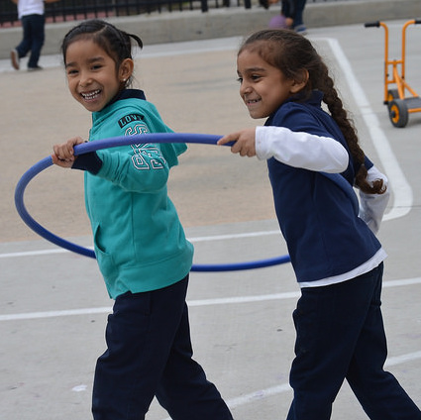
Stages of Sequential Bilingual Language Development
Home language use
Observational and listening period
Telegraphic and formulaic speech
Fluid language use
Notes:
Presenter Remarks:
Let’s review the stages of sequential bilingual language development:
Home language use
Observational and listening period
Telegraphic and formulaic speech
Fluid language use
Think about the children in your class who are English learners and what stage of language acquisition they may be at. Then consider their level of participation and engagement in singing activities. Brainstorm ways you can support the participation these children in your classroom.
The following information can be found in chapter five of the PEL Resource Guide, “Stages and Strategies in Second-Language Acquisition.”
Children do not necessarily follow these stages in a linear fashion. They often move in and out of these stages depending on the types of supports available to them in any particular interaction or setting:
Home Language Use
Children use home language
Teaching Tip: Activities should focus on listening comprehension
Teaching Tip: Activities should build receptive vocabulary
Observational and Listening Period
Children communicate with gestures and actions
Teaching Tip: Activities should expand receptive vocabulary
Teaching Tip: Activities should be designed to motivate children to produce vocabulary which they already understand
Telegraphic and Formulaic Speech
Children speak using one or two words or short phrases
Teaching Tip: Activities should expand receptive vocabulary
Teaching Tip: Activities are designed to develop higher levels of language use
Teaching Tip: Introduce language experience activities
Fluid Language Use
Children speak in longer phrases and complete sentences
Teaching Tip: Activities should expand receptive vocabulary
Teaching Tip: Activities are designed to develop higher levels of language use in content areas.

Slide 48
English Learners
“Continued use and development of the child’s home language will beneﬁt the child as he or she acquires English” (Preschool English Learners: Principles and Practices to Promote Language, Literacy, and Learning—A Resource Guide (Second Edition) [CDE], p. 43).
Notes:
Presenter Remarks:
Now that you’ve considered the stages of second language development, let’s look at what the PEL Resource Guide recommends for supporting English language development and the correlations to music and singing.
Read the slide or invite a participant to read it. “Continued use and development of the child’s home language will beneﬁt the child as he or she acquires English” (Preschool English Learners: Principles and Practices to Promote Language, Literacy, and Learning—A Resource Guide (Second Edition) [CDE], p. 43).
“Offer a rich variety of purposeful, playful, multisensory experiences with literacy and language, such as repetition accompanied by music or clapping” (U.S. Department of Education as cited in PEL Resource Guide, p. 85).
Children love to play with language. When talking to themselves and with others, they experiment with phrases and sounds. Correcting inaccurate language may hamper their tendency to experiment. Learning language is an important part of children’s cognitive development. One way in which TK teachers can help children acquire English as a second language is to support the continued development of their home language.
Extra Notes:
A good activity to illustrate these principles can be found on page 73 of the Preschool Curriculum Framework.
Use Handout 7: English-Language Development Strategies to provide examples.
Optional: Show the “Music and Movement” video clip from the Successful Language Development Strategies in the Early Childhood Classroom DVD, published by Educational Activities, Inc.

Slide 49
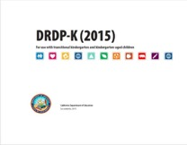
Key Features of the DRDP-K (2015)
An observation-based assessment tool, not a test
Individual child assessment
Completed by each child’s teacher
Based on developmental research and theory
Includes developmental sequences of behaviors along a continuum
Spans the developmental continuum of children in a two-year kindergarten program (TK)
Notes:
Presenter Remarks:
One resource that is used to support children’s development is the Desired Results Developmental Profile—Kindergarten (2015): A Developmental Continuum for Kindergarten (DRDP-K [2015]). This is especially helpful for English Learners.
The DRDP-K (2015) informs teachers’ understanding of the developmental continuum. It can be used with the Alignment Document to expand upon the developmental continuum.
One key feature of the DRDP-K (2015) to consider is that it is an observation-based assessment and not a test. It is used to support children’s learning. Observing and documenting children's progress provides teachers the information needed to differentiate instruction and experiences. It also provides information to individualize.
Observational tools are preferred over criterion-referenced tools because the information gathered by observation more accurately reflects what children are able to do.
Documentation provides concrete evidence of what children are able to do. With this documentation, we are then able to better plan activities that will meet and appropriately challenge children's developmental needs.
The DRDP-K (2015) also includes the following features:
It is an individual child assessment that can be shared with families.
It is aligned with the Preschool Learning Foundations.
It opens up the opportunity for articulation between preschool and TK teachers.
Sharing information as to where children are on the developmental continuum can better prepare the TK teacher to work with students.
A teacher can include a request form for previous records as part of the TK registration to help support the relationship between preschool, family, and TK.
The DRDP-K (2015) has been developed with world renowned experts. It is based on research and knowledge of what is most important for predicting school success.

Slide 50
DRDP-K (2015)
Notes:
Presenter Remarks:
The DRDP-K (2015) gives TK teachers a lens to measure the developing capacity of TK children to understand details and ideas from age-appropriate text presented by adults.
Take out Handout 2: Alignment Document and DRDP-K Measure VPA 2. The last page of this handout is a copy of the DRDP-K (2015) measure that most closely relates to the foundations for music.
Look closely at this DRDP-K (2015) measure. Take a few minutes to read each stage along with a few of the examples. Underline examples that you have seen in your classroom.

Slide 51
Musical Vocabulary
Beat and Rhythm Patterns
Melody
Time and Tempo
Timbre
Dynamics
©2017 California Department of Education
Notes:
Background Information:
The following glossary definitions can be found on pages 28-30 of the Preschool Learning Foundations, Volume 2.
Presenter Remarks:
Let’s review some key vocabulary concepts that are used in describing the Music strand foundations by referring to previous activities:
Beat: The beat or pulse in a piece of music is the regular rhythmic pattern of the music.
Activity 1: Going on a Bear Hunt
Rhythm: The rhythm is the controlled movement of music in time. Rhythm Patterns: A repeating pattern of beats and accents (loud and soft sounds) in music. Rhythmic Skills: The abilities to recognize and/or reproduce repeating pattern of beats and accents (loud/soft sounds) in music.
Activity 1: Going on a Bear Hunt
Melody: The melody is the “tune” you remember: pitches that are arranged in a tuneful manner; a succession of single tones or pitches perceived by the mind as a unity, etc.
Activity 6: Teacher as Songwriter
Time/Tempo: Time/tempo is the speed of music or a dance: fast, slow gradually changing; music styles with different time/tempos: waltz, march, merengue, salsa, etc.
Activity 1: Going on a Bear Hunt
Timbre: The timbre is the characteristic and distinct sound of each individual instrument or voice.
Activity 1: Going on a Bear Hunt
Dynamics: Dynamics is an element of musical expression relating to the degree of loudness or softness, or volume, of a sound.
Activity 1: Going on a Bear Hunt
Activity 5: Vocal Play

Slide 52
Teacher as Songwriter
Choose a familiar melody and a purpose for your song.
Work as a table group to create lyrics set to that tune.
Write your purpose, the tune, and your lyrics on the chart paper and place it on the wall.
Rehearse your song and be ready to share with the whole group.
Notes:
Activity 6: Teacher as Songwriter
Presenter Remarks:
Now we are going to create songs to support smooth transitions.
intent:
Engage teachers in a process of creating their own song lyrics based on familiar tunes that can be used to support smooth transitions, English learners, memory, cooperation, and other learning domains based on needs of students.
OUTCOME:
Participants create and use their own songs to enhance learning for children and support positive classroom management strategies.
Materials Required:
Chart paper/markers for each table group
Cards with sample songs
Time: 15-30 minutes
Process:
Distribute song card samples to each table group.
Presenter introduces activity by saying, “Writing your own song lyrics allow the teacher to personalize a song to meet the particular needs of his/her group of children. All parts of your daily schedule can be connected by using simple, familiar melodies such as “Where is Thumbkin?” or “Are You Sleeping?” with specific verses to meet the needs of your class.” This strategy supports transitions/classroom management, self-regulation, group participation, cooperation and responsibility, English language development, sequencing and memory, and vocabulary development. It’s also a stress reliever and increases the joy in any activity!
Reference: Learning through Music: The Support of Brain Research by Elizabeth Carlton. Exchange, Curriculum: Art, Music, Movement, Drama A Beginnings Workshop Book, pp. 45-48, edited by Bonnie Neugebauer.
Instruct participants to:
Choose a familiar melody and a purpose for your song. (Participants may use the Song Card samples for inspiration or a personal favorite. Songs can be in any language.)
Work as a table group to create lyrics set to that tune.
Using the chart paper, write your purpose, the tune and your lyrics. Place chart on the wall.
Rehearse your song. Be ready to share with the whole group.
For reporting back to whole group, have as many groups share their songs as time allows. Leave the charts around the room so participants can take a gallery walk at a break or after the workshop.
OPTIONAL:
To provide an opportunity for participants to get up and move during this activity, place chart paper on the walls spaced around the room. Direct table groups to select a chart paper and then follow the instructions to create their song.

Slide 53
Sharing Our “Key Notes”
Write one or two “key notes” from today’s training on the colored musical notes on your tabletop.
Share your “key notes” with your elbow partner.
Notes:
Presenter Remarks:
Write one or two “key notes” you want to remember from today on the colored musical notes on your table.
When finished, share your key notes with your elbow partner.

Slide 54
Thank You for Coming!
Notes:
Presenter Remarks:
Thank you for your participation and engagement in today’s Music in Transitional Kindergarten training!

Slide 55
Reference Guide for PowerPoint Citations
California Department of Education. 2011. California Preschool Curriculum Framework, Volume 2. http://www.cde.ca.gov/sp/cd/re/documents/psframeworkvol2.pdf (accessed January 6, 2017).
California Department of Education. 2008. California Preschool Learning Foundations, Volume 2. http://www.cde.ca.gov/sp/cd/re/documents/psfoundationsvol2.pdf (accessed January 6, 2017).
Carlton, Elizabeth. "Learning Through Music: The Support of Brain Research." In Curriculum: Art, Music, Movement, Drama: a Beginnings Workshop Book, edited by Bonnie Neugebauer, 53-57. Child Care Info Exchange, 2005.

