Slide 1
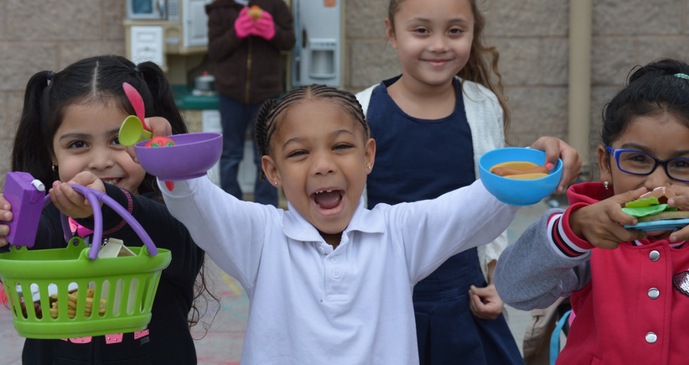
Transitional Kindergarten Mathematics: Mathematical Reasoning
California Preschool Learning Foundations, Volume 1
California Preschool Curriculum Framework, Volume 1
Notes:
Presenter Remarks:
Welcome to Transitional Kindergarten Mathematics: Mathematical Reasoning—a presentation focusing on the California Preschool Learning Foundations (Preschool Learning Foundations or PLF), the California Preschool Curriculum Framework (Preschool Curriculum Framework or PCF), and other California Department of Education (CDE) resources in support of the Mathematics domain.
This professional learning session is specifically designed to provide TK teachers with exposure to CDE resources that support TK curriculum planning, developmentally appropriate strategies, and classroom environment design recommendations that support the content area of math reasoning.

Slide 2
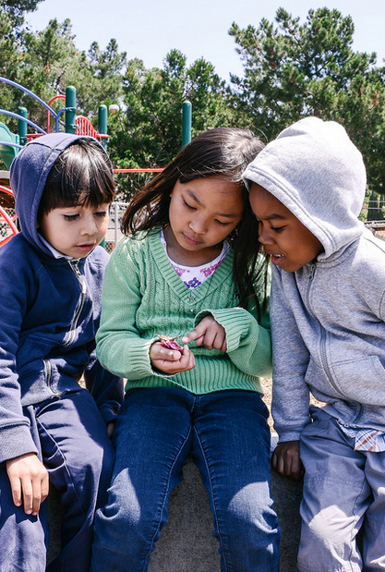
Math Reasoning
“Mathematical reasoning is a key process in learning and developing mathematical knowledge in all areas of mathematics…”
(PCF, Vol. 1, p. 290).
©2016 California Department of Education
Notes:
Presenter Remarks:
“Mathematical reasoning is a key process in learning and developing mathematical knowledge in all areas of mathematics…” (PCF, Vol. 1, p. 290).
What words from this quote stand out to you?
(Participants may notice “key,” “process” or “all areas of mathematics.” Any of these words indicate the importance of math reasoning.)
There will be many opportunities today for us to consider how math reasoning connects not only to math content areas but also to other domains such as the Science, Social-Emotional, and Language and Literacy domains.

Slide 3
Objectives
Become aware of key concepts to be developed in the Mathematical Reasoning strand of the California Preschool Learning Foundations, Volume 1 (Preschool Learning Foundations or PLF).
Experience, read, and discuss key strategies in the California Preschool Curriculum Framework, Volume 1 (Preschool Curriculum Framework or PCF) regarding mathematical reasoning development.
Reflect and discuss how to support the development of mathematical reasoning foundations for English-language learners.
Plan to adapt learning experiences to ensure access for children with varying needs.
Notes:
Presenter Remarks:
Become aware of key concepts to be developed in the Mathematical Reasoning strand of the California Preschool Learning Foundations, Volume 1 (Preschool Learning Foundations or PLF).
Experience, read, and discuss key strategies in the California Preschool Curriculum Framework, Volume 1 (Preschool Curriculum Framework or PCF) regarding mathematical reasoning development.
Reflect and discuss how to support the development of mathematical reasoning foundations for children learning English as a second language.
Plan to adapt learning experiences to ensure access for children with varying needs.
The last two bullets will be interwoven throughout the presentation.

Slide 4

Mathematical Reasoning Data Collection
Please walk around the room and add your information to the Daily Data charts.
Notes:
Activity 1: Daily Data
Presenter Remarks:
Observing and thinking about data is an important component of mathematical reasoning.
To begin let’s collect some of our own data to discuss. Please walk around the room and add your information/data to the Daily Data charts hung around the room. Once you have added information to all the charts please take a seat and discuss your thoughts regarding the charts with your groupmates.
When everyone is done adding their information to the charts we will look at our data to see what information we might be able to glean. (See activity process for full description of steps.)
intent:
Begin thinking about math in the classroom and experience different ways to support math reasoning through graphing.
OUTCOMES:
Participants will contribute to a welcome activity that involves math and will connect that activity to math concepts presented throughout the training.
Materials Required:
2-3 Daily Data charts (see example below)
Facilitator can make up own questions - try to have at least two different types of charts (e.g., Venn diagram and t-chart).
PPT Notes
Handout 1: Taking It Back to the Classroom
Time: 10 minutes total (5 minutes at the beginning of day and 5 minutes near closing)
Process:
Prior to the training:
Put 2-3 daily data charts up in the room. Examples:
A Venn Diagram with two circles overlapping: “I love math and can’t wait to learn more!” vs. “Math is my least favorite and I am scared you will give us a test today.”
A t-chart with the title “I do more…” and two columns labeled “math songs” and “math stories.”
A bar graph with numbers on the “Y” axis and the following four strands on the “X” axis: Numbers Sense, Geometry, Algebra and Function, and Measurement. Title the bar graph “Rate Your Ability in Each.”
Begin the activity:
Welcome participants as they enter and ask them to put their responses on the charts. Point out the slide being projected with the directions.
Wander the room supporting conversation as participants provide their daily data.
Debrief:
Say, “Let’s see what our daily data tells us.” Potential information:
Our bias towards math
Our strengths in math
Highlight that we are focusing on math reasoning; this means that we are looking all math content areas and can capitalize on any and all of our math strengths.
Point out the variety of responses (if there is variety) and emphasize that participants can use each other to expand their ideas.
Ask participants how they currently use charts and or graphs in the classroom.
Say, “Throughout the day we will deepen our understanding of math reasoning as it pertains to the Preschool Learning Foundations. Remember to think about how you may want to add graphs like those we just created to support this development in your classroom.”

Slide 5








CDE Publications and Resources that Support TK Math Implementation
Preschool Learning Foundations
California Common Core State Standards
Preschool Curriculum Framework
Math Framework
DRDP-K
Alignment Document
Preschool English Learners
TK Implementation Guide
Preschool Learning Foundations
California Common Core State Standards
Preschool Curriculum Framework
Mathematics Framework
DRDP Specific to TK and K
Alignment Document
Preschool English Learners Guide
Transitional Kindergarten Implementation Guide
Notes:
Presenter Remarks:
The California Department of Education has developed many publications, resources, and supports that enable teachers to facilitate the most positive outcomes for students.
Today our main focus will be on Volume 1 of the Preschool Learning Foundations and the Preschool Curriculum Framework. In addition, there are other key resources that support math: the California Common Core State Standards (CA CCSS) for Mathematics in kindergarten, the TK chapter of the Mathematics Framework for California Public Schools: Kindergarten Through Grade Twelve (Math Framework), the Transitional Kindergarten Implementation Guide—A Resource for Public School District Administrators and Teachers (TK Implementation Guide), and the Desired Results Developmental Profile—Kindergarten (2015): A Developmental Continuum for Kindergarten (DRDP-K [2015]).
(Name and hold up each resource.) The Preschool Learning Foundations, Volume 1, Volume 2, and Volume 3, and the Preschool Curriculum Framework, Volume 1, Volume 2, and Volume 3, are the center of the California Early Learning and Development System.
During additional professional learning opportunities we will also discuss alignment and make connections to all additional resources pictured in the graphic:
The Alignment of the California Preschool Learning Foundations with Key Early Education Resources (Alignment Document)
CA CCSS
Math Framework
TK Implementation Guide
DRDP-K (2015)

Slide 6
Why Use the Preschool Learning Foundations for TK?
CA Law (EC 48000):
Transitional kindergarten is the first year of a two-year kindergarten program that uses a modified kindergarten curriculum that is age and developmentally appropriate.
Transitional kindergarten programs are intended to be aligned to the California Preschool Learning Foundations developed by the CDE.
Notes:
Background Information:
CDE.CA.gov/ci/gs/em/kinderfaq.asp#program
Presenter Remarks:
The state of California provides guidance on utilizing the Preschool Learning Foundations and the Preschool Curriculum Framework as planning and curriculum resources in the TK classroom.
In addition, the following publications and resources are available to support age and developmentally appropriate TK curriculum:
TK Implementation Guide
Alignment Document
CA CCSS
Math Framework
DRDP-K

Slide 7

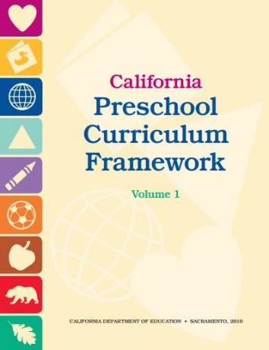
Foundations and Framework, Volume 1
Notes:
7
Presenter Remarks:
The purpose of the Preschool Learning Foundations is to promote a common understanding of preschool children’s learning and to guide instructional practice; they describe the knowledge and skills that young children typically develop when provided with developmentally, culturally, and linguistically appropriate learning experiences.
The Preschool Curriculum Framework was created as a companion to the Preschool Learning Foundations. The framework, “…presents strategies and information to enrich learning and development opportunities for all children” (PCF, Vol. 1, p. v).
The foundations and framework are designed to work together. While the foundations—known as standards in the K-12 arena—provide the background information to understand children’s developing knowledge and skills (the what), the curriculum framework offers guidance on how teachers and programs can support the learning and development that are described in the foundations (the how).
Extra Notes:
The foundations were developed with research-based evidence and are enhanced with expert practitioners’ suggestions and examples. All of the foundations were written by a team of researchers with expertise in that domain. A complete reference list of the source materials, along with detailed bibliographic notes for each of the developmental domains, can be found in the Preschool Learning Foundations. Sources used in the development of the foundations include:
Documents from CDE, such as the English-Language Arts Content Standards for California Public Schools, Kindergarten Through Grade Twelve (Language and Literacy, Introduction, page 48, left column).
Well-validated assessment tools such as the Ages & Stages Questionnaires (ASQ): A Parent-Completed, Child-Monitoring System (Social-Emotional, References and Source Materials, page 36).
General sources such as the Report of the National Reading Panel 2000 (Language and Literacy, Introduction, page 73, left column).
Early childhood education standards from other states, such as Hawaii and Texas (Social-Emotional, Introduction, page 5, footnote).

Slide 8

High Quality Programming and Appropriate Support
Describes what children should be able to do at around 48 and 60 months
Assumes children have access to appropriate support and high-quality programs
Notes:
Presenter Remarks:
Volume 1 of the Preschool Learning Foundations addresses four domains: Social-Emotional Development, Language and Literacy, English-Language Development, and Mathematics.
Today we are reviewing the chapter on mathematics. Let’s take a closer look at one foundation for an example:
Open the Preschool Learning Foundations and find a page where the age levels appear. This is an example of a foundation page. Compare pages with your elbow partner (allow 1 minute).
Let’s look at these pages together.
Look across the page and notice the developmental progression at around 48 months and what changes at 60 months of age. (Solicit a few participants to read what they see.)
(Summarize the exploration with the following key note.) Because children develop at different rates the foundations were designed to support the belief that certain stages of development will occur at different times for all students. You will notice “at around” in the description. It is important to remember that this variability occurs.
The foundations also assume that children have access to appropriate support in high-quality programs. This includes:
Environments and experiences that encourage active, playful exploration and experimentation
Clearly defined learning centers where materials are rotated
Purposeful teaching to help children gain knowledge and skills
Predictable schedules and routines with large blocks of time for play and skillful integration of curriculum with an intentional focus on content
Specific support for English learners with staff that have knowledge of the stages of English-language acquisition
Accommodations and adaptations for children with disabilities and additional support when needed

Slide 9
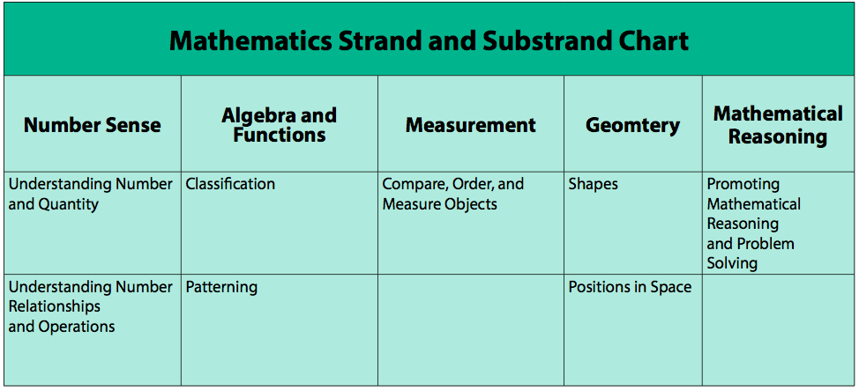
Mathematics Strand and Substrand Chart
Number Sense
  Understanding Number and Quantity
  Understanding Number Relationships and Operations
Algebra and Functions
  Classification
  Patterning
Measurement
  Compare, Order, and Measure Objects
Geometry
  Shapes
  Positions in Space
Mathematical Reasoning
  Promoting Mathematical Reasoning and Problem Solving
Notes:
Presenter Remarks:
The Preschool Learning Foundations in Mathematics cover five main developmental strands: Number Sense, Algebra and Functions (Classification and Patterning), Measurement, Geometry, and Mathematical Reasoning.
These strands were identified after a careful review of research including research by the National Council of Teachers on Mathematics, the Principles and Standards for School Mathematics, and the California Mathematics Content Standards for Kindergarten through Grade 12 (K–12).
Today’s focus will be on the Math Reasoning strand.

Slide 10
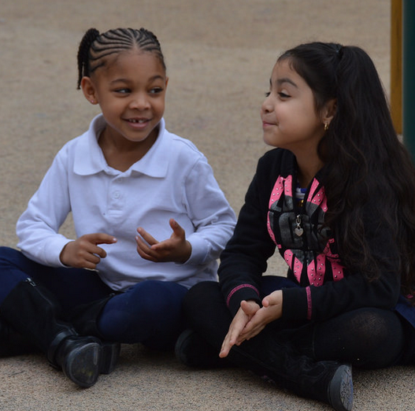
Mathematical Reasoning
Think
Reason logically
Apply math knowledge
Create different solutions
Notes:
Presenter Remarks:
Mathematical reasoning is the process of learning and developing mathematical knowledge in all areas of mathematics.
Included in this strand is the child’s ability to reason and apply mathematical knowledge and skills to solve problems in the everyday environment.
“[Mathematical reasoning] involves the ability to think and reason logically, to apply mathematical knowledge in different problem-solving situations, and to come up with different solutions. Mathematical reasoning is natural to most young children as they explore the environment and make sense of the world around them” (PCF, Vol. 1, p. 290).

Slide 11
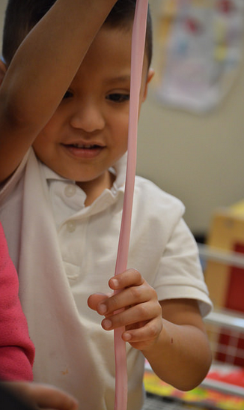
Preschool Curriculum Framework
The Preschool Curriculum Framework, “…presents strategies and information to enrich learning and development opportunities for all of California’s preschool children”
(PCF, Vol. 1, p. v).
©2016 California Department of Education
Notes:
Presenter Remarks:
The Preschool Curriculum Framework, “…presents strategies and information to enrich learning and development opportunities for all of California’s preschool children”(PCF, Vol. 1, p. v).
This resource provides teachers with the opportunity to gain ideas and expand their tool box of strategies to support mathematical reasoning in the classroom.

Slide 12

Mathematics Domain
Framework Strategies
Developmentally appropriate
Reflective and intentional
Individually and culturally meaningful
Inclusive
Notes:
Presenter Remarks:
The Preschool Curriculum Framework offers guidance on how teachers—through planned learning environments, materials, and experiences that are developmentally appropriate, individually and culturally meaningful, and engaging to families—can support the learning and development described in the foundations.
“Teachers address ideas and concepts that children can grasp at their developmental level and then progressively build on what children already know and understand. This approach applies to all children, including children with various abilities, disabilities, or other special needs (such as delays in language, cognition, or physical ability)” (PCF, Vol. 2, p. 227).
The Mathematics domain begins with guiding principles that set the tone for the entire chapter. Let’s take a moment to look at these guiding principles to see how they are:
Developmentally appropriate
Reflective and intentional
Individually and culturally meaningful
Inclusive

Slide 13
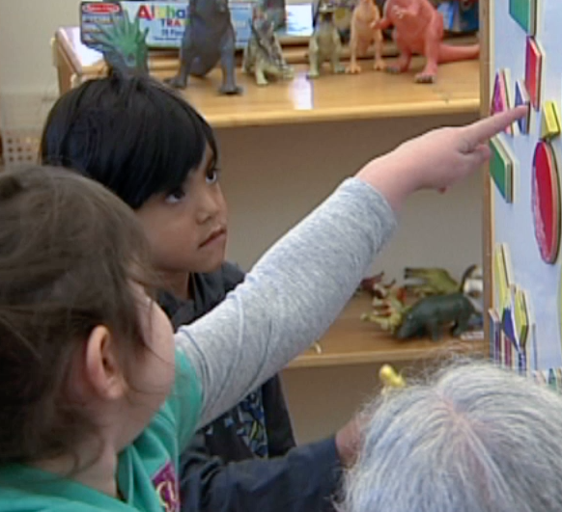
Universal Design for Learning
Universal design provides for:
Multiple means of representation
Multiple means of engagement
Multiple means of expression
(Preschool Curriculum Framework, Volume 1, p. 13)
©2016 California Department of Education
Notes:
Background Information:
PCF, Vol. 1, p. 13
Presenter Remarks:
The strategies within the Preschool Curriculum Framework include the concept known as Universal Design for Learning (UDL). This means there are many suggestions incorporated to support learning that can be used to provide multiple means of representation, engagement, and expression.
(If participants are not familiar with Universal Design for Learning have them read the description on page 13 of the Preschool Curriculum Framework [Vol. 1].)
“Universal design provides for multiple means of representation, multiple means of engagement, and multiple means of expression. Multiple means of representation refers to providing information in a variety of ways so that the learning needs of all children are met. For example, it is important to speak clearly to children with auditory disabilities while also presenting information visually, such as with objects and pictures. Multiple means of expression refers to allowing children to use alternative ways to communicate or demonstrate what they know or what they are feeling. For example, when a teacher seeks a verbal response, a child may respond in any language, including American Sign Language. A child with special needs who cannot speak may also respond by pointing, by gazing, by gesturing, by using a picture system of communication, or by using any other form of alternative or augmented communication system. Multiple means of engagement refers to providing choices in the setting or program that facilitate learning by building on children's interests. The information in this curriculum framework has been worded to incorporate multiple means of representation, expression, and engagement” (PCF, Vol. 1, p. 13).

Slide 14
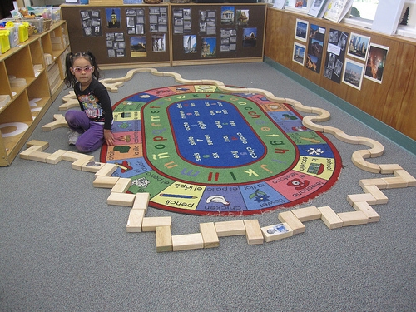
Guiding Principles
Discuss with your partner:
What immediate thoughts does this guiding principle inspire?
How do you see this guiding principle represented on a daily, weekly, or monthly basis?
What is one idea can you take from this guiding principle?
©2016 California Department of Education
Notes:
Activity 2: Picture It – Guiding Principles
Presenter Remarks:
The guiding principles provide the developmentally appropriate lens through which to read the strategies in the Preschool Curriculum Framework.
Understanding the guiding principles is one way teachers can embed appropriate math reasoning learning opportunities throughout the day.
Let’s look at the guiding principles for math and think about how they relate to our discussion of math reasoning.
Please find the Guiding Principle envelope on your tabletop. Reach into and the envelope and pull out one card—this card shows half of a guiding principle.
Now walk around the room around meeting the other participants until you find the other half of your guiding principle card—the person holding the other half of your card will be your partner.
Once you have a partner, read your full guiding principle and discuss the questions on the slide with them.
intent:
Become familiar with the guiding principles while interacting with each other.
OUTCOMES:
Participants will gain an understanding of the guiding principles for the Mathematics domain.
Materials Required:
PPT notes
Guiding Principles cards (laminated with photos on back)
Cards are cut in half so the guiding principle is unreadable
Guiding Principles envelope
Time: 15 minutes
Process:
Direct participants to the Guiding Principles envelope.
Have each participant reach into the Guiding Principles envelope and choose their half of a card.
Invite participants to wander around the room until they find the other half of their card.
Use the following questions to prompt discussion after participants have found their other half:
What immediate thoughts does this guiding principle inspire?
How do you see this guiding principle represented on a daily, weekly, or monthly basis?
What is one idea can you take from this guiding principle?
Invite participants to share out their “aha” moments, or have them go back to their table groups and share with their tablemates.

Slide 15
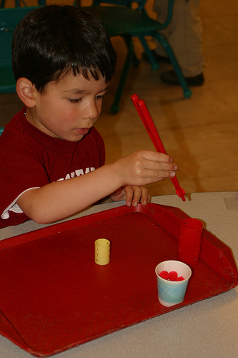
Research Bite
Recent research indicates that school-entry math skills have the greatest predictive power for later achievement in school, compared with reading, attention, and social-emotional skills.
©2016 California Department of Education
Notes:
Presenter Remarks:
Across six longitudinal studies that examined the link between three key elements of school readiness—school-entry academics, attention, and social-emotional skills—and later school reading and math achievement, the strongest predictors of later achievement were, “…school-entry math, reading, and attention skills. A meta-analysis of the results shows that early math skills have the greatest predictive power, followed by reading and then attention skills” (Greg J. Duncan et al., “School Readiness and Later Achievement,” p. 1428).
Consider the possible implications of this research and discuss your thoughts with your tablemates. Work together to come up with a statement—seven words or less—describing your conversation. You have 3-5 minutes to converse and come up with your statement.
Here are a few examples of what your statement might look like:
We must focus on math. (five words)
We must focus on integration of math. (seven words)
Math is important for all students. (six words)

Slide 16
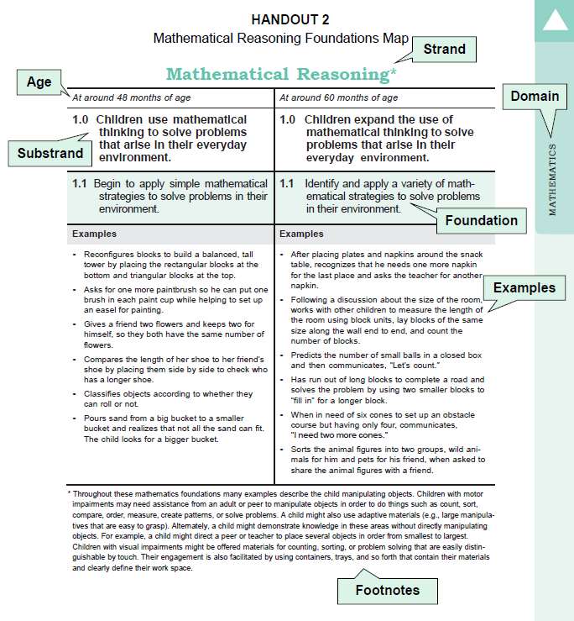
Map of the Foundations
Notes:
Presenter Remarks:
We have discussed the value and importance of math; now let’s take a closer look at math reasoning and how it is described in the Preschool Learning Foundations.
Please take out Handout 2: Mathematical Reasoning Foundations Map.
This foundation map provides a snapshot of the foundation organization. You may also turn to page 159 of the Preschool Learning Foundations (Vol. 1) to follow along.
The foundation chart provides another way to take notes on the foundations. Throughout the day we will continually return to this chart to add ideas and compare the foundation at 48 and 60 months.

Slide 17
Math Reasoning Foundation:
Video Example
Notes:
Background Information:
Prior to training embed the Math Reasoning Foundation Video Example (both 48 and 60 month levels).
Presenter Remarks:
At 48 months young children, “Begin to apply simple mathematical strategies to solve problems in their environment” (PLF, Vol 1, p. 159); at 60 months young children, “Identify and apply a variety of mathematical strategies to solve problems in their environment” (PLF, Vol. 1, p. 159).
Let’s watch a video example of this shift. Be prepared to discuss what you observe.

Slide 18
Math Reasoning Foundations:
Video Example
Pull a number from the number bin on your table.
Find someone with a different number than you and exchange your thoughts about the discussion questions with them.
Questions:
What observations did you make about the developmental shift?
What did you find most interesting about the developmental shift examples in the video?
Notes:
Background Information:
Prior to the training, place numbered bins on the tabletops. Each bin should be filled with enough numbers for each groupmate to have their own; for example, the table with the #1 bin will have a bucket with six number 1s in it, the table with the #2 bin will have a bucket with six number 2s in it, etc.
Presenter Remarks:
The video we just watched had some excellent examples of the developmental shift that occurs between four and five years old.
Please take a moment to finish making notes on your Video Viewing Guide, then:
Pull a number from the number bin on your table.
Find someone with a different number than you and exchange thoughts about the discussion questions; you will have about five minutes for this discussion.
(Invite everyone back to their seats after five minutes.)
Would anyone like to share one interesting thought they discussed with their partner? (Invite 2-3 people to share.)
This video showed the developmental shift that occurs between 4 and 5 years old. We will use the Alignment Document to help us think about the next developmental shift.

Slide 19
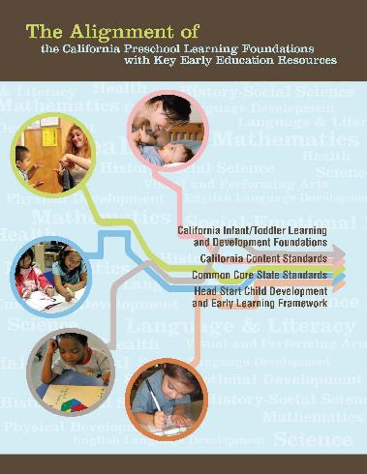
Alignment Document
http://www.cde.ca.gov/sp/cd/re/documents/psalignment.pdf
Notes:
Presenter Remarks:
The Alignment Document is another resource that will help answer questions related to developmental progressions.
Discuss the following questions with your table group (allow 3 minutes):
What do you know about this document?
How do you use it in your work now?
Extra Notes:
Depending on the size of your group, participants can share responses with tablemates or in pairs.

Slide 20
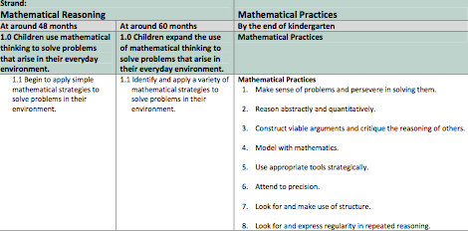
Alignment Document
http://www.cde.ca.gov/sp/cd/re/documents/psalignment.pdf
Notes:
Presenter Remarks:
Please take out Handout 3: Mathematical Reasoning Alignment.
The table on the slide details the alignment between specific preschool foundations and the eight mathematical practices that all teachers should be developing in their students’ mathematical thinking—regardless of the age of their students. The alignment between these foundations and mathematical practices communicates the need for teachers to begin supporting these practices in four and five year olds.
Extra Notes:
If you would like to go deeper into the Alignment Document, the following link will allow you to download the document: http://www.cde.ca.gov/sp/cd/re/documents/psalignment.pdf

Slide 21
Common Themes in Vignettes:
Making Connections Between Frameworks (PK-K/12)
First:
Find the labeled piece of chart paper on your tabletop.
Read each vignette in your strand.
Discuss and chart the common themes from the vignettes.
    Use words or pictures
Second:
Find your Eight Mathematical Practices envelope.
Tape to your chart the mathematical practice cards that align with the vignettes and common themes represented on your chart.
Prepare to share what you notice with the whole group.
Notes:
Activity 3: Common Themes in Vignettes
Background Information:
Prior to activity, provide each table group with a chart paper labeled with a strand title: Number Sense, Algebra and Functions [Classification and Patterning], Measurement, or Geometry.
Presenter Remarks:
We are going to look at common themes found throughout the Mathematics domain.
Please begin by reading through the vignettes in your assigned strand; you can read them all together or divide them up between group members. (Allow time for all vignettes to be read.)
(See activity process for full description of steps.)
intent:
Read through vignettes to find common themes.
OUTCOMES:
Participants will find common themes in the Mathematics domain and make connections to the eight mathematical practices.
Materials Required:
Preschool Curriculum Framework (PCF)
Sticky Wall
Chart paper placed on edge of each table group table (Title each piece of chart paper with the name of one of four Mathematics strands: Number Sense, Algebra and Functions [Classification and Patterning], Measurement, or Geometry)
Markers
Handout 4: Math Practices
Envelope labeled “Eight Mathematical Practices” containing the Eight Mathematical Practices cards (card stock sheet pre-cut by trainer into individual cards)
Tape for each table group
Time: 30 minutes
Process:
Prior to activity, provide each table group with a chart paper labeled with a strand title: Number Sense, Algebra and Functions [Classification and Patterning], Measurement, or Geometry.
PART 1
Have tablemates to read through the vignettes in their assigned strand; they may decide to read them all together or divide them up between group members. (Allow time for all vignettes to be read.)
Ask groups to discuss the common themes they found. For example:
Does each vignette include play?
Does each vignette include problem solving?
PART 2
Invite participants to use words and/or pictures to create a visual representation of the common themes from their assigned vignette. They may use any color markers they wish. (Allow time for groups to finish creating charts.)
PART 3
Ask groups to find the envelope at their table labeled “Eight Mathematical Practices.”
Guide participants to open the envelope and look at the individual Eight Mathematical Practices cards.
Ask groups to consider the vignettes from their assigned strand and to select the mathematical practice cards that align with the vignettes and common themes represented on their chart; have them tape the cards they select to their chart.
Debrief:
Invite groups to share briefly.
Highlight the connections between the vignettes that represent developmentally appropriate early childhood classroom experiences and the eight mathematical practices.

Slide 22
Why Early Childhood Is the Right Time to Start Learning Math
Dr. Clements says:
Children like to play with math!
What can you do to provide opportunities for this type of play?
Notes:
Background Information:
Click on the blue words “Dr. Clements Says” to connect to a YouTube video (https://youtu.be/B2Z0djuCDKA).
Dr. Clements is a national researcher and expert in mathematics development. He is one of the authors of the Preschool Learning Foundations and Preschool Curriculum Framework as well as the CA CCSS for Mathematics.
Presenter Remarks:
We will now watch a video clip of Dr. Clements. Afterwards, we will discuss the statement, “Children like to play with math.”
Do you see this type of play in your classroom? What do you need to do to provide more of these child-initiated play-based opportunities?

Slide 23
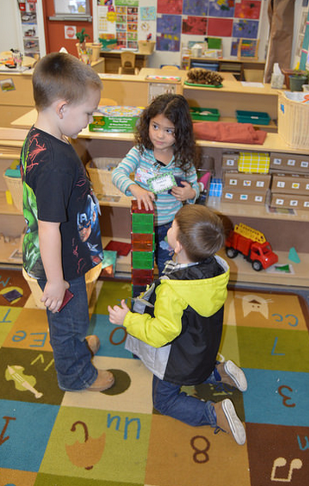
Guiding Principle
“Use everyday activities as natural vehicles for developing preschool [and TK] children’s mathematical knowledge” (PCF, Vol. 1, p. 234).
©2016 California Department of Education
Notes:
Presenter Remarks:
One guiding principle that directly relates to the message we just heard form Dr. Clements is, “Use everyday activities as natural vehicles for developing preschool children’s mathematical knowledge“ (PCF, Vol. 1, p. 234).
“Teachers should build upon the naturally occurring mathematics in children’s daily activities and capitalize on ‘teachable moments’ during such activities to extend children’s mathematical understanding and interest” (PCF, Vol. 1, p. 234).
In order to have these rich teachable moments the environment needs to have rich materials for children to play and explore with.
The Preschool Curriculum Framework, Volume 1, p. 237, includes an entire section with ideas for environments and materials for increasing math development. Let’s take a look at this section now.

Slide 24
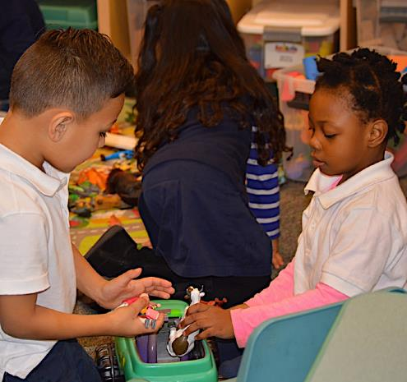
Environments and Materials
“Use materials and objects that are relevant and meaningful to the children in your group”
(PCF, Vol. 1, p. 238).
©2016 California Department of Education
Notes:
Presenter Remarks:
“Use materials and objects that are relevant and meaningful to the children in your group. Mathematical concepts and skills such as counting, sorting, and measuring can be learned with different materials and in various contexts. It is valuable to introduce math in a context that is familiar and relevant to children’s life experiences. Use materials, books, and real-life settings that reflect the culture, ways of life, and languages of the children in the group. When mathematical concepts are embedded in a context that is personally relevant to individual children, experiences are more pleasurable and meaningful” (PCF, Vol. 1, p. 238).
This strategy is easily achieved if teachers and families have relationships. Inviting families to share the types of experiences that children enjoy at home will enable teachers to replicate these experiences at school.
This strategy may also be helpful to some students with a disabilities. All children are different; but teachers may find that children with disabilities are more apt to explore and interact with objects if they are familiar with them.

Slide 25
Environment and Materials List
Wooden blocks
Tree cookies
Geometric foam blocks
Paper towel rolls
Boxes
Rocks
Acorns
Beads
Cubes
Buttons
Numeral blocks
Felt pieces or finger puppets to go with the books
Counting games (chutes and ladders)
Dice
Spinners
Measuring cups
Spoons
Scale
Register, measuring tape
Notes:
Background Information:
If presenter wishes to see what a tree cookie looks like in order to describe it during the training the following link may be used (https://www.google.com/search?q=tree+cookies&client=safari&rls=en&source=lnms&tbm=isch&sa=X&ved=0ahUKEwiojfy54djPAhXHXD4KHe-TDQkQ_AUICSgC&biw=1275&bih=627#imgrc=ir5U_5SQ4z-o7M%3A).
Presenter Remarks:
On the slide you see a small sample of materials that may provide opportunities for children to engage with math.
Look at the first three bullets (wooden blocks, tree cookies, and foam blocks). By including three different types of building materials children are able to compare, notice differences, experiment, and build more intricate structures.
Continuing down the list, the next four bullets (paper towel rolls, boxes, rocks, and acorns) are all essentially “free” items. It does not require spending an exorbitant amount of money at education stores to create a mathematically rich and diverse environment. Teachers can partner with families and the community to gather materials that can be sorted, counted, measured, and compared.
It is also important to consider how students will work with, manipulate, and move the materials in the environment. When looking at items that can be counted or organized, be sure to have multiple sizes so students who may have fine motor delays can choose to use the bigger items. Likewise, make sure to have items that can be manipulated while sitting down for children who use assistive devices to walk or stand.
“If children are receiving special education services, teachers should ask for ideas from the specialists and families” (PCF, Vol. 1, pp. 236-237).

Slide 26
Mathematize Your Environment
Read Handout 5: Math Environments and Materials with an elbow partner.
Walk around the room to gather more ideas (if you so desire).
Write down the ideas/items you would like to add to your classroom on Handout 6: Creating Invitations Throughout the Environment—Taking Inventory.
Choose two of your favorite ideas to share with your table group.
Notes:
Activity 4: Mathematizing the Environment
Presenter Remarks:
We will now read the Environments and Materials section from the Preschool Curriculum Framework (Vol. 1) and apply the ideas to your classroom environments.
Please take Handout 5: Math Environments and Materials and Handout 6: Creating Invitations Throughout the Environment—Taking Inventory.
Read through Handout 5: Math Environments and Materials with an elbow partner; write down any ideas you would like to add to your own classroom environment on Handout 6: Creating Invitations Throughout the Environment—Taking Inventory. Feel free to also stand up and wander around the room to look at the various math materials we have here today for inspiration. (Allow time for participants to finish.)
Review the ideas that you wrote down. Circle the two ideas that you are most excited to add to your learning environment and share those ideas with your table group.
intent:
Brainstorm ideas for materials and activities intended for interest areas that support children’s development in each of the Mathematics strands.
OUTCOMES:
Participants will leave the training with:
Concrete material ideas for each math strand that will strengthen their interest areas
An inventory sheet that can be filled out upon return to their classrooms
Materials Required:
Handout 6: Creating Invitations Throughout the Environment—Taking Inventory (two-sided handout, one side to be completed during training)
Handout 5: Math Environments and Materials (PCF pages 237-240)
PPT slides
Optional: Math materials as samples on tabletops
Optional: Math materials on display gallery table
Time: 20 minutes
Process:
Optional: Prior to the training set up a gallery table with sample math materials or place a tray with sample items on each tabletop. Use the list on the Environments and Materials PPT slide for ideas.
Ask participants to read Handout 5: Math Environments and Materials.
Direct participants to pair up with an elbow partner and brainstorm ideas for materials for each interest area that support children’s development in each of the Mathematics strands. Have them record ideas on Handout 6: Creating Invitations Throughout the Environment—Taking Inventory.
(After 10 minutes) Ask participants to finish-up by circling two ideas they are most excited to add to their classroom environment.
Have participants flip to the back side of the handout; point out that this can be used as an inventory list to help see what areas they might choose to focus on and add materials to in their own classrooms.
Ask if anyone in the group would like to share something surprising they wrote on their handout.

Slide 27
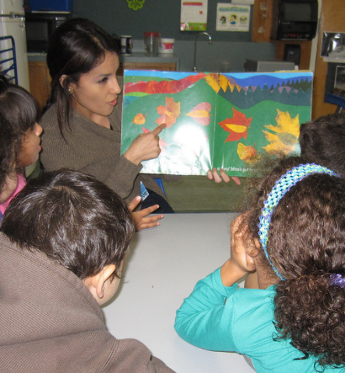
Guiding Principle
“Provide an environment rich in language, and introduce preschool [and TK] children to the language of mathematics” (PCF, Vol. 1, p. 235).
©2016 California Department of Education
Notes:
Presenter Remarks:
“Provide an environment rich in language, and introduce preschool [and TK] children to the language of mathematics. Language is a critical element in mathematics. Children should be introduced to mathematical vocabulary as well as to natural language in meaningful contexts” (PCF, Vol. 1, p. 235).
Teachers can label items in the classroom to enhance children’s vocabulary. Turn to your elbow partner and discuss the following questions:
How do you provide an environment that is rich in language?
How do you provide an environment that is rich in language for English learners?

Slide 28
Promote Investigation with Questions
First:
Second:
Read Handout 7: Language of Logic and Reasoning and highlight something in each section.
Write one of the questions on a sentence strip.
Select one participant from each table group to be the “observer.”
  Observers will leave the room for one minute.
Look to the front of the room to find the directions to sort.
Self-sort your table group according to the directions.
Bring observers back; they will use questions to reason and determine how the groups are sorted.
©2016 California Department of Education
Notes:
Activity 5: Language of Logic and Reasoning
Presenter Remarks:
Please take out Handout 7: Language of Logic and Reasoning.
One effective way to encourage transitional kindergarten children to think and reason mathematically is by asking questions that promote investigation and inquiry and challenge them to think through a problem and come up with a solution. For example:
How do you think we can find out who has more cars?
What is the class’ favorite kind of apple?
How can we find out …?
Which do you think is taller, the table or the tower?
What would happen if…?
We are going to focus on the language of logic and reasoning. First, we will look at Handout 7: Language of Logic and Reasoning. Next, we will make a sentence strip that will help remind us to use this language in the classroom. Lastly, we will practice using these questions and responses to reason about a problem. (See activity process for full description of steps.)
intent:
Become familiar with vocabulary and questions that support mathematical reasoning across the Mathematics strands.
OUTCOMES:
Participants will gain a greater understanding of the types of questions and vocabulary used to support children’s mathematical reasoning.
Materials Required:
PPT notes
Handout 7: Language of Logic and Reasoning
PPT slides
Sentence strips (1-2 per person)
Dark marker (1 per person)
Highlighters
Sign for grouping people (Part 2 of activity)
Time: 15 minutes
Process:
Part 1
Direct participants to Handout 7: Language of Logic and Reasoning.
Use echo reading, or another group reading strategy, to read through the handout.
Direct participants to highlight one thing in each section that is of interest to them.
Ask participants write one question on a sentence strip to take home to their classrooms.
PART 2
Have one participant from each table group either leave the room or close their eyes. These participants will be the “observers.”
Hold up a sign by which the remaining participants will self-sort. For example, the sign might read:
Boys vs. Girls
Slip-on shoes vs. Non slip-on shoes
Wavy hair vs. Straight hair
Direct participants to organize themselves without talking.
Have “observers” return to the room (or open their eyes).
Use a series of questions from Handout 7: Language of Logic and Reasoning to guide a discussion with the “observers” until they come up with the correct answer as to how the groups are sorted.
OPTION:
Rearrange the group into a pattern and repeat the process using the information from Handout 7: Language of Logic and Reasoning.
Ask two-three table groups to pair up and repeat the activity with another attribute. One person will become the “facilitator,” some group members will represent the “data,” and the others group members will be the “observers.”

Slide 29
Strategies for English Learners
“Scaffold communication by combining English words with some type of body gesture or visual cue” (PCF, Vol.1, p. 199).
Look back to the sentence strip you created.
Consider how you will pair this question with one of the strategies on this slide.
Share your ideas with your tablemates; be prepared to share with the whole group.
“Allow for wait time” (PCF, Vol.1, p. 199).
©2016 California Department of Education
Notes:
Presenter Remarks:
In California, almost half of the children under the age of five speak a language other than English.
We must be prepared to support and individualize for these children. One way to do this is to, “Scaffold communication by combining English words with some type of body gesture or visual cue” (PCF, Vol.1, p. 199).
Look at the sentence strip you created and think of a way you could combine it with a gesture or visual cue. Share your ideas with your tablemates and be prepared to share with the whole group.

Slide 30
Plan to Support English Learners
English-Language Development Stage | Home Language | Observational/ Listening | Telegraphic | Fluid Use of English
Example Questions: | Show me… Point to... Who has... | Show me… Point to... Who has… Yes/No Questions | Yes/No Questions Either/Or questions Who? Which? What? | How? Why? Explain… Describe…
Types of Questions: | Known answer Closed | Known answer Closed | Known answer Closed | Thought- provoking Open-ended
(Patton O. Tabors, One Child, Two Languages: A Guide for Early Childhood Educators of Children Learning English as a Second Language)
©2016 California Department of Education
Notes:
Presenter Remarks:
The last activity demonstrated how closely linked mathematical reasoning and language can be. This demonstrates how crucial it is for teachers to plan how to support students who are learning English as a second language as they develop mathematical reasoning skills.
The chart on this slide shows the different types of questions and prompts that are especially helpful for students at various stages of English-language development. For more in-depth information about supporting varying stages of English-language development, you may be interested in reading Preschool English Learners: Principles and Practices to Promote Language, Literacy, and Learning—A Resource Guide (Second Edition), published by the California Department of Education.
Let’s focus on how we can apply this information to mathematical reasoning. Look back at the questions on Handout 7: Language of Logic and Reasoning. Think about the students in your class right now. Using this chart, think about which prompts you should use with which children and make notes on Handout 7: Language of Logic and Reasoning. You may also want to adapt the questions or prompts. Think about this for a few minutes and then share your thoughts with your tablemates.

Slide 31
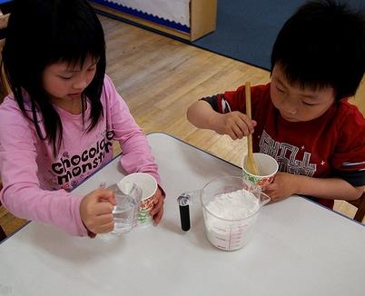
Engaging in Mathematical Reasoning
  Children eagerly engage in mathematical reasoning when:
  The context is familiar.
  The problem is meaningful.
  They have an existing knowledge base.
  (PCF, Vol. 1, p. 290)
Notes:
Presenter Remarks:
“Young children are eager and enthusiastic to search for solutions and apply different strategies, especially when the context is familiar and meaningful, the question or problem is understandable and important to them, and they have some knowledge base related to the problem. Effective teachers build on children’s natural motivation for mathematical reasoning and problem solving” (PCF, Vol. 1, p. 290).
As teachers choose the specific concepts and context to teach mathematical reasoning, it is important for them to think about the personal experiences and interests of students. Experiences for students should build on the past and be generalizable to their future.

Slide 32
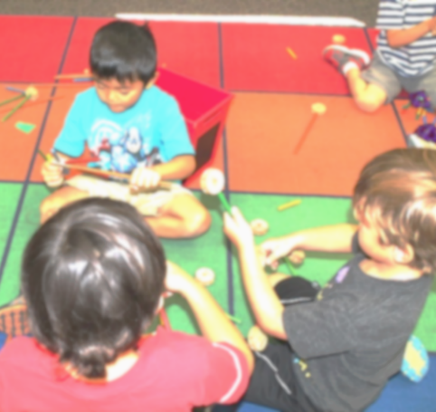
How Children Learn
From longitudinal research we know that children learn from:
Generalizing solutions
Repeating activities
Practicing mental actions
Notes:
Presenter Remarks:
Students who have a wide variety of experiences to solve similar problems are more able to generalize math reasoning to new situations.
The activity we did about increasing math in the environment is supported by the idea that children require more opportunities for repeating interactions with materials.
To support learning we need to understand the continuum of mathematical thinking. We began thinking about this when we looked at the Alignment Document earlier today. Another resource that provides more in depth information on the mathematical reasoning continuum is the DRDP-K (2015).

Slide 33

DRDP-K (2015)
An observation-based assessment tool, not a test
Individual child assessment
Completed by each child's teacher
Based on developmental research and theory
Includes developmental sequences of behaviors along a continuum
Spans the developmental continuum of children in a two-year kindergarten program (TK)
Notes:
Presenter Remarks:
The DRDP-K (2015) informs teachers' understanding of the developmental continuum.
One key feature of the DRDP-K to consider is that it is an observation-based assessment tool and not a test. It is used to support children's learning.
Observing and documenting children's progress provides teachers with information necessary to differentiate instruction and experiences. It also provides information to individualize.
Observational tools are preferred over criterion-referenced tools because the information gathered by observation more accurately reflects what children are able to do. Understanding what children are able to do allows teachers to better plan for activities that will meet and appropriately challenge children's developmental needs.
Other features of the DRDP-K (2015) include:
It is an individual child assessment that can be shared with families.
It is aligned with the PLF.
It opens up the opportunity for articulation between preschool and TK teachers.
Sharing information as to where children are on the developmental continuum can better prepare TK teachers to work with students.
It allows teachers to include a request form for previous records as part of TK registration to help support the relationships between preschool, family, and TK.
The DRDP-K (2015) has been developed with world-renowned experts. It is based on research and knowledge regarding what is most important for predicting school success.

Slide 34
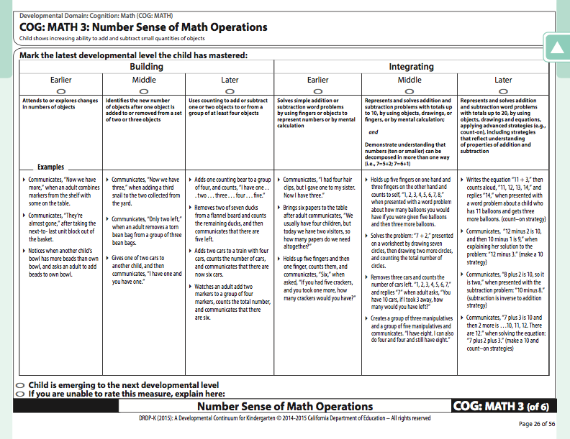
DRDP-K (2015):
Math Reasoning Measures
How might you use this measure to plan multiple experiences that support the same level of thinking?
Notes:
Presenter Notes:
Please read over Handout 8: Mathematics Reasoning Measures and consider how you might use this math measure to plan multiple experiences that support the same level of thinking so that children can more easily learn to generalize their skill.
Turn to your table partner and share your thoughts.

Slide 35
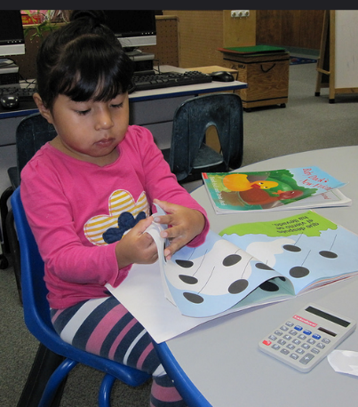
Interaction and Strategies
Interaction And Strategy
“Identify and create opportunities for mathematical reasoning”
(PCF, Vol. 1, p. 292).
.
©2016 California Department of Education
Notes:
Presenter Remarks:
“Teachers can provide children with opportunities of mathematical reasoning, whether through spontaneous questioning and reasoning or through carefully planned experiences. Teachers may use everyday activities to initiate moments of mathematical reasoning” (PCF, Vol. 1, p. 292). This photo is an example of an opportunity to integrate math opportunities with literacy opportunities. The more teachers can find time to capitalize on these moments the more mathematical reasoning become a part of children’s natural though process.
As we just discussed, using resources such as the DRDP-K will support teachers in planning learning experiences that target specific content and individualize learning for the variety of developmental levels in their classroom.

Slide 36
Taking It Back to the Classroom
PART 1:
PART 2:
Read through Handout 1: Taking It Back to the Classroom. Look closely at number #2 – Mr. Fur Ball.
Gather materials and start making your own puppet.
Discuss how you might change the language to enhance the experience for children:
  Think about children whose home language is not English.
  Think about children who may have IEPs or specified disabilities.
  Use chart paper to write your strategies.
Post your chart paper.
Walk around the room, gather ideas, and take photos.
©2016 California Department of Education
Notes:
Activity 6: Taking It Back to the Classroom
Presenter Remarks:
Let’s think about the strategies and resources we have explored today and plan how to take them back to the classroom.
You will be adapting a lesson plan to your specific classroom and teaching practices.
You will also have an opportunity to create a make-n-take that you can use with the lesson plan. (See activity process for complete list of steps.)
intent:
Create strategies on how to adapt a lesson plan for the classroom.
OUTCOMES:
Participants will:
Make a puppet for the lesson
Create strategies that involve math reasoning
Use strategies to adapt lesson plan for their classroom
Materials Required:
PPT Notes
Handout 1: Taking It Back to the Classroom
Large chart paper (1-2 per table)
Materials table arranged with materials to create puppet:
Paper bags (puppet base)
Colorful markers
Paper bags to make puppet
Construction paper
Glue sticks
Yarn
Decorative stickers
Buttons
Cloth or fabric
Timer or bell
TIME: 30 minutes
Process:
Part 1
Direct participants to find and read Handout 1: Taking It Back to the Classroom. (Allow five minutes to read handout.)
Explain to participants that they will now make their own puppet using the supplies provided on the materials table; have them grab a paper bag base and gather any other materials they would like to bring back to their table to use. (Allow five minutes to create puppet.)
Ask participants to refer to the activity #2 – Mr. Fur Ball from Handout 1: Taking It Back to the Classroom.
Have each table group work together to for 10 minutes create strategies to adapt the Mr. Fur Ball lesson plan to support the needs of the students in their classrooms. Remind groups to:
Consider children whose home language is something other than English
Consider children who may have IEPs or specified disabilities
Document their strategies on a large sheet of chart paper
Ask each group to come to the front of the room to place their chart on the designated wall or area; they will then stay standing by their chart.
Part 2
Explain that participants will now do a gallery walk to obtain more ideas from their peers. Moving in table groups, they will look at each chart for a specified amount of time (Divide the number of groups into 10 minutes to come up with how much time will be spent at each chart.) Each time the bell or timer rings, groups will proceed to the next chart, moving clockwise.
Remind participants to read through the strategies on each chart and to discuss how those strategies may help them in their classrooms.
Ring the bell or timer to begin the activity. (Groups move away from their own chart and proceed in a clockwise direction to the next chart.) (Allow 10 minutes to rotate through charts.)
Bring the whole group back to their seats.

Slide 37
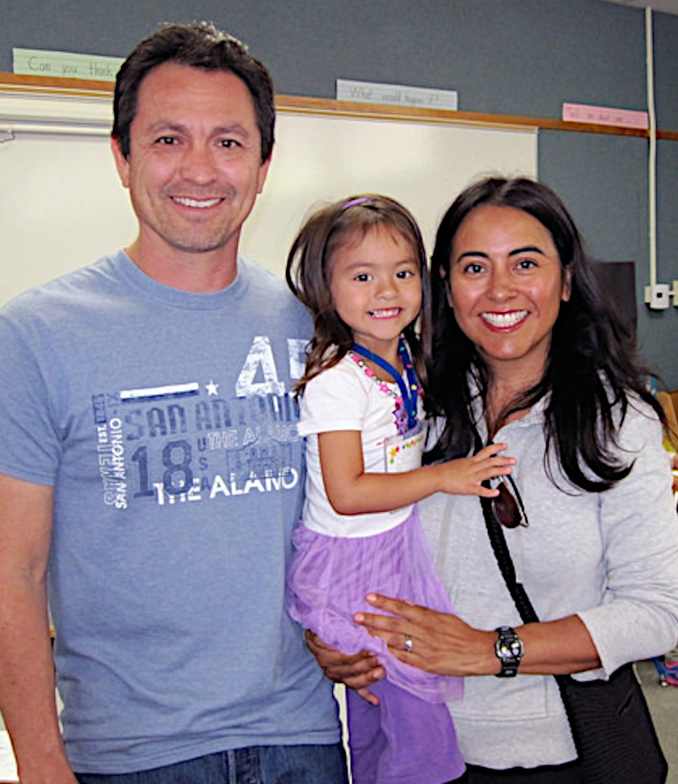
Partner with Families to
Learn About Strengths
Engaging Families: Preschool Curriculum Framework
All About Young Children
Best Practices for Planning Curriculum: Family Partnerships and Culture
TK Implementation Guide
Notes:
Presenter Remarks:
In order to effectively build on children's existing strengths, we must understand them. To do this, we need to partner with families to learn about their children’s strengths.
The resources on this slide are specifically beneficial for partnering with families. You may want to take a picture of this slide and refer to it later.
In our final activity, we’ll take a closer look at some of these resources.
Optional:
Create a gallery table and have examples of documents there.
Extra Notes:
The resources are hyperlinked, so if you have Wi-Fi access, you can go directly to each resource and do a resource walkthrough.

Slide 38
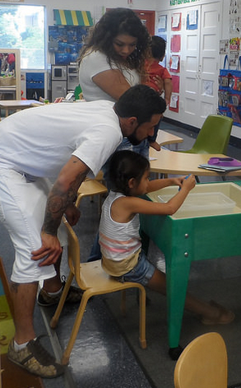
Engaging Families
“Encourage parents to engage children in mathematical reasoning” (PCF, Vol. 1, p. 294).
Notes:
Presenter Remarks:
When families and schools work together children become more excited and eager to learn.
As teachers we need to engage parents as partners in supporting math in the classroom and at home. This can be especially true when supporting students with learning differences or an IEP.
Many of the strategies we discussed today are also beneficial for families. There are many resources that may support teachers in partnering with families. But first let’s talk about what we already do to support the family-school connection.
Raise your hand or hands in the air and show the number of immediate family members you have. Keep your hand in the air and find someone with a similar number; use your math reasoning skills to determine what you define as similar.
Once you have found your partner, share one or two strategies you use or have seen used to partner with families in supporting math in the early childhood years. (Allow 5 minutes for discussion, then send everyone back to their table groups.)
Would anyone like to share one great new idea they learned? (Invite 3-4 people to share.)

Slide 39
Encouraging Families
It is important to encourage families to:
Recognize mathematics in daily events and interactions.
Ask questions related to everyday situations.
Play mathematical games.
Ask children to explain their thinking.
Model solutions.
Notes:
Presenter Remarks:
The Preschool Curriculum Framework, Volume 1, p. 294, has many strategies to engage and partner with families in planning for and supporting mathematical development.
Read the statements on the slide and decide which question you are most interested in considering. Hold that number of fingers above your head (1, 2, 3, 4, or 5).
Stand up and find someone who is interested in the same statement and reflect and brainstorm together. You will have about five minutes to think and talk.
(Invite everyone back to their seats.) Does anyone have a great idea they would like to share? (Invite 2-3 partners to share out.)

Slide 40
Language, Math Games, and Families
Find the math game materials on your tabletop.
Take five minutes to play the game with your group.
Consider the following questions:
  How could teacher language enhance the experience of this game for students?
  How might you support families to include this type of language in mathematical play?
Notes:
Presenter Remarks:
Language and math work together. Let’s play some games that are available on the CPIN.us Web site to experience this for ourselves.
Find the math game materials on your tabletop and play! Think about the questions on the screen as and after you play:
How could teacher language enhance the experience of this game for students?
How might you support families to include this type of language in mathematical play?
(Allow 5-10 minutes for participants to play and discuss.)

Slide 41
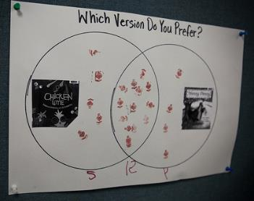
4-3-2-1: Second Look at Daily Data
How will you add daily data to your classroom? Consider…
4 ways to add data in the math environment.
3 ways to partner with families using daily data.
2 things to consider about the continuum of math reasoning when adding daily data.
1 planned learning opportunity for daily data.
Notes:
Presenter Remarks:
It is time to loop all the way back to the beginning of today’s training. Let’s take a second look at our Daily Data charts with your our newly expanded math reasoning lens.
Consider all the ideas and strategies we read, discussed, and experienced today. How will you add daily data to your classroom?
Use the 4-3-2-1 model to complete the list on the slide. You can complete the list by discussing it with your table group or an elbow partner; or your can write it down individually. Choose the reflective method that works best for you.
(Walk around and support conversations; you may use the list of examples below to facilitate conversations as necessary.)
4 ways to add data in the math environment (Post a Venn diagram as pictured in the slide in the library area for students to choose which they like the most.)
3 ways to partner with families using daily data (Invite families to complete a t-chart at home of their fruit preferences—bananas vs. apples—and bring it into class; then have each child share and make a class family chart of bananas vs. apples.)
2 things to consider about the continuum of math reasoning when adding daily data (Think about how to replicate the same concept several times; for example, place Venn diagrams in four different places in the environment instead of just one spot. Think about how to ask questions to extend learning; create opened-ended prompts to extend for students who are ready.)
1 planned learning opportunity for daily data (Use the Mr. Fur Ball idea but have students use their bodies to make a bar graph of their favorite time of the day.)

Slide 42
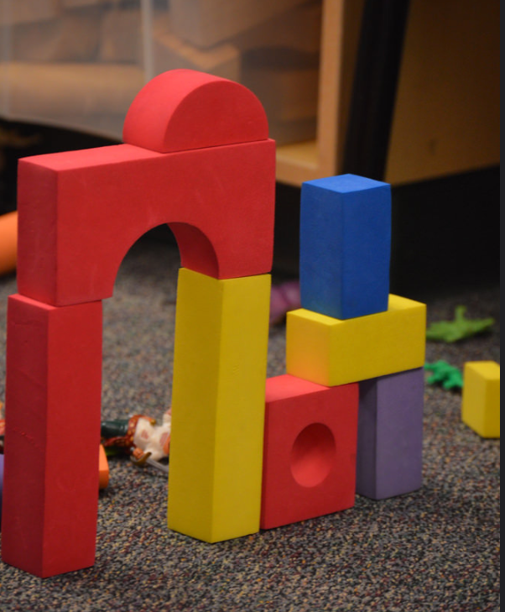
Thank you for coming!
We hope you gathered many ideas and resources to build mathematical reasoning in your classrooms.
©2016 California Department of Education
Notes:
Presenter Remarks:
Thank you for coming!

Slide 43
Reference Guide for PowerPoint Citations
California Department of Education. 2010. California Preschool Curriculum Framework, Volume 1. http://www.cde.ca.gov/sp/cd/re/documents/psframeworkkvol1.pdf (accessed October 10, 2016).
California Department of Education. 2011. California Preschool Curriculum Framework, Volume 2. http://www.cde.ca.gov/sp/cd/re/documents/psframeworkvol2.pdf (accessed October 10, 2016).
Duncan, Greg J., Chantelle J. Dowsett, Amy Claessens, Katherine Magnuson, Aletha C. Huston, Pamela Klebanov, Linda S. Pagani, Leon Feinstein, Mimi Engel, Jeanne Brooks-Gunn, Holly Sexton, Kathryn Duckworth, and Crista Japel. (2007). “School Readiness and Later Achievement,” Developmental Psychology 43 (6): 1428-1446). https://www.apa.org/pubs/journals/releases/dev-4361428.pdf (accessed October 10, 2016).
Tabors, P. O. (2008). One Child, Two Languages: A Guide for Early Childhood Educators of Children Learning English as a Second Language, Second Edition. Baltimore: Paul H. Brookes Publishing Co., Inc.

