Slide 1
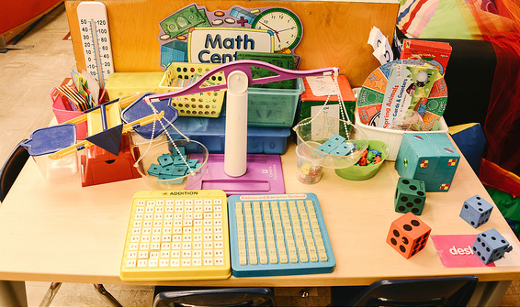
Transitional Kindergarten Mathematics: Number Sense
©2016 California Department of Education
Notes:
Presenter Remarks:
Welcome to Transitional Kindergarten Mathematics: Number Sense—a presentation focusing on the California Preschool Learning Foundations (Preschool Learning Foundations or PLF), the California Preschool Curriculum Framework (Preschool Curriculum Framework or PCF), and other California Department of Education (CDE) resources in support of the Mathematics domain.
This professional learning session is specifically designed to provide TK teachers with exposure to CDE resources that support TK curriculum planning, developmentally appropriate strategies, and classroom environment design recommendations that support the content area of number sense.

Slide 2
During this session we will:
Gain understanding of key concepts from the California Preschool Learning Foundations, Volume 1 (Preschool Learning Foundations or PLF)—Mathematics domain, Number Sense strand
Utilize the California Preschool Curriculum Framework, Volume 1 (Preschool Curriculum Framework or PCF) and other CDE documents to plan developmentally appropriate activities
Notes:
Presenter Remarks:
During this session we will:
Gain understanding of key concepts from the California Preschool Learning Foundations, Volume 1 (Preschool Learning Foundations or PLF)—Mathematics domain, Number Sense strand
Utilize the California Preschool Curriculum Framework, Volume 1 (Preschool Curriculum Framework or PCF) and other CDE documents to plan developmentally appropriate activities

Slide 3
Who is here today?
Present | Absent
Notes:
Activity 1: Who is here today?
Background Information:
Prior to the training, put the math character stick puppets on the tables. Keep the puppets that ARE NOT “present” at the front (e.g., Negative Nelly).
Presenter Remarks:
Welcome to the training! The first thing we are going to do is take attendance. (Draw participants’ attention to the “Who is Here Today?” T-chart.)
I am going to call roll. If you can help me out by letting me know which characters are here for the math training today, I would appreciate it.
(Begin by modeling with a co-trainer. Ask out loud, “Is Ms. Marvel Math here today?” The co-trainer says, “Oh yes, here she is,” and takes the puppet to the T-chart. Continue asking who is here by reading down the character list, until all of the characters are placed on the T-chart. Integrate the characters who are NOT present—these will be in the front with you—into the roll call.)
Let’s count how many characters are here today for the math training. How many characters aren’t here today?
What other math questions could be asked with your students?
How might you adjust this activity for your classroom?
What do you like about this activity?
This activity integrates a deeper level of math for calendar time and can be useful for all age levels.
(Refer to Handout 1: Who is Here Today Activity Plan for a specific example of how to do this in the classroom.)
Intent:
Participants interact with one another and think about math during a warm-up activity.
OUTCOMES:
Participants observe a welcome activity that involves math and have the opportunity to connect that activity to math concepts.
Materials Required:
Chart paper with “Who is Here Today?” T-chart
Character stick puppets
PowerPoint notes
Handout 1: Who is Here Today Activity Plan
Time: 10 minutes
Process:
Prior to the training, put the math character stick puppets on the tables. Keep the puppets that ARE NOT “present” at the front (e.g., Negative Nelly). Welcome participants to the math training.
Tell participants, “The first thing we are going to do is take attendance.”
Draw participants’ attention to the “Who is Here Today?” T-chart.
Tell participants, “I am going to call roll. If you can help me out by letting me know which characters are here for the math training today, I would appreciate it.”
Begin by modeling with a co-trainer. Ask out loud, “Is Ms. Marvel Math here today?” The co-trainer says, “Oh yes, here she is,” and takes the puppet to the T-chart.
Continue asking who is here by reading down the character list, until all of the characters are placed on the T-chart. Integrate the characters who are NOT present (these will be in the front with you) into the roll call.
Debrief:
Following completion of the list, say, “Alright, let’s count how many characters are here today for the math training. How many aren’t here?”
Have participants think about what other math questions could be asked with students.
How might participants adjust this activity for their classroom?
What do they like about it?
Explain how this activity integrates a deeper level of math for calendar time and that it can be useful for all age levels.
Refer to the Who is Here Today Activity Plan (Handout 1 for a specific example of how to do this in the classroom.
SUMMARY:
Participants build community through number sense.

Slide 4
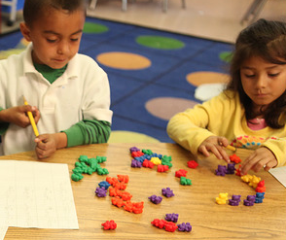
What is number sense?
“Number sense refers to children’s concept of numbers and their relationships” (PCF, Vol. 1, p. 241):
    Visual recognition of numbers
    Counting of objects
    Sense of quantity
    Number relationships
    Addition and subtraction
Notes:
Presenter Remarks:
“Number sense refers to children’s concept of numbers and their relationships. It starts early on with an infant’s ability to visually recognize the number of elements in a small set and continues with children’s verbal counting as they further develop the sense of quantity, number relationships (e.g., less than, greater than), and the fundamental understanding of addition and subtraction” (PCF, Vol. 1, p. 241).

Slide 5








CDE Publications and Resources that Support TK Math Implementation
Preschool Learning Foundations
California Common Core State Standards
Preschool Curriculum Framework
Math Framework
DRDP-K
Alignment Document
Preschool English Learners
TK Implementation Guide
Preschool Learning Foundations
California Common Core State Standards
Preschool Curriculum Framework
Mathematics Framework
DRDP Specific to TK and K
Alignment Document
Preschool English Learners Guide
Transitional Kindergarten Implementation Guide
Notes:
Presenter Remarks:
The California Department of Education has developed many publications, resources, and supports that enable teachers to facilitate the most positive outcomes for students.
Today our main focus will be on Volume 1 of the Preschool Learning Foundations and the Preschool Curriculum Framework. In addition, there are other key resources that support math: the California Common Core State Standards (CA CCSS) for Mathematics in kindergarten, the TK chapter of the Mathematics Framework for California Public Schools: Kindergarten Through Grade Twelve (Math Framework), the Transitional Kindergarten Implementation Guide—A Resource for Public School District Administrators and Teachers (TK Implementation Guide), and the Desired Results Developmental Profile—Kindergarten (2015): A Developmental Continuum for Kindergarten (DRDP-K [2015]).
(Name and hold up each resource.) The Preschool Learning Foundations, Volume 1, Volume 2, and Volume 3, and the Preschool Curriculum Framework, Volume 1, Volume 2, and Volume 3, are the center of the California Early Learning and Development System.
During additional professional learning opportunities we will also discuss alignment and make connections to all additional resources pictured in the graphic:
The Alignment of the California Preschool Learning Foundations with Key Early Education Resources (Alignment Document)
CA CCSS
Math Framework
TK Implementation Guide
DRDP-K (2015)

Slide 6
Why use the Preschool Learning Foundations for TK?
CA Law (EC 48000):
Transitional kindergarten is the first year of a two-year kindergarten program that uses a modified kindergarten curriculum that is age and developmentally appropriate.
Transitional kindergarten curriculum is intended to be aligned to the California Preschool Learning Foundations.
Notes:
Background Information:
http://cde.ca.gov/ci/gs/em/kinderfaq.asp#program
Presenter Remarks:
The state of California provides guidance on utilizing the Preschool Learning Foundations and the Preschool Curriculum Framework as planning and curriculum resources in the TK classroom.
In addition, the following publications and resources should be used:
TK Implementation Guide
Alignment Document
CA CCSS
Math Framework
DRDP-K
We will now look at how all of these resources work together to support Mathematics.

Slide 7

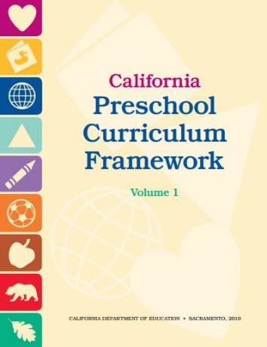
Foundations and Framework, Volume 1
Notes:
7
Presenter Remarks:
The purpose of the Preschool Learning Foundations is to promote a common understanding of preschool children’s learning and to guide instructional practice; they describe the knowledge and skills that young children typically develop when provided with developmentally, culturally, and linguistically appropriate learning experiences.
The Preschool Curriculum Framework was created as a companion to the Preschool Learning Foundations. The framework, “…presents strategies and information to enrich learning and development opportunities for all children” (PCF, Vol. 1, p. v).
The foundations and framework are designed to work together. While the foundations—known as standards in the K-12 arena—provide the background information to understand children’s developing knowledge and skills (the what), the curriculum framework offers guidance on how teachers and programs can support the learning and development that are described in the foundations (the how).
Extra Notes:
The foundations were developed with research-based evidence and are enhanced with expert practitioners’ suggestions and examples. All of the foundations were written by a team of researchers with expertise in that domain. A complete reference list of the source materials, along with detailed bibliographic notes for each of the developmental domains, can be found in the Preschool Learning Foundations. Sources used in the development of the foundations include:
Documents from CDE, such as the English-Language Arts Content Standards for California Public Schools, Kindergarten Through Grade Twelve (Language and Literacy, Introduction, page 48, left column).
Well-validated assessment tools such as the Ages & Stages Questionnaires (ASQ): A Parent-Completed, Child-Monitoring System (Social-Emotional, References and Source Materials, page 36).
General sources such as the Report of the National Reading Panel 2000 (Language and Literacy, Introduction, page 73, left column).
Early childhood education standards from other states, such as Hawaii and Texas (Social-Emotional, Introduction, page 5, footnote).

Slide 8

High Quality Programming and Appropriate Support
Describes what children should be able to do at around 48 and 60 months
Assumes children have access to appropriate support and high-quality programs
Notes:
8
Presenter Remarks:
Volume 1 of the Preschool Learning Foundations addresses four domains: Social-Emotional Development, Language and Literacy, English-Language Development, and Mathematics.
Today we are reviewing the chapter on mathematics. Let’s take a closer look at one foundation for an example:
Open the Preschool Learning Foundations and find a page where the age levels appear. This is an example of a foundation page. Compare pages with your elbow partner (allow 1 minute).
Let’s look at these pages together.
Look across the page and notice the developmental progression at around 48 months and what changes at 60 months of age. (Solicit a few participants to read what they see.)
(Summarize the exploration with the following key note.) Because children develop at different rates the foundations were designed to support the belief that certain stages of development will occur at different times for all students. You will notice “at around” in the description. It is important to remember that this variability occurs.
The foundations also assume that children have access to appropriate support in high-quality programs. This includes:
Environments and experiences that encourage active, playful exploration and experimentation
Clearly defined learning centers where materials are rotated
Purposeful teaching to help children gain knowledge and skills
Predictable schedules and routines with large blocks of time for play and skillful integration of curriculum with an intentional focus on content
Specific support for English learners with staff that have knowledge of the stages of English-language acquisition
Accommodations and adaptations for children with disabilities and additional support when needed
8

Slide 9
Domain: Mathematics
Domain: Mathematics
Strand:
Number Sense
Strand:
Geometry
Strand:
Algebra and Functions
Strand:
Measurement
Strand:
Mathematical Reasoning
Today's Focus
Notes:
Background Information:
PLF, Vol. 1, p. 144
Presenter Remarks:
The Preschool Learning Foundations in Mathematics cover five main developmental strands: Number Sense, Algebra and Functions (Classification and Patterning), Measurement, Geometry, and Mathematical Reasoning.
These strands were identified after a careful review of research including research by the National Council of Teachers on Mathematics, the Principles and Standards for School Mathematics, and the California Mathematics Content Standards for Kindergarten through Grade 12 (K–12).
Today’s focus will be on the strand of Number Sense.
“The Number Sense strand refers to concepts of numbers and their relationships. It includes the development of counting skills, the understanding of quantities, recognizing ordering relations (which has more, fewer, or less), part-whole relationships, and a basic understanding of ‘adding to’ and ‘taking away’ operations” (PCF, Vol. 1, p. 239).

Slide 10
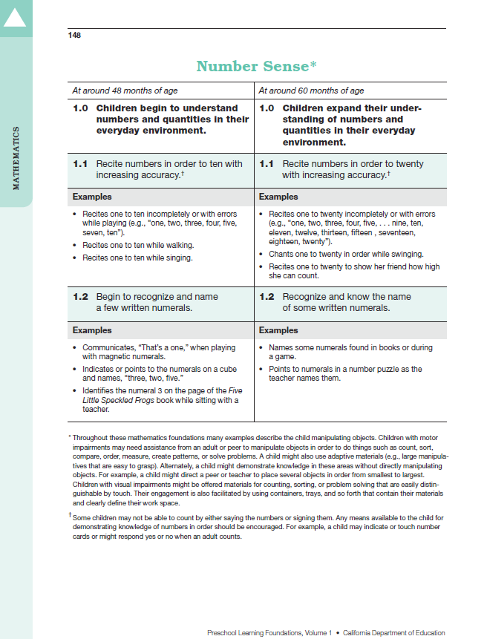
Map of the Foundations
2
4
3
5
1
6
7
Notes:
Activity 2: Foundations Map Explained in Numbers
Presenter Remarks:
On the screen you can see an example of a foundation.
Each foundation in the Mathematics domain has key elements that will help you understand the organization of the foundations and how to best use the foundations to support students’ learning.
We are going to do a group activity now to help us take a closer look at the makeup of the mathematics foundations.
INTENT: Explore the math foundations with participants.
OUTCOMES:
Participants will examine a map of a foundation and become aware of the terminology used in the Preschool Learning Foundations.
Participants will compare the age-level progression within the Preschool Learning Foundations.
Materials Required:
Chart paper
Handout 2: Foundation Map
Handout 3: Foundation Note Chart
PPT notes
Preschool Learning Foundations
Time: 15 minutes
Process:
Prior to the training create one chart paper per table group with the outline of Foundation 1.2 of Number Sense. A photo example is included at the end of the activity plan.
Show participants this slide with the components of the map numbered 1–7.
Invite participants to work together to complete their foundation map on the chart paper with all seven components and then use their numbered labels to label the map.
As the groups work together walk around the room to listen to conversations. Take note of anything interesting that might benefit the whole group to hear.
After all groups have completed ask for any reflections and share what you wrote down while walking around (if beneficial).
Ask participants to look closely at Handout 2 and compare the growth between 48 and 60 months.
Have participants refer to Handout 3 and write down anything that they notice as important especially within the progression between 48 and 60 months.
Tell participants that Handout 3 will be returned to frequently throughout the training. It can be used to take notes and save ideas about the foundations.
Provide three to five minutes of time for participants to navigate the map and the foundations, and to take notes.
Ask participants to share what they have noticed.
SUMMARY: Participants become familiar with the format of the foundations.

Slide 11
Map of the Foundations
Strand
Substrand
Age
Foundation
Domain
Examples
Foundation
Footnotes
Notes:
Presenter Remarks:
This slide should look similar to everyone’s charts. Take a moment and compare your chart to the slide. You can follow along on your chart or on Handout 2: Foundation Map while we discuss each component (You can read the list quickly if the groups have already discussed the components, or ask group members to volunteer to name and describe each component.):
The name of the domain: Mathematics.
The name of the strand: Number Sense (at the top of the table).
The name of a substrand: Children expand their understanding of numbers and quantities in their everyday environment.
Note that substrands always end in ".0.“
The two age levels: at around 48 months and at around 60 months.
Each foundation describes typical behaviors at around 48 months and at around 60 months or four to five years old.
The foundations: Two for each age level (1.1 for 48 months and 1.1 for 60 months, 1.2 for 48 months and 1.2 for 60 months) on this page.
The examples: These are only a few of the ways that children may demonstrate the behavior in the foundation.
Many of the foundations have footnotes that include information specific to students with IEPs or students with disabilities, such as information about adaptations or accommodations.
Compare the difference between the foundation at 48 months and at 60 months.
Notice that there is a developmental progression from four years old to five years old within a substrand. The order in which the strands and substrands are presented is not meant to indicate a developmental progression.

Slide 12
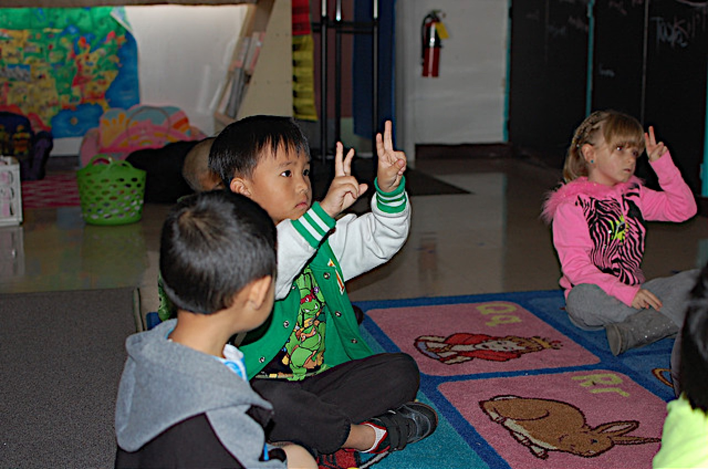
Insights from Research
“Exposure to preschool mathematics can increase language ability and has lasting effects into kindergarten”
(Douglas H. Clements and Julie Sarama, “PreK Mathematics Curriculum: Impacts on Early Literacy” [paper symposium, Society for Research and Child Development Biennial Meeting, Washington State Convention Center, Seattle, WA]).
Notes:
Presenter Remarks:
“After one and two years of a preschool experience with math curriculum, language skills were assessed in kindergarten to determine if the extra time spent on math was harmful to language development. Results demonstrate that language actually benefits, specifically the ability to produce independent language, produce complex grammar, and retell details of a story” (Douglas H. Clements and Julie Sarama, “PreK Mathematics Curriculum: Impacts on Early Literacy” [paper symposium, Society for Research and Child Development Biennial Meeting, Washington State Convention Center, Seattle, WA]).
These results highlight the importance of early mathematics exposure within the preschool and transitional kindergarten years.

Slide 13
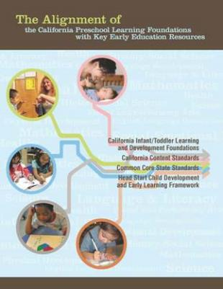
Alignment Document
Notes:
Presenter Remarks:
The Alignment Document is another resource that will help us to answer questions related to developmental progressions.
Discuss the following questions with your table group (allow 3 minutes):
What you know about this document?
How do you use it in your work now?
Extra Notes:
Depending on the size of your group, participants can share responses with table partners or in pairs.

Slide 14
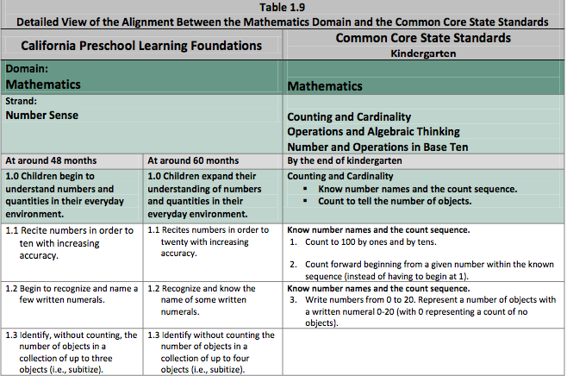
Alignment Document: Table 1.9
Notes:
Presenter Remarks:
Please refer to Handout 4: Alignment Document Tables 1.8 and 1.9.
Table 1.8 shows the alignment between strands and substrands in the Preschool Learning Foundations and the content categories in the California Common Core State Standards (CA CCSS) for Mathematics.
Table 1.9 details alignment between specific preschool foundations and specific kindergarten standards in the CA CCSS for Mathematics.
For every substrand of the Preschool Learning Foundations there is a category in the CA CCSS with corresponding content.
As shown in Table 1.8, the substrands under Number Sense—understanding numbers and quantities and understanding number relationships and operations—correspond directly to the CA CCSS in the categories of Counting and Cardinality, and Operations and Algebraic Thinking, respectively.
Content in the CA CCSS category of Number and Operations in Base Ten is too advanced for there to be corresponding content in the Preschool Learning Foundations.
The preschool substrand addressing sorting and classifying objects aligns with the Measurement and Data category of the CA CCSS (Classify objects and count the number of objects in categories).
Table 1.9 delineates the alignment between specific preschool foundations and specific CA CCSS in the Mathematics domain. Close inspection of this table reveals substantial similarities in content between these foundations and the CA CCSS.
Reach into your number bin and choose a number. Find one or two people with the same number and talk about what you find interesting in Handout 4: Alignment Document Tables 1.8 and 1.9.

Slide 15
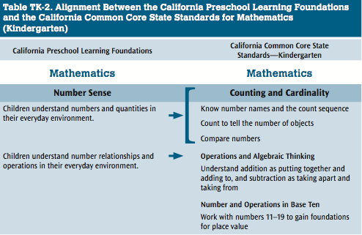
TK Mathematics Framework Chapter
Notes:
Presenter Remarks:
Please refer to Handout 5: TK Mathematics Framework Table TK-2.
Table TK-2 further shows the alignment between the Preschool Learning Foundations and the CA CCSS.
This table is from the Math Framework for K–12 public schools.

Slide 16

Mathematics Domain Framework Strategies
Developmentally appropriate
Reflective and intentional
Individually and culturally meaningful
Inclusive
Notes:
Presenter Remarks:
The Preschool Curriculum Framework offers guidance on how teachers can support the learning and development described in the foundations, through environments, materials, and experiences that are developmentally appropriate, individually and culturally meaningful, and engaging to families.
“Teachers address ideas and concepts that children can grasp at their developmental level and then progressively build on what children already know and understand. This approach applies to all children, including children with various abilities, disabilities, or other special needs (such as delays in language, cognition, or physical ability)” (PCF, Vol. 2, p. 227).
The Mathematics domain begins with guiding principles that set the tone for the entire chapter. Let’s take a moment to look at these guiding principles and see how they are:
Developmentally appropriate,
Reflective and intentional,
Individually and culturally meaningful, and
Inclusive.

Slide 17
Guiding Principles
Take five minutes to read Handout 6: Guiding Principles.
Choose a principle that speaks to you.
Pull a number from your number bucket.
Find a partner with the same number from another table.
Share with your partner an example of an experience from their classroom that represents one of the guiding principles.
Notes:
Activity 3: Representing Guiding Principles
Presenter Remarks:
Take a moment to read the guiding principle on the slide.
This is only one of the guiding principles at the beginning of the Mathematics domain. It highlights the importance of recognizing children’s natural motivation and current knowledge.
“Young children are mathematically competent, motivated, and naturally interested in exploring mathematical ideas and concepts. Teachers should recognize children’s early mathematical competence and build on children’s disposition to use mathematics as a way to make sense of their world” (PCF, Vol. 1, p. 234).
We will now take some time to get familiar with the rest of the guiding principles.
intent: Familiarize participants with the guiding principles of the Mathematics domain.
OUTCOMES:
Participants will read the guiding principles
Participants will reflect on how the guiding principles are represented in their classrooms.
Materials Required:
Handout 6: Guiding Principles
Table-group buckets of numbers
Time: 10 minutes
Process:
Invite participants to locate and read Handout 6: Guiding Principles.
After participants read the principles, invite each participant to pull a number from the number bucket at the center of the table.
Guide participants to stand up and find someone with the same number from another table and share an example of an experience from their classroom that represents one of the guiding principles.
Allow 2–4 minutes for participants to share with one another.
Invite participants back to their table groups and ask if anyone has something they would like to share before moving on.
Wrap up by reminding participants that these guiding principles set the tone for all of the Mathematics domain and should be infused into all classroom activities.
SUMMARY: Participants become familiar with the guiding principles of the Mathematics domain.

Slide 18
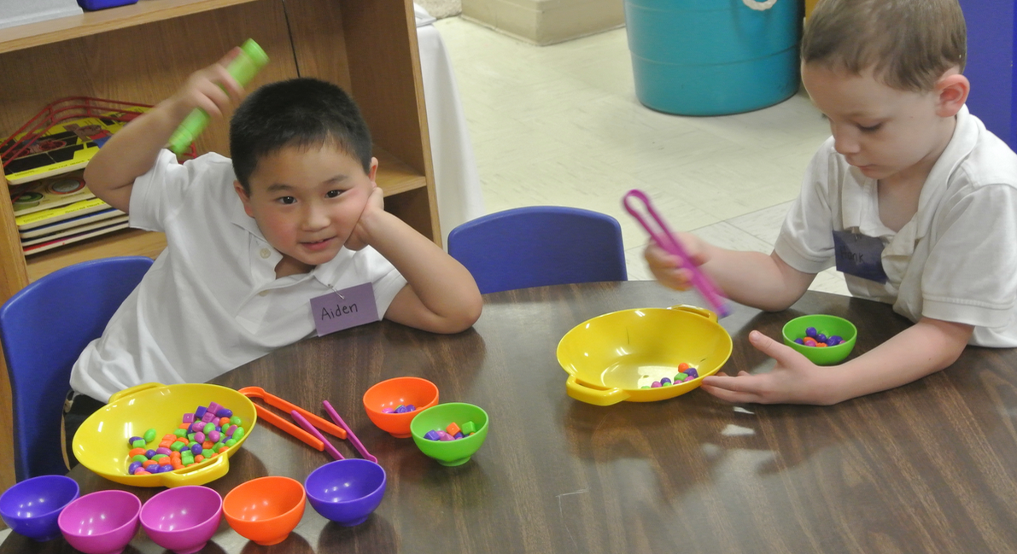
Guiding Principles
“Build on preschool children’s natural interest in mathematics and their intuitive and informal mathematical knowledge” (PCF, Vol. 1, p. 234)
Notes:
Presenter Remarks:
“Children enter preschool [and TK] with an intuitive understanding of number and operations and with a natural curiosity and eagerness to learn about numbers” (PCF, Vol. 1, p. 241).
“Research indicates that the ability to reason about numbers starts as early as infancy. Five-month-olds show sensitivity to the effects of addition or subtraction of items on a small collection of objects. Toddlers viewing three balls put into a container, and then one being removed, know to search for a smaller number of balls, and many search for exactly two balls” (PCF, Vol. 1, p. 251).
“By the time children are in preschool, prior to having any formal lesson in arithmetic, they use a variety of strategies to solve simple addition and subtraction problems. They may use manipulatives or fingers to represent the numbers in the problem and count out loud to find out the answer. As they get older, they rely less and less on finger counting. To solve an addition problem such as 4 + 2 presented with concrete objects (e.g., color crayons), the child may count all objects ‘one, two, three, four’ and then continue with the second set of objects ‘five, six’ and find out there are a total of six. At a later stage, the child may ‘count on’ from the second set of objects. Knowing the number of objects in the first set (e.g., ‘four’), the child starts with ‘four’ and continues to count ‘five, six’ to find out the total number of objects, rather than starting to count from ‘one’ with the second set of objects” (PCF, Vol. 1, p. 251).
Let’s look at an example of how an infant or toddler might demonstrate number sense ability.

Slide 19
Infant Example
Douglas H. Clements and Julie Sarama, eds., Engaging Young Children in Mathematics: Standards for Early Childhood Mathematics Education, p. 17)
Notes:
Presenter Remarks:
Picture this. “Three pictures hang in front of a six-month-old child. The first shows two dots, the others show one dot and three dots. The infant hears three drumbeats. Her eyes move to the picture with three dots” (Douglas H. Clements, “Subitizing: What is It? Why Teach It?” Teaching Children Mathematics 5 (7) [March]: p. 400).
“Young children spontaneously use the ability to recognize and discriminate small numbers of objects” (Klein and Starkey as cited in “Subitizing: What is It? Why Teach It?” Teaching Children Mathematics 5 (7) [March]: p. 400).
Preschoolers possess this and many other informal mathematical abilities (e.g., developing number and geometry abilities, counting objects, making shapes, and using math knowledge every day).
Educators must nurture these informal math abilities or risk missing opportunities to support children in the early stages of their mathematical development.

Slide 20
Six-Month-Old Example
(Douglas H. Clements and Julie Sarama, eds., Engaging Young Children in Mathematics: Standards for Early Childhood Mathematics Education, p. 17)
Notes:
Presenter Remarks:
“Number knowledge emerges surprisingly early in life and develops considerably during the first three years. Infants can discriminate among and match very small configurations (one to three) of objects. For example, when 6-month-old infants are shown a series of pictures that always depict three objects, albeit different types of objects from picture to picture, they gradually lose interest in the pictures” (Douglas H. Clements and Julie Sarama, eds., Engaging Young Children in Mathematics: Standards for Early Childhood Mathematics Education, p. 17).
However, . . . (Click to the next slide.)

Slide 21
Six-Month-Old Example
(Douglas H. Clements and Julie Sarama, eds., Engaging Young Children in Mathematics: Standards for Early Childhood Mathematics Education, p. 17)
Notes:
Presenter Remarks:
“If the configuration of objects depicted in the pictures is then changed from three to two or four, infants notice the change and become interested again” (Starkey, Spelke, & Gelman as cited in Engaging Young Children in Mathematics: Standards for Early Childhood Mathematics Education, p. 17).
“So, they can ‘see’ small configurations of objects nonverbally (called subitizing). By 18 months of age, infants can notice which of two collections contains more objects” (Cooper as cited in Engaging Young Children in Mathematics: Standards for Early Childhood Mathematics Education, p. 17).
“This provides an early perceptual basis for number, but it is not yet ‘number knowledge’” (Douglas H. Clements and Julie Sarama, eds., Engaging Young Children in Mathematics: Standards for Early Childhood Mathematics Education, p. 17).
It is clear, as the guiding principles suggests, that children come to us with a wealth of mathematical knowledge on which we can build.
Let’s take a closer look at the makeup of the Number Sense foundations and think about what types of strategies we can use to build upon children’s mathematical knowledge.

Slide 22
Subitizing
“Subitizing is a fundamental skill in the development of students’ understanding of number”
(Baroody as cited in “Subitizing: What is It? Why Teach It?” Teaching Children Mathematics 5 (7): p. 404).
What does it mean to subitize?
Look up subitizing in the Preschool Learning Foundations glossary.
Discuss the definition with your elbow partner.
Notes:
Presenter Remarks:
Look up the term “subitizing” on page 326 of the Preschool Curriculum Framework.
As we learned in the last activity, early number sense is not counting but recognition of number. Recognition of number is often done by subitizing.
It is important to note that recognition of number is often misinterpreted as meaning reading numerals, such as “3” or “2.” Instead, it means seeing a small group of objects and understanding how many are in that group.
It’s time for us to subitize! (Click to the next slide.)

Slide 23
How many dots do you see?
That’s subitizing!
Notes:
Presenter Remarks:
(Flash this slide for three seconds. Then go back to the previous slide or cover the slide.)
How many dots did you see?
How did you know?
Did you count in your head, “1, 2, 3”? (Most adults will answer “No,” they didn’t count)
No, you probably didn’t count. You knew automatically, because you can subitize three objects at a time.
As adults, you are capable of subitizing many more than three objects.
Let’s take a closer look at how subitizing develops on a continuum or learning trajectory.

Slide 24
Learning Trajectory for Subitizing
(Taken from Doug Clements’ and Julie Sarama’s research)
5
Can perceive group
without counting
4
Can use pattern of group
to determine the number
(e.g., domino pattern)
3
Can make small collection
1-2
Can name small collection
Notes:
Presenter Remarks:
When working on a skill, it is important to remember the trajectory, continuum, or developmental sequence for that skill. The trajectory for subitizing is listed on the screen (from Doug Clements’ and Julie Sarama’s research):
Can name small collection
Can make small collection
Can use pattern of group to determine the number (e.g., domino pattern)
Can perceive group without counting
The number represents the general age at which children may be able to do these skills.

Slide 25
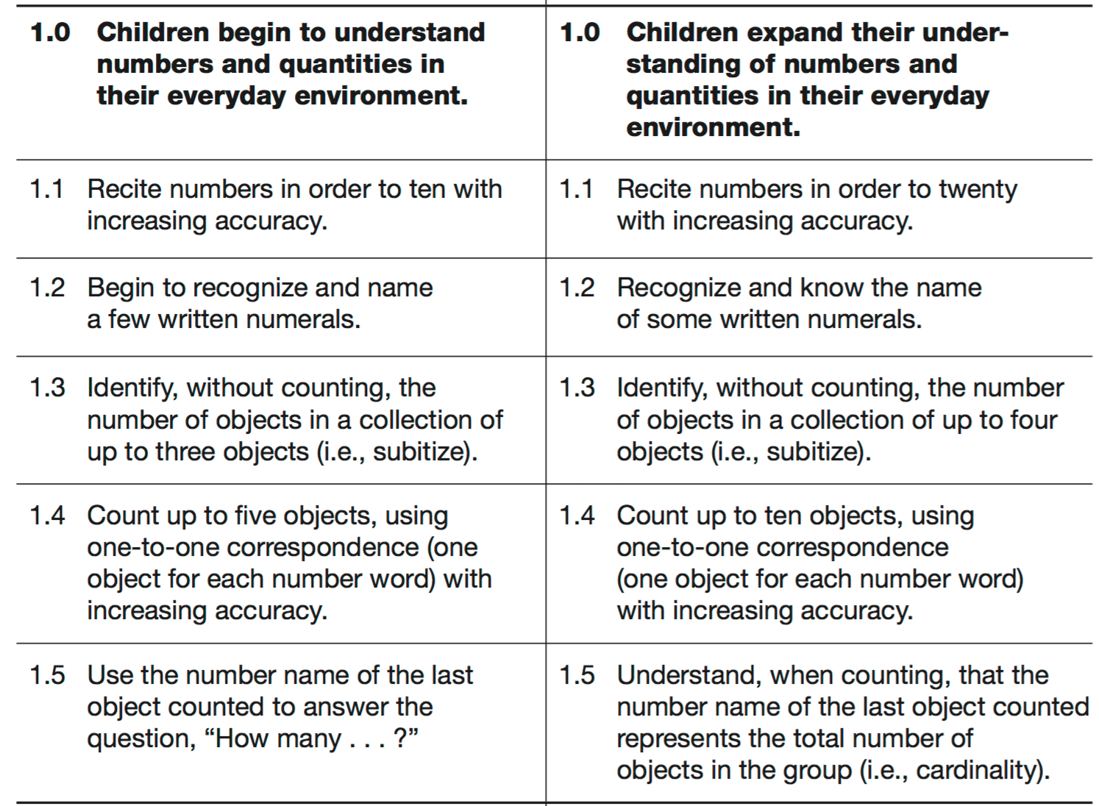
Number Sense Substrand 1.0
Children begin to understand and expand their ability to understand numbers and quantities in their everyday environment.
Notes:
Presenter Remarks:
There are two substrands in the Number Sense strand. The first is shown on the slide.
This slide shows all of the foundations within Number Sense substrand 1.0: Children begin to and expand their ability to understand numbers and quantities in their everyday environment.
Go back to Handout 3: Foundation Note Chart. Take a moment and jot down any notes that you might have thus far.
Next, we are going to take a closer look at the developmental continuum.

Slide 26
Developmental Sequence
Find the Developmental Sequence Envelope.
Put the Developmental Sequence Cards in sequential order.
Use page 242 in the Preschool Curriculum Framework to check your work.
Discuss your reactions with your table group:
  How might you use this information in planning for your students?
  What further questions do you have?
Notes:
Activity 4: Developmental Sequence
Presenter Remarks:
“All children, whatever their socioeconomic or cultural backgrounds, have the tendency to count and reason about numbers
in everyday life. Children’s intuitive sense of number does not imply, however, that everything they need to learn about numbers and operations comes naturally” (PCF, Vol. 1, p. 241).
It is important for teachers to understand the general developmental sequence of counting skills in order to support the developmental shifts in numbers sense. To refresh our memories and reflect about the information, we are going to do an activity.
INTENT: Improve participants’ understanding of the counting developmental sequence.
OUTCOME: Participants will practice identifying the counting developmental sequence.
MATERIALS REQUIRED:
Number line
Preschool Curriculum Framework
Table materials:
Developmental Sequence Envelope
Developmental Sequence Cards
TIME: 10 minutes
PROCESS:
Invite participants to find the Developmental Sequence Envelope.
Allow time for participants to put the Developmental Sequence Cards in order in table groups.
When all tables have completed the task, invite participants to turn to page 242 of the Preschool Curriculum Framework to check their work.
Highlight how this knowledge may help teachers in gathering better evidence for the DRDP-K measures.
Share any interesting findings or discussion points from the group.
Debrief:
Discuss how children may represent these developmental sequence levels differently.
Think back to the Number Rock activity. How might your experience with this activity impact how you consider the developmental sequence?
SUMMARY: Participants practice identifying the counting developmental sequence.

Slide 27
Foundation Video
Notes:
Background Information:
Prior to the training embed the Preschool Learning Foundations video example 1.3.
Presenter Remarks:
We will now watch the Preschool Learning Foundations Math Video Strand 1.3.
Pay close attention to the example in the video and take notes on the Video Viewing Guide.
The reflection questions on the guide are only to help narrow your observations. We will have an open-ended discussion after the video.

Slide 28
Focused Video Reflection
Pull a number from the table number bin.
Find someone with a different number than you and exchange thoughts about the discussion questions.
Questions:
What observations did you make about the learning trajectory examples for subitizing?
What examples did you notice that included students learning English as a second language?
What was most interesting to you in the video example?
Notes:
Presenter Remarks:
The video that we just watched has some excellent examples of subitizing in a natural environment.
Please take a moment to finish making notes on your video viewing guide.
When you are done, pull a number from the table number bin. Then find someone with a different number than you and exchange thoughts about the discussion questions.
You will have about 5 minutes for this discussion.

Slide 29
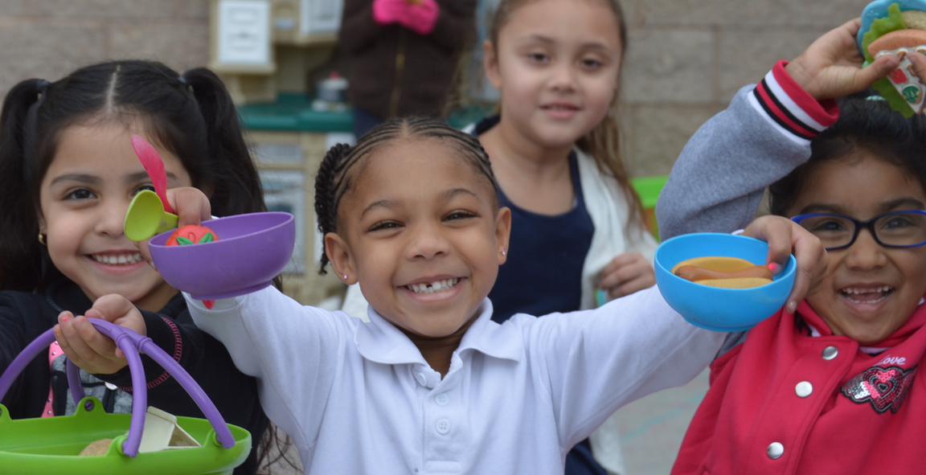
Interactions and Strategies to Remember
“Expose preschool children to quantities represented in different forms” (PCF, Vol. 1, p. 249).
“Promote use of the subitizing skill” (PCF, Vol. 1, p. 250).
©2016 California Department of Education
Notes:
Presenter Remarks:
“Preschool children gain a better sense of numbers as they come across different representations of numbers in their environment. For example, “three” can be represented with three objects, three fingers, a pictograph, a number symbol (3), tally marks (III), or a pattern of dots (● ● ●)” (PCF, Vol. 1, p. 249).
Providing children with opportunities to apply subitizing daily, and in natural settings, is key for supporting their subitizing skill. In this picture, the teacher could ask, “How many bowls do you have?”
Would anyone like to share an example of a time during the day when they frequently support subitizing? (Allow time for sharing.)
Next, we are going to play a few math games that provide opportunities for students to practice subitizing. We will also consider how we might individualize these games in our own classrooms.

Slide 30
Subitizing Games
Find Handout 8: Subitizing: Let’s Play Worksheet.
Read the last two pages (subitizing games).
Decide with your table group which game to play.
Play the game.
Complete the first page of Handout 8: Subitizing: Let’s Play Worksheet with your table group.
Be ready to share out.
Notes:
Activity 5: Subitizing: Let’s Play
Presenter Remarks:
Please take out
: Learning Trajectory: Subitizing, Handout 8: Subitizing: Let’s Play Worksheet, and Handout 9: Teacher Support Strategies.
The last two pages of Handout 8: Subitizing: Let’s Play Worksheet are games that you can plan to provide students with subitizing experience.
You will play one or both of these games with your table group and then complete the first page of Handout 8: Subitizing: Let’s Play Worksheet. Handout 9: Teacher Support Strategies includes strategies to support students learning English as a second language and may be helpful in completing this activity.
INTENT: Participants practice subitizing knowledge through game play and analyze games with regard to the Preschool Curriculum Framework, dual-language strategies, the DRDP-K, Universal Design for Learning, and the Alignment Document.
OUTCOME: Participants will practice multiple games to be used in a preschool classroom.
MATERIALS REQUIRED:
Handout 7: Learning Trajectory: Subitizing
Handout 8: Subitizing: Let’s Play Worksheet
Handout 9: Teacher Support Strategies
Index cards with 1–5 dots, as described in the Peace Card Game (2 sets per table group)
10 counters (e.g., acorns, plastic bears, plastic circles) per table group
PPT notes
TIME: 20 minutes
PROCESS:
Invite participants to read the last two pages of Handout 8 (subitizing games) and decide, with their table groups, which game to play.
Walk around and provide support for participants to practice each game. Allow 10 to 12 minutes for this exploration.
Regroup participants and demonstrate how to apply the game knowledge to the chart on the first page of Handout 8.
Walk around while participants think about and complete the first page of Handout 8 with their groups.
Invite participants to share out their “aha” moments. Presenters can also share out “aha” moments that they heard while walking around.
SUMMARY: Participants play and analyze subitizing games.

Slide 31
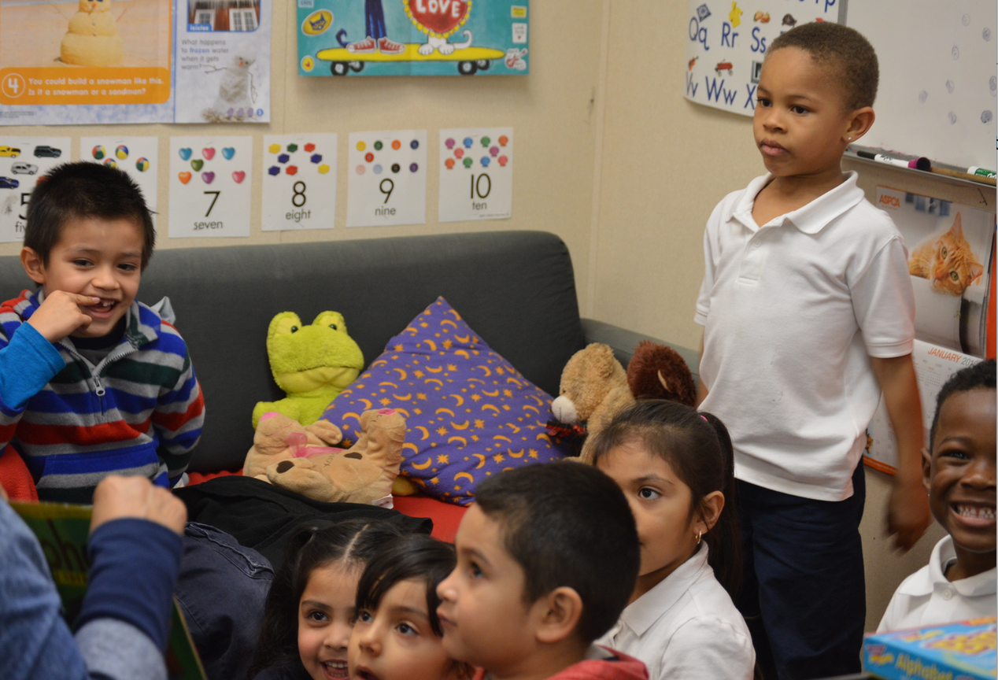
Teacher Role
Teachers have an extremely important role in supporting children’s understanding of number relationships and operations.
Notes:
Presenter Remarks:
It is important to think specifically about the teachers role.
“Encourage counting during everyday interactions and routines. Learning the sequence of number words in English involves the rote learning of the first 13 number words and, later, the rules for producing the subsequent “teens” number words and the beyond-twenty number words. This may proceed slowly and require a lot of practice because learning number names in order takes practice” (PCF, Vol. 1, p. 244).

Slide 32
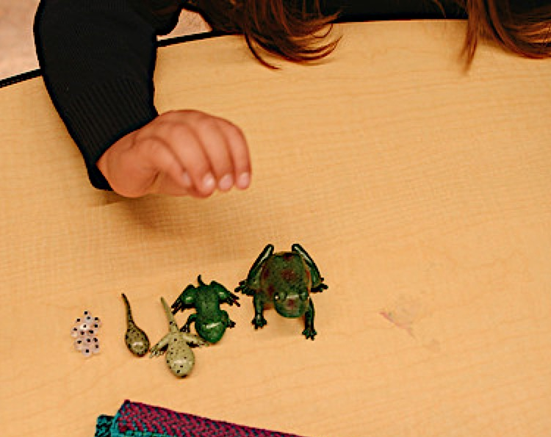
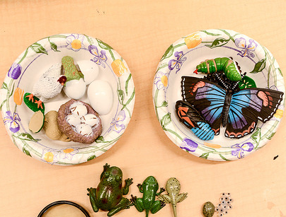
“As teachers observe the children throughout the day, they are likely to encounter a great deal of spontaneous counting and reasoning about numbers…” (PCF, Vol. 1, p. 242).
Notes:
Presenter Remarks:
“As teachers observe the children throughout the day, they are likely to encounter a great deal of spontaneous counting and reasoning about numbers” (PCF, Vol. 1, p. 242).
This is reinforced by the types of environments that teachers provide for students. It is important to provide a math-rich environment to support children’s natural curiosity with numbers.
Many opportunities to count are integrated with other learning, such as science, as you can see in these photos.

Slide 33
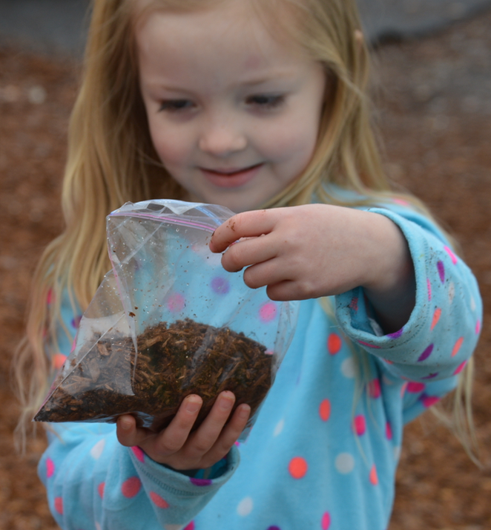
Ask questions that encourage purposeful counting.
Example questions:
How many worms can you find in the dirt?
How many scoops of dirt does it take to fill up your bag?
How many different colors do you see in your bag of dirt?
Notes:
Presenter Remarks:
One way to provide a mathematically rich environment is to, “Ask questions that encourage purposeful counting” (PCF, Vol. 1, p. 245).
On this slide are some examples of questions that encourage purposeful counting.
Extra Notes:
Optional Make and Take: Pass out colorful 3-by-5 cards and invite participants to think about their day and write down questions they could post in their classroom to remind them to ask questions that encourage purposeful counting.

Slide 34
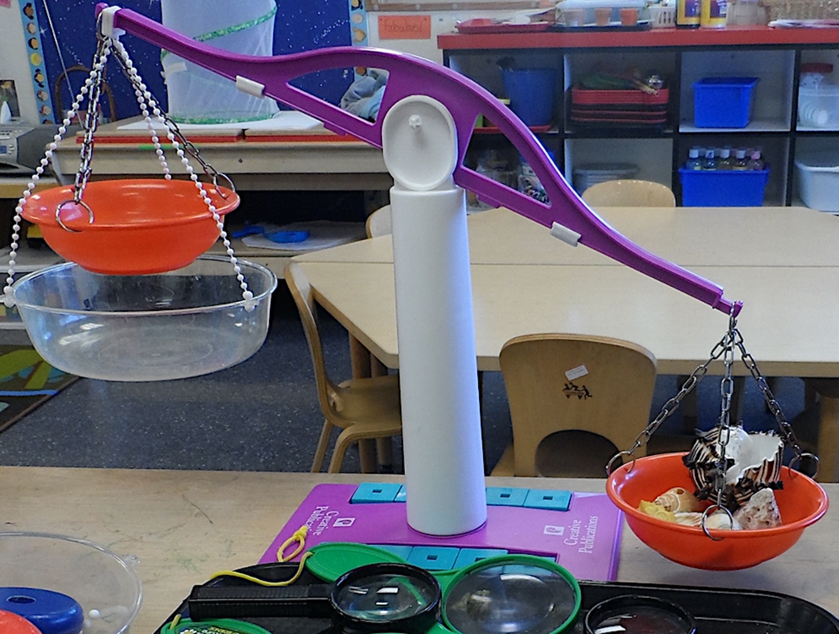
Creating Mathematically Rich Environments
“Integrate math-related materials into all interest areas in the classroom” (PCF, Vol. 1, p. 237).
  Examples:
  Tape measure
  Telephone
  Calculator or scale
  Puzzles, stickers, books, and cards with numbers
“Provide lots of objects to count” (PCF, Vol. 1, p. 246).
“Make number-related games, books, and other materials accessible…” (PCF, Vol. 1, p. 247).
Notes:
Presenter Remarks:
“Young children actively construct mathematical knowledge through everyday interactions with their environment. Setting up a high-quality physical environment is essential for children’s mathematical development” (PCF, Vol. 1, p. 237).
Read the list of suggestions on the slide for including math throughout the environment. Take a moment and visualize your classroom. Do you have these items? What else do you want to add to your classroom? Do you have other great ideas you want to share with your table group? Take about five minutes and talk about this list with your table group. (Allow 5 minutes for discussion.)
Does anyone have an idea they learned about that they would like to share? (Allow time for sharing out.)
(Trainer hold up the TK Implementation Guide and opens to Chapter 5 while speaking). The TK Implementation Guide is another resource that has ideas for creating rich environments.
Chapter 5 is filled with strategies for creating an environment that supports TK students. You may want to make a note of this and explore this chapter on your own time.
Look at the last bullet on the slide. The word “accessible” can mean many different things. In order to make items accessible to students in your class, you need to know the unique abilities of your students.
Using the concept of Universal Design for Learning, we need to consider how to support children engaging with these materials in different ways. Let’s take some time now to think about this in depth.

Slide 35
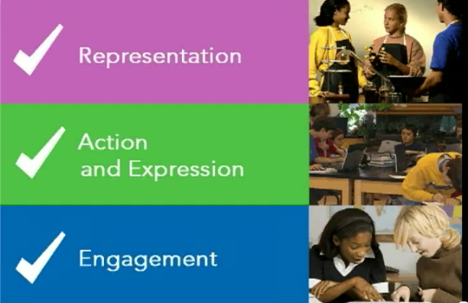
Universal Design for Learning
Multiple means of representation
Multiple means of engagement
Multiple means of expression
Number Rock
Notes:
Activity 6: Number Rock
Presenter Remarks:
(From the Preschool Curriculum Framework) “Although this curriculum framework presents some ways of adapting or modifying an activity or approach, it cannot offer all possible variations to ensure that a curriculum meets the needs of a particular child. Of course, the first and best source of information about any child is the child’s family. Additionally, several resources are available to support inclusive practices for young children with disabilities or other special needs. The resources, Web sites, and books listed in Appendix D are recommended for teachers’ use” (PCF, Vol. 1, p. 13).
For more information on Universal Design for Learning, see http://www.CAST.org/.
INTENT: Participants take a “brain break” while experiencing an activity that illuminates Universal Design for Learning.
OUTCOME: Participants will experience multiple means of engagement and representation while dancing and/or singing to Steve and Greg’s “The Number Rock.”
MATERIALS REQUIRED:
Access to Steve and Greg’s “The Number Rock” (via YouTube or computer download)
Number Rock Envelope with direction cards and necessary materials (scarves)
PPT notes
TIME: 5 minutes
PROCESS:
Invite table groups to open the Number Rock Envelope on their table and read the direction card within.
When participants are ready, let them know that we will be doing the Number Rock, but that we will all be engaging in different ways.
Play the song and watch all participants as they engage with the song in different ways (some will be standing and dancing, some will be tapping along to the song with fingers, etc.).
After the song, debrief with possible questions:
How did this activity represent Universal Design for Learning?
In how many different ways did we engage in this activity?
In how many different ways did we represent numbers?
If you did this activity without the direction cards, what forms of engagement and representation might you see in your classroom?
SUMMARY: Participants engage in an activity to illuminate Universal Design for Learning.

Slide 36
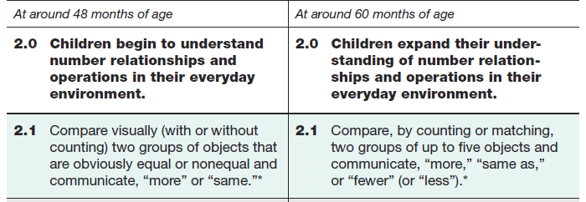
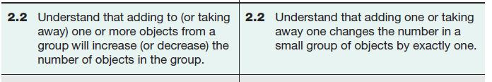
Number Sense Substrand 2.0
Notes:
Presenter Remarks:
This slide shows the Number Sense substrand 2.0: Children begin to and expand their understanding of number relationships and operations in their everyday environment.
We have already discussed these foundations while looking at the counting developmental continuum.
Next, we will take a closer look at these foundations by viewing a video example and taking note of the developmental shift represented.

Slide 37
Focused Foundation
Video Example 2.3
Notes:
Background Information:
Prior to the training embed video example foundations 2.3.
Presenter Remarks:
Now let’s look at a video example of Number Sense foundation 2.3.
In your Video Viewing Guide, take note of the developmental shift occurring and the examples of the counting continuum that you observe.

Slide 38
Focused Discussion
What did you notice in the developmental shift occurring between 48 months and 60 months?
What components of the counting developmental sequence did you notice?
Notes:
Presenter Remarks:
Take a moment to discuss the questions on the slide with your table group.

Slide 39
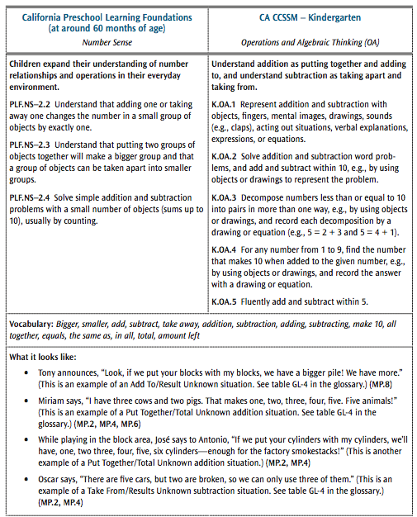
TK Vignette from the Mathematics Framework for California Public Schools: Kindergarten Through Grade Twelve
Read Handout 10: TK Vignette.
Refer to the “What it looks like” section at the bottom of the page.
Choose one bullet, turn to a table partner, and discuss the following question:
  What would you do to support the students?
Notes:
Presenter Remarks:
Let’s look at the connection between the foundations that we just discussed and the CA CCSS.
To do this, we will look at the Math Framework. This chapter has vignette sections titled “What it looks like.”
Please find and read Handout 10: TK Vignette. This handout shows foundations (at 60 months of age) for Number Sense and the California kindergarten standards for Operations and Algebra.
When you have finished reading the handout, choose one bullet from the “What it looks like” section, turn to a table partner, and discuss how you would support those students if you were their teacher.

Slide 40
Counting Game
Read Handout 11: Counting Games.
Decide which game to play (Bears in a Cave or the Pizza Game).
Play the game with your group.
Read the developmental levels in each measure on Handout 12: DRDP-K Measures.
Discuss the following questions with your group:
  How might you scaffold the game—depending on individual students?
  How might you use these measures to support your teaching?
Notes:
Activity 7: Counting: Let’s Play
Presenter Remarks:
We just read about what counting might look like in the classroom; now let’s experience counting by playing some games that can be used in the classroom.
intent: Practice counting knowledge through game play and analyze games with regard to the Preschool Curriculum Framework, dual-language strategies, and the DRDP-K.
OUTCOME: Participants will practice a game to be used in a TK classroom.
Materials Required:
Counting Game Packet (Support Materials)
Materials for the Pizza Game (1 per table group)
Materials for Bears in a Cave (1 per table group)
Handout 11: Counting Games
Handout 12: DRDP-K Measures
PPT notes
Time: 20 minutes
Process:
Invite participants to read through Handout 11: Counting Games.
Invite participants to choose to play the Pizza Game or Bears in a Cave with their table groups.
After table groups have played their chosen game, invite participants to read Handout 12: DRDP-K Measures, two math measure from the DRDP-K.
After participants have read the handout, invite table groups to discuss the questions on the slide:
How might you scaffold the game, depending on individual students?
How might you use these measures to support your teaching?
Allow five minutes for discussion. Walk around and listen to discussions, taking note of anything that you would like to share out or discuss with the whole group.
After the discussion, invite groups to share any conclusions or questions that they have about this experience.
SUMMARY: Participants play and analyze counting games.

Slide 41
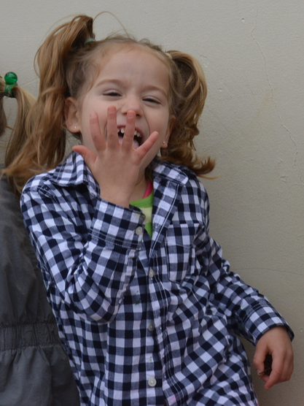
Make Number Relationships Meaningful
“Stories, songs, and games provide a playful way to introduce ‘adding-to’ and ‘taking-away’ operations, and part–whole relationships” (PCF, Vol. 1, p. 255).
Notes:
Presenter Remarks:
We just experienced some great games to make number relationships meaningful. Another way to do this is to use songs and stories. We have also already used songs today, with our “Number Rock” experience.
Let’s tap into our group knowledge! Please share-out your favorite stories to use in the classroom to make number relationships meaningful. (Allow time to share.)
The experiences we create through stores and other activities are important! The Preschool Curriculum Framework recommends that teachers, “Introduce preschool children to the concepts of addition and subtraction through literature, songs, and games. Experiences with concrete sets of objects, in particular, can illustrate for children addition and subtraction concepts and enable children to solve simple addition and subtraction problems by counting objects” (PCF, Vol. 1, p. 255).
For example, songs like “Five Little Monkeys Jumping on the Bed” provide a meaningful and playful way for children to use their bodies and songs to represent taking away.
Please find Handout 13: List of Books, which has a list of books that can provide ideas for how to use stories to support math. Take a moment and read over the list.
Now fill out the “my favorite books” column on the last page of the handout with books that you use or that you have seen used to support number sense. Once you have listed your favorite books, wait for the music to play, and go around the room asking other participants to share their favorite books and to list them under “Your favorite books.” Once the music stops, return to your seats.
Extra Notes:
If you do not do this activity, suggest that participants take this handout back to their classrooms and do the activity at a staff meeting, to learn about their colleagues’ favorite number-sense books.

Slide 42
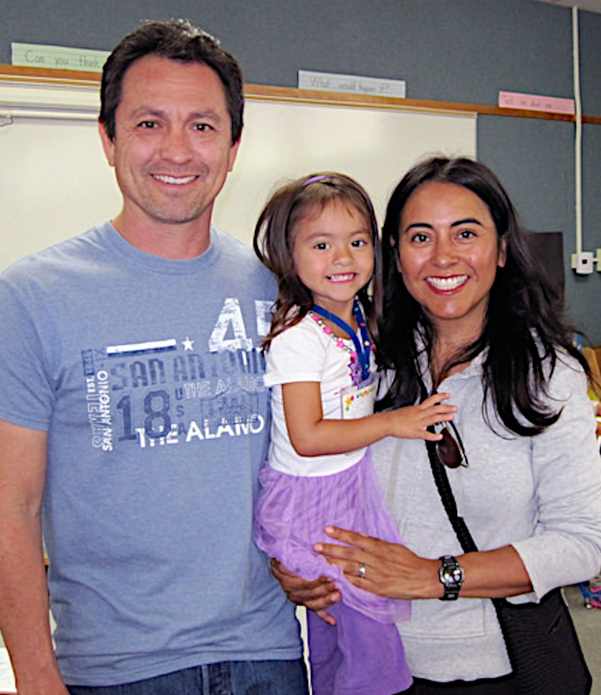
Partner with Families to
Learn About Strengths
Engaging Families: Preschool Curriculum Framework
All About Young Children
Best Practices for Planning Curriculum: Family Partnerships and Culture
TK Implementation Guide
Notes:
Presenter Remarks:
In order to effectively build on children's existing strengths, we must understand them. To do this, we need to partner with families to learn about their children’s strengths.
The resources on this slide are specifically beneficial for partnering with families. You may want to take a picture of this slide and refer to it later.
In our final activity, we’ll take a closer look at some of these resources.
Optional:
Create a gallery table and have examples of documents there.
Extra Notes:
The resources are hyperlinked, so if you have Wi-Fi access, you can go directly to each resource and do a resource walkthrough.

Slide 43
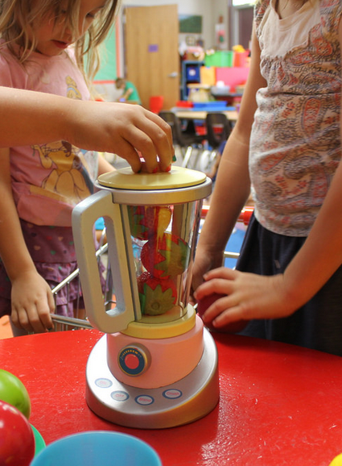
Engaging Families Blending Strategies
Read Handout 14: All About Young Children and Handout 15: Engaging Families.
With your table group, identify at least two strategies for engaging families in mathematics and write them on chart paper.
Reflect on the entire day:
  What are your key “take-away” thoughts?
  How can you blend these key “take-aways” with the strategies for engaging families?
Discuss and chart your ideas with your group.
Notes:
Activity 8: Engaging Families Blending Strategies!
intent: Share ideas on how to partner with and engage families with math.
OUTCOMES: Participants will become familiar with strategies for engaging families, gather ideas from one another, and create strategies that will support them in engaging families.
Materials Required:
Chart paper
Colored markers
Handout 14: All About Young Children
Handout 15: Engaging Families
Handout 16: Blender
Time: 15 minutes
Process:
Invite participants to read Handout 14: All About Young Children and Handout 15: Engaging Families.
Have participants, in table groups, identify at least two different strategies that they would like to use for engaging families in mathematics and write them on the chart paper.
Invite participants to think about all of the experiences and discussions that they have had today, and, as a group, decide on 2–4 key things that they want to remember or try from today.
Invite participants to look at their chart paper with the ideas that they just wrote down for engaging families. Can they blend these ideas together and include families in the ideas that they want to try from the day?
Ask participants to discuss how they might blend these strategies together and to write down their ideas on the chart paper. They may also choose to take personal notes on Handout 16: Blender.
Invite participants to walk around the room gathering ideas from other groups.
Ask participants to discuss handout strategies with tablemates and come up with some of their own ideas, and to document them on their copies of Handout 16: Blender.
SUMMARY: Participants identify strategies for engaging families, create new ideas, and share their ideas with other participants.

Slide 44
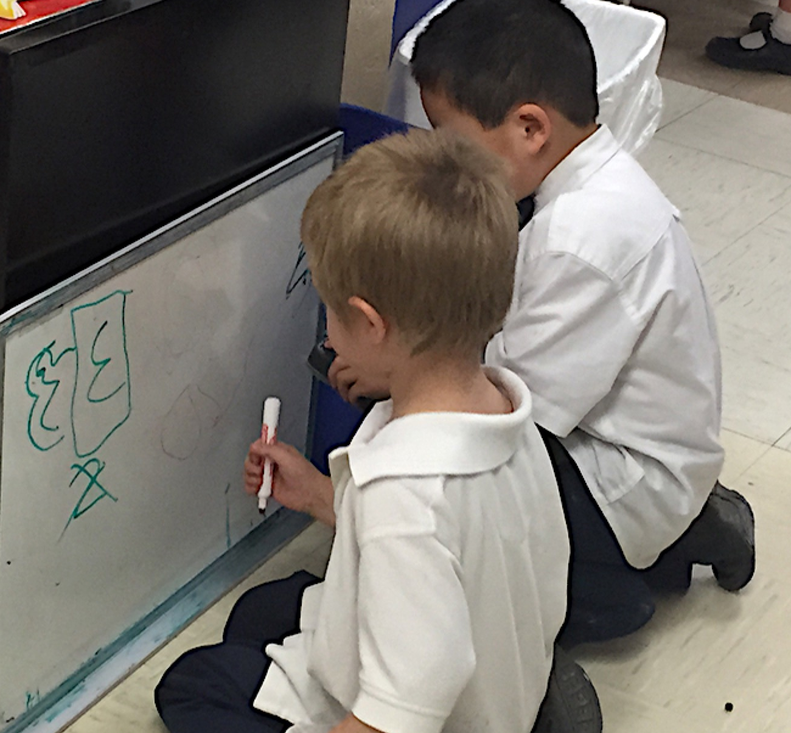
Thank you for coming!
We hope you learned AT LEAST three new ideas.
Notes:
Presenter Remarks:
Thank you for coming!
We hope you learned AT LEAST three new ideas.

Slide 45
Reference Guide for PowerPoint Citations
California Department of Education. 2010. California Preschool Curriculum Framework, Volume 1. http://www.cde.ca.gov/sp/cd/re/documents/psframeworkkvol1.pdf (accessed September 7, 2016).
California Department of Education. 2011. California Preschool Curriculum Framework, Volume 2. www.cde.ca.gov/sp/cd/re/.../psframeworkvol2.pdf (accessed May 10, 2016).
Clements, Douglas H. 1999. “Subitizing: What is It? Why Teach It?” Teaching Children Mathematics 5 (7) [March]: 400-05. http://gse.buffalo.edu/fas/clements/files/subitizing.pdf
Clements, Douglas H., and Julie Sarama, eds. 2004. Engaging Young Children in Mathematics: Standards for Early Childhood Mathematics Education. Mahwah: Lawrence Erlbaum Associates, Inc., Publishers.
Clements, Douglas H, and Julie Sarama. 2013. “PreK Mathematics Curriculum: Impacts on Early Literacy.” Paper presented at the Society for Research and Child Development Biennial Meeting, Seattle, WA.

