Slide 1
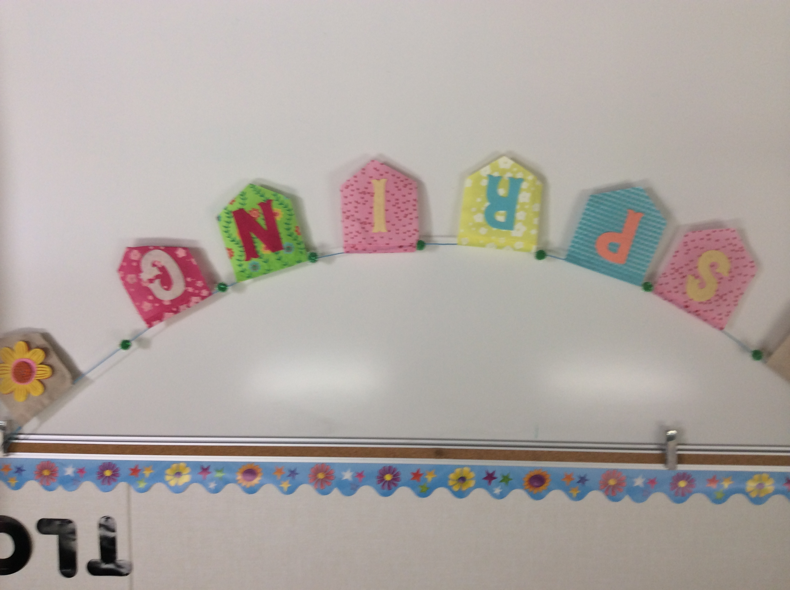
Pictures of Materials from Pilot

Slide 2
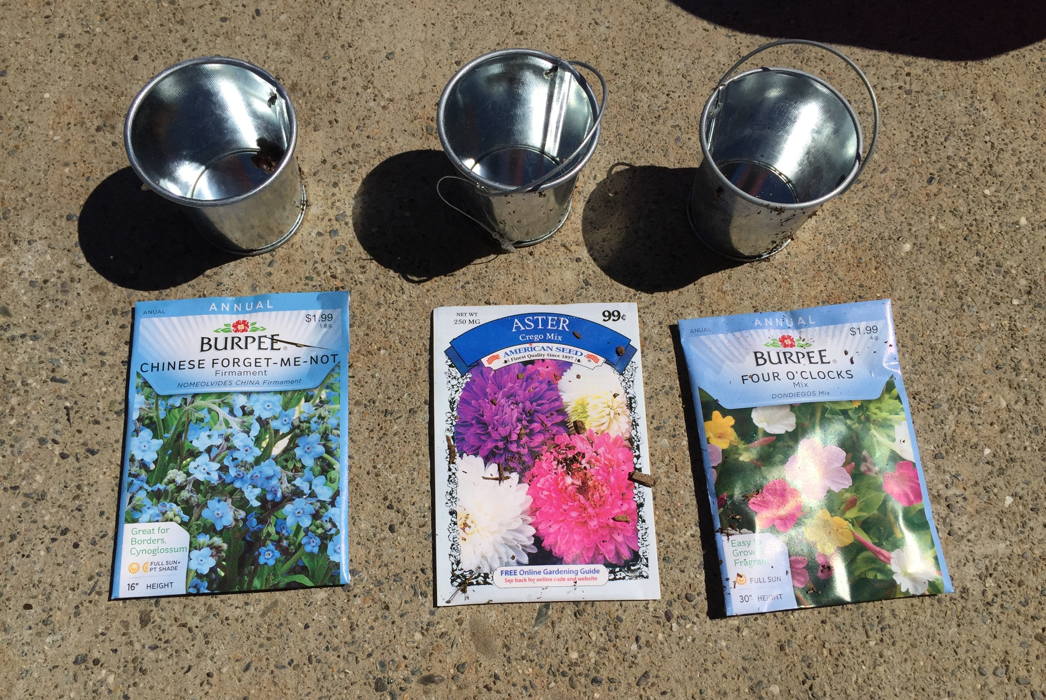
Three Seed Choices for
Plant the Seed Activity

Slide 3
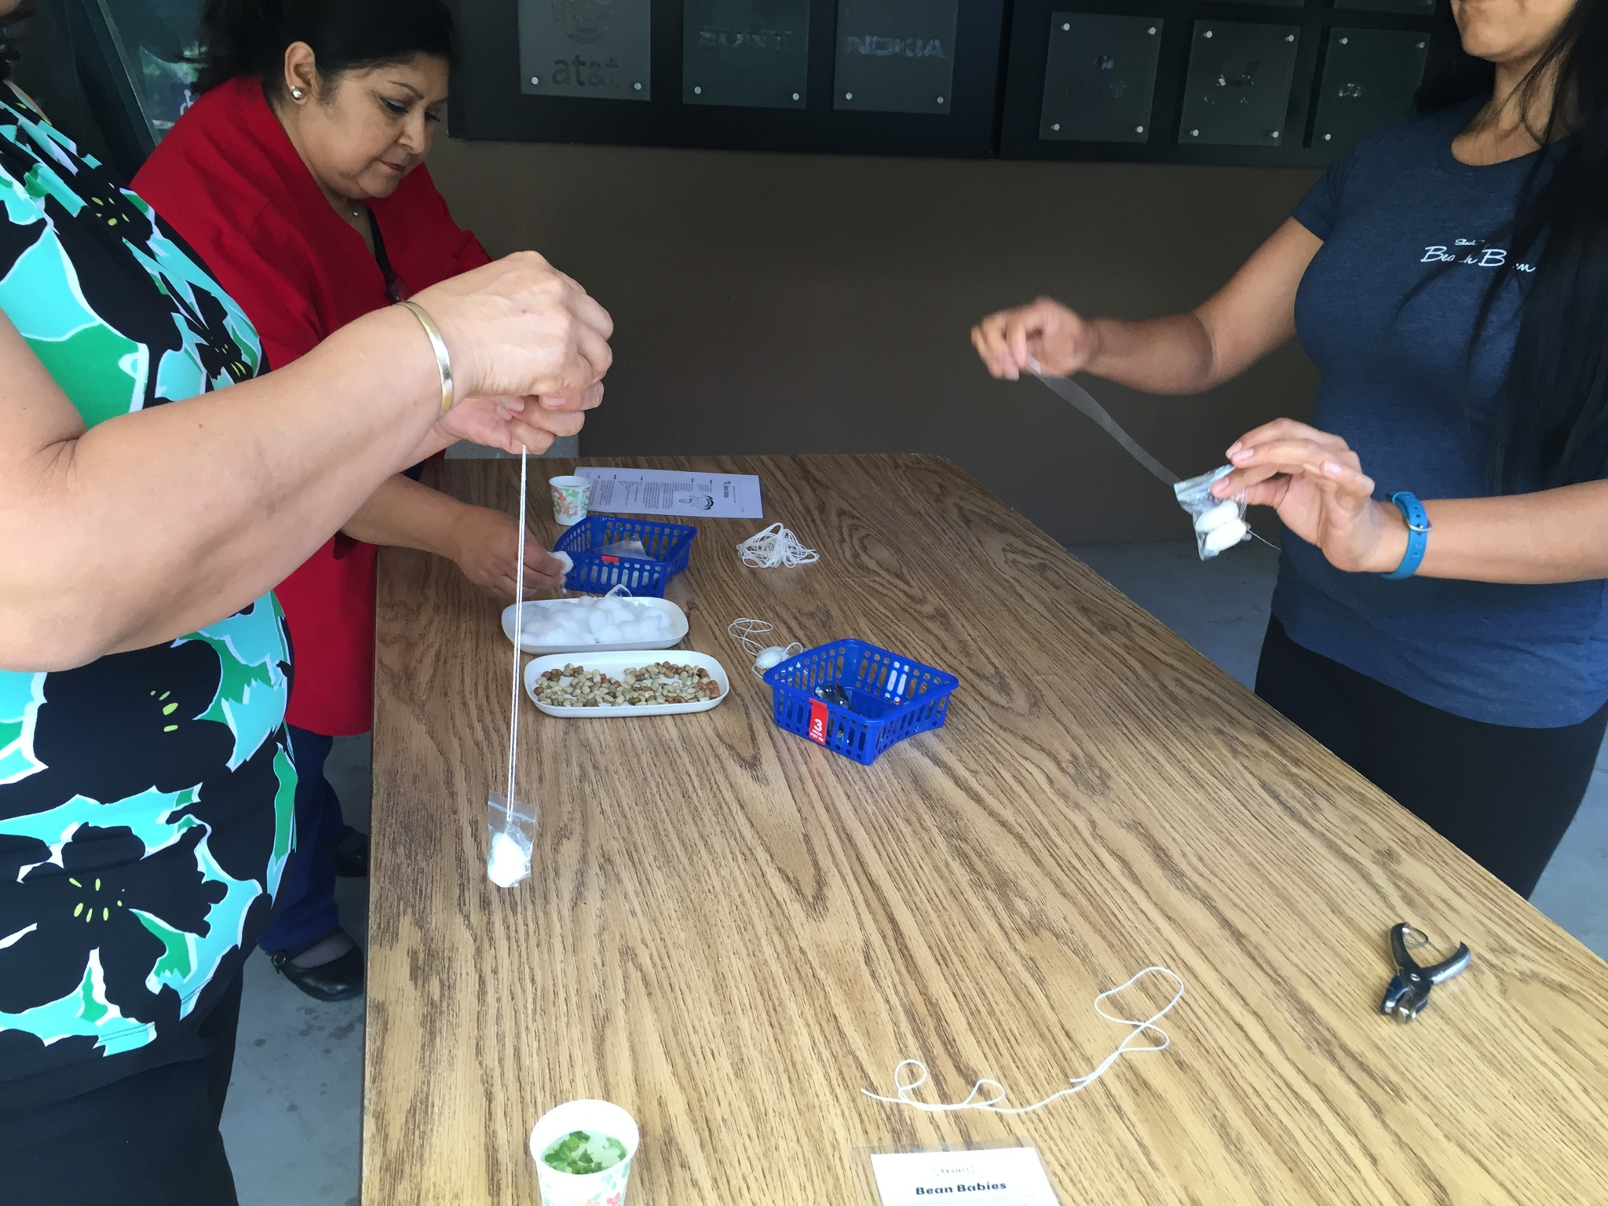
Basic Needs: Beanie Baby

Slide 4
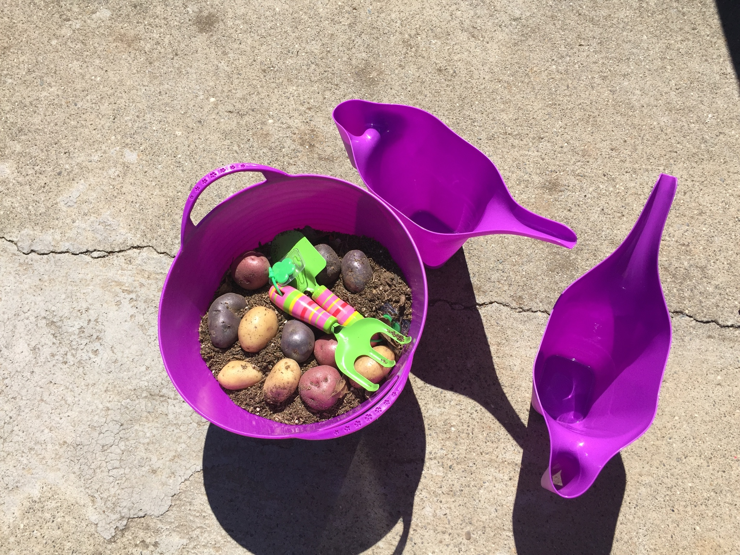
Habitats: Potatoes

Slide 5
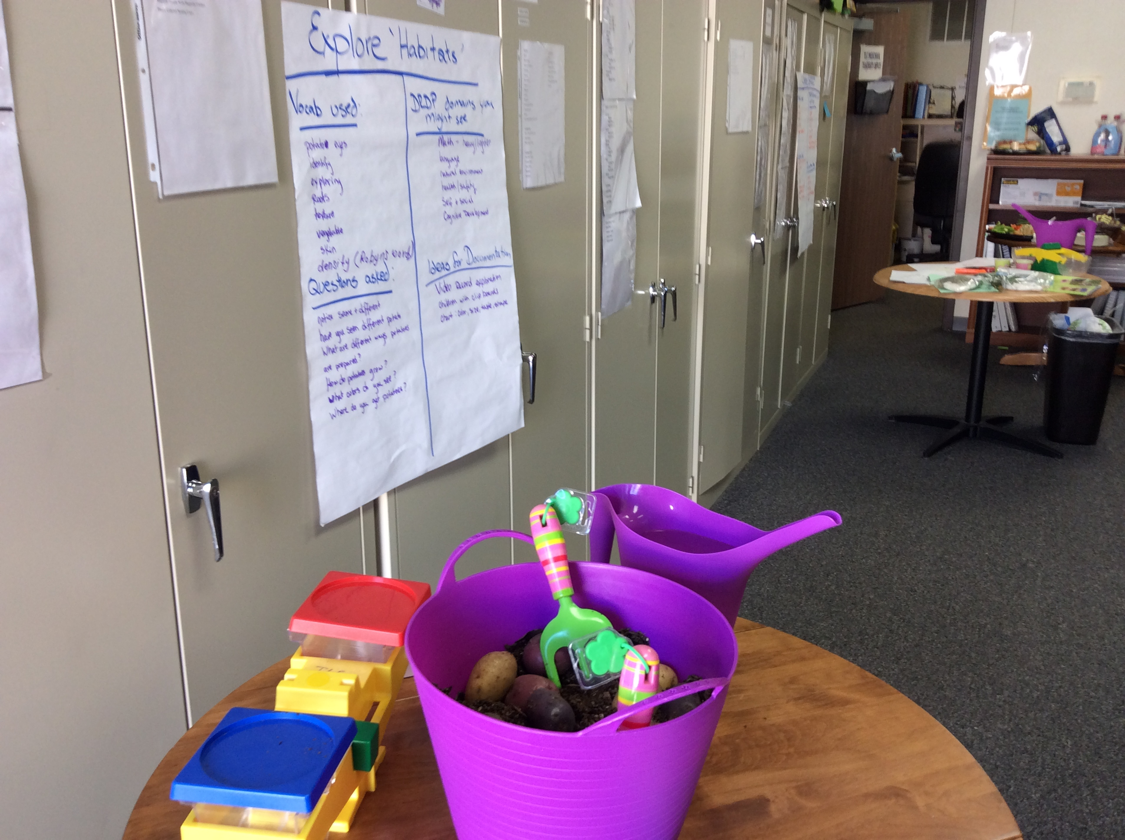

Slide 6
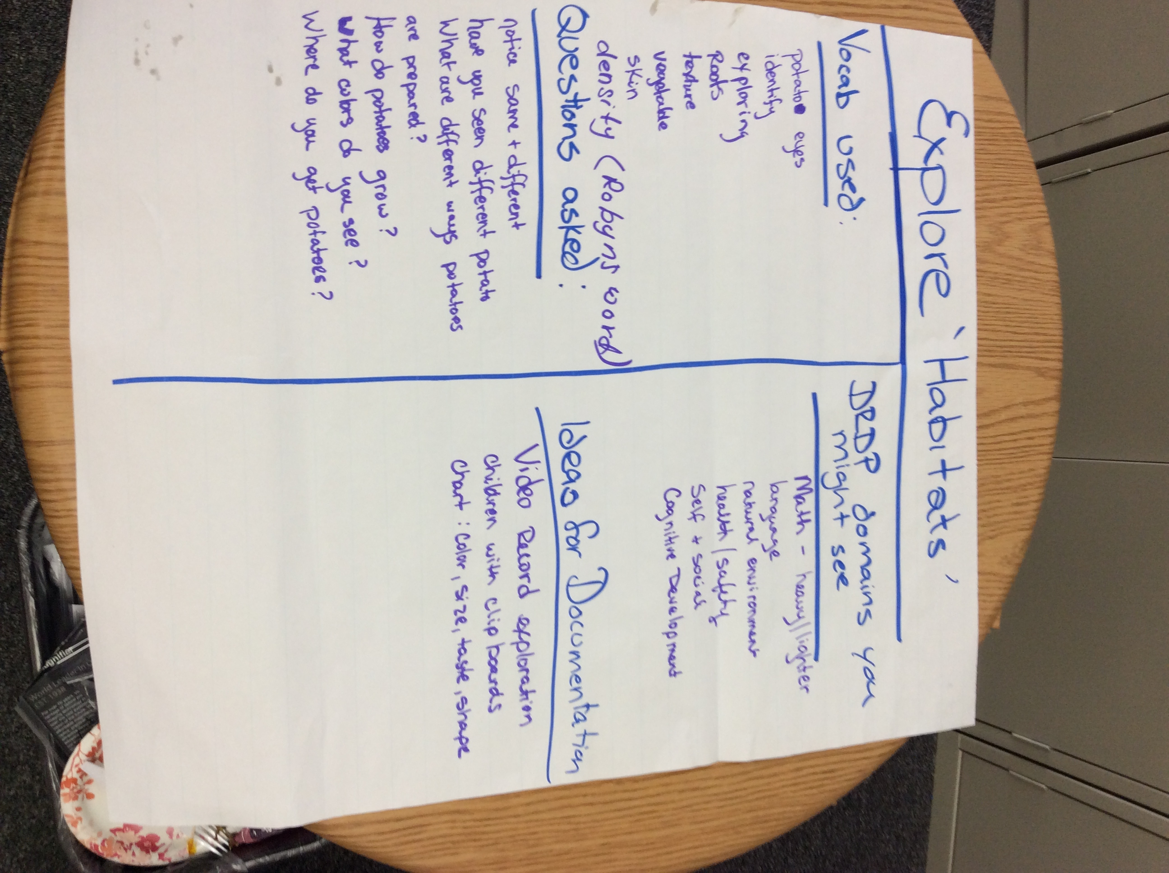
Group Chart for Habitats
©2016 California Department of Education.

Slide 7
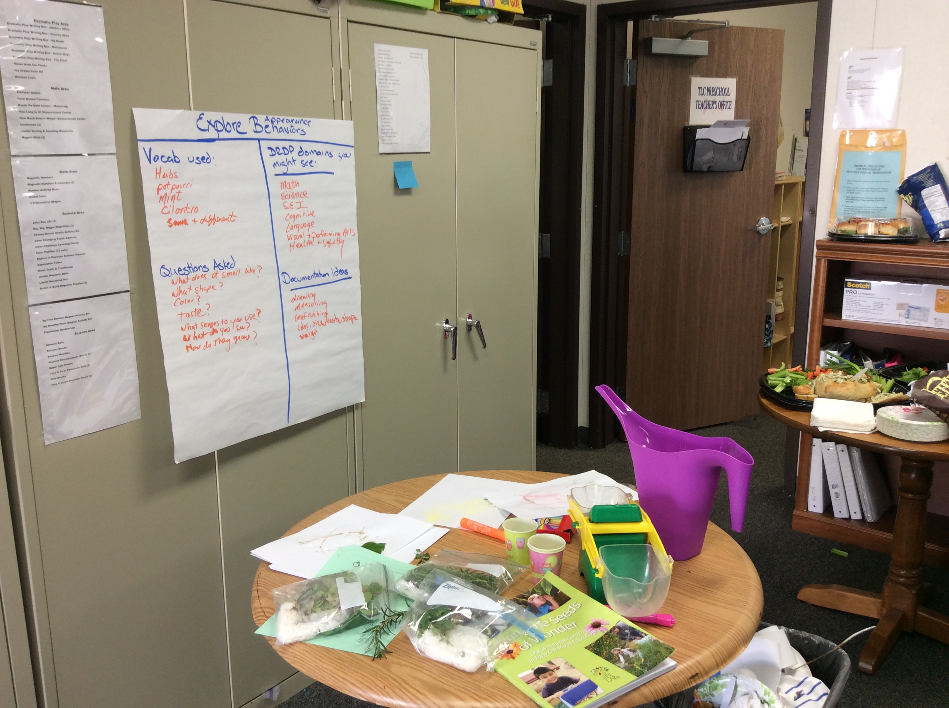
Behaviors and Appearance:
Leaf Rubbing and Solar Tea

Slide 8
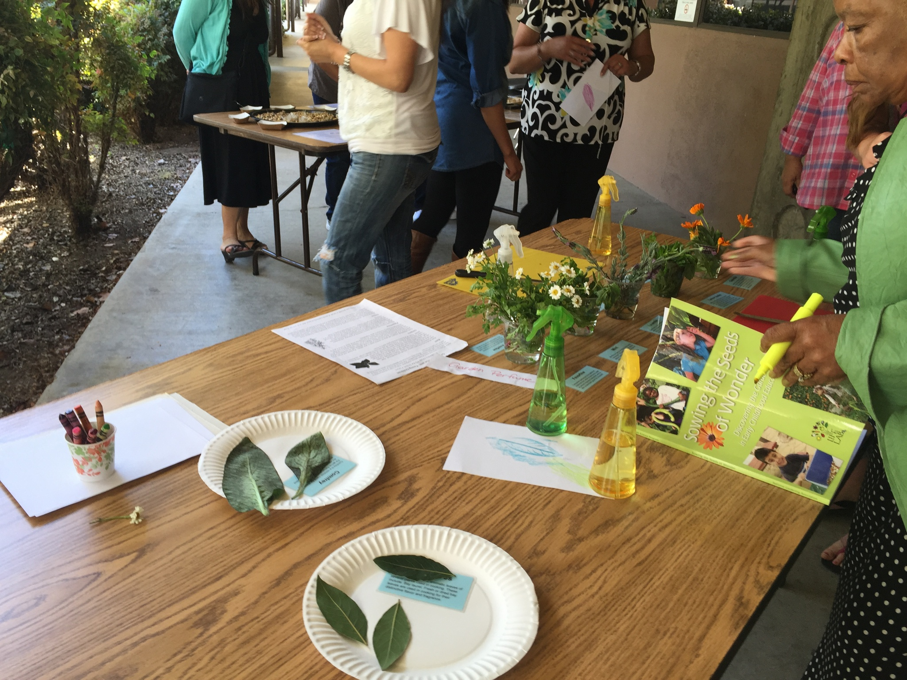

Slide 9
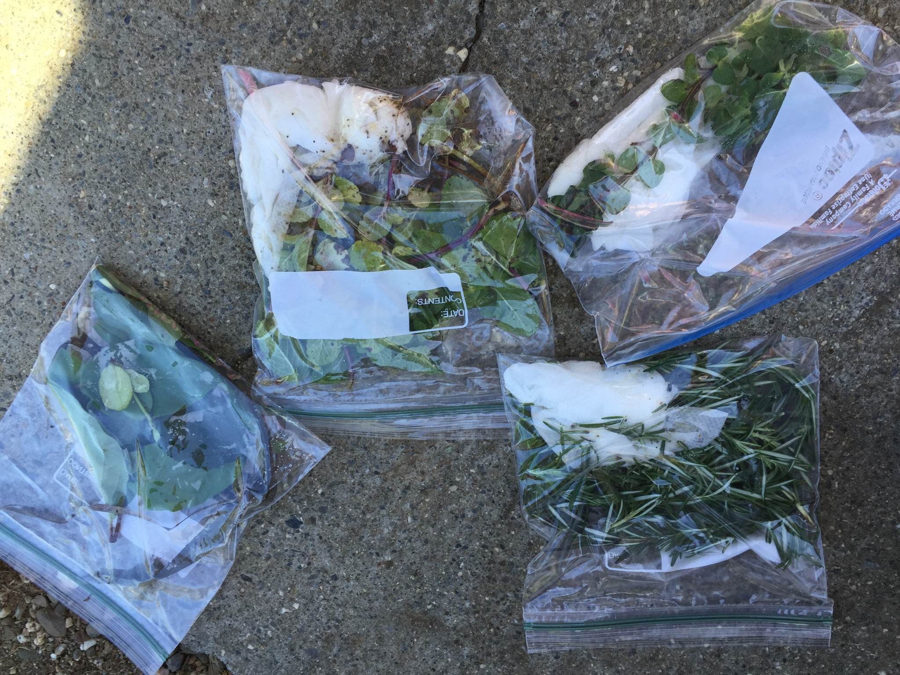
Materials for Solar Tea and Leaf Rubbing

Slide 10
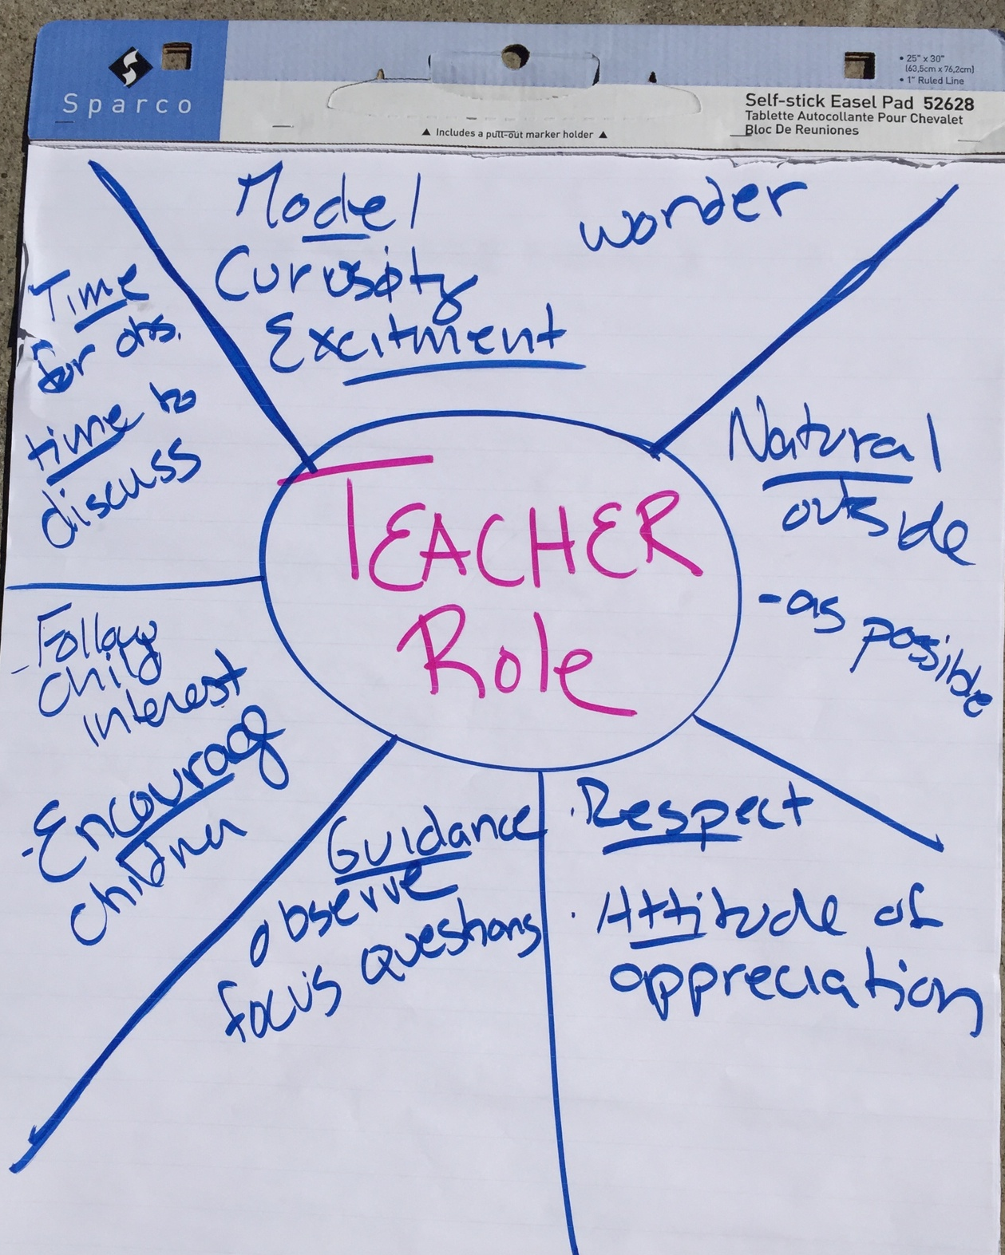
Teacher Role: Debrief Chart
©2016 California Department of Education.

