Slide 2
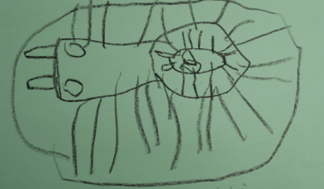
Notes:
Presenter Remarks:
“Children treat writing from a pictographic perspective, which is demonstrated by drawings as writing or using idiosyncratic scribbles (e.g. markings that have meaning only for the child).” (PLF 2008, 87)
(Read it or ask for volunteer to read it.)
Children use drawing to stand for writing.
Children may believe that drawings have “a message.”
Children “read” their drawings as if there were writing on them.
Children do not generally have a clear idea of the difference between drawing and writing.
They are just beginning to use pictures and symbols to represent ideas.
This is a drawing of ants.

Slide 3
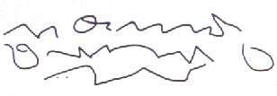

Slide 4
Notes:
Presenter Remarks:
Drawing and scribbling together.
It’s clear that there is an intent to replicate traditional writing.
The top of the page is drawing and at the bottom is scribbling.

Slide 5
Notes:
Presenter Remarks:
Have audience talk about which is writing and which is drawing.
Ask small groups to talk about which ones are writing and which are drawing.
Give groups a few minutes, then ask for feedback.
Go to next slide for answers.

Slide 6
Notes:
Presenter Remarks:
Have audience talk about which is writing and which is drawing.
Ask small groups to talk about which ones are writing and which are drawing.
Give groups a few minutes, then ask for feedback.
Go to next slide for answers.

Slide 7
Notes:
Presenter Remarks:
Have audience talk about which is writing and which is drawing.
Ask small groups to talk about which ones are writing and which are drawing.
Give groups a few minutes, then ask for feedback.
Go to next slide for answers.

Slide 8
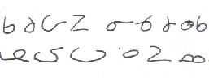
Notes:
Presenter Remarks:
(Read it or ask for volunteer to read it.)
Children’s scribbles are intended as writing.
The scribbling resembles writing.
Children begin to hold and use writing tools like an adult.
Letter-like forms (mock letters).
Children become aware of the different shapes of symbols that make up the words in a line of print (lines, zigzags, loops).
Shapes in writing actually resemble letters but are not actually letters.
Although poorly formed, many letter-like marks are unique creations.
(PLF 2008, 87)

