Slide 1
Best Practices for Planning Curriculum for Young Children Family Partnerships and Culture
Preschool English Learning Guide Connections

Slide 2
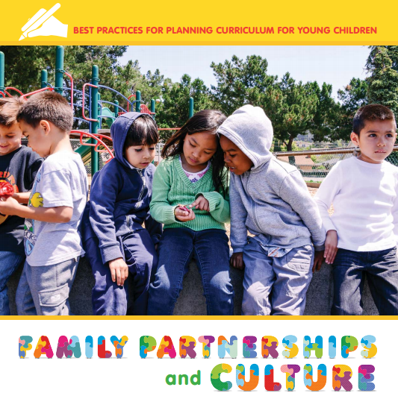
Best Practices for Planning Curriculum for Young Children: Family Partnerships and Culture
Ideas for increasing cultural competence
Ideas for communicating with families
Ideas for self-reflection
Ideas for planning with cultural reflection
Notes:
This publication:
values families and their contribution to children’s learning;
approaches cultural diversity with an open mind; and
applies knowledge gained about families, including their values and beliefs, to teaching and learning.
It is a guide for program staff members as they work through the process of learning about and working with the families of the children they serve. This guidance provides a foundation for the work that has to be done, but mastery of the ideas contained here is not enough.
In it, you will find ideas for:
Increasing cultural competence
Communicating with families
Self-reflection
Planning with cultural reflection
While in the document (or slide 9), go to the introduction.

Slide 3
The Guiding Principles for Developing Cultural Competence
Reflect on one’s own cultural background.
Learn about the children in the program and their families.
Examine the belief that one culture is better than another.
Adopt a posture of cultural respect.
Be a learner before trying to be a teacher.
Notes:
Take a moment to read these principles. Do you notice any connections to the core beliefs?

Slide 4

What do the principles look like in your daily routine?
“Frame child-learning objectives in ways that reflect the values and goals espoused by the children’s culture” (Family Partnerships and Culture [CDE], p. 77).
Notes:
Note: This information comes from Family Partnerships and Culture [CDE], pp 76-78 Box 4.
One of the strategies for cultural responsiveness in teaching and learning is learn about family goals.
Frame child-learning objectives in ways that reflect the values and goals espoused by the children’s culture.
Take time to find out what the most important goals of the family are. Then share with parents how their child is developing in the context of those family goals.
For example, in early childhood, some parents focus on social skills more so than on cognitive goals. They may want their children, at this age, to learn to get along with others, gain practical information, and acquire self-care skills more than they care about learning in areas such as numeracy, literacy, or drawing. Other parents may focus on learning objectives that place greater emphasis on numeracy, literacy, or drawing than on social skills.

Slide 5
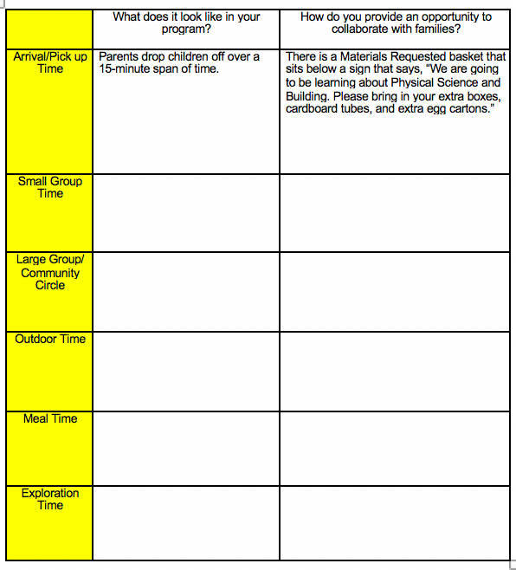
Application of Best Practices–1
How are families welcomed into your daily routines?
Use the handout to write down your ideas.

Slide 6
Integrated Nature of Learning
Preschool English Language Learner Guide Connections
Notes:
Use this document connection to extend chapters, 3, 6 or 8 as best meets your participants needs. Or use this document connection to provide a base for conversation with onsite support.

Slide 7
Questions Addressed by the Publication
What does it mean to teach when working with infants and young children birth to age five?
What does curriculum look like in this first period of education?
Notes:
This publication is a guide for program staff members as they work through the process of learning about the integrated nature of learning.
It aims to address these questions:
What does it mean to teach when working with infants and young children birth to age five?
What does curriculum look like in this first period of education?
The short answer is all early learning professionals, regardless of title, have the same goal: “nurturing young children and their families in ways that simultaneously support them in learning” (Integrated Nature of Learning p. 6)
“Children’s thinking, their feelings, and their dispositions are the center of the curriculum and inform the planning and implementation of educational experiences (Integrated Nature of Learning p. 7).

Slide 8
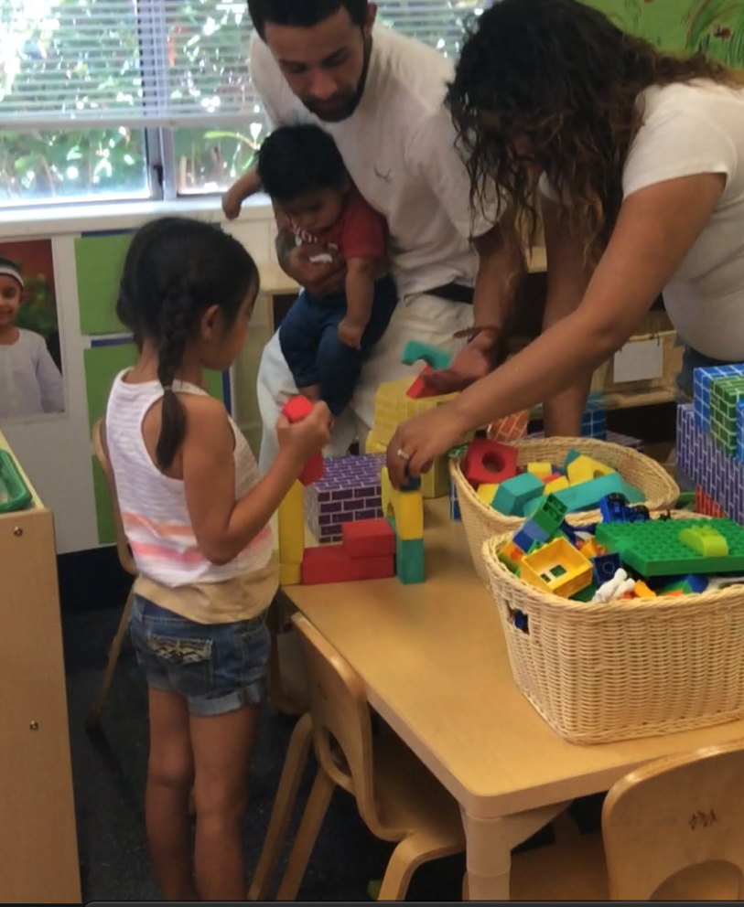
Dynamic Planning
“Curriculum plans that are dynamic, collaboratively constructed with children, and responsive put children’s thinking at the center of the curriculum planning process” (Integrated Nature of Learning, p. 54).
Notes:
“Curriculum plans that are dynamic, collaboratively constructed with children, and responsive put children’s thinking at the center of the curriculum planning process“ (Integrated Nature of Learning, p. 54).
Dynamic curriculum by nature does not look or feel just one way. It includes many qualities that change based on children and setting. Dynamic curriculum includes these qualities:
Unique
Different
Reflective of children, community and families
Inclusive
Changing
Unpredictable and predictable

Slide 9
Application of Best Practices–2
Choose a cultural/ family interest, practice, or lifeway
Map learning invitations for multiple domains
Add dual language learner supports
Cultural/ family interest, practice or lifeway
Learning Invitation
Learning Invitation
Learning Invitation

Slide 10
Preschool Program Guidelines
Preschool English Language Learner Guide Connections

Slide 11
Benefits of Bilingualism
“Being exposed to two or more languages at a young age is a gift. It is a gift because children who are able to learn through two or more languages benefit cognitively, socially, and emotionally.”
“Exposure to more than one language should be celebrated as a growth opportunity that offers many learning and social advantages. Children who are developing bilingual abilities are developing unique strengths that will add to the cultural and linguistic resources of California.”
(Source: CDE 2010, 224)
Notes:
It is critical to consider the child’s communication in all the languages that he or she is learning to have an accurate picture of a child’s knowledge and skills. Young children, including children with disabilities, can successfully learn two or more languages. Learning two or more languages has linguistic, social, cognitive, academic, and cultural benefits. The path to learning one language shares many similarities with the path to learning two or more languages.
Early childhood educators need to be knowledgeable about:
The role of the home language
The influence of cultural values
Stages of second language development
(Preschool Curriculum Framework, Volume 1 (PCF), Vol. 1, p. 179)

Slide 12
Why Both Languages Are Important
Advantages in infancy
Advantages in childhood
Advantages in later adulthood
Notes:
12
Overall, research indicates that learning and speaking more than one language bequeaths a cognitive advantage in a variety of tasks that is detectable as early as seven months of age (Kovacs and Mehler 2009 as cited in California’s Best Practices for Young Dual Language Learners Research Overview Papers) that persists throughout childhood to adulthood, and even offers some protection against symptoms of Alzheimer’s dementia (Craik, Bialystok, and Freedman 2010 as cited in California’s Best Practices for Young Dual Language Learners Research Overview Papers).

Slide 13
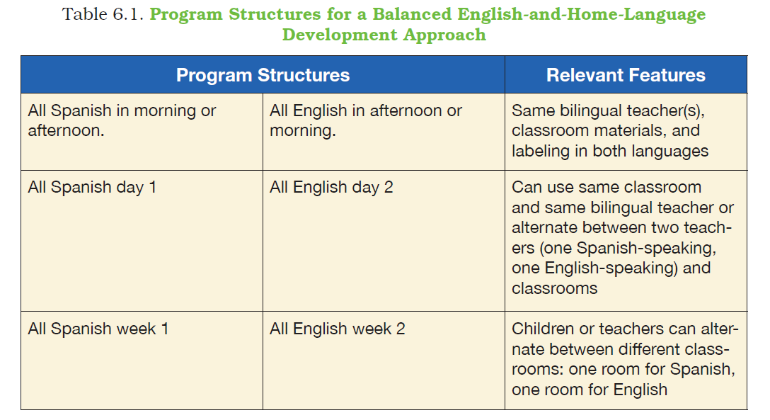
Chapter 6 (p. 75): Support for Young Dual Language Learners
Notes:
How can my program support more than one language?
California Preschool Program Guidelines provides the detailed guidance needed by administrators and teachers to offer high-quality preschool programs that prepare children to arrive in kindergarten with the foundational skills necessary for school success.

Slide 14
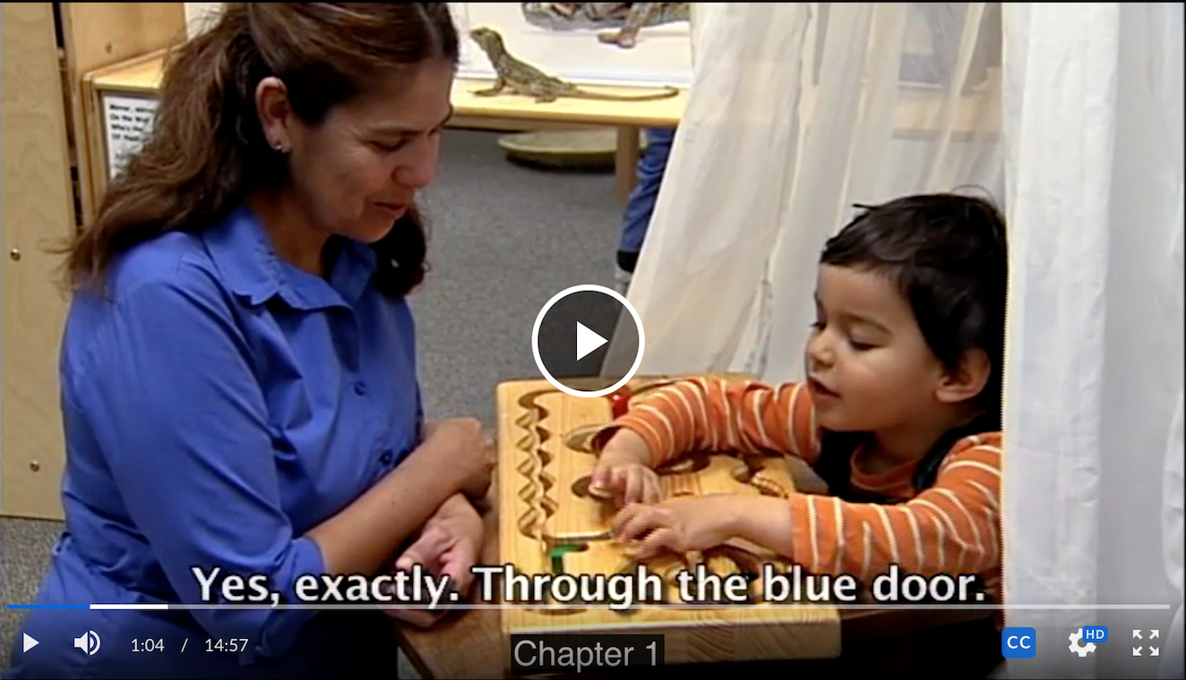
Let’s Watch an Example
SupportingDualLanguageLearners_ProgramApproaches.mp4
Notes:
Trainer note: Insert video clip
This video shows two different types of dual language:
Alternate days
Alternate teachers

Slide 15
Application of Best Practices–3
Edited 3, 2, 1,

Slide 16
California Preschool Curriculum Framework Engaging Families Vignette and Strategies
Preschool English Language Learner Guide Connections

Slide 17
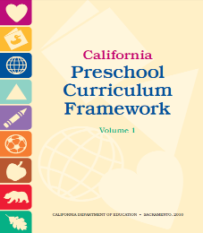
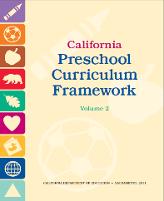
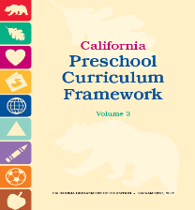
California Preschool Curriculum Framework
Integrated curriculum for young dual language learners
Interactions and strategies for engaging families in:
  Four domains for infant/toddler
  Nine domains for preschool
  Available in English and Spanish
Notes:
Chapter 5 focuses on the use of the California Preschool Curriculum Framework. This framework is integral in the planning and reflection of all preschool teachers and directors. There are three volumes of the framework, which cover nine domains. Each volume includes domain-specific information about the key points listed on the slide.
Key points that this chapter addresses:
Eight Overarching Principles
Integrated Curriculum for Young Dual Language Learners
Universal Design
The Curriculum Planning Process
This information is presented in a multitude of ways, including environments and strategies ideas, teacher vignettes, planned learning opportunity ideas, interaction and strategy ideas, engaging family ideas, and reflective questions.

Slide 18
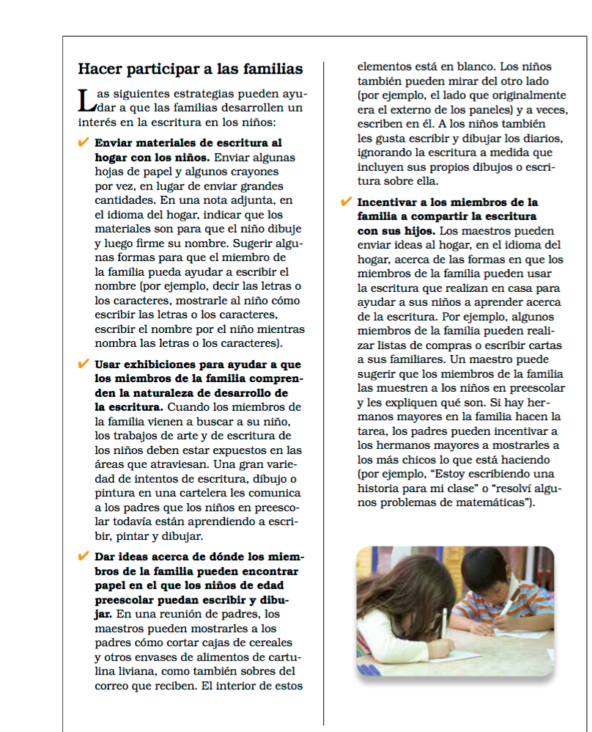
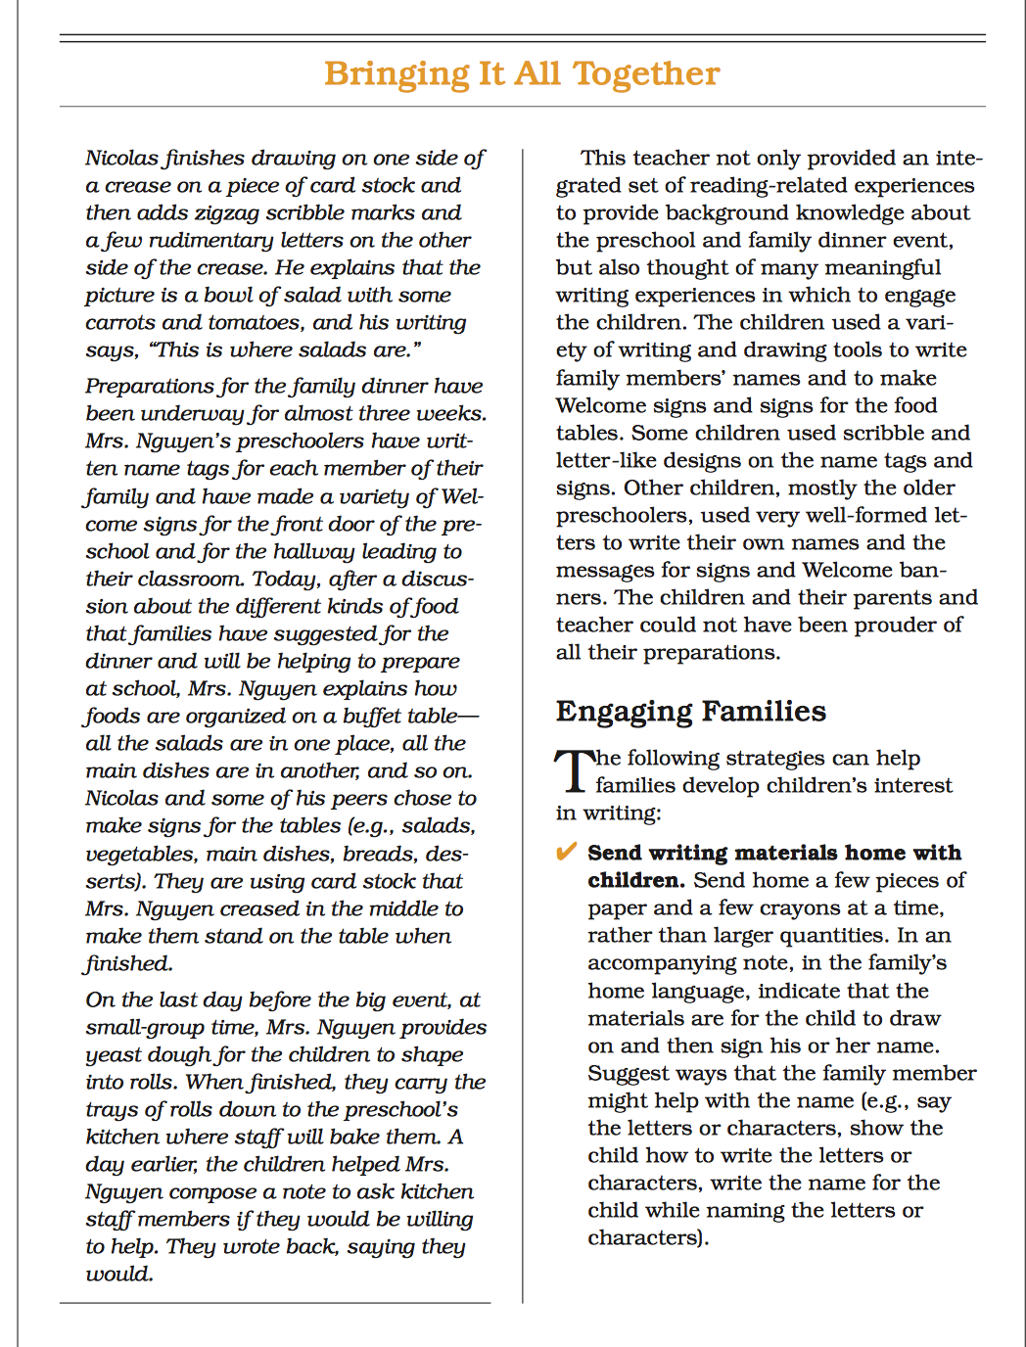
Strategies to Support Family Partnerships in Early Literacy Practices
(California Preschool Curriculum Framework, Volume 1, p. 165)
Notes:
Find and read the Engaging Families in Writing handout from California Preschool Curriculum Framework, Volume 1, p. 165.
What is interesting about this?

Slide 19
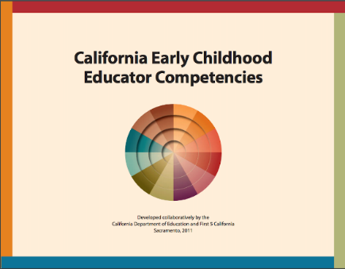
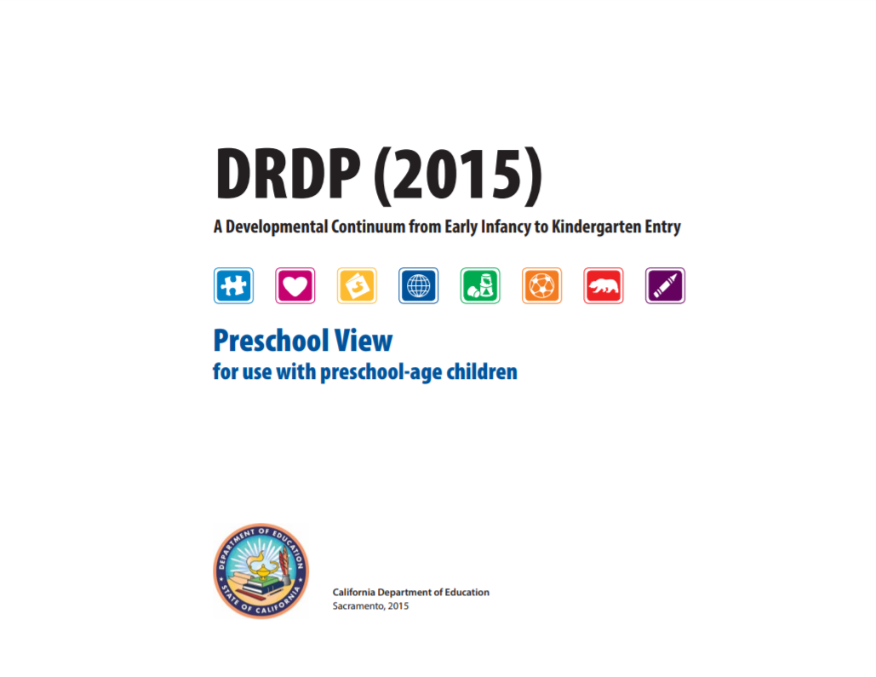

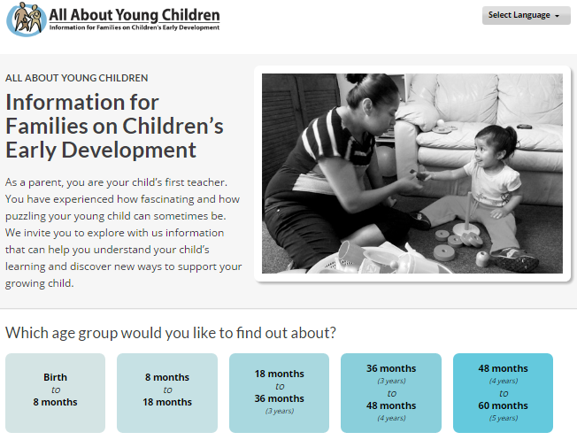

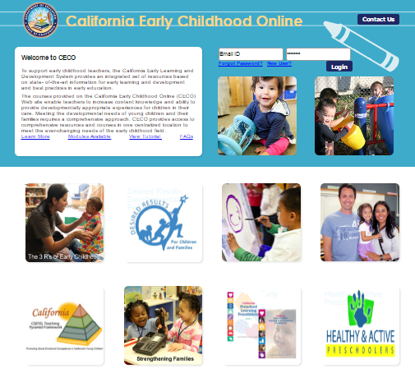
Other Resources to Rely On
Notes:
These resources will provide additional topics for on-site professional development and development strategies for supporting professionalism and continuous learning, especially for educators serving dual language learners.

Slide 20

Musical Chair Partners
Walk around while the music is playing.
When it stops, find a partner and share two (new and or used) ideas with your musical chair partner.
When the music starts again, find a new partner.
Notes:
Stand up. While you hear the music keep walking. When the music stops, make eye contact with someone immediately. Introduce yourself and share two (new and or used) ideas with your musical chair partner.
When the music starts begin walking again and switch partners.
Have 3-4 people share out their ideas.

