Slide 1

Funded by CDSS
This training is funded by the California Department of Social Services. The materials included in this training include materials or products developed in part or wholly by the California Department of Education and produced by the California Department of Social Services.
Notes:
This training is funded by the California Department of Social Services. The materials included in this training include materials or products developed in part or wholly by the California Department of Education and produced by the California Department of Social Services.

Slide 2


Partners in Early Learning
The California Department of Education (CDE) was given the authority in the 2021 Budget Bill to revise the Preschool Learning Foundations, which will now be known as the California Preschool/Transitional Kindergarten Learning Foundations (PTKLF). The California Department of Social Services (CDSS) is developing implementation materials and professional development. This partnership benefits all children regardless of funding sources.
Notes:
The California Department of Education (CDE) was given the authority in the 2021 Budget Bill to revise the Preschool Learning Foundations, which will now be known as the California Preschool/Transitional Kindergarten Learning Foundations (PTKLF). The California Department of Social Services (CDSS) is developing implementation materials and professional development. This partnership benefits all children regardless of funding sources.

Slide 3
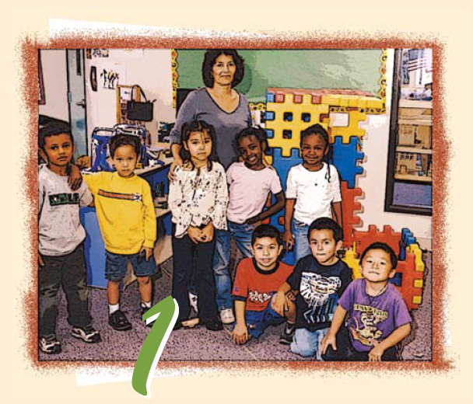
Preschool English Learners: Principles and Practices to Promote Language, Literacy, and Learning—A Resource Guide (Second Edition)
Chapter 1: Introduction to the Resource Guide
Notes:
Facilitator Notes:
Welcome! This Preschool English Learners: Principles and Practices to Promote Language, Literacy, and Learning—A Resource Guide, Second Edition (PEL Resource Guide) training was developed by WestEd with funding from the California Department of Social Services (CDSS) Child Care and Development Division (CCDD).
The California Department of Education developed the PEL Resource Guide—copyright 2009.
This training explores Chapter 1: Introduction to the Resource Guide.

Slide 4
What do you hold in your head, heart, and hands?
“Being exposed to two or more languages at a young age is a gift. It is a gift because children who are able to learn through two or more languages benefit cognitively, socially, and emotionally.”
“Exposure to more than one language should be celebrated as a growth opportunity that offers many learning and social advantages. Children who are developing bilingual abilities are developing unique strengths that will add to the cultural and linguistic resources of California.”
Source: CDE, California Preschool Curriculum Framework, Volume 1, 2010, 224
Notes:
Ask participants to share with the large group a word or words that resonate with them.
“Being exposed to two or more languages at a young age is a gift. It is a gift because children who are able to learn through two or more languages benefit cognitively, socially, and emotionally.” “Exposure to more than one language should be celebrated as a growth opportunity that offers many learning and social advantages. Children who are developing bilingual abilities are developing unique strengths that will add to the cultural and linguistic resources of California.”
Source: CDE, California Preschool Curriculum Framework, Volume 1, 2010, 224.

Slide 5
Training Outcome 1
Preschool teachers will recognize that preschool English learners bring an array of language skills, cognitive abilities, family resources, and life experiences that can serve as the foundation from which to begin their journey toward academic English mastery.
Notes:
Preschool teachers will recognize that preschool English learners bring an array of language skills, cognitive abilities, family resources, and life experiences that can serve as the foundation from which to begin their journey toward academic English mastery.
This essence of this outcome is stated in the section Principles and Practices: Children as Active Learners (CDE, Preschool English Learners—A Resource Guide (PEL Guide), Second Edition, p. 4).

Slide 6
Training Outcome 2
Preschool teachers, administrators, consultants, and others playing a supporting role in the education of preschool English learners will gain knowledge and strategies that will enhance their programs in moving children toward academic English mastery.
Notes:
Preschool teachers, administrators, consultants, and others playing a supporting role in the education of preschool English learners will gain knowledge and strategies that will enhance their programs in moving children toward academic English mastery.
Review and discuss the outcomes of this training and explain that subsequent key points for each of the remaining chapters will tie back to these outcomes.

Slide 7
Training Outcome 3
Participants will become familiar with the resources available on this topic from the California Department of Education:
  Preschool/Transitional Learning Foundations (PTKLF)
  Preschool Curriculum Framework (PCF)
  Preschool English Learners: A Resource Guide (PEL Guide) and DVD
  CPIN website: www.cpin.us
  Training materials
Notes:
Participants will become familiar with the resources available on this topic from the California Department of Education:
Preschool/Transitional Learning Foundations (PTKLF)
Preschool Curriculum Framework (PCF)
Preschool English Learners: A Resource Guide (PEL Guide) and DVD
CPIN website: www.cpin.us
Training materials

Slide 8
Assumptions Wall
On a large post-it note, record the one assumption that most influences the way you interact with multilingual learners and their families.
Place your note on the “Assumptions Wall.”
Read and reflect on the other posted assumptions.
Adapted from: Garmston, R. & Wellman, B. (1998). The Adaptive School: Developing and Facilitating Collaborative Groups. El Dorado Hills, CA: Four Hats Seminars.
Notes:
The “Assumptions Wall” is to be completed as participants arrive during sign-in/registration.
To set the mood, the trainer might play soothing background music during sign-in/registration, referring participants to the “Assumptions Wall” once they have checked in.
You may want to guide participants in recording what they are learning and feeling on a notepad.
Adapted from: Garmston, R. & Wellman, B. (1998). The Adaptive School: Developing and Facilitating Collaborative Groups. El Dorado Hills, CA: Four Hats Seminars.

Slide 9
Welcome & Introductions
Trainers
Participants: Do you work at a _________ program?
  State preschool
  Head Start
  Special Education
  Even Start
  First 5
  Private
  Other
Notes:
Trainers introduce themselves and survey the group of participants regarding the type of program from which they come.
Refer participants’ attention to the “Assumptions Wall.” Explain that some posted assumptions may change once we have explored and examined evidence to support or refute our beliefs. With an activity such as this one, some participants may post assumptions that are not supported by current and confirmed research. Even with evidence, it may be difficult for some participants to let go of their long-held beliefs. This training will offer participants an opportunity to examine their assumptions, reinforcing or replacing them with what current and confirmed research says about educating preschool English learners.
Remind participants that this activity should be more than a one-time examination of one’s assumptions. It is truly about a stance towards one’s teaching and viewing oneself as a lifelong learner.

Slide 10
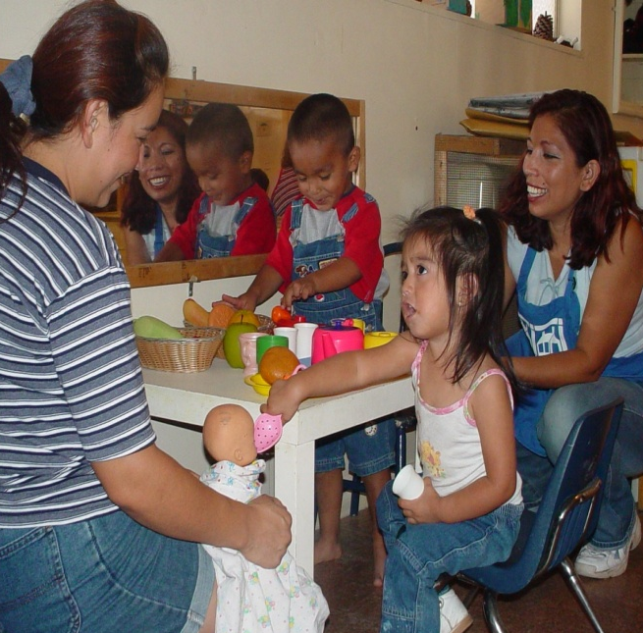
Preschool English Learners
Developing language and literacy skills in a child’s first language is important for developing skills in a second language and, therefore, should be considered the first step in the range of expectations for children learning English as a second language.
Source: CDE, CA Preschool Learning Foundations, Volume 1, 2008,104
Notes:
Developing language and literacy skills in a child’s first language is important for developing skills in a second language and, therefore, should be considered the first step in the range of expectations for children learning English as a second language.
Source: CDE, CA Preschool Learning Foundations, Volume 1, 2008,104

Slide 11

Multilingualism as a Strength
Recognizing and treating multilingualism as a strength is important:
  It supports children’s knowledge and skills in all their languages.
  It supports their connection to their home culture.
  Source: CA PTKLF: Language and Literacy Development (LLD), 2024, 11
Notes:
As children learn the language used in early their education program, it’s important that they are supported in using the strengths they bring from their home language varieties.
Research shows the importance of recognizing and treating multilingualism as a strength:
It supports children’s knowledge and skills in all their languages.
It supports their connection to their home culture.
Source: CA PTKLF: LLD, 2024, 11

Slide 12

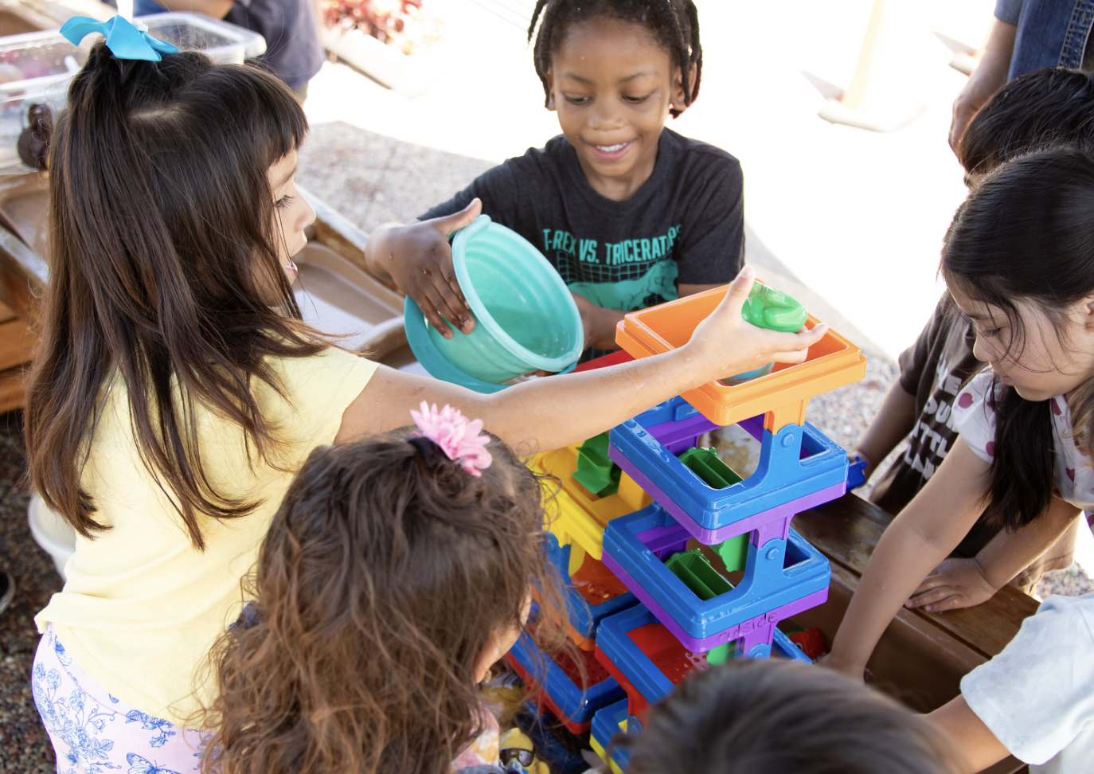
Research Nugget: Multilingual Learners
About 59 percent of children age birth to five in California live in homes where a language other than English is used.
Source: CA PTKLF: LLD, 2024, 4
Notes:
About 59 percent of children aged birth to five in California live in homes where a language other than English is used.
Source: CA PTKLF Language and Literacy Development (LLD), 2024, p. 4

Slide 13


Preschool English Learners: Principles and Practices to Promote Language, Literacy, and Learning
Notes:
Preschool English Learners: Principles and Practices to Promote Language, Literacy, and Learning, and the accompanying DVD: A World Full of Language, are available in English and Spanish. These resources provide information on how young children acquire English as a second language, and feature research-based teacher strategies that can be used to support English learners. The DVD is closed-captioned and formatted so that viewers can see it in its entirety or in sections.

Slide 14
Organization of the Resource Guide
Review the Key to the Resource Guide on page 7 to familiarize yourself with the icons used in the PEL Guide.
Read the Ask Yourself questions on page 8, noting that each chapter has questions to prompt self-reflection.
See the Additional References on page 8 and note that several are free and downloadable.
Notes:
Have participants turn to page 7 of the PEL Resource Guide, following along as you provide an overview of the sections contained in each chapter.
Call attention to each icon, formatting feature, and the Ask Yourself and Additional References sections on page 8 of the resource guide. Several resources in the guide are available via the Internet at no cost. Bring samples of these resources to display and/or distribute if possible.
Source: CDE, Preschool English Learners: A Resource Guide, 2009.

Slide 15
Organization of the Resource Guide (continued)
Refer to the last three sections:
  Appendixes
  Glossary
  References
Notes:
Appendixes begin on page 91 in this order:
Appendix A, Principles for Promoting Language, Literacy, and Learning for Preschool English Learners--p. 93
Appendix B, Prekindergarten Learning and Development Guideline--p. 94
Appendix C, Desired Results for Children and Families--p. 99
Appendix D, California Preschool Learning Foundations--p. 102
Appendix E, Transition to Kindergarten or Elementary School--p. 114
Includes Kindergarten English Language Arts Content Standards and excerpts from Map to ELD and ELA Standards
It is particularly important as it reminds us of our goal of helping build a strong foundation so that our preschool English learners have future success within the school system.
The glossary is on p. 124.
The trainer may want participants to highlight a few key definitions.
The works cited are on p. 129.

Slide 16
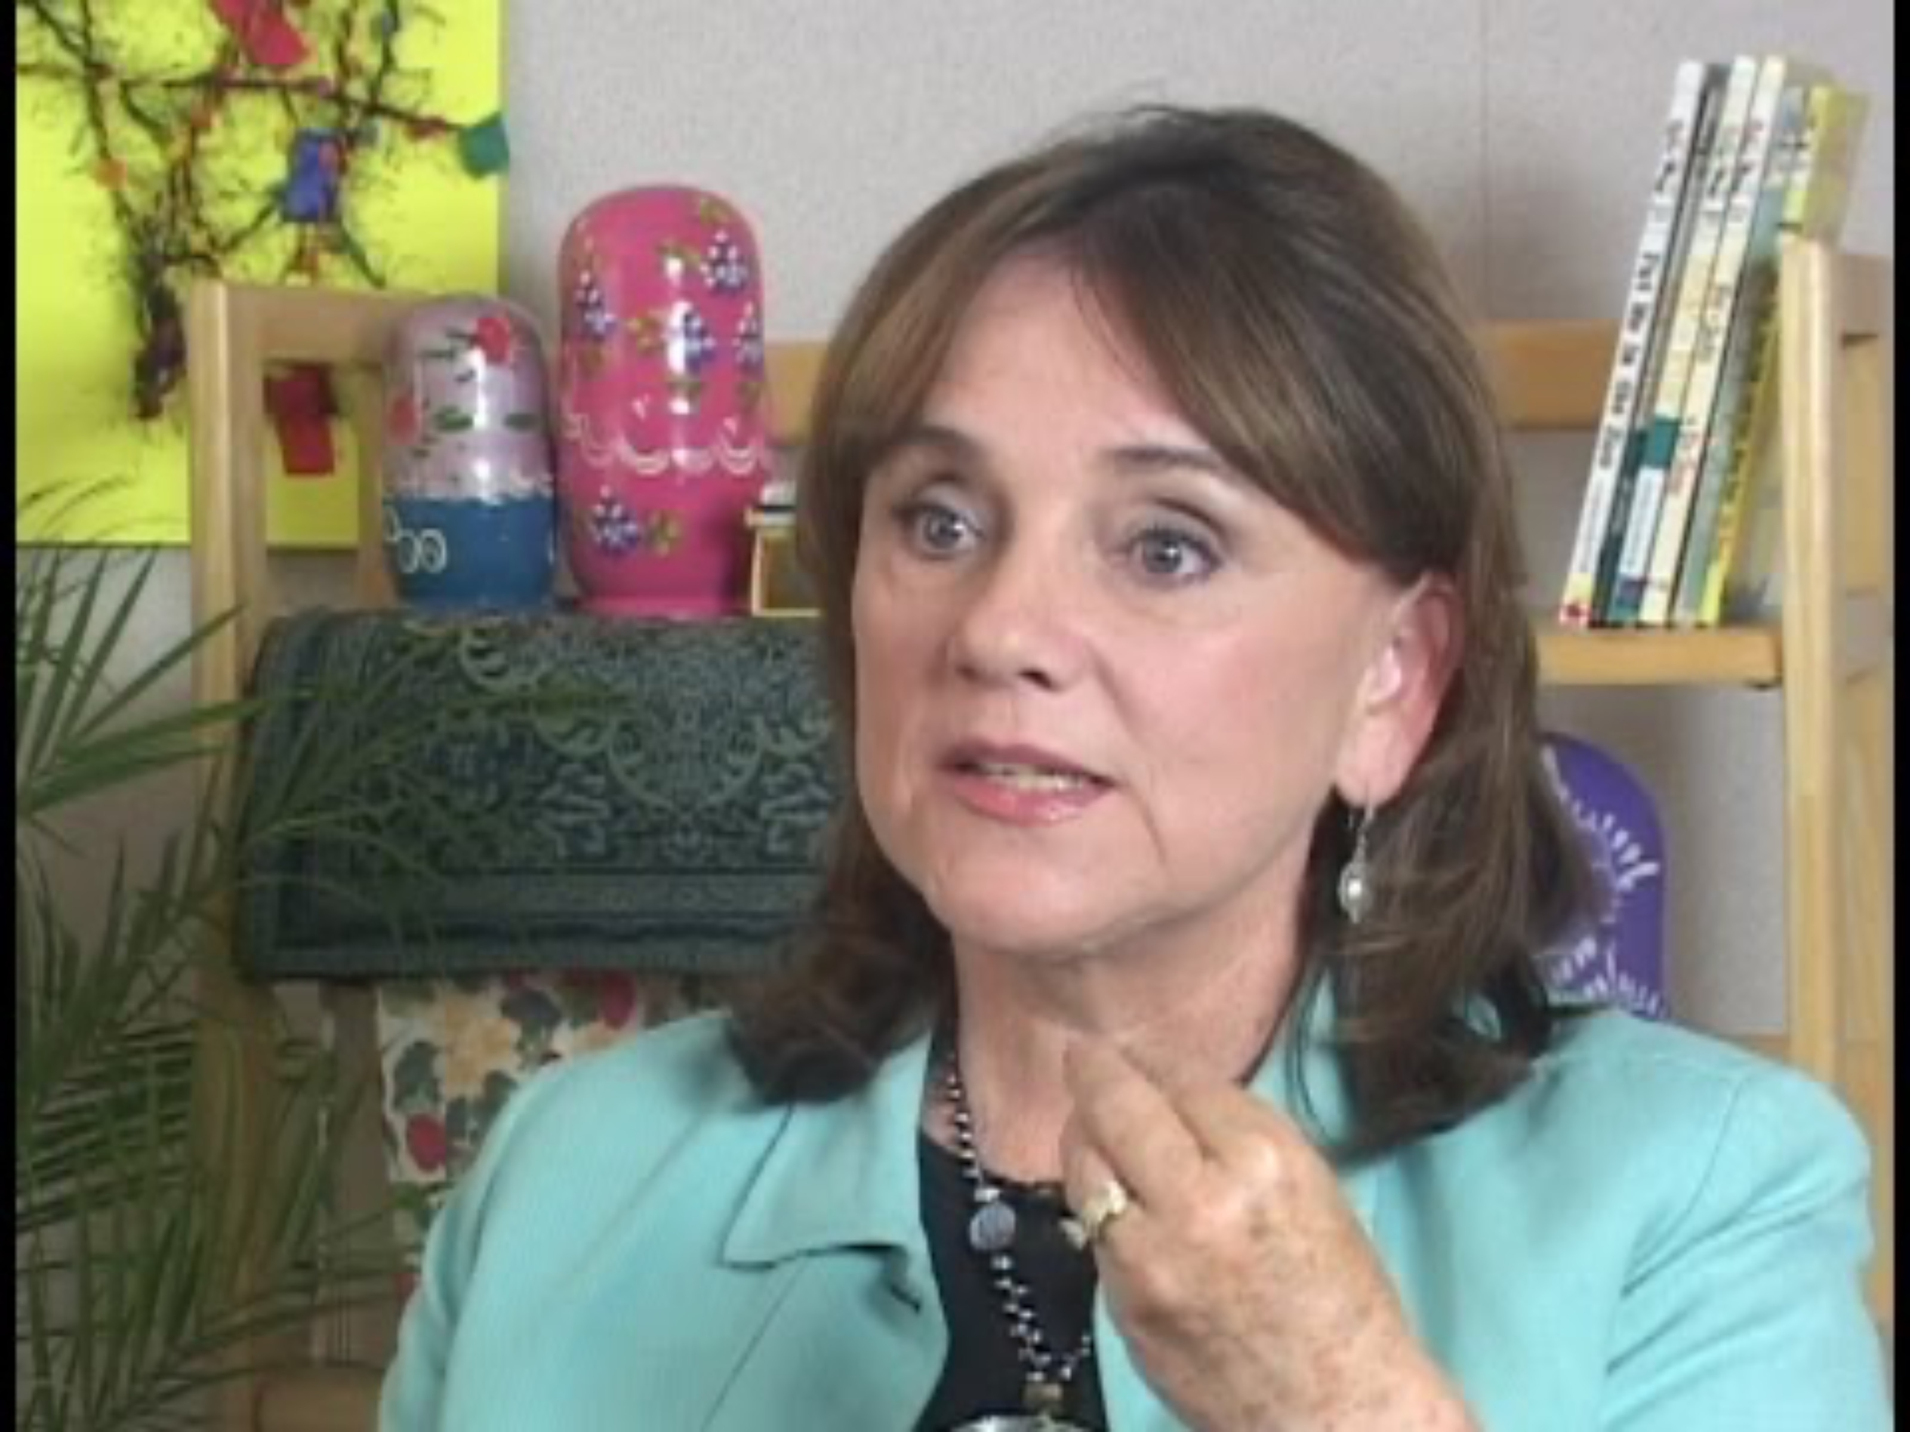
Be a learner first. Teach second.
Notes:
This video demonstrates how we will engage the rest of the day together and in our classroom. We all need to be the learner first and lean into learning from all other language experiences around us, similar to the teacher in this video learning how to pronounce a word in Chinese.
Video link: https://youtu.be/lXGU0QfSynE?si=nACBdIIZdS-CUzz2

Slide 17
Thank you!
Notes:
Facilitator Notes:
Thank you!

Slide 18
Presenter’s Name
Presenter’s Photo
CPIN Region
Date
Notes:
Facilitator Notes:
This is an introduction slide to be filled in by the presenter.

