Slide 1
Funded by CDSS
This training is funded by the California Department of Social Services. The materials included in this training include materials or products developed in part or wholly by the California Department of Education and produced by the California Department of Social Services.
Notes:
This training is funded by the California Department of Social Services. The materials included in this training include materials or products developed in part or wholly by the California Department of Education and produced by the California Department of Social Services.

Slide 2
Partners in Early Learning
The California Department of Education (CDE) was given the authority in the 2021 Budget Bill to revise the Preschool Learning Foundations which will now be known as the California Preschool/Transitional Kindergarten Learning Foundations (PTKLF). The California Department of Social Services (CDSS) is developing implementation materials and professional development. This partnership benefits all children regardless of funding sources.
Notes:
The California Department of Education (CDE) was given the authority in the 2021 Budget Bill to revise the Preschool Learning Foundations which will now be known as the California Preschool/Transitional Kindergarten Learning Foundations (PTKLF). The California Department of Social Services (CDSS) is developing implementation materials and professional development. This partnership benefits all children regardless of funding sources.

Slide 3
Preschool English Learners: Principles and Practices to Promote Language, Literacy, and Learning—A Resource Guide (Second Edition)
Chapter 2: Preschool English Learners, Their Families and Their Communities
Notes:
Facilitator Notes:
Welcome! This Preschool English Learners: Principles and Practices to Promote Language, Literacy, and Learning—A Resource Guide, Second Edition (PEL Resource Guide) training was developed by WestEd with funding from the California Department of Social Services (CDSS) Child Care and Development Division (CCDD).
The California Department of Education developed the PEL Resource Guide—copyright 2009.
This training explores Chapter 2: Preschool English Learners, Their Families, and Their Communities.

Slide 4
Our Assumptions: We Value More Than One Language
“Being exposed to two or more languages at a young age is a gift. It is a gift because children who are able to learn through two or more languages benefit cognitively, socially, and emotionally.”
Source: CDE, California Preschool Curriculum Framework, Volume 1, 2010, 224
Notes:
Ask participants to share with the large group a word or words that resonate with them.
“Being exposed to two or more languages at a young age is a gift. It is a gift because children who are able to learn through two or more languages benefit cognitively, socially, and emotionally.” “Exposure to more than one language should be celebrated as a growth opportunity that offers many learning and social advantages. Children who are developing bilingual abilities are developing unique strengths that will add to the cultural and linguistic resources of California.”
Source: CDE, California Preschool Curriculum Framework, Volume 1, 2010, 224

Slide 5
Training Outcomes
Become familiar with English learner demographics and the impact on early childhood education
Heighten awareness of the immigrant experience
Become familiar with “language registers”
Begin to think about ways to connect home and school languages
Notes:
This training aims to deliver the following outcomes:
Become familiar with English learner demographics and the impact on early childhood education
Heighten awareness of the immigrant experience
Become familiar with “language registers”
Begin to think about ways to connect home and school languages

Slide 6
Multilingual Learner
A multilingual learner is a child learning two or more languages at the same time or a child who is learning English while continuing to develop their home language. The term “multilingual learner” can overlap or be inclusive of other frequently used terms, such as English learner (EL) or dual language learner (DLL).
Notes:
The Preschool English Learner (PEL) Resource Guide focuses on children as English learners. We are taking a new approach, thinking about the child and all the linguistic capacities they bring to the early childhood setting. A multilingual learner is a child learning two or more languages at the same time or a child who is learning English while continuing to develop their home language. The term “multilingual learner” can overlap or be inclusive of other frequently used terms, such as English learner (EL) or dual language learner (DLL).

Slide 7
Demographics of Children in California
Source: CA PTKLF Introduction, 2024, 13
Notes:
“California has an extraordinarily diverse population of children. Among the 2.5 million children from birth to age five living in California in 2022, 51 percent were Hispanic, 23 percent were White, 12 percent were Asian, 5 percent were Black, and 0.2 percent were Native American/American Indian. In addition, nearly 60 percent of children aged birth to five speak a language other than English at home, and nearly 94,000 children aged birth to five were identified with a disability in 2021–22.”
Source: California Preschool/Transitional Kindergarten Learning Foundations (PTKLF) Introduction, 2024, 13
See notes 2-4 in the Endnotes section on page 30 of the PTKLF—Introduction publication for more information about the data sets used to create this chart.

Slide 8
Four-Year-Olds in CA
11% enrolled in federally funded Head Start
17% enrolled in State-Funded Preschool
Nearly 40% of those enrolled in Head Start or State-Funded Preschool are English learners
Source: CDE, California’s Best Practices for Young Dual Language Learners: Research Overview Papers, CDE, 2013, 91)
Notes:
In California, 50 percent of four-year-olds are children of immigrant parents, and 20 percent of these children live in linguistically isolated households (Cannon, Jacknowitz, and Karoly 2012).
Linda Halgunseth, Gisela Jia, and Oscar Barbarin, “Family Engagement in Early Childhood Programs: Serving Families of Dual Language Learners,” in California’s Best Practices for Young Dual Language Learners: Research Overview Papers, ed. Faye Ong and John McLean, in cooperation with Cecelia Fisher-Dahms (Sacramento, CA: Department of Education, 2013), 122.
California’s four-year-olds:
11% enrolled in federally funded Head Start
17% enrolled in State-Funded Preschool
Nearly 40% of those enrolled in Head Start or State-Funded Preschool are English learners
Claude Goldenberg, Karen Nemeth, Judy Hicks, Marlene Zepeda, and Luz Marina Cardona, “Program Elements and Teaching Practices to Support Young Dual Language Learners,” in California’s Best Practices for Young Dual Language Learners: Research Overview Papers, ed. Faye Ong and John McLean, in cooperation with Cecelia Fisher-Dahms (Sacramento, CA: Department of Education, 2013), 91.
To best meet the needs of our preschool English learners, we must understand the context in which they live. As we explore this chapter, we will develop a deeper understanding of the immigrant experience and how this may impact the experiences of the children in our care.
Ask participants to think about how we can achieve the following outcomes:
Ensure English-language learners can access our early childhood curriculum
Help children maintain their home language(s) and culture while they learn English
Build on children’s home language as a foundation upon which to build English fluency

Slide 9
The Newcomer Experience
Turn to pg. 14 in the Preschool English Learners (PEL): A Resource Guide and read The Diversity of the Immigrant Experience section.
After reading, share your thoughts and questions with your tablemates.
Notes:
Have participants read page 14 of the PEL Resource Guide, The Diversity of the Immigrant Experience.
After participants have read the page, have them share their thoughts and questions with their table mates.
Have 2-3 participants share.

Slide 10
Fostering Communication Is Critical
Authentic, reciprocal communication between teachers and families fosters a strong home-school connection. Because children may demonstrate their language development in any languages or language varieties they speak—including languages or varieties their teacher may not know or use—communication with families is necessary if teachers and family members are to understand and support children’s development.
Source: CDE, California’s Best Practices for Young Dual Language Learners: Research Overview Papers, 2013, 121)
Notes:
Strong connections between DLL families and schools are associated with important benefits for preschool-age and school-age children (Durand 2011; Fantuzzo et al. 2004; Jeynes 2012; Lin 2003).
Linda Halgunseth, Gisela Jia, and Oscar Barbarin, “Family Engagement in Early Childhood Programs: Serving Families of Dual Language Learners,” in California’s Best Practices for Young Dual Language Learners: Research Overview Papers, ed. Faye Ong and John McLean, in cooperation with Cecelia Fisher-Dahms (Sacramento, CA: Department of Education, 2013), 121.
This can be used as a partner, table, or whole group activity to discuss how participants foster communication. Solicit one idea from each table.
Note: Further examples are in Principle 1 and will be explored later.

Slide 11
Opportunities for Home Connections
Establish partnerships with families that are built on mutual respect, trust, and two-way communication.
Learn from families about children’s language environments at home and the language goals families have for their children
Learn from families about what a child knows and is able to do.
Communicate with families about culturally relevant storytelling, books, or games from home that can be integrated into the classroom environment and literacy activities
Collaborate with families to promote continued development of the home language.
Notes:
Teachers can:
Establish partnerships with families that are built on mutual respect, trust, and two-way communication. Teachers can ask respectful, open-ended questions to establish trusted channels of communication.
Learn from families about children’s language environments at home and the language goals families have for their children. This knowledge informs how the early education program can support children’s learning and development in a culturally and linguistically responsive way.
Learn from families about what a child knows and is able to do. When they are unable to speak a child’s home language, the teacher can partner with staff or family volunteers who speak the child’s home language. The teacher can also use interpreters and translation technology tools to communicate with families.
Communicate with families about culturally relevant storytelling, books, or games from home that can be integrated into the classroom environment and literacy activities. Teachers can invite parents to lead these activities.
Collaborate with families to promote continued development of the home language. The use of the home language supports children’s sense of belonging, bridges to children’s existing knowledge, and enhances connections to children’s homes and communities. All teachers should communicate with families about the critical role families play in their child’s continued development of the home language as an asset to overall learning.
Engaging families is essential, particularly for multilingual learners and children who speak varieties of English (CDE, PTKLF LLD, 2024,15).

Slide 12
Connecting School and the Home Language
Families are at differing levels of awareness about English language acquisition.
Some families are addressing children’s disabilities in addition to English language acquisition.
Teachers foster communication between home and school by helping children develop a working vocabulary in the home language to talk about school activities.
Notes:
At this time, we will move from focusing primarily on the child to examining family and community language practices and looking at ways to form strong connections between those practices and school practices.
Ask the group, “What if the parent is an English learner?”
Guide the participants in recognizing parents’ strengths in communicating with their children in their stronger language.
Families are at differing levels of awareness about English language acquisition.
Some families are addressing children’s disabilities in addition to English language acquisition.
Teachers and families of young dual language learners (DLLs) with special needs frequently raise questions about how to facilitate these children’s language development and what language(s) to use in preschool and intervention services. Source: Chen & Gutiérrez-Clellen, California’s Best Practices for Young Dual Language Learners: Research Overview Papers, CDE, 2013
Teachers foster communication between home and school by helping children develop a working vocabulary in the home language to talk about school activities.

Slide 13
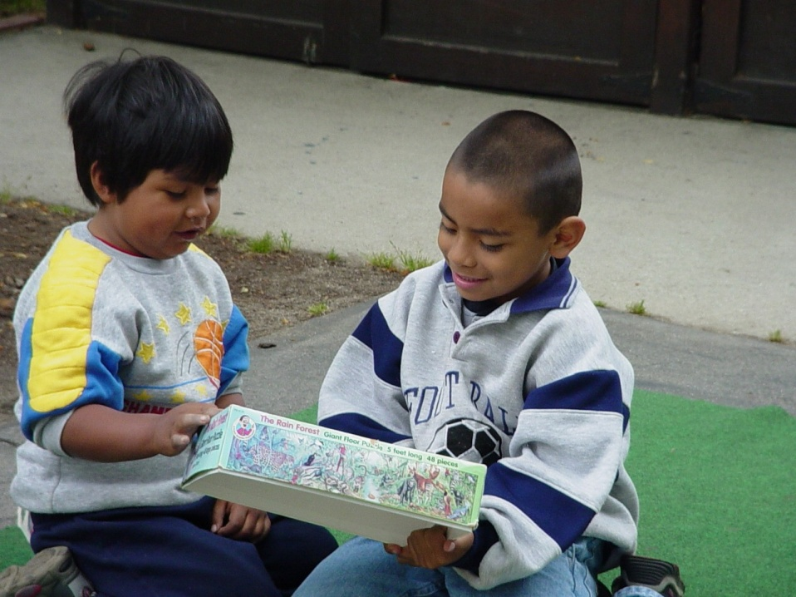
Language Registers
A Child’s World
Parents
Siblings
Friends
Other relatives
Teacher
Specialist
Visitors
Notes:
Mini-Lecture & Definitions: Connecting School and Home Language and Language Registers (8 minutes)
Young children use their language(s) for different social and cognitive purposes.
Language registers refer to different forms of the same language used with certain people or in certain situations.
Because of the changing demographics, children are exposed to many different languages. Children learn to use language(s) in various ways from the people they communicate within their daily activities.
A growing body of research concludes that multilingual learning is a strength that can significantly contribute to many skills, including children’s academic, cognitive, language, and social skills.
Children’s home language development also supports their English language development, as a strong foundation in one language transfers when learning another.
In addition, encouraging children’s home language development supports their positive cultural and linguistic identity development and strengthens ties with their families and communities
Source: CA PTKLF: LLD, 2024, 4

Slide 14
Formal Language Register
The formal register is used by children to speak to parents, elders, and teachers.
Notes:
Examples:
“Once upon a time, I lived in an egg… Nobody could see me.”
“Pass the crackers, please.”
Source: Callanan, M., Coto, P., Miranda, L., Striffler, A., Allen, J., Crandall, C., et al. (2001). Preschool science: Contextualizing curriculum with children's questions and family stories. In E. McIntyre, A. Rosebery & N. Gonzalez (Eds.), Classroom Diversity: Connecting Curriculum to Students' Lives. (pp. 61-75). Portsmoutn, NH: Heinemann.

Slide 15
Informal Language Register
The informal register is used by children on the playground, with siblings and friends, at home, and in the neighborhood.
Notes:
Example:
Child A: You be the wolf.
Child B: Okay. You put on the cape.
Adapted from: Ashworth & Wakefield. 2004. Teaching the World’s Children: ESL for Ages Three to Seven. Ontario; Pippin Publishers. p. 57

Slide 16
Academic English—The Language of School
Notes:
Academic language is the
language of books used at school, and
the language of school as spoken by teachers, administrators, and many children.
This will be addressed further in Chapter 5 of the PEL Resource Guide.

Slide 17
Let’s Practice
Leah wants a turn to paint.
How might she ask her cousin at home for a turn using an “informal language register”?
How might she ask a teacher at school for a turn using a “formal language register”?
At your table, come up with one more example of informal language and one more example of formal language.
Be ready to share out.
Notes:
This activity will help participants process the concept of language registers.
Model by doing the first example with the large group.
Then, give tables 2 or 3 minutes to come up with two additional formal and informal language examples. Guide them to page 17 of the PEL Resource Guide, the Varieties of Language, to use as a reference if needed.
After the activity, point out that you will return to the concept of language registers and give more attention to social and academic English in Chapter 5.

Slide 18
Activity: Courageous Conversation Compass
Find the Courageous Conversation Compass activity.
Read each of the statements and identify where you initially located yourself on the compass for each phrase.
Share at your table group and then discuss whether you noticed a change of position on the compass for any of the topics.
Source: CDE, 2022, Creating Equitable Early Learning Environments for Young Boys of Color
Notes:
Facilitator Notes:
[The Courageous Conversation Compass was excerpted from the Creating Equitable Early Learning Environments for Young Boys of Color publication, Appendix V—copyright 2022 by the California Department of Education]
The Courageous Compass is a tool that helps us understand how we each process and engage with different information and how we respond to discomfort. When we experience discomfort, we pull away from the center in a particular direction. Understanding the quadrants in the compass allows you to know where you fall and where others may be coming from.
Outcome: Participants will better understand educational inequities in early childhood.
Time: 15 minutes
Materials: Courageous Conversation Compass handout
Process:
Invite participants to find the Courageous Conversations handout.
Invite participants to read each statement on the handout. (Information from the Foundational Principles of Dual Language Learning and Development, from the multilingual toolkit)
All young children can acquire more than one language at once and achieve high proficiency in both languages.
Bilingualism is a strength associated with many academic and social benefits.
Strong partnerships with families using two-way communication are especially powerful for supporting ML children.
Multilingual children benefit from high-quality instruction in both languages that is aligned with their language skills and background.
Ask participants to locate themselves on the compass after reading each statement.
Have participants discuss the following with their tablemates:
Where did they locate themselves on the compass?
Did their position change after sharing?

Slide 19
Summary
Children and adults use different forms of language every day (formal, informal, social, and academic).
Young English learners are learning when and with whom to use the appropriate language registers.
Notes:
Both children and adults use different registers to speak to specific people or situations. The register we use with friends may differ from those with family, teachers, and professionals. All of the registers are valuable.
We must ensure we partner and collaborate with families to serve those people. Move away from the deficit model and find out who children communicate and interact with. For instance, a child might play on a sports team and interact with several different cultures and languages. Their communities might be quite diverse.

Slide 20
Who is Johnny?
Consider that names of children and family members are important ways of making connections to children and their families.
Discuss with an elbow partner one of the following topics:
The origin of your name, its significance, or how it was chosen
How you chose names for your children
Notes:
Who is Johnny? (5 minutes) (Optional slide, optional activity. Use as time permits)
Read Handouts 2A.1 and 2A.2: “Who Is Johnny?” Depending on the group of participants, the facilitator may choose to read the poem in English, Spanish (¿Quien es Johnny?), or both. Also, trainers who are comfortable translating the poem into another language are encouraged to do so.
Point out that the names of children and family members present important ways for making connections to children and their families. Experiences with people’s names in the titles are important for young children. The permission or license to use an ‘alternate’ name should come from the child and/or family. Also, many teachers may find the name Juan simple to pronounce, so you can point out other more challenging names, such as Eustaquio, Laurenio, Bakalian (last name), and draw examples from the participants as well. It is very valuable for them to see their names in print, especially if they are uncommon. Some examples are My Name is Yoon by Helen Recorvitz and Diego by Jonah Winter.

Slide 21
Principle 1—The Practices
At your table, create a chart of the ways you already implement the practices listed in the PEL Resource Guide, page 16.
Or
Review the practices on page 16. Place a checkmark next to those things you already do, a question mark next to practices you want to learn more about, and a plus sign next to the things you consider to be current program strengths.
Notes:
There are two options for this processing activity. Please edit the slide as needed.
Option 1: Ask individual tables to create a shared list (via chart or handout) of how they already implement the practices listed for Principle 1 on page 16.
Option 2: Looking at the practices on page 16, guide individuals to place a checkmark next to things they already do, a question mark next to practices they want to learn more about, and a plus sign next to the things they consider current program strengths.

Slide 22
Cultural Context of Learning
When the culture of the school and the culture of the family come into contact with each other, they influence and change each other…optimal learning for DLLs occurs when there is a strong, harmonious partnership between DLL families and ECE programs, which includes the consideration and incorporation of the DLL culture and language in program planning.
Source: CDE, California’s Best Practices for Young Dual Language Learners: Research Overview Papers, 2013,129
Notes:
When the culture of the school and the culture of the family come into contact with each other, they influence and change each other…optimal learning for DLLs occurs when there is a strong, harmonious partnership between DLL families and ECE programs, which includes the consideration and incorporation of the DLL culture and language in program planning.
Source: Linda Halgunseth, Gisela Jia, and Oscar Barbarin, “Family Engagement in Early Childhood Programs: Serving Families of Dual Language Learners,” in California’s Best Practices for Young Dual Language Learners: Research Overview Papers, ed. Faye Ong and John McLean, in cooperation with Cecelia Fisher-Dahms (Sacramento, CA: Department of Education, 2013), 129.

Slide 23
Key Points
Demographic trends impact practices at the preschool level.
Teachers should be sensitive to the diversity of the immigration experience.
Notes:
Key Points (5 minutes)
Briefly review the key points addressed in this presentation.
Demographic trends impact practices at the preschool level.
Teachers should be sensitive to the diversity of the immigration experience.

Slide 24
Key Points (2)
Families are valued contributors to their child’s education.
Teachers should recognize and respect families’ language beliefs and practices.
Notes:
Families are valued contributors to their child’s education.
Teachers should recognize and respect families’ language beliefs and practices.

Slide 25
Key Points (3)
Children’s language-rich environments might include the home language (formal and informal registers) and English.
Notes:
Children’s language-rich environments might include the home language (formal and informal registers) and English.

Slide 26
Reflection
Turn to page 18 in the PEL Resource Guide and take the time to answer question 4 on the Reflection handout:
How do I show the children and their families that I value their home language?
Notes:
Turn to page 18 in the PEL Resource Guide and take the time to answer question 4 on the Reflection handout:
How do I show the children and their families that I value their home language?

Slide 27
Thank you!
Notes:
Facilitator Notes:
Thank you!

Slide 28
Presenter’s Name
Presenter’s Photo
CPIN Region
Date
Notes:
Facilitator Notes:
This is an introduction slide to be filled in by the presenter.

