Slide 1

Funded by CDSS
This training is funded by the California Department of Social Services. The materials included in this training include materials or products developed in part or wholly by the California Department of Education and produced by the California Department of Social Services.
Notes:
This training is funded by the California Department of Social Services. The materials included in this training include materials or products developed in part or wholly by the California Department of Education and produced by the California Department of Social Services.

Slide 2
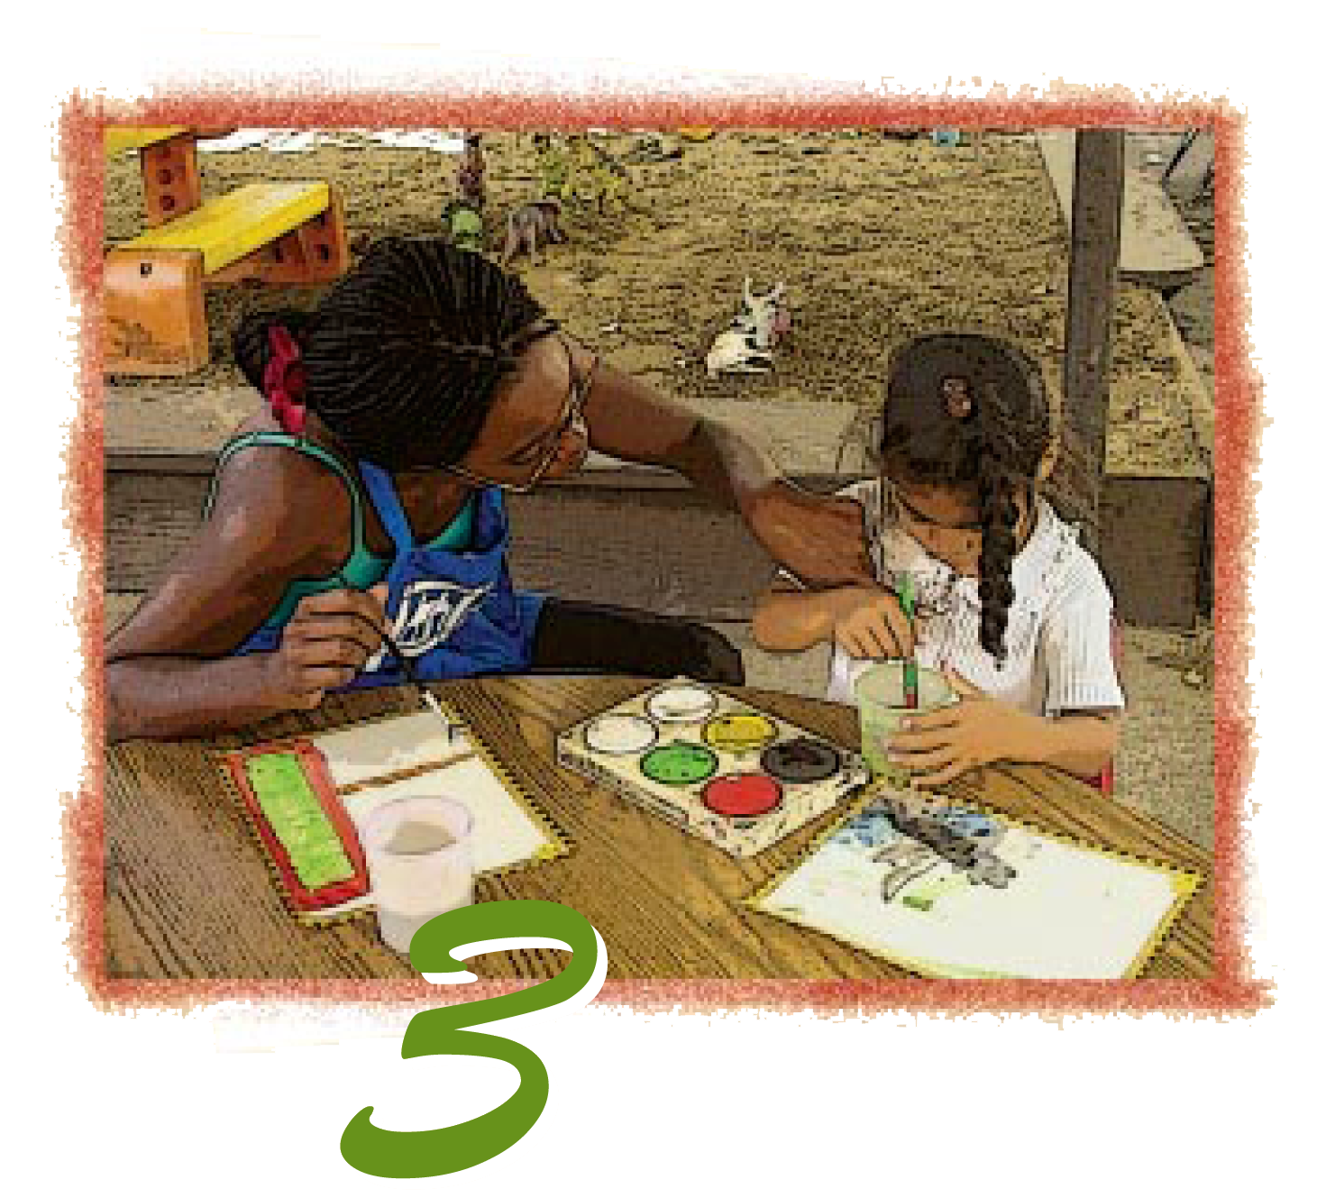
Preschool English Learners: Principles and Practices to Promote
Language, Literacy, and Learning—A Resource Guide (Second Edition)
Chapter 3: Connecting First and Second Language Development to Second Language Acquisition
Notes:
Facilitator Notes:
Welcome! This Preschool English Learners: Principles and Practices to Promote Language, Literacy, and Learning—A Resource Guide, Second Edition (PEL Resource Guide) training was developed by WestEd with funding from the California Department of Social Services (CDSS) Child Care and Development Division (CCDD).
The California Department of Education developed the PEL Resource Guide—copyright 2009.
This training explores Chapter 3: Connecting First and Second Language Development to Second Language Acquisition.

Slide 3


Partners in Early Learning
The California Department of Education (CDE) was given the authority in the 2021 Budget Bill to revise the Preschool Learning Foundations which will now be known as the California Preschool/Transitional Kindergarten Learning Foundations (PTKLF). The California Department of Social Services (CDSS) is developing implementation materials and professional development. This partnership benefits all children regardless of funding sources.
Notes:
The California Department of Education (CDE) was given the authority in the 2021 Budget Bill to revise the Preschool Learning Foundations which will now be known as the California Preschool/Transitional Kindergarten Learning Foundations (PTKLF). The California Department of Social Services (CDSS) is developing implementation materials and professional development. This partnership benefits all children regardless of funding sources.

Slide 4

Get to Know Each Other and Our Classrooms
Share an item that represents your classroom culture.
Why and how does this item represent your classroom culture?
Image licensed under CC BY-SA-NC
Notes:
Bring something that represents your classroom culture.
Introductions and getting to know each other (10 minutes)
Item to be shared in small groups at the tables. Why and how does this item represent the culture of your classroom?

Slide 5
Training Outcomes
Be familiar with the components of language
Be aware of cultural differences in language practices
Recognize that, as part of family life, most families engage in literacy activities such as reading books, singing songs, and reading poetry
Notes:
This training aims to deliver the following outcomes:
Be familiar with the components of language
Be aware of cultural differences in language practices
Recognize that, as part of family life, most families engage in literacy activities such as reading books, singing songs, and reading poetry

Slide 6
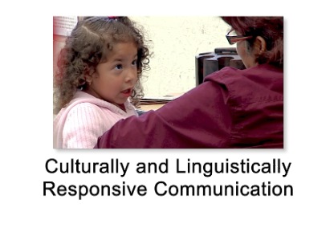
Framework
Guiding Principle
Respect cultural values and behaviors reflected in the child’s language and communication.
PEL Resource Guide, Principle 2
Notes:
Language and culture are highly integrated, so attention must be paid to cultural values and behaviors, which are embedded in both the language and communication style of the home language and the new language being learned.
Children benefit when their teachers understand cultural differences in language and communication use and incorporate them into their daily routine. Teachers must be understanding of how the child’s culture is reflected in his communication styles (e.g., the child waits for the adult to initiate the conversation, the child looks away from the adult).
Source: CDE, Preschool English Learners: A Resource Guide, 2009, 28.
Play video: https://wested.box.com/s/yv1iyux3326rj5qs6ml3zm667srt7t82

Slide 7
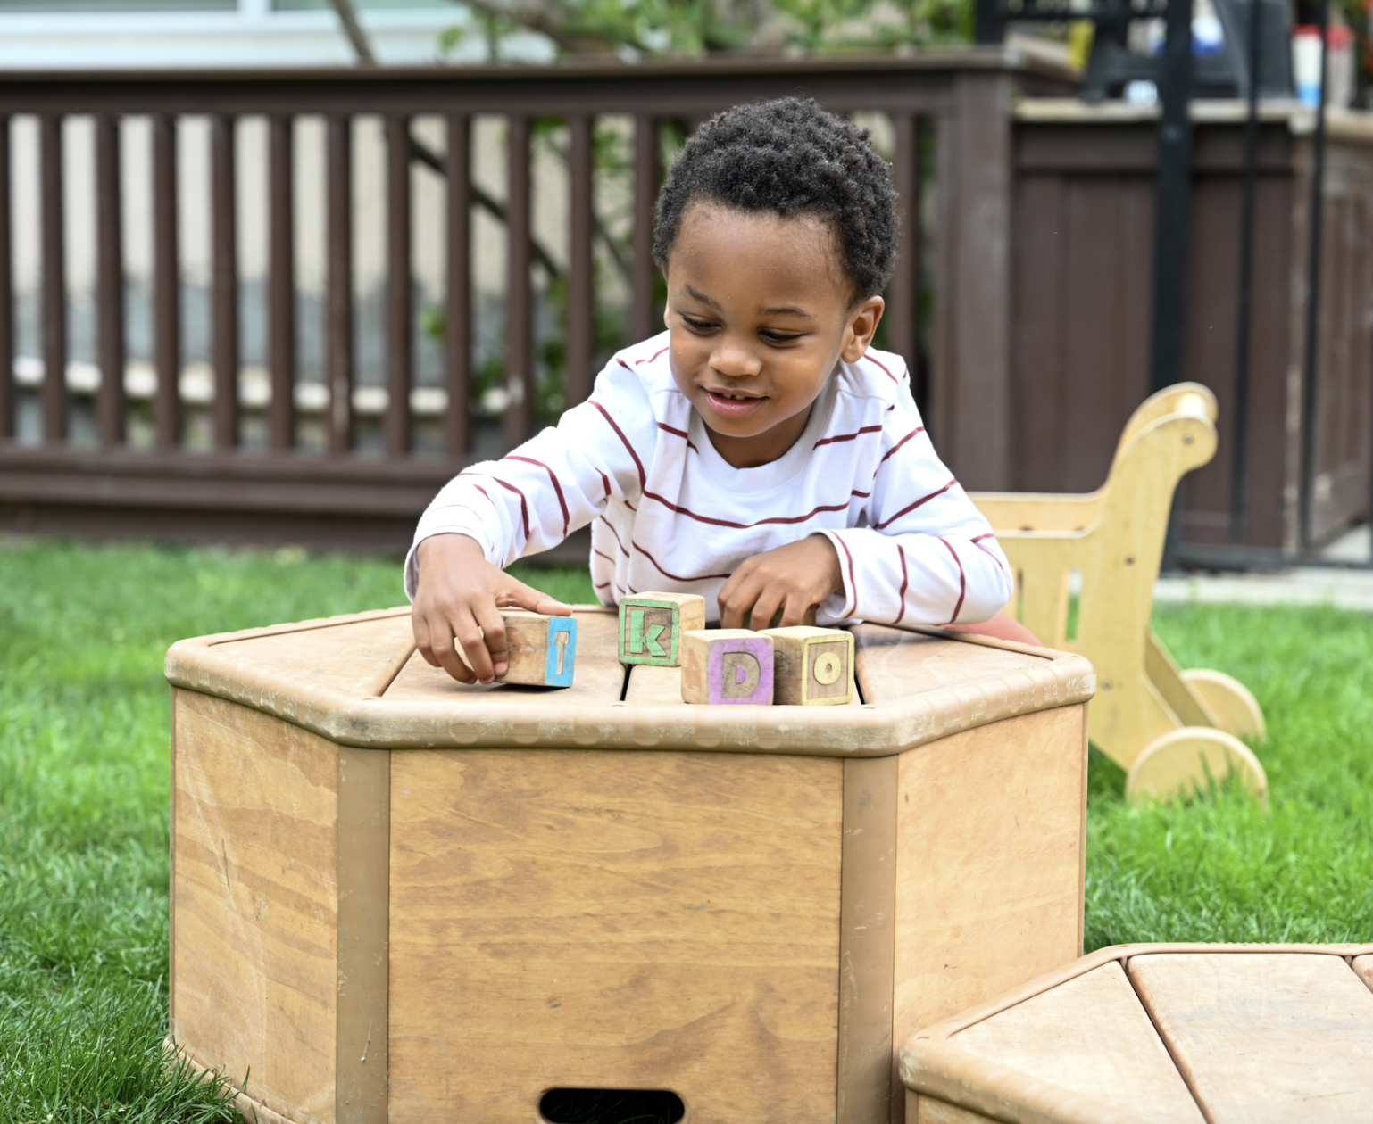
Linking Key Concepts to the Preschool Class
What do you hear from the three-year-olds you work with each day? What do you see them doing?
Compare what you hear and see to the list on page 21 of the PEL Resource Guide.
Notes:
What do you hear from the three-year-olds you work with each day? What do you see them doing?
Compare what you hear and see to the list on page 21 of the PEL Resource Guide.

Slide 8
Difference not Deficit
There is evidence that the differences arise from the cognitive demands that learning and processing two languages create for learners, including the need to selectively attend to each language’s sound patterns and grammatical rules, to inhibit the retrieval of words in one language when using the other language, to translate, and to process and produce mixed language input.
It is important that such differences are not viewed as deficits, but rather as opportunities for expanding the brain’s capacity.
Developmental milestones are achieved at similar ages in DLLs as in monolingual learners but might be achieved in slightly different ways.
Source: CDE, California’s Best Practices for Young Dual Language Learners: Research Overview Papers, 2013,129
Notes:
There are many similarities between bilingual and monolingual language learning and processing, but also some differences. There is evidence that the differences arise from the cognitive demands that learning and processing two languages create for learners, including the need to selectively attend to each language’s sound patterns and grammatical rules, to inhibit the retrieval of words in one language when using the other language, to translate, and to process and produce mixed language input.
It is important that such differences are not viewed as deficits, but rather as opportunities for expanding the brain’s capacity. Networks in the brain become established for each language based on experience with that language; this process requires time and rich input in each language.
Developmental milestones are achieved at similar ages in DLLs as in monolingual learners but might be achieved in slightly different
ways.
Source: CDE, California’s Best Practices for Young Dual Language Learners: Research Overview Papers, 2013,129

Slide 9

Research highlight
Learning the meanings of concepts and objects takes longer than learning labels for them. For example, learning that a cute furry animal is called a “cat” takes longer and is more difficult than recognizing that the word “cat” and “gato” (Spanish for cat) refer to the same thing (Peynircioglu and Durgunoglu 1993; Peynircioglu and Tekcan 1993).
Source: CDE, PEL Resource Guide, 2009, 23
Notes:
Invite participants to turn to page 23 in their PEL Resource Guide. Have them read the research highlights on that page. When participants have completed reading, debrief with the following questions:
What new fact did you learn?
What was especially interesting you?

Slide 10
Components of Language
Parts of Oral and Sign Language System
The Sound System (Phonology)
The Structure of Words (Morphology)
The Rules of Grammar
(Syntax)
Meaning and Vocabulary (Semantics)
Language Use in Social Context (Pragmatics/ Communicative Competence)
Adapted from “Even Start Research-based Early Childhood and Parenting Education Professional Development, 2003,” California Department of Education, Sacramento.
Notes:
Components of Language
Have participants locate the components of language in their PEL Resource Guide.
Phonology p. 22
Morphology p. 22
Syntax p. 23
Semantics p. 23
Pragmatics/Communicative Competence p. 23
Acknowledge that many preschool teachers know these concepts by using less technical terms, such as referring to phonology as “the basic units of sound.” With the increased attention given to student outcomes, program standards, and learning foundations, it is important to use technical terms.
Comment on the definitions and how they point to the enormous amount of learning that young children do as they learn the rules of language and experiment with language. Use this opportunity to link the definitions to what the participants identified as things they heard and saw from three and four-year-old children.
All of these key terms reinforce that learning and language development occur through social interaction.
Source: CDE, PEL Resource Guide, 2009, 22

Slide 11
Match Time
Look for the words and definitions at the center of your table.
Use your book and existing knowledge to match the meanings to the words.
Stand up when you have completed the task.
Notes:
This activity uses Table Activity 3A_Match Game. Print one copy for each table. Cut apart into cards for participants to match.
Invite all tables to participate in the word match game.
Give the first table to finish a prize.

Slide 12
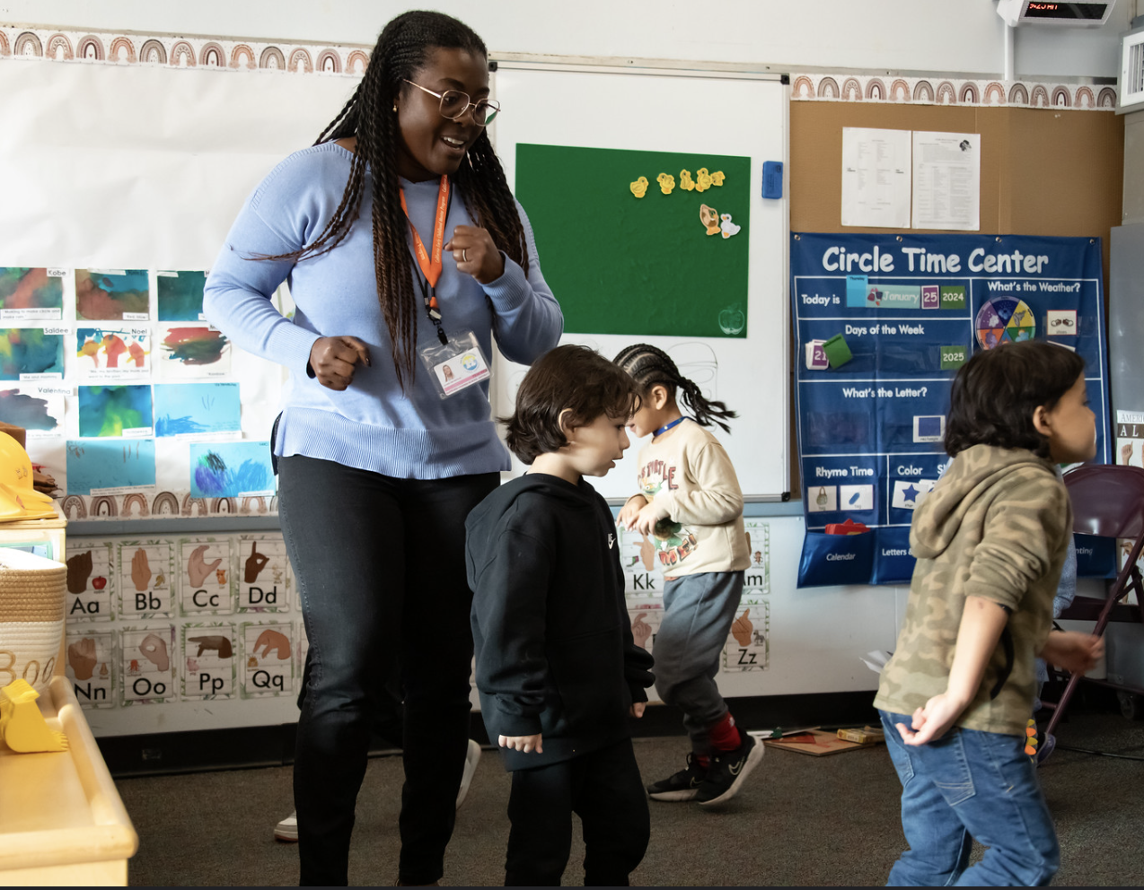
Language-Rich Activities at Home and School
Conversations
Songs
Tongue Twisters
Sayings or Proverbs
Finger Plays
Rhymes
Riddles
Games and Chants
Notes:
With songs, rhymes, finger plays, and all of the language-rich activities listed on this slide, it is important for teachers to be selective about the ones they will use so that they intentionally address skills and concepts that the children need to learn and review.
Note that within homes, families engage in many of these activities in their home language. Teachers can use these experiences, in the home language and in English, to scaffold children’s English language learning.
In one well-done preschool ethnographic study (Kenner 1999), for example, young DLL children’s reading and writing development was supported by incorporating elements familiar to children from their homes and communities, such as letter-writing to and from relatives, posters (e.g., from The Lion King), and recipes from a popular cooking program on television.
Source: Claude Goldenberg, Karen Nemeth, Judy Hicks, Marlene Zepeda, and Luz Marina Cardona, “Program Elements and Teaching Practices to Support Young Dual Language Learners,” in California’s Best Practices for Young Dual Language Learners: Research Overview Papers, ed. Faye Ong and John McLean, in cooperation with Cecelia Fisher-Dahms (Sacramento, CA: Department of Education, 2013), 93.

Slide 13
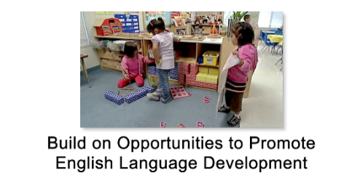
Build of Opportunities to Promote English Language Development
Notes:
Play video: https://wested.box.com/s/a33qpkrwcnx4mz9c0vusnxni4iu956vu

Slide 14
Time for Reflection
Ask Yourself
Do I look at each of my students as an individual who brings competencies to the learning situation or as a member of a group or category, such as English learners?
Am I familiar with how our program applies proven approaches to first- and second-language development and learning?
Notes:
Facilitator Notes:
Invite participants to stand and find someone they have not talked with yet today. Choose one or all of the questions to reflect on.
Do I look at each of my students as an individual who brings competencies to the learning situation or as a member of a group or category, such as English learners?
Am I familiar with how our program applies proven approaches to first- and second-language development and learning?

Slide 15
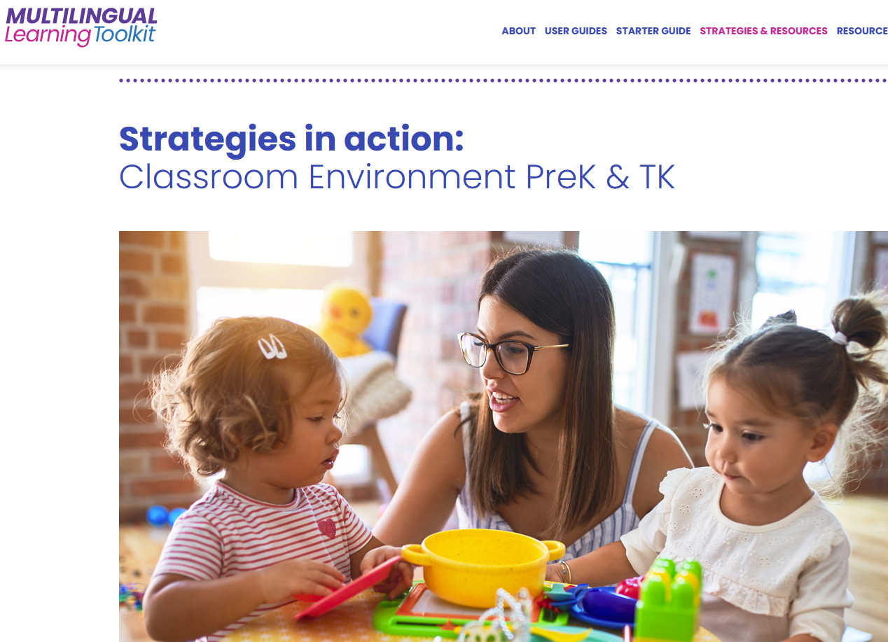
Strategies in Action
Read the scenario from the Multilingual Learning Toolkit: PreK Language Model: English Language Development with Home Language Support by Dr. Linda Espinosa and Dr. Marlene Zepeda.
As a group, discuss and respond to the reflective questions for your scenario.
Make a poster to share your scenario and your team’s responses.
Notes:
Facilitator Notes:
Select the image to go to the Multilingual Learning Toolkit: https://www.multilinguallearningtoolkit.org/vignette/classroom-environment-prek-transitional-kindergarten/
15 min SHARE KEY TAKE AWAY
Ask participants to break into three groups according to the age group they work with: PreK-TK, Kindergarten 1st, 2^{nd,} and 3rd grade. Have them read the scenarios for each age group and respond to the reflective questions on the handout. Make posters to share the responses they came up with as a team.
Each Strategy in Action has its own set of reflective questions.

Slide 16
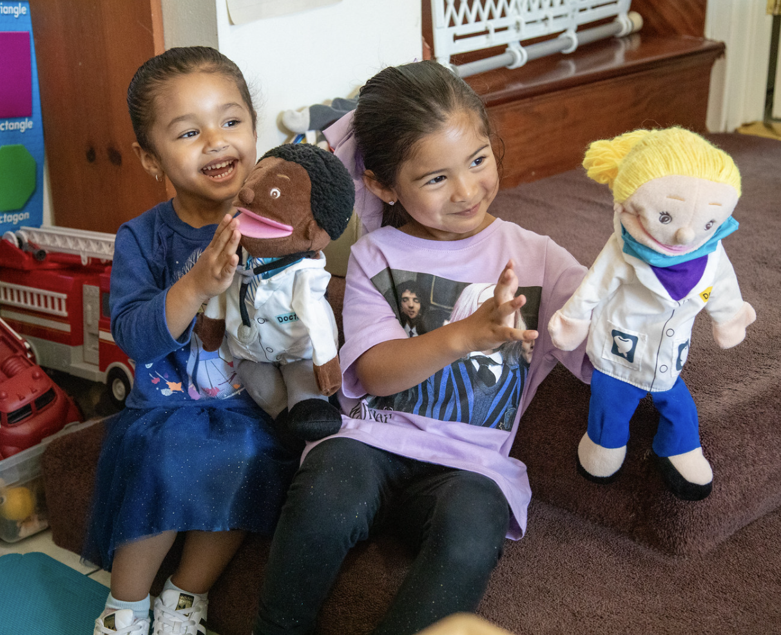
Reviewing Our Assumptions
Have any of the assumptions with which we started the day been challenged?
Have any been reinforced?
Have you changed your thinking about children’s abilities to learn language?
Notes:
All the terms on the previous slide point to the following:
The enormous amount of learning young children do as they learn the rules of language and experiment with language
The linguistic foundation children bring to school
Children’s varied learning experiences in their home language and other languages
Children’s exposure to various languages spoken around them

Slide 17
Key Points
During the preschool years, children are continually in the process of developing their language(s).
In learning to talk, children learn the components of language and how to use language in different social contexts.
It is important for teachers to become familiar with the process of home language development and English language development.
Notes:
Key Points (5 minutes)
Review and discuss the key points for this chapter, stopping to answer or clarify any questions participants may have regarding the key points.
During the preschool years, children are continually in the process of developing their language(s).
In learning to talk, children learn the components of language and how to use language in different social contexts.
It is important for teachers to become familiar with the process of home language development and English language development.

Slide 18
Key Points (continued)
Children need opportunities and activities to use the languages they are learning and practice using them.
Teachers are an important language model; more experienced peers can be effective language models for other children.
Notes:
Children need opportunities and activities to use the languages they are learning and practice using them.
Teachers are an important language model; more experienced peers can be effective language models for other children.
Facilitator Notes:
You might want to ask participants to take a moment and think about opportunities in their own settings that promote and support the valuing of multiple languages.

Slide 19
Thank you!
Notes:
Facilitator Notes:
Thank you!

Slide 20
Presenter’s Name
Presenter’s Photo
CPIN Region
Date
Notes:
Facilitator Notes:
This is an introduction slide to be filled in by the presenter.

