Slide 1

Funded by CDSS
This training is funded by the California Department of Social Services. The materials included in this training include materials or products developed in part or wholly by the California Department of Education and produced by the California Department of Social Services.
Notes:
This training is funded by the California Department of Social Services. The materials included in this training include materials or products developed in part or wholly by the California Department of Education and produced by the California Department of Social Services.

Slide 2


Partners in Early Learning
The California Department of Education (CDE) was given the authority in the 2021 Budget Bill to revise the Preschool Learning Foundations, which will now be known as the California Preschool/Transitional Kindergarten Learning Foundations (PTKLF). The California Department of Social Services (CDSS) is developing implementation materials and professional development. This partnership benefits all children regardless of funding sources.
Notes:
The California Department of Education (CDE) was given the authority in the 2021 Budget Bill to revise the Preschool Learning Foundations which will now be known as the California Preschool/Transitional Kindergarten Learning Foundations (PTKLF). The California Department of Social Services (CDSS) is developing implementation materials and professional development. This partnership benefits all children regardless of funding sources.

Slide 3

Preschool English Learners: Principles and Practices to Promote
Language, Literacy, and Learning—A Resource Guide (Second Edition)
Chapter 4: Paths to Bilingualism
Notes:
Welcome! This Preschool English Learners: Principles and Practices to Promote Language, Literacy, and Learning—A Resource Guide, Second Edition (PEL Resource Guide) training was developed by WestEd with funding from the California Department of Social Services (CDSS) Child Care and Development Division (CCDD).
The California Department of Education developed the PEL Resource Guide—copyright 2009.
Today, we will explore Chapter 4: Paths to Bilingualism.

Slide 4
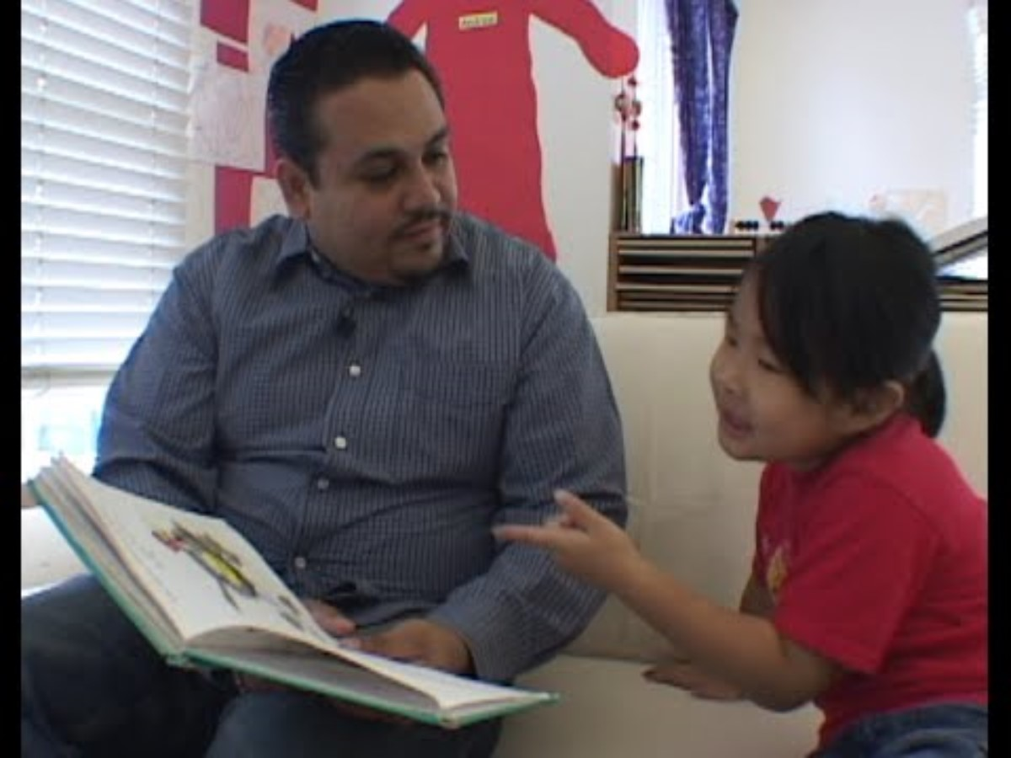
English, Spanish and Chinese too!
Notes:
https://youtu.be/j9vWg2yMnzM
Facilitator Notes:
Ask participants to write down 1-2 ideas from the video that support teachers when multiple languages are present in the classroom.
How does your school build on the language resources children bring?

Slide 5
Training Outcomes
Discuss the advantages of maintaining the home language and becoming bilingual.
Explain cross-language transfer.
Distinguish among the three paths to bilingualism.
Notes:
Facilitator Notes:
Briefly go over the outcomes for this section of the training.
Discuss the advantages of maintaining the home language and becoming bilingual.
Explain cross-language transfer.
Distinguish among the three paths to bilingualism.

Slide 6
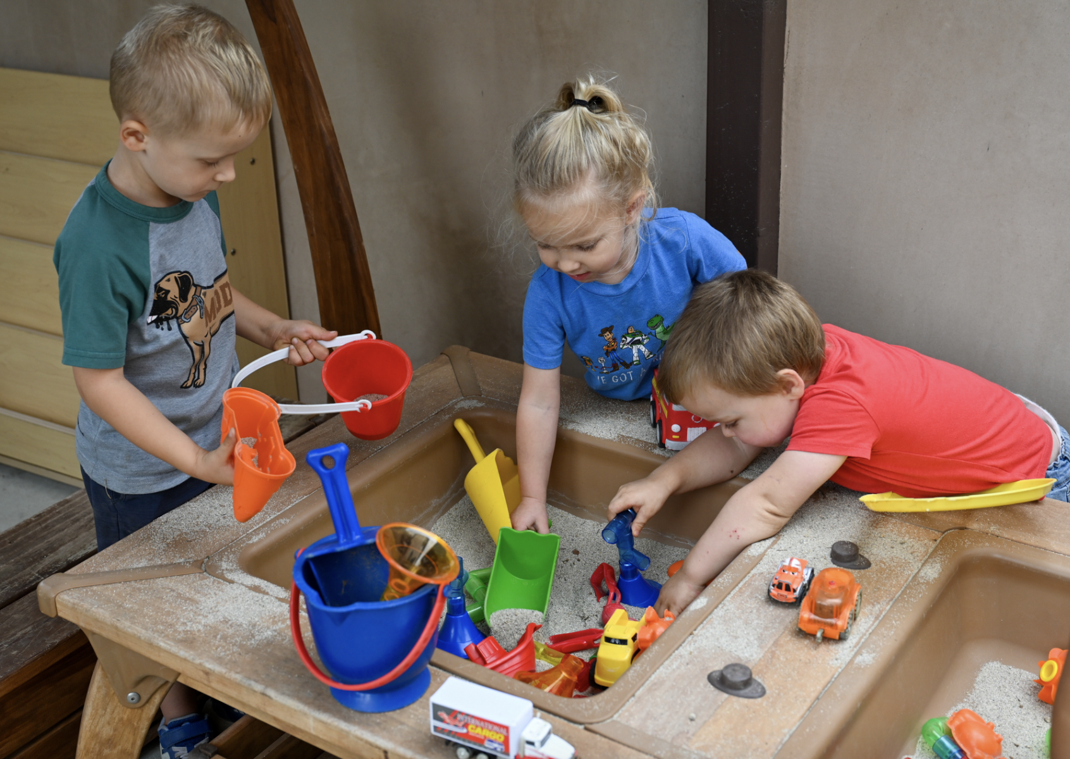
Why Two Languages?
With a partner discuss the benefits and advantages experienced by children and adults who know more than one language.
Notes:
Facilitator Notes:
Break participants into pairs. Relying on their own experiences, have pairs discuss the benefits and advantages experienced by children and adults who know more than one language. Ask volunteers to share one or two examples with the group.

Slide 7
Benefits of Multilingualism
Cognitive
Educational
Economic
Sociocultural
Notes:
There are multiple benefits to being multilingual, multiliterate, and multicultural in today’s global society. Knowing more than one language from birth, acquiring a new language through school, or learning languages later in life can provide tangible advantages in many areas. From delaying cognitive signs of aging to earning college credits and getting a better job offer, multilingualism is an asset that can benefit English learners as well as native English speakers in a variety of ways.
Cognitive: Executive function (Attentional control & Task switching (mental flexibility) ), May delay the onset of age-related cognitive decline and the onset of illnesses such as Alzheimer's disease, Increased intellectual flexibility
Educational: Comparable or higher academic achievement of students in dual language programs as compared to students in English-only programs, Improved learning outcomes in various subjects, Bilingualism associated with increased high school graduation rates among children of immigrants, Leads to increased levels of creativity, Promotes higher levels of abstract thought and reasoning, Engenders enhanced metalinguistic awareness to support the learning of languages in the future.
Economic: Greater job opportunities in multiple public and private sectors, greater business opportunities, bilingualism raises the occupational status and earning potential, and language skills are in high demand for employment with the federal government.
Sociocultural: Understanding of other world cultures, Increased empathy development, Enhanced connections to heritage cultures, Promotes global awareness, reduced discrimination, improved self-esteem, and stronger cross-group relationships
Use handout: https://ncela.ed.gov/sites/default/files/legacy/files/announcements/20200805-NCELAInfographic-508.pdf

Slide 8
Challenging Common Myths
It is now understood that the constant need to shift attention between languages leads to several cognitive advantages. Research has found that bilingual adults and children show improved executive functioning of the brain–that is, they are able to shift attention, switch between tasks, and solve problems more easily. Bilinguals have also been found to have increased metalinguistic skills (the ability to think about language per se and understand how it works). There is evidence that being bilingual makes learning a third language easier. Further, the accumulating effect of dual language experience is thought to translate into protective effects against cognitive decline with aging and the onset of Alzheimer’s disease.
Source: Ramirez, Why the baby brain can learn two languages at the same time,
The Conversation, 2016
Notes:
Bilingual kids are at an advantage.
The good news is that young children worldwide can acquire two languages simultaneously. In many parts of the world, being bilingual is the norm rather than an exception.
It is now understood that the constant need to shift attention between languages leads to several cognitive advantages. Research has found that bilingual adults and children show improved executive functioning of the brain – that is, they are able to shift attention, switch between tasks, and solve problems more easily. Bilinguals have also been found to have increased metalinguistic skills (the ability to think about language per se and understand how it works). There is evidence that being bilingual makes learning a third language easier. Further, the accumulating effect of dual language experience is thought to translate into protective effects against cognitive decline with aging and the onset of Alzheimer’s disease.
So, if you want your child to know more than one language, it’s best to start at an early age, before she even starts speaking her first language. It won’t confuse your child, and it could even give her a boost in other forms of cognition.
Source: Ramirez, N. F. (2016, April 15). Why the baby brain can learn two languages at the same time. The Conversation. https://theconversation.com/why-the-baby-brain-can-learn-two-languages-at-the-same-time-57470#:~:text=Bilingual%20kids%20are%20at%20an,in%20other%20forms%20of%20cognition

Slide 9

Importance of Home Language
Developing proficiency in the first language helps children learn a second language.
Source: CDE, PEL Resource Guide, 2009, 34
Notes:
Children who have the skills to understand and communicate in their home language will transfer that knowledge to the learning of a second language resulting in a more effective and efficient second language learning process. (Cummins, 1979; Wong Fillmore, 1991)
For example, building Spanish-speaking children’s language skills in their first language directly enhances their literacy development in English (Bialystok, 2001; Childhood Bilingualism, 2006; Preventing Reading Difficulties in Young Children, 1998).
Facilitator Notes:
Trainers may want to use Handout 4A: Key Concepts from Theory on Second Language Acquisition, as background information to help explain the process of mastering two languages. Refer to the bullet points for additional talking points. These are complex, but important, so trainers should work through them with detail, as time allows, providing a thorough explanation of the key concepts.

Slide 10
Cross Language Transfer Theory
Skills, background knowledge, and cognitive strategies transfer between the first and second language.
Source: CDE, PEL Resource Guide, 2009, 34
L1
L2
Notes:
Some skills, background knowledge, and cognitive skills transfer from the home language to other languages. For example, a child who has phonological awareness skills can transfer those skills to his/her second language. The same is true for certain concepts about print when languages share similar writing systems (e.g., alphabetic writing systems that are written and read in the same direction).
Bilingual children tend to bring elements from the dominant language into the less-dominant language (Gawlitzek-Maiwald and Tracy 1996), although transfer is also possible to occur from the weaker to the stronger language.
Source: Catherine Sandhofer and Yuuko Uchikoshi, “Cognitive Consequences of Dual Language Learning: Cognitive Function, Language and Literacy, Science and Mathematics, and Social-Emotional Development,” in California’s Best Practices for Young Dual Language Learners: Research Overview Papers, ed. Faye Ong and John McLean, in cooperation with Cecelia Fisher-Dahms (Sacramento, CA: Department of Education, 2013), 65.
Children are likely to apply the components of their home language to English while learning English. Teachers will want to pay attention to the “errors” children make in English to determine if the “errors” are due to differences between the structures of the first and second languages.

Slide 11
Threshold Hypotheses
Before the benefits of bilingualism can be achieved, one must achieve minimum levels of proficiency in both his home language and in the second language.
Source: CDE, PEL Resource Guide, 2009, 34
L1
L2
Benefits
Notes:
The threshold hypothesis provides the rationale for additive rather than subtractive bilingual programs.
The hypothesis supports that individuals with high levels of proficiency in both languages experience advantages in terms of linguistic and cognitive flexibility; while low levels of proficiency in one or both languages can result in cognitive or linguistic deficits.
Across multiple domains, the cognitive advantages of bilingualism were strongest when children were proficient with both languages, and there were no discernible benefits to dual language learning when children’s experience with one language was limited. For example, Carlson and Meltzoff (2009) found that six months of experience in a dual language immersion kindergarten program was not enough experience for children to demonstrate the benefits of dual language learning.
Source: Catherine Sandhofer and Yuuko Uchikoshi, “Cognitive Consequences of Dual Language Learning: Cognitive Function, Language and Literacy, Science and Mathematics, and Social–Emotional Development,” in California’s Best Practices for Young Dual Language Learners: Research Overview Papers, ed. Faye Ong and John McLean, in cooperation with Cecelia Fisher-Dahms (Sacramento, CA: Department of Education, 2013), 74.

Slide 12
Maintaining the home language…
Socializes children into their families and communities
Provides a foundation for success in learning and literacy in English
Source: CDE, PEL Resource Guide, 2009
Notes:
Maintaining the home language…
Socializes children into their families and communities
Provides a foundation for success in learning and literacy in English
Source: CDE, PEL Resource Guide, 2009

Slide 13
Results of Language Loss
Diminished parent-child communication, socialization, and identity Source: Wong Fillmore, 1991
Cultural and linguistic displacement
Source: Genesee, Paradis, and Crago, 2021
Reduced sense of self-efficacy, social, and cognitive development Source: Chang, 2007; Duke and Purcell-Gates, 2003; Moll, 1992; Riojas-Cortez, 2001; Vygotsky and Education, 1990
Notes:
Conversations shared between parents and children serve as an important source of narrative scaffolding (Schick & Melzi, 2010).
Schick, Adina, and Gigliana Melzi. 2010. “The Development of Children’s Oral Narratives Across Contexts.” Early Education and Development 21 (3): 293–317.

Slide 14
Connections to Principles and Practices
Principle 5: Experimenting with the use, form, purpose, and intent of both the first and second language leads to growth in the acquisition of the second language.
Principle 6: Continued use and development of the child’s home language will benefit the child as he or she acquires English.
Notes:
Connections to Principles and Practices
Principle 5: Experimenting with the use, form, purpose, and intent of both the first and second language leads to growth in the acquisition of the second language.
Principle 6: Continued use and development of the child’s home language will benefit the child as he or she acquires English.

Slide 15

Three Paths to Bilingualism
Simultaneous
Successive
Receptive
Notes:
Three Alternative Paths to Bilingualism (5 minutes)
Refer participants to Handout 4B: Three Alternative Paths to Bilingualism. Using the following three slides, explain that there are three ways that a child can become bilingual.
The first two terms, simultaneous and successive, focus on the child’s exposure to a first and second language. The third term refers to the process of learning a second language with few opportunities to speak the second language. As you introduce each of these definitions, you may want to make a connection to the experiences shared by the participants during the opening conversation. Also, draw upon your own classroom experiences, both personal and professional, as you see fit. This helps to bring the definitions to life. For example, someone might have shared that his grandmother spoke to him in Urdu growing up and that he heard Urdu at family gatherings. He also may have shared that while he understands almost everything in Urdu, it is difficult for him to respond using Urdu. This would be an illustrative example to share when you elaborate on the definition of receptive bilingualism.

Slide 16
Lens on Video Viewing
Reflect on the key concepts of theory.
Refer to Handout 4B: Three Alternative Paths to Bilingualism.
Respond in writing on Handout 4B.
Notes:
Video Viewing: A World Full of Language – Paths to Bilingualism
(10 minutes)
Walk participants through the lens for video viewing, what they should reflect on, refer to, and how they should respond in writing on Handout 4B: Three Alternate Paths to Bilingualism.
As participants watch the video, they should take notes on Handout 4B: Three Alternate Paths to Bilingualism, using the right-hand column that captures any additional ideas/concepts they have learned.

Slide 17
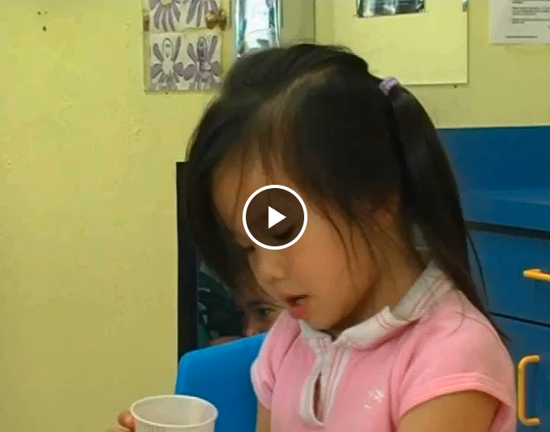
Video
Notes:
We will now show the entire section about the three paths to bilingualism.
Play video: https://wested.box.com/s/p7lgfbphehh62lyhebi9emgtfdbg4q46

Slide 18
Simultaneous Bilingualism
The process of learning two or more languages within the same space of time, starting before age 3.
Children develop equally, or nearly equally, in both languages through exposure and opportunities to use both languages.
Also known as simultaneous language acquisition.
Notes:
18
Review what participants viewed in the video clip.
Give an example of how a young child might have a parent or family member in his/her home that speaks one language, and a sibling or other family member who speaks a different language. That child would be exposed to two languages at a very early age and would acquire both languages simultaneously.
Executive functions for simultaneous bilinguals:
Are more developed than those of monolinguals
Show the largest advantages when children are more balanced in their bilingualism
Source: Catherine Sandhofer and Yuuko Uchikoshi, “Cognitive Consequences of Dual Language Learning: Cognitive Function, Language and Literacy, Science and Mathematics, and Social–Emotional Development,” in California’s Best Practices for Young Dual Language Learners: Research Overview Papers, ed. Faye Ong and John McLean, in cooperation with Cecelia Fisher-Dahms (Sacramento, CA: Department of Education, 2013), 57.

Slide 19
Successive Bilingualism
Process of learning a second language after having reached at least basic mastery in the first language
By age 3, most children have acquired most aspects of oral language
Also known as sequential bilingualism or successive second language acquisition
Explained in greater detail in Chapter 5
Notes:
Review what participants viewed in the video clip.
Point out that a child who hears and speaks one language at home and in their neighborhood may not be exposed to a second language until they begin preschool. This child would be on a sequential or successive path of second-language acquisition because they have achieved basic mastery of the first language before acquiring the second language.
Depending on the situation, children will often weave in and out of each stage. PEL Resource Guide, Second Edition, p. 46
If desired, solicit examples from the group.
Moving through the four stages may take 6 months to 2 years. The length of time a child remains at a stage and the level of expectation for second language learning depends on several important characteristics of the child and their language environment:
The age of the child
The child’s temperament (introverted vs. extroverted)
The quantity and quality of the language input at home and the school Source: PLF, Vol. 1, p. 106

Slide 20
Receptive Bilingualism
The process of learning a second language with few opportunities to speak it
Children understand a great deal more than they are able to express in words
Learning a second language through exposure, not active use
Notes:
Review what participants viewed in the video clip.
Point out that a child may have extended family members who speak a second language but have little opportunity to use it themselves. These children might become receptive bilingual learners. For example, many English learners experience English as the language of the larger social environment (on television for example), but they have little opportunity to use English before they enter preschool.

Slide 21
Connections to “Principles and Practices”
Volunteers read aloud the following principles from the PEL Resource Guide:
  Principle 4, page 40
  Principle 5, page 41
  Principle 6, page 43
At your table, share one practice from your selected principle to apply with the preschoolers you teach.
Notes:
Ask a volunteer to read Principle 4 in the PEL Resource Guide aloud. Encourage participants to mark the page with a removable flag. Repeat the process with Principles 5 and 6.
Ask participants to work in small groups or table groups. Have each choose one of the three Principles (4, 5, or 6) and share a practice that will meet the needs of their specific English learners and why.

Slide 22
Key Points
There are many advantages of bilingualism.
Cross-language transfer explains why maintaining the home language while acquiring a second language is important to a child’s language development.
There are three alternative paths to achieving childhood bilingualism.
Notes:
There are many advantages of bilingualism.
Cross-language transfer explains why maintaining the home language while acquiring a second language is important to a child’s language development.
There are three alternative paths to achieving childhood bilingualism.

Slide 23
Reflection
Turn to page 44 in the PEL Resource Guide and take the time to answer question 1 on the Reflection handout:
  How do I communicate to the children and their families the importance and benefits of learning more than one language?
Notes:
Guide participants to Handout 4C_Reflection.
Turn to page 44 in the PEL Resource Guide and take the time to answer question 1 on the Reflection handout: How do I communicate to the children and their families the importance and benefits of learning more than one language?

Slide 24
Thank you!
Notes:
Facilitator Notes:
Thank you!

Slide 25
Presenter’s Name
Presenter’s Photo
CPIN Region
Date
Notes:
Facilitator Notes:
This is an introduction slide to be filled in by the presenter.

