Slide 1

Funded by CDSS
This training is funded by the California Department of Social Services. The materials included in this training include materials or products developed in part or wholly by the California Department of Education and produced by the California Department of Social Services.
Notes:
This training is funded by the California Department of Social Services. The materials included in this training include materials or products developed in part or wholly by the California Department of Education and produced by the California Department of Social Services.

Slide 2
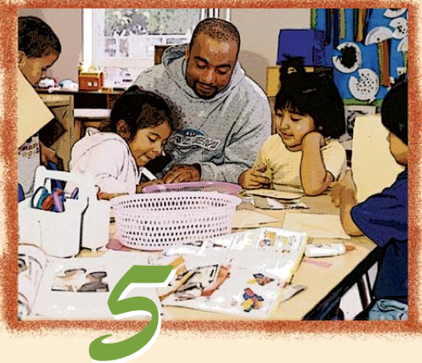
Preschool English Learners: Principles and Practices to Promote
Language, Literacy, and Learning—A Resource Guide (Second Edition)
Chapter 5: Stages and Strategies in Second Language Acquisition
Notes:
Facilitator Notes:
Welcome! This Preschool English Learners: Principles and Practices to Promote Language, Literacy, and Learning—A Resource Guide, Second Edition (PEL Resource Guide) training was developed by WestEd with funding from the California Department of Social Services (CDSS) Child Care and Development Division (CCDD).
The California Department of Education developed the PEL Resource Guide—copyright 2009.
This training explores Chapter 5: Stages and Strategies in Second Language Acquisition.

Slide 3


Partners in Early Learning
The California Department of Education (CDE) was given the authority in the 2021 Budget Bill to revise the Preschool Learning Foundations which will now be known as the California Preschool/Transitional Kindergarten Learning Foundations (PTKLF). The California Department of Social Services (CDSS) is developing implementation materials and professional development. This partnership benefits all children regardless of funding sources.
Notes:
The California Department of Education (CDE) was given the authority in the 2021 Budget Bill to revise the Preschool Learning Foundations which will now be known as the California Preschool/Transitional Kindergarten Learning Foundations (PTKLF). The California Department of Social Services (CDSS) is developing implementation materials and professional development. This partnership benefits all children regardless of funding sources.

Slide 4
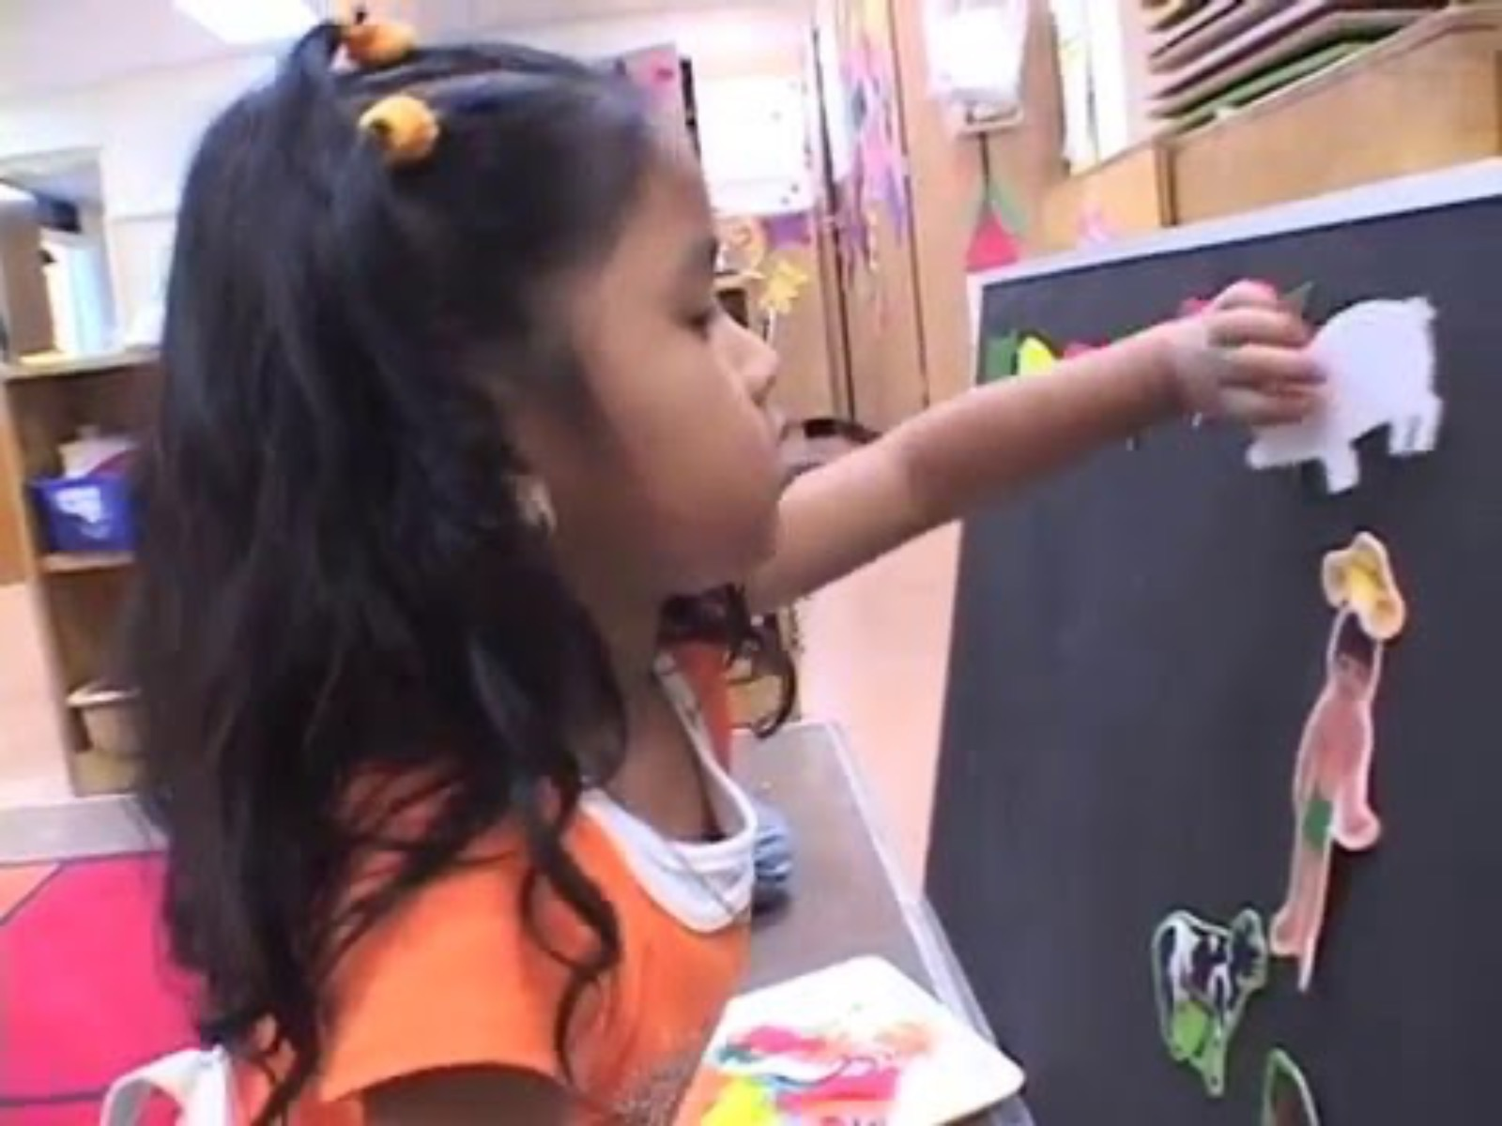
Felt Board Story
Notes:
This video shows an example of supporting language and literacy development by providing materials—such as a felt board—for children to use. (Video: A Felt Board Story | First & Second Languages)

Slide 5
Training Outcomes
Become familiar with the English language development foundations for listening and speaking.
Discuss the stages of second language development for listening and speaking.
Describe teaching strategies to support children’s second language development in listening and speaking.
Notes:
Facilitator Notes:
Briefly go over the outcomes for this section of the training.
Become familiar with the English language development foundations for listening and speaking.
Discuss the stages of second language development for listening and speaking.
Describe teaching strategies to support children’s second language development in listening and speaking.

Slide 6
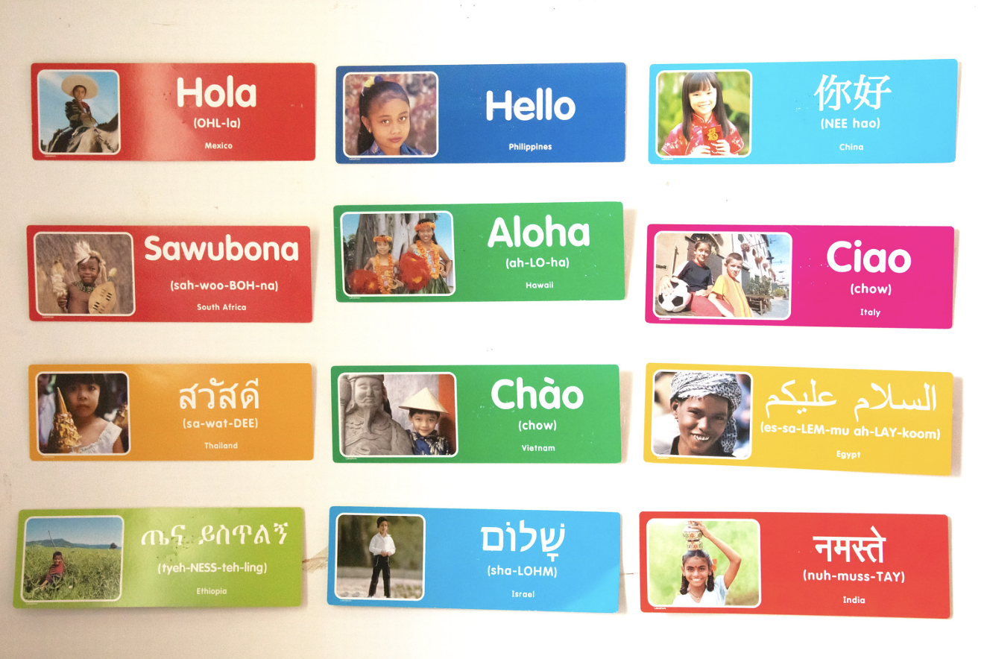
Diversity in English Language Development
Children who are beginning to experience English may spend a period of time observing others around them.
Even if they are not yet communicating in their new language environment, children learn through observation and other forms of active participation.
Notes:
Facilitator Notes:
Children who are beginning to experience English may spend a period of time observing others around them.
Even if they are not yet communicating in their new language environment, children learn through observation and other forms of active participation.

Slide 7
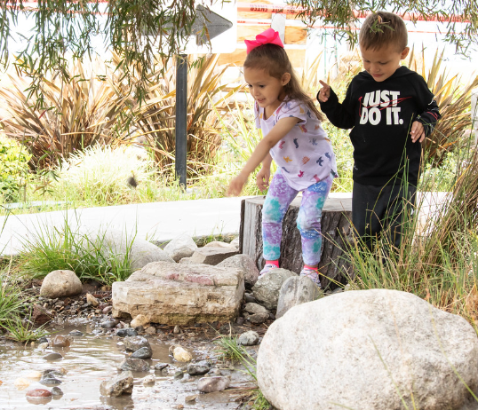
Various Ways of Communicating
Children express their thoughts through language, including spoken language, signed language, gestures, writing, pictures, and other augmentative and alternative communication (AAC) devices.
Writing is an area of significant growth between preschool and third grade. In early childhood settings, children learn pre-writing and dictate ideas to be written by an adult; in the early grades, children begin to write their own thoughts and ideas.
Notes:
Facilitator Notes:
Children express their thoughts through language, including spoken language, signed language, gestures, writing, pictures, and other augmentative and alternative communication (AAC) devices.
Writing is an area of significant growth between preschool and third grade. In early childhood settings, children learn pre-writing and dictate ideas to be written by an adult; in the early grades, children begin to write their thoughts and ideas.
The various ways children communicate their language and literacy knowledge and skills include the following:
In their home languages
In the language of instruction
In a combination of languages
Through the use of augmentative and alternative communication (AAC) devices
Through nonverbal ways of communicating:
Drawing and modeling with different materials
Expressing through movement, actions, or role-play

Slide 8
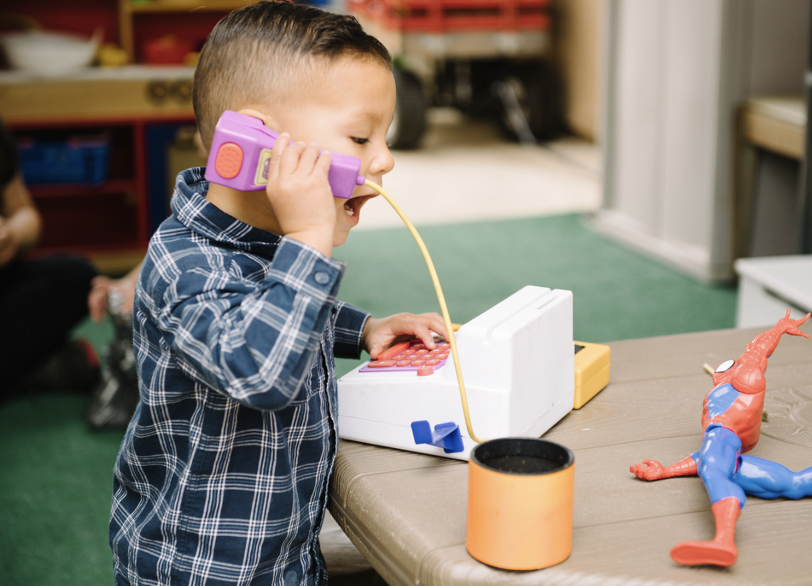
Multilingual Learners
Multilingual learners come to the classroom with a vocabulary foundation in their home language, which can contribute to their growth and development in English.
Source: CDE, CA PTKLF: Language and Literacy Development (LLD), 2024, 85
Notes:
Multilingual learners come to the classroom with a vocabulary foundation in their home language, which can contribute to their growth and development in English.
Source: California Department of Education (CDE), CA PTKLF: Language and Literacy Development (LLD), 2024, 85

Slide 9
Definitions: Language Learning
Second language acquisition is the process that a child goes through in learning more than one language.
Learning to understand and use language is a gradual and ongoing process that begins at birth and continues through the early childhood years and beyond.
Notes:
Research is now calling multilingual learners as children learning two or more languages. The new Preschool/Transitional Kindergarten Learning Foundations now refers to English language learners as multilingual learners.
Using this slide and the next, introduce the definition of language learning and the stages of second language acquisition.
Becoming proficient in a language is a complex and challenging process that takes many years for children of all ages (Hakuta, Bialystok, and Wiley, 2003). As with any type of learning, children will vary enormously in the rate at which they learn languages. The speed of language acquisition depends on factors within the child and in the child’s learning environment. The child’s personality, aptitude for languages, interest, and motivation interact with the quantity and quality of language inputs and opportunities for use to influence the rate and eventual fluency levels.
Source: Linda Espinosa and Vera Gutiérrez-Clellen, “Assessment of Young Dual Language Learners in Preschool,” in California’s Best Practices for Young Dual Language Learners: Research Overview Papers, ed. Faye Ong and John McLean, in cooperation with Cecelia Fisher-Dahms (Sacramento, CA: Department of Education, 2013), 177.

Slide 10
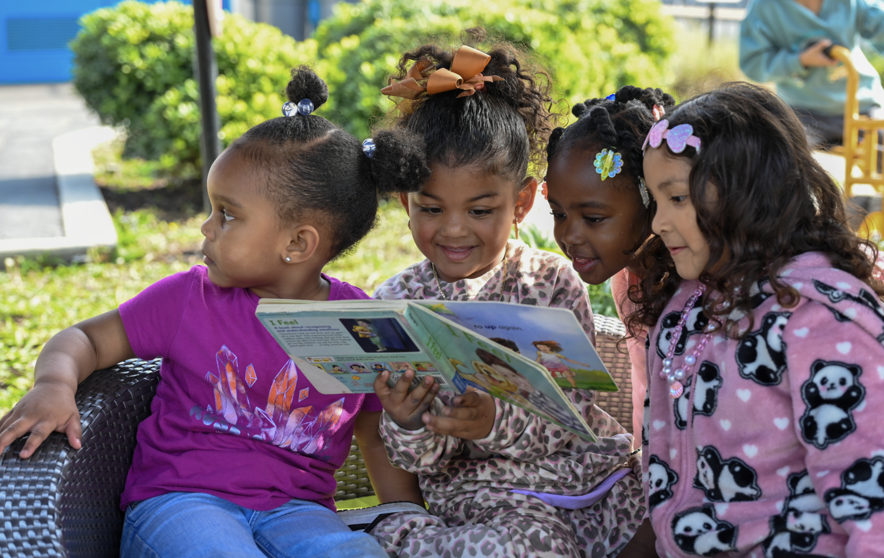
Second Language Acquisition at Age Three or Later
Home language stage
Observational/listening stage
Telegraphic/formulaic speech stage
Fluid language use stage
Notes:
Mini-Lecture: Stages of Second Language Acquisition (five minutes)
Review the four stages of second language acquisition using Handout 5A: Descriptions of the Stages of Second Language Acquisition. For additional information on each of the stages, direct participants to pages 46-51 in the PEL Resource Guide.
This information begins on page 45 of the PEL Resource Guide.
It is important to remember that it can take children more than the short time they are in preschool to move from the home language stage to the fluid language stage.
Note that the “fluid language use” stage is also known as “productive language use.”
Remind participants that during chapter four, they watched a video segment from “A World Full of Language” that discussed the paths to bilingualism. The successive or sequential path involves the four stages identified above, and each was described in the video clip. Explain that you will briefly review the characteristics of each stage and that participants will then be using the information for an activity.

Slide 11
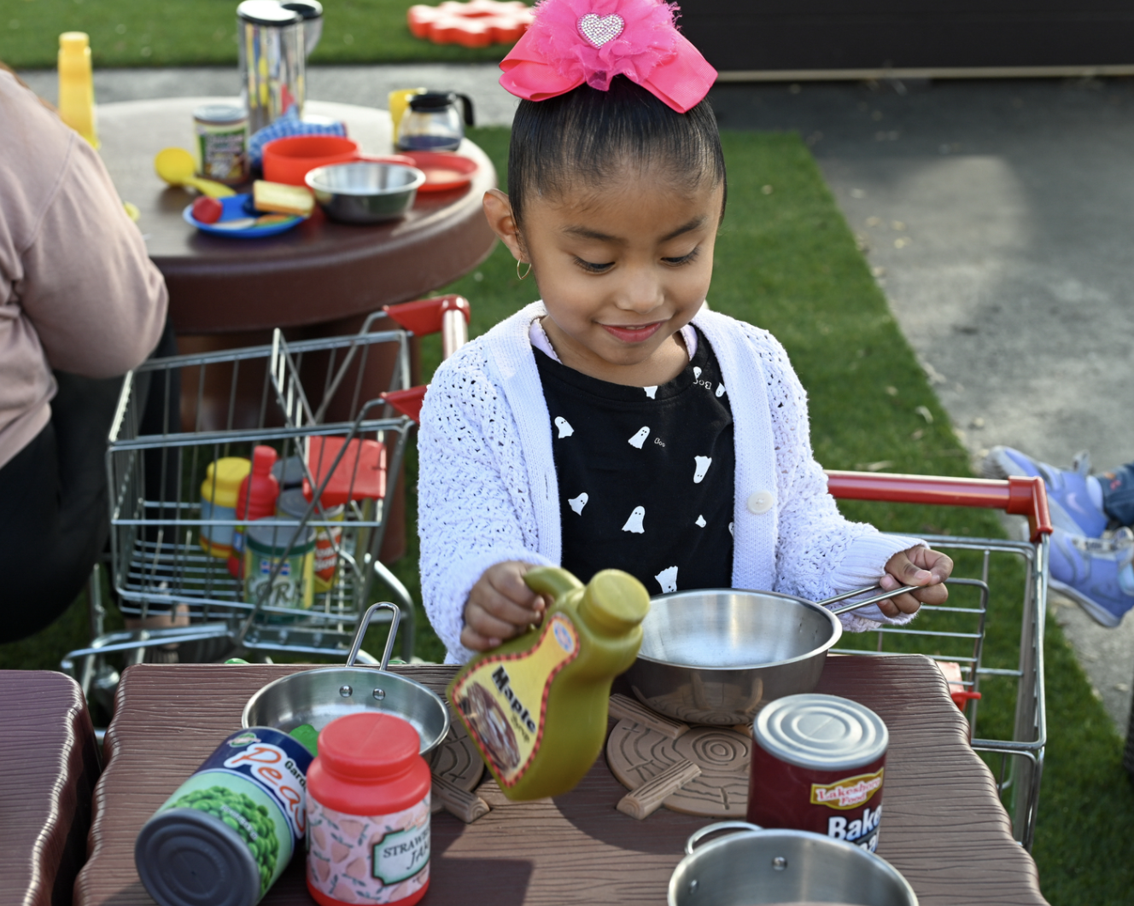
Home Language Stage
May use home language with others
Will eventually only use home language with others who also speak it
May ultimately stop using home language
Notes:
Review each of the following slides. Link back to the video clip seen during Chapter 4, and/or provide additional examples as necessary.
When a child finds herself in a context where a language other than the home language is spoken, she may use the home language to communicate, especially with other children, even if they speak a different language.
Eventually, the child speaks the home language only with others who speak it or stop using it. This stage is the shortest of all the stages.

Slide 12
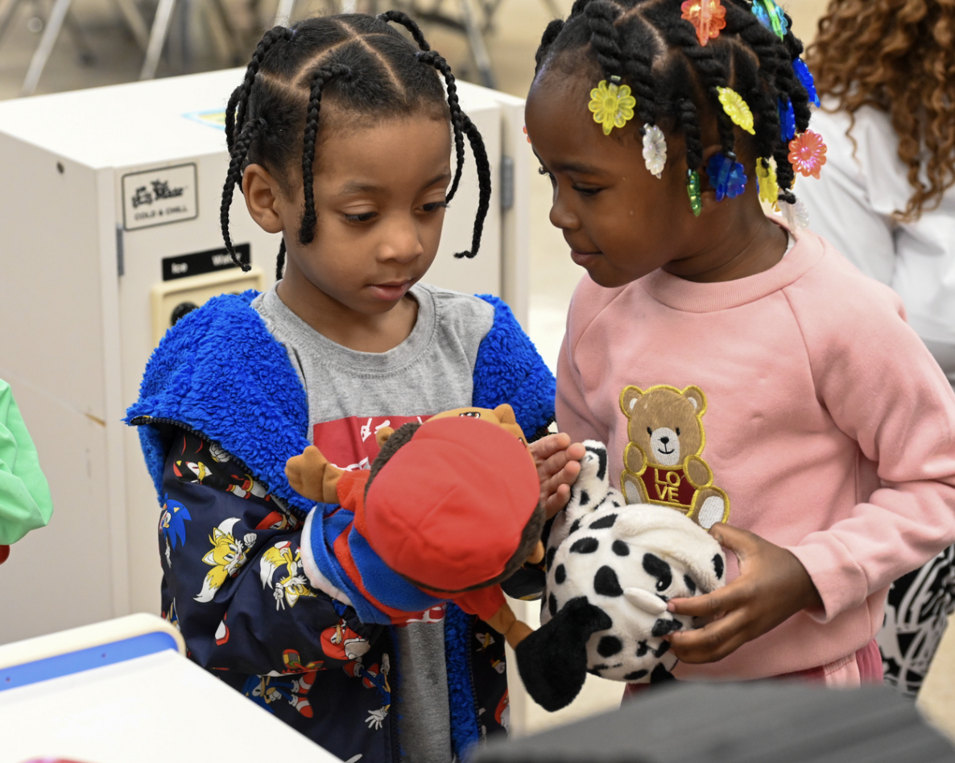
Observational/Listening Stage
Follows home language stage
Observes others
Tries to connect language with what’s happening
May be quiet when others are not speaking the home language
Notes:
Children in the observational/listening stage tend to watch what is happening and may or may not actively participate.
This stage usually follows the home language stage.
Children will observe what others do, how they behave in certain settings, and when they speak.
They to connect what is said with what is happening.
The child may choose to be quiet, even when they are usually quite verbal in the home language environment.
If a child is in the observational/listening stage, the teacher should provide him/her with frequent opportunities to participate at many different levels, and in many different ways. A teacher could provide a low-risk activity for the child to participate in (e.g., group sing-along, group chants, making puppets available in a center for a child to retell a story, working with puzzles, etc.).

Slide 13
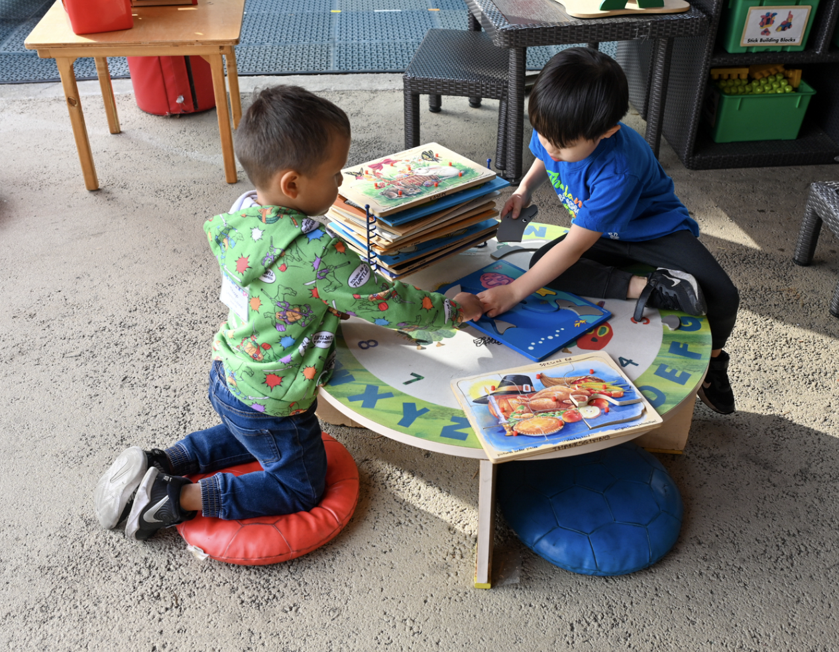
Telegraphic/Formulaic Speech Stage
Uses familiar word chunks, such as:
  “Go __,” (“Go up” or “Go mommy”)
  “Gimme ____,” (“Gimme book” or “Gimme juice”)
Notes:
Children in the telegraphic/formulaic stage may use short phrases, like a telegraph, to convey their messages. They may also use chunks or formulas that they hear are frequently used. These formulas may be misused at times.
Children will use a few content or function words (e.g., “Daddy shoe” or “Sara eat”).
Children rely on familiar or repetitive “chunks” or formulas, for example:
“Go __,” (“Go up” or “Go mommy”)
“Gimme ____,” (“Gimme book” or “Gimme juice”)
As teachers, we must observe and document a child’s progress OVER TIME.
Some ways to invite children to participate at this stage are to use chants during songs (refer to DVD) or to use puppets in a center area to “retell” a story (perhaps acting out the story first as a whole group activity).
Reference the video clip “No” example.
Telegraphic speech refers to the use of a few content words without functional words or certain grammatical markers that communicate, for example, action, possession, or location. Formulaic speech, or the use of formulas, is another strategy used by English learners observed by researchers (McLaughlin 1984; Tabors 1997). Preschool English Language Learner Guide Vol. 2., pp 48-49

Slide 14
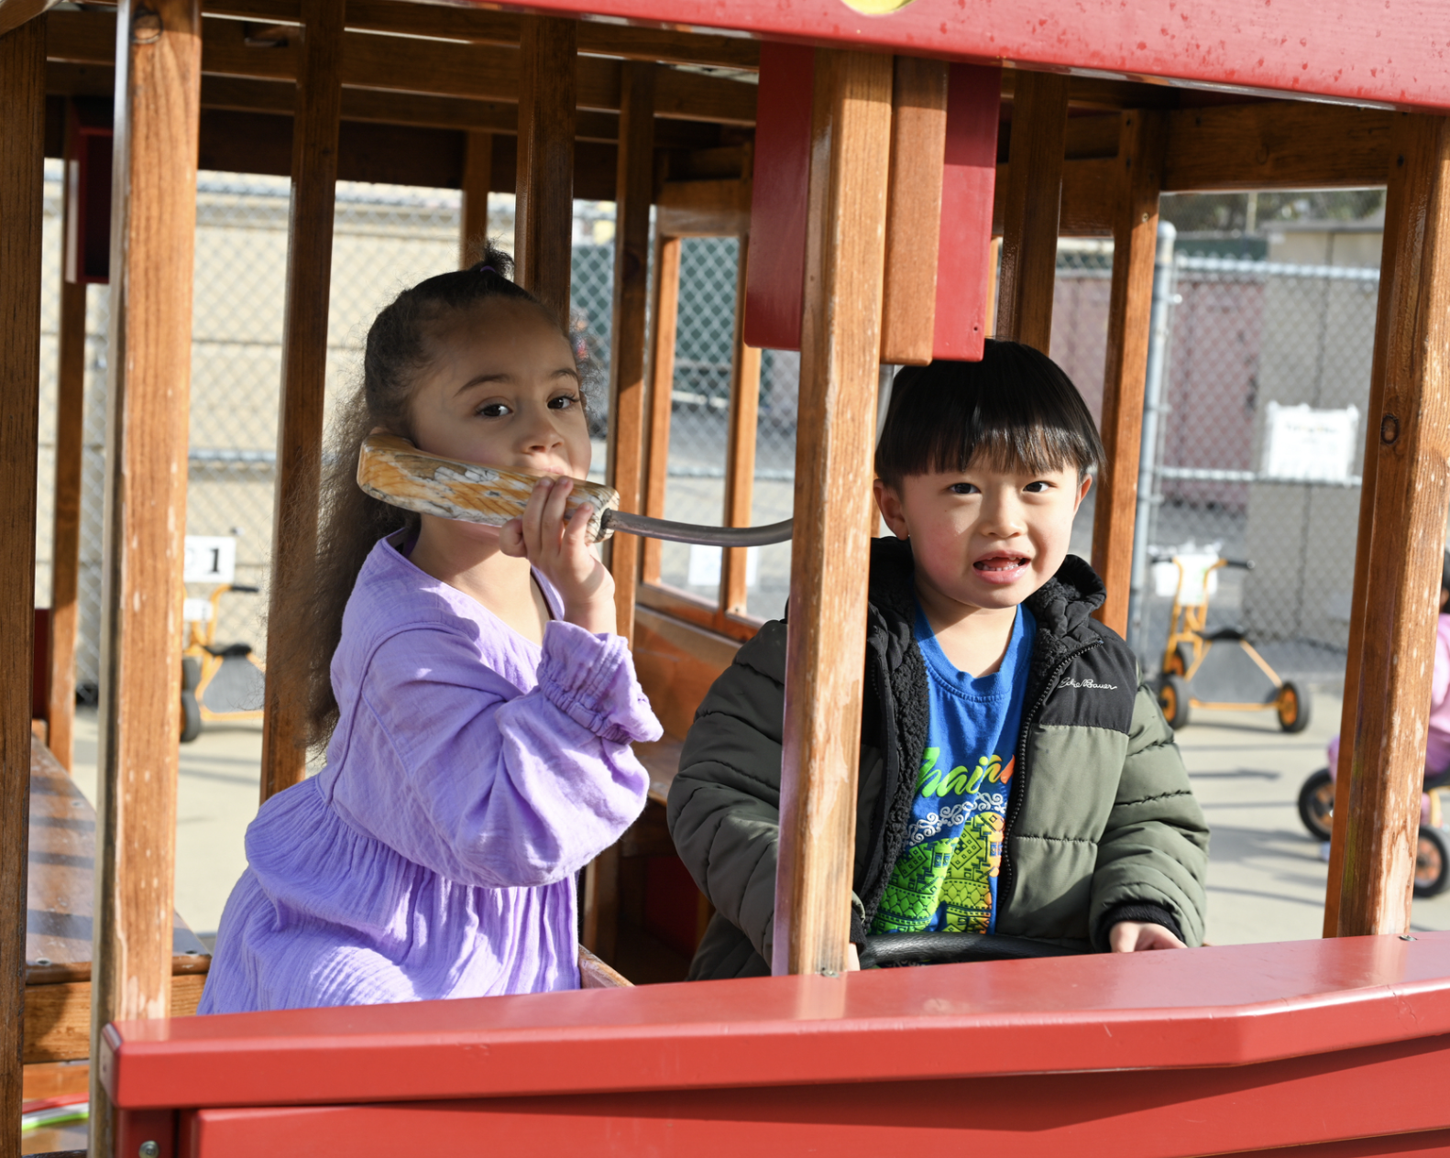
Fluid Language Use
Understands English language rules
Uses English more creatively
Uses social and academic English
Notes:
A child in the fluid stage:
Demonstrates understanding of the rules of English language
Uses new language more creatively
Uses social and academic English
Errors in language usage are common during this period as children experiment with their new language and learn its rules and structure.
Linda Espinosa and Vera Gutiérrez-Clellen, “Assessment of Young Dual Language Learners in Preschool,” in California’s Best Practices for Young Dual Language Learners: Research Overview Papers, ed. Faye Ong and John McLean, in cooperation with Cecelia Fisher-Dahms (Sacramento, CA: Department of Education, 2013), 180.
Remind participants that some children may not reach the fluid stage during their time in preschool, especially if they entered preschool as older four-year-olds. However, it is important to recognize the fluid stage (or productive stage), as it is marked by the emergence of social and academic English which will be discussed later.
Note that this stage is also known as the “productive language stage.”

Slide 15
Snapshots of Children
Number off from 1-3.
Reconvene in number-alike groups.
Refer to Handout 5A: Descriptions of the Stages of Second Language Acquisition.
Use the snapshot that corresponds to your number.
Notes:
Small Group Work: Snapshots of Children at Various Stages of Second Language Acquisition (10 minutes)
Use the next five slides of the PowerPoint presentation as a guide for this activity. You may follow the grouping instructions on this slide to get participants up and moving for a while. Or, you can just have them work at their tables to save time. Distribute one corresponding laminated snapshot to each group from Handout 5B: Snapshot Activity. For example, a small group assigned the number one would receive a laminated snapshot of Viviana.
Each number-alike group will work with their corresponding snapshot (There may be more than one group per snapshot). Their task is to complete the following steps in ten minutes:
Review the assigned snapshot silently.
Using handout 5A as a resource, discuss the various stages of language acquisition in relation to the child described in the snapshot. (five minutes)
Ask groups to come to a consensus on which stage(s) of second language acquisition most appropriately describe(s) the child in the snapshot. (two minutes)

Slide 16
Snapshots of Children (continued)
Review the assigned snapshot.
Discuss the various stages of language acquisition in relation to the child described in the snapshot. (five minutes)
  Use Handout 5A as a resource.
Come to a consensus on which stage(s) of second language acquisition most appropriately describe(s) the child in the snapshot. (two minutes)
Reconvene as a whole group to share your impressions.
Notes:
During the debriefing discussion be sure to address the following:
It may often be difficult to pinpoint the particular stage of second language development for a child. Obtaining additional information about the child’s language skills across multiple environments, and with various communication partners, will lead to a more accurate picture of child’s first and second language development (Refer to the next slide titled, “Keep in Mind”).
Teaming with educators or specialists who are knowledgeable about second language acquisition will offer additional support to the teacher.
Observing and documenting the child’s progress over time, and if possible, across contexts, often leads to a more complete picture of his/her language abilities than that which can be gained from a one-time assessment.
You can also encourage teachers to collect “snapshots” of the English learners in their class over the course of the school year. This will serve as another way to capture the process of second language acquisition and document both the noticeable progress and the subtle changes in their language use.

Slide 17
Keep in Mind . . .
A child may appear to be in one or more of these stages depending on:
  Context
  Communication partners
  Language scaffolds available to them
  Opportunities provided by the teacher
Notes:
This slide may be used as a final debrief for the previous activity, and as a reminder of the complex nature of second language acquisition. A number of variables impact children’s second language development, and it is critical to recognize each when assessing children’s growth.

Slide 18
Focus on Fluid Language Use
Social English
  Used in relaxed interactions with peers and adults.
Academic English
  Used in many school activities and lessons.
Notes:
Mini-Lecture: Focus on Fluid Language Use (five minutes)
Overall, this activity introduces the complex process that children go through as they acquire a second language. Teachers of preschool English learners need to know as much as possible about children’s language development because this knowledge will guide their work with the children and their acquisition of English.
Refer back to Handout 5A: Descriptions of the Stages of Second Language Acquisition. Tell participants that we are going to focus on key features of fluid language use: Social English and Academic English. The difference between these terms is significant when considering a child’s fluency. Use PowerPoint slides 110-114 and Handout 5C: Focus on Fluid Language Use, to introduce concepts. Examples of each are listed in the handout and the PowerPoint presentation. For additional information, refer participants to pages 50-51 in the PEL Resource Guide.

Slide 19
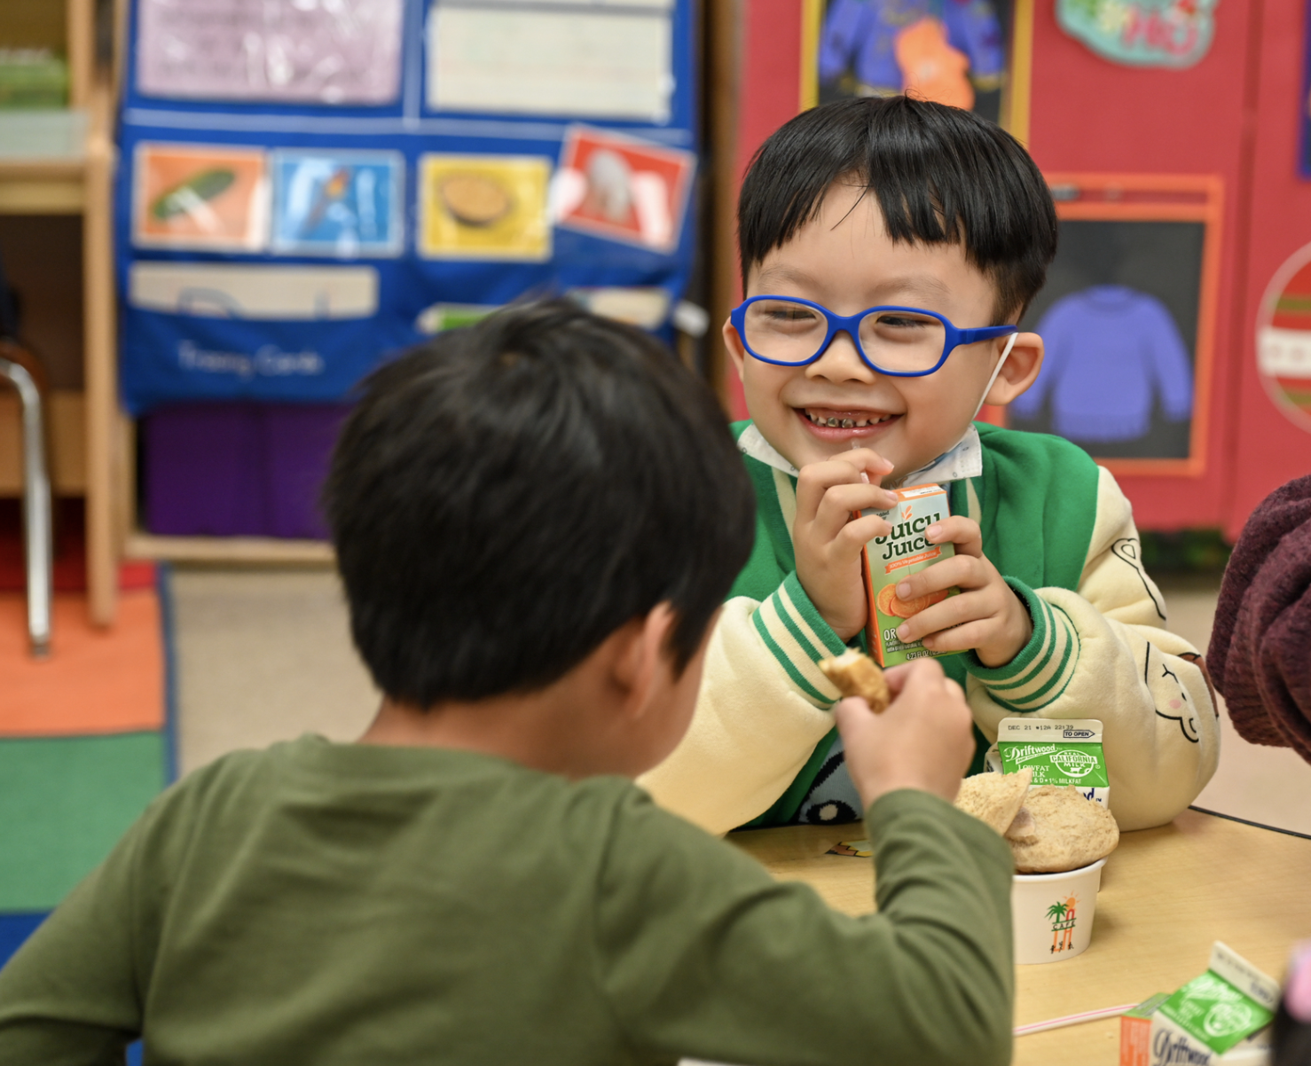
Social English
Relies mostly on spoken language using short, simple sentences
May mislead teachers/ adults to think that the child is ready to learn and comprehend new concepts in the second language
Notes:
When using social English, a child will mostly rely on spoken language, using short, simple sentences.
Caution: A child’s proficiency in social English may mislead teachers/adults to think the child is ready to learn and comprehend complex concepts in a second language.
Social English is the variety of English initially used by most speakers learning English as a second language. It is more informal than academic English, and it is used primarily in social situations. PEL Resource Guide, Second Edition, p. 128

Slide 20
Examples of Social English
Laura is talking with her friend Brianna outside during free play. Laura is telling Brianna to be the “baby” and that she will be the “mommy.”
The teacher asks Juan what he did with his family on the weekend. Juan tells him about their trip to the beach.
Notes:
Social English requires a vocabulary used in social settings. The conversation structure is more informal and does not use the higher-level vocabulary required for success in school.

Slide 21
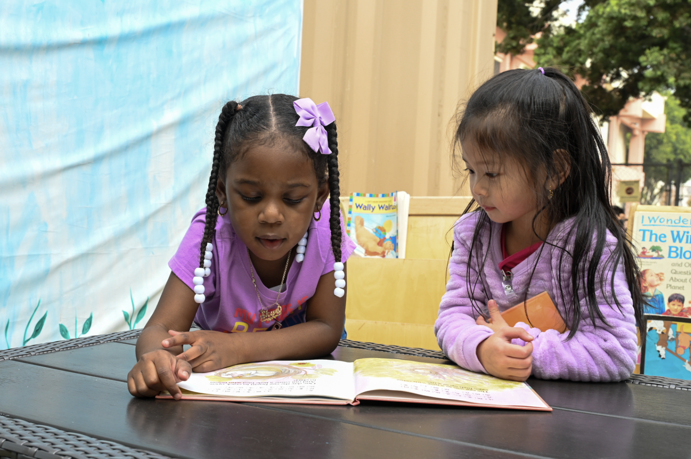
Academic English:The Language of School
Notes:
Academic language is the language of school as spoken by teachers, administrators, and many children. It is more formal and utilizes a greater breadth of vocabulary.

Slide 22
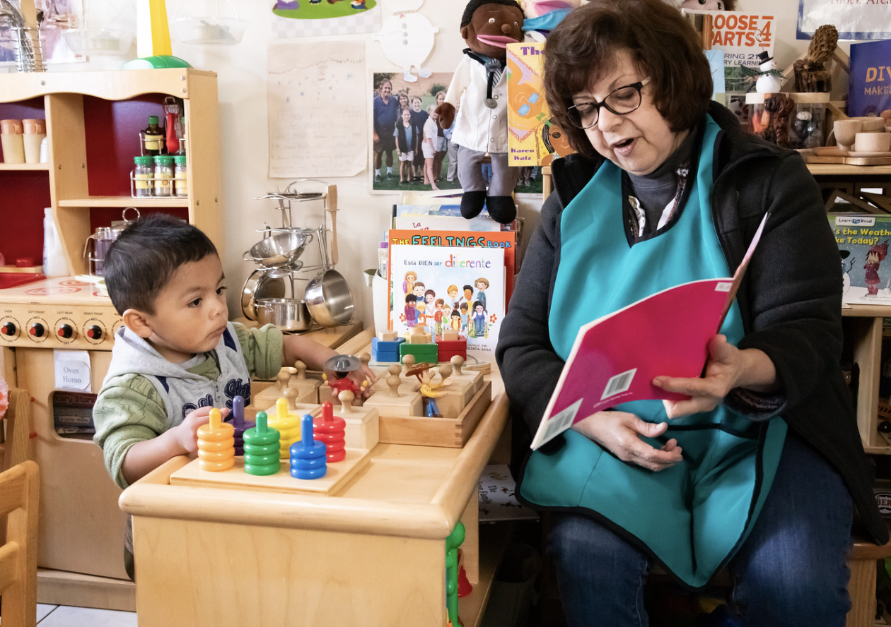
Academic English
Is used in many school activities and lessons
Requires written and spoken language, bigger and more complex vocabulary, etc.
Often offers fewer context clues for the child to grasp meaning
Notes:
Academic English:
Is used in many school activities and lessons
Requires written and spoken language, bigger and more complex vocabulary, etc.
Often offers fewer context clues for the child to grasp meaning

Slide 23
Examples of Academic English
Maximillian describes the pattern he has created with pattern blocks to his teacher.
Ms. Delgado reads a book to the class. Luz Isabel retells the story prompted by the teacher’s questions about the characters.
The goal is for children to perform in all four of the language skills addressed in school: listening, speaking, reading, and writing.
Notes:
Examples of Academic English
Maximillian describes the pattern he has created with pattern blocks to his teacher.
Ms. Delgado reads a book to the class. Luz Isabel retells the story prompted by the teacher’s questions about the characters.
The goal is for children to perform in all four language skills addressed in school: listening, speaking, reading, and writing.
Teachers should plan ahead to help young English learners learn key academic vocabulary. It is important to identify keywords to be used in formal and informal activities prior to use. Connecting vocabulary words to a visual aid, gesture, or other known words will help foster academic English skills. Source: PCF, Vol. 1, p. 199

Slide 24
Connections to “Principles and Practices”
Principle 4: Language development and learning are promoted when preschool teachers and children creatively and interactively use language.
Principle 5: Experimenting with the use, form, purpose, and intent of the first and second languages leads to growth in acquiring the second language.
Principle 6: Continued use and development of the child’s home language will benefit the child as he or she acquires English.
Notes:
Principle 4: Language development and learning are promoted when preschool teachers and children creatively and interactively use language.
Principle 5: Experimenting with the use, form, purpose, and intent of the first and second languages leads to growth in acquiring the second language.
Principle 6: Continued use and development of the child’s home language will benefit the child as he or she acquires English.
There are no new principles introduced in this chapter. However, participants may benefit from revisiting principles 4, 5, and 6, as covered in Chapter 4.

Slide 25

Promote Learning through Routines and Interactions
Encourage the use of home languages through everyday routines.
  For example, allow children to use their home languages while retelling, during play and other activities, and while interacting with another child who speaks the same language.
Make books available in children's home languages.
Notes:
Children’s experiences during regular routines and activities support the growth of vocabulary and grammar. Teachers can promote children’s development in their home languages by:
Encouraging the use of home languages through everyday routines. For example, allow children to use their home languages while retelling, during play and other activities, and while interacting with another child who speaks the same language.
Making books available in children's home languages.

Slide 26

Setting Up the Environment for Success:
Label and Provide Books!
Foster literacy development by:
  Labeling areas of the classroom (such as shelves, bins, and play areas) with the children's home language
  Providing and reading books that reflect children’s diverse cultures, family structures, and home languages
Notes:
Literacy development is supported by print-rich environments with many different types of written materials in English or the home language, such as books, posters, toys, signs, and labels.
Some ways to foster literacy development are to label classroom areas, such as shelves, bins, and play areas, with the children’s home language and provide and read books that reflect the children’s diverse cultures, family structures, and home languages.
For more information on learning opportunities, refer to pg. 129 of the California Preschool Curriculum Framework, Volume 1.

Slide 27
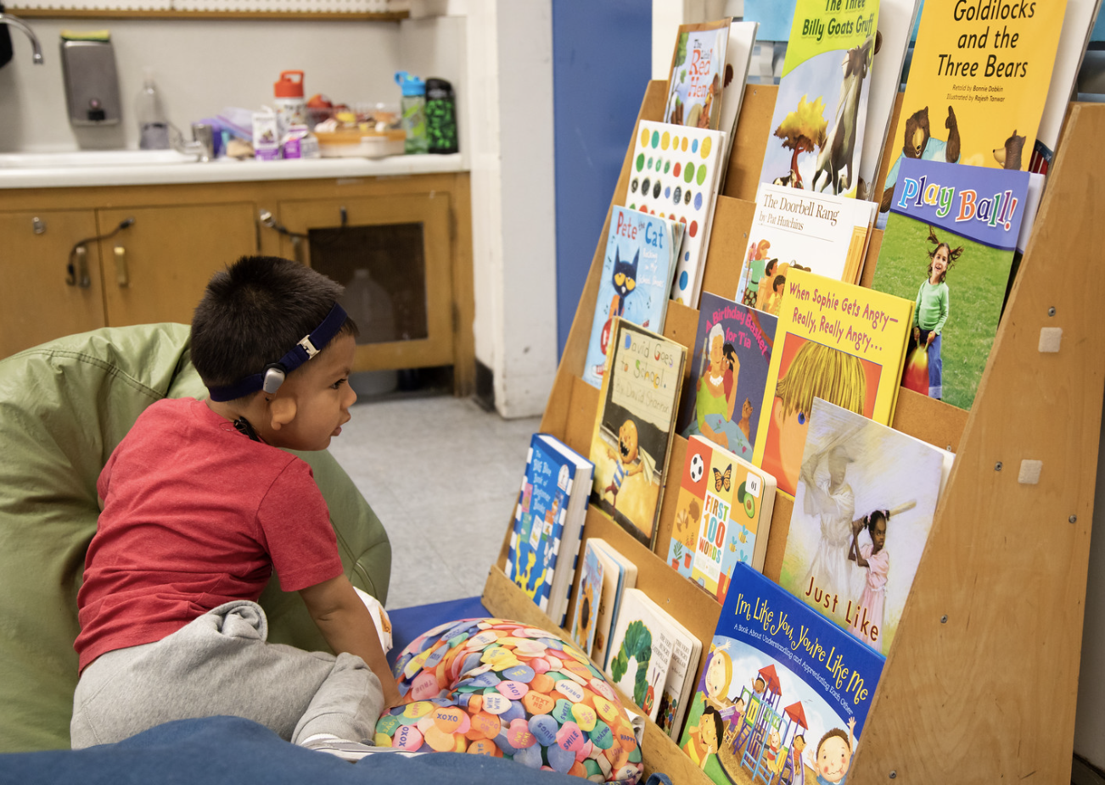
Setting Up the Environment for Success:
Create Spaces!
Foster literacy development by:
  Setting up cozy areas, indoors and outdoors, with a variety of books and comfortable mats for children to read
  Providing books in multiple languages to honor and support the home languages
Notes:
Foster literacy development by setting up cozy areas, indoors and outdoors, with a variety of books and comfortable mats for children to read and by providing books in multiple languages to honor and support the home languages.

Slide 28
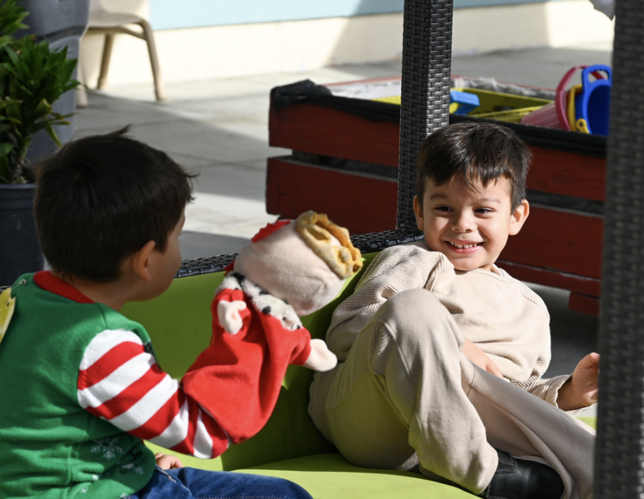
Summary
Provide a comfortable and welcoming environment that allows for language experimentation and the acceptance of children’s efforts to communicate.
Source: CA Preschool Curriculum Framework, Vol. 1, p. 196
Notes:
To foster the growth of both social and academic English, it is important to implement the following practices associated with Principle 5:
Allow “trial and error” speech.
Celebrate a child’s attempts to use a new language.
Remember, mistakes in pronunciation, vocabulary, and grammar are really how a child experiments with sounds, as well as other components of the new language.
Serve as an English language model; repeat utterances with correct grammar and vocabulary.
Source: PEL Resource Guide, Second Edition, pp. 41-42

Slide 29
Responding to the Cognitive Strategies Used by Children
Turn to pages 52-53 in the PEL Resource Guide.
Create A and B pairs:
  “A” pairs read Cognitive Strategies
  “B” pairs read Teaching Tips
Discuss: What did you notice? What strategies do you use most frequently? Which were new? How might these strategies be helpful?
Notes:
Responding to the Cognitive Strategies Used by Children (10-12 minutes)
Purpose: Review young children's cognitive strategies while learning a second language and identify the teaching strategies teachers can use to enhance young English learners' learning.
Ask participants to turn to pp. 52-53 in the PEL Resource Guide. Have them pair up as “A” and “B.” The “A” partner will read the cognitive strategies used by children, and the “B” partner will read the teaching tips to match the strategy.
When pairs have finished reading, ask them to discuss the questions on the slide with their partners. Debrief as a whole group.
Conclude the discussion by leading participants to pages 54-55 in the PEL Resource Guide. Explain that they just read general strategies for working with young English learners. To further differentiate strategies based on a child’s current stage(s) of English language development, use the chart on pp. 54-55.

Slide 30
Key Points
Second language acquisition is a complex process.
Children move through four stages of second language acquisition: home language, observational/listening, telegraphic/formulaic, and fluid language use.
A child may appear to be in one or more of the four stages at any given point in time, depending on several factors.
Notes:
Key Points (two minutes)
Second language acquisition is a complex process.
Children move through four stages of second language acquisition: home language, observational/listening, telegraphic/formulaic, and fluid language use.
A child may appear to be in one or more of the four stages at any given time, depending on several factors.
Trainer Note: Use this and the following slide to review and discuss the key points for this activity. Stop to answer or clarify participants’ questions regarding the key points. Explain that the key points will be elaborated upon throughout the activities for this chapter. This is just a brief overview to orient the group.
Be sure to emphasize that this chapter focuses on children who have had little or no exposure to English before entering preschool. This further elaborates on what happens to children on the path to bilingualism, named successive bilingualism, also known as sequential bilingualism.

Slide 31
Key Points (continued)
Language development and learning are shaped by children’s experiences.
Remember to celebrate children’s attempts at using a new language and, at the same time, model correct grammar and vocabulary in English.
Notes:
Key Points continued
Language development and learning are shaped by children’s experiences.
Remember to celebrate children’s attempts at using a new language and, at the same time, model correct grammar and vocabulary in English.

Slide 32
Thank you!
Notes:
Facilitator Notes:
Thank you!

Slide 33
Presenter’s Name
Presenter’s Photo
CPIN Region
Date
Notes:
Facilitator Notes:
This is an introduction slide to be filled in by the presenter.

