Slide 1

Funded by CDSS
This training is funded by the California Department of Social Services. The materials included in this training include materials or products developed in part or wholly by the California Department of Education and produced by the California Department of Social Services.
Notes:
This training is funded by the California Department of Social Services. The materials included in this training include materials or products developed in part or wholly by the California Department of Education and produced by the California Department of Social Services.

Slide 2


Partners in Early Learning
The California Department of Education (CDE) was given the authority in the 2021 Budget Bill to revise the Preschool Learning Foundations which will now be known as the California Preschool/Transitional Kindergarten Learning Foundations (PTKLF). The California Department of Social Services (CDSS) is developing implementation materials and professional development. This partnership benefits all children regardless of funding sources.
Notes:
The California Department of Education (CDE) was given the authority in the 2021 Budget Bill to revise the Preschool Learning Foundations which will now be known as the California Preschool/Transitional Kindergarten Learning Foundations (PTKLF). The California Department of Social Services (CDSS) is developing implementation materials and professional development. This partnership benefits all children regardless of funding sources.

Slide 3
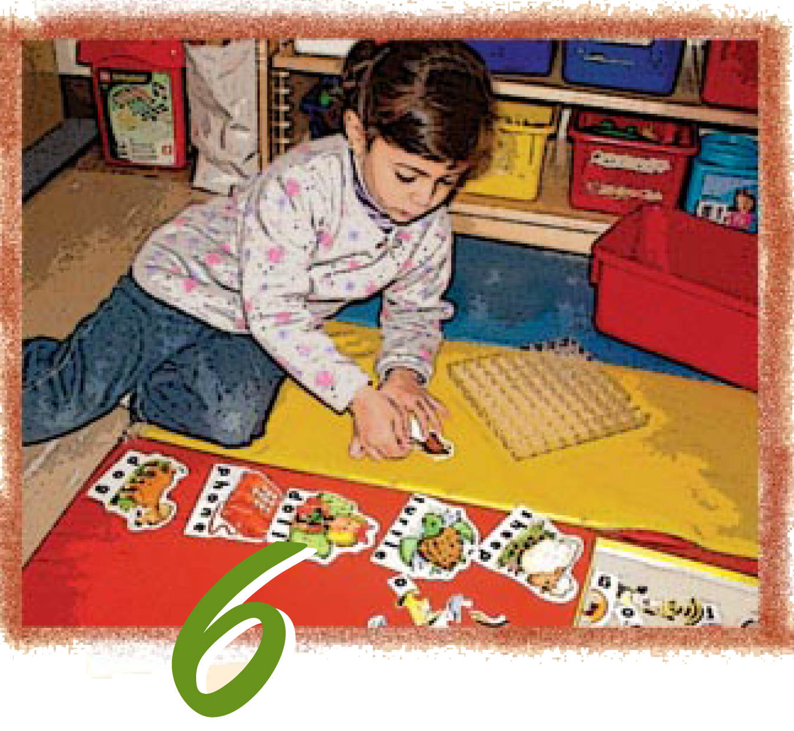
Preschool English Learners: Principles and Practices to Promote
Language, Literacy, and Learning—A Resource Guide (Second Edition)
Chapter 6: Code Switching and Language Loss
Notes:
Facilitator Notes:
Welcome! This Preschool English Learners: Principles and Practices to Promote Language, Literacy, and Learning—A Resource Guide, Second Edition (PEL Resource Guide) training was developed by WestEd with funding from the California Department of Social Services (CDSS) Child Care and Development Division (CCDD).
The California Department of Education developed the PEL Resource Guide—copyright 2009.
This training explores Chapter 6: Code Switching and Language Loss.

Slide 4
Training Outcomes
Describe and provide examples of code-switching
Identify the consequences of language loss
Provide examples of best practices for the intentional use of language
Notes:
The training outcomes for this chapter include the following:
Describe and provide examples of code-switching
Identify the consequences of language loss
Provide examples of best practices for the intentional use of language

Slide 5
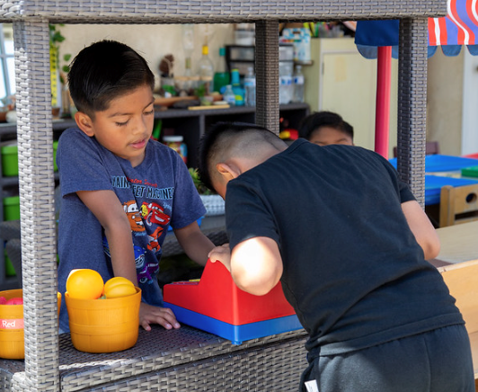
Translanguaging
Children use the full range of their language knowledge to understand and communicate.
Example: While in the dramatic play area, a child communicates in a mix of Russian and English to a peer who also speaks Russian and English, “You want to buy some фрукт? дай мне three dollars.” (You want to buy some fruit? Give me three dollars.)
Source: CDE, CA PTKLF: Language and Literacy Development (LLD), 2024, 11-12 & 28
Notes:
Facilitator Notes:
Translanguaging is how children use the full range of their language knowledge to understand and communicate.
Multilingual learners develop a vast array of language skills. They are learning when and how to draw on their different skills to help them navigate different communication needs.
For example, while in the dramatic play area, a child communicates in a mix of Russian and English to a peer who also speaks Russian and English, “You want to buy some фрукт? дай мне three dollars.” (You want to buy some fruit? Give me three dollars.)
The use of translanguaging in educational settings can aid children’s understanding of ideas, support home language development, and strengthen school-family-community connections.
Source: California Department of Education (CDE), California Preschool/Transitional Kindergarten Learning Foundations (PTKLF): Language and Literacy Development (LLD), 2024, 11-12 and 28
Optional video: https://youtu.be/z2qV5afTITY?feature=shared

Slide 6
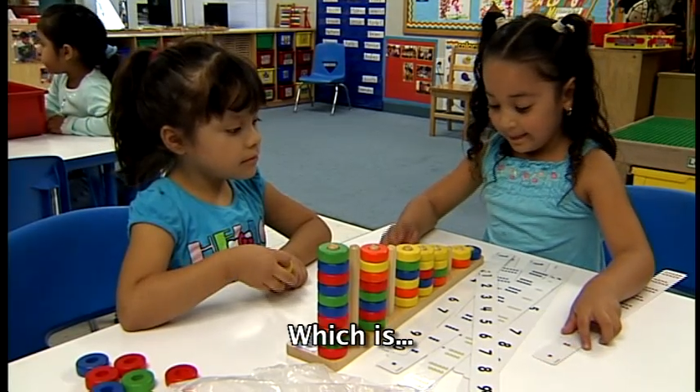
Code Switching: New Definition
One aspect of translanguaging is code-switching or using two or more languages within a conversation, phrase, or sentence.
Example: At drop-off, a child communicates in English and Spanish to a bilingual teacher, “¡Maestra, mira, tengo shoes nuevos!” (Teacher, look! I have new shoes!) while gesturing to their shoes.
Source: CDE, CA PTKLF: LLD, 2024, 11-12 & 28
Notes:
Facilitator Notes:
Code Switching (an aspect of translanguaging) is when a child uses two or more languages in a single conversation or within a single phrase or sentence.
For example, a child communicates in English and Spanish to a bilingual teacher at drop-off, “¡Maestra, mira, tengo shoes nuevos!” (Teacher, look! I have new shoes!) gesturing to their shoes.
Source: CDE, CA PTKLF: LLD, 2024, 11-12 & 28
Let’s revisit our conversation from the courageous conversation. One of the Multilingual Language Learning Toolkit principles is that all young children can acquire more than one language at once and achieve high proficiency in both languages.
Even though children code-switch between languages, they keep the grammatical rules of separate phrases intact. (PTKLF, LLD).
Code-switching is NOT combining two or more languages within one word.
It [code switching] does not mean that the child is confused or cannot separate the languages. In any case, code-switching, or language mixing, is a normal and natural process that teachers need not be concerned about. In fact, language mixing has been shown to be a linguistic resource that indicates growing proficiency in both languages (Paradis, Genesee, and Crago 2011).
Linda Espinosa and Vera Gutiérrez-Clellen, “Assessment of Young Dual Language Learners in Preschool,” in California’s Best Practices for Young Dual Language Learners: Research Overview Papers, ed. Faye Ong and John McLean, in cooperation with Cecelia Fisher-Dahms (Sacramento, CA: Department of Education, 2013), 181.

Slide 7
Examples of Code Switching from Preschoolers
Example | Translation | Language
“I see flower and I see 小鸟” | “I see flower and I see bird.” | English/ Mandarin
“Yo quiero los trucks red.” | “I want the red trucks.” | English/ Spanish
“I see bird. I see bug. Y una mariposa muy bonita. | “I see bird. I see bug. And a really pretty butterfly.” | English/ Spanish
Source: CDE, CA PTKLF, LLD, 2024
Notes:
Facilitator Notes:
Using this slide, share the examples of code-switching taken from the PTKLF LLD domain.
Ask if the participants have examples of their own to share.
Solicit examples from participants of code-switching in media, such as television commercials, books, radio, and movies.
Source: CDE, California Preschool/Transitional Kindergarten Learning Foundations (PTKLF), Language and Literacy Development (LLD), 2024, pp. 87, 89, and 97

Slide 8
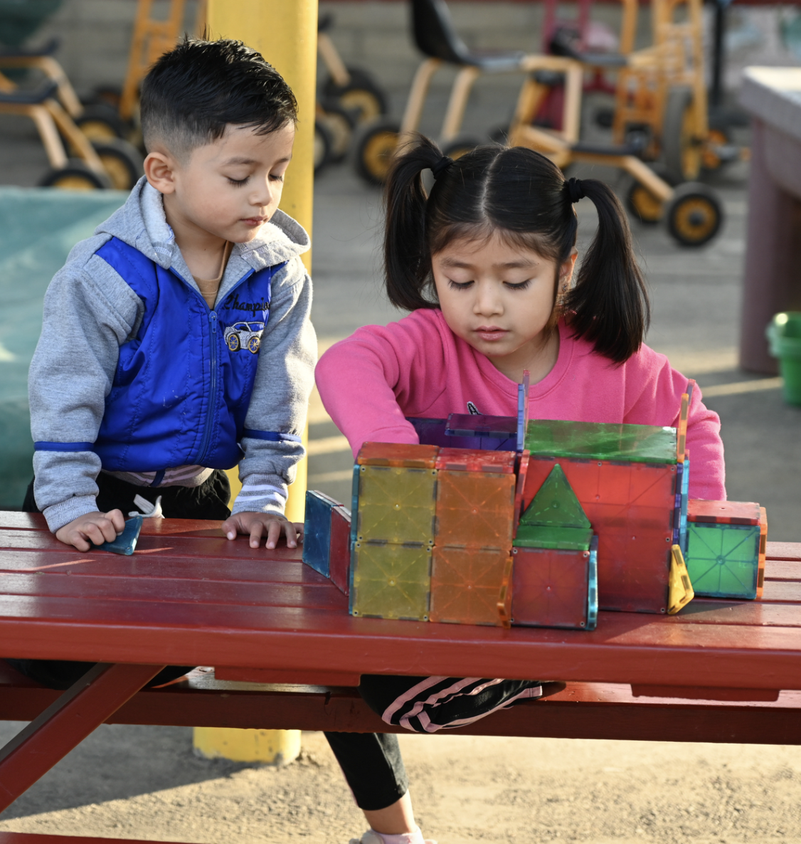
Connections to Principles and Practices
Principle 7: Code-switching is a normal part of language development for many bilingual children.
Notes:
Facilitator Notes:
Explain that many communities often subconsciously use code-switching. Reinforce the discussion thus far by having participants turn to Principle 7 on page 59 of the PEL Resource Guide. Allow time for the participants to read and review the principle and the practices that follow. Important points to cover in discussing the content of the PEL Resource Guide thus far include the following:
Code-switching is an ability that multilingual people use to code-switch for a variety of reasons. Some of the reasons are as follows (Nortier, n.d.):
Inability to retrieve a certain word in one language
To show solidarity with a group
There is no exact wording in one language to send the intended message
Studies have shown that even young children use code-switching for different purposes. Young children may be unable to explain why they code-switch, but they can often control when and with whom they code-switch. Although side-by-side translation is discouraged, purposeful and intentional use of code-switching by teachers can be a way to scaffold instruction for young English learners.
Additional notes on language choice:
Social context, such as familiarity with the person one is speaking to, also influences language choice (Paradis and Nicoladis 2007).
The age when DLL children begin to produce in their nondominant language also impacts the type and frequency of code switching (Jisa 2000).
In most cases, DLLs appear to use words and phrases from the language shared more broadly and by a greater majority of people regardless of their language dominance.
Source: Catherine Sandhofer and Yuuko Uchikoshi, “Cognitive Consequences of Dual Language Learning: Cognitive Function, Language and Literacy, Science and Mathematics, and Social-Emotional Development,” in California’s Best Practices for Young Dual Language Learners: Research Overview Papers, ed. Faye Ong and John McLean, in cooperation with Cecelia Fisher-Dahms (Sacramento, CA: Department of Education, 2013), 61-62.

Slide 9
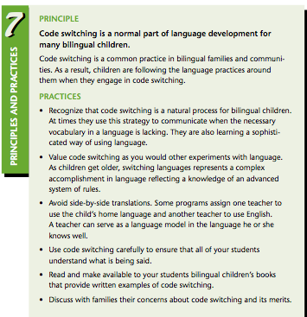
Principle 7 Practices
Turn to page 59 of the PEL Resource Guide.
Read each practice.
Draw a star next to what you already know.
Make a checkmark next to items that are new.
Draw a question mark next to items about which you have questions.
Notes:
Principle 7 Practices
Turn to page 59 of the PEL Resource Guide.
Read each practice.
Draw a star next to what you already know.
Make a checkmark next to items that are new.
Draw a question mark next to items about which you have questions.
As children are on the path to learning English as an additional language, teachers should create a welcoming environment that is supportive of children’s translanguaging, specifically code switching.
Teachers can intentionally use the child's home language to help them fully participate in activities in their environment.

Slide 10
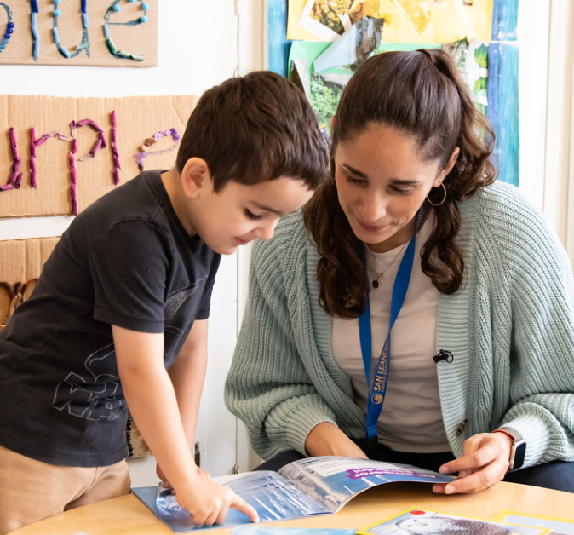
Welcoming Environments
As children are on the path to learning English as an additional language, teachers should create a welcoming environment that is supportive of children's translanguaging, specifically codeswitching.
Teachers can intentionally use the child's home language to help them fully participate in activities in their environment.
Source: CDE, CA PTKLF: LLD, 2024
Notes:
As children are on the path to learning English as an additional language, teachers should create a welcoming environment that is supportive of children's translanguaging, specifically codeswitching.
Teachers can intentionally use the child's home language to help them fully participate in activities in their environment.
Source: CDE, CA PTKLF: LLD, 2024

Slide 11
Language Loss
“I spoke only Spanish until I started school. I can’t remember exactly when it happened, but eventually, I lost most of it. I can communicate with my parents, I understand what they are saying, but I often have trouble finding the right words to answer them…”
Source: CDE, PEL Resource Guide, Second Edition, 61
Notes:
“I spoke only Spanish until I started school. I can’t remember exactly when it happened, but eventually, I lost most of it. I can communicate with my parents, I understand what they are saying, but I often have trouble finding the right words to answer them…”
Source: CDE, PEL Resource Guide, Second Edition, 61
In early chapters, we discussed the value of the home language in supporting English language development. The home language is also a key in family and community communication. Without sufficient exposure and opportunity to practice, children are likely to lose their home language once exposed to English. Language loss can have devastating consequences. To understand these consequences, we will watch a video clip from “Developing the Young Bilingual Learner” (NAEYC, 1998).
Trainer Note: This video is about 20 minutes.

Slide 12
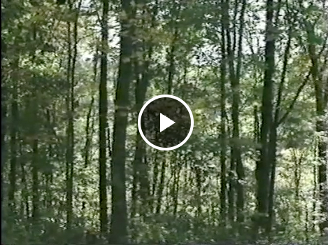
Video Viewing: Developing the Young Bilingual Learner
Notes:
Video Viewing: Developing the Young Bilingual Learner
(20 minutes)
Show the video: https://wested.box.com/s/rsz0ma1gw1jwygby0tefhvfvz2idsjyv
As they watch the video, encourage participants to consider the following questions:
What are the implications of losing the home language for the child? For the family? For society?
How does this video relate to what we know about second language acquisition? (This offers a great opportunity to remind participants of the benefits of cross-language transfer and the theoretical key points covered in Chapter Four.)
After viewing the video, have a few participants share their responses. Point out that in some instances, language loss happens over one to two generations, and in some cases within the same generation, due to the significantly reduced opportunities to use and practice the home language. Have participants turn to page 60 in the PEL Resource Guide and refer to the section on Language Loss. As they review the section, highlight the options that families have for maintaining and strengthening the home language such as:
After-school or weekend language programs.
Forming playgroups or organizing activities with friends and families who speak the home language.
Reading children’s books written in the home language.
Playing group or board games in the home language.

Slide 13

Strategies in Action
Read the scenario for your age group.
As a group, discuss and respond to the reflective questions for your scenario
Make a poster to share out your scenario and your team’s responses.
Notes:
15 min SHARE KEY TAKE AWAY
Select the image and open the link to go to the Multilingual Learning Toolkit website: https://www.multilinguallearningtoolkit.org/vignette/home-language-development-prek-transitional-kindergarten/
Ask participants to break into three groups according to the age group they work with: PreK-TK, Kindergarten 1st, 2nd, and 3rd grade. Have them read the scenarios for each age group and respond to the reflective questions on the handout.
Make posters to share the responses they came up with as a team.
Each Strategy in Action has its own set of reflective questions.

Slide 14
Key Points
Translanguaging encompasses many skills and behaviors, such as code-switching, that allow a multilingual individual to use language fluidly.
Code switching is a normal part of language development for many bilingual children.
Language loss is common for children learning a second language, which can negatively affect the child’s connection with the family and community.
Notes:
Key Points
Translanguaging encompasses many skills and behaviors, such as code-switching, that allow a multilingual individual to use language fluidly.
Code switching is a normal part of language development for many bilingual children.
Language loss is common for children learning a second language, which can negatively affect the child’s connection with the family and community.

Slide 15
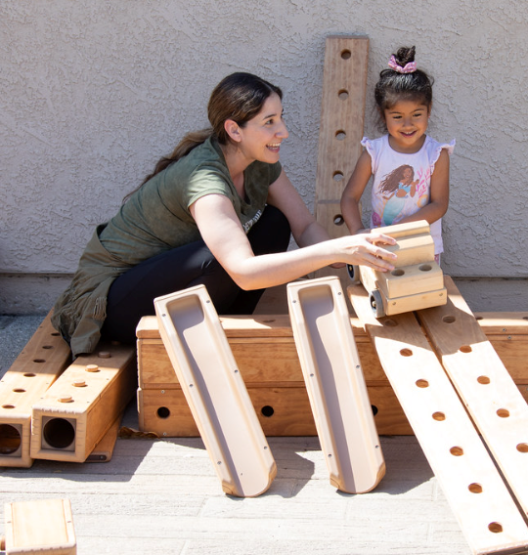
Key Points (2)
Teachers should use language intentionally.
Children need opportunities to acquire English as a second language while continuing to develop the home language.
Notes:
Key Points and Definitions (5 minutes)
Using slides 2-4 in the PowerPoint presentation for chapter 6, review and discuss the key points for this chapter, stopping to answer or clarify any questions participants may have.

Slide 16
Thank you!
Notes:
Facilitator Notes:
Thank you!

Slide 17
Presenter’s Name
Presenter’s Photo
CPIN Region
Date
Notes:
Facilitator Notes:
This is an introduction slide to be filled in by the presenter.

