Slide 1

Funded by CDSS
This training is funded by the California Department of Social Services. The materials included in this training include materials or products developed in part or wholly by the California Department of Education and produced by the California Department of Social Services.
Notes:
This training is funded by the California Department of Social Services. The materials included in this training include materials or products developed in part or wholly by the California Department of Education and produced by the California Department of Social Services.

Slide 2


Partners in Early Learning
The California Department of Education (CDE) was given the authority in the 2021 Budget Bill to revise the Preschool Learning Foundations which will now be known as the California Preschool/Transitional Kindergarten Learning Foundations (PTKLF). The California Department of Social Services (CDSS) is developing implementation materials and professional development. This partnership benefits all children regardless of funding sources.
Notes:
The California Department of Education (CDE) was given the authority in the 2021 Budget Bill to revise the Preschool Learning Foundations which will now be known as the California Preschool/Transitional Kindergarten Learning Foundations (PTKLF). The California Department of Social Services (CDSS) is developing implementation materials and professional development. This partnership benefits all children regardless of funding sources.

Slide 3
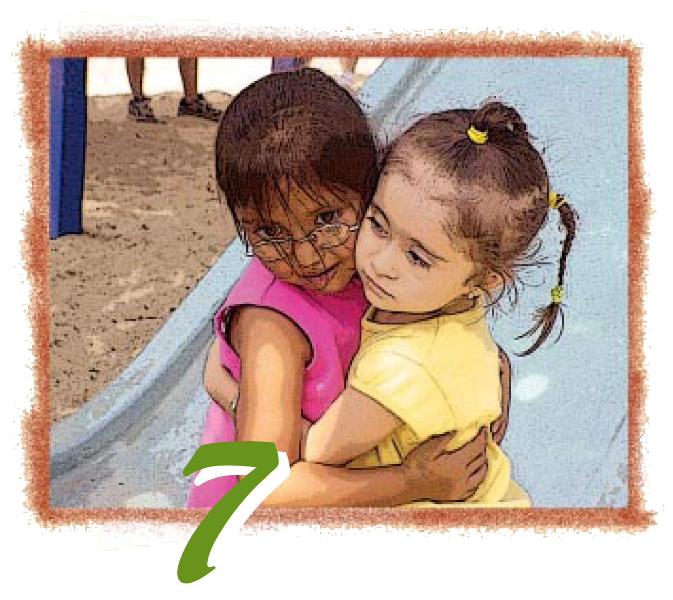

Preschool English Learners: Principles and Practices to Promote
Language, Literacy, and Learning—A Resource Guide (Second Edition)
Chapter 7: English Learners with Disabilities or Other Special Needs
Notes:
Facilitator Notes:
Welcome! This Preschool English Learners: Principles and Practices to Promote Language, Literacy, and Learning—A Resource Guide, Second Edition (PEL Resource Guide) training was developed by WestEd with funding from the California Department of Social Services (CDSS) Child Care and Development Division (CCDD).
The California Department of Education developed the PEL Resource Guide—copyright 2009.
This training explores Chapter 7: English Learners with Disabilities or Other Special Needs.

Slide 4
Training Outcomes
Become familiar with the terminology necessary for supporting children with Individualized Education Programs (IEP) who are learning English as an additional language
Raise awareness of varying cultural experiences with regard to special education.
Become familiar with the resources to support children with an IEP who are learning English as a second language
Notes:
The training outcomes for this chapter include the following:
Become familiar with the terminology necessary for supporting children with Individualized Education Programs (IEP) who are learning English as an additional language
Raise awareness of varying cultural experiences with regard to special education.
Become familiar with the resources to support children with an IEP who are learning English as a second language

Slide 5
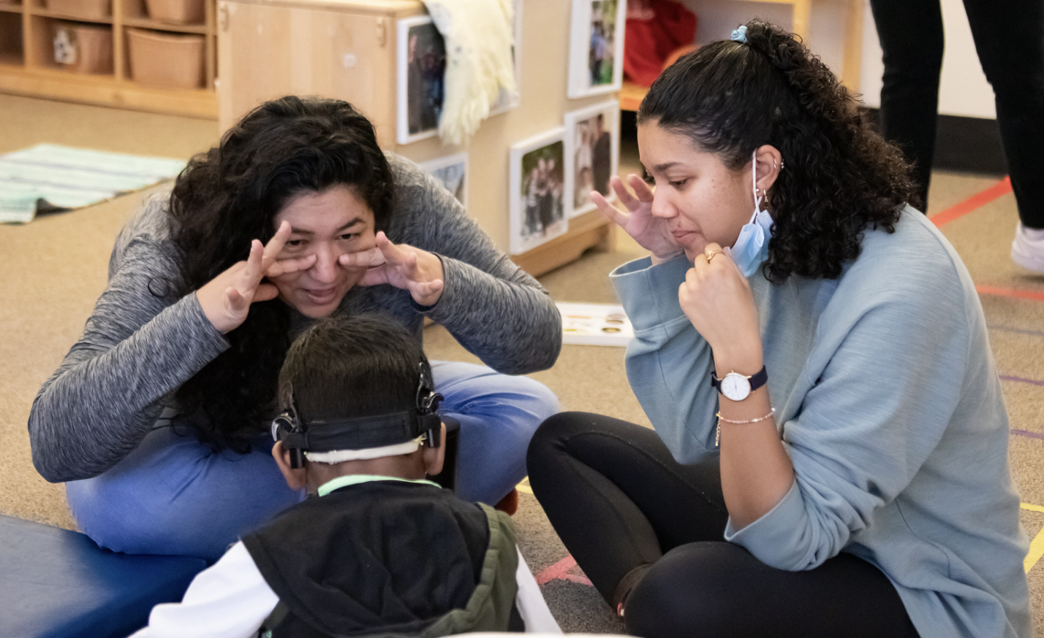
Children with Disabilities and Developmental Differences
Children may have developmental differences that impact the path and pace at which they learn different aspects of language and the ways they demonstrate their knowledge.
Example: Some may understand the language but may not speak
Source: CDE, CA PTKLF: Language and Literacy Development (LLD), 2024, 12
Notes:
Facilitator Notes:
Children may have developmental differences that impact the path and pace at which they learn different aspects of language and the ways they demonstrate their knowledge.
Some children, for example, may understand language but may not speak.
Source: CDE, CA PTKLF: Language and Literacy Development (LLD), 2024, 12

Slide 6
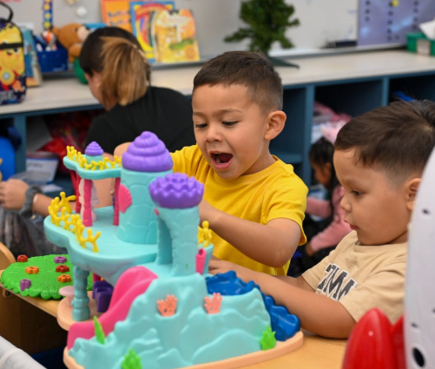
Cultural and Linguistic Assets
When the home language and culture are viewed as assets and resources, it becomes the foundation for enhanced learning.
Source: California Department of Education (CDE), California Preschool Curriculum Framework (PCF), Vol. 1, 185
Notes:
Transition slide:
When working with culturally and linguistically diverse families, it is important to remember that there are other aspects of a family’s culture to consider. The next few slides address several points to consider.
“When the home language and culture are viewed as assets and resources, it becomes the foundation for enhanced learning.”
Source: California Department of Education (CDE), California Preschool Curriculum Framework (PCF), Vol. 1, 185
The California Preschool Curriculum Framework highlights this in the English Language Development Guiding Principle: “Respect Cultural Values and Behaviors reflected in the child’s language and communication” (PCF, Vol. 1, 180).
Research indicates that many families of preschoolers with special needs value home language maintenance and bilingualism for their children. Given the significance of the culture of a family, parent-child interactions, a child’s sense of identity and belonging, and the parent’s sense of competence and confidence, families should be encouraged to maintain their home languages with their children.
Source: Deborah Chen and Vera Gutiérrez-Clellen, “Early Intervention and Young Dual Language Learners with Special Needs,” in California’s Best Practices for Young Dual Language Learners: Research Overview Papers, ed. Faye Ong and John McLean, in cooperation with Cecelia Fisher-Dahms (Sacramento, CA: Department of Education, 2013), 225.

Slide 7
Partners
Principle 8
Overarching Principle
Coordination and collaboration among families, teachers, and specialists become crucial in supporting the language and literacy development of children with disabilities or other special needs.
Source: CDE, PEL Resource Guide, 69
Family and community partnerships create meaningful connections.
Source: CDE, PCF, Vol. 1, 7
Notes:
Refer participants to Principle 8 in the PEL Resource Guide (p. 69). Next, read the paragraph under the overarching principle in the PCF (p. 7).
Invite participants to share their answers to the following questions with an elbow partner:
How do these two statements support each other?
What do you connect with most in these statements?
This is a reminder that the PEL Resource Guide contains Principle 8 and practical ideas to implement strategies that will support English learners with disabilities or special needs. These ideas are supported by the overarching principle in the PCF.

Slide 8
Access to Regular Preschool Activities:
The Law
To the maximum extent appropriate, children with disabilities, including children in public or private institutions or other care facilities, are educated with children who are nondisabled.
…removal of children with disabilities from the regular educational environments occurs only if the nature or severity of the disability is such that education in regular classes…cannot be achieved satisfactorily (this includes preschool).
§300.114 (a)(2) Preschool Least Restrictive Environment (LRE)
Notes:
This section of the law addresses placing preschool children in the least restrictive environment. The least restrictive environment must be the first setting considered, which means something different for each child. The least restrictive environment for a preschooler is a general education preschool program and the most restrictive environment may be a hospital setting or a home.
Background Information: § 300.116 also states:
(a)(3) Is as close as possible to the child’s home; unless the IEP of a child with a disability requires some other arrangement, the child is educated in the school that he or she would attend if nondisabled.
(e) A child with a disability is not removed from education in age-appropriate regular classrooms solely because of needed modifications in the general education curriculum.
Video trailer of the interview regarding Least Restrictive Environment/Inclusion SEEDS: http://www.scoe.net/seeds/resources/videos/zaca/zaca4.html

Slide 9
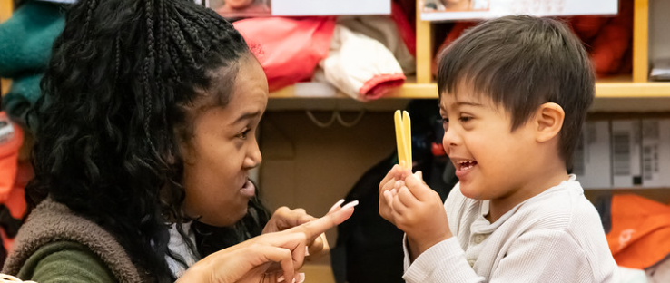
Language Disorder or Language Difference
Notes:
Add for article: https://www.cde.ca.gov/sp/ml/documents/mleleducation.pdf
Language differences are attributable to growing up with two languages and language delays, which may require specialized language interventions.
Source: Espinosa, L. M., & García, E. (2012). Working paper #1: Developmental assessment of young dual language learners with a focus on kindergarten entry assessment: Implications for state policies. Chapel Hill: The University of North Carolina, FPG Child Development Institute, Center for Early Care and Education Research-Dual Language Learners.
Developmental disorders are those that a child is born with, meaning their origins are genetic, which can be inherited or arise during neurodevelopment without a family link. Examples of developmental disorders that influence language communication and reading development are dyslexia, autism spectrum disorder (ASD), syndromes that include intellectual disabilities (e.g., Down syndrome, fragile X syndrome), or developmental language disorder (also known as specific language impairment). Disorders that are environmental in origin occur after a child is born and thus are not genetically determined. ( Paradis, Genesee, and Crago, 2011)
Source: Paradis, J., F. Genesee, and M. B. Crago. 2011. Dual Language Development and Disorders: A Handbook on Bilingualism and Second Language Learning. Baltimore, MD: Paul H. Brookes Publishing.

Slide 10
Children with disabilities can learn more than one language!
Similar to their typically developing peers, children with disabilities who are multilingual learners may:
  Learn multiple languages and should be able to maintain their home language while also learning English.
  Need both languages to develop and communicate effectively in all their environments.
  Require individualized supports in their home language, in English, in sign language, or in other ways to help them learn and communicate effectively
  Source: CDE, PEL Resource Guide, 2009, 66
Notes:
Children with disabilities can learn more than one language!
Similar to their typically developing peers, children with disabilities who are dual language learners (DLL) can learn multiple languages and should have the opportunity to maintain their home language while also learning English.
Children with disabilities who are DLLs and are taught in both or all their languages benefit more than their peers who are only taught in their second language.
Children who are DLLs and have a disability need both languages to develop and communicate effectively in all their environments.
Children who are DLLs and have a disability or a suspected delay may need individualized supports in their home language, in English, in sign language, or in other ways to help them learn and communicate effectively
Source: CDE, PEL Resource Guide, 2009, 66

Slide 11
Scaffolding Strategies…Making Preschool Accessible
Learning Through Everyday Routines and Interactions
Setting Up Environments and Materials
Planning Instructional Activities
Opportunities for Home Connections
Notes:
Learning Through Everyday Routines and Interactions
Children learn language daily, all day, in rich and varied interactions and learning experiences in the child’s home languages or English during regular routines. Children learn through practice, such as conversing with adults and other children and expressing their thoughts and opinions. Encourage children to use their home languages in the classroom, providing books in the home languages that children can access, and including children’s home languages on signs and labels along with pictures (for example, labeling a bin for blocks with both BLOCKS and BLOQUES).
Setting Up Environments and Materials
Literacy development is supported by print-rich environments, with many different types of written materials, such as books, posters, toys, signs, and labels, in English or the home language. Books representing children’s cultural, ethnic, and language backgrounds are especially valuable, as they can engage children’s interest in reading and support their comprehension.
Planning Instructional Activities
Literacy instruction should be play-based and developmentally appropriate. This instruction should be playful, including employing rhymes, active games, and hands-on materials. Teachers can offer various writing materials and surfaces to support writing development. Children can write using pencils on paper, sticks in sand, crayons on easels, chalk on sidewalks, or fingers in shaving foam, among many other possibilities.
Opportunities for Home Connections
Authentic, reciprocal communication between teachers and families fosters a strong home-school connection. Because children may demonstrate their language development in any languages or language varieties they speak—including languages or varieties their teacher may not know or use—communication with families is necessary if teachers and family members are to understand and support children’s development.
Source: CDE, CA PTKLF: LLD, 2024,13-15)

Slide 12
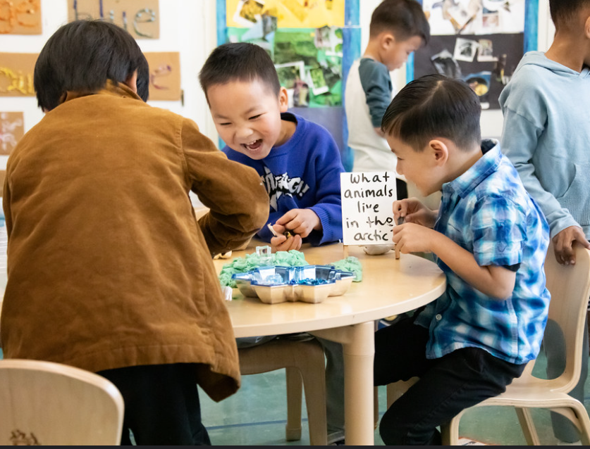
Early Warning Signs for 3 to 5 Year Olds
Differences across bilingual and monolingual children should not be interpreted as delay but rather a distinct developmental pattern linked to experience in each language.
Source: CDE, California’s Best Practices for Young Dual Language Learners: Research Overview Papers, 2013, 15
Shows difficulty following simple directions in either language
Exhibits immature speech and language in both languages
Source: Dunlap, L. L. (2009), McLaughlin, S. (2006), Hamaguchi (2001), CDE brochure
Notes:
Refer participants to the handout 7A: Language Disorder or Language Difference.
“Differences across bilingual and monolingual children should not be interpreted as delay, but rather a distinct developmental pattern linked to experience in each language.” Source: CDE, California’s Best Practices for Young Dual Language Learners: Research Overview Papers, 2013, 15
Speech-language pathologists expect students to reach certain milestones on time and at an expected level of intelligibility. These developmental milestones remain consistent across multiple languages and for monolingual and bilingual children. For example, a kindergartener whose speech remains equally unintelligible in both of his languages raises concern because research suggests typically developing children retain some sound errors but are fully intelligible by age 4.
Language development follows a similar set of guidelines. Certain language building blocks develop in all children before and during early spoken language. Bilingual children develop early vocabulary at the same rate as monolingual children. Bilingual and monolingual children also meet one- and two-word milestones around the same time.
The environment influences a child’s word use, so a bilingual student might know his colors in English because they were taught at school. The same child identifies clothing articles in Spanish because he learned them at home. Conceptual scoring doesn’t mean giving extra credit if they know a word in both languages, such as “hola” and “hello.”

Slide 13
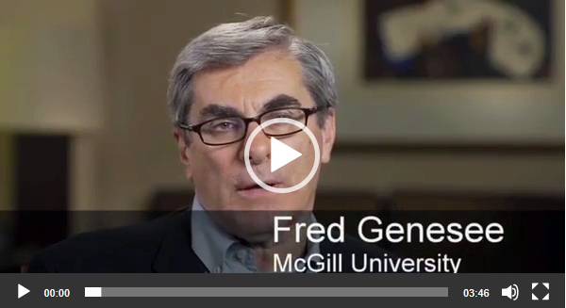
Interview of Fred Genesee
Notes:
Select the image to go to website and show video https://iris.peabody.vanderbilt.edu/mcontent/screening-and-assessing-young-dual-language-learners-instructors-guide/
Have participants watch video and answer the following questions:
Questions/Discussion Topics
What should teachers consider when assessing young dual languages?
Answers or discussions might include the following:
Assessment strategies should be age- and language-appropriate.
Assessments should include the child’s dominant language and any additional languages the child is learning.
Assessments should utilize a variety of different methods, including formal and informal assessment, observation and interviews, and they should gather assessment information from multiple sources, including families.
Assessments of young DLLs should consider how long the child has been speaking and exposed to his or her home language.
Assessments of young DLLs should consider how long the child has been speaking and exposed to English.
Assessments should determine whether the difficulties are present in both/all languages a young DLL speaks.
Why is it important to assess young DLLs both formally and informally both across the day and across the school year?
Answers or discussions might include the following:
Assessment of young DLLs should be ongoing.
Teachers should not restrict their assessments of DLLs to only certain times of year.
Teachers should use informal and semi-formal assessment, along with periodic formal assessment, to decide what to work on and to decide what is supporting children’s learning and development.
Assessments can help determine whether what the teachers are doing is working for young DLLs.

Slide 14
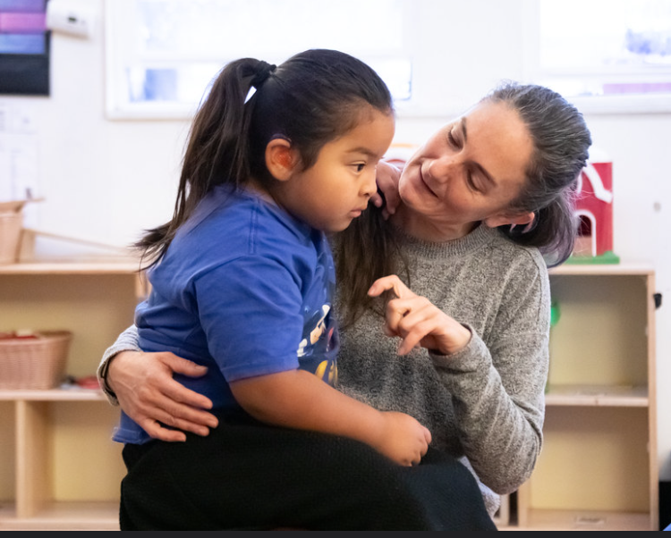
Key Points
Multilingual learners with and without disabilities can begin to understand a new concept or gain a deeper understanding of a familiar concept when a variety of scaffolding strategies are used to support their learning.
Notes:
Multilingual learners with and without disabilities can begin to understand a new concept, or gain a deeper understanding of a familiar concept, when a variety of scaffolding strategies are used to support their learning.

Slide 15
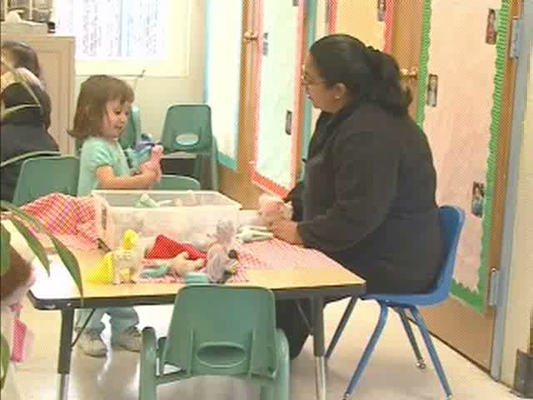
Scaffolds to Language Video
Notes:
Video Viewing (10 minutes)
Video: https://wested.box.com/s/jxzoj7wks68gihld457ciwtif15u5na4
Show the section of the VHS/DVD, A World of Full of Language, that addresses scaffolding and multi-sensory supports. As they watch the video segment, instruct participants to consider the following prompts:
Identify two to three examples of scaffolding in the video that would apply to your classroom or setting.
From your own experience, provide two to three examples of unique ways to scaffold learning.

Slide 16
Videos to embed and share
Teaching At The Beginning Videos
  https://www.youtube.com/@TeachatbOrg

Slide 17
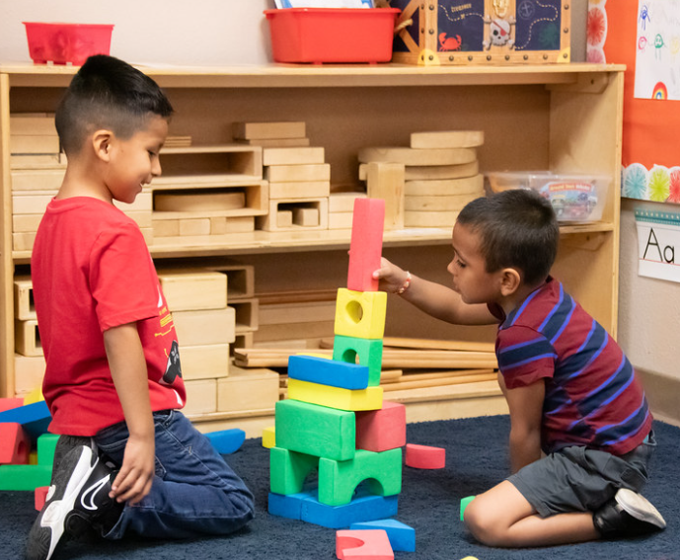
What have we learned?
What is one new fact you learned?
What is a new perspective you pondered?
What questions are you mulling over now?
How will you further this information?
Notes:
Discuss the following questions with the group:
What is one new fact you learned?
What is a new perspective you pondered?
What questions are you mulling over now?
How will you further this information?
Invite participants to share answers with their table group or the group entire.

Slide 18
Thank you!
Notes:
Facilitator Notes:
Thank you!

Slide 19
Presenter’s Name
Presenter’s Photo
CPIN Region
Date
Notes:
Facilitator Notes:
This is an introduction slide to be filled in by the presenter.

