Slide 1

Funded by CDSS
This training is funded by the California Department of Social Services. The materials included in this training include materials or products developed in part or wholly by the California Department of Education and produced by the California Department of Social Services.
Notes:
This training is funded by the California Department of Social Services. The materials included in this training include materials or products developed in part or wholly by the California Department of Education and produced by the California Department of Social Services.

Slide 2


Partners in Early Learning
The California Department of Education (CDE) was given the authority in the 2021 Budget Bill to revise the Preschool Learning Foundations which will now be known as the California Preschool/Transitional Kindergarten Learning Foundations (PTKLF). The California Department of Social Services (CDSS) is developing implementation materials and professional development. This partnership benefits all children regardless of funding sources.
Notes:
The California Department of Education (CDE) was given the authority in the 2021 Budget Bill to revise the Preschool Learning Foundations which will now be known as the California Preschool/Transitional Kindergarten Learning Foundations (PTKLF). The California Department of Social Services (CDSS) is developing implementation materials and professional development. This partnership benefits all children regardless of funding sources.

Slide 3
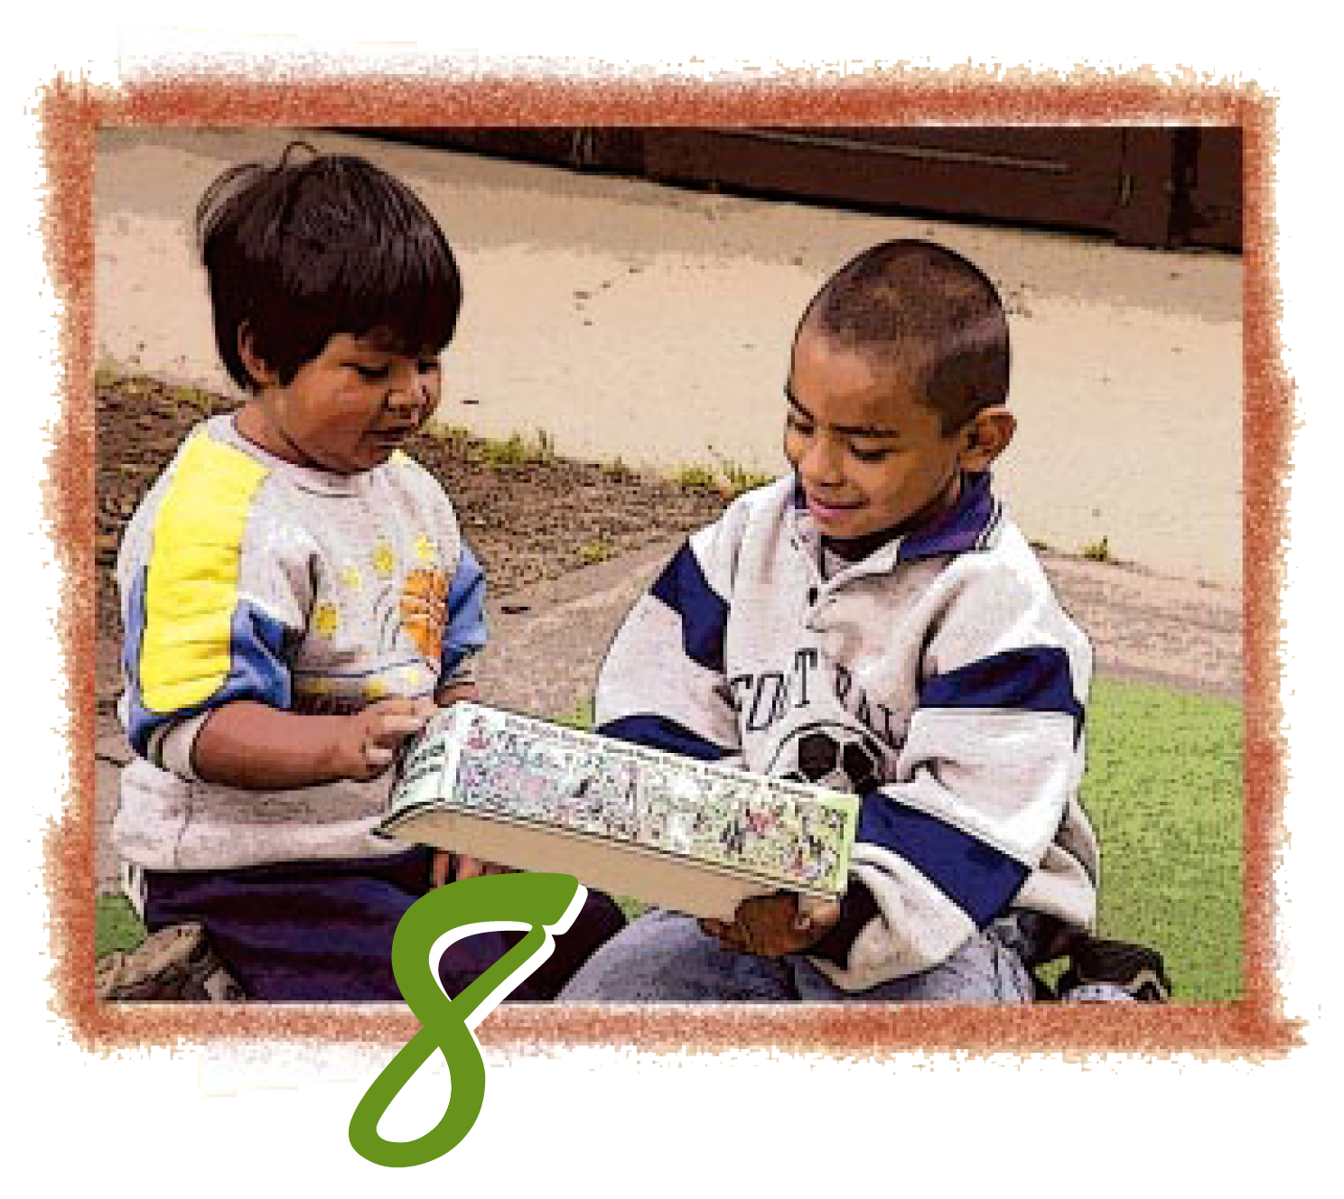
Preschool English Learners: Principles and Practices to Promote
Language, Literacy, and Learning—A Resource Guide (Second Edition)
Chapter 8: Recommended Early Literacy Practices
Notes:
Facilitator Notes:
Welcome! This Preschool English Learners: Principles and Practices to Promote Language, Literacy, and Learning—A Resource Guide, Second Edition (PEL Resource Guide) training was developed by WestEd with funding from the California Department of Social Services (CDSS) Child Care and Development Division (CCDD).
The California Department of Education developed the PEL Resource Guide—copyright 2009.
This training explores Chapter 8: Recommended Early Literacy Practices.

Slide 4
Training Outcomes
Define early literacy
Identify connections with CA the Preschool/Transitional Kindergarten Learning Foundations (PTKLF)
Consider the role of the family
Explore strategies for promoting English literacy development
Notes:
(2 minutes)
The training outcomes for this chapter include the following:
Define early literacy
Identify connections with CA Preschool/Transitional Kindergarten Learning Foundations
Consider the role of the family
Explore strategies for promoting English literacy development

Slide 5
Early Literacy
The gradual and ongoing process of learning to understand and use language that begins at birth and continues through the early childhood years. During this period children first learn to use oral forms of language-listening and speaking-and then begin to explore and make sense of written forms-reading and writing.
Source: Koralek, D. & Collins, R.. On the road to reading: A guide for community partners. Vienna, VA: The Early Childhood Technical Assistance Center, 1997, 10
Notes:
Definitions of Early Literacy
The gradual and ongoing process of learning to understand and use language begins at birth and continues through the early childhood years. During this period children first learn to use oral forms of language-listening and speaking-and then begin to explore and make sense of written forms—reading and writing.
Source: Koralek, D. & Collins, R.. On the road to reading: A guide for community partners. Vienna, VA: The Early Childhood Technical Assistance Center, 1997, 10
Trainer Notes:
The facilitator should read the definitions and concepts aloud from the next few slides, including early literacy, phonological awareness, print awareness, and alphabetic knowledge.
Have participants turn to the Defining Early Literacy section in the PEL Resource Guide, starting on page 72. The facilitator should read the definitions aloud as they are written in the handout and in the PowerPoint presentation. Suggest that participants highlight the terms and definitions in their resource guide. As you read the definition of early literacy, be careful to read it slowly, emphasizing and establishing the notion that most children and their families engage in language and early literacy practices daily.

Slide 6
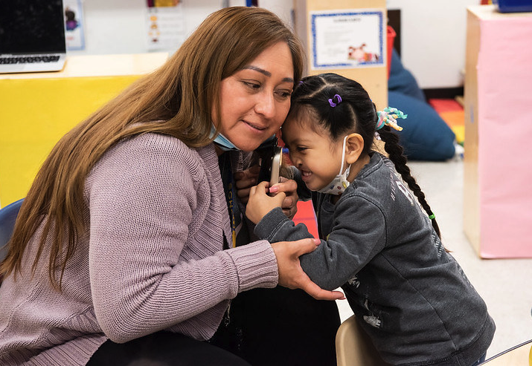
Skills and Knowledge in Foundational Language Development (FLD)
Children can demonstrate skills and knowledge using their home languages or any other languages they are learning.
Notes:
Facilitator Notes:
Children can demonstrate the skills and knowledge listed in the foundations using their home languages or any other languages they are learning.
Communication with families is vital to understanding and supporting a child’s language development, particularly when the child’s home language is not one the teacher understands or uses.
Source: CDE, CA PTKLF: Language and Literacy Development (LLD), 2024, 9

Slide 7
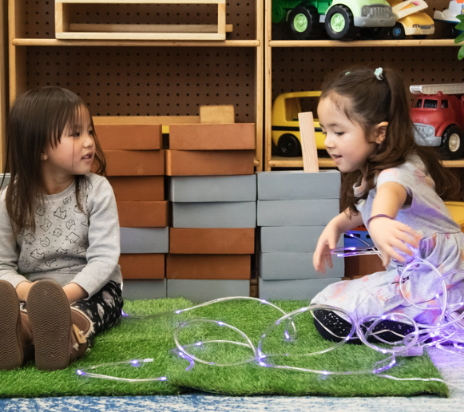
Activity: Get ‘Em Together: Strands for FLD
Listening and Speaking
Foundational Literacy Skills
Reading
Writing
Notes:
Facilitator Notes:
Get ‘Em Together Activity
The purpose of this activity is to provide participants with an active way to become familiar with the English language development strands and substrands. This will better enable participants to see the connections among the definition of early literacy, the language and literacy foundations, and the English development foundations. Such knowledge is paramount in understanding dual language learners' language and literacy needs.
Distribute 8A_Get ‘Em Together game board and sentence strips from 8B_Get ‘Em Together Sentence Master.
In the PTKLF, the foundational language development subdomain is organized into strands and sub-strands that address skills and knowledge that are most effectively supported in high-quality, responsive early education programs.
Background information for facilitator:
Listening and Speaking:
The development of spoken and signed language
How children develop vocabulary and grammar
Knowledge of how to use language to interact with others, communicate in meaningful ways and learn about the world around them
Foundational Literacy Skills:
Addresses skills that contribute to children’s future reading and writing development
Phonological awareness
Knowledge of alphabetics and print
Understanding of the concept of print
Reading:
Interest in and engagement with literacy
Understanding of stories and informational texts that are read to them
Writing:
Beginning abilities to communicate ideas through writing

Slide 8
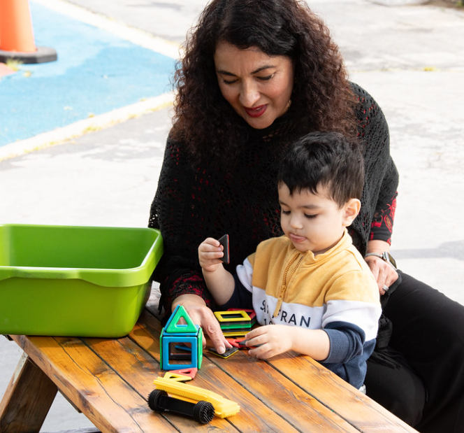
Intentional Teaching
Intentional teaching requires an ongoing awareness of the home language development of each child as well as the English learner’s ability to use English in activities…
Source: CDE, California Preschool Curriculum Framework (PCF), Vol. 1, 179.
Notes:
Intentional teaching requires an ongoing awareness of the home language development of each child as well as the English learner’s ability to use English in activities…
Source: CDE, California Preschool Curriculum Framework (PCF), Vol. 1, 179.
In the last activity, participants looked at the English language development foundations. These foundations are essential in planning for the dual language learner. They guide what children should know and be able to do at the beginning, middle, and later phases of English language acquisition. Paying attention to the developmental progression described in Chapter 5 of the Preschool English Learners Resource Guide and the English language development foundations will better enable teachers to individualize instruction for dual language learners.
Because the first and second language development of children who are English learners varies, the English language development foundations and the language and literacy foundations are each to be used in tandem with the curriculum framework. It is recommended that, when planning curriculum for all areas of learning, teachers begin by reading and considering the information in the English-language development foundation and the curriculum framework as they gauge each child’s current comprehension and use of English. Teachers then develop a plan for how to integrate and utilize suggested activities or strategies to support learning in language and literacy and the other areas of learning that consider the variability of children who are English learners. PCF, Vol. 1, p. 179
As children acquire a second language, one language may be more dominant because they use it more often than the other at a particular time. If children are assessed only in their least proficient language, their abilities will be underestimated.
Source: Linda Espinosa and Vera Gutiérrez-Clellen, “Assessment of Young Dual Language Learners in Preschool,” in California’s Best Practices for Young Dual Language Learners: Research Overview Papers, ed. Faye Ong and John McLean, in cooperation with Cecelia Fisher-Dahms (Sacramento, CA: Department of Education, 2013), 178.
Therefore, the child’s progress in both the home and English languages must be measured. The language and literacy foundations guide expected outcomes for children and, through the DRDP, can be measured in any language.

Slide 9
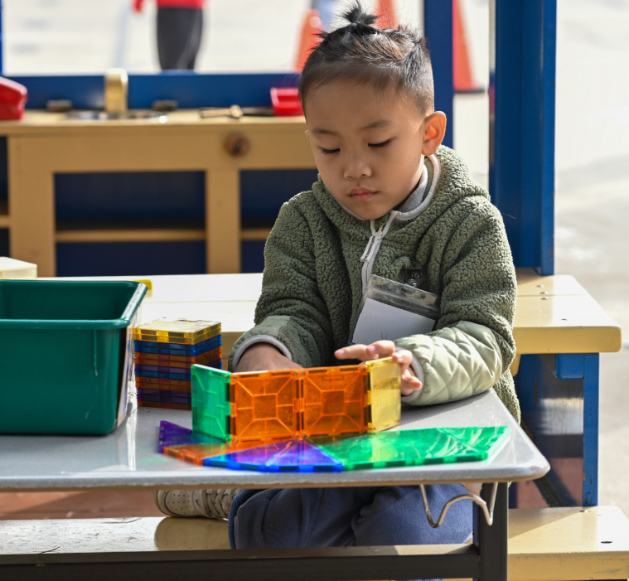
Environments Matter
The environment sends a message about who is welcome, what is valued, and what children learn about.
Every day, in a hundred small ways, children ask:
Do you see me?
Do you hear me?
Do I matter?
Their behavior often reflects our response.
Notes:
Transition slide.
Environment sends a message about who is welcome, what is valued, what children are learning about, and which behaviors are expected. Children can see whether their families, cultures, and languages are esteemed. The arrangement of the environment encourages specific activities whether relaxing with a quiet book, singing and dancing in the whole group, or building a block structure with a small group of friends. Open spaces and playgrounds invite children’s free play, running, chasing, and climbing. With the knowledge that the environment sends messages, educators need to consciously think about the messages they want their classroom environment to send to children and families.

Slide 10
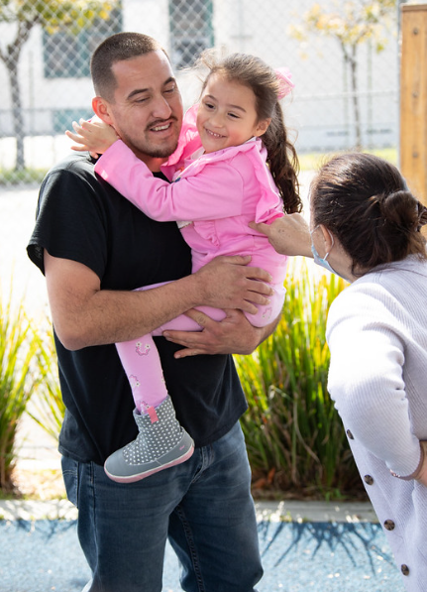
Principle 1
The education of English learners is enhanced when preschool programs and families form meaningful partnerships.
Source: CDE, PEL Resource Guide, Second Edition, 2009,16
Notes:
The education of English learners is enhanced when preschool programs and families form meaningful partnerships.
Family involvement and participation are improved when families are valued contributors as planners, trainers, and evaluators of their children’s educational programs. Teachers should recognize and respect families’ language beliefs and practices to develop a more comprehensive understanding of the language development of English learners.
Source: CDE, PEL Resource Guide, Second Edition, 2009,16
Trainer Notes:
Ask participants to turn to page 16 of the PEL and read the practices related to Principle 1. As participants read, they should make stars next to the practices that they feel are their strengths. If time permits, the small groups should share their strengths and areas where they would like to grow. Facilitators may consider doing a popcorn share to elicit specific ideas for some or all of the practices listed.
Numerous positive developmental child outcomes have been associated with family engagement, including early literacy skills (Durand 2011; López, Barrueco, and Miles 2006), cognitive and language development skills (Fantuzzo et al. 2004; Farver et al. 2006; Raikes et al. 2006), social–emotional skills (Fantuzzo et al. 2004), and academic achievement (Jeynes 2012; Lee and Bowen 2006; LeFevre and Shaw 2012; Lin 2003, 2006; Mantzicopoulos 2003; McWayne, Fantuzzo, and McDermott 2004; McWayne et al. 2004; Suizzo et al. 2012). Families have also been shown to serve a critical role in the preservation of their language and culture (Phinney et al. 2001; Schwartz 2010)…Strengthening DLL family engagement in preschool may be especially important, since the early years of development set the foundation for future learning, and since families who are engaged early on with schools are more likely to maintain engagement across future educational settings (Ou 2005; Weiss, Caspe, and Lopez 2008).
Linda Halgunseth, Gisela Jia, and Oscar Barbarin, “Family Engagement in Early Childhood Programs: Serving Families of Dual Language Learners,” in California’s Best Practices for Young Dual Language Learners: Research Overview Papers, ed. Faye Ong and John McLean, in cooperation with Cecelia Fisher-Dahms (Sacramento, CA: Department of Education, 2013), 121.

Slide 11
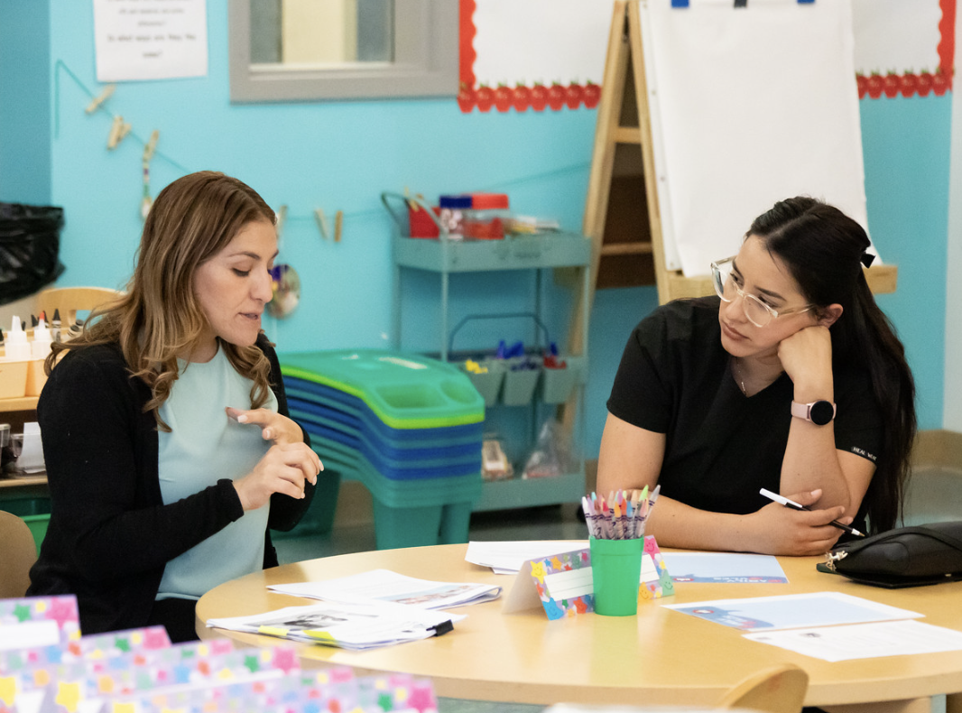
Create Opportunities for Home Connections
Foster reciprocal communication between teachers and families to strengthen home-school connections and support children’s language development.
  Schedule parent meetings.
  Plan a family literacy night.
  Schedule parent workshops.
Notes:
Facilitator Notes:
Foster reciprocal communication between teachers and families to strengthen home-school connections and support children’s language development.
Children might use different languages or ways of speaking that they know, and sometimes, these might be languages their teacher doesn't know. This is why teachers need to talk with families. This allows teachers and families to understand better and support children’s development. Teachers can schedule parent meetings, have a family literacy night, and have parent workshops to foster home connections. Engaging families is essential for multilingual learners and those speaking English varieties.
Teachers can establish partnerships with families built on mutual respect, trust, and two-way communication.
Video: https://www.youtube.com/watch?v=GUgFuPFnw7w&t=2s
Share with participants a video example of creating home connection opportunities.
Ask participants what other ways they would create opportunities for home connections. Have participants share at their table.

Slide 12
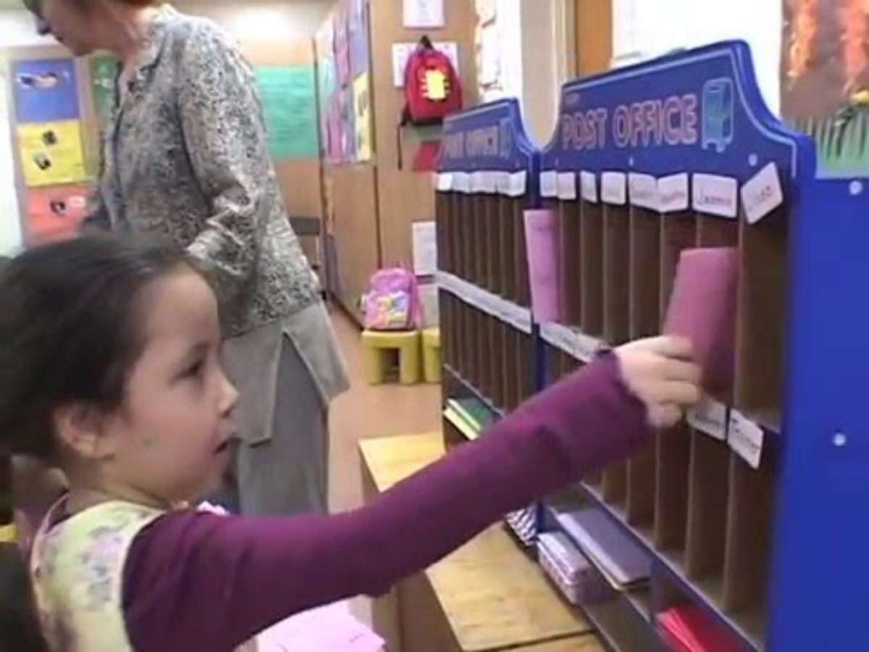
Video: Family Letter Writing
Notes:
Video: https://www.youtube.com/watch?v=GUgFuPFnw7w&t=2s

Slide 13
Connecting Home and School Literacy Practices
Principle 9
Handout 8C
Engaging in multiple literacy practices, such as reading books, singing songs, and reading poetry, is part of the daily life of most families.
Source: CDE, PEL Resource Guide, Second Edition, 2009, 73
Identifying the Early Literacy Skills Found in Songs, Books, and Rhymes Used by Families
Notes:
Small Group Work: Connecting Home and School Literacy Practices (10 minutes)
Part of forming meaningful partnerships is understanding that family language and literacy practices may vary. Remind participants that their own experiences and familiarity with rhymes and songs serve as examples of language practices that children may engage in with their families. The facilitator should emphasize that these culturally relevant practices (rhymes, songs, and word games) build phonological awareness. Using this PowerPoint presentation slide, draw their attention to Principle 9 on pages 73-74 in the PEL. Emphasize that families engage in a wide variety of literacy activities. Also, point out that when children see rhymes and songs in books and displayed on posters, the children develop an understanding of the relationship between words and print.
Distribute Handout 8D: Identifying the Early Literacy Skills Found in Songs, Books, and Rhymes Used by Families. In small groups of three or four, ask participants to identify familiar rhymes and songs, possibly drawing from rhymes used in activities from the previous chapters. They may complete the chart identifying the academic or cognitive concepts addressed by rhymes in books that children and their families may be familiar with. (5 – 7 minutes)
Ask two or three volunteers to share their findings as time allows. Reinforce the importance of incorporating cultural knowledge of children and their families in the classroom. In addition to rhymes in books, we will examine other activities that preschool children engage in that relate to early literacy.
Families should be encouraged to engage in multiple literacy practices in the home in the home language because:
Heritage language use in the home may serve as a protective factor for early cognitive development and math skills for children of immigrants
Linda Halgunseth, Gisela Jia, and Oscar Barbarin, “Family Engagement in Early Childhood Programs: Serving Families of Dual Language Learners,” in California’s Best Practices for Young Dual Language Learners: Research Overview Papers, ed. Faye Ong and John McLean, in cooperation with Cecelia Fisher-Dahms (Sacramento, CA: Department of Education, 2013), 120.
To promote literacy among DLLs, teachers may encourage DLL families to select books, make their own books in their home language (Bernhard et al. 2006; De Gaetano 2007), or engage in joint- or intergenerational reading. If there are shortages of books in certain languages, programs may encourage DLL families to purchase books in their home country, ask visiting family and friends from their home countries to bring children’s books and utilize online book ordering services that specialize in international children’s books. Furthermore, programs may encourage DLL families to implement other literacy-building activities in the home, such as singing nursery rhymes (Espinosa 2008) and narrating stories in their home language about activities that occurred during the day (Melzi, Schick, and Kennedy 2011).
Linda Halgunseth, Gisela Jia, and Oscar Barbarin, “Family Engagement in Early Childhood Programs: Serving Families of Dual Language Learners,” in California’s Best Practices for Young Dual Language Learners: Research Overview Papers, ed. Faye Ong and John McLean, in cooperation with Cecelia Fisher-Dahms (Sacramento, CA: Department of Education, 2013), 147.

Slide 14
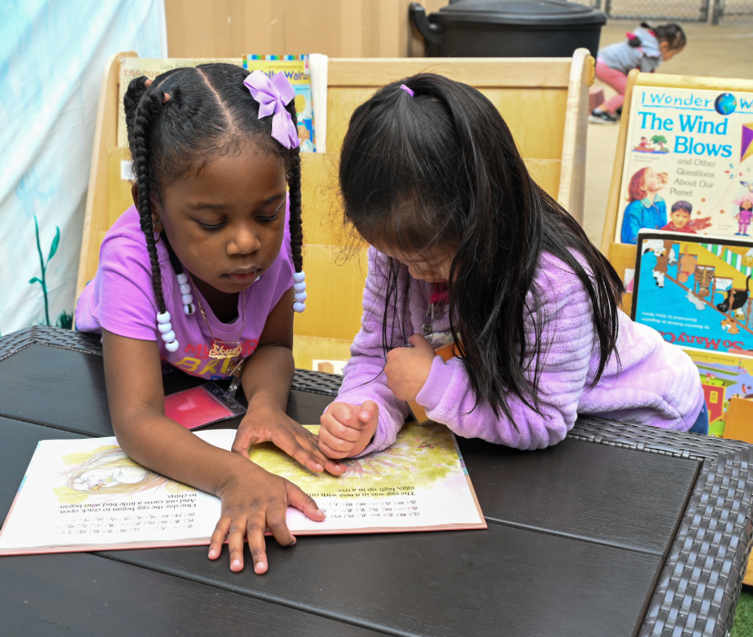
Principle 10
Offering a variety of opportunities for children to explore written materials and their meanings, as well as the sounds of spoken language through rhyme and alliteration, builds the language and literacy skills of preschool English learners.
Source: CDE, PEL Resource Guide, Second Edition, 2009, 84
Notes:
Offering a variety of opportunities for children to explore written materials and their meanings, as well as the sounds of spoken language through rhyme and alliteration, builds the language and literacy skills of preschool English learners. Source: CDE, PEL Resource Guide, Second Edition, 2009, 84
Ask participants to turn to page 84 in the PEL Resource Guide.
Have them review the practices associated with Principle 10.
If time permits, small groups should do round-robin or partner reads of each practice. While reading the practices, each participant should write a plus sign next to the practices they would like to implement.

Slide 15

Moving Toward Literacy Video
Notes:
Video Viewing & Discussion (20 minutes-note: video clip is 10 min)
Video: https://wested.box.com/s/lnw0j5uv2k7h2me0500qaa1fjq6w9zbc
Before we consider what the preschool children do in their classrooms, let us view the last section of the video that focuses on moving toward literacy.
Show the “Moving Toward Literacy” video clip from A World of Full of Language as another way to frame the day’s discussion. Ask participants to use Handout 8E_Note Taking Guide to record what they notice for each of the strategies discussed during the video clip. After viewing the video segment, ask participants to share their observations with a partner. Allow about 2 minutes for partners to talk. Ask the whole group to name some key points or strategies they noticed in the video. The presenter should then write their observations on chart paper titled “Moving Toward Literacy: Strategies.” Make a note of the activities and strategies identified by the participants, which are included in Chapter 8 and supported by research. For example, the facilitator could remind participants of the importance of acknowledging that many children recognize environmental print in their homes and communities. Following the discussion, ask participants to use the top box to record some strategies they want to try when returning to their classroom.

Slide 16
Key Points
Children need a well-developed base of oral language skills, including an extensive vocabulary, in order to become successful readers.
Children who have positive and repeated experiences with print tend to be better readers.
Notes:
Key Points (1 minute)
Children need a well-developed base of oral language skills, including an extensive vocabulary, in order to become successful readers.
Children who have positive and repeated experiences with print tend to be better readers.
Briefly review any additional key points which are discussed in Chapter 8.
DLL families can promote their children’s language development through everyday conversations and verbal exchanges with them. Responses to children’s queries and efforts to explain events and elaborate verbally on children’s experiences expand children’s vocabulary and language skills.
Source: Linda Halgunseth, Gisela Jia, and Oscar Barbarin, “Family Engagement in Early Childhood Programs: Serving Families of Dual Language Learners,” in California’s Best Practices for Young Dual Language Learners: Research Overview Papers, ed. Faye Ong and John McLean, in cooperation with Cecelia Fisher-Dahms (Sacramento, CA: Department of Education, 2013), 148.

Slide 17
Key Points (2)
Children who are stronger in a language other than English often have some of the foundational skills of literacy in their home language.
Many of the early literacy skills children have in their home language will transfer to reading in English when a child is ready to make that transition.
Notes:
Children who are stronger in a language other than English often have some of the foundational literacy skills in their home language.
Many of the early literacy skills children have in their home language will transfer to reading in English when a child is ready to make that transition.
Similarly, for the second key point, the facilitator may comment that just as with cross-language transfer (addressed in Chapter 4), cognitive skills transfer across languages. The important point here is that for languages that have an alphabet, many literacy skills will transfer from the first language to the second language (e.g., sound relationships). In addition, children exposed to either an alphabetic or logographic written language will also transfer skills such as phonological awareness, knowledge about print, familiarity with books, and understanding of the elements of a story.

Slide 18
Key Points (3)
Research shows that introducing phonological awareness, print awareness, and letter knowledge in brief, interactive, engaging, and multi-sensory activities builds young children’s early literacy skills.
Notes:
Review: Key Points
Research shows that introducing phonological awareness, print awareness, and letter knowledge in brief, interactive, engaging, and multi-sensory activities builds young children’s early literacy skills.
Note the connections among the research, English language development foundations, and the practices articulated in the “Moving Toward Literacy” section of “A World Full of Language.”

Slide 19
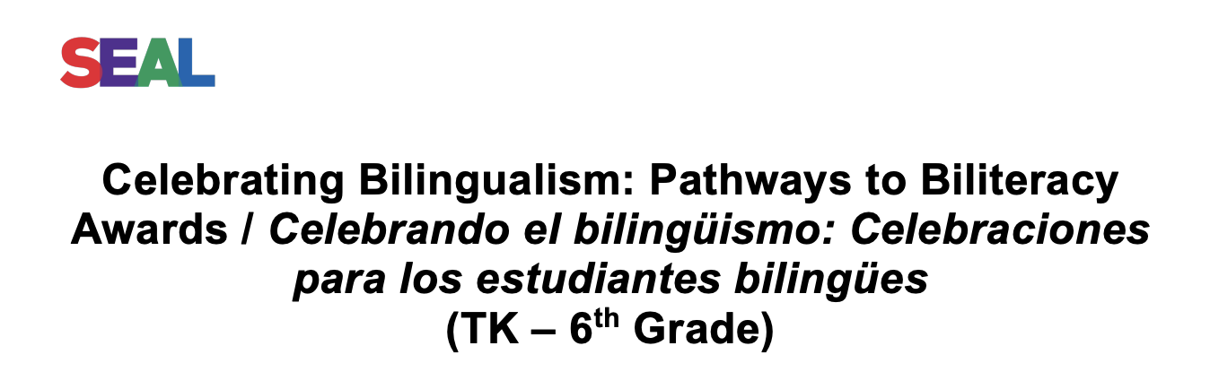
Finishing with CELEBRATION:
Celebrating Multilingualism
Notes:
Let’s take this handout out from your folder, read on your own then with a partner discuss what strategies you plan to use in your classroom to celebrate multilingualism.
8 minutes
Celebrate song: https://youtu.be/cIg6odS-fA0

Slide 20
Reflection
Turn to page 88 in the PEL Resource Guide and take the time to answer question three on your Reflection handout:
  Which strategies for becoming familiar with the literacy practices of the families of the children in my class have I implemented? What new strategies would I like to try?
Notes:
Resources and Review
Encourage participants to turn to pages 88-89 to find the sections on Additional References for Parents and Additional References for Teachers. Call attention to the fact that several of the resources listed in the guide are available via the Internet at no cost.

Slide 21

Thank you

Slide 22
Thank you!
Notes:
Facilitator Notes:
Thank you!

Slide 23
Presenter’s Name
Presenter’s Photo
CPIN Region
Date
Notes:
Facilitator Notes:
This is an introduction slide to be filled in by the presenter.

