Slide 1
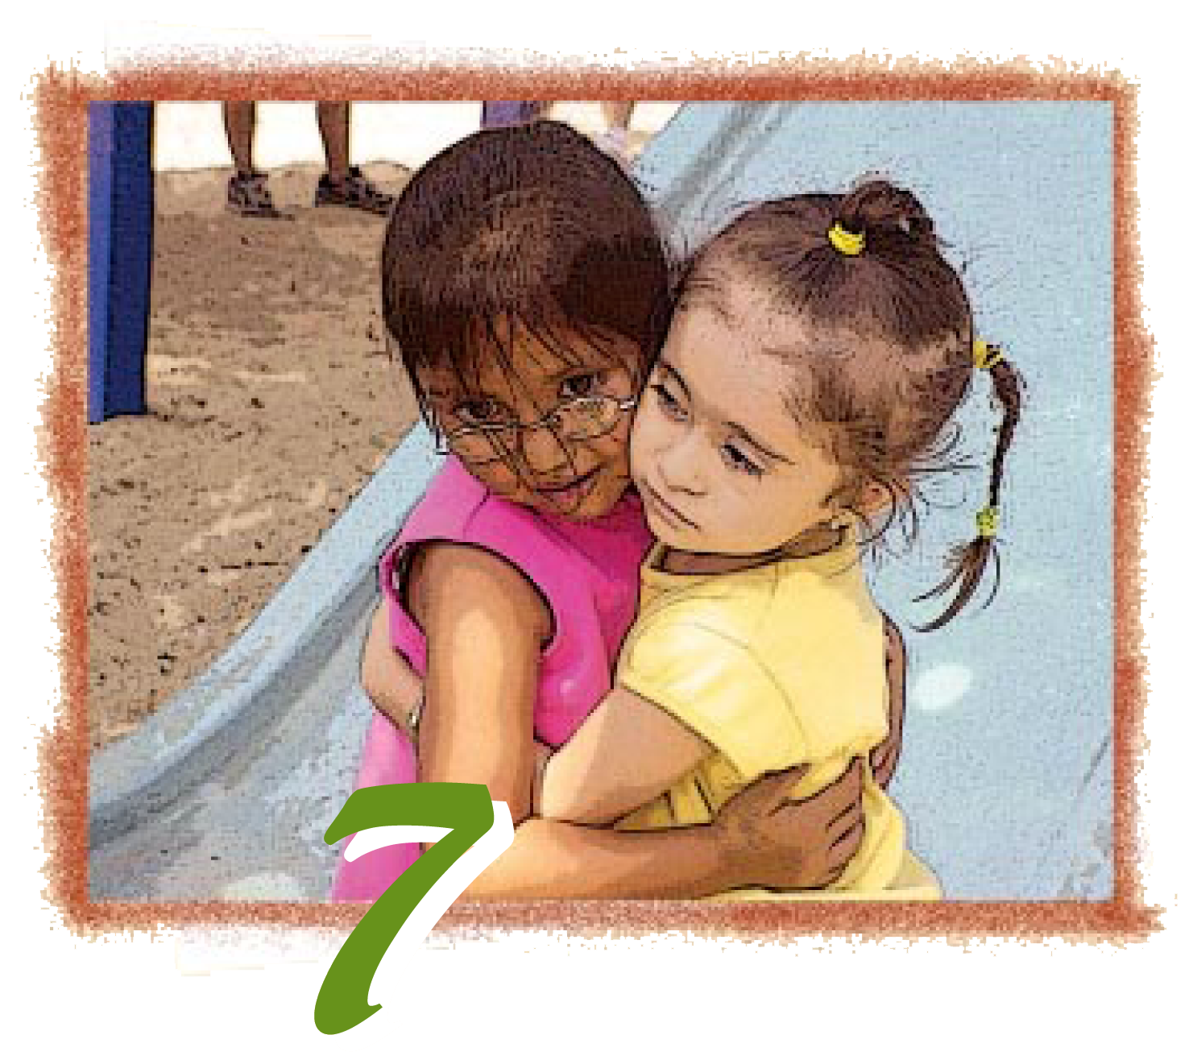
Chapter 7: English Learners with Disabilities or Other Special Needs

Slide 2
Training Outcomes
Become familiar with the terminology necessary for supporting children with IEPs who are learning English as a second language.
Raise awareness of varying cultural experiences with regard to special education.
Become familiar with the resources to support children with an IEP who are learning English as a second language.
Notes:
Briefly go over the outcomes for this section of the training.

Slide 3
Cultural Considerations:
When the home language and culture are viewed as assets and resources, it becomes the foundation for enhanced learning.
PCF, Vol. 1, p. 185
Notes:
Transition slide:
When working with families who are culturally and linguistically diverse, it is important to remember that there are other aspects of a family’s culture to consider. The next few slides address several points to consider.
“When the home language and culture are views as assets and resources, it becomes the foundation for enhanced learning” PCF p. 185
The California Preschool Curriculum Framework highlights this in English Language Development Guiding Principle: “Respect Cultural Values and Behaviors reflected in the child language and communication” PCF, p. 180
Research indicates that many families of preschoolers with special needs value home language maintenance and bilingualism for their children. Given the significance of the culture of a family, parent–child interactions, a child’s sense of identity and belonging, and the parents’ sense of competence and confidence, families should be encouraged to maintain their home languages with their children.
Deborah Chen and Vera Gutiérrez-Clellen, “Early Intervention and Young Dual Language Learners with Special Needs,” in California’s Best Practices for Young Dual Language Learners: Research Overview Papers, ed. Faye Ong and John McLean, in cooperation with Cecelia Fisher-Dahms (Sacramento, CA: Department of Education, 2013), 225.

Slide 4
Partners: School District
Principle 8
Coordination and collaboration among families, teachers, and specialists becomes crucial in supporting the language and literacy development of children with disabilities or other special needs.
Overarching Principle
Family and community partnerships create meaningful connections. PCF, Vol. 1, p. 7
Notes:
Refer participants to Principle 8 in the PEL Resource Guide (p. 69). Next, read the paragraph under the overarching principle in the PCF (p. 7).
Invite participants share their answers to the following questions with an elbow partner:
How do these two statements support each other?
What do you connect with most in these statements?
This is a reminder that the PEL Resource Guide contains Principle 8 and practical ideas to implement strategies that will support English learners with disabilities or special needs. These ideas are supported by the overarching principle in the PCF.

Slide 5
Special Education Division Early Childhood Support System
IDEA:
PART B
PART C
State Performance Plan
Annual Performance Report
Desired Results 2015
Early Childhood Special Education Handbooks
Preschool Learning Foundations
Child Development Division
CPIN
California Preschool
Instructional Network
Notes:
Here are the projects and programs from the Special Education Division (SED) that support Early Childhood Special Education.
Special Education is governed by IDEA (Individual with Disabilities Act) Part B for ages 3-21, and Part C for children ages 0-3. Each state has a State Performance Plan and Annual Performance Report that must be submitted to the Federal Office of Special Education Programs (OSEP) once a year. (This is the yellow overarching part.)
The Desired Results access Project supports and coordinates the DRDP Assessment System for children with IEPs. The DRDP access assessment tool is accepted by the Child Development Division, and will continue to be used as the DRDP-R is phased out. The DRDP 2010 is not being used for preschool-age children with IEPs at this time. For questions, please refer to the CDE policy memo at draccess.org.
The Early Childhood Special Education Handbooks is a series of handbooks covering topics such as: Developing and Evaluating Interagency Collaboration in Early Childhood Special Education Programs, Transition from Early Childhood Special Education Programs, Developing Individualized Family Service Plans and Individualized Education Programs in Early Childhood Special Education, Developing and Implementing Early Childhood Special Education Programs and Services, Assessment and Evaluation in Early Childhood Special Education Programs, Administration of Early Childhood Special Education Programs, Family Involvement in Early Childhood Special Education Programs. It is published by CDE Press and is available at the CDE Web site or SEEDS Web site for free download or purchase from the CDE Press.
The Preschool Learning Foundations are important for planning curriculum and specialized instruction within the curriculum in addition to informing IEP goals.
The SEEDS (Supporting Early Education Delivery Systems) Project supports special education programs in Local Educational Agencies (LEA) serving children with disabilities, ages 0-5.
SEECAP (Special Education Early Childhood Administrators Project) presents a symposium and special events yearly, and provides Early Childhood Special Education (ECSE) leadership training through workshops. Its Excellent in Early Childhood Education Leadership (ExCEL) program provides early childhood and/or early childhood special education leadership training and coaching.
The CPIN (California Preschool Instructional Network) Special Education Division provides funds to support special education leads in each region to share the rich content of CPIN to special educators.

Slide 6
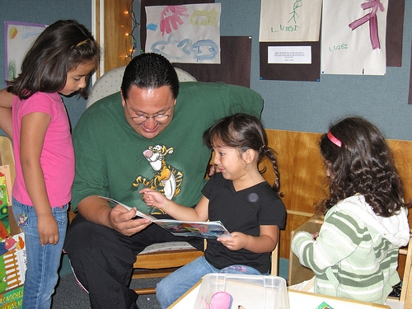
Key Points
With the right supports, many English learners with disabilities and other special needs can learn a second language.
Notes:
Many professionals mistakenly recommend that children with special needs should be exposed to a single language—that is, the language of the dominant society—to promote language development and later academic success. This recommendation is based on “the prominent belief that input in two languages places unwarranted demands on the deficient 210 language-learning systems of children with language impairment (LI)*
. . . This belief has led well-intended professionals to ignore the functional need for both languages of linguistically diverse children” (Kohnert et al. 2005, 255).
Deborah Chen and Vera Gutiérrez-Clellen, “Early Intervention and Young Dual Language Learners with Special Needs,” in California’s Best Practices for Young Dual Language Learners: Research Overview Papers, ed. Faye Ong and John McLean, in cooperation with Cecelia Fisher-Dahms (Sacramento, CA: Department of Education, 2013), 210.
Despite concern that dual language input will confuse or delay the language acquisition of young children with special needs, emerging research indicates that those children can learn more than one language. Moreover, there is no available evidence that limiting these children to one language will decrease language difficulties or that dual language learning will increase language delays and problems (Kohnert and Medina 2009).
Deborah Chen and Vera Gutiérrez-Clellen, “Early Intervention and Young Dual Language Learners with Special Needs,” in California’s Best Practices for Young Dual Language Learners: Research Overview Papers, ed. Faye Ong and John McLean, in cooperation with Cecelia Fisher-Dahms (Sacramento, CA: Department of Education, 2013), 211.

Slide 7
These Resources Support Access to Regular Preschool Activities for Children with IEPs
Notes:
We will be using two CDD resources during this session.
(Click to reveal) Preschool Learning Foundations, Volume 1.
This is the Preschool Learning Foundations, Volume 1 (PLF). The foundations describe how children develop, grow, and learn. The preschool foundations are for all children and reflect the diversity found in California.
(Click to reveal) Preschool Curriculum Framework, Volume 1.
This is the Preschool Curriculum Framework, Volume 1 (PCF). This framework presents strategies and information to help teachers enrich learning and development opportunities for all of California’s preschool children.

Slide 8
Working Together
Special Education Services
Provides services for children with disabilities
Occurs in a variety of settings
Ensures access to regular preschool activities
California Preschool Curriculum Framework
Planning learning opportunities
Teachable Moments
Routines, environments, and materials
Notes:
There are multiple Special Education handbooks that support Child Development. For more information go to www.scoe.net/seeds/resources/handbooks.html.

Slide 9
Language Disorder or Language Difference

Slide 10
Early Warning Signs for 3 to 5 Year Olds
Shows difficulty following simple directions in either language
Exhibits immature speech and language in both languages
Dunlap, L. L. (2009), McLaughlin, S. (2006), Hamaguchi (2001), CDE brochure
Notes:
Refer participants to the handout 7A: Language Disorder or Language Difference.
“Differences across bilingual and monolingual children should not be interpreted as delay, but rather a distinct developmental pattern linked to experience in each language” (Comboy, 2013, p.15).

Slide 11
Key Points
English learners with and without disabilities can begin to understand a new concept, or gain a deeper understanding of a familiar concept, when a variety of scaffolding strategies are used to support their learning.

Slide 12
Access to Regular Preschool Activities The Law:
To the maximum extent appropriate, children with disabilities, including children in public or private institutions or other care facilities, are educated with children who are nondisabled.
…removal of children with disabilities from the regular educational environments occurs only if the nature or severity of the disability is such that education in regular classes…cannot be achieved satisfactorily (this includes preschool).
§300.114 (a)(2) Preschool Least Restrictive Environment (LRE)
Notes:
This section of the law addresses placing preschool children in the least restrictive environment. The least restrictive environment must be the first setting considered, which means something different for each child. The least restrictive environment for a preschooler is a general education preschool program and the most restrictive environment may be a hospital setting or a home.
Background Information: § 300.116 also states:
(a)(3) Is as close as possible to the child’s home; unless the IEP of a child with a disability requires some other arrangement, the child is educated in the school that he or she would attend if nondisabled.
(e) A child with a disability is not removed from education in age-appropriate regular classrooms solely because of needed modifications in the general education curriculum.
Video trailer of interview regarding Least Restrictive Environment/Inclusion SEEDS: http://www.scoe.net/seeds/resources/videos/zaca/zaca4.html

Slide 13
Scaffolding Strategies… Making Preschool Accessible
Responsive Practices
Adaptations
Accessible Curriculum
- Universal Design
- Differentiating Instruction
Notes:
The third outcome of this presentation addresses strategies. Inform the participants that we will be focusing on three strategies. These strategies are for all children in our preschool programs:
Responsive practices
Adaptations
Accessibility to curriculum is very important and can be achieved by incorporating the concept of universal design and implementing differentiated instruction.
Turn to page 193 in the PCF and read the Flannel Board Activity example. This activity is designed to build listening skills and includes responsive practices and adaptations that enable access to curriculum for all students. This is an example that participants can read and return to after the presentation.

Slide 14
Scaffolds to Language Video
Notes:
Video Viewing (10 minutes)
Show the section of the VHS/DVD, A World of Full of Language, that addresses scaffolding and multi-sensory supports. As they watch the video segment, instruct participants to consider the following prompts:
Identify two to three examples of scaffolding in the video that would be applicable to your own classroom or setting.
From your own experience, provide two to three examples of unique ways to scaffold learning.

Slide 15
What have we learned?
What is one new fact you learned?
What is a new perspective you pondered?
What questions are you mulling over now?
How will you further this information?
Notes:
Discuss the following questions with the group:
What is one new fact you learned?
What is a new perspective you pondered?
What questions are you mulling over now?
How will you further this information?
Invite participants to share answers with their table group or the group entire.

