Slide 1
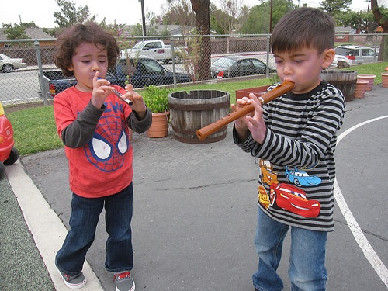
Music
Foundations and Framework
Volume 2
© 2014 California Department of Education (CDE) California Preschool Instructional Network (CPIN)
Notes:
1
Going on a Bear Hunt
INTENT: Engage participant interest in the workshop content by modeling and involving them in a typical classroom activity using musical instruments.
OUTCOMES: Participants will actively participate in the day’s workshop, be familiar with key musical vocabulary and successfully implement the modeled strategy to engage all learners in the classroom.
MATERIALS REQUIRED: PPT Slide 1 , “Going on a Bear Hunt” recording from Kids in Action by Greg and Steve. Musical Instruments: Drum, pair of sand blocks, wooden percussion block with mallet, triangle, and either a shell rattle, egg shaker, gourd rattle, Photos of instruments, Template “Class List “with 10 participant names and clothespin
Time: 5-7 minutes
PROCESS: Model and engage participants in the activity as if you, the presenter, are the teacher and they are the children. “Teacher” introduces the activity. Then as a whole group, listen to Going on a Bear Hunt by Greg and Steve using musical instruments or sounds using the body as the instrument.
Before the workshop begins, make a “class list” with 10 participant names using the template; place the clothespin on one of the names.
Presenter’s Sample Teacher Script:
Teacher: “We’re going on a bear hunt! Today I brought some special instruments that we can use to make the sounds we hear as we go on our bear hunt adventure.” We’ll need some musicians!. Musicians are people who make music! Did you know we can all be musicians? We can make music with instruments like these.” (Teacher shows and plays one of the instruments). “Or, with our bodies, like this…” (Teacher drums rhythmically on chest, making ahhh sound with voice) “You can do it with me.”
Teacher: “We need 5 musicians to tell our story today. Let’s see whose turn it is.” (Use “class list” to model for participants this classroom management strategy…and see who’s next, moving the clothespin as you select each musician. As each name is called, the “child” participant comes to the front of the room and chooses an instrument)
Teacher: “Let’s rehearse our story… that means we’ll practice with our instruments before we play along with the story on the CD.”
1. “Everyone stand up. Let’s all make the sounds of walking together like this….” (Start a rhythmic march with a steady walking tempo beat, tapping one hand at a time on thigh coordinated with marching leg. Participants do this with ‘teacher’).
2.“Drummer, you help us keep the beat as we use our walking feet. Come stand by me” (Show the photo of the drum and prompt the drummer to follow the beat using the drum.) “Can everyone feel the beat?” (Continue the walking beat as you preview the parts of the story as follows…)
3.“First we’ll walk through the wheat field- and that sounds like…” (teacher hold up the photo of the sand blocks, prompt the “musician” to stand next to the drummer then play while the other participants make the movement and sounds with hands/voice as they continue walking beat.)
4.“Next we’ll walk over the bridge- and that sounds like…” (Teacher hold up the photo of the wood percussion block/mallet, prompt the “musician” to stand next in line then play while the other participants to make a clicking sound with their tongue/mouth).
5.“Then, we’ll climb up the tree and when we get to the top, it sounds like…” (Teacher holds up the photo of the triangle, prompt the “musician” to stand next in line then play the “ding” while the other participants make a “ting” sound with their voice.)
6.“Then, we get in the boat and row across the water and it sounds like…” (Teacher holds up the photo of the rattle/egg shaker, prompt the “musician” to stand next in line then play while the other participants make a “shuuuuuu sound with their mouth.)
7.“After we see the bear- we are soooo scared, so we take his picture and run, run, run home. Let’s make a running beat!” (Teacher speeds up the walking beat to a running beat tempo. Then prompt participants to make appropriate sounds as you encounter each place on the path on the way home by saying… “we’ll go back over the water! Climb up the tree! Walk over the bridge! And walk through the wheat field! Until whew! we’re home!
Teacher: “Now we’re ready to go on a bear hunt!” (Teacher plays “Going on a Bear Hunt” from Kids in Action CD and leads the group to participate as they listen to the prompts in the story.)
Presenter debrief with participants:
Presenter says: The musical concepts demonstrated in this activity include:
Being a musician, rehearsing (practicing), beat, tempo, dynamics (soft/loud), and rhythm.
SUMMARY: Engage participant interest in the workshop content and experientially familiarize participants with key musical concepts/vocabulary by modeling and involving them in a typical classroom activity where presenter is the teacher and participants are the children.

Slide 2
Outcomes
Become familiar with:
  the importance of music education in the lives of preschool children as represented by the Preschool Learning Foundations
  what children should know and be able to do in the Music strand
  strategies from the Preschool Curriculum Framework in order to support all children develop their skills and knowledge in music
Practice utilizing this information with regard to dual language learners and children identified with special needs
Notes:
2

Slide 3
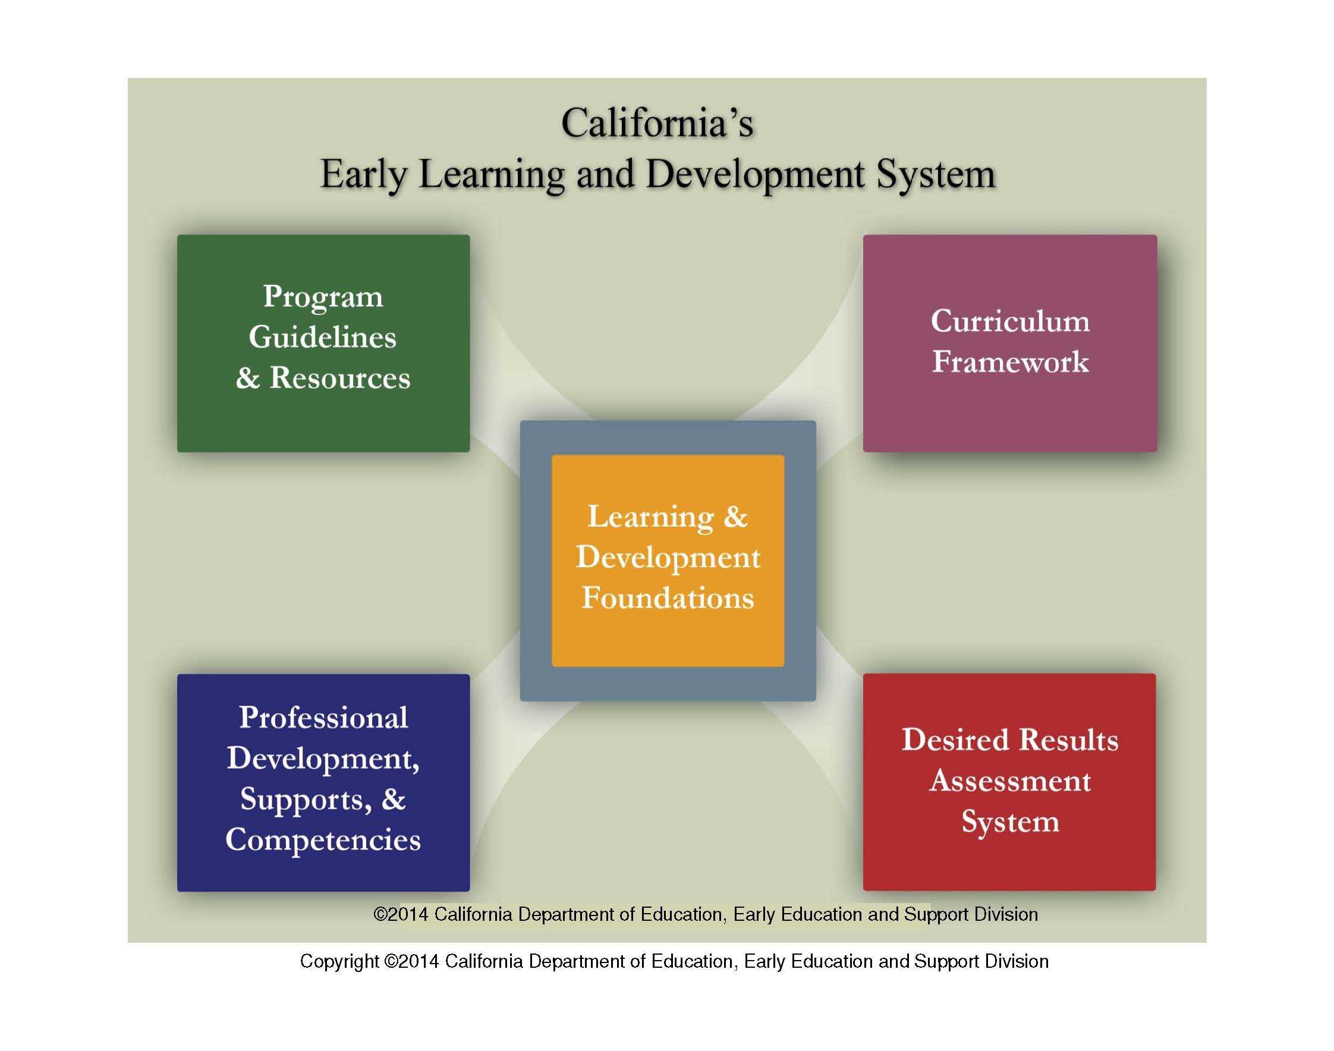
Start Here
Notes:
3
3
Briefly go over the 5 elements.
Element 1: At the center of the system are the Learning and Development Foundations which describe the learning and development infants and toddlers typically demonstrate with appropriate support at around 8, 18 and 36 months. It also describes the learning and development for preschool children that is typically demonstrated with appropriate support at around 48 and 60 months of age. Having statewide foundations provides all teachers and programs with knowledge of the expectations and goals for children in California to use as they plan activities, the environment, and interactions.
Element 2: Infant and Toddler and Prekindergarten Learning and Development Guidelines present information about how to provide high-quality early care and education, including recommendations for program policies and day-to-day practices that will improve program services. In addition, the Preschool English Learner Guide provides teachers with the knowledge and tools they seek to educate preschool English learners most effectively.
Element 3: The first and second volumes of the Curriculum Frameworks. These publications are a resource for teachers to support setting up environments, selecting appropriate materials, supporting children’s self initiated play and learning, and planning and implementing teacher guided learning activities. The frameworks are not a curriculum.
Element 4: The fourth component of the system is the Desired Results System. It is a continuous improvement system that is intended to improve program quality. The system consists of: the Desired Results Developmental Profile© which measures children’s progress towards the Desired Results, the Parent Survey which measures parents’ satisfaction with the program, the Environment Rating Scales which assesses the classroom environment, and the Program Self Evaluation which assesses program quality.
Element 5: In California, numerous professional development opportunities are available to assist programs. These include the Program for Infant/Toddler Care (PITC), California Preschool Instructional Network (CPIN), California School-Age Consortium (CalSAC), Family Child Care at Its Best, the mentor programs, pre-service, the CDE/ECE Faculty Initiative Project, the Child Development Training Consortium and the Desired Results Training and Technical Assistance Project.

Slide 4
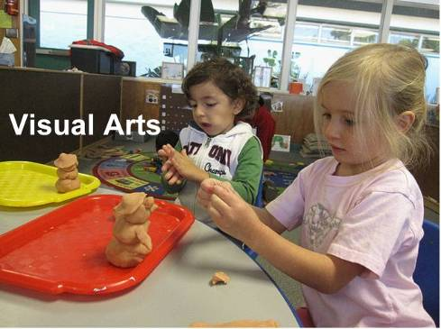
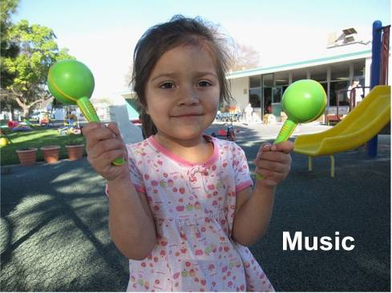
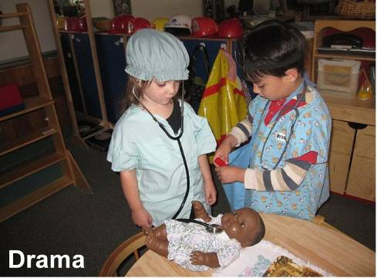
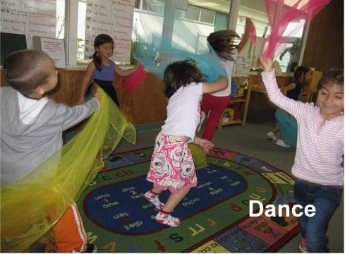
What are the Visual and Performing Arts
Notes:
(Click to reveal Visual Arts)
The preschool learning foundations for visual arts include observing and commenting on art, developing art skills, and creating art, e.g., painting, drawing, sculpting, and collages.
(click to reveal music)
The preschool learning foundation for music includes responding to and recognizing sounds and music, learning music skills, and creating music by keeping a beat with ones body, by singing, and by using musical instruments .
(click to reveal drama)
The foundations and framework for drama include pretend play and reenacting stories, as well as using props, costumes and roles in their play.
(click to reveal dance)
The foundations and framework for dance include engaging in dance movements, being aware of body space, and expressing oneself through dance.

Slide 5
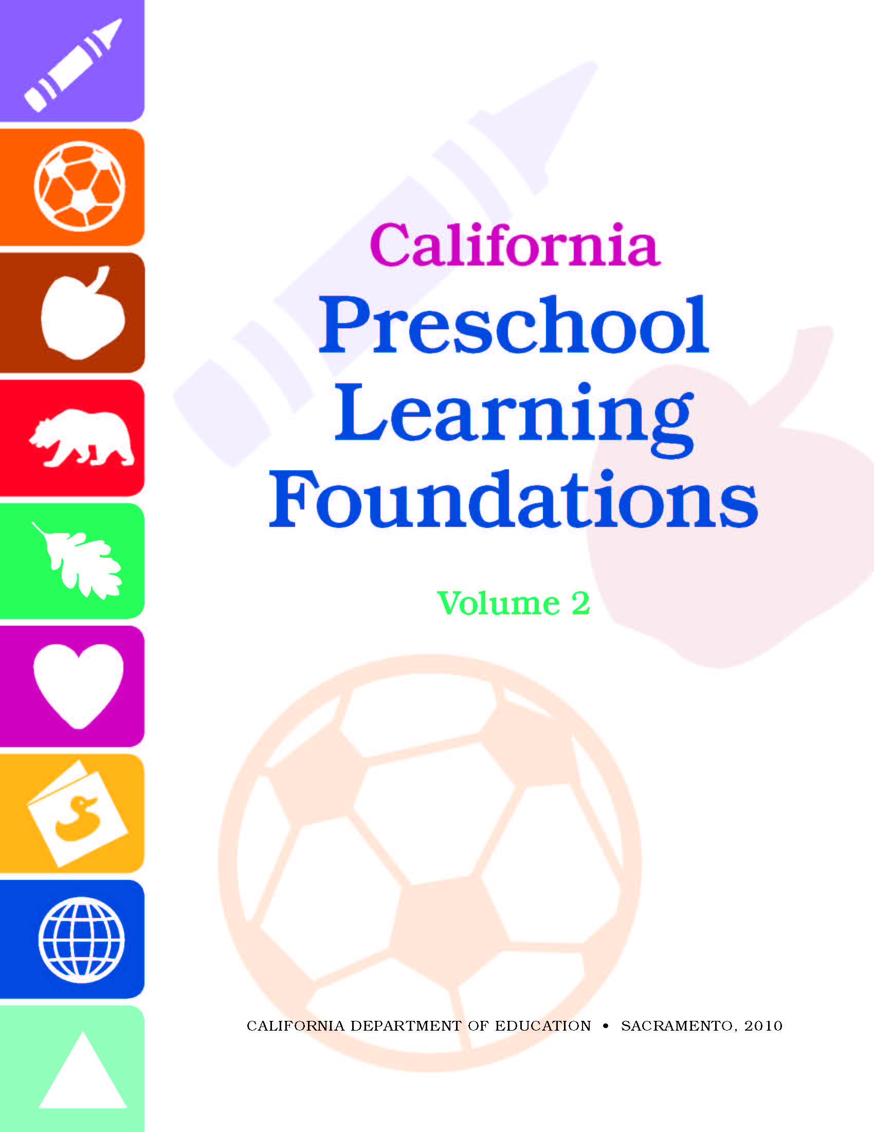
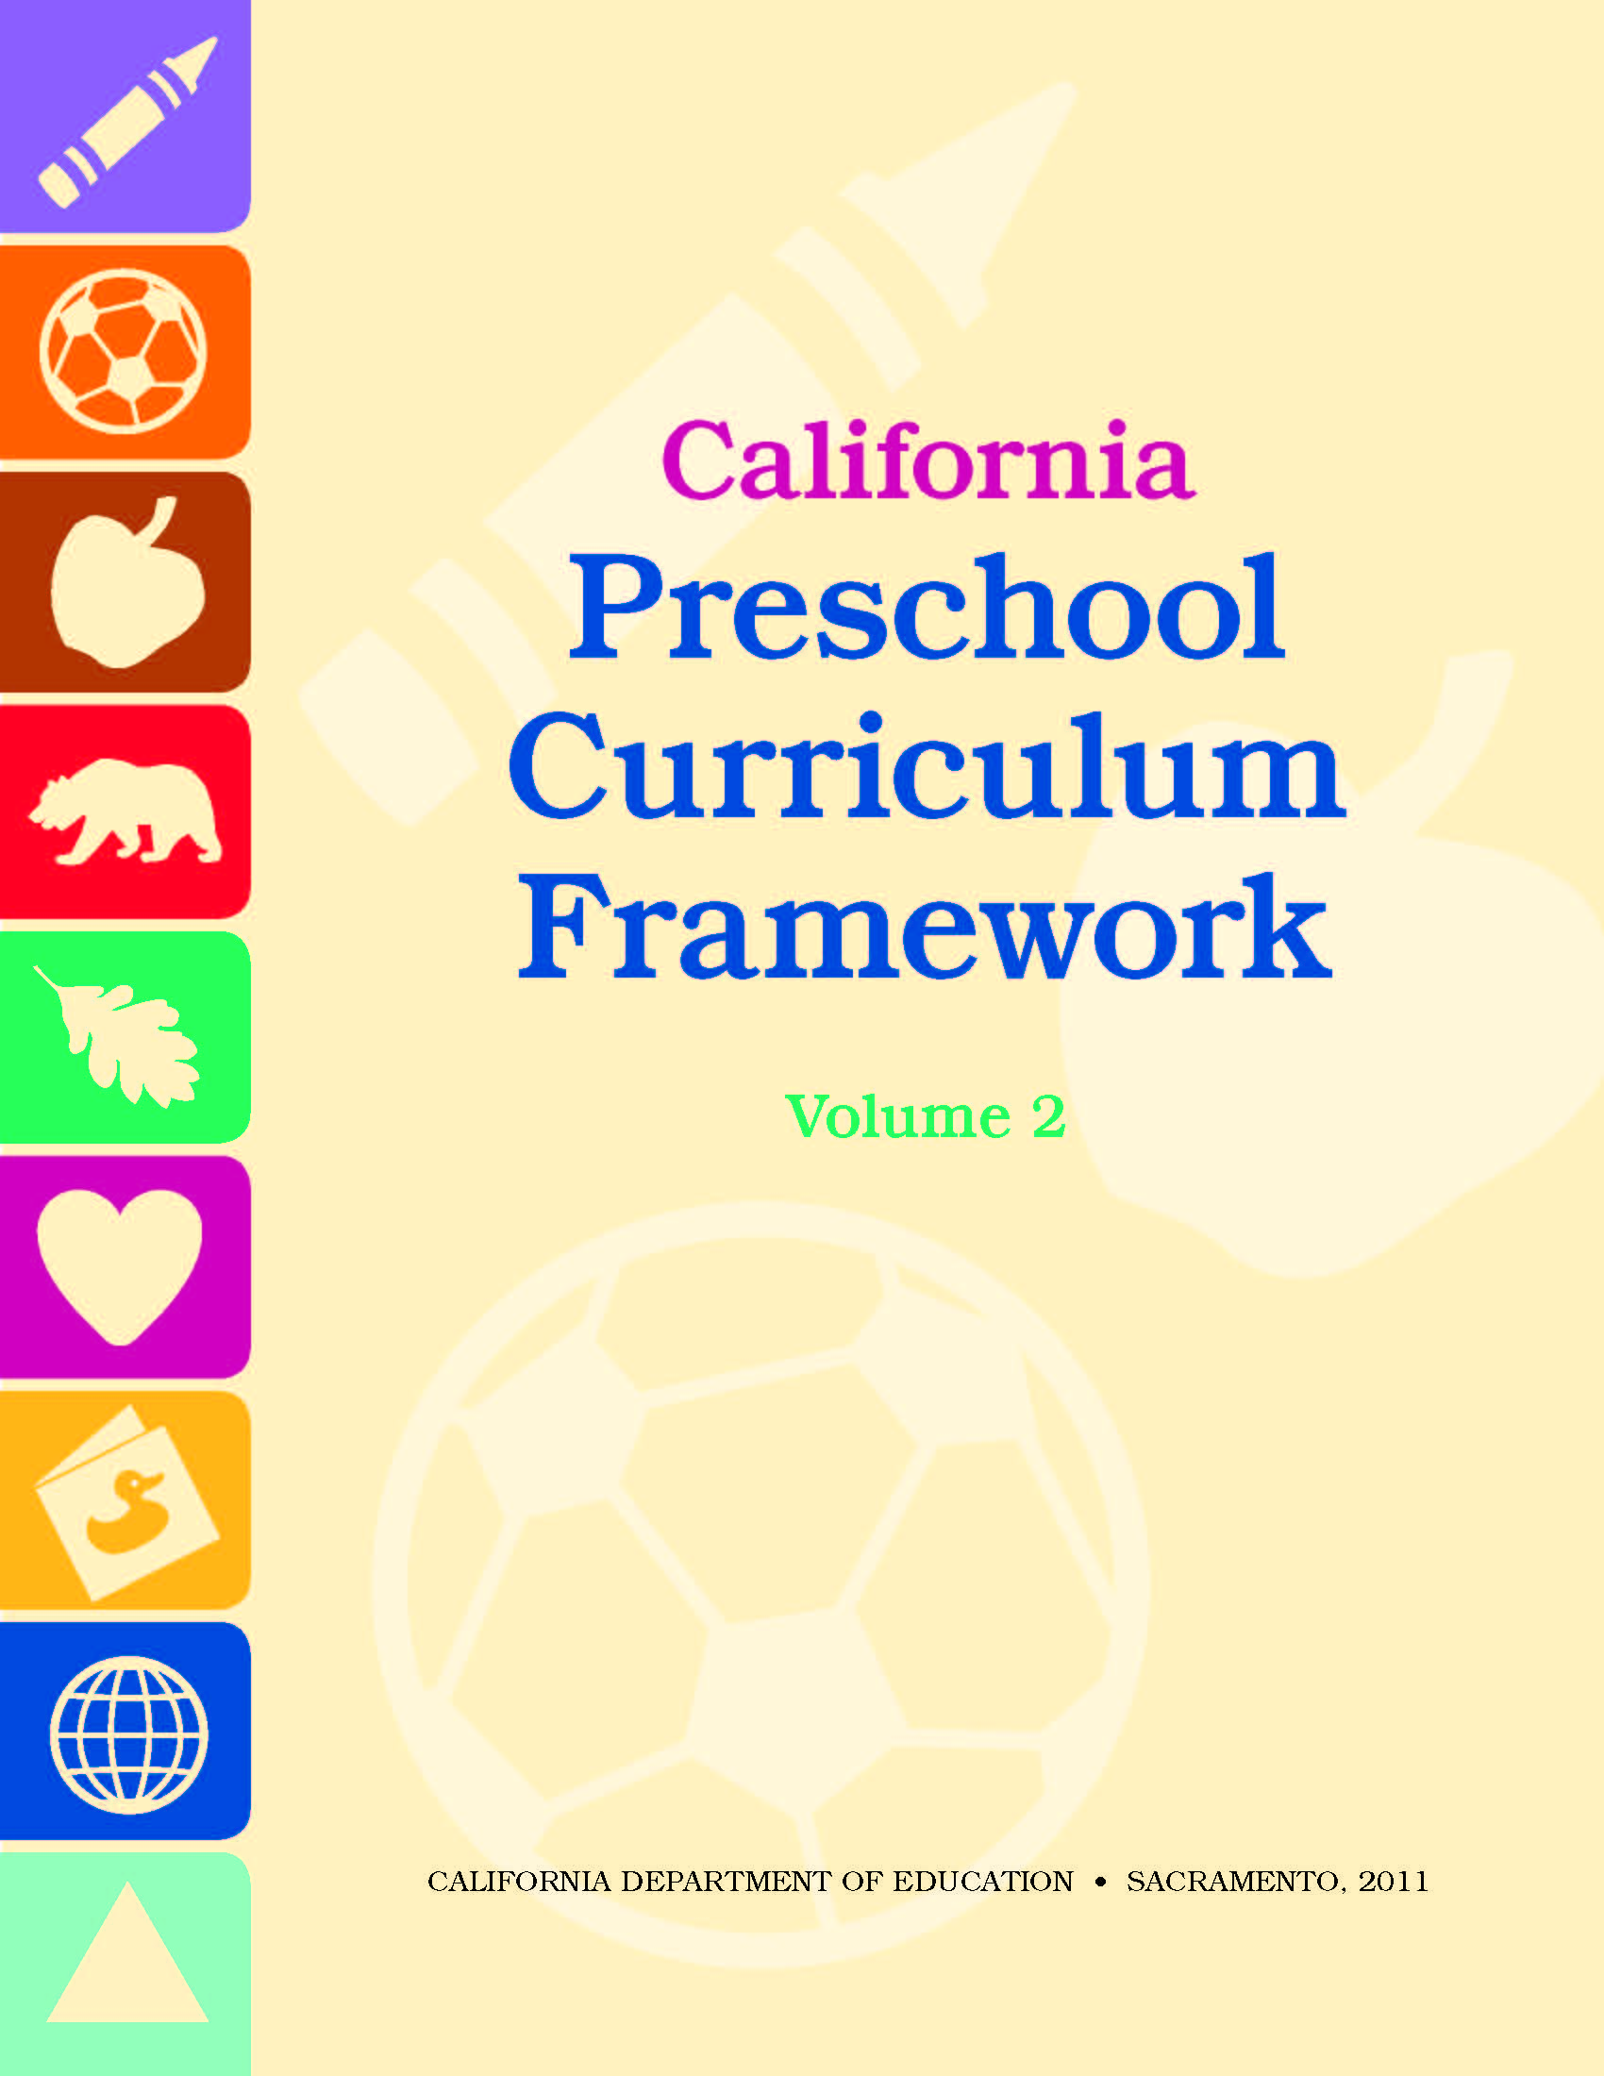
Two California Department of Education Resources
Notes:
We will be using two Early Education and Support Division (EESD) resources during this session.
(Click to reveal Preschool Learning Foundations, Volume 2.)
This is the Preschool Learning Foundations, Volume 2. The foundations describe how children develop, grow, and learn. They tell us what children should know and be able to do
at around 48 and 60 months of age;
as they complete their first or second year of preschool;
with appropriate support; and
when attending a high-quality preschool program.
The preschool foundations are for all children and reflect the diversity found in California.
(Click to reveal Preschool Curriculum Framework, Volume 2.)
This is the Preschool Curriculum Framework, Volume 2. This framework presents strategies and information to help teachers enrich learning and development opportunities for all of California’s preschool children. In the framework, you’ll find ideas for:
Setting up environments,
Encouraging and building on child's self-initiated play,
Selecting appropriate materials, and
Planning and implementing teacher-guided learning activities.
(Click to circle the Visual and Performing Arts icon of each book.)
The first domain of each book addresses our topic for today—visual and performing arts..

Slide 6
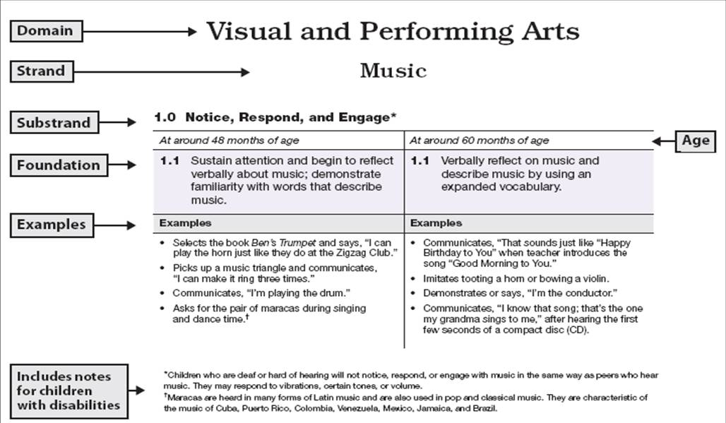
Visual and Performing Arts Foundations Map
Notes:
At the end of 5 minutes, ask participants to take out the Visual and Performing Arts Foundations Map and follow along as you explain the features. (Option: use the fill-in-the-blanks version of the foundations map handout and have participants fill in the blanks as you go over the map.)
Click to reveal domain name, strand name, and the substrand name.
Explain that we will go to foundations and examples after we go deeper into strands and substrands.
Go to next slide.

Slide 7
Music Substrands
Notice, Respond, and Engage | Notice, interact, and be interested in
Develop Skills | Learn the basic skills of performing, inventing, and creating, e.g., using a paintbrush
Create, Invent, and Express | Use skills to participate, express, invent, and create
© 2011 California Department of Education (CDE) California Preschool Instructional Networks (CPIN) 11/11/11
Notes:
What do each of the substrands mean?
Notice, respond, and engage--describes children’s interest and enjoyment in the arts. For example, a child might notice a drawing of a horse in a book and say, “This looks like Nana’s horse. Nana lets me ride it.”
Develop skills--talks about all the basic skills preschool children need to develop in order to create their own art. Examples are learning how to draw a circle, singing along at group time, and moving in time to the music.
Create, invent, and express -- means using the skills children have developed to do things like creating a pizza out of play dough, using the table as a drum, and inventing a dance about a thunderstorm.
In the drama strand, developing skills is combined with using skills to create, invent, and express. For example, a child might build a boat out of blocks, and sit inside it pretending to go fishing in the lake.

Slide 8
Music in Your Classroom
Part 1 - As a table group, read the definitions of each substrand and share your experience based on the following questions:
How do you currently engage children with music?
What music skills do you focus on?
What opportunities are available for children to create, invent, and express themselves through music?
Part 2 - Next, explore and note what you’d like to learn more about in the music foundations.
Notes:
Music in Your Classroom
INTENT: Engage participants with Music substrands and foundations by connecting this with their current classroom practices related to music and identifying areas for growth.
OUTCOMES: Participants will reflect on current classroom practices that support music development in relation to the foundations and identify areas for improving musical supports for children in their classrooms.
MATERIALS REQUIRED: PPT Slide 8, substrand table tents, VPA Foundations handout, “Take Note” handout. Optional: Chart paper/Pens
TIME: 10-15 minutes
PROCESS: This is a 2 part activity. Before beginning the activity, provide participants with instructions for both Part 1 and 2 of the activity. Participants will use their “Take Note” handout to record ideas, reflections, and action plans.
Part 1: Instruct table groups to read the definitions of each substrand on the table tent aloud. Ask them to reflect on the following questions as it relates to their experience and practice: 1. How do you currently engage children with music? 2. What music skills do you focus on? What opportunities are available for children to create, invent, and express themselves through music? Give participants 5-7 minutes to discuss and share at their table and make any notes on their “Take Note” handout.
Part 2: Instruct participants to refer to the Music Foundations handout, read and review the music foundations. Then using their “Take Note” handout, record new things they’d like to try and areas they’d like to learn more about.
OPTIONS: Participants share with the whole group what their areas of interest are and what they want to know more about. Presenter chart responses which can be used to relate content to participant goals.
SUMMARY: Participants are introduced to the music substrands and foundations, then reflect on current practice in relation to foundations and identify areas of interest/growth.

Slide 9
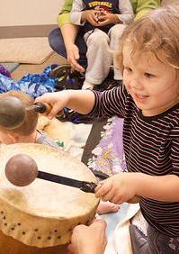
Framework Strategies
Developmentally appropriate
Reflective and intentional
Individually and culturally meaningful
Inclusive
Notes:
9
PCF, Vol. 2, p. 2

Slide 10
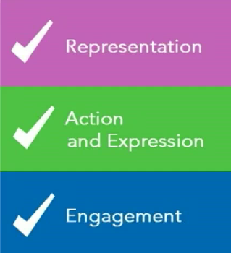
In Volume 2, Discover Ideas for:
10
Environments
Building on children’s play
Materials
Teacher-guided learning activities
Notes:
10
Click to reveal each in turn:
Setting up environments
Encouraging and building on child's self-initiated play
Selecting appropriate materials
Planning and implementing teacher-guided learning activities
Each of these strategies includes ideas for providing Universal Design for Learning. Universal Design provides for multiple means of representation, multiple means of engagement, and multiple means of expression:
Multiple means of representation refers to providing information in a variety of ways so the learning needs of all children are met. For example, it is important to speak clearly to children with auditory disabilities while also presenting information visually, such as with objects and pictures.
Multiple means of expression refers to allowing children to use alternative ways to communicate or demonstrate what they know or what they are feeling. For example, when a teacher seeks a verbal response, a child may respond in any language, including American Sign Language. PCF, Vol. 1, p. 13.
Although this curriculum framework presents some ways of adapting or modifying an activity or approach, it cannot offer all possible variations to ensure that a curriculum meets the needs of a particular child. Of course, the first and best source of information about any child is the family. Additionally, there are several resources available to support inclusive practice for young children with disabilities or other special needs. The resources, Web sites, and books listed in Appendix D are recommended for teachers’ use. PCF, Vol.1, p. 13
For more information on Universal Design for Learning, see UDL www.CAST.org.

Slide 11
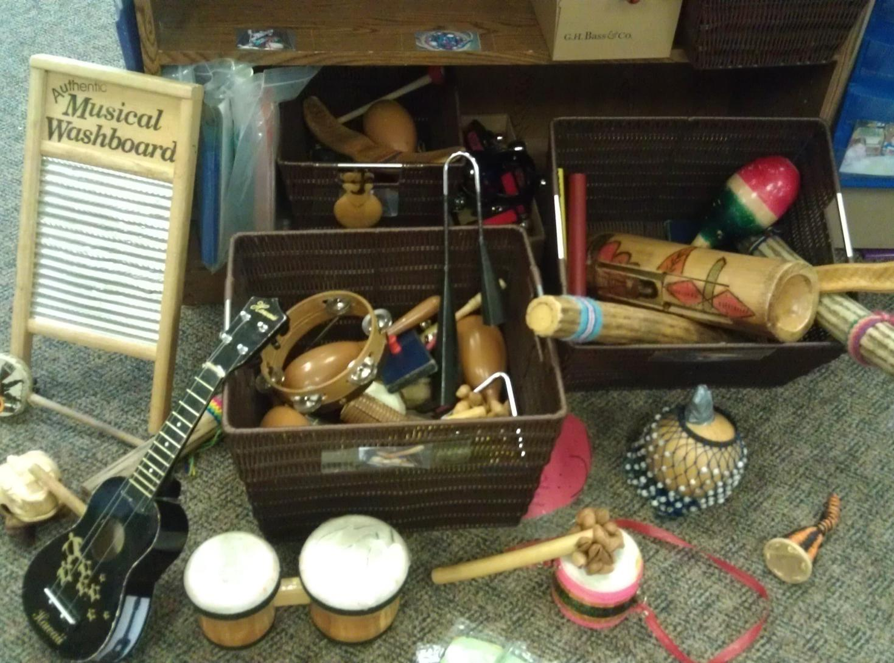
The Environment:
Inviting Musical Engagement
Notes:
Refer participants to Handout “Suggested Art Materials” and “Take Note.”
From the resource table, show some of the instruments you’ve collected for sample.
Presenter: Have participants review the “Suggested Art Materials” handout, then look at the slide and see how many instruments and environment enhancements they can find on the handout. Also to notice/discuss what invites musical engagement in the photo. Encourage special educators to share any easy adaptations they have used to make musical environments accessible for children with special needs. Using their “Take Note” handout, participants can make notes about new ideas to enhance their classroom environments.
The following slides provide multiple examples that the above discussion will enhance. You can choose to use all or only a few of the 6 slides.

Slide 12
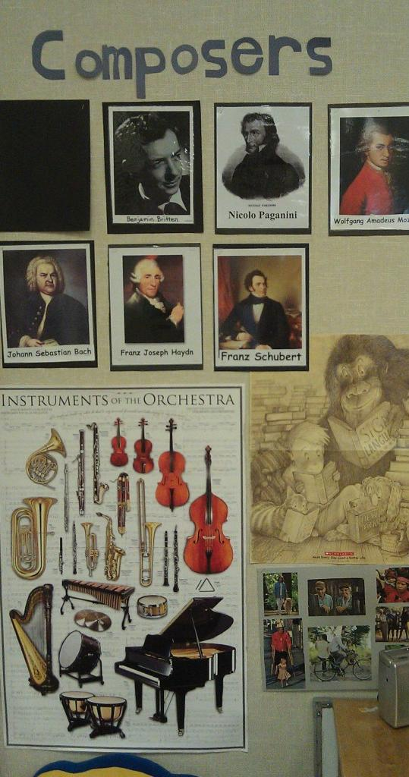
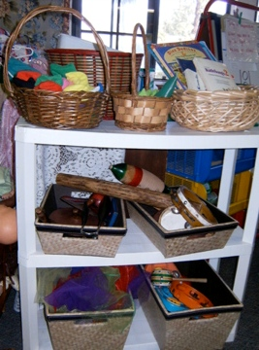
Examples of the Environment:
Inviting Musical Engagement
Notes:
Refer participants to Handout “Suggested Art Materials” and “Take Note.”
From the resource table, show some of the instruments you’ve collected for sample.
Presenter: Have participants review the “Suggested Art Materials” handout, then look at the slide and see how many instruments and environment enhancements they can find on the handout. Encourage special educators to share any easy adaptations they have used to make musical environments accessible for children with special needs. Using their “Take Note” handout, participants can make notes about new ideas to enhance their classroom environments.

Slide 13
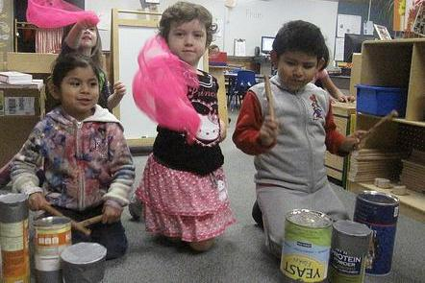
Examples of the Environment Inviting Musical Engagement
Notes:
Homemade instruments using cans, boxes and duct tape
Refer participants to Handout “Suggested Art Materials” and “Take Note.”
From the resource table, show some of the instruments you’ve collected for sample.
Presenter: Have participants review the “Suggested Art Materials” handout, then look at the slide and see how many instruments and environment enhancements they can find on the handout. Encourage special educators to share any easy adaptations they have used to make musical environments accessible for children with special needs. Using their “Take Note” handout, participants can make notes about new ideas to enhance their classroom environments.

Slide 14
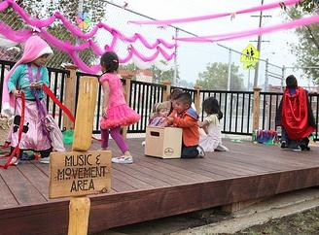
Examples of the Environment
Inviting Musical Engagement
Notes:
Outside spaces combining music and movement
Refer participants to Handout “Suggested Art Materials” and “Take Note.”
From the resource table, show some of the instruments you’ve collected for sample.
Presenter: Have participants review the “Suggested Art Materials” handout, then look at the slide and see how many instruments and environment enhancements they can find on the handout. Encourage special educators to share any easy adaptations they have used to make musical environments accessible for children with special needs. Using their “Take Note” handout, participants can make notes about new ideas to enhance their classroom environments.

Slide 15
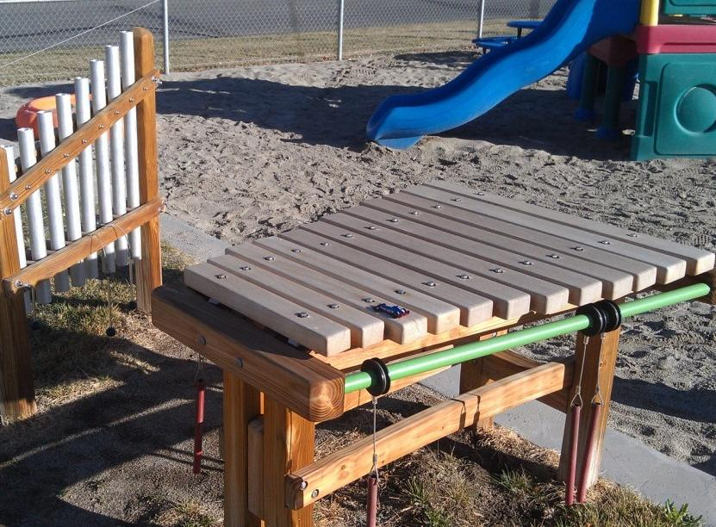
Examples of the Environment
Inviting Musical Engagement
Notes:
Permanently fixed instruments made for the outdoors
Refer participants to Handout “Suggested Art Materials” and “Take Note.”
From the resource table, show some of the instruments you’ve collected for sample.
Presenter: Have participants review the “Suggested Art Materials” handout, then look at the slide and see how many instruments and environment enhancements they can find on the handout. Encourage special educators to share any easy adaptations they have used to make musical environments accessible for children with special needs. Using their “Take Note” handout, participants can make notes about new ideas to enhance their classroom environments.

Slide 16
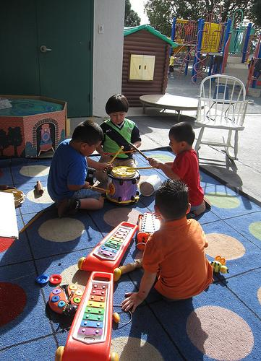
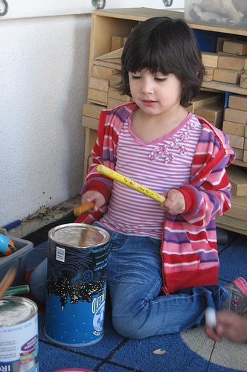
Examples of the Environment
Inviting Musical Engagement
Notes:
Area rugs good way to define a space
Refer participants to Handout “Suggested Art Materials” and “Take Note.”
From the resource table, show some of the instruments you’ve collected for sample.
Presenter: Have participants review the “Suggested Art Materials” handout, then look at the slide and see how many instruments and environment enhancements they can find on the handout. Encourage special educators to share any easy adaptations they have used to make musical environments accessible for children with special needs. Using their “Take Note” handout, participants can make notes about new ideas to enhance their classroom environments.

Slide 17
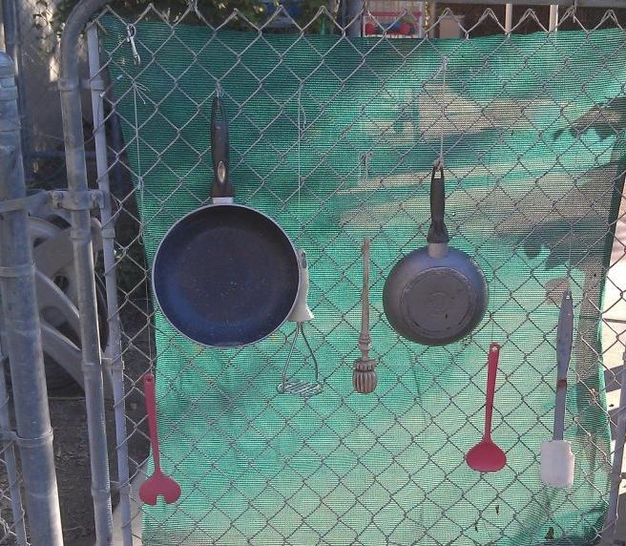
Examples of the Environment
Inviting Musical Engagement
Notes:
Homemade instruments using household items arranged in unique ways
Refer participants to Handout “Suggested Art Materials” and “Take Note.”
From the resource table, show some of the instruments you’ve collected for sample.
Presenter: Have participants review the “Suggested Art Materials” handout, then look at the slide and see how many instruments and environment enhancements they can find on the handout. Encourage special educators to share any easy adaptations they have used to make musical environments accessible for children with special needs. Using their “Take Note” handout, participants can make notes about new ideas to enhance their classroom environments.

Slide 18
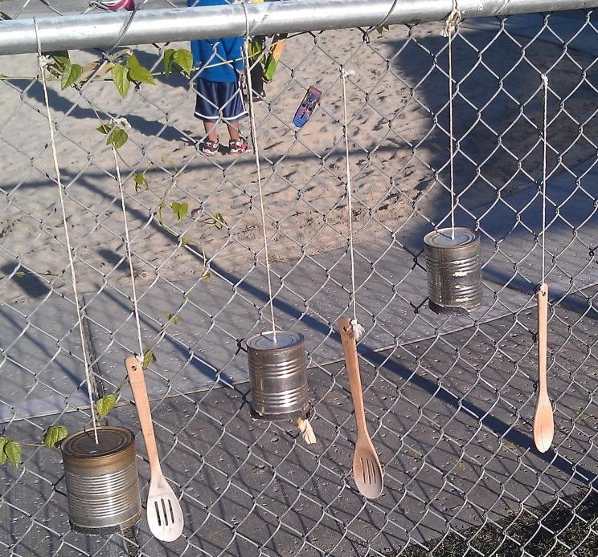
Examples of the Environment
Inviting Musical Engagement
Notes:
Refer participants to Handout “Suggested Art Materials” and “Take Note.”
From the resource table, show some of the instruments you’ve collected for sample.
Presenter: Have participants review the “Suggested Art Materials” handout, then look at the slide and see how many instruments and environment enhancements they can find on the handout. Encourage special educators to share any easy adaptations they have used to make musical environments accessible for children with special needs. Using their “Take Note” handout, participants can make notes about new ideas to enhance their classroom environments.

Slide 19
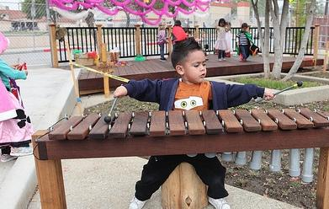
Musical Instruments
“Children’s play environments should include musical instruments that are safe, durable, and of excellent sound quality.” PCF Vol 2 pp 74
Notes:
From PCF Vol. 2, pg. 74
It’s important that musical instruments be treated as instruments rather than as toys. Equipment should be properly maintained and displayed so as to be available for children’s use.
When interacting with the instruments- as the child’s play partner- the teacher should demonstrate proper use and care of the instruments and oversee safe play.
Both exploratory and structured activities should be planned so that children have the opportunity to touch, hear, and manipulate the sounds of the instruments. Because musical instruments are designed to be played in a certain way, it is important for the teacher to model proper playing techniques and functions of the instruments.
Encourage children to analyze and make comparisons about the different instruments’ sound qualities and potential uses. This introduces children to the timbre of each instrument. Timbre is the characteristics and distinct sound of each individual instrument or voice. (Presenter can demonstrate this by playing a note on two different instruments at the resource table such as the musical triangle and a whistle or recorder).

Slide 20
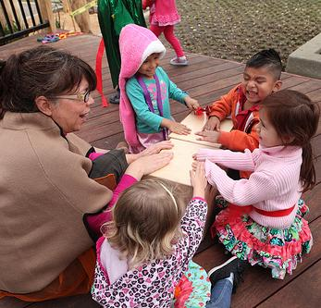
Access to Learning
It may be necessary to make special adaptations to create access to learning.
Notes:
For some children, it may be necessary to make special adaptations to create access to learning. Show examples off the resource table of simple adaptations for instruments and participation.
For example, the rhythm sticks on your table can be adapted in a variety of ways to enable children to better utilize and access curriculum. Take a moment now to find the handout from Tots-n-Tech.
In preschool classrooms patterning is often practiced with small objects that require fine motor ability. Using Grippers to build up any object will enable access to the curriculum for many students in your classroom that may have fine motor delays.
20

Slide 21
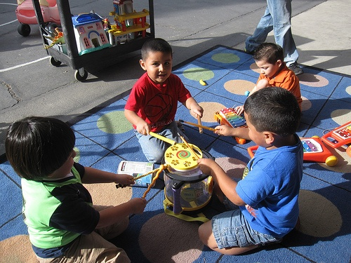
Guiding Principles Connections to Music
Notes:
Guiding Principles: Connections to Music
INTENT: To inspire and engage participants with key VPA Guiding Principles, making specific connections to music and to apply the experience for use with children.
OUTCOMES: Participants use the Guiding Principles to evaluate and inform their music curricular choices. Participants will be able to use/adapt the composition portion of the activity to support children’s learning in the Music substrand: Create, Invent, and Express.
MATERIALS REQUIRED: VPA Guiding Principles-Connections to Music, PPT Slide 21, Guiding Principle cards, Xylophone/Glockenspiel, 3-5 colored musical “notes” on each table, oversized strip of musical staff paper, photo of xylophone on tables.
TIME: 30 minutes
PROCESS: This is a jigsaw activity. Each table group needs one of nine Guiding Principle cards, 3-5 colored musical notes, pens, and a photo of a typical glockenspiel/xylophone found in classrooms. The musical staff paper is posted on the wall, and used to create a “composition” with the musical note highlights that are placed on the paper as reporters share out.
This activity is an opportunity to inspire participants about the significant role of the arts and music in our lives and that the Music Domain is uniquely suited to supporting connections with the family, home language development and English Language Learners, inclusion, diversity, and other learning domains.
Presenter says: “ With your table partners, read and discuss the Guiding Principle you have been given and determine 1-3 key points that all participants need to know as they plan for music in their classrooms. As you read, reflect on how the arts and music are important to the human spirit, capacities, and expression and notice how music is uniquely suited to supporting connections with the family, home language development and English Language Learners, inclusion, diversity, and other learning domains”
Instruct participants to record their highlights on the colored musical notes- one highlight per note. Each table needs to identify a reporter who will share the highlights with the large group. Presenter then says: “The notes will be used to create a simple composition using the glockenspiel/xylophone that is found in many early childhood classrooms. As you report your highlights, I will place the notes on the musical staff. Once everyone has shared, the composition will be played (10 min)
One at a time, Presenter calls on each table group’s reporter to share their highlights and insights on how it informs music curricular practices. Presenter may add to or facilitate discussion that may arise- draw attention to supporting connections with the family, home language development and English Language Learners, inclusion, diversity, and other learning domains. Presenter collects the musical notes from the table reporter after highlights are shared. The musical notes are placed in a line on the musical staff that is on the wall.
Once all table reporters have shared their highlights and all the “composition” is completed, presenter plays the composition on the glockenspiel/xylophone following the color coded musical notes. Participants can “follow” along with the glockenspiel/xylophone photo that is on their table. Presenter sums up this composing activity by telling participants that children can create simple compositions using these materials- or children can create on their own by writing/coloring/drawing/painting notes and musical staff.
See article Music From Inside Out: Promoting Emergent Composition with Young Children. By Jennifer Ohman-Rodriguez. Young Children July 2004.
SUMMARY: Participants engage with the VPA Guiding Principles, making connections with music curricular choices and together create a simple composition that can be adapted for use with children.

Slide 22
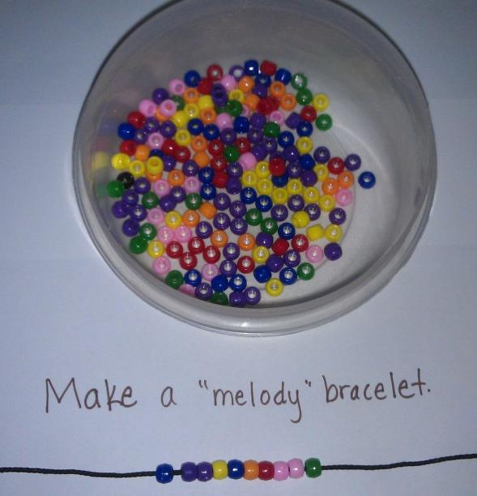
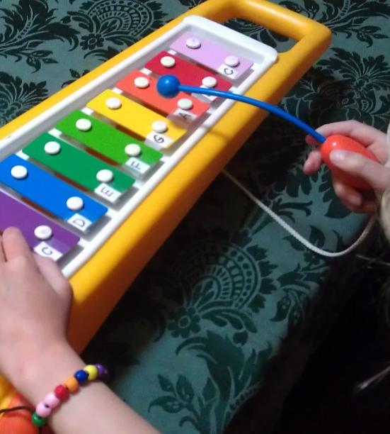
Melody Bracelet
Notes:
The last activity is one that can be used as an inspiration to encourage children to develop their own compositions using color coded musical notes or children’s own colored musical note drawings on staff paper.
Here’s another way for all children in your class to compose their own music and contribute to the musical community of the classroom.
Make a melody bracelet using beads and yarn! You can also use colored blocks lined up in various ways. Blocks are easier to grasp and manipulate for children with special needs or those at an early level of fine motor development. English learners can comfortably participate because the activity isn’t dependent upon their state of second language acquisition.
Compositions also can be “written” down (drawn) in order of the notes, then played by other children. This way, children can experience being composers and sharing creations with each other!
Melody Bracelet From: Four Steps for Becoming Familiar with Early Music Standards by Jinyoung Kim and Helen Mele Robinson Young Children, March 2010.

Slide 23
Let’s Sing!
My Ma Gave Me a Nickel
My Ma gave me a nickel
To buy a pickle
I didn’t buy a pickle,
I bought some bubble gum.
Some buh, buh, buh, buh bubble gum
I bought some bubble gum.
Notes:
Group singing/movement brain break-
Presenter: Sing this song and clap rhythmically together with the audience. Repeat it several times, with the participants choosing a new item to be “purchased” and the first letter sound sung at the appropriate line…. Popcorn… p, p, p popcorn.
This song supports English learners by exposing to and giving them fun practice with English phonemes.
It also support the Music substrands Notice, Respond, Engage, and Develops Skills.

Slide 24
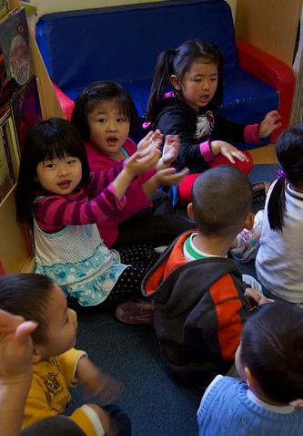
Singin
“Singing
is a joyful activity that builds community, social interaction, and self-esteem.”
- PCF, Vol. 2 p. 83
Notes:
Singing together creates a sense of belonging and naturally lends to including families as the family setting is where generations of songs are passed along and preserved. PCF Vol. 2, p. 85
Songs communicate our history, traditions, and values which reflects the collective and individual human experience and the communities to which we all belong.
“For many children today, stress blocks learning avenues. We can help create that safe feeling of being a caring “classroom family” through the songs and singing games we lead. Learning is strongly influenced by emotion- “The stronger the emotion connected with the experience, the stronger the memory of that experience” (Jensen, 1998, p. 73) Music wraps feelings or emotions around a song that enhances learning experiences. Think of the pride instilled when singing patriotic songs, the peace experienced singing campfire songs, the religious connections strengthened when singing great hymns of faith.”
Reference Article: Learning Through Music: The Support of Brain Research By Elizabeth Carlton. Exchange, Curriculum: Art, Music, Movement, Drama A Beginnings Workshop Book pgs 45-48 Edited by Bonnie Neugebauer
From PCF Vol. 2, p. 83
Set aside time each day for group singing- this builds a repertoire of songs that the whole class knows. Group singing can be done at various time, not only while “sitting in circle.” Sitting outside, singing in small groups, singing while waiting are all opportunities to incorporated music into the children’s day.
Make a chart of all the known songs. Add a picture, or other representation, along with the words.
Record the children singing.
From PCF Vol 2 pg 85
Engaging Families
Encourage children to bring their favorite songs and music from home. These selections can bridge and invite participation in other music activities.
Teachers can advocate greater family involvement. Send songs lyric sheets home with the child, share information about community concerts, invite families to come to the school and play musical instruments, or present small music ‘informance” presentations for families, and simply talk about the child’s interest and participation in music activities and how they can enrich their child’s intellectual and social-emotional development.

Slide 25

“The woods would be very silent if no birds sang except those that sing best.”
- Henry David Thoreau
Notes:
Singing is for everyone!
From PLF Vol. 2, pg. 23
Instruction in singing for preschool children means singing to them with them and for them.
PCF Vol. 2, pg. 74
Minimize use of recorded music when the goal is singing. Recorded music is a way for the teacher to learn new songs. However, the recorded songs often move quickly and do not have enough repetition for young children who are learning to sing. It is more effective to sing the song “a cappella” or with simple accompaniment such as an auto harp or guitar. This way teachers can match the children’s pace, encourage their participation, and repeat the song multiple times. Model the pleasure of singing together!
Teachers may have a different vocal range that children. Children’s voices are naturally higher than the adult singing range and it may feel uncomfortable at first- but it’s important that the children are able to easily participate and develop their voices and experience the joy of singing together! Sing-able keys for children are between middle C and A. Teachers can use a pitch pipe or keyboard get the starting note on a pitch that is comfortable for children.
Reference Article: Learning Through Music: The Support of Brain Research By Elizabeth Carlton. Exchange, Curriculum: Art, Music, Movement, Drama A Beginnings Workshop Book pgs 45-48 Edited by Bonnie Neugebauer

Slide 26
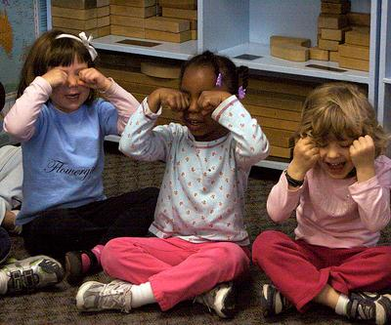
Vocal Play
“Dramatize poetry and nursery rhymes as a fun way to explore and develop vocal inflection and pitch capabilities in the young singer.”
-PCF Vol. 2. p. 73
Notes:
Vocal Play
INTENT: The intent of this activity is engage participants in a playful activity from the PCF Vol. 2 that supports the development of pitch capabilities and vocal inflections for preschoolers.
OUTCOMES: Participants will learn and be able to use this activity with children to playfully support the development of pitch capabilities and vocal inflections.
MATERIALS REQUIRED: PPT Slide 26, slide whistle, Optional- Candlestick.
TIME: 5-7 minutes
PROCESS: Invite participants to stand up, telling them it’s time to play with our voices! Remind them that standing up provides better diaphragm support, reducing stress on vocal chords.
Presenter says: “ vocal play warms up the vocal muscles needed for the more exact task of singing songs on pitch and supports expanding the range of notes they can sing.”
Instruct participants to place their hands on their chest, feeling the chest rise and fall with each breath. Together, make a low “ahhhhhhh” sound, patting the chest and feeling the sound vibrating in the body. Participants can play with various vocal sounds; emphasize attention to feeling the resonating in the body and where the sound arises from.
Use the slide whistle to regain attention of participants. Play the slide whistle sound again and say, “On my cue, we are going to slowly imitate the whistle sounds together.” Then presenter instructs and demonstrates: “Keep your hands on your chest, take a deep breath- fill up your chest and belly with air, then as you make the whistle sound, squeeze your belly in, pushing the air up through your chest as you make the whistle sound. You’ll feel the sound resonate as it moves up through your chest, passes through the vocal cords and out your mouth. Play with that sound a few times.
Presenter says: “Now let’s bring it to the classroom… Together, we’ll say the nursery rhyme , “Jack be nimble, jack be quick… as Jack/Jill jumps over the candle stick use your voice to say… WOOOOOOoooooop! As he/she jumps make your voice go up and down like a roller coaster- start in a low voice, bend over arms low… go up high with your voice, raise your arms, then slide back down to low for the final part of ‘woop.’
OPTIONAL: Engage several participants in being “Jack” or “Jill” as he/she jumps over the candle stick.
SUMMARY: This activity engages participants in a playful activity from the PCF Vol. 2 that supports the development of pitch capabilities and vocal inflections for preschoolers.

Slide 27
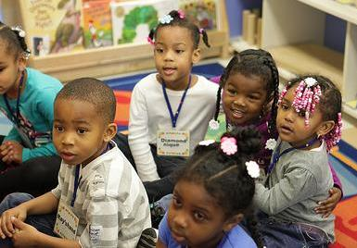
Singing and Language Development
“Singing songs reinforces learning new vocabulary, sequencing of events, contextual word meaning, pronunciation, and fluency.” PCF Vol. 2, p. 72
Notes:
“… the preschool years are the ones when language skills are developing rapidly; singing skill, another form of language should develop as well.” (Mc Donald and Simons 1998, 89 from PLF Vol. 2, p.23)
Songs can really be a potent form of storytelling in that they communicate our hopes and dreams, our deepest emotion- the range of human experiences which is a rich opportunity to support the development of language and literacy for all learners.
Music wraps feelings or emotions around a song that enhances learning experiences. Reference Article: Learning Through Music: The Support of Brain Research By Elizabeth Carlton. Exchange, Curriculum: Art, Music, Movement, Drama A Beginnings Workshop Book, pp. 45-48. Edited by Bonnie Neugebauer.

Slide 28
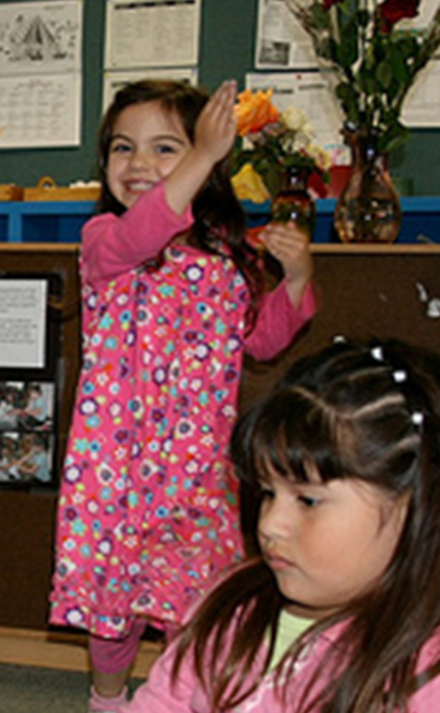
Stages of Second Language Acquisition
Home Language Use
Observational and Listening Period
Telegraphic and Formulaic Speech
Fluid Language Use
Notes:
Presenter: After reviewing the stages of Sequential Bilingual Language Development, instruct participants to discuss and consider the following: “Think about the children in your class who are English Learners and what stage of language acquisition they may be at… then consider their level of participation and engagement in singing activities. Brainstorm ways you support participation with your English learners.”
From: Preschool English Learners Training Manual, Chapter 5
Four Stages of Second-Language Acquisition
Children do not necessarily follow these stages in a linear fashion; they often move in and out of these stages depending on the types of supports available to them in any particular interaction or setting.
Home Language Use
– Children use home language
– Teaching Tip: Activities should focus on listening comprehension
– Teaching Tip: Activities should build receptive vocabulary
Observational and Listening Period
– Children communicate with gestures and actions
– Teaching Tip: Activities should expand receptive vocabulary
– Teaching Tip: Activities should be designed to motivate children
to produce vocabulary which they already understand
Telegraphic and Formulaic Speech
– Children speak using one or two words or short phrases
– Teaching Tip: Activities should expand receptive vocabulary
– Teaching Tip: Activities are designed to develop higher levels of language use
– Teaching Tip: Introduce language experience activities
Fluid Language Use
– Children speak in longer phrases and complete sentences
– Teaching Tip: Activities should expand receptive vocabulary
- Teaching Tip: Activities are designed to develop higher levels of language use in content areas.

Slide 29
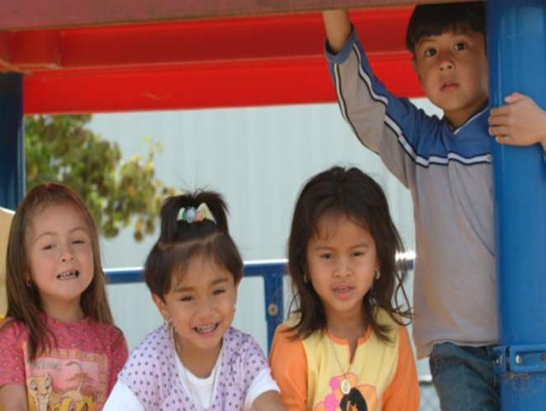
Preschool English Learners
Principle 6: Continued use and development of the child’s home language will benefit the child as her or she acquires English.
Preschool English Learner’s Guide, pp. 41-44
Notes:
Now that you’ve considered the stages of second language development, let’s look at what the PEL Guide recommends for supporting English language development and the correlations to music and singing.
“Offer a rich variety of purposeful, playful, multisensory experiences with literacy and language, such as repetition accompanied by music or clapping” (PEL Guide, p. 85)
Children love to play with language. When talking to themselves and with others, they experiment with phrases and sounds. Correcting inaccurate language may hamper their tendency to experiment.
Learning language is an important part of children’s cognitive development. One way in which preschool teachers can help children acquire English as a second language is to support the continued development of their home language.
Presenter suggestion: Good activity to illustrate these principles on pg. 73 of the PCF.
Use English Language Development Strategies Handout to provide examples.
Optional: Show the Music and Movement video clip from Successful Language Development Strategies in the Early Childhood Classroom. Published by Educational Activities, Inc.

Slide 30
Teacher as Songwriter
Choose a familiar melody and a topic for your song.
Work as a table group to create lyrics set to that tune.
Using the chart paper, write your purpose, tune and lyrics. Place chart on the wall.
Rehearse your song and be ready to share with the whole group.
Notes:
Teacher as Songwriter
INTENT: To engage teachers in a process of creating their own song lyrics based on familiar tunes that can be used to support smooth transitions, dual language learners, memory, cooperation, and other learning domains based on needs of students.
OUTCOMES: Participants create and use their own songs to enhance learning for children and support positive classroom management strategies.
MATERIALS REQUIRED: PPT Slide 30 Chart paper/markers for each table group, cards with sample songs.
TIME: 15-30 minutes
PROCESS: Song card samples are distributed to each table group.
Presenter introduces activity by saying: “Writing your own song lyrics allow the teacher to personalize a song to meet the particular needs of his/her group of children. All parts of your daily schedule can be connected by using simple, familiar melodies such as “Where is Thumbkin?” or “Are You Sleeping?” with specific verses to meet the needs of your class.”
This strategy supports transitions/classroom management, self-regulation, group participation, cooperation and responsibility, English Language Development, sequencing and memory, and vocabulary development. It’s also a stress reliever and increases the joy in any activity!
Reference: Learning Through Music: The Support of Brain Research By Elizabeth Carlton. Exchange, Curriculum: Art, Music, Movement, Drama A Beginnings Workshop Book pgs 45-48 Edited by Bonnie Neugebauer.
Presenter: Instruct participants to:
1.Choose a familiar melody and a purpose for your song. (Participants may use the Song Card samples for inspiration or a personal favorite. Songs can be in any language.)
2.Work as a table group to create lyrics set to that tune.
3.Using the chart paper, write your purpose, the tune and your lyrics. Place chart on the wall.
4. Rehearse your song, be ready to share with the whole group.
For reporting back to whole group: Have as many groups share their songs as time allows. Leave the charts around the room so participants can take a gallery walk at a break or after the workshop.
OPTIONAL: To provide an opportunity for participants to get up and move during this activity, place chart paper on the walls spaced around the room. Direct table groups to move to a chart paper, taking their sample song cards and markers. Then follow the instructions to create their song.
SUMMARY: Participants create and use their own songs using familiar melodies to enhance learning for children and support positive classroom management strategies.

Slide 31
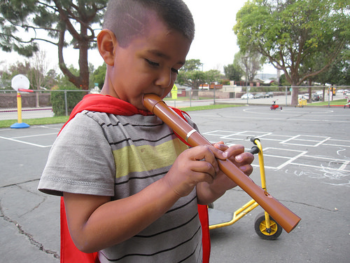
Musical Vocabulary
Beat and Rhythm patterns
Melody
Time and Tempo
Timbre
Dynamics
Notes:
Presenter: Remind participants of these key vocabulary concepts that are used in describing the Music foundations by referring to previous activities - See below.
Glossary definitions: PFL Vol. 2, pp. 28-30
Beat: The beat or pulse in a piece of music is the regular rhythmic pattern of the music; such as we did in Going on a Bear Hunt.
Rhythm Patterns: A repeating pattern of beats and accents (loud and soft sounds) in music. Varying rhythms: Steady beat vs. even, uneven Rhythmic Skills: The abilities to recognize and/or reproduce repeating pattern of beats and accents (loud/soft sounds) in music (Going on a Bear Hunt)
Melody: The “tune” you remember. Pitches that are arranged in a tuneful manner. A succession of single tones or pitches perceived by the mind as a unity. Can refer to the songs/melodies used in the Songwriter Activity.
Time/Tempo: The speed of music or a dance; fast, slow gradually changing; music styles with different time/tempos: waltz, march, merengue, salsa (Going on a Bear Hunt)
Timbre: The characteristic and distinct sound of each individual instrument or voice. (Going on a Bear Hunt)
Dynamics: An element of musical expression relating to the degree of loudness or softness, or volume, of a sound (Going on a Bear Hunt and Vocal Play)

Slide 32
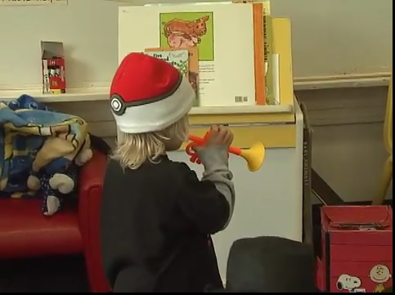
Music In Action: Video Clip: Trumpet Jingle Bells
Music In Action
Notes:
Jingle Bells Trumpet Video Clip
This video clip shows the link between the classroom and some key concepts/vocabulary of the musical foundations and substrands.
Refer participants to the VPA At a Glance handout, instructing participants to briefly review and reflect on the music substrands and foundations and notice which of these the classroom example illustrated.
To preview the upcoming slides and discussion, presenter says, “To help you understand the key differences between the 3 music substrands, the next few slides look specifically at each one: Notice, Respond, and Engage, Develops Skills in Music, and Create, Invent, Express. Following the substrand description slides, we’ll view 3 more classroom video clips and practice identifying how the classroom example supports development in the various substands.”
Participants should keep their VPA At a Glance handout available as you talk through the following substrand slides and video clips.

Slide 33
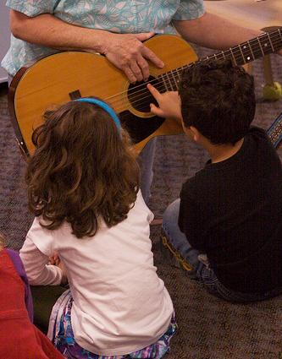
Notice, Respond, and Engage
“They are curious about environmental sounds and musical instruments in the classroom and will respond to music they hear.”
PCF Vol. 2, p. 64
Notes:
As children become more engaged in musical activities, they may request favorite activities and songs to be played repeatedly. Because children begin to use their language more fluently around age three, it is important to encourage them to talk about the music they hear and make. PCF Vol. 2, p. 64.

Slide 34
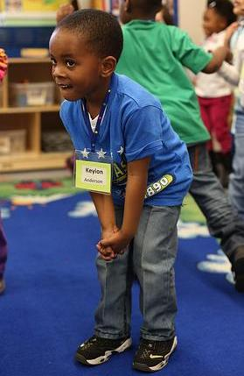
Develop Skills in Music
The basic skills of
performing, inventing,
and creating.
- PLF Vol. 2, p. 4
Notes:
Music skill with 3 & 4 year-old children develop along a continuum. PCF Vol. 2, p. 72.
Developmental continuum examples
Singing: Three year olds are usually able to sing a recognizable song when starting on their own pitch and they become better at matching pitches when singing with others. They enjoy improvising and making up songs to accompany their play and are able to use their voices expressively (e.g., loudly and softly). By age four, they enjoy a wide variety of songs and are better at singing in tune when they sing in their own range. PCF Vol. 2, p. 72
When listening, 3 year olds can recognize correct and incorrect melodies and rhythms of songs; they are not always able to reproduce what they hear. They like to play matching or sound-identification games, and enjoy listening to shorter instrumental music. By age 4, children become more competent at showing their awareness of beat, tempo, dynamics, melodic movement, and structures of musical form. They can focus on the sequence of a musical story or song and are able to focus on longer listening selections. PCF Vol. 2, p.72
In the preschool curriculum framework, the Develop Skills in Music section “focus on and is divided into the musical skills of singing, moving, and playing musical instruments. Listening is woven into all of these skills. PCF Vol. 2, p.72
Most children love to move; therefore, singing, listening and playing are typically expressed in movement. Three and four-year old children begin to show a sense of musical phrasing and expressiveness when moving or improvising. They gain coordination to tap rhythms, handle instruments and mallets. And maintain steady beat when accompanying their own music. Both age groups often like to use manipulatives and props when moving listening and singing.

Slide 35
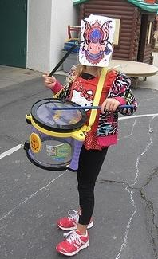
Create, Invent, Express
...tells us what
a child is thinking
about in regard
to what is heard,
seen or imagined musically…
- PCF Vol. 2., p. 80
Notes:
Children using their skills to participate, express, invent and create PLF Vol. 2, p. 4
Preschool children are quite enthusiastic about musical experimentation. They enjoy creating different sounds on instruments and with their voices, and they delight in uninhibited, expressive movement. Until a the child “externalizes” she is thinking about in regard to what is heard, seen, or imagined musically, adults have no idea what is going on in the child’s minds or how she is processing musical thought.
When the teacher gives the child an opportunity to create her own music and invent symbol systems, the child is able to express musical meaning on her own terms, then communicate this meaning to others. PCF Vol. 2, p.80

Slide 36
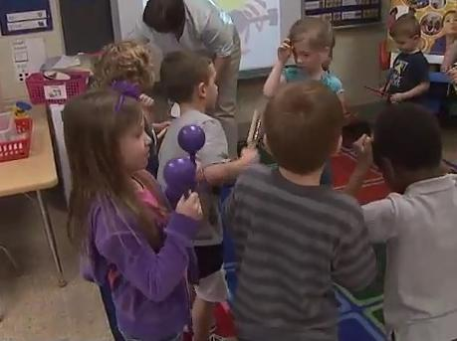
Music in Action
Notes:
Music in Action
INTENT: Using video classroom examples, engage participants in a process of analyzing how the activities support learning in the Music Domain and in other learning domains.
OUTCOMES: Participants will be able to demonstrate understanding of how classroom activities support the 3 Music substrand and foundations
MATERIALS REQUIRED: PPT Slides #36-38, 3 classroom video clips: Instruments Ensemble, Sandtable Song, and MicPlayV2- Lady; VPA At-A-Glance Handout
TIME: 30 minutes
PROCESS: Show participants one video clip at a time, pausing after each one to engage participants in process of understanding how the clip supports learning in one or more of the Music substrand/foundations.
Presenter says, “Take out the Visual and Performing Arts At-a-Glance handout as we’ll be using this as we view video clips from preschool classrooms. I’ll show one video at a time, giving you a minute or so after viewing to think about which substrands and foundations are supported by the classroom example.”
Show 1st video clip.
Give participants 1 or 2 minutes to review substrand/foundations.
Presenter says, “If you thought this example supports the substrand Notice, Respond, and Engage, stand up.” Presenter facilitates a 1-2 min discussion by asking a few of the participants to share how they thought the activity supports this substrand and any specific foundations. Participants sit down.
Presenter says, “If you thought this example supports the substrand Develops Skills, stand up.” Presenter facilitates a 1-2 minute discussion by asking a few of the participants to share how they thought the activity supports this substrand and any specific foundations. Participants sit down.
Presenter says, “If you thought this example supports the substrand Create, Invent, and Express, stand up.” Presenter facilitates a 1-2 minute discussion by asking a few of the participants to share how they thought the activity supports this substrand and any specific foundations. Participants sit down.
Presenter can replay video clip after discussion if desired.
REPEAT THE ABOVE PROCESS FOR REMAINING 2 VIDEO CLIPS
OPTIONAL: Instead of standing up to show which substrand/foundations participants chose, participants can make a music sound with available table instruments or their body such as clap hands/feet, pretend tooting of horn, etc.
SUMMARY: Using video classroom examples, participants engage in a process of analyzing and demonstrating how the activities support learning in the Music domain and in other learning domains.

Slide 37
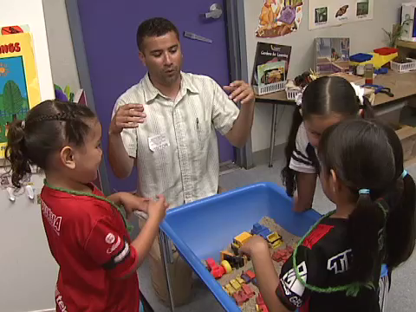
Music In Action
Notes:
Music in Action
INTENT: Using video classroom examples, engage participants in a process of analyzing how the activities support learning in the Music Domain and in other learning domains.
OUTCOMES: Participants will be able to demonstrate understanding of how classroom activities support the 3 Music substrand and foundations
MATERIALS REQUIRED: PPT Slides #36-38, 3 classroom video clips: Instruments Ensemble, Sandtable Song, and MicPlayV2- Lady; VPA At-A-Glance Handout
TIME: 30 minutes
PROCESS: Show participants one video clip at a time, pausing after each one to engage participants in process of understanding how the clip supports learning in one or more of the Music substrand/foundations.
Presenter says: “Take out your Visual and Performing Arts At-A-Glance Handout as we’ll be using this as we view video clips from preschool classrooms. I’ll show one video at a time, giving you a minute or so after viewing to think about which substrands and foundations are supported by the classroom example.”
Show 1st video clip
Give participants 1 or 2 minutes to review substrand/foundations.
Presenter says: “If you thought this example supports the substrand- Notice, Respond, and Engage-Stand up.” Presenter facilitates a 1-2 min discussion by asking a few of the participants to share how they thought the activity supports this substrand and any specific foundations. Participants sit down.
Presenter says: “If you thought this example supports the substrand Develops Skills - Stand up.” Presenter facilitates a 1-2 minute discussion by asking a few of the participants to share how they thought the activity supports this substrand and any specific foundations. Participants sit down.
Presenter says: “If you thought this example supports the substrand - Create, Invent, and Express-Stand up.” Presenter facilitates a 1-2 minute discussion by asking a few of the participants to share how they thought the activity supports this substrand and any specific foundations. Participants sit down.
Presenter can replay video clip after discussion if desired.
REPEAT THE ABOVE PROCESS FOR REMAINING 2 VIDEO CLIPS
OPTIONAL: Instead of standing up to show which substrand/foundations participants chose, participants can make a music sound with available table instruments or their body such as clap hands/feet, pretend tooting of horn, etc.
SUMMARY: Using video classroom examples, participants engage in a process of analyzing and demonstrating how the activities support learning in the Music domain and in other learning domains.

Slide 38
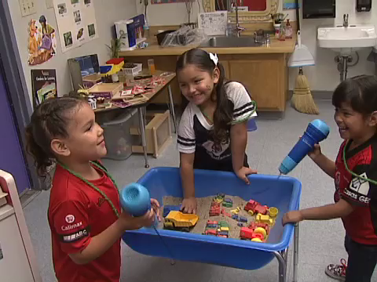
Music In Action
Notes:
Music in Action
INTENT: Using video classroom examples, engage participants in a process of analyzing how the activities support learning in the Music Domain and in other learning domains.
OUTCOMES: Participants will be able to demonstrate understanding of how classroom activities support the 3 Music substrands and learning Foundations
MATERIALS REQUIRED: PPT Slides #36-38, 3 classroom video clips: Instruments Ensemble, Sandtable Song, and MicPlayV2- Lady; VPA At-A-Glance Handout
TIME: 30 minutes
PROCESS: Show participants one video clip at a time, pausing after each one to engage participants in process of understanding how the clip supports learning in one or more of the Music substrand/foundations.
Presenter says: “Take out your Visual and Performing Arts At-A-Glance Handout as we’ll be using this as we view video clips from preschool classrooms. I’ll show one video at a time, giving you a minute or so after viewing to think about which substrand and foundations are supported by the classroom example.”
Show 1st video clip
Give participants 1 or 2 minutes to review substrand/foundations.
Presenter says: “If you thought this example supports the substrand - Notice, Respond, and Engage- Stand up.” Presenter facilitates a 1-2 min discussion by asking a few of the participants to share how they thought the activity supports this substrand and any specific foundations. Participants sit down.
Presenter says: “If you thought this example supports the substrand - Develops Skills-Stand up.” Presenter facilitates a 1-2 minute discussion by asking a few of the participants to share how they thought the activity supports this substrand and any specific Foundations. Participants sit down.
Presenter says: “If you thought this example supports the substrand- Create, Invent, and Express- Stand up.” Presenter facilitates a 1-2 minute discussion by asking a few of the participants to share how they thought the activity supports this substrand and any specific foundations. Participants sit down.
Presenter can replay video clip after discussion if desired.
REPEAT THE ABOVE PROCESS FOR REMAINING 2 VIDEO CLIPS
OPTIONAL: Instead of standing up to show which substrand/foundations participants chose, participants can make a music sound with available table instruments or their body such as clap hands/feet, pretend tooting of horn, etc.
SUMMARY: Using video classroom examples, participants engage in a process of analyzing and demonstrating how the activities support learning in the Music domain and in other learning domains.

Slide 39
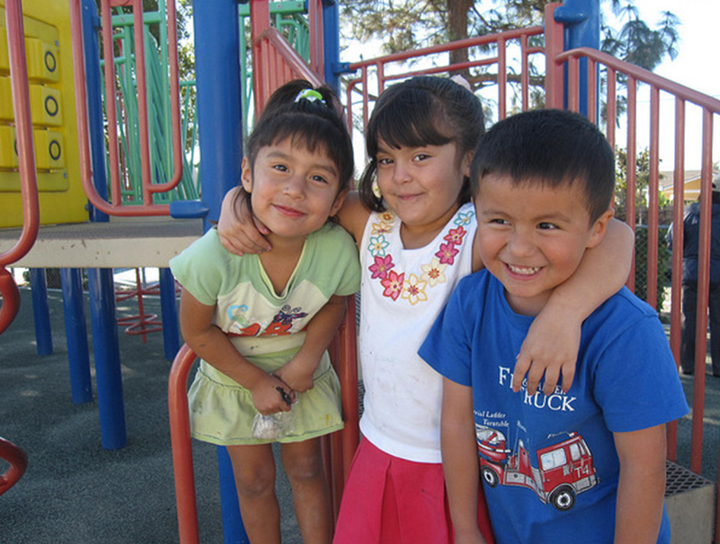
Sharing Our Key Notes
Using the colored musical notes on your table, write 1 or 2 “key notes” you want to remember from today.
Share them with your elbow partner.

Slide 40
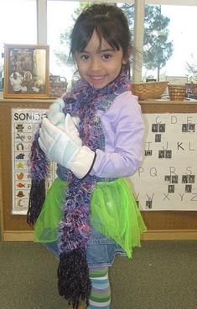
Thank You for Coming!

