Slide 1
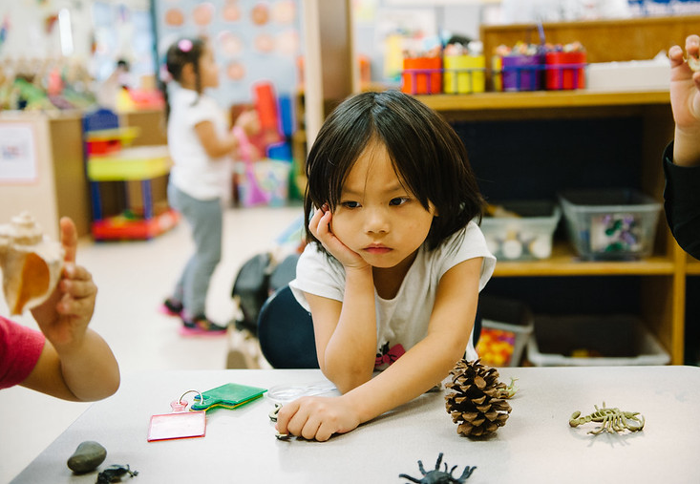

Building Resiliency Through Play
Notes:
Building Resiliency Through Play; California Preschool Instructional Network (CPIN)

Slide 2
Building Resiliency Through Play Acknowledgement
This presentation is based on a presentation given by Dr. Julie Nicholson and Mr. Jonathan Iris-Wilbanks on October 1, 2020 to CPIN on behalf of the California Department of Education (CDE), Early Learning and Care Division (ELCD). CPIN would like to thank Dr. Nicholson for her invaluable work as a co-writer and presenter on The Powerful Role of Play in Early Education, a Best Practices for Planning Curriculum for Young Children publication from the California Department of Education.
Notes:
Note to Regional Leads: Please share this slide and talk about something from the training day with Dr. Julie Nicholson and Mr. Johnathan Iris-Wilbanks.
This presentation is based on a presentation given by Dr. Julie Nicholson and Mr. Jonathan Iris-Wilbanks on October 1, 2020 to CPIN on behalf of the California Department of Education (CDE), Early Learning and Care Division (ELCD). CPIN would like to thank Dr. Nicholson for her invaluable work as a co-writer and presenter on The Powerful Role of Play in Early Education, a Best Practices for Planning Curriculum for Young Children publication from the California Department of Education.
Dr. Nicholson is a professor of practice at Mills College. She is also the author of several books that we use in CPIN, including Responsive Early Education for Young Children and Families Experiencing Homelessness, Creating Equitable Early Learning Environments for Young Boys of Color (It's at CDE press.), and the book we will be referencing today: The Powerful Role of Play in Early Education. We will be focusing on “Chapter 6: A Trauma-Informed Approach to Play-Based Learning” as we look at building resilience through play.
Jonathan Iris-Wilbanks is co-presenting with Dr. Nicholson. He is an assistant professor of practice at Mills College and the Director and Program Head for the Childlike Graduate Program. He is also a certified Child Life Specialist at the Lucile Packard Children’s Hospital at Stanford.

Slide 3

Honoring Native Land
Notes:
Trainer Remarks: We want to start with a land acknowledgement; or sometimes it's called a territorial acknowledgement. When we think about a land acknowledgement, we think about a reconciliation process. This is the beginning of that process—to raise awareness of the Indigenous peoples, the first nations, the native American tribes that had the land that we are on before the settlers came in and are, in many ways, still around us. They're here today in our communities doing the land acknowledgement. This process asks that we all learn more about those tribes, about the families, and about the communities and to begin to turn in personally to ask: How am I benefiting from the land that I'm on? How am I personally, and how are we collectively—in our families and communities, benefiting from this land?
Chat: To start as the first of many invitations for you to share in the chat, we would like to invite all of you to share your name, the tribal nation or nations, and one aspect of the land that you're on that's calling to your mind and your heart and your spirit.
Native Land resource: The Native-Land.ca website is a helpful map tool to identify the land you’re on . You can also text your town and state to 907-312-5085 and it will text you back the land you are on.
Trainer provides an example of the land they are currently on during this session or gives acknowledgment to another land. Here is Dr. Nicholson’s example: I want to say that this morning I’m Zooming in from the occupied and unseated territory of the Aloni peoples who have stewarded this land in the Bay area for generations. When I look out my window, even though it's quite smoky this morning, I always resonate with this beautiful tree that I can see.
Read aloud some of the responses from the chat.

Slide 4
Agenda
The impact of trauma on children’s play
Different types of play that support children impacted by stress and trauma to cope, build resilience, and heal
Strategies for addressing difficult themes in play
Learning from medical play
Applying concepts to a vignette
Notes:
Dr. Nicholson’s Remarks: One of the things that we know from any work about trauma and stress is that we ourselves can have trauma reminders and an activation of our stress-response system in a sort of unconscious way at any moment in time when we're talking about some of these things. So, it's really important for us to say two things before we start today:
We want you to take care of yourself at all times—self care, and you monitoring your body and doing body scans and just reading the cues of what you need, is what we invite everybody here to do.
If you need to get up and walk around, please do so: turn off your camera, get a glass of water, take a deep breath, stretch and move your body, and get some of that stress out as you're shaking your body and moving; this is what we want to do with children.
Agenda:
The impact of trauma on children’s play
Different types of play that support children impacted by stress and trauma to cope, build resilience, and heal
Strategies for addressing difficult themes in play
Learning from medical play
Applying concepts to a vignette

Slide 5

Creating Grounding and Safety
Write down a word or draw an image that describes a place, activity, person, or object you use in your life to calm you, ground you, or that helps you feel safe.
Notes:
Dr. Nicholson’s Remarks: The other thing is, there's something incredibly powerful about when we are calm, thinking about a grounder that we can use. Something that when you think about it—an image, a person, a location, a mantra, a sort of object—this thing, this place, this thought, this saying, or this prayer has associations in your mind with safety, with belonging, with feeling a sense of wholeness and peace.
So, we invite you to think now, while we're calm or before any of you might experience an activation, of what that grounder is. And if you have it in your mind, if you write it down or if you draw a picture of it, it's easier to remind yourself when you start to feel that activation to bring your grounder into your heart, your mind, your spirit, your body.
Chat: We want to ask you to take a minute to think about what your grounder could be. Write down a word or draw an image that describes a place, activity, person, or object you use in your life to calm you, ground you, or that helps you feel safe.
Grounders can be very personal, so you don't have to share, but we invite you. We see this as being able to teach and learn from one another. What you use as a grounder might be helpful to somebody else; so, if you're comfortable sharing privately with us, we can read it out or in the chat with one another. Please feel free to share your grounder now.
Trainer provides an example. Here is Dr. Nicholson’s example: I put the redwoods. These really—when I think about them, when I see them, when I'm in the redwoods—they ground me.
And your grounders, again, you don't have to be in front of them: you can imagine them, or you can see a photo of them. Holding a rosary or an object can be very grounding, or even petting your dog.

Slide 6
Almost half of the children in the U.S. have experienced at least one type of serious childhood trauma.
Notes:
Almost half of the children in the United States have experienced at least one type of serious childhood trauma.
Dr. Nicholson’s Remarks: And these numbers are going up now. We can imagine with COVID, with our racial pandemic, with the fires here in California—and so many things—these numbers are going to be sky high. So, what we're talking about today is so relevant and so important—more than ever.
We're going to spend a good amount of time talking about trauma: what it is and its impact on play. We’ll also go into how we can use play to support coping, healing, and resilience—just to make sure you have that sense.

Slide 7
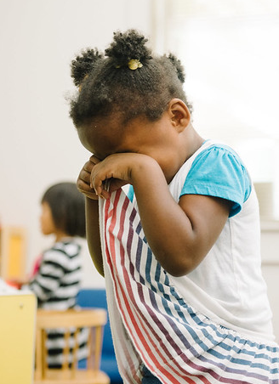
What is trauma?
Trauma is an actual or perceived threat of danger which overwhelms a person’s usual coping ability and impacts functioning.
Trauma is defined by its effect on an individual’s nervous system, not on the intensity of the circumstance itself.
The younger the child, the more likely they are to be overwhelmed by common occurrences that might not affect an older child or adult.
Notes:
What is Trauma?
Trauma is an actual or perceived threat of danger which overwhelms a person’s usual coping ability and impacts functioning.
Trauma is defined by its effect on an individual’s nervous system, not on the intensity of the circumstance itself.
The younger the child, the more likely they are to be overwhelmed by common occurrences that might not affect an older child or adult.
Dr. Nicholson’s Remarks: The Statman-Weil definition of trauma is thought about through an adult lens: she talks about it as the result of an overwhelming amount of stress that exceeds one's ability to cope or integrate the emotions involved with that experience. It differs among individuals by their subjective experience, not the objective facts. That is so important for us to remember: it is subjective. We can't look at a child and know if they've experienced trauma and it's not an event per se. It's the experience on your nervous system and how it sits with your nervous system and leaves you with the perception of fear and terror—the perception that you feel out of control, the perception of helplessness.
Trainer provides an example. Here is Dr. Nicholson’s example: Jonathan and I could be in the same room going through the same experience of an earthquake coming and shaking the building, but because of all sorts of factors, we might have a different experience of fear, loss of control, and helplessness. And so, we could have two very different experiences.
Summary: The younger the child, the more vulnerable they are to trauma because of so many things:
They may not be able to use coping skills yet.
They may not have developed those social-emotional capacities that we are teaching children today in terms of learning the body, scanning the breathing.

Slide 8
Common Myths and Misunderstandings about Trauma and Young Children
Children don’t feel pain or remember traumatic events or experiences—especially infants and toddlers.
Young children are naturally resilient.
Trauma is a life sentence.
Notes:
Trainer Remarks: These are just a few of the many myths and misunderstandings about trauma. Take a moment and notice for yourself if you've heard some of these myths or seen when they pop up when we're working with children:
Children don’t feel pain or remember traumatic events or experiences—especially infants and toddlers. In the early 19th century, this was a very common medical teaching: that children can't feel pain because their nervous systems aren't fully developed.
Young children are naturally resilient. The neuroplasticity and healing and buffering from trauma and its short and long-term effects is most possible in the early childhood years. Adults have the most vulnerability and the most possibility for protective factors, but children aren't naturally resilient. They must experience contexts in the environment to support that resilience; we can build resilience throughout our life span.
Trauma is a life sentence. Through Adverse Childhood Experiences (ACEs), but especially from epidemiological data, we know that you can't look at somebody's adverse experiences and predict their outcomes. That’s a really important thing and why we don't actually talk a lot about adverse experiences in ACEs scores anymore because “we aren't our ACEs score.” There's so much we can do to interrupt and buffer stress—especially in early childhood—and make sure that children don't have those short and long-term impacts. So, we have to remember that it's a fact of life; it's not a life sentence.
Dr. Nicholson’s Remarks: There are lots of reasons why a young child is more vulnerable. And we also just want to name that although it hits children across every demographic, every city, and every town in our country, it is disproportionately experienced. And we see that with COVID today—that our communities of color, our children of color, and our children experiencing poverty and the sequela and impact of poverty will have more effects, cumulative effects of toxic stress and trauma.

Slide 9
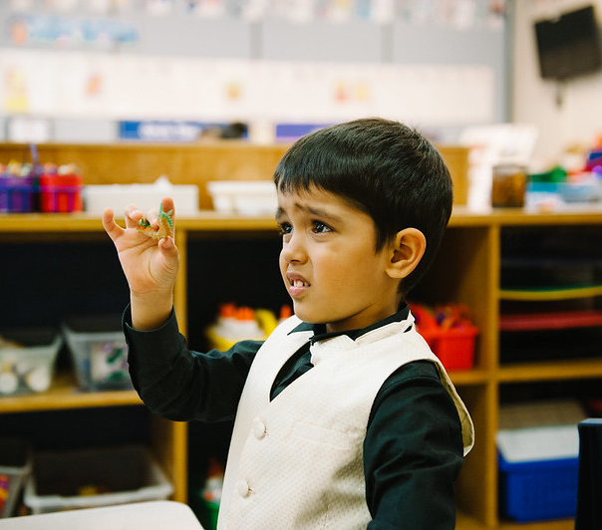
Elements of a Traumatic Experience
Fear, a complete loss of control, and a sense of utter powerlessness are elements of a traumatic experience.
Therefore, regaining control is an important aspect of coping with traumatic stress and helping the child return to a situation that is predictable and safe.
Notes:
Fear, a complete loss of control, and a sense of utter powerlessness are elements of a traumatic experience.
Therefore, regaining control is an important aspect of coping with traumatic stress and helping the child return to a situation that is predictable and safe.
Dr. Nicholson’s Remarks: We want to recognize the elements of a traumatic experience: the sense of fear, helplessness, and a lack of control. This is why—when we think about some of the foundations of trauma responsive practice—it's so critical to support children and adults to have a sense of agency and control, because it's that sense. This is why it matters to have predictable routines to reduce uncertainty. These things increase people's feelings of control and reduce that uncertainty that activates the stress response. Remember trauma is not in the event; it resides in the nervous system.

Slide 10
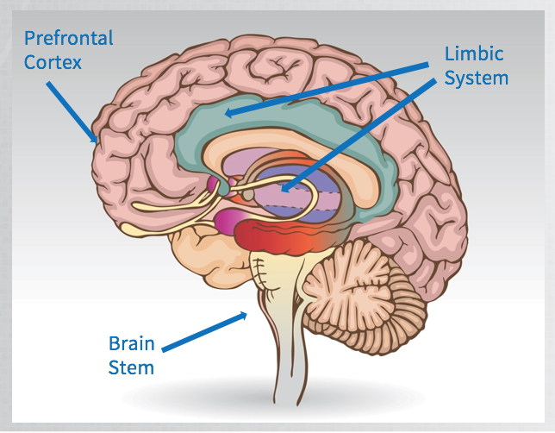
The Hierarchical Nature of Brain Development
Forebrain/Cortex:
Abstract
Thought/Reasoning
Impulse Control
Empathy
Perspective Taking/Logic
Limbic Brain
Attachment
Affect Regulation
Emotional Reactivity
Significance and Belonging
Emotions/Needs
Connection
Brainstem
Motor Regulation
Heart Rate/Breathing
Blood Pressure
Body Temperature
Sensations
Notes:
The Hierarchical Nature of Brain Development
Key facts of the developing brain on play and why play is impacted by trauma and toxic stress.
Dr. Nicholson’s Remarks: The hierarchical nature of brain development is to understand the cortical processing of events and experiences. This is what we share with reptiles and it's the part of our brain that scans for danger and that is responsible for the fight-flight-freeze response and that activation of stress. You might have heard the word somatics or body work, body scanning as helpful for healing from trauma. Trauma is in the body, and in order for us to heal, we can't just talk about it through a cognitive lens of talk therapy or talking through problems and naming our feelings. We have to actually learn how it sits and holds in the body and how to release that charge.
Forebrain/Cortex (Abstract Thought/Reasoning, Impulse Control, Empathy, Perspective Taking/Logic)—This is uniquely human. Mammals and reptiles don't have this. It's the part of our brain that's responsible for our logical decision-making, our problem-solving, our ability to build empathy, to understand somebody else's experience, to slow down and regulate our reactivity, to use language to tell stories with a beginning, middle, and end, and a coherent structure.
Limbic Brain (Attachment, Affect Regulation, Emotional Reactivity, Significance and Belonging, Emotions/Needs Connection)—This is what we share with all mammals on the earth. This generates our feelings, our emotions, the intensity of our feelings, our need for attachment, for belonging, for feeling significant. We are all born with an experience-dependent limbic system. And this means that we need lots of repeated positive emotional, social, and cognitive interactions to support the development of a healthy limbic system. And unfortunately, if we have negative interactions relationally or relational trauma, relational loss, it takes hundreds and thousands of iterations for us to re-teach and re-learn, which is why we must have so much patience, do so much self care, when we are working with trauma-impacted children and families.
The amygdala is part of the limbic system. It controls our survival responses and responds to things within a fraction of a second; it tells us if we perceive danger or threat. It is the racing heartbeat that we feel, the sweaty palms, the sort of pupils dilated—all of those things are very impacted by the amygdala. The amygdala is developed at birth, and this is why it's so important for us to recognize how easy it is for a young infant to perceive fear, to perceive threat, because it's fully developed—whereas other parts of the brain in the perceptual system are not. Fear is one of our earliest and strongest emotions because of that.
Brainstem (Motor Regulation, Heart Rate/Breathing, Blood Pressure, Body Temperature, Sensations)—When we think about the brain, let's remember that the brainstem is the first part of the brain to develop. The brainstem also controls our basic functions: breathing, sleeping, and regulation of your blood pressure; which is why when it perceives danger, those things are impacted because it's coming up through that brainstem that is responsible for those things.
Summary: Everything comes through the brainstem, every single experience we have. If our subconscious, unconscious scanning for danger brain perceives a threat in order to react quickly and in order to react smartly for your survival, it's going to cut off or greatly reduce the neural access to your limbic system and to the forebrain and the prefrontal cortex.

Slide 11

Toxic Stress Video
Notes:
This video, 3. Toxic Stress Derails Healthy Development, is free and available from the Center on the Developing Child at Harvard University YouTube channel. It shows the process in the brain explained on the previous slide (two minutes in length).
Think about what's coming up for you:
What questions do you have?
What feelings are in your body?
What are you noticing?
What are your cognitive thoughts?
Chat: Take a minute to unmute or share in the chat box what's coming up for you: what's top of mind or in your body—what do you feel?
OPTIONAL: End the conversation or share out with the reminder of utilizing and owning their grounders from the the beginning of the session.

Slide 12
The Impacted Hierarchical Nature of Brain Development
Forebrain/Cortex:
Abstract
Thought/Reasoning
Impulse Control
Empathy
Perspective Taking/Logic
Limbic Brain
Attachment
Affect Regulation
Emotional Reactivity
Significance and Belonging
Emotions/Needs
Connection
Brainstem
Motor Regulation
Heart Rate/Breathing
Blood Pressure
Body Temperature
Sensations
Notes:
The Impacted Hierarchical Nature of Brain Development
Return here and talk about neural growth. The neural growth goes sequentially from the bottom up, and the first areas of the brain are the brainstem and the midbrain, which is part of the brainstem, and they're responsible for the bodily functions: breathing, sleeping, and blood pressure. The last part of the brain to develop, and it takes many years, is the cortex, the forebrain, and the limbic system.
Dr. Nicholson’s Remarks: Because of the sequential nature of neural growth, if one part of the brain like the brainstem is interrupted because of a lot of toxic stress in its development, it's going to impact the other areas of the brain as they're developing. So, this is why we see a lot of children who experienced toxic stress having delays in things like language development or social-emotional skills—that limbic system, that attachment, the connection to social-emotional capacity and functioning.

Slide 13
Fight. Flight. Freeze.
Common Behaviors in Fight, Flight, or Freeze Responses
FIGHT
Yells or screams
Argues
Curses
Throws self on floor
Kicks, hits, bites, spits
Destroys property
Makes threats
FLIGHT
Covers face with hands, pulls jacket over head, buries face in hands
Hides in the room and out of site of caregiver
Runs out of room
Hides under something
Sits in corner and just watches
Falls asleep in the middle of the action
Becomes absorbed with things and oblivious to the surroundings
FREEZE
Appears lethargic and spaced out
Child is unresponsive to name being called
Child is unresponsive to commands, requests or questions
Child appears to daydream a lot
Notes:
Common behaviors in fight, flight, or freeze responses:
FIGHT
Yells or screams
Argues
Curses
Throws self on floor
Kicks, hits, bites, spits
Destroys property
Makes threats
FLIGHT
Covers face with hands, pulls jacket over head, buries face in hands
Hides in the room and out of site of caregiver
Runs out of room
Hides under something
Sits in corner and just watches
Falls asleep in the middle of the action
Becomes absorbed with things and oblivious to the surroundings
FREEZE
Appears lethargic and spaced out
Child is unresponsive to name being called
Child is unresponsive to commands, requests or questions
Child appears to daydream a lot
Jonathan’s Remarks: Now we're getting into what it looks like when a child’s fight, flight, or freeze system is activated. What does it look like, but also what does it feel like, because we can feel it within ourselves as it's happening. What you can see is under these different categories, there are a number of different responses that are designed to share with the world what it is that's happening inside of them: they might yell or scream; they might argue, kick, hit, bite, spit, destroy property, or make threats.
Children with flight might run out of the room. They might hide under something. They might sit in a corner and just watch and try to be as far away as they can—become absorbed with things and oblivious to the surroundings. They can run away into something. And then there's this freeze response, where they could become unresponsive to their name being called. They might appear lethargic or spaced out, or they might be daydreaming a lot. This is an automatic survival response. It's not, "Why is she choosing to bite?" This is being activated and it's an autonomic, automatic response to this perceived threat. This is the way the body is saying, "This is how we'll keep ourselves safe.”
Dr. Nicholson’s Remarks: And it may not be that it's adaptive in situations outside of that initial moment of stress and trauma, but it is their body's attempt to be as adaptive and supportive as possible. We can help children unlearn these things and to help them feel safe and to stop activation. It does help us build empathy to understand that it's out of their control. It is their body's way of being safe. It is a survival response. And it's for you too.
Trainer provide example. Here is Dr. Nicholson’s example: Jonathan and I are at Mills in Oakland and one of my teachers said to me one day, "I was held up at gunpoint in my apartment one day in Oakland. I have always felt so embarrassed and ashamed that I couldn't say anything. I couldn't do anything. I just sat there. I thought I would be so brave and productive and supportive in a moment like that and I couldn't." She said, ”You're helping me see it was my body's attempt to keep me safe. I went into a freeze-dissociative response, and it wasn't in my control." I said, "Yes, it is very helpful to know that." This stuff will help you know your own body too, and for us to build empathy with others and ourselves in understanding these responses. Now, we want to say, obviously, when you see these things, it doesn't mean it's trauma. It doesn't mean it's stress. Some of these are just developmentally responsive behaviors. But when you see it as a pattern and it's often triggered in a moment when you don't know where it came from, that can be a clue and there's a lot we can talk about and share with you about the difference between something that is just sort of a developmental behavior and a trauma trigger.

Slide 14
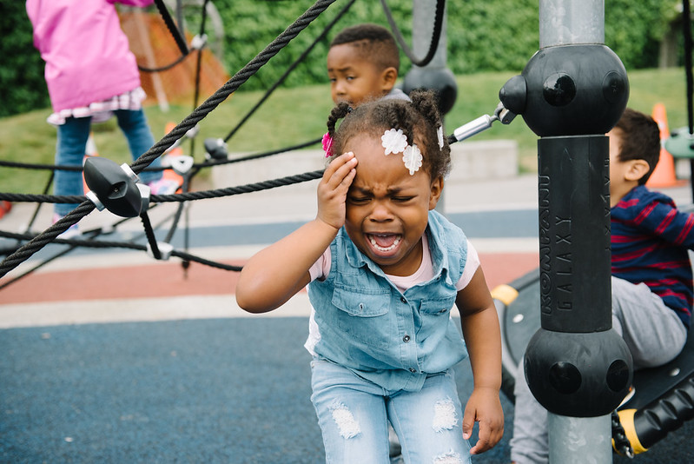
Trauma and Memory
Although an event may disappear from conscious memory, the body “keeps the score.”
Children with early trauma may retain implicit memories.
Physical or emotional sensations can trigger these memories, causing flashbacks, nightmares, or other distressing reactions.
Notes:
Although an event may disappear from conscious memory, the body “keeps the score.”
Children with early trauma may retain implicit memories.
Physical or emotional sensations can trigger these memories, causing flashbacks, nightmares, or other distressing reactions.
Dr. Nicholson’s Remarks: When discussing trauma and memory, I always like to bring in Bessel van der Kolk, he's a trauma researcher and clinician. He's thought of as a grandfather of this work. He talks about this idea that an event may come and go, but the body keeps the score. This is why when you might've been hearing My Grandmother's Hands or some of these books that are talking about racialized trauma or trauma in the body, this is what they're talking about. That the body holds on to the memory of the trauma because of the charge, then the associations that happen. We're going to be talking about how play can be so supportive of children and healing from trauma, but as children or adults, trauma is not remembered in a narrative way in the brain.
Let's make sure you understand the difference about the different ways that memory is in the brain. Implicit memory are stored as images and sensations. The feelings in our body, the heartbeat, the feeling of worry. And they're unconscious, they're not in our awareness. This is why if a caregiver is nurturing when the baby cries, you sing that lullaby. It's that baby's association with the feeling of what it feels to be safe, what it feels to be attuned to. Before children have spoken language, their memories are largely implicit. Explicit memories—we think about these as emerging in the second year of life. They're stored in the brain often with words. This is when we can access stories and we can begin to think about telling a story about something that happened with a beginning, a middle, and an end. And when you can do that, you have a time register. "That was then; that happened back then. This is now.”

Slide 15

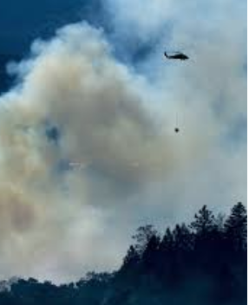
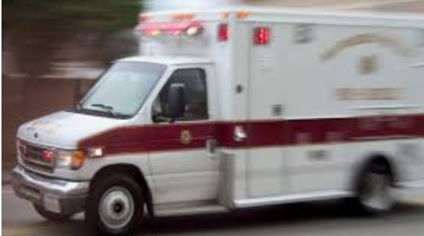
What is a trauma trigger?
The brain creates associations between two patterns of neural activity occur simultaneously and repetitively.
Negative emotions often make things even more memorable than positive ones
Information first comes in to the lower, more primitive areas of the brain.
This is why associations we have during traumatic experiences can become “trauma triggers,” starting the cascade of trauma related symptoms in the child.
Notes:
The brain creates associations between two patterns of neural activity occur simultaneously and repetitively.
Negative emotions often make things even more memorable than positive ones
Information first comes in to the lower, more primitive areas of the brain.
This is why associations we have during traumatic experiences can become “trauma triggers,” starting the cascade of trauma related symptoms in the child.
Dr. Nicholson’s Remarks: Because trauma memories are so often associated with implicit memories and those sensations and the senses—what we smelled, what we touched, what we heard, what we saw—they don't have time registers. It's not like, “That happened then. And now I'm here and I'm safe." This is why we want to understand what a trauma reminder is or a trauma trigger. The child's brain associates that perceived feeling of fear, hopelessness, lack of control. A freezing cold evening, the smoke in a fire, the sound of an ambulance rushing, a parent away from a home, the sound of a gunshot. They associate the feeling they had in their body with the things they saw, with the things they heard, with the smells. In this case, maybe the child remembers the red jacket of somebody with intimate partner violence, somebody who abused a caregiver. Or, like I said, the sound of the ambulance.
What happens is the moment they experienced those sensory memories or the feeling of discomfort in their body, it triggers that stress response. It's not like that happened way back then. It's like they see the red jacket and their brain says, "You're in danger again." It's like it transports them back to being in that place, of observing the intimate partner violence. This is why we can have a child sitting with us calm, reading a story. They have a trauma reminder, and it's automatic and it’s a split second, and they go into all those fight-flight-freeze behaviors that Jonathan talked about. And we say, "Where did that come from?”
It feels irrational. But if we can learn to understand the stories they're telling us, we can build empathy and realize they're not feeling safe. They need to feel safe. We can learn to tell them that they're safe. They're here and now. We can take deep breaths with them. We can hum to them. We can help them understand that, "You're safe in my care. We're going to make sure that we stay together with you until you feel safe." There are lots of things we can do and we're going to get into that. But we want you to understand that this can happen in a split second because of what trauma reminders are.

Slide 16
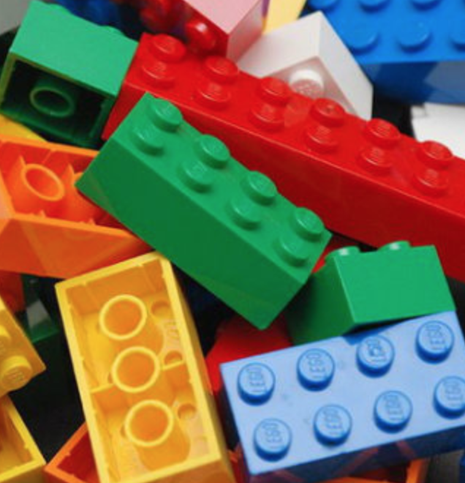
Two-Year-Old Mateo: Fight Response
Notes:
Two-Year-Old Mateo: Fight Response
Trainer: Give a trigger warning that this piece includes trauma and encourage participants to find the place in the world where their body meets the world: it could be their bottom or their back against the chair. Just have them find that spot on their body where they meet the world and bring their attention to that spot for a second.

Slide 17
Fight Response
Two-year-old Mateo and his family are experiencing homelessness. Over the last few months, Mateo has been moving from one relative’s house to another. Because of the constant disruptions in his life and his mother’s need to quickly pack their clothes and move at night to whatever house they can find to give them a place to sleep, Mateo no longer has any toys that he can play with when he leaves his child care center. He worries that just like he lost his home, he will lose other things that he cares about, including the toys he plays with when he is at the center. One morning, Mateo arrived at the center and started playing with Legos, spending a long time trying to build a tower. Another child in the toddler class, John, walked up to Mateo and started taking some of the Legos. Mateo immediately responded by hitting, kicking, and pulling John’s hair until he got the Legos back.
Notes:
Trainer: Read the vignette out loud and tell participants to listen for trauma reminders and stress behaviors:
Two-year-old Mateo and his family are experiencing homelessness. Over the last few months, Mateo has been moving from one relative’s house to another. Because of the constant disruptions in his life and his mother’s need to quickly pack their clothes and move at night to whatever house they can find to give them a place to sleep, Mateo no longer has any toys that he can play with when he leaves his child care center. He worries that just like he lost his home, he will lose other things that he cares about, including the toys he plays with when he is at the center. One morning, Mateo arrived at the center and started playing with Legos, spending a long time trying to build a tower. Another child in the toddler class, John, walked up to Mateo and started taking some of the Legos. Mateo immediately responded by hitting, kicking, and pulling John’s hair until he got the Legos back.
Participants shared answers in the chat box; these were some of the triggers discussed:
Taking up the toys, somebody coming into his space, taking the Legos—he's taking them back.
The Lego could represent a shelter.
There is the reminder, the loss of control, a reminder of the loss, the disruption—then hitting, pulling the hair, kicking.
The fear of losing something and their sense of control is to grab everything they can find and try to hold onto it and not let go.

Slide 18
Five-Year-Old Ella: Flight Response
Suriya is a visitor who has permission to be in the kindergarten classroom at a public elementary school; the children have never seen before her before. She starts observing the children as part of an assignment she is completing in her teacher-training program at the local university. Suriya has hair just like Ella’s mother (a child in the center) who used to abuse Ella before she was removed by Child Protective Services and placed in care with her aunt and uncle. Ella starts to cry the moment Suriya enters the classroom; she runs and hides under a table and her whole body starts to shake.
Notes:
Dr. Nicholson’s Remarks: Let's look at five-year-old Ella and a flight response.
Trainer reads the vignette out loud:
Suriya is a visitor who has permission to be in the kindergarten classroom at a public elementary school; the children have never seen before her before. She starts observing the children as part of an assignment she is completing in her teacher-training program at the local university. Suriya has hair just like Ella’s mother (a child in the center) who used to abuse Ella before she was removed by Child Protective Services and placed in care with her aunt and uncle. Ella starts to cry the moment Suriya enters the classroom; she runs and hides under a table and her whole body starts to shake.
Dr. Nicholson’s Remarks: Ella starts to cry the minute that she sees Suriya. We could imagine that she runs, she hides under the table. She might pull up a jacket over her head. In another instance, we could imagine a child trying to run out of the room. We might see a whole-body startle. We might see a shake. We might see a collapse to the ground. Let's think about the trauma reminder here. This is a familiar example. We could imagine that in this kind of situation.
Feel free to share what's coming up for you as you see this using a trauma-responsive lens, that attunement and understanding and asking a question.
A lot of folks use this language that we're going to move away from of, “What is wrong?” or “What's wrong with that child?”—which we wouldn't ever want to use in early childhood in any case—to, “What happened to that child?” I have concerns about that. I feel that instead of saying what happened to the child, I think we need to say, “What is the child's story? What are they communicating to me about how they're feeling and what they need? How can we be responsive to help them feel safe?” Nobody, no child, no adult wants to be defined by trauma. We don't want to lead with that being how we define them.
We're not recognizing that buffering effect and the resilience that we can build and strengthen throughout our lives, so it worries me to say that. “What is the child experiencing?” Is something that came through chat. I love that question. “What is the child experiencing? How can I learn and lean in, notice, observe, and create safety for that child so that I can respond to what that child's experiencing?”
Jonathan’s Remarks: What happened is past-focused. And it could be...I'm always trying to think. I'm trying to empathize with these responses and thinking, hmm, even why that, and maybe what is happening in that moment is what happened. This response is what happened. And they're showing again the world, this is what happened. This is when I need help. And if we go to what happened, maybe that response is telling us, this is too intense for me right now. My brain wants to go intellectually into the past. And it's just a call to say, "Oh, I need to table that curiosity and refocus on what is happening.”
Dr. Nicholson’s Example: And build that safety for the child. Even if we don't know what happened, we don't know what the trauma reminder is, we don't even know if it's trauma, but we notice these behaviors that look like they don't feel safe, we can attune, we can build empathy. And it's a mindset, a total mind shift. My dear colleague, Julie Kurtz, many of you know who I do a lot of training and book writing with and so on, she was in a training the other day with somebody who said they live in one of the communities that's impacted by the fire. A young child had been begging the mother, "Could we please, please, have pancakes? Could we please go out and have pancakes?” So, the parent brought this child to have outdoor pancakes after many asks. They arrived, they ordered, and while they were waiting for their food, the smell from the kitchen was a little bit smokey, the smell that you'd have from the kitchen, but it was enough that it had the child have a trauma reminder of the smoke from the fires in their neighborhood. All of a sudden, the child said, "We've got to go, we've got to go home. We've got to go home. We got to go." And she said, "A year ago before I had any trauma awareness training, I would have been so upset. Like, ‘Why? We just got here. Go to that rational place.’” She said this gave her the mindset of saying, "Something's happening. My child's not feeling safe and I'm going to lean in and attune, remind him that he's safe." Say, "Okay, we can go, but I just want you to know we're safe. Let's take a deep breath together." There's lots of different strategies, but it was such a powerful reminder that this is a mindset shift in building empathy.

Slide 19
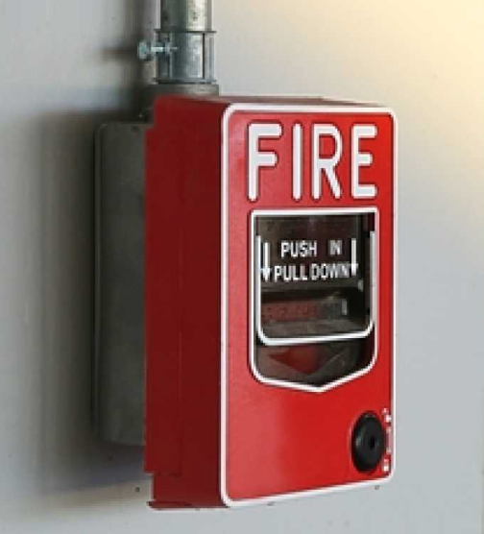
Four-Year-Old Benji: Freeze Response
Notes:
Optional slide: If time permits here is another vignette that provides and example of Freeze Response—Four-Year-Old Benji: Freeze Response.

Slide 20
Freeze Response
Benji, a four-year-old child in a Head Start classroom, was home when a water heater in his apartment building exploded; the explosion started a fire and lead to the evacuation of his building and two of the residents being transported by ambulance to the local emergency room. Ever since this traumatic event, Benji has been very sensitive and frightened when he hears loud noises. One morning, the school fire alarm is accidentally triggered, and all the children are told by their teacher to line up and walk outside to wait on the playground until the firefighters come and determine that the site is safe and that they can return to their classroom. All the children walk outside as they are asked to do except Benji, who is later found by the program director who sees him standing in the corner of the room, holding his ears, completely frozen and unable to move. He is unresponsive to the director’s touch, verbal direction, or guidance. Benji is staring into space, completely unresponsive to all the stimulation and sounds around him.
Notes:
Trainer reads the vignette out loud:
Benji, a four-year-old child in a Head Start classroom, was home when a water heater in his apartment building exploded; the explosion started a fire and lead to the evacuation of his building and two of the residents being transported by ambulance to the local emergency room. Ever since this traumatic event, Benji has been very sensitive and frightened when he hears loud noises. One morning, the school fire alarm is accidentally triggered, and all the children are told by their teacher to line up and walk outside to wait on the playground until the firefighters come and determine that the site is safe and that they can return to their classroom. All the children walk outside as they are asked to do except Benji, who is later found by the program director who sees him standing in the corner of the room, holding his ears, completely frozen and unable to move. He is unresponsive to the director’s touch, verbal direction, or guidance. Benji is staring into space, completely unresponsive to all the stimulation and sounds around him.

Slide 21
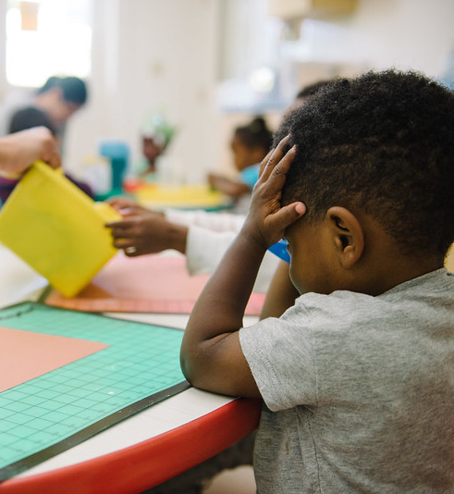
All behavior is communication.
“Fundamental acceptance and approval of each child is not contingent on her meeting the teacher’s expectations of what she should be; it simply depends on her being alive, being a child, and being in the group.” (Hendrick, 1996)
Being present is a part of a process of noticing. Can you return to an available emotional presence, a curiosity and wonderment of the child?
Notes:
“Fundamental acceptance and approval of each child is not contingent on her meeting the teacher’s expectations of what she should be; it simply depends on her being alive, being a child, and being in the group.” (Hendrick, 1996)
Being present is a part of a process of noticing. Can you return to an available emotional presence, a curiosity and wonderment of the child?
Jonathan’s Remarks: This is part of that mindset shift; it came from an investigation that we were looking at in our laboratory school at Mills College. I want to acknowledge that when we work with children, we are busy. There is so much to attend to, so much on our plate. We're thinking 10 steps ahead. We're planning an activity while getting the food ready, while tending to the child who's having this response. We can all recall moments where we're just present, where we have that connection and that feeling. For many people, it's those moments that are the sustaining moments of the work.
This quote really sums it up for me. The fundamental acceptance and approval of each child is not contingent on her meeting the teacher's expectations of what she should be. It simply depends on her being alive, being a child, and being in the group. There's so much pressure, there's developmental milestones, and tasks, and things they're working on. But at the end of the day, we can return back to this, the acceptance and the approval of this little person is just because they're alive, not because they're working on something.
A reminder to ourselves that being present is part of a process of noticing. You can return to this available emotional presence and a curiosity and a wonderment with the child.

Slide 22
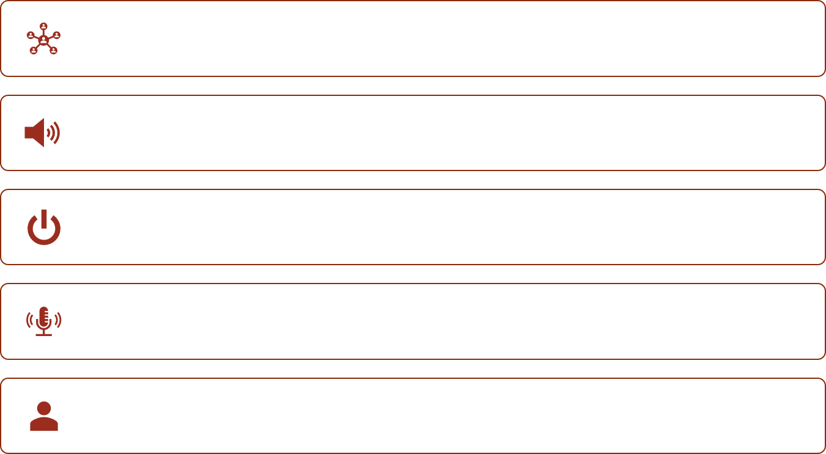
Breakout Room
Join your breakout room.
Unmute yourself.
You may turn on your video.
Assign a recorder.
Assign a reporter.
Notes:
Facilitator should review expectations of the breakout room feature before participants are assigned to their rooms. Some of the expectations might be
join your breakout room:
unmute yourself;
you may turn on your video;
assign a recorder to take notes that will be shared in the main room; and
assign a reporter who will share out the group’s findings.
Also, before releasing participants to their rooms, facilitator may copy and paste the instructions from the next slide into chat. This will allow participants to see the instructions while in their rooms. Provide this information to participants. You can say “I’ve pasted the instructions to chat. You can open chat in your breakout room and view the instructions to facilitate your conversations.”
OPTIONAL: Have groups utilize the Google Slides in the Breakout Room. Facilitator may want to show the steps to accessing the Google Slide and show how groups can record their responses. Each group will record their responses on the Google Slide that corresponds with their Breakout Room number (i.e., Breakout Room 1 will work on Google Slide 1). Each group should only open their own slide to work on:
Facilitator may want to copy and paste the Google Doc link into chat. The Google Doc will be used to record the groups share-out items while in their rooms. Provide this information to participants. You can say, “I’ve pasted the link to the Google Slide in chat. You can open chat in your Breakout Room and use the Google Slide to record your conversations.”
Invite participants to breakout rooms.
Share out in the main room: Once everyone is back in the main room, facilitator will open the Google Slide and share screen. The facilitator will then invite the reporters in each group to share their list.

Slide 23
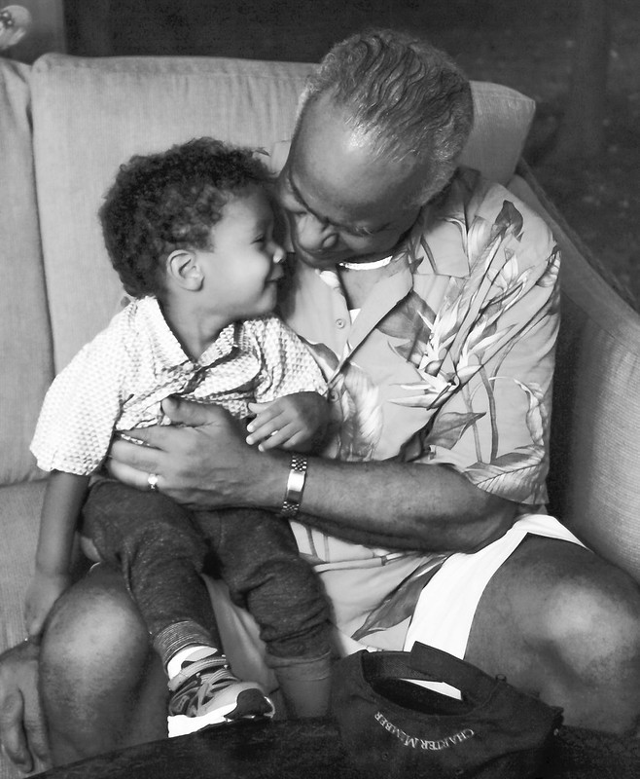
Breakout Room (2)
How does traumatic stress impact the young children you are working with?
How can understanding the automatic stress response system (FFF) help you build understanding and empathy for children impacted by trauma—Children like Mateo, Ella, and Benji?
Notes:
How does traumatic stress impact the young children you are working with?
How can understanding the automatic stress response system (FFF) help you build understanding and empathy for children impacted by trauma—Children like Mateo, Ella, and Benji?
Breakout room instructions: We're going to give you 5 minutes in a breakout room with a couple of colleagues to think about and name this. We're going to shift right after this breakout to thinking about play and what we can do about all this. But it's important to begin by having a few minutes to think about how is it impacting either young children that you're directly working with, or maybe you're working with folks, you're supporting those who are working directly with. And how does understanding this neurobiology of stress and trauma help you build understanding and empathy for children like Mateo, Ella, and Benji, or those that you're working with? Begin to name some of those things, and we're going to build from that onto how you support them with play.
I'm going to put folks in breakout rooms. You'll have five minutes in a group of two or three. So, you’ll have a minute or two each to take turns sharing. You can use the help button if you need us for anything. Take a picture of this slide if you want to remember the questions and we'll see you back in five minutes. You'll get that one-minute reminder when it's time to come back. (One or two participants shared out.)

Slide 24
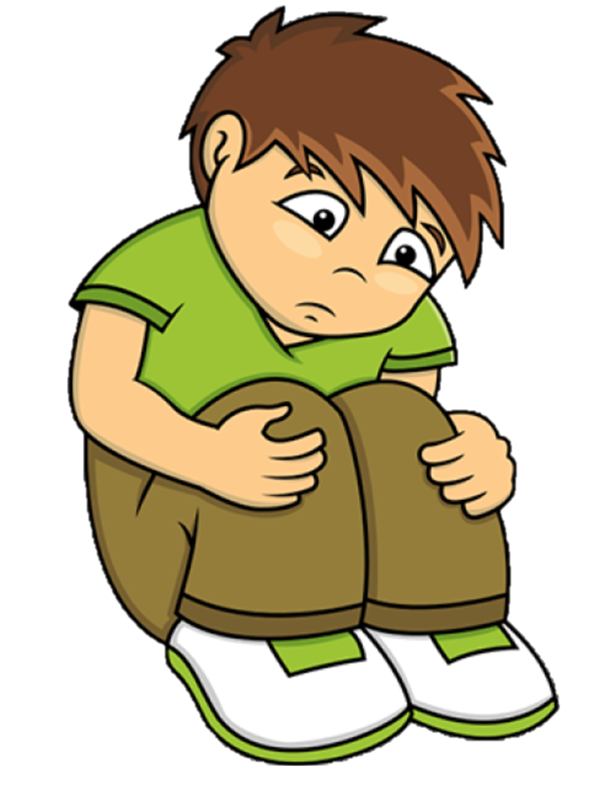
Trauma can significantly influence how children play.
Notes:
Jonathan’s Remarks: Play is difficult for children who've experienced trauma. It's complicated. It's complex. And children with a trauma history have difficulty being really present in the moment. Their amygdala is constantly activated. They're in this state of scanning; it's a constant vigilance scanning for harm, scanning for potential danger. And this is called hyper vigilance. They often perceive that others are judging them or trying to harm them. Being able to go into that play state is really interrupted constantly and unconsciously.
Because their relational parts of their brain, their limbic systems and their neocortex, or the self-control systems are affected and underdeveloped, they might judge situations as personally threatening when they're actually not.
This is an example, a little girl with a history of trauma might observe a classmate across a space laughing and immediately perceive that they're being laughed at, that the little girl is being laughed at herself. And if they have a fight response to that trauma trigger, they might go over and hit, or kick, or yell, or confront and start confrontation with the child who's laughing. If they have a flight response, they might run away or just start crying. And in a freeze response, they may suddenly just look like they're daydreaming. And this is the response that so often is unnoticed, the peaceful child in the corner that's daydreaming and tuned out. With all the chaos around us in settings it could be easy to miss that this could be a trauma response. As they mature and their verbal abilities increase, we can support them by helping them to learn to read social cues more accurately and readjust that alarm system. Give them some pause in their reactivity so that they can go through a process. We can join with them to go together, to ask "Why are you laughing?” Give the other person a chance to explain, to help share what their experience. A child may misperceive the intentions of their peers, but they can be supported to start to build trust and feel safe at school. And it's especially important when they have this fight response, because there can be a tendency to start to label the child. That child might be the child that fights or the biter, the hitter, the kicker.
They start to acquire these identities that are given to them by the others in the space. We see this and other parents might start to be afraid of that child. Teachers might have more reactivity to that child. We have to be really conscious as these identities start to get put onto the child. We have to interrupt that. We also have to recognize the historical bias and especially the racial bias of reactive children being suspended or removed from center's more quickly and we need to counteract that.

Slide 25
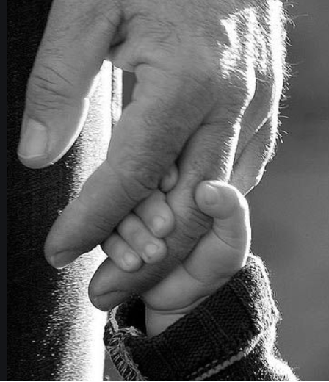
Safety and Basic Needs
For children to engage in play, they must have a feeling of trust that their primary caregivers will keep them safe and ensure that their basic needs are met (food, water, protection, safety).
If children are preoccupied with their own survival, they are prevented from using their cognitive energy to imagine new and interesting possibilities for their toys and play materials or to enter imaginary play frames that depart from the world right in front of them (what they perceive).
Notes:
For children to engage in play, they must have a feeling of trust that their primary caregivers will keep them safe and ensure that their basic needs are met (food, water, protection, safety).
If children are preoccupied with their own survival, they are prevented from using their cognitive energy to imagine new and interesting possibilities for their toys and play materials or to enter imaginary play frames that depart from the world right in front of them (what they perceive).
Dr. Nicholson’s Remarks: So, does it make sense now for us to say this: that if children are preoccupied in their reptile brain, and their limbic brain and their forebrain are cut off—their CEO is not in business, and they're preoccupied with their survival—that they're not going to have cognitive energy to be able to do things like imaginary play. Imaginary play, it's a privilege if we think about it from a neuro-biological context, and maybe not just imaginary play, but risky play. Play that's developing where you're with others, and you're deeply engaged where you lose that sense of space and time and you're just so focused. If the brain is perceiving threat or your stress response is activated, you're hypervigilant. You're constantly scanning for danger. You can't afford to let go and be in a play frame. So, this is why it's really important for us to understand why children who are activated and are impacted by trauma may come to us, or we may see them not engaging in play.
We might say they don't know how to play. They probably do have some sense of knowing how to play, but their body is telling them they can't afford to play. It's not safe to play. And there also might be some, if they had chronic stress and chronic activation, they may not have had a history of playing. And so, it might be that they need a lot of scaffolded support. I just want to bring this home that children have to have a feeling of trust that their basic needs are going to be met, that they're not threatened, in order to play. And that's one of the things that is really sad about our trauma impacted children. That it's a right for their thriving, for their learning and their development, that can be taken away as they're scanning the environment constantly.

Slide 26
Trauma enters into children’s play in several ways:
Infants may show very little engagement with toys and little interest in interacting with others in a playful manner.
Toddlers’ play often has a chaotic and purposeless quality.
Preschoolers may struggle to engage in imaginary play; or they may play out the trauma over and over with negative emotion and aggression in play that feels “stuck.”
Often children have no joy, adventure, story, or imaginative discovery in their play.
Notes:
Trauma enters into children’s play in several ways:
Infants may show very little engagement with toys and little interest in interacting with others in a playful manner.
Toddlers’ play often has a chaotic and purposeless quality.
Preschoolers may struggle to engage in imaginary play; or they may play out the trauma over and over with negative emotion and aggression in play that feels “stuck.”
Often children have no joy, adventure, story, or imaginative discovery in their play.
Jonathan’s Remarks: We see the trauma show up in their play when they are engaged in play in lots of different ways. Infants might have very little engagement with toys. They have little interest in interacting with others in a playful manner. Sometimes toddler's play is very chaotic and has a purposeless quality. Preschoolers can struggle to engage in imaginary play. They might be too scared to engage because their fears and their worries live there. And, that imaginary play might represent too closely the life experiences that they have, and it's overwhelming, and it can be scary. Other children that have developed symbolic capacities, they have no joy or adventure or imaginative discovery within their play.
Sometimes, especially with preschoolers, you'll see this mapping behavior where they start and then stop and bounce to a new thing and start, and then stop and then bounce to a new thing. And there's a little pinball or those old comics with the little dotted line of the kiddo going everywhere and this inability to settle in.
Dr. Nicholson’s Remarks: And we can understand if you have that charge in your body that feels uncomfortable, you don't want to be with it. It's why it's so hard for children who have trauma reminders to nap. Because the settling in, and the quiet in the dark, those feelings flood in. So, we see children trying desperately not to nap—to ask us questions, to fiddle, to, “Can we do this? Can we do that? One more bedtime story, one more...”—because they feel all of the trauma reminders, even just the internal physiological feelings in the quiet.

Slide 27
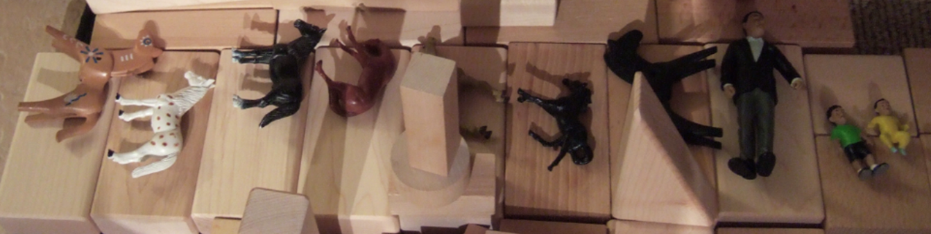
Reenacting Traumatic Through Play
When children reenact a traumatic experience over and over in reenactment play, they can turn an overwhelming and frightening traumatic event into something predictable that they feel a sense of control over. Pattern and repetition are the key to creating predictability and a sense of control for a child. This is why it is not unusual to see a child reenacting worries and concerns in play in a manner that can feel “stuck” for observing teachers. For many children, this repetition is helpful—the surprise and fear of the trauma becomes familiar and predictable and, therefore, under their control.
Notes:
Dr. Nicholson’s Remarks: I just wanted to show you this slide. This is from my own family. When children re-enact a traumatic experience over and over in reenactment play, in many cases, what they're doing is they're taking a very overwhelming and frightening event and they're creating that sense of control and agency and predictability.
So, we might see something, a child reenacting an experience they had. And in this case for my young daughter, with this, she would create over the period of about three years, graves all over our house. And she did this at school; she did this at home. It is important and there are mental-health consultants who can help us understand when we need certain targeted intervention for children, when it's just a trauma story that's being played over and over in a way that's not helping the child, but sometimes we see children so engaged, so focused on this play in ways that it can feel stuck, but they're working through it. And they're taking something where they had a feeling of fear, terror, helplessness, and by repeating and iterating that over and over and over, they're creating a pattern and predictability.
They're reducing the uncertainty, reducing the lack of control in their brains. And in that way, they're learning to cope and heal with it. And after they get to that point of creating the predictability, they can re-narrate the ending. They can become the heroes and heroines of their own story. We can help them with those endings of that bad thing that happened and look at how you're so strong and you're here and you've made friends and you're in kindergarten and all of these things. I want to say, Bruce Perry talks about how it sometimes takes thousands of these iterations for children to do this.
So, I wanted to share this example with you, because we went through this for three years and it was helping her cope to go through this story of the burying and the graves. And I wrote a paper about this. One day, the animals were just sleeping in their graves and then the animals woke up. And then she was able to stop working in this way, through the play with the graves. But I just want to say that, when children re-enact through play, it can look stuck. It can be worrisome for us, but we also must not jump to conclusions that that's traumatizing for children. It can be very helpful for children to create that sense of predictability and routine.

Slide 28
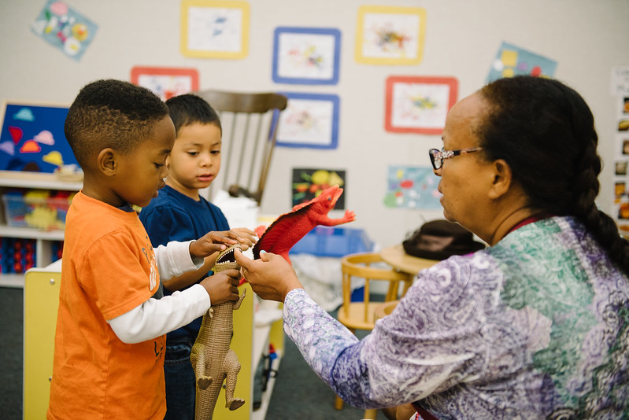
Good news…
Healing can be induced through consistent, attuned communication within the context of our most important relationships.
Notes:
Healing can be induced through consistent, attuned communication within the context of our most important relationships.
Dr. Nicholson’s Remarks: We have been saying this, but we're going to leave on this note that healing can be taught, can be supported, can be scaffolded. And I know that was a heavy first piece of the training, and we're going to shift after break into looking at what we can do to set up our environments, how we can use play to support children's coping and healing. And you all have a tremendous power to disrupt these things from becoming harmful, short and long term.
(15-minute break was given)

Slide 29
Anthony in Preschool
Anthony is riding a tricycle at his preschool when a loud airplane flies overhead. He covers his ears and screams “no, no, no, no” repeatedly. His preschool teacher, Lawanda, walks over to Anthony, bends down to his eye level and uses a calm and reassuring voice to tell him, “Anthony, you are safe, you are here in preschool where the teachers will take care of you. That loud sound was an airplane way up high in the sky. You are safe down here on the ground with me. Let’s take some deep breaths together.”
Notes:
Anthony is riding a tricycle at his preschool when a loud airplane flies overhead. He covers his ears and screams “no, no, no, no” repeatedly. His preschool teacher, Lawanda, walks over to Anthony, bends down to his eye level and uses a calm and reassuring voice to tell him, “Anthony, you are safe, you are here in preschool where the teachers will take care of you. That loud sound was an airplane way up high in the sky. You are safe down here on the ground with me. Let’s take some deep breaths together.”
How does Teacher Lakrisha help Anthony feel safe?
Consider Anthony’s trauma reminders, stress behaviors, trauma-informed strategies, and your own reaction to Anthony.
Dr. Nicholson’s Remarks: We wanted to share this as a way to realize some very simple ways of looking at trauma responsive practices. Reads slide out loud.
Part of trauma-informed practice is also just giving language and brain-based strategies to say, “Good for you; thumbs up on what you're doing.” And here's why this is helpful. But you may not know. And the teacher may not know that Anthony observed a car accident with really loud crashing sounds. And it's okay if we don't know that, if we do know it, we understand his trauma reminder even more. But even if we didn't, I want to just ask us to take a look at this and to say: What are some of the things that you see Lawanda, his teacher, doing that are trauma responsive? Not just, what is she doing, but why? What's happening here? What do you see in this?
Read responses from the chat: So, if we were to say that the loud sound is reminding, that's the trauma reminder; his body is being transported back as though he were in that moment of the crash. So, recognizing his feelings—yep. That’s like, what is he experiencing? She's noticing that he's fearful, bends down and explains: “You're safe.” I can't say enough how important that is. You're going to say that and train people and encourage people to say that a hundred times a day. She's co-regulating him. She's letting him borrow her calm to help guide him back to regulation. Acknowledging his feelings. She's making herself smaller so that she is helping his lower brainstem not to perceive threat because somebody bigger and taller over him might... It's unconscious, it would happen. Comforting him, close to the student, not far away. So, creating that secure base—we're in this together, I'm going to stay with you—helping him feel safety, letting him know he's not alone.
She's helping him move that experience and memory from an implicit memory that is sensory based that takes him back as though he's in the original traumatic situation and helping him ground himself in the here and now saying that's up there, you're down here with me. She's helping him separate, that loud sound is up there you're here where you're safe. Because his body is thinking I'm in that unsafe situation with that loud sound
Jonathan’s Remarks: It's a recreation of the process of assessing a threat and you could see her walk through that process and help redo the architecture of: Who are you? You're Anthony. You are safe. You are here; Where are you? When are you? What is that noise? It's a slow and together re-going through that process of assessing what he just reacted to.
Dr. Nicholson’s Remarks: And I would say that we could imagine the more trauma responsive, she wouldn't rush up to him because again, she wants his perceptual system not to perceive threat. And when we go back, this is our evolutionary system, right? So, it was perceiving the lions and tigers and those things that were harmful and scary to us. We don't want the perceptual system to perceive threat. So, she might be walking up slowly, calmly bending down gently. She's going to use a soft tone of voice. She might even just give him a moment without saying anything, just being with him. This is where I might come down and just start a little hum to help his body just relax so that he can take in my co-regulation.
You'll see in having a visual aid for children that shows some of these things that they can do when they feel worried, not in the moment, but just, we can take belly breath together. You can ask for a hug. These kinds of things: helping him see what was done and how he has power and agency to not feel stuck in that place of trauma and fear, and even to name, you know how Daniel Siegel talks, “name it to tame it”—that when we can name something, it helps reduce stress. This is why it's so powerful to build sensory literacy and naming what's happening in your body. Do you feel like you have a volcano ready to explode? Do you feel like you have a rock? Do you feel all those kinds of sensory sensations in our body—not the emotional; emotional literacy is important, but we have to start with sensory before we can get to emotional literacy when we're talking about trauma.

Slide 30
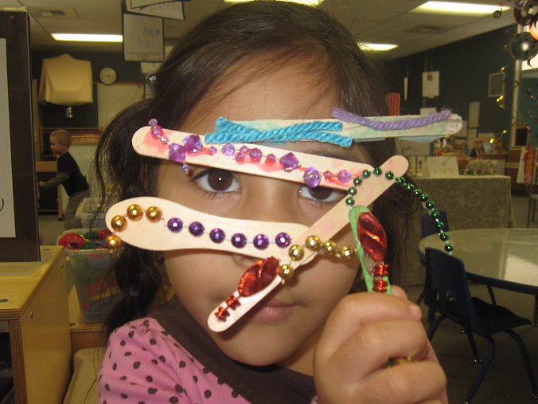
Create opportunities for children to communicate their fears and worries and express their anger and big feelings in constructive ways.
Sensory/Structured play
Expressive arts
Loose parts
Big body/Active play
Rhythmic movements
Outdoor play/Nature play
Inspirations from medical play
Storybooks
Notes:
Create opportunities for children to communicate their fears and worries and express their anger and big feelings in constructive ways:
Sensory/Structured play
Expressive arts
Loose parts
Big body/Active play
Rhythmic movements
Outdoor play/Nature play
Inspirations from medical play
Storybooks
Dr. Nicholson’s Remarks: We are going to shift into thinking about different opportunities for children to communicate fears and worries and to express anger and big feelings through play. And what are ways that we can set up environments to support healing and coping and building resilience through the use of play. And we're going to just whip through these. Know that we're keeping an eye on the chat. We welcome you to add anything. And there's a handout on this that I worked on with the Early Childhood Funders. It's a free resource. You'll have access to it. It's in Spanish and English, but we'll talk through some of these things and why they are supportive of children and why we need to really fight for play to remain in our early childhood settings. Because this is such a part of the human rights for children, that they have a way to cope with the big feelings that they are experiencing.

Slide 31
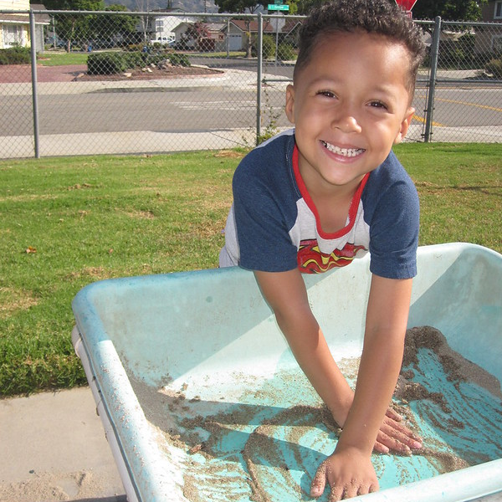
Sensory Play,
Structured Play
Notes:
When we think about sensory play, we often think about such things as water and sand. Sometimes people will use things like beans in a water table, other people don't because they feel like using food is not appropriate and sends the wrong messages. But those are used to have sensory play or any kind of sensory object like that. That can be an individual bin during COVID, or we used to have larger bins where children were together.
A couple of reasons to have this kind of play are really critical. Remember, we talked about how they might be hypervigilant. If they need to scan the environment to feel safe in that environment, if they're constantly activated and stressed, this is a way in which they can be playing with a sand table, even if it's an individual bin or water, not only soothing and calming their stress response system by doing so, but it allows them a way to actually play where they don't have to take their attention away from survival. For children who can't, because they don't feel safe enough to do things like taking away that cognitive energy to engage in object play or fantasy play, it's like an access-equity issue. This is a way that we can support them to play with us.
Jonathan’s Remarks: Sensory play often brings you right into the moment because the fluid or the object you're using is just often so controlled by gravity. And so, it can be repetitive. It can be repeated. It can be engaged in just to the amount that they want to. They might just want to get their fingertips wet. They might want to dive their whole arms, but also that through all of these, they tell you so much in the way they engage in it, they might be just dumping or submerging, and you can learn so much from sensory play by watching how they engage with something.
Dr. Nicholson’s Remarks: For some children who are sensory defensive, which could be impacted because of trauma, they might not want to touch things, but they'll use the objects to pour water, play with sand. They may not want it to touch them. And other kids, like Jonathan said, might just literally put their arms and bodies into it. And it's modulating for their sensory system to do that. So, with my children, this is where a therapist took us, was this play to start with. We couldn't do any play therapy with objects. They weren't ready. So, we started with this kind of play as an entry in.

Slide 32
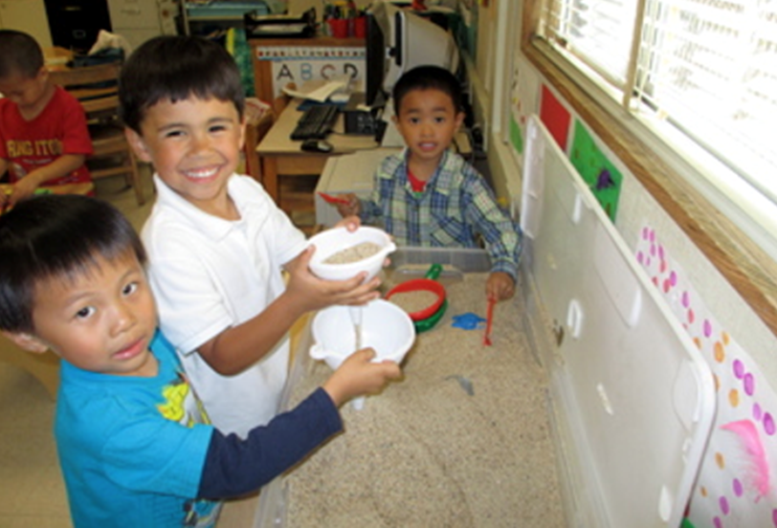
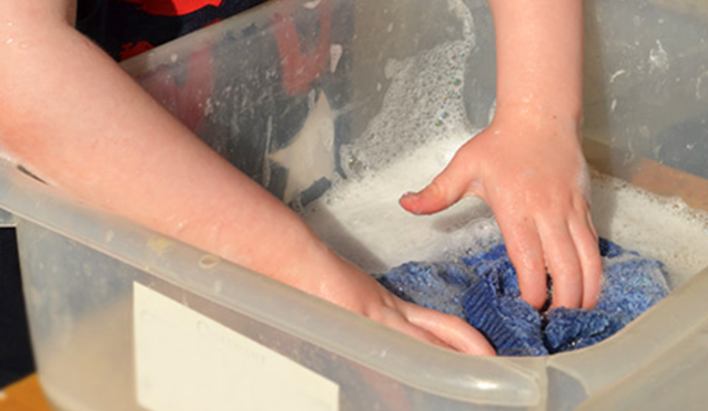
Sensory Experiences
Notes:
Dr. Nicholson’s Remarks: Here we have two different examples. A lot of people in COVID-responsive settings are using individual bins.

Slide 33
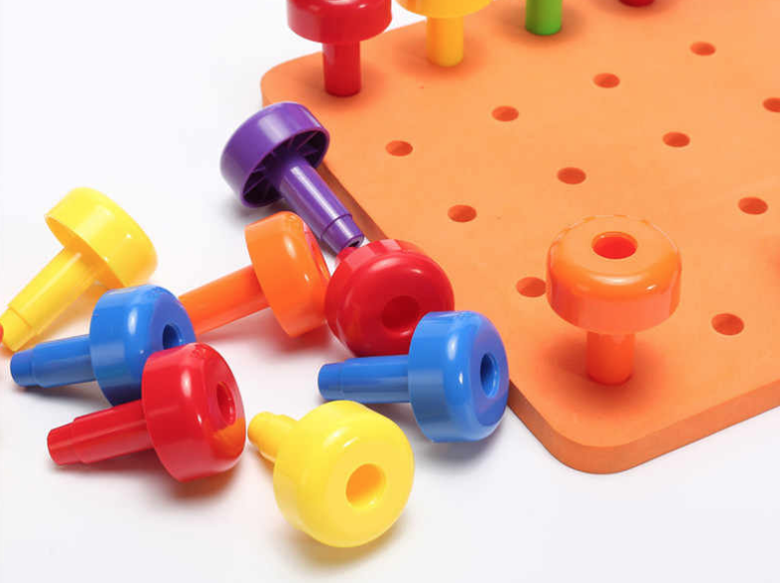
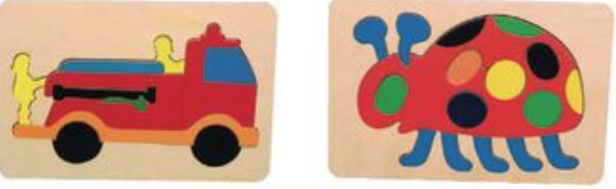
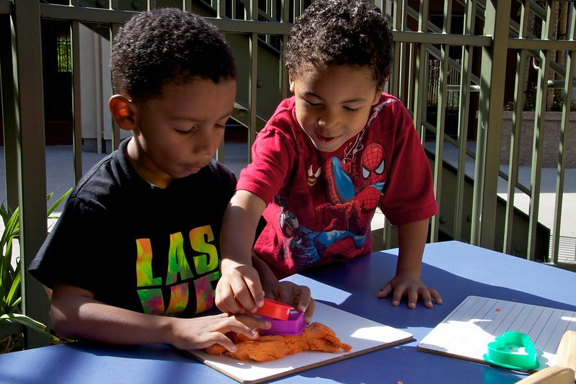
Sense of Mastery
Notes:
Dr. Nicholson’s Remarks: For sensory play you've see the Play-Doh. Play-Doh can be extremely calming. Children can pound at it. They can poke at it. They can regulate. Think of how many of you as adults find it calming in a meeting to hold on and squish something, to bite on a pen, to do different things—to drink coffee—right? The same can be for children holding something like Play-Doh: they can regulate their systems. It's a co-regulator for them.
Structured play: I want to just talk about this for a minute. These things like pegboards that you see here, puzzles without too many parts, very simple things without too many pieces. What does this offer to the child whose CEO, and maybe their limbic system, is out of business right now. They're activated, or they came in activated, or you're worried that they might activate quickly. It doesn't require—and this is the same with the sensory play—it doesn't require them to engage with children. It could, the way you said it could do that, but it doesn't have to. Children can play with water and sand without having to have all those social-emotional capacities, without having to share and negotiate and use language. And if they're activated and their neurons aren't firing in their limbic system and in their forebrain, this allows them to both engage and participate and have access to play. But it reduces the cognitive demand on them. They don't have to navigate socially/emotionally. They don't have to navigate with language.
But here's another piece: children who experience a lot of trauma have the reduction in learning opportunities and therefore the reduction in opportunities for them to develop a sense of self efficacy, a sense of mastery that is so critical to those early childhood years. Those tasks that they do over and over: as they're learning to climb up a play structure and they climb the first step, and then the second step, and they feel a sense of mastery as they work towards a goal. Children impacted by trauma have that interrupted. So small, structured play objects like this can give them a sense of mastery without requiring more than they're capable of doing if their stress response systems are activated.

Slide 34
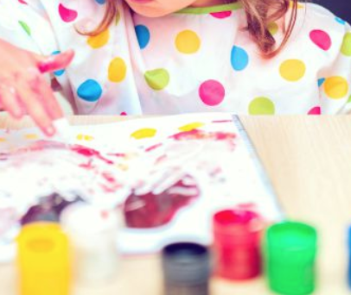
Expressive Arts
Notes:
Dr. Nicholson’s Remarks: Expressive arts: This makes sense to a lot of us—painting, drawing, acting— anything where it's open-ended enough. And they're able to take their big feelings, their big emotions, and embed them in a process in an experience; this is really, really helpful. And if we go back to this idea that for adults and for children to name something, to take it out from the internal lived experience where it might be scary because we're not sharing it, it's something we're hiding and it's deep inside. And in the case of trauma, we're not even aware of it. It's there to bring it out into the open, to tell our stories. And I'm thinking of, when I talk about telling stories, I mean, in the hundred languages of children way. Telling our stories through dance, through acting things out, through painting, through drawing. In many different ways, when we're able to tell a story of how we feel or what we're experiencing, it can be very soothing, but it can also be part of what builds resilience. It gets that experience out from inside of us, that charge of energy into the outside. And that's the first step in calming the stress response system.
It also might be that something is way too scary for a child to talk about. And they might first need to talk about something where there's some distance. So that picture I showed you with the horses, my daughter, who had several relational losses in the first year of her life, she couldn't talk about that, but she could bury an animal. She could create a funeral for something else where there was some symbolic distance before she could tune it inward and work on her own trauma and healing.
Jonathan’s Remarks: Expressive arts is a great space to be a curator also, of an experience. And to be really conscious of the materials, the colors, the textures of the paper, they can all play into the experience. Trauma might be something around fire and providing lots of cool colors on the color spectrum can be a chance to make sure that the expressive art activity is potentially less triggering. But you really get a chance to be the person who helps set the safe space by what is being offered and, and how. If you know that they have sensory things, maybe think of painting isn't going to be such a therapeutic or expressive art activity for that kiddo.
Dr. Nicholson’s Remarks: Everything is so individual. And what we're talking about here, especially with these opening ideas, this is for a child who you see is very activated and dysregulated and isn't going to be able to engage in a lot of other play or learning activities in the classroom. These are things that can help bring a child back to calm and regulation so that they can engage in other ways of being and other activities. So, I'm all about challenge and I'm all about individualizing and noticing, but we just wanted to give you some tools for those children that look like they're showing you the fight, flight, or freeze. And they're not going to be able to participate in other things, so this is helping you think about how to support those children to be able to reenter and reconnect but yes, scaffolding and supporting is always really what we're about.

Slide 35
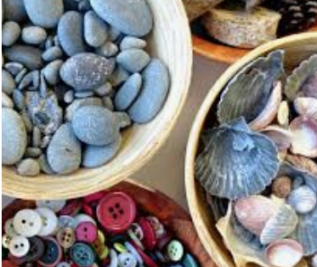
Loose Parts
Notes:
Dr. Nicholson’s Remarks: We're going to quickly go through, for the same reasons that these are loose parts, that the child can bring themselves, their experiences and have a sense of a way to tell their stories and they get to reveal what they want to. They have a sense of agency and control. Loose parts can be very helpful for children in that way.
It also can be though for children who experienced trauma; making a choice, making a decision, or having too many variables and options can be completely overwhelming. For one of my children, she couldn't be in a co-op or a preschool where there's a lot of changing adults, a lot of options and choice. That was completely debilitating and scary for her. She needed her world to be brought smaller and down with just a couple of choices that helped her feel safer and it reduced the cognitive load and helped create more predictability. So loose parts can go either way, we just want you to have a sense of how they can be important and helpful for children and others. You'll see, it can be very overwhelming.

Slide 36
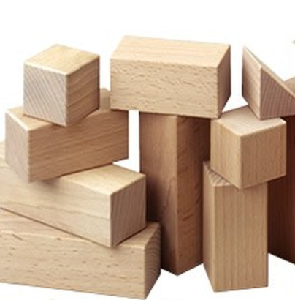
Blocks
Notes:
Dr. Nicholson’s Remarks: Blocks can be one of those things that, I know that in COVID, it's very hard and exhausting and time consuming to clean them. A lot of programs are choosing to spend effort and energy to keep them available for the very reason that children can bring so much of their worries and concerns into the blocks and have that open-ended way of working through things.

Slide 37
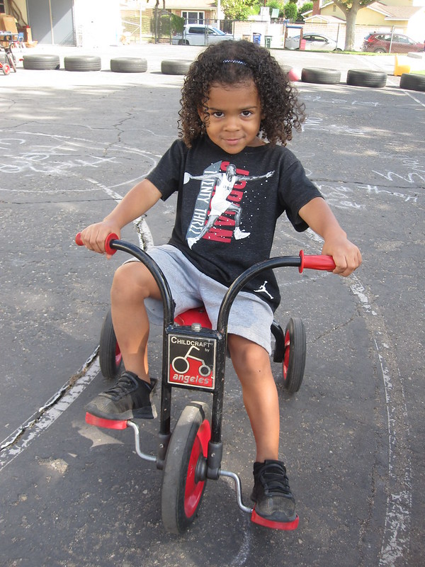
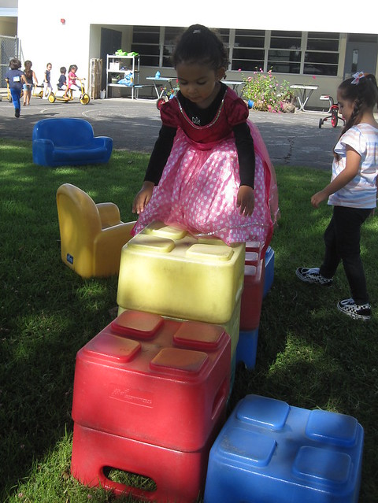
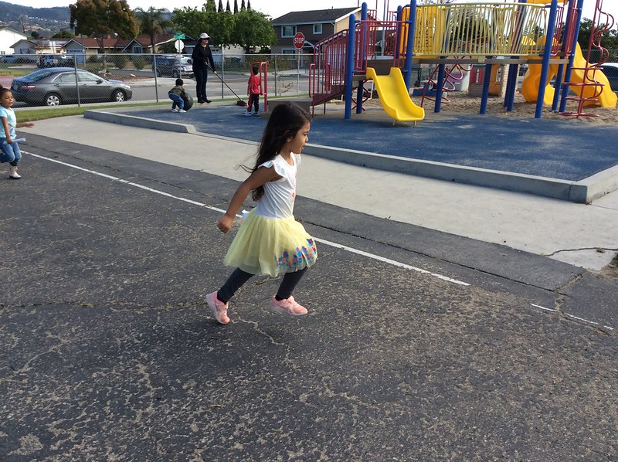
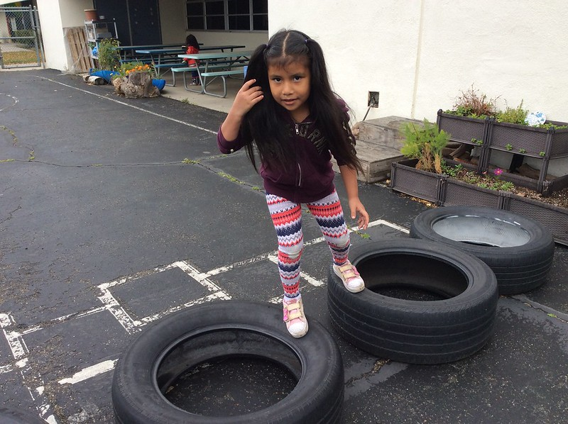
Support Children to Release Extra Energy
Notes:
Support children to release the extra energy charge that accumulates in their bodies when their stress response systems have been triggered.
Children who live with high levels of stress need opportunities to engage in large motor activities that allow them to release the additional energy in their bodies that results from the activation of stress chemicals. The early learning program may be their only opportunity to run, climb, jump, stretch, swing, ride a tricycle, or otherwise engage in big body play and release of energy. Not only are these opportunities supportive of children’s physical development, but they also reduce the chances of long-lasting impact resulting from the stress chemicals released after a triggering event.

Slide 38
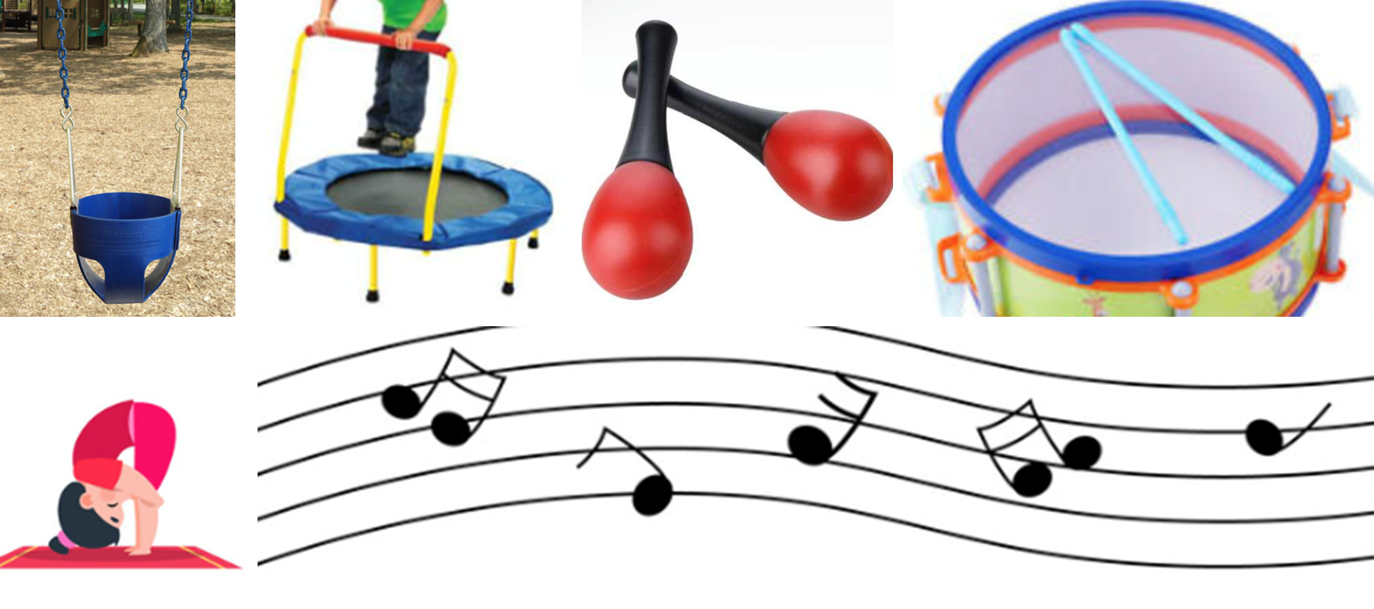
Support Children to Engage in Repetitive Rhythmic Movements
Notes:
Dr. Nicholson’s Remarks: For those of you who have taken trainings with Bruce Perry or others, the neurosequential model and so on, you know how important repetitive rhythmic activities are for young children. They heal the brain from trauma. They both create with a rhythmic activity, swinging, rocking, jumping on a trampoline, drumming sounds, chanting. These things create a patterned predictability for the child, but it also helps in terms of the brain and it's rewiring.
It helps the brain to develop optimally to engage in these things, but it helps to calm the stress response more than most things, which is why people use the fold-up rocking chairs or different kinds of rockers, or even just hold a child and rock back and forth. The humming and chanting of something over and over and over or swinging can just sooth and immediately regulate a child and stop the release of stress chemicals.
The more we can build these in throughout the day or give children options of choosing to use these if they start to feel those body dysregulations the better. We're helping them build resilience and we're helping ourselves to help them get back to a learning state more quickly.

Slide 39
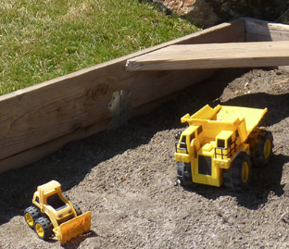
Outdoor Play,
Nature Play
Notes:
Dr. Nicholson’s Remarks: Nature play. You saw how many of you found your grounders in nature? There are decades of research on the power of nature to regulate our systems. It has something to do with engaging the senses, and it's the beauty of nature that is full of loose parts. Children can choose their level of engagement. They can bring stories to nature and play with loose parts in a way where they can bring all those big feelings. But in the research on nature, it's not just being in nature. That's fabulous, but if you can't do that, bringing nature to the child—even just looking at greenery, looking at pictures of nature—can be regulating. Hearing the sounds can be regulating from nature, which is why some of these apps have us doing that, Calm and Headspace, right? It can be a coregulator for children. So just thinking and knowing that outdoor play—whether we're actually outdoors or bringing the outdoors in—can be a really helpful tool for supporting children as trauma responsive.

Slide 40
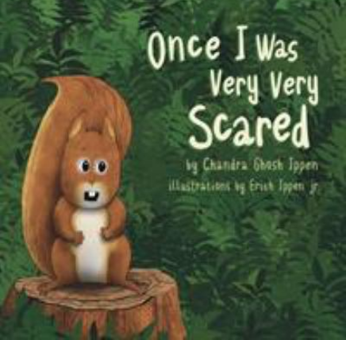

Bibliotherapy
Notes:
Dr. Nicholson’s Remarks: Rudine Sims Bishop talks about the importance of children having mirrors and being able to see their life experience named. It's part of “name it to tame it.” And so bibliotherapy can be very powerful for children. I just wanted to put these books here as an example of some of the things in these times that can be really valuable

Slide 41
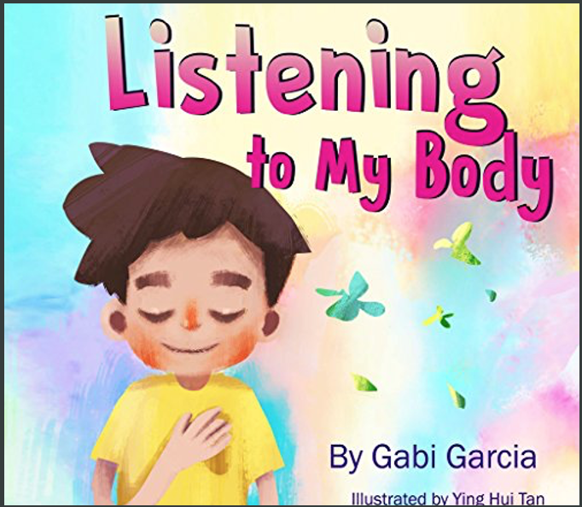
To Help Children Learn Body Awareness/
Sensory Literacy
Notes:
Dr. Nicholson’s Remarks: Gabby Garcia's Listening To My Body is beautiful for teaching body awareness and sensory literacy. And we have handouts in English and Spanish that go along with this book, Listening To My Body, that you will have access to.

Slide 42
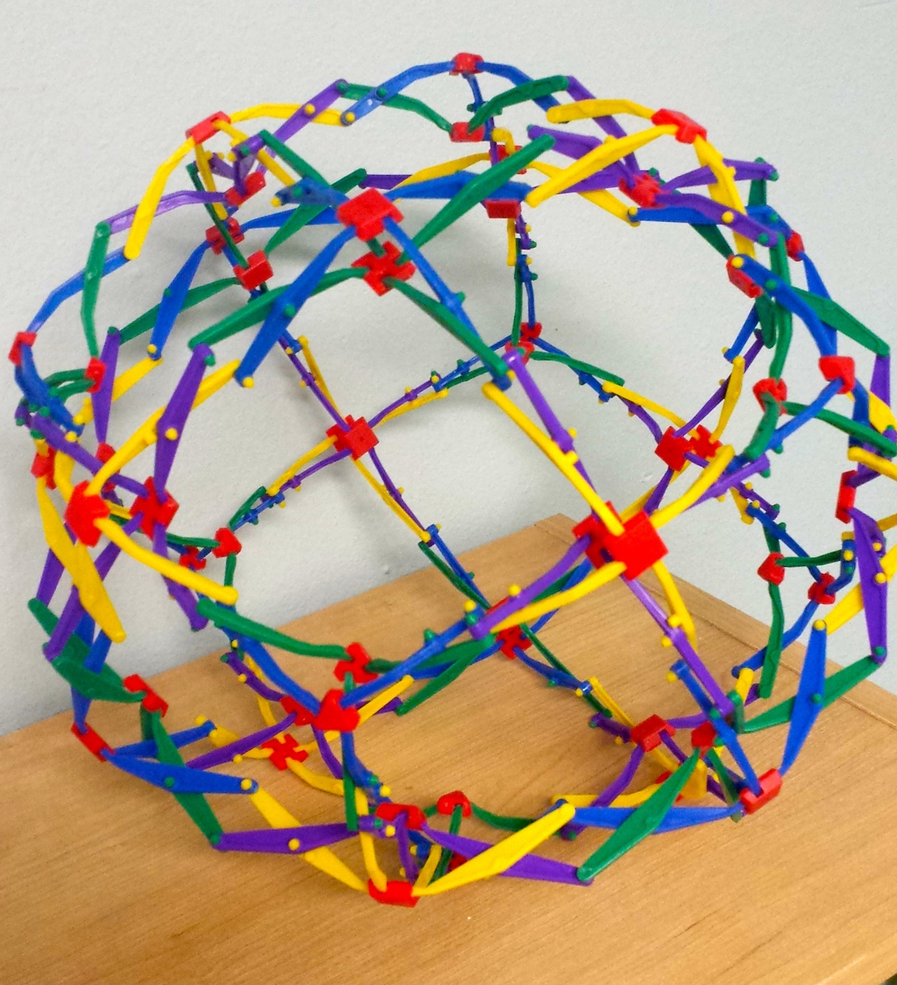
Breathing Ball
Notes:
Jonathan’s Remarks: Breathing ball: Sometimes it's a helpful visual cue of expanding and contracting and could be done together. A lot of people were saying, "We're activated too." Sometimes using this together can calm yourself and show them that it's possible to breathe while I'm activated a little bit. We don't have to hide that always.
We talk a lot about calming corners and some of those are trickier now because of COVID, but something like some objects to help co-regulate with breathing can be very, very helpful

Slide 43
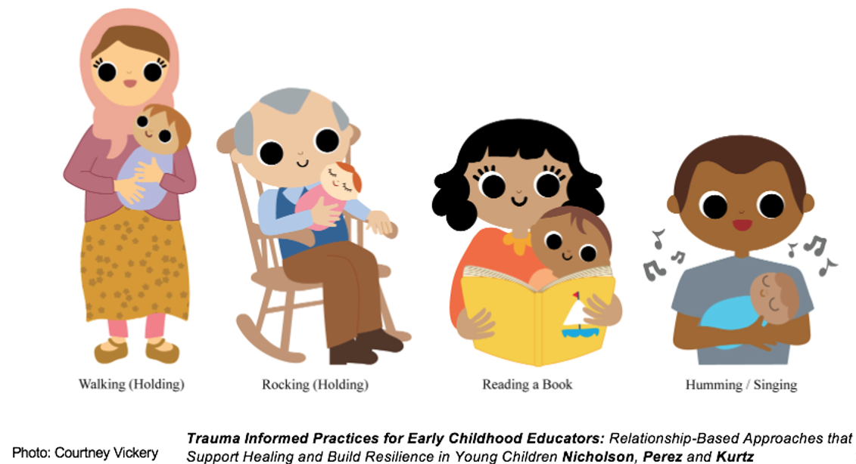
Trauma Informed Practices
Notes:
Trauma Informed Practices for Early Childhood Educators: Relationship-Based Approaches that Support Healing and Build Resilience in Young Children

Slide 44
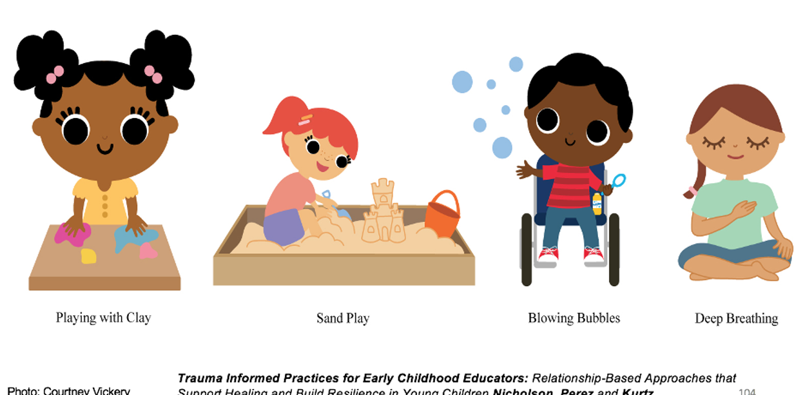
Trauma Informed Practices (2)
Notes:
Continued: Trauma Informed Practices for Early Childhood Educators: Relationship-Based Approaches that Support Healing and Build Resilience in Young Children

Slide 45
Which types of play do you include in your environment? What can you add?
Sensory/Structured play
Expressive arts
Loose parts
Big body/Active play
Rhythmic movements
Outdoor play/Nature play
Inspirations from medical play
Storybooks
Notes:
Poll:
Which types of play do you include in your environment? What can you add?
Sensory/Structured play
Expressive arts
Loose parts
Big body/Active play
Rhythmic movements
Outdoor play/Nature play
Inspirations from medical play
Storybooks

Slide 46
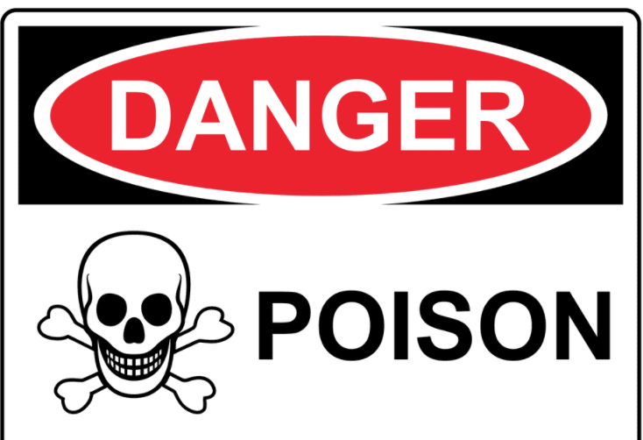
It was poison!
Four-year-olds Zoe and Mateo are playing in the sandbox. Zoe grabs a handful of sand and offers it to Mateo, “Would you like some ice cream? It’s rainbow sprinkles.” Mateo takes the sand and pretends to eat it. Zoe laughs and yells, “It was poison! Now you might just get really sick and die.”
Notes:
Read slide out loud: Four-year-olds Zoe and Mateo are playing in the sandbox. Zoe grabs a handful of sand and offers it to Mateo, “Would you like some ice cream? It’s rainbow sprinkles.” Mateo takes the sand and pretends to eat it. Zoe laughs and yells, “It was poison! Now you might just get really sick and die.”
Dr. Nicholson’s Remarks: This was taken from a child care center that my daughter works at here in the Mission in San Francisco. So, this kind of talking about poison and being sick and dying, this comes up right now: it's coming up a lot. We wanted to just give you a minute to just share with one another in the chat box. Given all that we've talked about, what are some ways that you can acknowledge the experience for these children and think about how to help them feel safe and how to respond to something like this as it emerges in a classroom or in a program. It could be a play group or family child care. What are some things that you could take away?
Read some responses from the chat.

Slide 47

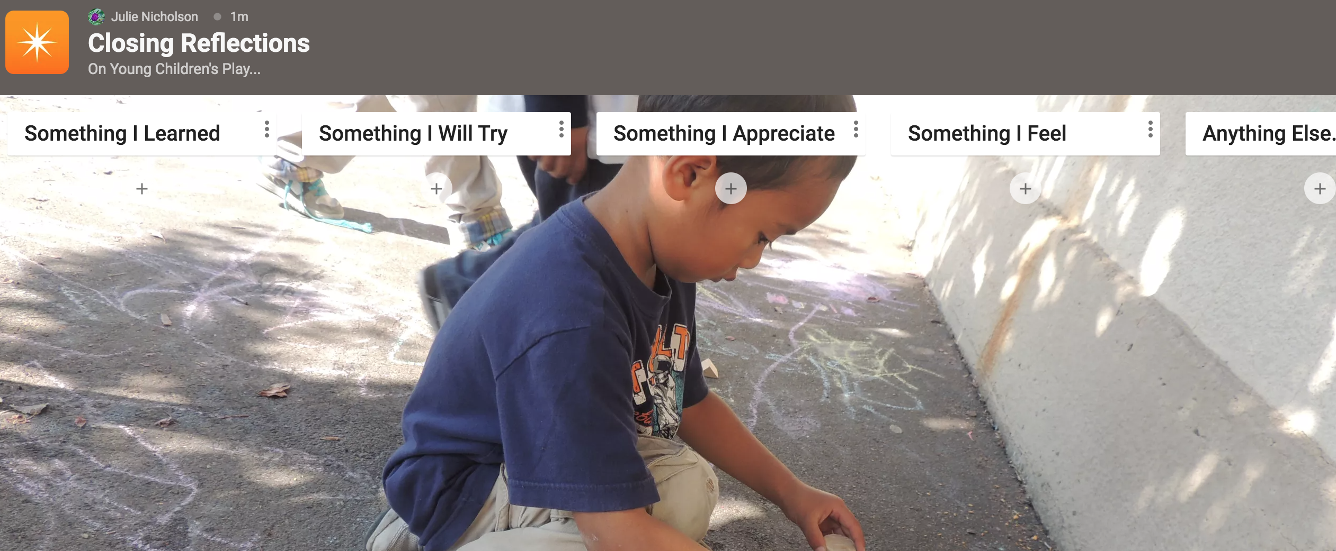
Closing Reflections
Julie Nicholson
Closing Reflections
On Young Children’s Play…
Notes:
Optional Slide: Include a Padlet Link and have participants respond to each of the columns on the Padlet. Share the Padlet the screen as responses are typed in. Trainer may change out the picture on the slide with a screenshot of the Padlet they created.

Slide 48
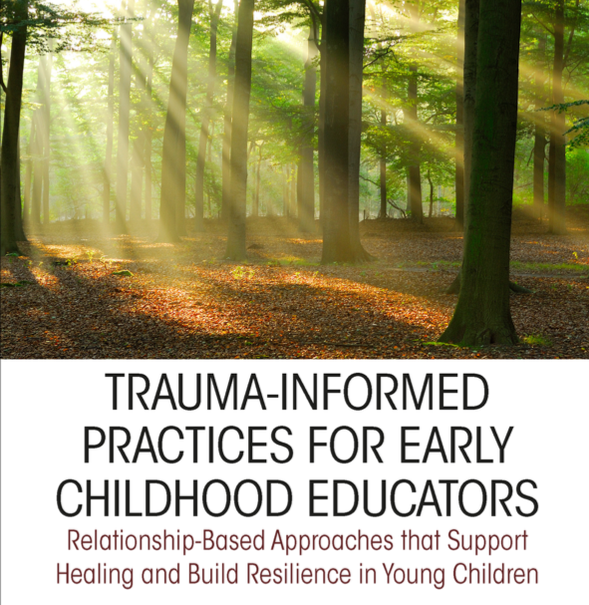
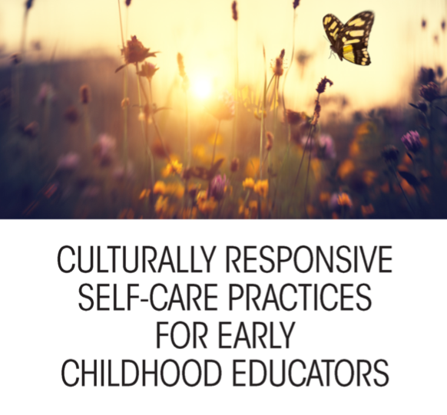
This training was based on content from The Powerful Role of Play in Education and the following additional resources:
TRAUMA-INFORMED PRACTICES FOR EARLY CHILDHOOD EDUCATORS:
Relationship-Based Approaches that Support Healing and Build Resilience in Young Children
JULIE NICHOLSON, LINDA PEREZ, AND JULIE KURTZ
An Eye On Education Book
CULTURALLY RESPONSIVE SELF-CARE PRACTICES FOR EARLY CHILDHOOD EDUCATORS
JULIE NICHOLSON, PRIYA SHIMPI DRISCOLL, JULIE KURTZ, DOMENCA MARQUEZ, AND LAWANDA WESLEY
An Eye On Education Book
Notes:
This training was based on content from The Powerful Role of Play in Education and the following additional resources:
TRAUMA-INFORMED PRACTICES FOR EARLY CHILDHOOD EDUCATORS: Relationship-Based Approaches that Support Healing and Build Resilience in Young Children; JULIE NICHOLSON, LINDA PEREZ, AND JULIE KURTZ; An Eye On Education Book
CULTURALLY RESPONSIVE SELF-CARE PRACTICES FOR EARLY CHILDHOOD EDUCATORS; JULIE NICHOLSON, PRIYA SHIMPI DRISCOLL, JULIE KURTZ, DOMENCA MARQUEZ, AND LAWANDA WESLEY; An Eye On Education Book

Slide 49

Thank you!
Notes:
Thank you!

