Slide 1
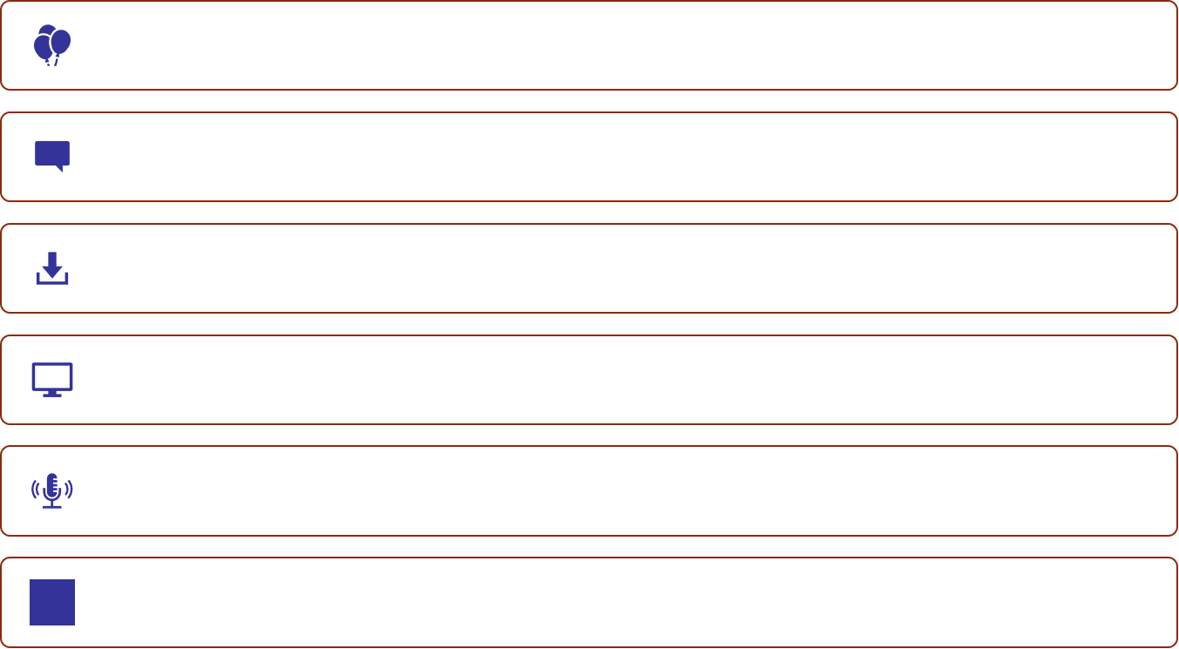
Before we begin…
Welcome!
Introduce yourself in chat.
Download the publication.
Join from a desktop or laptop (recommended).
Utilize audio and breakout room features.
Ensure the "Share Screen" feature is available.
Notes:
Text from the slide:
Welcome!
Introduce yourself in chat.
Download the publication.
Join from a desktop or laptop (recommended).
Utilize audio and breakout room features.
You will need paper and a pen.
Welcome to the virtual session of the Preschool English Learners: Principles and Practices to Promote
Language, Literacy, and Learning—A Resource Guide (Second Edition) (PEL Guide)—”Chapter Seven: English Learners with Disabilities
or Other Special Needs.”
This module is an extended version of the Chapter Seven segment in the Overview Module.
If you have not already done so, you may download the publication to follow along at https://www.cde.ca.gov/sp/cd/re/documents/psenglearnersed2.pdf.
This session lasts for three hours—inclusive of interactive breakout rooms and chat conversations. Please locate the chat feature to stay in communication with everyone. Set up your messages to be sent to ”All panelists and attendees.”
Invite participants to introduce themselves with the following information (The facilitator may add their own questions if necessary.):
Name
City of location
Current role at agency
Agency/organization
How long have you been in the ECE community?
We will be utilizing the breakout room feature. It is preferable that you participate with a desktop or laptop to make this transition smoother. You will have the option to unmute yourself in the breakout room and share information. You may also turn on your video at any time during the session by selecting the video camera icon on your Zoom floating tool bar.
Make sure you can utilize the Share Screen feature. Please locate it now and type the letter ”S” in the chat after you have found it.
Please locate the Q&A box to ask questions at any time.
Steps to receive professional learning hours will be reviewed at the end of the session.

Slide 2
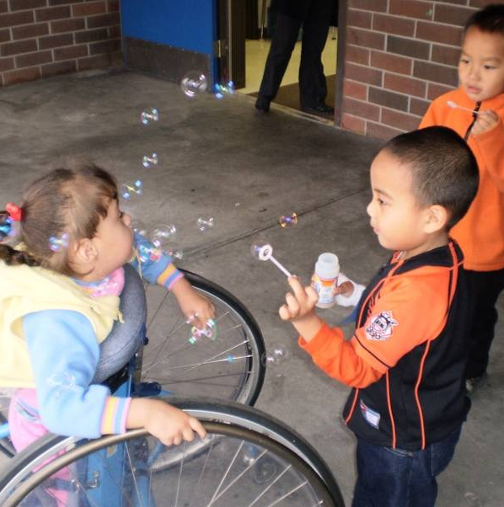
Chapter 7 Extended Module: “English Learners with Disabilities or Other Special Needs”
Preschool English Learners: Principles and Practices to Promote Language, Literacy, and Learning—A Resource Guide (Second Edition) (PEL Guide)
Notes:
Chapter 7 Extended Module: “English Learners with Disabilities or Other Special Needs” (Preschool English Learners: Principles and Practices to Promote Language, Literacy, and Learning—A Resource Guide [Second Edition] [PEL Guide]
Some of the information in this module was introduced at the overview training conducted by CPIN and will be developed in greater depth in this training. Trainers would thus benefit from reviewing what has been previously covered related to this module and should refer to that content as needed.
©2021 California Department of Education (CDE)
2

Slide 3
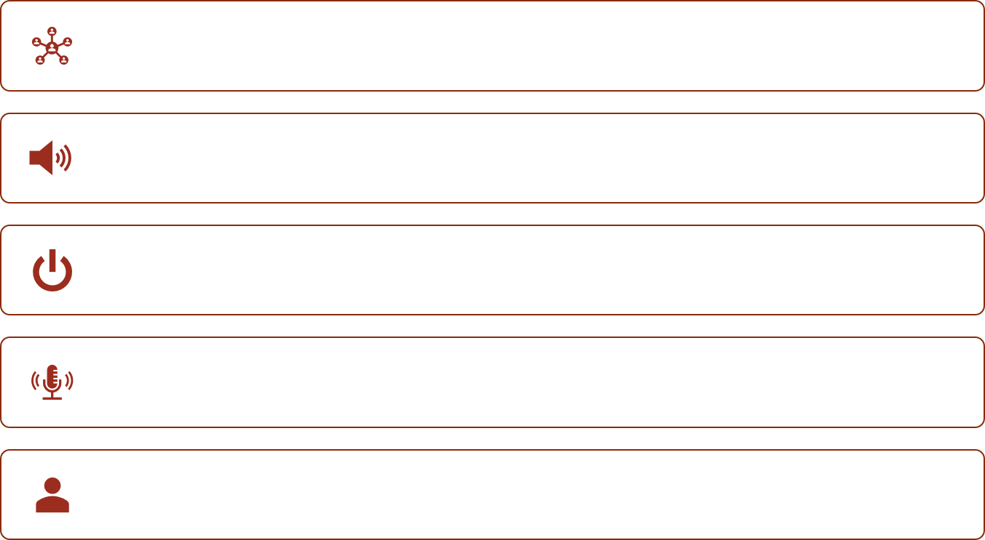
Breakout Room
Join your breakout room.
Unmute yourself.
You may turn on your video.
Assign a recorder.
Assign a reporter.
Notes:
Facilitator notes: Facilitator should review expectations of the breakout room feature before participants are assigned to their rooms. Some of the expectations might be
join your breakout room:
unmute yourself;
you may turn on your video;
assign a recorder to take notes that will be shared in the main room; and
assign a reporter who will share out the group’s findings.
Also, before releasing participants to their rooms, facilitator may copy and paste the instructions from the next slide into chat. This will allow participants to see the instructions while in their rooms. Provide this information to participants. You can say “I’ve pasted the instructions to chat. You can open chat in your breakout room and view the instructions to facilitate your conversations.”
OPTIONAL: Have groups utilize the Google Slides in the Breakout Room. Facilitator may want to show the steps to accessing the Google Slide and show how groups can record their responses. Each group will record their responses on the Google Slide that corresponds with their Breakout Room number (i.e., Breakout Room 1 will work on Google Slide 1). Each group should only open their own slide to work on:
Facilitator may want to copy and paste the Google Doc link into chat. The Google Doc will be used to record the groups share-out items while in their rooms. Provide this information to participants. You can say, “I’ve pasted the link to the Google Slide in chat. You can open chat in your Breakout Room and use the Google Slide to record your conversations.”
Invite participants to breakout rooms.
Share out in the main room: Once everyone is back in the main room, facilitator will open the Google Slide and share screen. The facilitator will then invite the reporters in each group to share their list.

Slide 4

Find the Best Seashell
Guiding Principle: “Celebrate and support the individual” (PCF, Vol. 1, p. 101).
Notes:
Activity: Seashells Disability Awareness Activity
Preparation: Use the image on the slide or upload a new photo.
Procedure: Show the slide in Present view. Ask participants to find a "perfect shell” on the slide or on their Find a Perfect Shell handout (Point: All shells are shaped differently. Some have spots, and so forth, so there really is no "perfect shell.”).
Breakout Room: Invite participants to discuss the experience of picking their shells in their small group. Have them talk about why they picked their shell as the “perfect shell.” (Point: Talk about how boring it would be if all shells looked the same and how interesting it was to look at their differences.)
Ask participants why they think we did this activity or how they think this activity relates to the topic.
One more thought: Children are not only different on the outside, but they are also unique on the inside.
Debrief: All children come to our classrooms with their own special unique differences! Invite participants to debrief about finding the “perfect shell.” Again, all children are important regardless of their abilities and appearances. Make sure to introduce the concept of People First Language so that participants and presenters are mindful of using appropriate terms throughout this presentation.
Presenters can reference the brochure titled, Guidelines for Reporting and Writing about People with Disabilities, Seventh Edition (2008) [https://www.ndrn.org/images/Documents/Advocacy/Amicus_Activity/Guidelines_for_Reporting_and_Writing_about_People_with_Disabilities.pdf]. For further reading, have participants highlight the “People First Language” article (The article is in the training binder and can be found at www.disabilityisnatural.com).
4

Slide 5
Training Outcomes
Become familiar with the California Early Learning and Development System and regulations related to special education.
Develop a better understanding of the characteristics of language disorder and language difference based on cultural considerations.
Explore cultural considerations and research-based instructional strategies for English learners with disabilities or other special needs.
Become familiar with statewide and local resources.
Notes:
This presentation consists of three major sections:
Current issues (systems, data, complexities of diagnosis, etc.) related to English learners with disabilities (outcomes 1 and 2).
Cultural considerations and instructional strategies for the classroom and home (culturally considerate responsive practices, adaptations, and accessible curriculum) (outcome 3).
Collaboration (Who might the local partners be, and what are some resources?) (outcome 4).
Training outcomes:
Become familiar with the California Early Learning and Development System and regulations related to special education.
Develop a better understanding of the characteristics of language disorder and language difference based on cultural considerations.
Explore cultural considerations and research-based instructional strategies for English learners with disabilities or other special needs.
Become familiar with statewide and local resources.
5

Slide 6
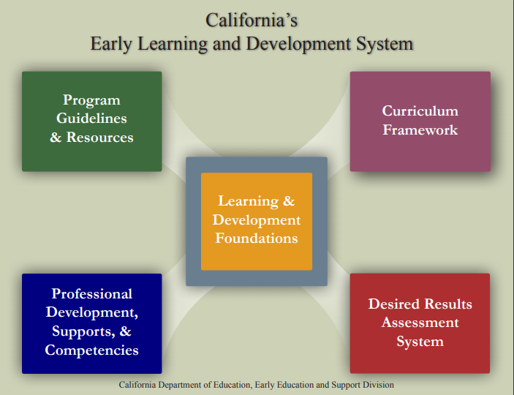
California’s Early Learning and Development System
Notes:
Briefly review the five elements.
Element 1: At the center of the system are the Learning and Development Foundations which describe the learning and development infants and toddlers typically demonstrate with appropriate support at around 8, 18, and 36 months. It also describes the learning and development for preschool children that is typically demonstrated with appropriate support at around 48 and 60 months of age. Having statewide foundations provides all teachers and programs with knowledge of the expectations and goals for children in California to use as they plan activities, interactions, and the environment.
Element 2: Infant /Toddler and Prekindergarten Learning and Development Guidelines present information about how to provide high-quality early care and education, including recommendations for program policies and day-to-day practices that will improve program services. In addition, the Preschool English Learner Guide provides teachers with the knowledge and tools they seek to educate preschool English learners most effectively.
Element 3: The first and second volumes of the Curriculum Frameworks. These publications are a resource for teachers to support setting up environments, selecting appropriate materials, supporting children’s self-initiated play and learning, and planning and implementing teacher guided learning activities. The frameworks are not a curriculum.
Element 4: The fourth component of the system is the Desired Results System. It is a continuous improvement system that is intended to improve program quality. The system consists of the Desired Results Developmental Profile© which measures children’s progress towards the Desired Results, the Parent Survey which measures parents’ satisfaction with the program, the Environment Rating Scales which assesses the classroom environment, and the Program Self Evaluation which assesses program quality.
Element 5: In California, numerous professional development opportunities are available to assist programs. These include the Program for Infant/Toddler Care (PITC), California Preschool Instructional Network (CPIN), California School-Age Consortium (CalSAC), Family Child Care at Its Best, the mentor programs, pre-service, the CDE/ECE Faculty Initiative Project, the Child Development Training Consortium, and the Desired Results Training and Technical Assistance Project.
6

Slide 7
Special Education Law and Age Three
§300.101
§300.323 (b)
Starting at age three, local Education Agencies (LEAs) must provide free appropriate public education (FAPE).
If a child transitions from a Part C program, the LEA must provide an Individualized Education Program (IEP) by the child’s third birthday.
Notes:
We have just reviewed the Special Education Division of Early Childhood Education. Now we are going to look at special education based on the law (This symbol (§) means section number.):
§300.101: Starting at age three, local Education Agencies (LEAs) must provide free appropriate public education (FAPE).
§300.323 (b): If a child transitions from a Part C program, the LEA must provide an Individualized Education Program (IEP) by the child’s third birthday.
Preschoolers with IEPs are assured a free appropriate public education. Appropriate placement is determined during the IEP process according to the child's least restrictive environment (next slide).
The term FAPE is defined as pre-k through secondary school special education and related services that are provided at public expense under public supervision and direction, meet the state’s educational standards, and address the individualized educational needs of the student.
The Individuals with Disabilities Education Act (IDEA) least restrictive environment directive requires the inclusion of children with disabilities in the general education program to the maximum extent appropriate.
The IEP process determines eligibility for special education. Special education is considered a service, NOT a place.
Background Information: If a child’s birthday occurs during the summer, the child’s IEP team shall determine the date when services under an IEP will begin.
7

Slide 8

Special Education Division and Early Childhood Support System
IDEA:
PART B
PART C
State Performance Plan
Annual Performance Report
Desired Results 2015
Early Childhood Special Education Handbooks
Preschool Learning Foundations
Child Development Division
CPIN
California Preschool Instructional Network
Notes:
Here are the projects and programs from the Special Education Division (SED) that support early childhood special education:
IDEA: Part B and Part C; State Performance Plan Annual Performance Report:
Desired Results 2015
Early Childhood Special Education Handbooks
Preschool Learning Foundations, Child Development Division
CPIN (California Preschool Instructional Network)

Slide 9
Access to Regular Preschool Activities and the Law
§300.114 (a)(2) [Preschool Least Restrictive Environment (LRE)]:
To the maximum extent appropriate, children with disabilities, including children in public or private institutions or other care facilities, are educated with children who are nondisabled.
Special classes, separate schooling, or other removal of children with disabilities from the regular educational environment occurs only if the nature or severity of the disability is such that education in regular classes with the use of supplementary aids and services cannot be achieved satisfactorily.
Notes:
300.114 (a)(2) [Preschool Least Restrictive Environment (LRE)]:
To the maximum extent appropriate, children with disabilities, including children in public or private institutions or other care facilities, are educated with children who are nondisabled.
Special classes, separate schooling, or other removal of children with disabilities from the regular educational environment occurs only if the nature or severity of the disability is such that education in regular classes with the use of supplementary aids and services cannot be achieved satisfactorily.
This section of the law addresses placing preschool children in the least restrictive environment. The least restrictive environment must be the first setting considered, which means something different for each child. The least restrictive environment for a preschooler is a general education preschool program and the most restrictive environment may be a hospital setting or a home.
Background information—§ 300.116 also states the following:
(a)(3) Is as close as possible to the child’s home; unless the IEP of a child with a disability requires some other arrangement, the child is educated in the school that he or she would attend if nondisabled.
(e) A child with a disability is not removed from education in age-appropriate regular classrooms solely because of needed modifications in the general education curriculum.
(Individuals with Disabilities Education Act reauthorization 2004)
9

Slide 10


These resources support access to regular preschool activities:
Notes:
In California, we use the early learning standards called the Preschool Learning Foundations (PLF); we use the Preschool Curriculum Framework (PCF) to support teachers in planning and content knowledge.
These resources provide research for a better understanding of the developmental continuum, the content in the developmental continuum of what children may know with high-quality experiences at or around the end of the first and second year of preschool, and teaching strategies for the environment and interactions to support development on this continuum.

Slide 11

Working Together
Special education services:
Preschool Curriculum Framework:
Provides services for children with disabilities
Occurs in a variety of settings
Ensures access to regular preschool activities
Planning learning opportunities
Teachable moments
Routines, environments, and materials
Notes:
Special education services:
Provides services for children with disabilities
Occurs in a variety of settings
Ensures access to regular preschool activities
Preschool Curriculum Framework:
Planning learning opportunities
Teachable moments
Routines, environments, and materials
Children who are receiving special education services must meet eligibility requirements. Special education services and supports for children age three years and older are provided through an Individualized Education Program (IEP) as required in IDEA 2004 (Individuals with Disabilities Education Improvement Act 2004). Special Education services and supports might include transportation, physical therapy, speech therapy, etc. These services can be given in any setting, NOT a special school, classroom, or facility only.
Special education services should be offered in a variety of settings. LRE assumes a continuum of placement settings (starting with typical preschool and moving towards more restricted environments, such as special day classes, home, or hospital programs) based on the individual needs of the child as determined by the IEP team.
Background information for presenter: The Individualized Education Program (IEP) gives access to regular preschool activities through goals, adaptations, services, and support. Goals are written to address the needs of the child due to the disability, and to provide access to, or progress in, the general curriculum. The second part is particularly important when we look at inclusive settings and preschool learning foundations. It is the IEP team’s responsibility to plan a program that helps the child progress in the general curriculum (foundations) in the Least Restrictive Environment (inclusive preschool as an example).
Preschool teachers can make it possible to implement IEP goals in inclusive settings by implementing various strategies. The individualized education program should consist of goals based on developmental levels and a child's particular needs and strengths. These goals are reached by careful mapping out of activities using toys, exercises, games, and other types of play to help the child move toward new goals. Most goals can be incorporated into the child care setting's range of activities during the child’s normal day. Early childhood teachers, parents (crucial partners in the IEP), and various specialists (such as speech and language specialists, psychologists, physical therapists, and special education teachers), team together to plan and carry out a program that meets the students’ individual needs.
§ 300.34—Related services:
(a) General. Related services means transportation and such developmental, corrective, and other supportive services as are required to assist a child with a disability to benefit from special education, and includes speech-language pathology and audiology services, interpreting services, psychological services, physical and occupational therapy, recreation, including therapeutic recreation, early identification and assessment of disabilities in children, counseling services, including rehabilitation counseling, orientation and mobility services, and medical services for diagnostic or evaluation purposes. Related services also include school health services and school nurse services, social work services in schools, and parent counseling and training.
11

Slide 12
IEP Team Members
Legally required:
  Family or guardian
  Designated instruction service providers (specialists)
  Early childhood special education teacher
  General education preschool teacher
  Administrator or designee
  Interpreter
Recommended
  Agency Representative (may be required if transitioning from Part C program)
  Others as requested by family or district
Notes:
Legally required:
Family and/or guardian (equal partner of team, must be respected and valued as an expert of their child)
Designated instruction service providers (speech and language specialist, occupational therapist, adaptive physical education teacher, etc)
Early childhood special education teachers (generate adaptations to meet child’s needs based on disabilities and/or second language acquisition)
General education preschool teachers (articulate typical child development, developmentally appropriate environment, curriculum, and/or second language acquisition)
Administrators (site and/or district) or designees (usually school psychologists)
Interpreter (English learners or sign language users): [CFR §300.501(c)(5)]The public agency shall make reasonable efforts to ensure that the parents understand, and are able to participate in, any group decisions relating to the educational placement of their child, including arranging for an interpreter for parents with deafness or whose native language is other than English.
Recommended, but not required:
Agency representatives (case manager from a local regional center, play or social skill therapists contracted by the regional center)
Others as requested by family or district, such as experts on second language acquisition and community advocates or cultural brokers (who are fluent in the child’s home language and knowledgeable about the home culture)
Background Information: A collaborative approach among team members in the IEP process is required. Access to all children, the importance of general education, and preschool teachers’ involvement in the IEP process need to be explained and emphasized. General education preschool teachers should know the goals and accommodations identified for the child. The intent of the team is to foster collaboration and articulation of joint efforts to serve the child with an IEP. Thus, the intent of the IEP process is collaboration among the team members. General education preschool teachers and special educators work together to understand how the goals, adaptations, services and supports will be implemented in the classroom.
12

Slide 13
The Elements of Successful Collaboration
Children and families first!
Knowledgeable staff
Supportive administrators
Communication and cooperation
Clear understanding of each role
Shared goals
Mutual respect
Humor
Notes:
The single most important element for successful collaboration is respect for each other. Building a strong relationship with families and children is very crucial. In addition, the following ideas are important:
When collaborating as a team, we need to remember that children and families come first. Use people first language. Since the word “families” can be highly diverse in terms of how they define themselves, we should respect to their definition. Strategies to keep families involved:
Establish on-going communication (home visits, daily or weekly notebooks, emails, and phone calls).
Make the classroom accessible and welcoming for parents so they can easily observe .
Help parents access resources and support.
Involve families at your center/program/classroom.
Develop parent support groups (daytime and evening).
Hold informational meetings on specific topics (daytime and evening).
Supportive administrators from both special and general education are very important.
Each professional brings specific expertise to the team discussion and decision.
Humor elevates the success of collaboration.
Resources: The Handbook on Developing and Evaluating Interagency Collaboration
in Early Childhood Special Education Programs (2007) [https://icdr.acl.gov/system/files/resources/eciacolbrtn.pdf]. This handbook provides specific information and resources to assist early intervention professionals and agencies in creating and executing agreements between various agencies that provides efficient and seamless delivery of services. There is also a very informative chart about collaboration on page three in the Handbook on Family Involvement in Early Childhood Special Education Programs (1999) [https://www.seedsofpartnership.org/pdf/familyInvolvement.pdf], which is applicable beyond families.
13

Slide 14
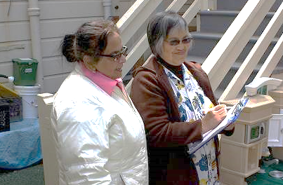
Elements of Successful Collaboration
Discuss your experiences with collaboration; what made those experiences successful?
Notes:
Have participants discuss on the following:
Think about a time in your personal life, or in a work setting, when you were a part of a successful collaboration. Use the following question to guide a discussion with your table group: What made that experience successful, and how did you feel during and after that experience?
Resources in multiple languages can often foster collaboration. The Center for Parent Information and Resources website is a good resource (https://www.parentcenterhub.org/).
14

Slide 15
School District Partners
Families
Pre/K special education teachers and K teachers
Administrators
Designated instructional service (DIS) providers:
  Speech and language specialist
  School psychologist
  Physical therapist
  Occupational therapist
  Assistive technology specialist
English as a second language specialist
Bilingual assistant/interpreter
Notes:
School district partners:
Families
Pre/K special education teachers and K teachers
Administrators
Designated instructional service (DIS) providers:
Speech and language specialist
School psychologist
Physical therapist
Occupational therapist
Assistive technology specialist
English as a second language specialist
Bilingual assistant/interpreter
The role of each team member is as follows:
Families: Collaboration with families is essential when working with young children. Parents have a vast wealth of knowledge about their child’s strengths, weaknesses, and developmental history.
Developmental specialist or special education administrator (special ed. program specialist): Specialists design learning environments and activities that promote a child’s skill development.
Designated instructional service providers:
Speech and language specialists who implement a planned program to improve and correct a child’s speech and/or language or communication issues.
Physical therapists who provide therapy to enhance a child’s overall physical functioning.
Occupational therapists who design services to improve the child’s functional ability to perform tasks at home and in other environments.
The main point is that teachers shouldn’t feel alone. There are people who can help, and they should be sought out.
15

Slide 16
Partners: School District
Principle 8
  “Coordination and collaboration among families, teachers, and specialists become crucial in supporting the language and literacy development of children with disabilities or other special needs” (PEL Guide, p. 69).
Overarching Principle
  “Family and community partnerships create meaningful connections” (PCF, Vol. 1, p. 7).
Notes:
This is a reminder that the PEL Guide contains Principle 8 and practical ideas to implement strategies that will support English learners with disabilities or special needs; Principle 8 is supported by an overarching principle in the PCF:
“Coordination and collaboration among families, teachers, and specialists become crucial in supporting the language and literacy development of children with disabilities or other special needs” (PEL Guide, p. 69).
“Family and community partnerships create meaningful connections” (PCF, Vol. 1, p. 7).
Remind participants of their pre-reading.
Refer participants to Principle 8 on page 69 of the PEL Resource Guide.
Turn to page seven in the Preschool Curriculum Framework (PCF) and read the paragraph under the Overarching Principle.
16

Slide 17

10 Practices
Read, review, and discuss Principle 8 and the practices that follow on page 69 of the PEL Guide.
Notes:
Procedure:
Review pre-reading: Have participants read, review, and discuss Principle 8 and the practices that follow on page 69 of the PEL Guide.
Invite them to share successful strategies they have used before, as well as those learned from the reading with their breakout groups.
Note: Overarching principle “Family and community partnerships create meaningful connections” (PCF, Vol. 1, p. 7).
17

Slide 18
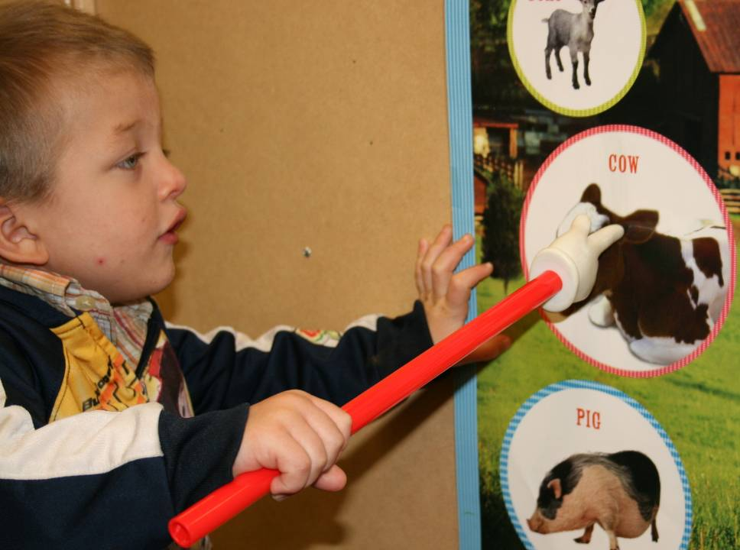
What have we learned?
California’s Early Learning and Development System
Special Education Division and Early Childhood Support System
Special Education Law—IDEA 2004
Notes:
These are the topics we have covered so far:
California’s Early Learning and Development System
Special Education Division and Early Childhood Support System
Special Education Law—IDEA 2004
Now we are moving into looking at language disorders and language differences, which are included in the second outcome for this presentation.
18

Slide 19
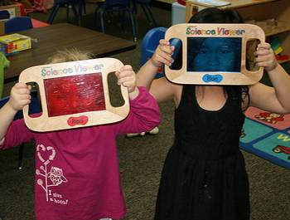
Let’s take a closer look!
Notes:
Let’s take a closer look!
19

Slide 20
Preschool Children with IEPs by Ethnicity and Disability (CDE Special Education Date, 12/01/2011)
Major Ethnic Group | MR | SLI | SLD | AUT | TOTAL
Native American | 8 | 186 | 0 | 35 | 246
Asian | 306 | 3,989 | 27 | 1,701 | 6,592
Hispanic | 1,625 | 15,770 | 185 | 3,565 | 23,678
African-American | 174 | 1,491 | 16 | 518 | 2,461
White | 482 | 8,712 | 52 | 2,617 | 13,332
TOTAL | 2,595 | 30,148 | 280 | 8,446 | 46,409
Table Key: (MR: Mental Retardation, SLI: Speech and Language Impairment, SLD: Specific Learning Disability, AUT: Autism)
Notes:
These statistics show the incidence of disabilities in preschool children with IEPs by ethnicity. The most prevalent category of disability at age three and four is speech and language impairment (SLI).
The most recent reauthorization of the Individuals with Disabilities Education Act 2004 (IDEA), stipulates that children should not be found eligible for special education services if their learning challenges are primarily the result of environmental, cultural, or economic disadvantage. Consequently, teachers and specialists must take steps to assure that young children are assessed in their home language(s).
Background Information: The purpose of this slide is to show the incidence of disabilities by ethnicity. Note the disproportionate numbers of Hispanic students identified with speech and language Impairments.
Table Key: (MR: Mental Retardation, SLI: Speech and Language Impairment, SLD: Specific Learning Disability, AUT: Autism)
20

Slide 21
What do you think?
Do you agree or disagree?
Preschool children with disabilities are not capable of being bilingual.
A preschool child with a disability will be confused by being exposed to more than one language.
Preschool children who are bilingual and have a disability will be better off in a setting where they only hear English.
Many of the principles and practices in the PEL Guide apply to children with disabilities who are learning English.
Limited English skills are sometimes mistaken for disabilities.
Notes:
Adapted from the CDE, Child Development Division (CDD), CDE/Early Childhood Education (ECE) Faculty Initiative Project, WestEd Center for Child and Family Studies, Sep. 2008 (draft).
Invite participants to vote with their feet by standing if they agree and remaining seated if they disagree. Let participants know that each statement will be read, then they will have a chance to vote. After everyone has voted, we will discuss the facts and false assumptions associated with these statements (following two slides).
Now its time to read each statement and ask participants to annotate depending on their vote:
Preschool children with disabilities are not capable of being bilingual.
A preschool child with a disability will be confused by being exposed to more than one language.
Preschool children who are bilingual and have a disability will be better off in a setting where they only hear English.
Many of the principles and practices in the PEL Guide apply to children with disabilities who are learning English.
Limited English skills are sometimes mistaken for disabilities.
Alternative: Ask participants to record their responses on the Agree or Disagree handout.
21

Slide 22
Do you agree or disagree?
False Assumption:
Children with language disorders and/or other disabilities should not receive bilingual intervention; they will get more confused trying to learn two languages as opposed to learning only one language.
Fact:
“There is no evidence that a bilingual approach in intervention would ‘confuse’ or tax the learning abilities of children with disabilities” (Gutiérrez-Clellen, “Language Choice in Intervention with Bilingual Children,” p. 299).
Notes:
Let's look at these agree or disagree statements:
Preschool children with disabilities are not capable of being bilingual.
A preschool child with a disability will be confused by being exposed to more than one language
False assumption: Children with language disorders and/or other disabilities should not receive bilingual intervention; they will get more confused trying to learn two languages as opposed to learning only one language.
Here are the facts:
“There is no evidence that a bilingual approach in intervention would ‘confuse’ or tax the learning abilities of children with disabilities” (Gutiérrez-Clellen, “Language Choice in Intervention with Bilingual Children,” p. 299).
“Instruction in the primary language is especially beneficial when new concepts are first introduced. Once a concept has been acquired in the primary language, transfer to a second language will be easier” (Roseberry-McKibbin, Multicultural Students with Special Language Needs: Practical Strategies for Assessment and Intervention, p. 281).
Let’s consider the implications:
When we recommend that English learners use only English due to disabilities and/or fear of their confusion, that recommendation can hinder them from learning and developing socially.
English learners with disabilities or other special needs can learn more than one language (This is from the PEL Guide Chapter 7 presenter slide.).
“…[T]he literature in bilingual education over the last two decades suggests that children who are learning two languages may benefit from a bilingual approach in intervention. None of the studies designed to prove to the contrary have been able to show that an English-only approach is superior. The research clearly shows that mediation in the native language does not slow development or learning of a second language” (Gutierrez-Clellen, “Language Choice in Intervention with Bilingual Children,” p. 291).
Suggestions
Ask participants to turn to pages 66–67 in the PEL Guide. Have them highlight the research piece by Baker (2000); this research further validates the facts mentioned above.
Also, you can choose to read the following fact from the research:
“It is critical to provide culturally sensitive intervention in the child's primary language as early as possible while the child is developing a foundation (i.e., building a lexicon of single words) for language development” (Seung, Siddiqi, and Elder, “Intervention Outcomes of a Bilingual Child with Autism, p. 62).
22

Slide 23
Do you agree or disagree? (2)
False Assumption:
If children with language disorders learn a second language, they may make more errors in grammar.
Fact:
“Children with disabilities can learn more than one language and can function bilingually as effectively as their typically developing peers” (PEL Guide, p. 66).
Notes:
False assumption: If children with language disorders learn a second language, they may make more errors in grammar.
Here are the facts:
“For children between the ages of 4 years 5 months and 6 years, bilinguals with language impairment do not appear to have greater difficulty with learning two languages compared to children who are only learning one language” (Gutiérrez-Clellen, Simon-Cereijido, and Wagner, “Bilingual Children with Language Impairment: A Comparison with Monolinguals and Second Language Learners,” p. 17).
“Children with disabilities can learn more than one language and can function bilingually as effectively as their typically developing peers” (PEL Guide, p. 66).
“In their studies on the language development of children with Down syndrome, Mundy and others (1995) found that when teachers and parents took into account the children’s skills in English, the home language, and sign language, they realized that the children were at or above the same level in vocabulary and syntax as monolingual children of the same age who had Down syndrome” (PEL Guide, p. 66).
Refer participants to the Applied Psycholinguistics article by Gutiérrez-Clellen, Simon-Cereijido, and Wagner: “Bilingual Children with Language Impairment: A Comparison with Monolinguals and Second Language Learners.” This article articulates that bilingual children with language disorders may show language differences because they are still learning their second language. However, it also mentions that their deficits are similar to the deficits of monolinguals with language disorders.
Let’s consider the implications:
There is no evidence that bilingual children with language disorders are more impaired due to exposure to two languages.
It is critical to provide culturally sensitive intervention in the child's primary language as early as possible while the child is developing a foundation (i.e., building a lexicon of single words) for language development.
23

Slide 24
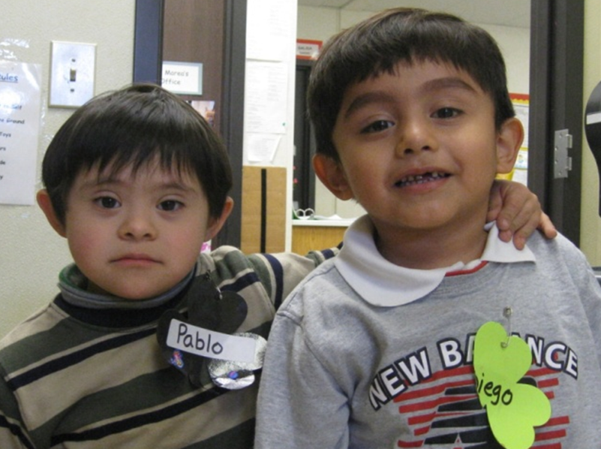
Language Disorder or Language Difference
Notes:
Have participants refer to page 64 in the PEL Guide.
Have participants take out Handout 2: Language Disorder or Language Difference and read the definitions of language disorder, language difference, and general characteristics.
Note: “Language Disorder versus Language Difference” was revised to “Language Disorder or Language Difference” by the CDE in 2009. The picture is from the Ethel I. Baker Preschool Program in the Sacramento Unified School District.
24

Slide 25
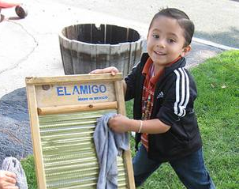
Early Warning Signs for 3- to 5-Year-Old Children
Shows difficulty following simple directions
in either language
Exhibits immature speech and language in both languages
(Sources: Dunlap, (2009), McLaughlin, (2006), Hamaguchi (2001), CDE brochure: Reasons for Concern that Your Child or A Child in Your Care May Need Special Help)
Notes:
It may be necessary for you to get further help from professionals, such as speech and language specialists, who can help you determine if a child should be referred for a complete speech and language assessment.
Early warning signs for 3- to 5-year-old children:
Shows difficulty following simple directions
in either language
Exhibits immature speech and language in both languages
(Sources: Dunlap, (2009), McLaughlin, (2006), Hamaguchi (2001), CDE brochure: Reasons for Concern that Your Child or A Child in Your Care May Need Special Help)
Preparation: Have participants refer to the CDE brochure—Reasons for Concern that Your Child or a Child in Your Care May Need Special Help—that can be found in their folders. This brochure can also be downloaded in several languages from the following links:
https://www.cde.ca.gov/sp/se/fp/concerns.asp
https://www.dds.ca.gov/services/early-start/
Note: It is important to understand typical development so as not to confuse normal behavior at different age/developmental levels for behaviors that can point to the potential for learning disabilities.
25

Slide 26
Behaviors Demonstrated by English Learners and Children with Language Disorders
Speaks infrequently
Speaks excessively (in the home language or in English)
Refuses to answer questions
Confuses similar sounding words
Is unable to tell or retell stories
Has poor recall
Uses poor pronunciation
Uses poor syntax and grammar
Does not volunteer information
Adapted from Ortiz and Maldonado-Colon (1986).
(See page 64 of the PEL Guide)
Notes:
Refer participants to the PEL Guide pre-reading on page 64.
Behaviors demonstrated by English learners and children with language disorders:
Speaks infrequently
Speaks excessively (in the home language or in English)
Refuses to answer questions
Confuses similar sounding words
Is unable to tell or retell stories
Has poor recall
Uses poor pronunciation
Uses poor syntax and grammar
Does not volunteer information
Adapted from Ortiz and Maldonado-Colon (1986).
English learners may exhibit the same kind of classroom behaviors that may be exhibited by children with language disorders. Because such behaviors may be considered problematic, they may result in a referral to special education. Although the external behaviors of English learners can be similar to those exhibited by children with language disorders, the reasons for them are different.
For English learners, these behaviors are temporary adjustments in response to being placed in an environment in which they do not understand the rules, or the language being spoken. It is very important to team up with professionals knowledgeable about second language acquisition to carefully sort out which behaviors are due to the child learning English as a second language, and which are due to other possible explanations.
It is important to note that all the behaviors listed may indicate that the English learner is in the observational stage of second language acquisition.
(Source; PEL Guide, p. 64)
Note: Make it clear to participants that it is not up to them to determine if it is a language disorder or a language difference; rather, that they need to become more aware of the differences.
26

Slide 27
Synthesis Activity Part 1: Research Highlight—PEL Resource Guide
“Second language learners might exhibit social interaction patterns along with limited communication abilities that are similar to those exhibited by children identified with specific language and/or speech impairments. Thus, it is not uncommon for many of these children to be labeled as having challenging behaviors or communication disorders when in fact they are following a fairly typical developmental path in acquiring second language” (Santos and Ostrosky, “Understanding the Impact of Language Differences on Classroom Behavior”).
Notes:
This quote captures what we have just been focusing on. Read the quote out loud with participants, then move on to the next slide.
“Second language learners might exhibit social interaction patterns along with limited communication abilities that are similar to those exhibited by children identified with specific language and/or speech impairments. Thus, it is not uncommon for many of these children to be labeled as having challenging behaviors or communication disorders when in fact they are following a fairly typical developmental path in acquiring second language” (Santos and Ostrosky, “Understanding the Impact of Language Differences on Classroom Behavior”).
Synthesis Activity Part 1: Research Highlight—PEL Resource Guide
INTENT: Synthesize the information and highlight the philosophical connections between the PEL Guide and the Preschool Curriculum Framework (PCF).
OUTCOMES: Participants will synthesize previous information and read a section of the PCF.
MATERIALS REQUIRED: PCF
TIME: 20 minutes
PROCESS: Read the quote on slide 28 aloud. Review the pre-reading and work: Ask participants to read the Cultural Context of Learning on page 185 of the PCF. Following the reading, ask participants to discuss the following at their table: How do the two readings relate to one another? How might you use both pieces of information in you daily work? Invite participants to breakout room to share their findings.
SUMMARY POINTS: Highlight connections between the quote and PCF section.
27

Slide 28

Synthesis Activity Part 2
Read the Cultural Context of Learning on page 185 of the PCF (Vol. 1).
Discuss the following with your group:
How do the two readings relate to one another?
How might you use both pieces of information in your daily work?
Notes:
Read the Cultural Context of Learning on page 185 of the PCF (Vol. 1).
Discuss the following with your group:
How do the two readings relate to one another?
How might you use both pieces of information in your daily work?
28

Slide 29
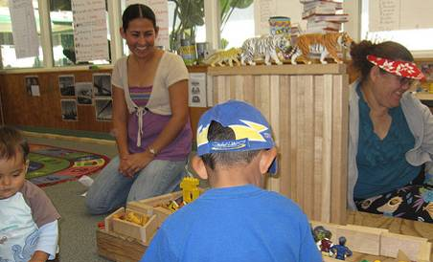
Cultural Considerations
“When the home language and culture are viewed as assets and resources, it becomes the foundation for enhanced learning” (PCF, Vol. 1, p. 185).
Notes:
Transition slide:
When working with families who are culturally and linguistically diverse, it is important to remember that there are other aspects of the family’s culture to consider.
The next few slides address several points to consider:
“When the home language and culture are views as assets and resources, it becomes the foundation for enhanced learning” (PCF, Vol. 1, p. 185).
The PCF highlights this point in a guiding principle from the English-Language Development domain: “Respect cultural values and behaviors reflected in the child’s language and communication” (PCF, Vol. 1, p. 180).
29

Slide 30
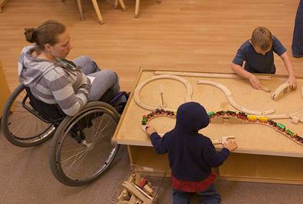
Cultural Consideration #1: Perspectives on Educational Beliefs
In some cultures, special education is not dealt with as openly as it is in the mainstream American culture.
Notes:
Use the following statements to initiate discussion within table groups:
In some cultures, special education is not dealt with as openly as it is in the mainstream American culture. How have you seen this statement reflected in your own culture, or in the culture of your students?
Educators need to be honest and talk about how the mainstream American culture believes that many children need help to better navigate the educational system. Our special education services may be a viable option for English learners with disabilities.
The word "special" bothers some individuals within different cultures—educating them about the programs and stressing confidentiality helps. For example, some Asian-American and Hispanic families have a tendency of not allowing their children with disabilities to explore the outside world. They try to keep those children in their home due to their collectivist view of life. Parents believe that their children belong to them, so it is their responsibility to take care of the children, especially those children with disabilities (collectivism vs. individualism).
Because different cultures view individuals with disabilities differently, it is very important to build connections with families to address concerns and culturally appropriate ways to work with their children. Invite parents to share their observations of their child.
Adapted from Bridging: Assessment for Teaching and Learning in Early Childhood Classrooms, PreK-3, by Jie-Qi Chen and Gillian Dowley McNamee.
30

Slide 31
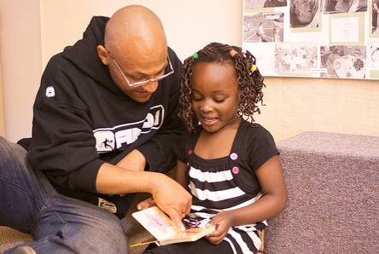
Cultural Consideration #2: Perspectives on Educational Practices
Families practice different ways of learning.
Notes:
Educators need to be aware of each family’s values:
Independence vs. interdependence
Individual work vs. group work
There are contrasting perspectives on child-raising practices among different cultures. Most mainstream American parents value teaching children to be independent and self assertive—to be successful “on their own.” In contrast, many Asian American and Hispanic parents, as well as some African American parents, value teaching children to be interdependent—to support the needs of others and, in turn, to be reliant upon others for help to be successful in life. Cooperation and interdependence are important values within these cultures. Children from these groups may be more accustomed to participating in group activities as members of families with several siblings or communities in which they are often together, or where intergenerational interactions are common. Being asked to do individual tasks may be an unfamiliar and possibly uncomfortable experience.
Relationships with parents will improve when we explore contrasting perspectives, and respect those contrasts between different cultures. What we believe about the best learning environment depends on our experiences and our understanding of what children need (A helpful video resource is Diversity: Contrasting Perspectives, produced by Magna Systems, Inc.).
Adapted from page 17 of the CDE booklet, Assessing Children with Disabilities Who Are English Learners: Guidance for the DRDP access and the PS DRDP-R for Children with IEPs.
Suggest participants read the “Engaging Families” section of each strand in the PCF when planning curriculum. The following pages are examples of “Engaging Families” sections that may be helpful in planning; you can have participants turn to these pages as examples (PCF, Vol. 1, pp. 85, 165, 222, 269).
31

Slide 32
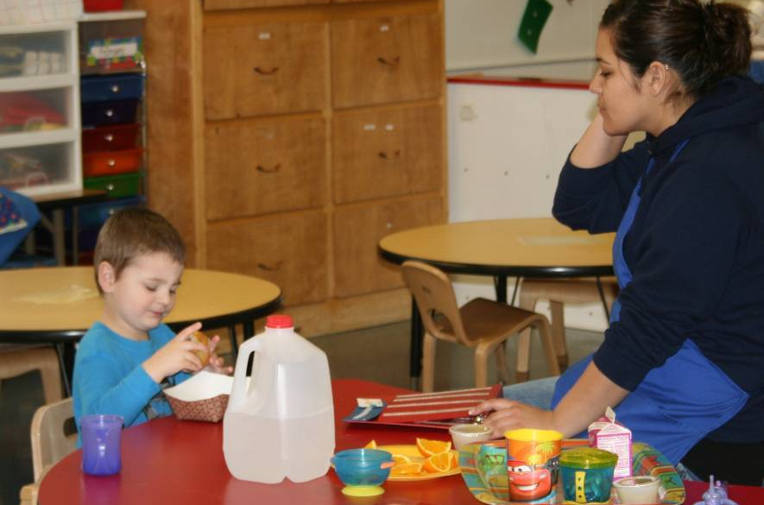
Cultural Consideration #3: Perspectives on
Communication Styles
Families have different forms of conversation based on age and social status.
Notes:
Educators need to know the expectations families have for interactions between children and adults, for example,
requests might only be initiated by an adult or older siblings;
children might only be allowed to talk with an adult by invitation, in certain situations, or when they reach school age; and
questions might only be allowed upon request.
Adapted from Dunlap, An introduction to early childhood special education, birth to age five (p. 167, Figure 6.3).
Background Information for Presenter: Cultural considerations in linguistic variation need to be considered since communication occurs within a cultural context. Professionals must make sure they understand typical language development with regard to each child’s language and cultural environment. For example, it is uncommon in Asian culture for children to make eye contact while they are conversing with adults.
“Language acquisition is a subset of the larger socialization process. The nature of linguistic interactions vary from one culture to another culture, depending on values and beliefs” (Lessow-Hurley, The Foundations of Dual Language Instruction, p. 50).
“Before referring a child from diverse backgrounds for special education, teachers should ensure that the child’s performance is not being negatively impacted by cultural issues, such as not speaking up and not being competitive with peers” (Smith, Gartin, Murdick, and Hilton, Families and Children with Special Needs).
32

Slide 33
Answers to Frequently Asked Questions
Answer one) Yes. What is important to remember is that the child with a disability or special needs, who is growing up in a bilingual family or community, will benefit from learning both the home language and English, just like any other child.
Answer two) English learners need a period of adjustment in which they are supported, encouraged and provided with learning experiences that meet them where they are academically and linguistically. How long that period is depends on the individual child.
Answer three) Careful observation, documentation over time and in multiple settings, and gathering information from the many adults who know the child will provide a more accurate picture of the child’s language abilities in their home language and in their second language.
Notes:
These are the answers to common questions asked by classroom teachers about English learners with disabilities.
Zip Around Activity Cue Cards
Preparation:
Use Zip Around Activity Cue Cards handout.
Directions:
The presenter starts by reading the first question. Participants can look at their handout while viewing the slide. Participants respond by annotating on the correct answer to the question or by typing the number to the correct answer in chat. Follow this same process of questioning and answering with cue cards one through three:
Is it OK for me to use English and the child’s home language at school when the child has a disability? Answer one) Yes. What is important to remember is that the child with a disability or special needs, who is growing up in a bilingual family or community, will benefit from learning both the home language and English, just like any other child.
How do I know if a child is experiencing difficulties in learning a language, such as a speech disorder, or is just going through the process of second language acquisition? Answer three) Careful observation, documentation over time and in multiple settings, and gathering information from the many adults who know the child will provide a more accurate picture of the child’s language abilities in their home language and in their second language.
How long do I wait to make a referral when I have concerns regarding a child who is learning English as a second language? Answer two) English learners need a period of adjustment in which they are supported, encouraged and provided with learning experiences that meet them where they are academically and linguistically. How long that period is depends on the individual child.
33

Slide 34
Zip Around Activity: Question One
Question one:
Is it OK for me to use English and the child’s home language at school when the child has a disability?
Answer one:
Yes. What is important to remember is that the child with a disability or special needs, who is growing up in a bilingual family or community, will benefit from learning both the home language and English, just like any other child.
Notes:
Question one is from page 63 of the PEL Guide.
Question one: Is it OK for me to use English and the child’s home language at school when the child has a disability?
Answer one: Yes. What is important to remember is that the child with a disability or special needs, who is growing up in a bilingual family or community, will benefit from learning both the home language and English, just like any other child.
Background Information for Presenter: The child may find themselves in contexts or situations in which the adults caring for them only speak the home language, or when many of their friends and peers in their neighborhood speak the home language better and more often than English. The same child may hear mostly, or only, English at school or in specialized settings. Encouraging the continued development of both the home language and English will assure that the child has access to the caring wisdom and support of all the adults responsible for their growth and development.
34

Slide 35
Zip Around Activity: Question Two
Question two:
How do I know if a child is experiencing difficulties in learning a language, such as a speech disorder, or is just going through the process of second language acquisition?
Answer three:
Careful observation, documentation over time and in multiple settings, and gathering information from the many adults who know the child will provide a more accurate picture of the child’s language abilities in their home language and in their second language.
Notes:
Question two is from page 63 of the PEL Guide.
Use the same procedure for the next question.
Question two: How do I know if a child is experiencing difficulties in learning a language, such as a speech disorder, or is just going through the process of second language acquisition?
Answer three: Careful observation, documentation over time, and in multiple settings, and gathering information from the many adults who know the child will provide a more accurate picture of the child’s language abilities in his /her home language and in his/her second language.
35

Slide 36
Zip Around Activity: Question Three
Question three:
How long do I wait to make a referral when I have concerns regarding a child who is learning English as a second language?
Answer two:
English learners need a period of adjustment in which they are supported, encouraged and provided with learning experiences that meet them where they are academically and linguistically. How long that period is depends on the individual child.
Notes:
Question three is from page 63 of the PEL Guide.
Use the same procedure for the last question.
Question three: How long do I wait to make a referral when I have concerns regarding a child who is learning English as a second language?
Answer two: English learners need a period of adjustment in which they are supported, encouraged, and provided with learning experiences that meet them where they are academically and linguistically. How long that period is depends on the individual child.
Presenter may want to add the following information to the answer: The best mechanism we have in schools is a Student Study Team (SST) whose members are informed about second language issues. If the team determines that an evaluation is warranted, it must be conducted in the child’s home language as well as English. Further, observations and interviews provide additional data for making an informed decision.
Background Information for Presenter: Student Study Team (SST) is a general education function and should not be confused with an individualized education program (IEP) team, which focuses on special education eligibility and placement options. By providing problem‐specific support, the SST will ensure that appropriate referrals are made to special education.
36

Slide 37
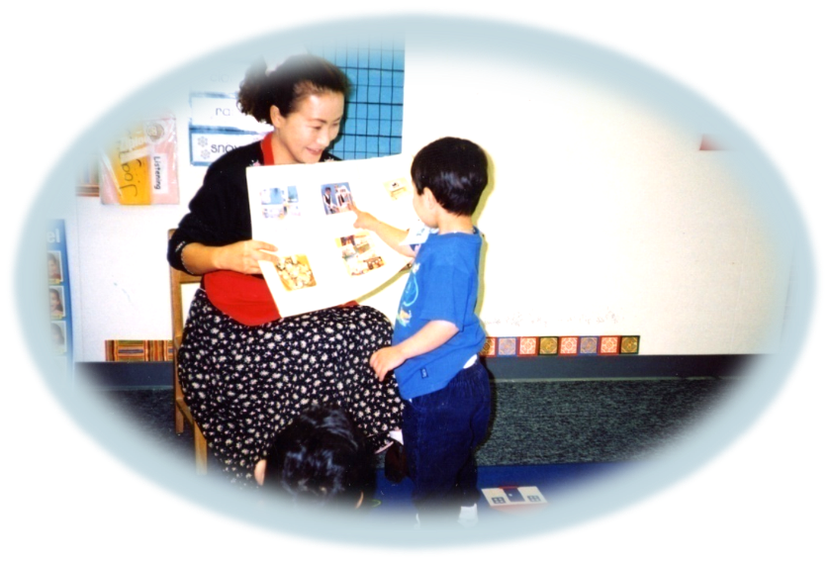
Strategies
Notes:
We will now move into the second section of this presentation. We will be focusing on specific teaching strategies to enhance the language development of English learners with disabilities.
Review the pre-reading and work: Refer participants to pages 54–55 of the PEL Guide or Handout 3: Teacher Support Strategies. The checklist gives specific strategies for responding to stages of communication that children move into and out of as they learn a second language. Many of the strategies from the checklist are incorporated in this section. The article on Handout 4: English Language Learners with Special Needs Effective Instructional Strategies highlights important strategies for supporting English language Learners with Special needs.
37

Slide 38
Strategies: Making Preschool Accessible
Responsive Practices
Adaptations
Accessible Curriculum
  Universal design
  Differentiating instruction
Notes:
The third outcome of this presentation addresses strategies. Inform the participants that we will be focusing on three strategies. Each strategy will be viewed in video clips and explained verbally. These strategies are for all children in our preschool programs:
Responsive practices
Adaptations
Accessibility to curriculum (This is very important and can be achieved by incorporating the concept of the universal design and implementing differentiated instruction.)
Page 193 of the PCF has an example of a flannel board activity designed to build listening skills that includes responsive practices and adaptations that enable access to curriculum for all students. This is an example that participants can read and return to after the presentation.
38

Slide 39
1. Responsive Practices
Use body language and visuals.
Learn key words and phrases in the child’s home language.
Use language and literacy activities that contain repetitive refrains.
Use narratives to describe a child’s actions.
Provide longer wait times for responses (5 seconds or more).
Notes:
Share the following with the group: Learning experiences must be meaningful to English learners. By selecting universal themes and topics, you are opening a learning door for English learners. Some examples of universal themes and topics are eating, weather, housing, plants and flowers, clothing, the sun and moon, rainbows, colors and numbers, families, and emotional themes such as joy and sadness.
Adapted From the Faculty Initiative Seminar PowerPoint; page 69 of the PEL Guide; and Klein and Chen, Working with Children from Culturally Diverse Backgrounds, pp. 155-160.
Background Information for Presenter: The acquisition of English requires deliberate and intentional instructional practices that assist young children to hear the sounds of the second language slowly and clearly. Young English learners may be relatively non-verbal when entering preschool, so it is important that they be included in a variety of activities that promote listening and comprehension throughout their daily schedule:
Use physical gestures and signed words. Show visual cues and props when the actual items are not an option. Always try to show the real object while you are explaining or referring to the item.
To the extent possible, learn some key words or phrases in the child’s native language. A parent, sibling, or other staff member who speaks the child’s home language may assist in this effort. Learn how to pronounce the child’s name as accurately as possible. Because a child’s name is so closely linked to their sense of self, it is very important that the correct pronunciation of their name be used.
Use language and literacy activities that contain repetitive refrains so that English learners can hear the idea or concept multiple times (e.g., Brown Bear, Brown Bear, What do You See?).
Use ongoing commentary when an English learner with disabilities is engaged in an activity. For example, if the child is climbing up the ladder to the slide, teacher might say, “You are going up the ladder and then you will go down the slide.”
Wait at least five seconds for a response. Give more time for English learners to respond. Whether or not they have disabilities, English learners need to have a longer wait time to process information.
39

Slide 40
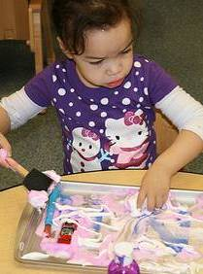
2. Adaptations
Adaptations are changes in the environment that allow children with disabilities to participate in the same assessment as their peers.
Notes:
See Handout 5: Seven Adaptations.
Adaptations are changes in the environment that allow children with disabilities to participate in the same assessment as their peers.
Adaptations have been developed so that the DRDP (2015) [Desired Results Developmental Profile assessment] more accurately reflects the child’s abilities, rather than the impact of the child’s disability. The use of adaptations is an essential component when we think about strategies to access the general education curriculum.
Source: Using Adaptations with the DRDP (2015) Tutorial page (https://www.draccess.org/AdaptationsTutorial.html) of the Desired Results Access Project website (https://www.draccess.org/
Prepare copies of DRDP (2015) to show participants.
The Individualized Education Program must include a statement of any adaptations that are necessary to measure the academic achievement and functional performance of children on the statewide assessment. However, adaptations should be in place for the child’s daily routines and activities—not just during assessments.
A description of each of these adaptations is included in the handout.
Refer participants to Handout 5: Seven Adaptations, which lists seven specific adaptations identified by the Desired Results Access Project:
Augmentative or Alternative Communication System
Alternative Mode for Written Language
Visual Support
Assistive Equipment or Device
Functional Positioning
Sensory Support
Alternative Response Mode
Have participants focus on Augmentative or Alternative Communication System and Sensory Support since they are directly connected to the language development of English learners with disabilities.
40

Slide 41
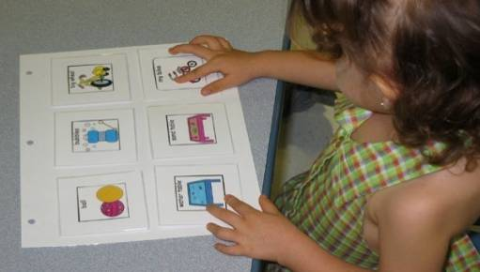
Augmentative or Alternative Communication Systems
Another system of communication may be used when the child cannot use spoken language.
Notes:
Another system of communication may be used when the child cannot use spoken language.
Post pictures and words in key places and help a child touch the picture before accessing the following places:
Bathroom (picture or word)—near bathroom door
Playground (picture or word)—near exit door
Cookies (picture or word)—near cupboard
Refer participants to Handout 6: Assistive Technology Toolkit
Background Information for Presenter: Communication aids are used when oral language supports are needed. A range of communication assistance aids are available. Examples include sign language, picture cards, and electronic communication devices. It is important to use these systems as part of the observation and not just to elicit responses. Again, it may be as simple as a piece of cardboard with an empty raisin bag stuck to it to represent a desire for raisins, or as complex as a laptop computer with voice activation. (Source: Augmentative and alternative communication Wikipedia page (http://en.wikipedia.org/wiki/Augmentative_and_alternative_communication).
NOTE: If American Sign Language (ASL) is the child’s primary language, it is now designated as the home language, and not an adaptation. If sign language is used as a bridge to learning verbal language, then it is considered to be an adaptation (FAQs page of the Desired Results Access Project website [https://www.draccess.org/faq]. In addition, assessments for the DRDP (2015) and DRDP Access for preschool special education may be conducted in the child’s home language.
Assessors should observe the child using language in a natural context rather than contriving an adult-directed situation. The child's home language, if other than English, is also acceptable.
41

Slide 42
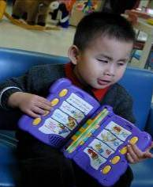
Sensory Support
Ideas include the following:
Reducing background noise
Adjusting tactile stimulation
Adjusting visual stimulation.
Notes:
Background Information for Presenter: Some children may require a more supportive environment to enhance their communication. They may need quiet spaces with fewer distractions (auditory and/or visual) in order to enjoy looking at books. Some children may need pillows around them to provide stability and ground them. Think about the reading areas in your classroom. Are children able to look at books comfortably? Do some children need those quiet spaces more than others? A child on the autism spectrum may wear a weighted vest (prescribed by the occupational therapist and approved by the child’s family) in order to help them focus their attention during a particular activity.
Adaptations are identified by the IEP team and noted on the child’s IEP. All staff should be knowledgeable about the adaptations for a particular child. Even with planning, an adaptation may not work or a change in plans may occur. All staff who are responsible for the educational needs of that child must be in communication to develop skills for modifying and adapting curriculum activities. The purpose of using adaptations is to support access to the general education curriculum.
42

Slide 43
What Communication Adaptation in Inclusive Classrooms Might Look Like
Insert communication video clip here
Notes:
Insert the communication video clip here.
43

Slide 44
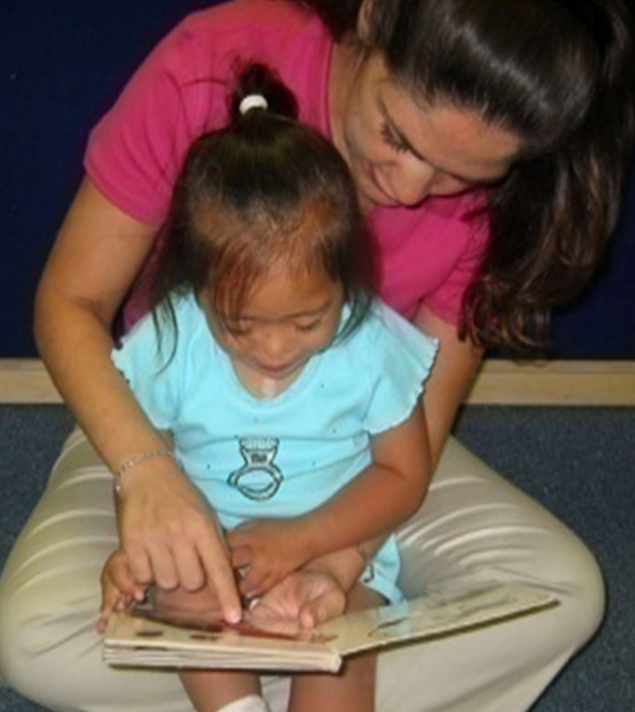
A Closer Look at Adaptive Materials
Notes:
Refer participants to Handout 7: Ways to Adapt Classroom Materials to introduce more examples of adapted materials.
Ask your region’s CPIN Regional Lead and English Learner lead to bring several examples of adapted materials used with English learners (with or without disabilities) to display and share with participants.
Optional ways to debrief before or after activity:
Have participants hold up items that they use as adaptive materials in their classroom.
Ask participants to hold up one material from their table. Ask other participants to shout out what the adaptive material is used for.
44

Slide 45
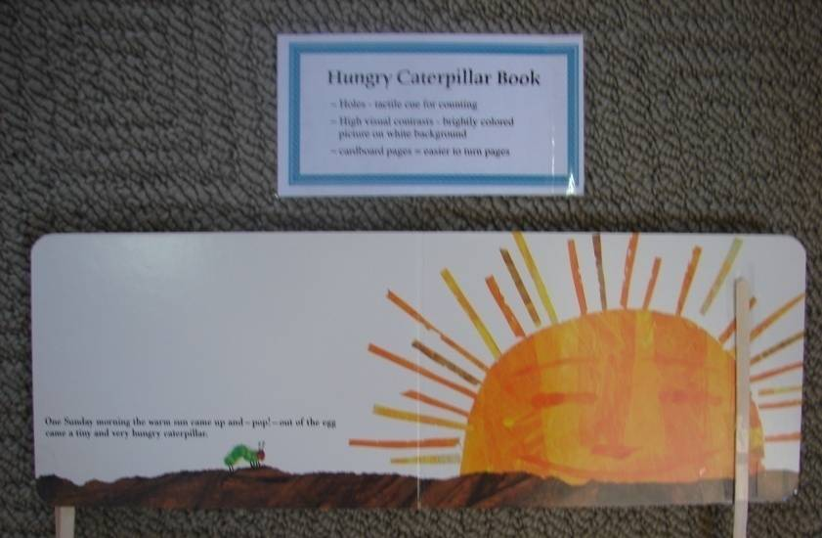
Book Activity: Easy-To-Turn Pages
Notes:
Refer participants to Handout 8: 101 Ways to Fluff and Turn a Page for more ideas.
Activity:
Purpose: Participants will make an adapted book for their students.
Preparation: Prepare a set of the book making materials (a hardcopy book, NO paper clips for safety reasons, tongue depressors, clear tape, plastic shower curtain rings, bulldog clips, ponytail holders, sponge pieces, elastics, clothespins, velcro dots, pom poms, pipe cleaners, laminated description of the book making procedure, etc).
Example: Hungry Caterpillar (hard copy), tongue depressor, and scotch tape.
Procedure: Each participant will choose materials from above to attach to the book. For example, tape a tongue depressor to each page of the book to make it easier to turn the pages. Place adapted books in the reading area.
45

Slide 46
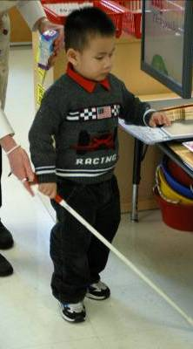
3. Accessible Curriculum
Accessible curriculum is for all children so they can participate in a meaningful way in daily routines and activities:
Differentiated instruction to meet individual needs
Universal design for learning
Adaptations based on progress monitoring and data
Special education services and supports
Source: Division for Early Childhood (DEC) of the Council for Exceptional Children, Promoting Positive Outcomes for Children with Disabilities: Recommendations for Curriculum, Assessment, and Program Evaluation, p. 4.
Notes:
Refer participants to Handout 9: Practices of Universal Design. This handout is based on page four of Promoting Positive Outcomes for Children with Disabilities: Recommendations for Curriculum, Assessment, and Program Evaluation, a publication from Division for Early Childhood (DEC) of the Council for Exceptional Children.
Background Information for Presenter: Universal design is an educational approach to teaching, learning, and assessment that draws on new brain research and media technologies to respond to differences of individual learners. It is inspired by universal access in architecture.
Note: Universal design is considered throughout the Preschool Learning Foundations (PLF), but you will also see specific notes for children with disabilities. We want to ensure that children with special needs have access to the early childhood curriculum, including specialized instruction to support them.
Adapted from pages three and four of Promoting Positive Outcomes for Children with Disabilities: Recommendations for Curriculum, Assessment, and Program Evaluation.
Pre-reading: The definition of universal design for learning can be found on page 13 of the PCF. This is a good section to have participants read to better understand access to curriculum for all.
Background Information for Presenter: Differentiating instruction means creating multiple paths so that students of different abilities, interests, or learning needs experience equally appropriate ways to absorb, use, develop, and present concepts as a part of the daily learning process. It is now recognized to be an important tool for engaging students and addressing the individual needs of all students. Differentiating instruction is also an essential tool for integrating technology into classroom activities.
46

Slide 47
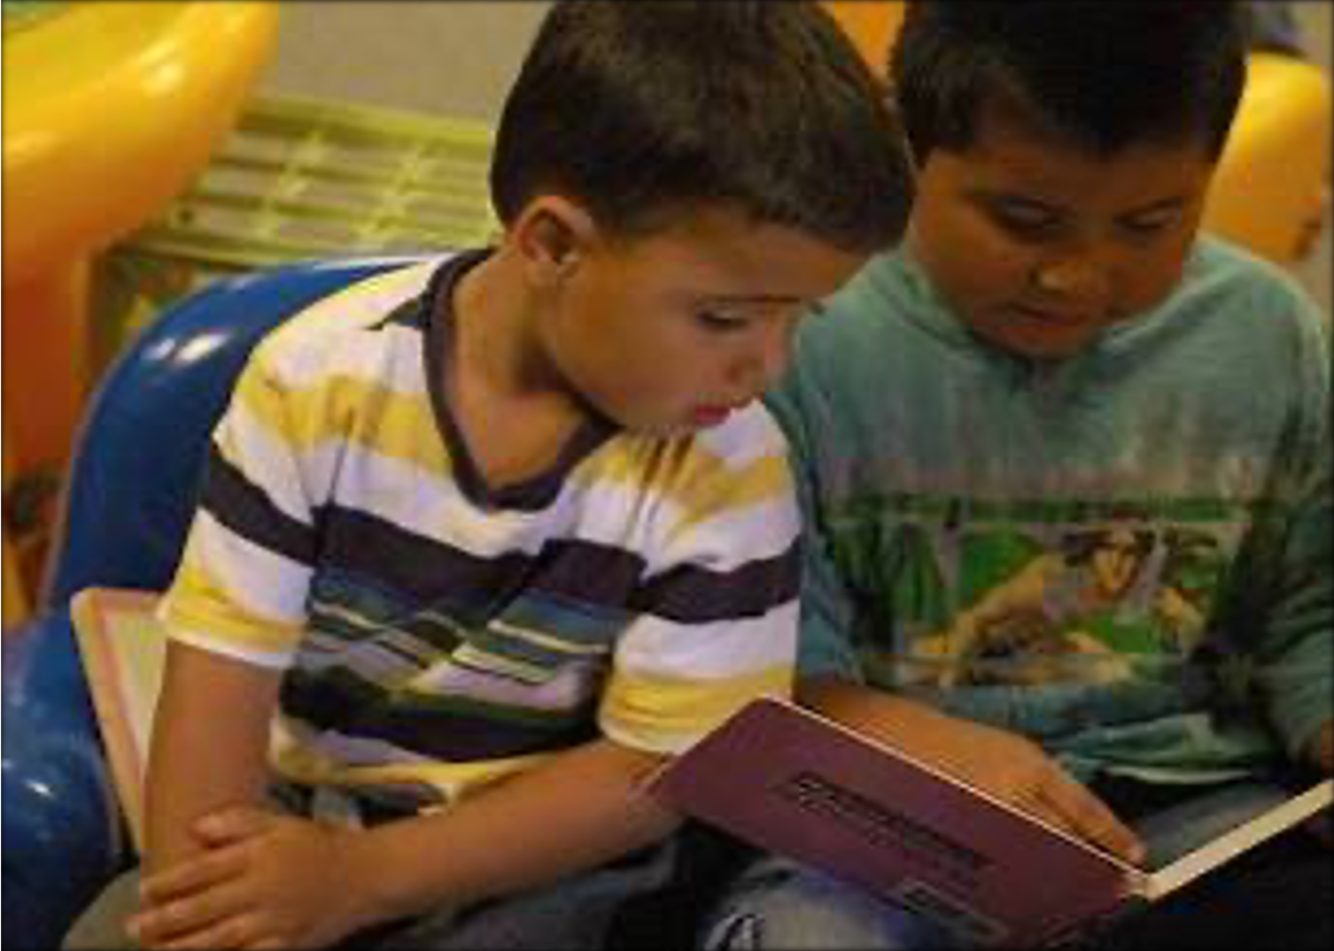
The Inclusive Classroom
“Instructional goals and objectives based on a student’s IEP need to be embedded within the normally occurring routines…” (Belk, “The Inclusion in early childhood programs: A kaleidoscope of diversity”).
Notes:
Instructional goals and objectives based on a student’s IEP need to be embedded within the normally occurring routines and contexts of home, daycare, and preschool. Because children with special needs need intentional instruction, it is important in inclusive settings to make adaptations that focus on maintaining an intense level of instruction, purposeful participation in activities, and educational achievement.
Adapted from Belk, “The Inclusion in early childhood programs: A kaleidoscope of diversity.”
Prepare to show participants a copy of the DEC (Division for Early Childhood) Recommended Practices. These recommended practices show how intentionality applies for children with disabilities.
Invite participants to think about an inclusive preschool program and children’s activities in the program throughout the daily schedule. Have them share their thoughts in chat. (Facilitator reads 2-3 responses aloud.)
Suggestion: If time permits, share the National Professional Development Center on Inclusion website [https://npdci.fpg.unc.edu/].
Adapted from Belk, “The Inclusion in early childhood programs: A kaleidoscope of diversity.”
47

Slide 48

Visiting an Inclusive Classroom:
Welcoming ALL Children
Circle Time
Mealtime
Outside Play Time
Transition Time
Center Time
Notes:
Intent: These five clips from the Welcoming ALL Children video—Circle Time, Mealtime, Center Time, Transition Time, and Outside Play Time— explain creative strategies to make accommodations to meet the unique needs of each child. This video, and companion updated CD, were developed for child care providers to help them welcome and include children with special needs into their child care programs.
The CD was updated and expanded by Elizabeth Traub, Lois Hutter-Pishgahi, Tamyra Freeman, Early Childhood Center and The Indiana Parent Information Network (2008).
Procedure: Refer participants to Handout 10: Viewing Guide for note taking.
“We will be viewing the video Welcoming ALL Children which includes 5 short segments. While viewing the clips, please jot down some notes. For example, What are some of the ideas/strategies that stood out to you in the video clip? What ideas/strategies did you hear that might be helpful for your students?”
After watching the five video clips, have participants share what they learned with a partner in a breakout room.
48

Slide 49
What Circle Time in Inclusive Classrooms Might Look Like
Insert Circle Time video clip here
Notes:
After viewing the Circle Time clip, have participants break into small groups to discuss any new ideas the clip has brought forward.
49

Slide 50
Circle Time
Plan a shorter circle time as needed.
Use preferential seating for an English learner with a hearing impairment.
Establish a clear routine and sequence of actions.
Provide wait time.
Provide bilingual materials.
Reinforce good behavior verbally.
Notes:
Circle time:
Plan a shorter circle time as needed.
Use preferential seating for any child (especially a child who is an English learner) with a hearing impairment so that the child can make the most use of their hearing and get close attention from a teacher. Seat the child away from ongoing noises, such as heaters, electrical equipment, and outdoor windows so that hearing aids do not pick up those sounds.
Establish a clear daily routine and sequence of actions so that children know what to expect.
Provide wait time; wait long enough to give the child plenty of time to respond to your comments or questions.
Provide bilingual materials.
Reinforce good behavior verbally; have an adult help by whispering reinforcement for good behavior or asking questions.
(Example picture from a site: “These are the circle time books that several of our students use. Depending on what the lesson is for the day, the students can independently choose a color, shape, or parts of a story. This allows them to participate in some way along with the rest of the group. For instance, when we do the weather report each day, the student will choose the appropriate weather picture from the choices in the book. This is just a small glimpse into the book. All the items I am sending you are from the computer program, Boardmaker” [Provided by Ms. Collen at Ethel I. Baker Inclusion Preschool]).
Slide adapted from Traub, Hutter-Pishgahi, and Freeman, Welcoming All Children: Creating Inclusive and Project Support: Early Childhood Inclusion Support Consultant Project, Klein, M. D. et all, California State University, LA, Division of Special Education, 1999.
50

Slide 51
What Mealtime in Inclusive Classrooms Might Look Like
Insert Mealtime video clip here
Notes:
After viewing the Mealtime clip, have participants break into small groups to discuss any new ideas the clip has brought forward.
51

Slide 52
Mealtime
Encourage conversational turn taking (Strive for 5!).
Include words and concepts relevant to every child’s home experience and cultural backgrounds.
Put a non-slip work surface (drawer liner) under dishes, cups, and utensils.
Use open-ended questions.
Notes:
Mealtime:
Encourage conversational turn taking (Strive for 5!).
Include words and concepts relevant to every child’s home experience and cultural backgrounds.
Put a non-slip work surface (drawer liner) under dishes, cups, and utensils.
Use open-ended questions.
Teachers must intentionally sit with children to enhance their communication skills or language development. Use the Strive for 5 strategy to help the conversation go to a deeper level, and to foster more language.
The children may all know “bread,” but they may not all be familiar with English muffins, bagels, or tortillas.
Work with the occupational or physical therapist for additional ideas.
Background Information for Presenter:
“Strive for 5” is a technique developed by David Dickinson to encourage children to use a greater variety of words, build their vocabularies, and express complex ideas in full sentences. The goal is to have at least five turns on the same topic.
Teachers can expand conversations by asking open-ended questions to encourage children to tell them more. Dickinson states to avoid too much “adult language.” This needs to be balanced with a child’s level of cognitive development.
Teachers intentionally choose the words and concepts that can be common in a variety of different cultures so that children can easily join in the conversations.
Slide adapted from Traub, Hutter-Pishgahi, and Freeman, Welcoming All Children: Creating Inclusive and Project Support: Early Childhood Inclusion Support Consultant Project, Klein, M. D. et all, California State University, LA, Division of Special Education, 1999.
52

Slide 53
What Center Time in Inclusive Classrooms Might Look Like
Insert Center Time video clip here
Notes:
After viewing the Center Time clip, have participants break into small groups to discuss any new ideas the clip has brought forward.
53

Slide 54
Center Time
Have a parent read classroom books in the home language.
Place multilingual audio tapes in the listening area.
Encourage children to work in pairs.
Arrange the classroom so all children can move around easily.
Provide materials that are easy to grasp or manipulate in the discovery area and all areas.
Notes:
Center time:
Have a parent read classroom books in the home language.
Place multilingual audio tapes in the listening area.
Encourage children to work in pairs.
Arrange the classroom so all children can move around easily.
Provide materials that are easy to grasp or manipulate in the discovery area and all areas.
Provide a cozy place for reading with a bean bag chair, a sofa, or even an indoor tent to block distractions. Make sure to have books and audio tapes in primary languages. Have parents translate books into home languages on audio tapes for the listening area. Make other adaptations to the reading area as necessary. For example, glue a tongue depressor on the pages of each book in the reading area to make the pages easier to turn.
Working with another child enhances the language development and social skills of all English learners.
Arrange the environment so there is space for children to independently manipulate a walker or wheelchair to different areas of room. Having all children move around easily provides more opportunities for language practices.
More accessible manipulatives in the discovery area would entice more children to that area. Prepare materials that are easy to grasp or manipulate (e.g., puzzles with knobs, paint brushes with larger handles, squeeze scissors, board books, big size Legos, giant crayons/pencils/washable markers, larger sizes of trucks, puzzles, magnets, etc.).
Slide adapted from Traub, Hutter-Pishgahi, and Freeman, Welcoming All Children: Creating Inclusive and Project Support: Early Childhood Inclusion Support Consultant Project, Klein, M. D. et all, California State University, LA, Division of Special Education, 1999.
54

Slide 55
What Transition Time in Inclusive Classrooms Might Look Like
Insert Transition Time video clip here
Notes:
After viewing the Transition Time clip, have participants break into small groups to discuss any new ideas the clip has brought forward.
55

Slide 56
Transition Time
Use pictures or objects to represent what will happen next.
Prompt the child to watch and follow where peers in the classroom are going.
Give simple auditory cues, visual cues, or tactile prompts before the transition occurs.
Notes:
Transition time:
Use pictures or objects to represent what will happen next.
Prompt the child to watch and follow where peers in the classroom are going.
Give simple auditory cues, visual cues, or tactile prompts before the transition occurs.
Strategies:
Have a picture of a toothbrush going to the bathroom to ibrush teeth. Use a picture of a cup when it’s time for snack. Make the sign for swing when it’s time to go outside.
A clothespin attached to where the class is in the sequence of the daily picture schedule is helpful.
Say clearly, “first wash hands, then lunch.” Use auditory signals by using a bell sound, clapping your hands, or playing appropriate music.
Use an anticipation book which is a series of photos representing what is going to occur next (Show a sample.).
(Example from a site: The CSEFEL website has great examples and templates for Picture schedules. Refer participants here or use to make an example to show participants.)
Background Information for Presenter: The following are typical causes of problem behaviors during transition:
The child has difficulty transitioning between activities.
The child is uncomfortable not knowing what to do next.
The child has difficulty remembering the daily sequence of events.
The child has difficulty with any change.
The child cannot understand verbal explanations of what will happen next.
Slide adapted from Circle of Inclusion, University of Kansas, Dept. of Special Education, 3001 Dole, Lawrence, KS 66045 (913) 864-0685, Supporting Children with Challenging Behaviors (http://circleofinclusion.org/) and Project Support: Early Childhood Inclusion Support Consultant Project, Klein, M. D. et all, California State University, LA, Division of Special Education, 1999.
56

Slide 57
What Outside Time in Inclusive Classrooms
Might Look Like
Insert Outside Time video clip here
Notes:
After viewing the Outside Time clip, have participants break into small groups to discuss any new ideas the clip has brought forward.
57

Slide 58
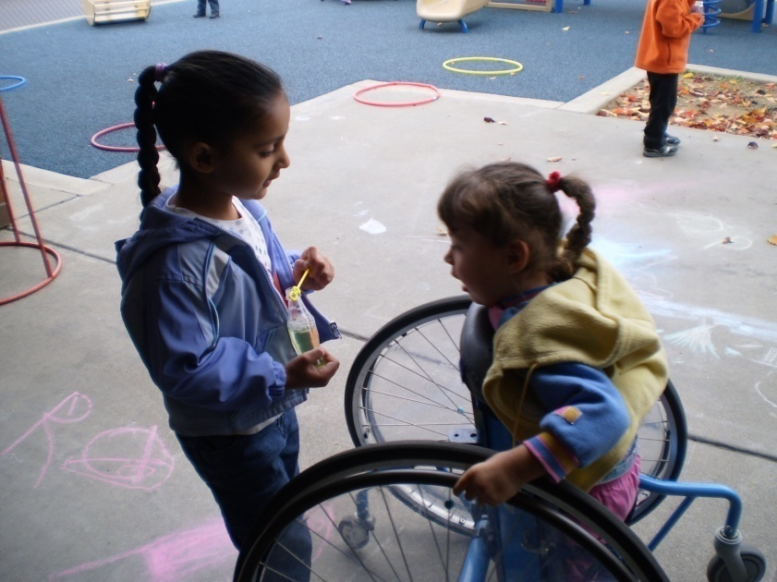
Outside Play Time
Provide an outdoor setting that encourages language development and communication.
Notes:
Provide an outdoor setting that encourages language development and communication:
Partially deflate beach-type balls to allow an easier grasp for catching and tossing.
Provide wagons with room for two children so that they can talk to each other.
Interact with children and play games, such as I Spy with My Little Eye and Teacher May I?
Set up two toy saddles outside so that children can sit as a pair and talk with each other. Provide other outdoor items that encourage language, such as a picnic table, a sandbox, a water table, gardening tools, and deflated balls.
The intent is that the environment is arranged to encourage communication with one another.
Slide adapted from Traub, Hutter-Pishgahi, and Freeman, Welcoming All Children: Creating Inclusive and Project Support: Early Childhood Inclusion Support Consultant Project, Klein, M. D. et all, California State University, LA, Division of Special Education, 1999.
58

Slide 59
Pair Share
What are some of the ideas/strategies that stood out to you in the video clips?
What ideas/strategies did you hear that might be helpful for your students?
Notes:
After watching the five video clips, have participants share their learning with a partner in a breakout room.
If time permits, have some volunteers share out to the whole group.
Say: “We have shared three outcomes so far with the contents of special education laws, language disorder and differences, and specific strategies to help English learners with disabilities. Now, as the fourth outcome, we will be looking at collaborative partners and resources.”
59

Slide 60
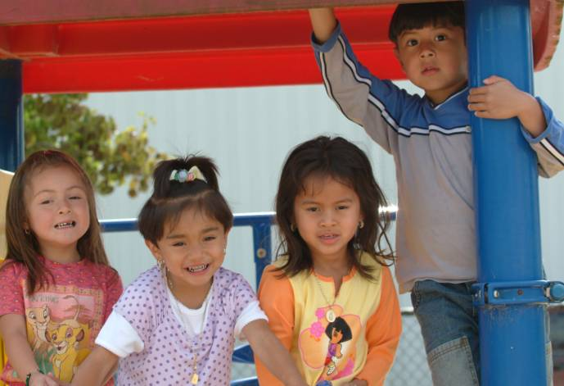
Collaborative Partners and Resources
Notes:
Collaboration and partnerships between program personnel and families, or other members of the community, are necessary to serve English learners with disabilities. “Regardless of type or intensity of the partnerships, collaboration is not only desirable, but also necessary in providing services to young children that (a) are accessible, (b) ensure full participation, and (c) promote progress (Sandall et al., 2005)” (Division for Early Childhood [DEC] of the Council for Exceptional Children, Promoting Positive Outcomes for Children with Disabilities: Recommendations for Curriculum, Assessment, and Program Evaluation, p. 4).
Information about partners and resources will be covered in the remainder of this presentation.
60

Slide 61
What Collaborative Partners in Inclusive Classrooms Might Look Like
Insert Partners in Preschool video clip here
Notes:
After viewing the Partners in Preschool clip, have participants break into small groups to discuss any new ideas the clip has brought forward.
61

Slide 62
Collaborating Partners: State Agencies
California Department of Education (CDE)
- Special Education Division (SED)
- Early Education and Support Division (EESD)
Department of Developmental Services (DDS)
- Regional Centers
California Children's Services (CCS)
Notes:
California Department of Education (CDE)
Special Education Division (SED)
Early Education and Support Division (EESD)
Department of Developmental Services (DDS) (https://www.dds.ca.gov/)
Regional Centers (https://www.dds.ca.gov/rc/)
California Children's Services (CCS) (https://www.dhcs.ca.gov/services/ccs)
62

Slide 63
Resources in California
California Preschool Instructional Network (CPIN)
Desired Results for Children and Families
Desired Results Access Project
California Association for the Education of Young Children (CAEYC)
Notes:
Resources in California:
California Preschool Instructional Network (CPIN)
Desired Results for Children and Families
Desired Results Access Project
California Association for the Education of Young Children (CAEYC)
Suggestion: Presenter may want to share the information about Projects for Families: The MAP to Inclusive Child Care (available online at http://www.cainclusivechildcare.org/camap/). The site has a section on cultural competency and resources in multiple languages. MAP provides a statewide system of support information and resources for families and providers that will facilitate barrier-free access to inclusive childcare for children birth to 21.
63

Slide 64
National Resources
Division for Early Childhood (DEC) of the Council for Exceptional Children
National Association for the Education of Young Children (NAEYC)
National Early Childhood Technical Assistance Center (NECTAC)
Notes:
National resources:
Division for Early Childhood (DEC) of the Council for Exceptional Children is an international membership organization for those who work with, or on behalf of, young children with disabilities and other special needs.
National Association for the Education of Young Children (NAEYC) is a professional membership organization that works to promote high-quality early learning for all young children, birth through age 8, by connecting early childhood practice, policy, and research.
National Early Childhood Technical Assistance Center (NECTAC) is supported by the U.S. Department of Education's Office of Special Education Programs. NECTAC serves all 50 states. This center improves service systems and outcomes for infants, toddlers, and preschool aged children with special needs and their families. Each state's Part C and Section 619 Program Coordinators have a contact person at NECTAC and request Technical Assistance on behalf of their state programs.
64

Slide 65
Closure: Revisit the Outcomes
Become familiar with the California Early Learning and Development System and regulations related to special education.
Develop a better understanding of the characteristics of language disorder and language difference.
Explore cultural considerations and research-based instructional strategies for English learners with disabilities or other special needs.
Become familiar with statewide and local resources.
Notes:
“We have been focusing on specific outcomes throughout today’s presentation. Let’s review those four outcomes to close this presentation:
Become familiar with the California Early Learning and Development System and regulations related to special education.
Develop a better understanding of the characteristics of language disorder and language difference.
Explore cultural considerations and research-based instructional strategies for English learners with disabilities or other special needs.
Become familiar with statewide and local resources.”
65

Slide 66
References
Belk, J. “The Inclusion in Early Childhood Programs: A Kaleidoscope of Diversity.” National Forum of Special Education Journal 16, no. 1 (2005).
California Department of Education (CDE). Assessing Children with Disabilities Who Are English Learners: Guidance for the DRDP access and the PS DRDP-R for Children with IEPs. Sacramento, CA: CDE Press, 2007.
California Department of Education (CDE). California Preschool Learning Foundations, Volume One. Sacramento, CA: CDE Press, 2008.
California Department of Education (CDE). Preschool English Learners: Principles and Practices to Promote Language, Literacy and Learning. Sacramento, CA: CDE Press, 2009.
Notes:
Belk, J. “The Inclusion in Early Childhood Programs: A Kaleidoscope of Diversity.” National Forum of Special Education Journal 16, no. 1 (2005).
California Department of Education (CDE). Assessing Children with Disabilities Who Are English Learners: Guidance for the DRDP access and the PS DRDP-R for Children with IEPs. Sacramento, CA: CDE Press, 2007.
California Department of Education (CDE). California Preschool Learning Foundations, Volume One. Sacramento, CA: CDE Press, 2008.
California Department of Education (CDE). Preschool English Learners: Principles and Practices to Promote Language, Literacy and Learning. Sacramento, CA: CDE Press, 2009.
66

Slide 67
References (2)
California Department of Education (CDE). Reasons for Concern that Your Child or A Child in Your Care May Need Special Help. Available for download in several languages from https://www.cde.ca.gov/sp/se/fp/concerns.asp or https://www.dds.ca.gov/services/early-start/.
California Department of Education (CDE)/Special Education Division. Handbook on Developing and Evaluating Interagency Collaboration. Sacramento, CA: CDE Press, 2007. https://icdr.acl.gov/system/files/resources/eciacolbrtn.pdf.
California Department of Education (CDE)/Special Education Division. Handbook on Family Involvement in Early Childhood Special Education Programs. Sacramento, CA: CDE Press, 1999. https://www.seedsofpartnership.org/pdf/familyInvolvement.pdf.
Notes:
California Department of Education (CDE). Reasons for Concern that Your Child or A Child in Your Care May Need Special Help. Available for download in several languages from https://www.cde.ca.gov/sp/se/fp/concerns.asp or https://www.dds.ca.gov/services/early-start/.
California Department of Education (CDE)/Special Education Division. Handbook on Developing and Evaluating Interagency Collaboration. Sacramento, CA: CDE Press, 2007. https://icdr.acl.gov/system/files/resources/eciacolbrtn.pdf.
California Department of Education (CDE)/Special Education Division. Handbook on Family Involvement in Early Childhood Special Education Programs. Sacramento, CA: CDE Press, 1999. https://www.seedsofpartnership.org/pdf/familyInvolvement.pdf.
67

Slide 68
References (3)
Chen, Jie-Qi, and Gillian Dowley McNamee. Bridging: Assessment for Teaching and Learning in Early Childhood Classrooms, PreK-3. Thousand Oaks, CA: Corwin Press, 2007.
Division for Early Childhood (DEC) of the Council for Exceptional Children. Promoting Positive Outcomes for Children with Disabilities: Recommendations for Curriculum, Assessment, and Program Evaluation. Missoula, MT: Author, 2007.
Dunlap, L. L. An Introduction to Early Childhood Special Education: Birth to Age Five. Upper Saddle River, NJ: Pearson Education, Inc., 2009.
Freeman, Tanyra, Lois Hutter-Pishgahi, Elizabeth Traub. Welcoming All Children: Creating Inclusive Child Care. 2nd ed. Bloomington, IN: Indiana University Press, 2002.
Notes:
Chen, Jie-Qi, and Gillian Dowley McNamee. Bridging: Assessment for Teaching and Learning in Early Childhood Classrooms, PreK-3. Thousand Oaks, CA: Corwin Press, 2007.
Division for Early Childhood (DEC) of the Council for Exceptional Children. Promoting Positive Outcomes for Children with Disabilities: Recommendations for Curriculum, Assessment, and Program Evaluation. Missoula, MT: Author, 2007.
Dunlap, L. L. An Introduction to Early Childhood Special Education: Birth to Age Five. Upper Saddle River, NJ: Pearson Education, Inc., 2009.
Freeman, Tanyra, Lois Hutter-Pishgahi, Elizabeth Traub. Welcoming All Children: Creating Inclusive Child Care. 2nd ed. Bloomington, IN: Indiana University Press, 2002.
68

Slide 69
References (4)
Genesee, F., J. Paradis, and M. Crago. Dual Language Development and Disorders. Baltimore, MD: Paul H. Brooks Publishing Co., Inc., 2004.
Gould, P., and J. Sullivan. The Inclusive Early Childhood Classroom: Easy Ways to Adapt Learning Centers for All Children. Beltsville, MD: Gryphon House, Inc., 1999.
Gutierrez-Clellen, Vera F. “Language Choice in Intervention with Bilingual Children.” American Journal of Speech-Language Pathology 8, no. 4 (1999): 291–302. https://doi.org/10.1044/1058-0360.0804.291. https://doi.org/10.1044/1058-0360.0804.291.
Gutiérrez-Clellen, V., G. Simon-Cereijido, and C. Wagner. “Bilingual Children with Language Impairment: A Comparison with Monolinguals and Second Language Learners.” Applied Psycholinguistics 29, no. 1 (2008): 3–19.
Notes:
Genesee, F., J. Paradis, and M. Crago. Dual Language Development and Disorders. Baltimore, MD: Paul H. Brooks Publishing Co., Inc., 2004.
Gould, P., and J. Sullivan. The Inclusive Early Childhood Classroom: Easy Ways to Adapt Learning Centers for All Children. Beltsville, MD: Gryphon House, Inc., 1999.
Gutierrez-Clellen, Vera F. “Language Choice in Intervention with Bilingual Children.” American Journal of Speech-Language Pathology 8, no. 4 (1999): 291–302. https://doi.org/10.1044/1058-0360.0804.291. https://doi.org/10.1044/1058-0360.0804.291.
Gutiérrez-Clellen, V., G. Simon-Cereijido, and C. Wagner. “Bilingual Children with Language Impairment: A Comparison with Monolinguals and Second Language Learners.” Applied Psycholinguistics 29, no. 1 (2008): 3–19.
69

Slide 70
References (5)
Hamaguchi, P. A. Childhood Speech, Language, and Listening Problems: What Every Parent Should Know. New York: John Wiley & Sons, Inc., 2001.
Klein, M. Diane, and Deborah Chen. Working with Children from Culturally Diverse Backgrounds. Delmar Cengage Learning, 2000.
Klein, M. D., R. E. Cook, and A.M. Richardson-Gibbs. Strategies for Including Children with Special Needs in Early Childhood Settings. Thomson/DelMar Learning, 2001.
Lessow-Hurley, Judith. The Foundations of Dual Language Instruction. 5th ed. Old Tappan, NJ: Pearson, 2008.
McLaughlin, S. Introduction to Language Development. 2nd ed. San Diego, CA: Thomson/DelMar Learning, 2006.
Notes:
Hamaguchi, P. A. Childhood Speech, Language, and Listening Problems: What Every Parent Should Know. New York: John Wiley & Sons, Inc., 2001.
Klein, M. Diane, and Deborah Chen. Working with Children from Culturally Diverse Backgrounds. Delmar Cengage Learning, 2000.
Klein, M. D., R. E. Cook, and A.M. Richardson-Gibbs. Strategies for Including Children with Special Needs in Early Childhood Settings. Thomson/DelMar Learning, 2001.
Lessow-Hurley, Judith. The Foundations of Dual Language Instruction. 5th ed. Old Tappan, NJ: Pearson, 2008.
McLaughlin, S. Introduction to Language Development. 2nd ed. San Diego, CA: Thomson/DelMar Learning, 2006.
70

Slide 71
References (6)
National Association for the Education of Young Children (NAEYC). Screening and Assessment of Young English-Language Learners: Supplement to the NAEYC and NAECS/SDE Joint Position Statement on Early Childhood Curriculum, Assessment, and Program Evaluation. Washington, DC: Author, 2005. https://www.naeyc.org/sites/default/files/globally-shared/downloads/PDFs/resources/position-statements/ELL_SupplementLong.pdf.
Paradis, J., and F. Genesee. “Syntactic Acquisition in Bilingual Children: Autonomous or Interdependent?” Studies in Second Language Acquisition 18, no. 1 (1996): 1–25.
Pearson, B., S. Fernandez, V. Lewedeg, and D. Oller. “The Relation of Input Factors to Lexical Learning by Bilingual Infants.” Applied Psycholinguistics 18 no. 1 (1997): 41–58.
Notes:
National Association for the Education of Young Children (NAEYC). Screening and Assessment of Young English-Language Learners: Supplement to the NAEYC and NAECS/SDE Joint Position Statement on Early Childhood Curriculum, Assessment, and Program Evaluation. Washington, DC: Author, 2005. https://www.naeyc.org/sites/default/files/globally-shared/downloads/PDFs/resources/position-statements/ELL_SupplementLong.pdf.
Paradis, J., and F. Genesee. “Syntactic Acquisition in Bilingual Children: Autonomous or Interdependent?” Studies in Second Language Acquisition 18, no. 1 (1996): 1–25.
Pearson, B., S. Fernandez, V. Lewedeg, and D. Oller. “The Relation of Input Factors to Lexical Learning by Bilingual Infants.” Applied Psycholinguistics 18 no. 1 (1997): 41–58.
71

Slide 72
References (7)
Rhodes, R., S. Ochoa, and S. Ortiz. Assessing Culturally and Linguistically Diverse Students. New York: Guilford Publications, 2005.
Roseberry-McKibbin, Celeste. Multicultural Students with Special Language Needs: Practical Strategies for Assessment and Intervention. 2nd ed. Oceanside, California: Academic Communication Associates, 2002.
Sandall, S., M. L. Hemmeter, B. J. Smith, and M. McLean. DEC Recommended Practices: A Comprehensive Guide for Practical Application. Missoula, MT: Division for Early Childhood (DEC), 2005.
Santa Clara County Office of Education (2009). Inclusion Collaborative. Accessed March 28, 2021. http://www.inclusioncollaborative.org/.
Notes:
Rhodes, R., S. Ochoa, and S. Ortiz. Assessing Culturally and Linguistically Diverse Students. New York: Guilford Publications, 2005.
Roseberry-McKibbin, Celeste. Multicultural Students with Special Language Needs: Practical Strategies for Assessment and Intervention. 2nd ed. Oceanside, California: Academic Communication Associates, 2002.
Sandall, S., M. L. Hemmeter, B. J. Smith, and M. McLean. DEC Recommended Practices: A Comprehensive Guide for Practical Application. Missoula, MT: Division for Early Childhood (DEC), 2005.
Santa Clara County Office of Education (2009). Inclusion Collaborative. Accessed March 28, 2021. http://www.inclusioncollaborative.org/.
72

Slide 73
References (8)
Santos, R. M., and M. M. Ostrosky. "Understanding the Impact of Language Differences on Classroom Behavior." Center on the Social and Emotional Foundations for Early Learning. Accessed March 20, 2021. http://csefel.vanderbilt.edu/resources/wwb/wwb2.html.
Seung, H., S. Siddiqi, and J. H. Elder. “Intervention Outcomes of a Bilingual Child with Autism.” Journal of Medical Speech-Language Pathology 14, no. 1 (2006): 58–63.
Smith, Tom E.C., Barbara L. Gartin, Nikki L. Murdick, and Alan Hilton. Families and Children with Special Needs: Professional and Family Partnerships. Upper Saddle River, NJ: Pearson, 2006.
Notes:
Santos, R. M., and M. M. Ostrosky. "Understanding the Impact of Language Differences on Classroom Behavior." Center on the Social and Emotional Foundations for Early Learning. Accessed March 20, 2021. http://csefel.vanderbilt.edu/resources/wwb/wwb2.html.
Seung, H., S. Siddiqi, and J. H. Elder. “Intervention Outcomes of a Bilingual Child with Autism.” Journal of Medical Speech-Language Pathology 14, no. 1 (2006): 58–63.
Smith, Tom E.C., Barbara L. Gartin, Nikki L. Murdick, and Alan Hilton. Families and Children with Special Needs: Professional and Family Partnerships. Upper Saddle River, NJ: Pearson, 2006.
73

